Slide 1
SuperB Experimental hall
General considerations on the Babar experimental area
Preliminary space requirements hall proposal.
A floor plan.
Specification step plan.
Design Process and specifications
Conclusions

Slide 2
General considerations on the Babar experimental area
The design of the Babar hall was driven by an exiting building structure. Floor plan is about 38mX22m
The actual space in the interaction area does not allow an easy access to the detector for maintenances.
The doors can not clear complete the central part of the detector (IFR).
The new inner tracker + machine interface will require maybe more longitudinal space for extraction.

Slide 3
General considerations on the Babar experimental area
The door sliding system must be redone. We have to include a central stops to protect the beam line and an large travel to clear IFR complete.
The position of the beam axis respected to the floor should be increase at least of .5m + the increase of the steel size. The previous beam height from the floor was 3.5m
The increase of height of the beam axis respects to the floor is going to facilitate the positioning of doors and service passages on the bottom.
The overhead crane hook high was 34.10’ ( 10.39meter). It was not comfortable for assembly the detector. We need to increase at least .5 meter or more.

Slide 4
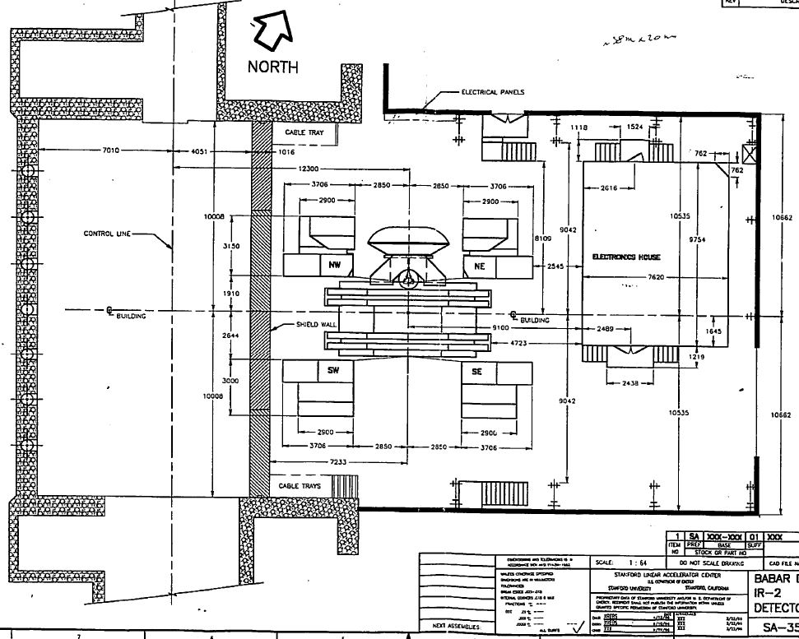
General considerations
Assembly configuration
38m
21.324m
Architecture of the Babar experimental area

Slide 5
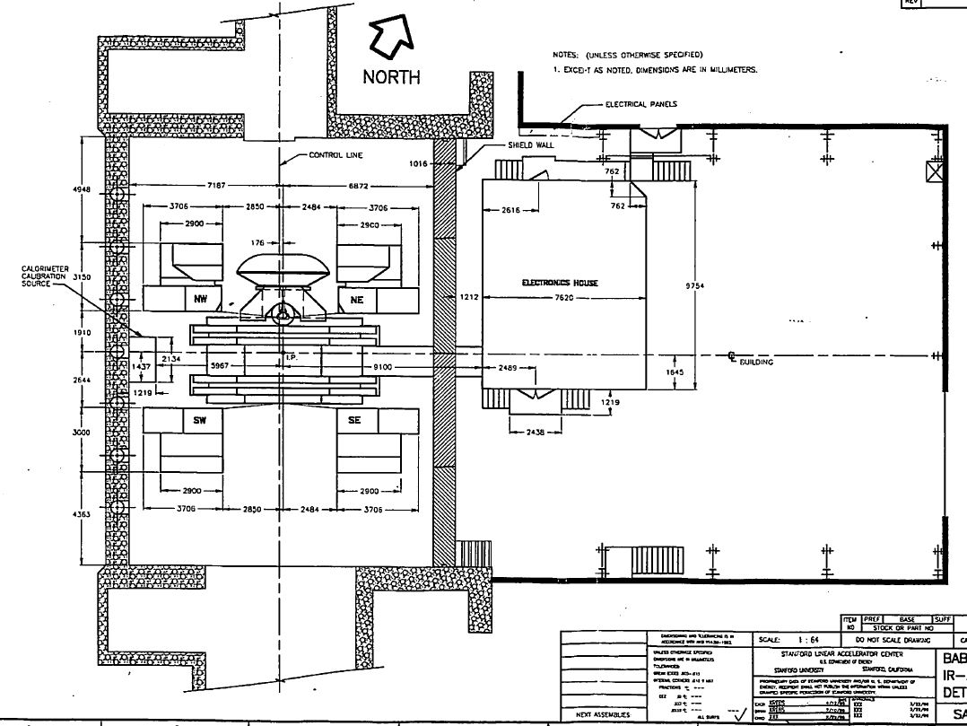
General considerations
Running configuration
38m
21.324m
Architecture of the Babar experimental area

Slide 6
Preliminary space requirements hall proposal.
Assuming to adopt the Babar architecture that It is convenient for the independence of accelerator and detector activities.
1)We need a large collision area for an easy maintenance.
2)A temporary storage and preparation area for mounting parts.
3) Enough space for the required service.
4) Space for mounting the detector.
5) We need to define if it necessary to have an area for the service accessible during all phases, assembly commissioning and running.

Slide 7
Preliminary space requirements hall proposal.
Heavy parts stored on the assembly collision hall have advantages: a) tooling for preparation and adjusting are present in only one place; b) only a big crane can handle all the operations; c) Commissioning of the subsector using the final services.

Slide 8
A floor plan proposals.
Super B detector assembled, commissioned at proper beam axis distance, minimizing the travel to his final position.
It is important to define the beam axis position respect to the ground level. Depending of what we could have: a) a pit with a crane on surface level; b) a dedicate access ramp.
The two configurations have an impact of the way of organizing the handling and commissioning of the sub detector and safety issues.
The accelerator tunnel will be enlarged in the interaction area to locate the machine apparatus . This must be integrate in the design of the experimental hall.

Slide 9
A floor plan proposals.
We need a shielding specification around the beam pipe.
All services must be place in the experimental area cryogenic cooler, storage thanks, chiller, air conditioning, auxiliary tooling, etc.
Specification for the temperature and humidity control must be addressed considering the heat dissipated inside and the thermal insulation of the hall.

Slide 10
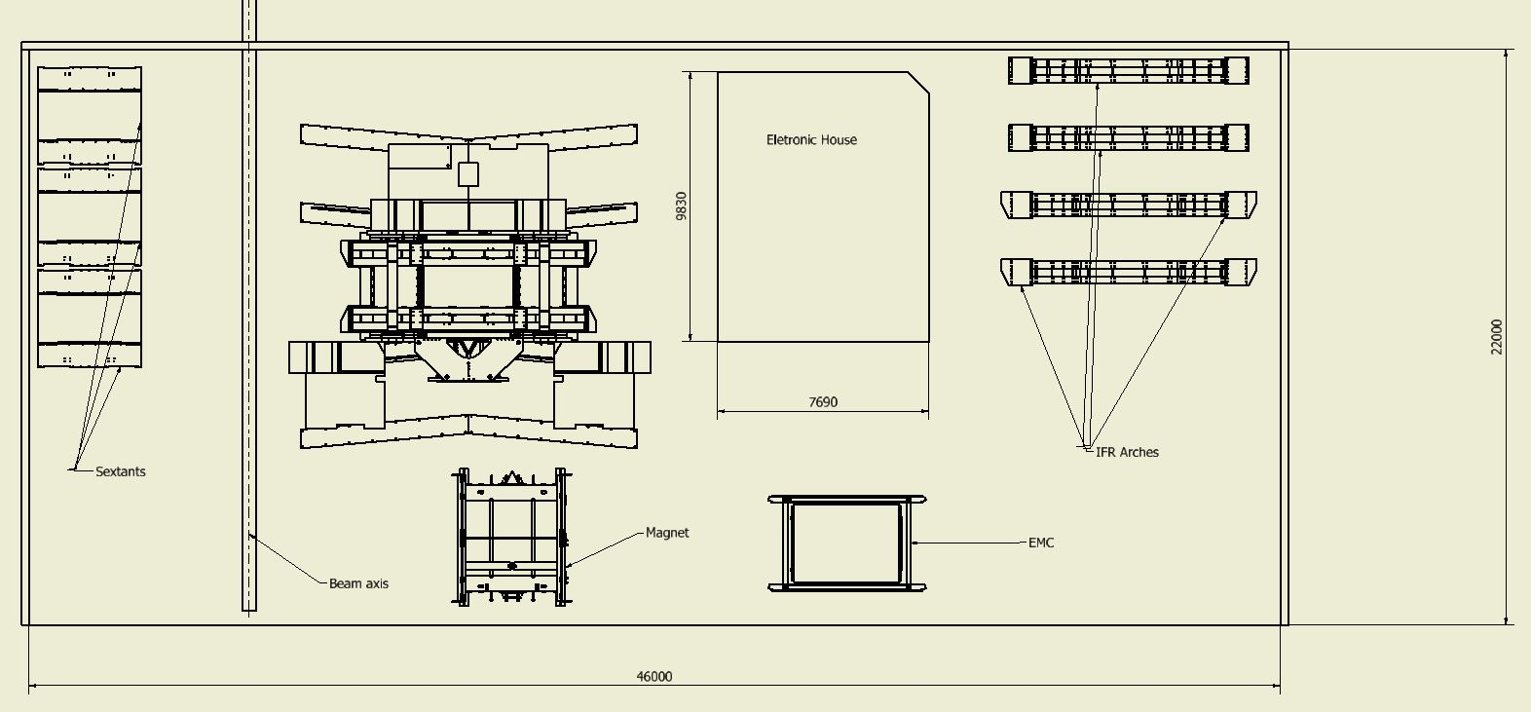
A floor plan proposals.
Radiation shielding
Assembly stage

Slide 11
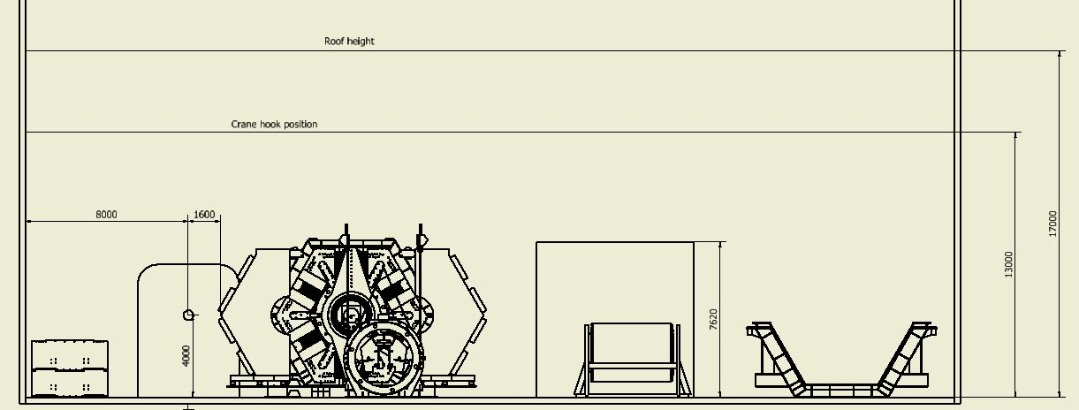
A floor plan proposals.
Assembly stage

Slide 12
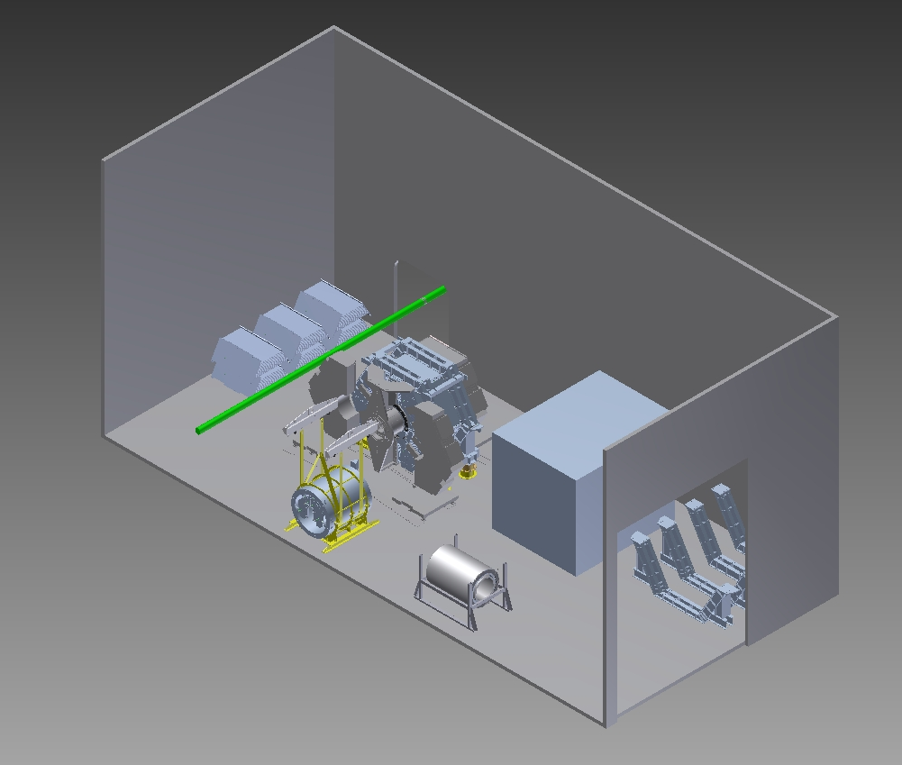
A floor plan proposals.
Assembly stage

Slide 13
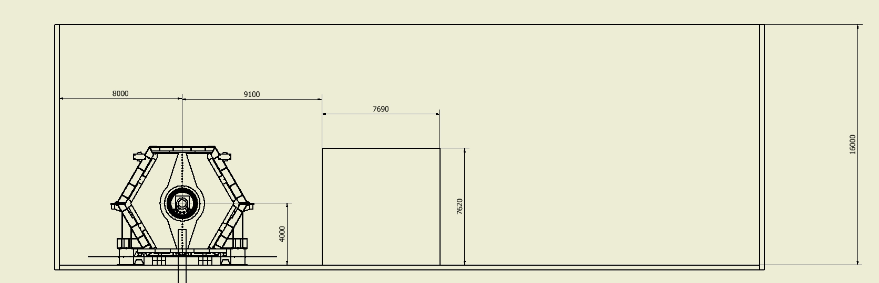
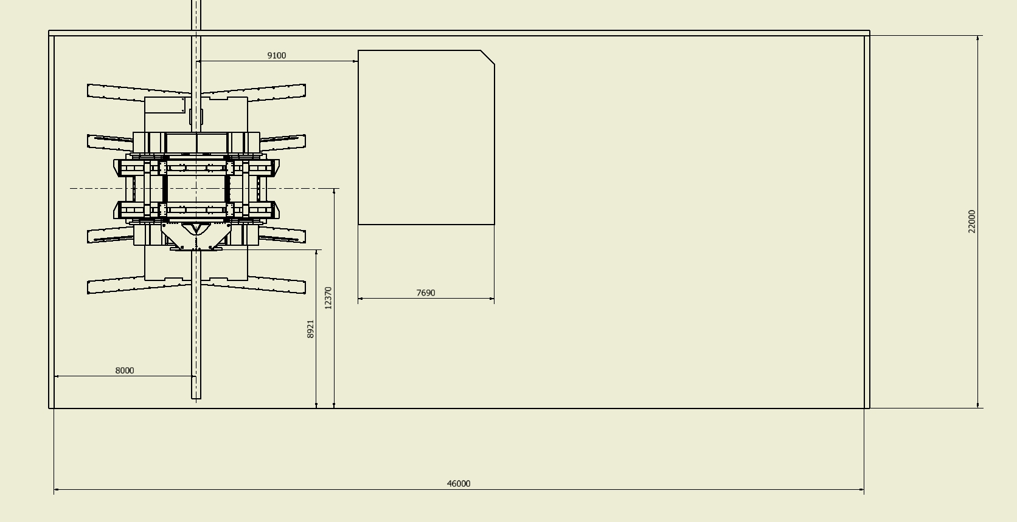
A floor plan proposals.

Slide 14
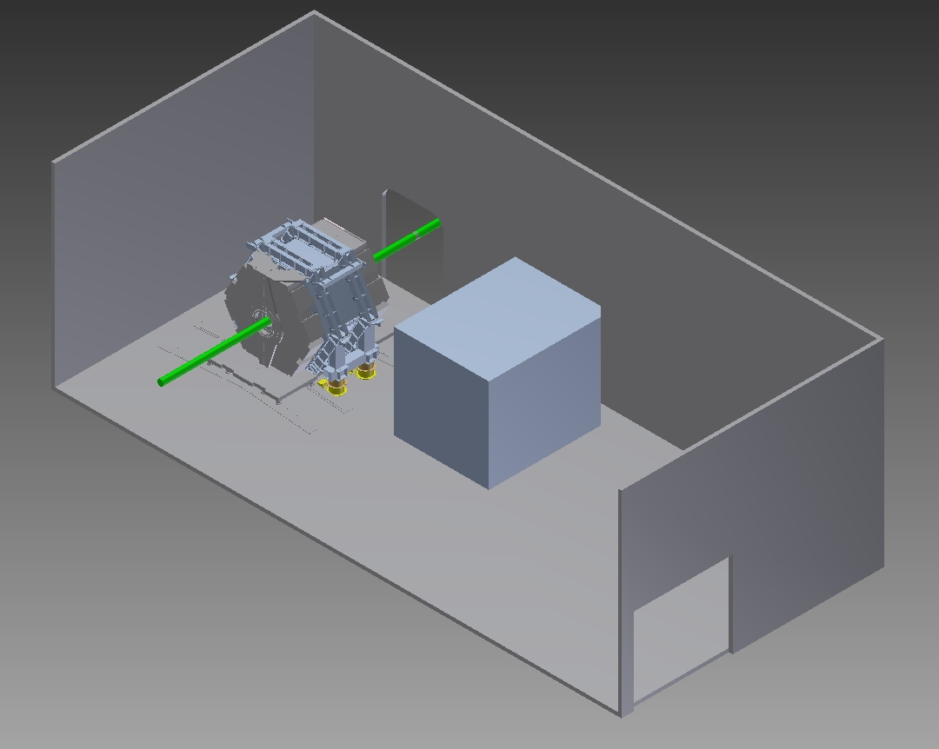
A floor plan proposals.
Beam pipe location

Slide 15
Specifications Step Plan. (SSP)
Define the architecture of the experimental area such that makes the works of the detector and accelerator people easy and economical. This work needs to be made involving the machine people that are the interface with the experimental area. I believe that the solution with an access ramp in which everything is at the same level is the more economical and efficient.
We need to get all the information from the sub component and detector in term of needs of service (size, position respect to detector, energy dissipated and cooling required, etc). In the region of the interaction we need to establish a direct line with the machine people.
Furthermore to understand better of the requirements of detectors in term of accuracy, environmental control services, this will add many specification to the experimental area.
3)Iteration while the design of the experiment will be in progress will make changes on the specification document.

Slide 16
Design Process and the Specification
Define the specification is the first step but the design of the apparatus or system to fulfill the specification require the definition of the boundary conditions. For instance setting the temperature variation on the experimental area of +/-2 degree. The design can be carried out knowing the thermal input location coming for the internal apparatus and for the surface of the exp. Area. The solutions implemented can be different for price and environmental impact and expected performance. Focus on precise goals in the specification defined by precise requirements obtained by deep technical discussion help to make a best design.

Slide 17
Conclusions
At this stage of the project is premature to go in deep in precise study when it is not clear for instance location space available for access, constrain on environmental impact ,etc.
We need to have an interaction with the machine people to understand: the machine equipment near to the detector; the position of the tunnel; the constrain of the experimental building.
Furthermore to understand better of the requirements of detectors services, this will add many specification to the experimental area.
To gathering all the information we need to start circulating some questionnaire to all people involved of detector.

