Slide 1
Re.Ca.S. Project
Rete di Calcolo per SuperB
E-Infrastructure for SuperB
1

Slide 2
Characteristics of the «call for projects»
P.O.N. (National Operational Programme) is funded by EU
Funding is strictly limited to 4 southern regions
Funding request: min 15 M€, max 45 M€
Only for «large» infrastructure, including grid
About 9,5% is for educational purposes

Slide 3
Characteristics of our project
Amount requested: 44,5 M€
Partecipants:
INFN (NA, BA, CT, CS)
UniNA
UniBA
INFN: 22,5 M€; UniNA: 11 M€; UniBA: 11 M€
3
S.Pardi
Ferrara, 2011 july 7th

Slide 4
Key persons
L. Merola (NA - head, empowering project)
R. Bellotti (BA – head, educational project)
G. Russo (NA - relationship with funding agency; proposal submission and follow-up)
One administrative officer for each partner

Slide 5
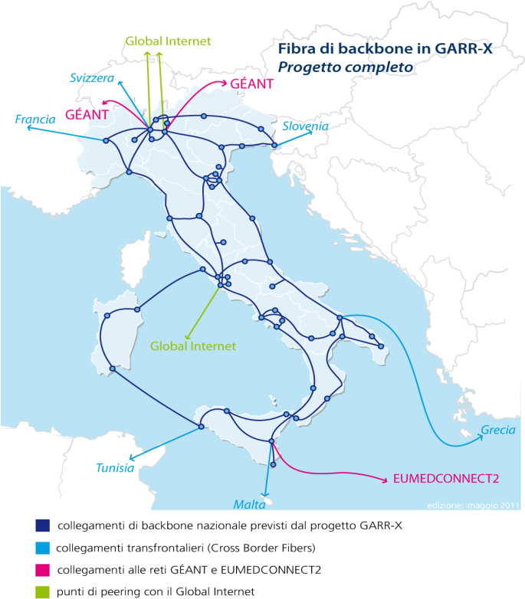
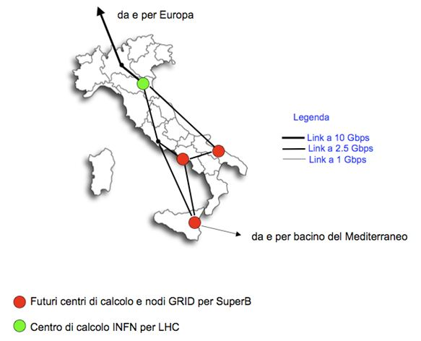
Contents of the project (1)

Slide 6
Contents of the project (2)
Build 4 Data Centers
Sizes in the ratio 15:15:10:2.5 (NA:BA:CT:CS)
# of racks in the ratio 50:50:30:10
Infrastructure in each center:
Energy (HPC: trigeneration from methane)
Electrical apparatuses
Technical (mechanics, fire systems etc)
5

Slide 7
Contents of the project (3)
Storage – 40% of rack units:
space for 6 PB at NA, BA
space for 3 PB at CT
space for 1 PB at CS
Nodes: – 50% of rack units:
space for 24.000 cores at NA, BA
space for 15.000 cores at CT
space for 3.000 cores at CS

Slide 8
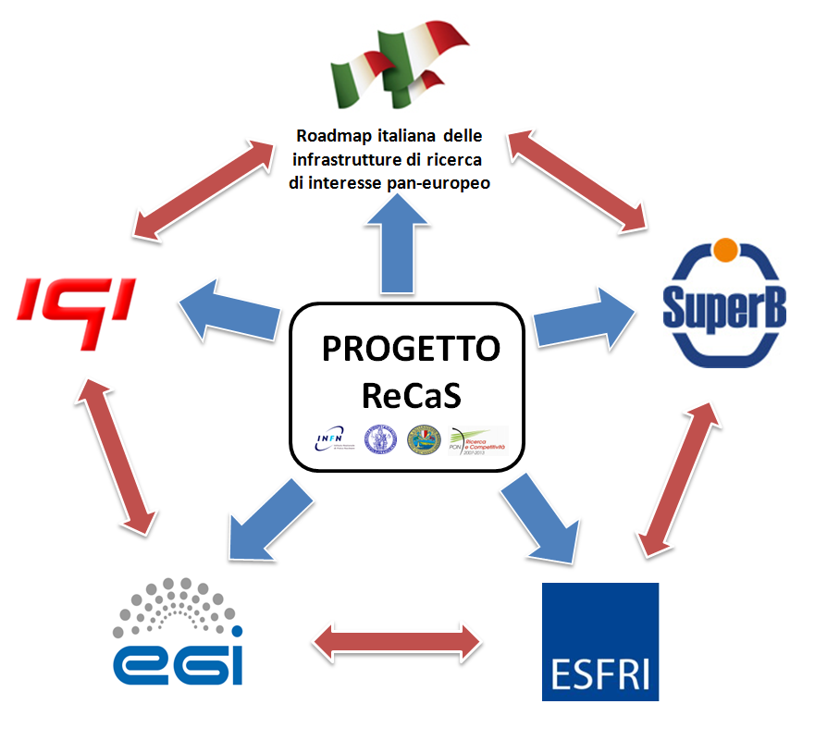
ReCaS Framework
ReCaS
Project

Slide 9
Work in progress
Waiting for the approval, we are starting to organize the main aspects of the future data-centers in order to be ready to start as soon as the project will be approved .
All the resource must be spent no later than December 2014

Slide 10
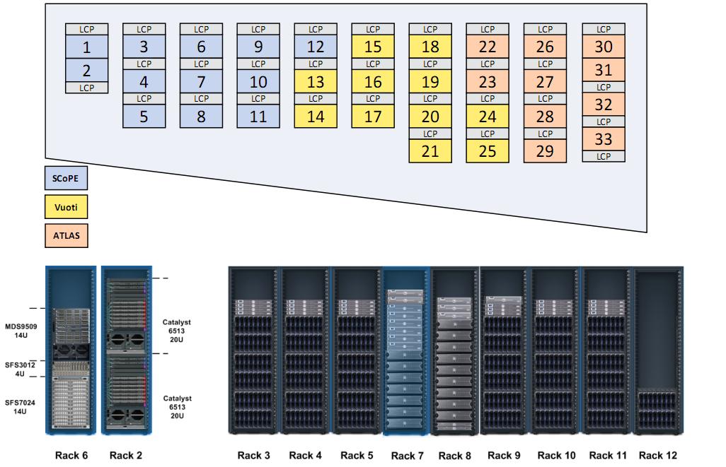
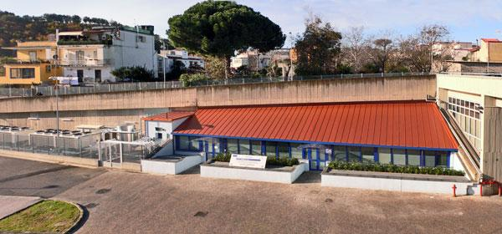

Slide 11
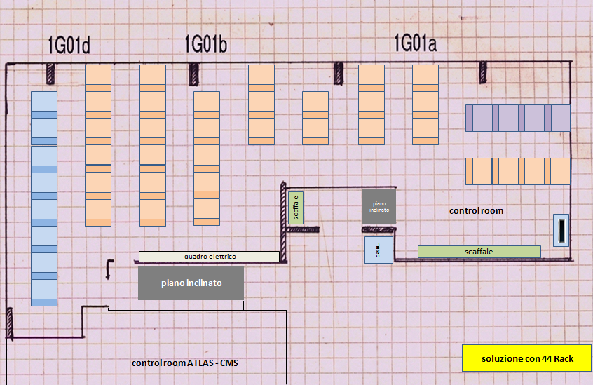
Space rationalization in Naples
44 RACK SOLUTION

Slide 12
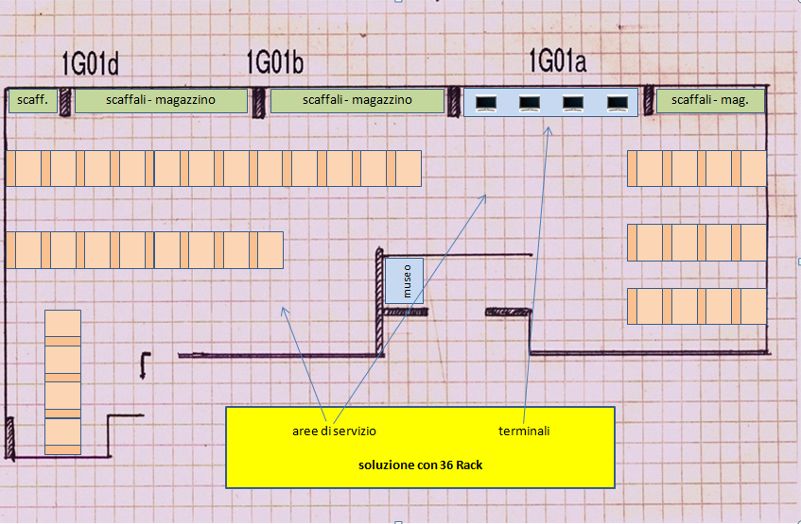
Space rationalization in Naples
36 RACK SOLUTION

Slide 13
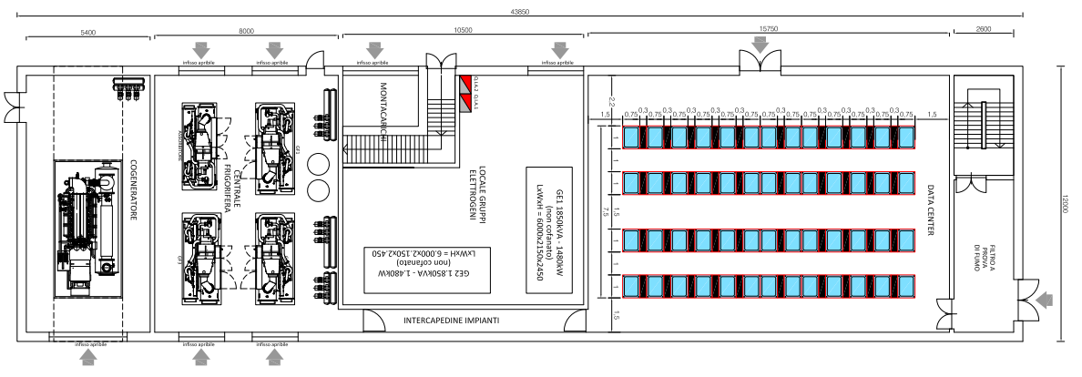
New datacenter in Bari

Slide 14
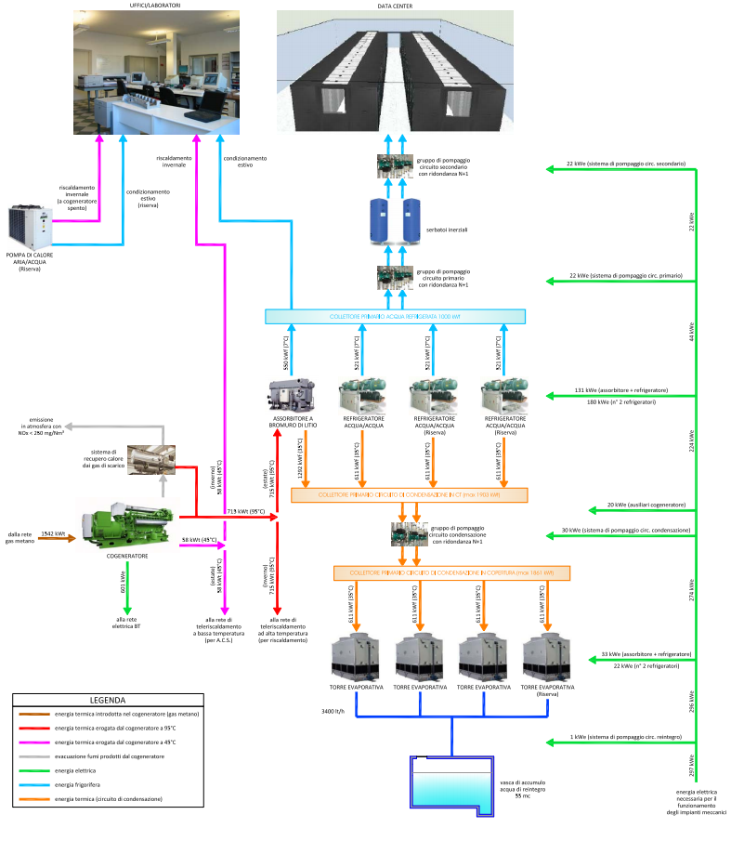
New datacenter in Bari

Slide 15
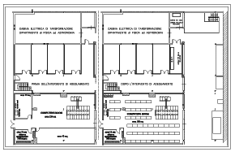
New datacenter in CATANIA

Slide 16
Timeline
The Project has been admit at the evaluation phase and the review process is started
Approval expected by december2011-Jan 2012
The Project Start officially the first of October 2011
Tenders to start by June 2012
Tender duration: 18 months
Installation: first semester 2014

Slide 17
Commissioning phase
From march 2014 to dec 2014
Likely on LHC, and partially on SuperB
Universities will use the Data Centers also for other researches (estimated 10% of resources)

Slide 18
Conclusions
Unique opportunity
Timeline for hw non optimal with respect to SuperB
Timeline for personnel and educational programme compatible with R&D for SuperB

