Slide 1

SVT
Mechanics
F. Bosi
INFN-Pisa
on behalf of the SuperB SVT Group

Slide 2


Outline
Preliminary SVT design on layer 1-5
- Work on the L0 supports Striplets version
Work on the L0 supports (MAPS version)
Update IR layout for positioning matching card support
Conclusion

Slide 3
SVT L1-5 Layout design
First Attempt to model L1-L5 SVT modules starting from BaBar design:
assumed the same radial position for all layers
2) used same width of BaBar sensors/modules to keep the same transversal r-phi section (# of modules, overlap…….)
3) For L1-L2-L3, modified the length in z direction
5) For L4-5 extended only the barrel part of the module while wedge sensors are kept identical to the BaBar ones ( same sensor dimensions and angle w.r.t. the barrel part).

Slide 4
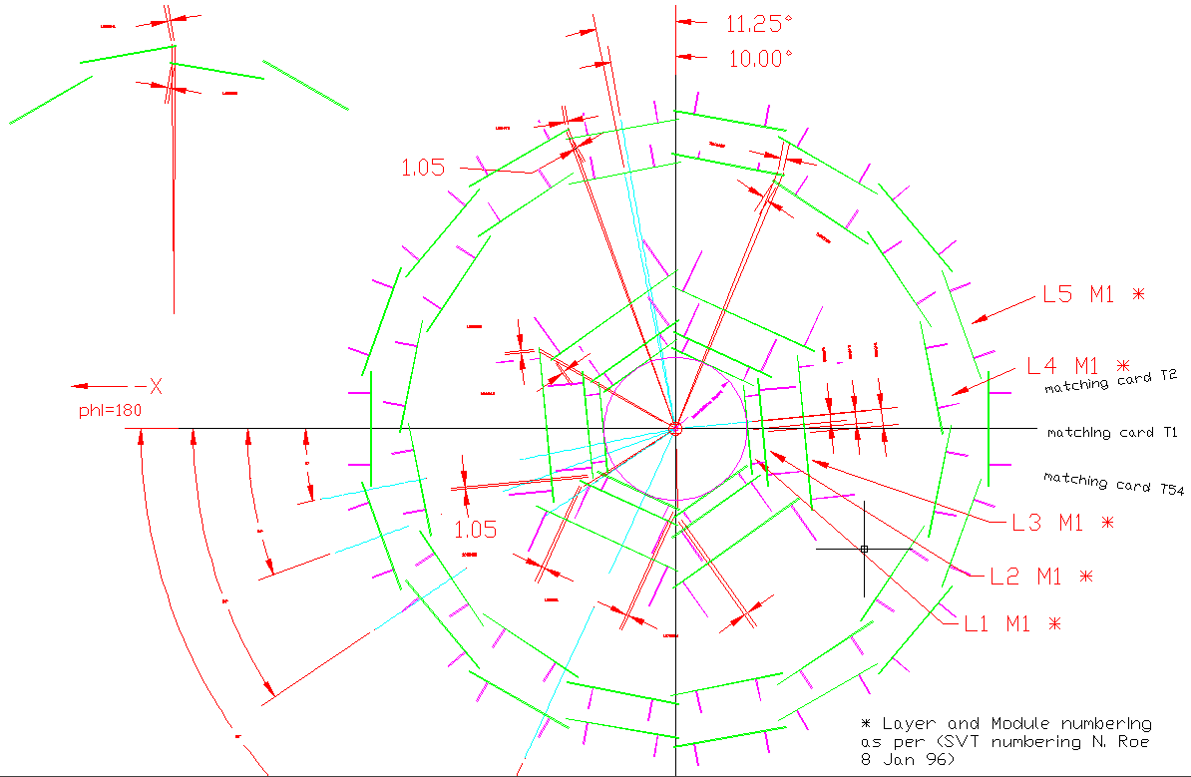
SVT L1-5 Layout design
Previous point 1) and 2) means that for SuperB SVT there is no front view difference from the BaBar SVT layout

Slide 5
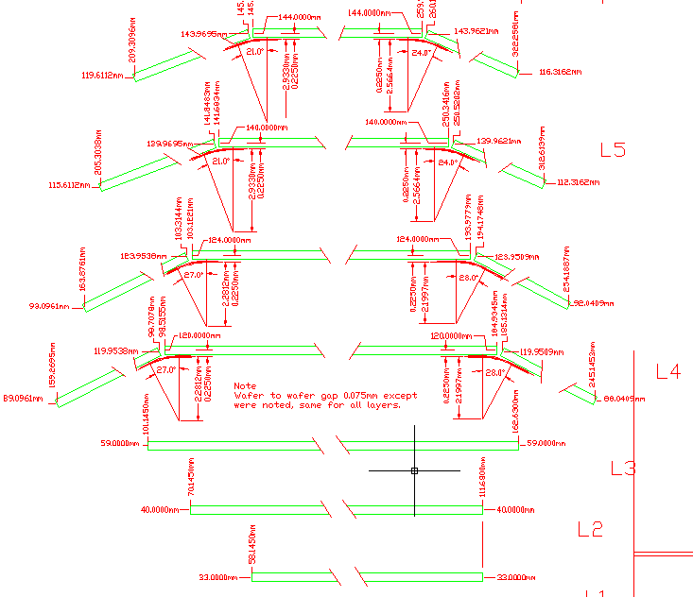
SVT L1-5 Layout design
L5B
L5A
Assumed same BaBar module’s radius. (different the length in Z direction)
L4B
L4A
L3
L2
L1

Slide 6
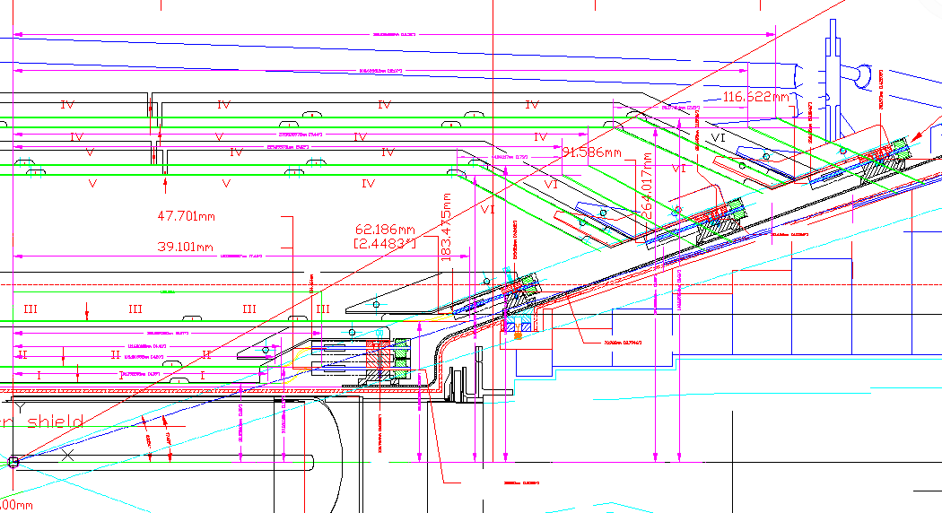
SVT L1-5 Layout design
350 mrad
300 mrad
Z direction
For full covering angle, sliding the wedge VI sensor parallel to z direction till to cover the 300 mrad line

Slide 7
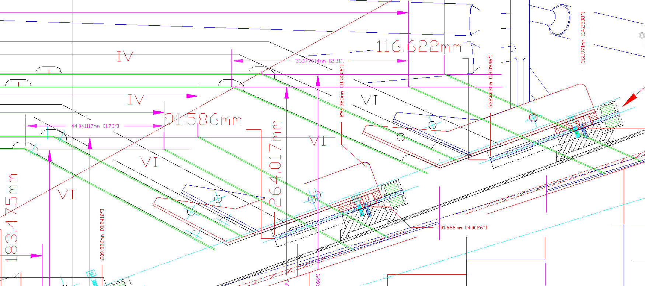
SVT L1-5 Layout design
Layer 4-5 extra length from the I.P.
350 mrad
300 mrad

Slide 8
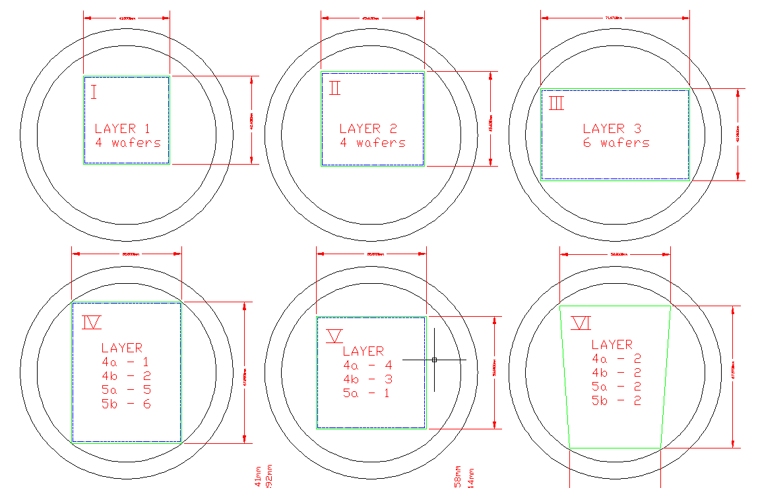
SVT L1-5 Layout design
Z
Sensor I-II-III-IV-V:
different Z dimension
same dimension in r-phi
R-phi
Sensor VI
same dimension in z and r-phi
L.Bosisio (trieste Univ.) is working on the design of the sensors and on the optimization of the dimensions

Slide 9
SVT dimensions in Fastsim – N. Neri

Slide 10
L1-L5 barrel modules dimensions table
Not big difference between N.Neri SVT module dimension and actual design !
Layer |  | Radius cm | Modules quantity | Module width (r-phi ) BaBar (cm) | Barrel module length - Fastsim N.Neri (cm) | Barrel modules length - Bosi new design (preliminary) (cm)
1 | 0.3 | 3.3 | 6 | 4.13 | 21.466 | 21.478
2 | 0.3 | 4 | 6 | 4.94 | 25.992 | 26.278
3 | 0.3 | 5.9 | 6 | 7.15 | 38.276 | 38.57
4a | 0.3 | 12 | 16 | 5.28 | 44.57 | 45.795
4b | 0.3 | 12.4 | 16 | 5.28 | 44.57 | 47.942
5a | 0.3 | 14 | 18 | 5.28 | 61.81 | 61.304
5b | 0.3 | 14.4 | 18 | 5.28 | 61.81 | 63.584

Slide 11
L1-L5 full modules length
Module length - Fastsim Neri (barrel + 2 wedges) (cm) | modules length - Bosi new design (preliminary (barrel + 2 wedges) (cm) | All Barrel Modules lehgth without arch shape (cm)
Layer 4a 58.164 | 59.389 | 77.585
Layer 4b 58.164 | 61.536 | 80.172
Layer 5a 75.404 | 74.898 | 90.516
Layer 5b 75.404 | 77.178 | 93.103
Large difference in length

Slide 12
SVT L1-5 Layout design
In this first design there are good news for layer 3-4-5 and some bad news for layer 1-2 !
1) Strong interpenetration between sensors layer 1 and layer 0 !
2) Light interpenetration between sensors layer 2 and layer 0
3) No problem for layer 3-4-5
The problem arise from the position of layer 0 that is constrained between the central Be pipe flanges and the 300 mrad acceptance angle.
In practice no space available for the necessary clearance between layer0 and layer1 !

Slide 13
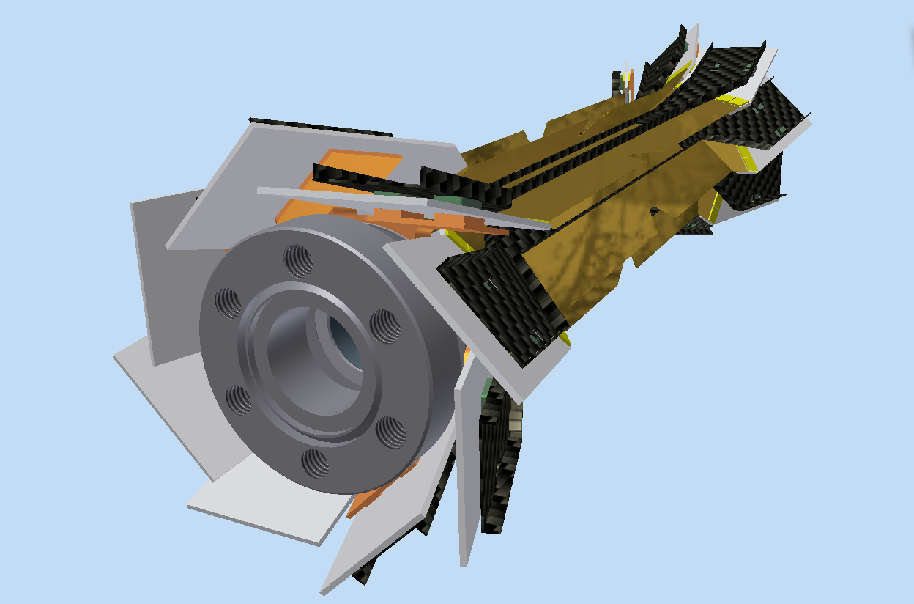
Module Striplets
Complete Modules striplets positioned on the Be beam-pipe and supported by Cold Flange.
Cold Flanges Buttons
All L0 components very close to the flanges beam pipe
Be pipe flanges
Notes:
13

Slide 14
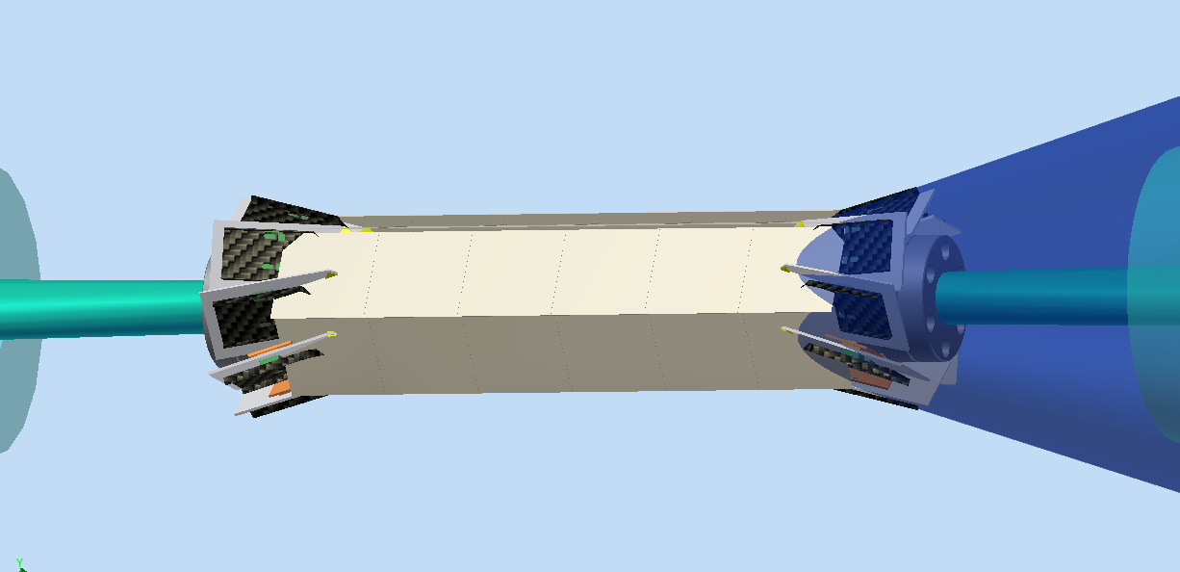
Problem with layer 1 sensors
SVT L1-5 Layout design
Layer 0
300 mrad acceptance angle
Central Be pipe flanges

Slide 15
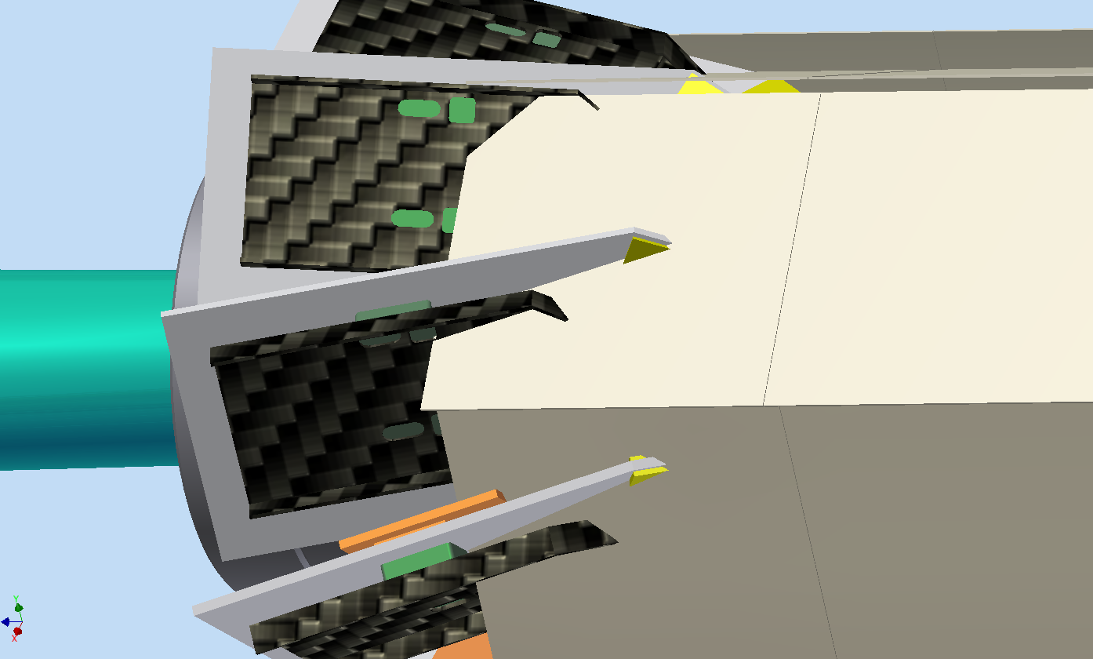
SVT L1-5 Layout design
Layer 0 HDI
About 20 mm
Layer 0
C.F. structure
Layer 1

Slide 16
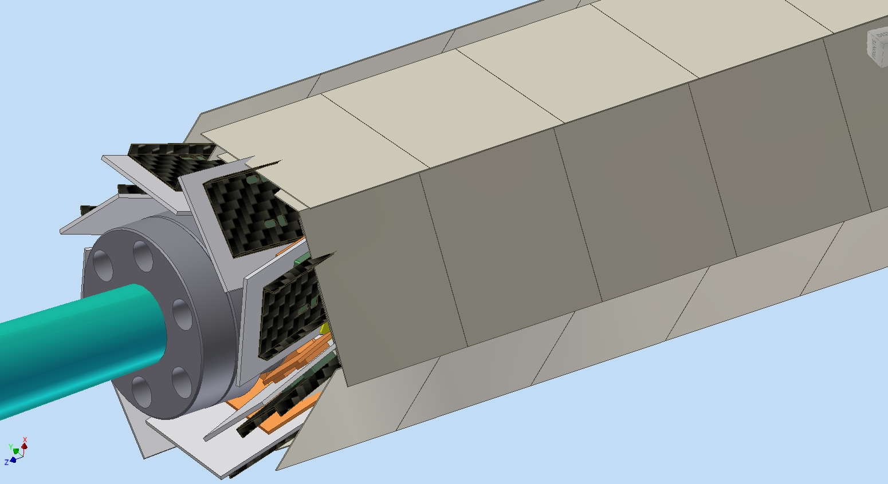
SVT L1-5 Layout design
Layer 0 HDI
Layer 2
Central Be pipe flanges

Slide 17
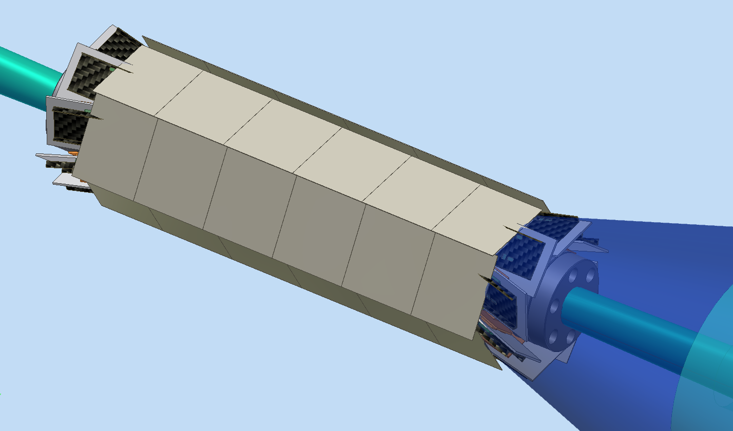
Layer 2
SVT L1-5 Layout design
300 mrad acceptance angle

Slide 18
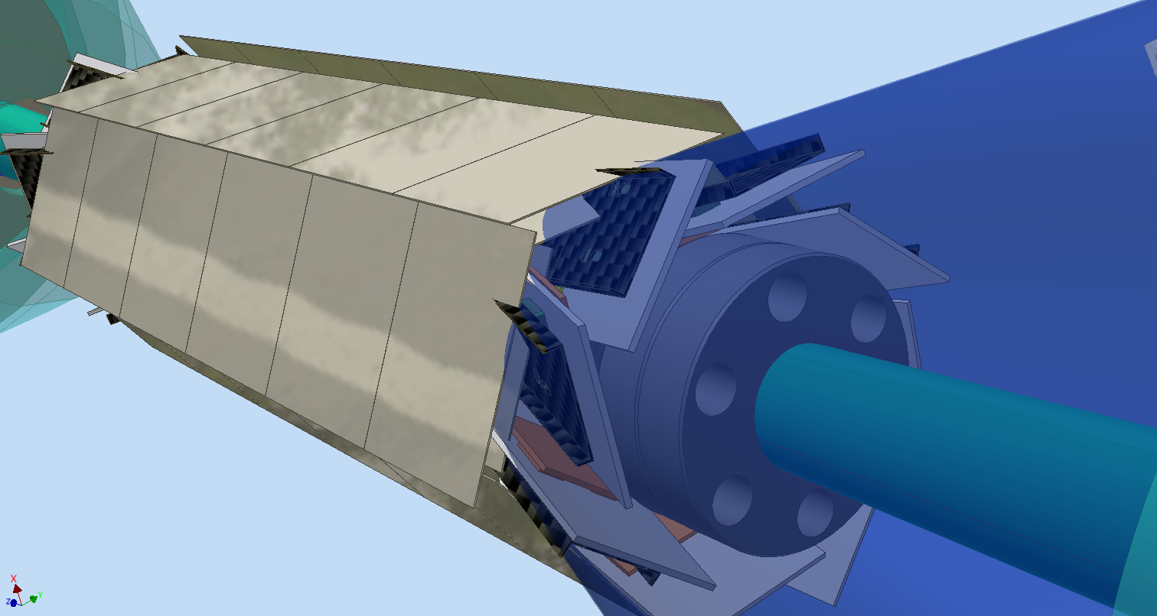
SVT L1-5 Layout design
Layer 2

Slide 19
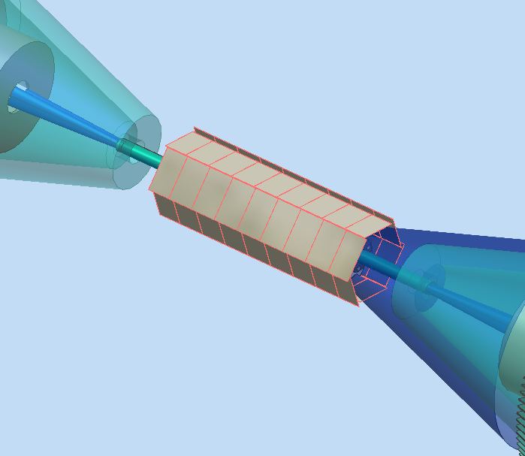
SVT L1-5 Layout design
W shielding
300 mrad acceptance angle
Layer 3
No problem for layer 3

Slide 20
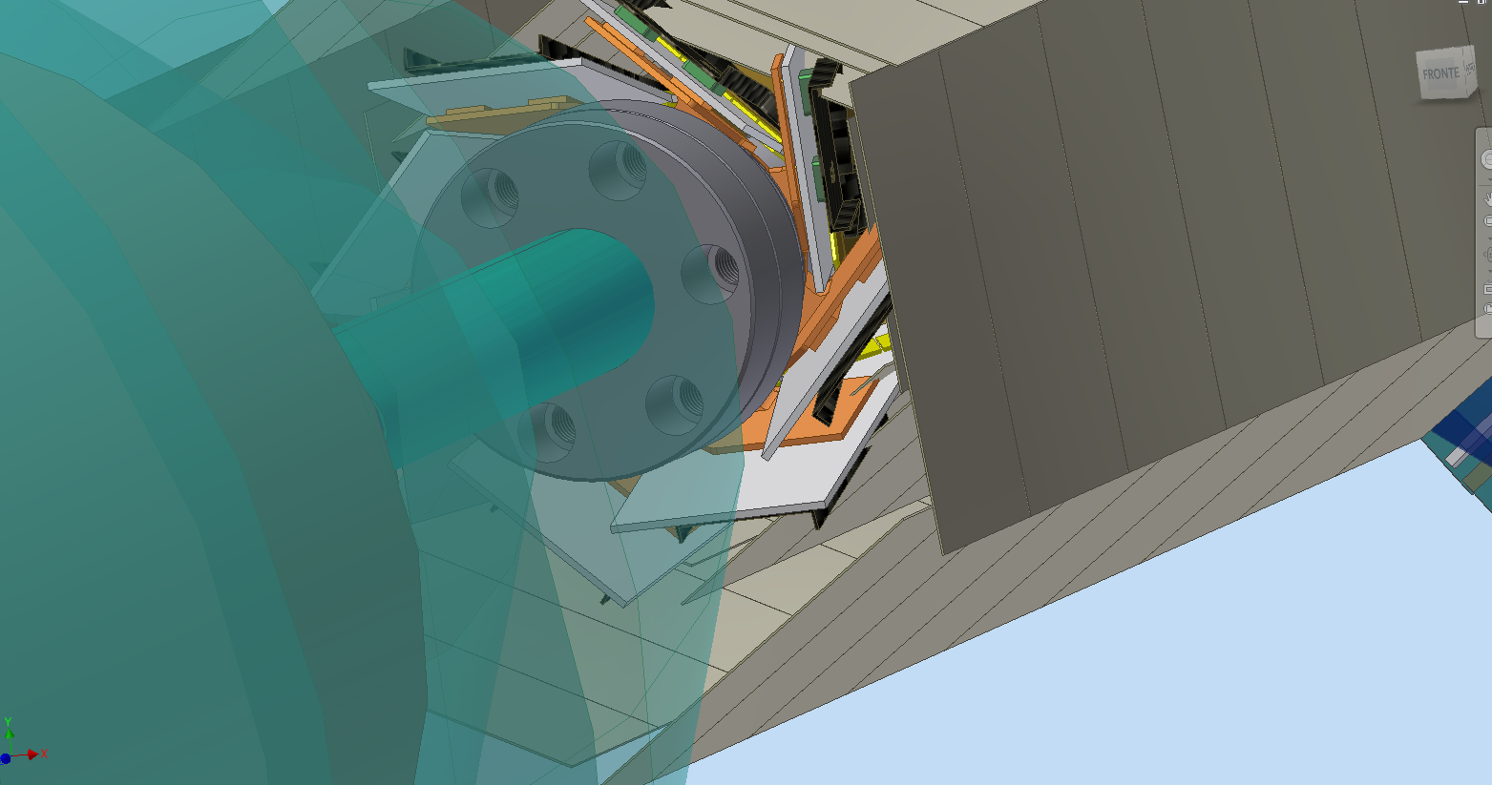
Layer 1-2-3
SVT L1-5 Layout design

Slide 21
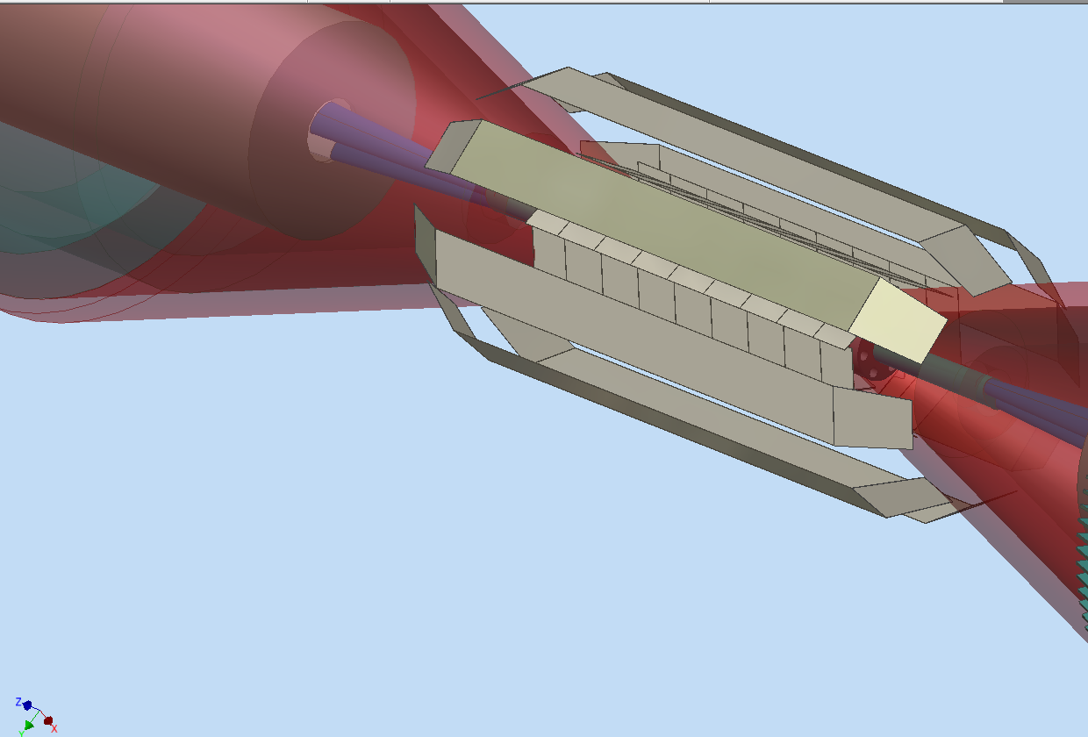
Layer 4B
SVT L1-5 Layout design

Slide 22
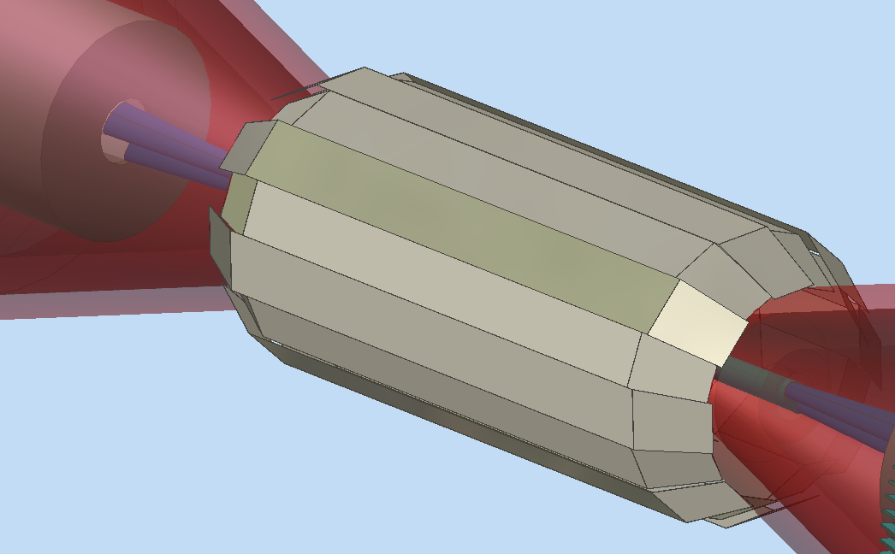
Layer 4 A-B
SVT L1-5 Layout design

Slide 23
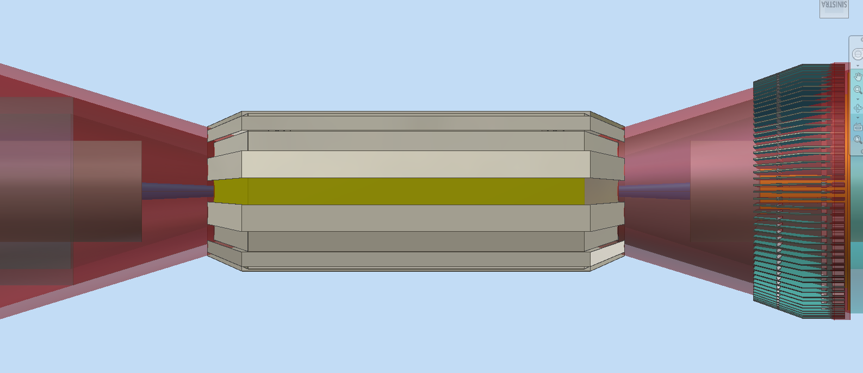
Layer 5 A-B
SVT L1-5 Layout design
300 mrad cone
Services space 20 mm

Slide 24
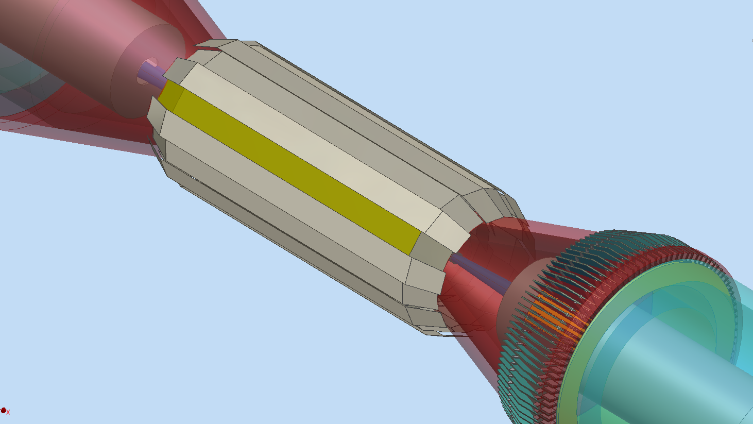
Layer 5 A-B
SVT L1-5 Layout design
N. 52 radial double board positioned on an half-flange support
transition card

Slide 25
Layer 5 A-B
SVT L1-5 Layout design
300 mrad cone
Services space 20 mm
transition card

Slide 26
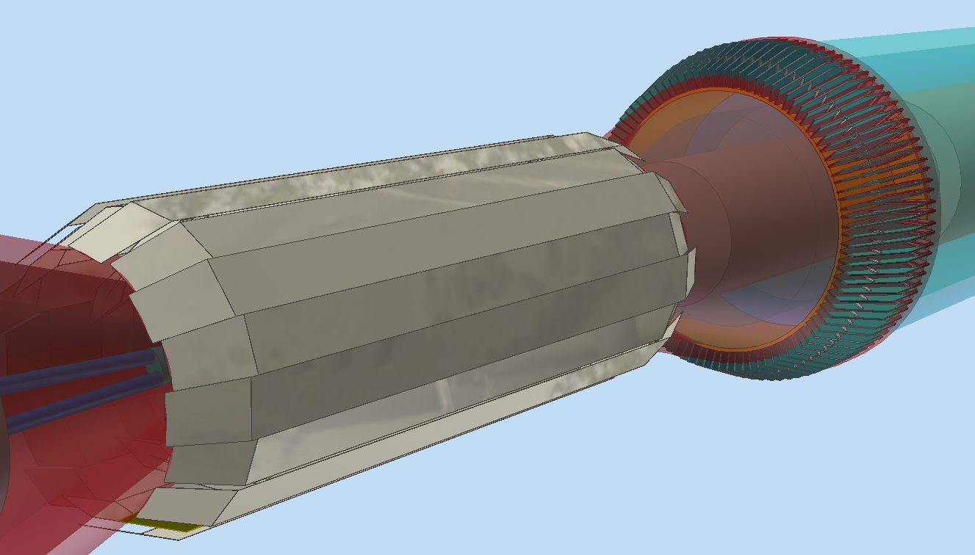
SVT and Transition Card
SVT L1-5 Layout design

Slide 27
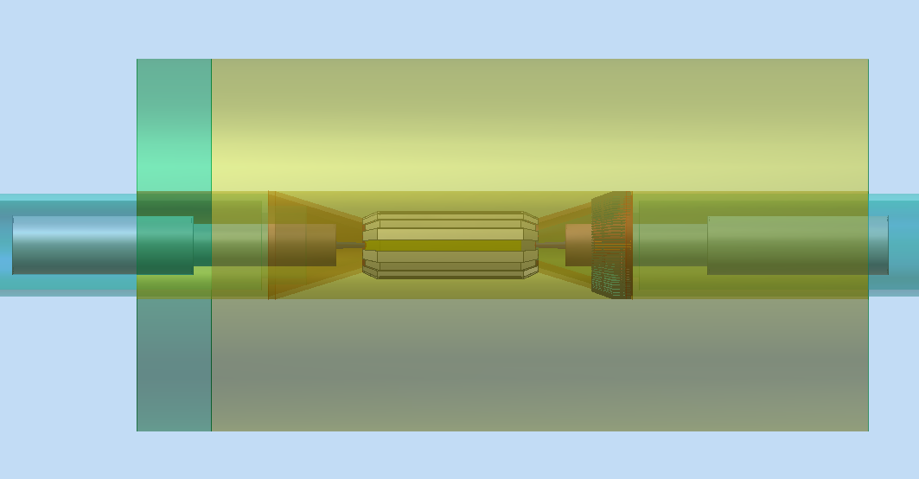
side view
General layout
Drift chamber
Transition card
SVT

Slide 28
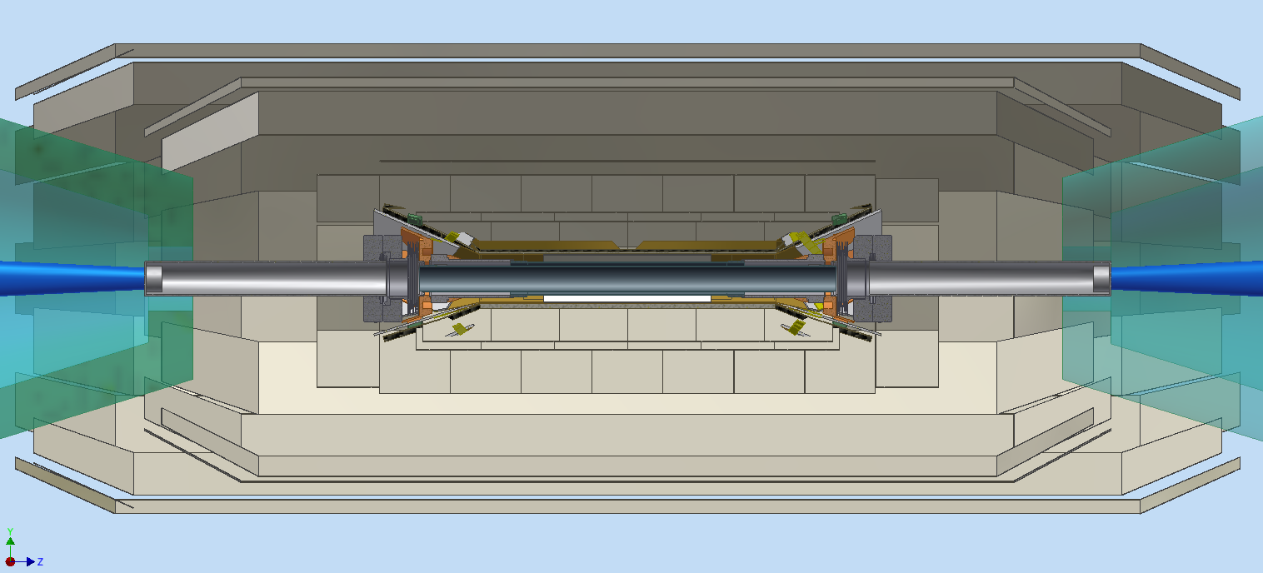
SVT side section
General layout

Slide 29
SVT L1-5 Layout design
What are the possible solution to eliminate interpenetration problem between layer 0 and layer 1-2 ?
1) modify the HDI/supp. structure and layer 0 geometry
    HDI and C.F. support structure reduced in dimensions
    position of HDI nearer of 3-4 mm to the L0 sensor
2) Move the Be pipe flanges forward in z of about 10-12 mm in order to reduce radial L0 HDI position
3) Position at larger radius L1-2 (+ 5-10 mm)

Slide 30
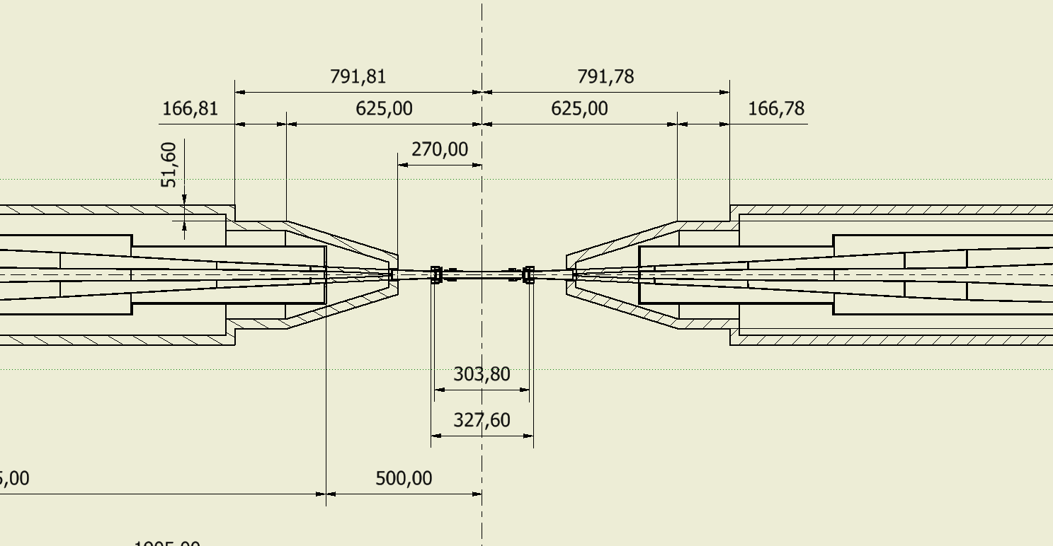
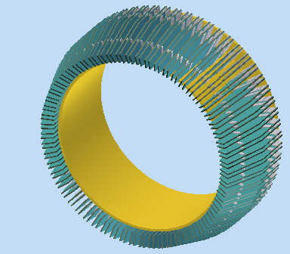
Proposed W shielding layout to meet transition card location
Shielding layout
Space for clearance from D.C. and SVT cable
Space for SVT gimbal ring
Space for trans.card
25,0

Slide 31
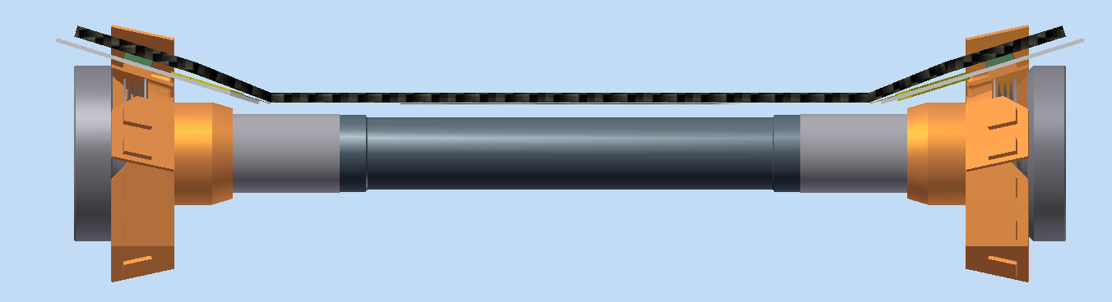
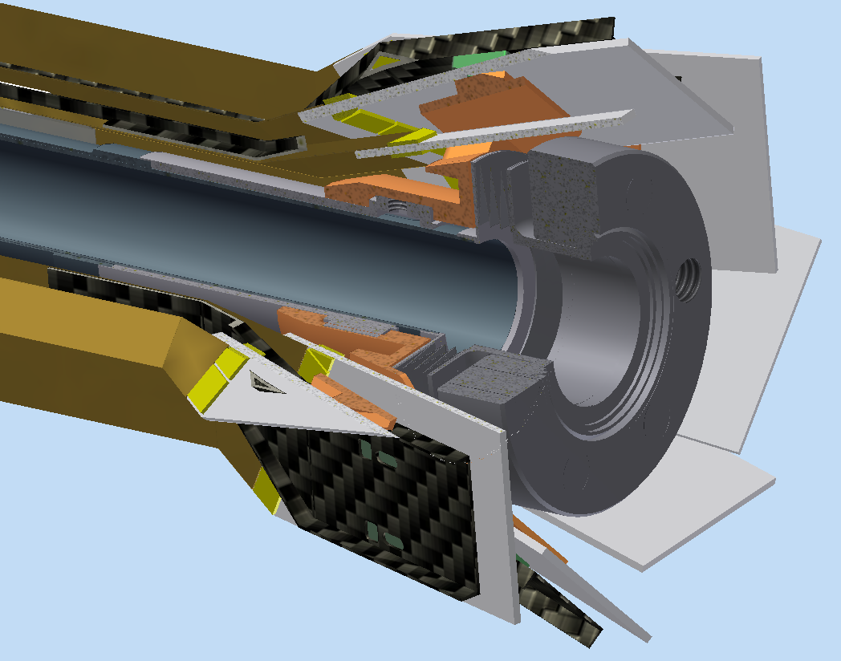
Radiation Monitor position
Possible position for radiation monitor.
Not yet defined the position of radiation monitor, its design depends still by definition of many other I.R. components, anyway we will try as soon as possible, to place the overall dimension on the general layout.
Notes:
31

Slide 32
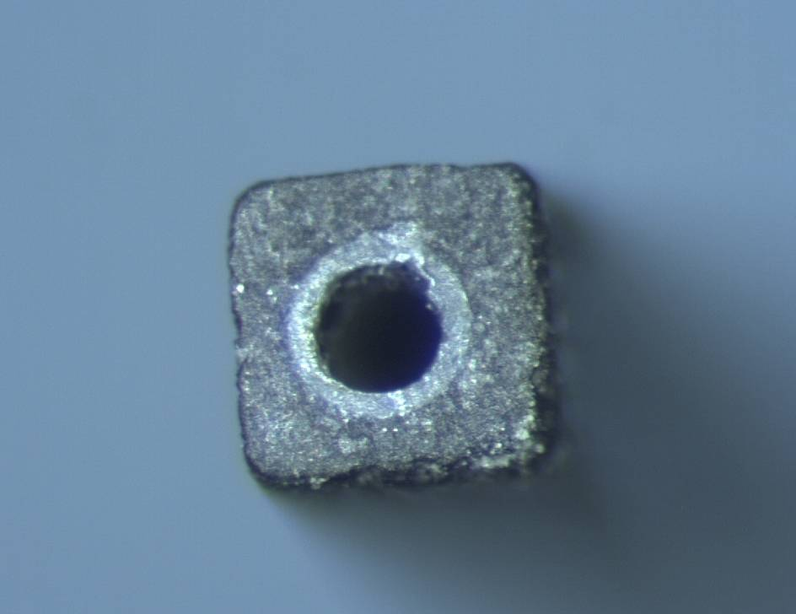
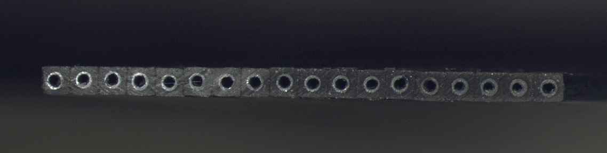
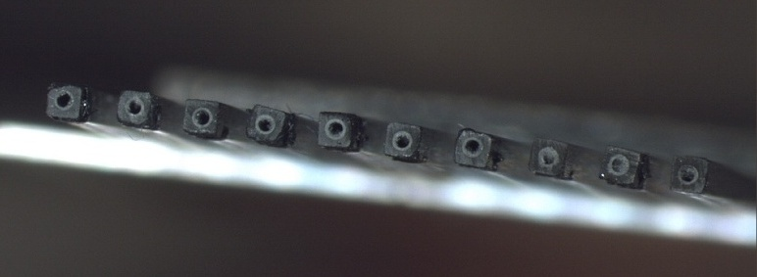
Work on Module MAPS supports
Peek pipe
700 μm
The single base microchannel unit
A square CF micro-tube with an internal peek tube 50 μm thick used to avoid moisture on carbon fiber
700 μm
Dh=300 μm
Carbon Fiber Pultrusion
Full micro-channel module
The total radiation length ^{(*)} of this support is 0.28 %X₀
12.8 mm
700 μm
Support Cross Section
Net micro-channel module
Same dimensions of full micro-channel but vacancies of tubes in the structure.
The total radiation length ^{(*)} is 0.15 %X₀
^{(*)}: Material of the support structure: ( All C.F. material + peek tube + Water)
Notes:
32

Slide 33
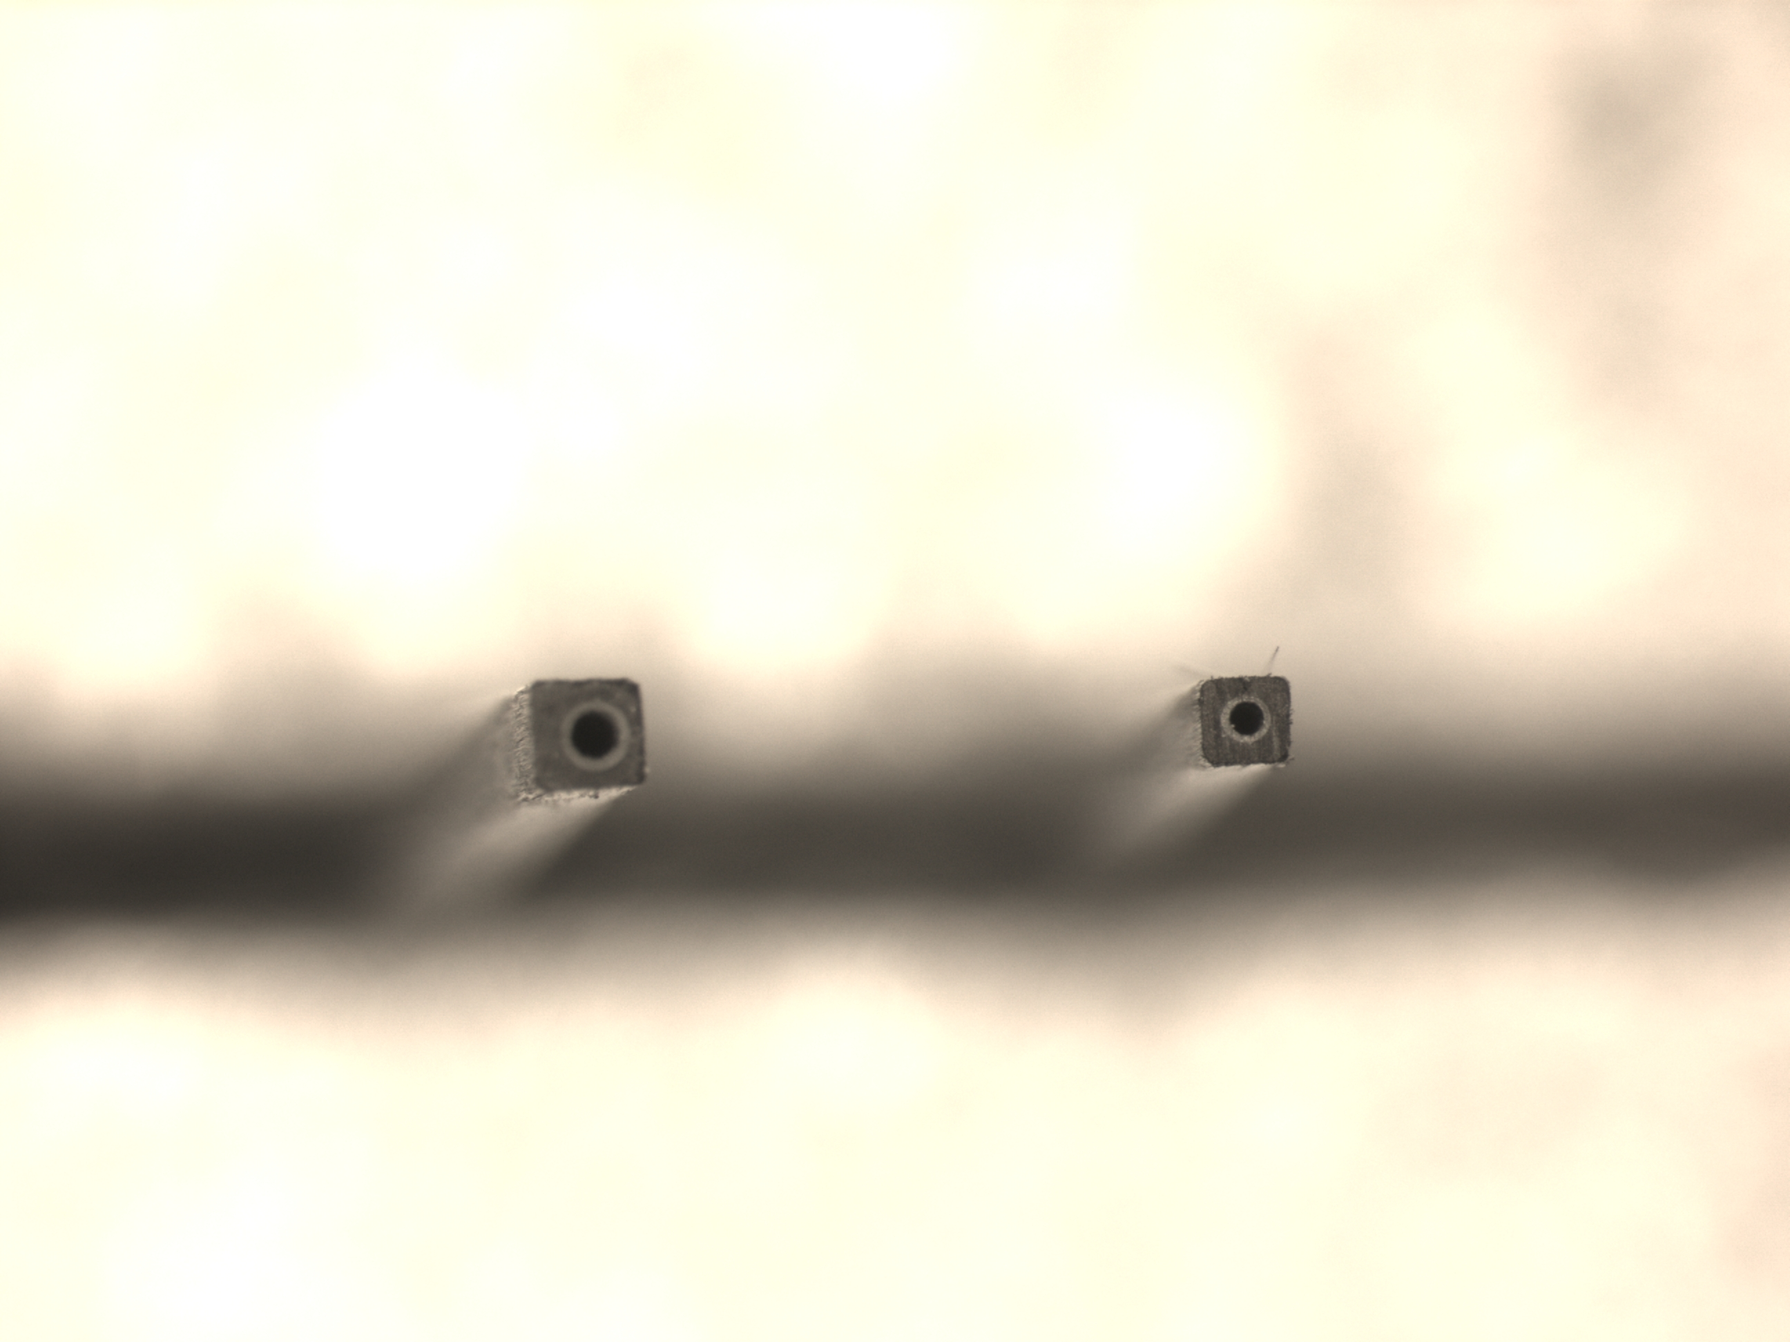
Work in progress
Further Miniaturization microtube technology
Peek pipe
Peek pipe
Dh=300 μm
Dh=200 μm
700 μm
550 μm
700 μm
550 μm
Old Carbon Fiber Pultrusion
New Carbon Fiber Pultrusion
Full Module X = 0,28 % X₀
Full Module X = 0,22 % X₀
Net Module X = 0,15 % X₀
Net Module X = 0,11 % X₀
Module Microtubes 550 μm th, Full and Net version tested at the TFD lab

Slide 34
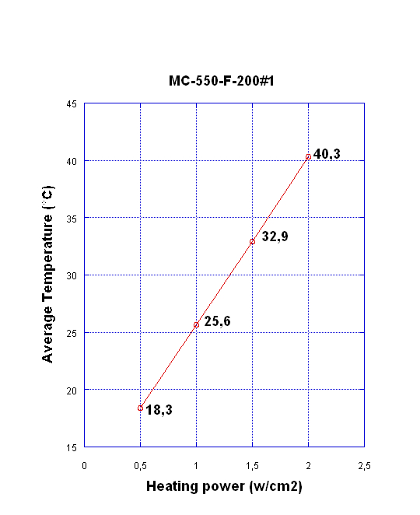
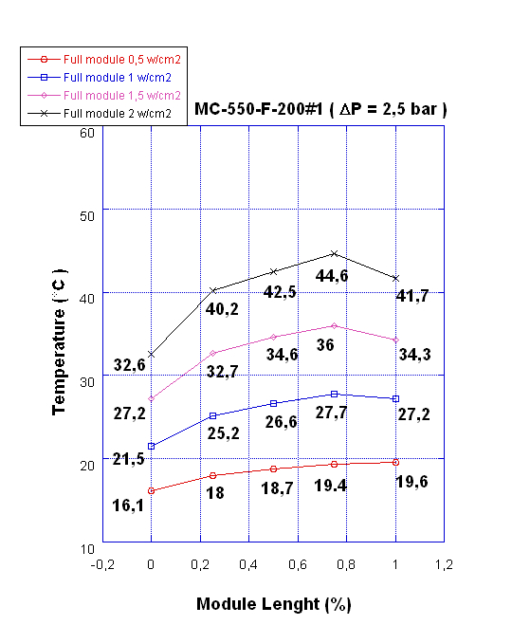
Full module H=550μm test results
Tests performed on full module sample (length = 120 mm) with water-glycol @ 10 °C as coolant (Δp =2,0 atm).
Average module Temperature vs Specific Power
Temperature along the module: ΔT = 7,1 °C at 1.5 W/cm² and Δp =2.0 atm
Notes:
34

Slide 35
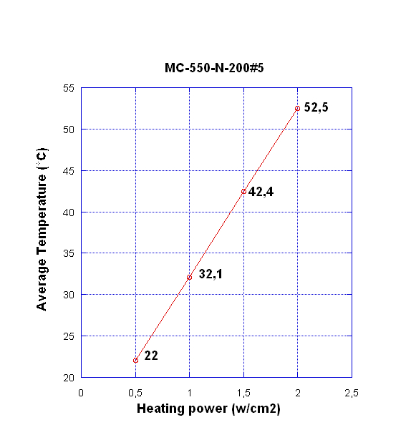
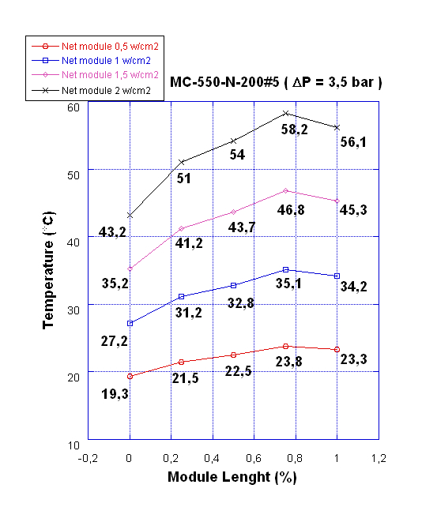
Net Module H=550μm test results
Tests performed on net module sample (length = 120 mm) with water-glycol @ 10 °C as coolant (Δp =3,5 atm).
Average module Temperature vs Specific Power
Temperature along the module:
ΔT = 7.0 °C at 1.0 W/cm² Δp =3.5 atm

Slide 36
Microchannel Module Comparison Data
Comparison List
 |  | % X0 | T max °C | Specific Power W/cm2 | Hydraulic. Diam. μm | Flow rate g/min | Δ Temperature °C
1 | Microchannel FULL Module support H=700 μm |  | 35.8 | 2.0 | 300 | 244 | 5.3
2 | Microchannel NET Module support H=700 μm | 0.15 | 38.3 | 1.5 | 300 | 128 | 6.70.28
3 | Microchannel Full Module support H=550 μm | 0.22 | 34.3 | 1.5 | 200 | 33* | 7.1*
4 | Microchannel NET Module support H=550 μm | 0.11 | 34.2 | 1.0 | 200 | 24 | 7.0
Tests performed on net module sample (length = 120 mm) with water-glycol @ 10 °C as coolant at Δp =3,5 atm (Δp not valid for value *).

Slide 37
Pixel maps module support
Although the results on Net module H550 microchannel support satisfy the thermal spec we had a problem of bad sealing of the liquid coolant in all these prototypes
We produced N. 4 Net H550 microchannel support and all the samples presented coolant leakage outside the c.f. channel at low pressure ( 1.0-1.5 atm).
We improve the hydraulic interface design in order to perform better sealing from epoxy araldite casting by large space devoted to the sealing and vacuum control but we did not gain in sealing quality.
This might be a serious problem for use of this kind of very light supports. Net module H700 ( 0.15% X₀ ) is anyway OK !

Slide 38
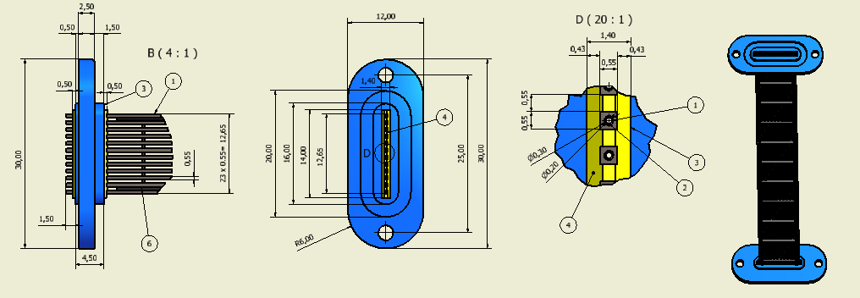
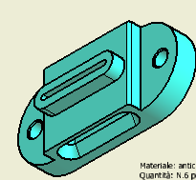
Pixel maps module support
Araldite 2011 sealing
Coolant input
Probably coolant infiltration
through face surfaces
Leakage region
Coolant input
The leakage is probably due to a poor rate of resin respect to the carbon fiber that allow the coolant pass trough the pultrusion at the face region of the microchannel
Hydraulic interface new design

Slide 39
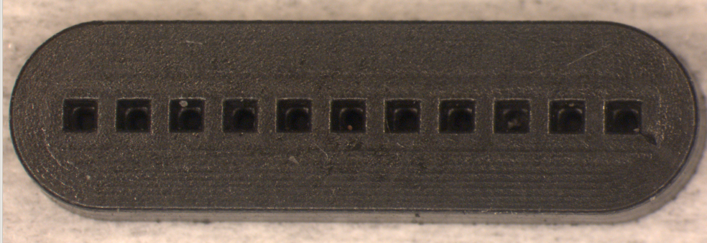
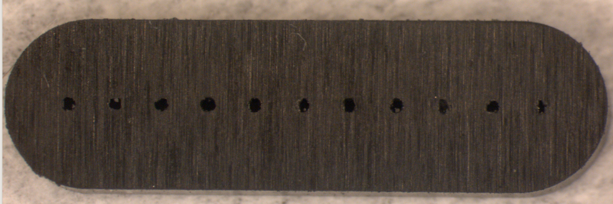
Pixel maps module support
Possible cure for the H 550 microchannel leakage:
Coating of the external microchannel c.f. face
Viton sealing on the microchannel face surface
New production of H550 microchannel with higher epoxy rate respect c.f. ( about 60 -65%)
Solution 1) and 2) will be realized in Pisa .
For solution 2) we have already realized a special viton sealing that we can test immediately!
Front side
Back side
I think anyway should be useful to have also a new microtube production with higher resin rate !

Slide 40
Pixel maps module support
If H550 micro-tube should be a critical choice, it is possible another solution:
-In order to make comparable from the Xo point of view microchannel Net support H700 and H550, is possible to design an H700 module support with less microchannel number ( more empty space between the micro-tube) and to obtain the same X₀ value (0,11% X₀) .
Of course this kind of support will have less cooling performance but should be devoted to serve evenctually the pixel hybrid sensor !
We will test also this solution!

Slide 41
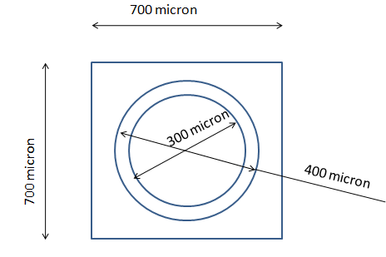
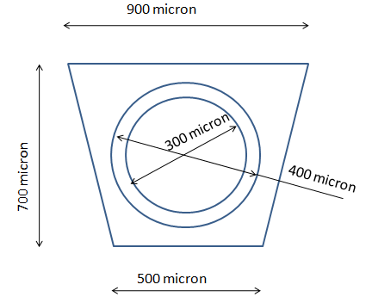
Pixel maps module support
In this hypotesis of new support design with less number of H700 microtube, should be important to improve the efficiency of thermal exchange.
At this purpose another design implementation is the following:
This implementation can improve of about 20% the thermal exchange surface between support and sensors and partially compensate the decreased number of microtube in the new H700 microchannel support

Slide 42
Conclusion
SVT Engineering situation
1) QM Engineers started to work on the items they agree to cover (space/frame and support cone)
2) N.1 Young engineer will begin ( October 1st) his work in Pisa (planned to work on the jig and features design for SVT Modules prototype production)
3) N.1 Engineer at 50% will be operative beginning of next year at INFN Milan to work on trans. Card support and cooling
A significant acceleration in the engineering design is expected in the next months due to the larger number of engineers involved.
*Priority on the baseline design ( strplets+L1-5 ) andto eliminate the conflict with layer 1-2
* Works on pixel prototype modules has lower priority until TDR is ready
* Quick demounting procedure and IR layout , are still strongly depending on beam pipe dimension definition , W shielding dimension, criostat and QD0 design, etc. but anyway one engineering proposal has to be presented to the Tech. Board as soon as possible
* Work on TDR mechanical chapter has started

Slide 43
BACKUP

Slide 44
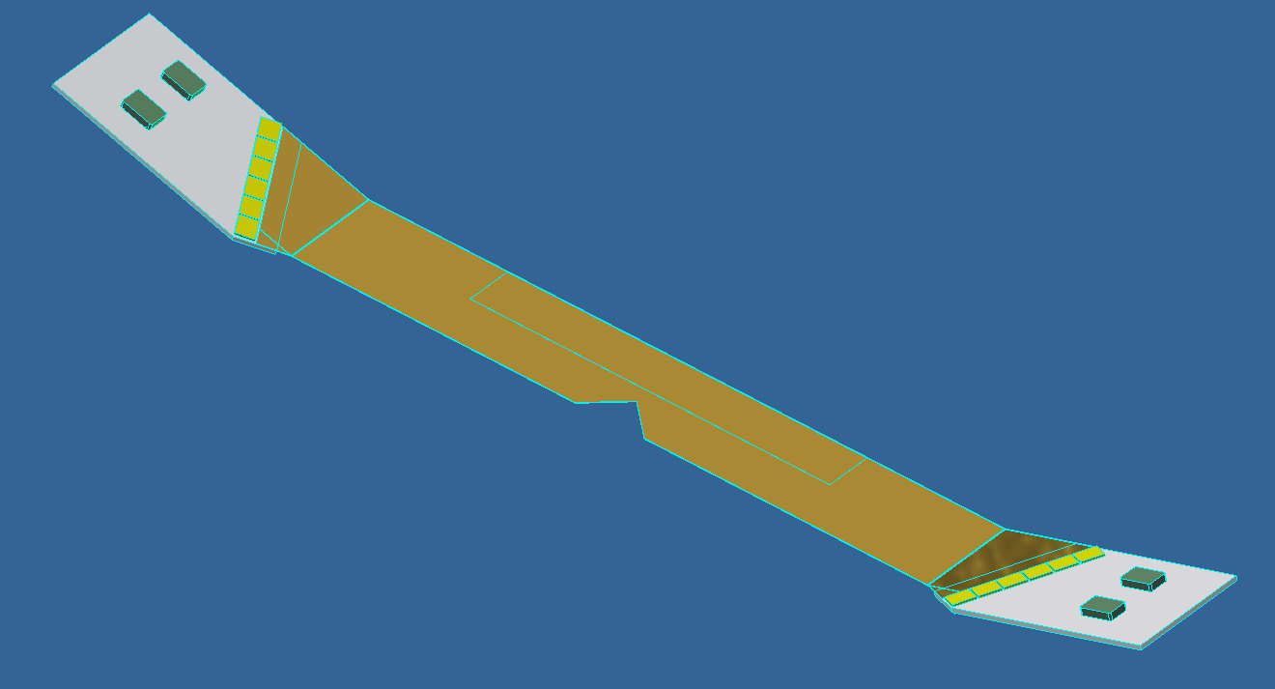
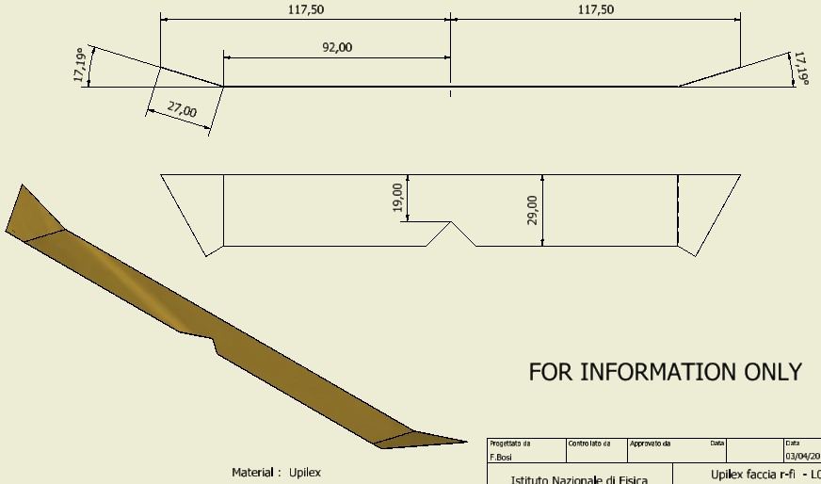
Module Striplets
Fixing buttons
Sensor position
R-fi fanout
Front-end chips
HDI
Final solution –HDI in axial direction inclinated at 300 mrad, with front-end chips 30° oriented
Notes:
44

Slide 45
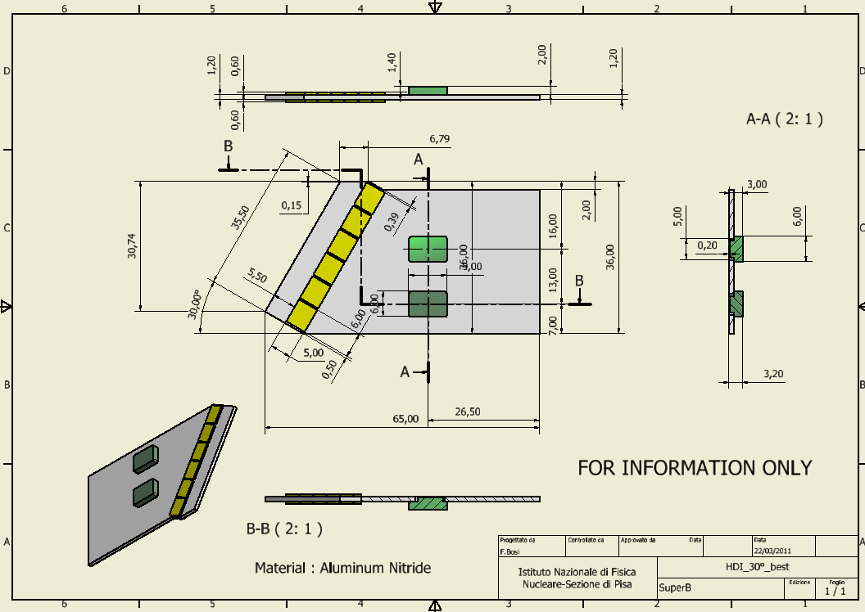
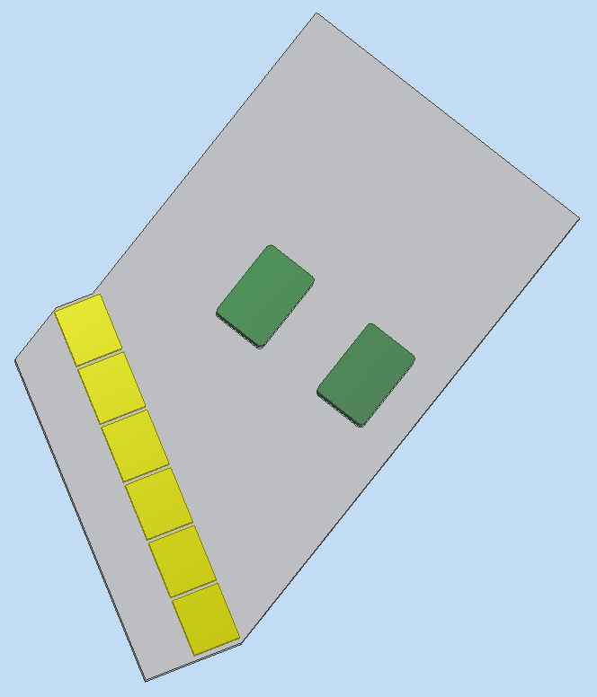
Module Striplets
Some modification about the previous HDI dimensions ;
to facilitate the cold flange design, bottons are positioned
forward and in asymmetric position .
Widht of HDI: important to limitate material in the 300 mrad envelope
Buttons positioned asymmetric and moved in forward direction
Notes:
45

Slide 46
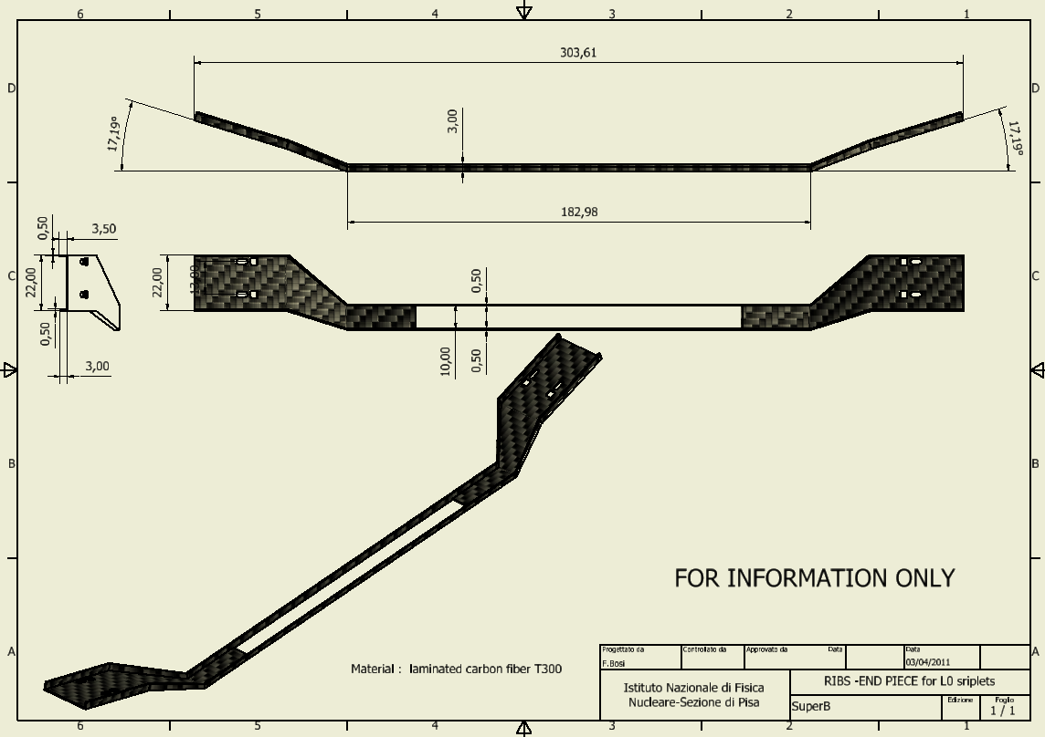
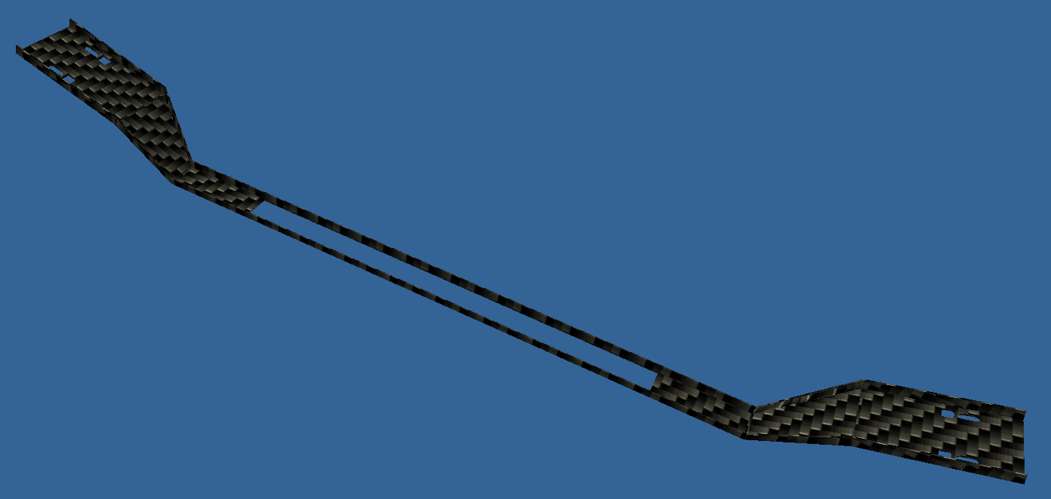
Module Striplets
Asymmetric pot for buttons glueing
Button-hole for screws and final glueing to the buttons
Low mass ribs for active region
CFRP structure , glued on the fanout-sensor and HDI buttons, freezes the exact positions of HDI and sensors .
Notes:
46

