Slide 1
Segmentation of pancreas tumor
Nicola Ferrara

Slide 2
TASK07_PANCREAS
Public Database: Medical Segmentation Decathlon
420 ct
Thickness 2.5 mm
281 training
TASK: transform medical images into clinically relevant, spatially structured information for treatment response monitoring
Computer-aided diagnosis, biomarker extraction, surgical intervention planning, disease prognosis
parenchima pancreatico
neoplasia mucinosa intraduttale, tumore pancreatico neuroendocrino e adenocarcinoma pancreatico duttale (PDAC).

Slide 3
PREPROCESSING
Data harmonization: in all studies, before training the model there is a pre-processing phase which may include the following steps:
Contrast enhancement (windowing with WW and WL based on the values ​​present in the literature and/or Histogram equalization);
Resampling, to make the size of the voxels and pixels of the entire dataset uniform;
Filtering (e.g. Butterworth low-pass, local binary pattern filtering);
Reduction of the size of the dataset (e.g. from a scan of 512x512xN to 256x256xN by cutting the images starting from the center or from 512x512xN to 512x512xM, with M<N by removing the slices in which the target is not present);
Data augmentation (scaling, translation, rotation, addition of noise, etc.);
Normalization/standardization of intensity values.

Slide 4
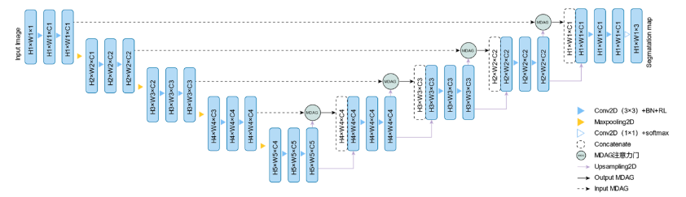
Case of study
Multi-target segmentation of pancreas and pancreatic tumor based on fusion of attention mechanism (paper)

Slide 5
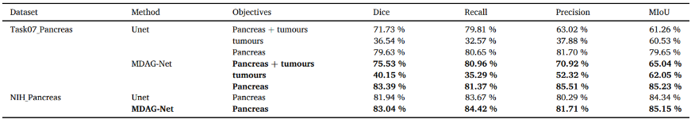
Results
Our results on TUMORS segmentation: MIoU = 0.8279

Slide 6
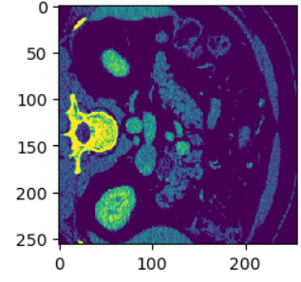
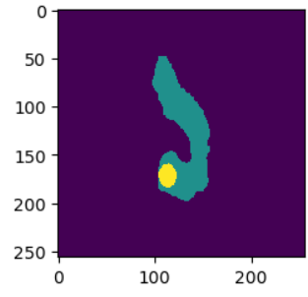
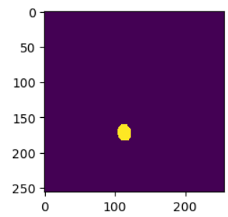
Example of prediction
Image
Label
Tumor segmentation

