Slide 1
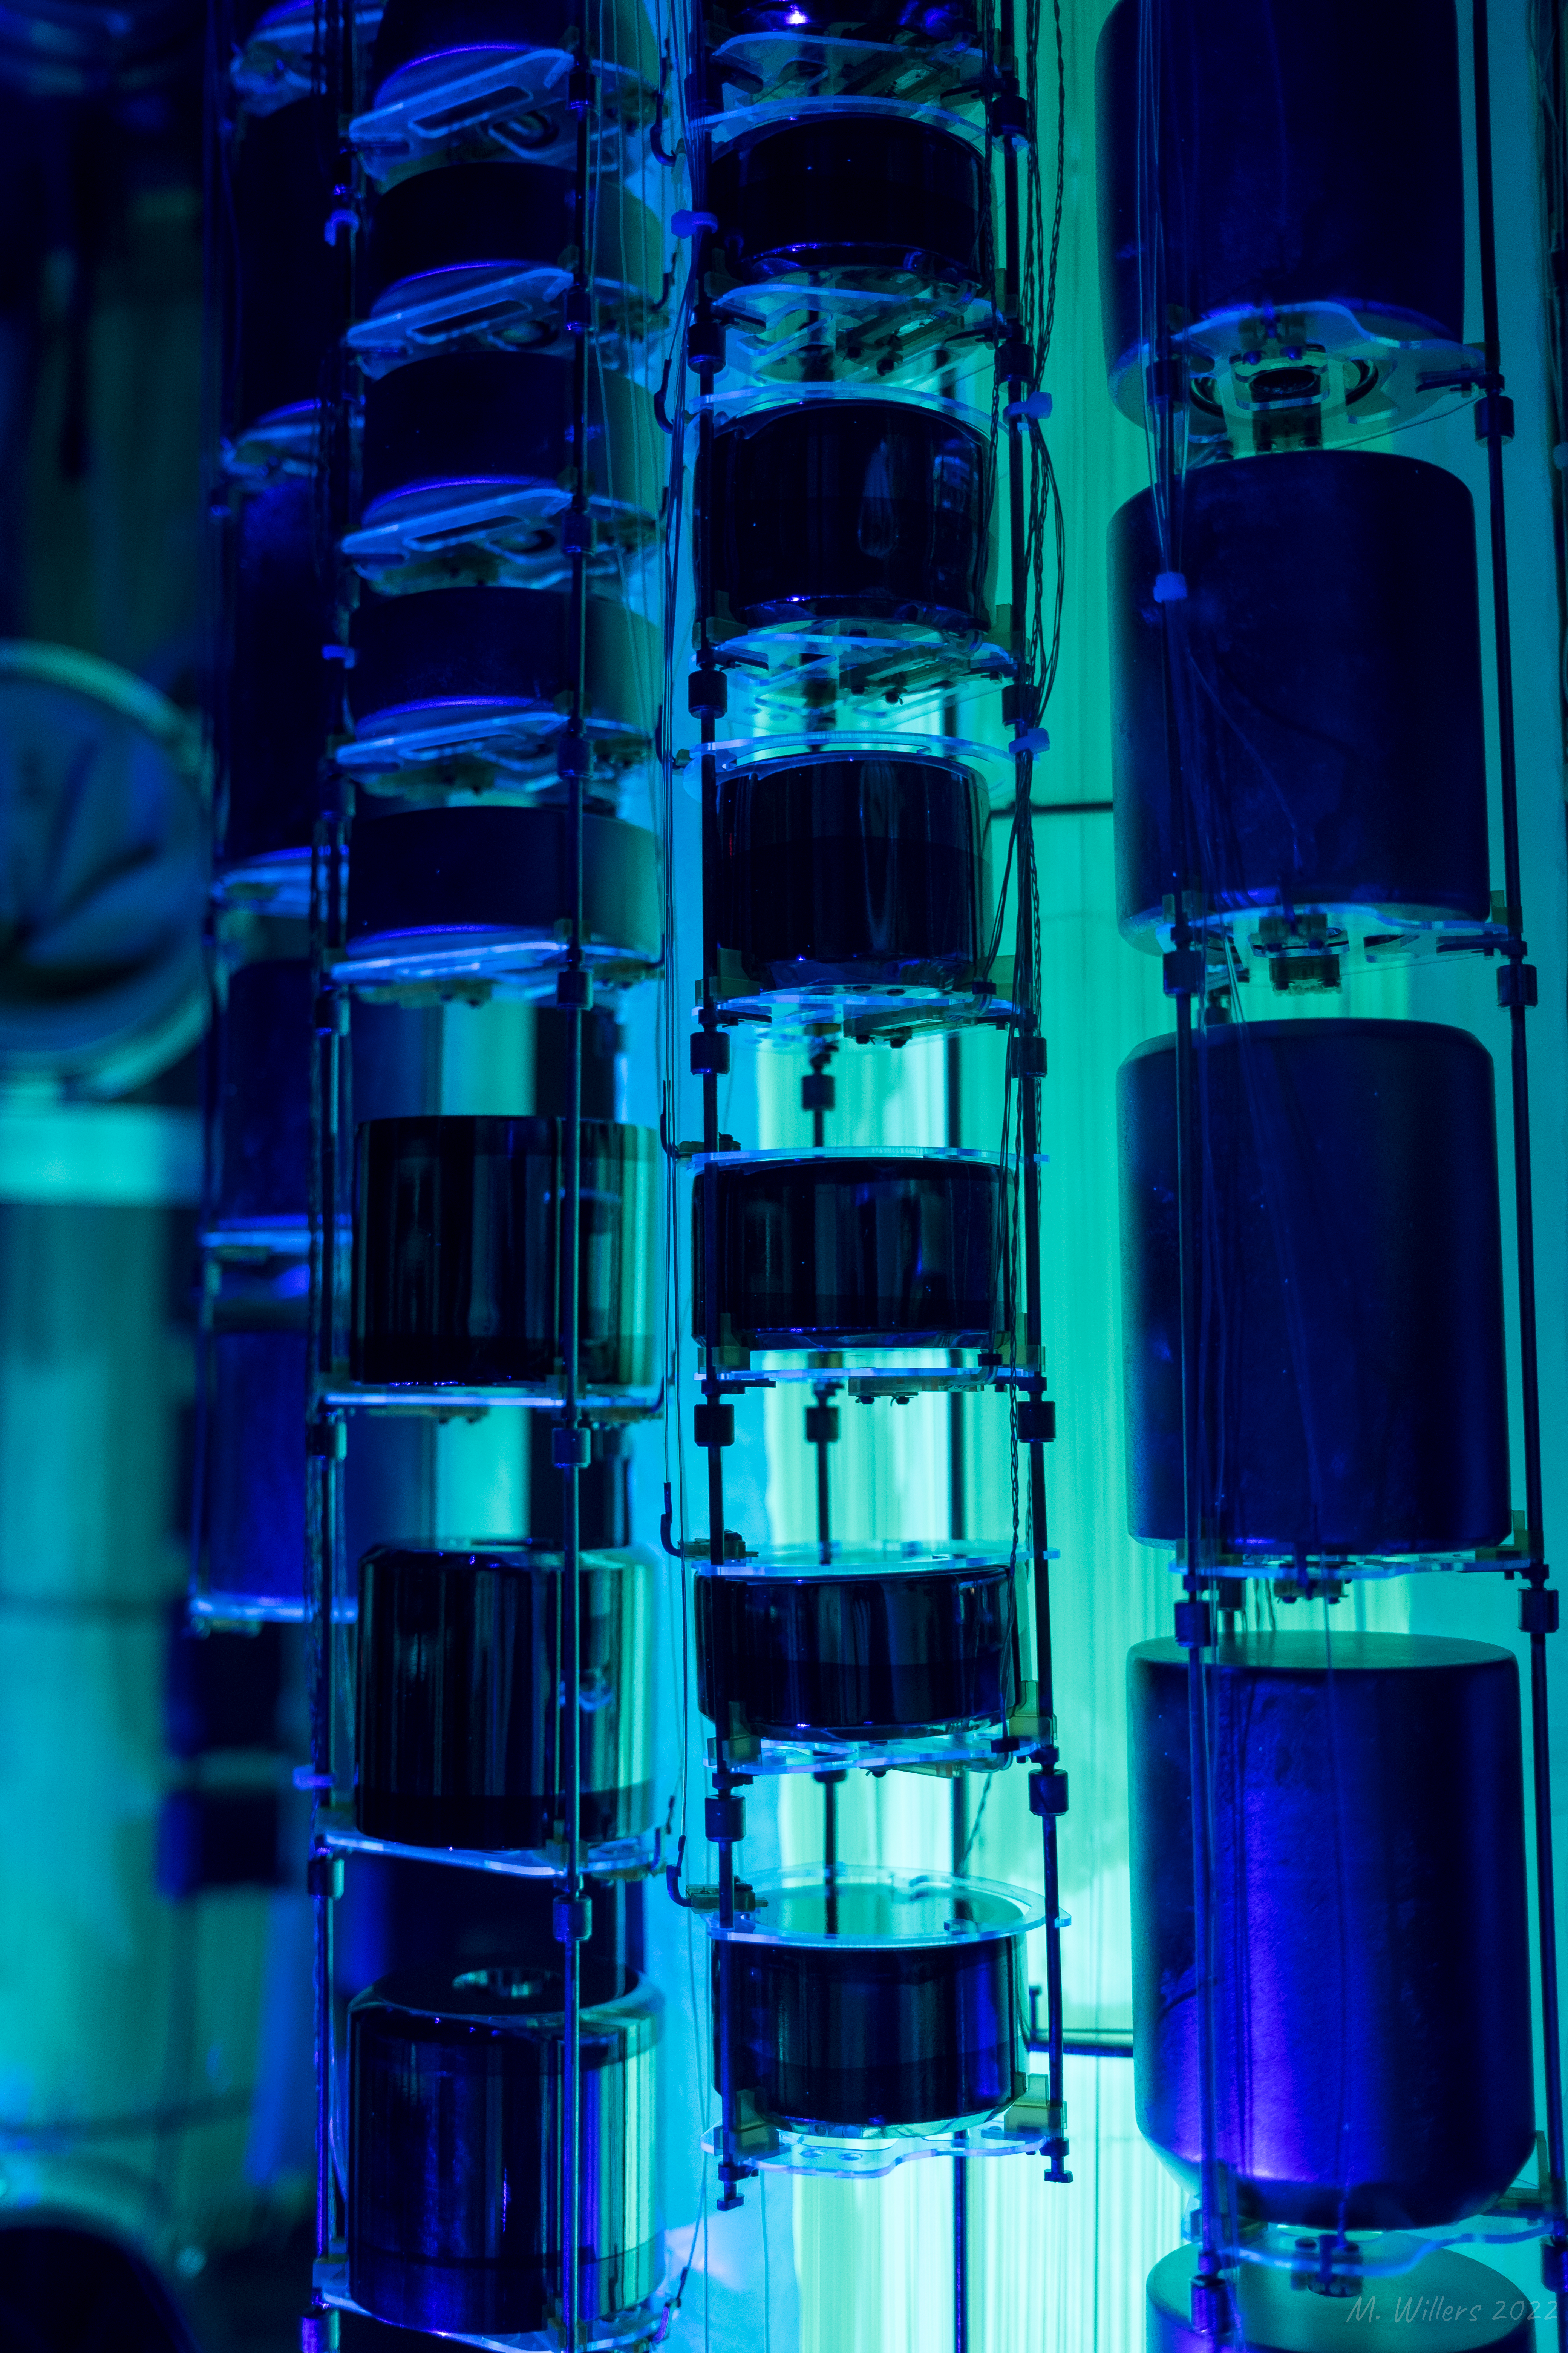




Raoul Cesarano
on behalf of the collaboration
La Thuile 2024

Slide 2
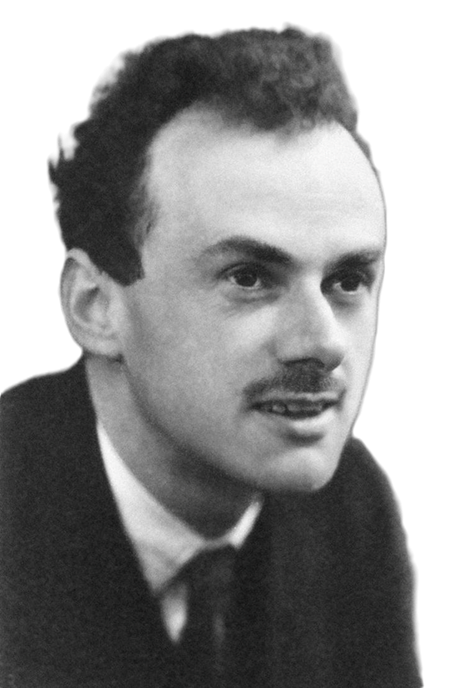
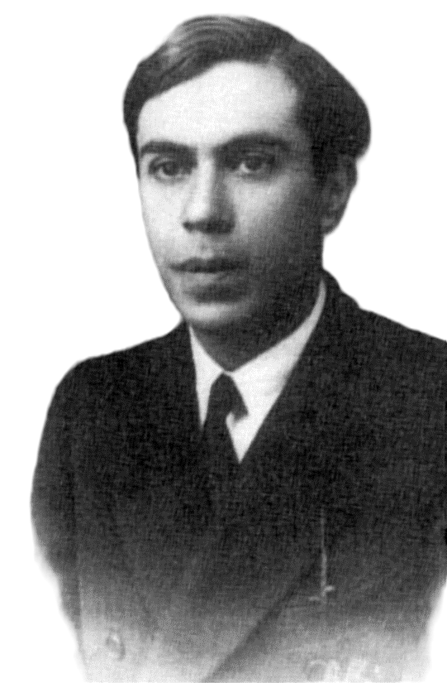
How can we discover the neutrino’s true nature?
Dirac
Majorana
Raoul Cesarano – La Thuile 2024
1

Slide 3
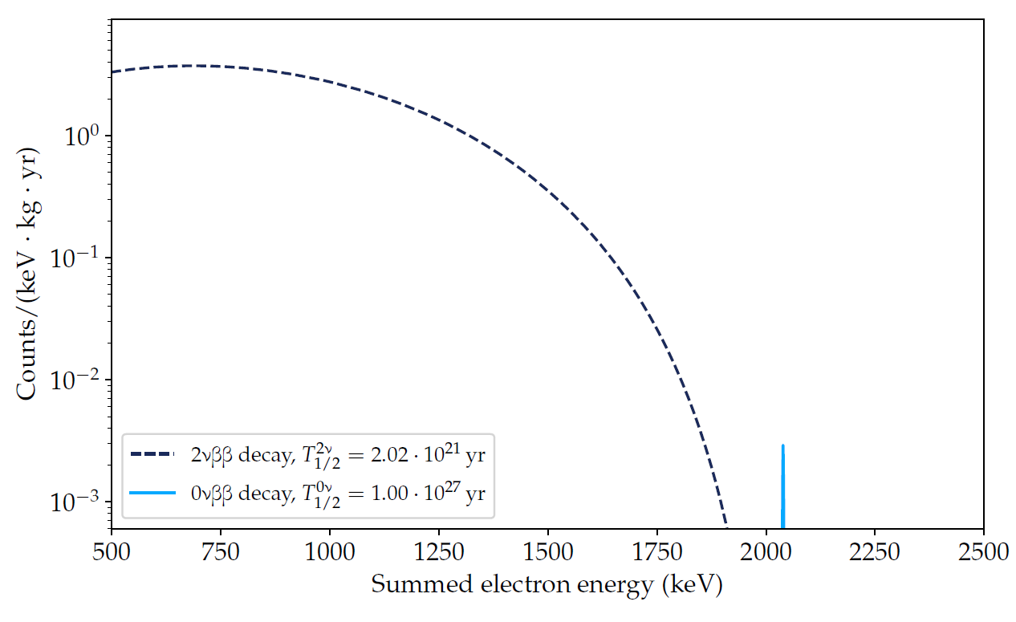
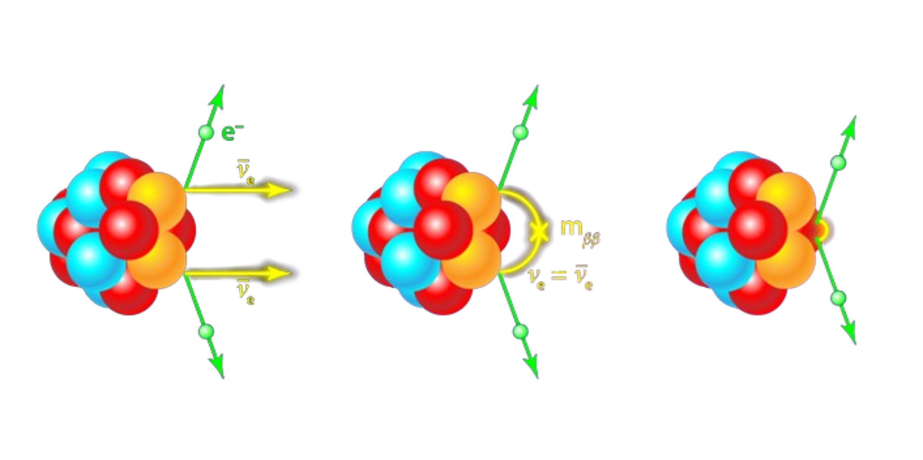
What to search for
⁷⁶Ge
Raoul Cesarano – La Thuile 2024
2

Slide 4
What to search for
⁷⁶Ge
Q_{ββ} = 2039 keV
Raoul Cesarano – La Thuile 2024
2

Slide 5

What to search for
Isotopic abundance
Detector signal efficiency
⁷⁶Ge
Exposure
$$T_{1/2}^{0νββ}=ln2∙\frac{N_{A}∙ia∙ε}{n_{σ}∙m_{A}}∙\sqrt{\frac{M∙T}{B_{i}∙∆E}}$$
Sensitivity
Q_{ββ} = 2039 keV
Background index
Energy
resolution
Raoul Cesarano – La Thuile 2024
2

Slide 6
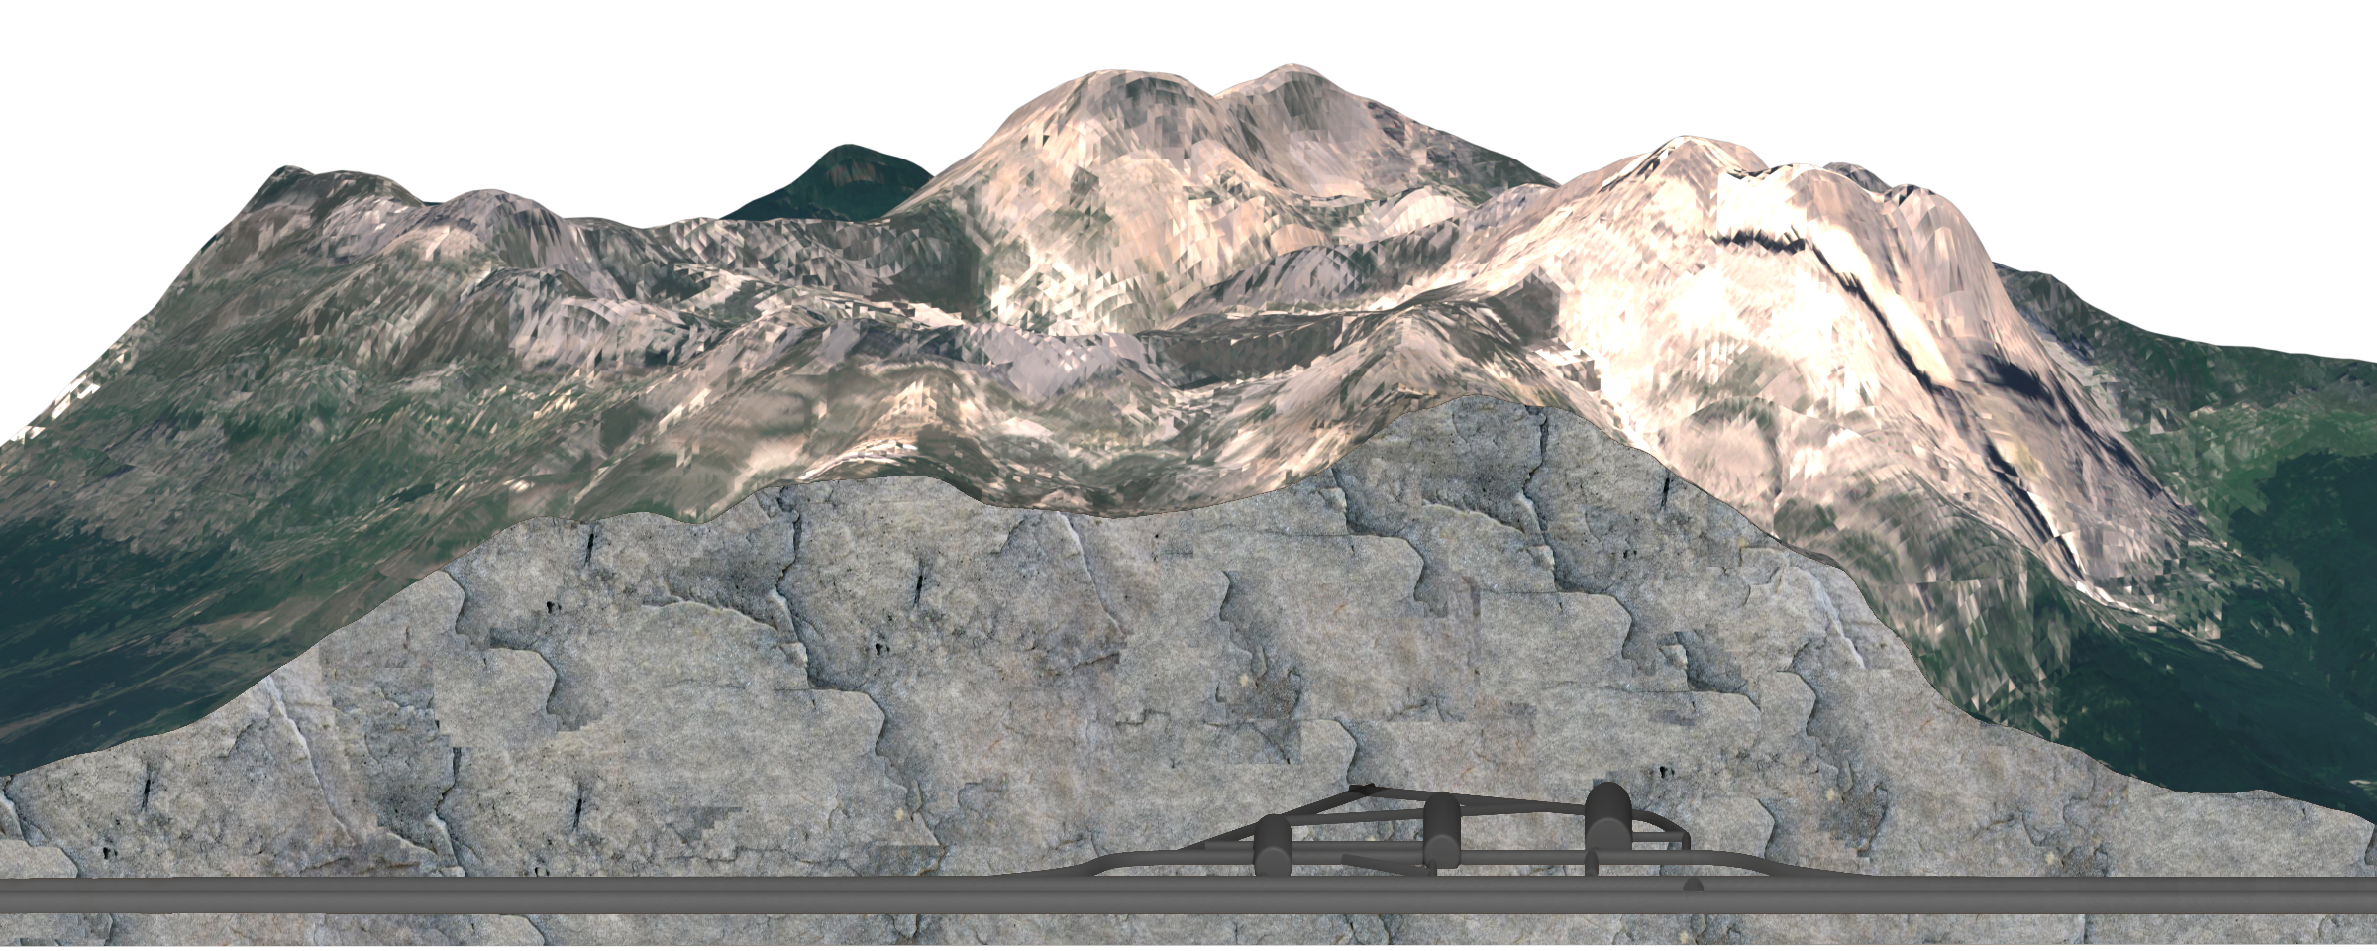
Gran Sasso National Laboratory (LNGS)
3600 m water equivalent
Muon flux reduced of a factor 10⁶
Raoul Cesarano – La Thuile 2024
3

Slide 7
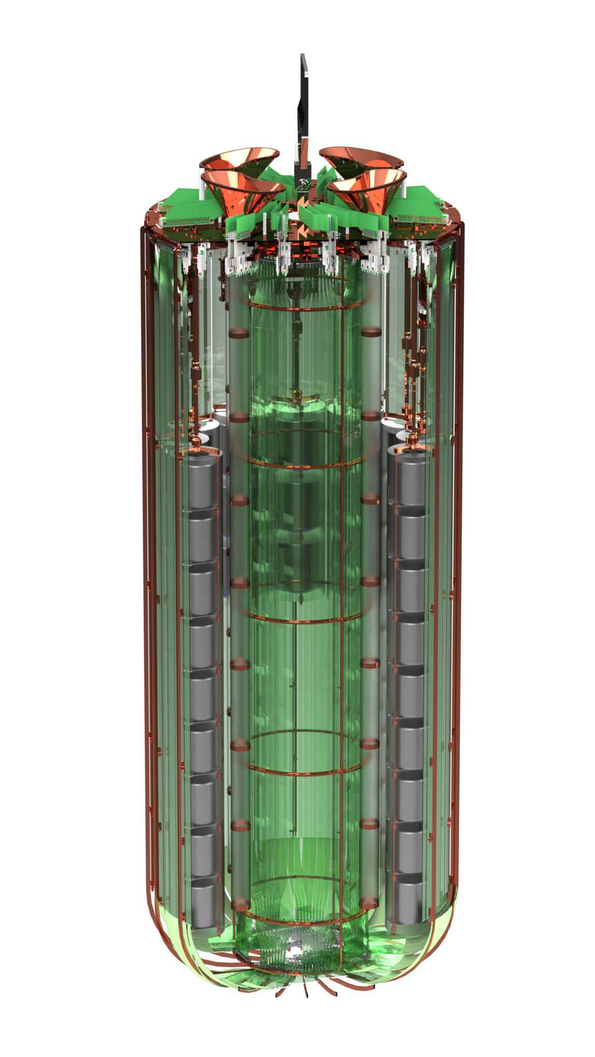

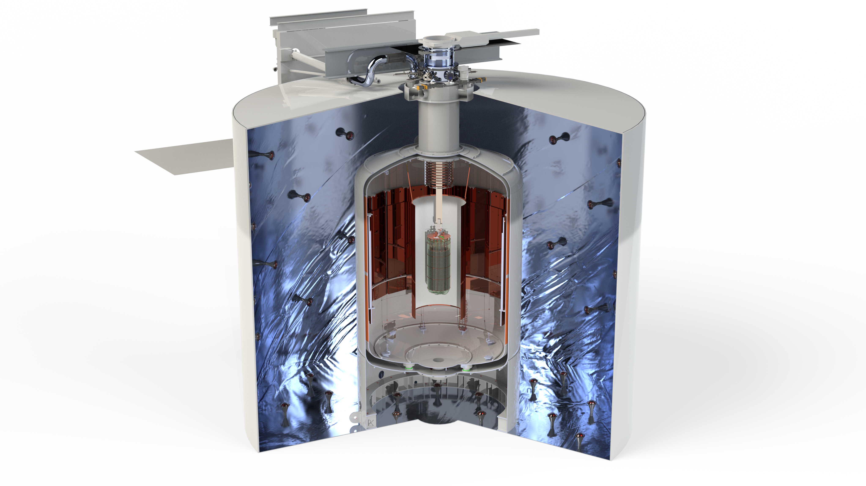
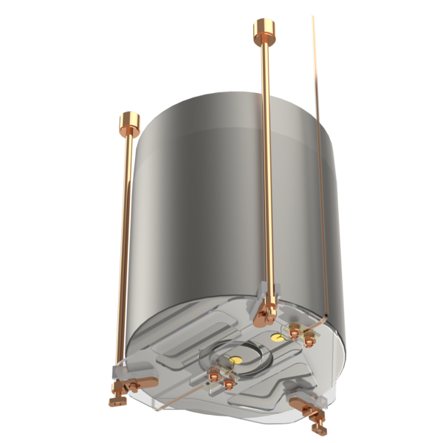
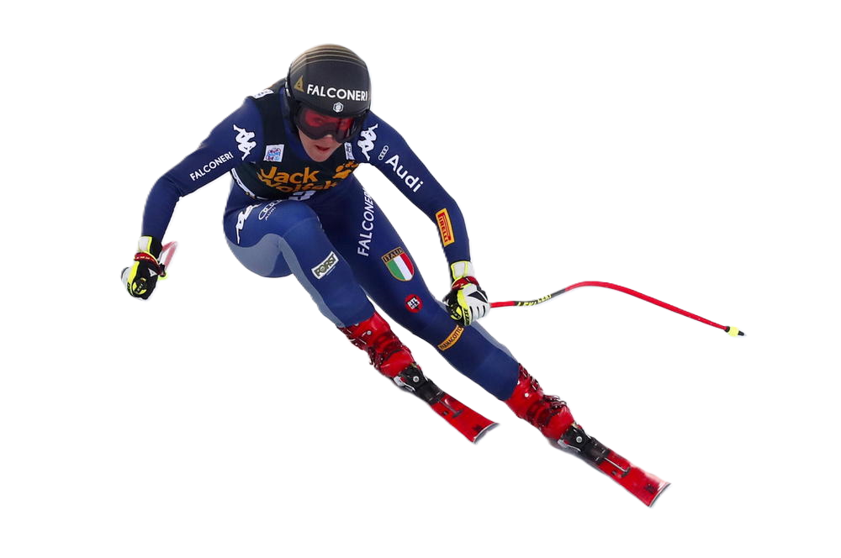

90 tons of liquid Ar
200 kg of enriched Ge
Stably taking data since 1 yr
$T_{1/2}^{0νββ}$> 10²⁷ yr @ 90% CL (5 yrs)
- 200
Water tank
Liquid Ar cryostat
Raoul Cesarano – La Thuile 2024
4

Slide 8
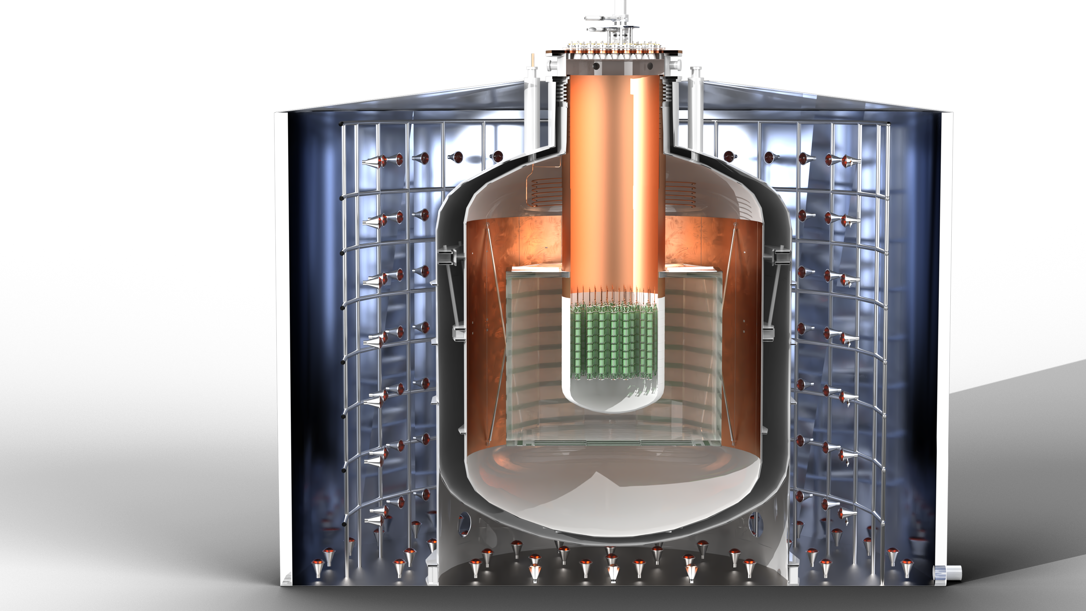
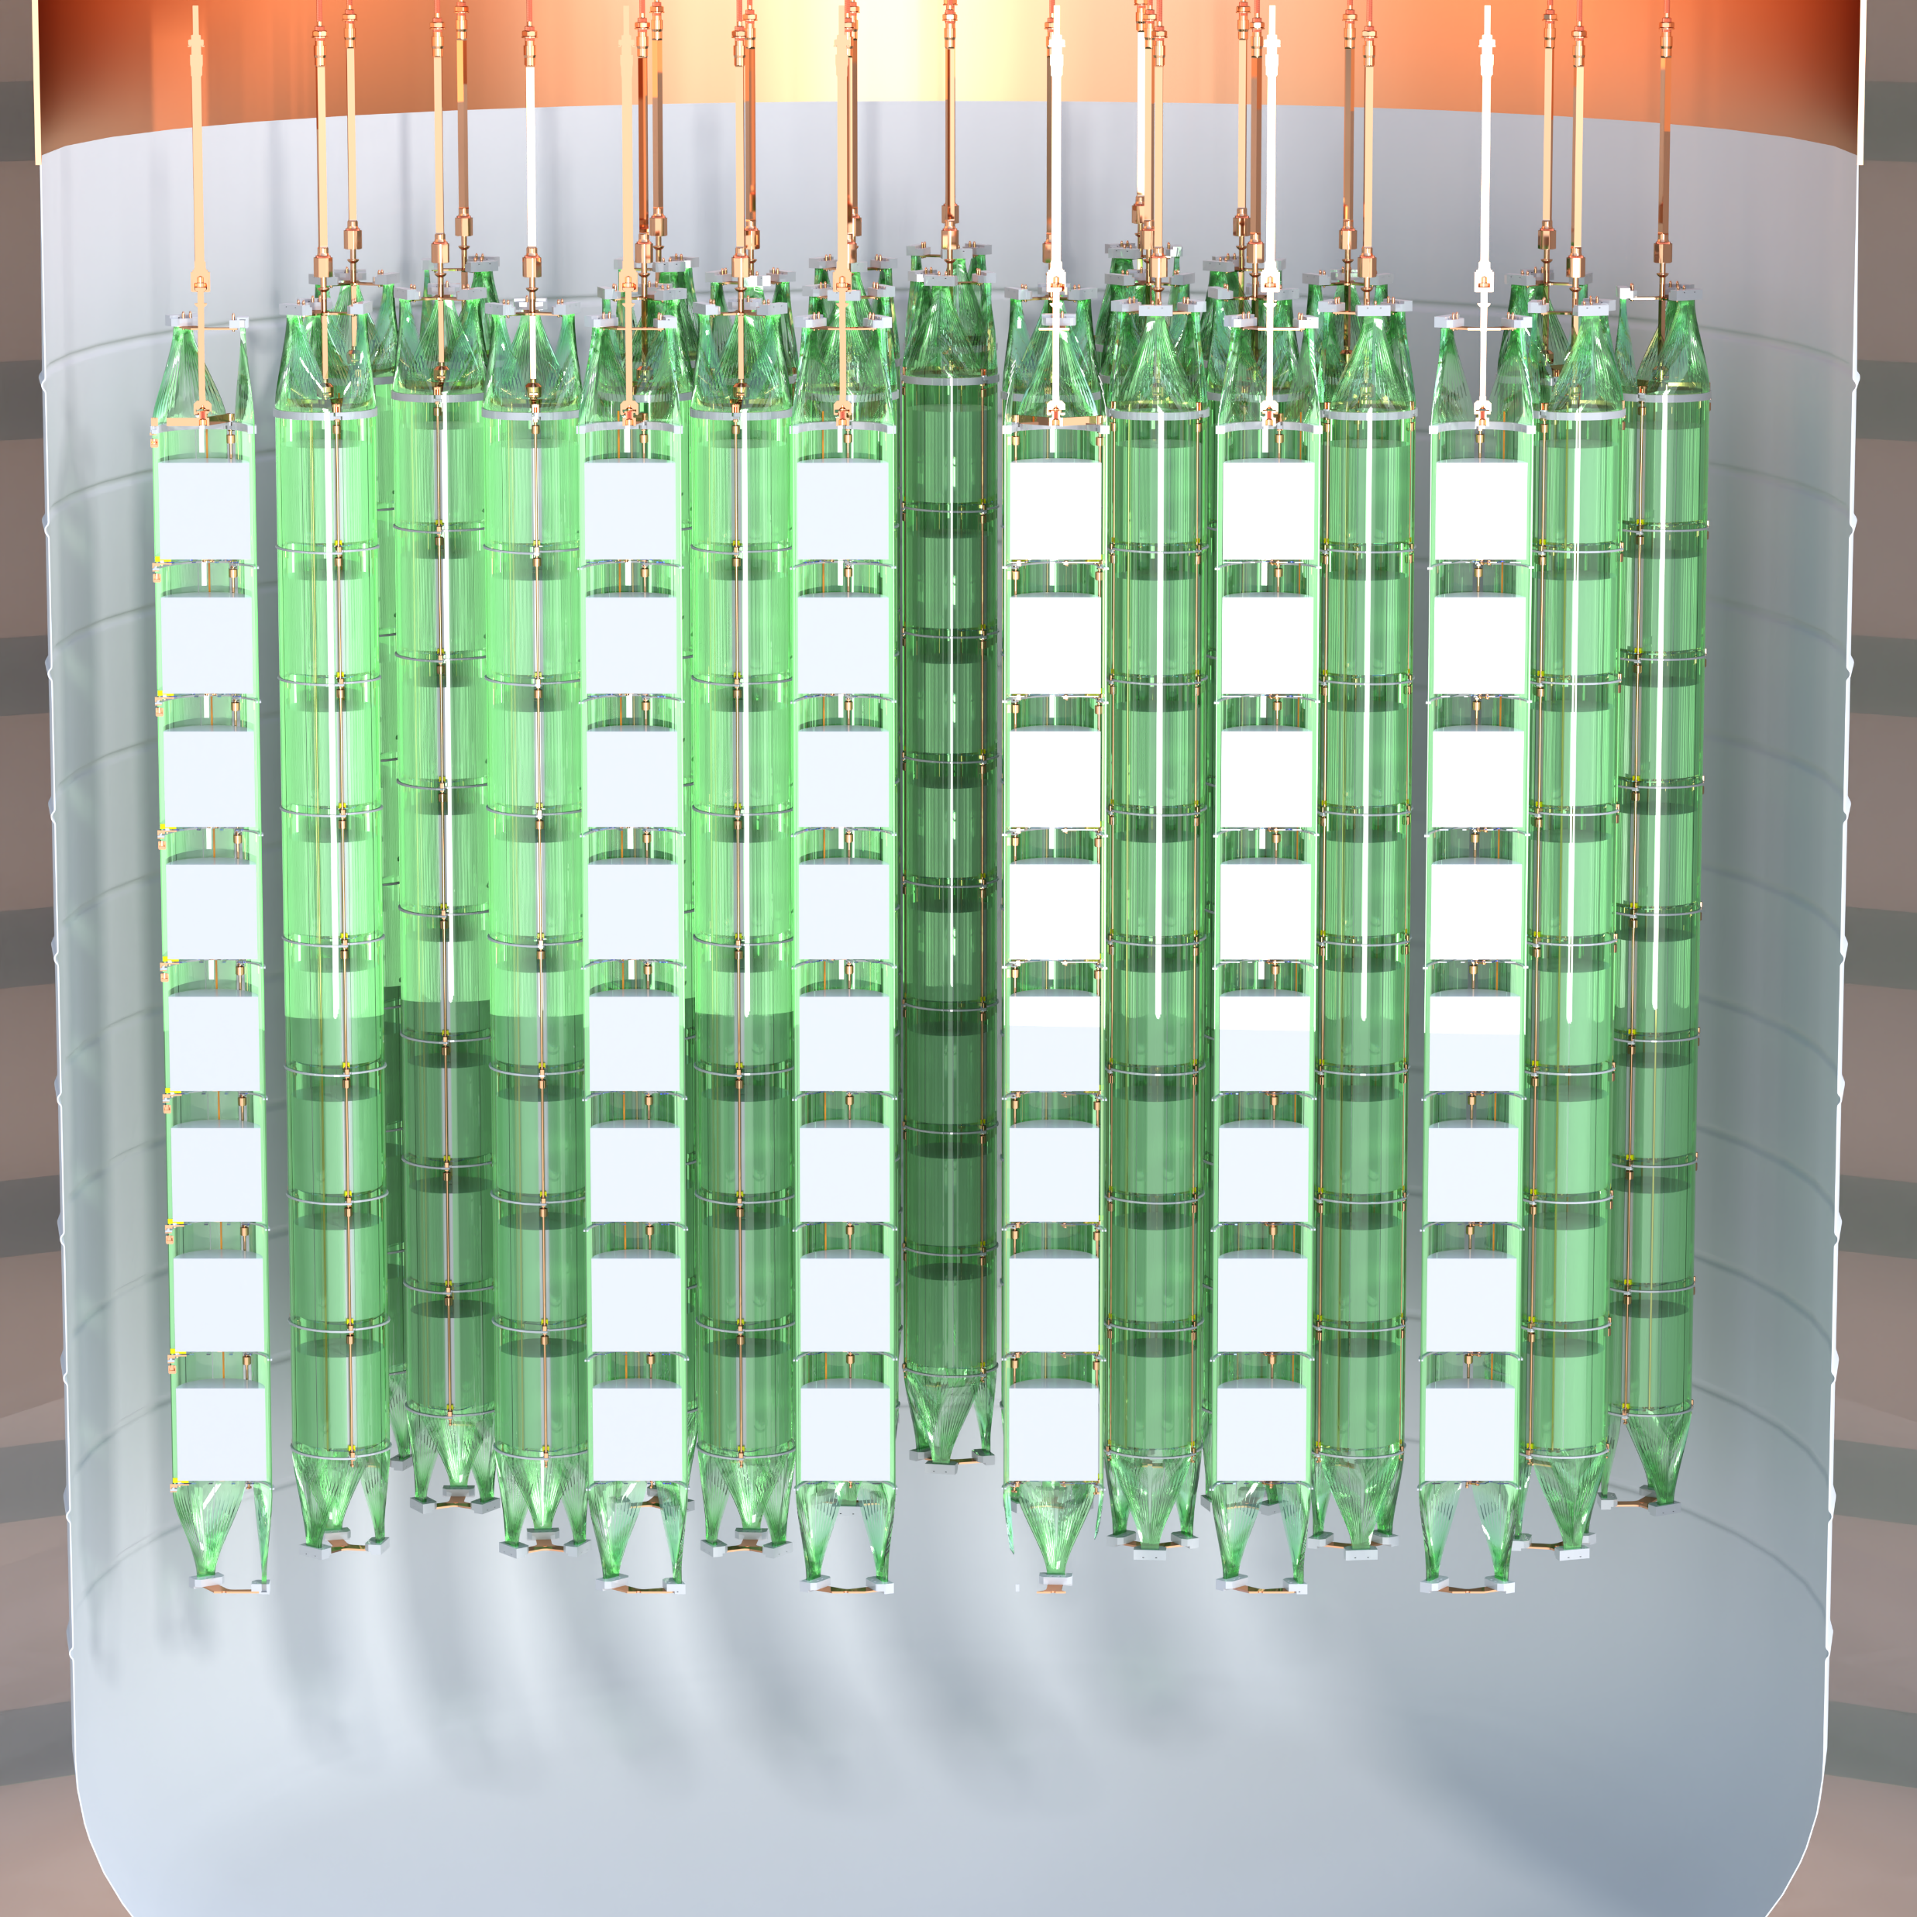

- 1000
Underground Ar
336 detectors of 3 kg avg. mass
1000 kg of Ge detectors
First data in 2030
$T_{1/2}^{0νββ}$> 1.4 • 10²⁸ yr @ 90% CL (10 yrs)
Atmospheric Ar
Raoul Cesarano – La Thuile 2024
5

Slide 9

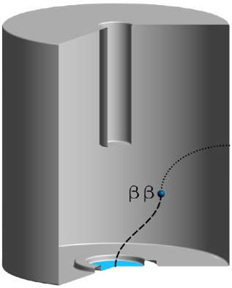
Event topology
Single Site Event (SSE)
Raoul Cesarano – La Thuile 2024
6

Slide 10
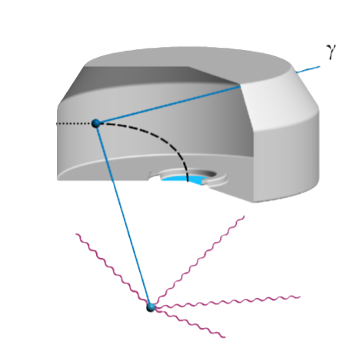
Event topology
Single Site Event (SSE)
Liquid Ar coincidence
Raoul Cesarano – La Thuile 2024
6

Slide 11
Event topology
Multiplicity
Single Site Event (SSE)
Liquid Ar coincidence
Raoul Cesarano – La Thuile 2024
6

Slide 12
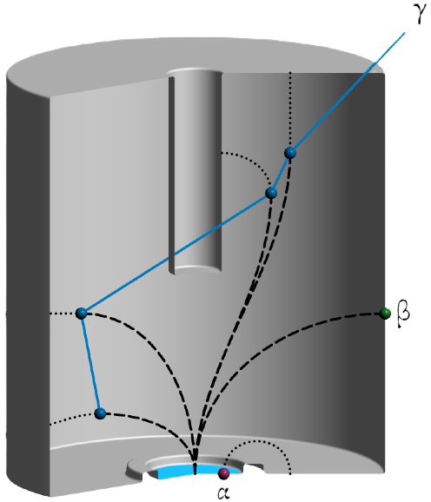
Event topology
Multiplicity
Single Site Event (SSE)
Liquid Ar coincidence
Multi Site Event (MSE)
Raoul Cesarano – La Thuile 2024
6

Slide 13
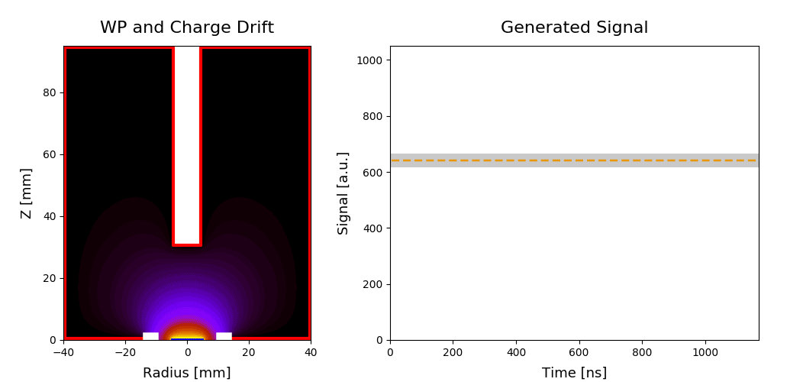
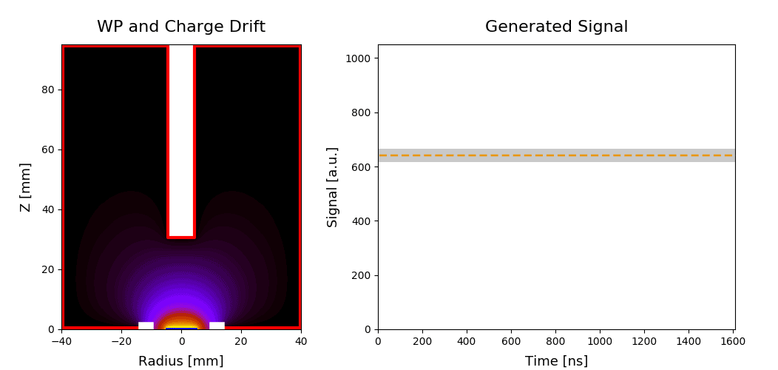
How signals generate in Germanium detectors
Acceptance band
Charge
Current
Raoul Cesarano – La Thuile 2024
7

Slide 14
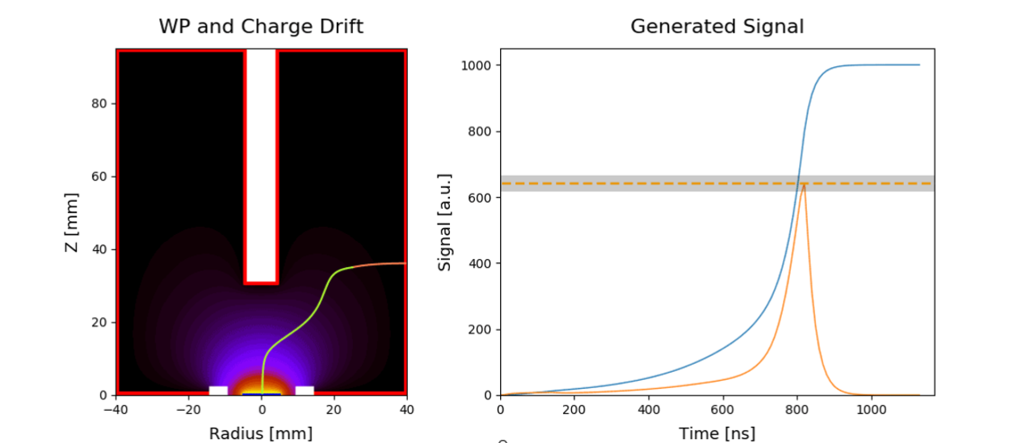
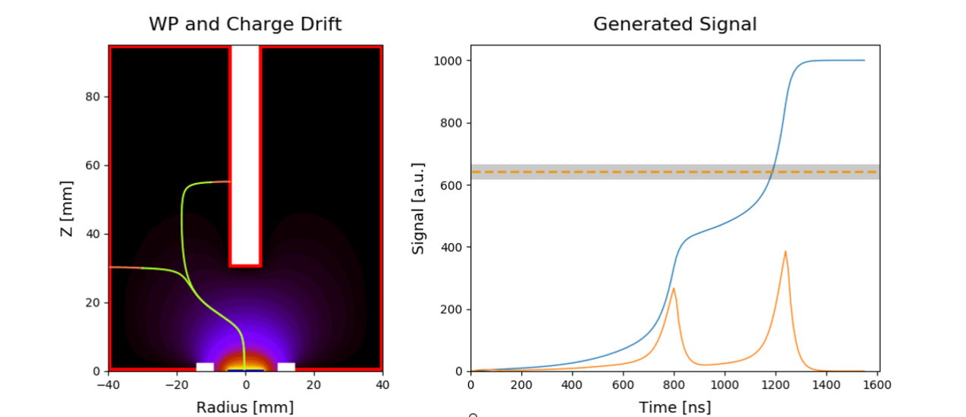
How signals generate in Germanium detectors
Acceptance band
Charge
Current
Raoul Cesarano – La Thuile 2024
7

Slide 15
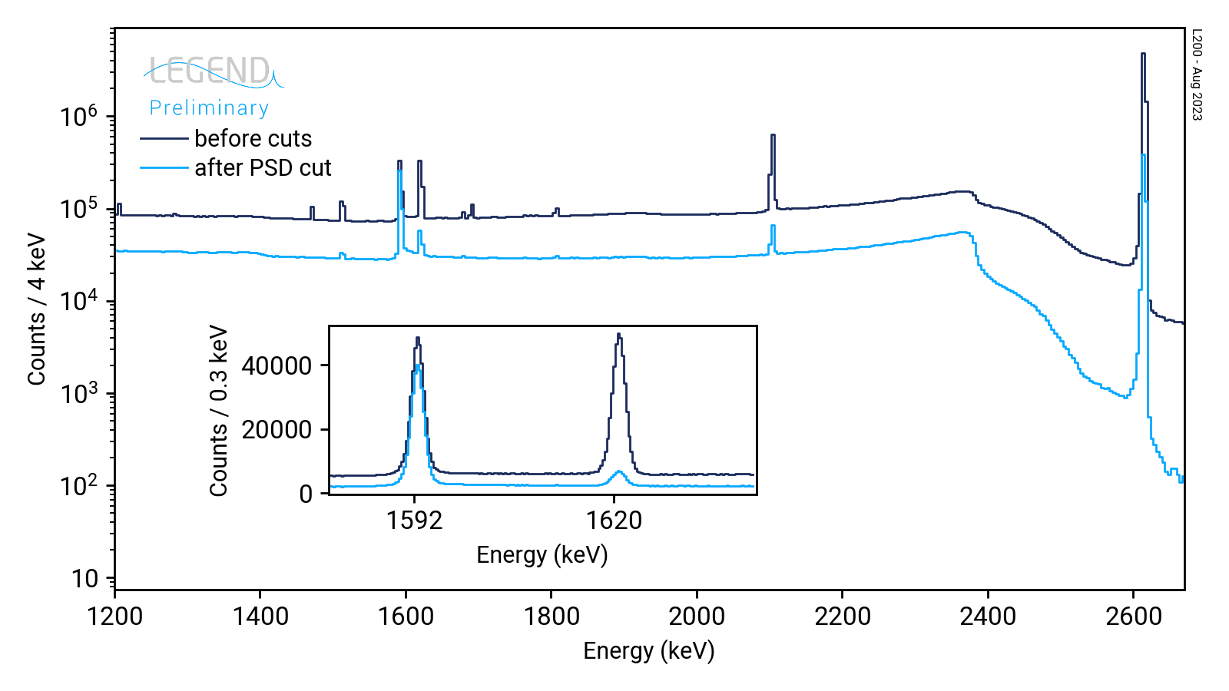
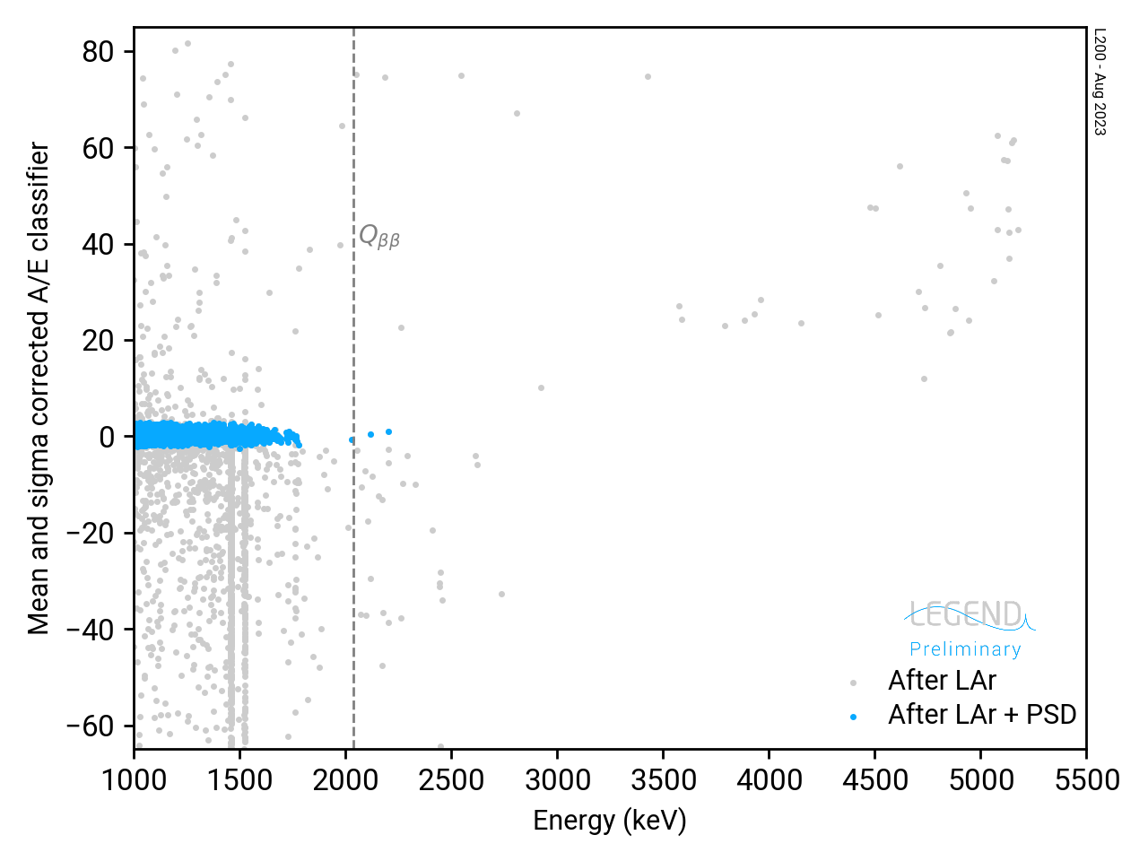
PSD preliminary performance
SEP
²⁰⁸Tl
DEP
²¹²Bi
FEP
A/E classifier (sigma)
²⁰⁸Tl (DEP)
²¹²Bi (FEP)
γ
DEP are used as proxy for SSE
FEP and SEP for MSE
PSD tuned to 90% survival at ²⁰⁸Tl DEP
γ
Raoul Cesarano – La Thuile 2024
8

Slide 16
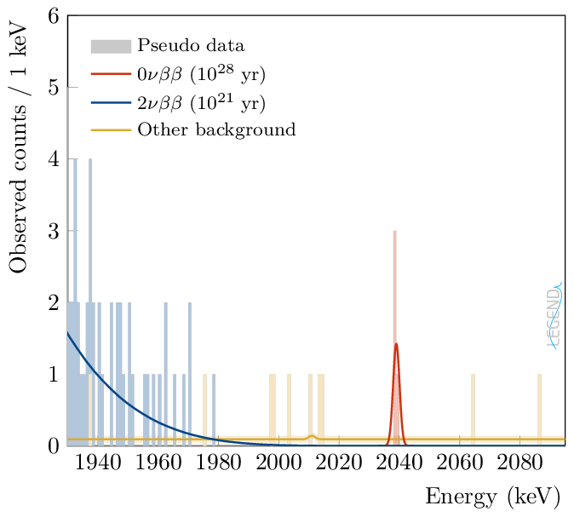
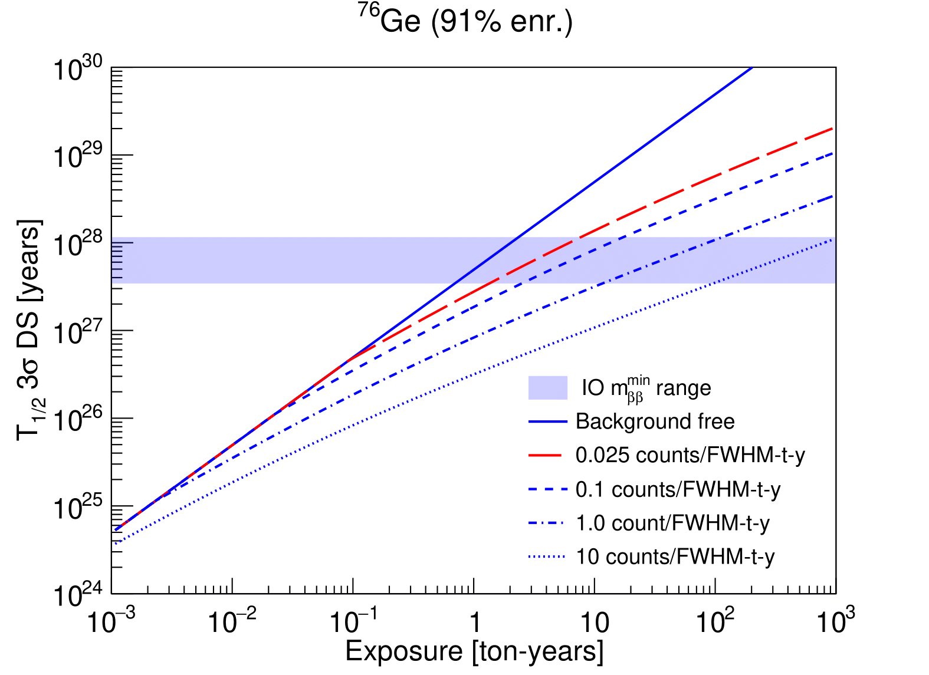

Designed for an unambiguous discovery
10 t ∙ yr
-1000
-200
Raoul Cesarano – La Thuile 2024
9

Slide 17
Thank you for your attention

Slide 18
BACKUP SLIDES

Slide 19
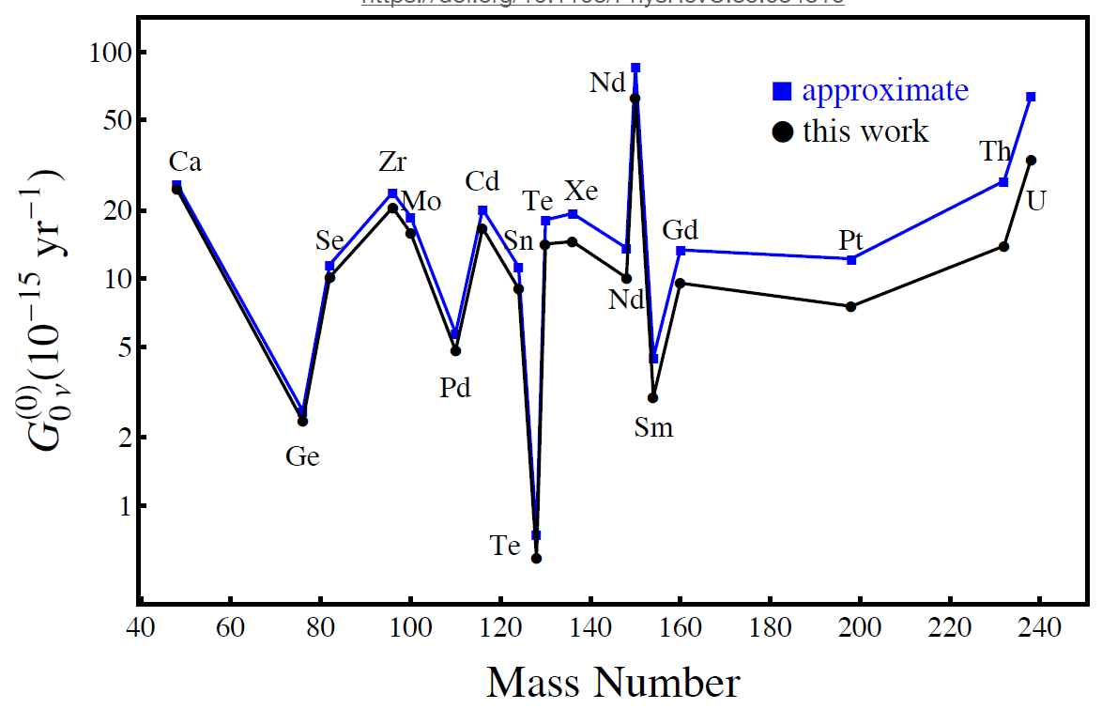
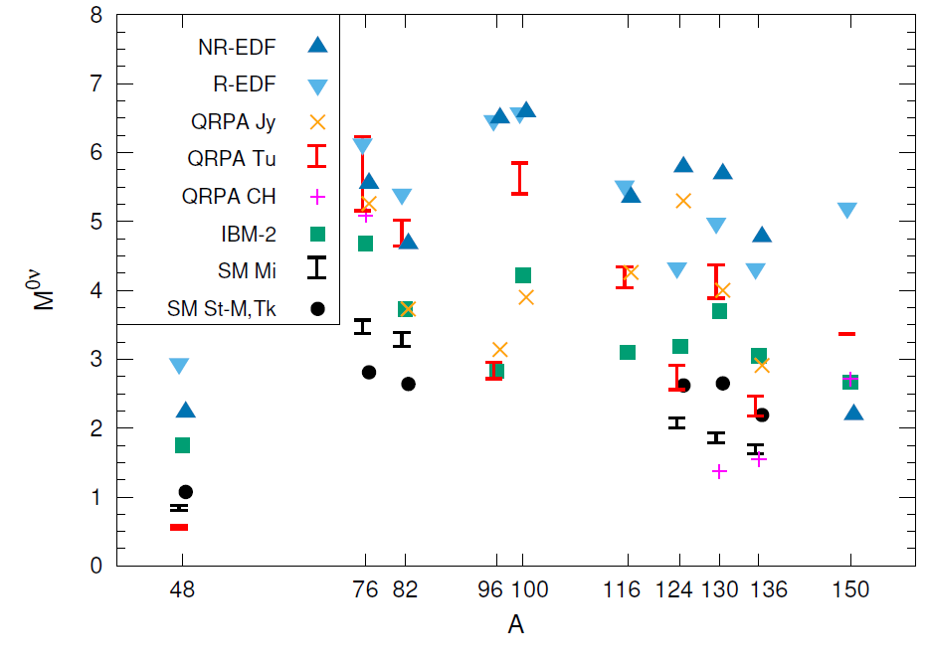
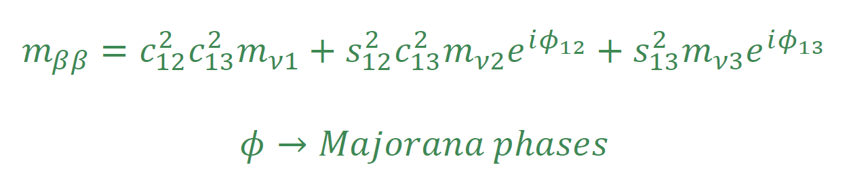
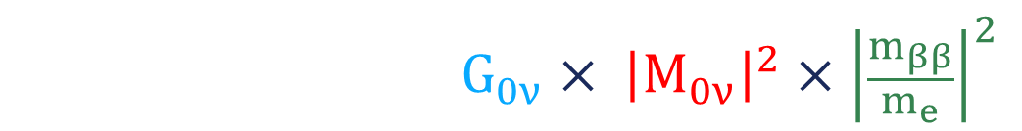
0νββ half life
$${Γ^{0ν}=\left(T_{1/2}^{0ν}\right)}^{−1}=G_{0ν}× {\left|M_{0ν}\right|}^{2}×{\left|\frac{m_{ββ}}{m_{e}}\right|}^{2}$$
Phase space factor
Atomic physics
Nuclear matrix element
Nuclear physics
Effective Majorana mass
Particle physics
https://doi.org/10.1103/PhysRevC.85.034316
https://doi.org/10.48550/arXiv.1610.06548

Slide 20
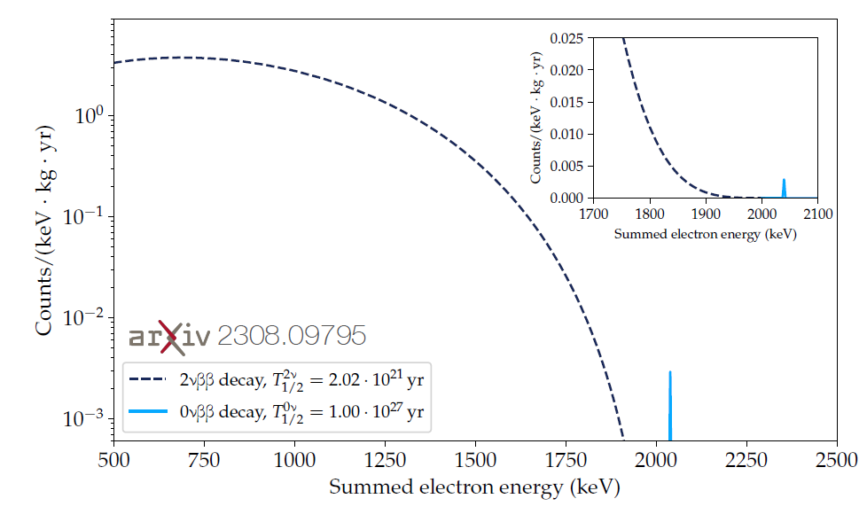
Ge advantages
The source is embedded in the detector, providing high efficiency
Best energy resolution, FWHM better than 0.1% at Q_{ββ} = 2039 keV
Highly radio-pure
High density
PSD capabilities
Enrichment up to 88% in ⁷⁶Ge

Slide 21

Ge disadvantages
Low Q_{ββ}, below the ²⁰⁸Tl line of 2615 keV
Rather expensive enrichment process
Low value of the phase space factor respect to other isotopes. This implies the need to reach a longer $T_{1/2}^{0ν}$ to probe a given m_{ββ} value
https://doi.org/10.1103/PhysRevC.85.034316

Slide 22
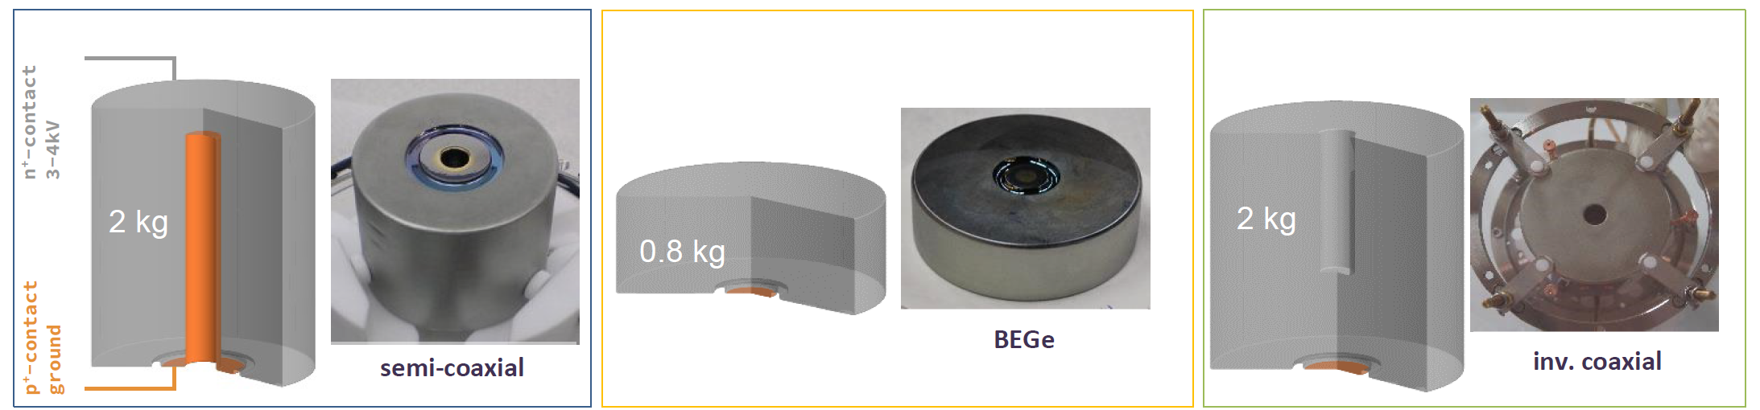
HPGe detectors geometries
M= 2,5 kg
Bore hole → depletion of a larger volume → large mass detector
D=8 cm, H = 3 cm, M= 0,8 Kg
Mass limited down to 1 kg
Smaller p+ area
Lower noise
Better ΔE
Better PSD
The well allows depleting the detector at the usual operational voltage of about 4000 V with a mass above 3 kg
Good PSD capabilities

Slide 23
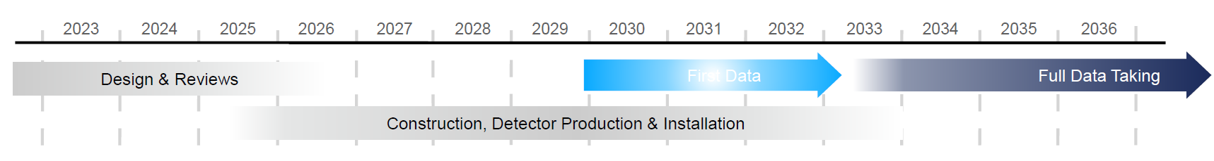
LEGEND timeline
Best energy resolution
Lowest BI
 | GERDA | MAJORANA | -200 | -1000
Mass [kg] | 45 | 30 | 200 | 1’000
Exposure [kg ∙ yr] | 100 | 26 | 1’000 | 10’000
BI [cts/(keV∙kg∙yr)] | (5.2±1.6)∙10⁻⁴ | (4.7±0.8)∙10⁻³ | 2∙10⁻⁴ | 2∙10⁻⁴
Resolution [KeV] | 2.6±0.2 | 2.52±0.08 | 2.5 | 2.5

Slide 24
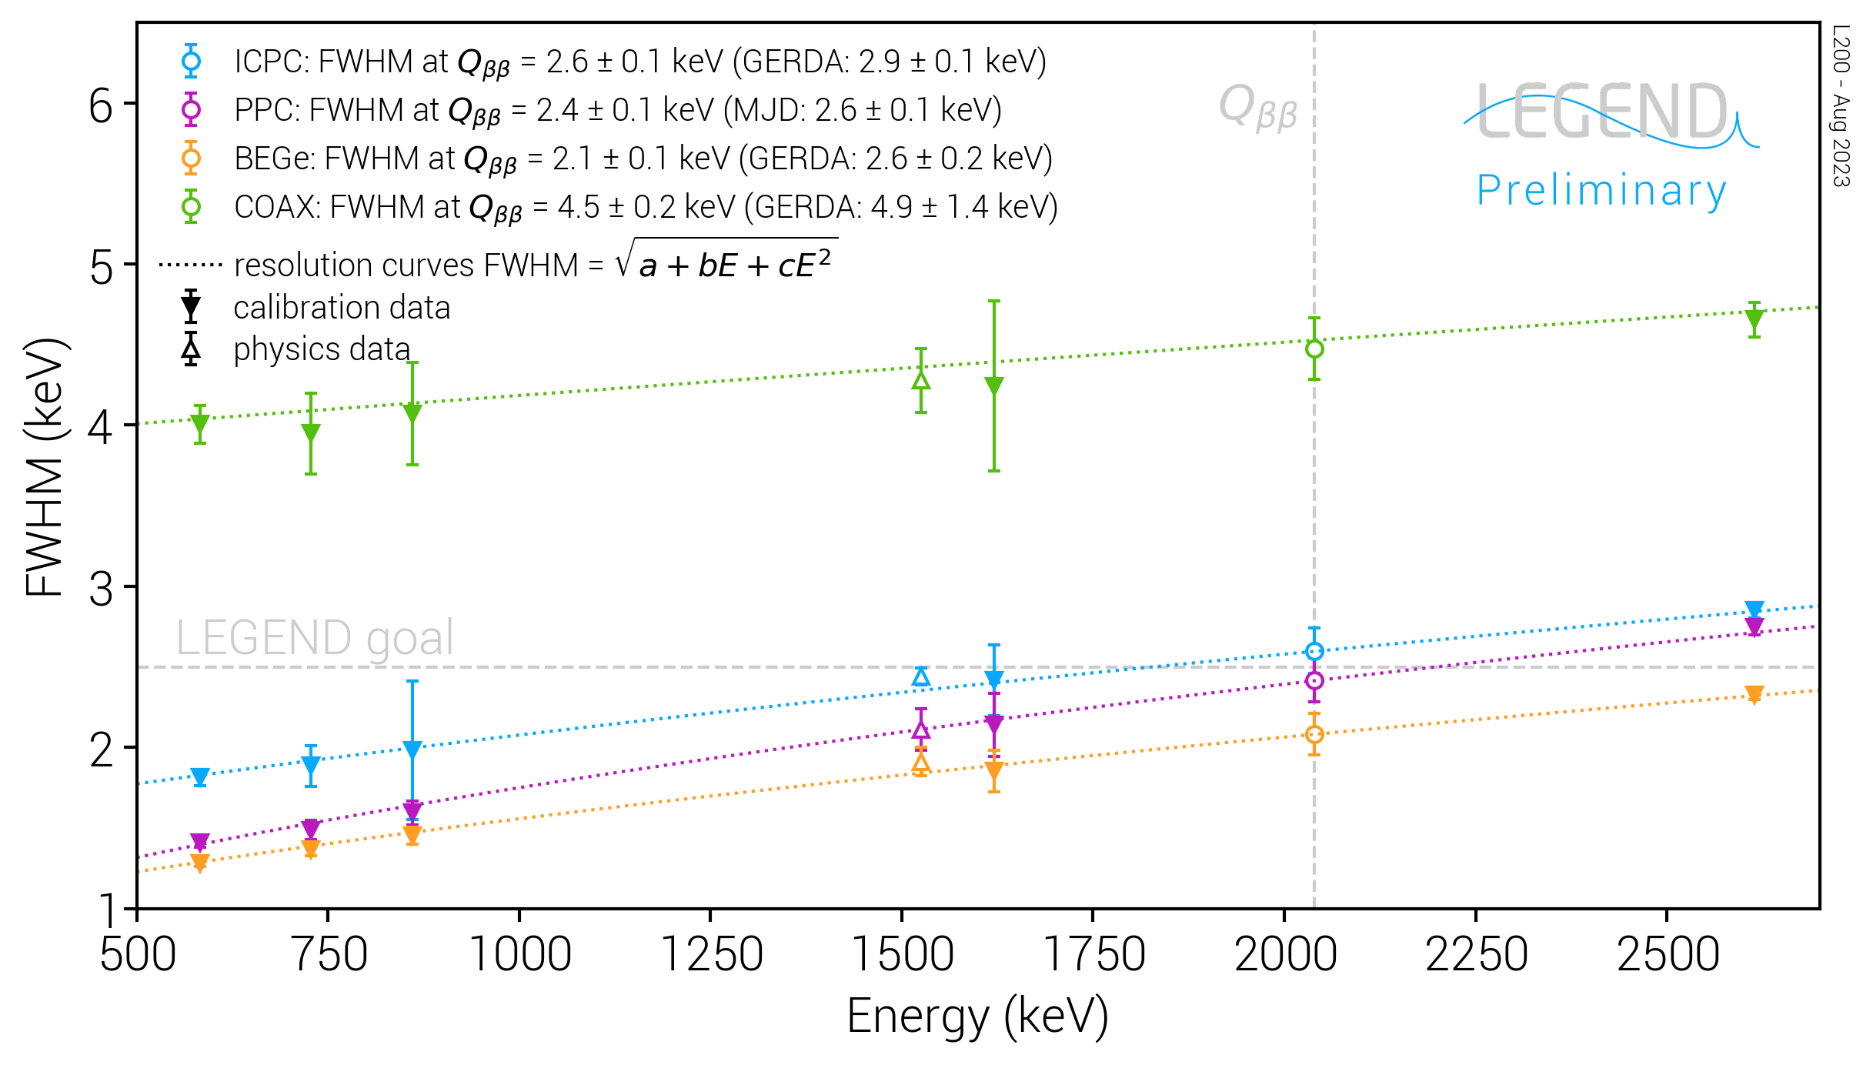
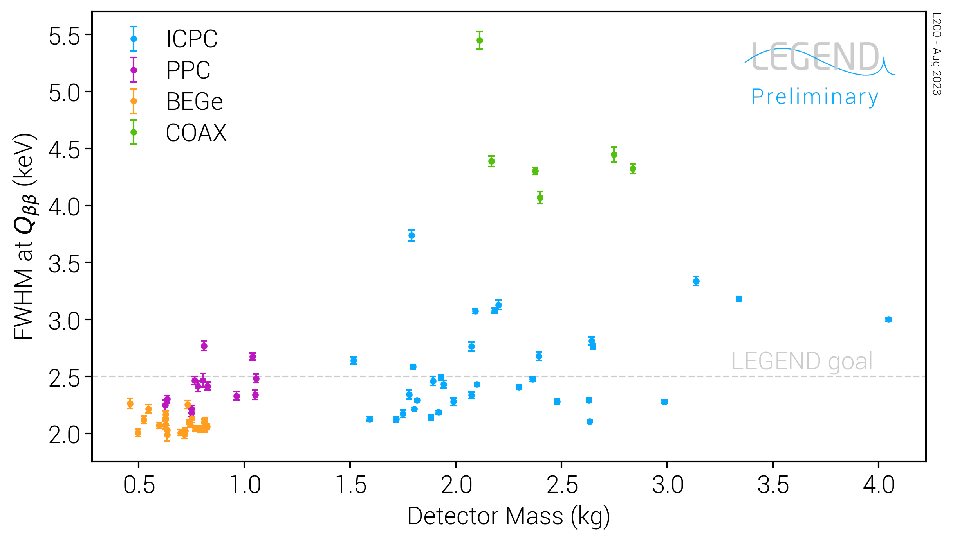
Energy resolution preliminary performance
Overall improvement in energy resolution @Q_{ββ}
Energy scale very stable between calibrations
Raoul Cesarano – La Thuile 2024
9

Slide 25
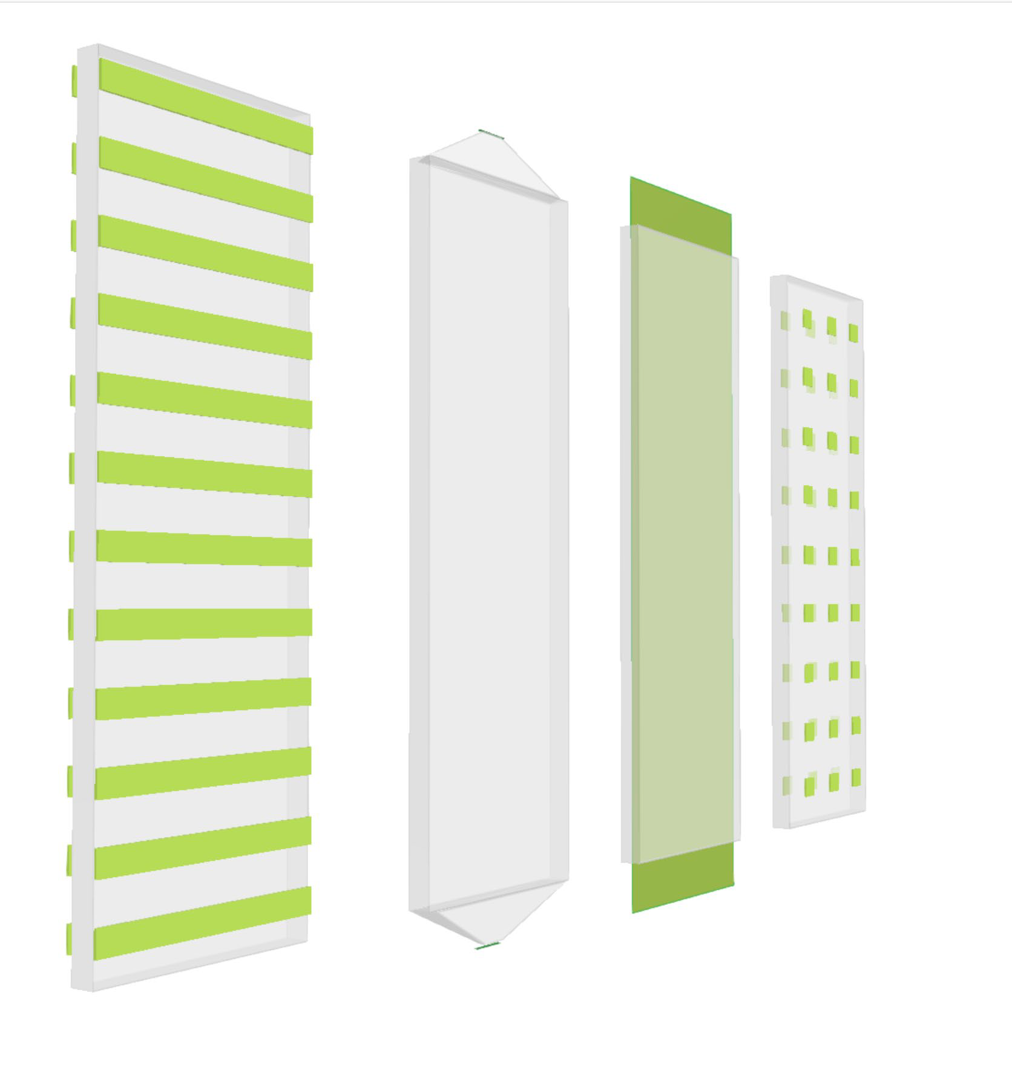
Neutron moderator

Slide 26
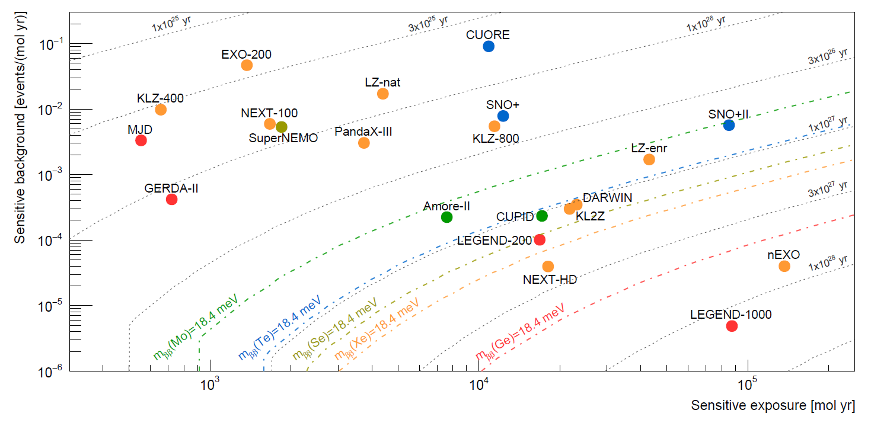
0νββ experiments comparison

