Slide 1
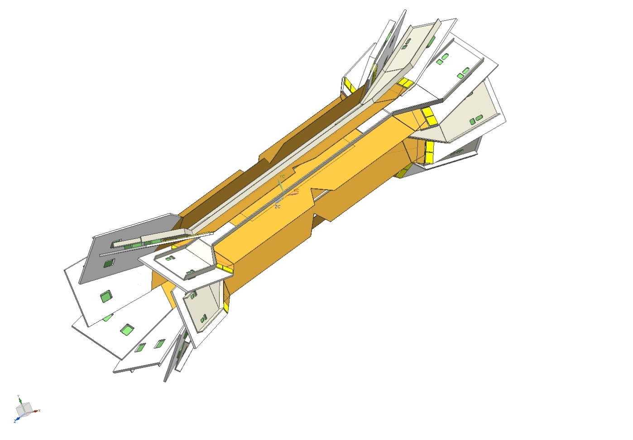
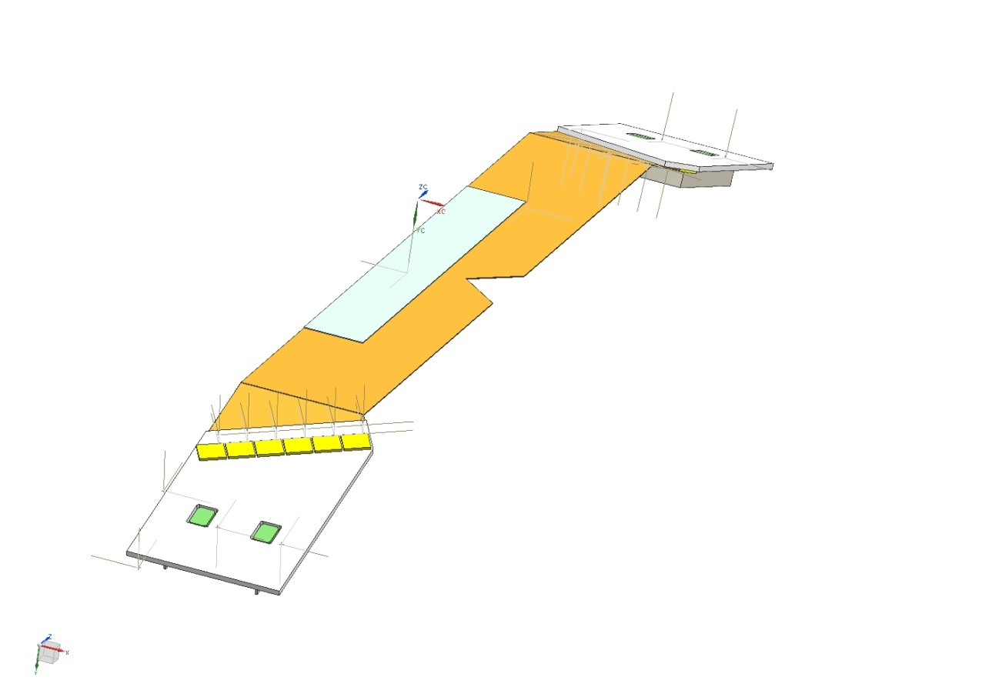
SuperB SVT HDI for Layer 0
Detector and Fan-out
HDI

Slide 2
HDI size and shape: No real concern. AUREL has experience scoring and cutting substrate in various shapes. They will probably work with on 2/4 up AlN substrate

Slide 3
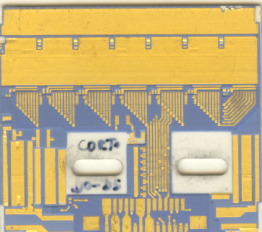
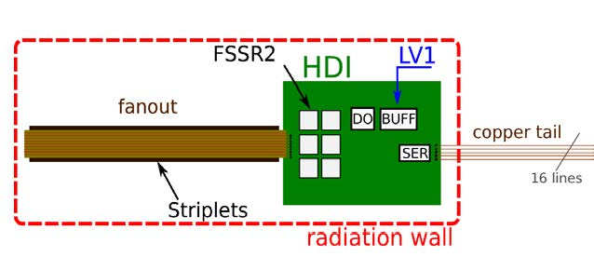
From BABAR to SuperB HDI (1 of 2)
Technology : AlN thick film hybrid | Similar technology for SuperB HDI
Detector fan-out is glued on the hybrid edge and chips inputs are wire bonded to the fan-out. | Same approach
Five conductive layers (3 power/ground layers, 2 for signal) | Same number of layers or 1 more → OK However, each additional signal layer for HDI-0 will “degrade” planarity and line resolution
Layout rules: - each layer has a thickness of 65 μm (15 um conductor and 50 μm dielectric) traces were 15 μm thick, 250 μm wide traces pitch were 400 μm pads dimensions were 250 x 400 μm*2. minimum distance between two vias was 400 μm | New layout rules - layer thickness ~ 65 μm (5% tolerance *) (15 um conductor and 50 μm dielectric) Thickness usually decreases during oven curing Line size/space: inner signal layer >100/100 um (typical 150/150 um), 200/200 um TOP layer Pads 200 x 200 um*2 Vias 200-250 um, space between via ~ 200 um

Slide 4
From BABAR to SuperB HDI (2 of 2)
Technology : AlN thick film hybrid | Similar technology for SuperB HDI Maybe new material ….
No systematic impedance control | Limited possibility to change the dielectric layer thickness with the standard process. By print screening Aurel will prefer to use the standard “3 pass” procedure → dielectric thickness ~ 50 um). Some avenue to be pursued: evaluate the usage of dielectric in tape (predefined thickness) → limited choices of thick film materials compatible with AlN Mix AlN and Al2O3 materials. Possible after the first power/ground layer.
Clock lines were “qualified” by try and test | Difficult prediction of Z → dielectric constant usually not well specified by material manufacturer (ex. in next slide)
Some prototypes were produced to master the technology | Same approach to be pursued. Of particular interest is the implementation of differential lines (digital signal ~ 150-250 MHz) Prototype: small substrate (length counts), two layer (plane and one signal), array of lines of minimum size (number to be defined)

Slide 5
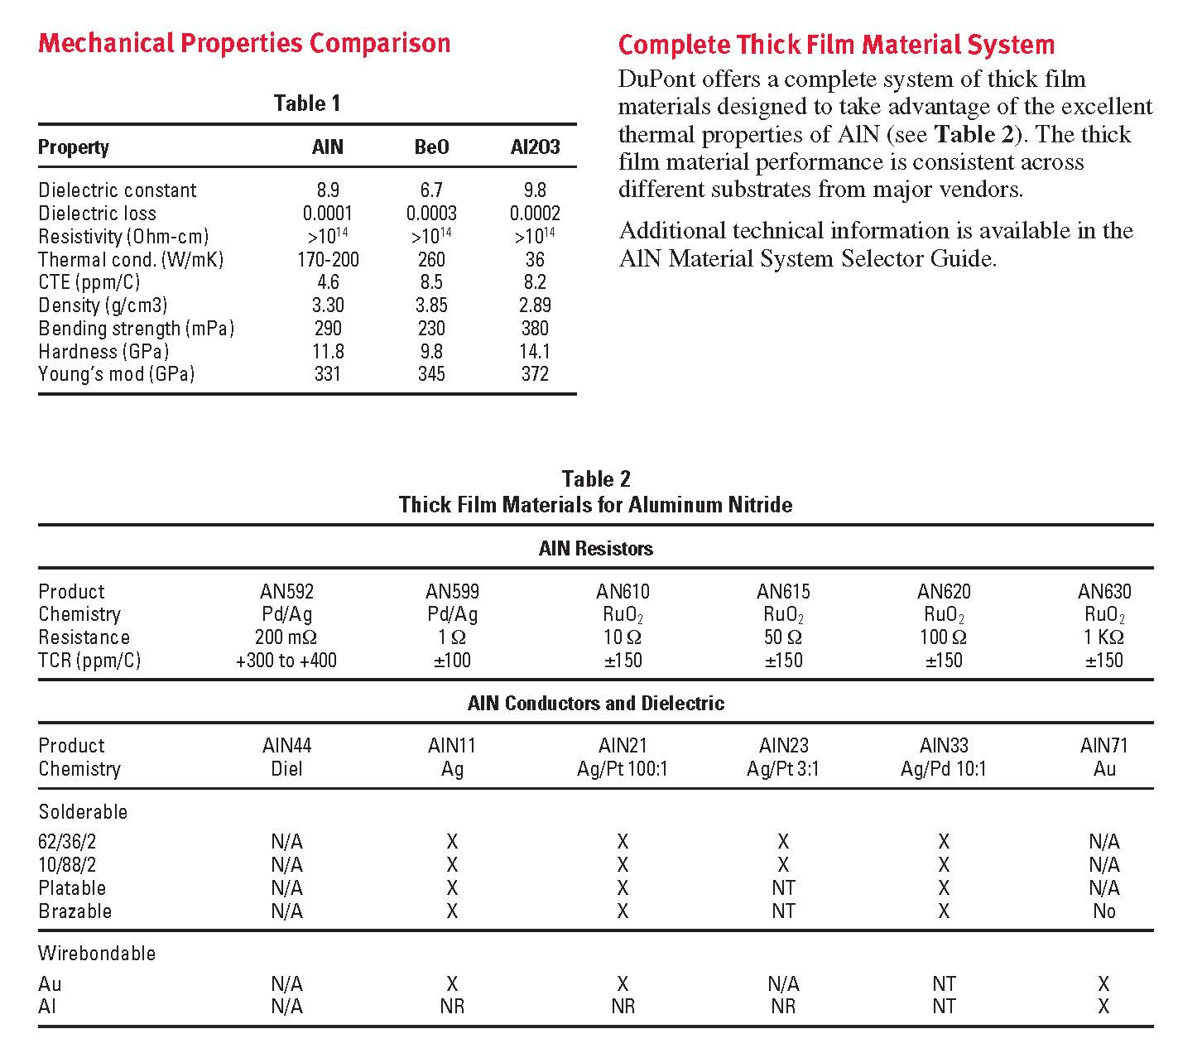
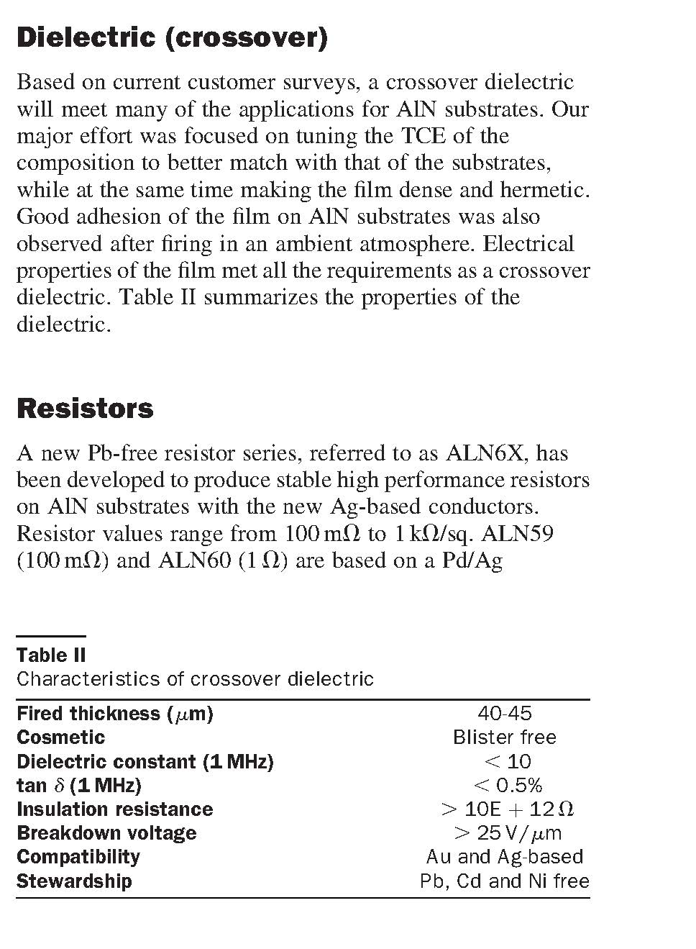
The dielectric constant is specified only as an upper limit. In the dielectric are present organic vehicles. During the
initial drying process (at ~150 C) the organic vehicle evaporates and the paste becomes a semi-solid phase mixture of dielectric and binder. Only proper curing will eliminate completely the residue.

