Slide 1

Results and Perspectives of the Muon g-2 Experiment at Fermilab
A Muon g-2 storm seems to be brewing
Marco Incagli – INFN-Pisa
Seminario presso INFN e Università di Bari
6 Febbraio 2024

Slide 2
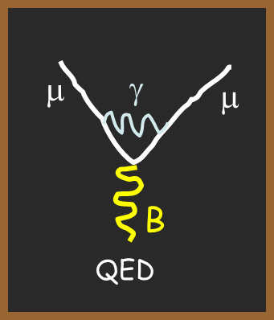
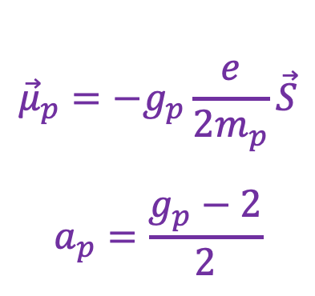
What is “g-2” ?
$${\vec{μ}}_{p}=−g_{p}\frac{e}{2m_{p}}\vec{S}$$
$$a_{p}=\frac{g_{p}−2}{2}$$
g_{P} : proportionality constant between spin and magnetic moment for particle P
a_{P} : magnetic anomaly
a_{P} = 0 at tree level (purely Dirac particle)
Using modern language, the term (g-2)/2 reflects the magnitude of the Feynmann diagrams beyond leading order
  a = 0 + α/2π + ....
Dirac
Schwinger
μ
μ
B

Slide 3
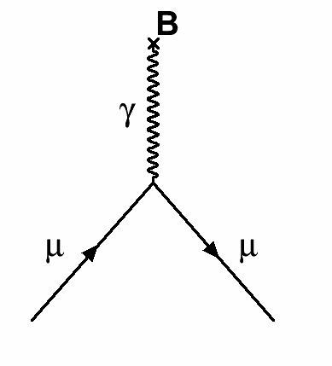
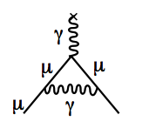
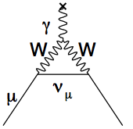
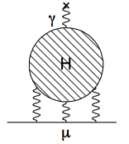
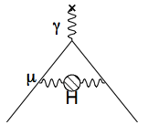
Standard Model Components of g_{μ}
Dirac Equation
Hadronic Light-by-Light
Hadronic Vacuum Polarization
QED
Electroweak
a_{μ} = 0
QED dominates the value itself
Uncertainty is dominated by QCD, in particular by the Hadronic Vacuum Polarization (HVP) term
SM values taken from the Muon g-2 Theory Initiative
Last compilation in 2020:
White Paper: Phys. Rept. 887 (2020) 1-166
https://doi.org/10.1016/j.physrep.2020.07.006
https://muon-gm2-theory.illinois.edu/

Slide 4
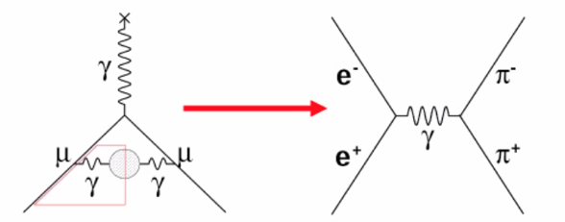
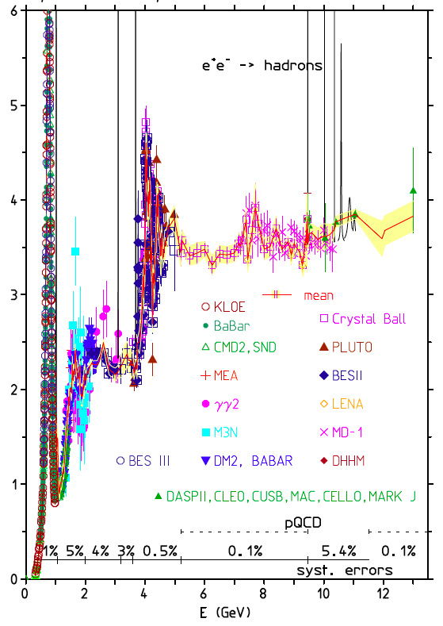
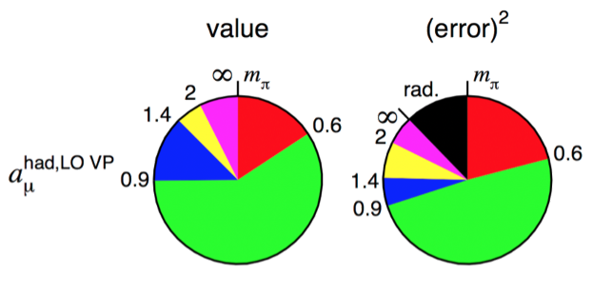
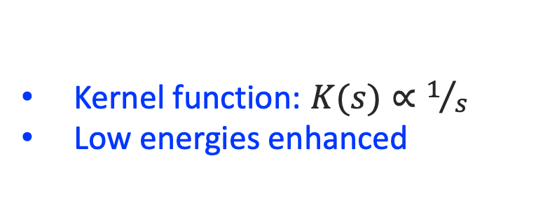
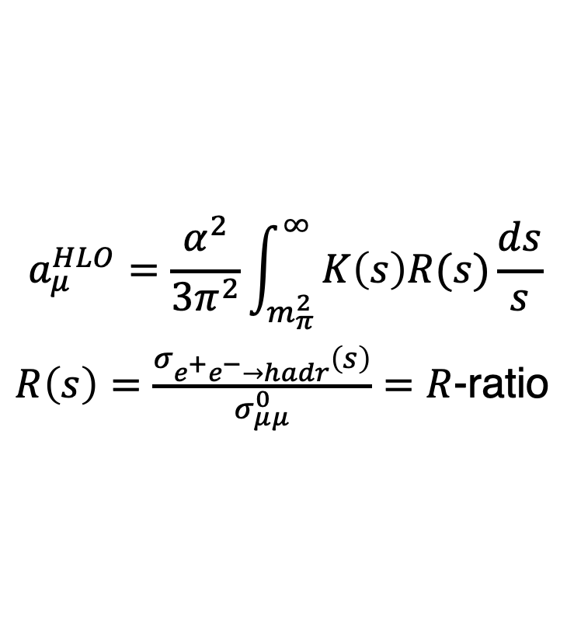
HVP Calculation: Dispersive (e⁺e⁻) Method
$$a_{μ}^{HLO}=\frac{α^{2}}{3π^{2}}\int_{m_{π}^{2}}^{∞}{K\left(s\right)R(s)\frac{ds}{s}}$$
$R\left(s\right)=\frac{σ_{e^{+}e^{−}→hadr}\left(s\right)}{σ_{μμ}^{0}}=R$-ratio
Kernel function: $K(s)∝1/s$
Low energies enhanced
R-ratio
rho resonance region

Slide 5
Standard Model Components of g_{μ}
Dirac Equation
Hadronic Light-by-Light
Hadronic Vacuum Polarization
QED
Electroweak
a_{μ} = 0
Everything in SM needs to be included here: but are we sensitive to some physics beyond the SM?
We can compare experimental & predicted values and ask:
“Is there some New Physics in our experiment that isn’t in the Standard Model?”

Slide 6
A rich history of g-2 Theory and Experiment
CERN
BNL
THEORY
EXPERIMENT
THEORY
“Consolidation”
Situation before Fermilab exp.: tension between theory and experiment

Slide 7
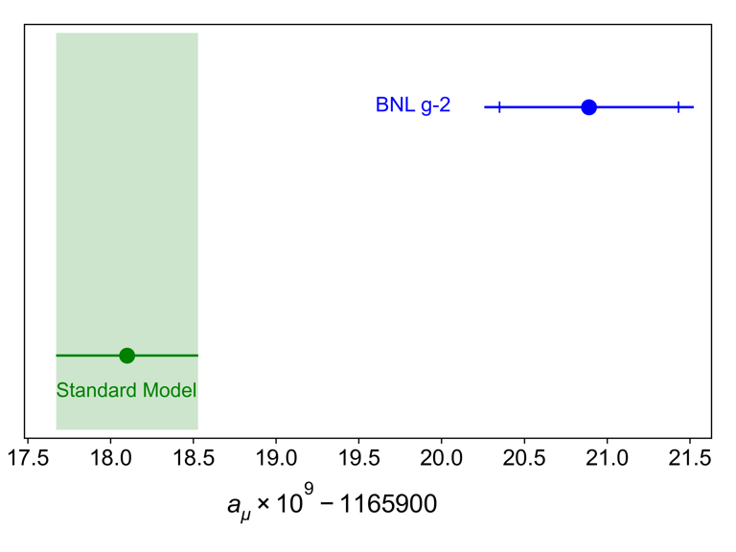
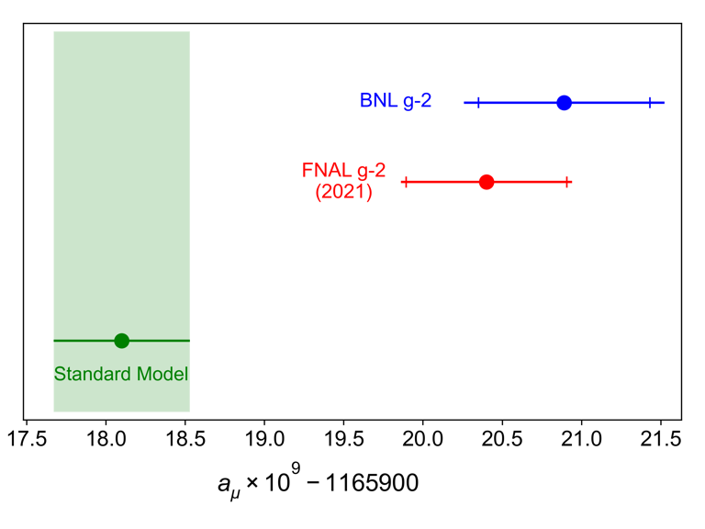
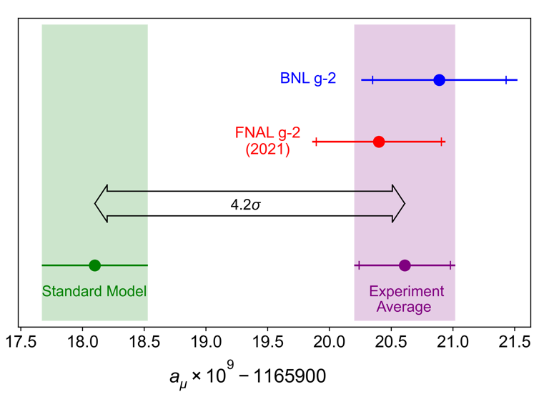
Fermilab Run-1 Result (2021)
BNL E821 (2004) disagreed with SM prediction:
https://journals.aps.org/prl/abstract/10.1103/PhysRevLett.126.141801
7th April 2021, we released our Run-1 result
→ 3.7σ
Using only 5% of our data, we confirmed BNL value
→ 3.3σ
FNAL+BNL average stood 4.2σ from Theory Initiative White Paper (2020)
https://doi.org/10.1016/j.physrep.2020.07.006
  Today’s talk is mostly about the new experimental result
  There have also been some new results from the SM prediction side of the plot…

Slide 8
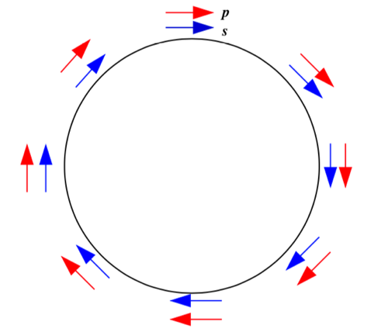
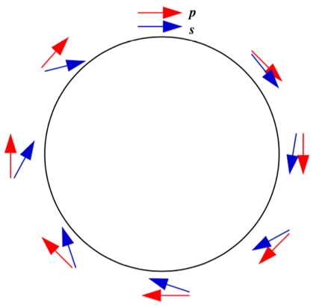

The Fundamental Experimental Principle
Difference between spin precession and cyclotron revolution for a muon (charged particle with spin) in a magnetic field*:
$$ω_{a}=ω_{s}−ω_{c}=g\frac{e}{2m}B−\frac{e}{m}B=\frac{g−2}{2}\frac{e}{m}B=a_{μ}\frac{e}{m}B$$
*s and p are assumed to be in a plane perpendicular to B
simple classical calculation
the relativistic approach provides the same result
g = 2
g > 2

Slide 9
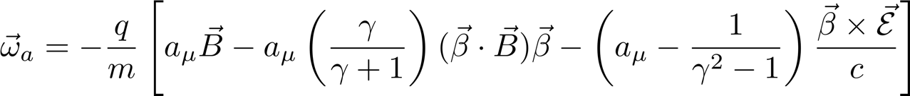
From single muon to muon beam
The expression is more complicated when you add out-of-plane betatron oscillations and E-field focusing magnets
Pitch effect
E-field effect
0 if “in plane”
Term cancels at 3.094 GeV/c, the “Magic γ”
the beam motion is very nearly planar
the momentum distribution is centered on the “magic momentum” with a spread of 0.2%
both terms are 0, at first approximation, but require corrections for a precision measurement

Slide 10
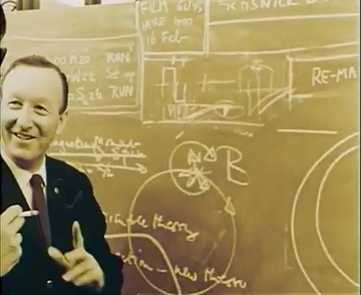
The Cern3 g-2 experiment
Francis Farley view of the Cern3 g-2 experiment
Video from CERN CDS Video Service
https://videos.cern.ch/record/43113

Slide 11
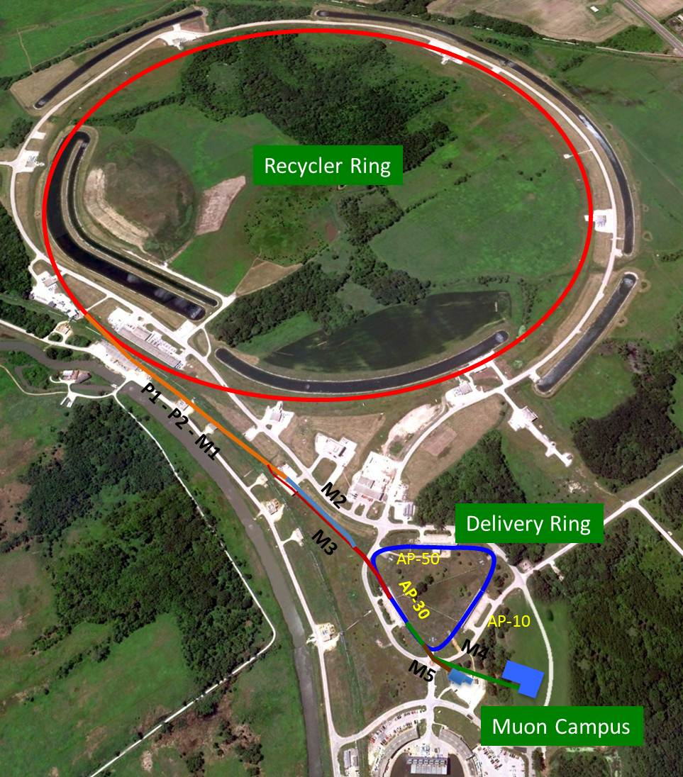
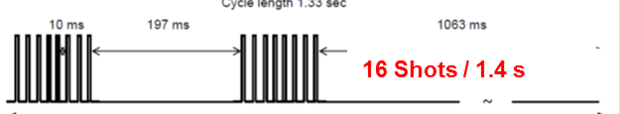
Creating the Muon Beam for g-2:
8 GeV protons into the Recycler
Target for pion production
Long FODO channel to collect π →μν
pions decay in ~2km channel
μ enter storage ring
Notes:
A proton batch is delivered from the Booster into the Recycler (green) where it is divided into four smaller bunches by a new rf system. Each
bunch is esctrcted one-at-a-time and directed along the antiproton target at
AP0. The pions produced there travel out along the red path toward the antiproton accumulator and then to the g-2 building
Each bunch is separated by 11 ms or more, and 16 bunches
are expected every 1.33-second accelerator cycle leading
to an average storage ring fill rate of 12 Hz.

Slide 12
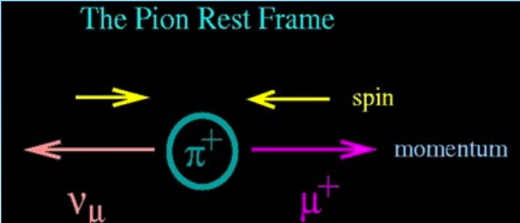
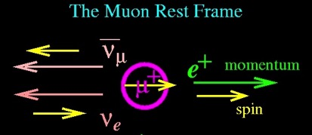
How do we measure the spin direction?
Use V-A structure of weak decays to build a polarized beam...
... and to measure the muon polarization looking for energetic positrons
spin anti-parallel to muon momentum
high momentum positrons emitted preferentially along muon spin

Slide 13
Measuring the spin precession
The number of observed positrons above a threshold energy oscillates with the ω_{a}/2π frequency due to spin precession
exponential decay modulated by spin precession
note that the x-axis "wraps up" every 100 μsec for a total of ~700 μs → ~10 muon lifetimes
time (μsec)

Slide 14
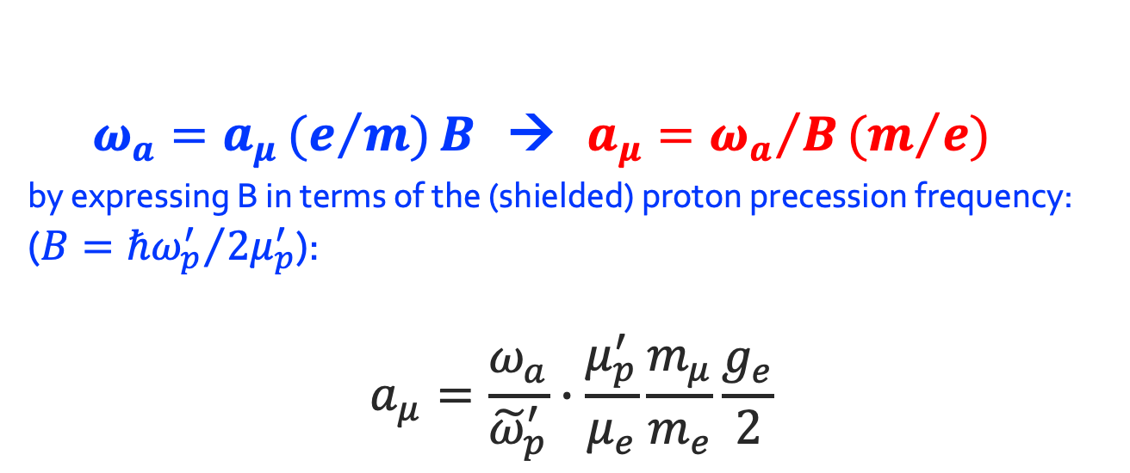
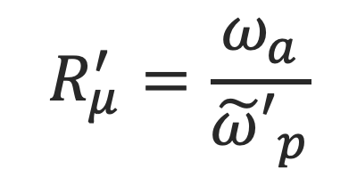
Extracting a_{μ}(simplified)
$ω_{a}=a_{μ}{(e}/{m)}B$ → $a_{μ}={{ω_{a}}/B(m}/e)$
by expressing B in terms of the (shielded) proton precession frequency:
($B={ℏω_{p}^{′}}/{2μ_{p}^{′}}$):
$$a_{μ}=\frac{ω_{a}}{{\tilde{ω}}_{p}^{′}}∙\frac{μ_{p}^{′}}{μ_{e}}\frac{m_{μ}}{m_{e}}\frac{g_{e}}{2}$$
External data
$$R_{μ}^{′}=\frac{ω_{a}}{{\tilde{ω}′}_{p}}$$
ratio of muon to proton precessions in the same magnetic field
${\tilde{ω}′}_{p}$ = (shielded) Proton angular velocity weighted for the muon distribution

Slide 15
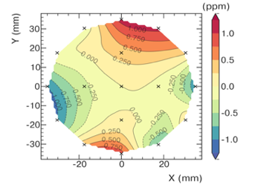
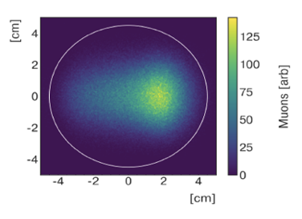
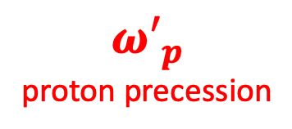
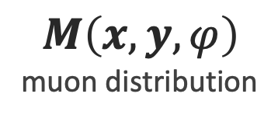

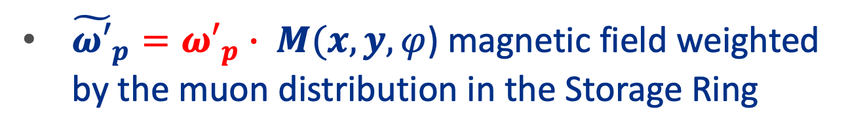
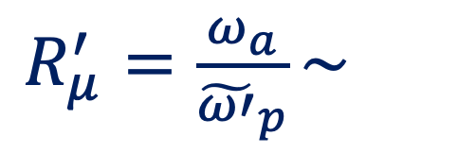
The key ingredients
$$ω_{a}$$
muon precession
$R_{μ}^{′}=\frac{ω_{a}}{{\tilde{ω′}}_{p}}\sim$
∙
$${ω′}_{p}$$
proton precession
$$M\left(x,y,φ\right)$$
muon distribution
${{\tilde{ω′}}_{p}=ω′}_{p}∙ M(x,y,φ$) magnetic field weighted by the muon distribution in the Storage Ring

Slide 16
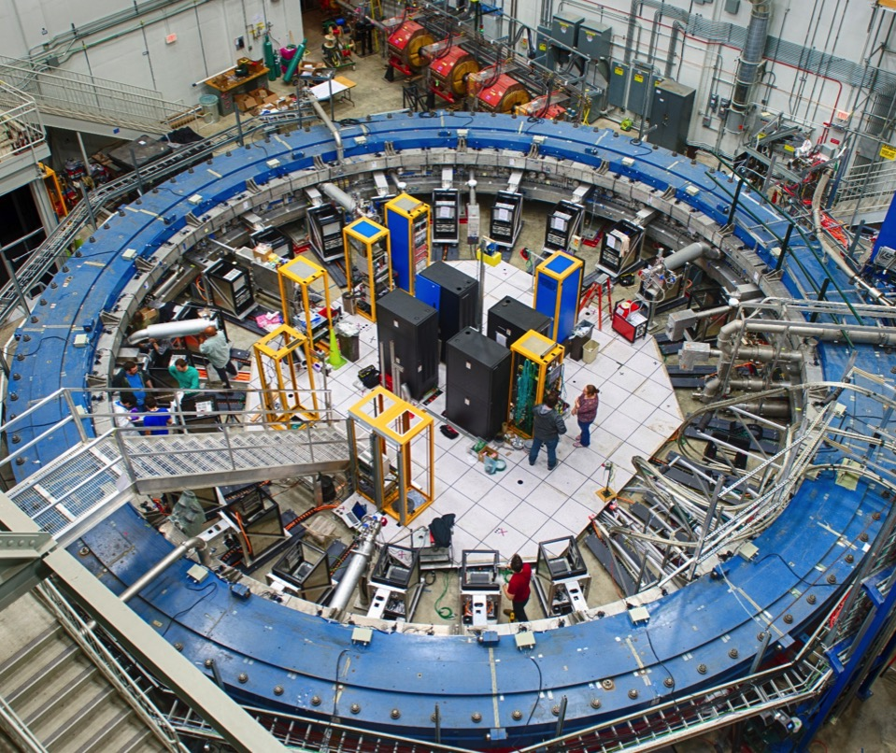
Muon g-2
RING
muons
Inflector
FIELD
QUADS
DETECTORS
24 Calorimeters + 2 trackers located all around the ring
NMR probes and electronics located all around the ring
Kicker

Slide 17
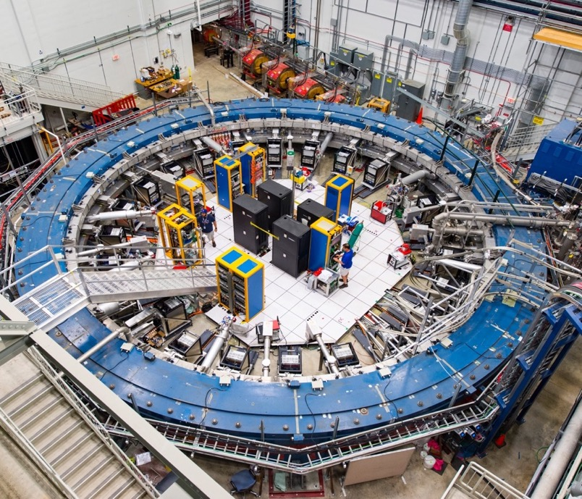
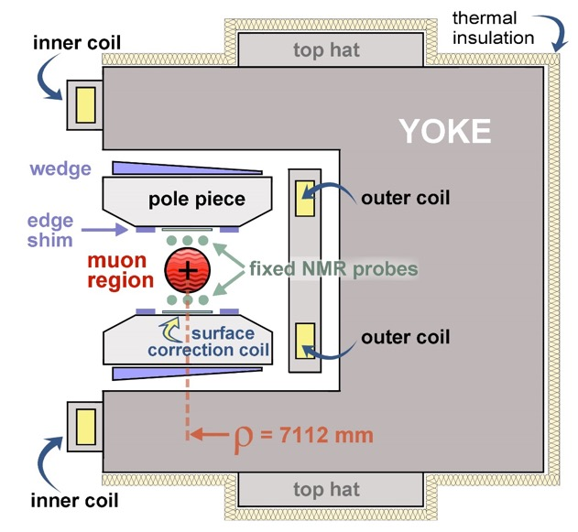
Real World Experiment: Storage Ring
14 m diameter, 1.45 T C-shaped magnet stores muons
B

Slide 18
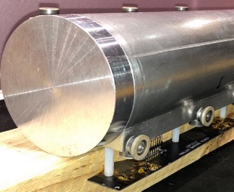
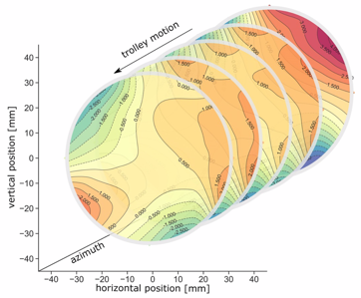
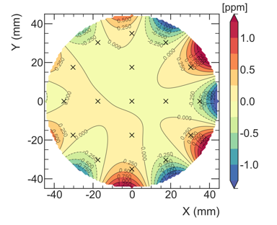
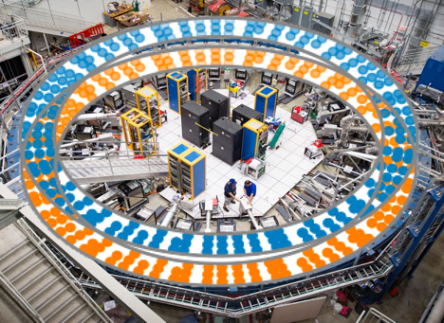
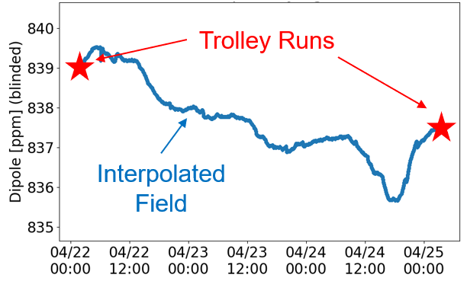
Measuring the Field: NMR Probes
In-vacuum NMR trolley maps field every ~3 days
17 petroleum jelly NMR probes
2D field maps (~8000 points)
Azimuthally-Averaged
Variation < 1 ppm
378 fixed probes monitor field during muon storage at 72 locations
Fixed probes above/below muon storage region

Slide 19
Real World Experiment: Muon Injection
Muons are injected into storage ring & bend in the B field
μ⁺

Slide 20
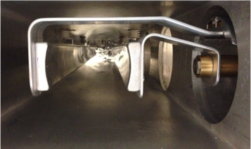
Real World Experiment: Kicker
Fast kicker magnet tweaks direction from injection trajectory
to center of aperture
μ⁺
μ⁺
Kicker
B

Slide 21
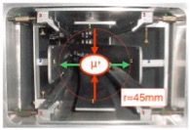
Real World Experiment: Quads
Electrostatic quadrupoles vertically contain the beam
μ⁺
Quadrupole Plates
B

Slide 22
Real World Experiment: Decay Positrons
Experiment measures decay e⁺ which curl inwards as they have lower momentum
μ⁺
μ⁺
e⁺
B

Slide 23
Real World Experiment: Trackers
We measure the decay point with 2 trackers
μ⁺
μ⁺
Trackers
B

Slide 24
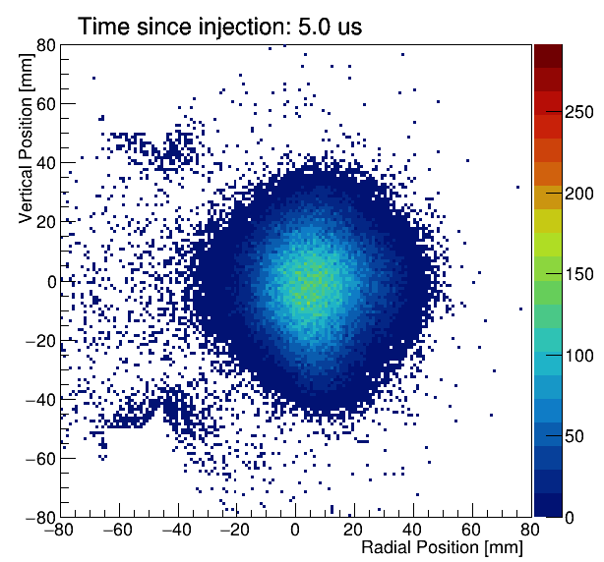
Muon Distribution from Trackers:
Measure beam oscillations directly
  Beam-dynamics corrections
  Tuning simulations
  Optimizing experiment running

Slide 25
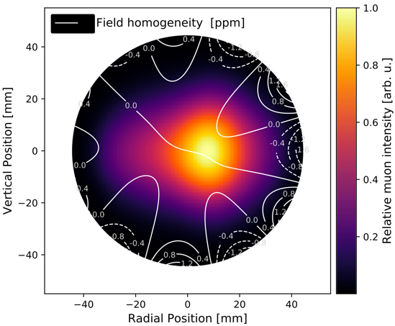
Muon Distribution from Trackers:
Measure beam oscillations directly
  Beam-dynamics corrections
  Tuning simulations
  Optimizing experiment running
Use distribution to weight the field maps by where the muons live

Slide 26
Real World Experiment: Calorimeters
Time & energy of decay e⁺ are measured by 24 calorimeters
μ⁺
μ⁺
Calos
B

Slide 27
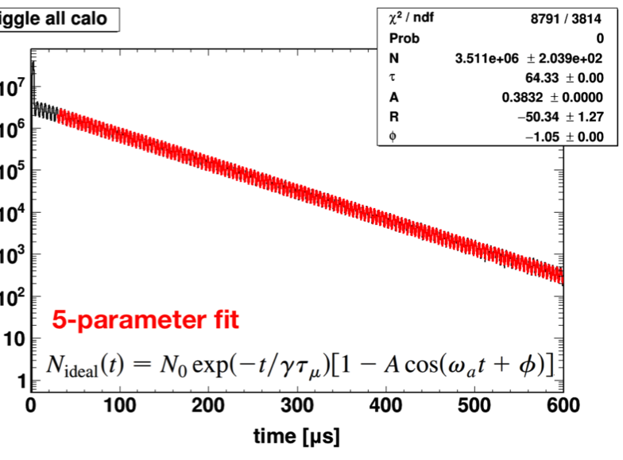
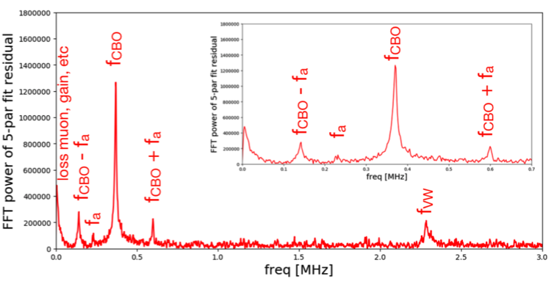

Measuring $ω_{a}$ : 5 parameters fit function
Fit with simple positron oscillation:
    $$N_{e}\left(t\right)=N_{0}\exp\left(−{t/τ }_{μ}\right)[1+Acos\left(ω_{a}t+φ\right)]$$
This simple fit is clearly not sufficient and well defined resonances are observed in the residuals
muon lifetime: τ_{μ}=γτ_{0μ} = 64.33 μsec
CBO = Coherent Betatron Ocillations
VW = Vertical Waist (oscillations)
number of positrons above threshold
RESIDUALS (in frequency space)

Slide 28
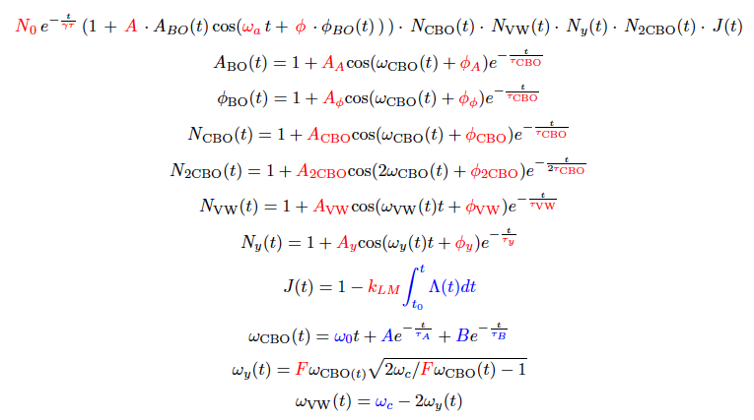
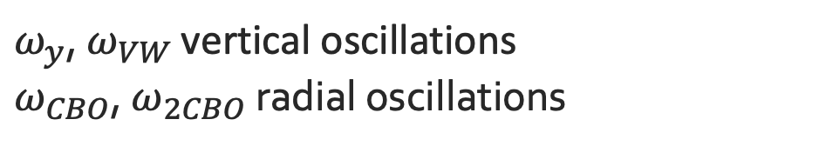
The complete 22 parameters fit function
$ω_{y}$, $ω_{VW}$ vertical oscillations
$ω_{CBO}$, $ω_{2CBO}$ radial oscillations
Red = free parameters
Blue= fixed parameters
Lost muons (μ hitting collimators)

Slide 29
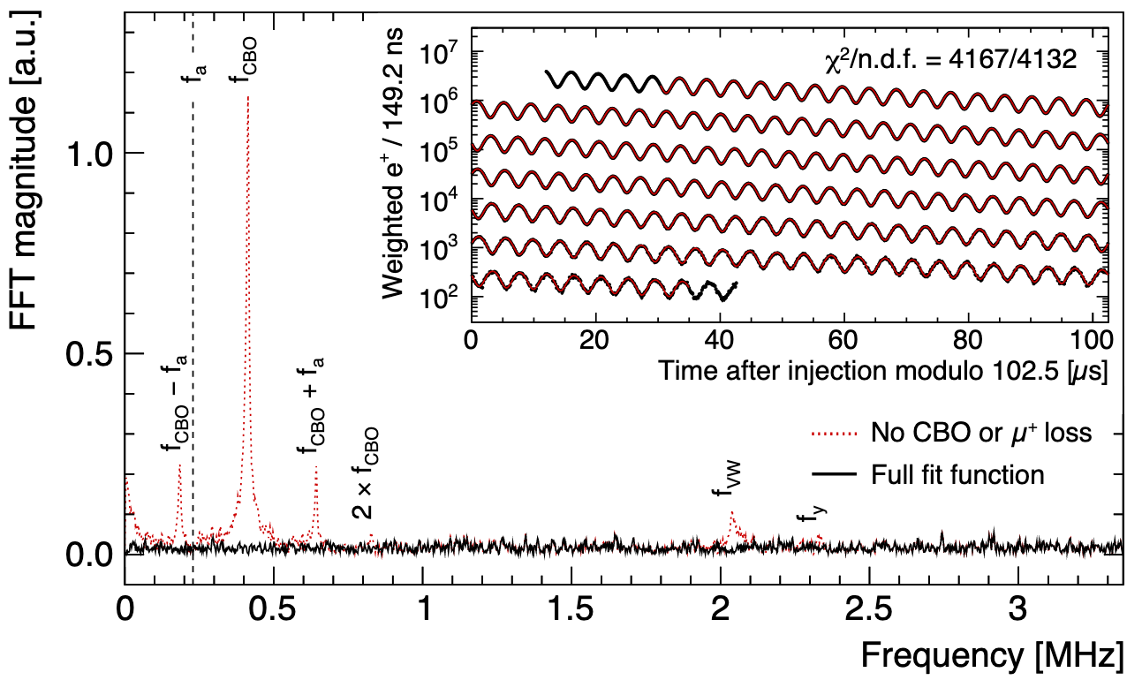
Final fit to get $ω_{a}$

Slide 30


Real World Complications: Corrections
We need to make corrections for several small effects:
E-field & Up/Down motion: Spin precesses slower than in basic equation
Phase changes over each fill:
Phase-Acceptance, Differential Decay, Muon Losses
Transient Magnetic Fields:
Quad Vibrations,
Kicker Eddy Current,
Measured Values
$$φ\left(t\right)=φ_{0}+\frac{dφ}{dt}∙t=φ_{0}+ω_{fake}∙t$$
Total correction is 622 ppb, dominated by E-field & Pitch…

Slide 31




Run-2/3 Uncertainty Improvement Categories
Statistics
Running Conditions
Systematic Measurements & Studies
Analysis Improvements

Slide 32


Run-2/3 Improvement: Statistics
Weighted e⁺ in our final fit after quality control
E > 1 GeV
t > 30 us
Factor 4.7 more data in Run-2/3 than Run-1
Dataset | Statistical Error [ppb]
Run-1 | 434
Run-2/3 | 201
Run-1 + Run-2/3 | 185

Slide 33
Run-2/3 Uncertainty Improvement Categories
Statistics
Running Conditions
Systematic Measurements & Studies
Analysis Improvements

Slide 34





Running Conditions: Hall Temperature
Temperature stability makes magnetic field less variable
Run-2
Run-1
Run-3
Added Insulation

Slide 35
Running Conditions: Hall Temperature
Temperature stability makes magnetic field less variable
Improved Hall Cooling
Run-2
Run-1
Run-3

Slide 36


Running Conditions: Kicker Strength
Last 18% of Run-2/3 has upgraded, stronger kicker
Mom. distribution more centered
Lower E-field correction C_{e}
Fractional Momentum Shift: dp/p0 [%]
Phase space matching improved
Smaller beam oscillations

Slide 37
Run-2/3 Uncertainty Improvement Categories
Statistics
Running Conditions
Systematic Measurements & Studies
Analysis Improvements

Slide 38

Analysis Improvements: Pile-up
Number of clusters
Decay end point
Pile-up
Energy [MeV]
Pile-up: 2 e⁺ arriving at same time → 1 cluster in ECAL
Probability higher at injection (more muons): can bias ω_{a}
Clusters with E>3.1GeV are certainly Pile-up
Reduced uncertainty by:
  Improved reconstruction
  Improved correction algorithms

Slide 39

Uncertainty Improvements Summary
Systematic improvements in all parameters:
Run1 → Run2/3 improvement: 157→70 ppb
Analysis Improvements
Running Conditions
Improved Measurements

Slide 40

Run-2/3 Uncertainties: Final Values
Total uncertainty is 215 ppb
[ppb] | Run-1 | Run-2/3 | Ratio
Stat. | 434
Syst. | 157
[ppb] | Run-1 | Run-2/3 | Ratio
Stat. | 434 | 201
Syst. | 157
[ppb] | Run-1 | Run-2/3 | Ratio
Stat. | 434 | 201
Syst. | 157 | 70
[ppb] | Run-1 | Run-2/3 | Ratio
Stat. | 434 | 201 | 2.2
Syst. | 157 | 70 | 2.2
Near-equal improvement: We’re still statistically dominated
Systematic uncertainty of 70 ppb surpasses our proposal goal of 100 ppb!

Slide 41

Blind Analysis
Perform analysis with software & hardware blinding
Hardware blind comes from altering our clock frequency
Clock is locked and value kept secret until analysis completed
  Non-collaborators set frequency to (40 – δ) MHz
Greg Bock & Joe Lykken

Slide 42


July 24th 2023: Unblinding
Physics week in Liverpool for unblinding meeting:
Unanimous vote from all collaborators to unblind!
Secret envelopes were finally opened to reveal the hidden clock frequencies and the result…
Photo credits: McCoy Wynne

Slide 43

... a moment of panic!
two layers of unblinding: software and hardware
first the software unblinding was removed and the following image appeared on screen: few seconds of panic!
39 998 000 Hz

Slide 44

After inserting the secret frequency ...
The secret frequency, written in the two envelopes, was inserted in the program
39 998 095 Hz

Slide 45


Run-2/3 Result: Measured Value
a_{μ}(FNAL; Run-2/3) = 0.00 116 592 057(25) [215 ppb]
Excellent agreement with Run-1 and BNL!
Uncertainty more than halved to 215 ppb
Both FNAL values dominated by statistical error
Assume systematics are 100% correlated and combine…

Slide 46

Run-2/3 Result: FNAL Run-1 + Run-2/3 Combination
a_{μ}(FNAL) = 0.00 116 592 055(24) [203 ppb]
FNAL combination: 203 ppb uncertainty
Both FNAL and BNL dominated by statistical error

Slide 47

Run-2/3 Result: FNAL + BNL Combination
a_{μ}(FNAL) = 0.00 116 592 055(24) [203 ppb]
FNAL combination: 203 ppb uncertainty
Both FNAL and BNL dominated by statistical error
Combined world average dominated by FNAL values.
a_{μ}(Exp) = 0.00 116 592 059(22) [190 ppb]

Slide 48

Measurements at Different Magnetic Fields
Datasets were taken at slightly different field settings
Allows a cross check with one of the most basic “handles”:
Also checked a_{μ} against temperature, day/night & others
~14 ppm

Slide 49



Experiment vs Theory Comparison
Theory prediction is less clear now, but we can still compare
Large discrepancy between experiment and WP (2020)
Significance for Fermilab alone get to 5.0σ
... but the theoretical band is not as sharp as it was in the 2021 comparison!

Slide 50



HVP Calculation: Lattice QCD Method
Ab-initio calculation of HVP on lattice
Results not included in White Paper (2020)
BMW collaboration reached the precision of 0.8%, comparable to R-ratio method
Their calculation is closer to the experimental result
Other groups are cross checking
Intermediate stages agree, but no full HVP calculations to same precision.
new results
Simon Kuberski Lattice 2023

Slide 51

Experiment vs Theory Comparison
Theory prediction is less clear now, but we can still compare
Include BMW result by swapping HVP from WP with their value
As expected, BMW falls in between WP (2020) and experiment

Slide 52




HVP Calculation: Dispersive (e⁺e⁻) Method
Calculated from data for σ(e⁺e⁻→ hadrons)
1/s weights low energy strongly: 73% from π ⁺ π ⁻ channel
~
Analyticity & Unitarity
Hadronic R-ratio
(Data Driven)
Keshavarzi, Nomura, Teubner: Priv. Comm.
New results from SND2k and CMD-3 in π ⁺ π ⁻ channel since White Paper
CMD-3 discrepant → prediction moves towards experimental value
... what is going on?

Slide 53


Tension in $e^{+}e^{−}→π^{+}π^{−}$
Hints of tension in the cross section $σ\left(\sqrt{s}\right)$ of $e^{+}e^{−}→π^{+}π^{−}$ between the two most accurate experiments, KLOE and BABAR, already existed:
but the last measurement from CMD-3 is clearly discordant, and in tension with CMD-2 itself

Slide 54


Experiment vs Theory Comparison
Theory prediction is less clear now, but we can still compare
Following A. Keshavarzi at Lattice 2023…
Substitute CMD-3 data for HVP below 1 GeV
Cherry-picking one experiment but gives a bounding case
SND2k cannot be processed in this way, but would fall closer to WP (2020).
Many parallel efforts are underway to resolve the theoretical ambiguity
Disclaimer from A. Keshavarzi’s Lattice 2023 talk:

Slide 55


Data Collection 2018 – 2023
PROPOSAL GOAL
9 July 2023
Director Lia Merminga switches off the beam in Muon g-2 control room
Apr. 2021: Run-1 Result (2018 data)
Aug. 2023: Run-2/3 Result (2019-20 data)
~2025: Run-4+5+6 Result (2021-23 data)
  Reach our proposal goal for statistics (~21 BNL)

Slide 56

The experimental landscape will improve …
FNAL Muon g-2 :
  a_{μ} measured at 0.2 ppm
  data already available to reduce error to ~ 0.12 ppm
A new type of experiment projected at J-Parc using low energy muons (p~300 MeV/c)
  new technique
  under construction
  final goal ~0.4 ppm

Slide 57
The experimental landscape will improve …
Ongoing work in experimental inputs on σ(e⁺e⁻→ hadrons)
Initial State Radiation technique:
  BaBar: new analysis of large ππ data set with better detector
  KLOE: new analysis of 7x larger ππ set
  BESIII: new results for ππ channel and πππ
  Belle II: promising greater statistics than BaBar or KLOE and similar or better systematics for low-energy cross sections
Energy scan (VEPP-2000 machine in Novosibirsk)
  SND: new results for ππ channel
  CMD-3: confirmation of their result on ππ channel (paper submitted to Journals); more channels to be analyzed

Slide 58

The theoretical landscape will improve …
Simon Kuberski, Lattice 2023
close scrutiny of lattice calculations to establish its solidity
how to reconcile it with dispersion approach?

Slide 59

New experimental approach: Muone@CERN
Use the dispersive approach with t-channel data (muon-electron scattering), instead of the standard s-channel
Letter Of Intents submitted at CERN: Muone (mu-on-e) scattering experiment
TDR in preparation
μ
μ
e
e

Slide 60

Conclusions
We’ve determined a_{μ} to an unprecedented 203 ppb precision
New result is in excellent agreement with Run-1 & BNL
More than halved the total uncertainty from Run-1
Smashed our design goal with systematic uncertainty of 70 ppb.
There’s more data to analyze and we’ll squeeze uncertainty down further in our future results!

