Slide 1
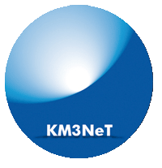
Combined KM3NeT/ARCA and ANTARES searches for point-like neutrino emission
Presenter: Vladimir Kulikovskiy
Francesca Badaracco, Barbara Caiffi, Vladimir Kulikovskiy, Vittorio Parisi, Matteo Sanguineti, Sandra Zavatarelli
Recently joined by Giulia Illuminati, Ilaria del Rosso (INFN Bologna – University of Bologna)

Slide 2
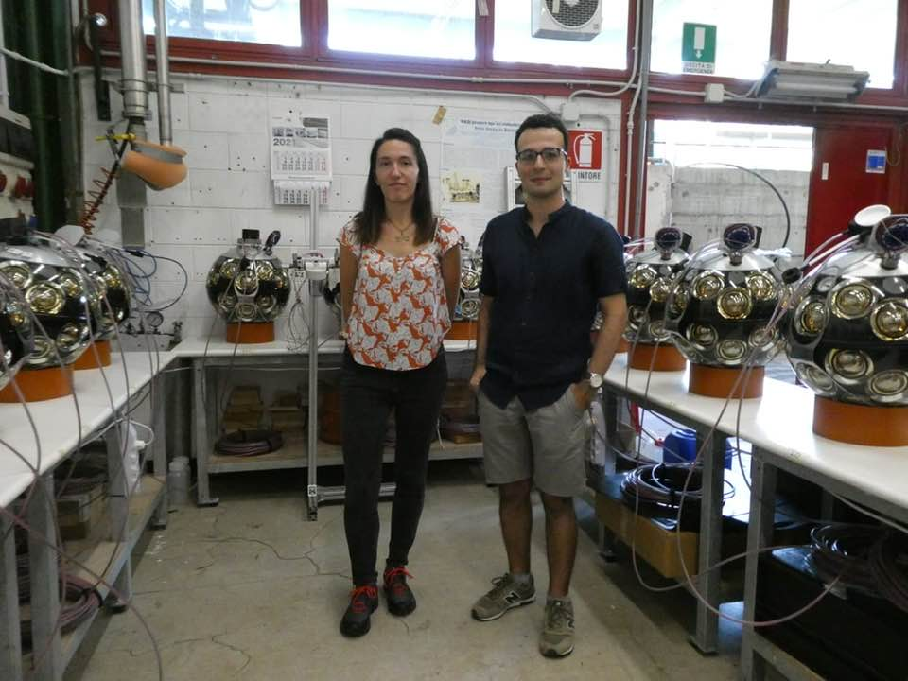
Recruitment at UniGe completed
PhD student Vittorio Parisi – started Feb 23
RTDa researcher Francesca Badaracco – started Oct 23

Slide 3
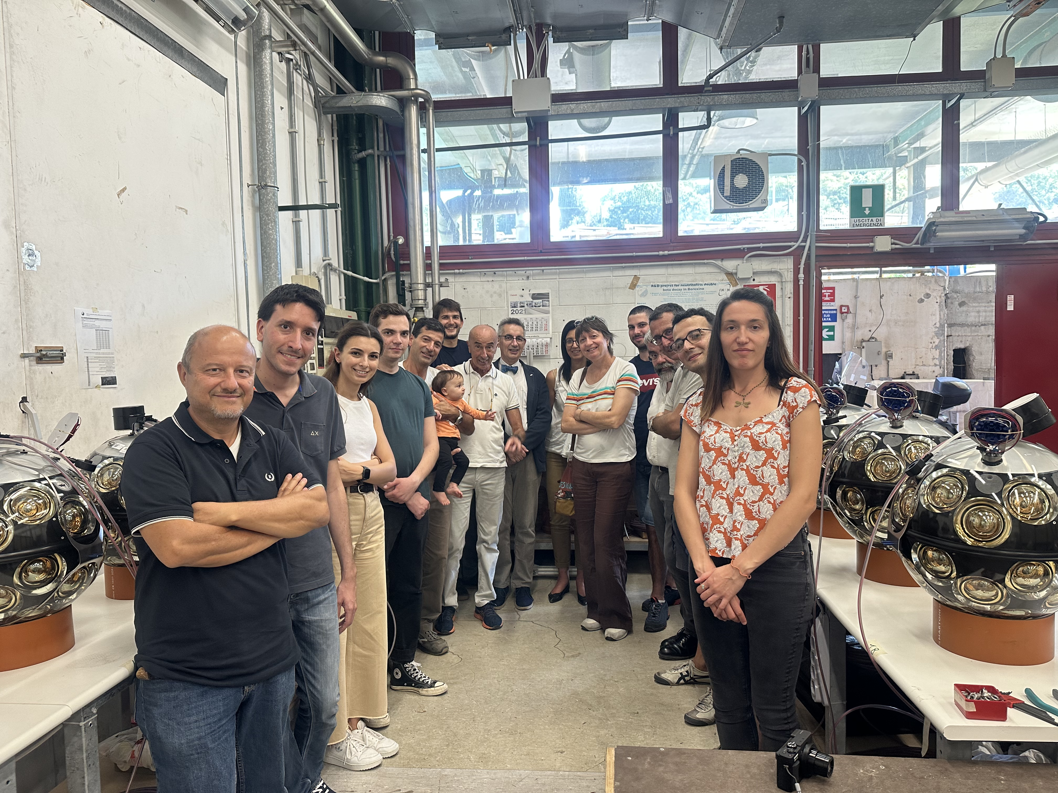
Synergy UniGe and INFN within KM3NeT
Il gruppo creato da Prof. Mauro Taiuti e Marco Anghinolfi segue le attività di ANTARES e KM3NeT oltre 20 anni.

Slide 4
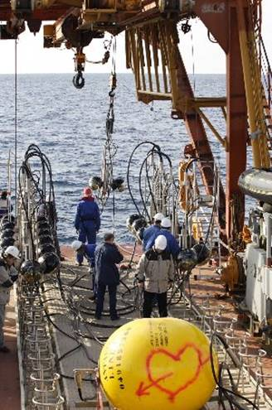
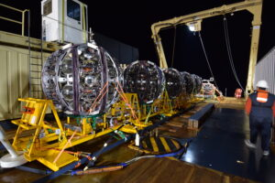
Combined point-like search motivations
ANTARES detector switched off in February 2022 after 15 years of data taking.
This analysis exploits 2007-2020 data.
KM3NeT collaboration installs next generation of neutrino detectors in the deep sea.
The data from about 1 year of ARCA6-8 is used in this analysis. Similar detector volume as ANTARES

Slide 5
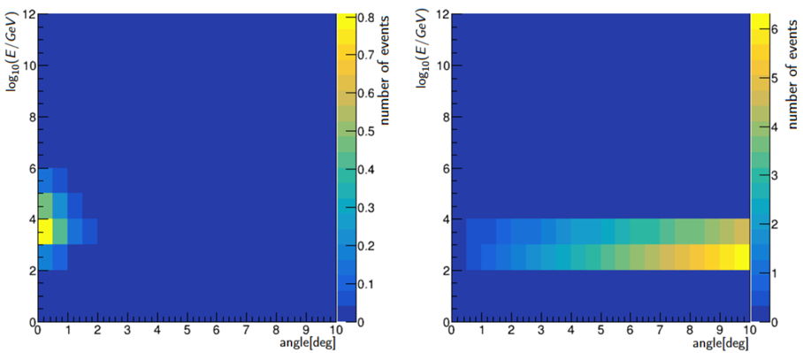
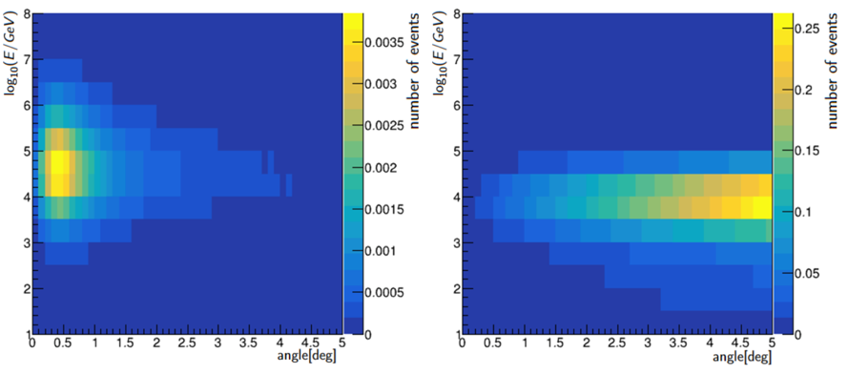
Binned analysis
Data set: detector period with a particular event selection (track/showers etc).
Data sets do not overlap (no common events).
For each data set:
Signal expectation (MC) S,
Background expectation (MC, data sampling) B,
Data/pseudo-experiment N,
Histogram binnings are customizable for each set.
number of events
number of events
signal
background
log₁₀(E/GeV)
log₁₀(E/GeV)
1
ANTARES 2007-2020
preliminary
1
angle [deg]
angle [deg]
number of events
number of events
signal
background
log₁₀(E/GeV)
log₁₀(E/GeV)
1
KM3NeT/ARCA8 (210 days)
preliminary
μ signal strength (for a given default flux)
Sum over bins of all data sets
angle [deg]
angle [deg]

Slide 6
Signal simulation
ANTARES 2007-2020
PSF, preliminary
Signal is simulated using detector properties (from MC):
effective area, dependent on true neutrino energy and zenith/declination. It serves as a measure for the detector sensitivities to neutrinos at different energies and incoming angles;
neutrino energy resolution estimated as the fraction of the events with a given reconstructed neutrino energy for a given bin of true neutrino energy and zenith/declination;
point spread function estimated as the fraction of the events with a reconstructed angular distance from the true source centre for a given bin of true neutrino energy.
Can be further smeared with source extension (if known).
log₁₀(α/deg)
log₁₀(E/GeV)
log₁₀(α/deg)
KM3NeT/ARCA8
PSF, preliminary
log₁₀(E/GeV)

Slide 7
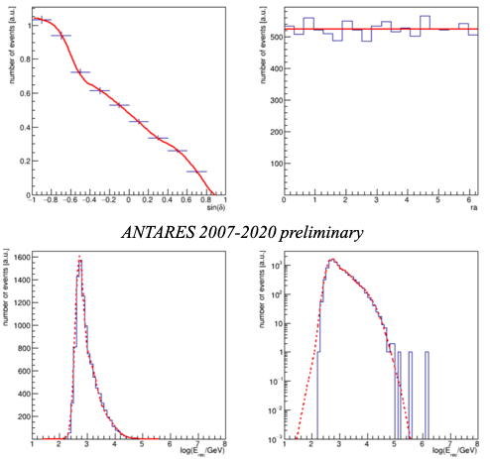
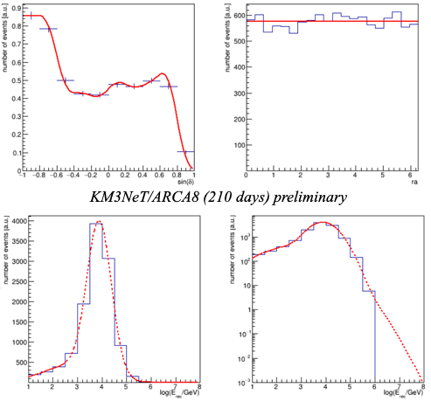
Background and pseudo-experiments
Background is factorised by data fits in reconstructed declination and energy.
B=n*F(DEC)*F(E)
Pseudo-experiments are generated as Poisson with mean μS+B (for each bin).
number of events [a.u.]
number of events [a.u.]
number of events [a.u.]
number of events [a.u.]
ANTARES 2007-2010 preliminary
sin(δ)
ra
KM3NeT/ARCA8 (210 days) preliminary
sin(δ)
ra
number of events [a.u.]
number of events [a.u.]
number of events [a.u.]
log₁₀(E/GeV)
log₁₀(E/GeV)
log₁₀(E/GeV)
log₁₀(E/GeV)

Slide 8
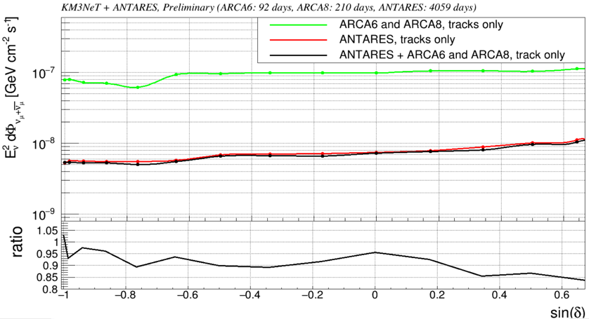
Sensitivities
Median Neyman upper limit for pseudo-experiments with no signal.
PoS(ICRC2023)1147
Sensitivity of the analysed KM3NeT/ARCA data sets is order of magnitude worse than the ANTARES data set.
Sensitivity gain of combined analysis is ~10%.
This will rapidly change for the upcoming data sets (ANTARES 2007-2022, 1 year of KM3NeT/ARCA21..)

Slide 9
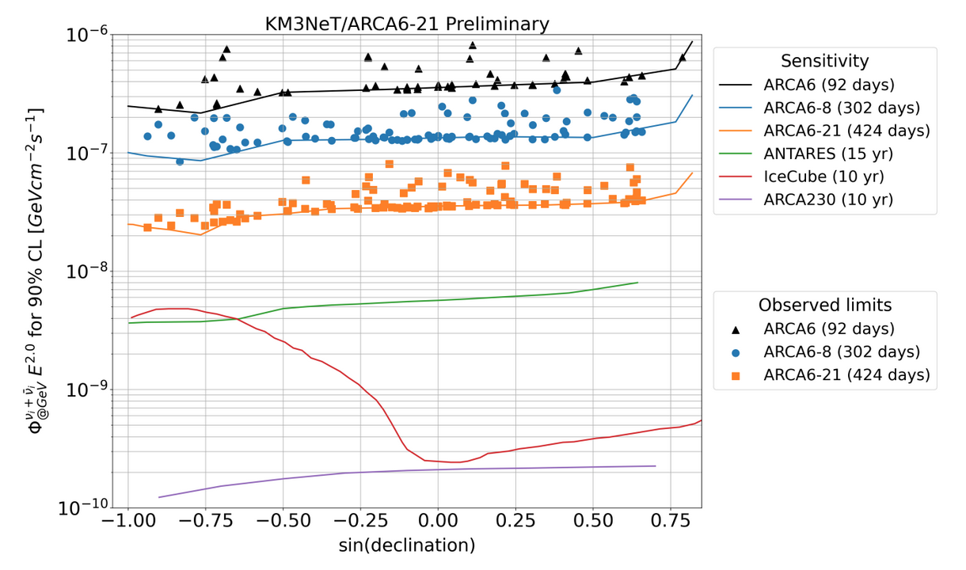
Hand-waving estimations for the future
ARCA6/8/19/21
@ICRC2023 by
Thijs, Rasa, Aart
The effective data taking time of ∼ 424 days contains:
∼ 92 days with 6 lines (referred to as ARCA6),
∼ 210 days with 7 - 8 lines (referred to as ARCA8),
∼ 52 days with ARCA19 and
∼ 69 days with ARCA21.
ARCA6/8 sensitivity is ~12/3.5=4 times worse than ARCA6/8/21
-> dominated by ~1/2 year of ARCA19/21
ARCA6-21 sensitivity is ~3.5/0.55=6.4 times worse than ANTARES.
In 2023 ARCA19 of 9 months => ~sqrt(2.5)=1.7 sensitivity for the full ARCA6/8/21 set vs reduced set.
~3.8 times worse sensitivity than ANTARES (or ~20% improvement in sensitivity / significance).
Next 1-2 years (ICRC2025 and Neutrino 2026) we (KM3NeT/ARCA) should reach ANTARES sensitivity.

Slide 10
Hand-waving estimations for the future
ANTARES 15 year 163 candidate-list search extrapolated to adding:
20% pre-trial significance (source is steady and real, dataset has 20% better sensitivity) with 100 candidates
or 30% with 163 candidates
*in the official analysis post-Z of (MG3…) was 1.7 (higher).
 | pre-trial (σ) | post-trial (σ) | post-trial (σ) +20% | post-trial (σ) +30%
MG3J225517+2409 | 3.40 | 1.60 | 2.84 | 3.15
3C403 | 3.40 | 1.60 | 2.84 | 3.15
J0242+1101 | 2.60 | -0.71 | 1.34 | 1.56
J2136+0041 | 2.40 | #NUM! | 0.85 | 1.05
TXS 0506+056 | 2.40 | #NUM! | 0.85 | 1.05
J0609-1542 | 2.30 | #NUM! | 0.56 | 0.75
If sources observed by ANTARES are real and steady,
then next 1-3 years ARCA+ANTARES should have 3 sigma observation (post-trial!).
This fits KM3NeT4RR scale perfectly!
z=TMath::ErfInverse(1-2*p)*sqrt(2)
p=(1-TMath::Erf(3.4/sqrt(2)))/2.

Slide 11
Summary and Perspectives
In this work, the framework for joint analysis has been demonstrated. Its features:
Binned analysis with different data sets: different detectors (ANTARES, ARCA..), different event selection (track-like, shower-like...),
Inclusion of source morphology (extension with Gaussian, disk, etc..)
Using ARCA6/8 helps to improve ANTARES standalone analysis by ~10%.
⟹ The framework is ready to use the new data sets (ANTARES 2007-2022, ARCA6-21, ORCA6-18...).
In the next few years, KM3NeT/ARCA statistics will reach the ANTARES one and overcome it.
⟹ In the end of PNRR we may have 3-sigma observation?!
Work in progress ⟹ include shower sample for both ARCA & ANTARES
⟹ include sample for ARCA 18, ARCA 21..
⟹ use the same PDF as in the last ANTARES analysis
(more accurate accounting of declination/energy dependence)
Notes:
Combination with ORCA

