Slide 1
Transversity 2024 Round Table 1
Alessandro Bacchetta, Carlo Flore, Gunar Schnell

Slide 2
Umberto’s wishlist
use/misuse of the Soffer bound
impact/use/relevance of lattice calculations
tensor charge (comparisons, new physics?)
uncertainties beyond statistics (parametrizations, unpolarised FFs & diFFs, Collins FFs,...),
different statistical approaches (replica method vs. MC approach, chi2's and correlations, bands...)
role of kinematical cuts imposed to select SIDIS data in the fitting procedure
compatibility of the extractions of h1 via the Collins effect (TMD approach) and dihadron production (Collinear approach)
data binning, large-x region, Q2 coverage...
…

Slide 3
Positivity bounds

Slide 4
Soffer bound
positivity bound linking the 3 independent collinear PDFs at leading twist
useful constraint for phenomenology
how to properly use it?
it depends on the adopted PDF and helicity extractions – always consistent choices? –
unnatural shrinkage of uncertainties observed if SB automatically fulfilled by adopted parametrizations (e.g. in SIDIS when fitted w/ Collins function [D’Alesio, Flore, Prokudin] or in 2h production w/ diFF function [Benel, Courtoy, Ferro-Hernandez])
positivity bounds useful for checking theory consistency [De Florian, Forte, Vogelsang]
most stringent positivity requirement is on actual cross sections (or asymmetries); PDFs are only derived quantities subject to various assumptions
⇒ better to fit without bound and then check consistency?
Notes:
I started to put down some ideas that we discussed in the email exchange, please feel free to modify

Slide 5
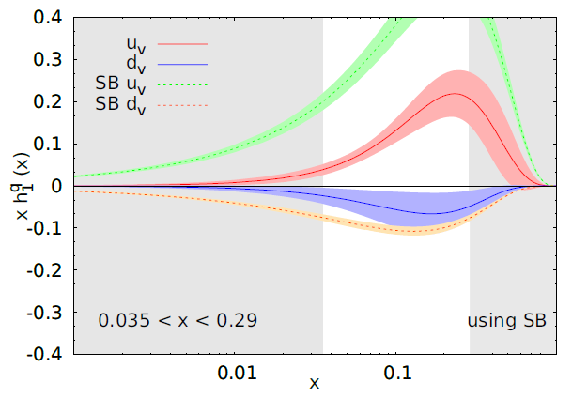
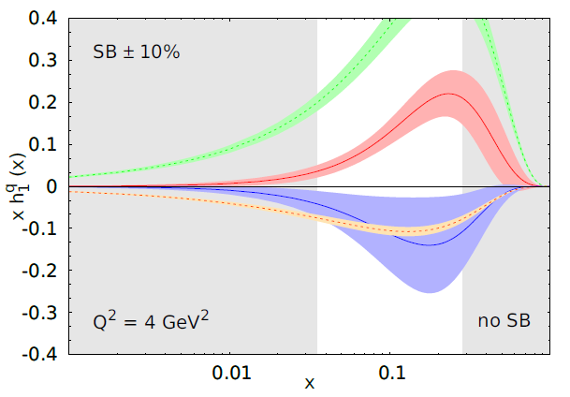
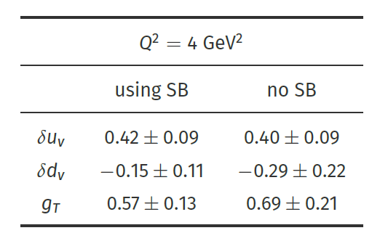
Soffer bound
SIDIS data
Notes:
I started to put down some ideas that we discussed in the email exchange, please feel free to modify

Slide 6
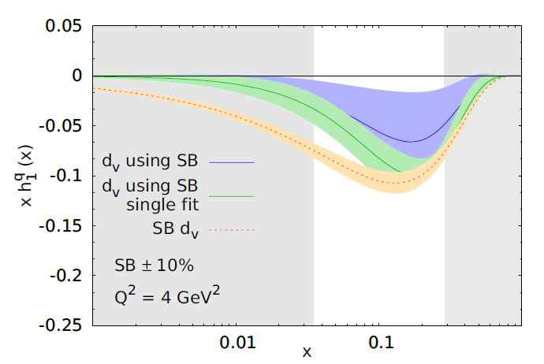
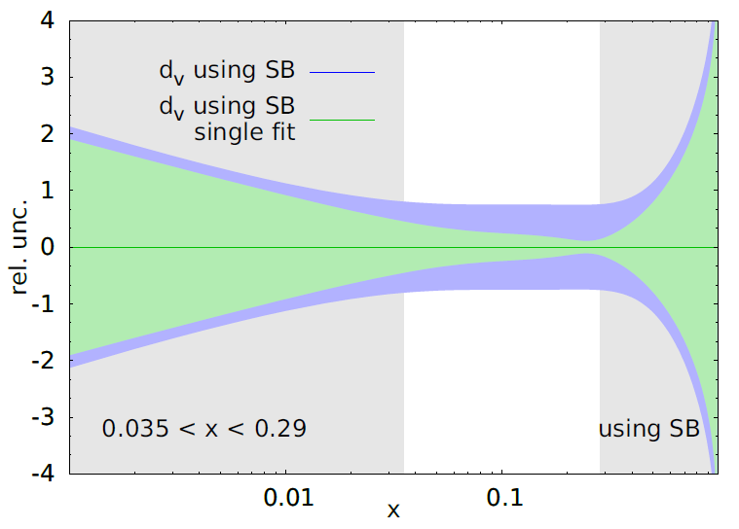
Soffer bound
“using SB single fit”: SB a priori, corresponding normalization parameter saturates ⇒ uncertainty underestimated
“using SB”: SB applied a posteriori, configuration not explored when enforcing SB in the fit now explored
underestimation of uncertainty more severe in the x-region probed by experimental data !!
Notes:
I started to put down some ideas that we discussed in the email exchange, please feel free to modify

Slide 7
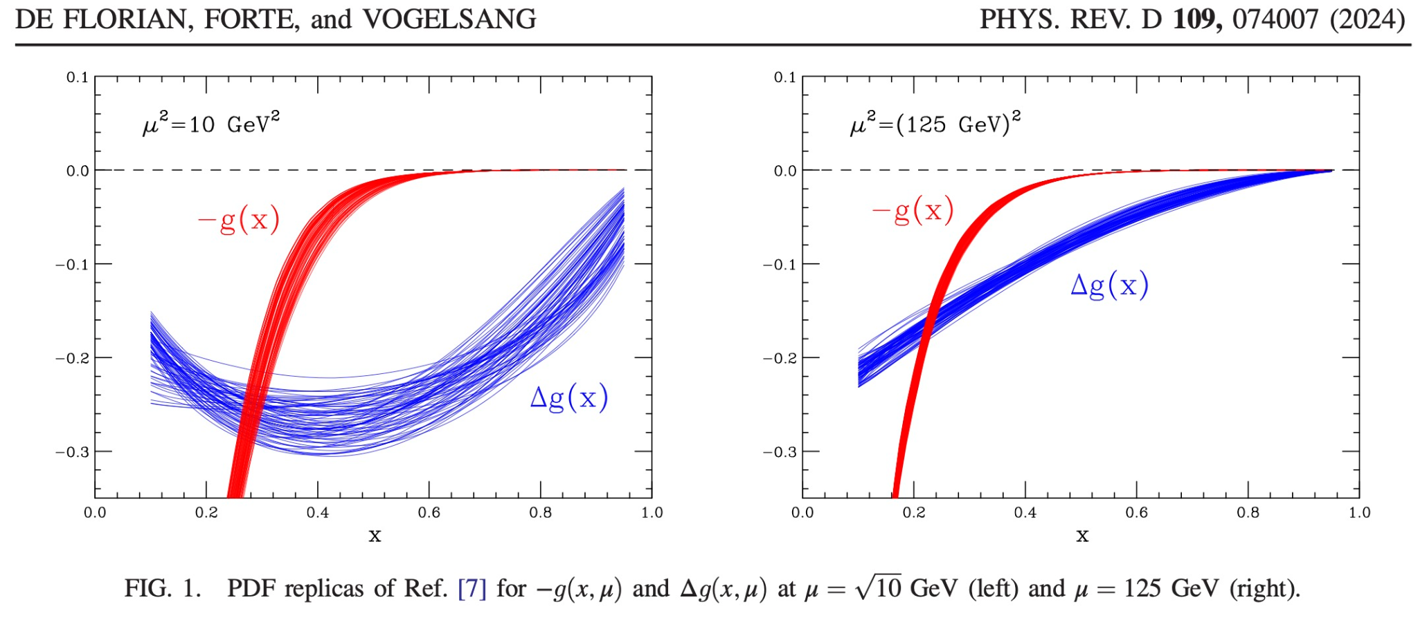
Positivity constraints
on the other hand, need to be careful if positivity is not imposed and check for severe violations

Slide 8
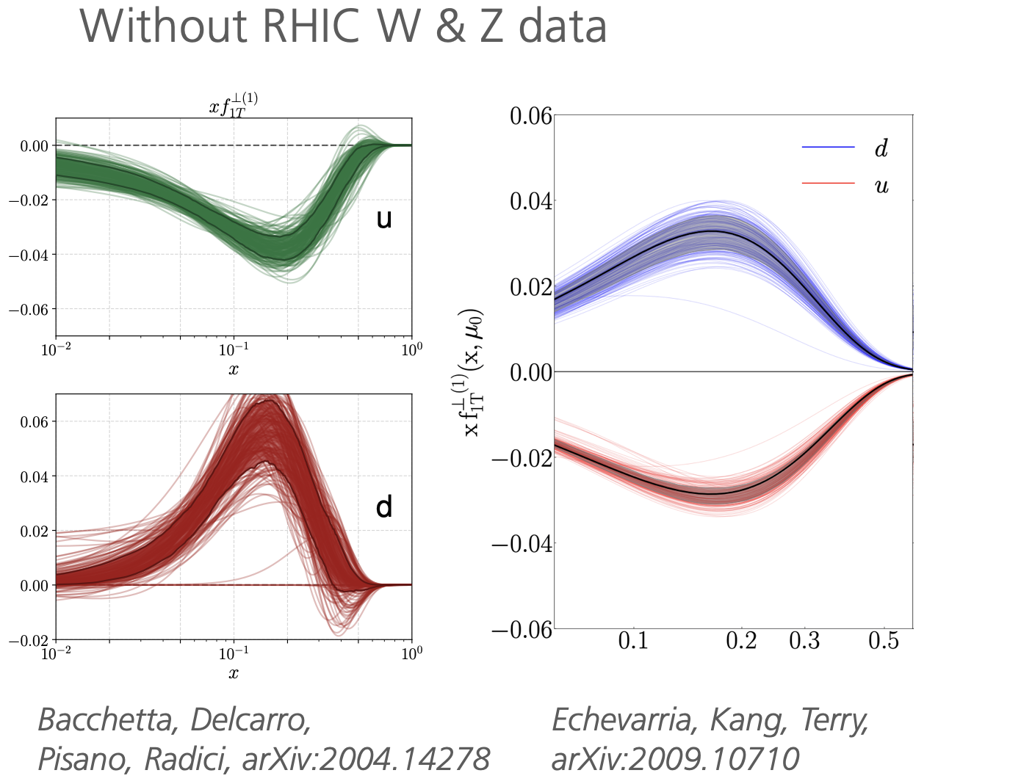
Positivity and Sivers function

Slide 9
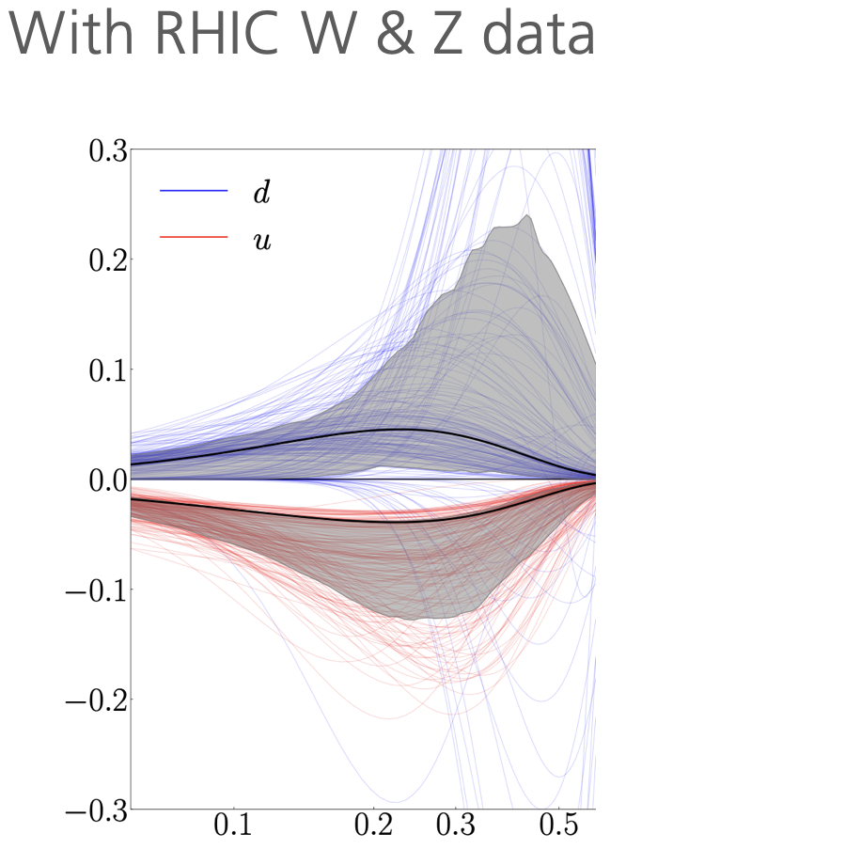
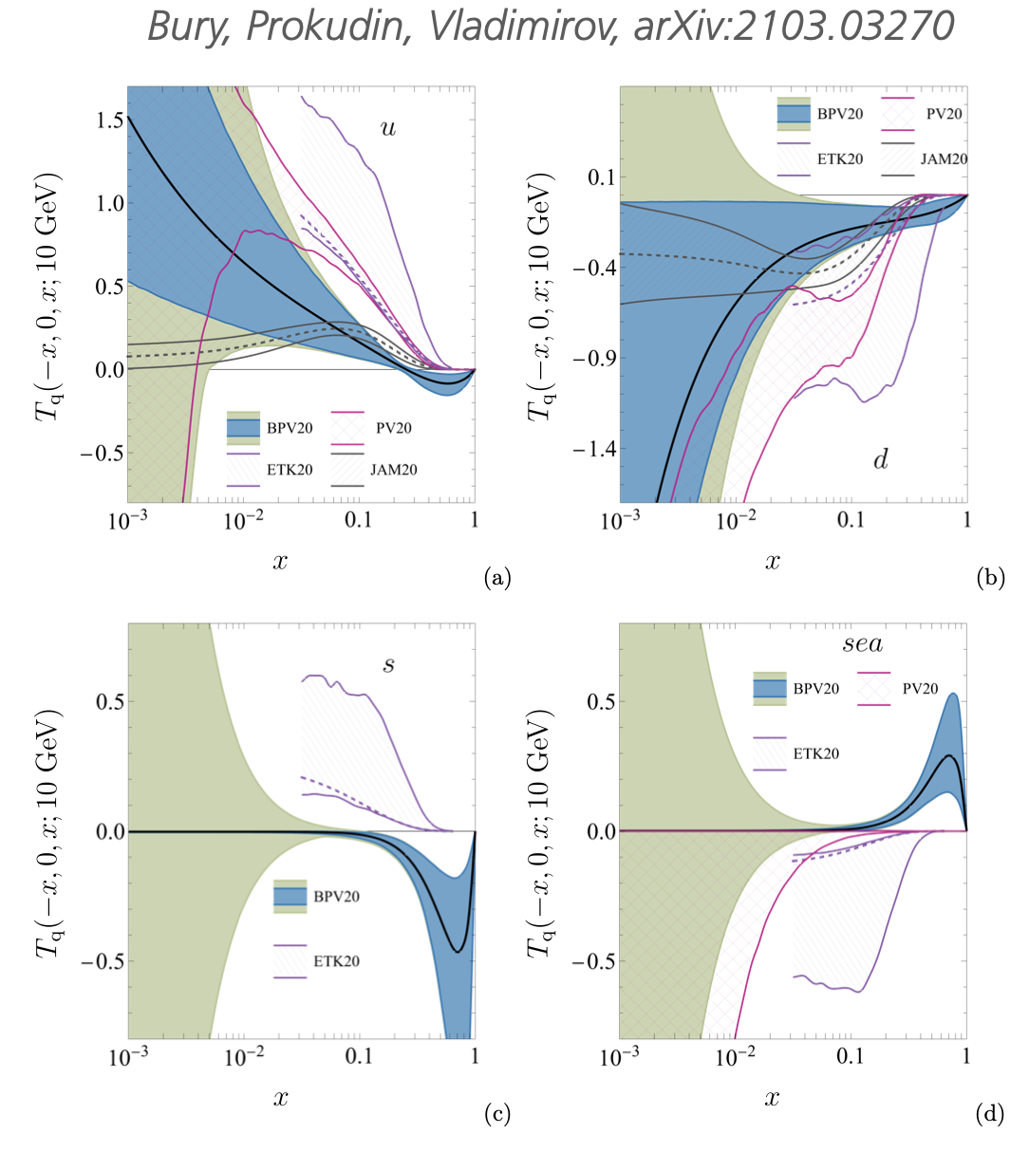
Positivity and Sivers function
Echevarria, Kang, Terry, arXiv:2009.10710
Bury, Prokudin, Vladimirov, arXiv:2103.03270

Slide 10
Lattice and phenomenology

Slide 11
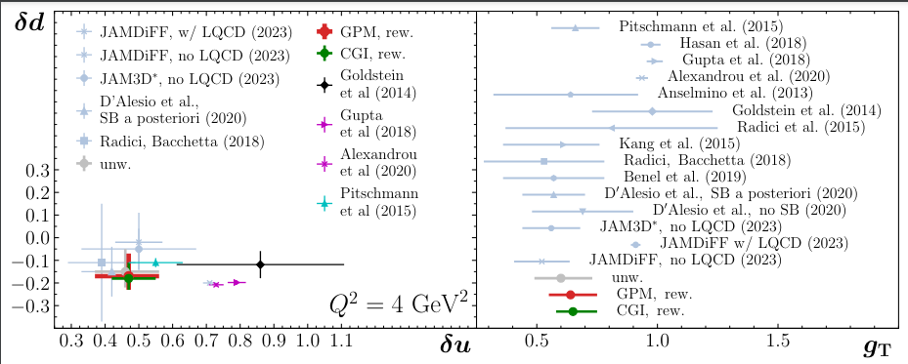
Lattice-phenomenology tension?

Slide 12
Lattice-phenomenology tension?

Slide 13
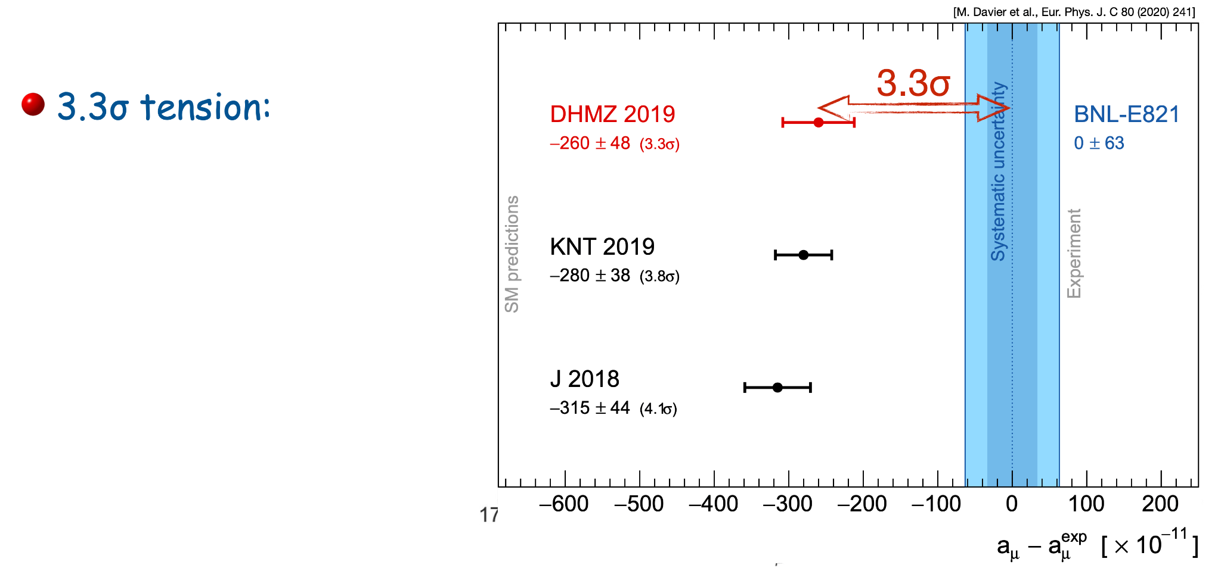
consistency of data sets

Slide 14
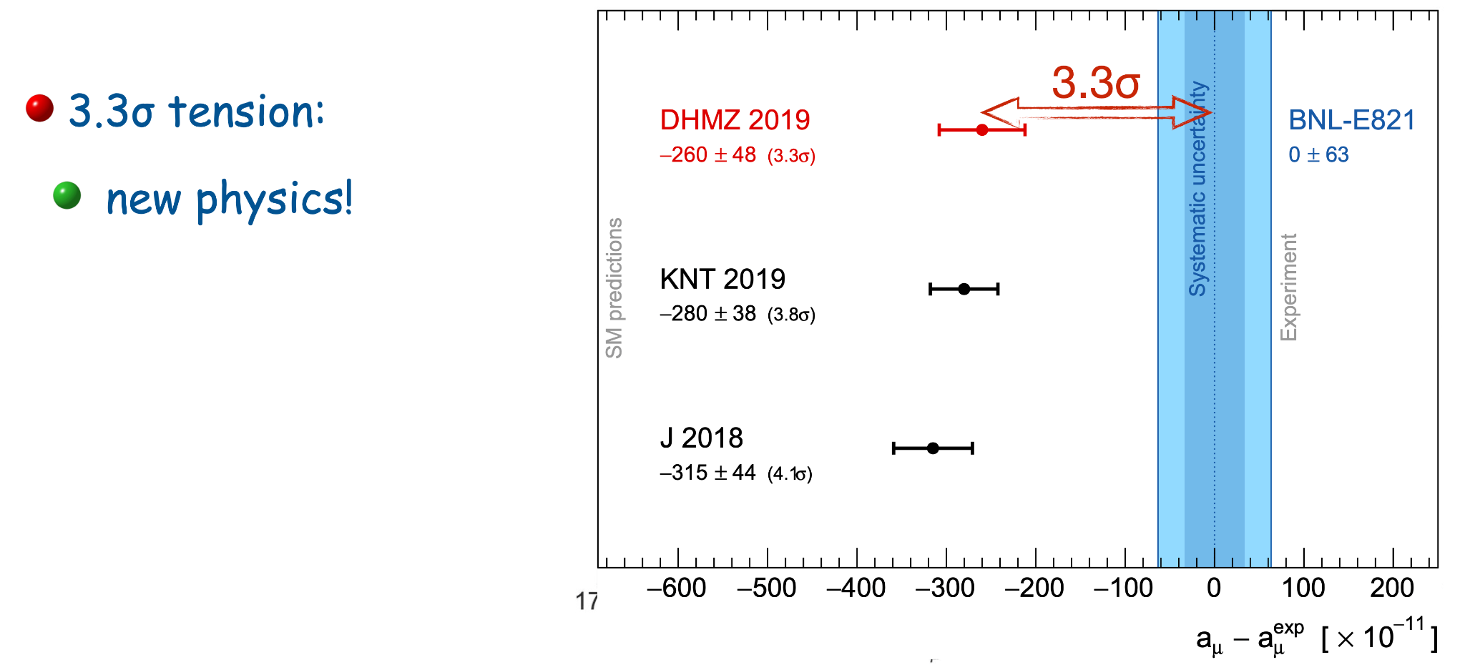
consistency of data sets

Slide 15
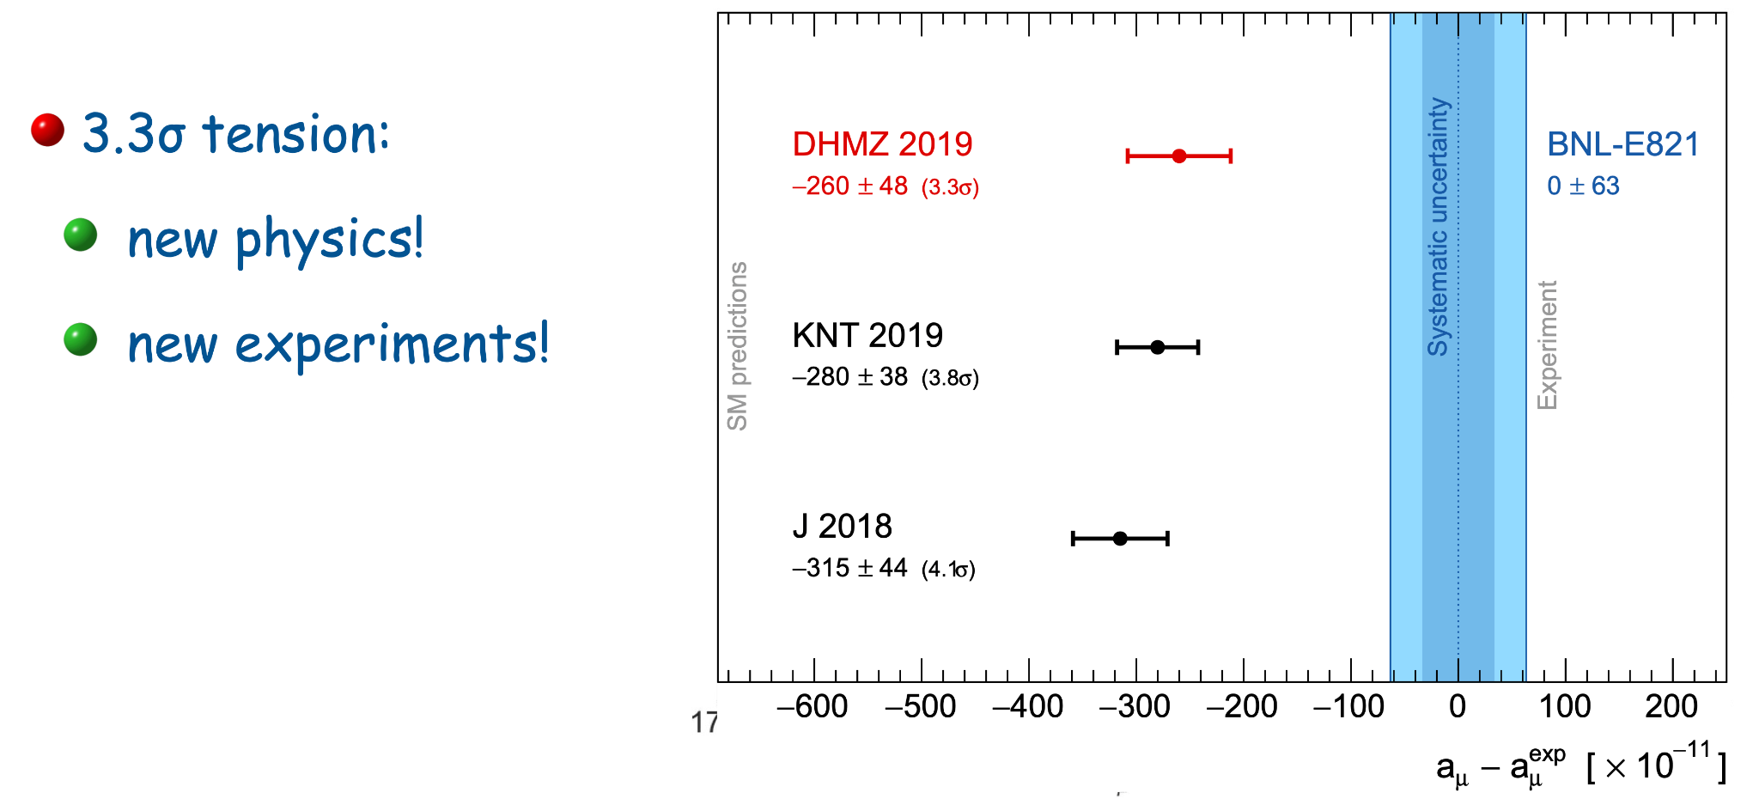
consistency of data sets

Slide 16
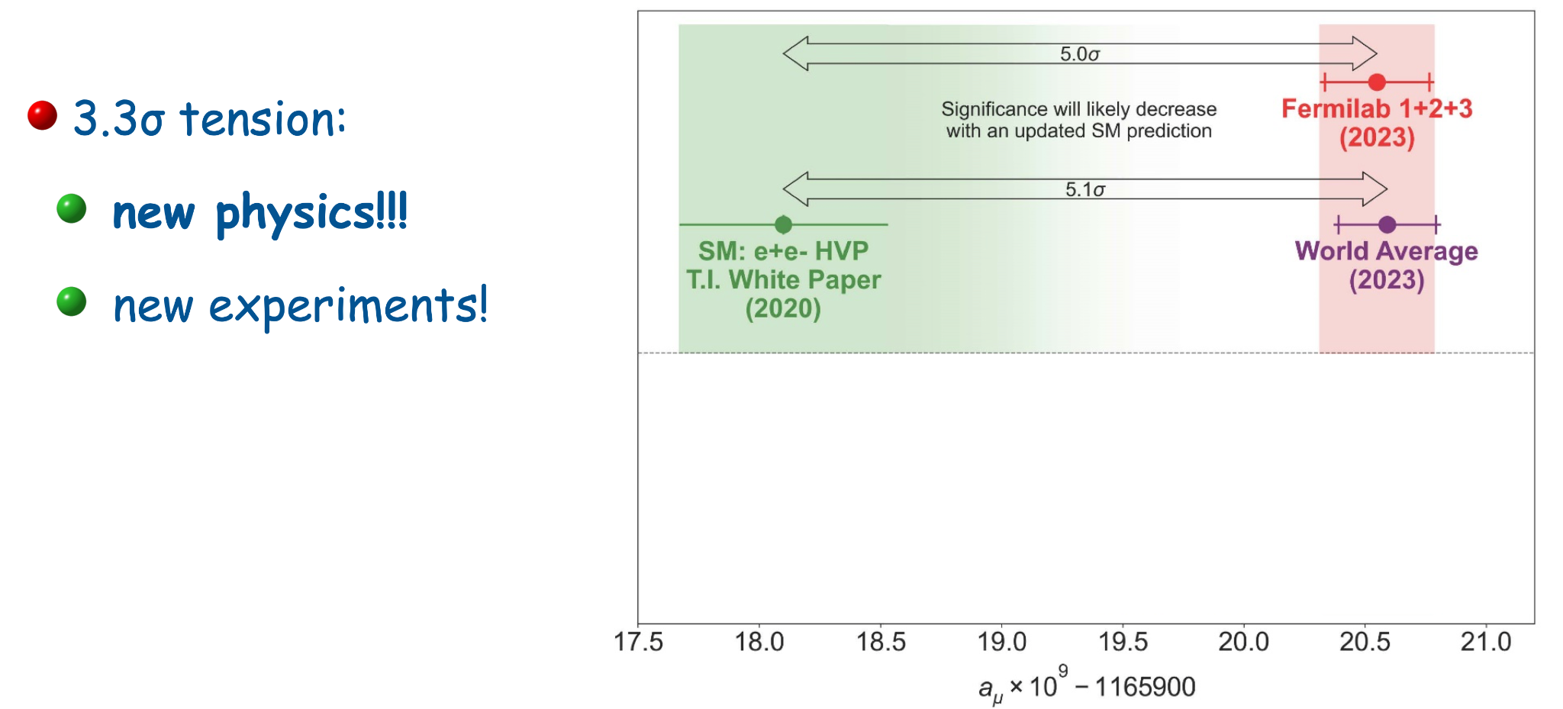
consistency of data sets

Slide 17
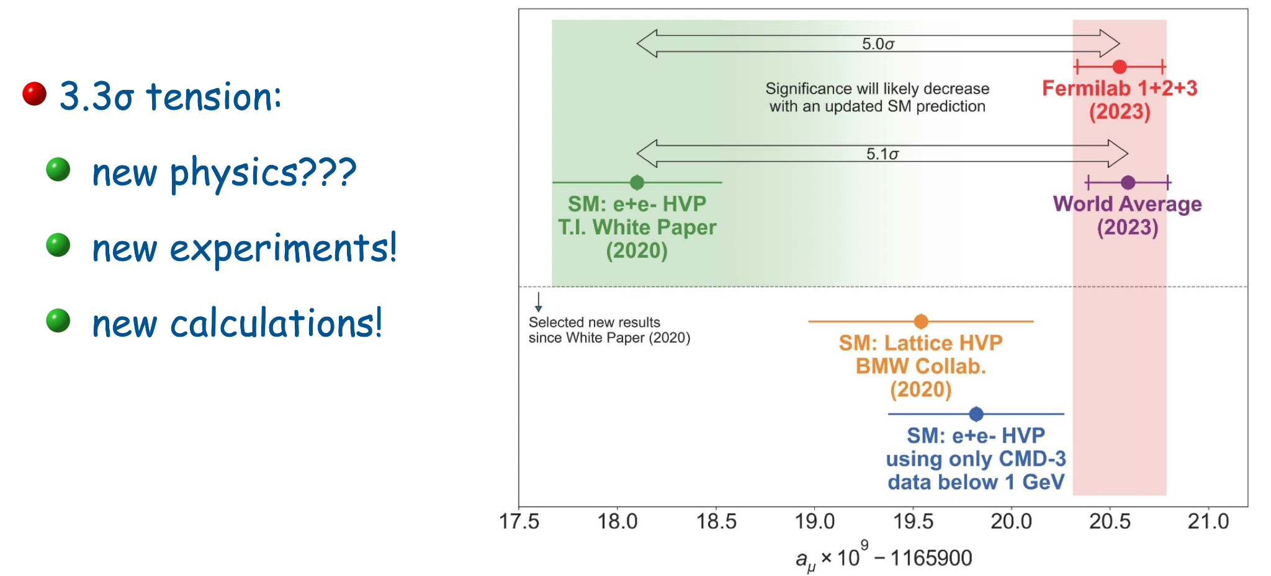
consistency of data sets

Slide 18
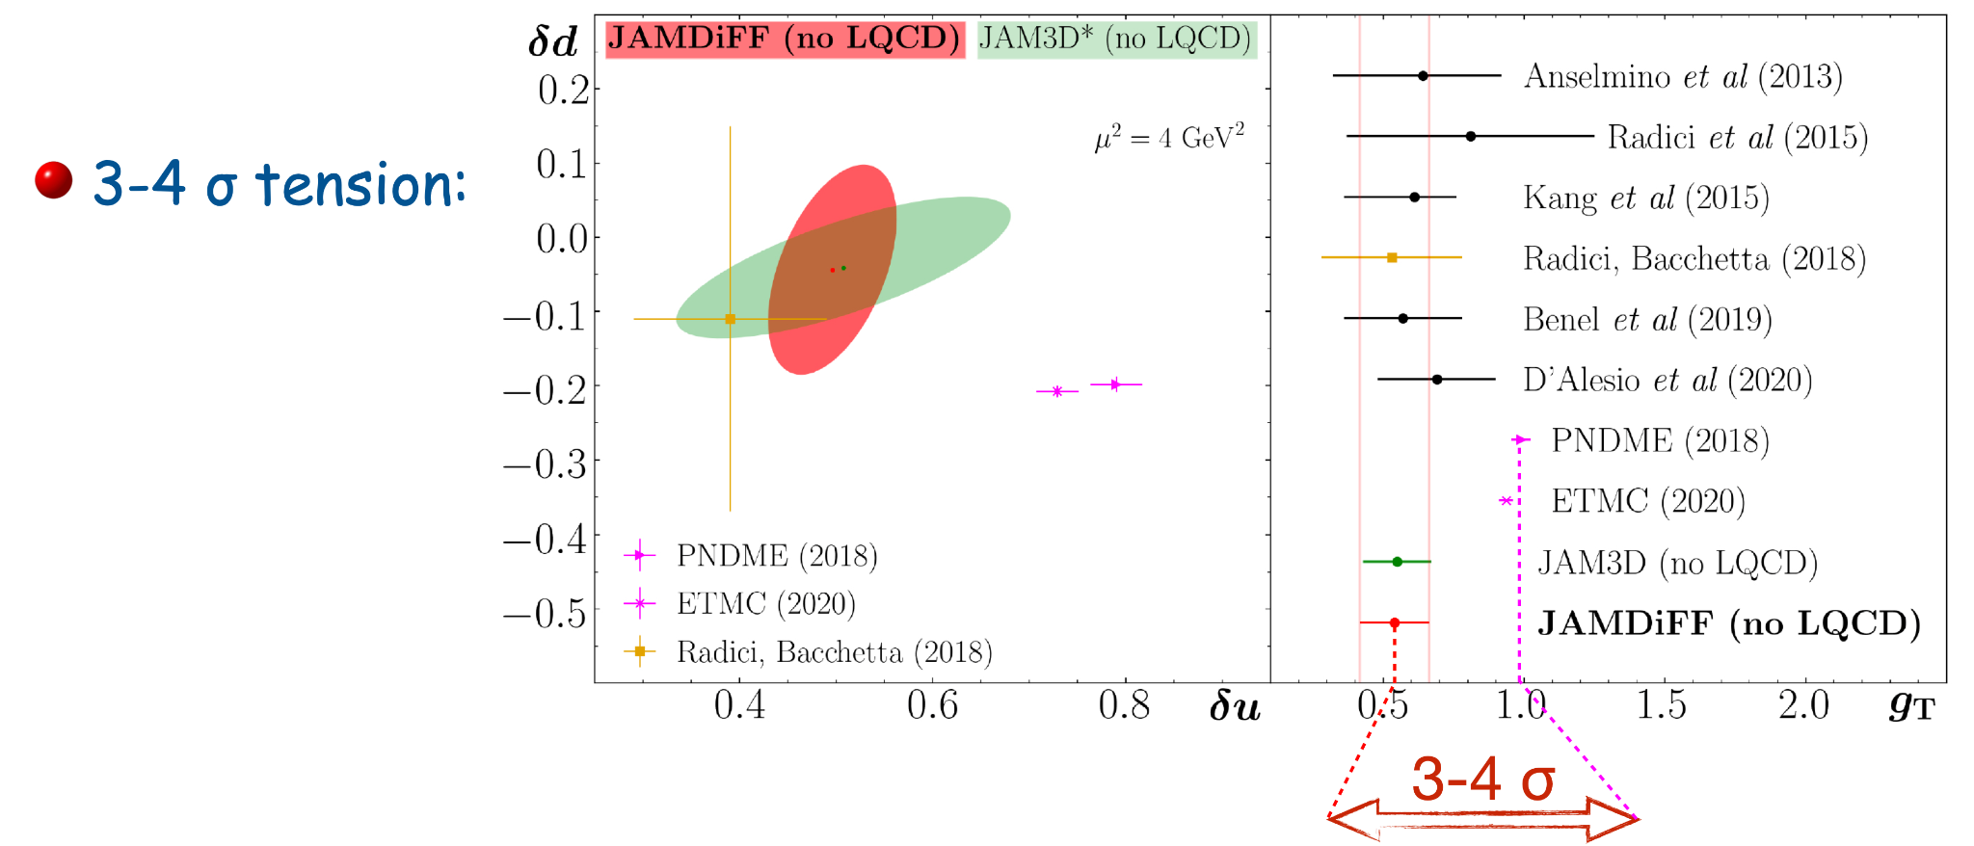
consistency of data sets

Slide 19
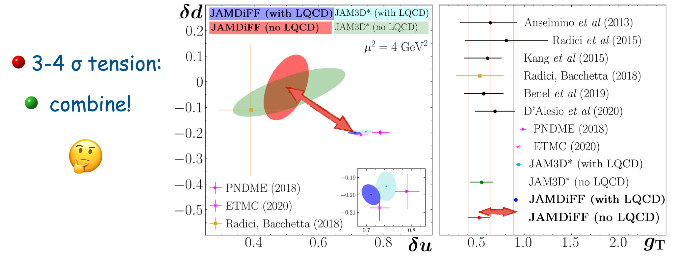
consistency of data sets

Slide 20
consistency of data sets

Slide 21
consistency of data sets

Slide 22
consistency of data sets

Slide 23
consistency of data sets

Slide 24
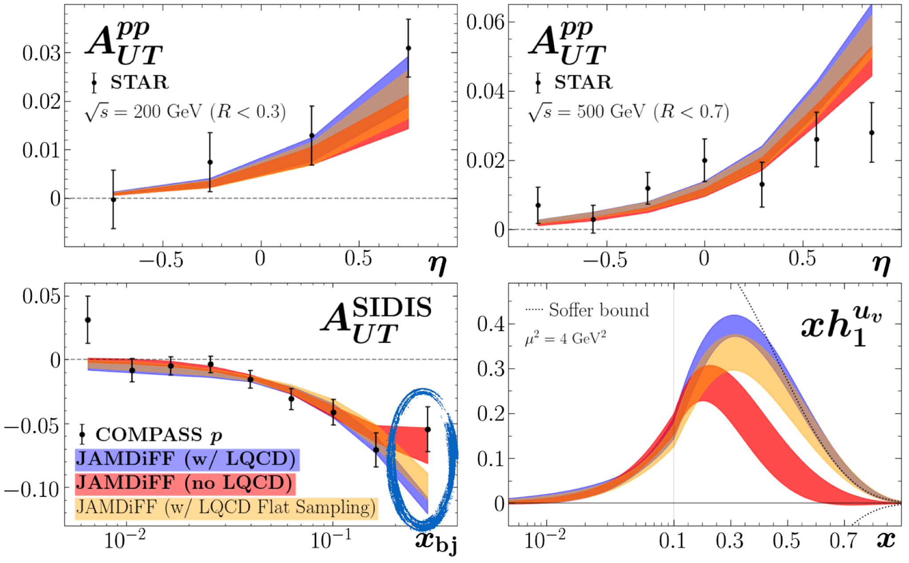
consistency of data sets

Slide 25
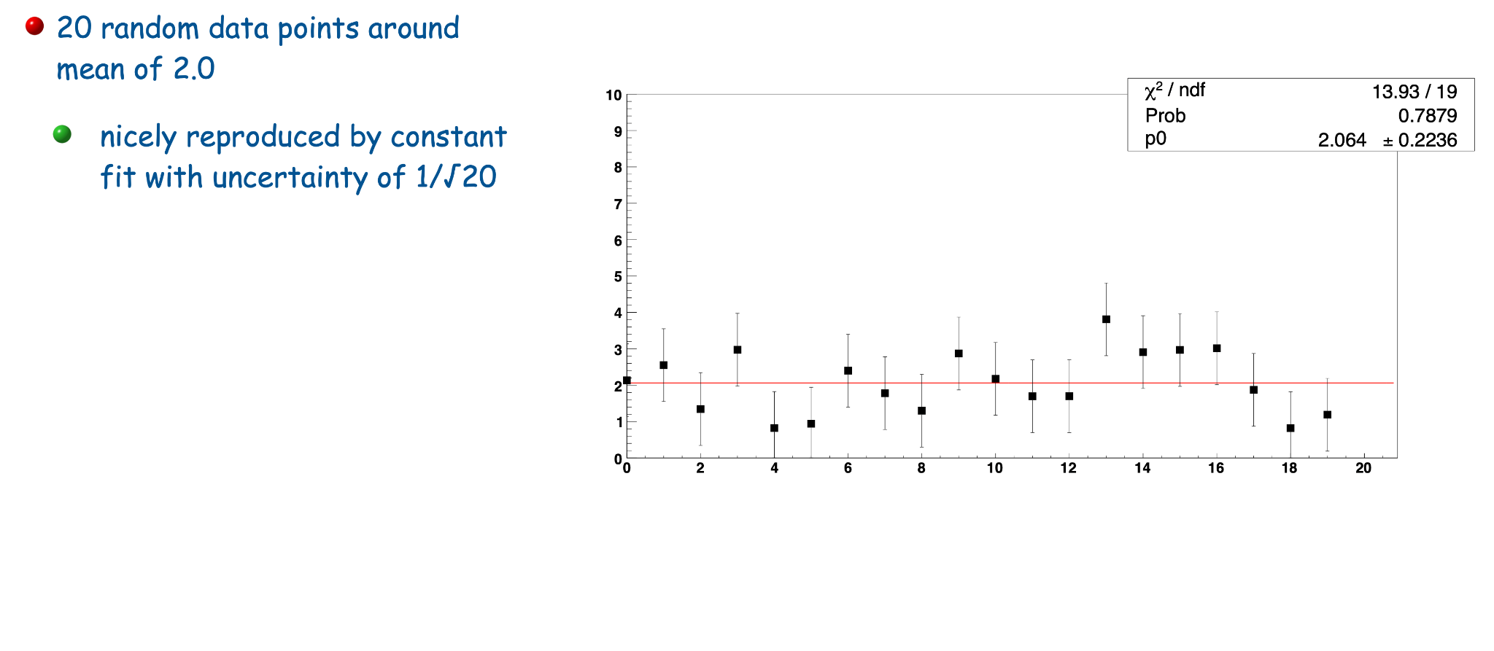
consistency of data sets

Slide 26
consistency of data sets

Slide 27
consistency of data sets

Slide 28
consistency of data sets

Slide 29
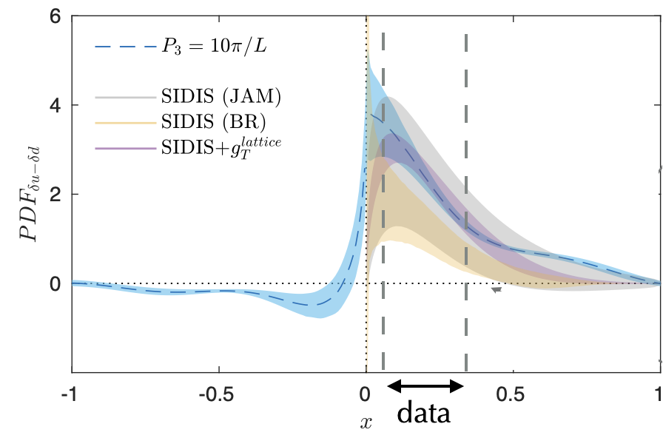
Lattice transversity calculation

Slide 30
usage of lattice data
on one side, have examples of using lattice data in phenomenology, e.g., muon (g-2)
but what is confidence in accuracy of lattice data (and properly reflected in assigned uncertainties?)
⇒ would we use also axial and vector charges from same calculation as constraints in other PDF fits? (is Soffer bound calculated in those fits consistent with axial and vector charges from lattice?)
⇒ why only total tensor charge and not also integrals of transversity of u and d separately, and of also s
lattice data come with very small uncertainty; dominates the fit
⇒ if so much trust in lattice result, hardly need experimental data unless in studies of what functional form for lattice transversity is still in agreement with experimental data
lattice points in combination with rigid parametrization can be difficult as the previous is an integral of the latter over the whole x range, e.g., also in regions where we have no data to guide choice of parametrization.

Slide 31
Data selection

Slide 32
Data selection criteria: TMDs

Slide 33
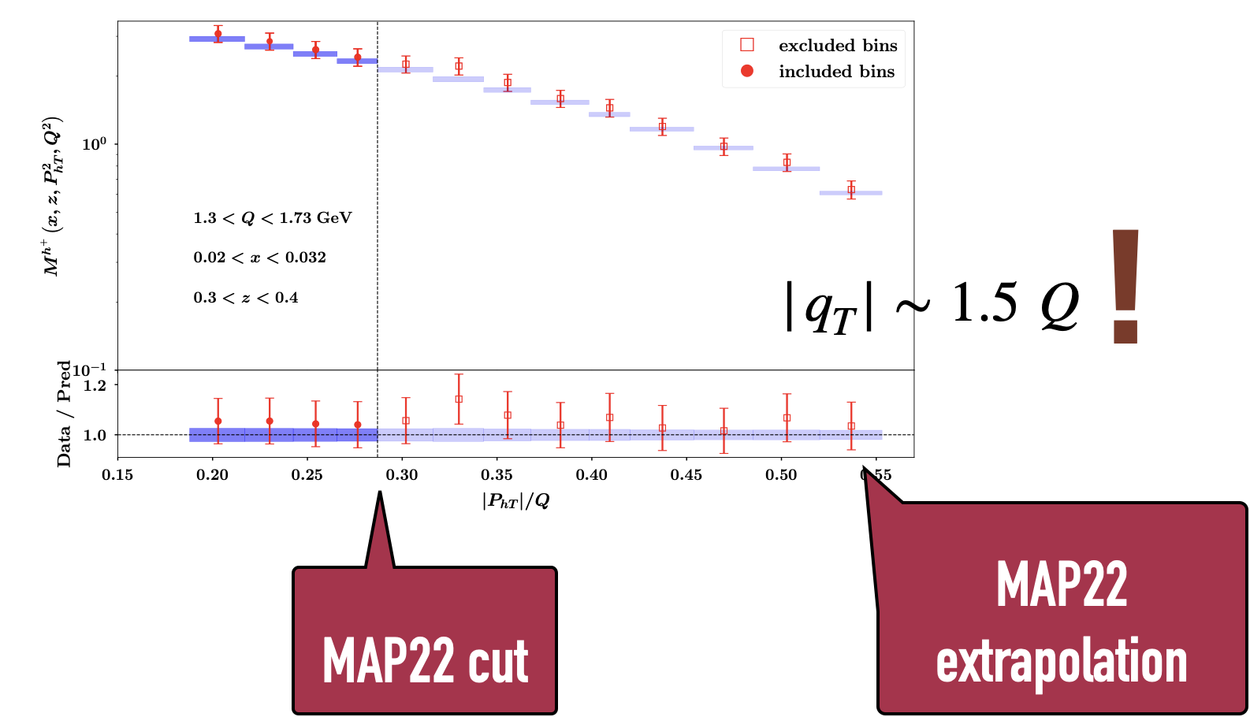
Data selection criteria: TMDs

Slide 34
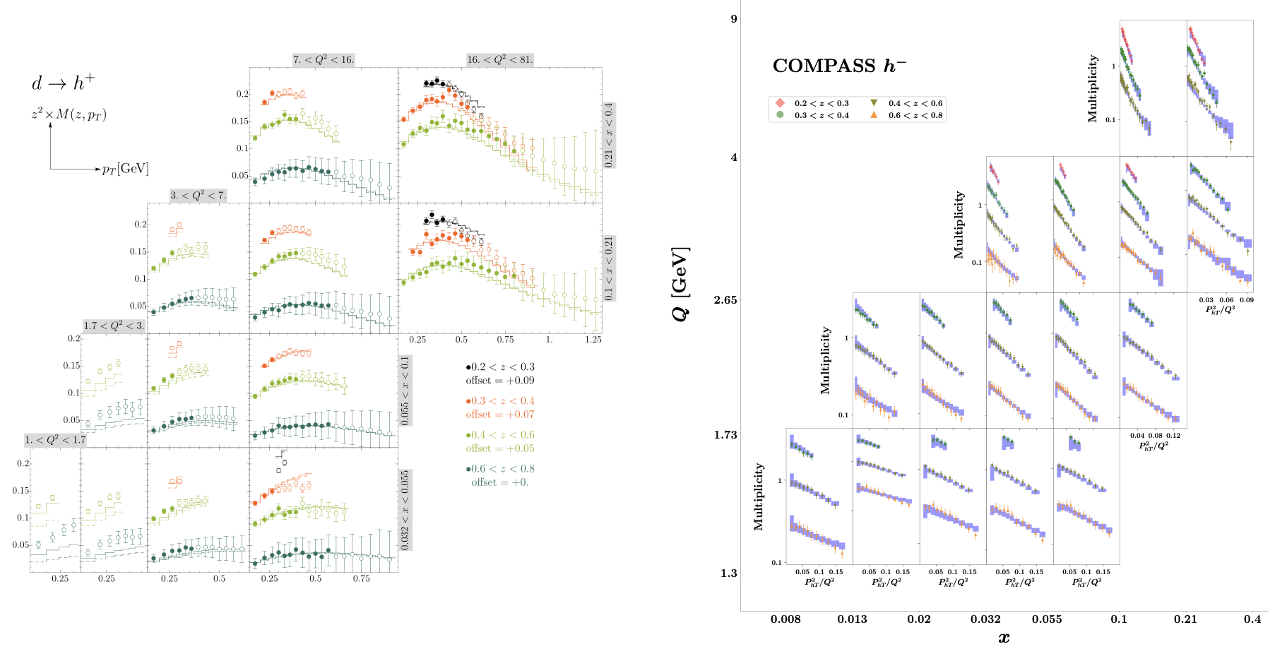
Data selection criteria
MAP24
SV19
about 20 points per bin
about 50 points per bin

Slide 35
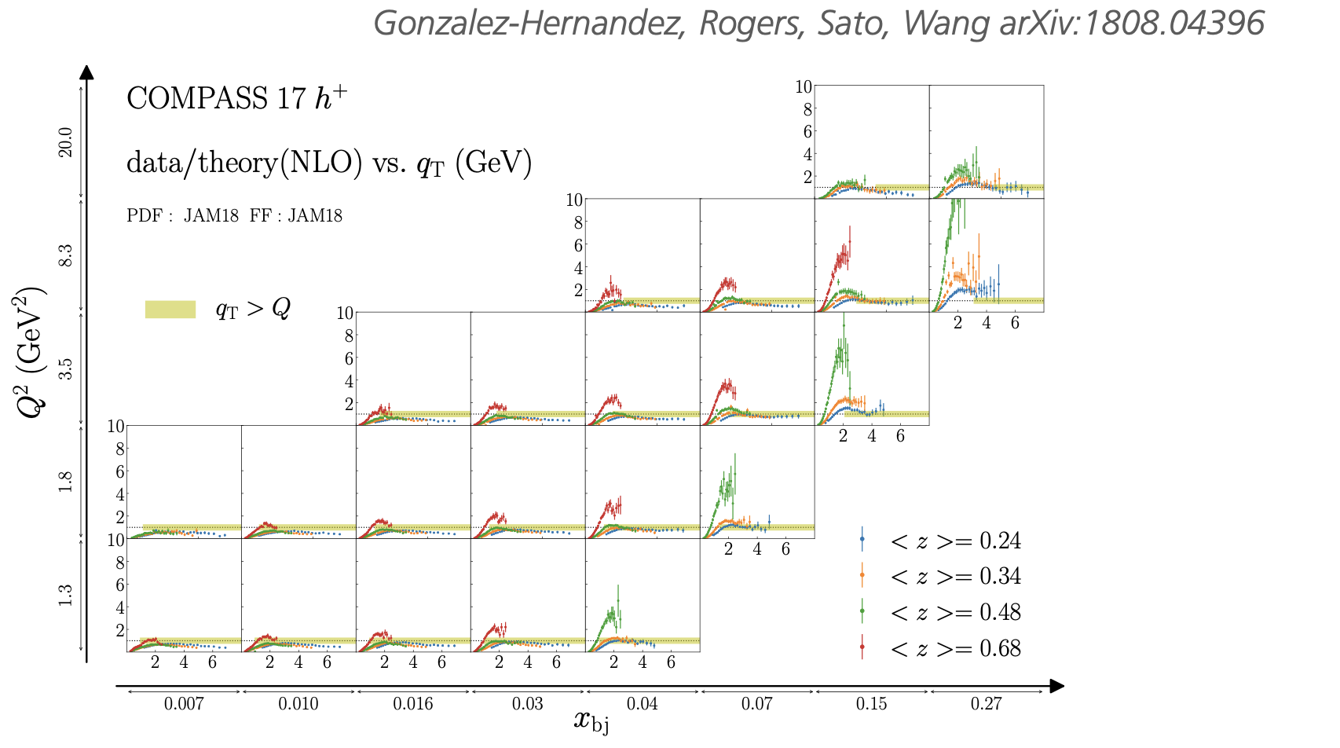
Data selection criteria: matching

Slide 36
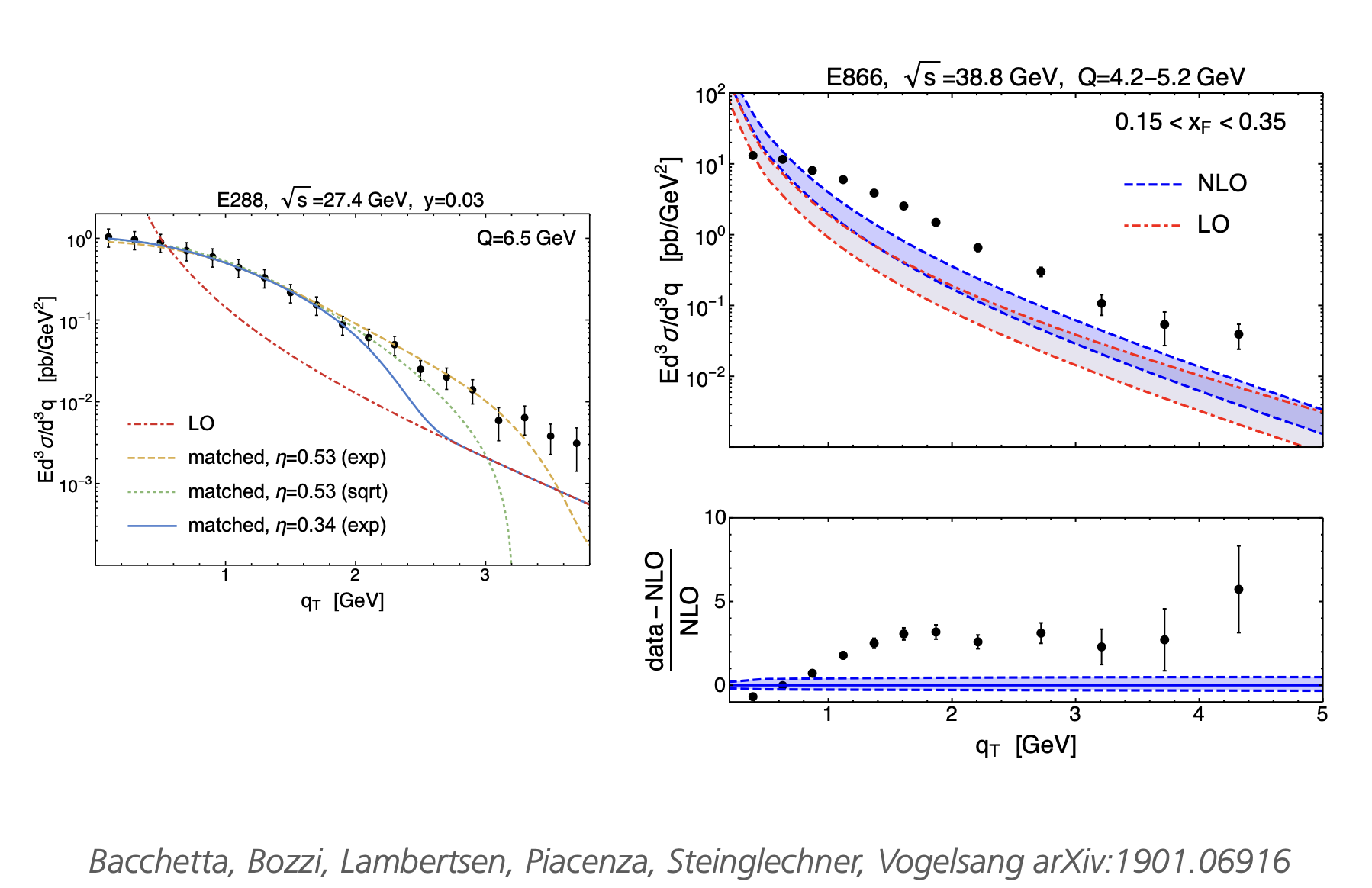
Data selection criteria: matching

Slide 37
Harut
Theory analysis

Slide 39
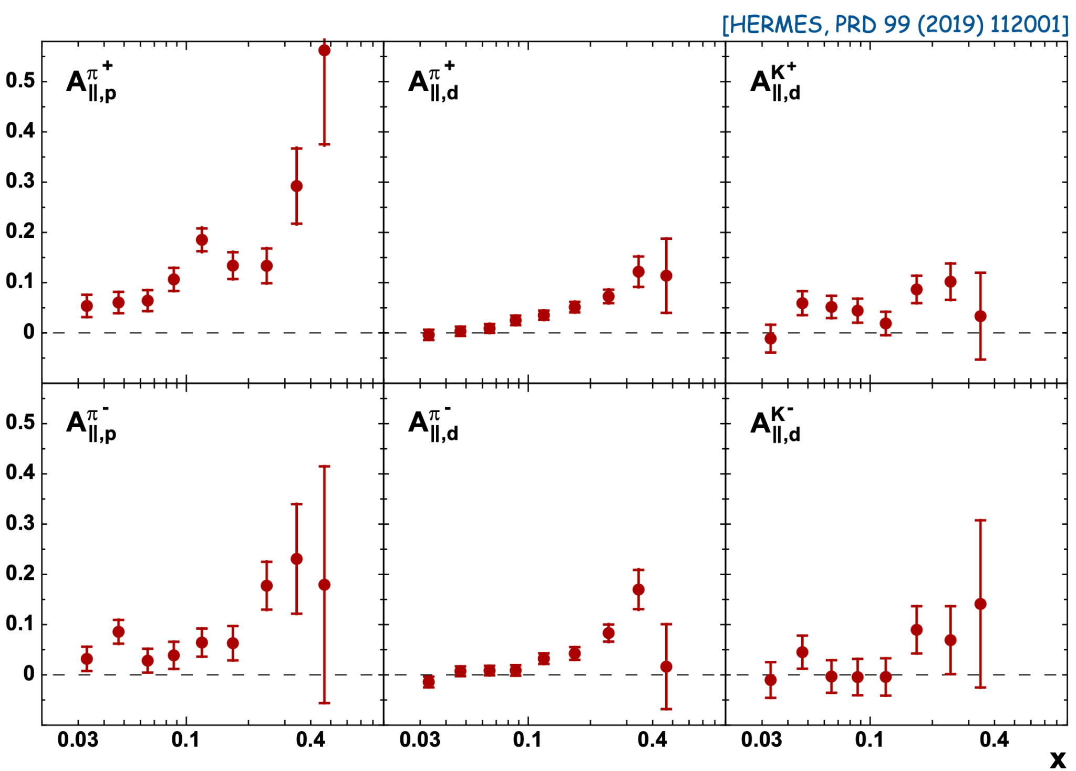
Data selection criteria: binning

Slide 40
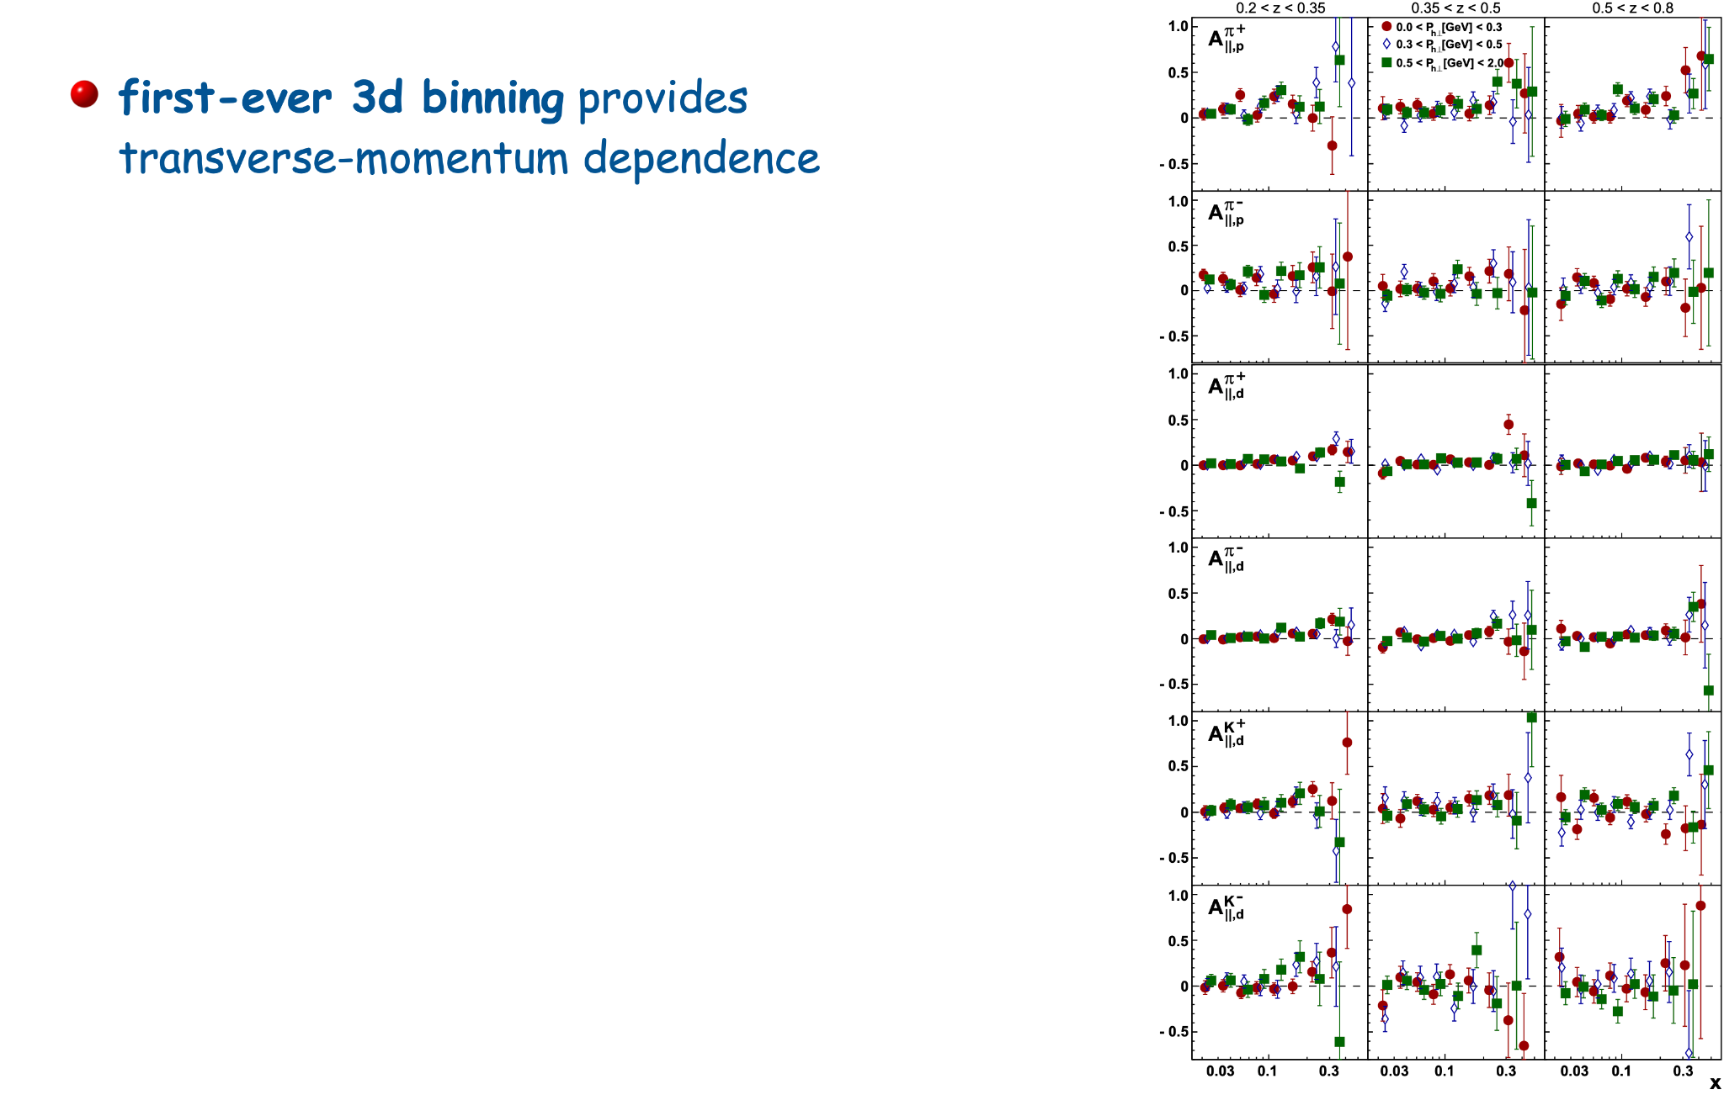

Slide 42
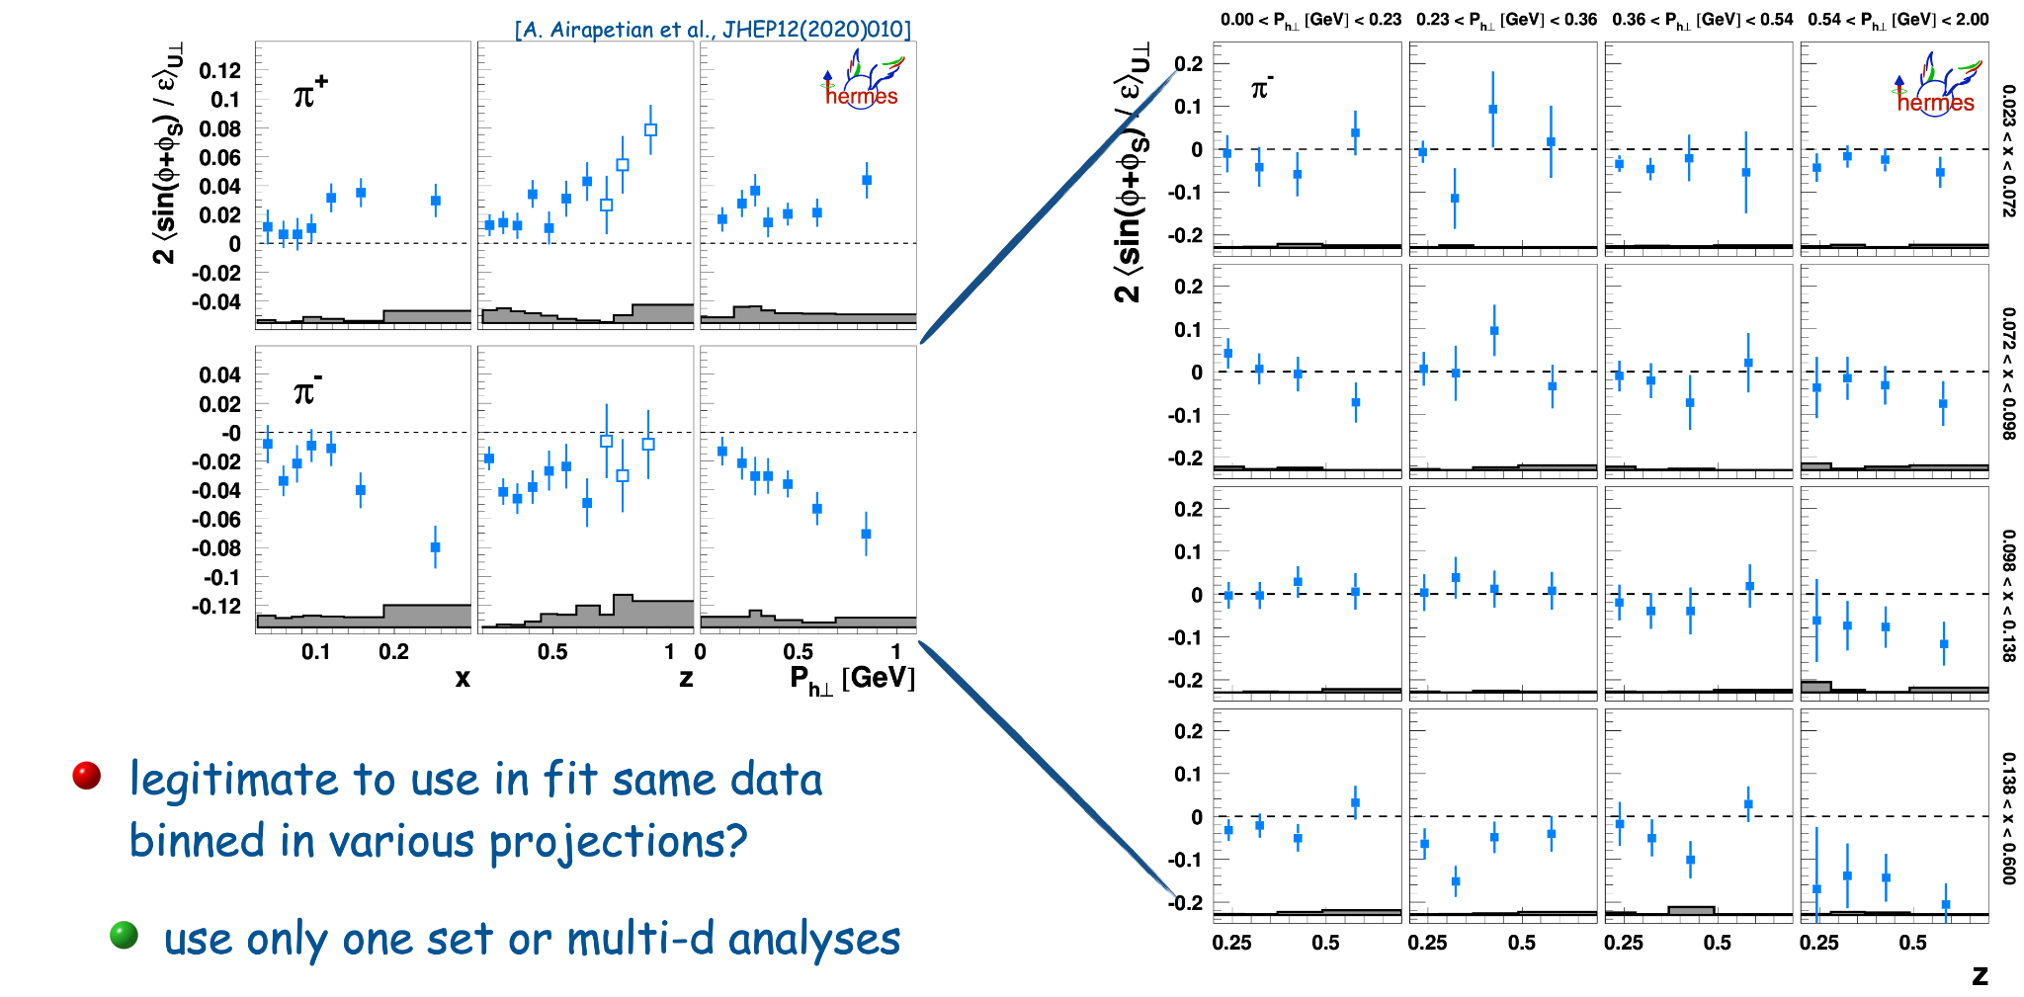
Data selection criteria: binning

Slide 43
Data selection criteria: binning

Slide 44
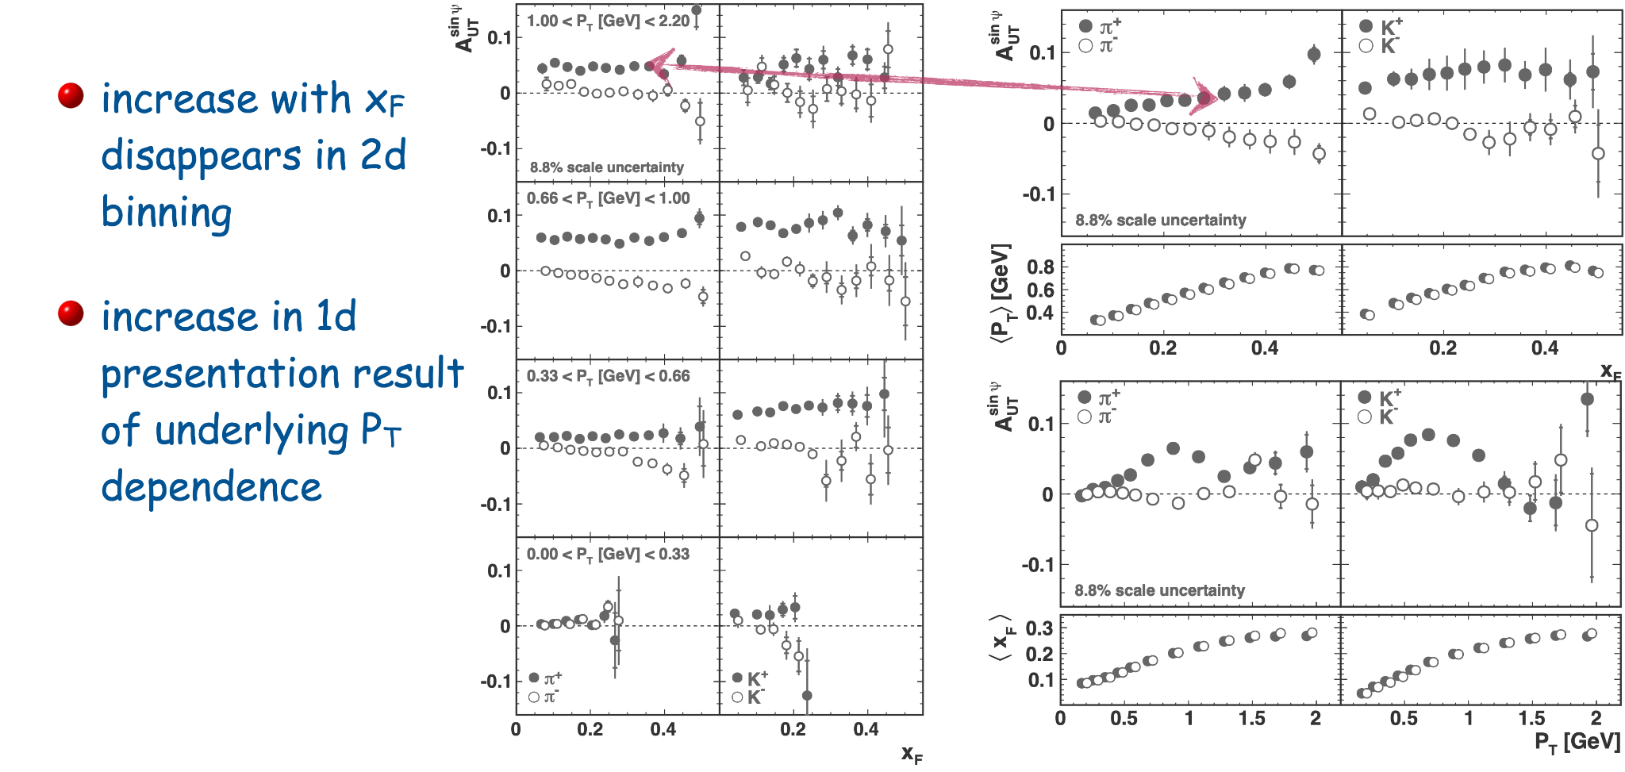
Data selection criteria: binning

Slide 45
Future data

Slide 46
Experimental prospects

Slide 47
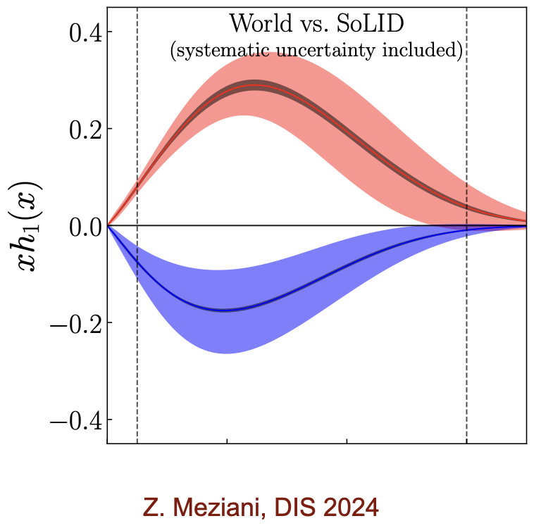
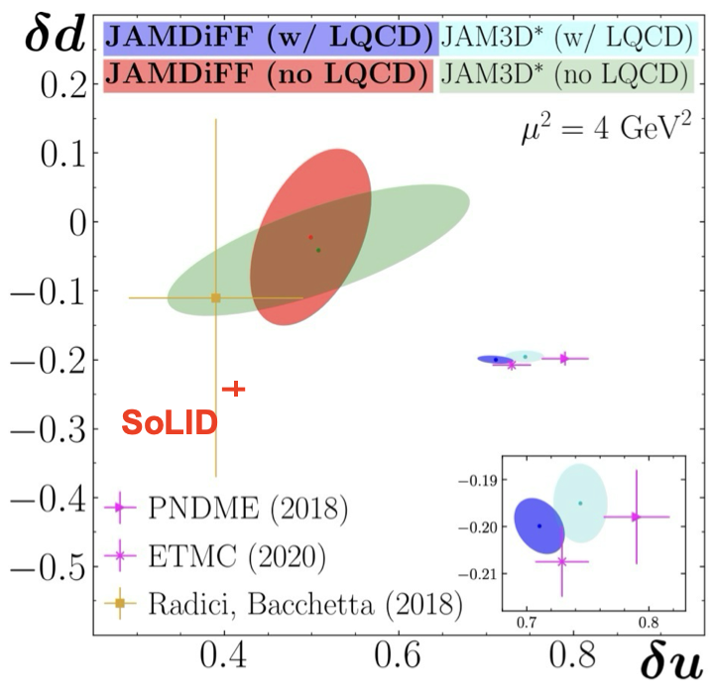
Impact of new data: SOLID

Slide 48
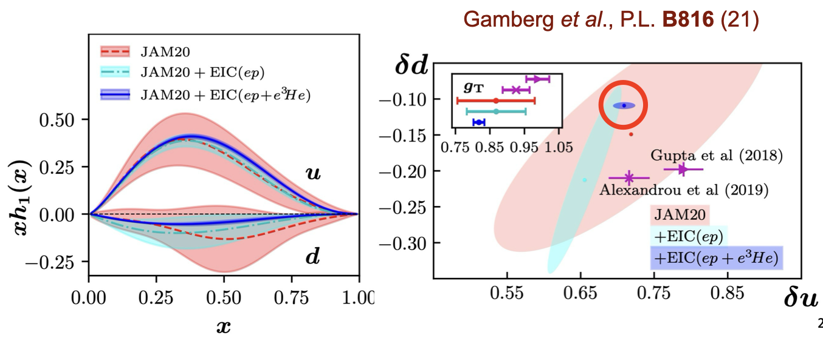
Impact of new data: EIC

Slide 49
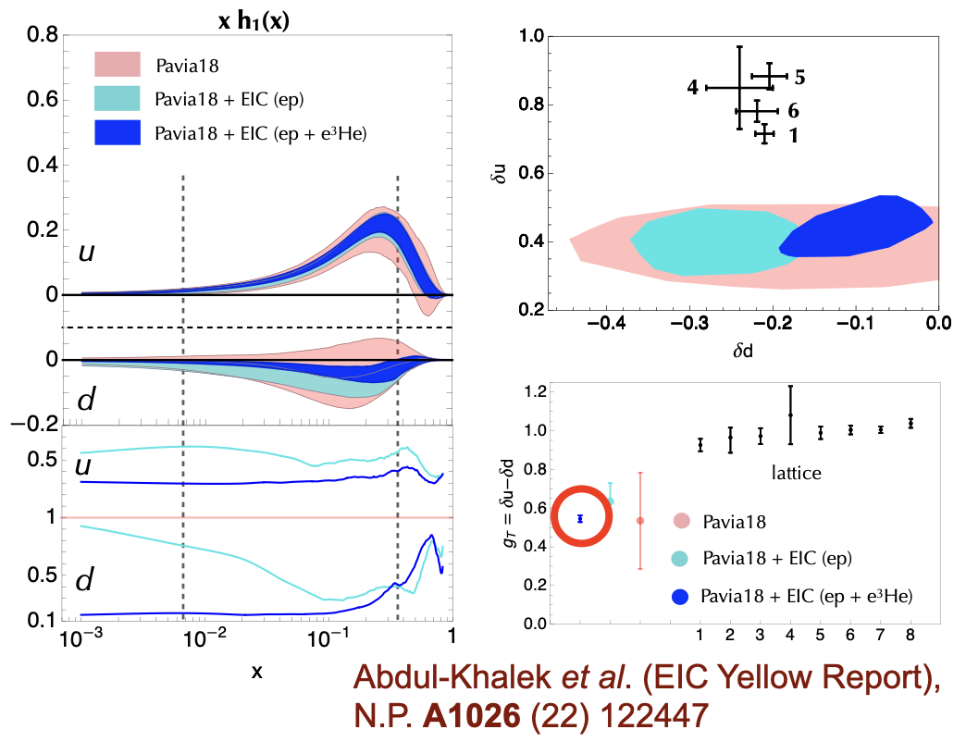
Impact of new data: EIC

Slide 50
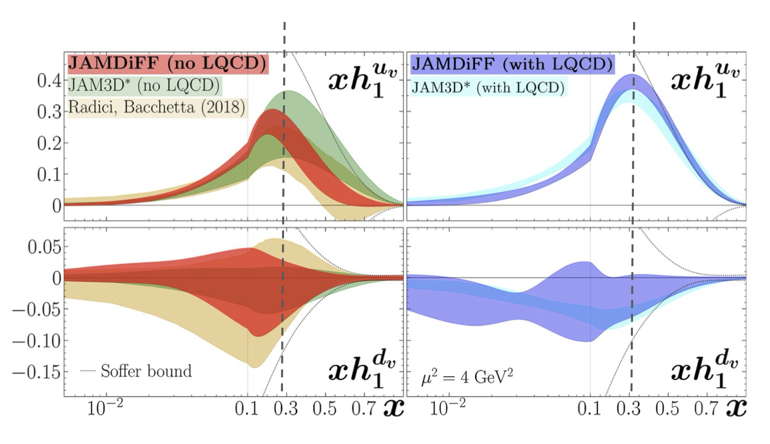
Impact of new data

Slide 51
Discussion
how to properly use the Soffer Bound in phenomenological analyses?
how to handle lattice information?
more data to come at large-x (SoLID, LHCSpin?), what to expect?
usage of complementary information from other processes (A_{N} in p↑p →h X, hadron in jet in p↑p collisions…)

