Slide 1
Unpolarised SIDIS measurements at COMPASS

Slide 2
Covered Results
Hadron transverse momentum distributions in muon deep inelastic scattering at 160 GeV/c, Eur. Phys. J. C (2013) 73:2531
Measurement of azimuthal hadron asymmetries in semi-inclusive deep inelastic scattering off unpolarised nucleons, Nuclear Physics B 886 (2014) 1046–1077
Transverse-momentum-dependent multiplicities of charged hadrons in muon-deuteron deep inelastic scattering, PHYSICAL REVIEW D 97, 032006 (2018)
Contribution of exclusive diffractive processes to the measured azimuthal asymmetries in SIDIS, Nuclear Physics B 956 (2020) 115039
Preliminary results from 2016 with a proton target, toward the publication (improving on RCs)

Slide 3
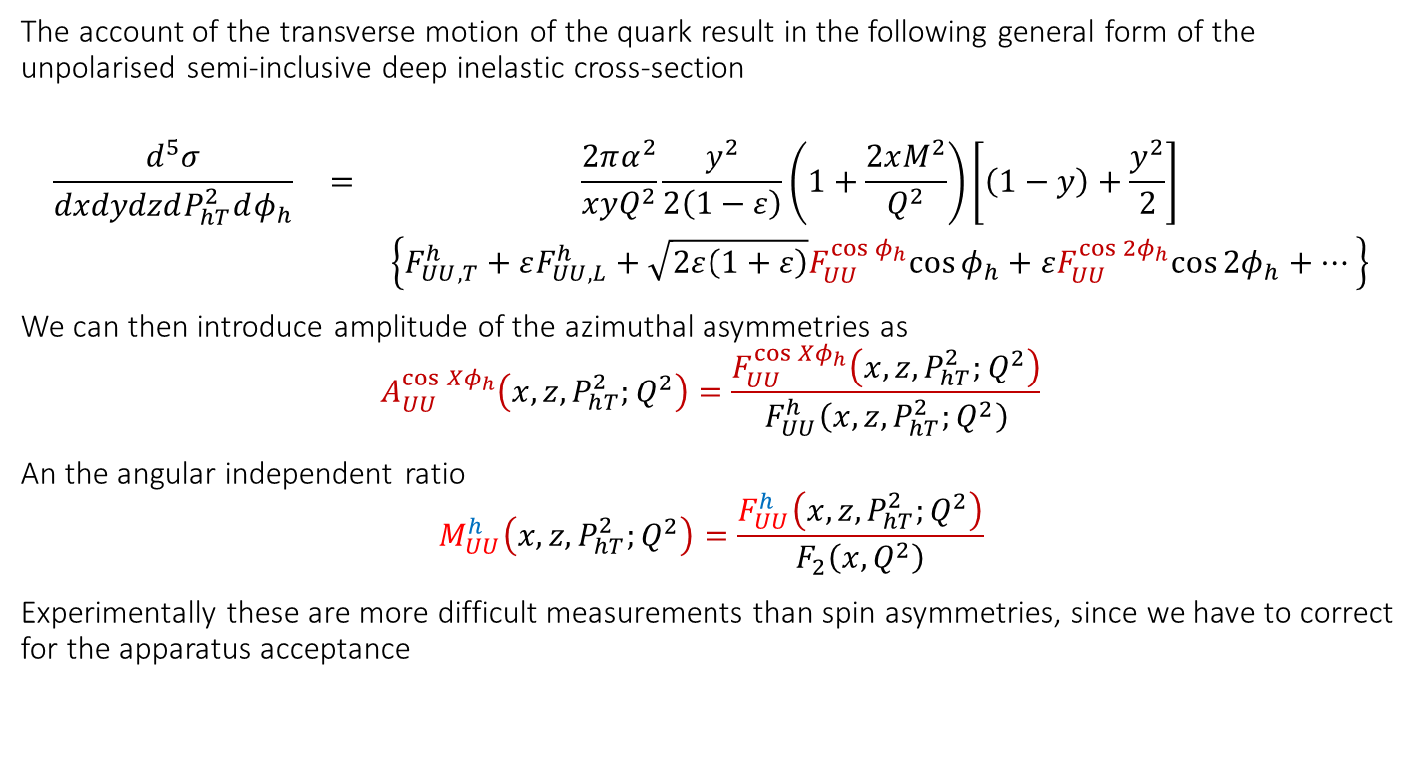
Semi Inclusive unpolarised DIS Cross Section
The account of the transverse motion of the quark result in the following general form of the unpolarised semi-inclusive deep inelastic cross-section
$$\begin{matrix}\frac{d^{5}σ}{dxdydzdP_{hT}^{2}dφ_{h}} & = & \frac{2πα^{2}}{xyQ^{2}}\frac{y^{2}}{2\left(1−ε\right)}\left(1+\frac{2xM^{2}}{Q^{2}}\right)\left[\left(1−y\right)+\frac{y^{2}}{2}\right] \\ & & \left\{F_{UU,T}^{h}+εF_{UU,L}^{h}+\sqrt{2ε\left(1+ε\right)}F_{UU}^{\cos{φ_{h}}}cos{φ_{h}}+εF_{UU}^{\cos{{2φ}_{h}}}cos{{2φ}_{h}}+…\right\}\end{matrix}$$
We can then introduce amplitude of the azimuthal asymmetries as
$$A_{UU}^{\cos{{Xφ}_{h}}}\left(x,z,P_{hT}^{2};Q^{2}\right)=\frac{F_{UU}^{\cos{{Xφ}_{h}}}\left(x,z,P_{hT}^{2};Q^{2}\right)}{F_{UU}^{h}\left(x,z,P_{hT}^{2};Q^{2}\right)}$$
An the angular independent ratio
$$M_{UU}^{h}\left(x,z,P_{hT}^{2};Q^{2}\right)=\frac{F_{UU}^{h}\left(x,z,P_{hT}^{2};Q^{2}\right)}{F_{2}\left(x,Q^{2}\right)}$$
Experimentally these are more difficult measurements than spin asymmetries, since we have to correct for the apparatus acceptance

Slide 4

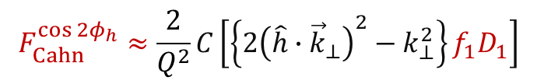
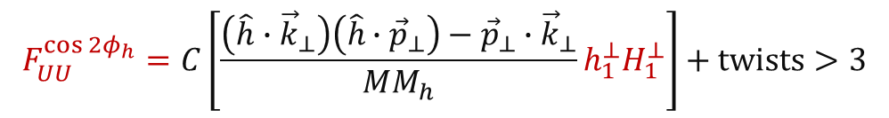
Unpolarised Azimuthal Modulation
When looking at the content of the structure functions/modulations in terms of TMD PDFs for the $\cos{φ_{h}}$ and $\cos{{2φ}_{h}}$ we can write:
In the $\cos{{2φ}_{h}}$ Cahn effects enters only at twist4
$$F_{UU}^{\cos{φ_{h}}}=−\frac{2M}{Q}C\left[\frac{\hat{h}∙{\vec{k}}_{⊥}}{M}f_{1}D_{1}−\frac{p_{⊥}k_{⊥}}{M}\frac{{\vec{P}}_{hT}−z\left(\hat{h}∙{\vec{k}}_{⊥}\right)}{zM_{h}M}h_{1}^{⊥}H_{1}^{⊥}\right]+twists>3$$
$$F_{UU}^{\cos{{2φ}_{h}}}=C\left[\frac{\left(\hat{h}∙{\vec{k}}_{⊥}\right)\left(\hat{h}∙{\vec{p}}_{⊥}\right)−{\vec{p}}_{⊥}∙{\vec{k}}_{⊥}}{MM_{h}}h_{1}^{⊥}H_{1}^{⊥}\right]+twists>3$$
$$F_{Cahn}^{\cos{{2φ}_{h}}}≈\frac{2}{Q^{2}}C\left[\left\{2{\left(\hat{h}∙{\vec{k}}_{⊥}\right)}^{2}−k_{⊥}^{2}\right\}f_{1}D_{1}\right]$$

Slide 5
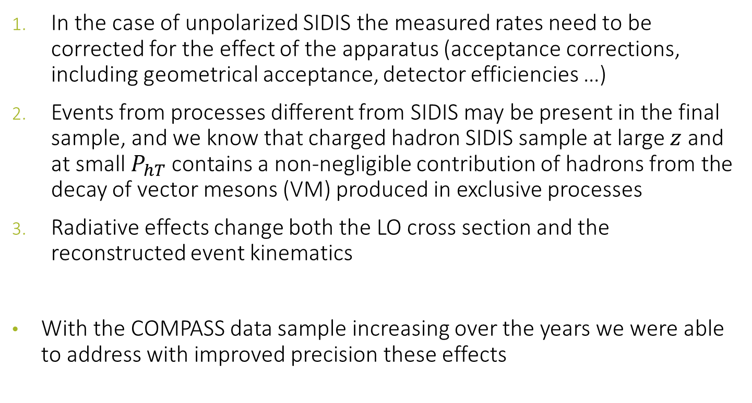
Experimentally
In the case of unpolarized SIDIS the measured rates need to be corrected for the effect of the apparatus (acceptance corrections, including geometrical acceptance, detector efficiencies …)
Events from processes different from SIDIS may be present in the final sample, and we know that charged hadron SIDIS sample at large $z$ and at small $P_{hT}$ contains a non-negligible contribution of hadrons from the decay of vector mesons (VM) produced in exclusive processes
Radiative effects change both the LO cross section and the reconstructed event kinematics
With the COMPASS data sample increasing over the years we were able to address with improved precision these effects

Slide 6
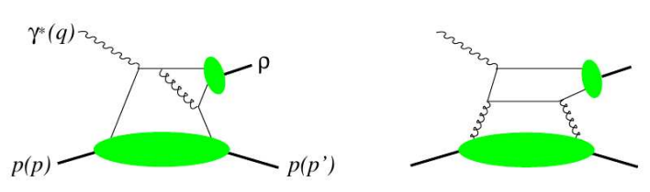
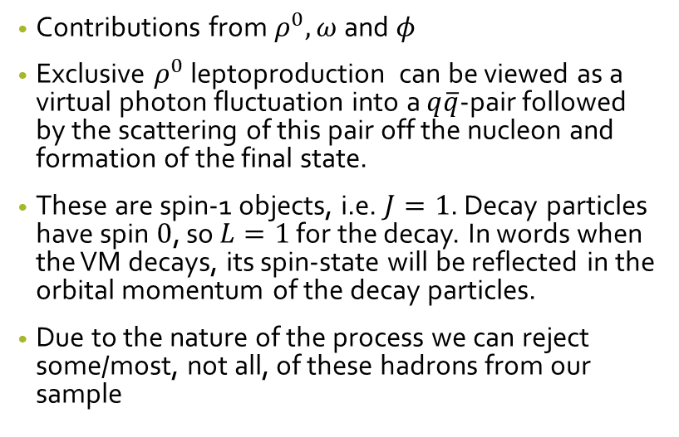
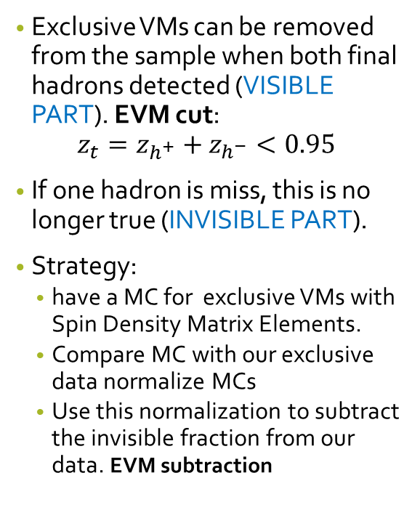
Background from exclusive VMs
Exclusive VMs can be removed from the sample when both final hadrons detected (VISIBLE PART). EVM cut:
$$z_{t}=z_{h^{+}}+z_{h^{−}}<0.95$$
If one hadron is miss, this is no longer true (INVISIBLE PART).
Strategy:
  have a MC for exclusive VMs with Spin Density Matrix Elements.
  Compare MC with our exclusive data normalize MCs
  Use this normalization to subtract the invisible fraction from our data. EVM subtraction
Contributions from $ρ^{0}, ω$ and $φ$
Exclusive $ρ^{0}$ leptoproduction can be viewed as a virtual photon fluctuation into a $q\overline{q}$-pair followed by the scattering of this pair off the nucleon and formation of the final state.
These are spin-1 objects, i.e. $J=1$. Decay particles have spin $0$, so $L=1$ for the decay. In words when the VM decays, its spin-state will be reflected in the orbital momentum of the decay particles.
Due to the nature of the process we can reject some/most, not all, of these hadrons from our sample

Slide 7
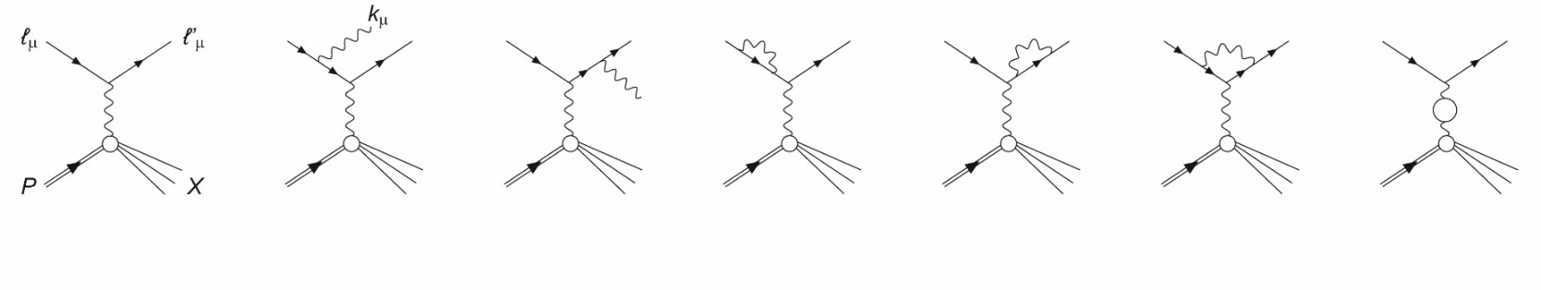
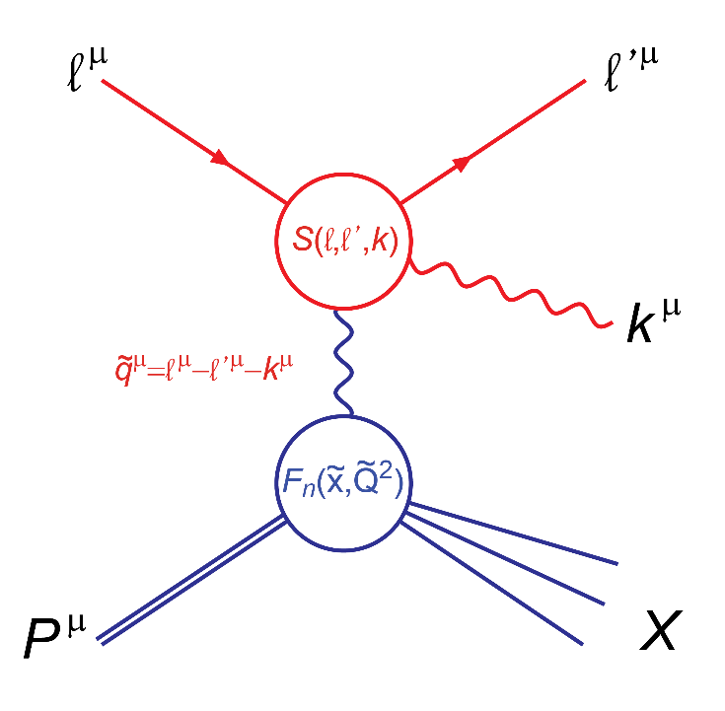
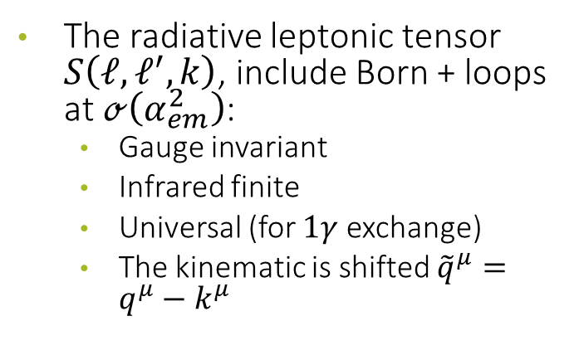
LEPTONIC RADIATION
Feynman diagrams for leptonic radiation
The radiative leptonic tensor $S\left(ℓ, ℓ^{′},k\right)$, include Born + loops at $ℴ\left(α_{em}^{2}\right)$:
  Gauge invariant
  Infrared finite
  Universal (for $1γ$ exchange)
  The kinematic is shifted ${\tilde{q}}^{μ}=q^{μ}−k^{μ}$

Slide 8
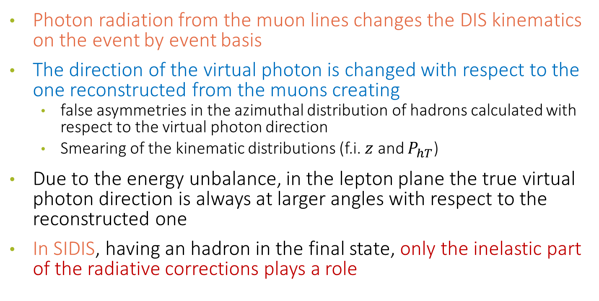
Effects on SIDIS
Photon radiation from the muon lines changes the DIS kinematics on the event by event basis
The direction of the virtual photon is changed with respect to the one reconstructed from the muons creating
  false asymmetries in the azimuthal distribution of hadrons calculated with respect to the virtual photon direction
  Smearing of the kinematic distributions (f.i. $z$ and $P_{hT}$)
Due to the energy unbalance, in the lepton plane the true virtual photon direction is always at larger angles with respect to the reconstructed one
In SIDIS, having an hadron in the final state, only the inelastic part of the radiative corrections plays a role

Slide 9

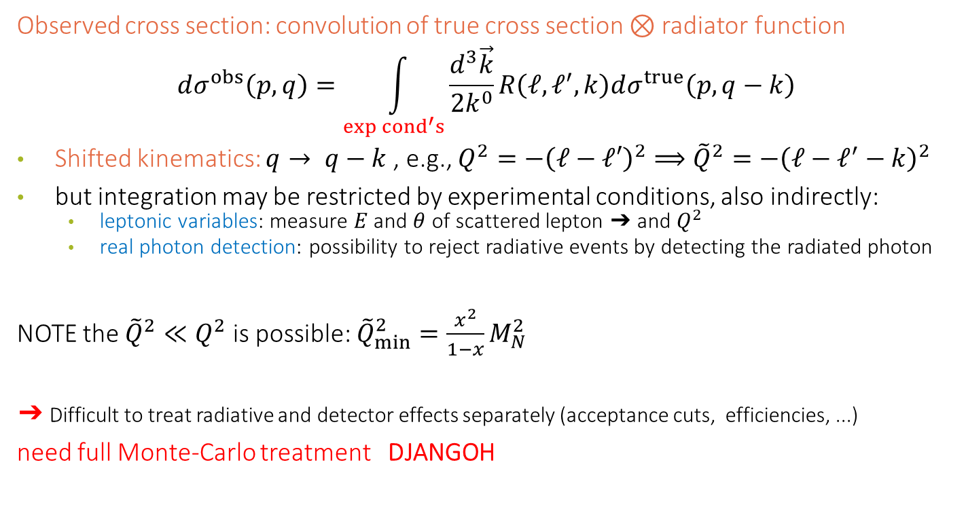


LEPTONIC RADIATION
Observed cross section: convolution of true cross section $⊗$ radiator function
$$dσ^{obs}\left(p,q\right)=\int_{exp {cond}^{′}s}{\frac{d^{3}\vec{k}}{2k^{0}}R\left(ℓ,ℓ^{′},k\right)dσ^{true}\left(p,q−k\right)}$$
Shifted kinematics: $q→ q−k$, e.g., $Q^{2}=−{\left(ℓ−ℓ′\right)}^{2}⟹{\tilde{Q}}^{2}=−{\left(ℓ−ℓ^{′}−k\right)}^{2}$
but integration may be restricted by experimental conditions, also indirectly:
  leptonic variables: measure $E$ and $θ$ of scattered lepton ➔ and $Q^{2}$
  real photon detection: possibility to reject radiative events by detecting the radiated photon
NOTE the ${\tilde{Q}}^{2}≪Q^{2}$ is possible: ${\tilde{Q}}_{min}^{2}=\frac{x^{2}}{1−x}M_{N}^{2}$
➔ Difficult to treat radiative and detector effects separately (acceptance cuts, efficiencies, ...)
need full Monte-Carlo treatment DJANGOH
$$k^{μ}$$
$$γ^{∗}\left(q^{μ}\right)$$

Slide 10

$P_{hT}$-dependent multiplicities

Slide 11
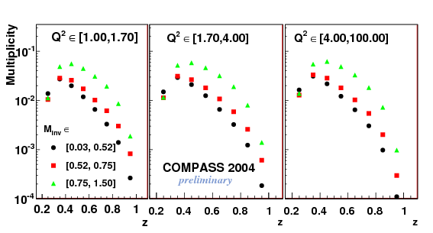
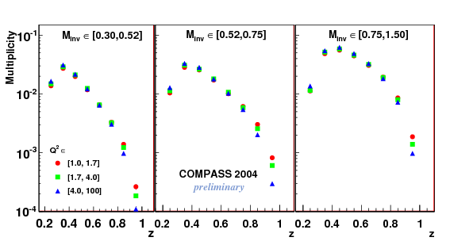
2h Multiplicities (>10 years ago)

Slide 12
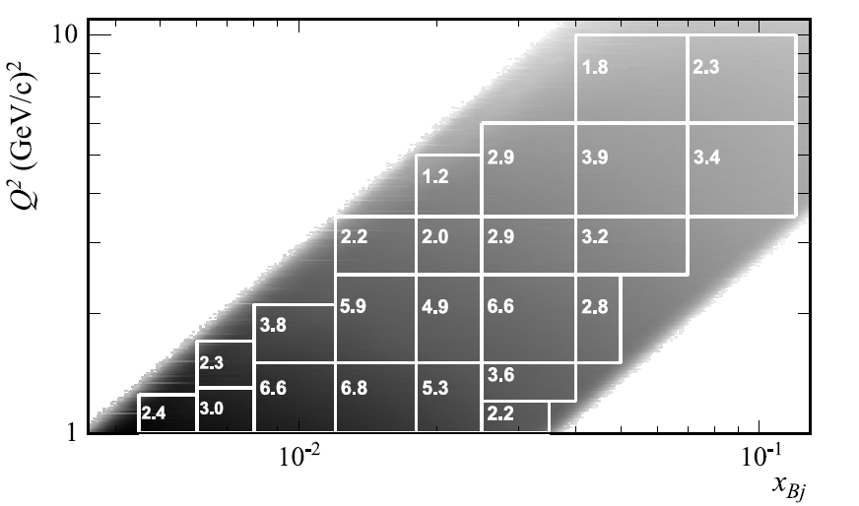
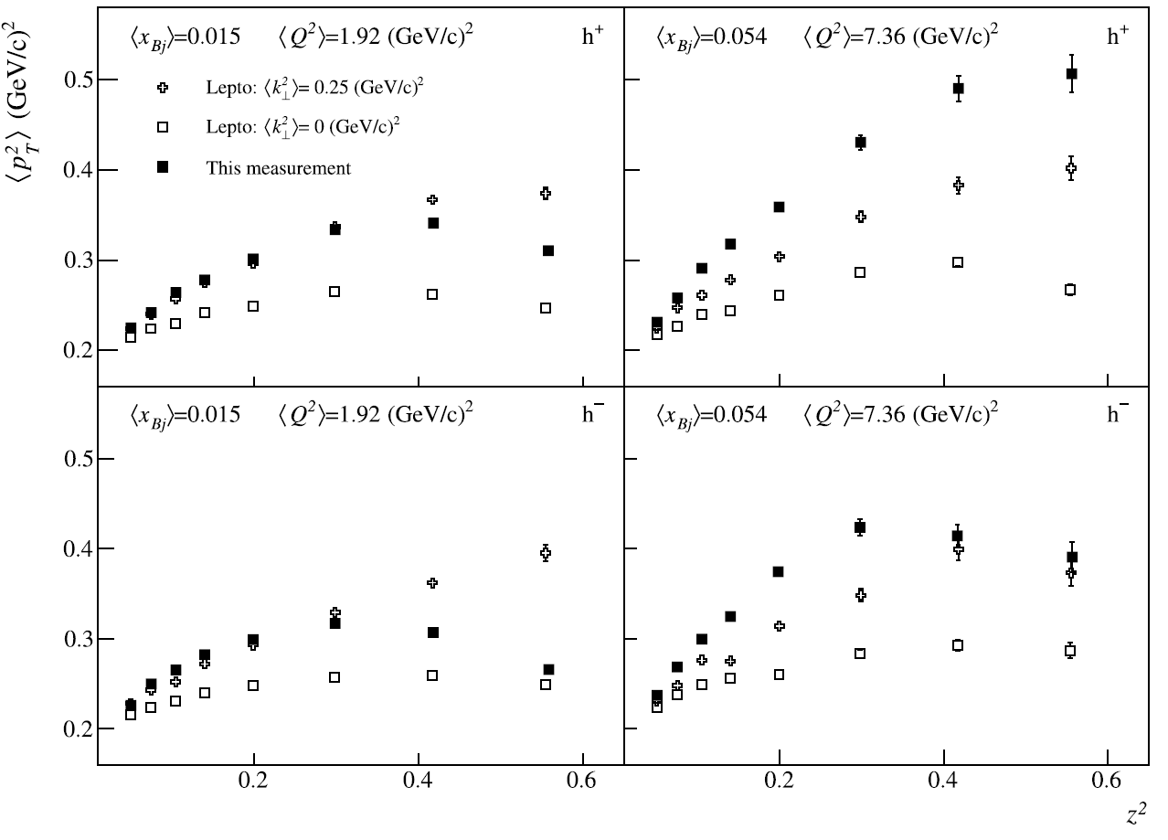
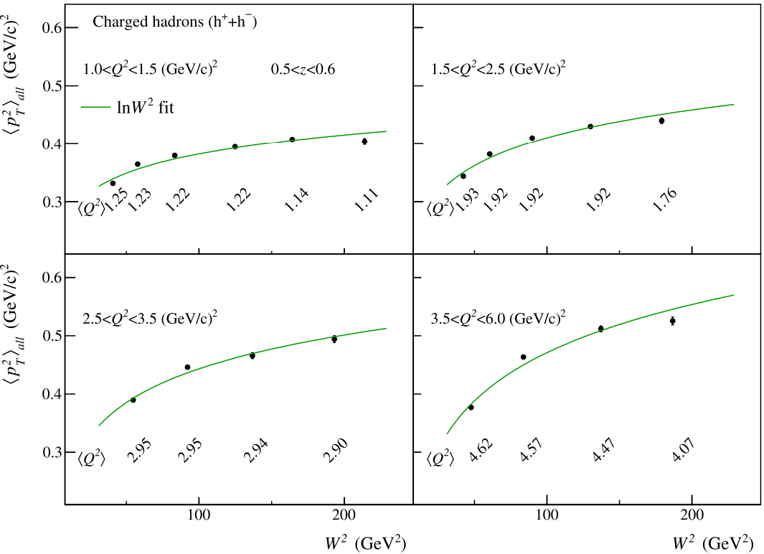
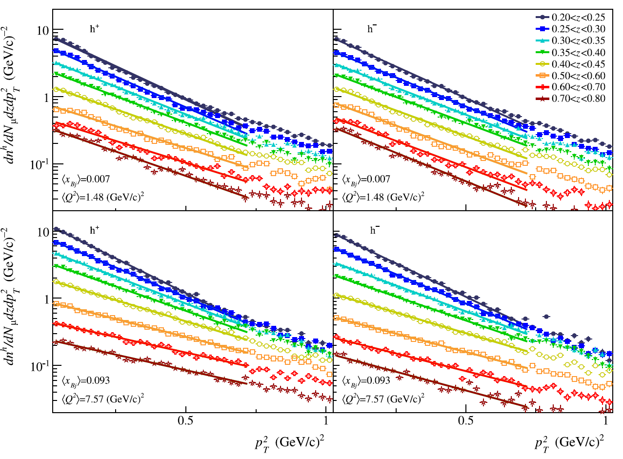
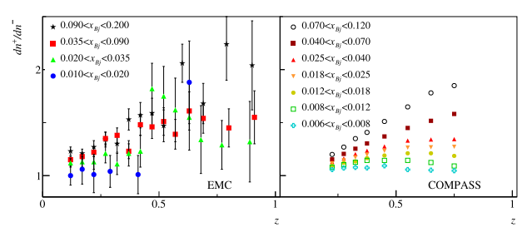
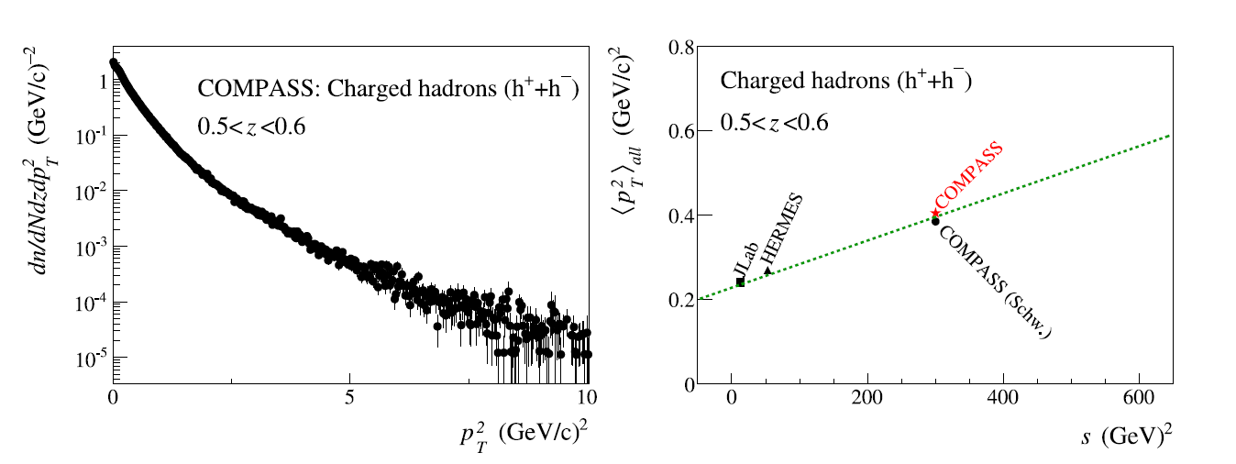
1st publication on $P_{hT}$ distributions (2013);

Slide 13
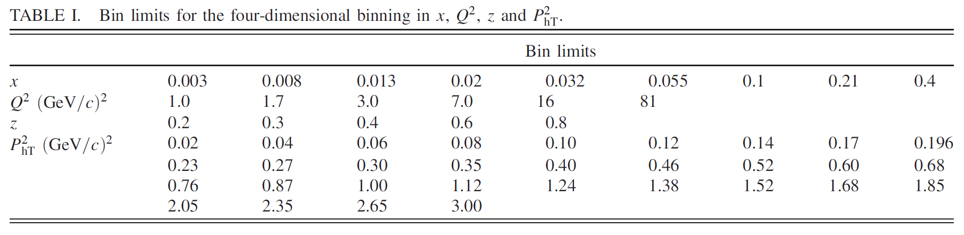
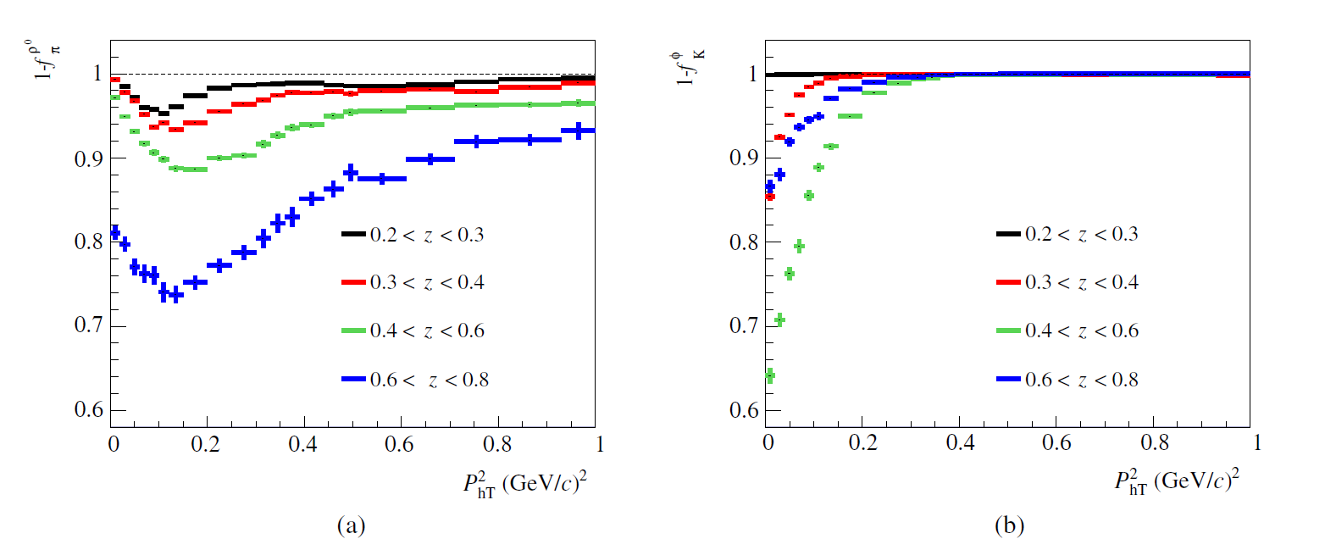
2nd publication on $P_{hT}$ distributions (2018);
Improved binning
Subtraction of Diffractive Vector Mesons

Slide 14
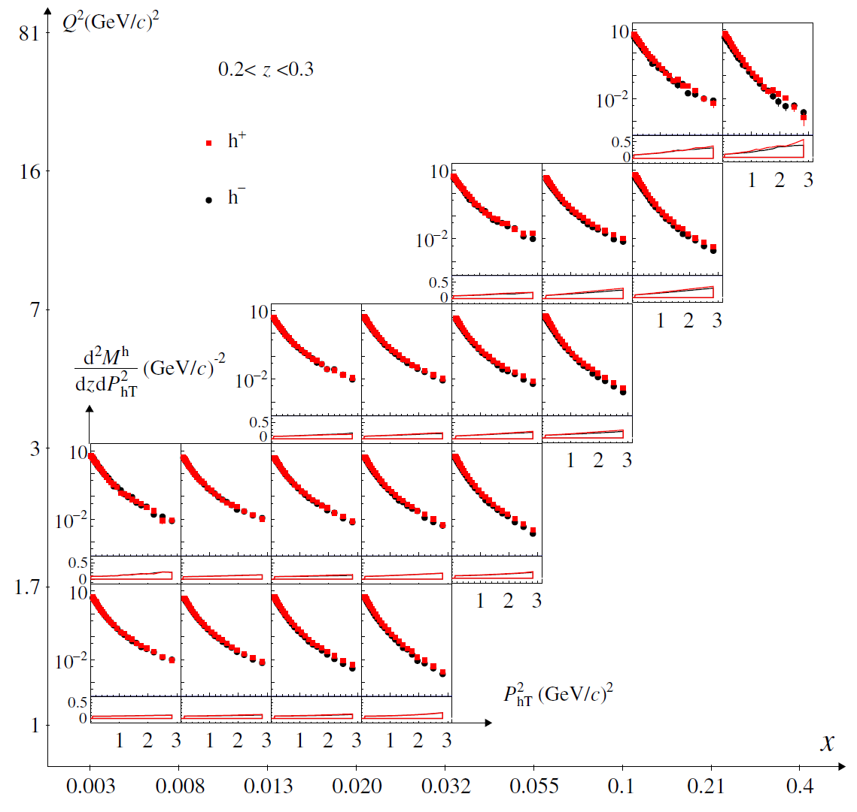
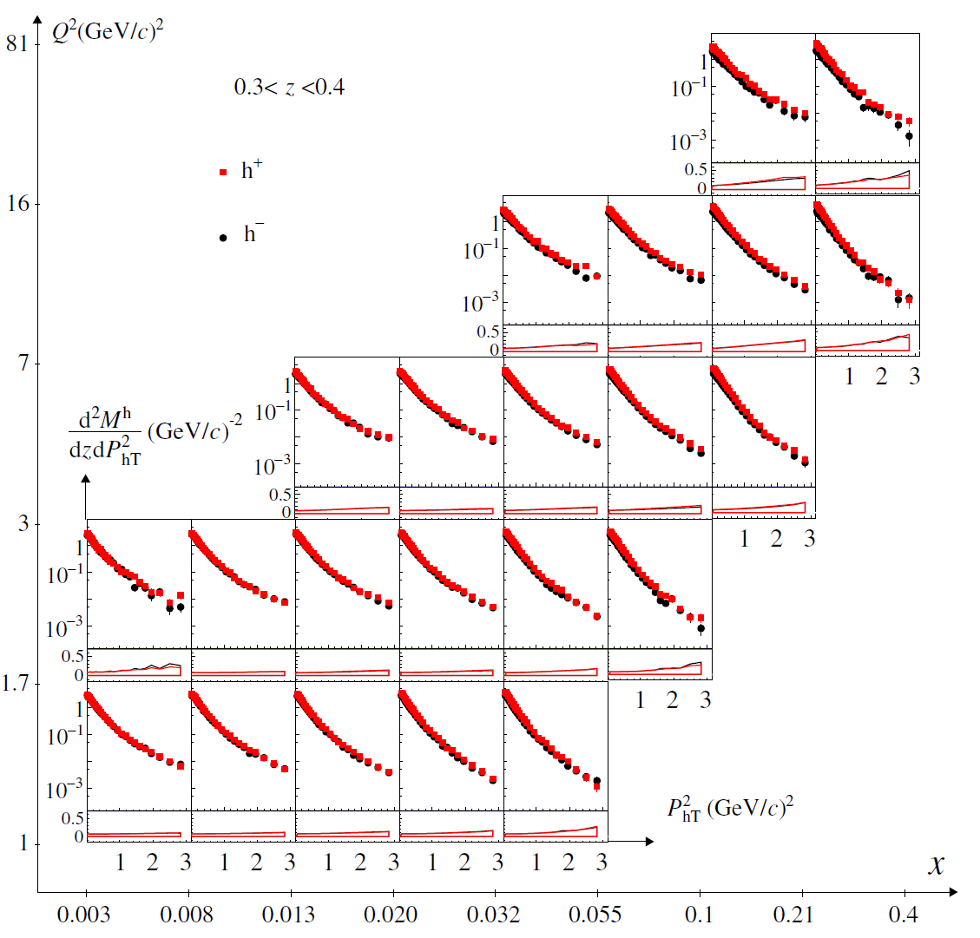
2nd publication on $P_{hT}$ distributions;

Slide 15
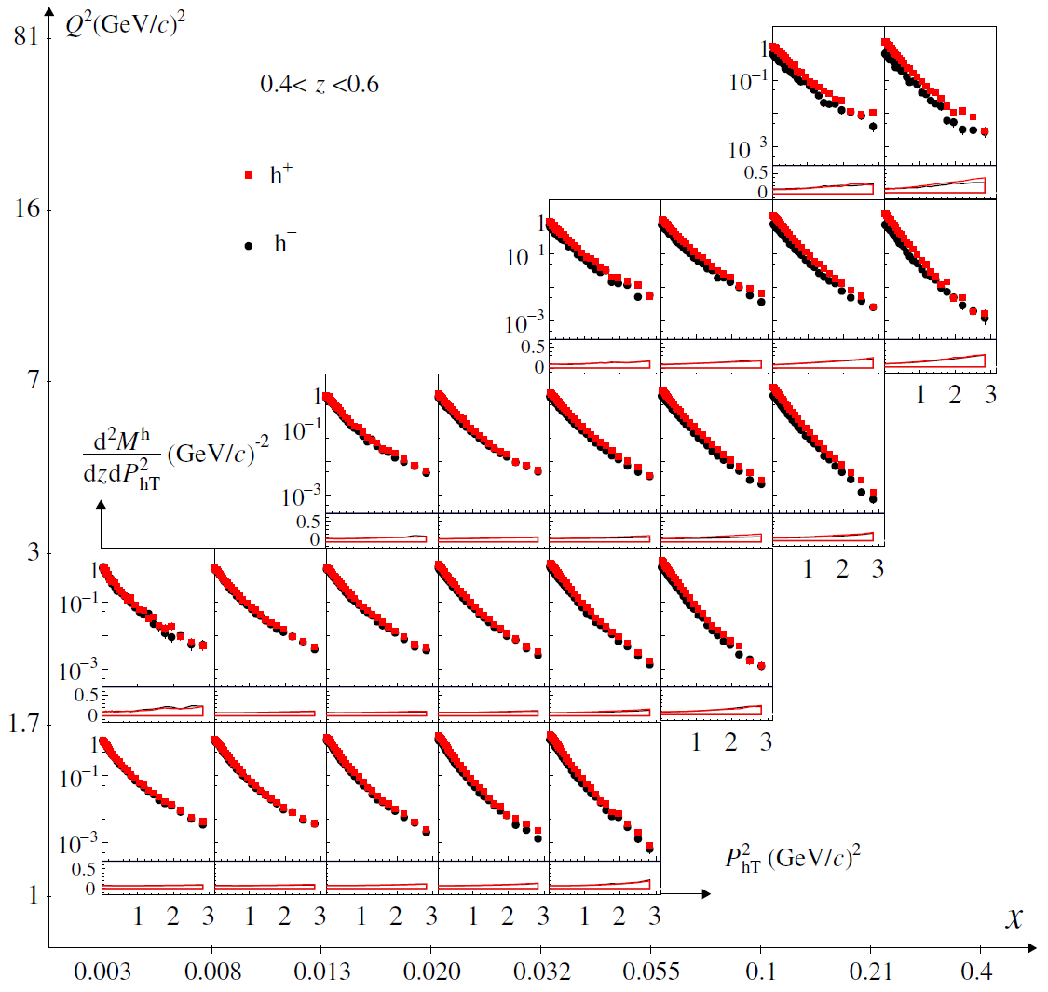
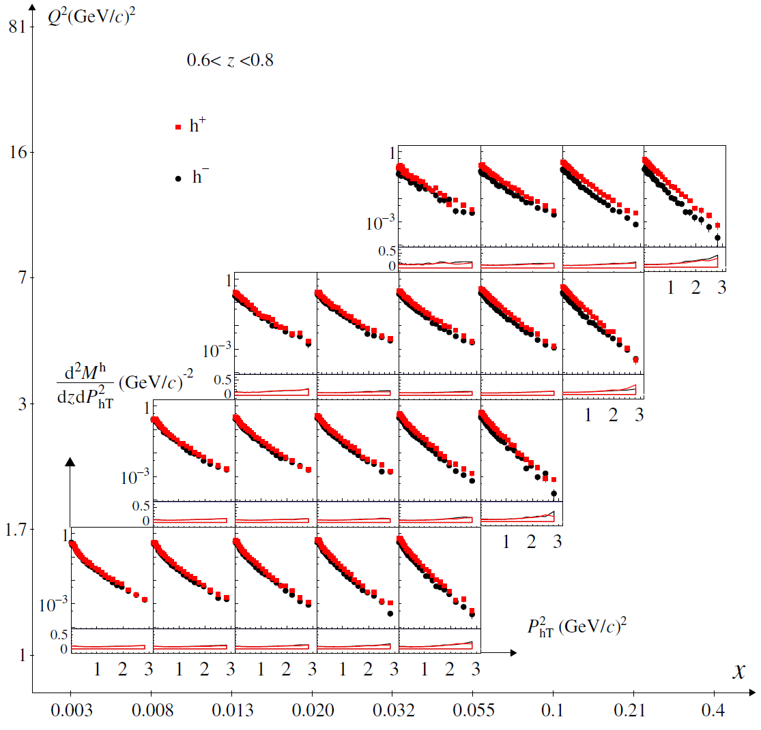

2nd publication on $P_{hT}$ distributions;

Slide 16
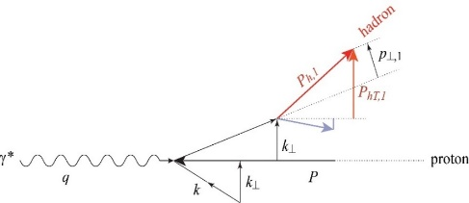


Positive vs Negative charged hadrons (${}_{}^{6}{LiD}$)
$$F_{UU}^{h}\left(x, z, P_{hT}^{2}; Q^{2}\right)=x\sum_{q}{e_{q}^{2}\int{d^{2}{\vec{k}}_{⊥}d^{2}{\vec{p}}_{⊥}δ\left({\vec{p}}_{⊥}−z{\vec{k}}_{⊥}−{\vec{P}}_{hT}\right) f_{1}^{q}\left(x, k_{⊥}^{2};Q^{2}\right)D_{1}^{q→h}\left(z,p_{⊥}^{2};Q^{2}\right)}}$$
$\left\langle Q^{2}\right\rangle =9.78 {\left(GeV/c\right)}^{2}$and $\left\langle x\right\rangle =0.149$

Slide 17
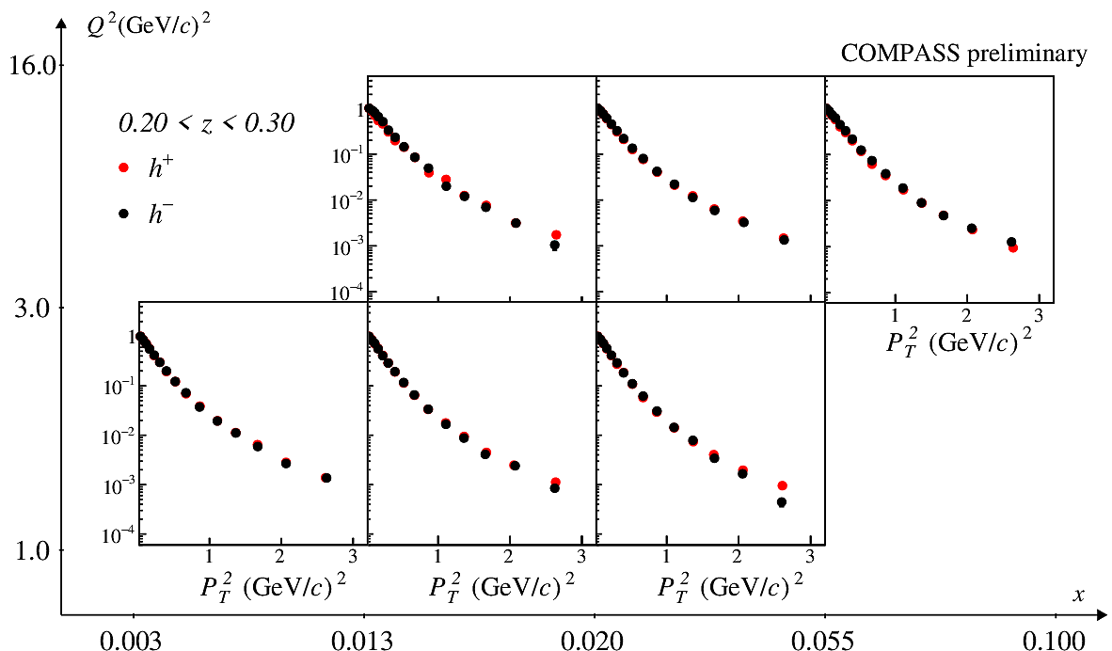
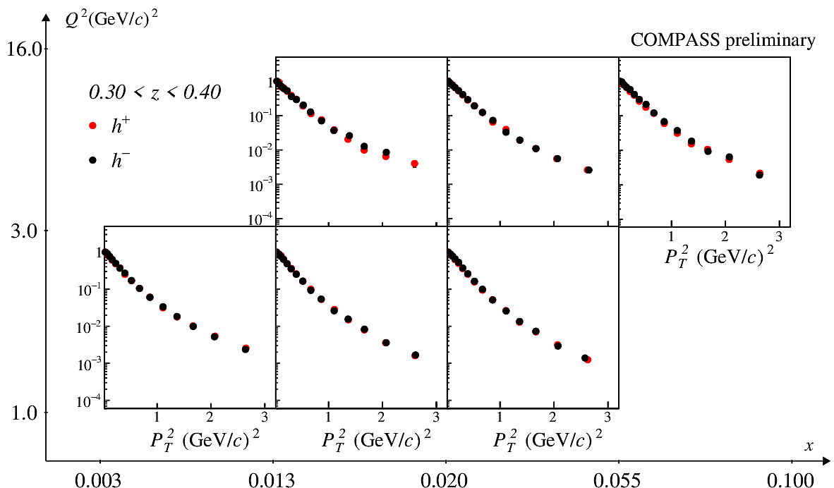
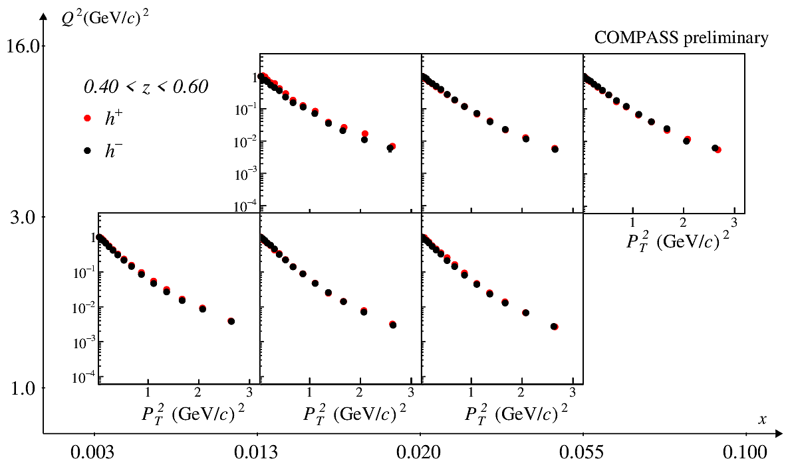
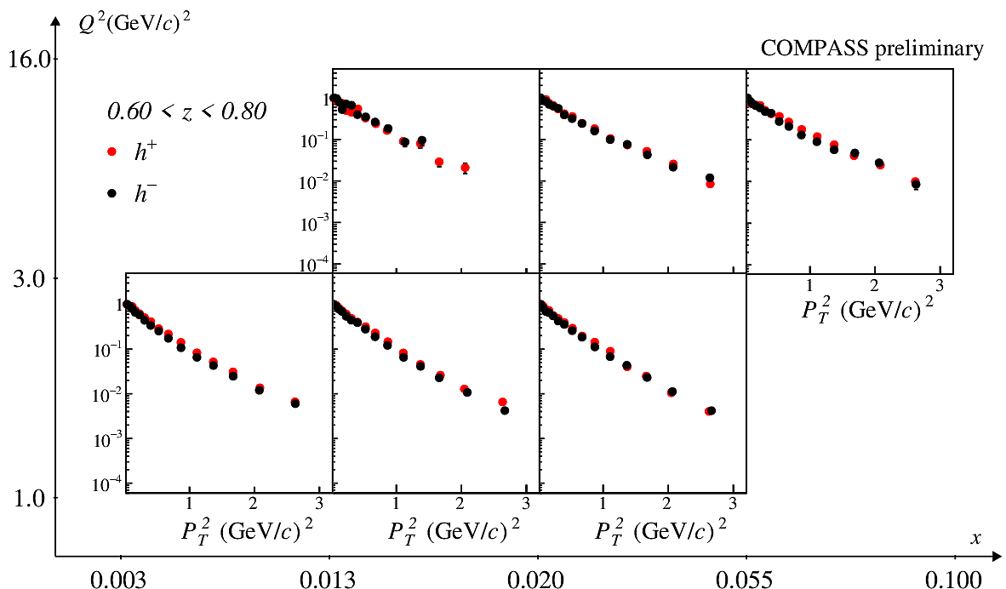
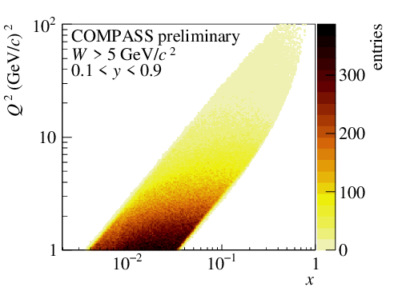

Positive vs Negative charged hadrons (${LH}_{2}$)

Slide 18
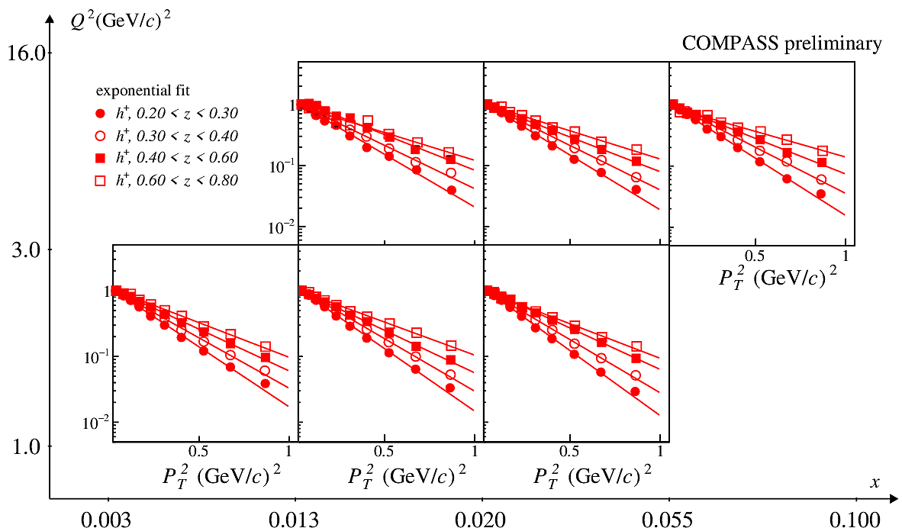
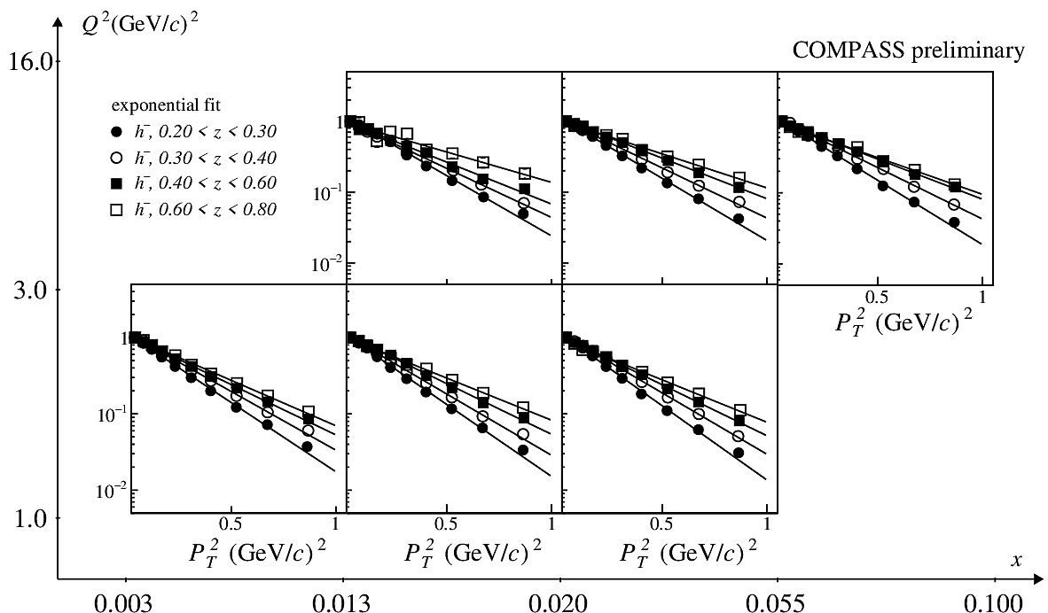
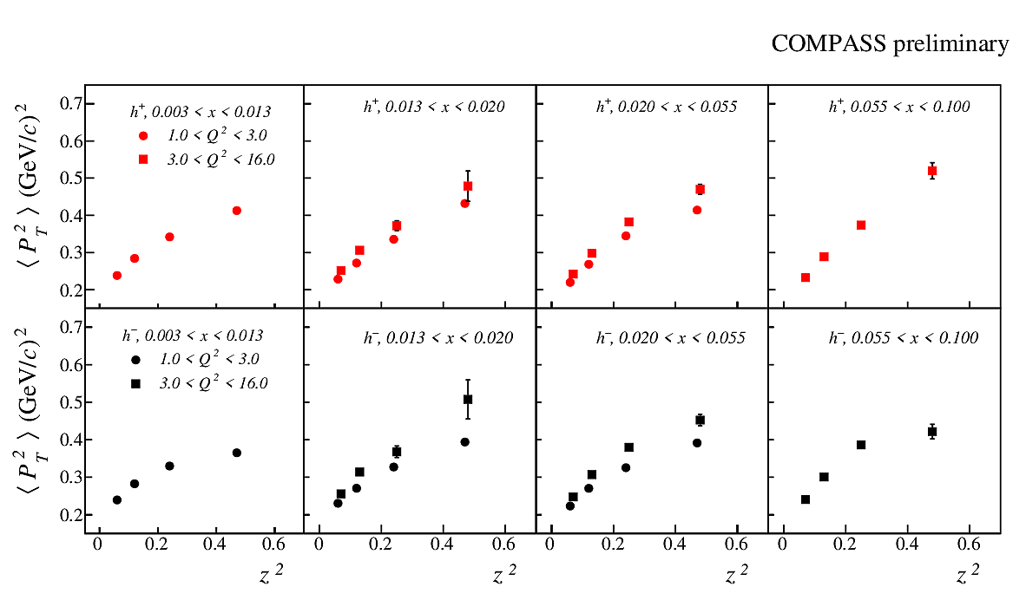
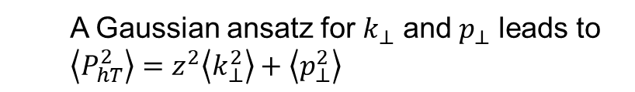
Slope dependence
  A Gaussian ansatz for $k_{⊥}$ and $p_{⊥}$ leads to $\left\langle P_{hT}^{2}\right\rangle =z^{2}\left\langle k_{⊥}^{2}\right\rangle +\left\langle p_{⊥}^{2}\right\rangle$

Slide 19
Azimuthal Modulations

Slide 20
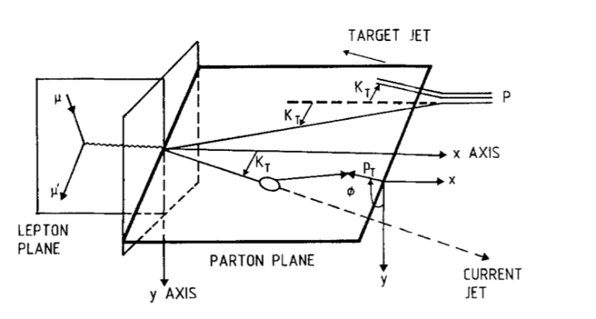
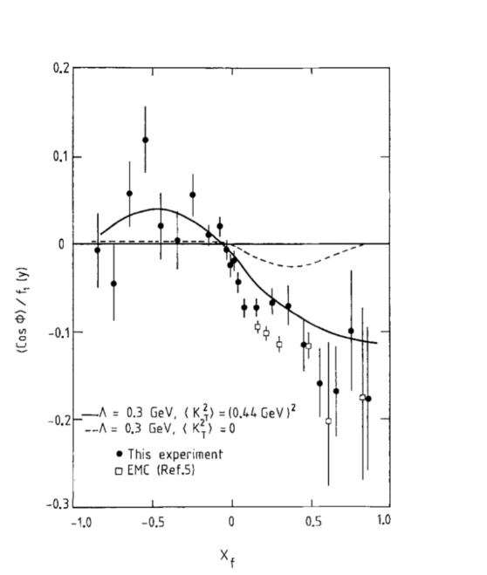
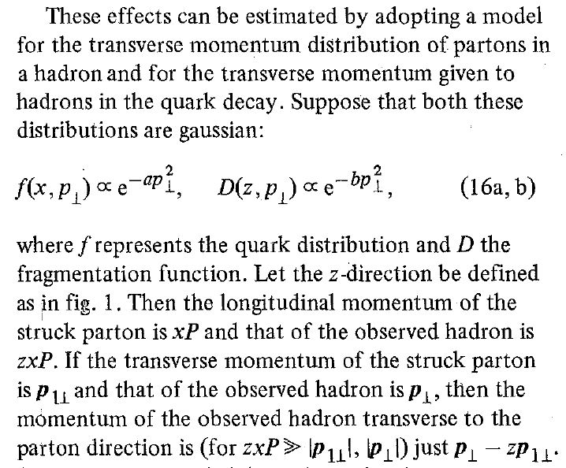

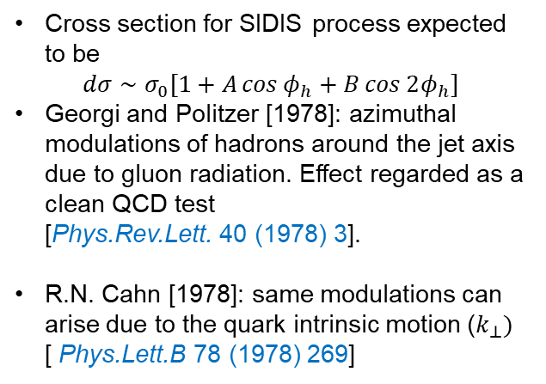
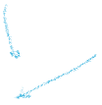
An old story
QCD alone
QCD + quark transverse motion
EMC experiment [1987]
Fit: Konig-Kroll model [1982] + Lund String
Cross section for SIDIS process expected to be
$$dσ∼σ_{0}[1+A\cos{φ_{h}}+B\cos{2φ_{h}}]$$
Georgi and Politzer [1978]: azimuthal modulations of hadrons around the jet axis due to gluon radiation. Effect regarded as a clean QCD test [Phys.Rev.Lett. 40 (1978) 3].
R.N. Cahn [1978]: same modulations can arise due to the quark intrinsic motion ($k_{⊥})$ [ Phys.Lett.B 78 (1978) 269]

Slide 21
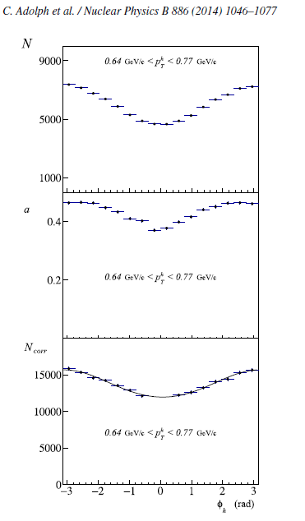
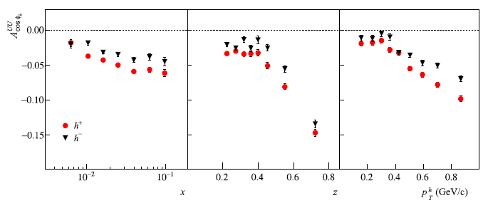
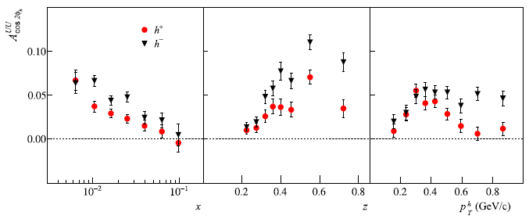

Azimuthal modulations on ${}_{}^{6}{Li}D$
NPB 886 (2014)

Slide 22
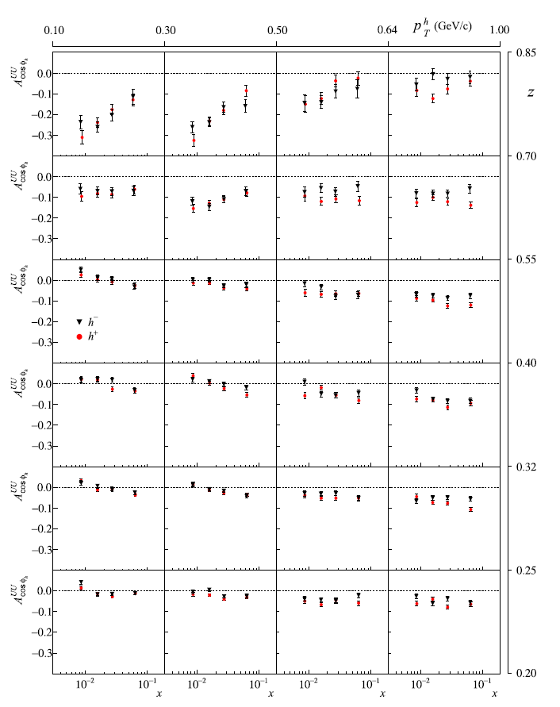
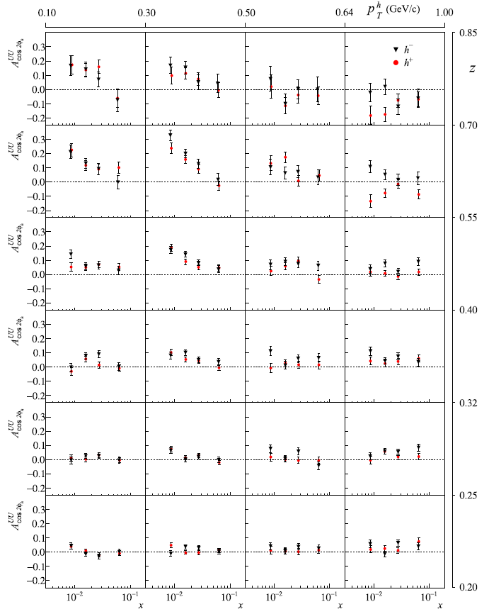
Azimuthal modulations on ${}_{}^{6}{Li}D$
NPB 886 (2014)

Slide 23
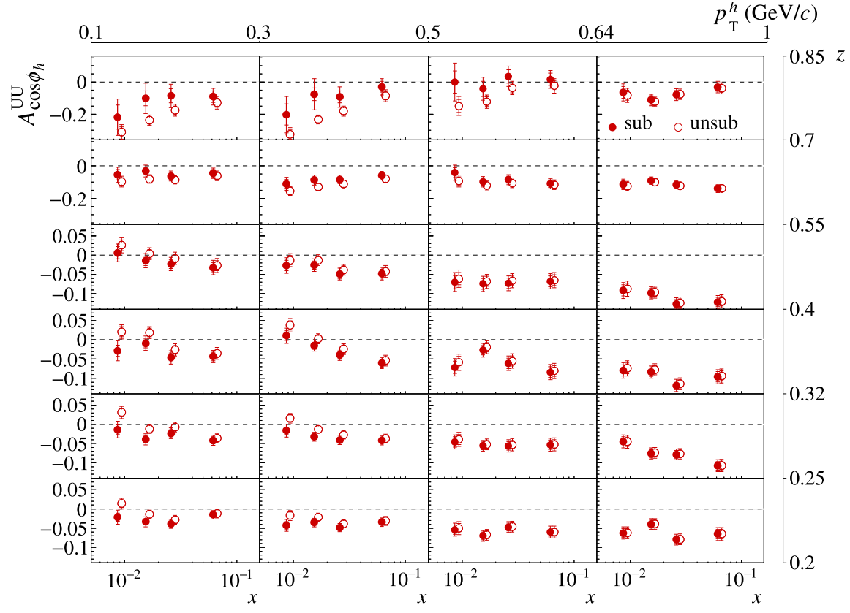
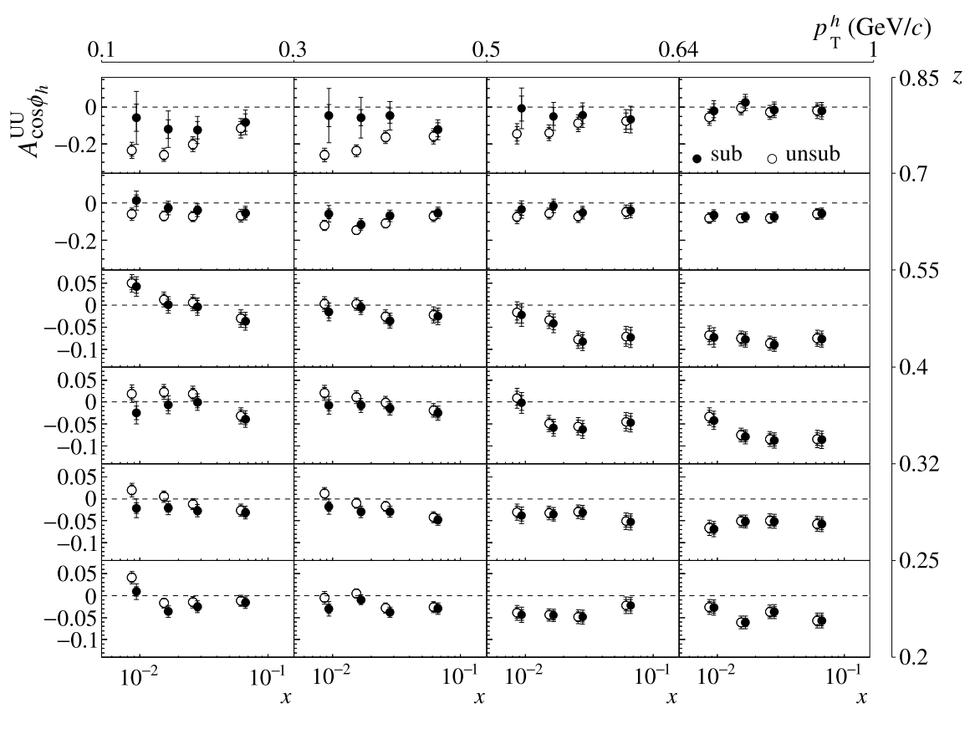
VM subtraction from ${}_{}^{6}{Li}D$ results
NPB 956 (2020) 115039

Slide 24
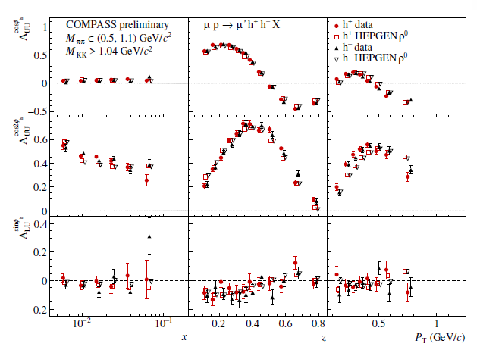


Study of VM contamination $LH_{2}$
Normalization of HEPGEN

Slide 25


Effect of Exclusive VM subtraction

Slide 26


Radiative effects

Slide 27

Corrected results
MultiD on LH2, corrected for both VM and RC is coming

Slide 28
Outlook
In the study of unpolarized multiplicities and azimuthal asymmetries we are able already today to obtain precise multidimensional results
This should allow the start for the transition from “exploratory/consolidation” to the “maturity” era that will arrive with the EIC
But also offers us the glimpse on the challenges that this “precision” will bring for both the experimentalist and the theoreticians

Slide 29
Thank you

Slide 30


P vs D

Slide 31



Contamination of hadrons from $ρ^{0}$and $φ$

Slide 32



Azimuthal modulations on (${LH}_{2}$) – 1D

Slide 33





Contamination on (${LH}_{2}$) – 1D
Determined from $z_{1}+z_{2}>0.95$
Selecting $ρ^{0}, ω$ and $φ$

Slide 34





$P_{hT}$ distributions vs W

Slide 35







Unpolarised Transverse Momentum dependent PDFs
When we consider the transverse momentum of the quark in the calculation of the cross section Transverse Momentum Dependent parton distribution (TMDs)
The unpolarised number density of the quarks gains a dependence from the intrinsic transverse momentum $k_{⊥}$
$$f_{1}^{q}\left(x,k_{⊥}\right)$$
New parton densities arise: the Boer-Mulders functions $h_{1}^{⊥,q}\left(x,k_{⊥}\right)$, describing the correlation between the intrinsic quark transverse momentum and the spin of the quark in an unpolarised nucleon
$$f_{q↑}\left(x,k_{⊥}, \vec{s}\right)=f_{1}^{q}\left(x,k_{⊥}\right)−\frac{1}{M}h_{1}^{⊥,q}\left(x,k_{⊥}\right)\vec{s}∙\left(\hat{p}×{\vec{k}}_{⊥}\right)$$
$$k_{⊥}$$
$$p_{q}≈xP$$
$$f\left(x\right)$$
$$f\left(x,k_{⊥}\right)$$
Longitudinal motion only
Longitudinal + transverse motion

Slide 36




Unpolarised Azimuthal Modulation
The cross-section is $dσ^{ℓp→ℓ^{′}hX}=\sum_{q}{f_{q}\left(x,Q^{2}\right)}⊗dσ^{ℓq→ℓ^{′}q}⊗D_{q}^{h}\left(z,Q^{2}\right)$ with the partonic process is given by $dσ^{ℓq→ℓ^{′}q}={\hat{s}}^{2}+{\hat{u}}^{2}$
In collinear PM $dσ^{ℓq→ℓ^{′}q}={\hat{s}}^{2}+{\hat{u}}^{2}=x\left[1+{\left(1−y\right)}^{2}\right]$, i.e. no $φ_{h}$ dependence.
$$\hat{s}≔{\left(ℓ+k\right)}^{2}\sim 2ℓ∙k$$
$$\hat{u}≔{\left(ℓ−k\right)}^{2}\sim −2ℓ∙k$$
$$k=xP+k_{⊥}$$

Slide 37


Unpolarised Azimuthal Modulation
When $k_{⊥}$is taken into account:
$\hat{s}=sx\left[1−\frac{2k_{⊥}}{Q}\sqrt{1−y}\cos{φ}\right]+ℴ\left(\frac{k_{⊥}^{2}}{Q}\right) \hat{u}=sx\left(1−y\right)\left[1−\frac{2k_{⊥}}{Q\sqrt{1−y}}\cos{φ}\right]+ℴ\left(\frac{k_{⊥}^{2}}{Q}\right)$ and
$dσ^{ℓq→ℓ^{′}q}∝{\hat{s}}^{2}+{\hat{u}}^{2}∝{\left[1−\frac{2k_{⊥}}{Q}\sqrt{1−y}\cos{φ}\right]}^{2}+{\left(1−y\right)}^{2}{\left[1−\frac{2k_{⊥}}{Q\sqrt{1−y}}\cos{φ}\right]}^{2}$ ,
Resulting in the $\cos{φ_{h}}$and $\cos{2φ_{h}}$ modulations observed in the azimuthal distributions
$$k≅\left(xP,k_{⊥}\cos{φ},k_{⊥}\sin{φ}, xP\right)$$
$$k_{⊥}≅\left(0,k_{⊥}\cos{φ},k_{⊥}\sin{φ}, 0\right)$$

Slide 38

1D vs multi D
The asymmetries are:
$$A_{UU}^{w\left(φ_{h} \right)}\left(x,z,P_{hT}^{2};Q^{2}\right)=\frac{F_{UU}^{w\left(φ_{h} \right)}}{F_{2}\left(x,Q^{2}\right)}$$
When we measure on 1D, i.e. as a function of $x$, we integrate over the phase space of the other variables
$$A_{UU}^{w\left(φ_{h} \right)}\left(x\right)=\frac{\int_{Q_{min}^{2}}^{Q_{max}^{2}}{dQ^{2}\int_{z_{min}}^{z_{max}}{dz\int_{p_{T,min}}^{p_{T,max}}{{dP}_{hT}^{2}F_{UU}^{w\left(φ_{h}\right)}}}}}{\int_{Q_{min}^{2}}^{Q_{max}^{2}}{dQ^{2}\int_{z_{min}}^{z_{max}}{dz\int_{p_{T,min}}^{p_{T,max}}{{dP}_{hT}^{2}\left(F_{2}\left(x,Q^{2}\right)\right)}}}}$$

Slide 39


Comparison with the publish deuteron

Slide 40



$q_{T}$ distributions

Slide 41




Phenomenological fits
arXiv:2206.07598v1 [hep-ph] 15 Jun 2022

Slide 42



Azimuthal modulations on (${LH}_{2}$) – 3D

Slide 43




Contamination on (${LH}_{2}$) – 3D

Slide 44



$Q^{2}$ behavior

Slide 45

Semi Inclusive unpolarised DIS Cross Section
The account of the transverse motion of the quark result in the following general form of the unpolarised semi-inclusive deep inelastic cross-section
$$\begin{matrix}\frac{d^{5}σ}{dxdydzdP_{hT}^{2}dφ_{h}} & = & \frac{α^{2}}{xyQ^{2}}\left[\left(1−y\right)+\frac{y^{2}}{2}\right]F_{2}\left(x,Q^{2}\right)× \\ & & M_{UU}^{h}\left\{1+\frac{2\left(2−y\right)\sqrt{1−y}}{1+{\left(1−y\right)}^{2}}A_{UU}^{\cos{φ_{h}}}cos{φ_{h}}+\frac{2\left(1−y\right)}{1+{\left(1−y\right)}^{2}}A_{UU}^{\cos{{2φ}_{h}}}cos{{2φ}_{h}}\right\}\end{matrix}$$
Where we have introduced the amplitude of the azimuthal asymmetries as
$$A_{UU}^{\cos{{Xφ}_{h}}}\left(x,z,P_{hT}^{2};Q^{2}\right)=\frac{F_{UU}^{\cos{{Xφ}_{h}}}\left(x,z,P_{hT}^{2};Q^{2}\right)}{F_{UU}^{h}\left(x,z,P_{hT}^{2};Q^{2}\right)}$$
An the angular independent ratio
$$M_{UU}^{h}\left(x,z,P_{hT}^{2};Q^{2}\right)=\frac{F_{UU}^{h}\left(x,z,P_{hT}^{2};Q^{2}\right)}{F_{2}\left(x,Q^{2}\right)}$$
Experimentally these are more difficult measurements than spin asymmetries, since we have to correct for the apparatus acceptance

Slide 46

RADIATIVE CORRECTIONS
Measure FFs, PDFs, etc. by comparing data with theoretical predictions:
$$σ_{exp}=σ_{theory}\left[PDFs, TMDs…\right]$$
High precision requires knowledge of higher-order corrections
$$σ_{theory}=σ^{\left(0\right)}\left[≡σ_{Born}\right]+α_{em}σ^{\left(1\right)}+α_{em}^{2}σ^{\left(2\right)}+…$$
Emission of real photons
  experimentally often not distinguished from non-radiative processes: soft photons, collinear photons
  ➔ ”radiative corrections”
Virtual corrections: loop diagrams
  needed to cancel infrared divergences

