Slide 1
The 3D structure of the nucleon at EIC
Elke-Caroline Aschenauer (BNL)

Slide 2
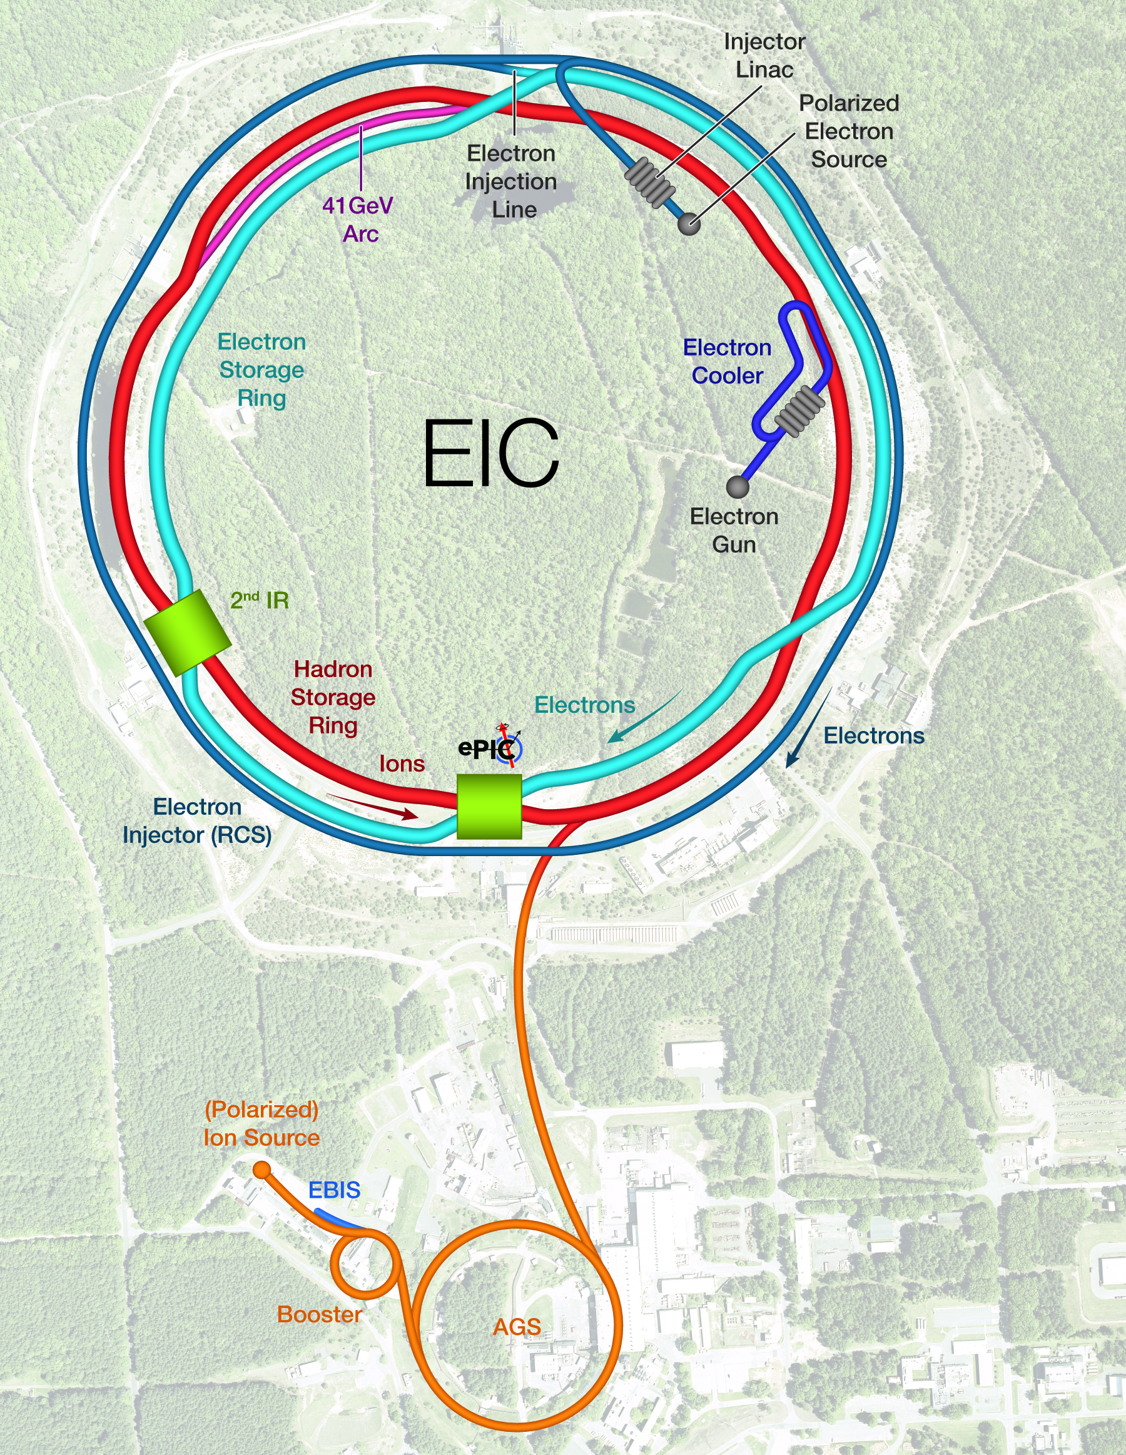
What is the EIC Facility
What is the EIC:
A high luminosity (10³³ – 10³⁴ cm⁻²s⁻¹) polarized electron proton / ion collider with √s_{ep} = 28 – 140 GeV
What is special:
EIC is the ONLY new collider in foreseeable future. Allows to remain at frontier of Accelerator S&T.
factor 100 to 1000 higher luminosity as HERA
both electrons and protons / light nuclei polarized,
nuclear beams: d to U
Fixed Target Facilities i.e.:
at minimum > 2 decades increase in kinematic coverage in x and Q²
Science Program: An EIC can uniquely address profound questions about nucleons, the properties of nuclear matter and its emergence through the underlying partonic structure and dynamics of quarks and gluons
State of the art general purpose collider detector

Slide 3
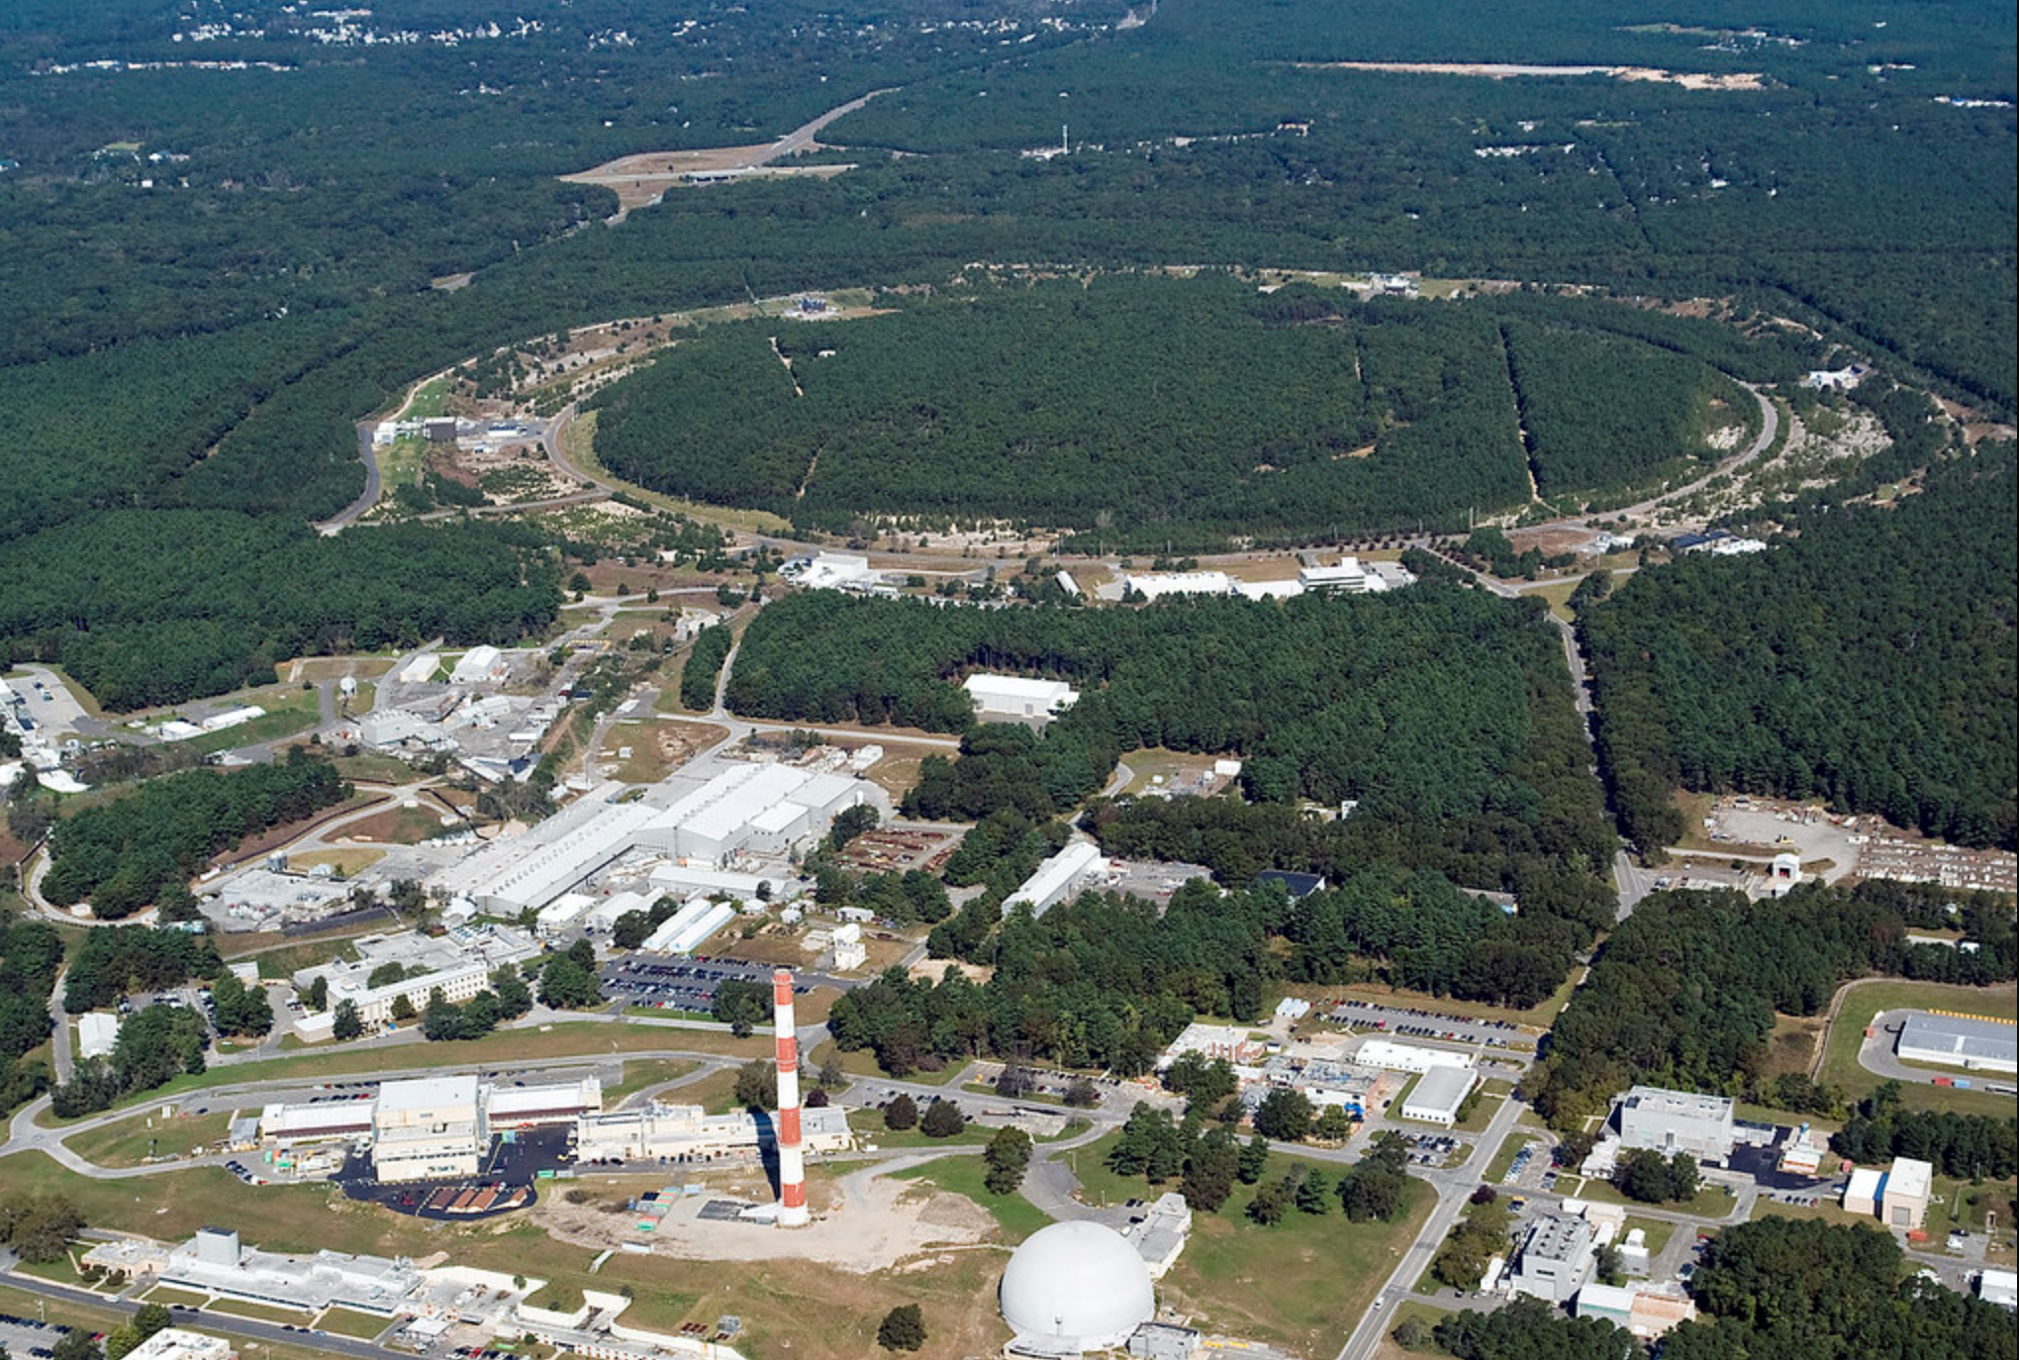
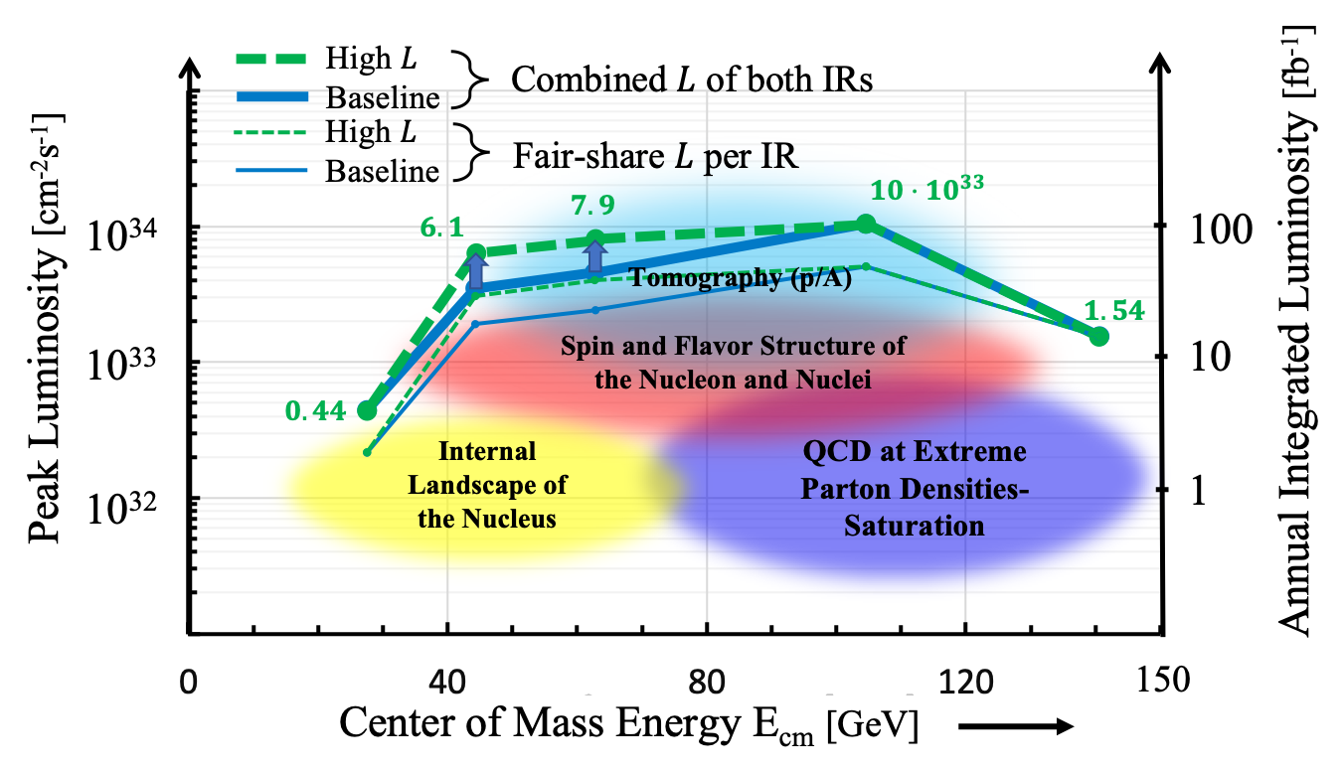
EIC Design Overview
Based on existing, well maintained, well performing RHIC
Hadron storage Ring (RHIC Rings) 40, 100-275 GeV
  Superconducting magnets (existing)
  1160 bunches, 1A beam current (3x RHIC)
  Bright vertical beam emittance 1.5 nm (“flat beams”)
  Strong cooling (coherent electron cooling)
Electron Storage Ring 5–18 GeV
  Large beam current, 2.5 A, 9 MW S.R. power, S.C. RF
  Need to inject polarized bunches
Electron rapid cycling synchrotron, 1Hz, (0.4- 18) GeV
  Spin transparent due to high quasi periodicity
High luminosity Interaction Region(s)
  Large bore superconducting final focusing
  magnets
  25 mrad crossing angle with crab cavities
  Spin Rotators (longitudinal spin)
  Forward hadron instrumentation
  Bunch Crossing ~ 10.2 ns/98.5 MHz
RHIC

Slide 4
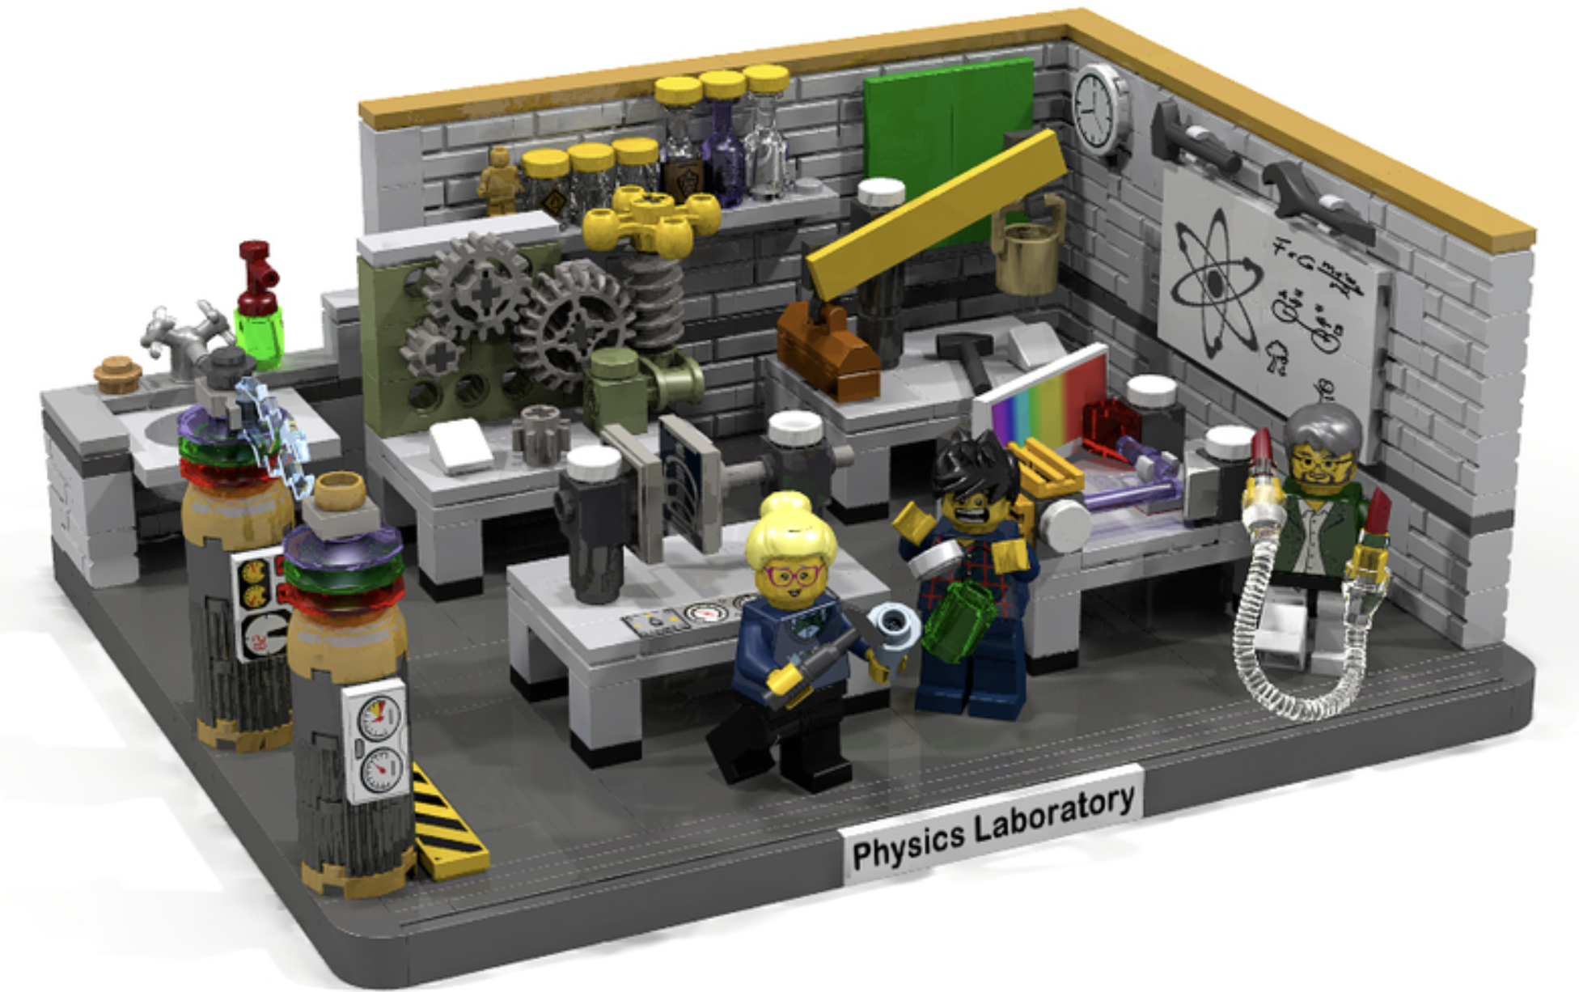
EIC Science Program

Slide 5


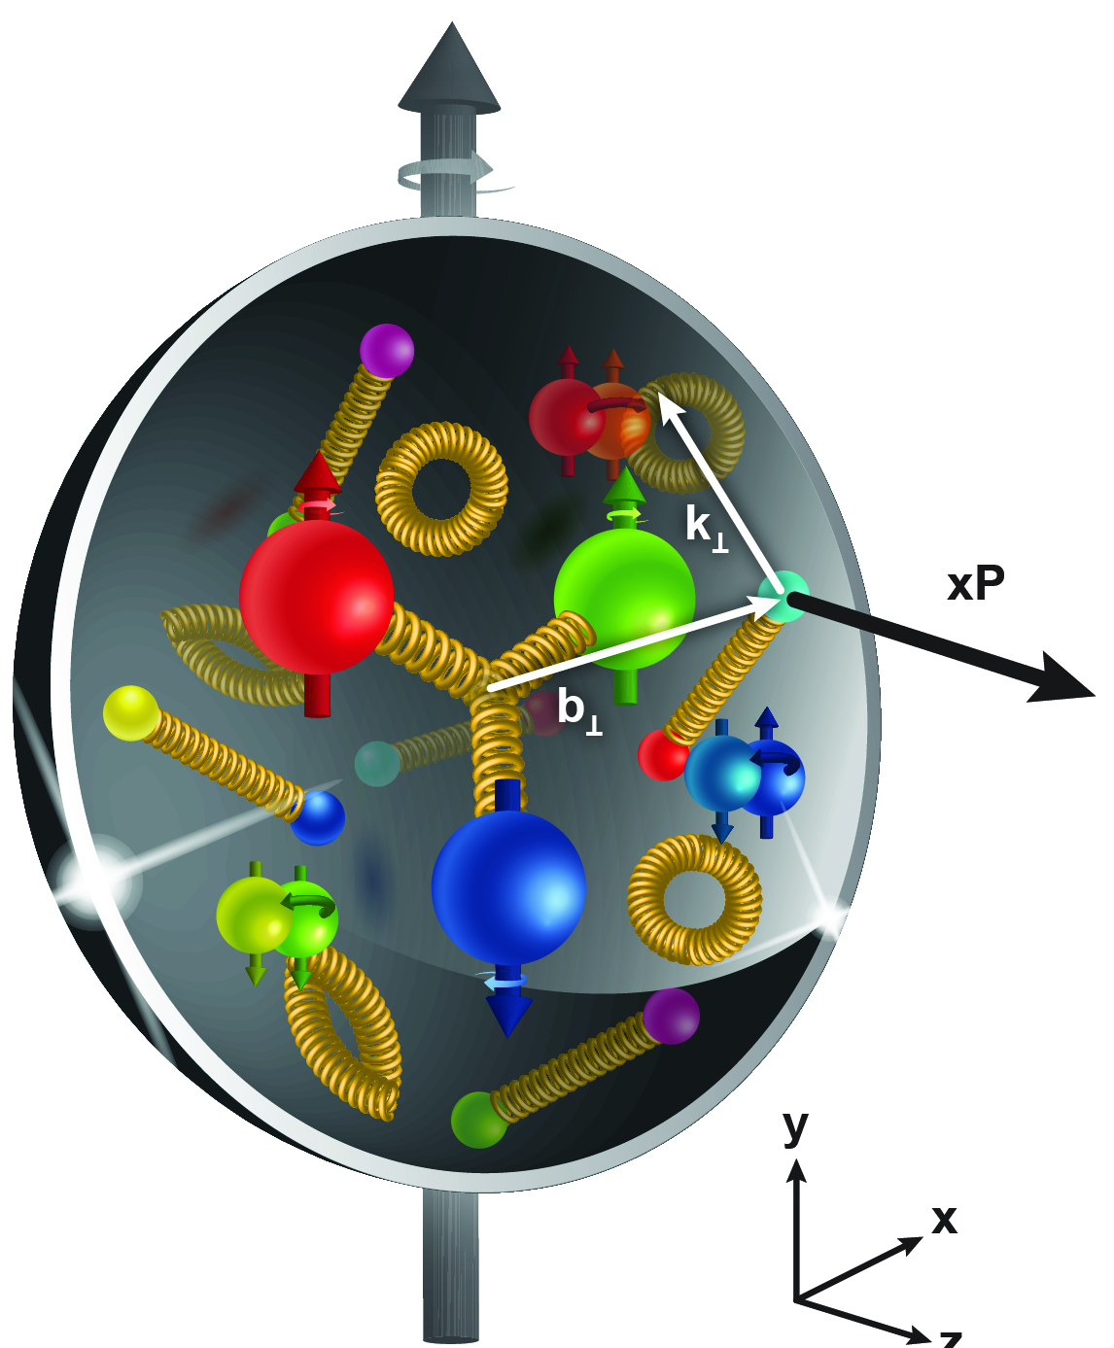
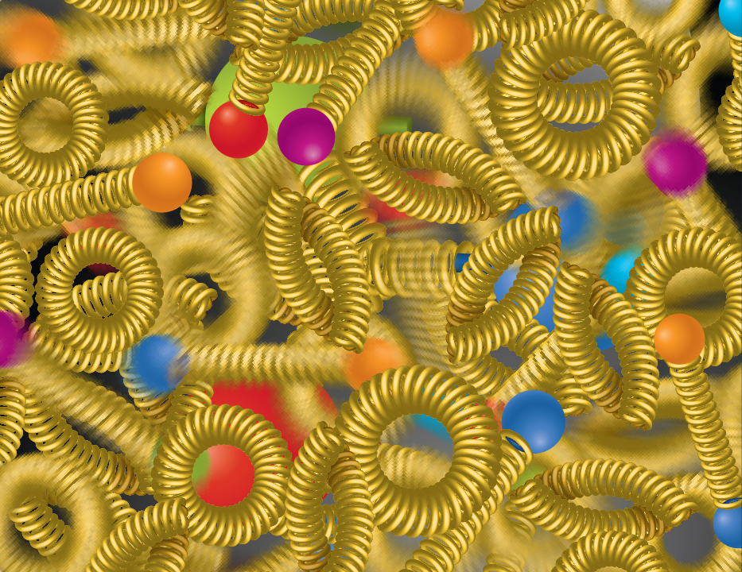
EIC Science Highlights
SPIN is one of the fundamental properties of matter.
All elementary particles, but the Higgs carry spin.
Spin cannot be explained by a static picture of the proton
It is the interplay between the intrinsic properties and interactions of quarks and gluons
The EIC will unravel the different contribution from the quarks, gluons and orbital angular momentum.
Does the mass of visible matter emerge from quark-gluon interactions?
Atom: Binding/Mass =
0.00000001
Nucleus: Binding/Mass = 0.01
Proton: Binding/Mass
= 100
For the proton the EIC will determine an important term contributing to the proton mass, the so-called “QCD trace anomaly
How are the quarks and gluon distributed in space and momentum inside the nucleon & nuclei?
How do the nucleon properties emerge from them and their interactions?
How can we understand their dynamical origin in QCD?
What is the relation to Confinement
Is the structure of a free and bound nucleon the same?
How do quarks and gluons, interact with a nuclear medium?
How do the confined hadronic states emerge from these quarks and gluons?
How do the quark-gluon interactions create nuclear binding?
How many gluons can fit in a proton?
How does a dense nuclear environment affect the quarks and gluons, their correlations, and their interactions?
What happens to the gluon density in nuclei? Does it saturate at high energy?
?
gluon
splitting
=
gluon
recombination

Slide 6


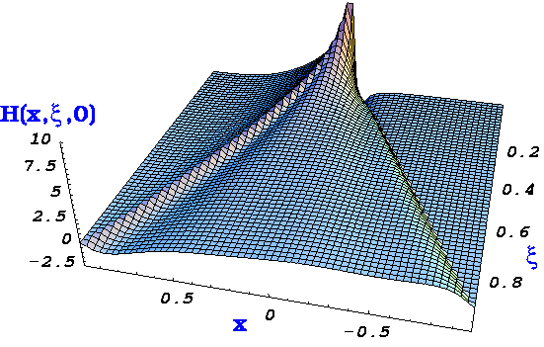

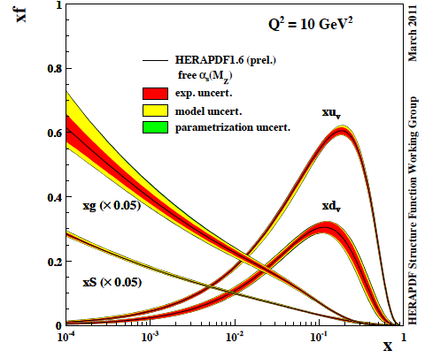

EIC: The Path to Imaging Quarks and Gluons
Wigner function
4+1-D
not related by
Fourier transf.
2+1-D
transv. mom. dep. PDF
impact par. dep. PDF
generalized PDF
semi-inclusive DIS
exclusive processes
1-D
parton densities
form factor
There are many reasons why one wants to have a 3d picture of nucleons and nuclei
one is to get a full picture of the nucleon structure

Slide 7
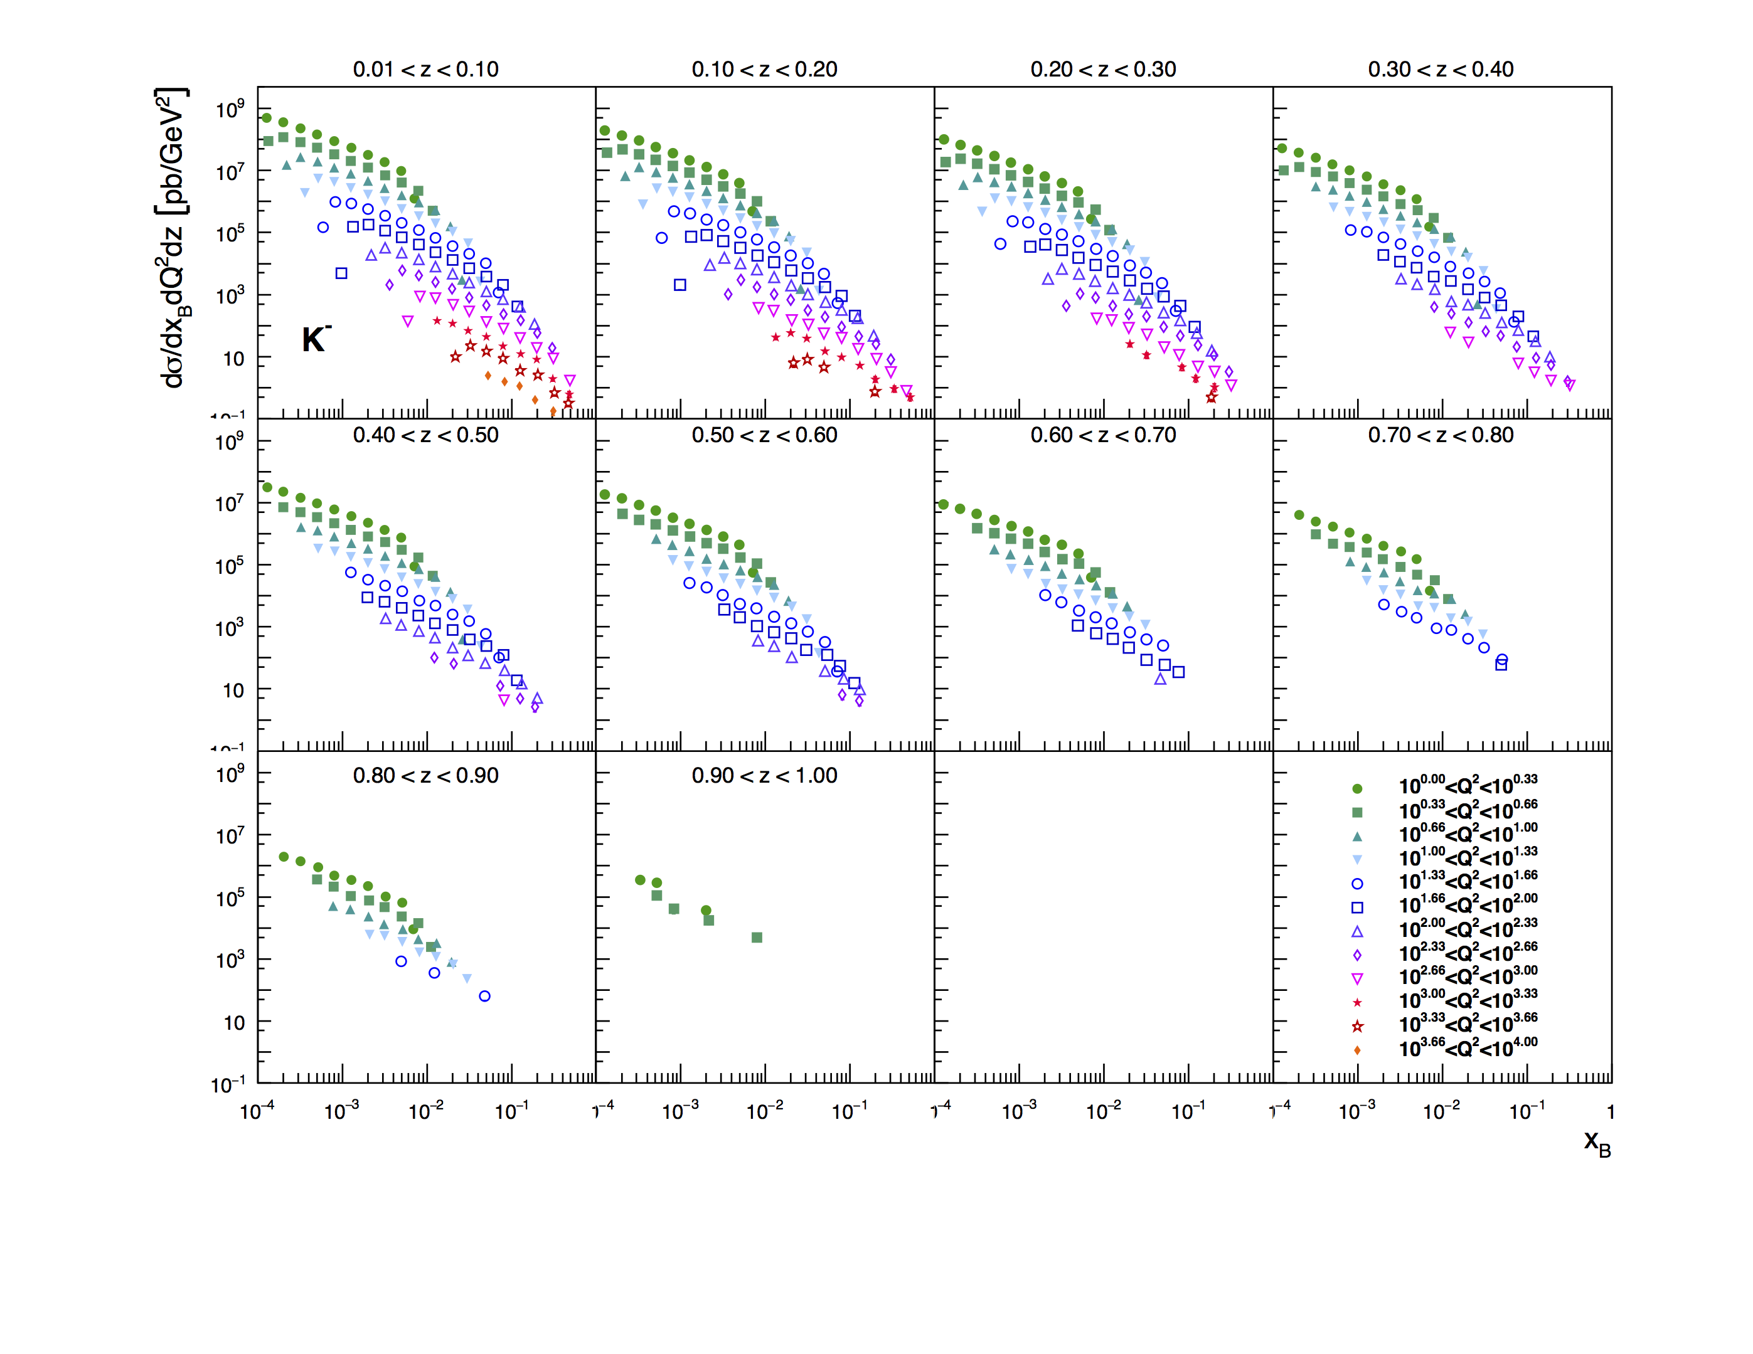
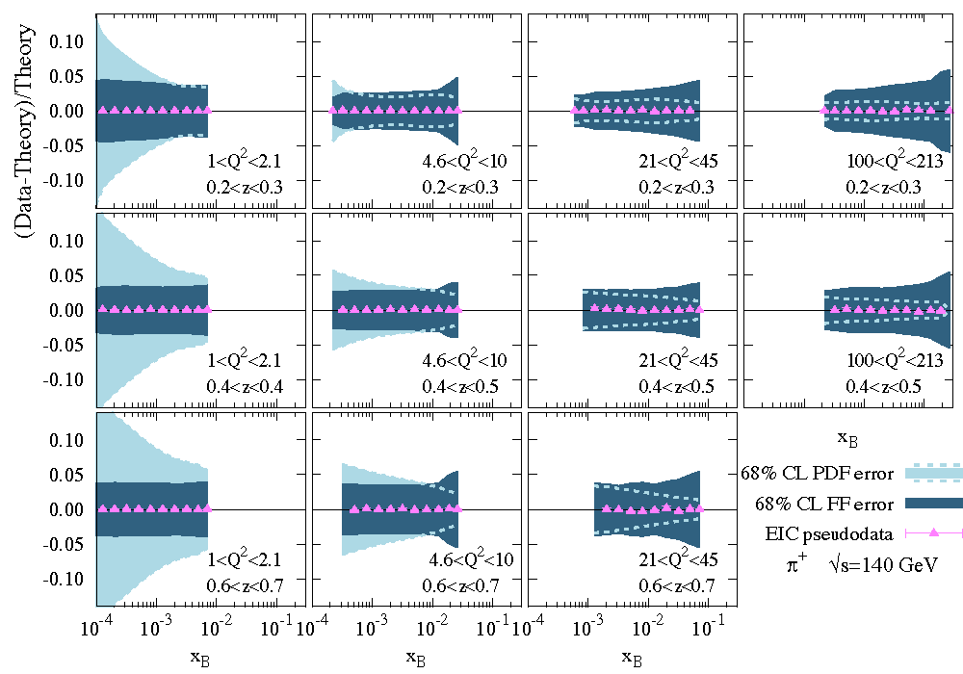
Unpolarized Flavor Structure: Proton
very precise 3d SIDIS cross section covering
a wide kinematics in z,x,Q²
arXiv:1902.10663
If you want to know s-PDF ask the EIC
→ impact grows with √s
√s=140 GeV
∫L=10fb⁻¹
If one wants to obtain the best PDF and FF constrain it will be critical
to perform a simultaneous extraction of PDFs and FF

Slide 8
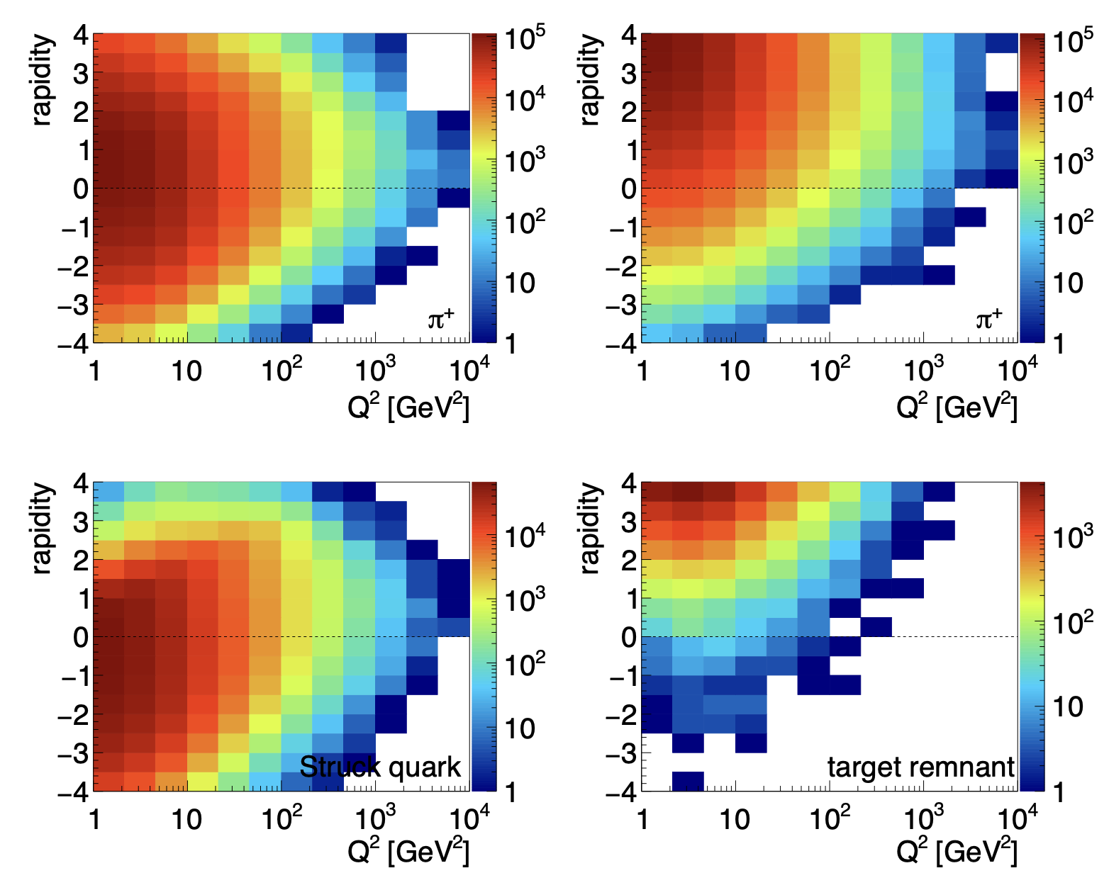
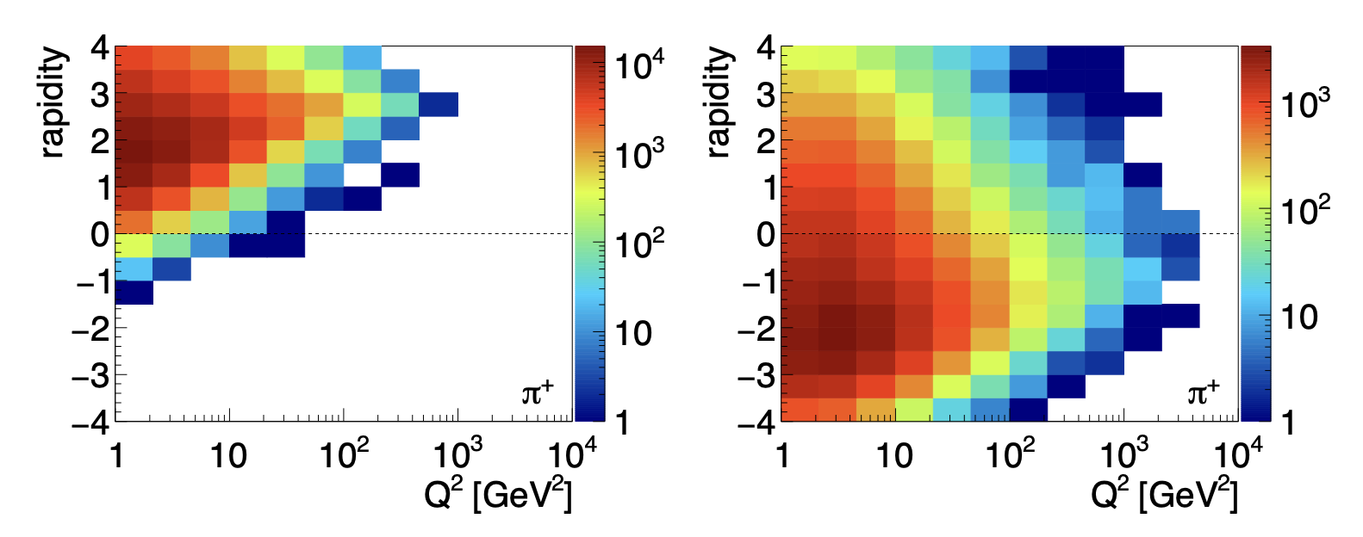
Kinematics important for TMDs at EIC
√s=45 GeV ∫L=10fb⁻¹
√s=140 GeV ∫L=10fb⁻¹
200 GeV² < W² < 300 GeV²
16000 GeV² < W² < 18000 GeV²

Slide 9
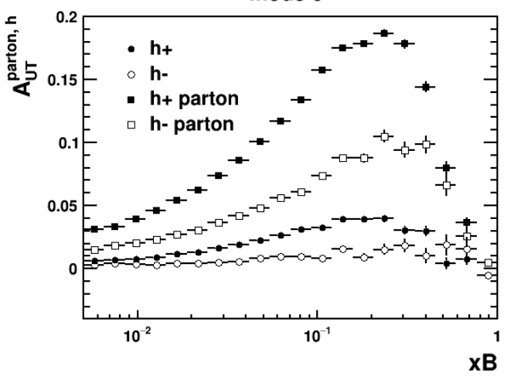
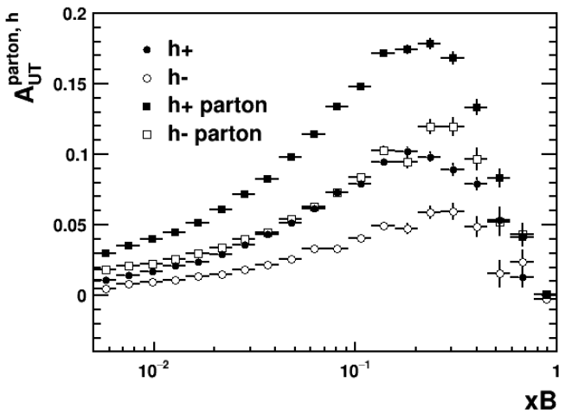
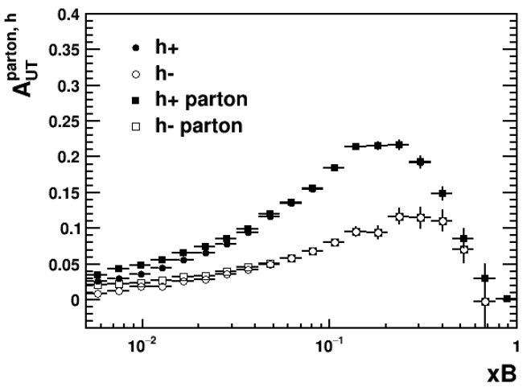
What we measure is not directly parton level Info
Full simulation
PARJ(21)=0
Turn off
frag p_{T}
Turn off decay
of resonances
PARJ(21)=0,MSTJ(21)=0
Fragmentation momenta smearing and resonance decay contribution accounts for the parton to hadron level asymmetry dilution at fixed-target energy.
→ same issue with SIDIS at EIC

Slide 10
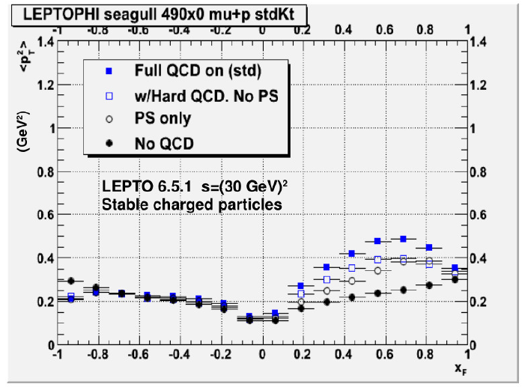
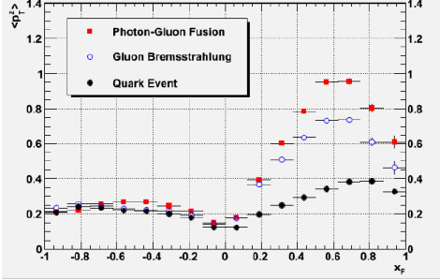
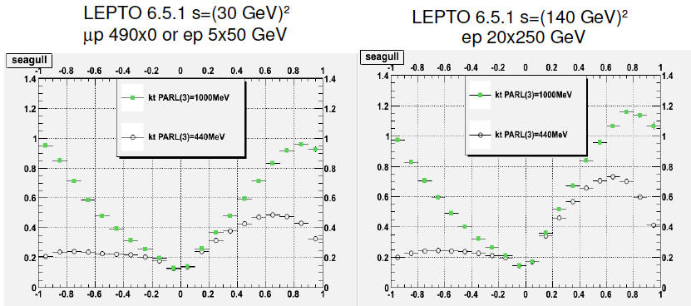
Can we constrain: k_{t}
<p_{t}²> (GeV²)
<p_{t}²> (GeV²)
Best variable <p_{t}²> vs x_{F}
→ negative x_{F} seems to
be very sensitive to
intrinsic k_{t}
x_{F}
x_{F}

Slide 11
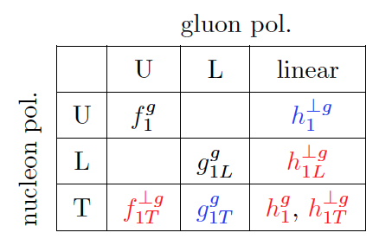
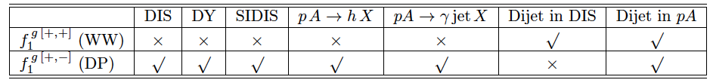
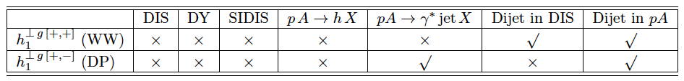
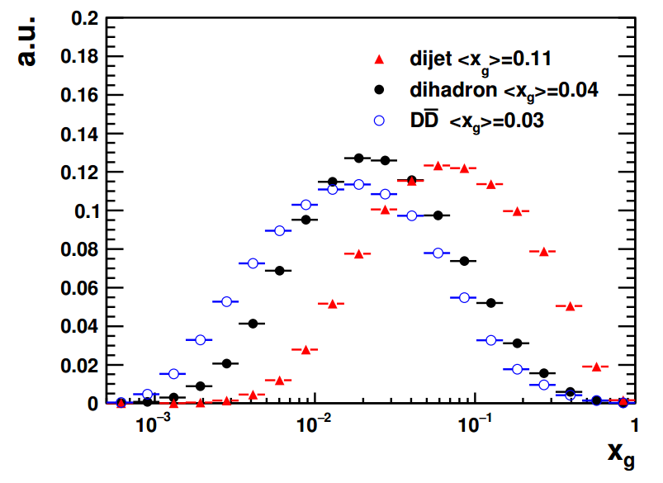
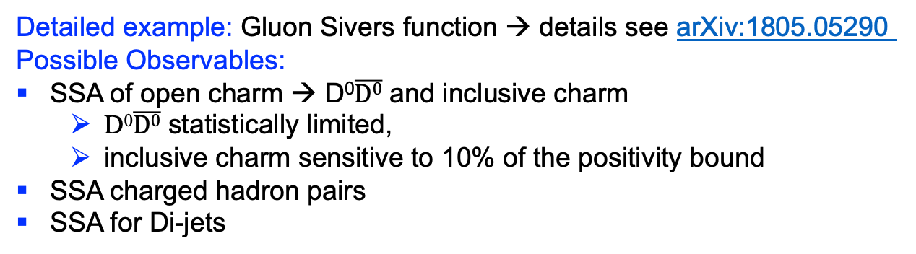
Gluon TMDs
pA: for low x physics → gluon distribution
Need measurements to separate
G_{WW}(x,k⊥) is the conventional gluon distribution
G_{DP}(x,k⊥)
Different processes for unpolarised gluon distributions:
Different processes to access linear polarised gluon distributions:
Detailed example: Gluon Sivers function → details see arXiv:1805.05290
Possible Observables:
SSA of open charm → D⁰$\overline{D0}$ and inclusive charm
  D⁰$\overline{D0}$ statistically limited,
  inclusive charm sensitive to 10% of the positivity bound
SSA charged hadron pairs
SSA for Di-jets

Slide 12
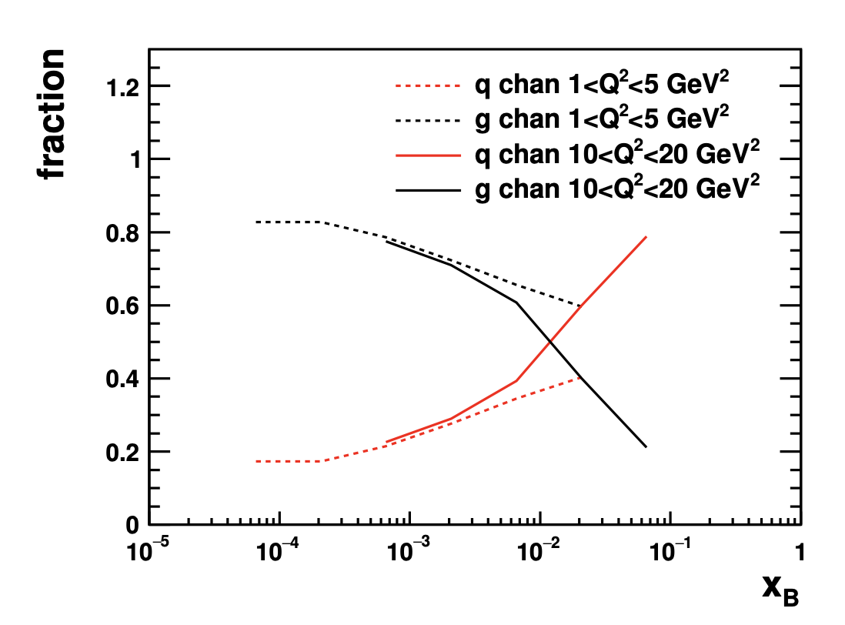
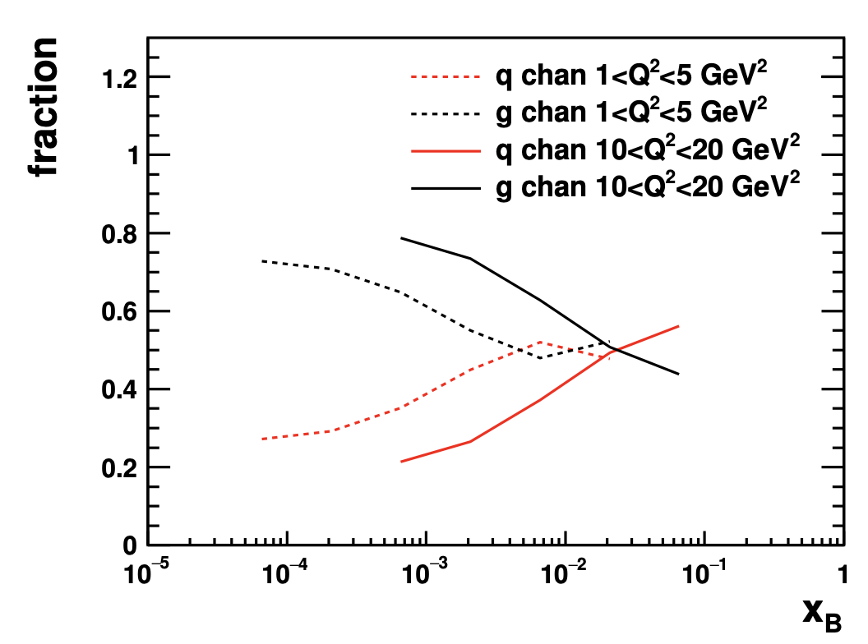
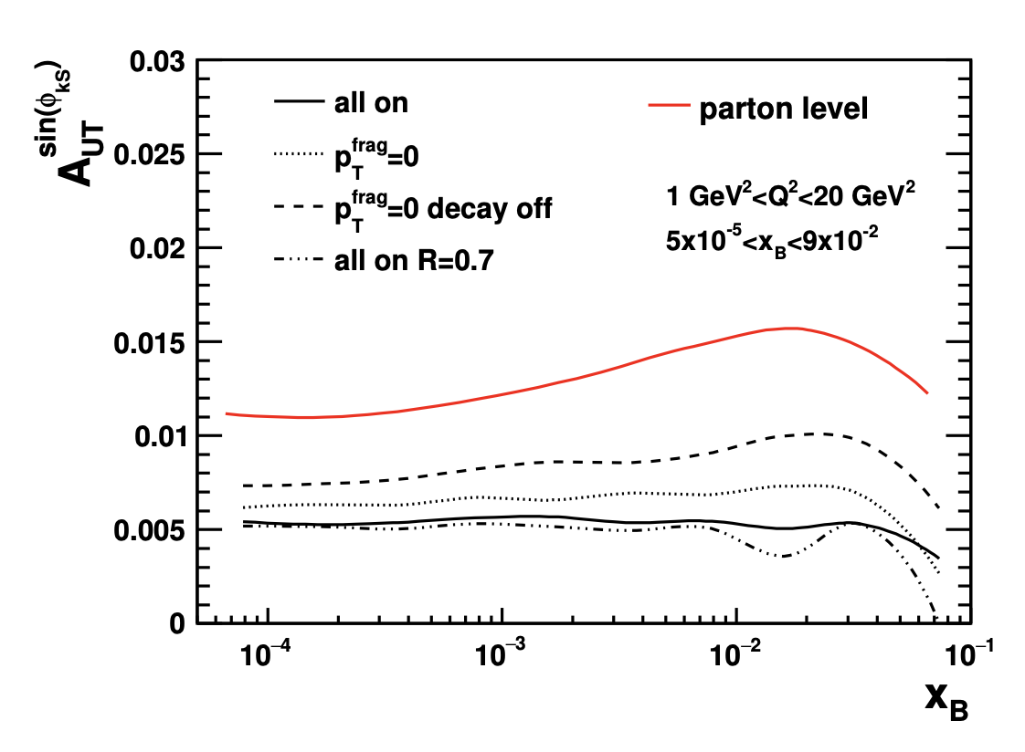
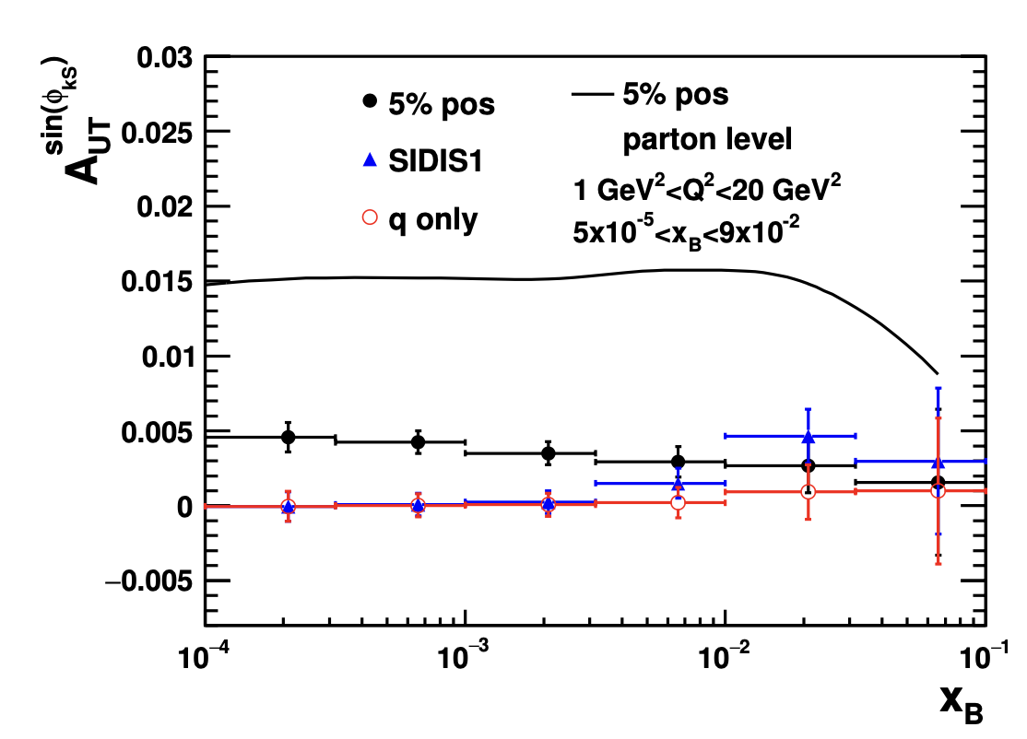
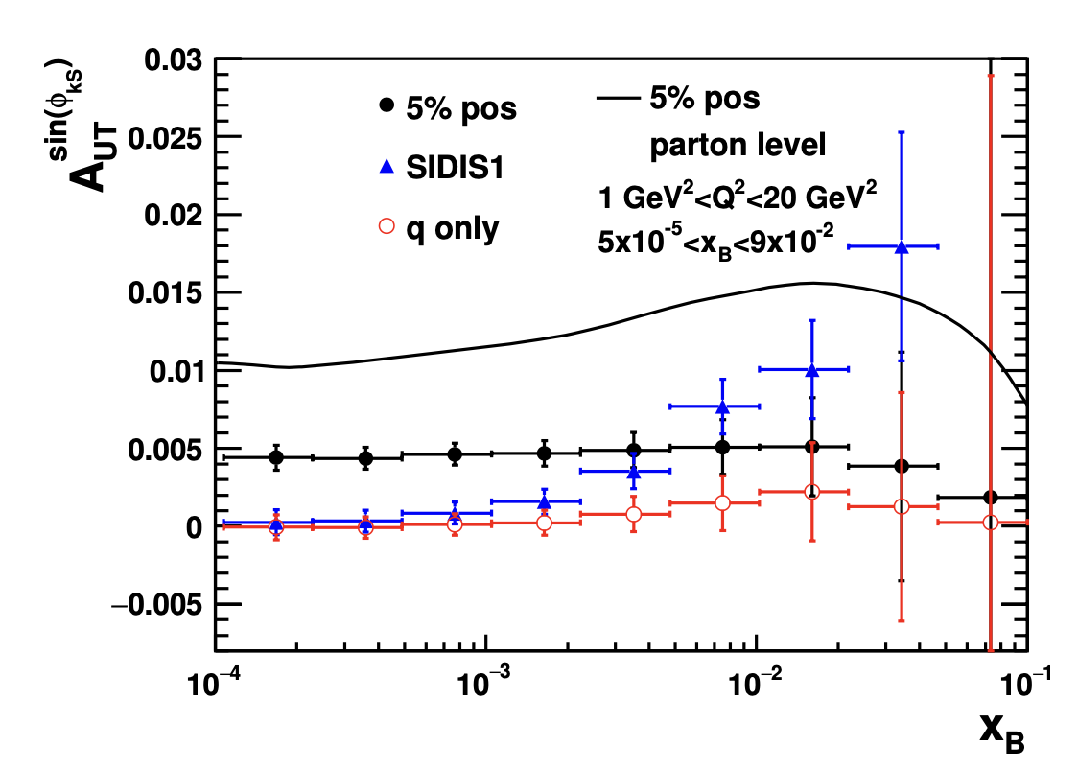
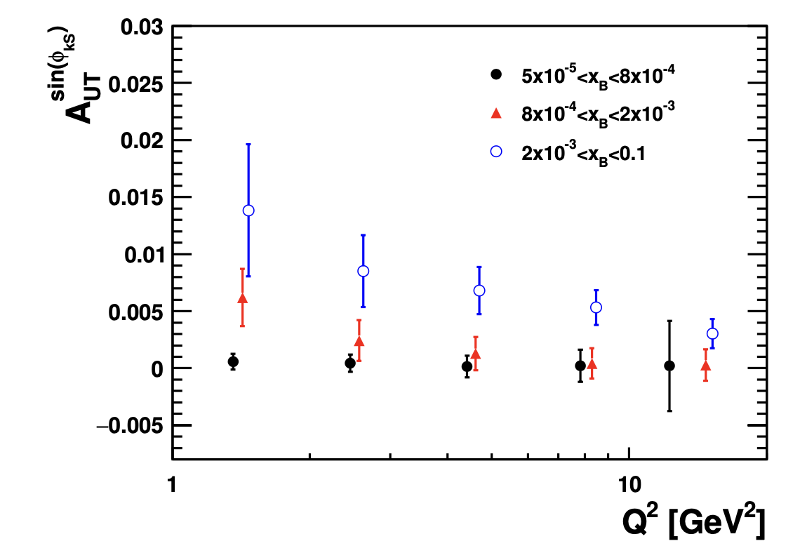
Gluon Sivers TMD: Di-hadrons & Di-Jets
Di-Hadrons
Di-Jets
subprocess fraction
Gluon initiated process dominant at small x_{B}
Resolution down to 5% positivity bound gluon Sivers size
Di-Jets:
  Stronger correlation between final state observable to parton level kinematics
  Strong correlation of jet momentum to its mother parton
  Direct handle on parton kinematics put stronger constraint such as x_{parton}
  Large statistics allow to explore SSA in multidimensional analysis.

Slide 13
Jet Physics at the EIC
The importance of jet probes was reflected in the EIC Yellow Report where they touched on nearly every major physics topic (Nucl. Phys. A, Vol 1026, 122447)
Jets have several properties which will make them important tools for realizing the EIC physics program
Global properties and parton structure of hadrons
Well understood theoretically and experimentally
Borsa, de Florian, Pedron `20
Excellent proxies for the underlying parton kinematics
Multi-dimensional imaging of nucleons, nuclei and mesons
Arratia, Kang, Prokudin, Ringer `20
Showers probe QCD from hard interaction to hadronization scale within the same event – can explore dynamics at different time (angular) scales
The nucleus: a laboratory for QCD
J. Adam et al 2022 JINST 17 P10019
Precision tools exist to probe these shower properties - substructure
Understanding hadronization

Slide 14
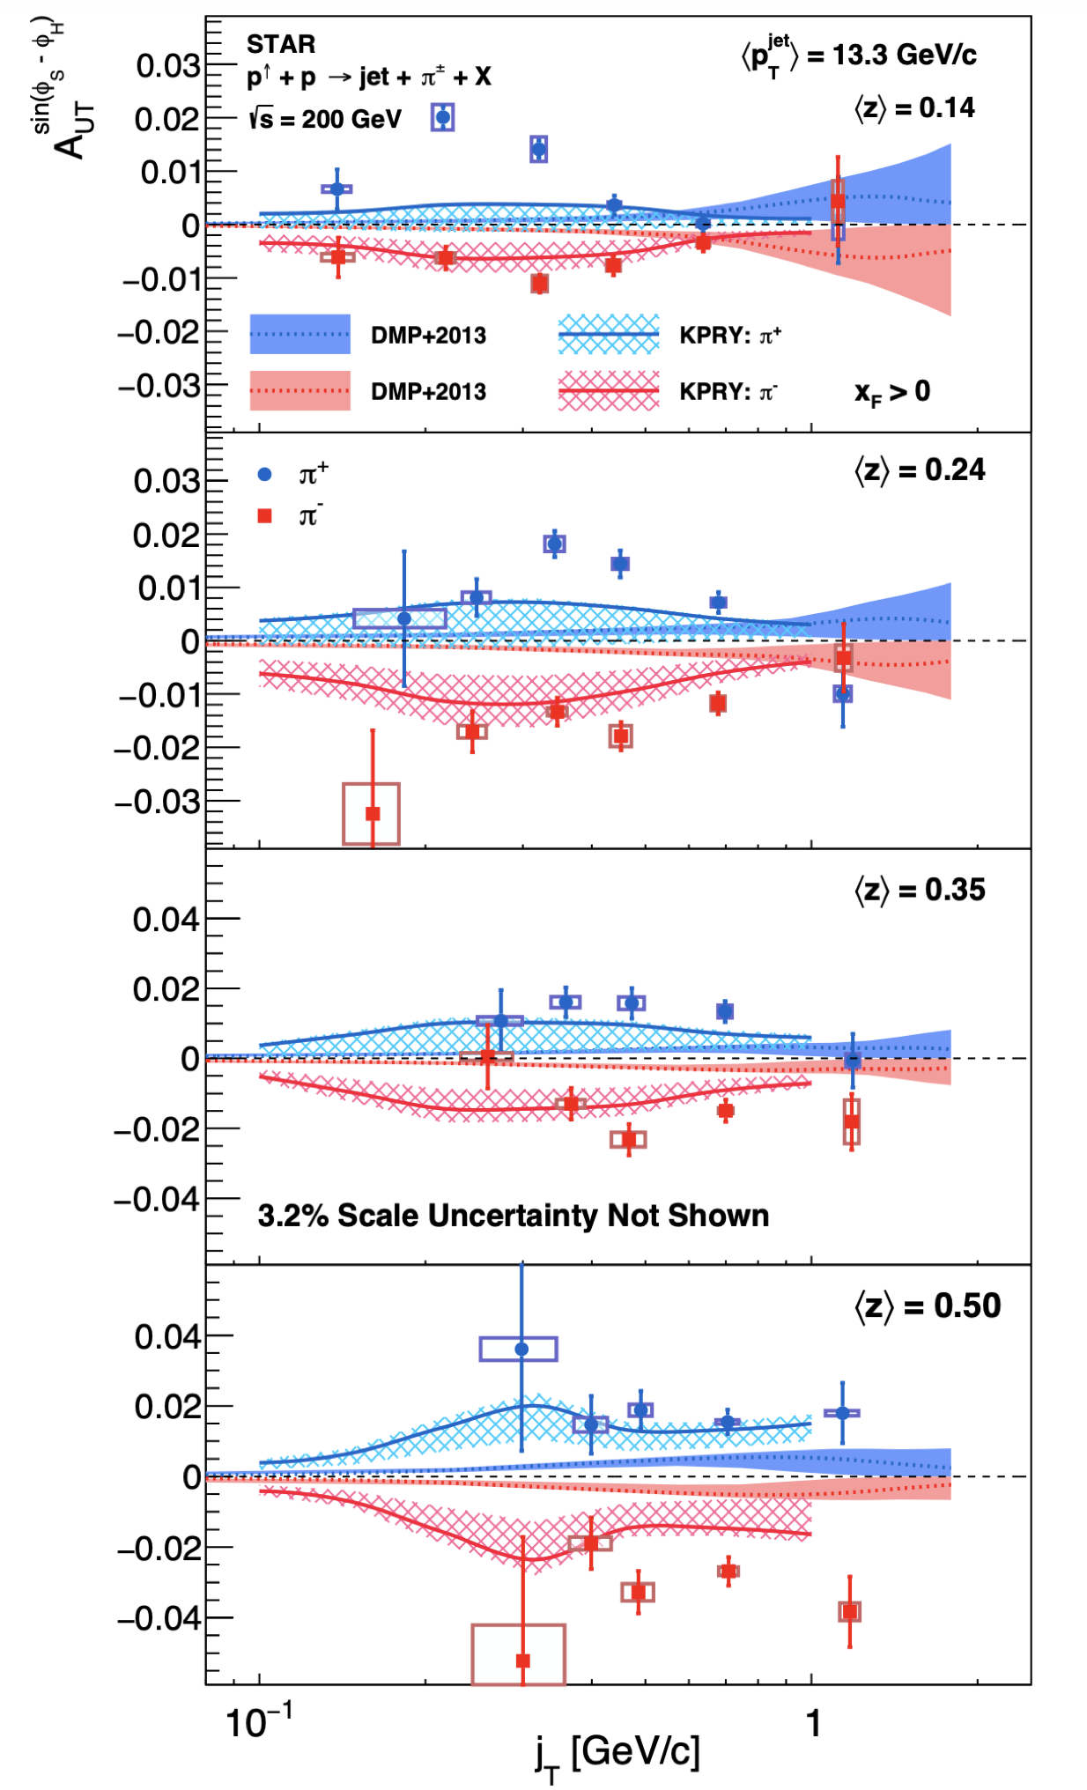
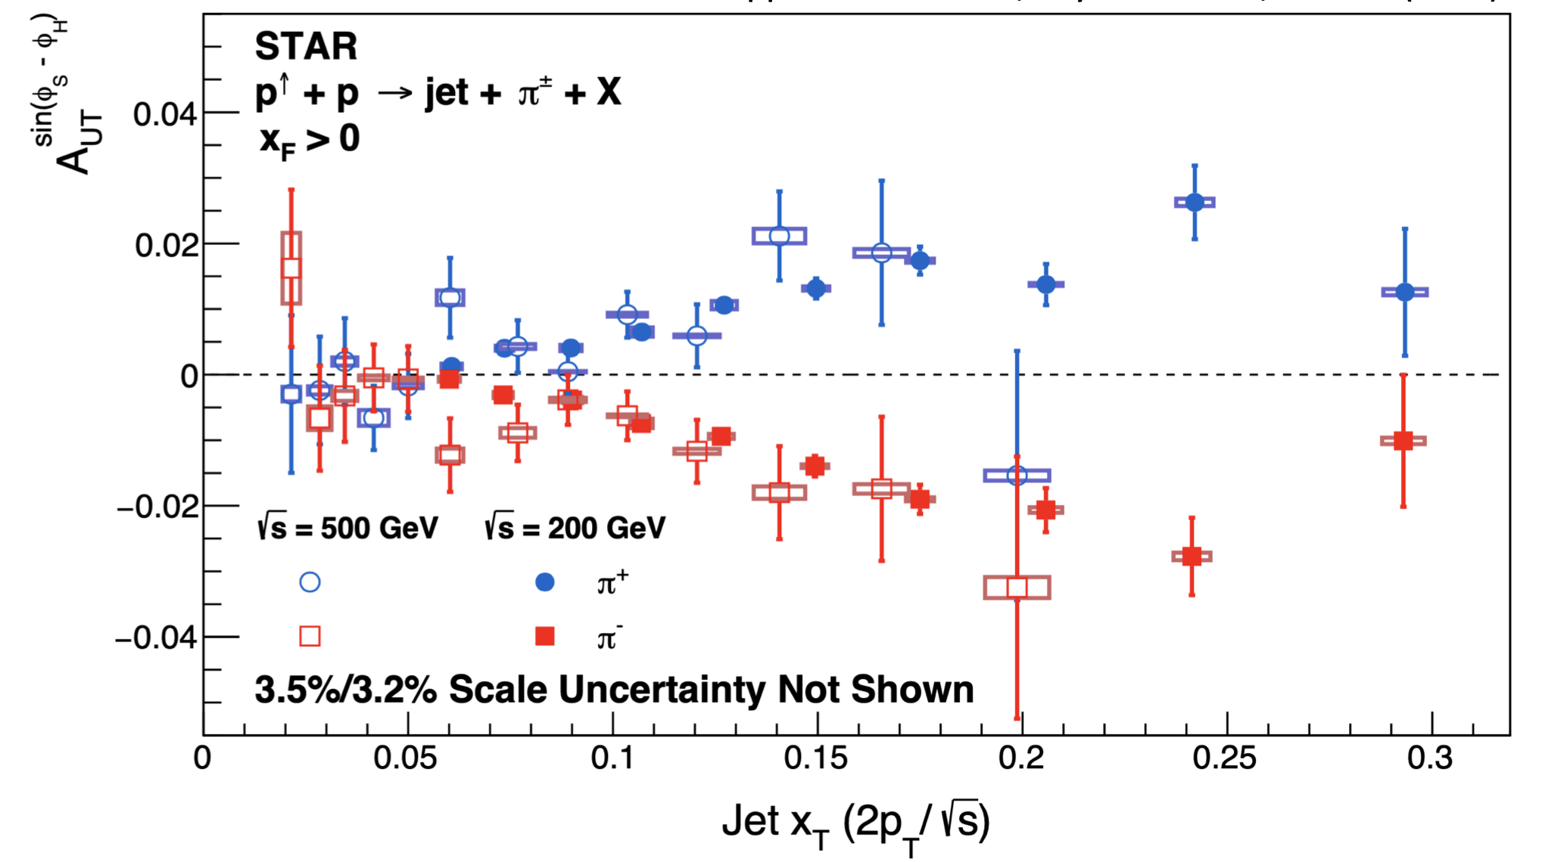
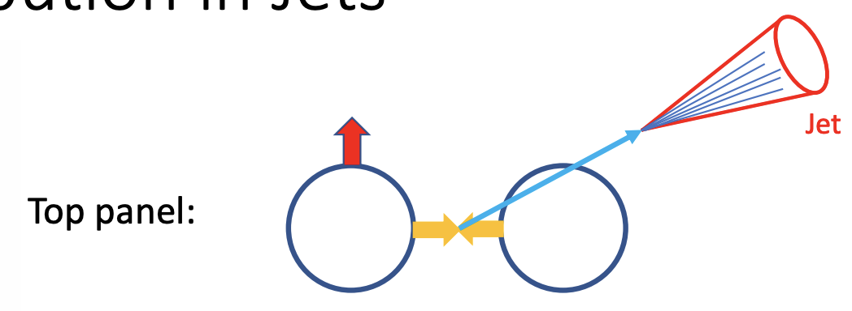
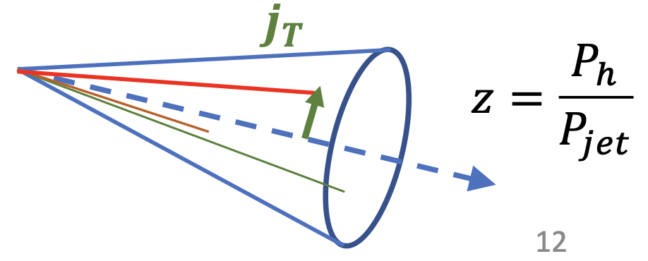
RHIC: Collins asymmetry for $π^{±}$ in jets
arXiv:2205.11800, submitted to PRD
2012 + 2015
$$x^{F}>0$$
Collins asymmetries of $π^{±}$measured with extremely high precision; agree at 0.06 <x_{T}< 0.2, Q² differ by a factor of 6
Collins asymmetry has a weak energy dependence in hadronic collisions;
Collins TMD FF is sensitive to the (𝑗_{T}, z); z and 𝑗_{T} dependences of the Collins FF are closely related.
Our results slightly favor the KPRY model than DMP+2013;
Sizable differences between data and both theoretical calculations.

Slide 15
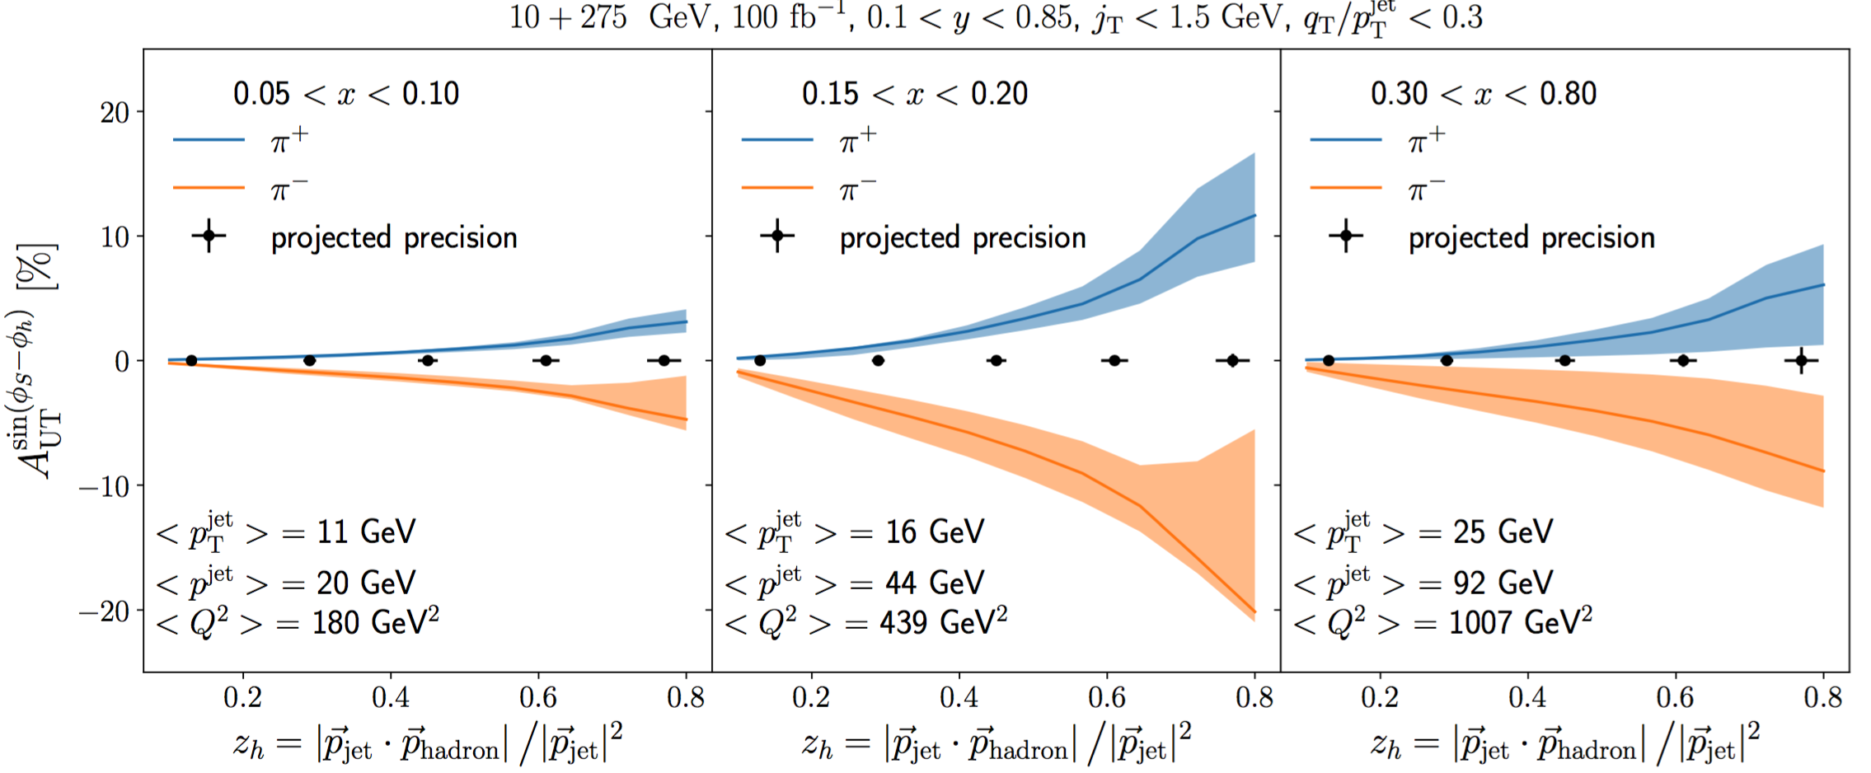
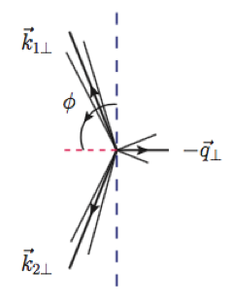
EIC: TMD Fragmentation in Jet
Factorization involves jet axis definition, applying jet thrust as an alternate approach:
Kang, Shao, Zhao, 2007.14425
Boglione, Simonelli, 2011.07366, 2306.02937
Arratia, Kang, Prokudin, Ringer, 2007.07281
See also, polarized jet fragmentation functions:
Kang, Lee, Zhao, 2005.02398; D’Alesio, Gamberg, Murgia, Zaccheddu, 2402.01612
Azimuthal angular asymmetries induced by soft gluon radiation
Catani-Grazzini-Sargsyan 2017
Azimuthal angular asymmetries arise from soft gluon radiations
  ϕ is defined as angle between total and different transverse momenta of the two final state particles
Infrared safe but divergent
  <cos(ϕ)>, <cos(2ϕ)>, … divergent, ~1/q_{T}²
  Integral is finite for small q_{T}-cutoff, resummation can be carried out for the harmonics, <cos(nϕ)>~q_{T}^{n}
  Examples discussed include Vj, top quark pair production
P_{T}
q_{T}

Slide 16
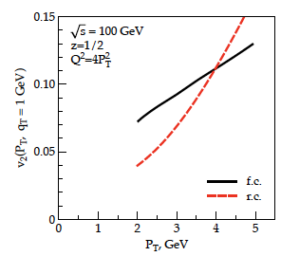
TMDs and “QGP” in small systems
Collective flow signatures
seen even in the smallest
systems and at the lowest
RHIC energies
Phys. Rev. C 95 (2017) 034910
TMD formalism in DIS predicts a distribution for linearly polarized gluons in an unpolarized target. This is reflected in cos(2φ) asymmetries in dijet production
Study azimuthal anisotropy as a function of the rapidity dis-balance of the jets
Process sensitive to unpolarized and linearly polarized gluon distribution
Phys.Rev. D94 (2016) no.1, 014030
Phys.Rev.Lett. 115 (2015) no.25,252301
Phys.Rev. D91 (2015) no.7, 074006
Phys.Lett. B743 (2015) 134-137

Slide 17
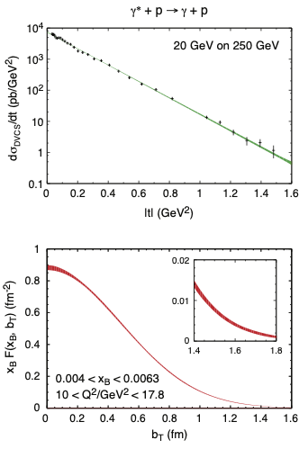
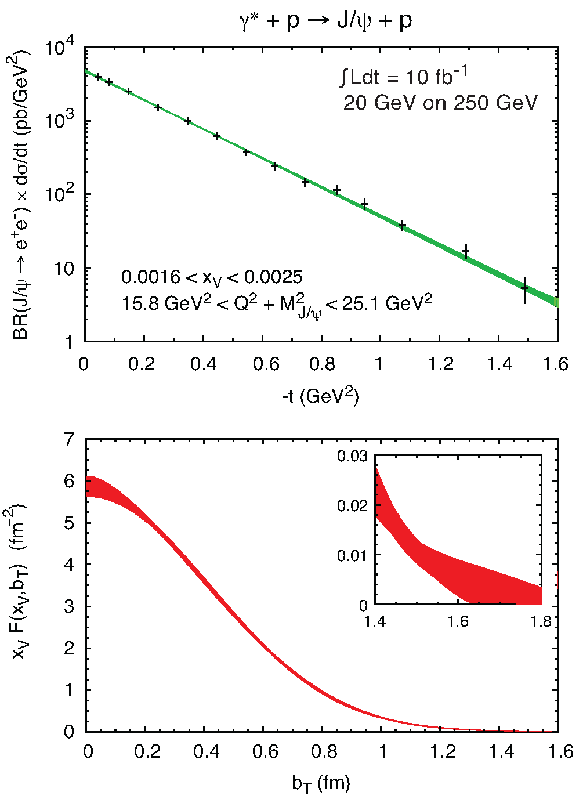
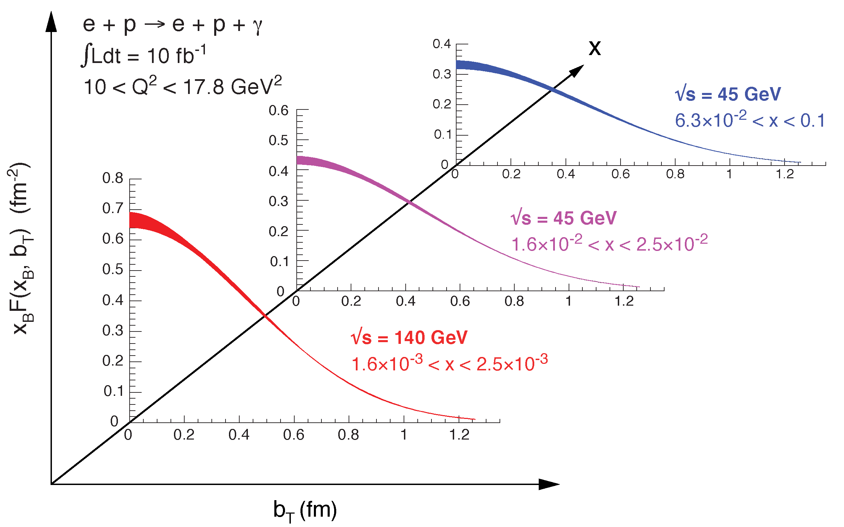
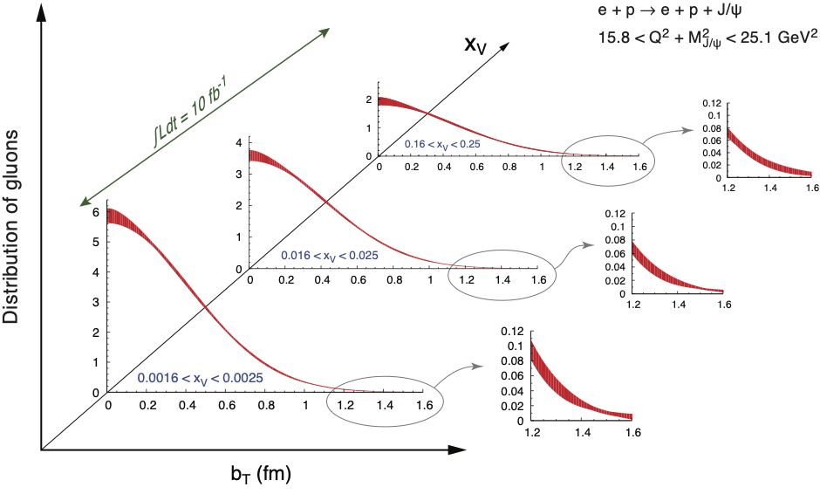

2+1d-Imaging in coordinate space
High precision
imaging at EIC
at low and high x
Golden channels:
e’
e
γ_{L}*
γ, J/ψ
(Q²)
x+ξ
~
x-ξ
~
p
H, H, E, E (x,ξ,t)
p’
t
DVCS
J/ψ
pion cloud
effects seen
at high b_{T}

Slide 18
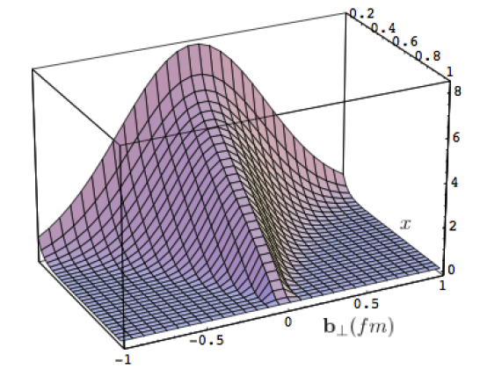
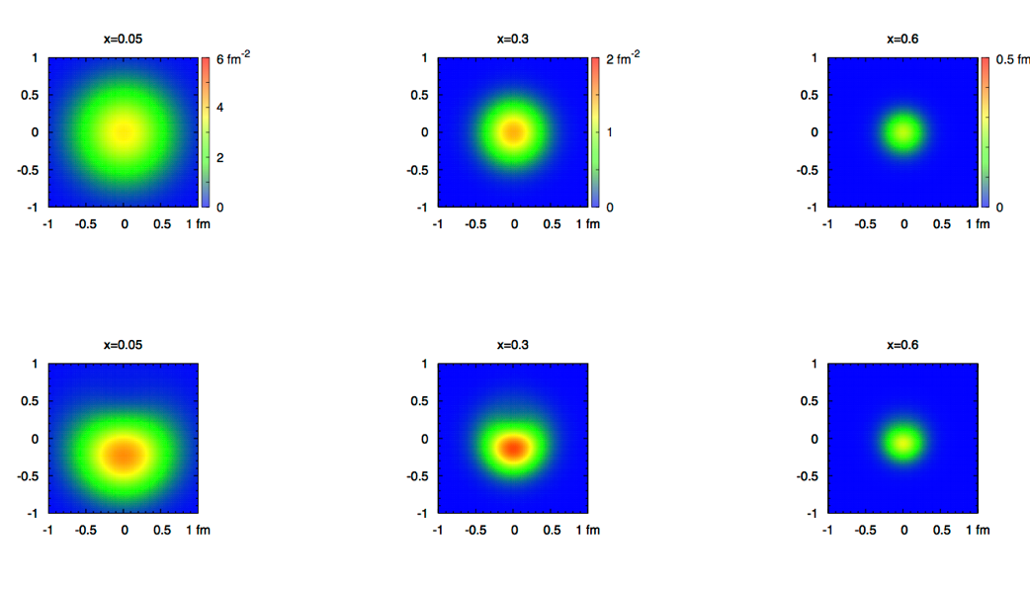
What can we learn
Model of a quark GPD
x
down valence quark
b_{T} (fm)
b_{T} decreasing as a function of x
x
EIC
Valence (high x) quarks at the center → small b_{T}
Sea (small x) quarks
at the périphérie → high b_{T} ?
GLUONS ???

Slide 19

Experimental Reality
Precise Cross section measurements need precise corrections for BH
1
2
3
Milou:
Process 1, 2, 3, and 4
Process 5 is not:
→ not at all a problem
it can be easily rejected
or is not a problem
The magnitude of 2, 3 and 4 has been estimated, more details are shown in the next pages.
DVCS
BH -FSR
BH -ISR
4
5
q₃
q₃
All also included in new
EPIC generator
arXiv:2205.01762, Eur. Phys. J. C 82, 819 (2022)
DVCS
&
BH -ISR
DVCS
&
BH -FSR

Slide 20
BH Fraction
5 GeV x 100 GeV
BH subtraction will be important, at large y, depending on the x-Q² bin
BUT…
5 GeV x 100 GeV
and
5 GeV x 250 GeV
are overlapping:
x-sec. measurements at 5x250 at low-y can
crosscheck the BH
subtrac. made for 5x100
20 GeV x 250 GeV
BH subtraction will be not an issue for y<0.6

Slide 21
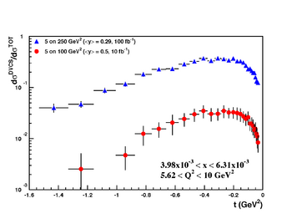
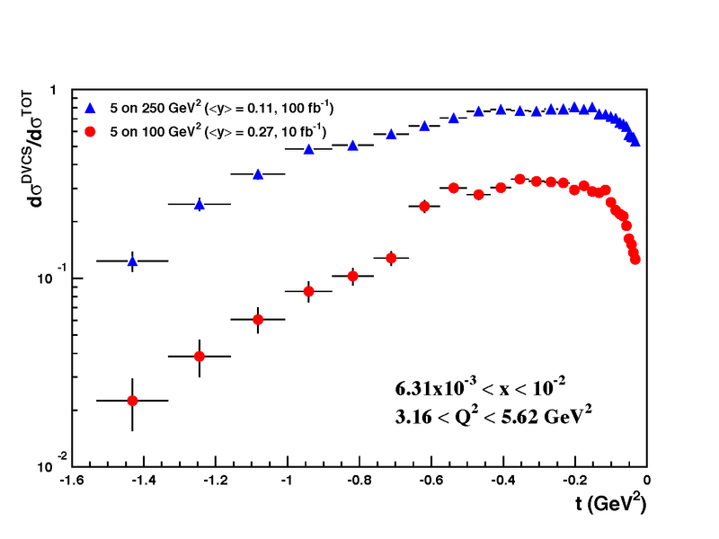
Rosenbluth Separation
Rosenbluth separation of the electroproduction cross section
→ verify MC based BH corrections
The statistical uncertainties include all the selection criteria to suppress the BH
exponential |t|-dependence assumed

Slide 22
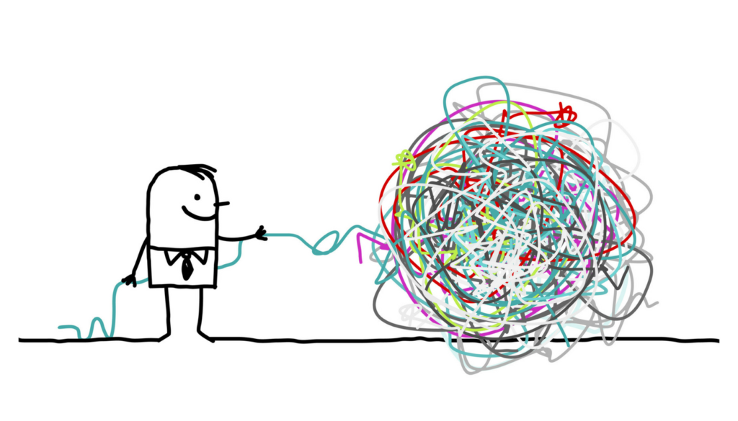
Disentangle Different CFFs and constrain GPDs

Slide 23
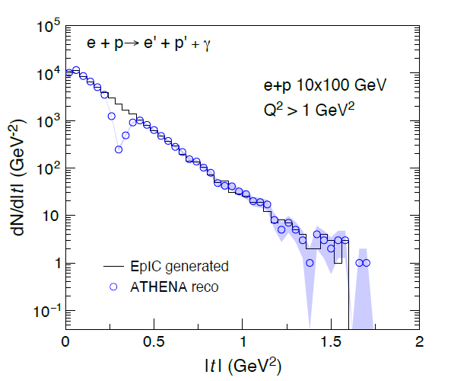
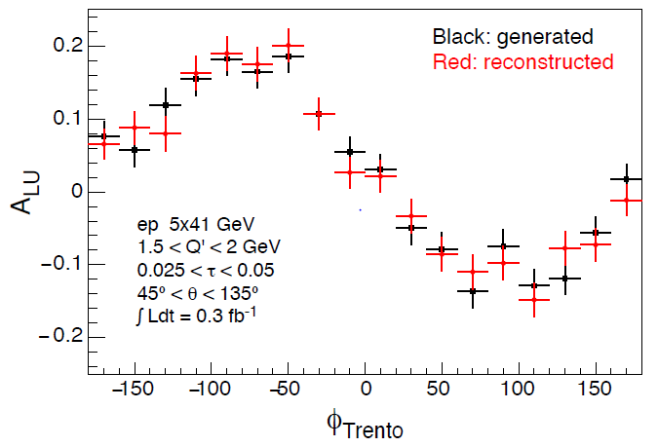
DVCS and TCS
assess to chiral-even GPDs and EMT
These exclusive channels challenge the detector
  DVCS: high energy γ
  TCS: di-lepton pair
  TCS scattered e at very small angles (not always detectable, in spite of FB)
  FB detectors key of the require measurement in large /t/-range (0.03-1.6 GeV²) → IMPACT PARAMETER by Fourier transformation
KEY:
Acceptance (including FF, possibly also FB)
fine resolution and good PID for γ, π⁰, e required for background suppression
Calorimetry (also HCal potentialities in the barrel)
at mid rapidity
FB gap intrinsic in
beam-line design
Q′ is the invariant mass of the lepton pair
τ = Q²=(s − m²_{p}) equivalent of x_{B}
θ angle between a produced lepton and the scattered proton
TCS and Bethe-Heitler (~100 more abundant !)
same kinematics,
their interference results in spin asymmetries

Slide 24
Disentangle different CFFs → GPDs
Vary electron and proton beam spin directions:
electron
beam
longitudinal
polarised
proton
beam
transverse
polarised
proton
beam
longitudinal
polarised
Δσ_{UT}
beam target

Slide 25
What will we learn about 2d+1 structure of the proton
GPD H and E as function of t, x and Q²
GPD H and E 1d+1
arXiv:1304.0077
A global fit over all pseudo data was done, based on the GPDs-based model:
[K. Kumerički, D Müller, K. Passek-Kumerički 2007]
Known values q(x), g(x) are assumed for H^{q}, H^{g}
(at x=0, t=0 forward limits E^{q}, E^{g} are unknown)
Excellent reconstruction of H^{sea}, H^{sea} and good reconstruction of H^{g} (from dσ/dt)
GPD H and E 2d+1 structure for sea-quarks and gluons

Slide 26
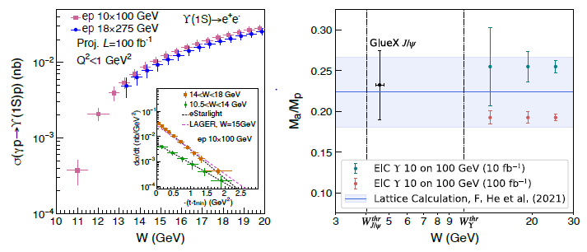
Exclusive Upsilon Production
photo- and electro-production of heavy quarkonia near-threshold
t measured from:
Incoming and out-going proton four-momenta
Υ four-momenta
uncertainty of total and differential cross section of Υ(1S) near threshold for photo-production and electro-production (Q² < 1 GeV²) in e+p collisions via the di-electron decay channel
trace anomaly contribution to the proton mass in Ji’s decomposition;
green and red points are offset; band from a recent lattice QCD calculation; di-electron and di-muon decay channels
KEY:
good sensitivity over the entire rapidity range
good mass resolution to separate the three Υ states
good t resolution
e and μ PID

Slide 27
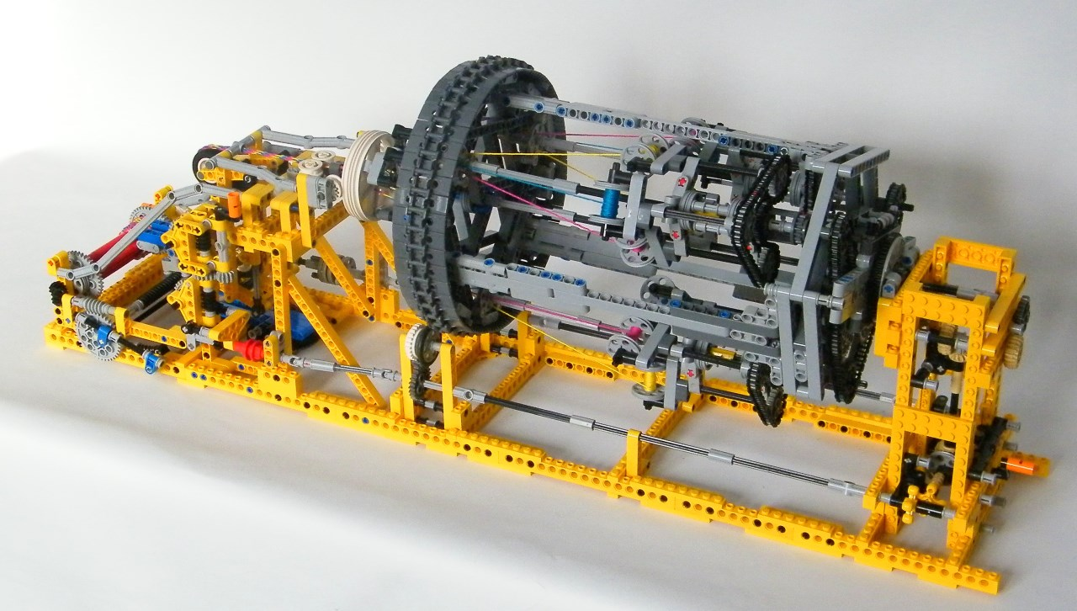
EIC Detector Concept

Slide 28
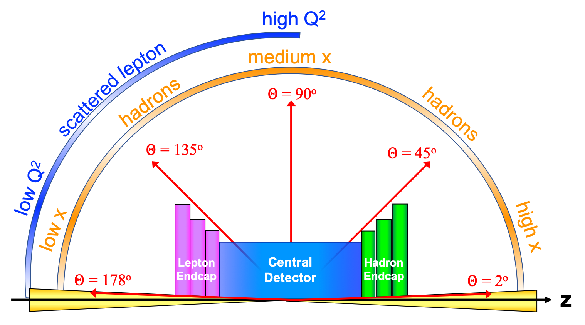

Experimental Equipment Scope
High Luminosity: L= 10³³ – 10³⁴cm⁻²sec⁻¹,
10 – 100 fb⁻¹/year
Highly Polarized Beams: 70%
→ requires high precision electron and hadron polarimetry
Large Center of Mass Energy Range:
E_{cm} = 29 – 140 GeV
→ Large Detector Acceptance
Asymmetric beam energies
→ require an asymmetric detector Barrel
with electron and hadron endcap → 9.5 m
→ equal coverage (-4 < η < 4) Tracking, particle dentification,
electromagnetic and hadronic calorimetry
  High precision low mass tracking
  good e/h separation critical for scattered electron identification
  separate e, π, K, p on track level
Science program required momentum resolution
→ requires a large bore (⌀ 2.4 m) 2T magnet
(1.7 T magnet operation point, stretch goal 2T)
Imaging science program → Large Ion Species Range: protons – Uranium
→ requires specialized detectors integrated in
the Interaction Region over 80 m
Streaming readout electronics model
→ highest scientific flexibility
very compact Detector → Integration is key
Good Background Conditions
Details see:
https://indico.bnl.gov/event/20473/contributions/85389/attachments/51976/88992/eca.EIC.Background.ePIC.pptx
25 different Subsystems incl. Polarimetry
local hadron polarimeter
hadronic calorimeters
Time.of.Flight,
DIRC,
RICH detectors
MPGD trackers
Solenoidal Magnet
MAPS tracker
e/m calorimeters
Luminosity
Monitor
low Q² electron-tagger
off-Momentum
taggers
Roman
Pots
Zero-Degree
Calorimeter
p: 41 GeV, 100 to 275 GeV
p/A beam
e beam
e: 5 GeV to 18 GeV
lepton and hadron polarimeters not shown

Slide 29









ePIC Tracking Detectors
μVertex Tracker
Barrel Tracker
Outer Barrel MPGD Tracker
EndcapTracker
μRWELL
Disks
MicroMega Tracker
μRWELL Tracker
MAPS
Disks
Main Function
Excellent momentum 0.05%pT⊕0.5%
and spatial resolution
20μm/pT⊕ 5μm
Tracking layer close to DIRC detector → improved angular and space point resolution.
Redundancy and pattern recognition for tracking
Provide redundancy and pattern recognition for tracking
Excellent momentum 0.05 (0.10)% pT⊕1.0 (2.0)%
and spatial resolution
30μm/pT⊕ (20 – 40) μm
Provide redundancy and pattern recognition for tracking
Displaced vertex reconstruction
Monolithic Active Pixel Sensor → ALICE ITS3 MOSAIX sensor (65 nm), small pixels (~18 μm) and power consumption (<20 mW/cm²)
Proven Technology
Cylindrical resistive Micromegas technology
Used: ATLAS NSW, CLAS12, SPHENIX, MINOS& T2K TPC
EIC Large Area Sensor (LAS), modification of ITS3 sensor with 5 or 6 RSU forming staves as the basic building elements for the Outer Barrel
world’s first at
24 planar Thin-gap & double amplification (GEM & μRWELL) modules &
2D-strip readout
EIC Large Area Sensor (LAS), staves as the basic building elements for the MAPS disks
GEM- 𝜇Rwell hybrid configuration with increased gain

Slide 30







ePIC Calorimetry
Backward ECal
Barrel ECal
Forward ECal
Backward HCal
Barrel HCal
Forward HCal
Main Function
scattered lepton detection
→ very high-precision
scattered lepton and γ detection, hadronic final state characterization
lepton and g detection, hadronic final state characterization
→ π⁰, γ separation
muon and neutral detection
→ improved jet
Energy
reconstruction
muon and neutral detection
→ improved jet Energy reconstruction
particle-flow measurements
Proven Technology
PbWO4 – crystals
→ long lead procurement
Pb/SciFi sampling part using SiPMs combined with imaging section (6 layers) interleaving Pb/SciFi with ASTROPIX
Tungsten-powder + SciFi SPACAL design
Developed through EIC R&D and applied successfully in sPHENIX
Steel + Scintillator SiPM-on-tile
Steel + Scintillator design
re-used from sPHENIX
longitudinal segmented Steel + Scintillator SiPM-on-tile
Pioneered by CALICE analog HCal
High resolution insert next to beam-pipe
world’s first at
SiPM as Photonsensors
Use of ASTROPIX in Calorimetry
first-time full-size CALICE like calorimeter in collider experiment

Slide 31


Particle ID
In general, need to separate:
Electrons from photons → 4π coverage in tracking
Electrons from charged hadrons → mostly provided by calorimetry
Charged pions, kaons and protons from each other → Cherenkov detectors
  Cherenkov detectors, complemented by other technologies at lower momenta
  Time-of-flight or dE/dx
Physics requirements:
Need more than one technology to cover the entire momentum ranges at different rapidities
Rapidity | π/K/p and π0/γ | e/h | Min pT (E)
-3.5 − -1.0 | 7 GeV/c | 18 GeV/c | 100 MeV/c
-1.0 − 1.0 | 8-10 GeV/c | 8 GeV/c | 100 MeV/c
1.0 − 3.5 | 50 GeV/c | 20 GeV/c | 100 MeV/c

Slide 32





ePIC Particle Identification Detectors
Backward RICH
Barrel DIRC
Forward RICH
Time-of-Flight
Main Function
e, π, K, p separation through 20-35 ps ToF
Barrel: 0.15 < p_{T} < 1.5 GeV/c
Forward: 0.15 < p_{T} < 2.5 GeV/c
Accurate space point for tracking
e, π, K, p separation
→ π/K 3σ sep. up to 9 GeV/c
and 10-20 ps timing → ToF
e, π, K, p separation
→ π/K 3σ sep. at 6 GeV/c
e, π, K, p separation
→ π/K 3σ sep. up to 50 GeV/c
Proven Technology
Classical single volume proximity focusing aerogel RICH with long proximity gap (~30 cm)
High Performance DIRC
Quartz bar radiator
→ Reuse of BaBAR DIRC bars
light detection with MCP-PMTs
Fully focused
Dual Radiator RICH
Aerogel and C₂F₆ gas
Spherical Mirrors (6 Azimuthal Sectors)
Photon-Sensors tiled on spheres
world’s first at
Photonsensors:
HRPPDs for ToF
First use of SiPMs as Photonsensors in a RICH
First time use of AC-LGAD (Low Gain Avalanche Detector) in collider detector

Slide 33








Far-forward physics at EIC
e+p DVCS
e+d exclusive J/Psi
with p/n tagging
spectator tagging in light nuclei
Proton spin: orbital angular momentum; imaging
Short-Range Correlations
Free neutron structure, EMC effect, etc.
coherent/incoherent
VM production in eA
Sullivan process
Quasi-elastic electron scattering
VM
𝜋/K form factors and structure functions
Short-Range Correlations
Saturation
u-channel backward exclusive electroproduction
All these processes require the detection of protons, neutrons, photons and hadrons at small scattering angles
→ MAJOR EIC science and detector emphasis
Diffraction
Backward-angle collinear factorization
Saturation
Nucleon/Nuclei Structure
Rapidity
gap

Slide 34






ePIC Ancillary Detectors
Main Function:
detection of forward scattered neutrons and γ
Technology:
EMCAL: 2x2x20 cm³ PbWO₄ calorimeter
Synergy with backward ECal
HCAL: Steel-SiPM-on-Tile
Synergy with forward HCal
Zero Degree Calorimeter
e beam
Main Function:
measure bunch-by-bunch luminosity through Bethe-Heitler process
Technology:
Pair-spectrometer: each with
2 tracking layers of AC-LGAD / FCFD
Synergy with Barrel-ToF
Calorimeter: Tungsten-powder + SciFi SPACAL
Synergy with forward ECal
Roman Pots and
Off-Momentum Detectors
Main Function:
detection of forward scattered protons and nuclei
Technology:
2 stations with 2 tracking layers each
AC-LGAD / EICROC ( 500x500 μm² pixel)
Synergy with forward ToF
p/A beam
B0 Magnet Spectrometer
Luminosity System
Main Function:
detection of forward scattered protons and and γ
Technology:
4 tracking layers each
AC-LGAD / EICROC ( 500x500 μm² pixel)
Synergy with forward ToF
EMCAL: 2x2x20 cm³ PbWO₄ calorimeter
Synergy with backward ECal
Low-Q2 Taggers
Main Function:
detection of scattered electrons
Technology:
2 stations with 4 tracking layers each (16x18cm²)
Si / Timepix4
Calorimeter: Tungsten-powder + SciFi SPACAL
Synergy with forward ECal

Slide 35

EIC Streaming DAQ/Computing Architecture
No External trigger
All collision data digitized but aggressively zero suppressed at FEB
Low / zero deadtime
Collision data flow is independent and unidirectional-> no global latency requirements
Data volume is reduced as much as possible at each stage ensuring that biases are controlled
Limit the number of ASICs → currently 5
  H2GCROC/CALOROC (IN2P3/OMEGA/IJCLAB, LLR, ORNL)
  SALSA (U. of São Paulo, CEA/IRFU)
  EICROC (IN2P3/OMEGA/IJCLAB, BNL, CEA/IRFU)
  ALCOR (INFN-TORINO) and FCFD (FNAL)
Integrate AI/ML as close as possible to subdetectors → cognizant Detector

Slide 36

Let’s get to work and built the EIC → to realize all the opportunities for 3d imaging
Please join us
the time is now
Jobs:
BNL: https://jobs.bnl.gov/search-jobs/eic?orgIds=3437&kt=1
JLab: https://www.jlab.org/recruiting

Slide 37


Slide 38

Complementarity for 1st-IR & 2nd-IR
1st IR (IP-6)
2nd IR (IP-8)
Globally:
same accelerator highlights and challenges
Geometry:
ring inside to outside
ring outside to inside
Crossing Angle:
25 mrad
35 mrad
→ more difficult to get acceptance at high η
different blind spots
different far-forward detector acceptances
Luminosity:
same luminosity at both IRs
same center-of-mass energy coverage
IR-Design:
0.2 GeV < p_{T} < 1.3 GeV
2nd Focus
→ improved low p_{T} acceptance at far-forward Roman Pots
x_{L} ~1 → p_{T} ~0
Experiment:
complementarity through
different subdetector technologies

Slide 39



2ndDetector: Discovery through Complementary
What do we want from “Complementary”
Cross-checking important results (obvious!)
  Many examples of wrong turns in history of nuclear and particle physics.
  Independent cross checks (detector, community, analysis tools) are essential for timely verifications and corrections
Cross Calibration
  Combining data gave well beyond the √2 statistical
  improvement …
  Different dominating H1, ZEUS systematics…
  Effectively use H1 electrons with ZEUS hadrons
  … not all optimal solutions have to be in one detector…
Technology Redundancy
... by applying different detector technologies and philosophies
to similar physics aims
  mitigates technology risk vs. unforeseen backgrounds
  differently optimizes precision and systematics
Different primary physics focuses
... EIC has unusually broad physics program
(from exclusive single particle production to high multiplicity
eA or γA with complex nuclear fragmentation)
→ Impossible to optimize for the full program in a single detector.
→ Impact on IR design
ATLAS
CMS

Slide 40
Impact of reduced scattered proton acceptance
Measurement
Physics Obsevable
Plots from
EIC WP:
Requirement:
∫L_{int}=10fb⁻¹
0.18 < p_{t} (GeV) < 1.3
0.03 < |t| (GeV²)< 1.6
Fourier
Transform
Plots with
reduced
lower
p_{t}-acceptance
∫L_{int}=10fb⁻¹
0.44 < |p_{t}| (GeV) < 1.3
∫L_{int}=10fb⁻¹
0.18 < |p_{t}| (GeV) < 0.8
Plots with
reduced
high
p_{t}-acceptance

Slide 41



Far-Forward Detectors: Roman Pots
need two configurations:
high acceptance:
measure the low-t region
lowest t impacted by beam optics
high divergence
measure high-t tail
highest t reach driven by IR magnet
design → bore size
t= p_{T}²
HA
HD
$$\boxed{σ(z)=\sqrt{ε∙β(z))}}$$
Note:
→ high luminosity and low p_{T} acceptance for forward scattered particles are anticorrelated
Luminosity increases if β* ↓ &divergence $σ^{′∗}$↑
Highest luminosity → smallest low p_{T} acceptance at RPs

Slide 42



ePIC: MARCO Magnet Design Details
B₀ | 1.5 T | 1.7 T | 2.0 T | Units
Current | 2942 | 3335 | 3924 | A
T_{op} | 4.7 | 4.7 | 4.7 | K
B_{peak} | 2.00 | 2.27 | 2.67 | T
Temp. margin | 3.06 | 2.82 | 2.45 | K
Load line margin | 59.6 | 54.2 | 46.1 | %
I / Ic(T,B_{peak}) | 17.9 | 22.1 | 29.3 | %
Dimensions in mm
Robust and safe operating parameters
Order of conductor samples put in place based on these specifications !
Working on sample conductor qualification
Discussed with test facilities around the world
Already have estimated cost from at least one test facility
Conductor is similar to the conductor used for 11.7 T MRI magnet at CEA, Saclay
Coil is divided in 3 modules with 6 layers each. This is done mainly to accommodate possible conductor length.
Flux return steel layout fully defined to minimize forces and fringe fields (~10G)
Mechanical:
2D and 3D mechanical analysis done on the overall magnet assembly, coils, mandrel and tie-rods.
All the stresses, displacement are well within the acceptable limits.
Cryogenic:
Redundant cooling system is used to ensure that thermosiphon works properly
6.10.07 Magnet – strands that are sent from Luvata to Twente for sample tests, the filaments are beautifully arranged – These are the final quality assurance tests before starting the long-lead procurement for conductor.

