Slide 1
HONEY kick-off meeting: Introduction to PGT measurements
Francesco Pennazio¹
V. Ferrero¹, J. Werner², M. Aglietta¹, P. Cerello¹, E. Fiorina¹, F. Mas Milian^{1,3}, F. Mostardi⁴, M. Pullia⁵, R. Sacchi⁴, A. Vignati⁴, and M. Rafecas²
1. INFN, Torino, Italy 2. Institute of Medical Engineering, Universitat zu Lübeck, Germany 3. UESC, Bahia, Brazil 4. Physics Dept., University of Torino, Italy 5. CNAO, Pavia, Italy
Notes:
Good afternoon everybody, the study I'm going to present is in the field of treatment monitoring in particle therapy. We will see the experimental results of a method allowing to reconstruct the emission of prompt photons in the domain of time and space.

Slide 2
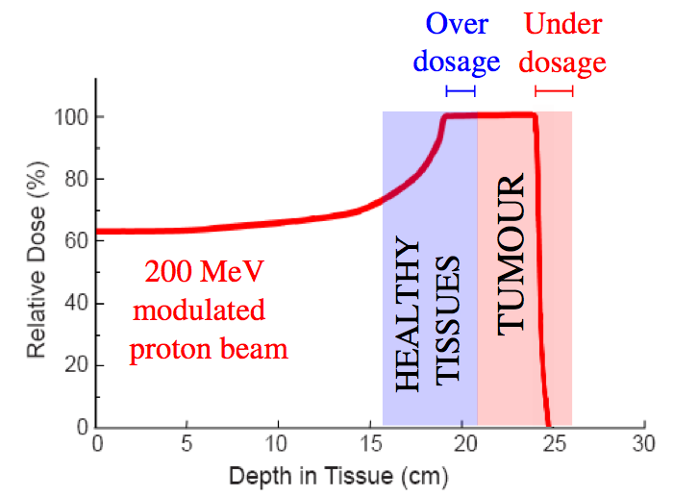
Introduction: particle therapy range verification
Particle therapy planning and delivery must ensure:
Complete target coverage with the prescribed dose
Sparing of the surrounding healthy tissues
Treatment planning accounts for range deviation
Range verification goals:
Verify in-vivo the patient irradiation
Help clinicians in scheduling treatment replanning when needed
Provide a further layer of safety
Zhu X, Fakhri GE. Theranostics. 2013;3(10):731-740.
Notes:
As you know, in short the energy loss of charged particles in the matter allows to precisely cover the tumor while sparing as much as possible the healthy tissues surrounding. This happens of course thanks to the bragg peak. But if the tissues properties are different with respect to what was calculated during the treatment planning, there is the risk of under-dosing the target volume and over-dosing the healthy tissues. To tackle this, safety margins are considered in TP and verification CT during the treatment. In this context, treatment quality assessment and range verification would be a welcome tool to verify in-vivo the irradiation, and then help clinicians in re-scheduling treatment planning, increase the treatment safety, reduce the safety margins and so on

Slide 3
Outline
Prompt gamma timing offers time information about the prompt photon emission during proton therapy
What happens when there are multiple detectors at different longitudinal position?
We describe a new algorithm reconstructing the space versus time photon emission
We test the algorithm for range measurement by means of Monte Carlo simulations
…we also have a bit of preliminary experimental results

Slide 4
z
t
Notes:
We are approaching the end of the conference, and maybe we are a bit tired. So, before diving into formulas, we can start with an example. There is a straight road, and we see a bike travelling. It is easy for us to measure its motion.

Slide 5
Notes:
But then the night comes. Luckily for us, the bike has a light, so we are still able to see the motion

Slide 6
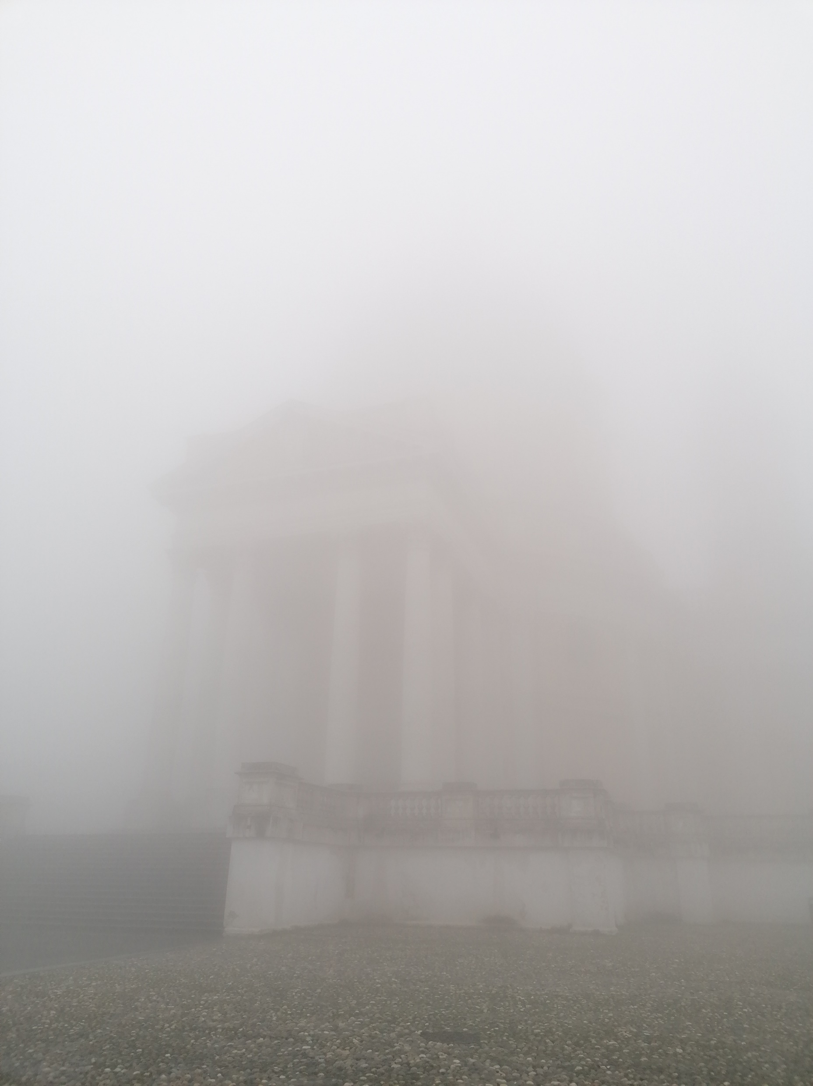
Notes:
So you know, we're in northern Italy here, and we have plenty of fog. What we see now is something very very blurred

Slide 7
Notes:
So you know, we're in northern Italy here, and we have plenty of fog. What we see now is something very very blurred

Slide 8
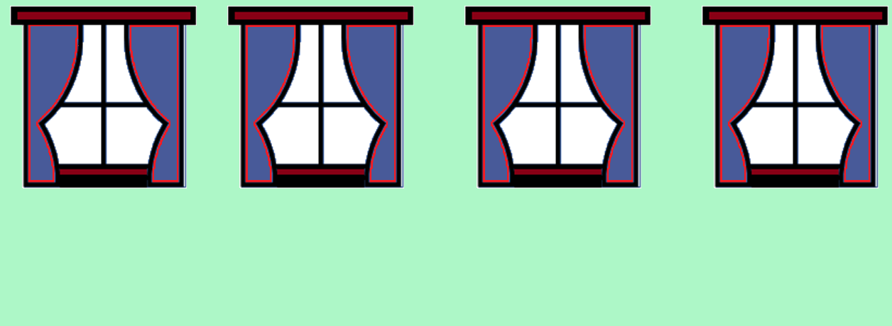
?
z
t
Notes:
Now we go inside our cozy home, we have a few windows to look outside. What we see now? A light coming from the windows, changing over time. Our problem here is to reconstruct the motion of the bike, with just the blurred information coming from the windows observation.
But, as you may now expect, our bike is travelling at relativistic speed….

Slide 9
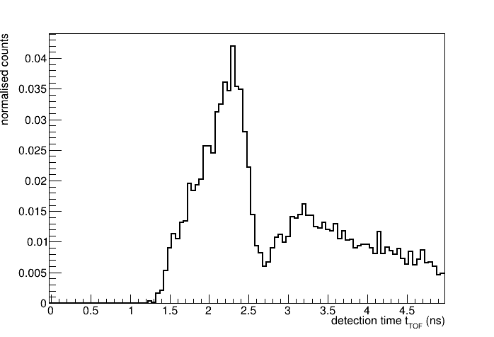
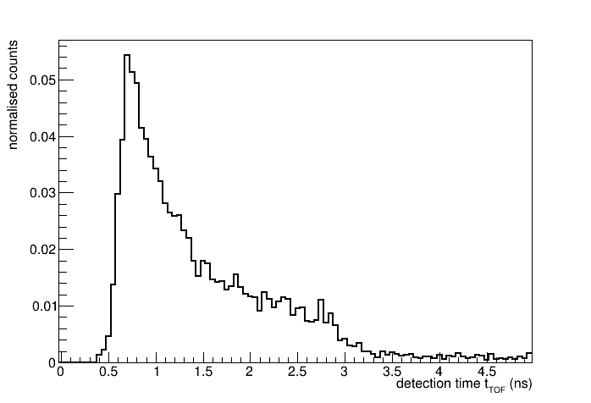
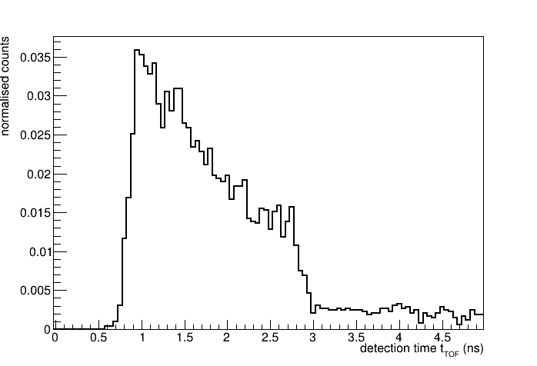
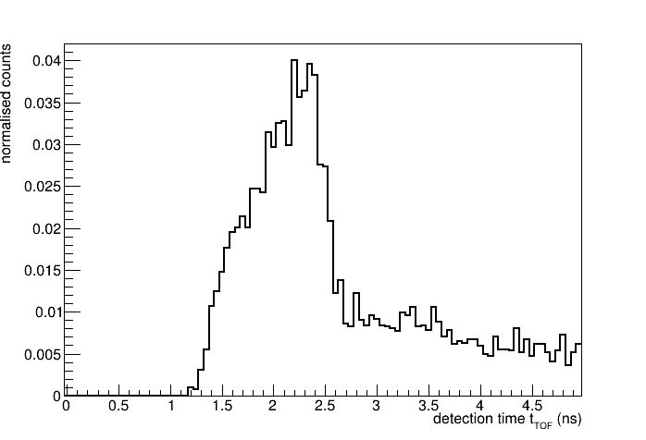
The Spatiotemporal Emission Reconstruction (SER) PGT problem
TOF start
Proton beam
TOF stop
TOF stop
Notes:
…our windows are particle detectors, and the light is some prompt photons emitted by a proton beam crossing a phantom, and everything is happening on nanosecond scale.
The protons cross a detector giving the start of a time measurement, we have a set of detectors around the phantom providing the measurement stop. For a given prompt photon emission, each detector measures a different time distribution which depends on its position with respect to the phantom and the beam.

Slide 10
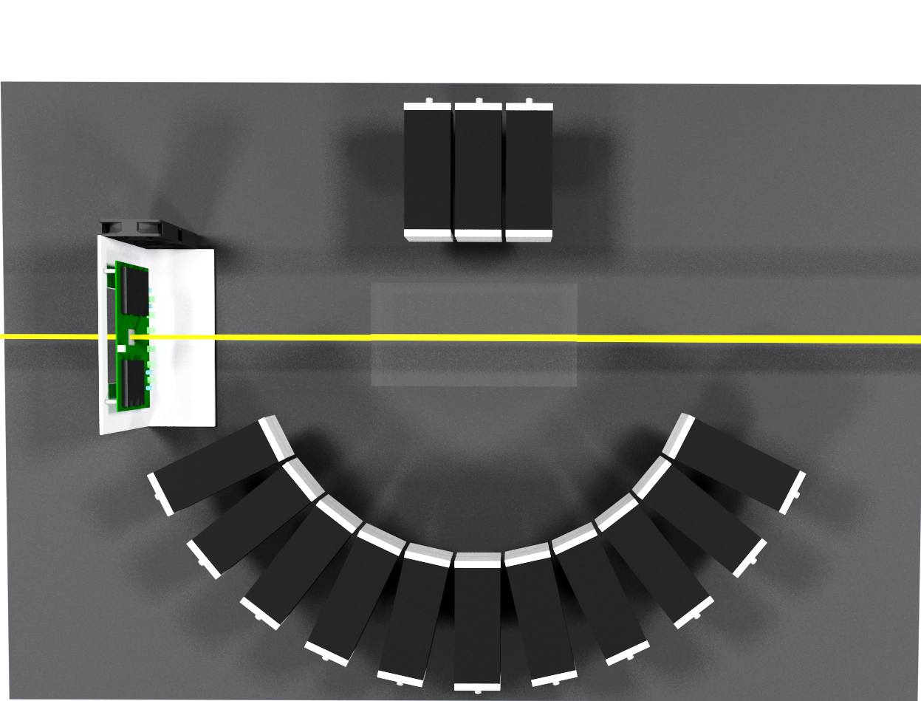
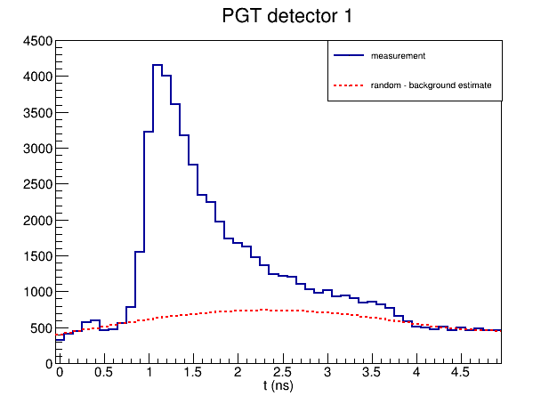
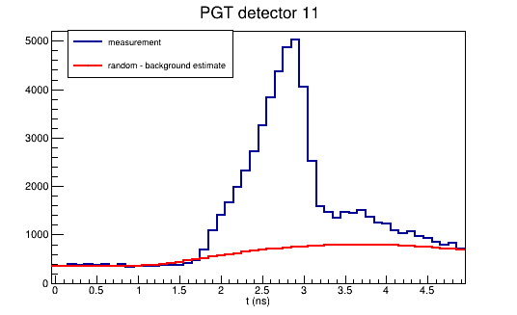
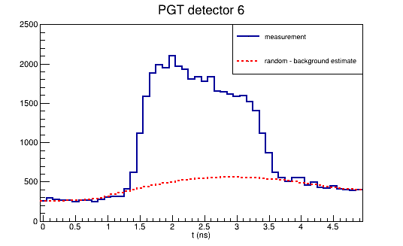
Multi-detector Prompt Gamma Timing (PGT) measurement
TOF start
Proton beam
TOF stop
TOF stop
Notes:
Now what is Prompt gamma timing? We implemented a multi detector version. We have a fast low gain avalanche diode silicon strip sensor on the beam, which very fast and allows single proton discrimination and measurement. We have also a set of scintillators around the target in different positions along the beam axis. What is measured is the distribution of the time of flight between the primary particles crossing the LGAD detector and the prompt photons interacting in the scintillator. What is measured depends on proton energy, target density and composition and on the position of each detector with respect to the target.

Slide 11
The Spatiotemporal Emission Reconstruction MLEM-based solution
Goal: from multi-detector PGT measurements to reconstruction of PG emission in space and time
Linear detection model
MLEM solution
Y
PGT detector N
PGT detector …
PGT detector 2
PGT detector 1
System Matrix element: probability of a photon emitted at spatial bin j and time bin p to be detected by detector d in time bin n
Y multi-detector PGT measurements
X PG emission (unknown)
B expected background in the data space
S sensitivity
k iteration index
Pennazio, F, et al. "Proton therapy monitoring: Spatiotemporal emission reconstruction with prompt gamma timing and implementation with PET detectors." PMB 67.6 (2022): 065005.
Notes:
So, now that we have seen the measurements, what can we do with them? First, we figured out that the detection can follow a linear model, where H is our model, X is the unknow emission of prompt photons along the z axis and B is the unavoidable background.
Then we had to pass from the measurement to our goal that is to measure the emission, we realized that we could exploit background-corrected MLEM. The core of this part is the system model H, its elements corresponds to the probability distribution of a photon emitted at a certain depth and in a certain time to be detected in each time bin of the PGT spectra of each detector. When calculating the model, it is also possible to account for the timing resolution of the system.
Background estimation with Statistics-sensitive Non-linear Iterative Peak-clipping (SNIP) https://root.cern/root/htmldoc/guides/spectrum/Spectrum.html#dimensional-spectra

Slide 12
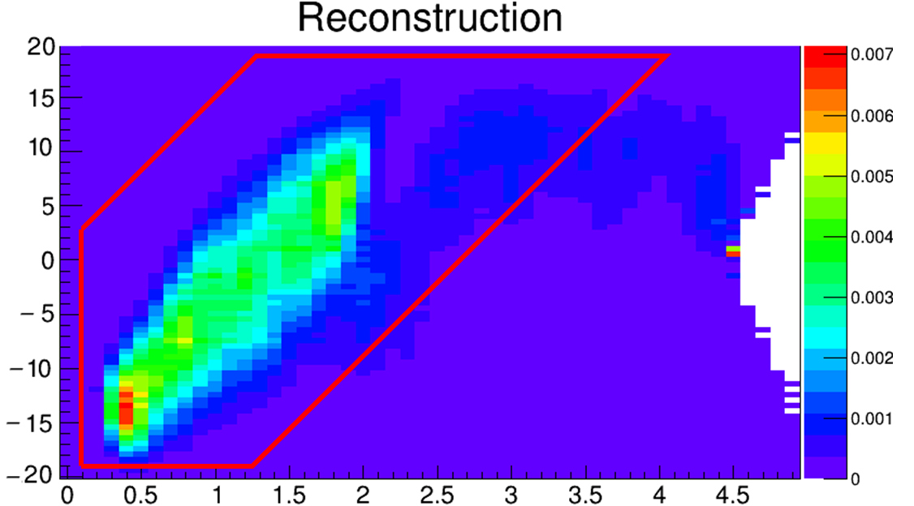
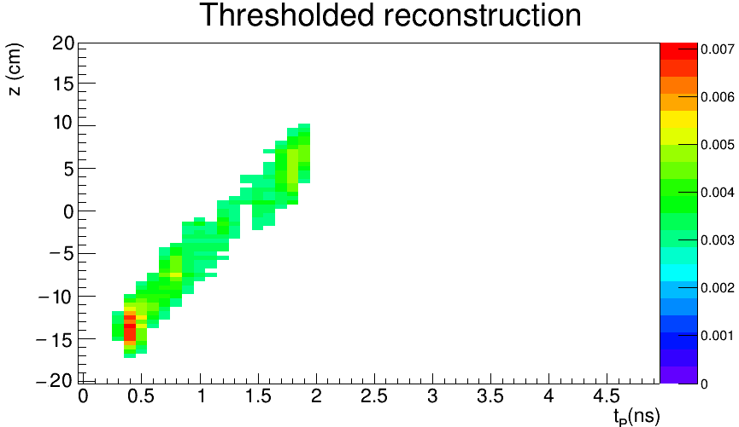
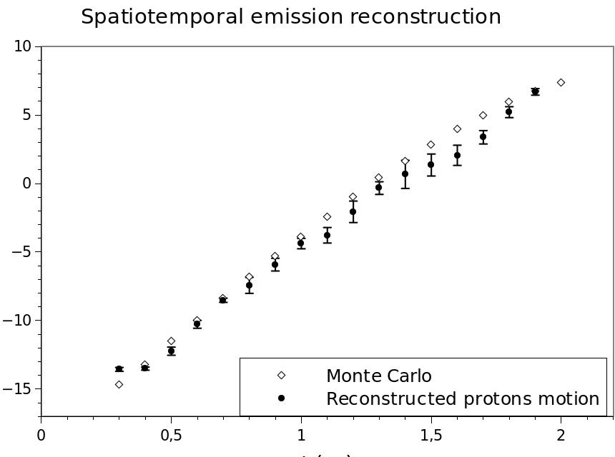
Parameter optimization and post-processing of reconstructed emission
threshold
z(cm)
z(cm)
free parameter: number of MLEM iterations
free parameter: threshold wrt maximum
profile
t(ns)
t(ns)
F. Pennazio et. al, Proton therapy treatment monitoring: Prompt Gamma Emission Reconstruction in the time and space domain, IEEE 2022 NSS MIC and RTSD Conference, Milano, Italy
z(cm)
Reconstructed range
t(ns)
Notes:
After very few iteration the depth versus time shows up, and with it we have our first free parameter, which is the number of iterations to early-stop the MLEM algorithm. Don't pay too much attention to the details of the plot now. Then we focus our attention on the actual emission zone discarding obvious artifacts and we apply a threshold with respect to the maximum intensity, and here comes our second free parameter. Lastly we calculate the average of each column of this istogram and what we obtain is the depth versus time emission of the prompt photons, which basically is the proton motion inside our target.
As you know, it is the ionization energy loss that on average rules the proton motion inside the target, in other words with this distribution we have a direct probe on the electromagnetic stoppoing power.
Last, the point at the maximum z on this plot is the particle range.

Slide 13
Experimental setup
About 2.9-6.6 E7 irradiated protons
Proton beam 226.9 MeV
Average rate about 2 – 4 E 7 pps
14 x MERLINO detectors: LaBr₃ cylinder scintillator 3.81 cm diameter 3.81 cm height + PMTs
EXPECTATION
LGAD¹ silicon sensor 8 strip + fast amplifier board
15 x 15 x 30 cm³ PMMA target
1. Cartiglia, N., et al. "LGAD designs for future particle trackers." NIM A 979 (2020)
Notes:
LGAD 8 strips 2 mm2 each, Silicon on Silicon (non epytaxial), high resistivity (> 3000 ohm x cm), active thickness 60 um, thickness 630 um full, depletion 23 V. Gain less than10, it depends on polarization actually used, it is actually around 6-8.

Slide 14
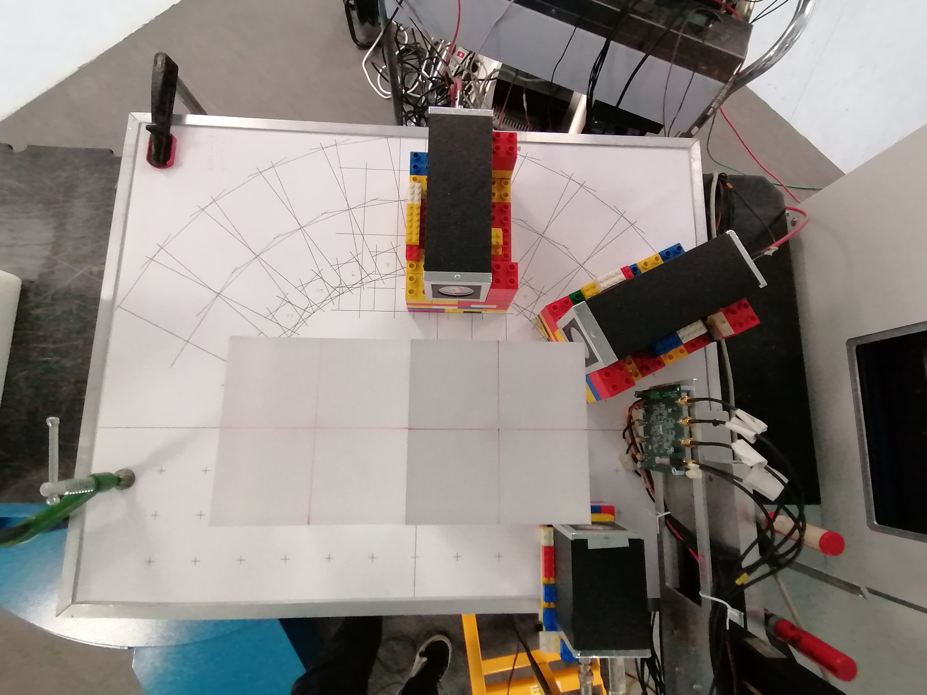
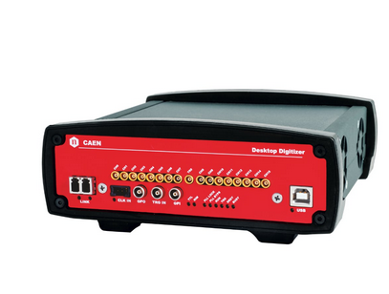
Experimental setup
2 x MERLINO detectors in seven different positions
REALITY
LGAD silicon sensor 5 strip + fast amplifier board
Beam nozzle
CAEN DT5742 DRS-4 based, 8 channels @ 2.5 Gsample/s

Slide 15
Part I: Preliminary results of stopping power measurement
Generated with AI ∙ 7 novembre 2023 alle ore 3:28 PM https://www.bing.com/images/create/a-stream-of-many-plastic-balls-of-the-same-size/654ac80dd0104208907f59dcbec2b989?id=jzuka84w6HVe%2f1OMaZvcRg%3d%3d&view=detailv2&idpp=genimg

Slide 16
Experimental results: parameter optimization with homogeneous target
226.9 MeV proton range in PMMA = 28.0 cm
Error in range reconstruction wrt MLEM number of iterations and post-processing threshold
Post-processing threshold
Large stable region between 500 and 4000 iterations of range reconstruction error < 1 mm
number of MLEM iterations

Slide 17
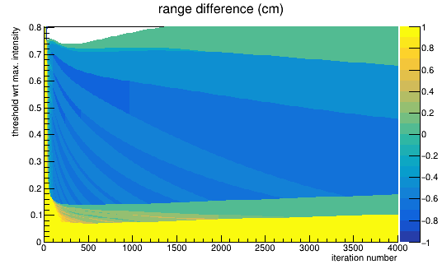
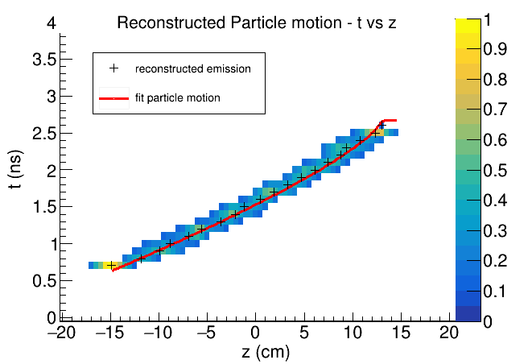
Experimental reconstruction of proton motion
Post-processing threshold
Preliminary result with 1k iteration, 0.12 threshold
number of MLEM iterations

Slide 18
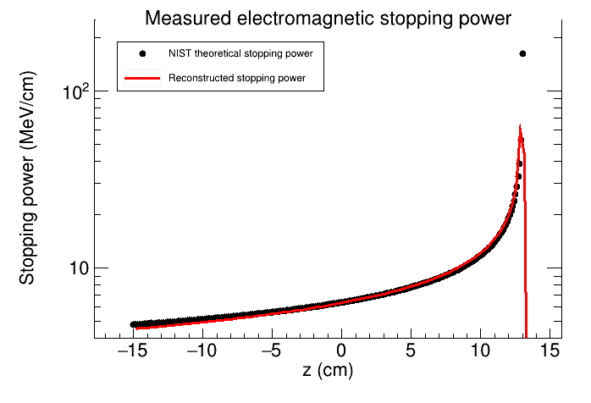
Reconstruction of stopping power
Particle range =
(T. Bortfeld 1997)
Boundary conditions: initial beam energy, target position, estimated range
error of stopping power ratio wrt water @ 100 MeV: 3.3%
mean relative distance to NIST pstar: 2.7 %
Details of the method: Ferrero V., Werner J., et al. "Estimating the stopping power distribution during proton therapy: A proof of concept." Frontiers in Physics 10 (2022): 971767.
Notes:
We wit the profile of the reconstructed emission with a motion model of time over position t(z) based on Bortfeld 1997
Initial kinetic energy, target position and the measured particle range range as boundary condition of fit
Evaluate stopping power equation with the parameters obtained from the fit.
The figures of merit are satisfactory, because if we compared the experimental results with the NIST pstar tables, we have that the error with respect to the stopping power ratio to water at 100 MeV is 3.3% and the mean absolute error with respect to the PMMA stopping power is 2.7%
The details of the method tested with simulations are in this publication.

Slide 19
Part II: Range measurement
Generated with AI ∙ 7 novembre 2023 alle ore 3:33 PM
https://www.bing.com/images/create/a-sheet-of-graph-paper-with-many-colored-rulers-on/654ac92734504570ae63daa3cbb547f9?id=olswNPnTIStOcXsT6K9ICw%3d%3d&view=detailv2&idpp=genimg
Notes:
Part 2: range measurement

Slide 20
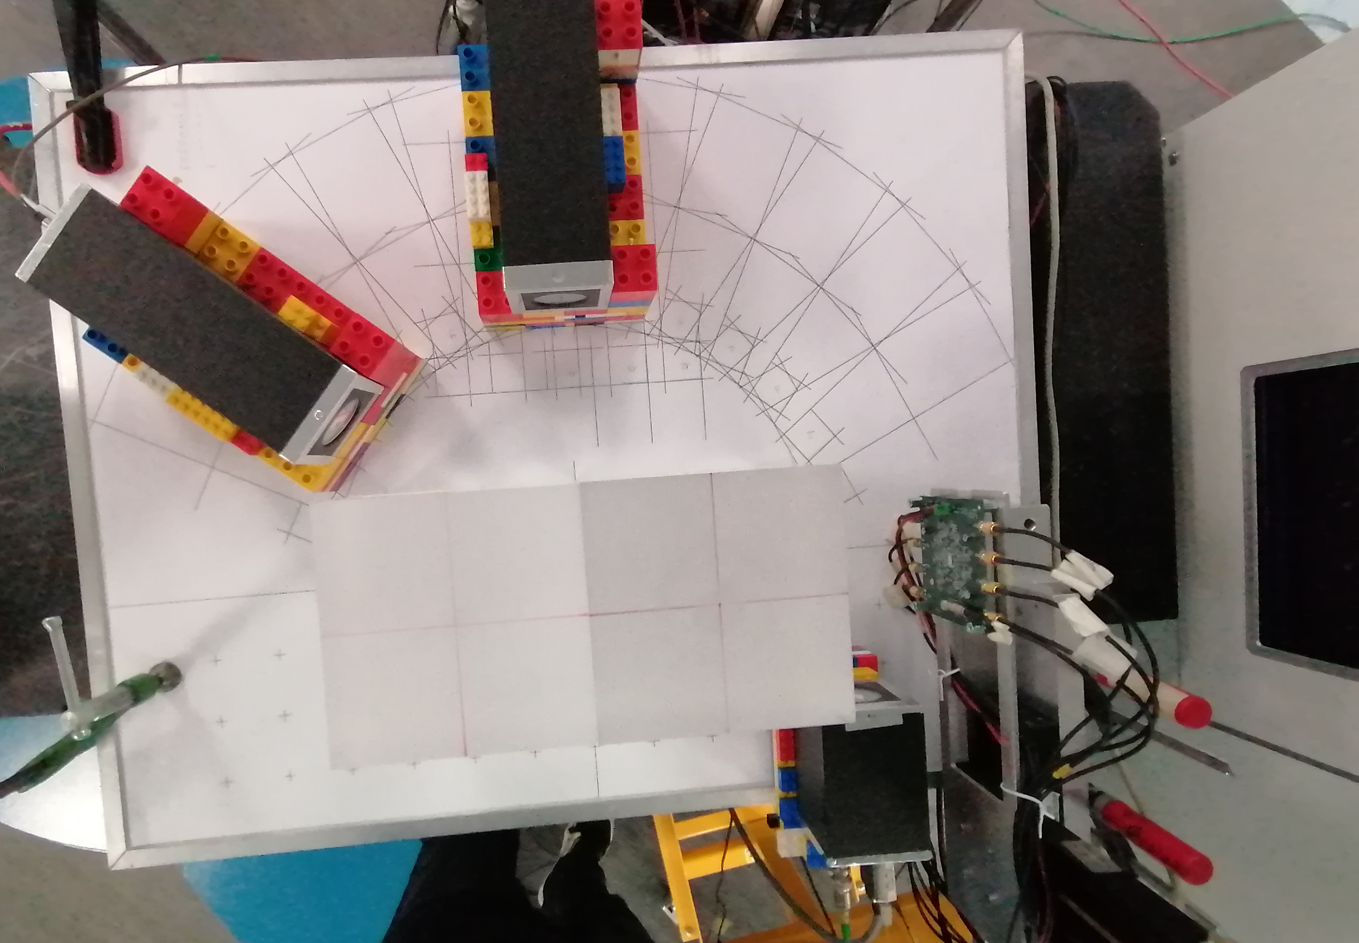
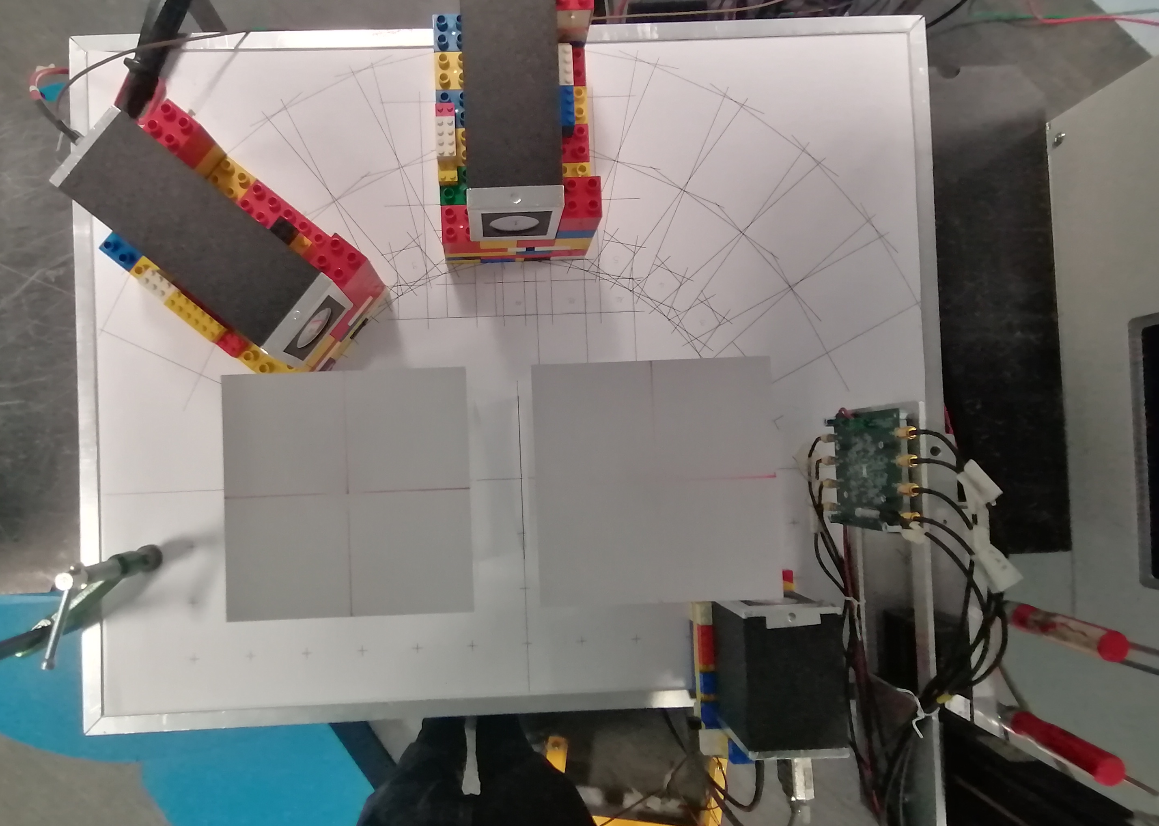
Range verification 1: setup
For range verification we compared two measurements setups:
Each setup measurement has been divided into 10 subsets about 2.9-6.6 E6 protons each
No prior information exploited
homogeneous PMMA
target with a 4 cm air cavity
Notes:
Now for range verification we pretend to forget everything that we exploited so far. We are dealing with the same dataset as before and a new one, which is the same irradiation but this time on a phantom with a 4 cm long air cavity. We divide the collected data into 10 subset, so each one corresponds to approximately 2.9 – 6.6 E6 protons each

Slide 21
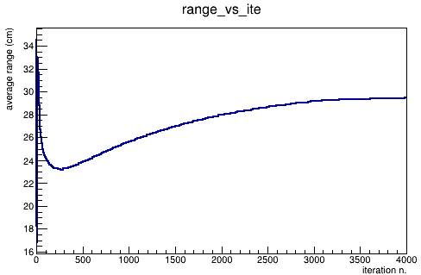
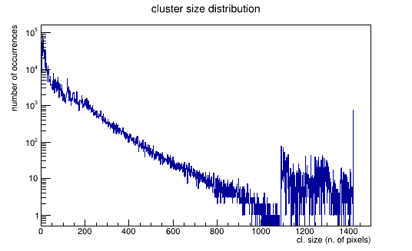
Range verification 2: training subset analysis
Blind analysis of the first subset of homogeneous target:
Minimum number of iteration for having a stable range measurement = 100
Number of pixels above threshold (cluster size) N 50 < N < 500
Notes:
First we observe the general behavior of the reconstruction.
The first feature that we notice is that the

Slide 22
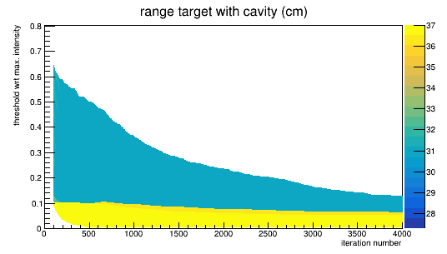
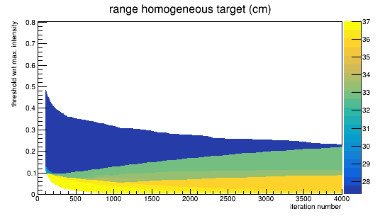
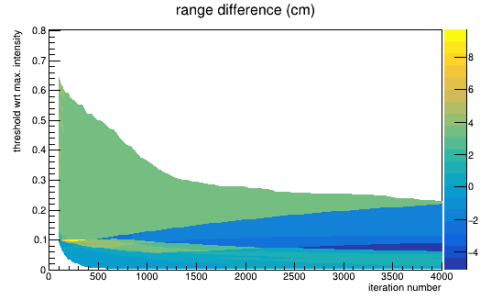
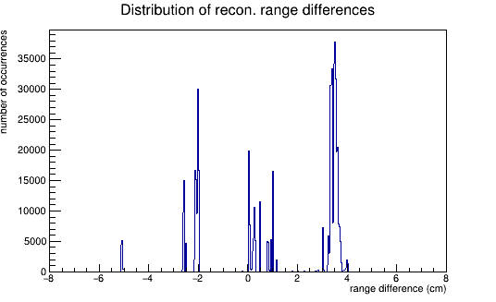
Range verification 3: range difference
Range difference for each (iteration number, threshold) pair
10 subsets of cavity phantom vs 10 subset homogeneous
-
=
10x
10x
10x
100x
100x
100x
Moving 1 cm wide window on the distribution to identify the peak
distribution
Results…

Slide 23
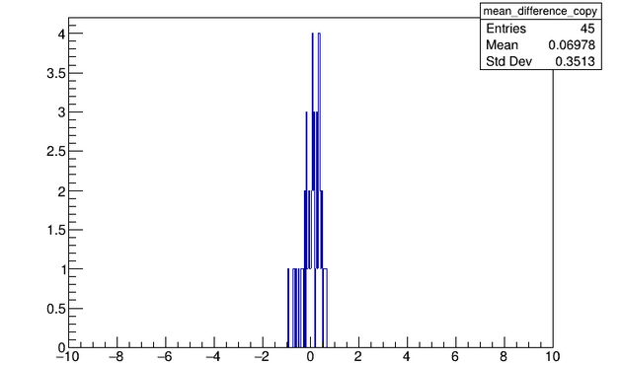
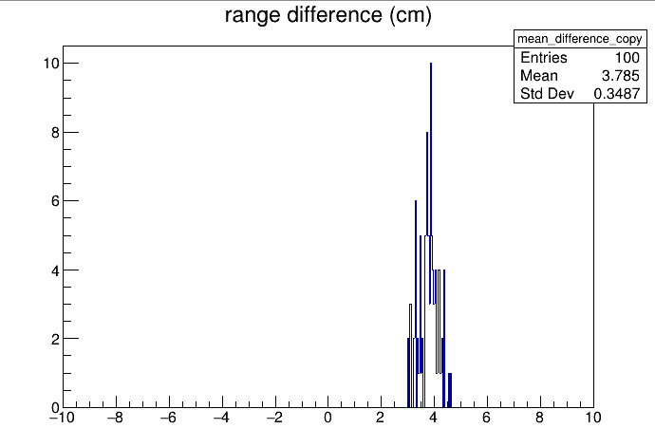
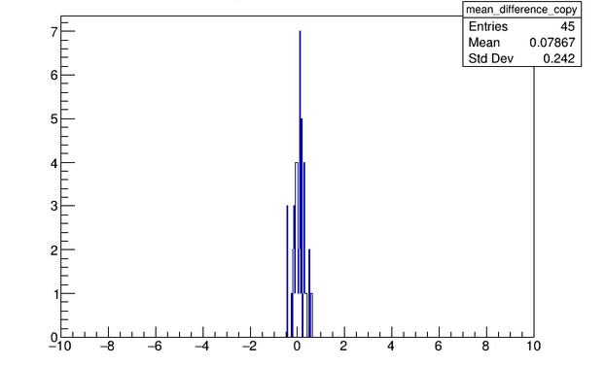
Range verification 4: results
Subsets of the same measurement
cavity
Comparison of subsets of different measurements
homogeneous
10 cavity subsets vs 10 homogeneous subsets (100 comparisons):
3.8 ± 0.3 cm, no outliers
Expected value: 4.0 cm
10 cavity subsets vs each other, 10 homogeneous subsets vs each other (49 comparisons):
0.08 ± 0.3 cm, no outliers
Expected value: 0.0 cm

Slide 24
Conclusions
First experimental verification of the SER-PGT algorithm with homogeneous targets
LGAD fast detectors on beam line to measure TOF starts allows measurements of each primary particle time
Emission reconstruction corresponds to proton motion inside the target
Fit of proton motion model and kinematic-based stopping power measurements
Preliminary results are very promising (3% agreement with NIST values)
Splitting data into subsets allows uncertainty estimation in range difference measurements with a cavity phantom
Error of -0.2 ± 0.3 cm
Spatio-temporal emission reconstruction allows the reconstruction of the average beam particle motion inside a target.
This study is supported by the INFN Group 5 Young Investigators Grant MERLINO, N. 23246/21 and by the DFG Grant PROSIT, N. 383681334

Slide 26
The Spatiotemporal Emission Reconstruction MLEM-based solution
Goal: from multi-detector PGT measurements to reconstruction of PG emission in space and time
$y_{nd}$: number of detections in temporal bin n of detector d
$h_{ndjp}$ (system matrix element): probability of an emission in spatial bin j emitted in time bin p to be detected in detector d in time bin n
Maximum Likelihood Expectation Maximization (ML-EM) with background compensation $$x_{jp}^{(k+1)}=\frac{x_{jp}^{(k)}}{s_{jp}}\sum_{d}{\sum_{n}{\frac{y_{dn}h_{ndjp}}{\sum_{j^{′}}{\sum_{p^{′}}{h_{ndj^{′}p^{′} }x_{j^{′}p^{′}}^{(k)}}}+\overline{b_{nd}}}}}$$
$x_{jp}$: emission at spatial bin j and temporal bin p
$s_{jp}$: sensitivity
$\overline{b_{nd}}$: expected number of background counts in temporal bin n of detector d
Implementation in C++ is fast
Pennazio, F, et al. "Proton therapy monitoring: Spatiotemporal emission reconstruction with prompt gamma timing and implementation with PET detectors." PMB 67.6 (2022): 065005.

Slide 27
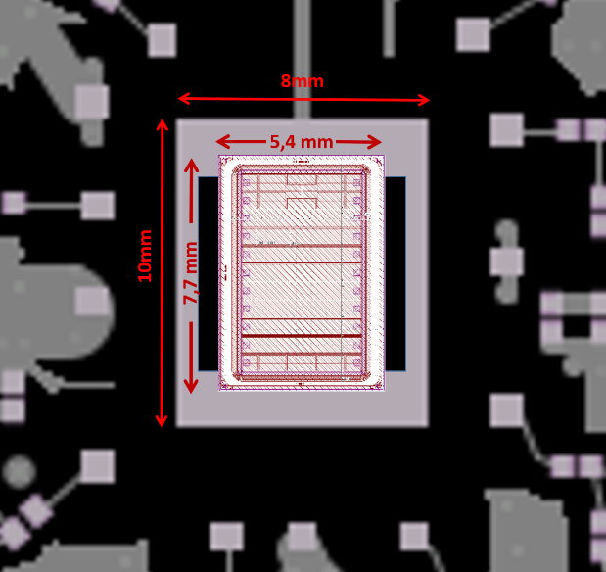
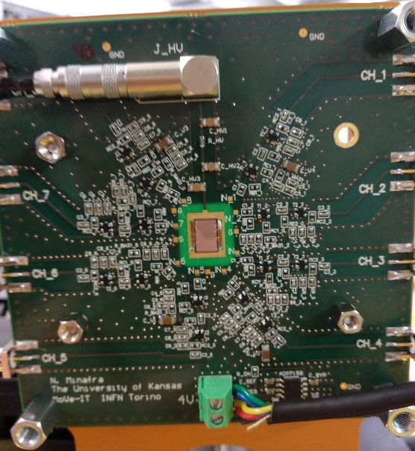
The LGAD and fast amplifier board
The board used for reading the sensor signal is an 8-channel board based on two stages of amplification specially optimized for our apparatus, as detailed below.
1. A hole was drilled on the board at the position of the sensor so as to minimize the material passed through, thus the energy loss and beam deflection. The sensor rests on the board only along the short sides of the sensor.
2. The dynamic range of the charge (3-150 fC) was defined based on the signal produced by clinical proton beams (60-250 MeV) in sensors with a gain of 10.
3. Short signal duration (~2 ns) and fast pedestal recovery were set to allow separation of single proton signals at high fluxes (up to 10E9 p/s cm2; i.e., > 10 MHz/ch)
4. 2.5-3 mV noise; 24-30 signal-to-noise ratio; 25-30 ps jitter.
5. Time resolution on single protons of a few tens of ps after applying corrections of time dependence on input charge (Constant Fraction Discrimination algorithms).
6. Input capacitance of 4 pF per channel.
Isidori, T, et al. "Performance of a low gain avalanche detector in a medical linac and characterisation of the beam profile." Physics in Medicine & Biology 66.13 (2021): 135002.

