Slide 1



WP2: PET-PGT detector
HONEY kick off meeting 2023, November 17th
Elisa Fiorina

Slide 2
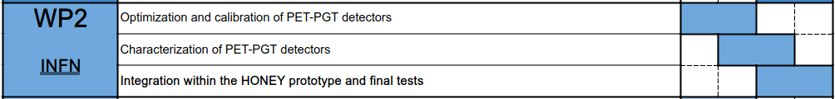
WP2
Develop and build PET-PGT detectors
Characterization, configuration and test on CPT beams
Strong collaboration with WP1, WP3, WP4
Deliverables:
D2.1: Characterization of detector separately working in PET and PGT modalities (M18)
D2.2: Final PET-PGT system and integration in the HONEY prototype (M24)

Slide 3
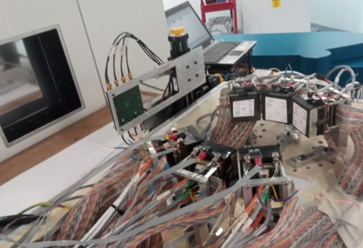
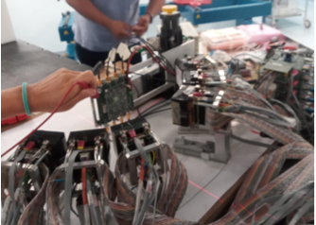
Detectors
I3PET detector
PET-PGT
Pixelated LFS + SIPMs
Read out: TOFPET2 ASIC
Clinical rate feasible
(data acquired in 2022 July)

Slide 4
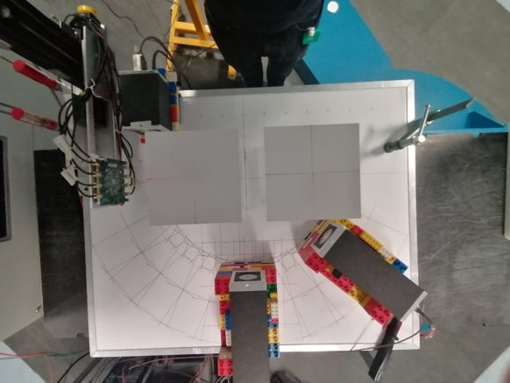
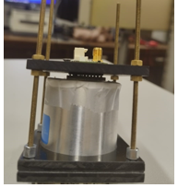
Detectors
I3PET detector
PET-PGT
Pixelated LFS + SIPMs
Read out: TOFPET2 ASIC
Clinical rate feasible
(data acquired in 2022 July)
MERLINO detector
PGT
Monolithic LaBr3 + PMT
Time resolution = 100 ps
Read out: digitizer
(proton) clinical rate not feasible
SIG detector
PGT
Monolithic LaBr3 + PMT
Read out:
discriminator + CFD + picoTDC(cern)
Clinical rate feasible (to be proven – next beam test in December)

Slide 5

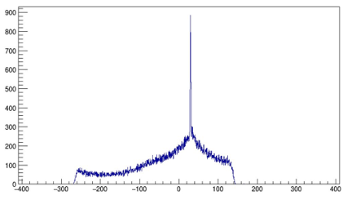

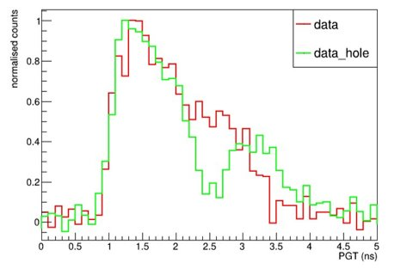
MERLINO results
beam
TOF distributions
beam

Slide 6
Next 6-12 months
Characterization of I3PET setup in lab
Analysis of PGT data acquired in 2022: is clustering feasible for PGT application?
Advanced software analysis for delay correction
Design a preliminary test of TOFPET2 ASICs– DAQ FPGAs data management
Open issues?
Calibration in laboratory. New radioactive sources @ Unito? Sources available are not enough in the case of LFS crystals (high radiation background)
Improvement in FE electronics. New ASICs available (e.g. ALCOR) and new project funded (MET prin)
New personnel hired by Autumn 2024

Slide 7
To be discussed
WP leaders
Beam test
Units budget
CUP

