Slide 1



Welcome and project summary
HONEY kick-off meeting 2023, November 17th
Elisa Fiorina

Slide 2
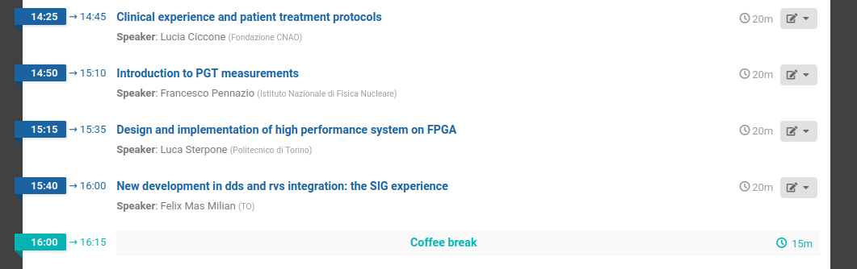
Meeting schedule

Slide 3

Hybrid ONline tEchnologY for particle therapy
AIM
Improving beam monitoring and in-vivo range verification in Charged Particle Therapy (CPT) developing hybrid technology
Institution involved: INFN, UniTo, PoliTo, Fondazione CNAO
Duration: 2 years (2023.09.28 - 2025.09.27)
Budget: about 210 kE
CLINICAL ENVIRONMENT
BEAM MONITORING
SECONDARY RADIATION DETECTORS
DATA ACQUISITION SYSTEM

Slide 4
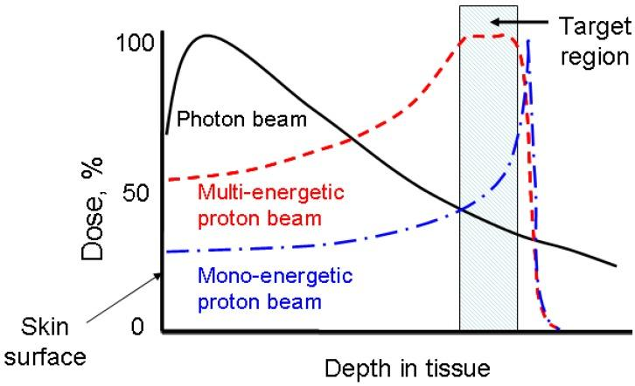
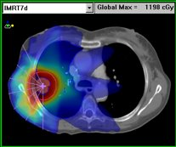
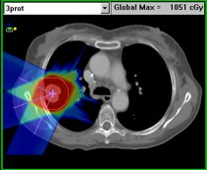

Charged Particle Therapy
favourable depth dose deposition (Bragg peak)
+
enhanced radiobiological effectiveness for heavier ions
=
reduced integral dose
better sparing of organs-at-risk
reduced toxicity​
lower secondary malignancy risk​
increased tumor local control

Slide 5
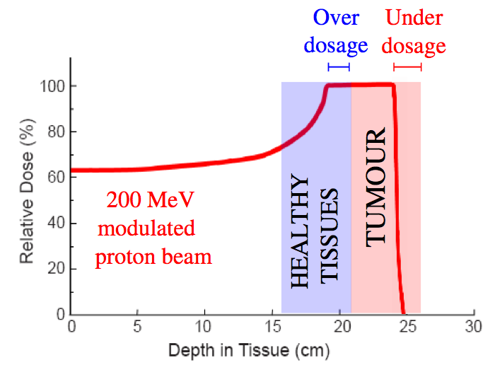
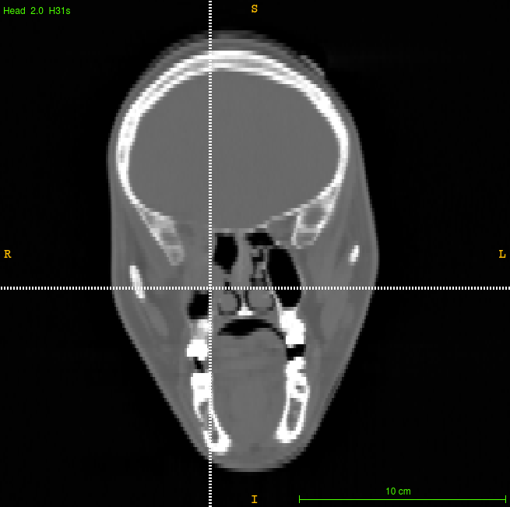
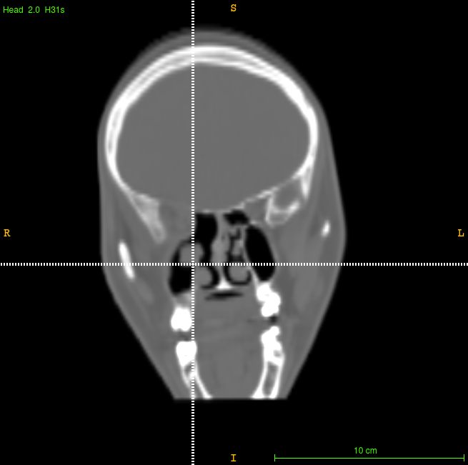
Why in-vivo range verification system?
Clinical motivation!
Planning CT
Control CT
Patient affected by ACC (Adenoid Cystic Carcinoma), treated at CNAO with protons, enrolled into the INSIDE clinical trial
Zhu X, Fakhri GE. Theranostics. 2013;3(10):731-740.
Interfractional morphological changes
See Lucia's talk!

Slide 6
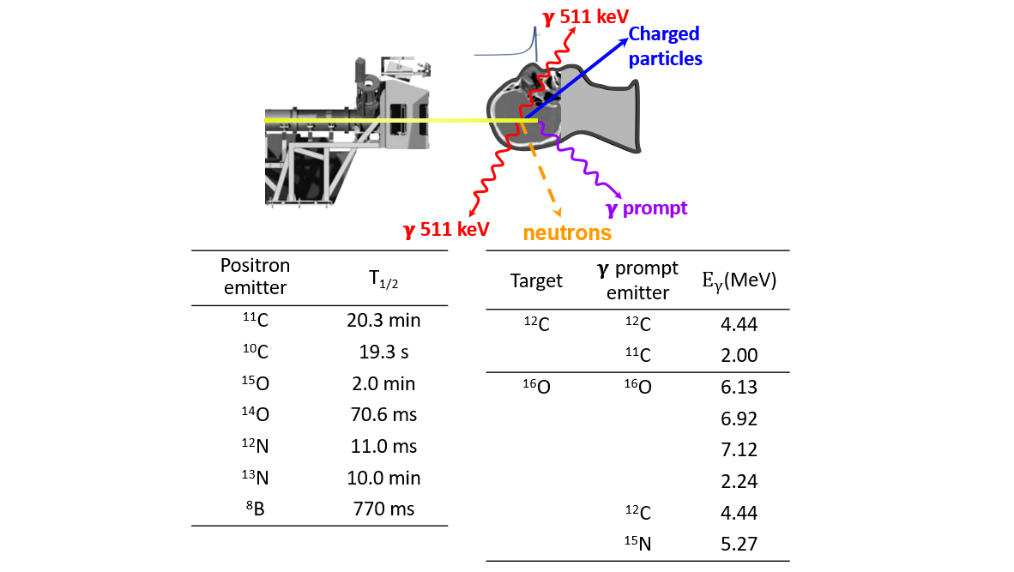
How? Exploiting secondary radiation!

Slide 7
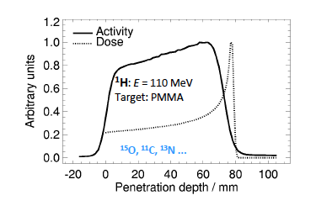
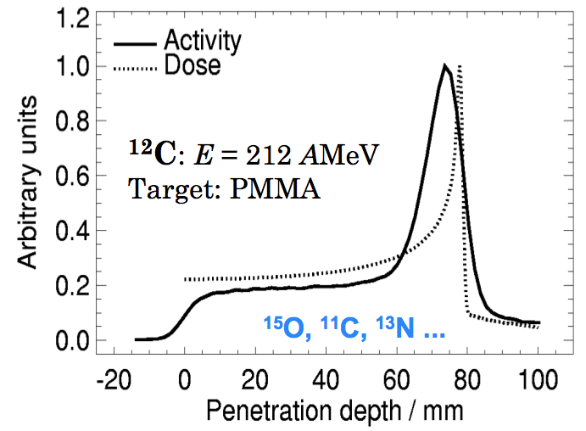
Positron emitters
Protons
Carbon ions
J Pawelke et al., Proceedings IBIBAM, 26.-29.09.2007, Heidelberg

Slide 8
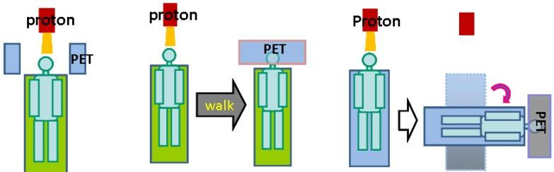
Positron emitters
Protons
Carbon ions
J Pawelke et al., Proceedings IBIBAM, 26.-29.09.2007, Heidelberg
in-beam PET
off-room PET
in-room PET

Slide 9
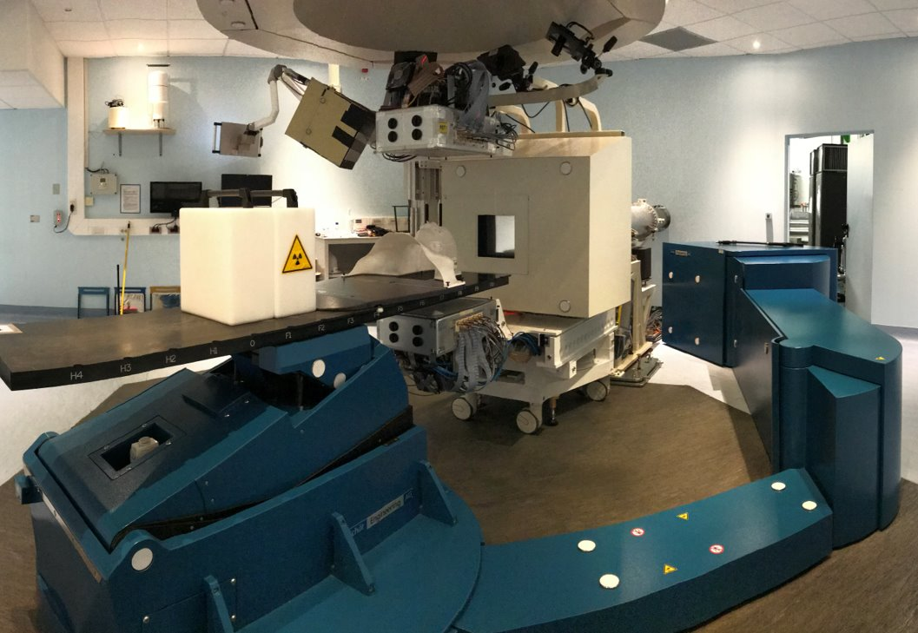
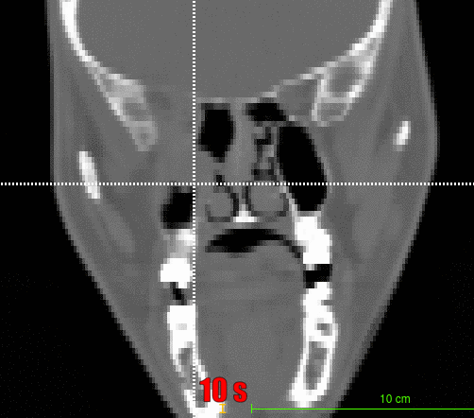
The INSIDE PET experience
Patient ID: 006P: female, 39y, affected by ACC, IMPT, CTV dose: 70 GyE in 35 fx (2.0 GyE/fx, 5 fx/week), two beams (15° - 175° IEC)
planning CT
control CT - 20 fx
beam​
beam​
in-beam PET image - 2 fx
In-beam PET image - 21 fx

Slide 10
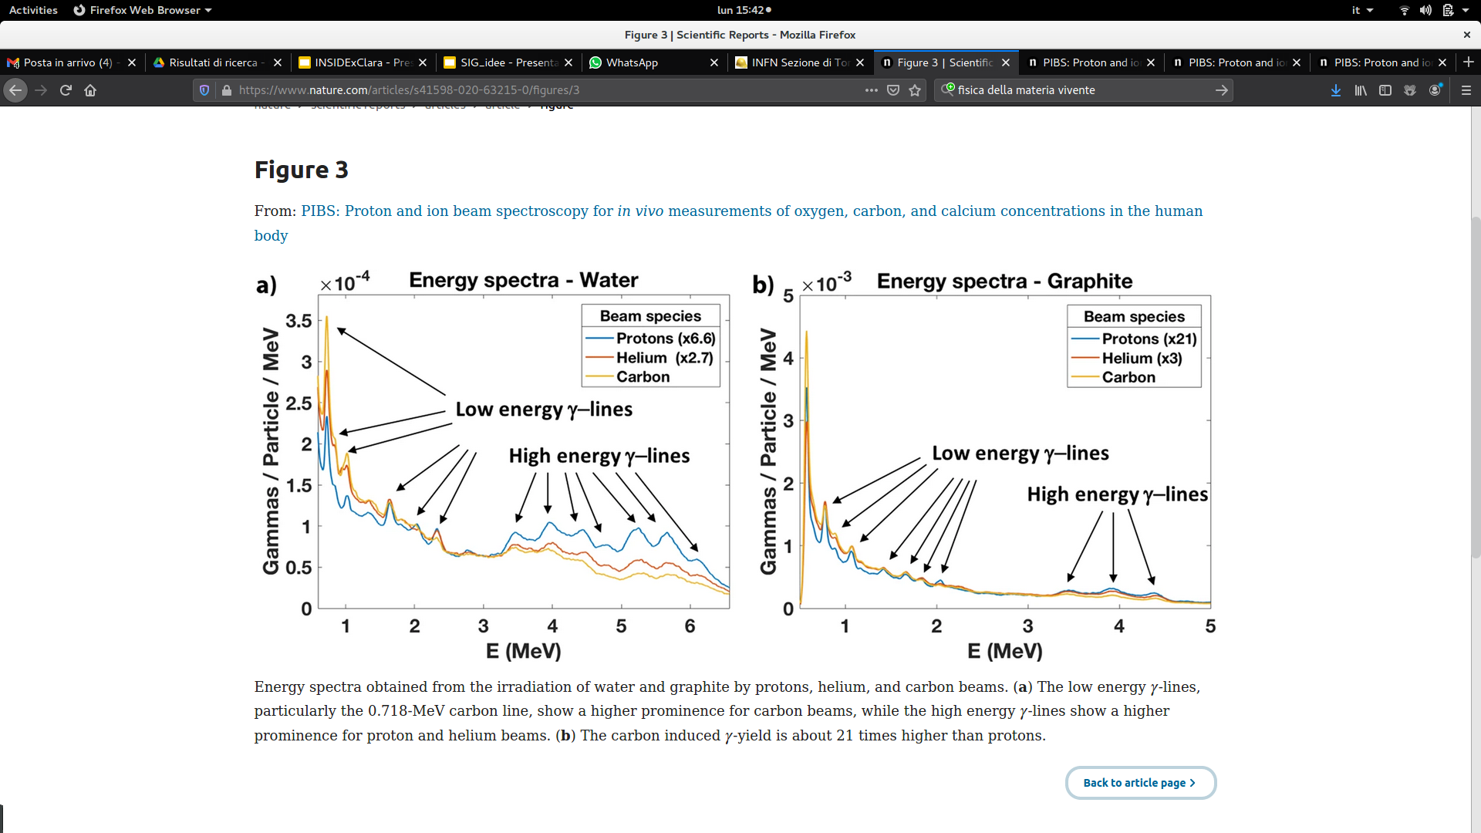
Prompt photons
Magalhaes Martins, P. et al., Sci Rep 10, 7007 (2020)
10

Slide 11
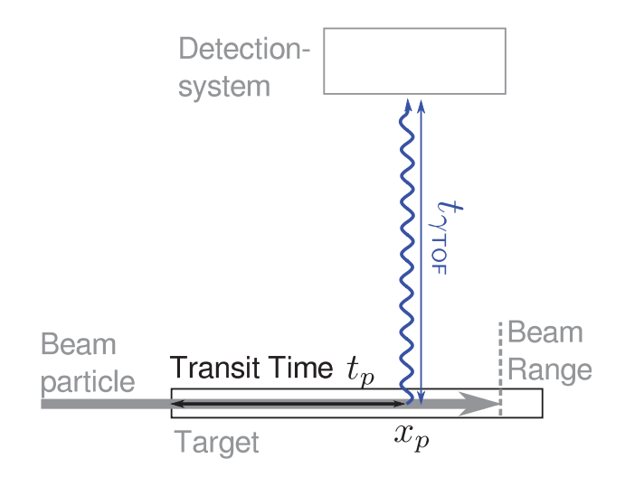
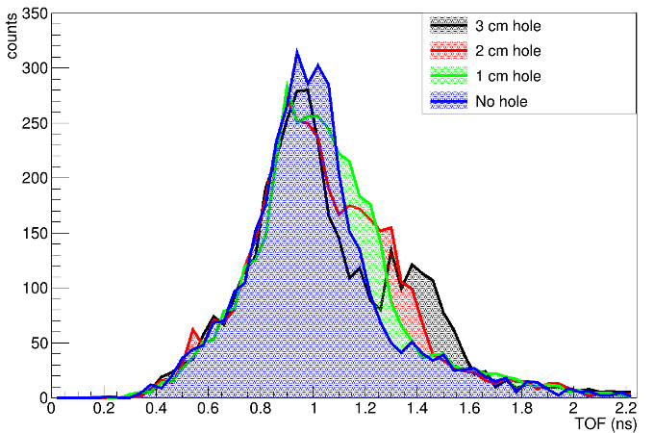
Prompt photons
Magalhaes Martins, P. et al., Sci Rep 10, 7007 (2020)
PROMPT GAMMA TIMING (PGT)
Golnik et al., PMB (2014)
Ferrero et al., TRPMS (2019)
11

Slide 12
HONEY project
CLINICAL ENVIRONMENT
BEAM MONITORING
SECONDARY RADIATION DETECTORS
DATA ACQUISITION SYSTEM
… let's develop an hybrid prototype keeping in mind clinical application (limitations & requirements)

Slide 13
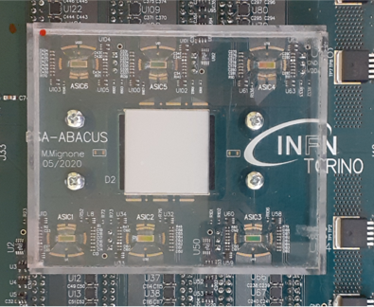
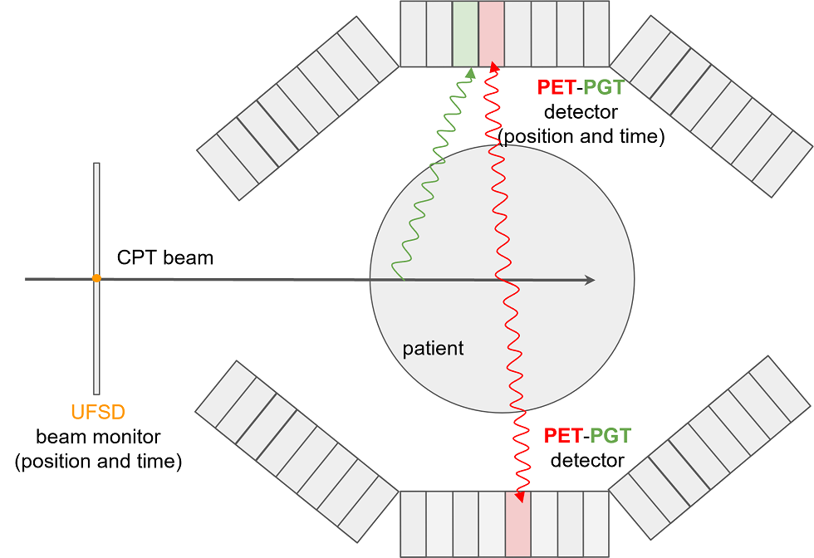
HONEY prototype
WP1
BEAM MONITOR
UFSD/LGAD strip sensors
(previous proj: MoVe-IT)
See Felix's talk!

Slide 14
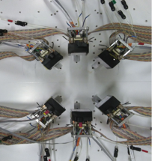
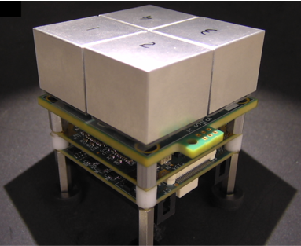
HONEY prototype
WP1
WP2
PET-PGT DETECTORs
LFS + SiPM read out by TOFPET2 ASICs
(previous proj: I3PET)
BEAM MONITOR
UFSD/LGAD strip sensors
(previous proj: MoVe-IT)
See Felix's talk!

Slide 15
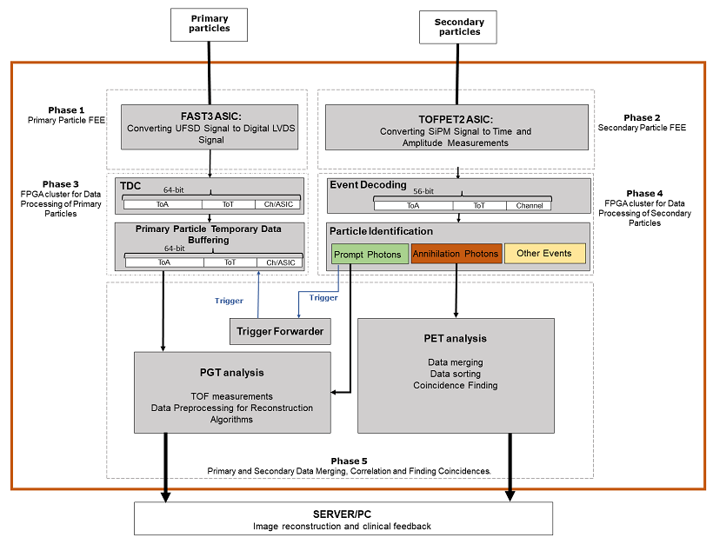

HONEY prototype
WP3
DAQ
FPGA-based
Time measurement of single primary particle
Trigger based on PET-PGT signals
Data synchronization
See Luca's talk!

Slide 16

HONEY prototype
WP3
DAQ
FPGA-based
Time measurement of single primary particle
Trigger based on PET-PGT signals
Data synchronization
See Francesco's talk!
WP4
ONLINE ANALYSIS
Data selection for reconstructing PET and Prompt Gamma Timing images during irradiation
See Luca's talk!

Slide 17
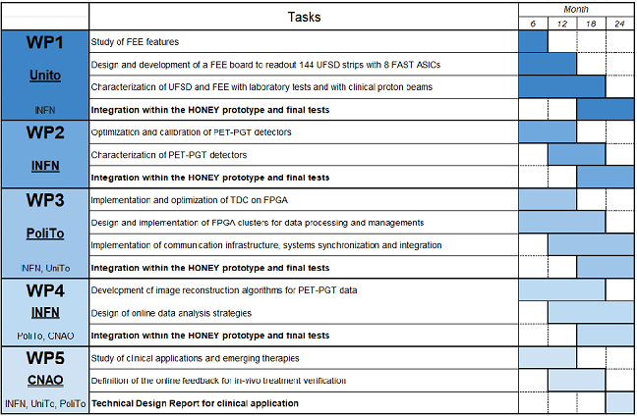
HONEY units & GANTT
INFN Torino
[Fiorina (PI), Pennazio, Giordanengo]
Responsible for PET-PGT detectors(WP2) and online data analysis (WP4)
Università di Torino
[Vignati, Sacchi]
Responsible for beam monitoring (WP1)
Politecnico di Torino (DAUIN)
[Rebaudengo, Portaluri]
Responsible for DAQ system (WP3)
SUB-UNIT
Fondazione CNAO
[Ciccone]
Responsible for study of clinical applications (WP5)

Slide 18
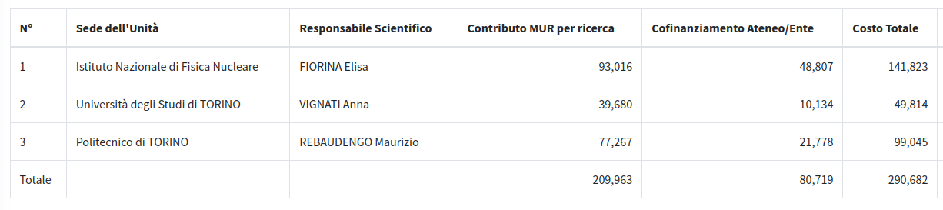
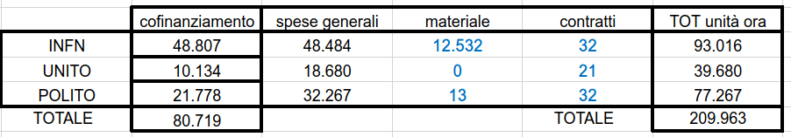
HONEY budget
FAST3 and FE board
FPGA

Slide 19
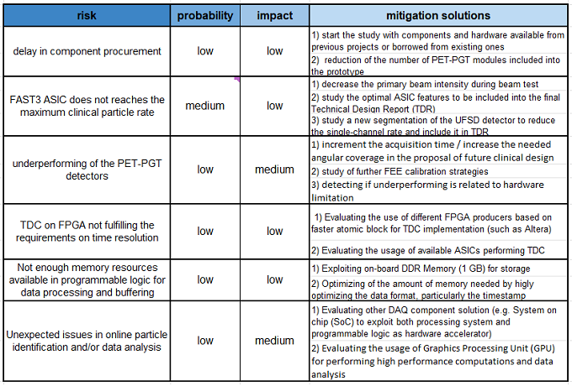
HONEY risk analysis

Slide 20

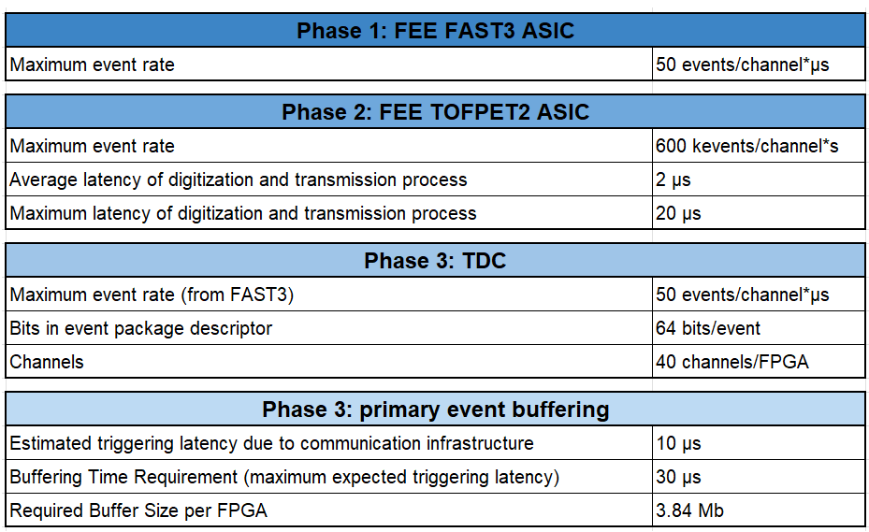
HONEY in numbers
DAQ system
Beam monitor
144 strip
Pitch
Size
Opt. time resolution (PGT) = 50ps
PET-PGT detector
6 modules
LFS criystals
Opt. time resolution (PGT) = 100ps
24 TOFPET2
12 eval. boards Artix 7
UDP data protocol @ Gbit ETH
Clinical Environment
2E9 pps: average proton rate
5E7 pps: average carbon ion rate
Instantaneous rate 10-100 times higher

