Slide 1
Radiative corrections in
two-photon event generator
Leonid Kardapoltsev
Budker Institute of Nuclear Physics

Slide 2
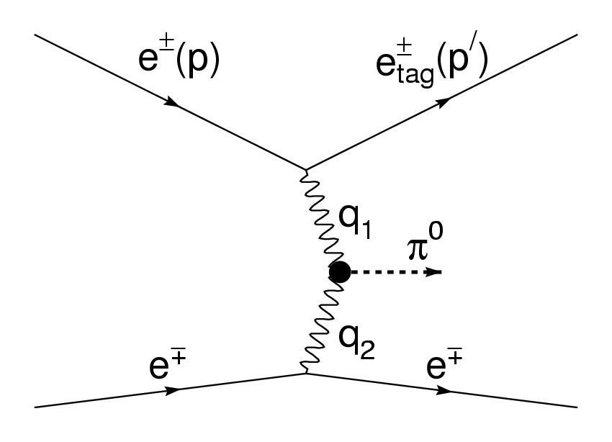
In the two-photon process e⁺e⁻→ e⁺e⁻ P, virtual photons radiated by colliding electrons produce C-even resonance.
For pseudoscalar meson production cross section depends on only one form factor F(q₁²,q₂²)
which describes the γ*γ* → P transition.
P
No-tag mode
both electrons are undetected
resonance Γ_{γγ} and mass can be measured
Single-tag mode
one of electrons is detected
Q²=- q₁², dσ/dQ²~ 1/Q⁶ for π⁰, cross section decreases rapidly with Q² increase
transition form factor F(-Q²,0) can be measured

Slide 3
In the two-photon process e⁺e⁻→ e⁺e⁻ P virtual photons, radiated by colliding electrons, produce C-even resonance.
For pseudoscalar meson production cross section depends only on one form factor F(q₁²,q₂²)
which describe the γ*γ* → P transition
P
No-tag mode
Radiative correction less then 1%
M.Defrise, S. Ong, J. Silva and C. Carimalo, Phys. Rev, D 23, 663 (1983)
W.L. van Neervan and J.A.M. Vermeseren, Nucl. Phys. B 238, 73(1984)
Single-tag mode
At large Q² radiative correction may reach several percents. And for good precision it should be taken into account.

Slide 4
The transition form factor is determined from the measured differential cross section and the MC calculated cross section
The radiative correction modifies not only the cross section but also Q². Emission of photons by electrons changes momenta of final particles and as a result changes Q². So such effects also should be simulated.

Slide 5
The process-independent correction for a single-tag two-gamma experiment was obtained by S.Ong and P.Kessler, Phys.Rev. 38 (1988)2280. The following diagrams for the tagged electron were taken into account
dσ = dσ_{B}(1+δ) = dσ_{B}(1 + δ` + δ_{VP})
δ` includes the virtual correction due to the interference between diagrams (a) and (c), and the correction due to real photon emission (diagrams (d) and (e)).
δ_{VP} , the vacuum polarization correction due to the interference between the diagrams (a) and (b)

Slide 6
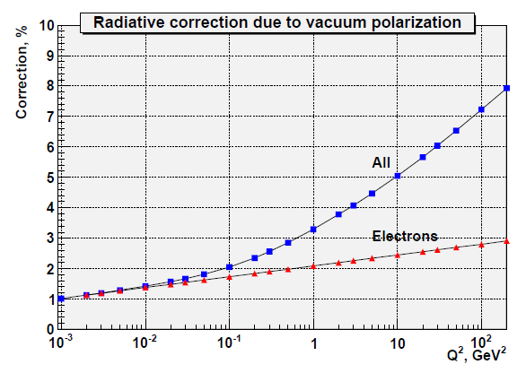
To obtain δ` we have used result of S.Ong and P.Kessler, Phys.Rev. 38 (1988)2280 for the total radiative correction, removing from it the contribution of the vacuum polarization diagram, since only electron contribution was taken into account in their paper.
where r_{max} = E_{γ max}/E_{b} , L = ln(Q²/m_{e}²)
For δ_{VP} we have used result of F.V. Ignatov PhD thesis, which includes the contribution from e, μ, τ leptons and hadrons.

Slide 7
Radiative correction δ` , %
Q² ( GeV² ) | r_{max} = 0.03 | r_{max} = 0.05 | r_{max} = 0.1
1 | -9.1 | -7.4 | -5.2
10 | -10.6 | -8.6 | -6.0
100 | -12.1 | -9.8 | -6.8
Total radiative correction δ = δ` + δ_{VP}, %
Q² ( GeV² ) | r_{max} = 0.03 | r_{max} = 0.05 | r_{max} = 0.1
1 | -5.9 | -4.3 | -2.0
10 | -5.6 | -3.7 | -1.0
100 | -4.8 | -2.6 | +0.4
δ` and δ_{VP} have opposite signs and partly compensate each other

Slide 8
For the simulation of the initial state radiation we represent the radiative correction in the form
where β = (α/π) ( L - 1 ) , r = E_{γ} /E_{b}
The function under the integral is the energy spectrum of photons in the soft photon approximation.
The simulation looks as follows :
ISR photon is simulated according to the integrand.
Final particles momenta (electrons and resonance) are simulated according to Born cross section with s’ = s(1-r)
Final particles momenta are boosted to laboratory frame

Slide 9
The FSR photon energy E_{γ} and angle θ_{γ} with respect to the electron direction are generated with
is the electron energy after radiation
The final meson four momentum is then modified to provide the energy momentum balance.

Slide 10
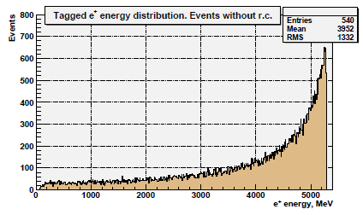
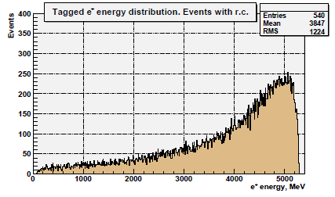

Slide 12
Conclusion
The radiative correction was taken into account in the event generator
Simulation of photons radiated by initial and final tagged electron was realized
This generator was used for measurements of π⁰, η, η’ and η_{c} transition form factors at BaBar
Systematic uncertainty due to radiative correction is ~1%
The detailed description of the generator can be found in
V.P.Druzhinin, L.V.Kardapoltsev, V.A.Tayursky
hep-ph 1010.5969v1

