Slide 1






Development of superconducting magnets for the future
Muon Collider
Daniel Novelli
Ph.D. in Accelerator Physics – XXXVIII cycle
24 October 2024
Funded by the European Union (EU). Views and opinions expressed are however those of the author only and do not necessarily reflect those of the EU or European Research Executive Agency (REA). Neither the EU nor the REA can be held responsible for them.

Slide 2
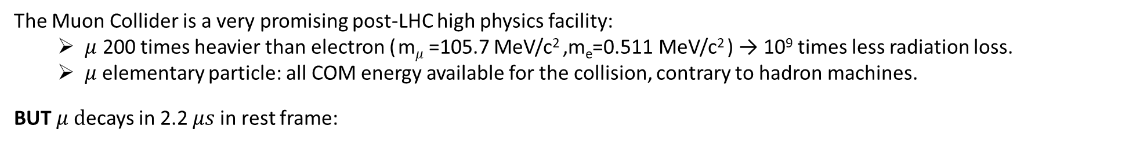
Why a Muon Collider?
IMCC (Internation Muon Collider Collaboration) aims at studying the feasibility of a 10 km, 10 TeV center of mass energy Muon Collider, as indicated by the European Strategy for Particle Physics.
The Muon Collider is a very promising post-LHC high physics facility:
  $μ$ 200 times heavier than electron ( m$μ$=105.7 MeV/c² ,m_{e}=0.511 MeV/c² ) → 10⁹ times less radiation loss.
  $μ$elementary particle: all COM energy available for the collision, contrary to hadron machines.
BUT $μ d$ecays in 2.2 $μs$in rest frame:
must be produced, accelerated and collided ASAP
decay products must be shielded to avoid damage to the machine or radiation
Notes:
The energy at which the proton collider cross-section equals that of a muon collider. The dashed line assumes comparable Feynman amplitudes for the muon and the proton production processes. A factor of ten enhancement of the proton production amplitude squared, possibly due to QCD production, is considered in the continuous line

Slide 3
Why a Muon Collider?
IMCC (Internation Muon Collider Collaboration) aims at studying the feasibility of a 10 km, 10 TeV center of mass energy Muon Collider, as indicated by the European Strategy for Particle Physics.
The Muon Collider is a very promising post-LHC high physics facility:
  $μ$ 200 times heavier than electron ( m$μ$=105.7 MeV/c² ,m_{e}=0.511 MeV/c² ) → 10⁹ times less radiation loss.
  $μ$elementary particle: all COM energy available for the collision, contrary to hadron machines.
BUT $μ d$ecays in 2.2 $μs$in rest frame:
must be produced, accelerated and collided ASAP
decay products must be shielded to avoid damage to the machine or radiation
J.P. Delahaye et al., Muon colliders,
arXiv:1901.06150 [physics.acc-ph].
Physics?
Muon collisions in the range of 14 TeV
have comparable discovery potential to hadron (proton) collisions in the range of 100 TeV
Comparable Feynman amplitudes for the muon and the proton production processes.
A factor of ten enhancement of the proton production amplitude squared,
possibly due to QCD production, is considered.

Slide 4
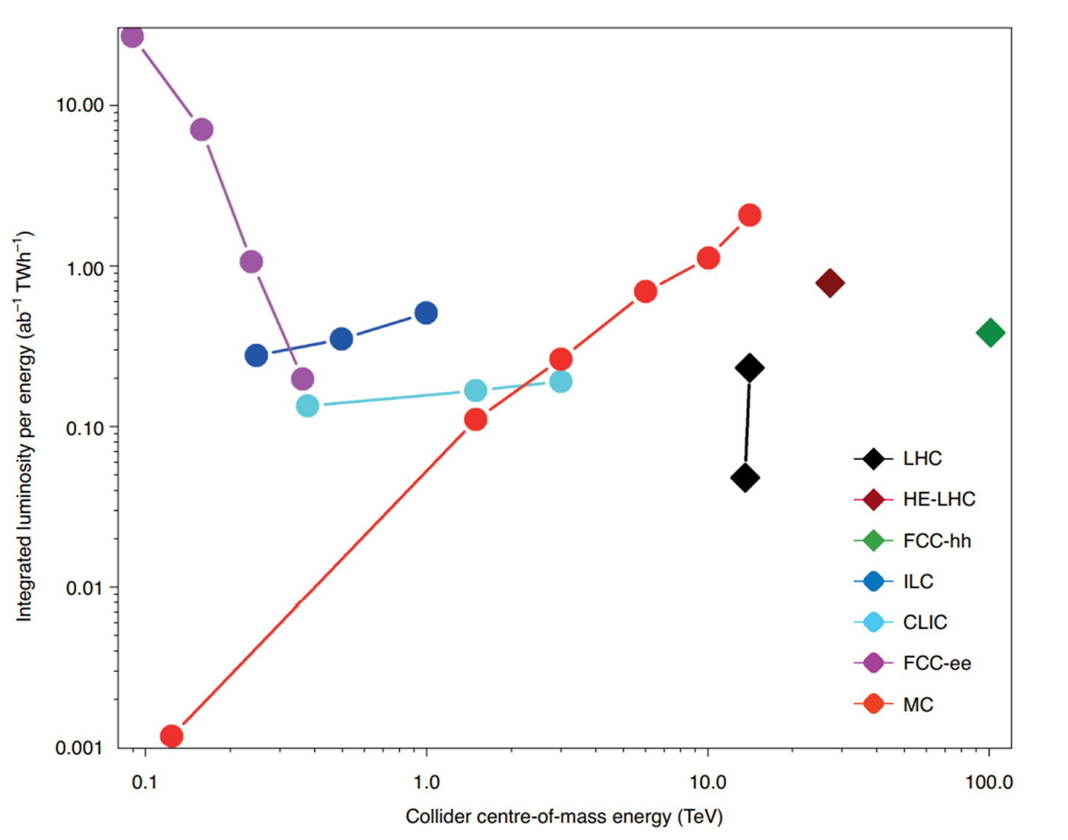
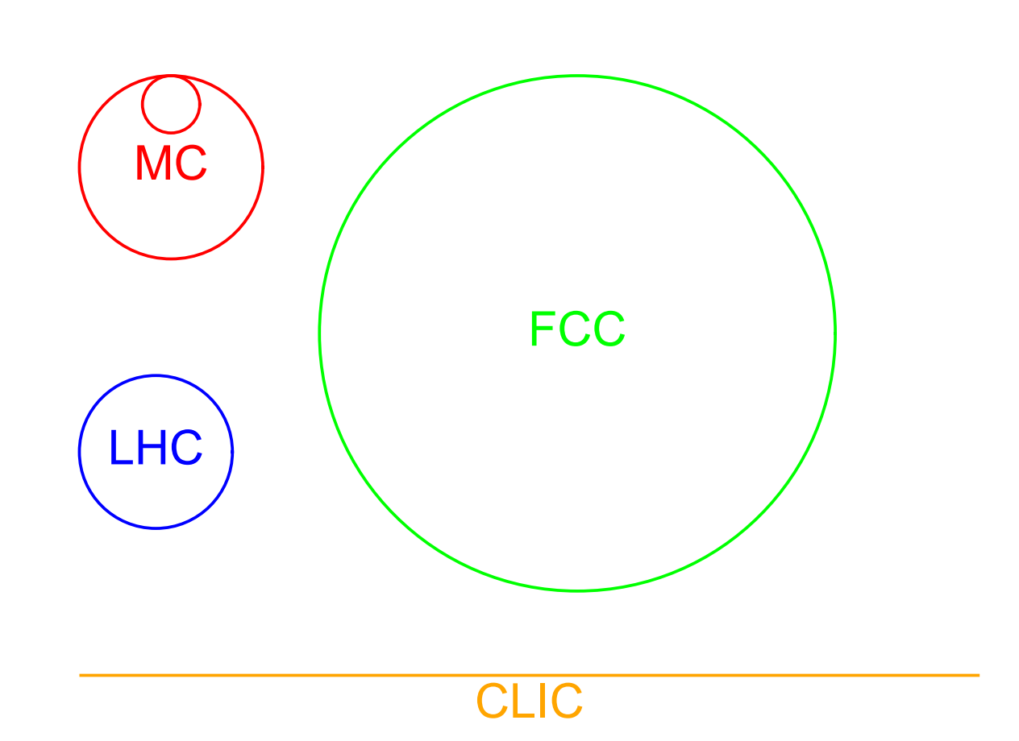
Why a Muon Collider?
IMCC (Internation Muon Collider Collaboration) aims at studying the feasibility of a 10 km, 10 TeV center of mass energy Muon Collider, as indicated by the European Strategy for Particle Physics.
The Muon Collider is a very promising post-LHC high physics facility:
  $μ$ 200 times heavier than electron ( m$μ$=105.7 MeV/c² ,m_{e}=0.511 MeV/c² ) → 10⁹ times less radiation loss.
  $μ$elementary particle: all COM energy available for the collision, contrary to hadron machines.
BUT $μ d$ecays in 2.2 $μs$in rest frame:
must be produced, accelerated and collided ASAP
decay products must be shielded to avoid damage to the machine or radiation
K. R. Long et al, Nature Physics, v.17, p.289, 2021.
Collider size comparison
Sustainability?
A 10 TeV muon collider
can provide the highest integrated luminosity
per unit of energy consumption.
D. Schulte, The muon collider, IPAC2022, Bangkok, Thailand.

Slide 5
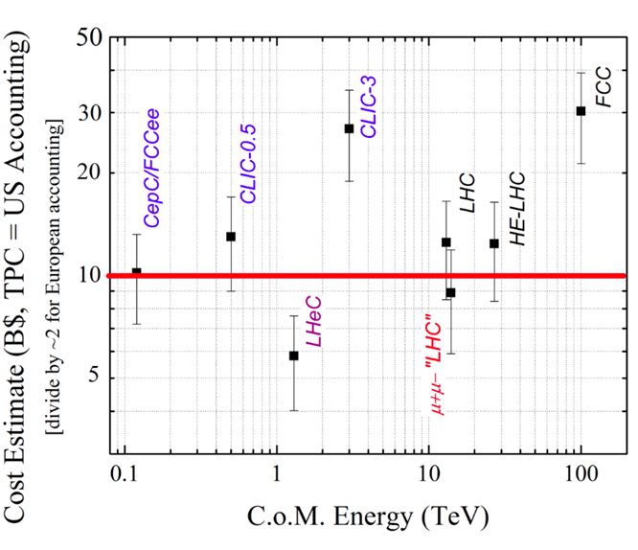
Why a Muon Collider?
IMCC (Internation Muon Collider Collaboration) aims at studying the feasibility of a 10 km, 10 TeV center of mass energy Muon Collider, as indicated by the European Strategy for Particle Physics.
The Muon Collider is a very promising post-LHC high physics facility:
  $μ$ 200 times heavier than electron ( m$μ$=105.7 MeV/c² ,m_{e}=0.511 MeV/c² ) → 10⁹ times less radiation loss.
  $μ$elementary particle: all COM energy available for the collision, contrary to hadron machines.
BUT $μ d$ecays in 2.2 $μs$in rest frame:
must be produced, accelerated and collided ASAP
decay products must be shielded to avoid damage to the machine or radiation
Collider size comparison
Affordability?
Its size is competitive because it is compact.
A 10 TeV muon collider making use of the LHC infrastructure could be the most cost-effective energy frontier collider
D. Schulte, The muon collider, IPAC2022, Bangkok, Thailand.
D. Neuffer and V. Shiltsev 2018 JINST 13 T10003

Slide 6
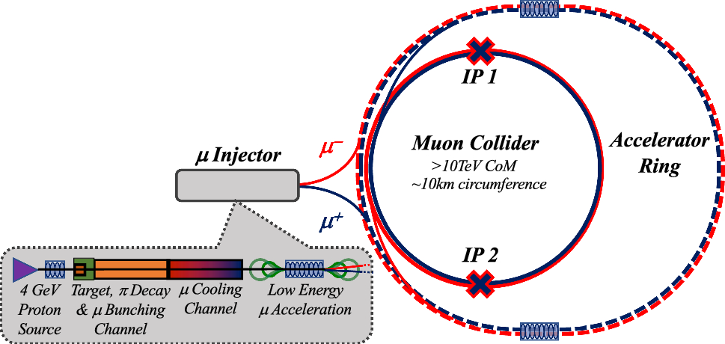
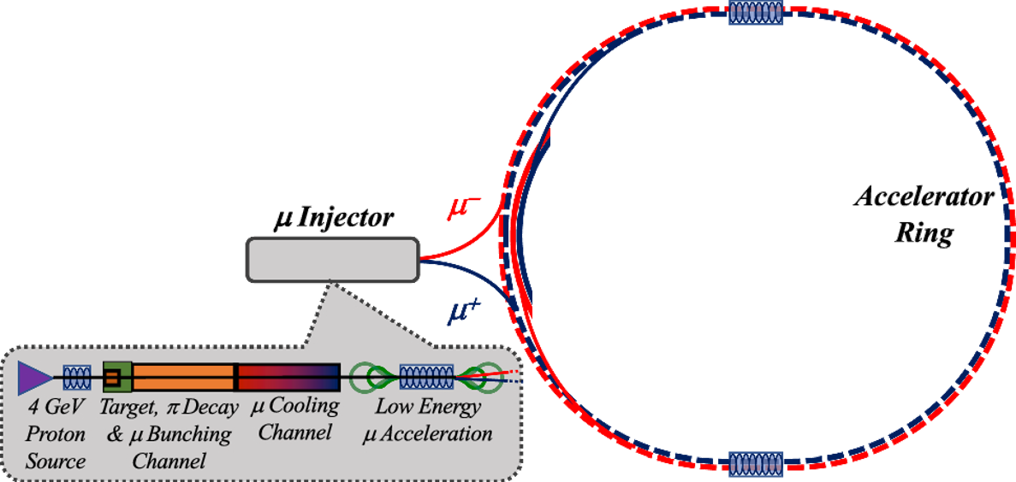
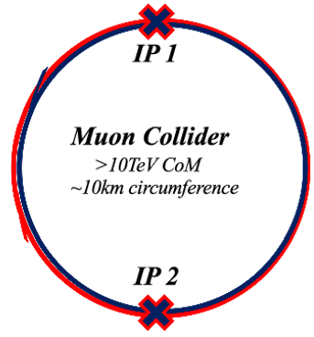
The Muon Collider Complex
Main stages of a muon collider complex
Magnets:
Dipoles
Quadrupoles
Sextupoles
Purpose:
Evaluate realistic performance targets for the collider magnets, in close collaboration with studies of beam physics, cryogenics, and energy storage.
Produce a credible and affordable design study (contain costs, energy efficiency, sustainable operation).
Task 7.4

Slide 7
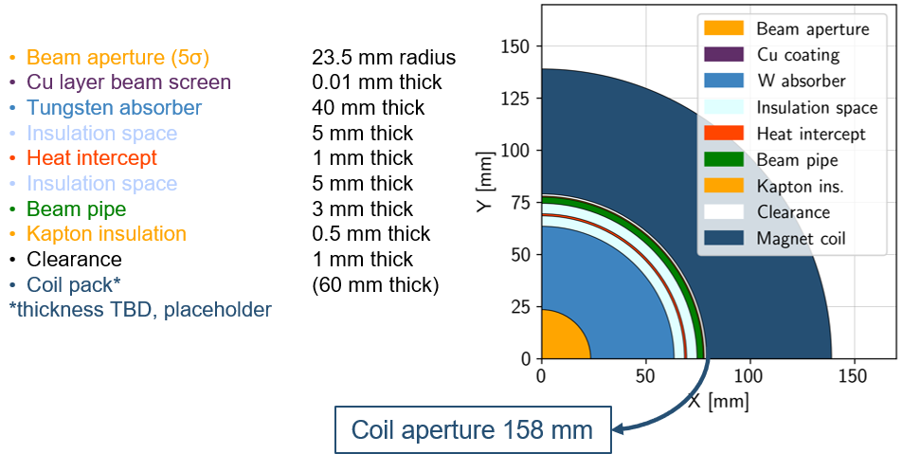
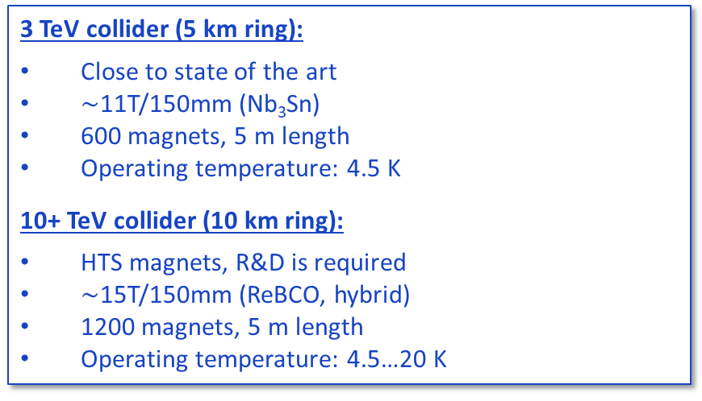
Collider Magnets Requirements
3 TeV collider (5 km ring):
Close to state of the art
$∼$11T/150mm (Nb₃Sn)
600 magnets, 5 m length
Operating temperature: 4.5 K
10+ TeV collider (10 km ring):
HTS magnets, R&D is required
$∼$15T/150mm (ReBCO, hybrid)
1200 magnets, 5 m length
Operating temperature: 4.5…20 K
Assuming 10 TeV machine and coil at 4.5 K
Courtesy of Patricia Borges de Sousa
https://indico.cern.ch/event/1250075/contributions/5357594/
High field dipoles to minimize collider ring size and maximize luminosity.
with HTS @20K the absorber can be thinner
Beam loss protection
High-energy electrons and positrons arising from muon decay and striking the collider ring magnets can cause radiation damage and unwanted heat load.
Shielding
Large aperture
Courtesy of A. Lechner

Slide 8
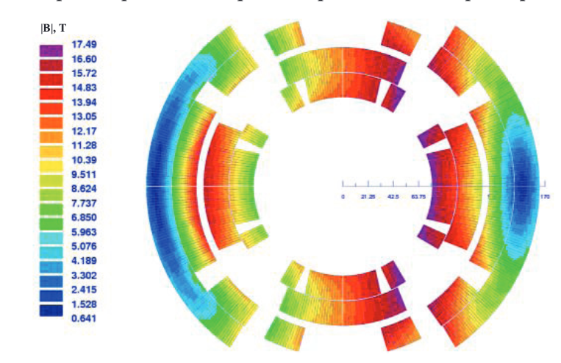
Collider Magnets Requirements
3 TeV collider (5 km ring):
Close to state of the art
$∼$11T/150mm (Nb₃Sn)
600 magnets, 5 m length
Operating temperature: 4.5 K
10+ TeV collider (10 km ring):
HTS magnets, R&D is required
$∼$15T/150mm (ReBCO, hybrid)
1200 magnets, 5 m length
Operating temperature: 4.5…20 K
Arc:
Combined function magnets: B1, B1+B2 and B1+B3
B ≈ 8…16 T; G ≈ 320 T/m; G’ ≈ 7100 T/m²
Aperture ≈ 160 mm
Final focus:
Combined function magnets: B1, B2, B1+B2, B1+B3
B ≈ 4…16 T; G ≈ 100…300 T/m; G’ ≈ 12000 T/m²
Aperture ≈ 150…330 mm
Difficult to define
a single magnet
specification
High field dipoles to minimize collider ring size and maximize luminosity.
Beam loss protection
High-energy electrons and positrons arising from muon decay and striking the collider ring magnets can cause radiation damage and unwanted heat load.
Shielding
Large aperture
V.V. Kashikhin et al.
Courtesy of A. Lechner

Slide 9
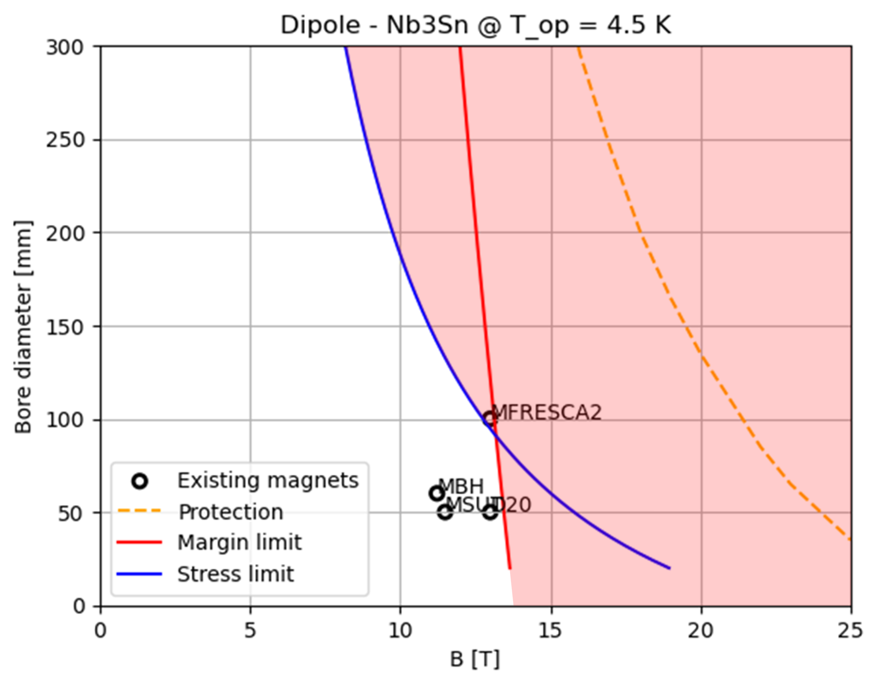
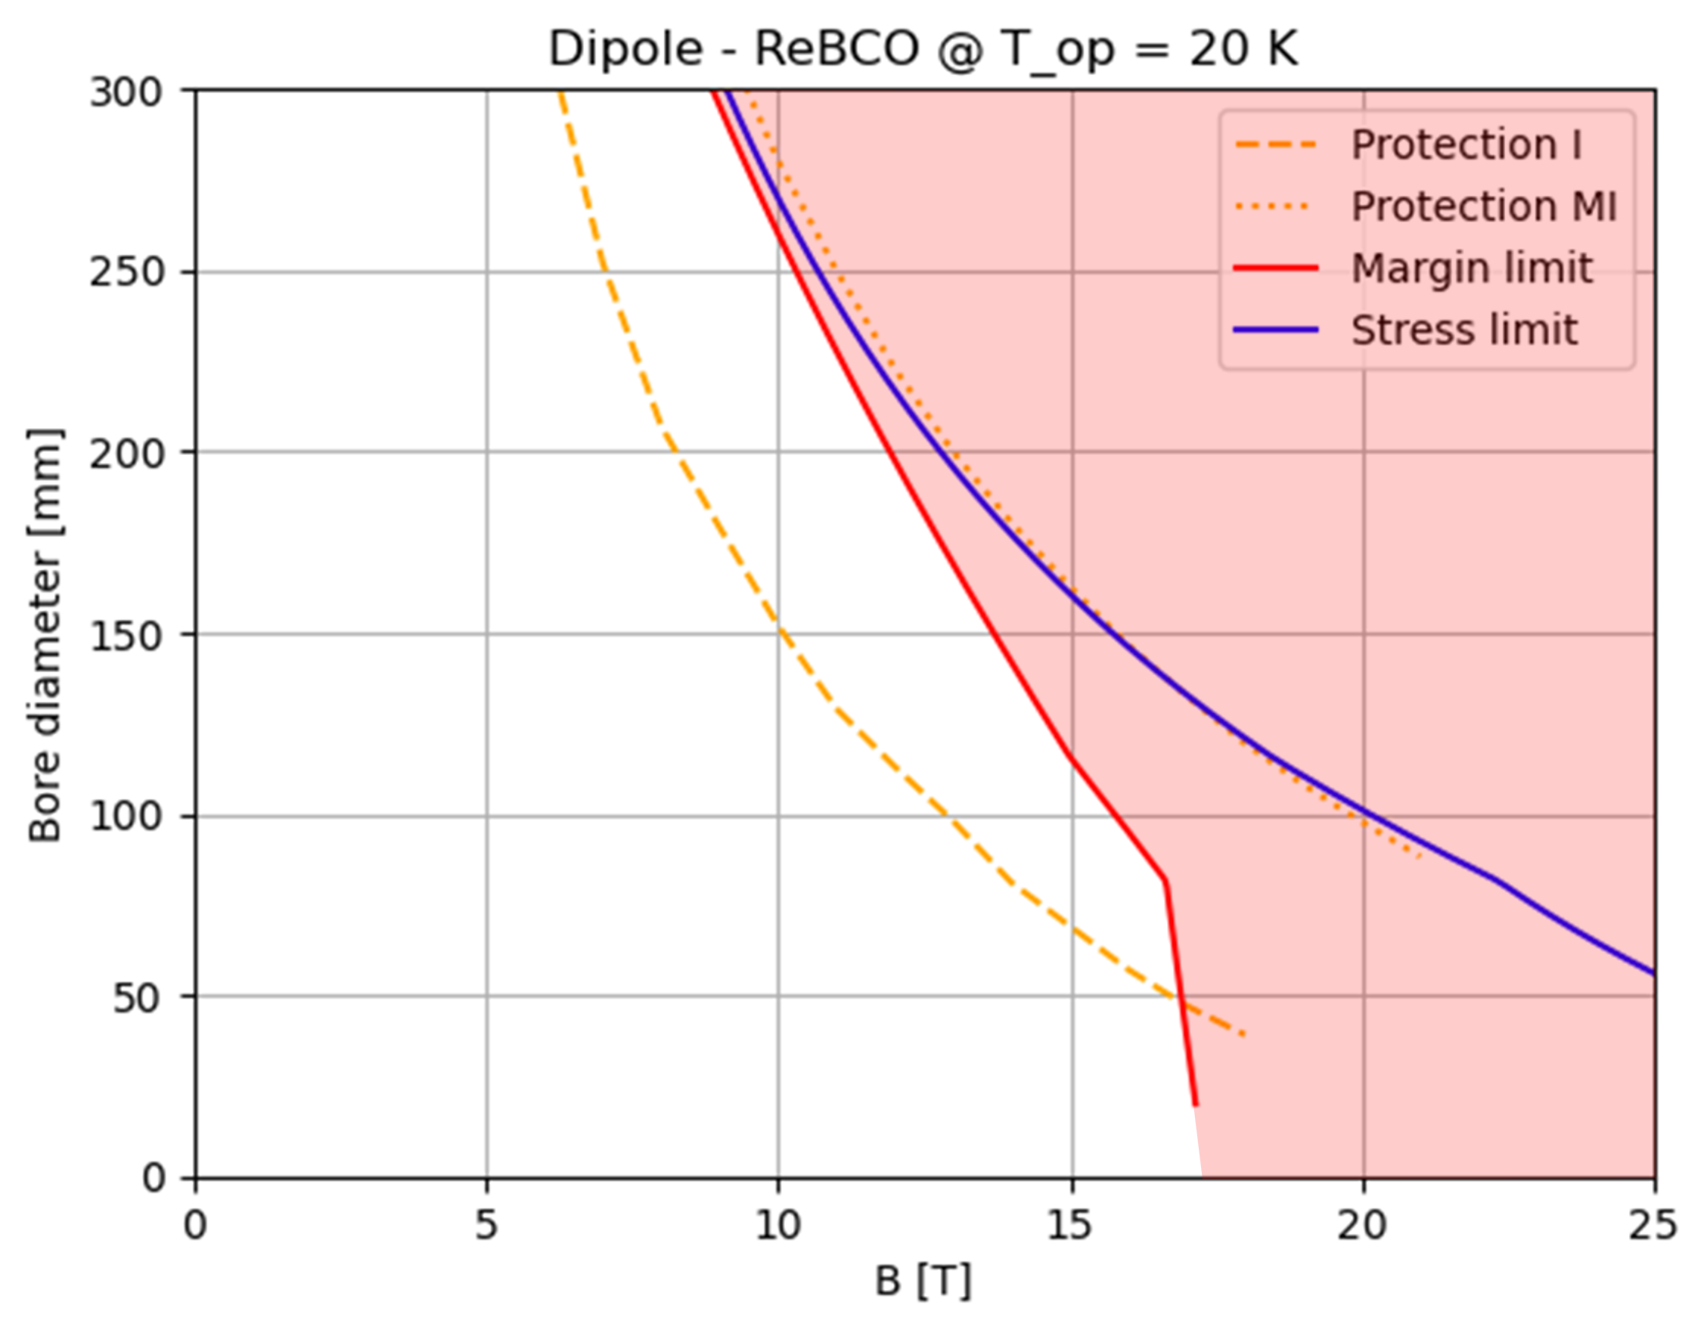
Introduction to A-B plots
Need for high fields in large apertures
We perform plots that can show the allowed area between aperture diameter (A) and bore field (B).
We consider Nb₃Sn for the 3 TeV machine and HTS (ReBCO) for the 10 TeV collider.
Innovative approach, useful for interfacing the needs of beam dynamics with the technological limits (of today and the near future) related to superconducting magnets.
Immediate feedback capable of analyzing many possible configurations in a single plot

Slide 10
Introduction to A-B plots
Need for high fields in large apertures
We perform plots that can show the allowed area between aperture diameter (A) and bore field (B).
We consider Nb₃Sn for the 3 TeV machine and HTS (ReBCO) for the 10 TeV collider.
Limit curves are introduced by mechanical challenges (stress limit), critical current density (margin limit) and stored magnetic energy (quench protection), depending on the superconducting material.

Slide 11
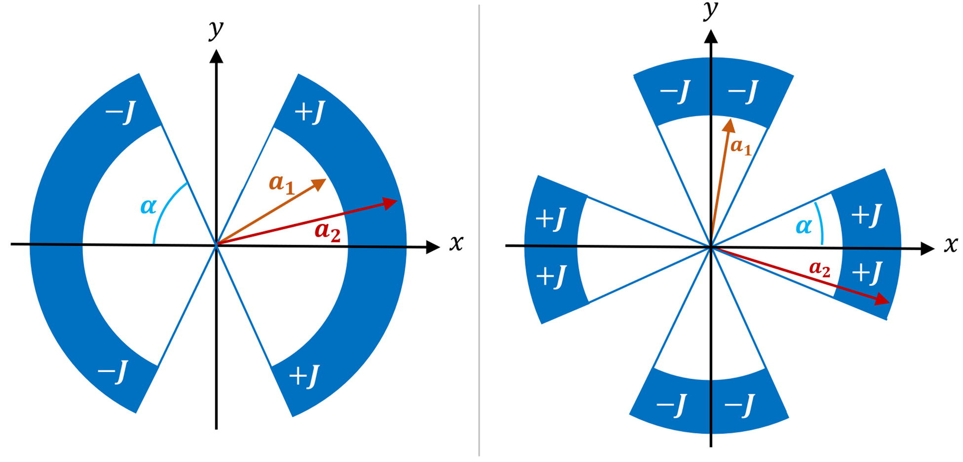



Method and Assumptions
A Python code is used to implement the analytic formulas for the cos-theta magnets in sector coil approximation.
($α$ is 60° for the dipole and 30° for the quadrupole)
Dipole
Quadrupole
$$B\left(w,J\right)=\frac{2μ_{0}J(a_{2}−a_{1})sinα}{π}$$
$$G\left(w,J\right)=\frac{2μ_{0}J}{π}\ln\left(\frac{a_{2}}{a_{1}}\right)sin⁡(2α)$$
($w=coil width )$

Slide 12
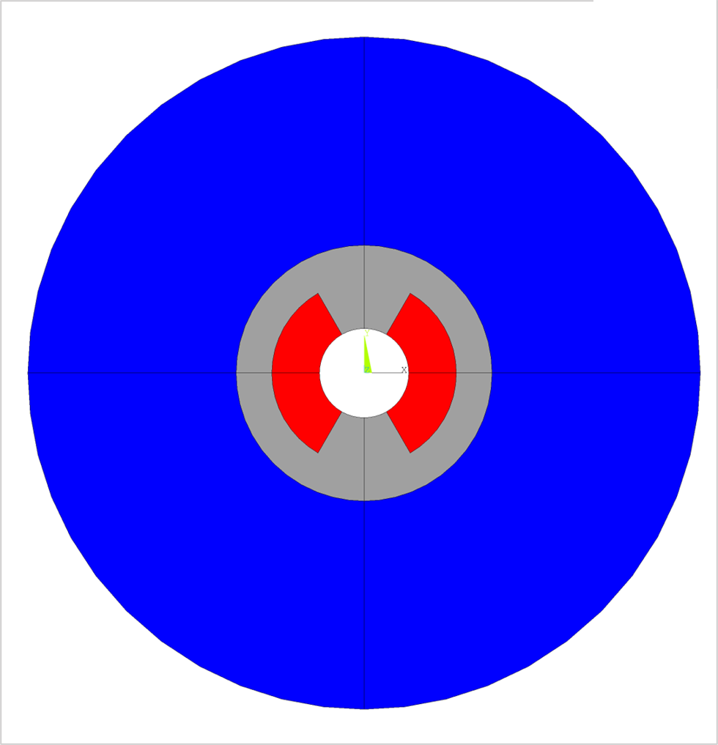
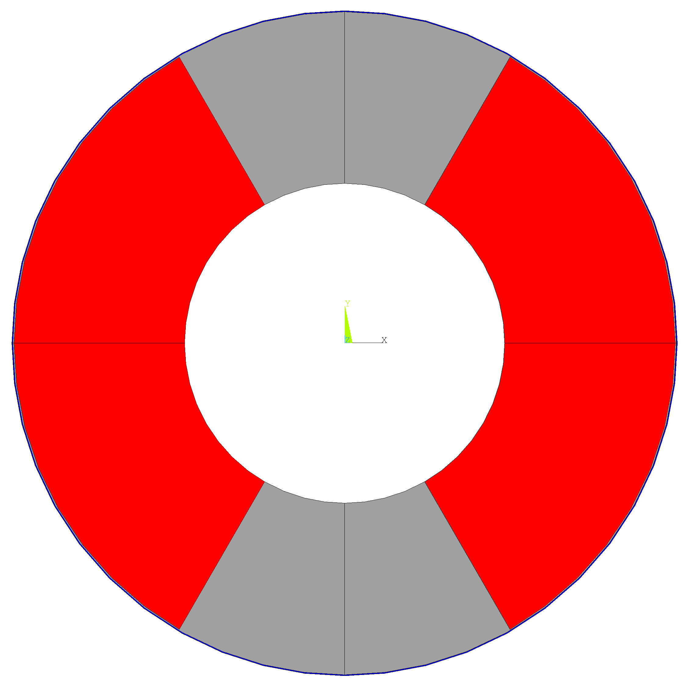
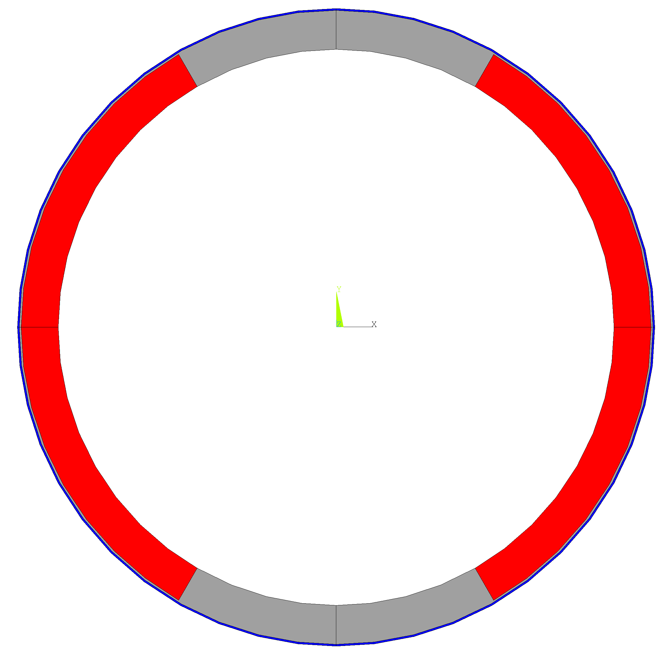
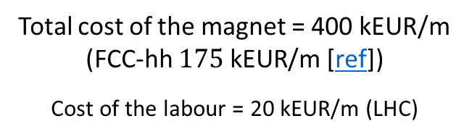
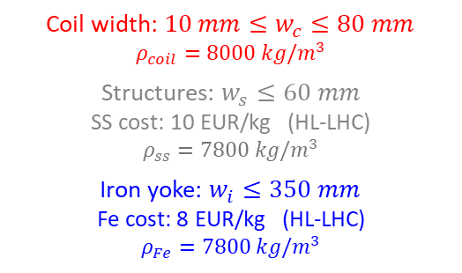
Method and Assumptions
A Python code is used to implement the analytic formulas for the cos-theta magnets in sector coil approximation.
Cost model: by setting an upper limit to the cost of the magnet, the maximum coil width can be calculated for each aperture, taking into account the other components.
Example diagram with bore aperture set at 150 mm.
Total cost of the magnet = 400 kEUR/m (FCC-hh $175 \text{k}\text{EUR}\text{/}\text{m}$ [ref])
Cost of the labour = 20 kEUR/m (LHC)
Aperture
150 mm
Aperture
150 mm
Materials | SC cost [EUR/kg] | Aspirational SC cost [EUR/kg]
Nb₃Sn | 2000 | 700 (FCC target)*
ReBCO | 8000 | 2500 (realistic projection)**
Coil width: $10 mm≤w_{c}≤80 mm$
$$ρ_{coil}=8000 kg/m^{3}$$
Structures: $w_{s}≤60 mm$
SS cost: 10 EUR/kg (HL-LHC)
$ρ_{ss}=7800 kg/m^{3}$
Iron yoke: $w_{i}≤350 mm$
Fe cost: 8 EUR/kg (HL-LHC)
$$ρ_{Fe}=7800 kg/m^{3}$$
Aperture
150 mm
* 7€/kAm, FCC target 5€/kAm
  ** 50 €/kAm: 1/3 of today prize (150€/kAm)
  Also based on projection of ref
  A. Molodyk and C. Larbalestier, Science, 2023
Bore
Coil
Structures
Iron
The maximum total cost of the magnet is the same for both materials.

Slide 13
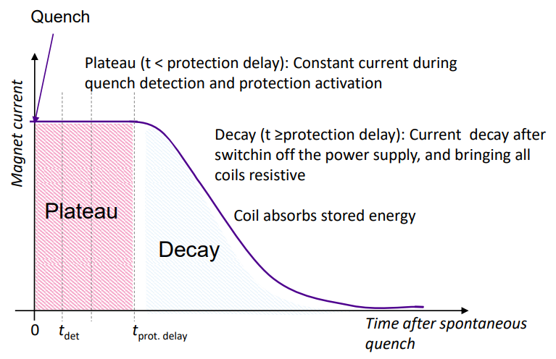
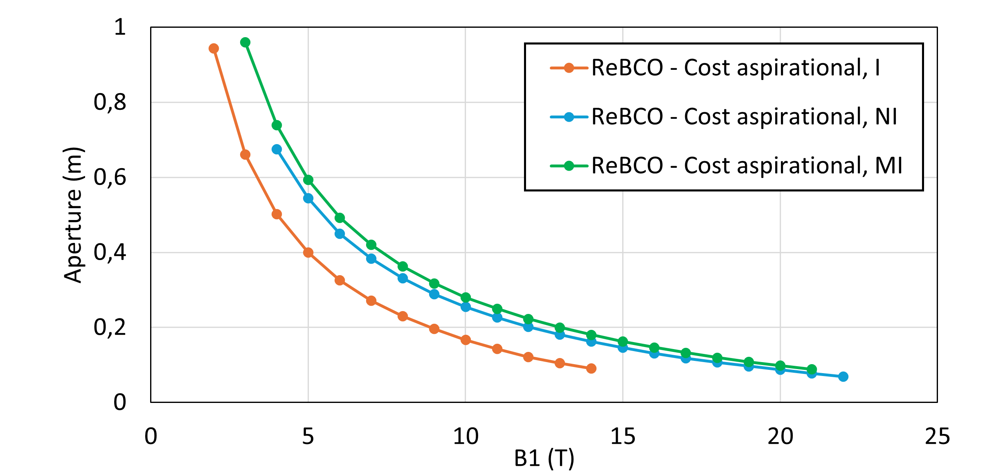

Method and Assumptions
A Python code is used to implement the analytic formulas for the cos-theta magnets in sector coil approximation.
Cost model: by setting an upper limit to the cost of the magnet, the maximum coil width can be calculated for each aperture, taking into account the other components.
The protection scheme consists in QH (or CLIQ) for classical insulated coils, limiting the hotspot temperature and the stored energy in the coils.
For the ReBCO, high cost requires small coil and very high current density → Protection will be a limiting factor
  Need to devise alternative protection schemes!
    → Non-Insulated and Metal-Insulated coils
40 ms protection delay
Materials | Hotspot T [K]
Nb₃Sn | 350
ReBCO | 200
Courtesy of Tiina Salmi https://indico.cern.ch/event/1240045/

Slide 14
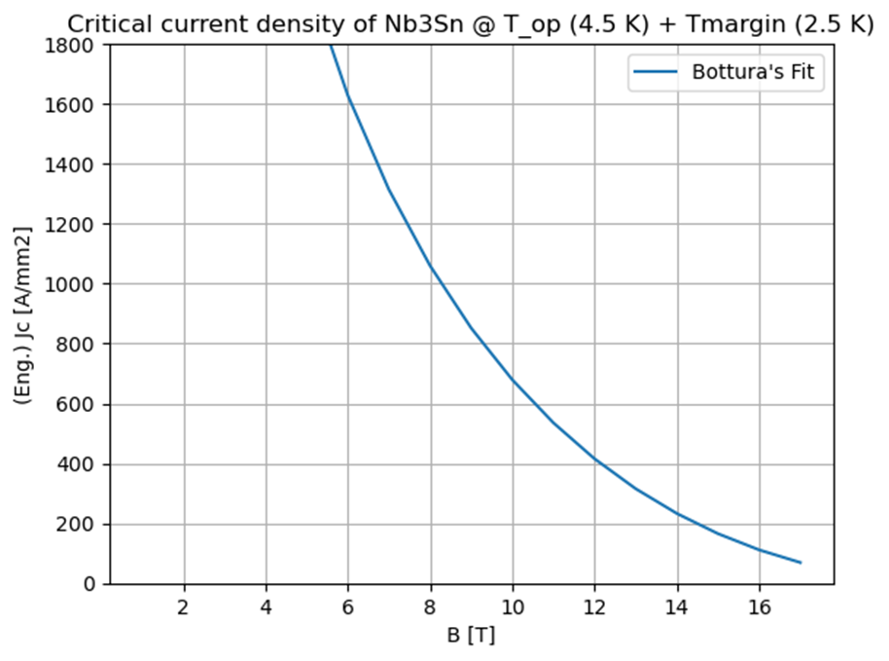
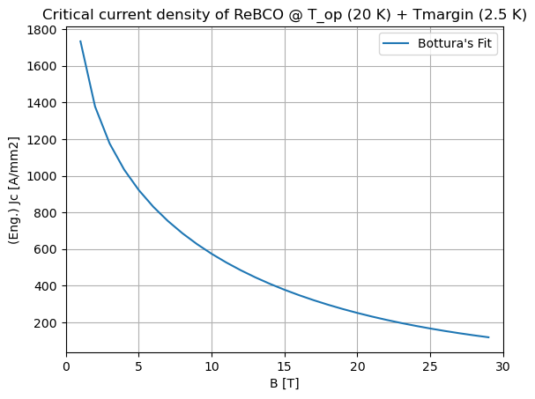
Method and Assumptions
A Python code is used to implement the analytic formulas for the cos-theta magnets in sector coil approximation.
Cost model: by setting an upper limit to the cost of the magnet, the maximum coil width can be calculated for each aperture, taking into account the other components.
The protection scheme consists in QH (or CLIQ) for classical insulated coils, limiting the hotspot temperature and the stored energy in the coils.
The margin limit is the limit due to the SC material itself, starting from the Bottura’s fit for the critical current density.
Materials | Operating T [K] | T margin [K]
Nb₃Sn | 4.5 | 2.5 (HL-LHC)
ReBCO | 20 | 2.5
J_{c} refers to:
Nb₃Sn: FCC cable target performance
ReBCO: Fujikura FESC-AP tape

Slide 15
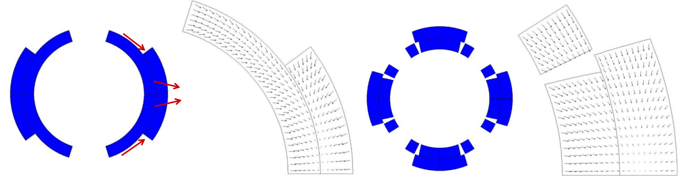
Method and Assumptions
A Python code is used to implement the analytic formulas for the cos-theta magnets in sector coil approximation.
Cost model: by setting an upper limit to the cost of the magnet, the maximum coil width can be calculated for each aperture, taking into account the other components.
The protection scheme consists in QH (or CLIQ) for classical insulated coils, limiting the hotspot temperature and the stored energy in the coils.
The margin limit is the limit due to the SC material itself, starting from the Bottura’s fit for the critical current density.
The stress limit considers the maximum mechanical stress we can have on the coils, starting from the analytical formula for the midplane pressure of cos-theta magnet in sector coil approx. (Reference: https://doi.org/10.15161/oar.it/143359 )
Materials | Peak Stress [MPa]
Nb₃Sn | 150
ReBCO | 400
LARP TQ
(P. Ferracin)
Currently, only stresses generated by Lorentz forces are considered.
Tevatron dipole
(P. Ferracin)

Slide 16

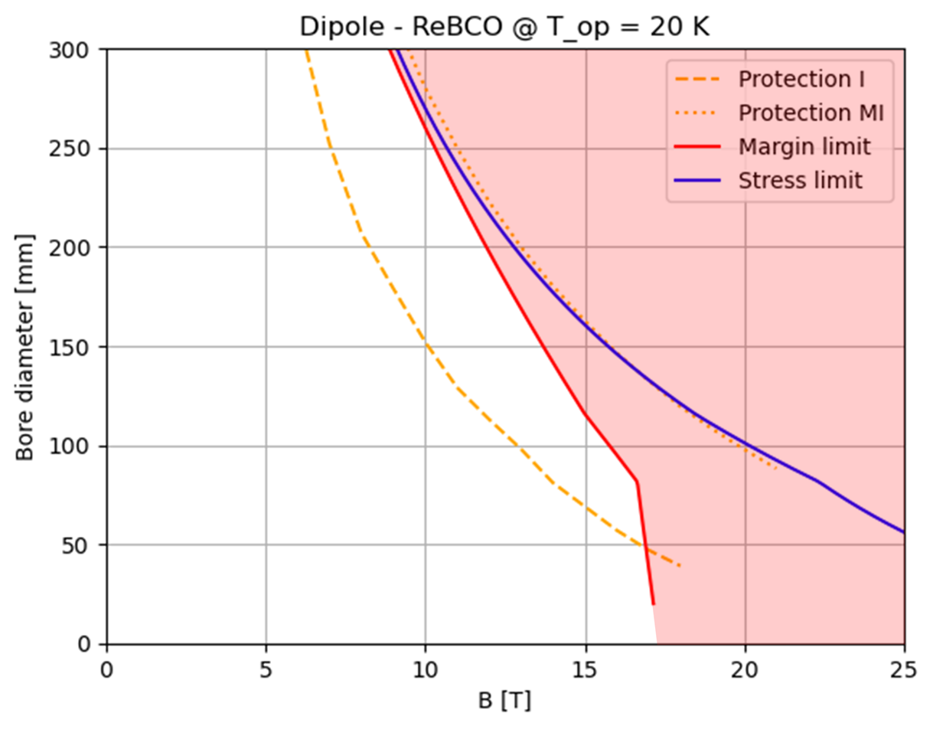
Dipole A-B Plots
IR [10T, 300 mm]
IR [10T, 300 mm]
ARC [16T, 140 mm]
ARC [16T, 140 mm]
Nb₃Sn falls short of required performance because of operating margin and peak stress (at affordable cost !)
HTS falls short of required performance with classical insulated coils. Assuming MI or NI magnets, the protection limit becomes comparable with the other limits.

Slide 17
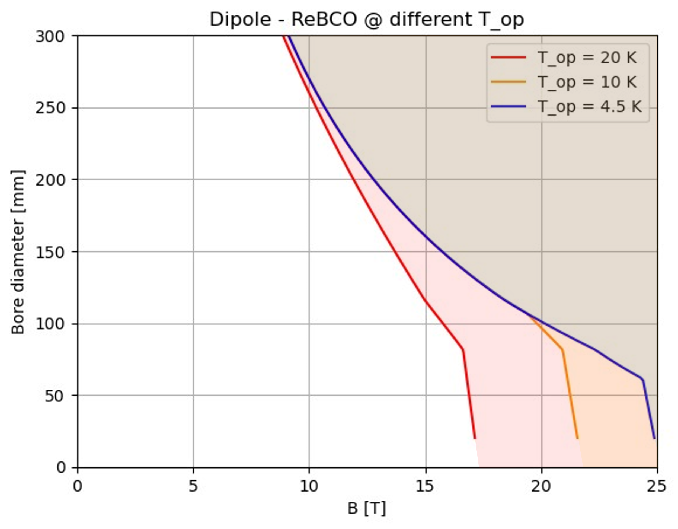
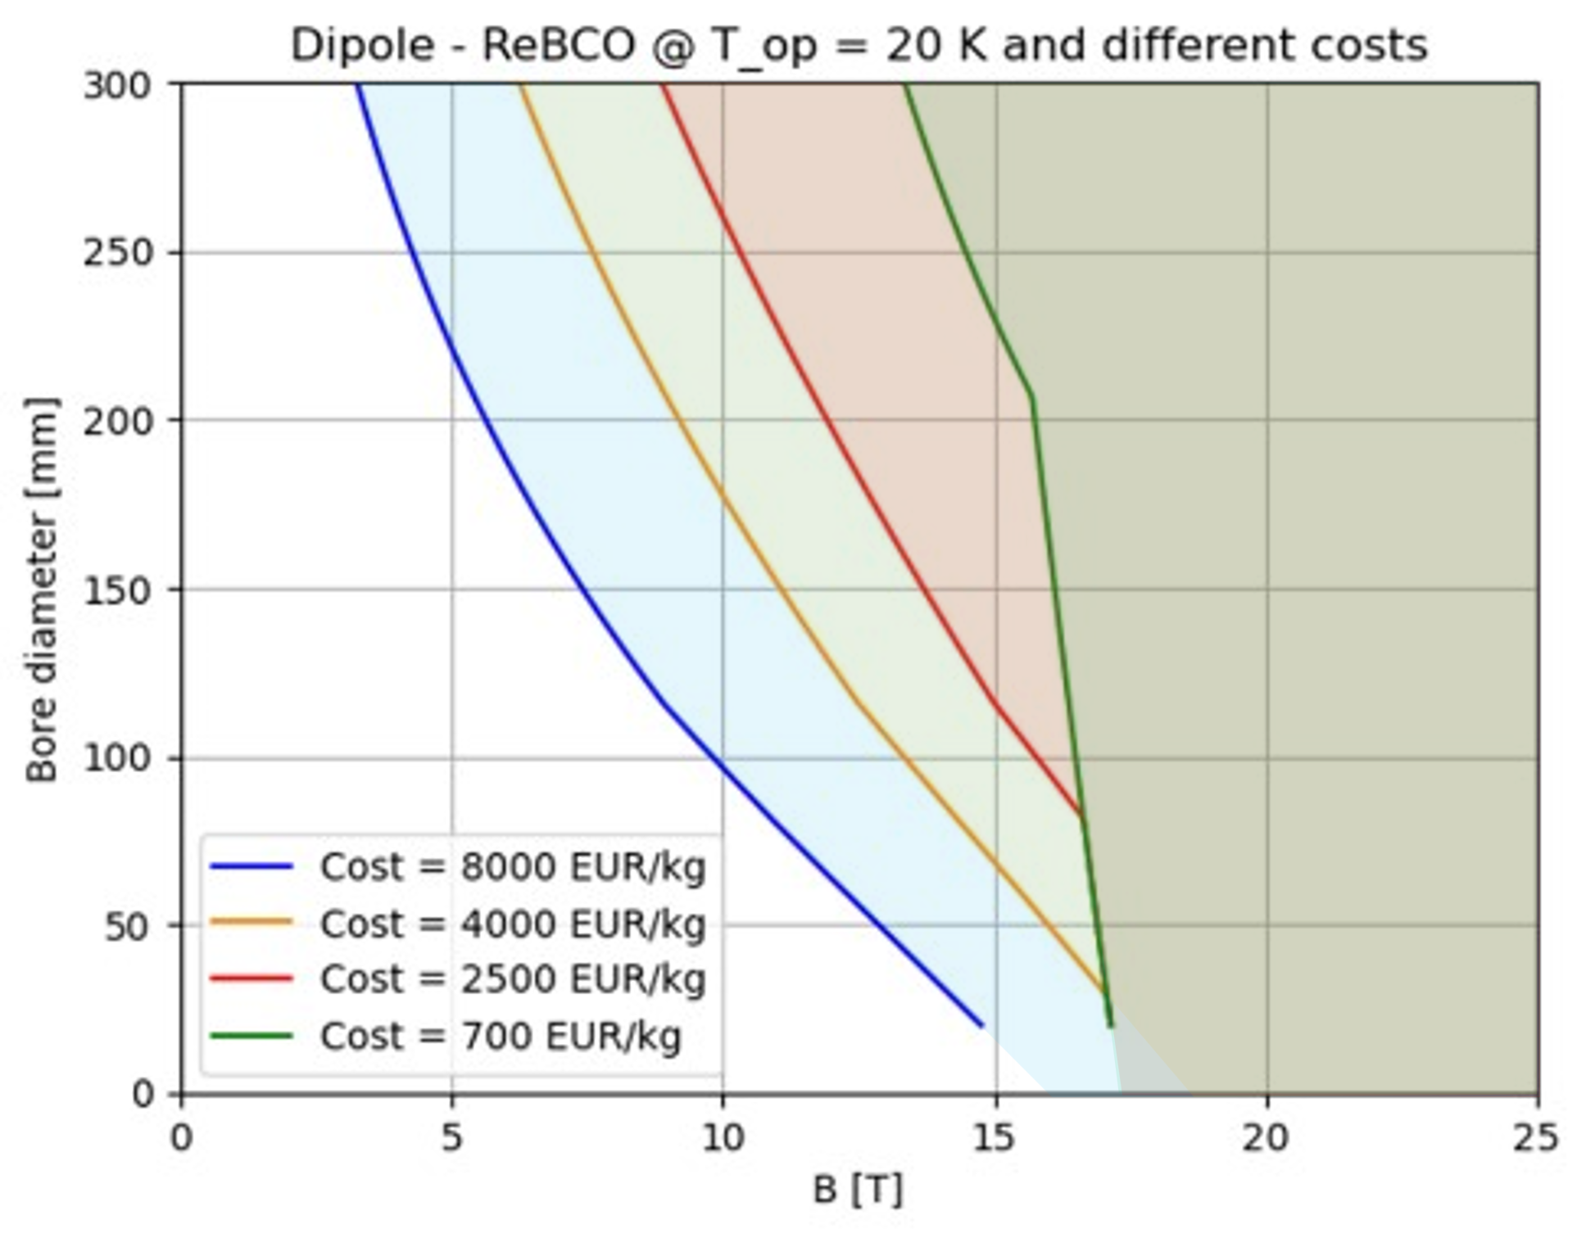

HTS dipole A-B Plots
IR [10T, 300 mm]
IR [10T, 300 mm]
Cost
reduction
ARC [16T, 140 mm]
ARC [16T, 140 mm]
$T_{op}$reduction
A reduction of operating temperature will result in wider design A-B range
The curves shown in the plots are the limit curves,
i.e., for each aperture value the strictest limit is taken, excluding the limit for insulated magnets.
A reduction of HTS cost will result in wider design A-B range

Slide 18
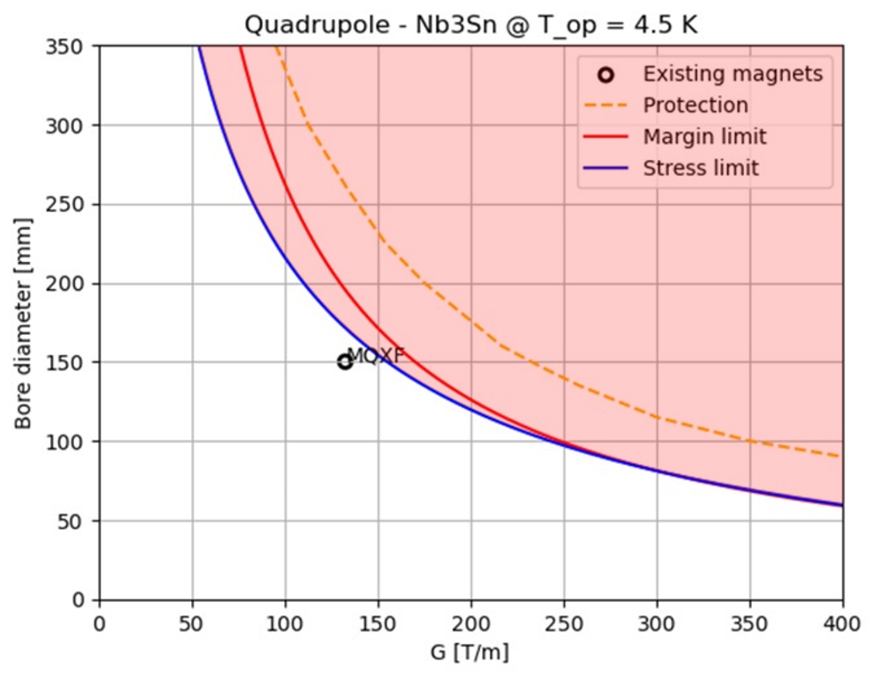
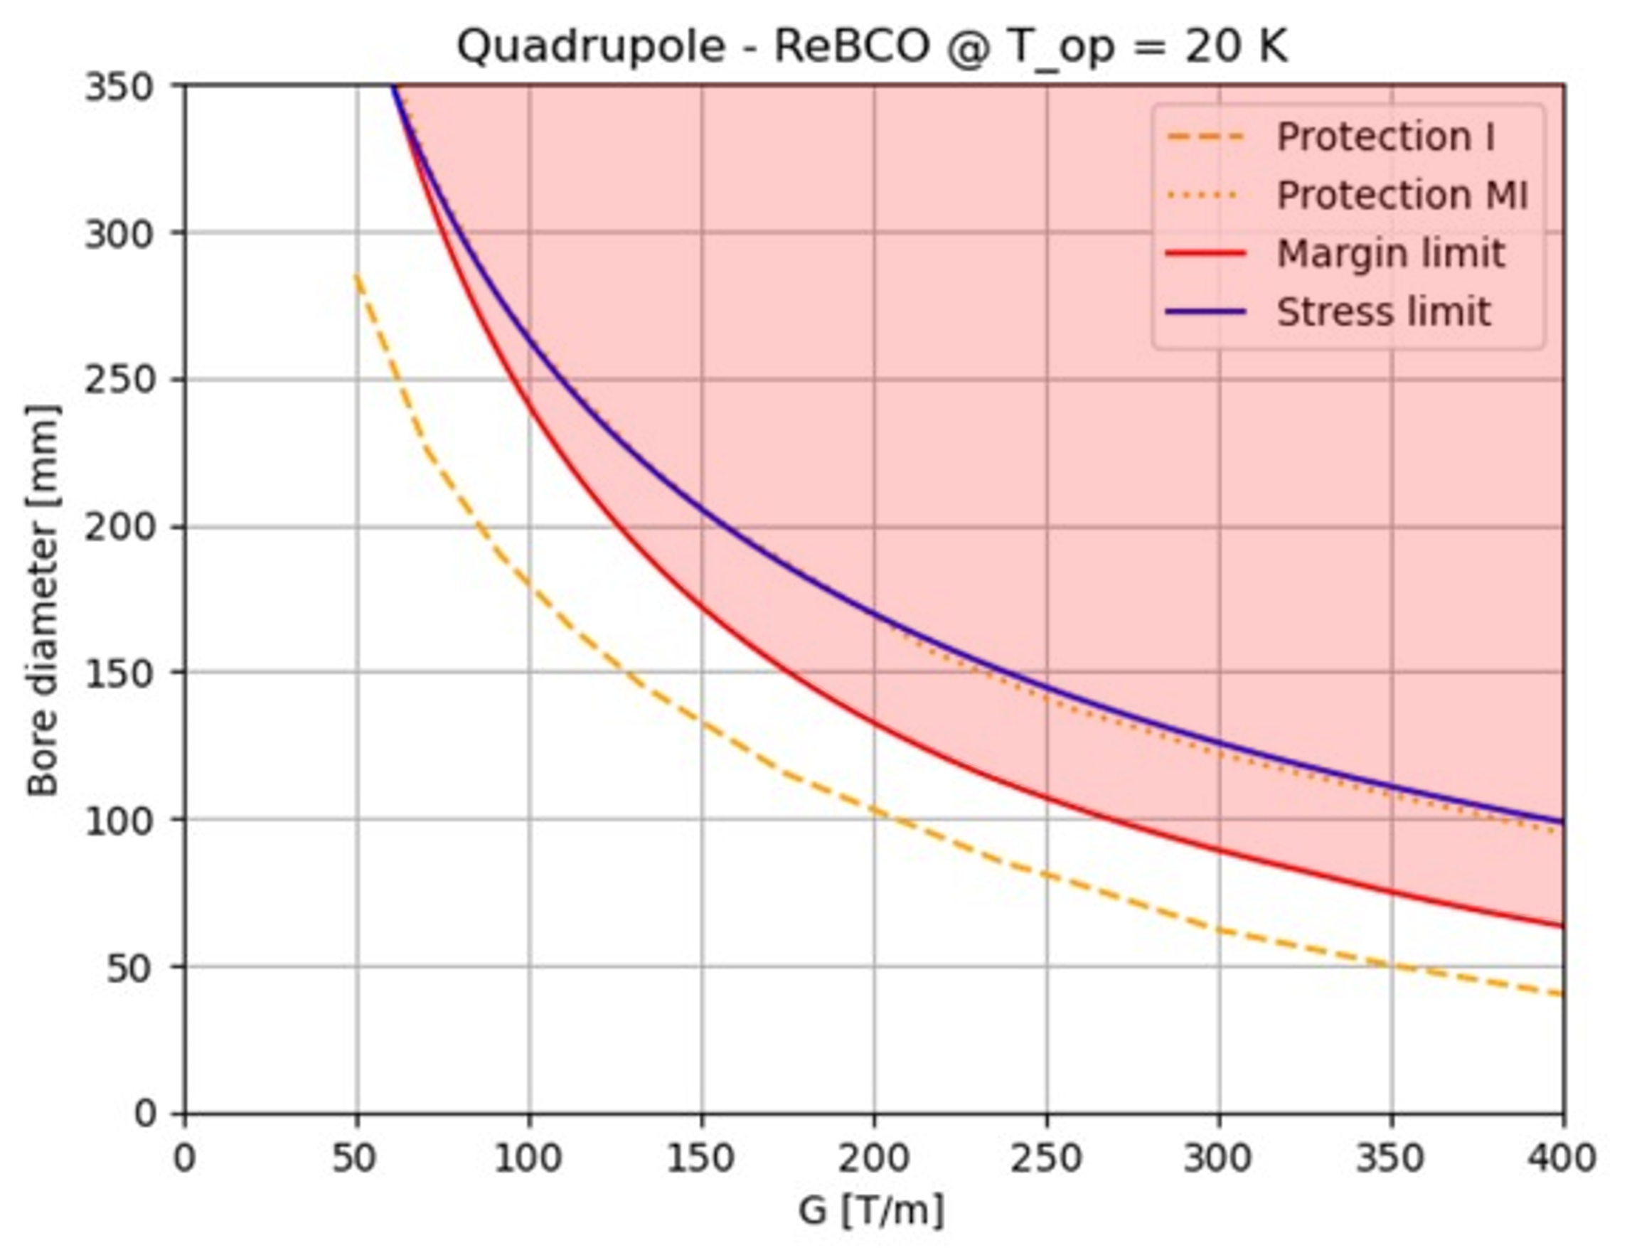
Quadrupole A-B Plots
IR [115T/m, 290 mm]
IR [115T/m, 290 mm]
ARC [240T/m, 170 mm]
ARC [240T/m, 170 mm]
ARC [330T/m, 130 mm]
ARC [330T/m, 130 mm]
Nb₃Sn is limited by peak stress and operating margin
HTS is mainly limited by cost production and protection. Working @20K the margin curve is also a limiting factor.

Slide 19
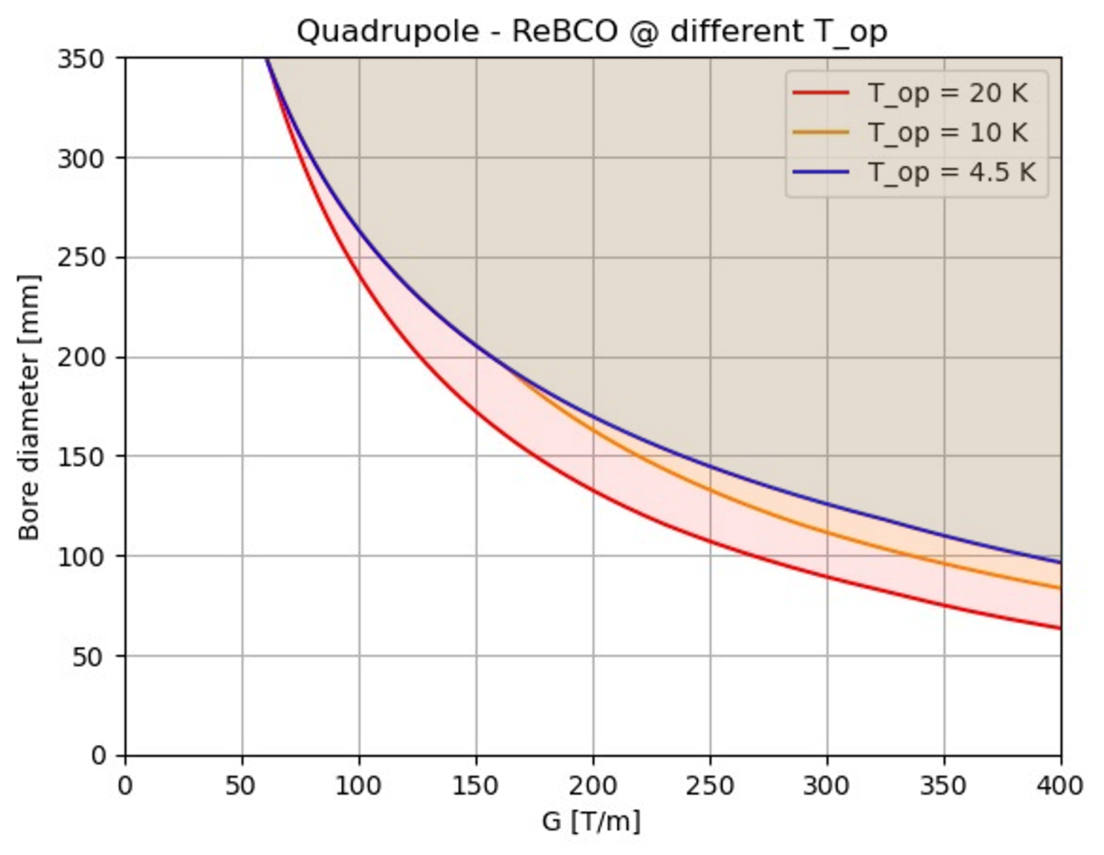
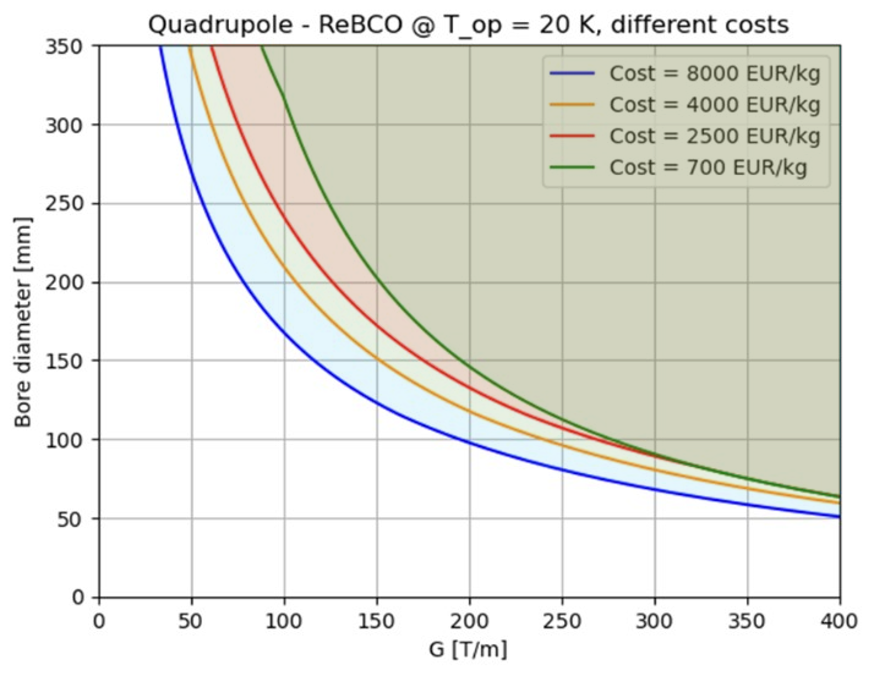

HTS quadrupole A-B Plots
IR [115T/m, 290 mm]
IR [115T/m, 290 mm]
Cost
reduction
ARC [240T/m, 170 mm]
ARC [240T/m, 170 mm]
ARC [330T/m, 130 mm]
ARC [330T/m, 130 mm]
$T_{op}$reduction
A reduction of operating temperature will result in wider design A-B range
A reduction of HTS cost will result in wider design A-B range
The curves shown in the plots are the limit curves,
i.e., for each aperture value the strictest limit is taken, excluding the limit for insulated magnets.

Slide 20
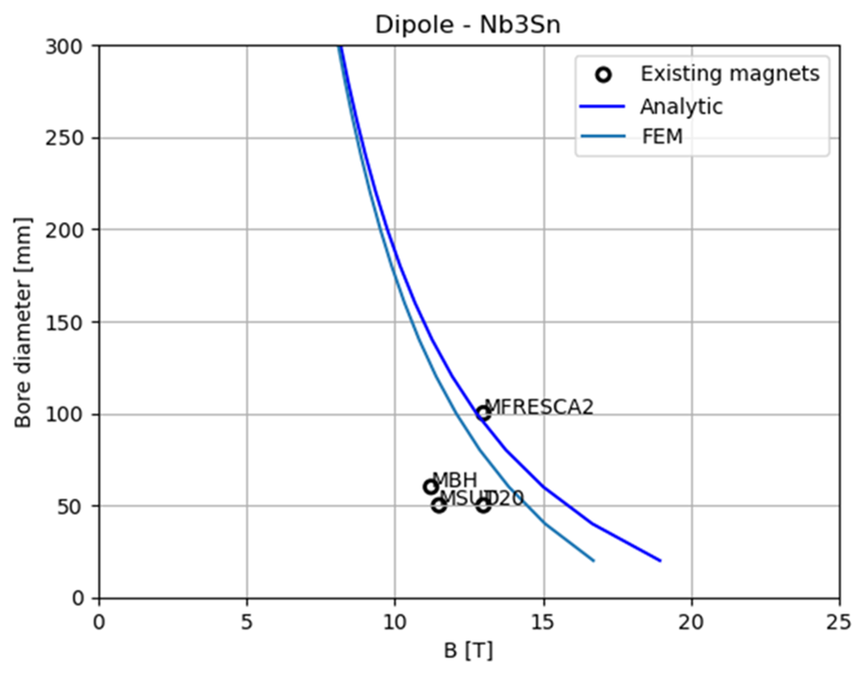
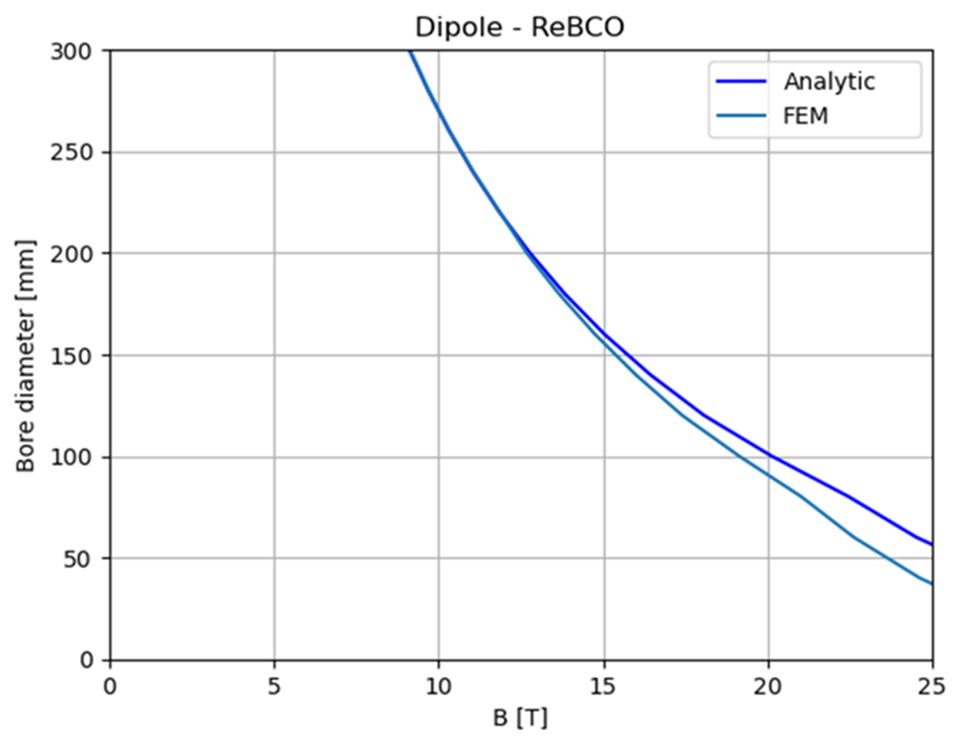
FEM Crosscheck for Stress Curves
We implemented a FEM model for a sector dipole in ANSYS.
We implemented a Python code able to work with Ansys software
to run FEM simulations with the same inputs as the analytical study.
In the comparison, the FEM curves are always more restricting than the analytical ones
since they take the maximum pressure on the midplane instead of an average over the coil width.

Slide 21
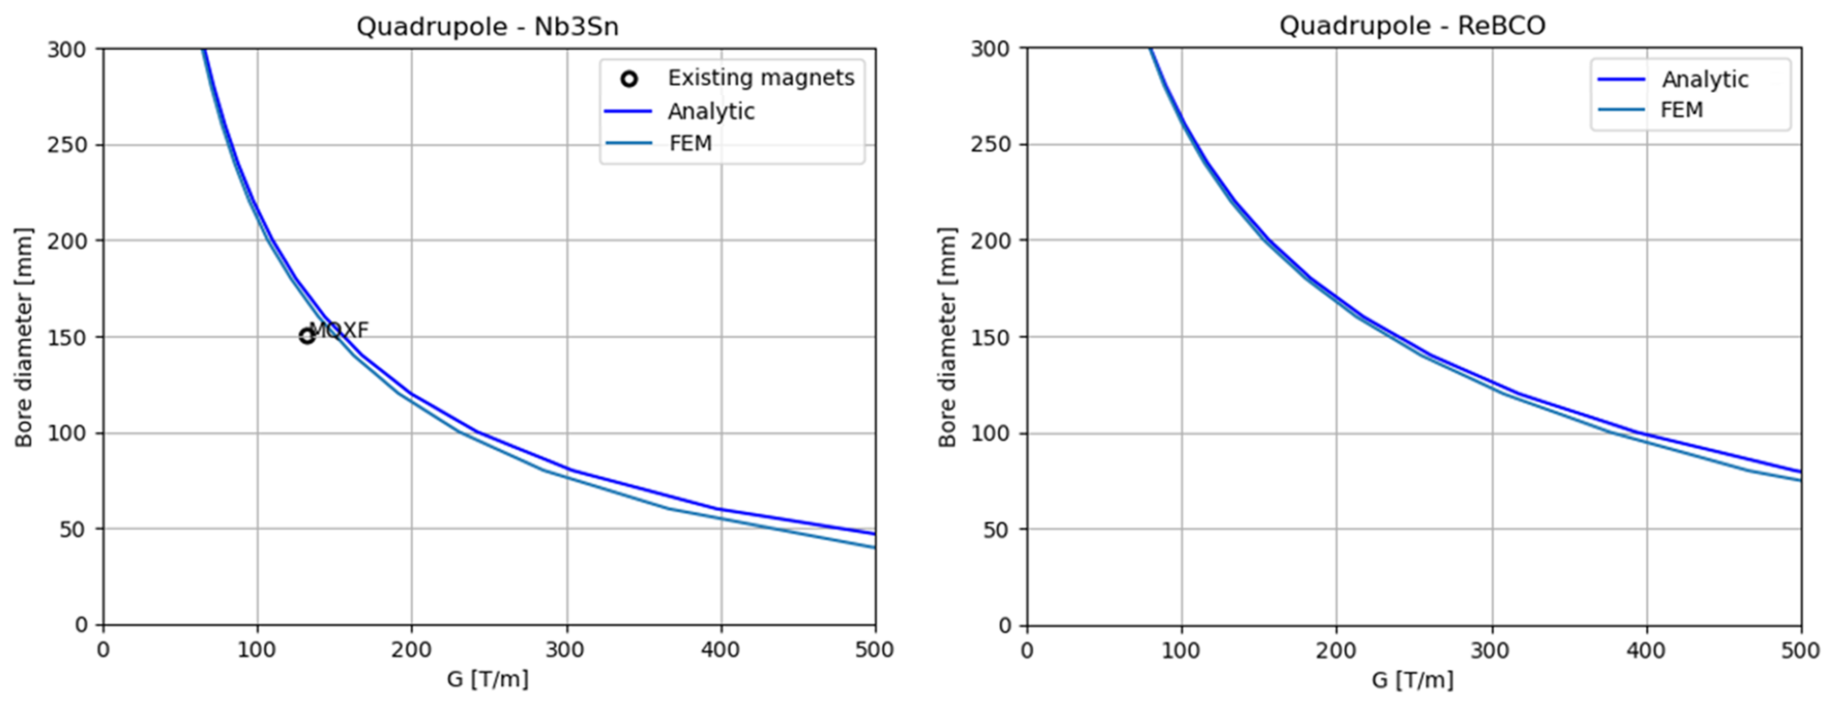
FEM Crosscheck for Stress Curves
We implemented a FEM model for a sector quadrupole in ANSYS.
We implemented a Python code able to work with Ansys software
to run FEM simulations with the same inputs as the analytical study.
In the comparison, the FEM curves are always more restricting than the analytical ones
since they take the maximum pressure on the midplane instead of an average over the coil width.

Slide 22
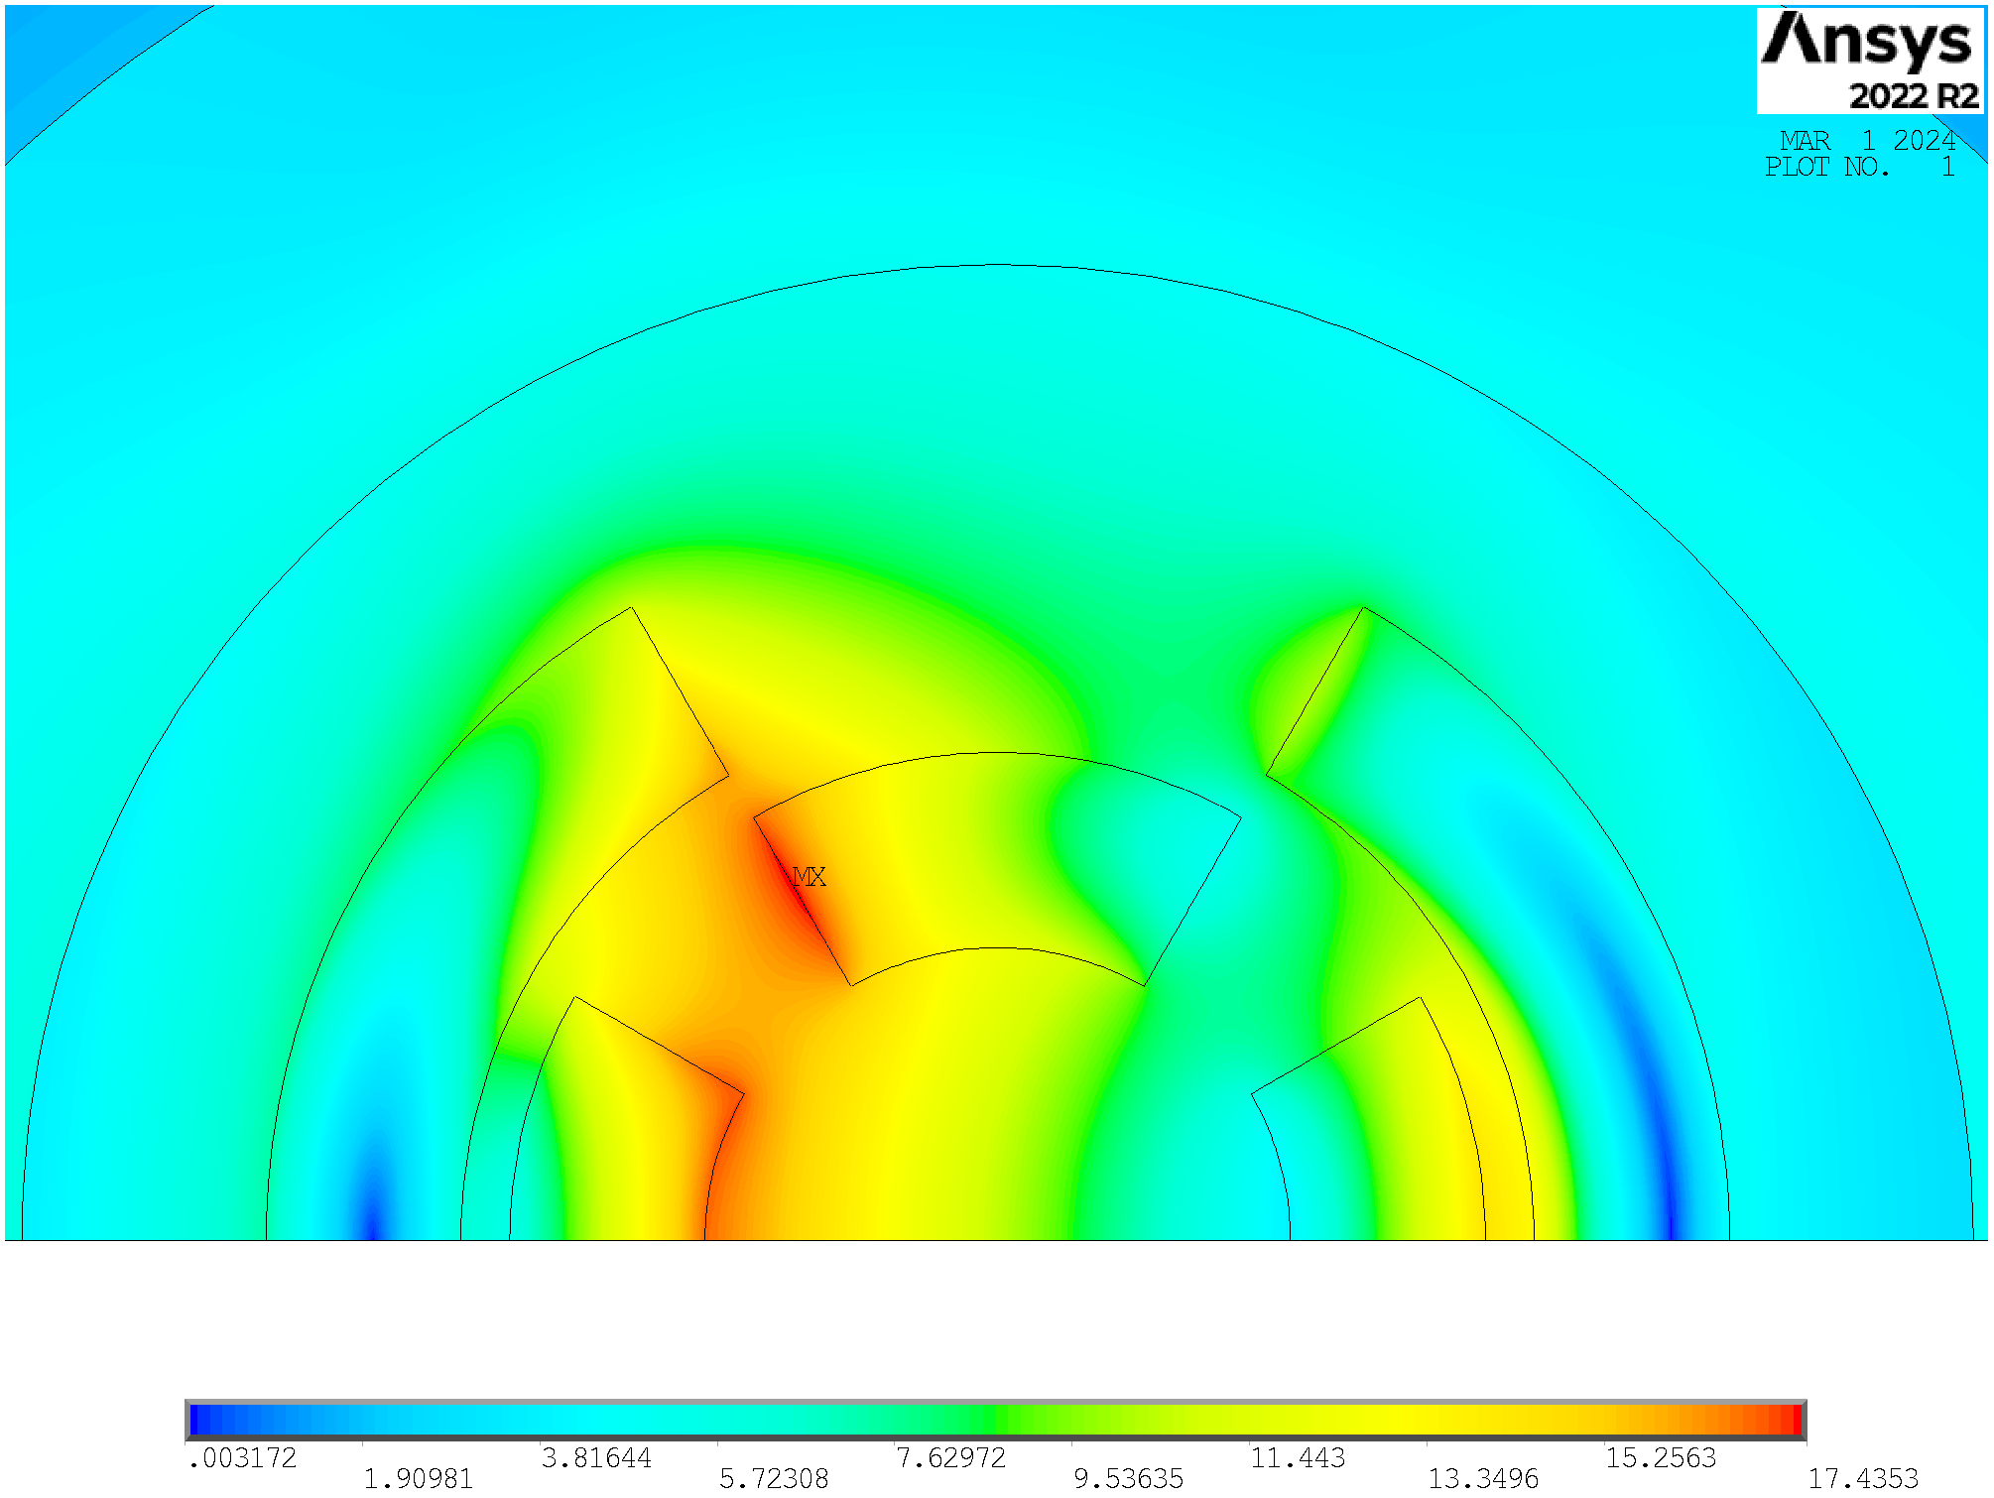
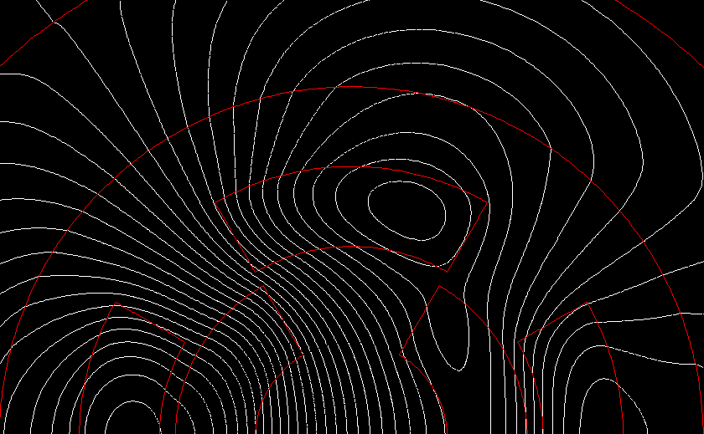
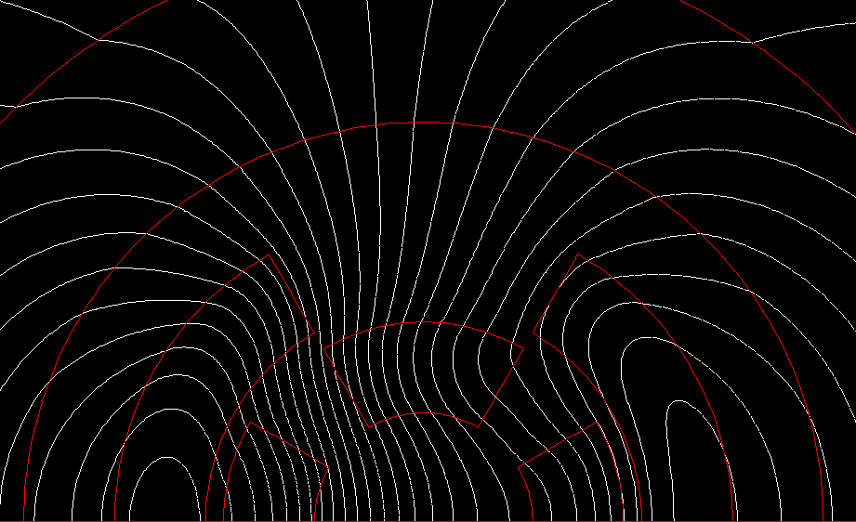
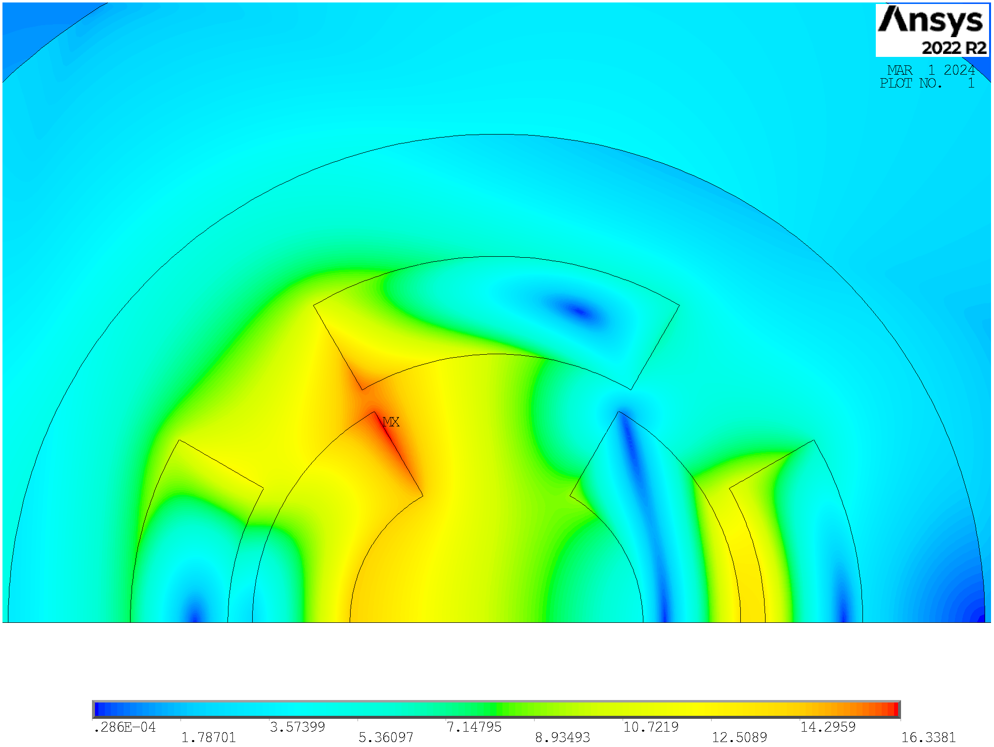
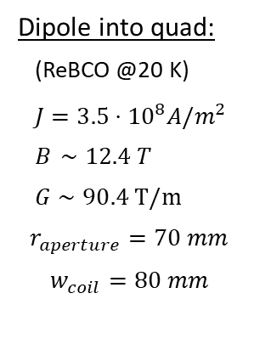

Combined Function Magnet
Arc:
Combined function magnets: B1, B1+B2 and B1+B3
B ≈ 8…16 T; G ≈ 320 T/m; G’ ≈ 7100 T/m²
Aperture ≈ 160 mm
Final focus:
Combined function magnets: B1, B2, B1+B2 , B1+B3
B ≈ 4…16 T; G ≈ 100…300 T/m; G’ ≈ 12000 T/m²
Aperture ≈ 120…300 mm
Preliminary results obtained with ANSYS in a sector coil approximation
Quad into dipole:
(ReBCO @20 K)
$J=3.5⋅{10}^{8}A/m^{2}$
$B_{ }∼11.7 T$
$G∼143.3 T/m$
$$r_{aperture}=70 mm$$
$$w_{coil}=80 mm$$
Dipole into quad:
(ReBCO @20 K)
$J=3.5⋅{10}^{8}A/m^{2}$
$B_{ }∼12.4 T$
$G∼90.4 T/m$
$$r_{aperture}=70 mm$$
$$w_{coil}=80 mm$$
Quadrupole inside dipole is more efficient, in agreement with US-MAP [ref]

Slide 23
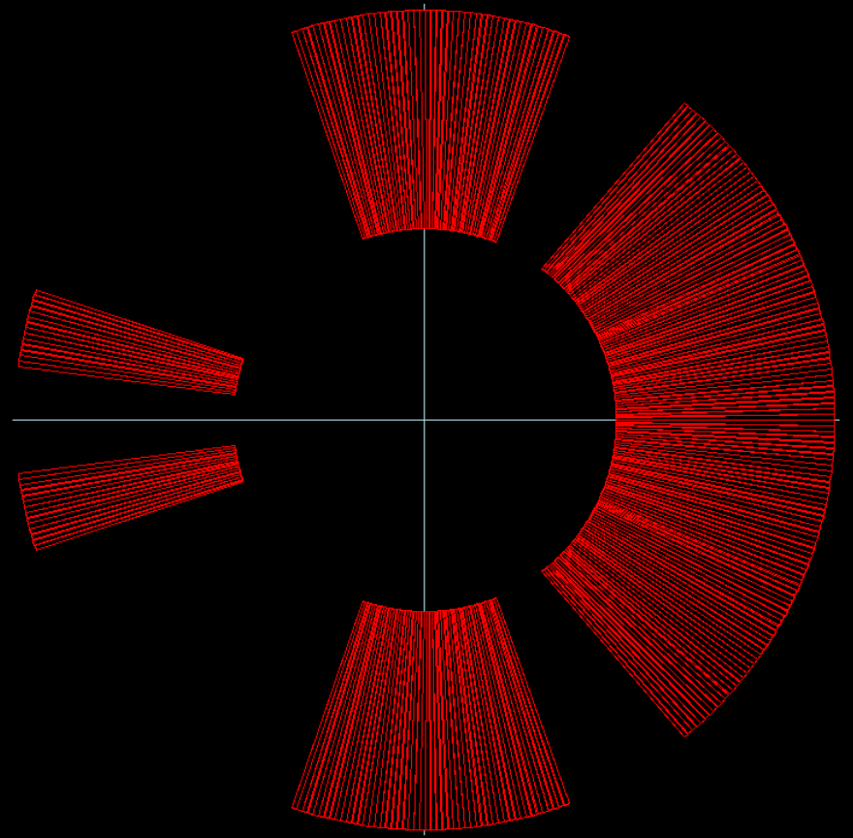
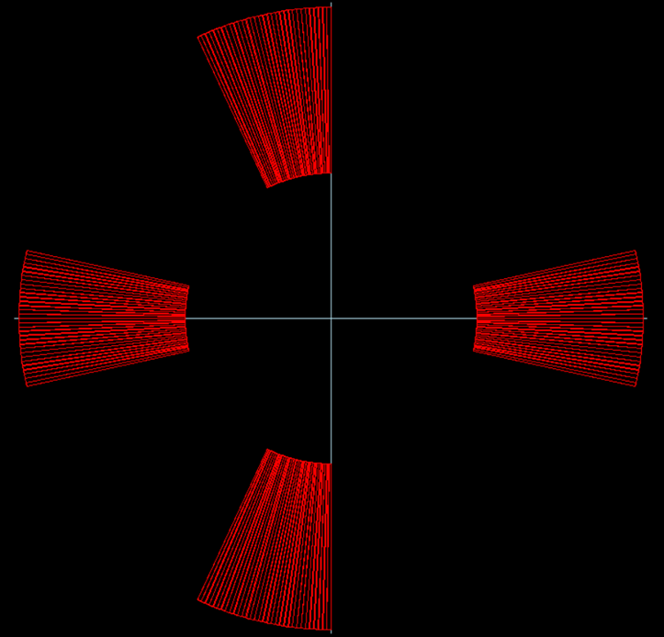




Combined Function Magnet
Nested: Quad into dipole
Asymmetric Dipole
Asymmetric Quadrupole
$$B=13 T$$
$$G=140 T/m$$
$$Ratio=0.5$$
$$B=4 T$$
$$G=80 T/m$$
$Ratio=0.$2
$$Ratio=\frac{B_{2}@R_{ref}}{B1}$$
$$Ratio=\frac{B1}{B_{2}@R_{ref}}$$
B and G are not independent and the feasibility of windability still to be studied
Quadrupole inside dipole is the primary choice for the combined functions of the muon collider

Slide 24
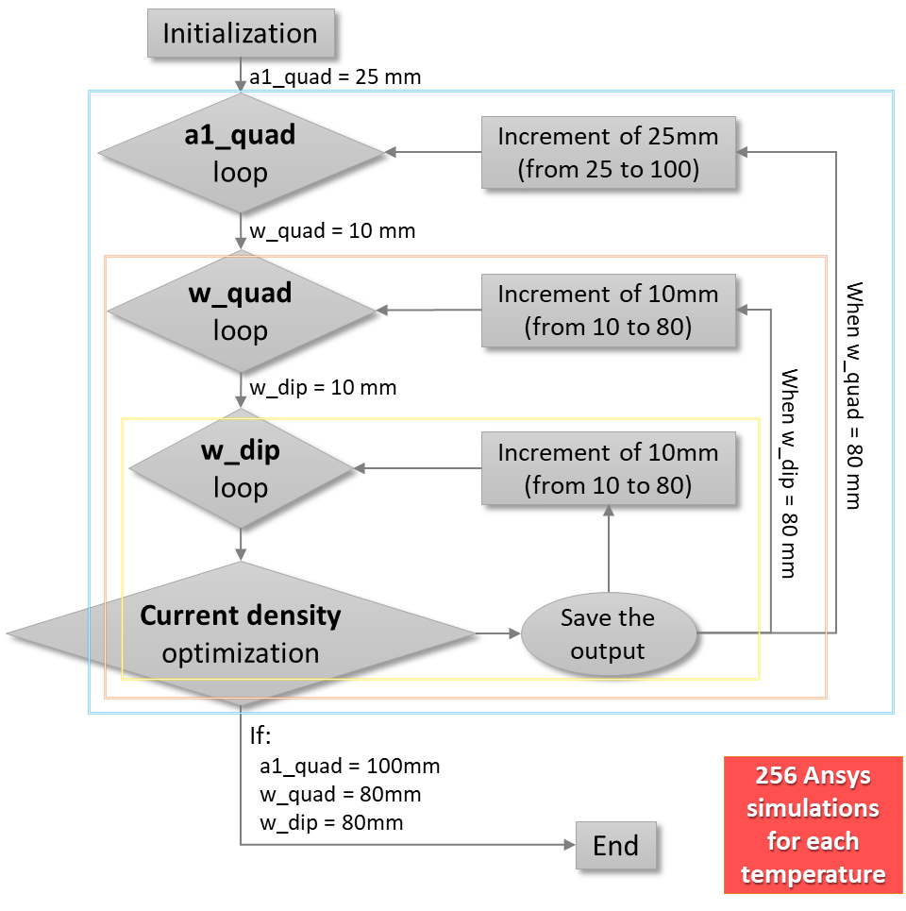
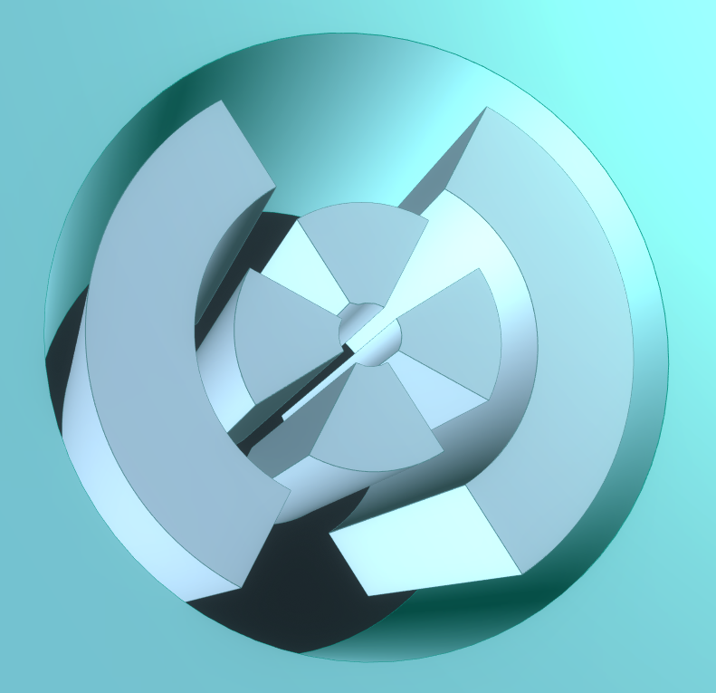
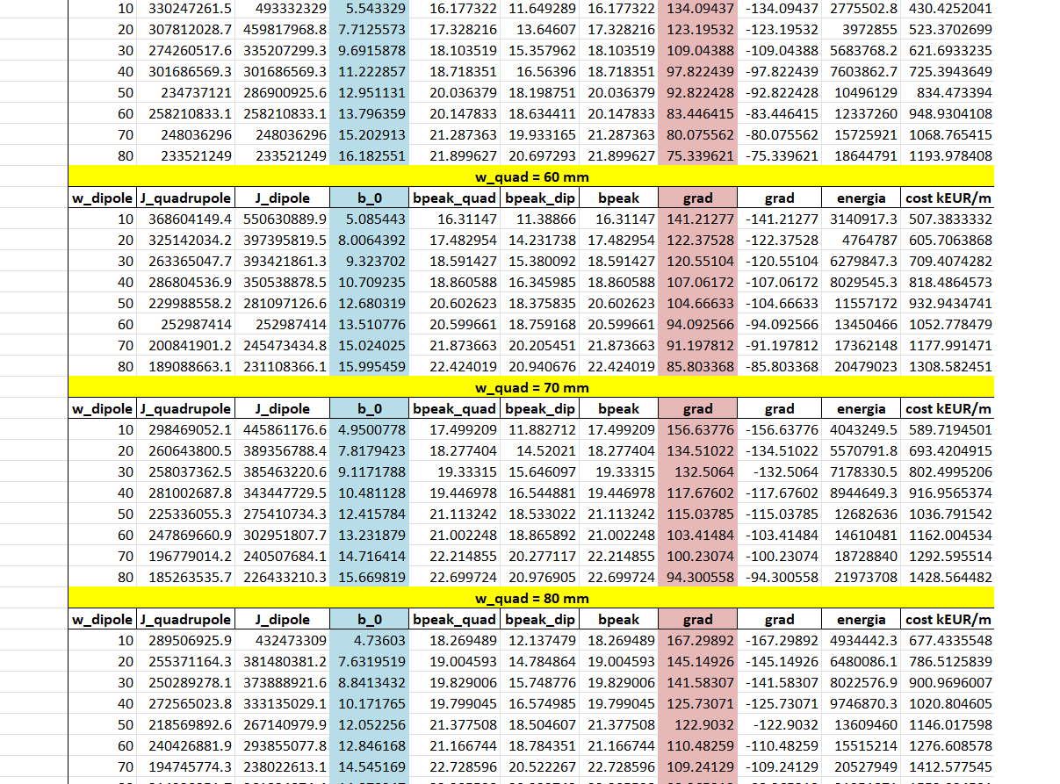
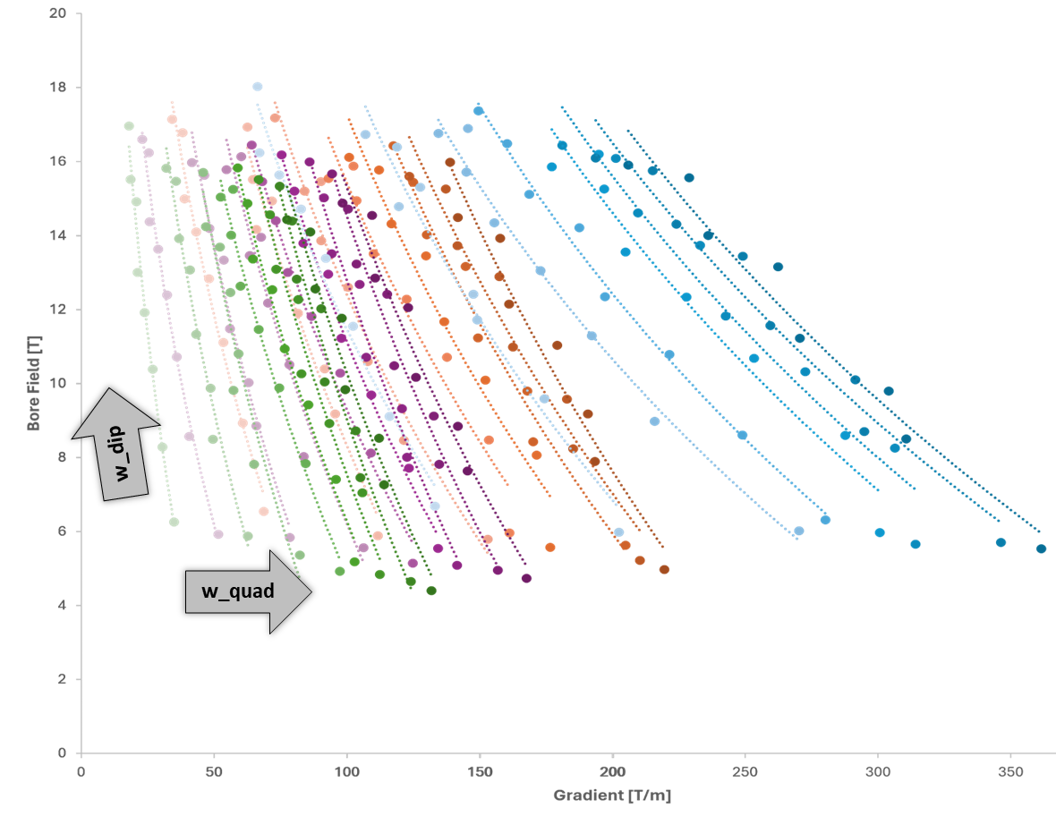
Combined Function Magnet
What’s next? We would like to produce B-G plots in order to provide the allowed area for the combined function magnets
Python-Ansys Interface
Scheme of the code
Data saving
30 mm
a1_quad
w_dip
30 mm
w_quad
Data study
Graphical representation

Slide 25
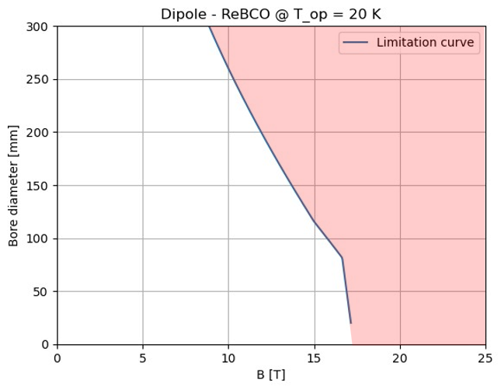
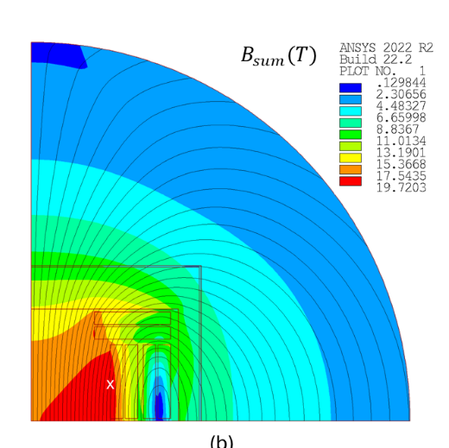
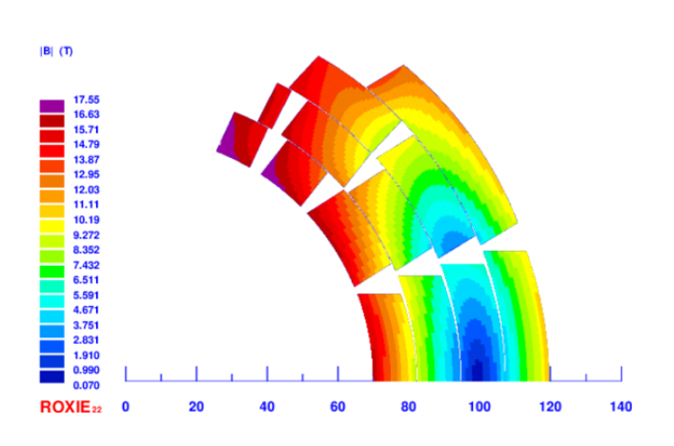
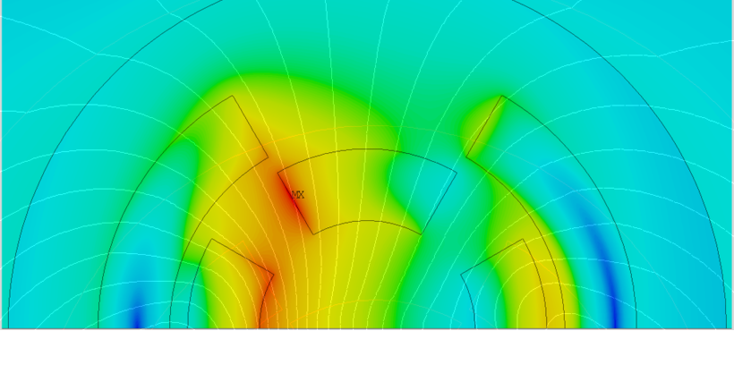
Conclusions
The allowed magnet aperture (A) - magnetic field (B) phase spaces are provided and discussed, representing the starting point to define possible beam optics which are also acceptable from a technological point of view.
To address the issue of neutrino flux in the straight sections, combined function magnets must be used in the Muon Collider. In this regard, we are working to identify realistic target designs from a technological point of view.
Courtesy of L. Alfonso
Courtesy of F. Mariani
Thanks to the A-B plots, we were able to identify a target design, allowing us to begin studying specific designs.
  In particular, we are exploring a cos-theta design and a block coil design.

Slide 26
Thank you
for your attention
Daniel Novelli
Ph.D. in Accelerator Physics – XXXVIII cycle
24 October 2024

