Slide 1
PhD Seminars
Terahertz/Infrared Radiation: From the Production with Accelerator Based Sources to the Use in Material Characterization for Accelerator Cavities
PhD Student: Lorenzo Mosesso
PhD Supervisor: Stefano Lupi
PhD Co-Supervisor: Salvatore Macis

Slide 2
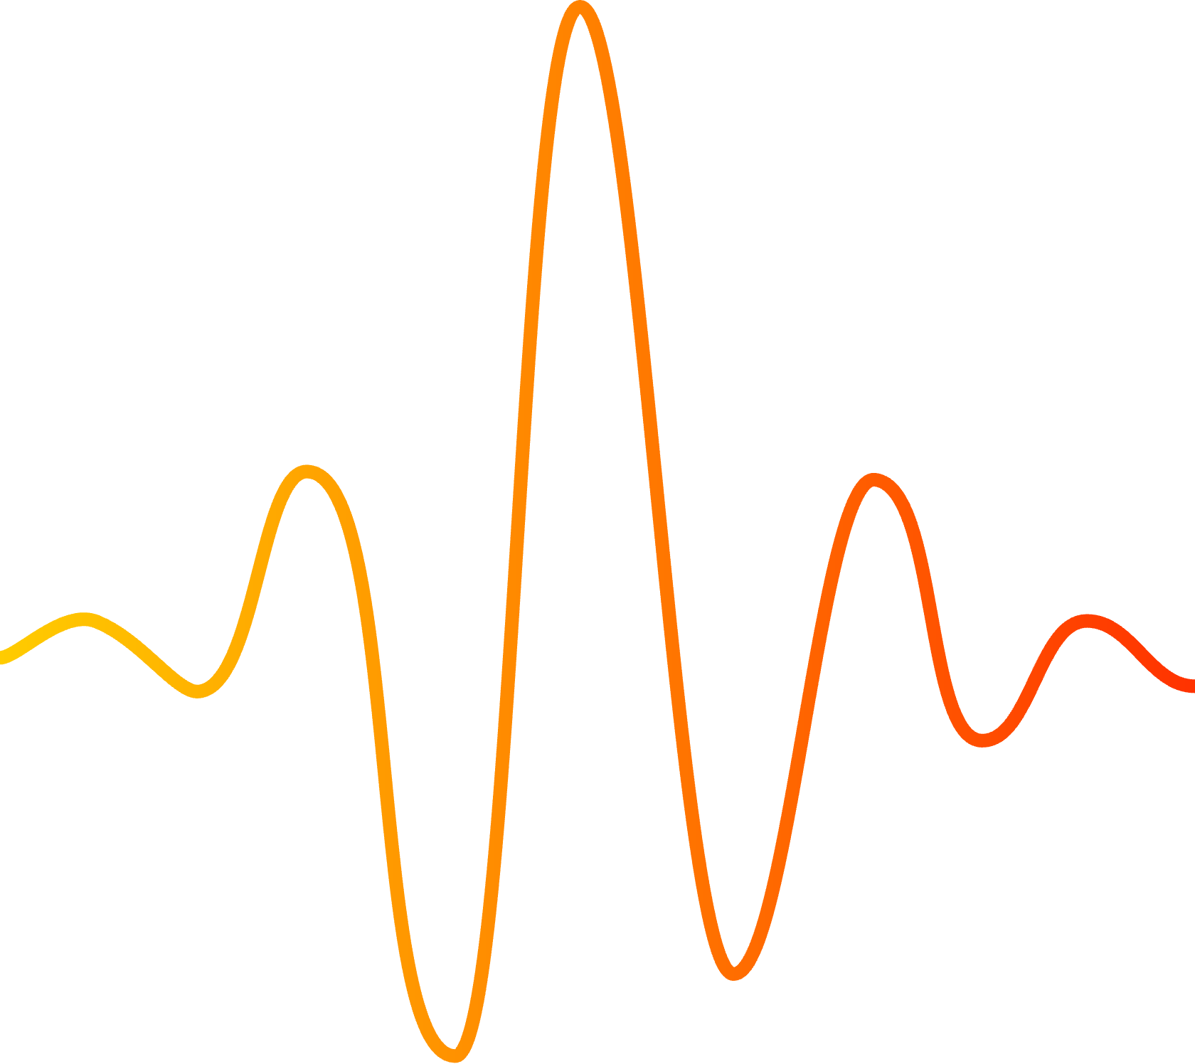
Why THz/IR Radiation?
1
Characterization and control of quantum materials
Materials
2
Non-destructive, non-contact and label-free optical method for biological detection
Biology
3
Imaging technique as a replacement for medical X-rays.
Medicine
4
Can be used for sensing and characterizing airborn pollution and VOCs
IR/THz Units:
$$200 cm^{−1} \sim 300K \sim 25 meV$$
$$∼50 μm∼7 THz$$
Enviromental science
5
Can penetrate fabrics and plastics, so it can be used in surveillance
Security

Slide 3
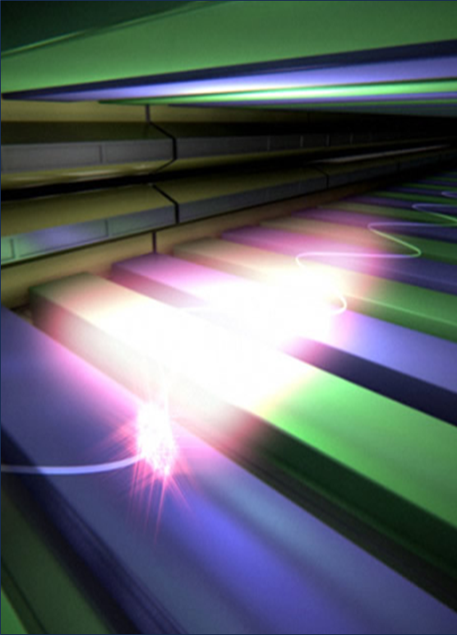
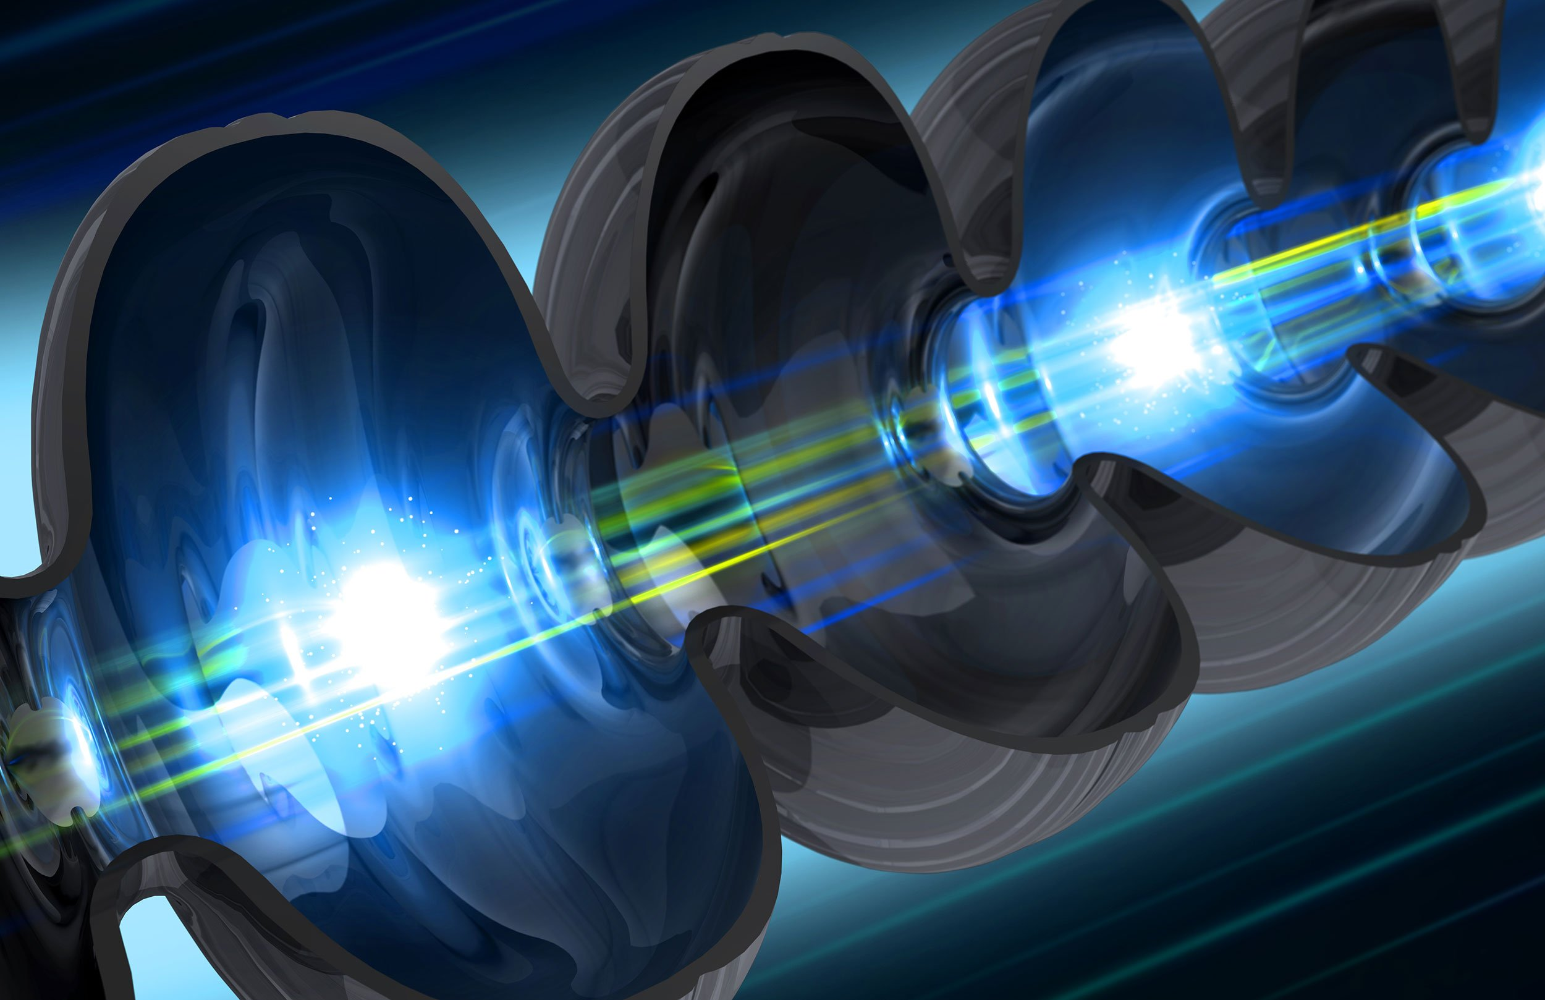
Outline: THz/IR Radiation in Accelerator Physics
Particle Accelerators as THz/IR Radiation Sources – Design of optical beamlines
THz/IR Radiation for Material Characterization in Accelerator Technologies
SISSI 2.0 Beamline @ Elettra
SABINA THz/MIR Free Electron Laser @ SPARC_LAB
$CuAg$ alloys with different Ag concentrations
Transition Metal Oxide Thin Films on Cu ($MoO_{3}$ coatings)
Notes:
The first part of my PhD project deals with the THz/IR radiation intended as the product of particle acceleration.

Slide 4
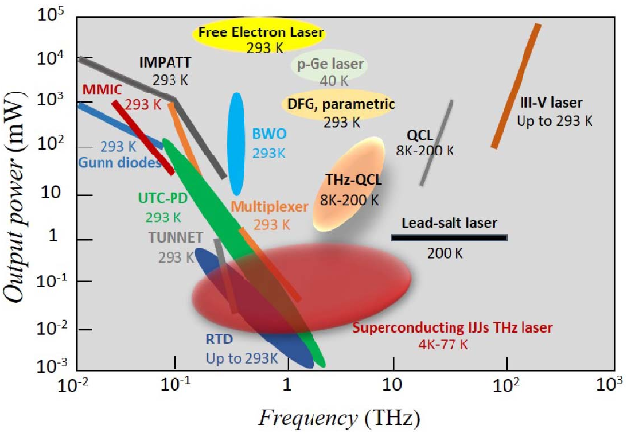
Why Sources Based on Particle Accelerators
‘THz Gap’: Challenges associated with the generation, manipulation and detection of THz radiation
THz/IR Sources:
Conventional IR Sources (CW operation, low brightness, low collimation)
Quantum Cascade Lasers (work mainly in CW, strict operational temperatures, small frequency tunability…)
Laser-based sources (pulsed radiation, frequency range limited by the non-linear crystals, high energy pulses…)
Particle Accelerator-based sources $→$ they can provide radiation with astonishing properties, overcoming the previous limitations
Broadband Emission
Frequency Tunability (over a broad range)
Infrared Synchrotron Radiation
(ISRS)
Pulsed Radiation
FEL Radiation
Low angular divergence (suitable for micro-spectroscopy)
Polarized Light
Unmatched Brightness
Suitable for time-resolved spectroscopy

Slide 5
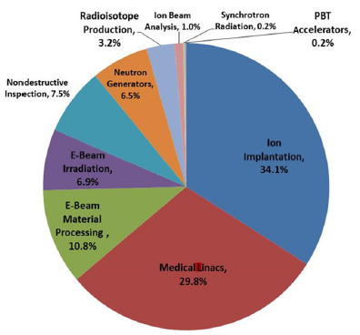
Dedicated THz/IR Facilities in the World (Not Exhaustive List!)
DIAMOND, Uk
B22 Miriam Beamline
ELBE/FELBE High-Power THz Facility, Dresda, Germany
ALS, Berkley (CA)
IRSR for Microspectroscopy
SOLEIL, Orsay, France
SMIS Beamline
SISSI and THz TeraFermi @ Elettra, Trieste
THz @ Phoang Accelerator Laboratory, Korea
Spring-8, Harima Japan
IRSR for Microspectroscopy
NSLS, BNL, Upton, NY, USA
IRSR for Microspectroscopy
DAΦNE – SINBAD
SABINA THz/MIR FEL
@ SPARC_LAB, Frascati (RM)
CAEP THz FEL facility Peking University, China
Santa Barbara (CA)
UCSB THz/FIR Free Electron Laser Source
ISIR THz FEL @ Osaka University, Japan
LNSL, Sao Paulo, Brasil
IMBUIA IR Beamline
ANSTO, Melbourn
THz-FIR Beamline

Slide 6
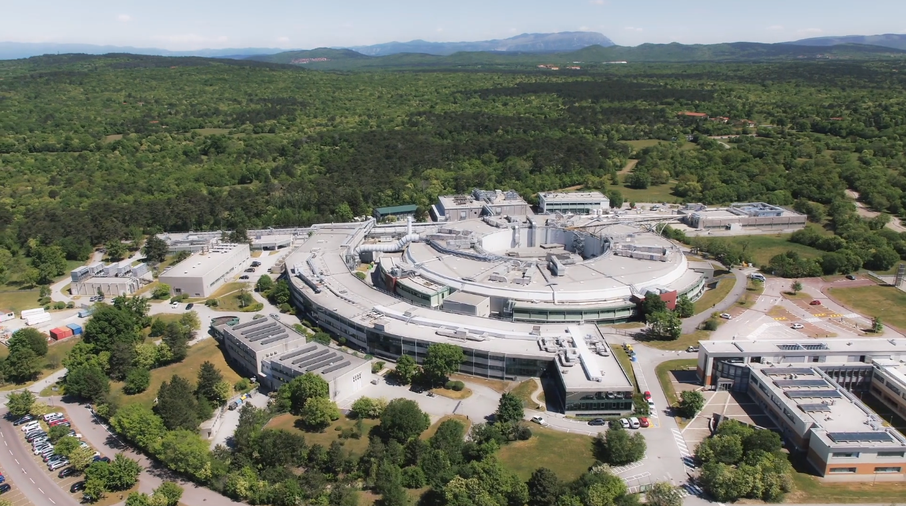
Towards the Fourth Generation Light Sources: Upgrade@Elettra
Elettra is a third generation synchrotron light source with:
a storage ring of $259.2 m$
operation energy of $2$ and $2.4 GeV$
28 beamlines available for external users
Major upgrade towards the realization of a ‘Diffraction Limited SR' light source in the soft X-rays
Higher brilliance:
Innovative design in magnetic optic: new modified multi-bend achromats dipoles (with Longitudinal Gradient and Reverse Bendings)
$$B=\frac{{\dot{N}}_{γ}}{4π^{2}σ_{x}σ_{y}σ_{x}^{′}σ_{y}^{′}(0.1\%BW)}$$
Great reduction in transverse emittance (mainly horizontal)
Increased coherence:
$$C={\left(\frac{hc}{2hν}\right)}^{2}\frac{1}{σ_{x}σ_{y}σ_{x}^{′}σ_{y}^{′}}$$

Slide 7
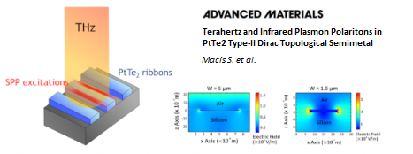
SISSI: Present and Future Upgrade
The SISSI (Synchrotron Infrared Source for Spectroscopy and Imaging )infrared beamline at Elettra extracts the IR and visible components of synchrotron radiation generated by bending magnets
Present Elettra Storage Ring with S2BA (9.1 Section)
Planned and Developed thorugh the collaboration:
Sapienza University (Stefano Lupi)
CNR-IOM (Michele Zacchigna)
Future Elettra 2.0 Storage Ring with S6BA-E (9.1 Section)
Two branchelines (Material Science and Chemical-Life Science) are provided with a full equipment to perform at different thermodynamics conditions:
IR and Optical Spectroscopy
Microspectroscopy
Imaging
Nanospectroscopy (s-SNOM)
SISSI 2.0
6 dipoles
16 quadrupoles
20 sextupoles
4 skew quadrupoles
4 octupoles with correctors
Design of the new optical beamline for IRSR extraction:
Spatial constraints and new emission properties must be taken into account

Slide 8
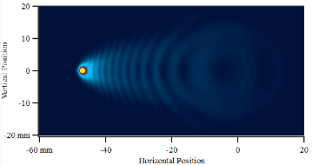
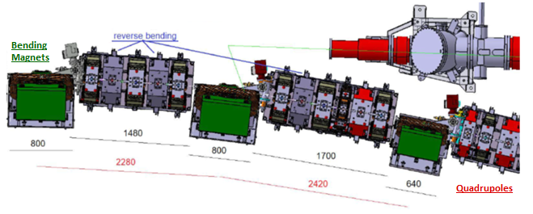
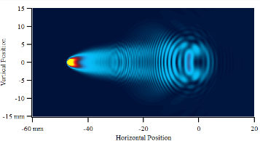
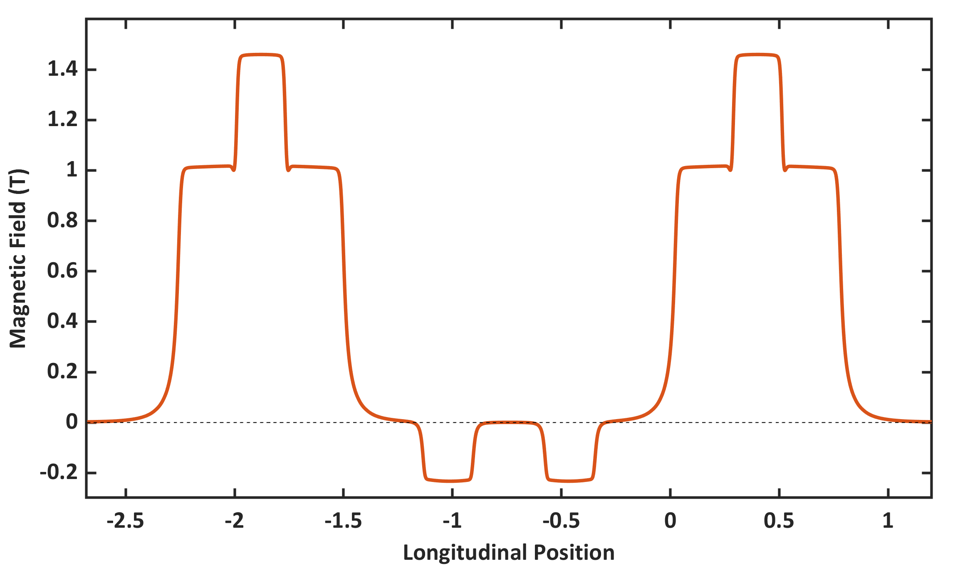
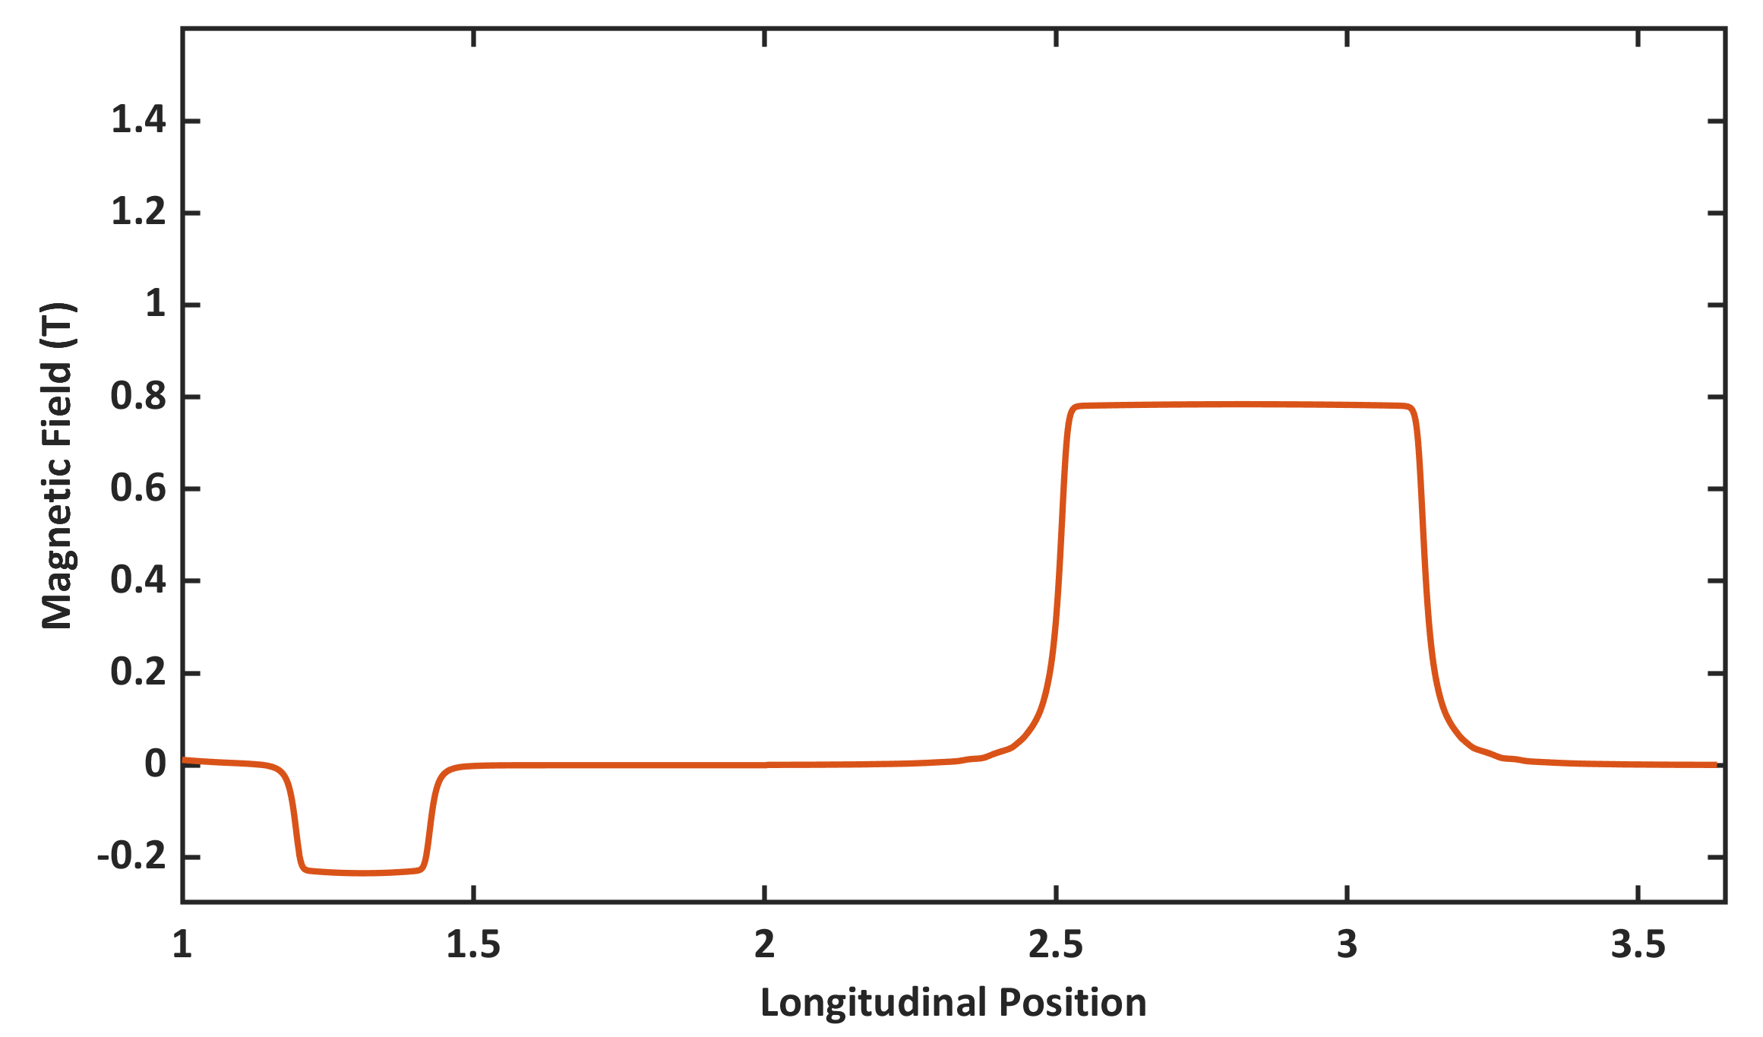
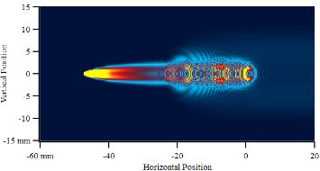
SISSI 2.0 Beamline Design: Radiation Properties
Observation Screen
$$100 μm∼3 THz$$
Section of the Storage Ring dedicated to SISSI 2.0
Dipolar contribution of the magnetic lattice provided with:
Longitudinal Gradient Bending Dipoles
Reverse Bendings
B80
B80
$$10 μm∼30 THz$$
B64
SRW Simulations to calculate the SR Electric Field in Near Field Regime
$$1 μm∼10000 cm^{−1}$$

Slide 9
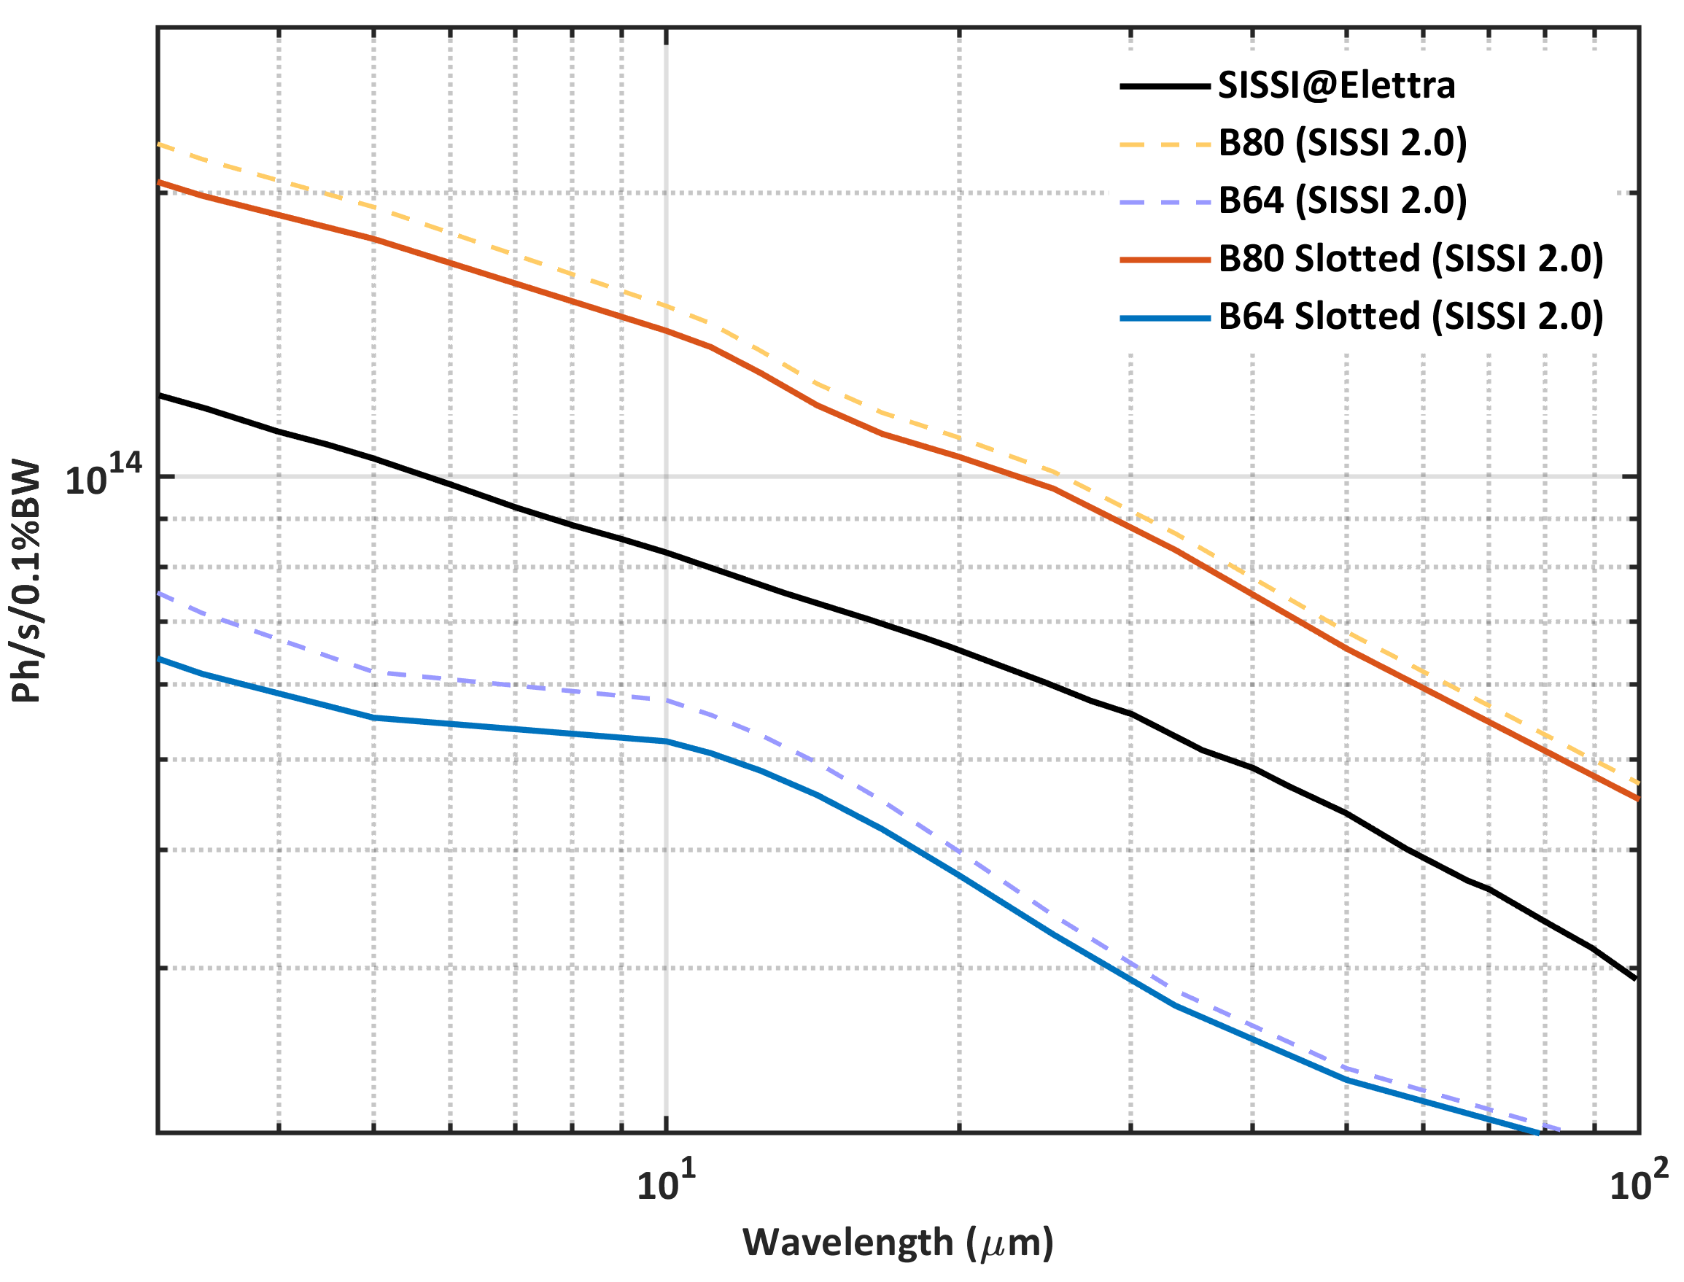
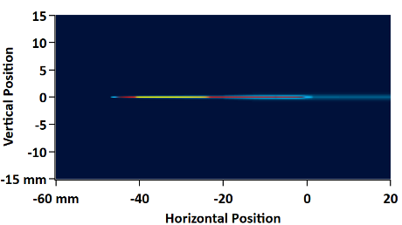
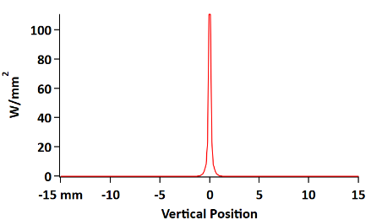
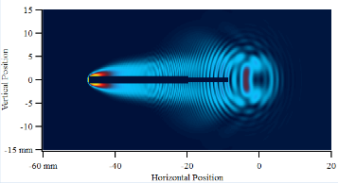
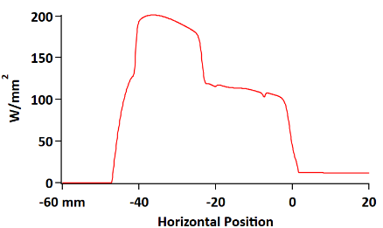
Design of the Optical Beamline: Collecting Mirror
The most critical point in the beamline design is the radiation extraction through a collecting mirror. Several issues need to be addressed:
Mirror installation within the machine and space availability
Mirror thermal load induced by SR broadband emission
Photon Flux collection (minimum required for the experimental applications)
Power Density
X-Rays load:
$∼100 W/mm^{2}$ are unbearable. Required slotted mirrors
Downstream B80
Slotted Mirror
$$H40×V24 mm$$
Larger slot: $1.5 mm$
Thinner slot: $1 mm$
$15 mm$ from the $e^{−}$ beam
$$10 μm$$

Slide 10
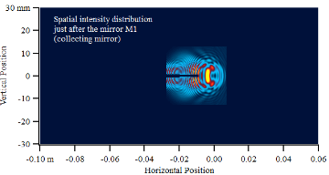
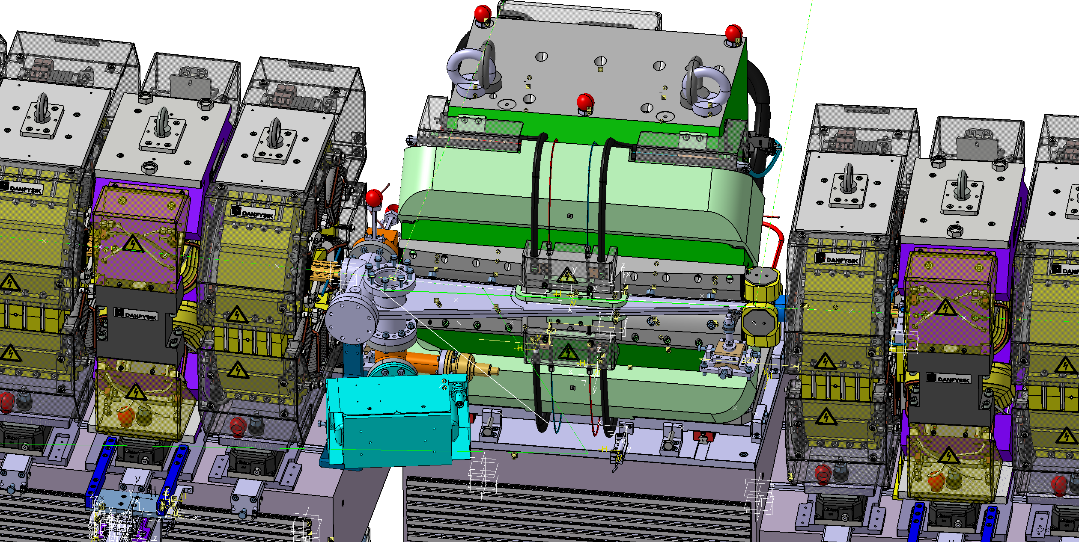
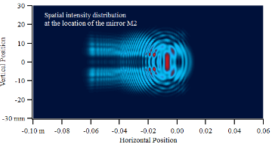
Design of the Optical Beamline: Wavefront Propagation
Toroidal or Parabolic for M2
Oral Contribution:
TeraDays 2024 (Federico II, Napoli)
SRI 2024 (DESY, Hamburg)
SILS 2024 (Università della Calabria, Rende)
WORK IN PROGRESS: Beam Propagation through the rest of the optical beamline up to the existing end-station:
Installation of a conical mirror for beam reshaping (beam profile suitable for micro-spectroscopy)

Slide 11
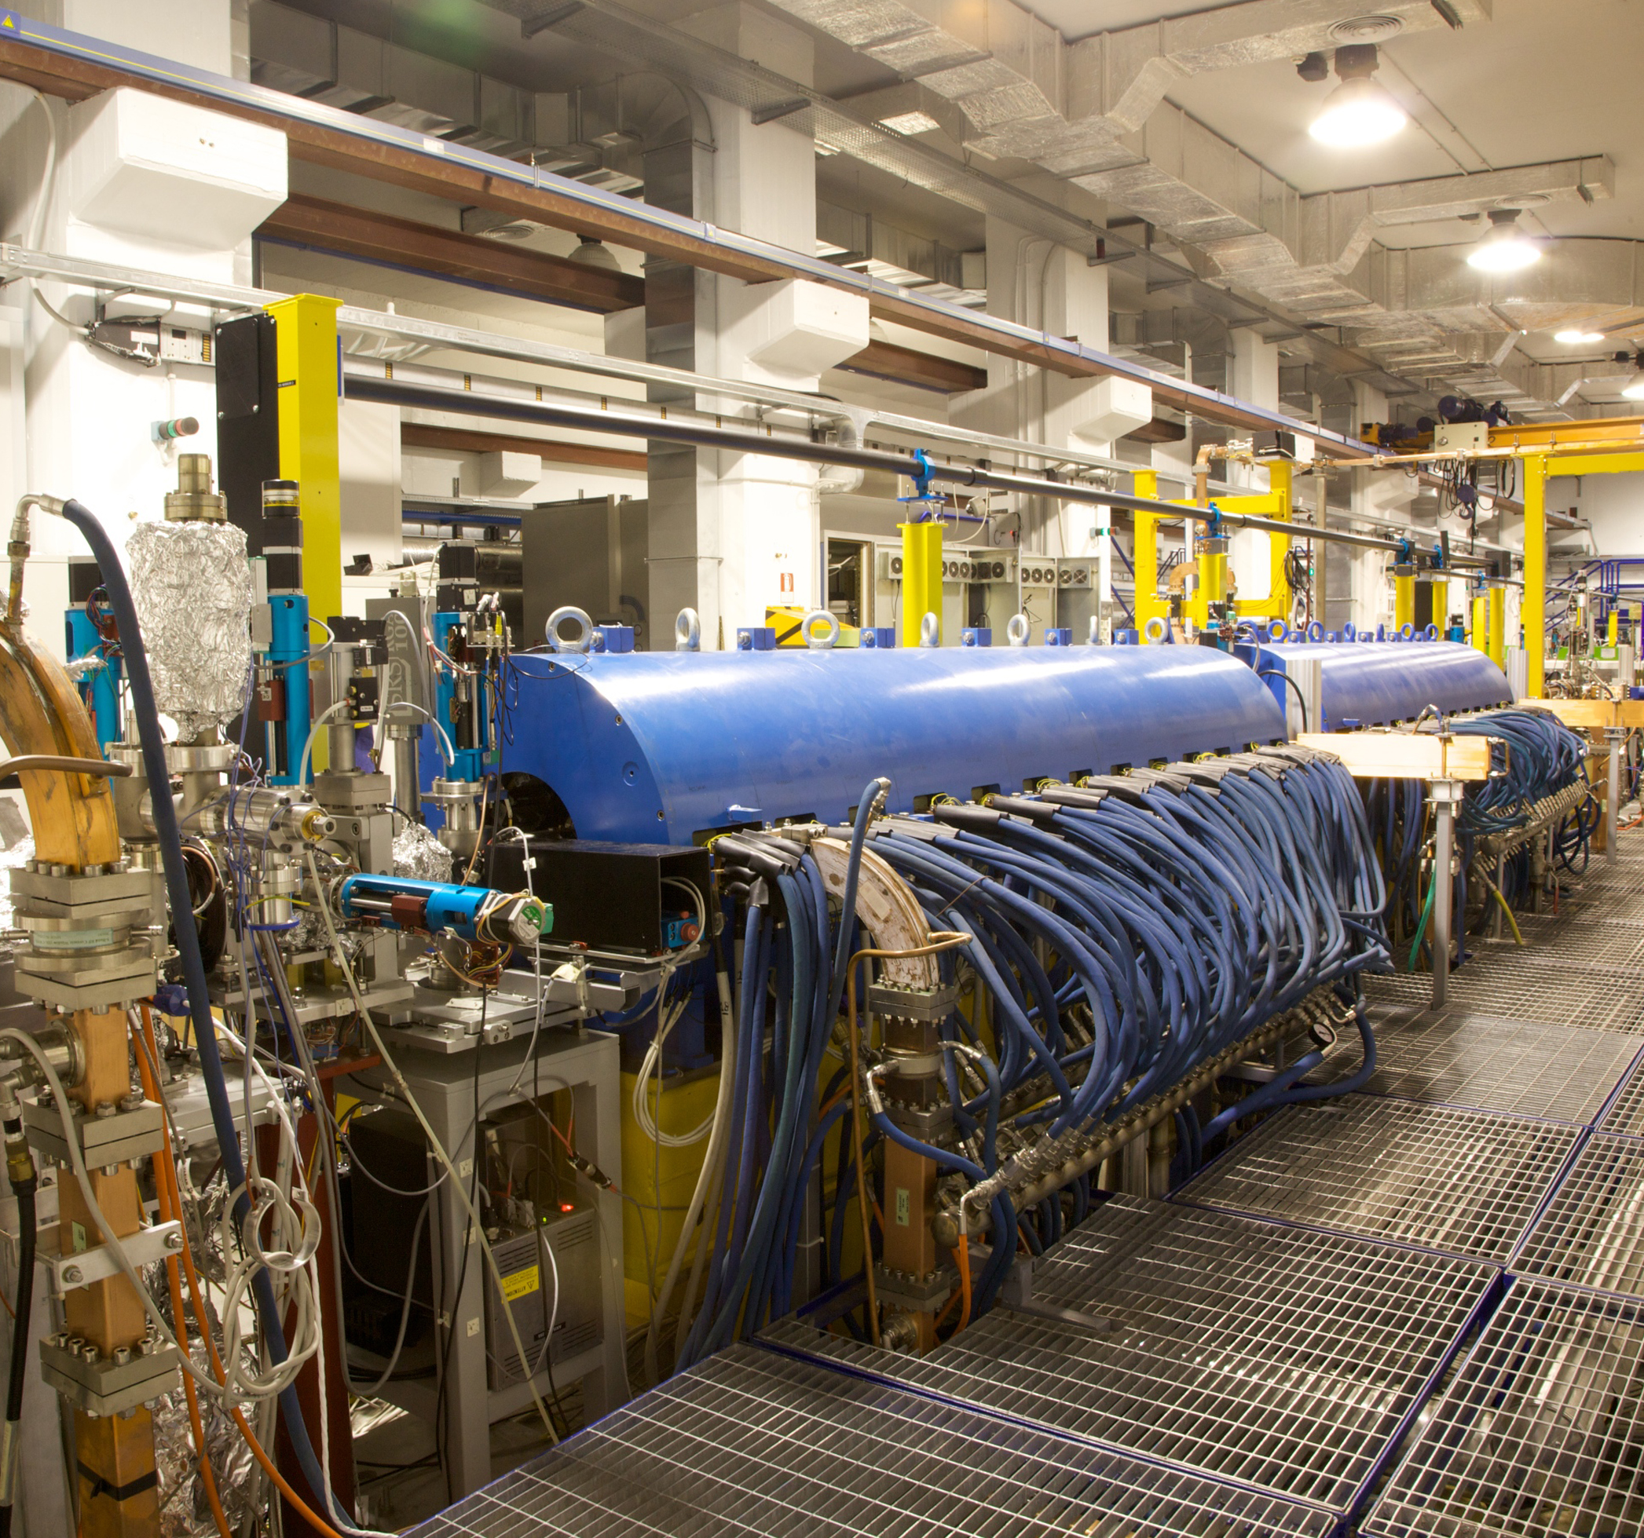
SABINA: About the Project
SABINA: Source of Advanced Beam Imaging for Novel Applications
Project co-founded by Regione Lazio within POR-FESR 2014-2020 funds and INFN
GOAL: Enhancement of the SPARC_LAB research facility – increase of the uptime and improvement of the accelerator performances:
Technological plant renewal
Substitution of the ancillary systems and upgrade of the facility in terms of technology
Creation of two user facilities:
FLAME: High power laser for solid target experiments
THz/IR FEL: radiation source for optical spectroscopy (pump probe), also at cryogenic T
STATUS: kick off Sept. 2019, project finalization: end of 2025

Slide 12
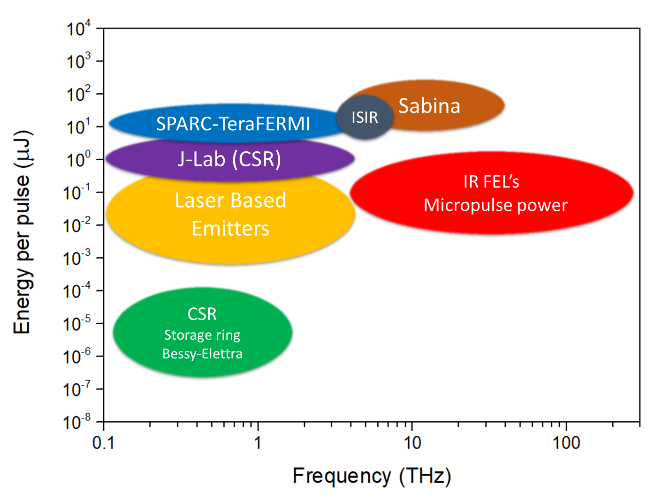
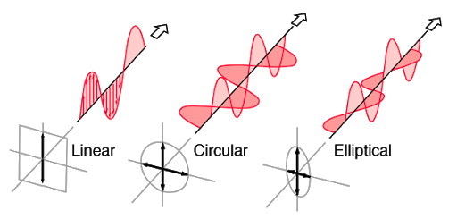
The SABINA THz/IR FEL
SABINA aims to develop a user facility based on a FEL delivering radiation with the following important properties:
monochromatic light with $\sim ps$/sub-$ps$ time duration
Tunable frequency in a large spectral range between $3$-$30 THz$ (by tuning the beam energy in the LINAC)
High energy per pulse (up to $100 μJ/pulse$)
Tunable polarization (from linear, to circular, to elliptical)

Slide 13
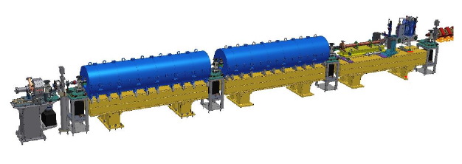
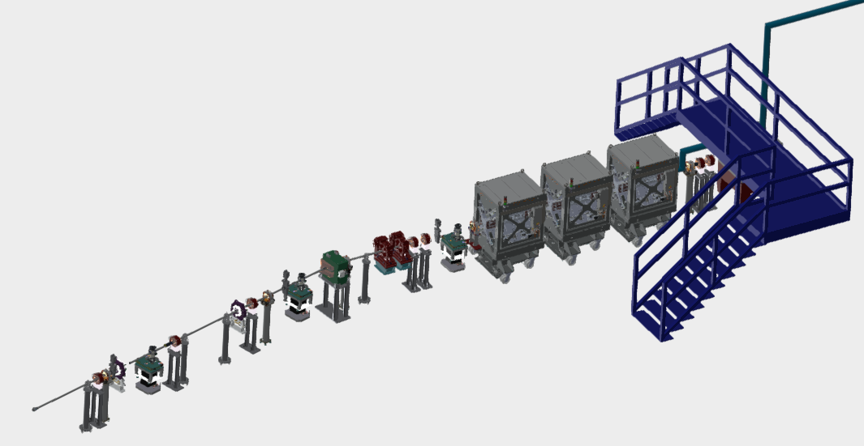
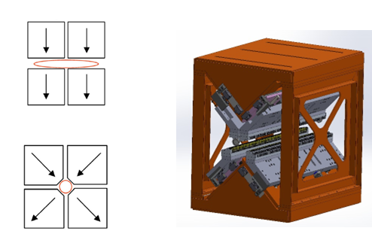
FEL Beamline Layout
C band
S1 band
S2 band
APPLE X Undulators
SPARC_LAB LINAC
RF Photocatode gun
Two S-band accelerating RF cavities
One C-band accelerating section

Slide 14
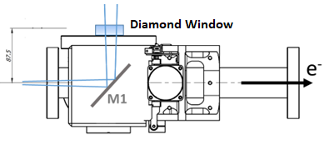
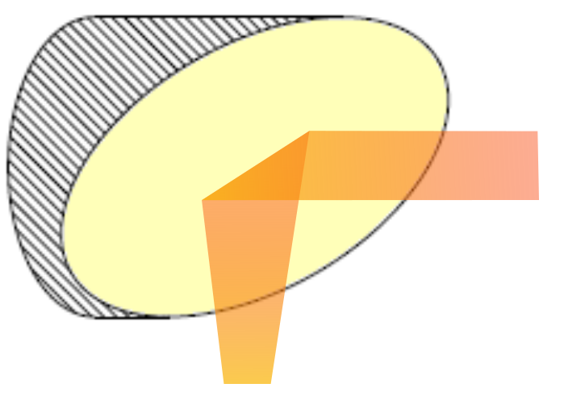
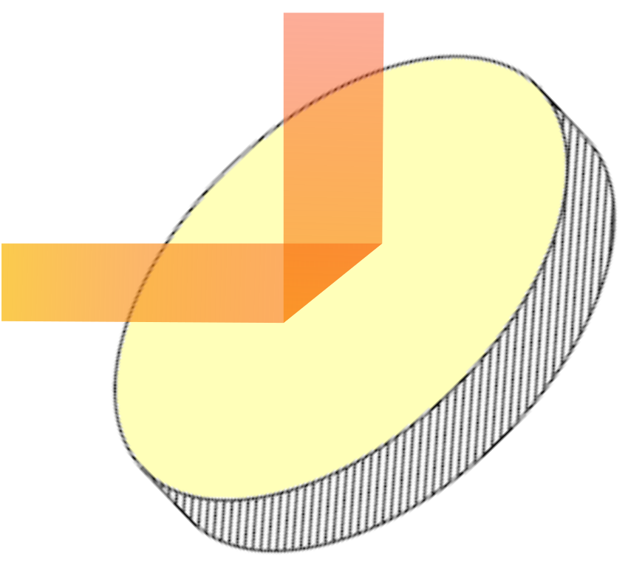
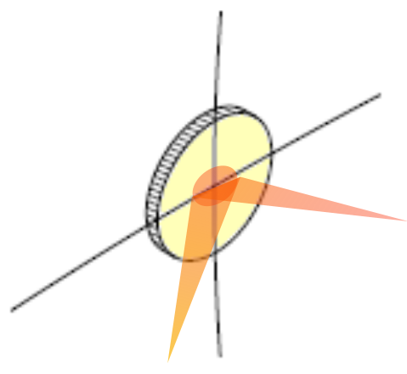
PhD Thesis: Extraction Beamline Design
M1 OTR Screen
M4 Parabolic Mirror
(EFL = 7530 mm)
M3 Plane Mirror
Extraction optics
Undulator
An OTR screen separate the electron beam and the THz-IR radiation
Here the accelerated electrons generate the FEL radiation in the THz-IR range
M2 Parabolic Mirror
(EFL = 908 mm)
M5 Toroidal Mirror
(EFL1 = 7530 mm)
(EFL2 = 3000 mm)
$$1.6 m$$
$$1.851 m$$
$$2.662 m$$
$$15.06 m$$
$$0.458 m$$
$$1.2 m$$
$$0.45 m$$

Slide 15
PhD Thesis: Extraction Beamline Design
Diagnostic Hutch
Extraction optics
Undulator
An OTR screen separate the electron beam and the THz-IR radiation
Here the accelerated electrons generate the FEL radiation in the THz-IR range
Diagnostic
The radiation is focused on a diagnostic setup (alignment, beam characterization)
$$1.6 m$$
$$1.851 m$$
$$2.662 m$$
$$15.06 m$$
$$0.458 m$$
$$1.2 m$$
$$0.45 m$$

Slide 16
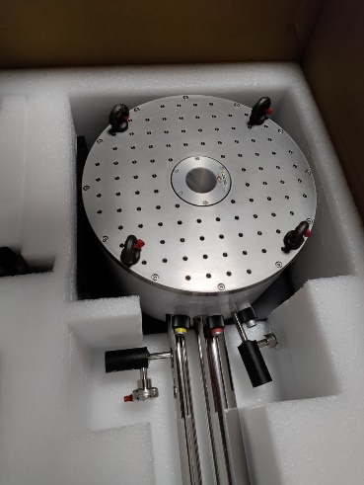
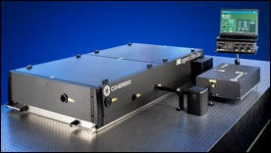
PhD Thesis: Extraction Beamline Design
Extraction optics
Experimental hutch
Undulator
An OTR screen separate the electron beam and the THz-IR radiation
The radiation is directed inside the experimental hutch where spectroscopy measures are performed
Here the accelerated electrons generate the FEL radiation in the THz-IR range
Diagnostic
The radiation is focused on a diagnostic setup (alignment, beam characterization)
$$1.6 m$$
$$1.851 m$$
$$2.662 m$$
$$15.06 m$$
$$0.458 m$$
$$1.2 m$$
$$0.45 m$$
Oral Contributions:
SILS 2023 (Sapienza, Roma)
TeraDays 2024 (Federico II, Napoli)
SRI 2024 (DESY, Hamburg)
SILS 2024 (Università della Calabria, Rende)

Slide 17
Outline: THz/IR Radiation in Accelerator Physics
Particle Accelerators as THz/IR Radiation Sources – Design of optical beamlines
THz/IR Radiation for Material Characterization in Accelerator Technologies
SISSI 2.0 Beamline @ Elettra
SABINA THz/MIR Free Electron Laser @ SPARC_LAB
$CuAg$ alloys with different Ag concentrations
Transition Metal Oxide Thin Films on Cu ($MoO_{3}$ coatings)

Slide 18
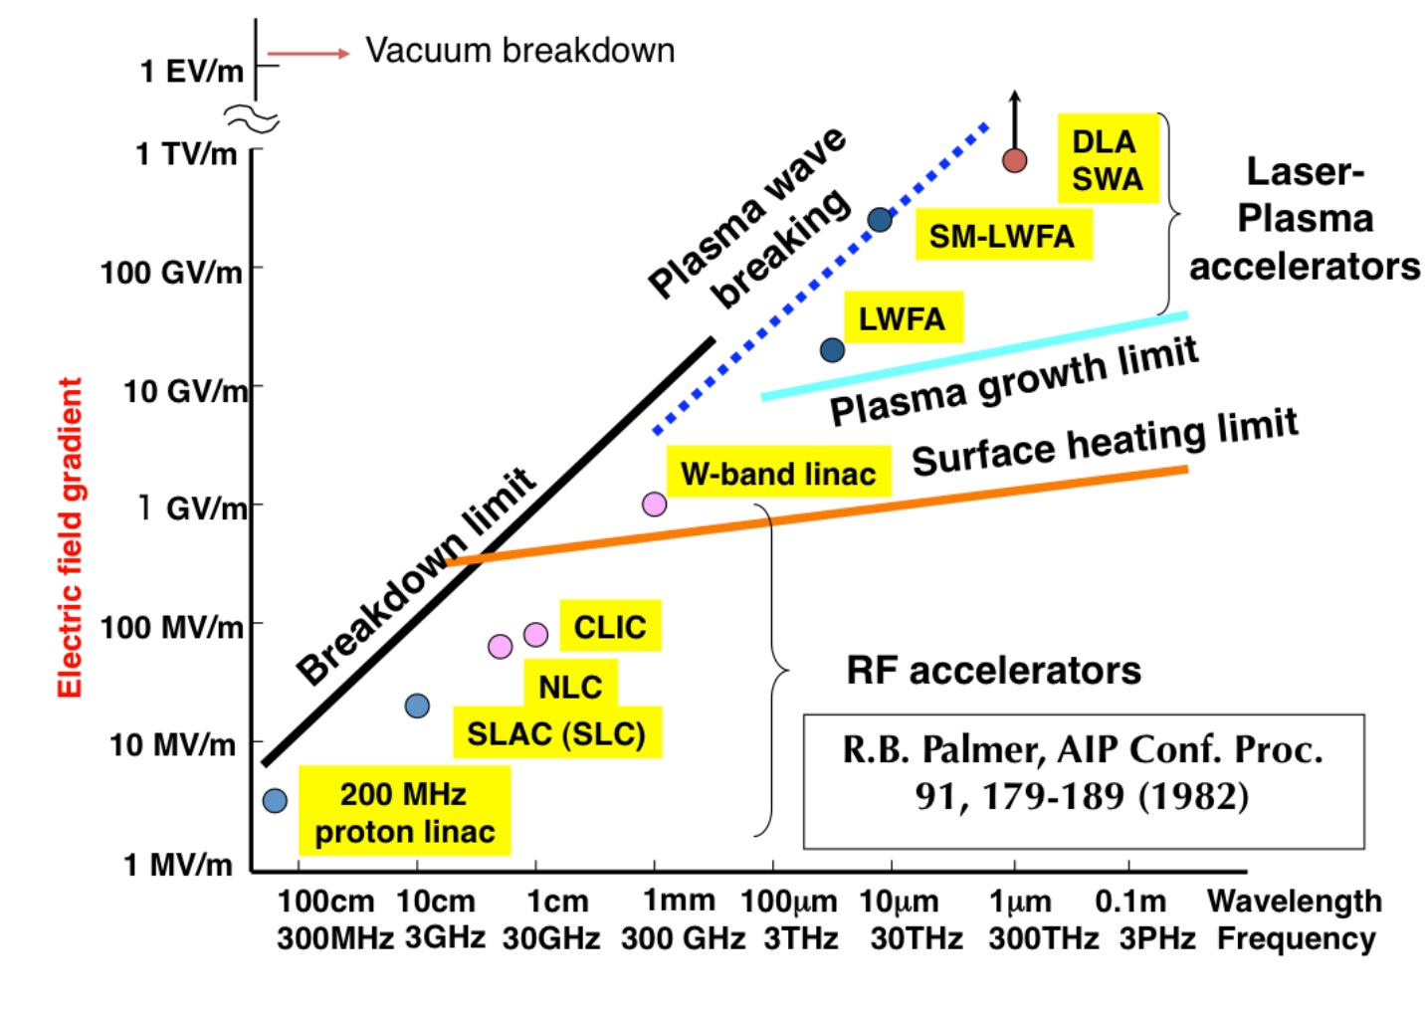
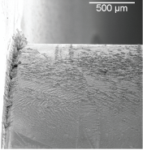
Motivation of the Study: Future Perspectives on RF Cavities
Conventional Accelerating Schemes:
RF Cavities
Technological Improvements required for:
Higher Accelerating Gradients
($≥200 MV/m$)
Reduced Costs (compact accelerator)
Existing Limitations:
Dielectric Breakdowns
RF Pulse Heating
Field Emission and Dark Currents
Mechanical and Thermal Stress
Natural Continuation of previous INFN Projects (Gruppo V):
DEMETRA (LNF, SLAC, KEK, UCLA)
TERA (LNF, Sapienza, Federico II, Torino)
NUCLEAAR (LNF, Sapienza, Tor Vergata)
IMPACT (LNF, Sapienza)
Solutions?
Find innovative materials to overcome the proposed limitations

Slide 19
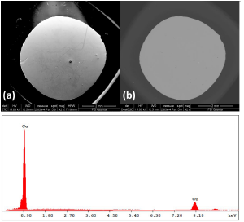
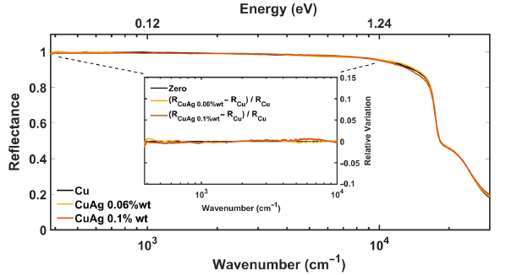
1° Case Study: Diluted CuAg Alloys
CuAg alloys with low Ag concentrations (0.028% wt Ag to 0.1% wt Ag)
Complete solid solubility (uniform samples – no microstructures)
Increased mechanical strength
(solution hardening)
High electrical and thermal conductivities (comparable to Cu)

Slide 20
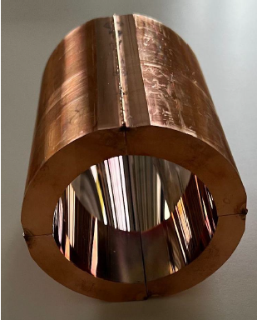
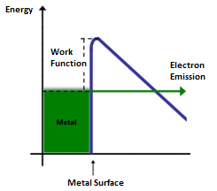
2° Case Study: $MoO_{3}$ Thin Films on Cu Substrate
Thin film growth procedures
Quality of the deposition (AFM, SEM, Raman, X-Rays)
Transport and mechanical characterization vs. film thickness
Coating of cylindrical RF cavity prototypes
Research on $MoO_{3}$ has reached some important milestones within the framework of the past INFN projects
Key Features:
High conductivity at low thickness ($≤300 nm$):
$$Insulator → Metal$$
High work functions
Reduced field emission and dark currents
High thermal stability and mechanical resistance

Slide 21
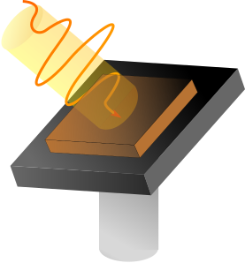
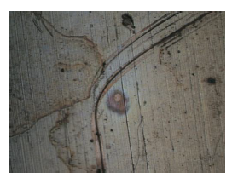
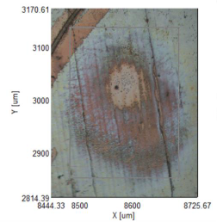
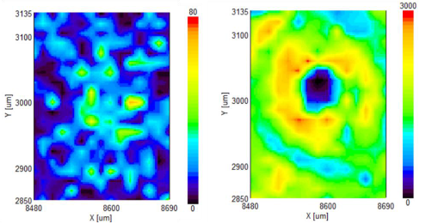
Experimental Methodology: Irradiation with High Intensity sub-THz/THz Radiation
Specific properties are being investigated:
Ultrafast thermodynamic evolution
Thermal induced deformations on the surface/thin film removal
Ablation phenomena
Change of surface chemical composition
New testing protocol to evaluate the damage induced by high electric fields on Cu-based samples
No needs for assembled RF cavities
High intensity THz pulses irradiating the sample with:
Polarization p or s
Tunable incident angle
Tunable energy per pulse
Varying number of pulses
Repetition Rate
RF Cavity environment reproduced!

Slide 22
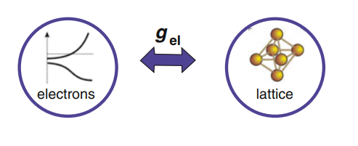
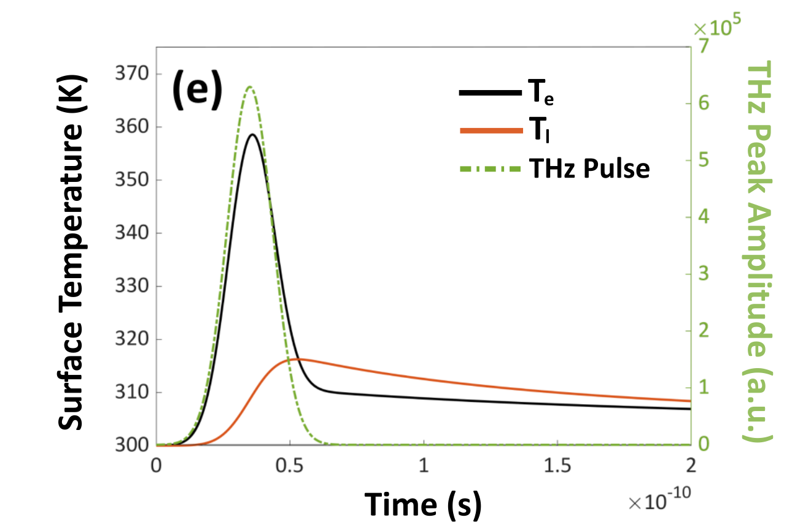
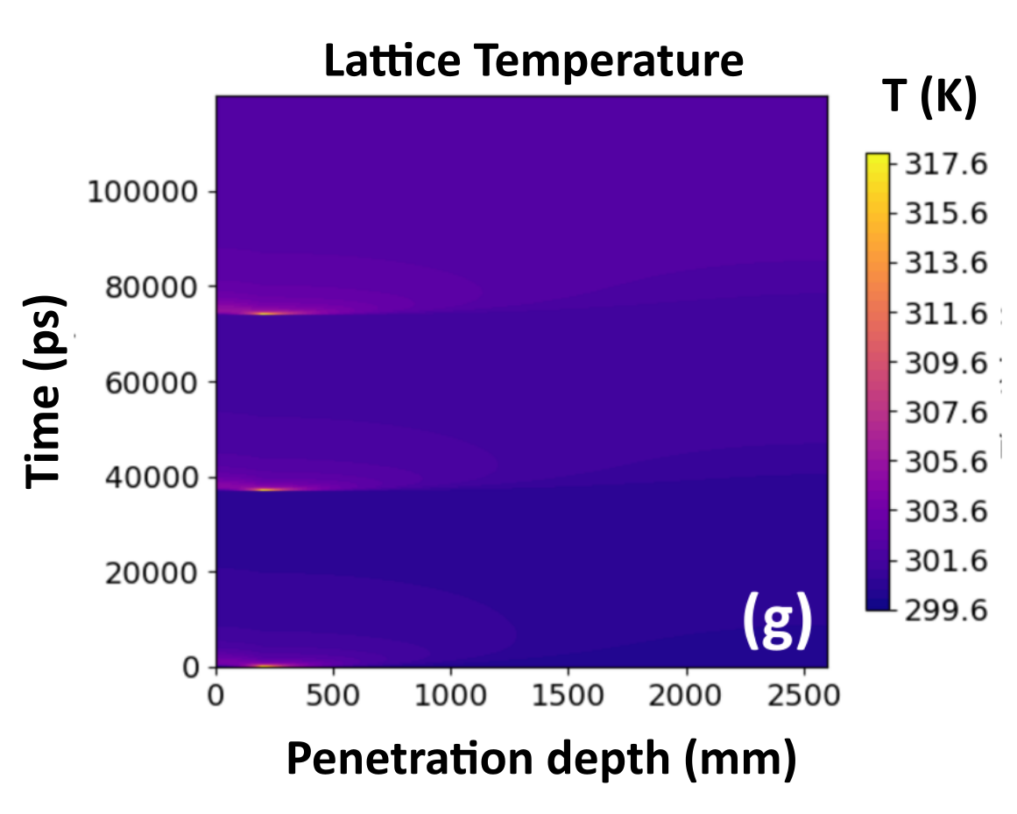
Theoretical Methodology: N-Temperature Model
We are interested in describing the thermal dynamics of a system when irradiated by ultra-fast pulsed radiation using a complementary theoretical approach:
2 – Temperature Model
Different inertia!
Different degrees of freedom of the system are considered as separated interacting thermal reservoirs, each with its own temperature
Completely implemented for Cu
Some experimental results have been preliminarily reproduced with the numerical simulations
Work in progress: Implementation of the model for the Cu-based materials

Slide 23
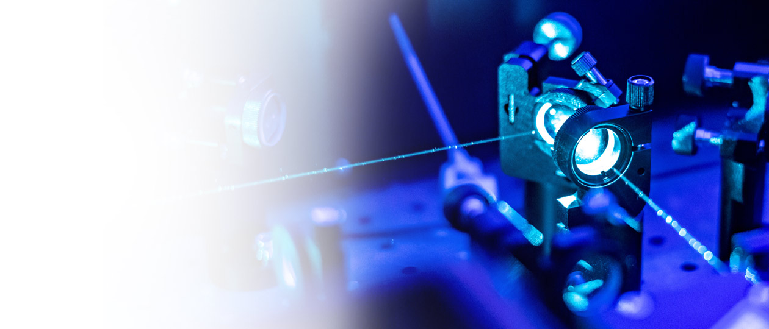
Future Perspectives
Sapienza Terahertz group will be involved in the practical realization of the beamlines, both in the installation and alignment of the optics.
The installation of the optics for SABINA is scheduled for the middle of next year. The group will be involved in the implementation of the equipment for the diagnostic chamber and for the installation of the optical set-up in the experimental chamber

Slide 24
Acknowledgements
Sapienza Terahertz Group:
Prof. Stefano Lupi (Sapienza University of Rome, INFN)
Salvatore Macis (Sapienza University of Rome, INFN)
Annalisa D’Arco (INFN, Sapienza University of Rome)
Elettra – Sissi Group
Giovanni Birarda
Lisa Vaccari
Michele Zacchigna
INFN – Gruppo V
Augusto Marcelli
Bruno Spataro
External Collaborations
Vincenzo Stagno (Sapienza University of Rome, Department of Earth Science)
Andrea Notargiacomo (CNR, Institute of Photonics and Nanotechnologies)
Maria Lilia Pia (CNR, Institute of Photonics and Nanotechnologies)
Thanks for your attention!!

Slide 25
Question Time

Slide 26
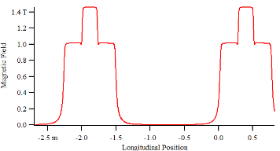
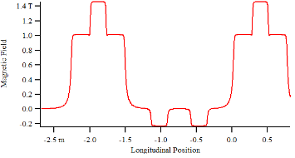
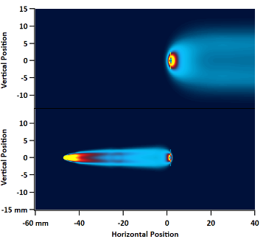
Properties of the Radiation: Just the Idea
Interference pattern studied for $λ=1 μm$. The electron trajectory in the simulations is unchanged and the single SR Electric Field contributions from the single magnetic components are disentangled from the total emission
Observation Screen
Superposition Region due to Reverse Bend.
The superposition between the two contribution is located along the direction of the straight section
Superposition between the two Edges
By superimposing the electric fields to calculate the combined Intensity distribution we get
Classical Edge Radiation contribution with the single interference pattern in the direction of the straight section
Superposition of two SR contribution in NF regime: strong interference!

Slide 27
Magnetic Field Disentanglement: Interference Pattern
Together with the conventional Synchrotron Radiation emission we need to consider the Edge Radiation contributions, which gets more relevant the more the wavelength is longer
Integration interval to study the contribution from the first three magnetic elements
Observation Screen
Edge radiation from BM80#01 and Q24RB#01 (downstream and upstream edges respectively)
This set of Edge contributions overlap with the interference background within the superposition region generated by the Reverse Bendings, providing for the complex spatial intensity distribution in SISSI 2.0
SR emission from the second reverse bending Q24RB#02
(the interference pattern derives from the superposition with the SR emission from the first bending)
Edge Radiation (conventional) given by the two consecutive reverse bending
Geloni et al. Theory of the Edge Radiation

Slide 28
Backup slide for Elettra

Slide 29
Question Time: Multiband Achromats with reverse bendings
To get the full understanding of the magnetic structure it is necessary to get some detail on the full magnetic lattice expected in the new Elettra 2.0.
The new magnetic lattice has 24 arcs, 12 short straights and 12 long straight, and it has a 12-fold symmetry, i.e. 12 equal achromats
Each achromats is composed by two arcs, separated by a $1.26 m$ short straight section of free space
The achromats are separated by a long free space straight section with length $5.224 m$
Each arc of Elettra 2.0 consist in 3 unit cells, i.e.:
3 bending dipoles, of which only one is characterized by a vertical field gradient, while the others two have both transverse and longitudinal field gradients. In other words this is the difference between the B64 and the two B80
8 quadrupoles, four of which are shifted to give the reversed kick (purple element in the picture)
10 combined sextupoles
Single Arc
Reverse bending is introduced through the dipole kick obtained by shifting the quadrupoles!!
Full Achromat based on two arcs

Slide 30
Question Time: ELETTRA 2.0
Let’s start with the description of the single magnetic components. In particular let’s start with the bending dipole B80. Each half achromat has two B80, each one characterized by three sections named BQ, B and BQ respectively
The dipole magnet B80 is composed of three sectors (BQ, B, BQ) with longitudinal symmetry. The central sector (B) has a constant field. The other two (BQ) have a transverse quadrupolar gradient. What does it means for a dipole to have a quadrupolar gradient? The idea is explained by the following figure:
The idea is to imagine a quadrupole centred at a given point and to take the field generated by this quadrupole as the field produced by a dipole located at an off-centred position with respect to the origin of the quadrupole. The more the dipole is located near the origin of the imaginary quadrupole and the more is bigger the transverse gradient in the dipole field
The picture above explain very well the reason why the B80 dipoles have strong magnetic gradients in the transverse direction. These transverse gradients can’t be simulated in SRW, which assume as an important hypothesis that the magnetic field is UNIFORM in the transverse direction.

Slide 31
Question Time: Dipoles B80
The magnetic field in the figure is reported as a function of the longitudinal position expressed in $m$. The total length of the dipole is $800 mm$ but the tails of the field extends for a total length of $1600 mm$
$∼$ 1.459 T
$∼$ 1.01 T
220 mm
290 mm

Slide 32
Question Time: ELETTRA 2.0
Let’s consider now the quadrupoles definition, focusing in particular on the reverse bending. The Elettra 2.0 standard lattice hosts eight quadrupoles for each half-achromat, four of which are used for reverse bending (RB). The RB is obtained by shifting the quadrupoles with respect to their nominal position in order to obtain a dipolar kick.
The table shows the parameters characterizing the quadrupoles. The last four elements, namely $Q5$ - $Q8$ are the reverse bending
All the quadrupoles are grouped in three distinct families, which differs in terms of magnetic length and gap aperture. The three different groups are reported in the picture and are listed below:
Q13 $→$ This group includes $Q1$ and $Q3$, which are $106 mm$long
Q24 $→$ This group includes $Q2$ and $Q4$, which are $240 mm$ long
Q24RB $→$ This group includes all the reverse bending quadrupoles. In particular they have a magnetic length $L_{m}=240 mm$ as for the case of the Q24 quad, with the only difference that the Q24RBs need a larger gap aperture

Slide 33
Question Time: some Elettra 2.0 parameters
The new magnetic lattice reduces the present horizontal emittance by a factor 49, increasing the brilliance and the coherence of the radiation

Slide 34
Question Time: SABINA

Slide 35
SPARC Photoinjector
The SPARC photoinjector consist of:
RF photocatode gun (1.6 cell S-Band RF cavity with high gradients)
LINAC to produce electron bunches with high brilliance and high currents
With the introduction of the last C-band section the electron beam can be accelerated up to $180$ - $200 MeV$
Just after the RF gun, the electron beam is focalized by a motorized solenoid and then it is injected with the proper matching conditions in the booster.
The entrance of the first accelerating section is placed at 1.5 meters from the cathode, where the local maximum of transverse emittance oscillations is expected

Slide 36
(1) RF Photocatode Gun
The photocathode is composed by a 1.6 cell RF gun operated at S-band (2.856 GHz, of BNL/UCLA/SLAC type)
Acceleration is obtained by means of high fields in the cavity, with a peak on the cathode (120 MV/m)
Electron beam energy is up to 5.5 MeV at the entrance of the LINAC
The cathode consist of a polycrystalline oxigen-free copper with high quantum efficiency ($\sim {10}^{−5}$)
A laser system with tunable properties allows the extraction of electron bunches with the required properties

Slide 37
(1) Laser System
SPARC_LAB photocathode laser system is based on a Titanium-Sapphire laser at 800 nm of about 150 fs and its harmonics
The laser is synchronized with the RF system and it is based on the Chirped Pulse Amplification (CPA) of the pulse
The laser is used both to extract electrons from the photocathode and to feed the Vis-UV FEL in the seeded mode
The photocathode pulses are up-converted via harmonic generation to the 3rd harmonic at $266 nm$, which is the wavelength required for electron extraction out of copper cathode

Slide 38
(2) LINAC
SPARC LINAC is based on three SLAC-Type TW (traveling wave) high gradient RF cavities
TW acceleration: the beam is accelerated having the particles standing on the crest of the wave propagating inside the cavity
High gradients:
Max energy reached at the end of the LINAC: $180$ - $200 MeV$
During the operation time of SABINA, only the first section is used at full capacity:
$22\frac{MV}{m}$ in the first two S-band sections
$>40\frac{MV}{m}$ in the ending C-band sections
C-band turned off and the gradients in the second S-section are reduced at $30 MeV$
C-band turned on at $100 MeV$

Slide 39
SABINA Design and Simulations
The first problem for the SABINA undulator section is the lack of space due to the structural limitations of the room hosting the FEL. The constraint on the total length is $L≤4.5 m$. This in turn implies that the undulator has to be made up by a single module, or by more modules with reduced space between them
A single undulator module $4.5 m$ long is subjected to important mechanical stress and torque, so the best option is to choose an undulator consisting in three identical modules $1.3 m$ long spaced by $20 cm$ of drift
There are two important disadvantages due to the lack of space:
Reduced space to install diagnostic devices or quadrupole doublets between the undulators
Limited length for the undulators requires a short gain length for the amplification process
Since we want to produce radiation with tunable polarization, we need to choose the undulator within the APPLE family. APPLE-X undulators have been chosen in order to have symmetric focalization on the low energy beam

Slide 40
SABINA Design and Simulations
Preliminary considerations for the undulator design:
Total length $L≤4.5 m$ (available space in SPARC_LAB)
Minimum Energy of $30 MeV$ to limit degradation by space charge effects
Short gain length: possible criticality at $30 THz$
Given a conventional operational $B\sim 1.2 T$ for the undulator, it is possible to determine $λ_{u}$ from:
$$λ_{r}=\frac{λ_{u}}{2γ^{2}}\left(1+a_{w}^{2}\right) coherence condition$$
The magnetic period should not be too long. Long periods for a fixed length reduce the number of periods and increase the gain length, reducing the performances of the FEL

Slide 41
About the Undulator: the APPLE X Configuration
Requirement for tunable polarization $→$ undulator in the APPLE family
Symmetric focalizing properties are needed due to the absence of quadrupoles between the undulator modules: APPLE X is the best choice
Polarization and Energy can be tuned with longitudinal shifts of the magnetic array pairs. The intensity of $B$ along the undulator axis can be tuned by changing the gap
$$λ_{r}=\frac{λ_{u}}{2γ^{2}}\left(1+a_{w}^{2}\right) coherence condition$$

Slide 42
FEL Output: GENESIS Simulation Results
Power Growth
Field Spectrum
$$100 μm$$
Saturation condition for FEL dynamics:
Completely realized at $3 THz$($30 MeV$)
Partially realized at $30 THz$($100 MeV$)
Monochromatic pulses with the expected properties of:
High energy per pulse
Ps/sub-ps temporal duration
$100 μm$ - $3 THz$
$$10 μm$$
$10 μm$ - $30 THz$

Slide 43
FEL Output: GENESIS Simulation Results at 3 THz
Beam dynamics simulated along the beamline up to the undulator entrance with different conditions:
Space charge on/off
Matching constraint at the undulator entrance
The results have been used as GENESIS input to verify the FEL performances $→$ Condition II. is crucial while space charge effects change slightly the output
Matching condition at the undulator relaxed
Beam constrained to match the Twiss parameter conditions at the undulator entrance

Slide 44
Endstation: User Facility
THz Reflectance and Transmittance Setup for optical spectroscopy experiments
Femtosecond laser ($50 ps$pulses) synchronized with SABINA and coupled with:
Optical Parametric Amplificator (OPA) + Difference Frequecy Generator (DFG) to tune radiation in the range $1.5$ - $14 μm$ by means of non-linear optical effects
High harmonic generation
Wide range pump probe setup
EXP.
AREA
fs-LASER
M5
High magnetic field Optical Cryostat ($B$ up to $5 T$)

Slide 45
Comparison between SABINA and other conventional sources
Femtosecond laser ($50 ps$pulses) with:
Optical Parametric Amplificator (OPA) + Difference Frequecy Generator (DFG) to tune radiation in the range $1.5$ - $14 μm$ by means of non-linear optical effects
The laser power in the MIR spectral region is of the order of $\sim 10 mW$. Assuming a beam of $∼4 mm$ and a RR of $1 kHz$, the energy radiation per pulse is $∼10 μJ$, which is one order of magnitude lower with respect to the SABINA radiation emitted in the same spectral range

