Slide 1
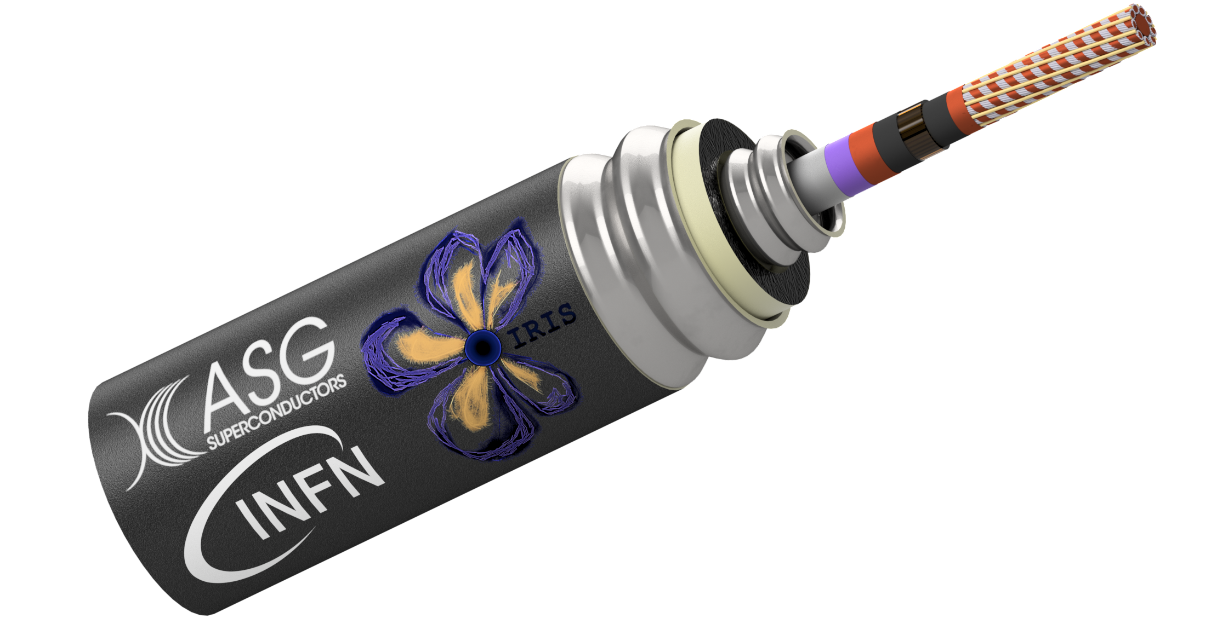
IRIS Green Superconducting Line (GSL)
Seminar for PhD Accelerator Physics – Second Year

Slide 2
Outline
IRIS project introduction
IRIS Green Superconducting Line introduction
PhD work
  Magneti analysis
  Critical current and margin
  Mechanical analysis
  Transition analysis
  Mathematical model
  Potential use cases

Slide 3
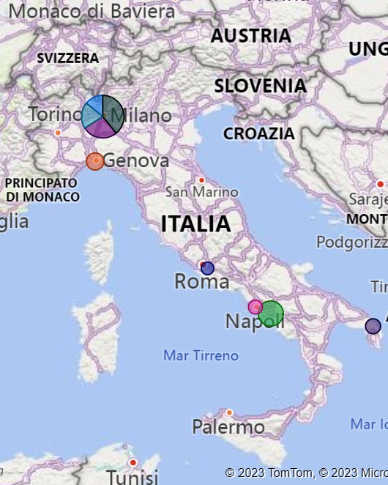

IRIS - Innovative Research Infrastructure on applied Superconductivity
Goal: developing applied superconductivity for HEP future collider (FCC-hh) and exploiting potential applications to societal applications in green energy (higher sustainability) and in medical field
The challenge:
60 M € including taxes (39 M € scientific instrumentation)
Geographical distribution 45% North 55% South
36 Fixed-term positions (50% academic) 5 PhD
End of project: 28 February 2025 + 6 Months (10/2025)
From Marco Statera at ASC24

Slide 4
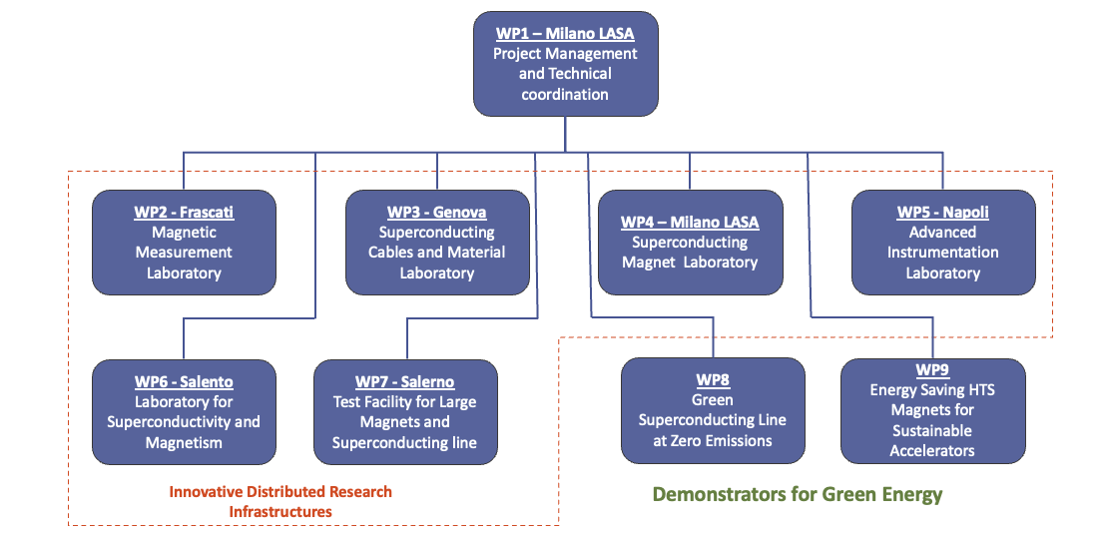
IRIS structure
PI Pierluigi Campana (INFN G.E.)
TC Lucio Rossi (INFN LASA)
IM Marta Della Torre (INFN LASA)
6 Poles
2 demonstrators
Start date of the project:
1 November 2022
End of project:
February 2025
→ 6 months extension to October 2025
(mentioned in the call)
From Marco Statera at ASC24

Slide 5
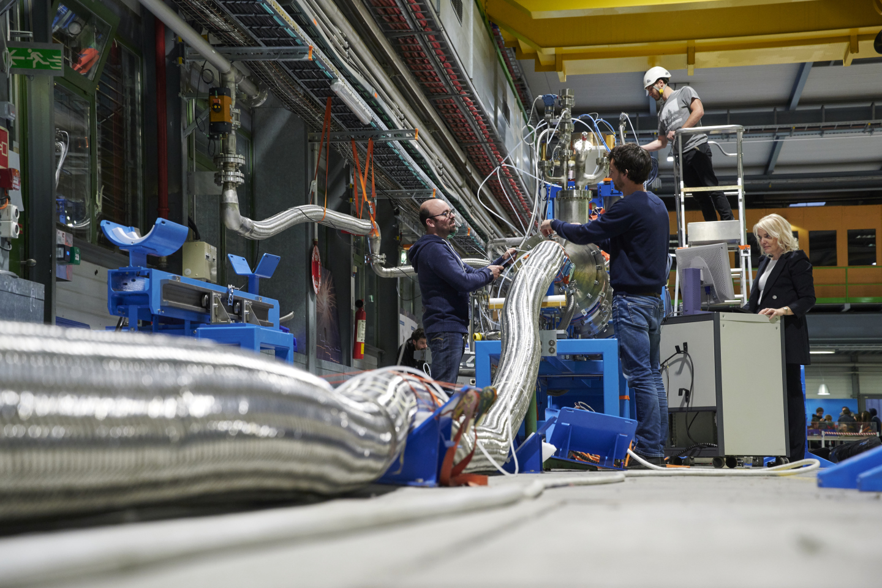
Green Superconducting Line GSL (WP8)
Green Energy
Energy transport at 0³ (zero cubed) emission
Zero (almost) C0₂ emission:
Energy loss about 1% (average about 6 % for TERNA)
Zero emission of e.m. radiation (DC)
Zero (almost) ground occupation: 0.5 m underground piping may be rated up to 5 GW, the rating of a overhead line (30 m high and 50 m wide area required).
Important for society but also for the sustainability of research infrastructures
Courtesy A. Ballarino - CERN
The GSL demonstrator is a key component for the commissioning of a TEST FACILITY in construction at the Salerno site within the IRIS WP7.
The test facility will be available for users after commissioning at least 10 years.
A dedicated study to install the GSL on the grid at IRIS completion
From Marco Statera at ASC24

Slide 6
−
GSL specifications
+
Design and supply of the 1Gw GSL, the cryostat and the power leads
Delivery and installation to Salerno to commission the Test Station
spare
Power rating | 1 GW
Voltage | 25 kV
DC current | 40 kA
Operating temperature | 20 K
Line length | 130 m
Expected losses | 3.0 W/m
Bending radius | 2.2 m
Inner pressure | 10 bar
100% redundancy
Main features
One conductor per cryostat
Redundancy: 1 full cable + 1 (naked cable)
500 W cooling power at 20 K for the 130 m
In line joint
Compatible with LH₂ operation
From Marco Statera at ASC24

Slide 7
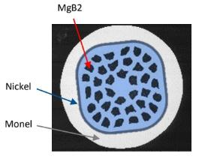

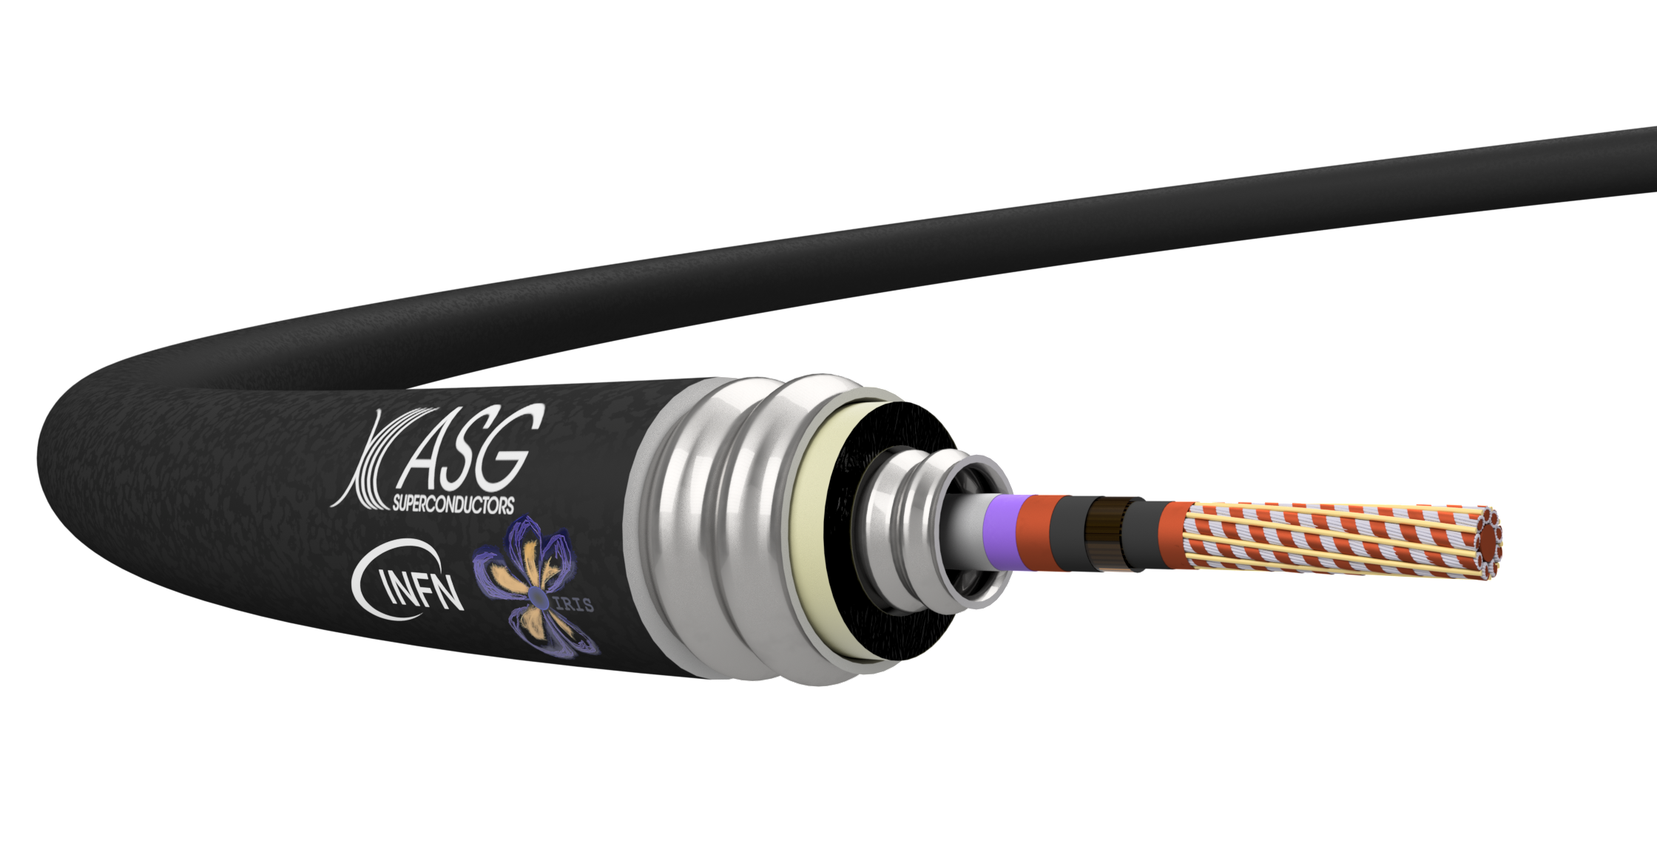
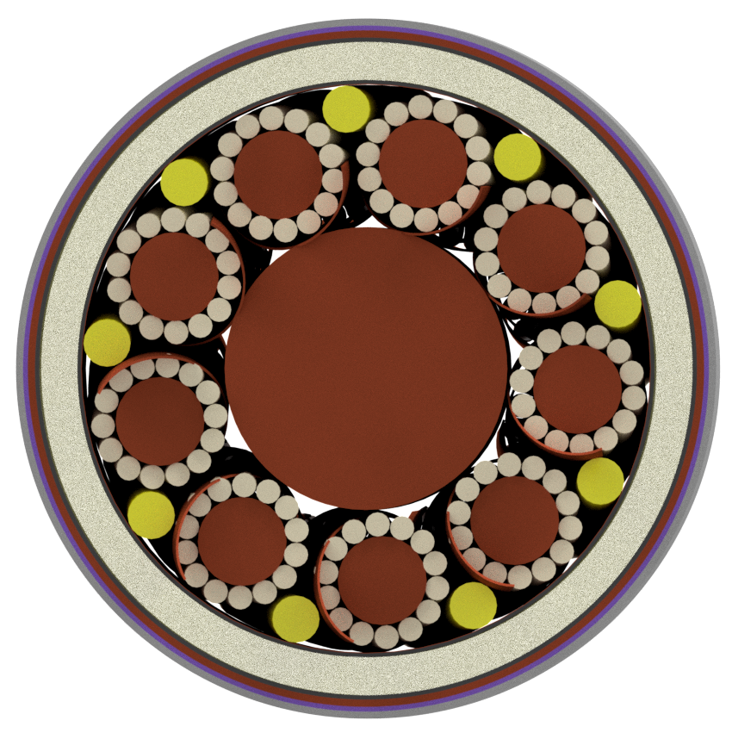
GSL the conductor
petal
HV insulation
filler
Cabling test
Courtesy of ASG
Cu
Cu
Diameter 38 mm
From Marco Statera at ASC24

Slide 8
Demonstrators
The demonstrators will be tested in ASG via a dedicated test station
20 m demonstrator:
A 20m long line with a final cable configuration
Verification of cryostat thermal losses
Measurement of the critical temperature of the superconducting cable at 5kA
Verification of ground insulation
Measurement of cryostat losses at the minimum bending radius
Verification of cold junction technology
5 m demonstrator:
A 5m long line with a single 5kA uninsulated petal equipped with a cryostat and connection flanges
Thermal leakage verification of the cryostat
Characterization of the critical current up to a maximum value of 5 kA
From Marco Statera at ASC24

Slide 9
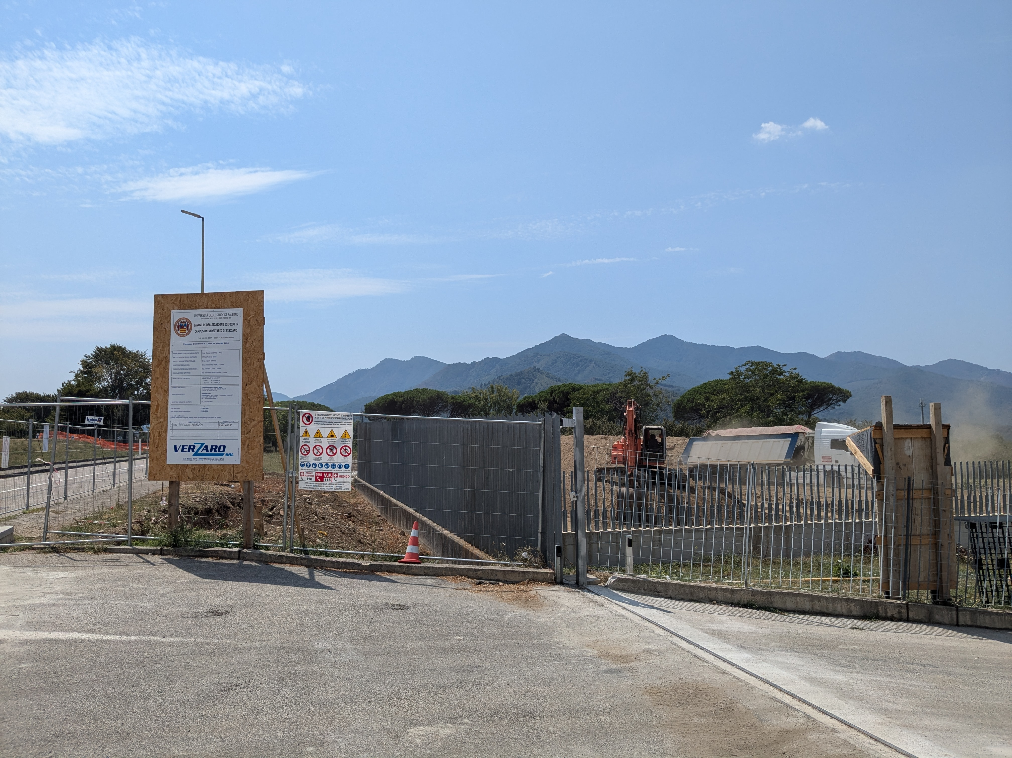
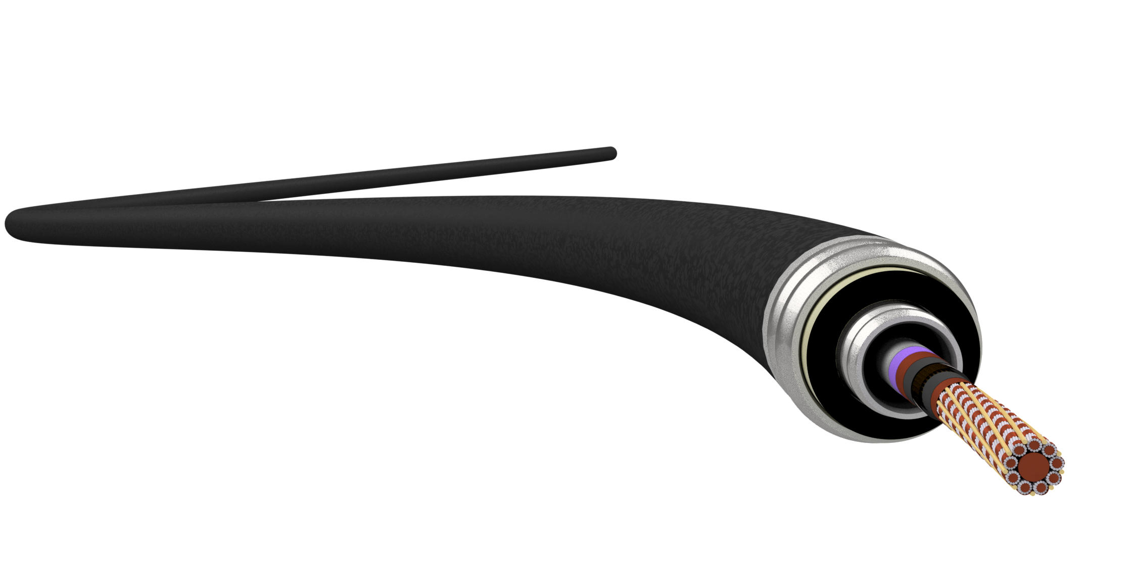
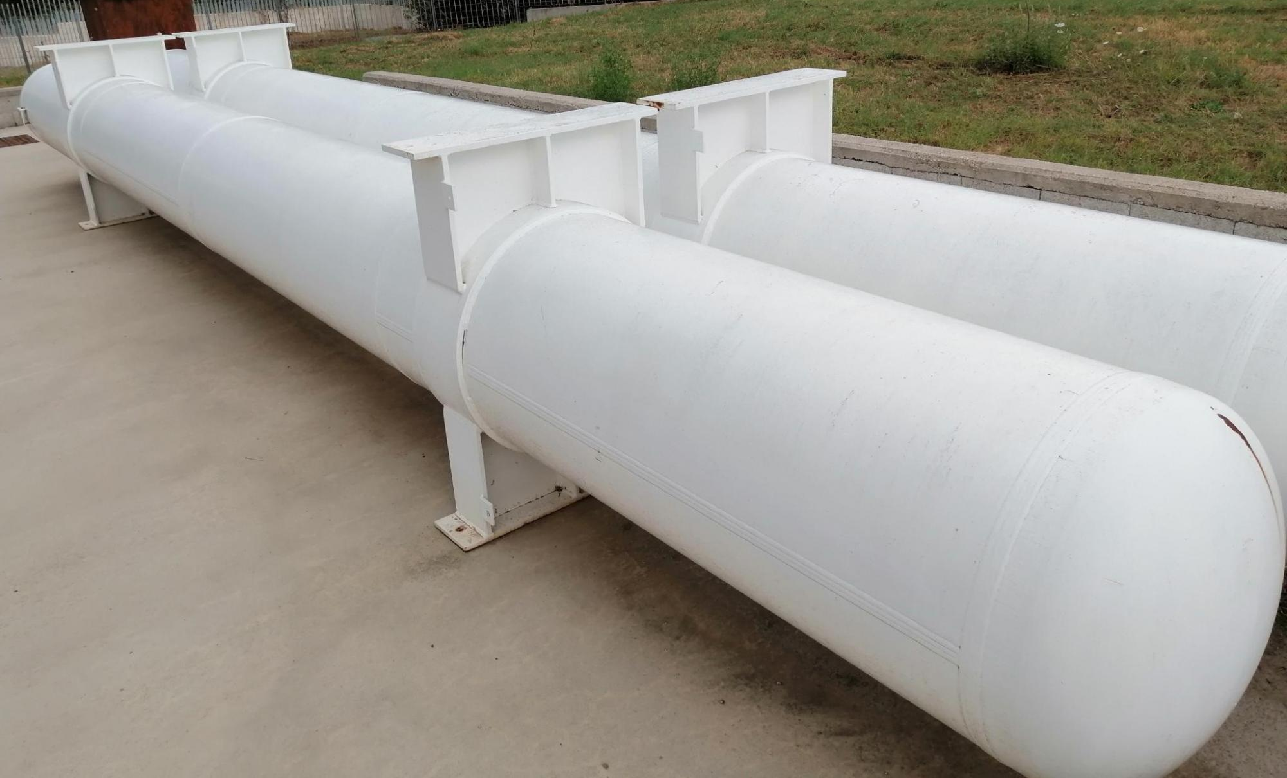
Timeline
GSL
Engineering design
Test Station
time
11/24
12/24
1/25
2/25
3/25
4/25
5/25
POWER CONVERTER 40kA
Demostrator 5kA
Demostrator full cable
Construction started in June 2024
GSL
cold powering
Test Station
time
6/25
7/25
8/25
9/25
10/25
11/25
12/25
SITE CONSTRUCTION
GAS He Tank and recovery baloon
HV TBC
He GAS cooling 20K 500W
installation
From Marco Statera at ASC24

Slide 10
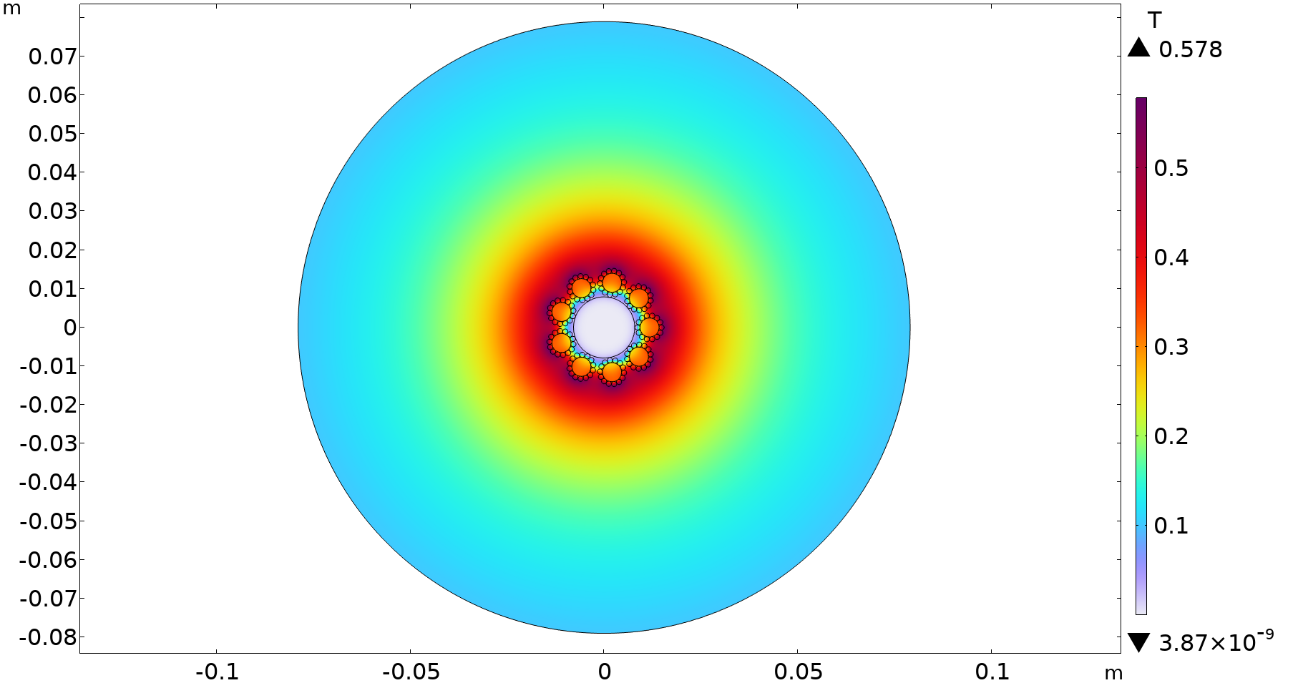
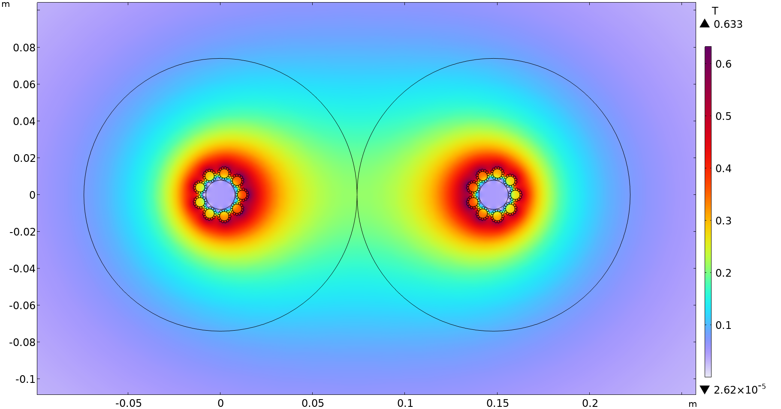

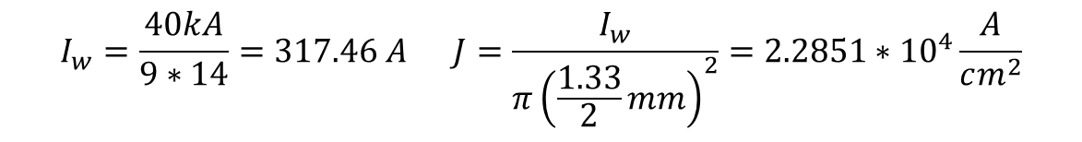
2D induction magnetic field
$$D_{cryo}=148 mm$$
$$I_{w}=\frac{40kA}{9∗14}=317.46 A J=\frac{I_{w}}{π{\left(\frac{1.33}{2}mm\right)}^{2}}=2.2851∗{10}^{4}\frac{A}{cm^{2}}$$

Slide 11
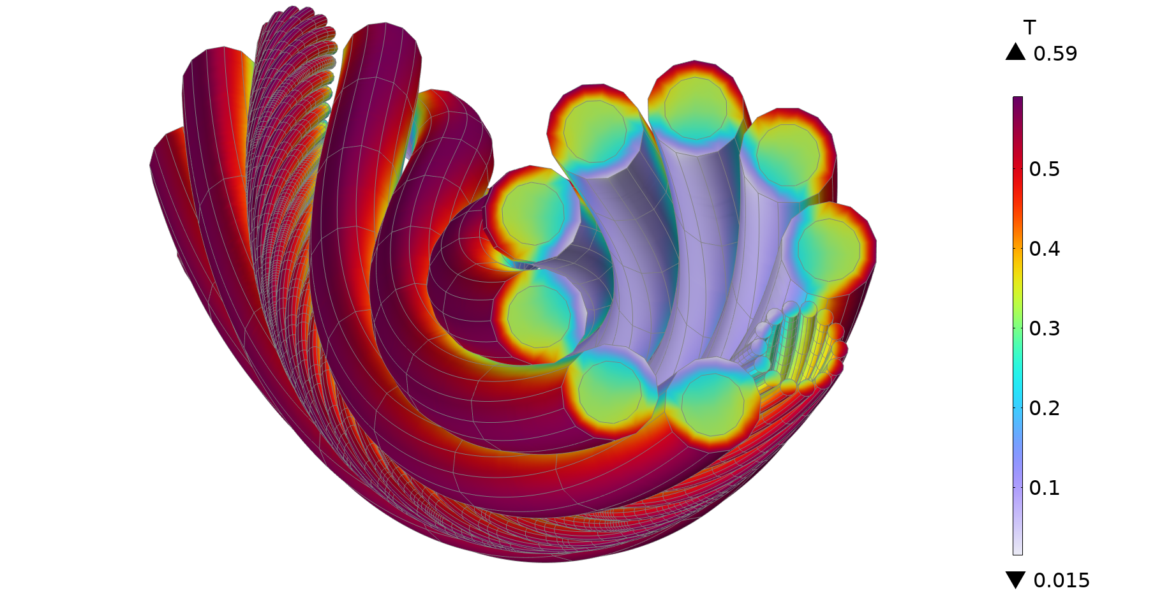
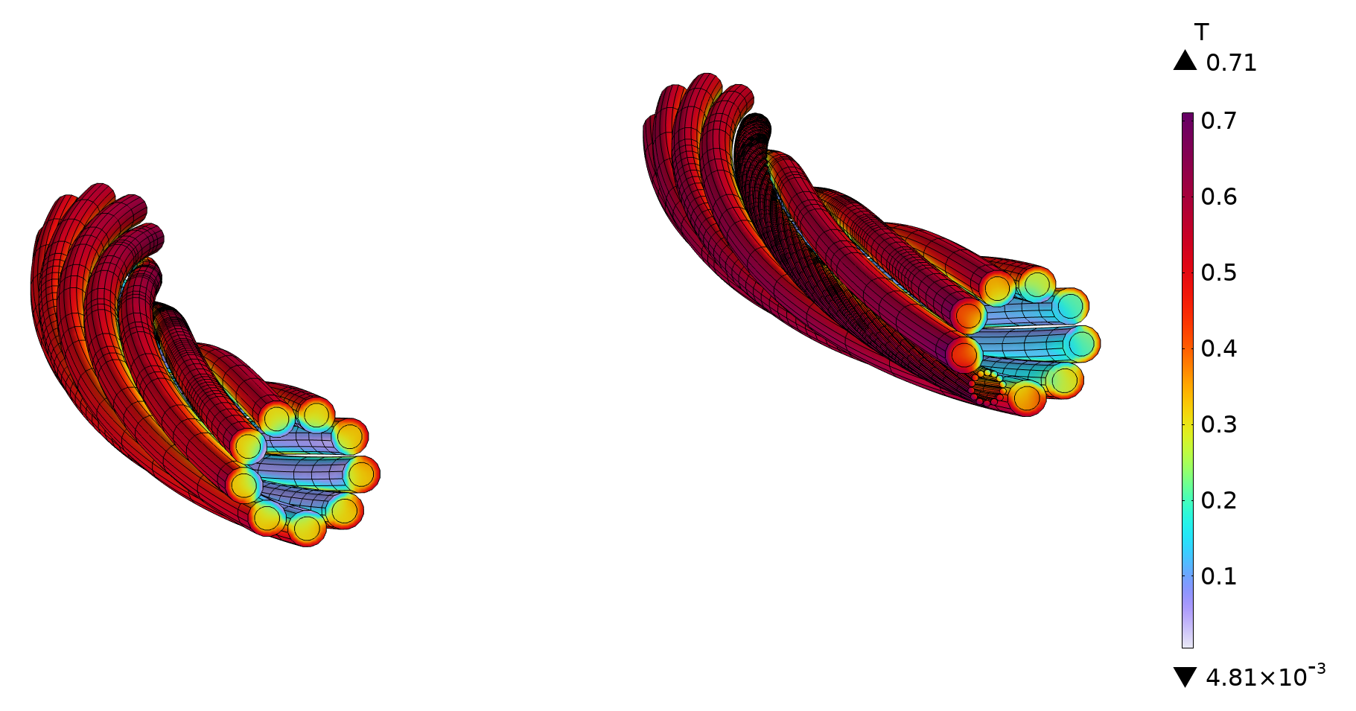




3D induction magnetic field
$$l=500 mm$$
$$tp_{w}=250 mm$$
$$tp_{p}=800 mm$$
$$R=2.2 m$$

Slide 12
Magnetic field results
Single cable: 0.58 T
Double cable:
  2D: 0.63 T
  3D: 0.71 T
In 3D, for meshing purposes strand sections are polygonal, not circular. This results in higher current concentration in edges and a stronger magnetic field.

Slide 13
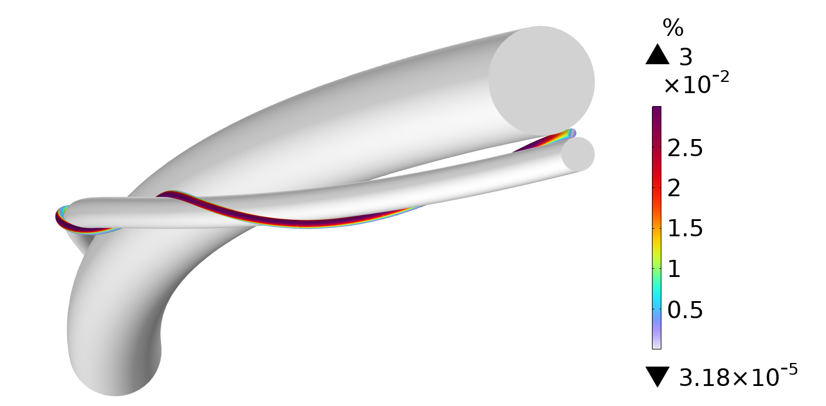
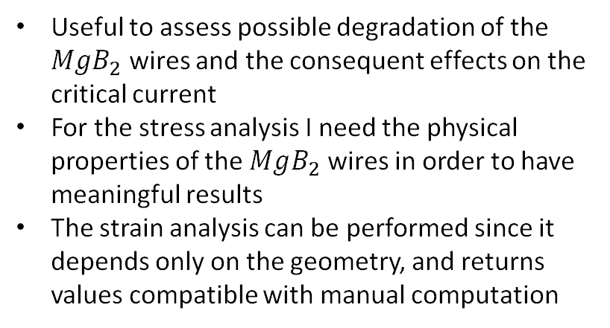
Mechanical analysis – single cable
Useful to assess possible degradation of the $MgB_{2}$ wires and the consequent effects on the critical current
For the stress analysis I need the physical properties of the $MgB_{2}$ wires in order to have meaningful results
The strain analysis can be performed since it depends only on the geometry, and returns values compatible with manual computation
Strain

Slide 14

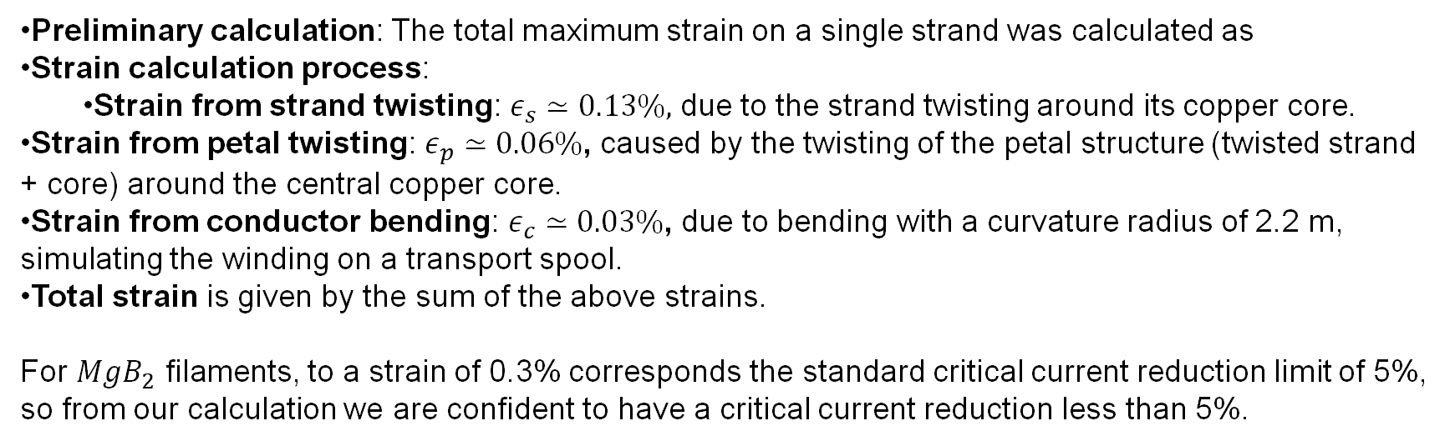
Mechanical analysis – single cable - strain
$$ε=0.22\%$$
Preliminary calculation: The total maximum strain on a single strand was calculated as
Strain calculation process:
  Strain from strand twisting: $ε_{s}≃0.13\%,$ due to the strand twisting around its copper core.
Strain from petal twisting: $ε_{p}≃0.06\%$, caused by the twisting of the petal structure (twisted strand + core) around the central copper core.
Strain from conductor bending: $ε_{c}≃0.03\%$, due to bending with a curvature radius of 2.2 m, simulating the winding on a transport spool.
Total strain is given by the sum of the above strains.
For $MgB_{2}$ filaments, to a strain of 0.3% corresponds the standard critical current reduction limit of 5%, so from our calculation we are confident to have a critical current reduction less than 5%.

Slide 15
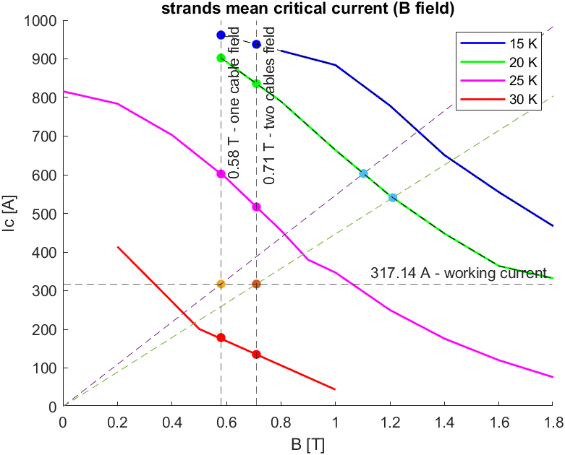
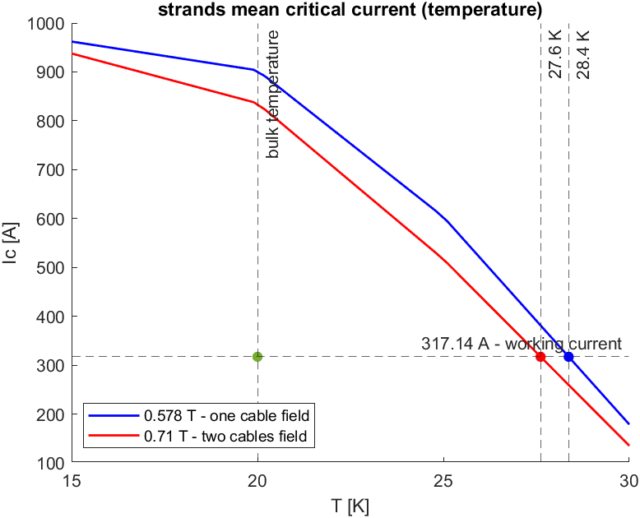


Mean critical current and temperature margins
One cable
$$∆T=8.4 K$$
Two cables
$$∆T=7.6 K$$

Slide 16
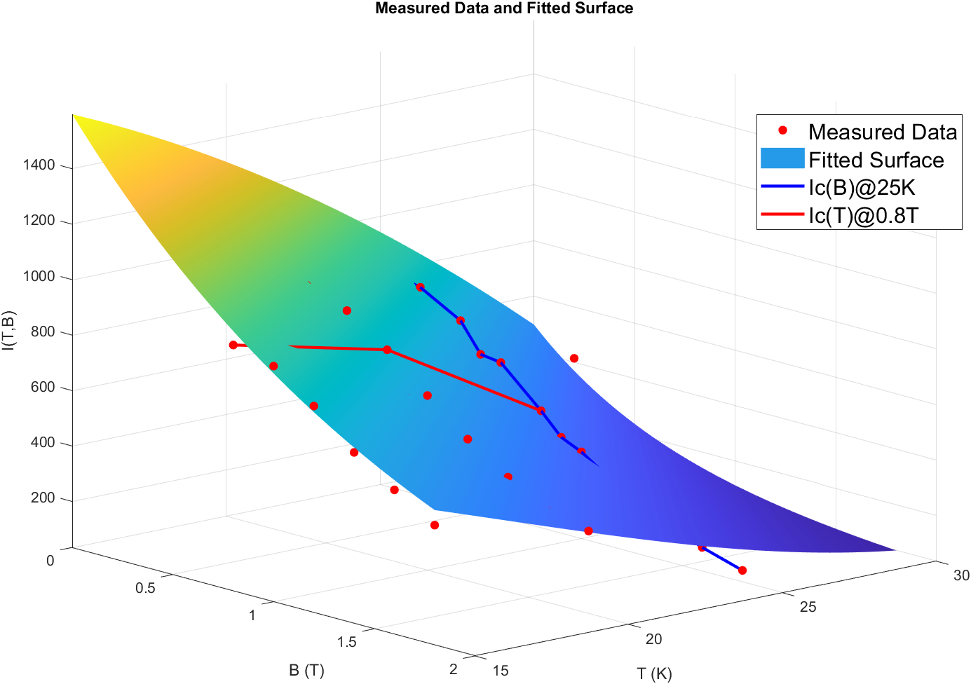
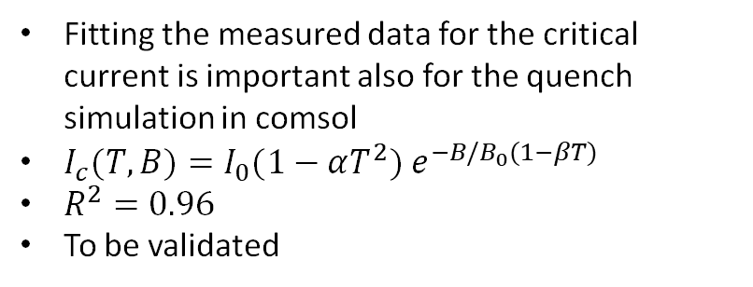
Critical current surface - $MgB_{2}$ fit
Fitting the measured data for the critical current is important also for the quench simulation in comsol
$I_{c}(T,B)=I_{0}(1−αT^{2}) e^{−B/B_{0}(1−βT)}$
$R^{2}=0.96$
To be validated

Slide 17
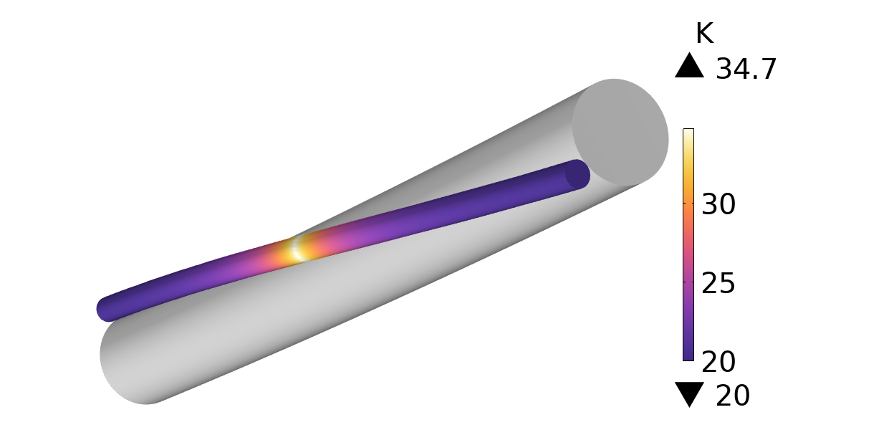
Transition SC to NC analysis – single wire
Transition analysis is ongoing
Try to understand how to have convergence in COMSOL
What I want to retrive:
  Heat propagation velocity after transition
  Voltage variation to define threshold for detection
  Current sharing with copper core

Slide 18
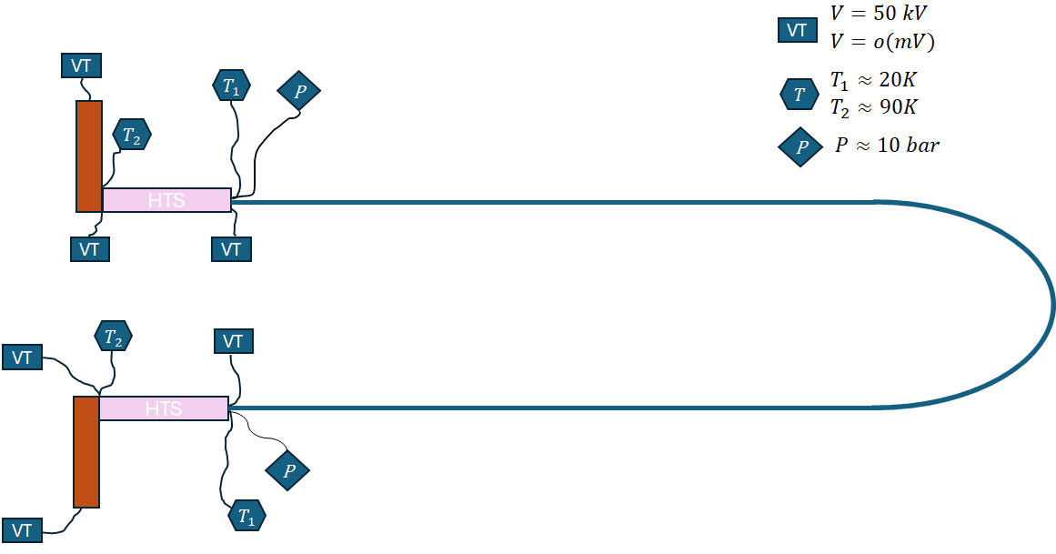
Line diagnostics

Slide 19
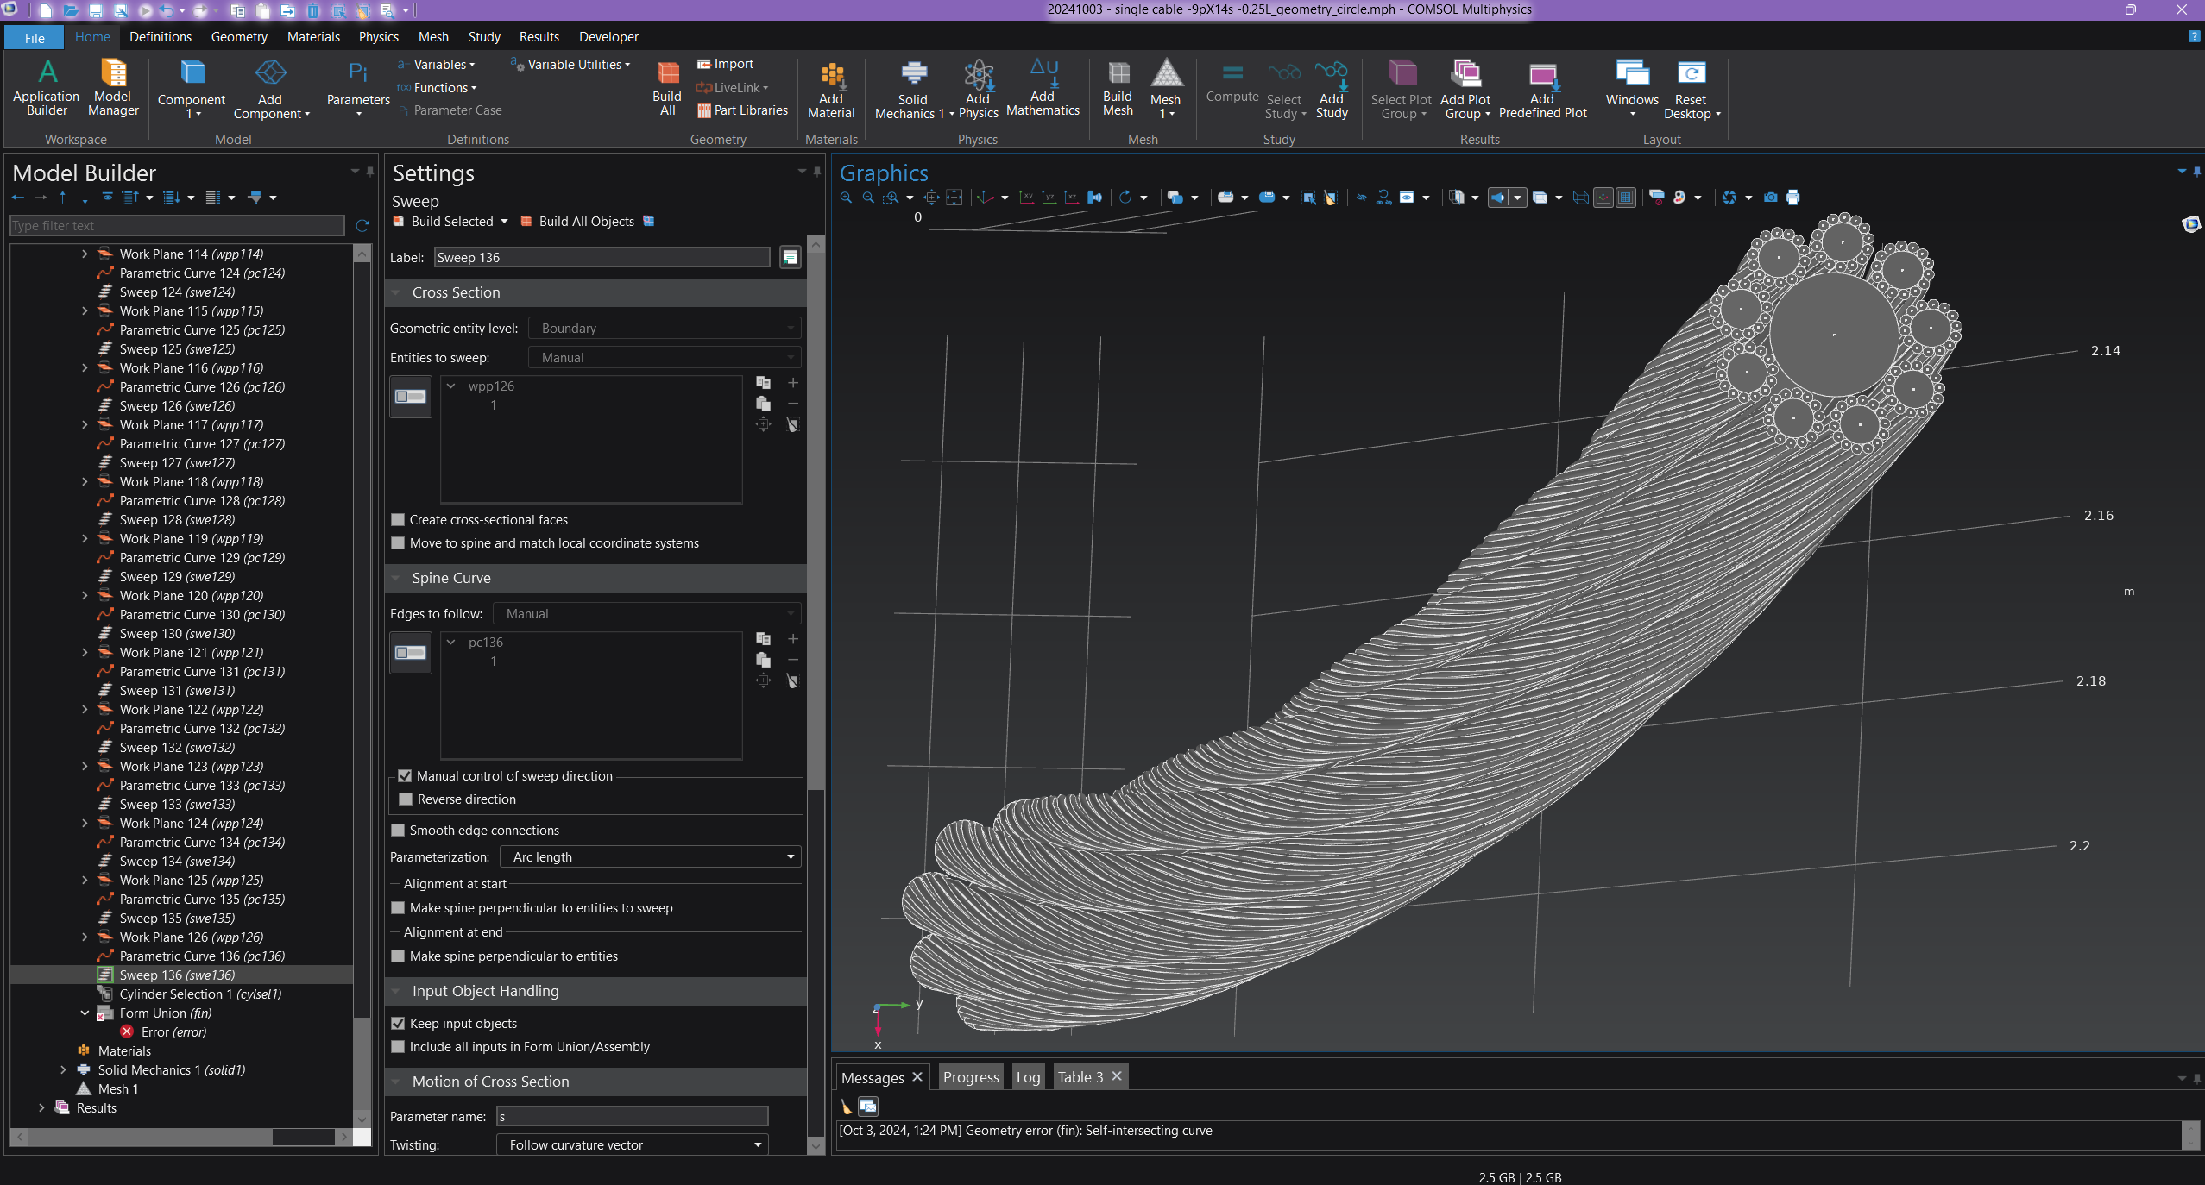
Cable Geometry Mathematical Model
It is helpful for:
Geometrical design in Comsol, Inventor, Ansys etc
Parametrical optimisation of general design
Already used for the Comsol simulations and Inventor renders
Fully parametric

Slide 20




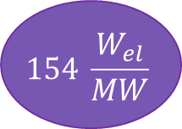
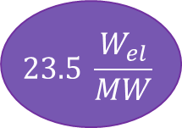






Power consumptions estimation
$$P_{loss,cryo}=1.5 W/m$$
$$P_{cool,cable}\left(L=130 m\right)=195 W$$
$$P_{el,cable}\left(COP^{−1}=100\right)=19.5 kW$$
$CL_{cool}=2.5\frac{W}{kA}$
$$P_{cool,leads}=100 W$$
$$P_{el,leads}\left(COP^{−1}=20\right)=2 kW$$
$$P_{cool,line}=2∗P_{cool,leads}+P_{cool,cable}=395 W$$
$$P_{cool,line}\%=3.95∗{10}^{−5} \%$$
$$23.5 \frac{W_{el}}{MW}$$
$$P_{el,line}=2∗P_{el,leads}+P_{el,cable}=23.5 kW$$
$$P_{el,line}\%=2.4∗{10}^{−3} \%$$
$$P_{cool,line}(1000 m)=1.7 kW$$
$$P_{cool,line}\%=1.7∗{10}^{−4} \%$$
$$154 \frac{W_{el}}{MW}$$
$$P_{el,line}\left(1000 m\right)=154 kW$$
$$P_{el,line}\%=15.4∗{10}^{−3} \%$$

Slide 21

Uses cases
Einstein telescope and Frascati facility
Requirements
  2 MW
  L = 150 m
$$22.9 \frac{W_{el}}{W}$$

Slide 22
Next steps
Models' validation
Further investigations for critical current behaviour
Complete the mechanical analysis with stresses
Finalise the transition analysis
Fully automatise the mathematical model
Study of fault case scenarios
More use cases (focus and accelerator facilities)
Definition of tests for the demonstrator

Slide 23
The end

Slide 24
Backup

Slide 25
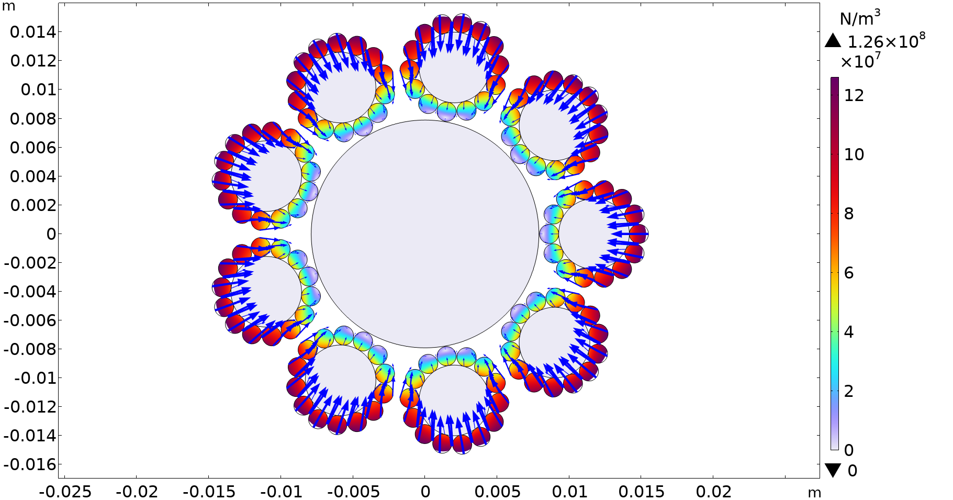
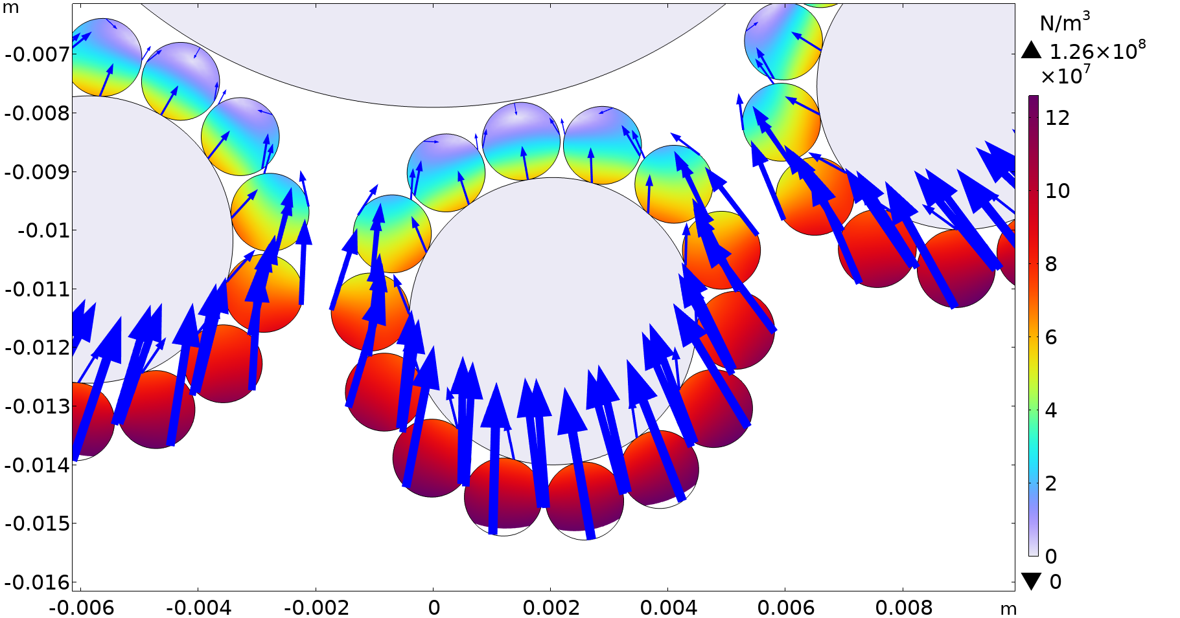
2D Lorentz force

Slide 26
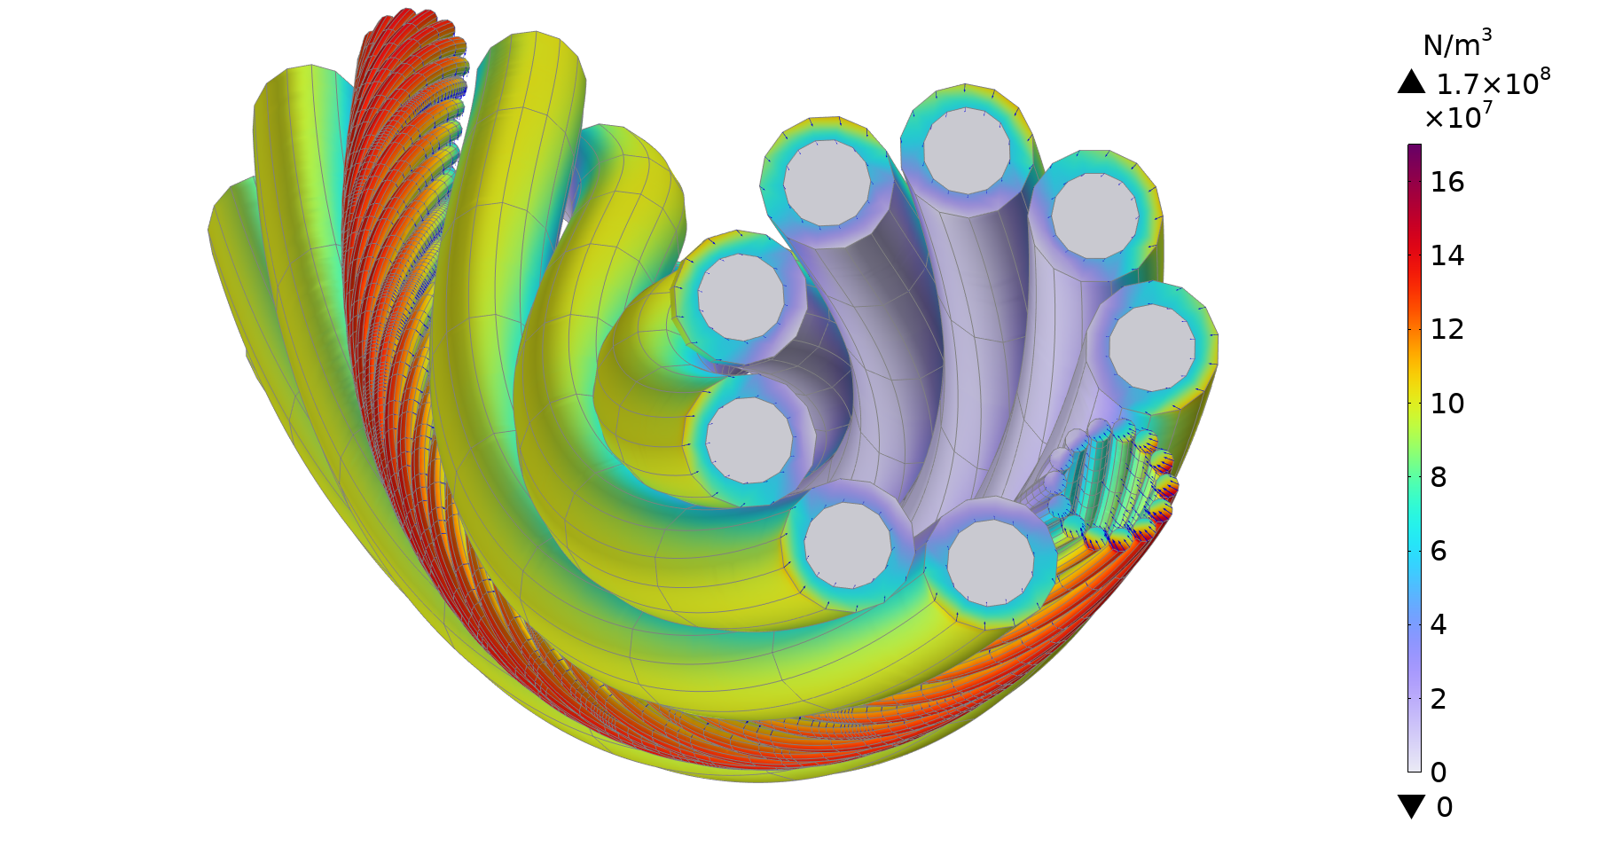
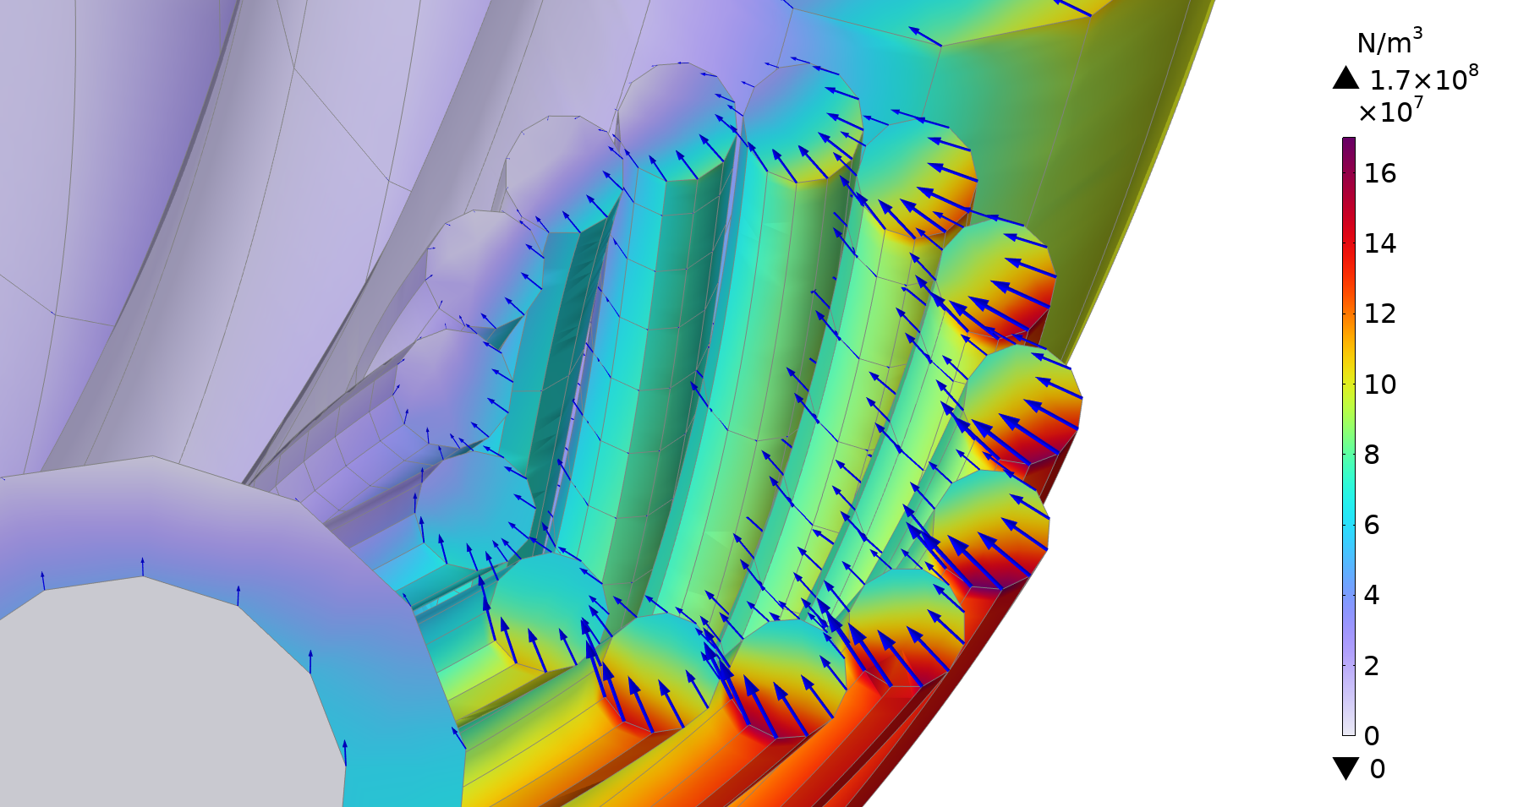



3D Lorentz force – single cable
$$l=500mm$$
$$tp_{w}=250mm$$
$$tp_{p}=800mm$$
$$R=2.2 m$$

Slide 27
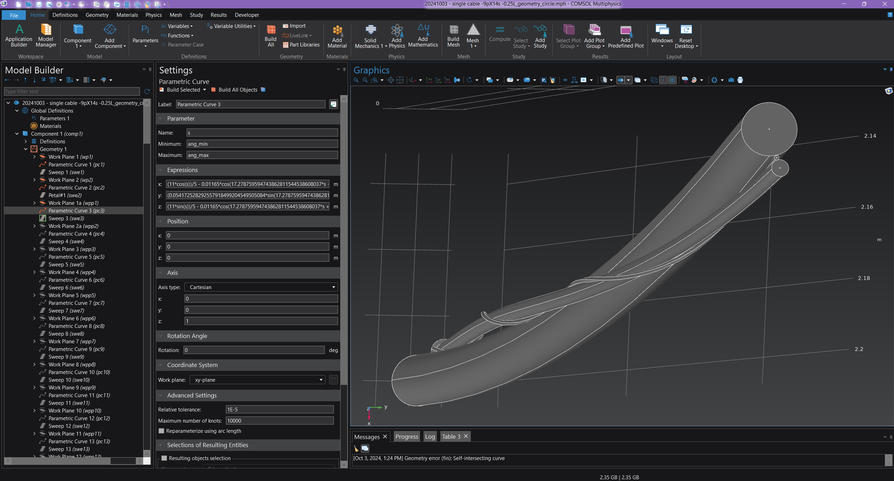
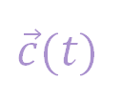
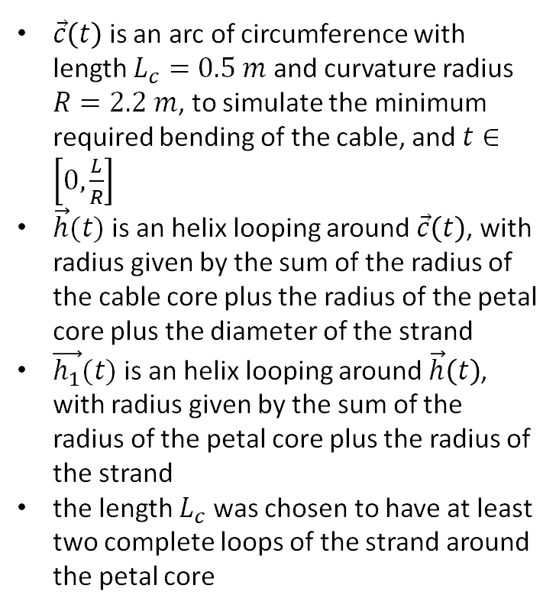


Cable Geometry Mathematical Model
$\vec{c}\left(t\right)$ is an arc of circumference with length $L_{c}=0.5 m$ and curvature radius $R=2.2 m$, to simulate the minimum required bending of the cable, and $t∈\left[0,\frac{L}{R}\right]$
$\vec{h}(t)$is an helix looping around $\vec{c}\left(t\right)$, with radius given by the sum of the radius of the cable core plus the radius of the petal core plus the diameter of the strand
$\vec{h_{1}}(t)$is an helix looping around $\vec{h}\left(t\right)$, with radius given by the sum of the radius of the petal core plus the radius of the strand
the length $L_{c}$was chosen to have at least two complete loops of the strand around the petal core
$$\vec{c}(t)$$
$$\vec{h}(t)$$
$$\vec{h_{1}}(t)$$

Slide 28
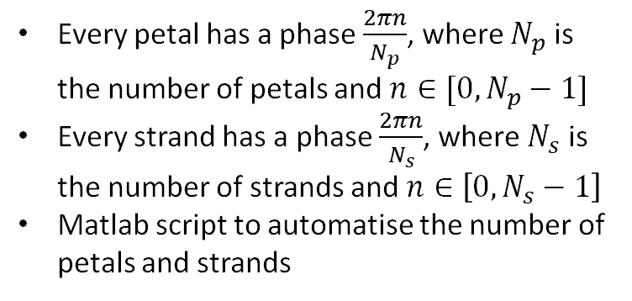
Cable Geometry Mathematical Model - CGMM
Every petal has a phase $\frac{2πn}{N_{p}}$, where $N_{p}$ is the number of petals and $n∈[0,N_{p}−1]$
Every strand has a phase $\frac{2πn}{N_{s}}$, where $N_{s}$ is the number of strands and $n∈\left[0,N_{s}−1\right]$
Matlab script to automatise the number of petals and strands

Slide 29
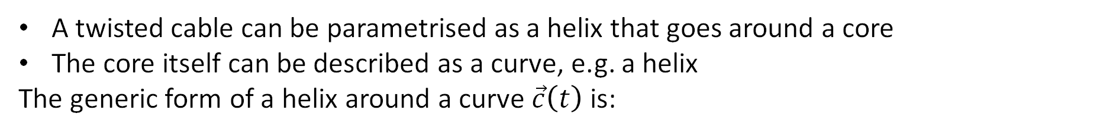
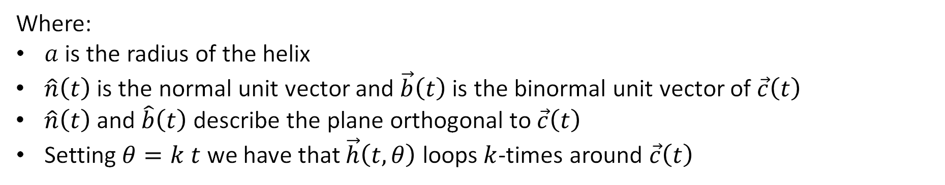
Cable Geometry Mathematical Model - CGMM
A twisted cable can be parametrised as a helix that goes around a core
The core itself can be described as a curve, e.g. a helix
The generic form of a helix around a curve $\vec{c}\left(t\right)$ is:
$$\vec{h}\left(t,θ\right)=\vec{c}\left(t\right)+a\cos\left(θ\right)\hat{n}\left(t\right)+a sin⁡(θ)\hat{b}(t)$$
Where:
$a$ is the radius of the helix
$\hat{n}\left(t\right)$ is the normal unit vector and $\vec{b}\left(t\right)$ is the binormal unit vector of $\vec{c}\left(t\right)$
$\hat{n}\left(t\right)$ and $\hat{b}\left(t\right)$ describe the plane orthogonal to $\vec{c}\left(t\right)$
Setting $θ=k t$ we have that $\vec{h}\left(t,θ\right)$ loops $k$-times around $\vec{c}\left(t\right)$

Slide 30
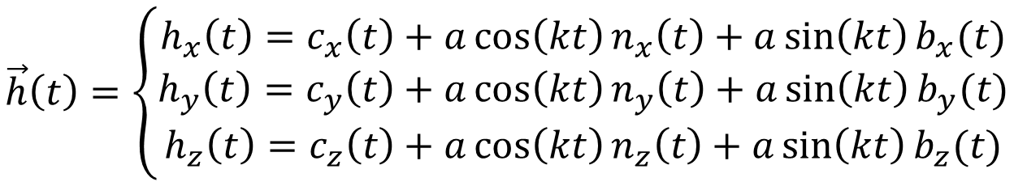
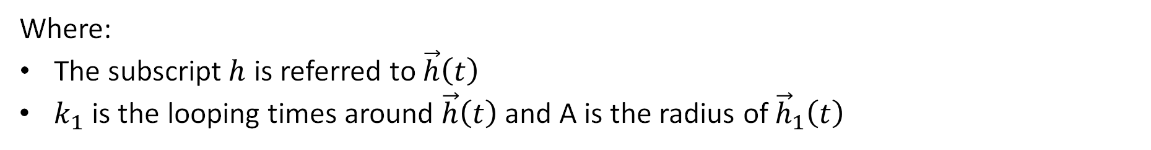
Cable Geometry Mathematical Model - CGMM
In cartesian coordinates useful for design in Comsol/Inventor
$$\vec{h}\left(t\right)=\left\{\begin{aligned}h_{x}\left(t\right)=c_{x}\left(t\right)+a\cos\left(kt\right)n_{x}\left(t\right)+a\sin\left(kt\right)b_{x}(t) \\ h_{y}\left(t\right)=c_{y}\left(t\right)+a\cos\left(kt\right)n_{y}\left(t\right)+a\sin\left(kt\right)b_{y}(t) \\ h_{z}\left(t\right)=c_{z}\left(t\right)+a\cos\left(kt\right)n_{z}\left(t\right)+a\sin\left(kt\right)b_{z}(t)\end{aligned}\right.$$
Iterating the process, one can write a helix that goes around $\vec{h}\left(t\right)$ as:
$$\vec{h_{1}}\left(t\right)=\vec{h}\left(t\right)+A\cos\left(k_{1}t\right)\hat{n_{h}}\left(t\right)+A sin⁡(k_{1}t)\hat{b_{h}}(t)$$
Where:
The subscript $h$ is referred to $\vec{h}\left(t\right)$
$k_{1}$ is the looping times around $\vec{h}\left(t\right)$ and A is the radius of ${\vec{h}}_{1}\left(t\right)$

Slide 31
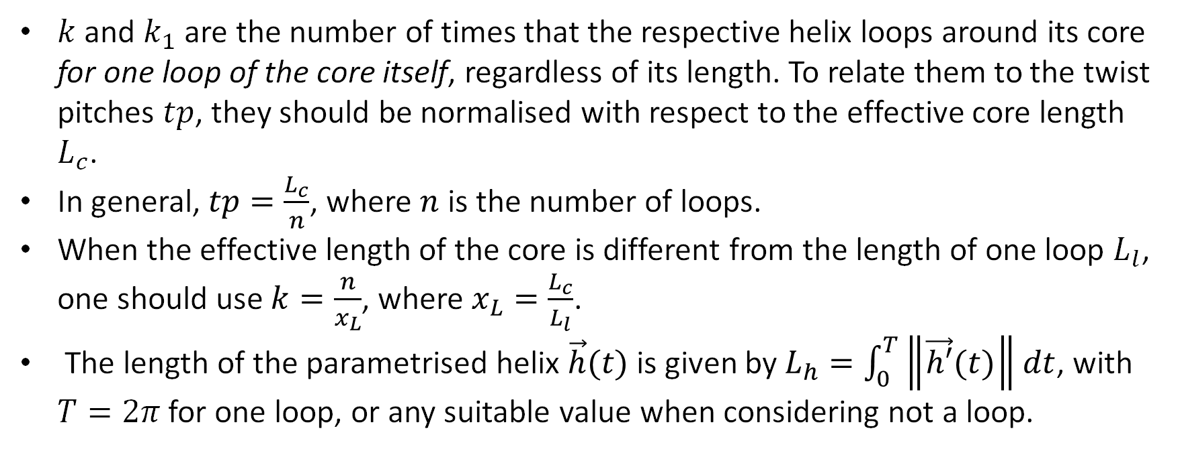
Cable Geometry Mathematical Model - CGMM
$k$ and $k_{1}$ are the number of times that the respective helix loops around its core for one loop of the core itself, regardless of its length. To relate them to the twist pitches $tp$, they should be normalised with respect to the effective core length $L_{c}$.
In general, $tp=\frac{L_{c}}{n}$, where $n$ is the number of loops.
When the effective length of the core is different from the length of one loop $L_{l}$, one should use $k=\frac{n}{x_{L}}$, where $x_{L}=\frac{L_{c}}{L_{l}}$.
The length of the parametrised helix $\vec{h}(t)$is given by $L_{h}=\int_{0}^{T}{\left\|\vec{h′}(t)\right\|dt}$, with $T=2π$ for one loop, or any suitable value when considering not a loop.

