Slide 1
Simulation and Design of the Diagnostics Stations for Eupraxia@Sparc_Lab
Francesco Demurtas – PhD Seminar 2° year – 24/10/2024
Supervisor : Enrica Chiadroni (Università Sapienza di Roma)
Anna Giribono (INFN-LNF)

Slide 2
Outline
Diagnostics Stations in Eupraxia: High-Energy diagnostics
Polarizable X Band Transverse Deflecting Structure (PolariX), working principle and design
Measurement Simulation at High-Energy:
- Length Measurement with the PolariX TDS
- Emittance Measurement in Both Planes
Jitter Measurement at SPARC: Electro-Optical Sampling
Collaboration with PSI: Activities on PolariX TDS

Slide 3
Diagnostics Station and Measurements
Eupraxia Electron Diagnostics Station Positions:
After the Photoinjector at $E∼80−250$MeV $→$ 60 cm TDS
Before the Plasma at $E∼750$MeV
After the Plasma and Before the Undulator at $E∼1$ GeV $→$ 96 cm TDS
Quadrupole Triplet
PolariX TDS
Screen
Dipole
Types of Measurements:
Bunch Length Measurement with PolariX TDS
Beam Emittance in both Transverse Planes
Energy Measurement
Slice Emittance in both Transverse Planes with the same PolariX TDS
Energy Jitter Measurement to the spectrometer with the Electro Optical Sampling
Dispersive Screen

Slide 4
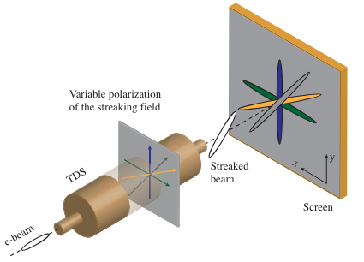
PolariX Transverse Deflecting Structure
The PolariX is a Transverse Deflecting Structure with the feature of changing the beam streaking direction
Allows to perform tomography of the beam to retrieve the 3D beam distribution
Allows to measure the slice emittance on different transverse planes by using the same TDS device
Combined with a quadrupole scan and a magnetic spectrometer allows to measure the full 6D beam distribution
Marx, Daniel. Characterization of ultrashort electron bunches at the SINBAD-ARES Linac. No. DESY-THESIS--2019-026. Hamburg, Germany: Deutsches Elektronen-Synchrotron, 2019.

Slide 5
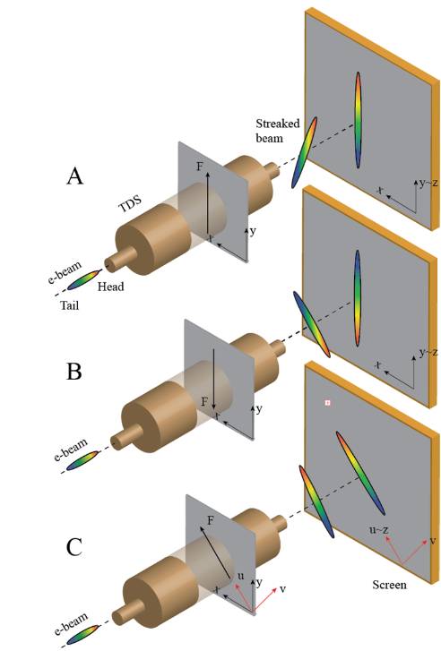
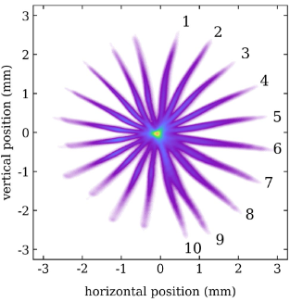
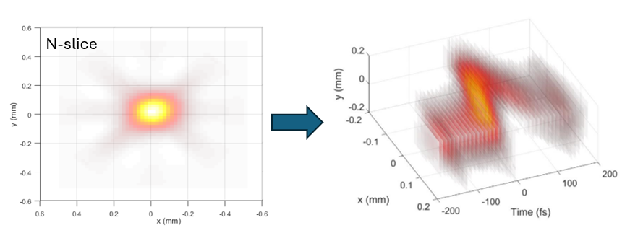
3D Charge Distribution Recontruction
The reconstruction requires to take one streaked image for each angle of streaking
2D Distribution is Obtained from tomographic algorithm

Slide 6
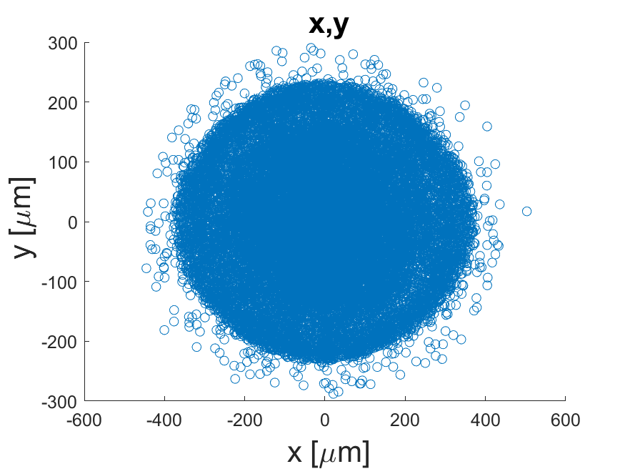
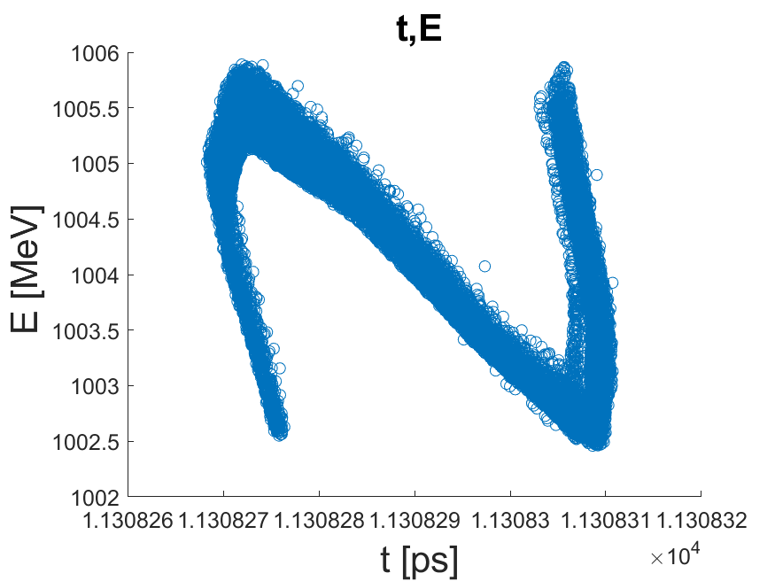
Input Beam (After Separation Chicane)
Beam Parameters
$$Q [pC]$$ | 23.86
$$E [GeV]$$ | $$1$$
$$E_{spread} [\%]$$ | $$0.09$$
$$RMS Beam Duration [fs]$$ | $$14.7$$
$$RMS Beam Size x, y [μm]$$ | $$157$$ | $$105$$
$$RMS Beam Emittance x, y$$ $$[mm mrad]$$ | $$1.43$$ | $$1.17$$

Slide 7
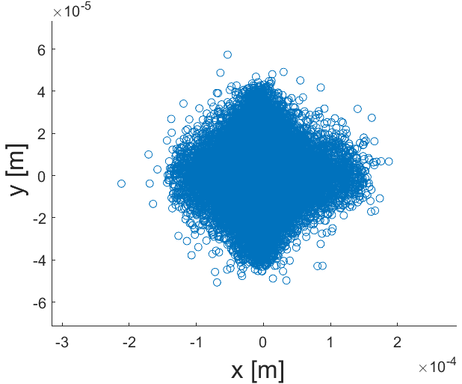
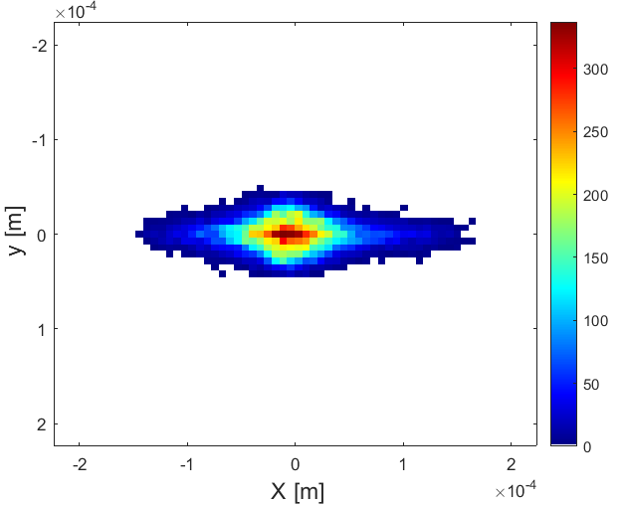
Distribution – CCD Conversion
Conversion of the distribution obtained from the simulation into a CCD-like image to compute the beam size and centroids
Size Camera : 1200 x 1920 Pixel
Calibration : 3.5 $μm/$Pixel
Example Distribution at the Screen
CCD-like converted image

Slide 8
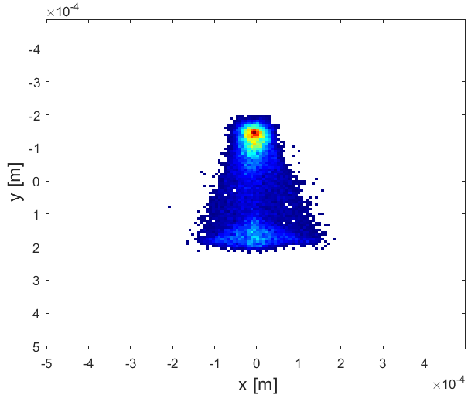
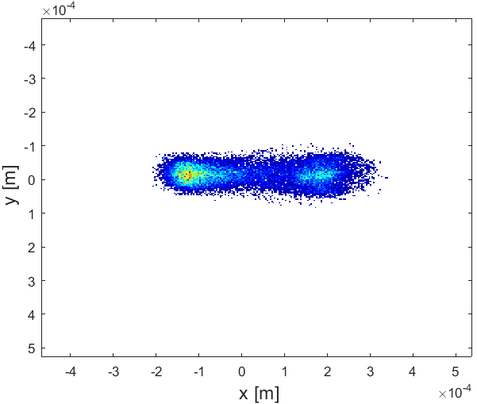
Beam Distribution at the Zero Crossing
Implemented the PolariX 3D maps provided by PSI in Astra to simulate the length measurement
Beam Streaked at Zero Crossing with 96 cm Transverse Deflecting Structure after a 3.07 m drift to the screen in two streaking direction
Y plane - streaking
X plane - streaking
$$φ_{deflector}∼−129.5 deg$$
$$φ_{deflector}∼50.5 deg$$
Deflector On
Deflector On

Slide 9
Resolution (Streaking in y-plane)
General equation for RF deflector Resolution
$$R_{y}=\sqrt{\frac{ε_{y}}{β_{y}^{PX center}}}\frac{1}{|sinΔμ|}\frac{E}{eV_{0}k_{rf}}$$
$$k_{rf}=\frac{ω_{rf}}{c}$$
Phase advance from the TDS center to the screen: $|sinΔμ|≈1$
$β_{y}^{PX center}$ as large as possible
$α_{y}=0$ at the TDS entrance and screen
In case of just a drift between the TDS and screen:
$$R_{34}=\sqrt{β_{y}^{PX center}{β_{y}}_{screen}}\left|sinΔμ\right|=L_{drift}$$
$$R_{y}=\frac{\sqrt{ε_{y}{β_{y}}_{screen}}}{L_{drift}}\frac{E}{eV_{0}k_{rf}}$$
Calibration Factor:

Slide 10
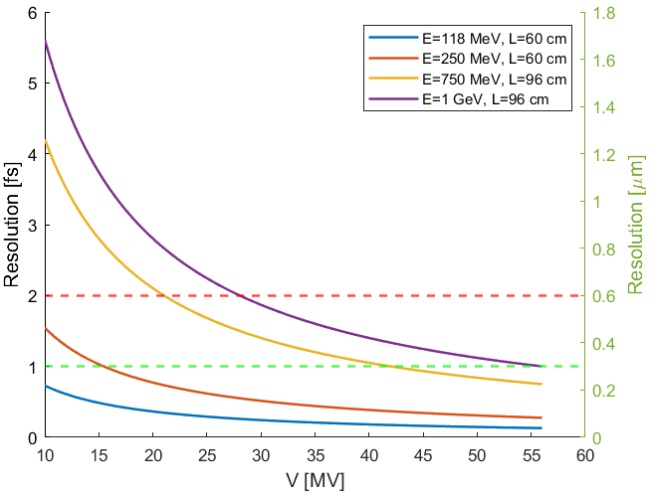
TDS Resolution
After the Laser Heater: $L=60 cm$
Before the Undulator: $L=96 cm$
$$R_{t}=\frac{σ_{off}}{L_{drift}}\frac{E}{eV_{0}k_{rf}c}$$
$$σ_{off}≈15 μm$$
$2 fs$ Resolution
$1 fs$ Resolution

Slide 11
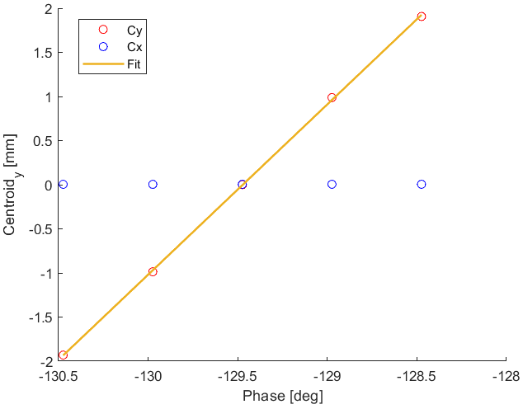
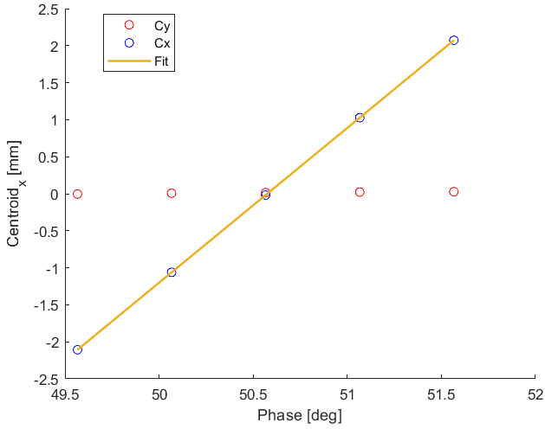
TDS Calibration in x-y planes
PolariX Calibration:
Integrated V$∼31 MV$ at a beam Energy of 1 GeV
y-streaking
x-streaking
x-streaking Calibration : $∼110.88 fs/mm$
y-streaking Calibration : $∼117.53 fs/mm$

Slide 12
Length Measurement in x-y planes
Different sets of quadrupole strength for the two measurements, optimised to minimize the beam vertical and horizontal size to maximise the resolution
Parameters | Streaking y-plane | Streaking x-plane
$σ_{x}$ Def. Off | $$42.3 μm$$ | $$27.5 μm$$
$σ_{y}$ $\text{Def}\text{. }\text{Off}$ | $$15.1 μm$$ | $$36.6 μm$$
$$V_{deflector}$$ | $∼31 MV$ | $∼31 MV$
Calibration | $$∼117.53 fs/mm$$ | $$∼110.88 fs/mm$$
Resolution | $$∼1.8 fs$$ | $$∼3.0 fs$$
$$σ_{t}$$ | $$(14.8±0.8) fs$$ | $$(14.8±0.9) fs$$

Slide 13
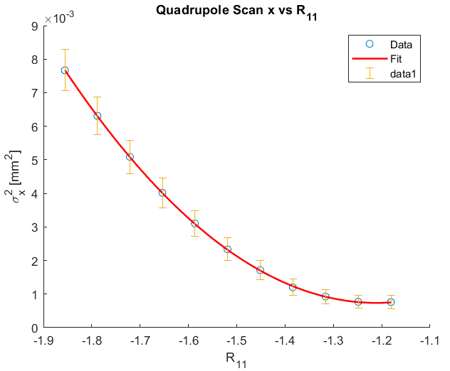
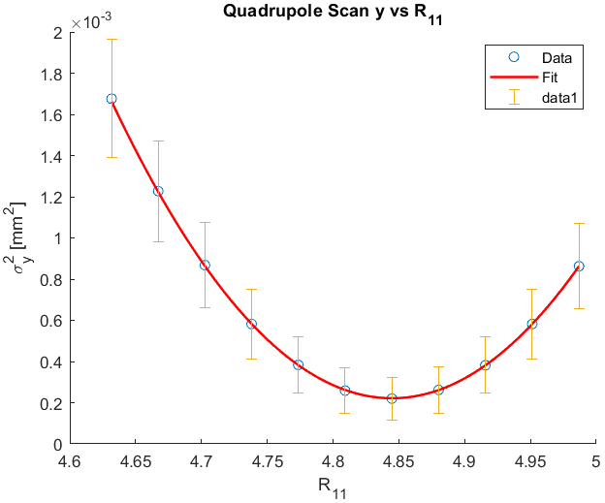
Emittance Measurement
Last Quadrupole Strength Scan
$$α_{y} Range:[−2, 2]$$
$$α_{x} Range:[−2,1.5]$$
$$k [m^{−2}] Range:[−3.93,−3.59]$$
$$k [m^{−2}] Range:[2.24,2.95]$$
 | $$y Plane$$ | $$x Plane$$
$$Expected ε$$ | $$∼1.17 mm mrad$$ | $$∼1.43 mm mrad$$
$$Reconstructed ε$$ | $$(0.96±0.03) mm mrad$$ | $$(1.44±0.05) mm mrad$$

Slide 14
Emittance Resolution
Simulations to determine the resolution on the emittance measurement
Repeated the simulations with beams with increasingly smaller emittance
Beam | $ε_{x}$ (Expected) [mm mrad] | $ε_{y}$ (Expected) [mm mrad] | $ε_{x}$ (Recon.) [mm mrad] | $ε_{y}$ (Recon.) [mm mrad] | Rel. Error $ε_{x}$ [%] | Rel. Error $ε_{y}$ [%]
1 | 1.43 | 1.17 | 1.44 | 0.96 | $$∼3.5$$ | $$∼2.7$$
2 | 0.96 | 0.86 | 0.75 | 0.70 | $∼$3.9 | $∼$3
3 | 0.66 | 0.6 | 0.66 | 0.50 | $∼$4.5 | $∼$3.4
4 | 0.44 | 0.4 | 0.51 | 0.35 | $∼$5.1 | $∼$4.4
Resolution in both planes at 1 GeV : $∼0.4 mm mrad$

Slide 15
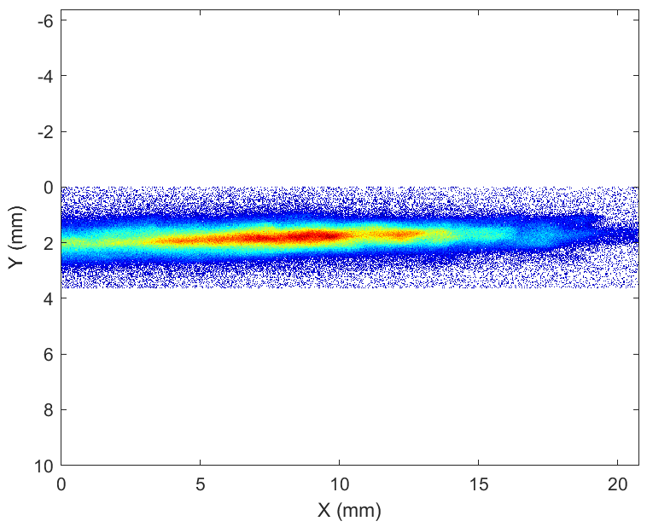
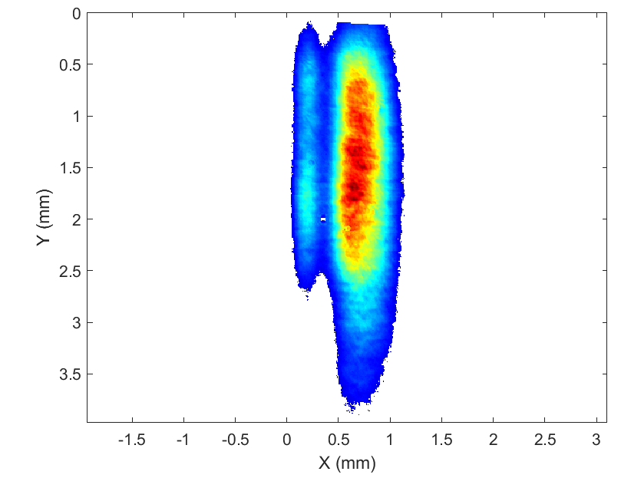
Energy Jitter Measurement at SPARC
The witness energy measurement at the high-energy spectrometer will be combined with the measurement of the relative distance between the driver and witness beams
This distance is affected by the jitter from the RF system, resulting in a jitter in the witness energy gain in the plasma
The relative distance between the beams is measured with the Electro-Optical Sampling, a non-intercepting and single-shot device based on an external field, i.e. the beam coulomb field, which induces birefringence on an electro-optical crystal, ZnTe in this case.
Witness
Witness
Driver

Slide 16
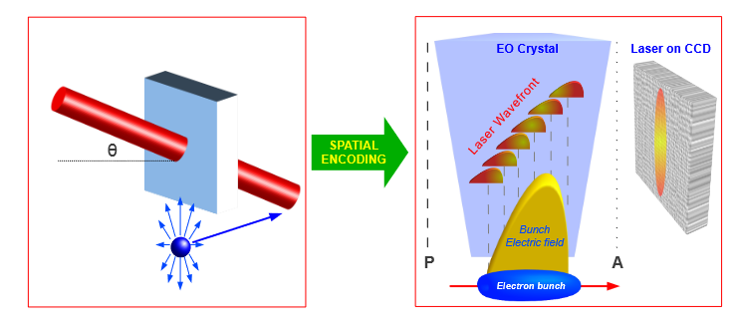
Electro-Optical Sampling
This change in the refractive indexes, can be measured with an opportune polarized laser pulse that crosses the crystal.
In the spatial decoding scheme the laser crosses the crystal with an angle $θ=30 deg$, therefore different points across the transverse profile of the laser pass through the crystal at different times and acquire a different polarization
The resolution in the measurement of the beam arrival time is of fs, so it is suitable for measuring the beam's arrival time and the driver-witness relative distance in each shot
Riccardo Pompili et al. “Femtosecond timing-jitter between photo-cathodelaser and ultra-short electron bunches by means of hybrid compression”.In: New Journal of Physics 18.8 (2016), p. 083033.

Slide 17
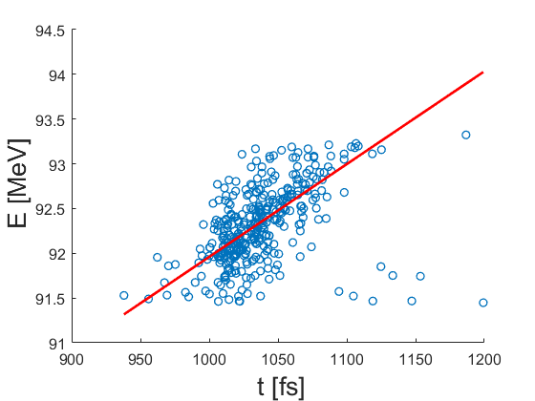
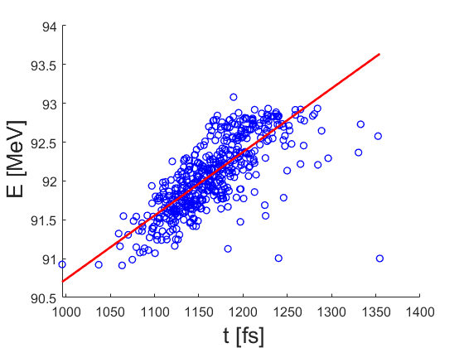
Measurement Results
$$φ_{1}=132.10 deg$$
$$φ_{2}=131.30 deg$$
${t_{1}}_{mean}=\left(1.0±0.1\right) ps$
${t_{2}}_{mean}=\left(1.2±0.1\right) ps$
$$m_{1}=\left(10±1\right)\frac{KeV}{fs}$$
$$m_{2}=\left(8.2±0.6\right)\frac{KeV}{fs}$$
The compression phase is slightly different: when the phase is smaller the compression is larger and therefore, the distance between the bunches increases.
The different slope is dependent on the plasma density (the used density for the experiment is $∼{10}^{15} cm^{−3}$): the first measurement corresponds to a larger density and so it is higher the slope with respect to the second case.

Slide 18
Third Year Program
Complete the Measurement Simulation at High-Energy:
- Slice Emittance Virtual Measurement
- Energy Measurement: Spectrometer Design
Implementation of the simulated measurements in the other Diagnostics Stations in Eupraxia:
- Low-Energy (120 MeV), including the 60 cm PolariX design
- Mid-Energy diagnostics (750 MeV)
PolariX activities in ATHOS at the PSI center

Slide 19
PolariX Activities Plan at PSI
Slice Emittance Measurements
1° step: Simulations to calculate the optics in the beamline for the measurement in both transverse planes
2° step: Set up the Simulations of the measurement
3° step: The Measurements will be done in November, and the Data Analysis will follow
5D Phase Space Measurement
The Experiment is planned for 2025, in collaboration with the DESY group working on the PolariX
Specific Requests for Eupraxia Diagnostics
Study on the passive streaker in substitution of a PolariX TDS after the undulator
Design of the 60 cm deflector at 120 MeV

Slide 20
Thank you for your attention

Slide 21
BACKUP SLIDE

Slide 22
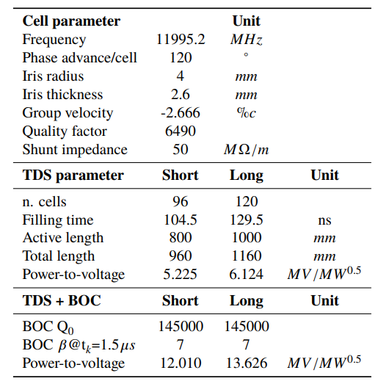
TDS parameters
Craievich, Paolo, et al. "The Polarix-TDS Project: bead pull measurements and high power test on the prototype." Proceedings of FEL. 2019.

Slide 23
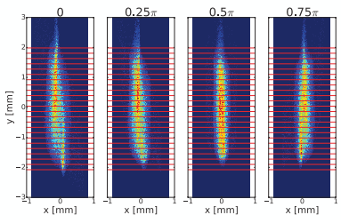
3D Charge Distribution Recontruction
1D distribution for each slice :
$$D_{t}(θ)$$
The SART reconstruction algorithm integrates the 1D distribution that is treated as a projection of the 2D distribution

Slide 24
5D Phase Space Recontruction
The 5D reconstruction requires to streak the beam in different angles and also for different phase advance combinations in x and y, to also rotate the beam transverse phase space
Shear Parameter:
$$S=\frac{V_{0}Lk_{rf}}{E}$$
The Shear Parameter is determined for each streaking angle and phase advance combination, by measuring the beam centroid with respect to the changing of the deflector phase
The 3D distribution is then reconstructed via tomography for each phase advance combination
Each 3D reconstruction can be seen as the projection of the $(x,x^{′},y,y^{′},t)$ phase space on the $(x,y,t)$ space, so for each slice they are combined with the filtered back projection technique, to obtain the full 5D distribution
Jaster-Merz, S., et al. "5D tomographic phase-space reconstruction of particle bunches." Physical Review Accelerators and Beams 27.7 (2024): 072801.
Hock, K. M., and A. Wolski. "Tomographic reconstruction of the full 4D transverse phase space." Nuclear Instruments and Methods in Physics Research Section A: Accelerators, Spectrometers, Detectors and Associated Equipment 726 (2013): 8-16.
Notes:
Da tenere per le presentazioni future

Slide 25
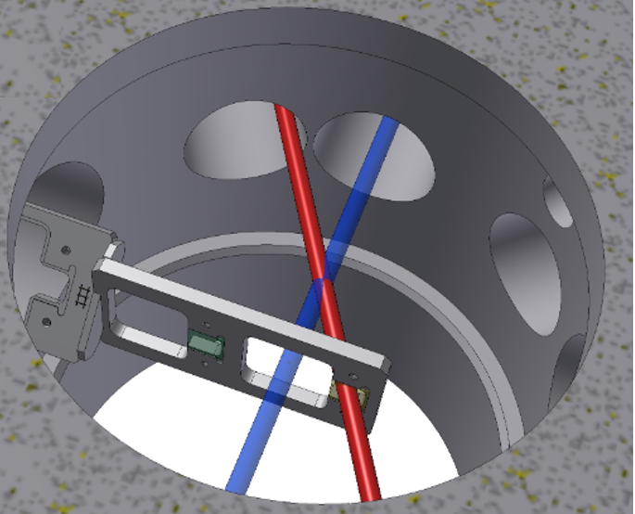
Electro-Optical Sampling
EOS position: entrance of the experimental chamber
$e^{−}$ bunch
EOS Crystal
Laser
Resolution of a few fs on the beam arrival time
Resolution of tens of fs on the longitudinal beam distribution
Complemented with the energy measurement of the witness allows for the measurement of the Beam Arrival Timing Jitter on the Plasma Acceleration

