Slide 1



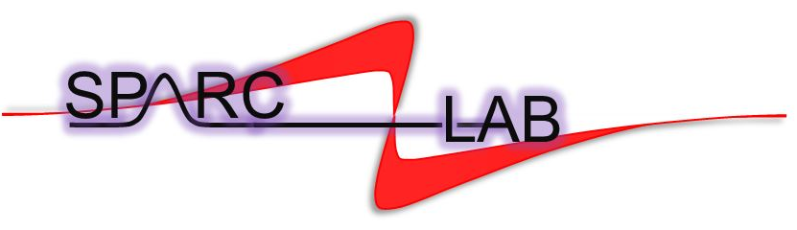
Beam dynamics optimization of EuPRAXIA@SPARC_LAB RF injector*
Beam dynamics studies for high
gradient, high brightness, and high repetition rate
C-band RF photoinjector for EuPRAXIA@SPARC_LAB
Gilles Jacopo Silvi (Sapienza University of Rome - INFN Roma1)
gillesjacopo.silvi@uniroma1.it
Supervisor: Prof.ssa Enrica Chiadroni
Supervisor: Prof. Andrea Mostacci
Supervisor: Dr.ssa Anna Giribono

Slide 2
Beam dynamics optimization of EuPRAXIA@SPARC_LAB RF injector*
OUTLINE
EuPRAXIA@SPARC_LAB
EuPRAXIA@SPARC_LAB S-band RF injector
  Beam Dynamics studies
  X-Band linearizer cavity, jitters studies
Proposal of a full C-band RF injector
  Beam Dynamics studies
Conclusions and future prospectives

Slide 3

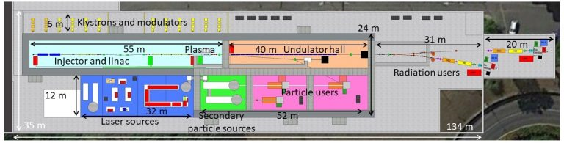
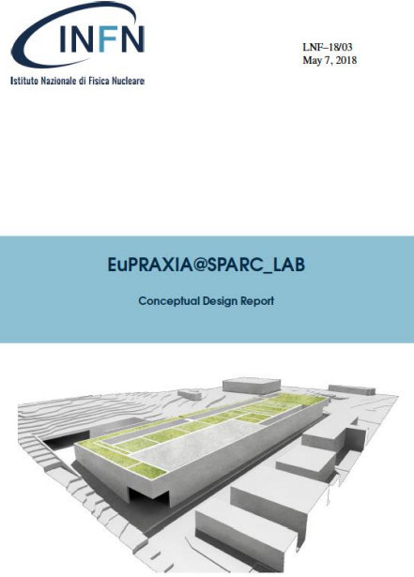
EuPRAXIA@SPARC_LAB
EuPRAXIA@SPARC_LAB is the first European research infrastructure to demonstrate the usability of a plasma accelerator combining a high-brightness GeV–range electron beam generated in a state-of-the-art linac, and a 0.5 PW–class laser system.
X-band cavity
[1]M. Ferrario et al., EuPRAXIA@SPARC_LAB Conceptual Design Report, LNF Technical Note 18-03, 07/05/2018.

Slide 4
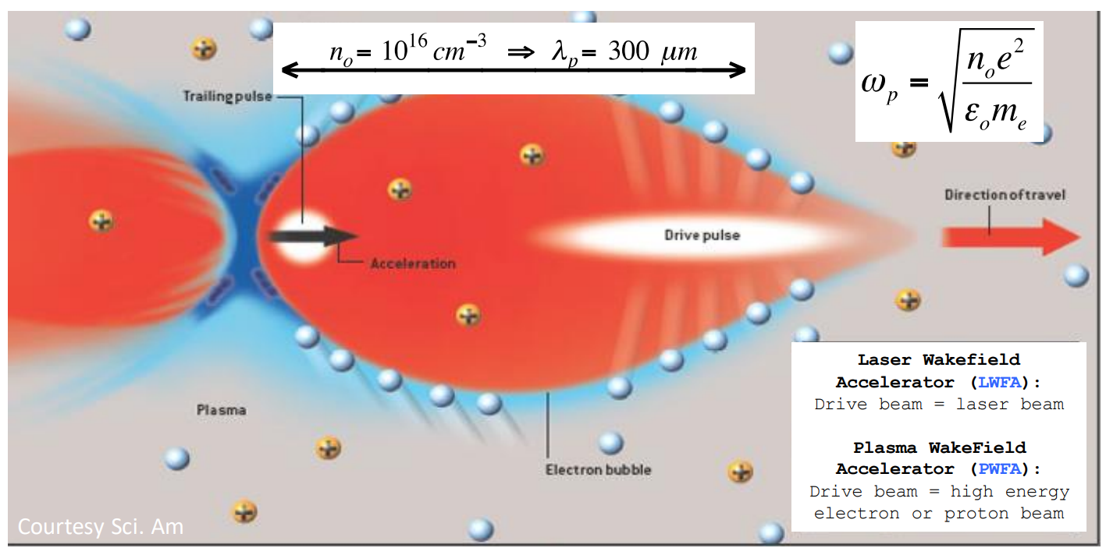
Particle Driven Wakefield Acceleration

Slide 5
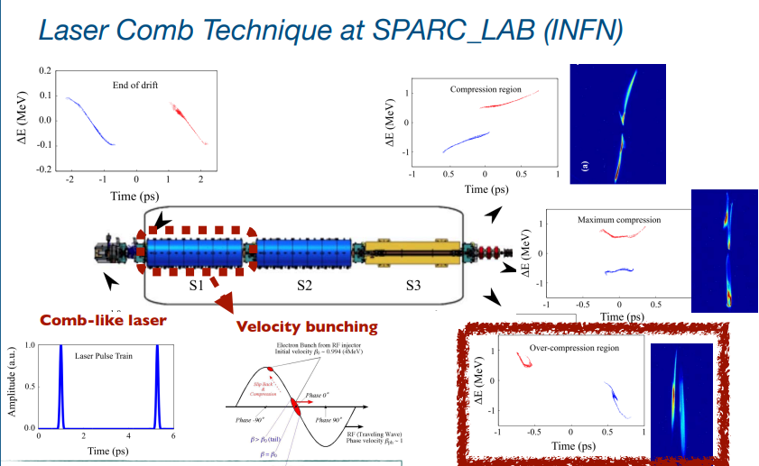
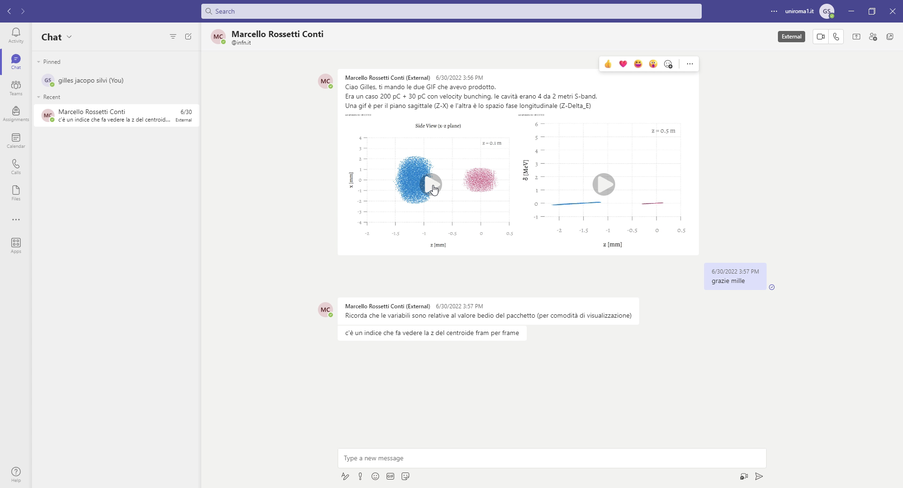

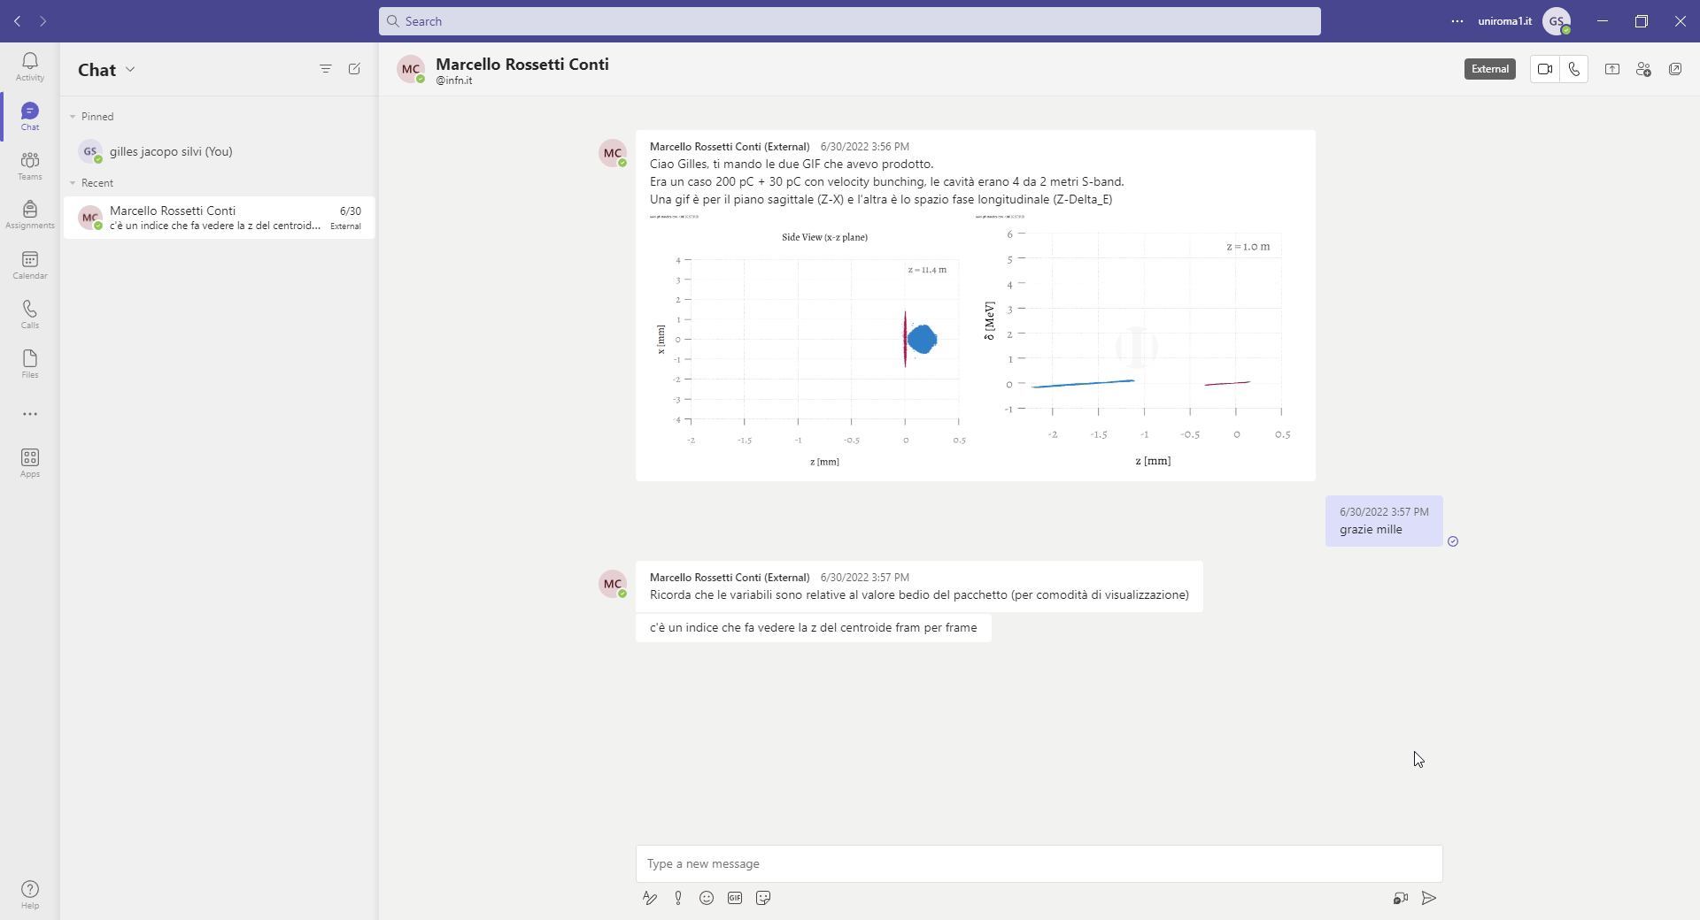
Driver and witness configuration
Courtesy of E.Chiadroni
[2]L. Serafini and M. Ferrario, AIP Conf. Proc. No. 581 (AIP, New York, 2001), p. 87.
[3]M. Ferrario et al., Phys. Rev. Lett. 104, 054801 (2010) 3.
[4]S. G. Anderson et al., Phys. Rev. ST Accel. Beams 8, 014401 (2005)
Courtesy of M. Rossetti Conti

Slide 6
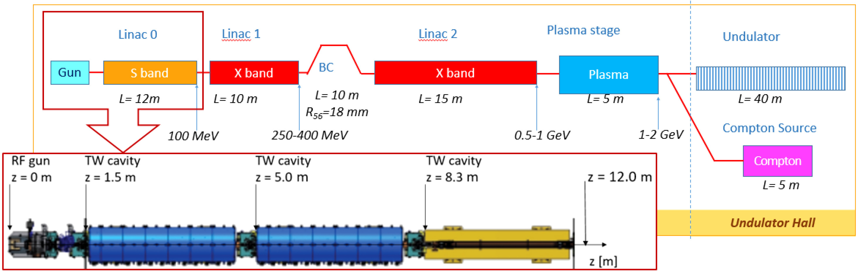
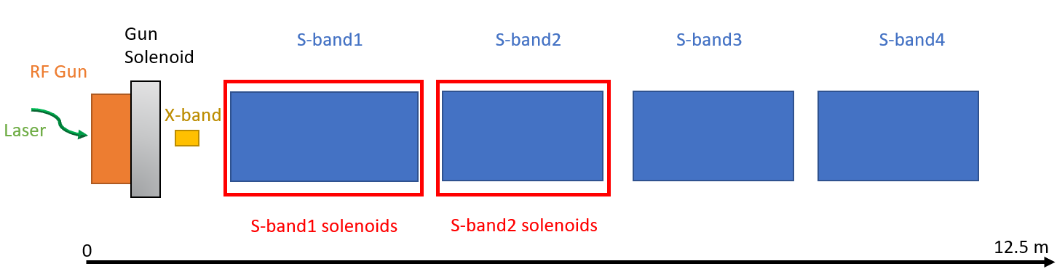
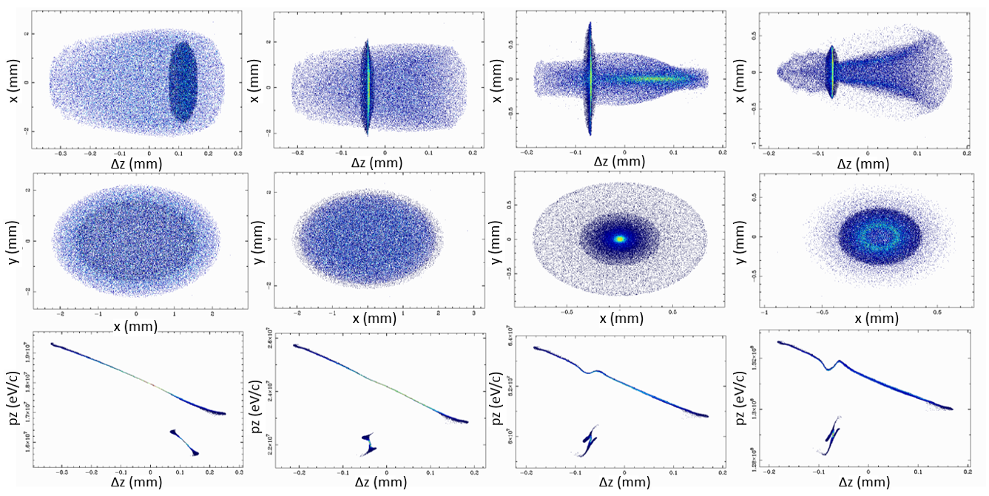
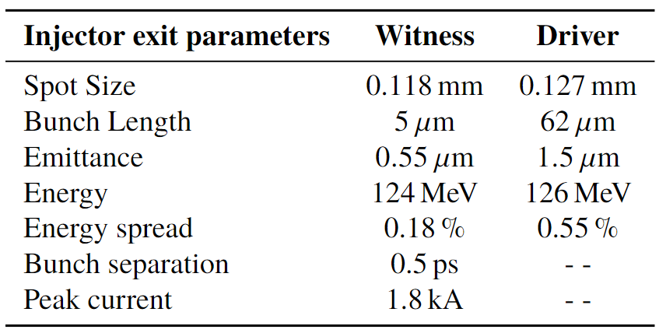
EuPRAXIA@SPARC_LAB injector
Simulation code
ASTRA
GIOTTO
[5]A. Giribono et al. https://doi.org/10.1016/j.nima.2018.03.009
[6]Young L M and J B 2003 The particle tracking code Parmela Proceedings of the 2003 Particle Accelerator Conference
[7]Floettmann K A space charge tracking code https://www.desy.de/ mpyflo/
[8]Bacci A, Rossetti Conti M and Petrillo V 2016 Giotto: A genetic code for demanding beam-dynamics optimizations

Slide 7
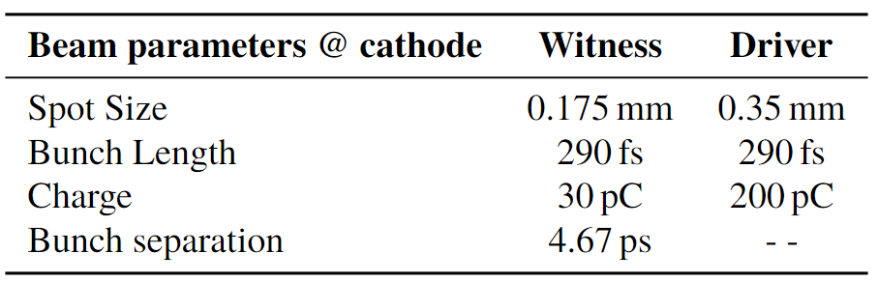
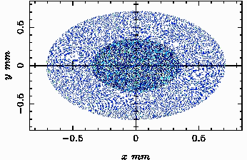
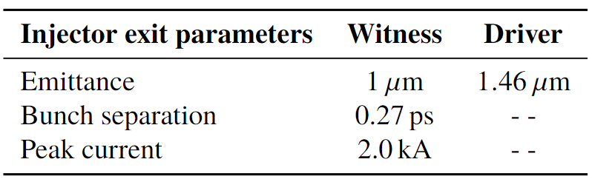
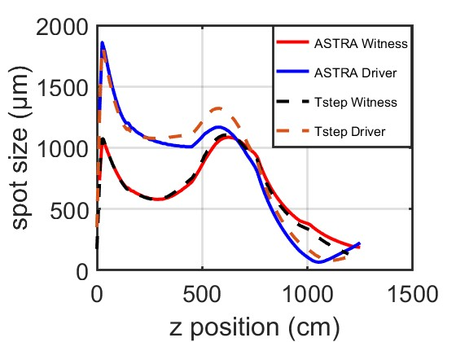
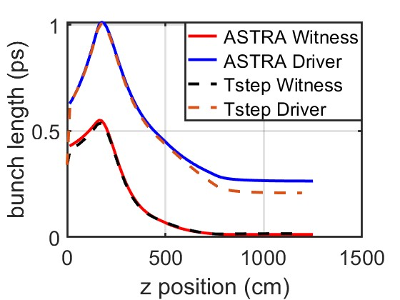
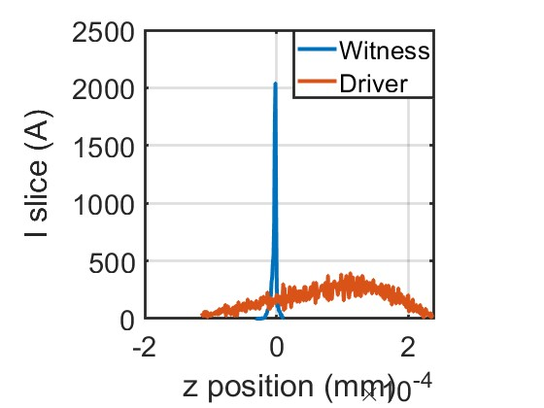


Beam dynamics studies with the ASTRA code
y (mm)
X (mm)
ASTRA simulation

Slide 8
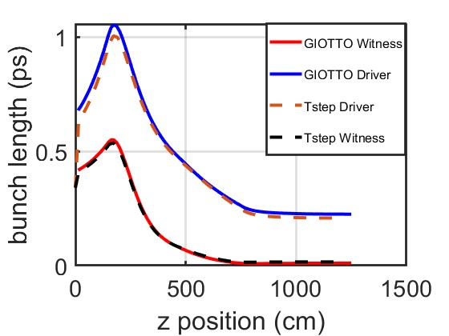
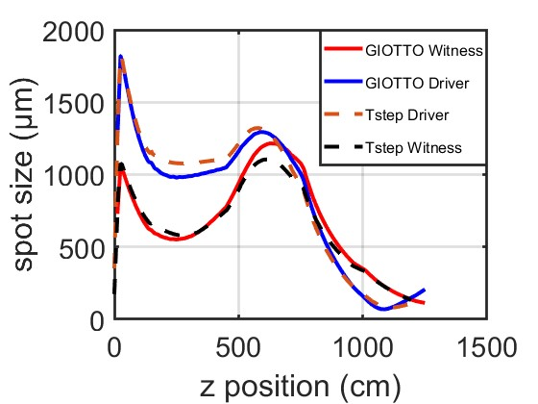
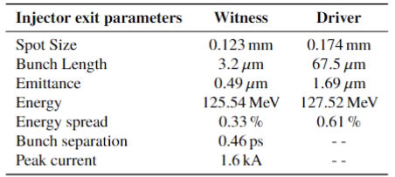
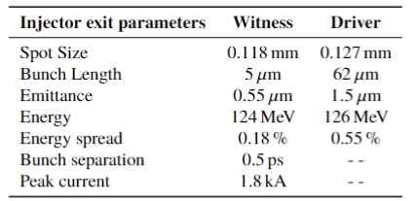
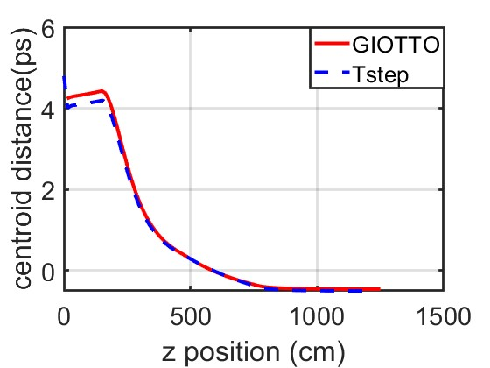
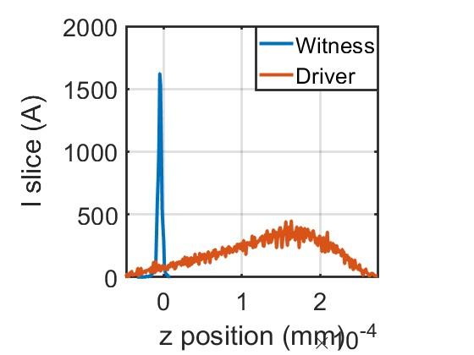
Beam dynamics optimizations with GIOTTO
ASTRA GIOTTO
Injector parameters optimized with GIOTTO
Reference Injector parameters

Slide 9
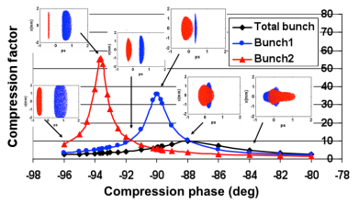
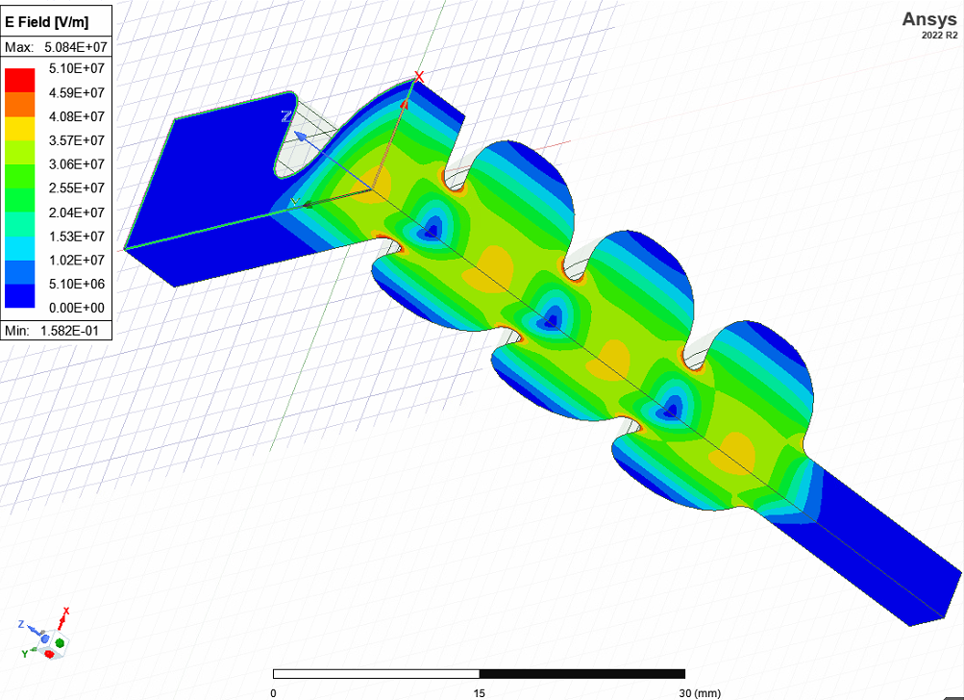
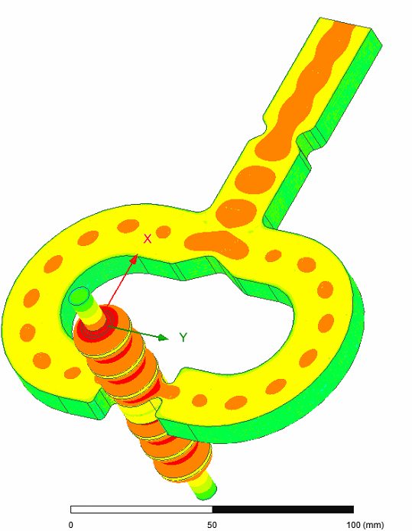
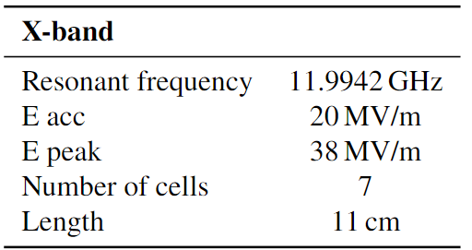
X-band linearizer cavity
High Harmonic Cavity (HHC) to improve beam stability, the X-band shapes the current distribution and pre-correct the longitudinal phase space.
Courtesy of L. Faillace
[9]A Mostacci et al. Proceedings of IPAC2011, San Sebastián, Spain

Slide 10
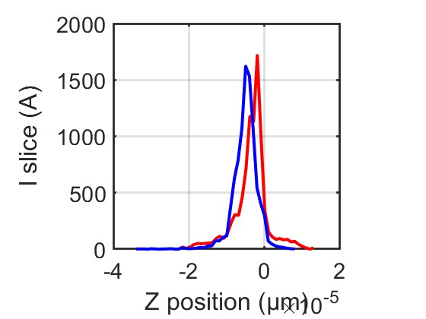
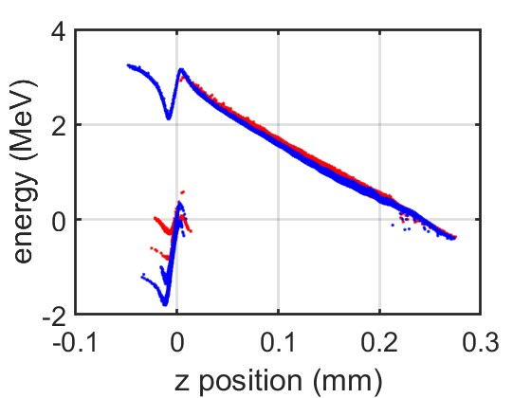
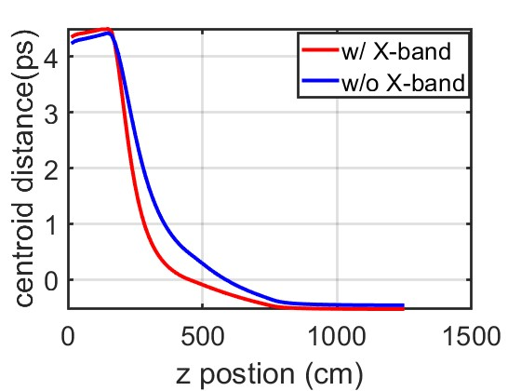


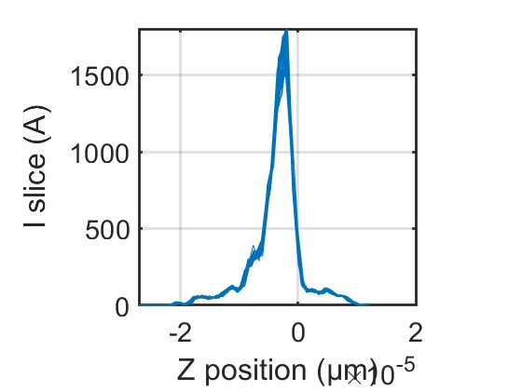
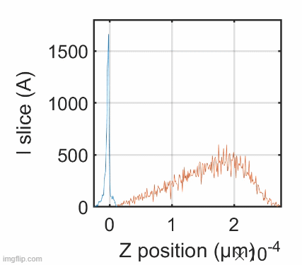
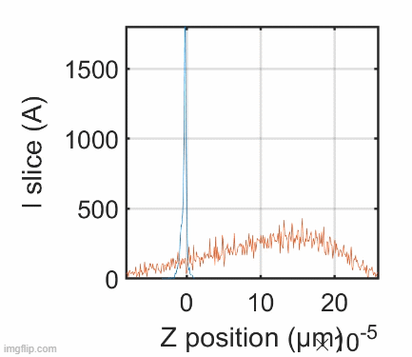
RF jitter simulations
The RF jitters simulated are 30 fs RMS, 0.03 deg for S-band and 0.12 deg for X-band cavity
[10]Bacci A, Faillace L and Rossetti Conti M 2018 Extreme high brightness electron beam generation in a space charge regime.
[11]Alesini D et al., 2015 Study of a C-band harmonic RF system to optimize the RF bunch compression process of the SPARC beam 6th International Particle Accelerator Conference p TUPWA058
[12]Emma P., 2001 X-Band RF harmonic compensation for linear bunch compression in the LCLS SLAC Nation Accelerator Laboratory Technical Note SLAC-TN-05-004, LCLS-TN-01-1
Witness peak current
D&W
50 shots of witness current profiles with X-band
with X-band
Without X-band

Slide 11
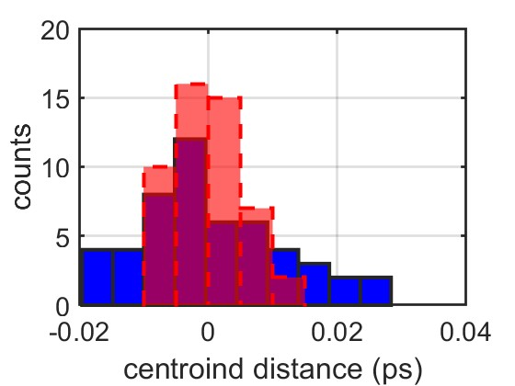
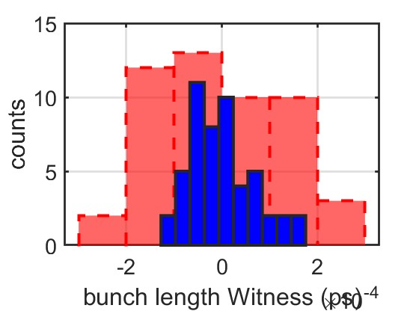

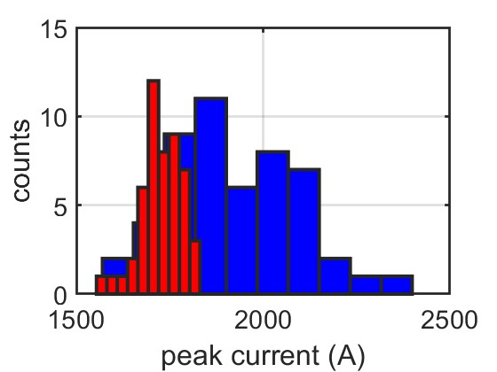
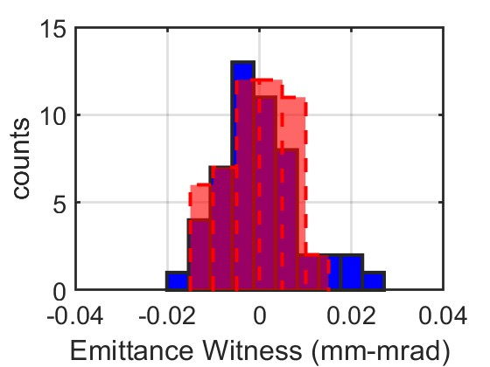
RF jitter simulations

Slide 12
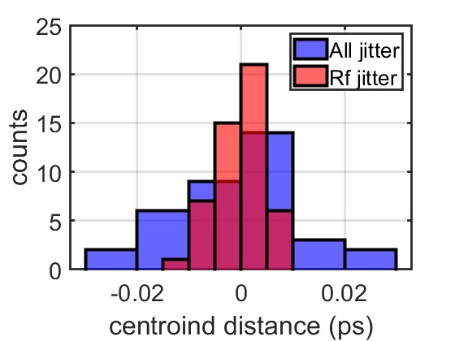
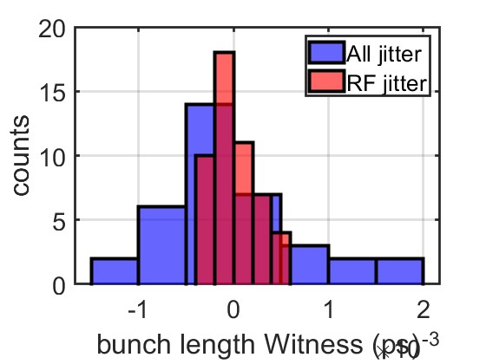
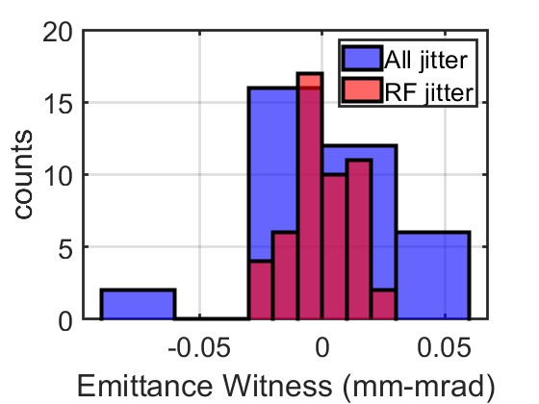

Simulations considering all machine jitters
Sensitivity jitter study for all RF injector components in parallel with the generation of the cathode beam parameters.
Beam parameters | w/ X-band all jitter | w/ X-band RF jitter | w/o X-band all jitter
<ε> (mm-mrad) | 0.672 ± 0.031 | 0.676 ± 0.013 | 0.571 ± 0.091
<Bunch length> (ps) | 0.0137 ± 7e-4 | 0.0140 ± 2e-4 | 0.0180 ± 7e-4
<peak current> (A) | 1733 ± 230 | 1728 ± 56 | 1923 ± 173
<centroid distance> (ps) | 0.5337 ± 0.0117 | 0.5462 ± 0.0048 | 0.5011 ± 0.0115
Total Charge | Spot Size | Time of arrival | RF phases | Voltage
2% of the total | 1% of the total | 30 fs RMS | 30 fs RMS | 0.2% of the total

Slide 13
Motivation of an RF injector upgrade
C-band :
Higher achievable cathode, and cavity peak field as high as 160-180 MV/m and 40 MV/m.
Higher efficiency, so it is suitable for applications requiring repetition rates in the 200 Hz÷1 kHz range.
Reduce injector footprint by maintaining high-quality high-brightness beams.

Slide 14
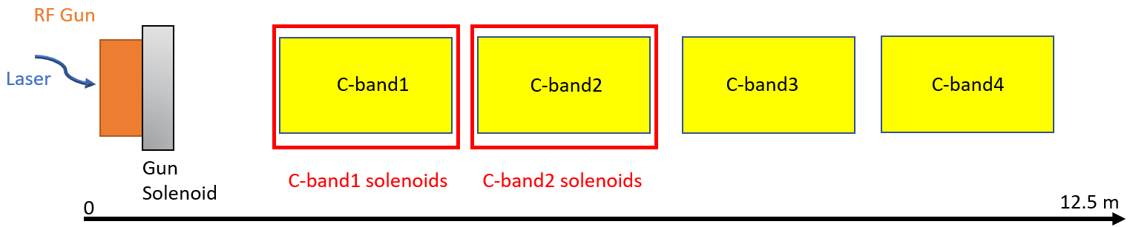

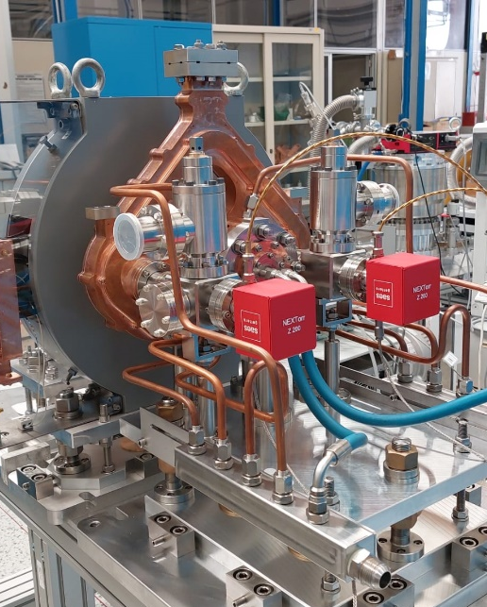

EuPRAXIA@SPARC_LAB C-band RF injector
Velocity bunching
11.5 m
Emittance compensation solenoids
Courtesy of
F. Cardelli
[13]A. Giribono PRAB 26, 083402, 2023

Slide 15
Driver-like (200 pC) beam dynamics
[13]A. Giribono PRAB 26, 083402, 2023
Slice analysis for different degrees of compression for a 200 pC Beam

Slide 16
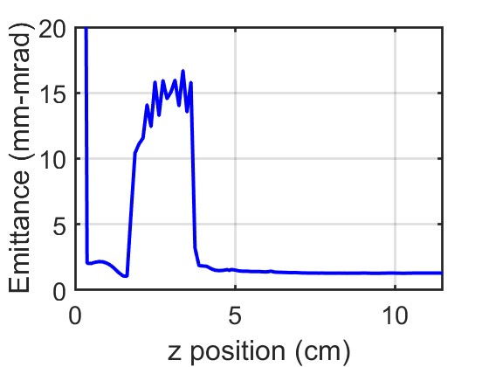
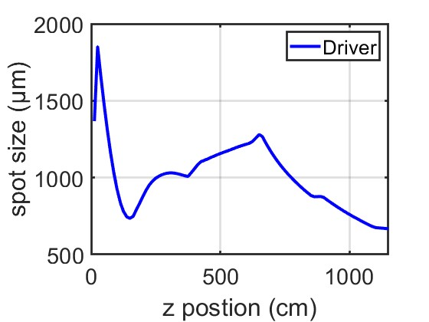
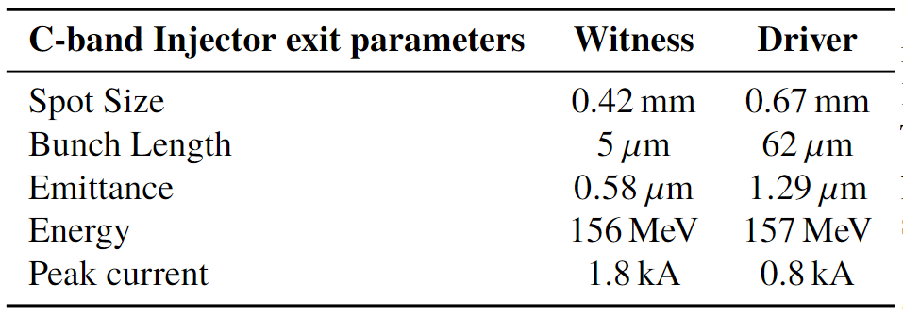

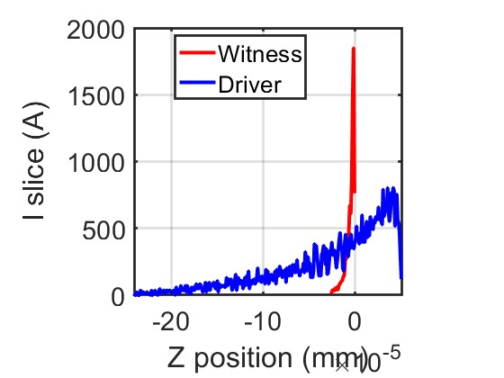
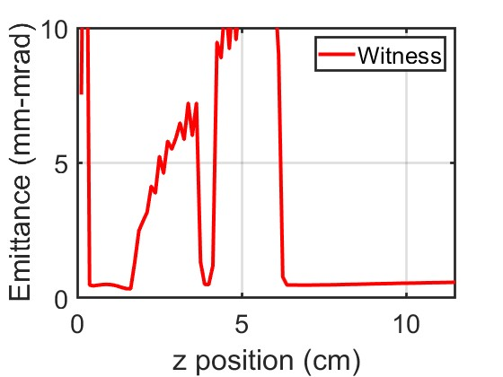
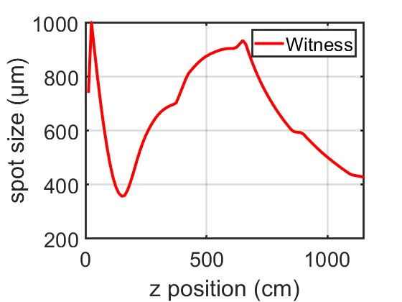
Single bunch simulations
Beam parameters @ injector exit for single bunch simulations
Z (m)

Slide 17
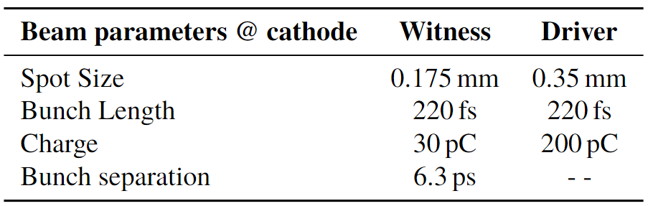
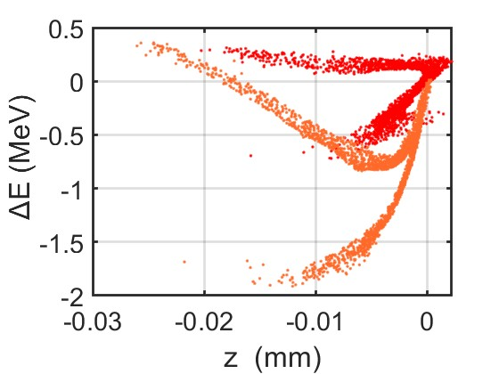





Driver and Witness beam dynamics
Driver comb
Driver
Witness comb
Witness
Z (m)

Slide 18

Conclusions and future prospectives
The ASTRA code was added to our toolset to have a further simulation tool for implementing beam dynamics studies.
Jitters simulations including RF components and cathodes’ generation.
C-band layout has been studied both with single and comb simulations.
Comb simulations are ongoing, the optimizations work on cathode distributions i.e., charge, separation, and length as well as the degree of compression achievable in the VB structures.
Design a new injector, scaling the S-band one, going through a High repetition rate, high brightness, and more compact accelerator.

Slide 19
Poster and Presentations
October 2023: Longitudinal Electron Beam Dynamics for Coherent Light Sources (LEDS 2023), ENEA Frascati, Italy, participant.
September 2023: European Advanced Accelerator Concept (EAAC), Isola D’Elba, Italy, “Beam dynamics simulation of a High Brightness High repletion rate RF C-band Photoinjector for future EuPRAXIA@SPARC_LAB upgrade”, Poster oral presentation and contributed oral presentation.
September 2023: Italian Physics Society National Congress, Fisciano, Italy, “Beam dynamics optimization of the EuPRAXIA@SPARC_LAB RF injector” and “Numerical Studies for EuPRAXIA@SPARC_LAB plasma beam driven working point”, Contributed oral presentation.
June 2023: Physics and Application of high brightness beams (PAHBB), San Sebastian, Spain “Beam Dynamics simulations with X-band linearizer cavity for the EuPRAXIA@SPARC_LAB RF injector”, Poster oral presentation.
May 2023: 14th International Particle Accelerator Conference (IPAC), Venice Italy, “Beam dynamics optimization of the EuPRAXIA@SPARC_LAB RF injector” and “Numerical Studies for EuPRAXIA@SPARC_LAB plasma beam driven working point”, Posters oral presentation.
September 2022: EuroNNAC Special Topic Workshop, Isola D’Elba, Italy, “Beam dynamics studies with comb electron beams for Particle driven Wakefield Acceleration”, Poster oral presentation.

Slide 20
Journal Paper
October 2023: Journal Paper, Romeo, S; Biagioni, A; Crincoli, L; Del Dotto, A; Ferrario, M; Giribono, A; Parise, G; Rossi, A R; Silvi, G J; Vaccarezza, C “Evaluation of the transfer matrix of a plasma ramp with squared cosine shape via an approximate solution of Mathieu differential equation” - In: PLASMA PHYSICS AND CONTROLLED FUSION. - ISSN 0741-3335. - 65:11(2023), p. 115005. [10.1088/1361-6587/acfbf6]
December 2022: Journal Paper, V. Shpakov, D. Alesini, M.P. Anania, M. Behtouei, B. Buonomo, M. Bellaveglia, A. Biagioni, F. Cardelli, M. Carillo, E. Chiadroni, A. Cianchi, G. Costa, M. Del Giorno, L. Faillace, M. Ferrario, M. Del Franco, G. Franzini, M. Galletti, L. Giannessi, A. Giribono, A. Liedl, V. Lollo, A. Mostacci, G. Di Pirro, L. Piersanti, R. Pompili, G. Di Raddo, S. Romeo, G.J. Silvi, A. Stella, C. Vaccarezza, F. Villa, and A. Vannozzi “Design, optimization and experimental characterization of RF injectors for high brightness electron beams and plasma acceleration” 2022 JINST 17 P12022 DOI 10.1088/1748-0221/17/12/P12022

Slide 21
References
[1] M. Ferrario et al., EuPRAXIA@SPARC_LAB Conceptual Design Report, LNF Technical Note 18-03, 07/05/2018.
[2] Serafini L and Ferrario M 2001 AIP Conference Proceedings 581 87–106
[3] M. Ferrario et al., Experimental Demonstration of Emittance Compensation with Velocity Bunching, Physical Review Letter 104, 054801 (2010).
[4] S. G. Anderson et al., Phys. Rev. ST Accel. Beams 8, 014401 (2005)
[5] Giribono A et al. 2018 Nuclear Instruments and Methods in Physics Research Section A: Accelerators, Spectrometers, Detectors and Associated Equipment 909.
[6] Young L M and J B 2003 The particle tracking code Parmela Proceedings of the 2003 Particle Accelerator Conference
[7] Floettmann K A space charge tracking code https://www.desy.de/ mpyflo/
[8] Bacci A, Rossetti Conti M and Petrillo V 2016 Giotto: A genetic code for demanding beam-dynamics optimizations
[9] A Mostacci et al. Proceedings of IPAC2011, San Sebastián, Spain
[10] Bacci A, Faillace L and Rossetti Conti M 2018 Extreme high brightness electron beam generation in a space charge regime.
[11] Alesini D et al., 2015 Study of a C-band harmonic RF system to optimize the RF bunch compression process of the SPARC beam 6th International Particle Accelerator Conference p TUPWA058
[12] Emma P., 2001 X-Band RF harmonic compensation for linear bunch compression in the LCLS SLAC Nation Accelerator Laboratory Technical Note SLAC-TN-05-004, LCLS-TN-01-1
[13] A. Giribono PRAB 26, 083402, 2023
[14] Giribono A et al. Electron beam analysis and sensitivity studies for the EuPRAXIA@SPARC_LAB RF injector IPAC’23 TUPL130
[16] W. Anders et al., An Engineering Guide to Photo-injector, Editors D.H. Dowell and T. Rao, ISBN-13: 978-1481943222, ISBN-10: 1481943227,2013.
[17] Assmann. et al. EuPRAXIA Conceptual Design Report. Eur. Phys. J. Spec. Top. 229, 3675–4284 (2020). https://doi.org/10.1140/epjst/e2020-000127-8.
[18] G D’Auria et al., Conceptual Design Report of the CompactLight X-ray FEL, (2021).
[19] M. Ferrario, SPARC-BD-12/01, Accelerator physics: basic principles of beam focusing and transport, Lecture given at the International School of Physics ”Enrico Fermi”, Course CLXXIX -” Laser-Plasma Acceleration” – Varenna - 20- 25 June 2011.
[20] D. Alesini et al., Technical Design Report for the SPARC Advanced Photoinjector, Laboratori Nazionali di Frascati Istituto Nazionale di Fisica Nucleare (2004).
[21] M. Croia et al., High gradient ultra-high brightness C-band photoinjector optimization, Journal of Physics 1596, 012031 (2020).
[22] J.B Rosenzweig, E. Colby, TESLA-95-04.
[23] D. Alesini et al., Design of a full C-band injector for ultra-high brightness electron beam, 10th Int. Particle Accelerator Conf., IPAC19, Melbourne, Australia (2019).
[24] M. Ferrario et al., Direct Measurement of the Double Emittance Minimum in the Beam Dynamics of the Sparc High-Brightness Photoinjector, Physical Review Letter 99, 234801 (2007).
[25] A. Giribono PRAB 26, 083402, 2023

Slide 22
Beam dynamics optimization of EuPRAXIA@SPARC_LAB RF injector*
Thank you for the attention
Gilles Jacopo Silvi (Sapienza University of Rome - INFN Roma1)
gillesjacopo.silvi@uniroma1.it

