Slide 1


Longitudinal beam coupling impedance mitigation studies for
CERN PS accelerator complex
PhD Accelerator physics – XXXVII cycle
Michela Neroni*
Supervisors
Andrea Mostacci (Sapienza, University of Rome), Christine Vollinger (CERN)
23rd of October 2023
*michela.neroni@uniroma1.it

Slide 2
Outline
Introduction
        Longitudinal beam coupling impedance and implications on beam dynamics
        Motivation of the study
        The main extraction kickers in the CERN Proton Synchrotron
Electromagnetic calculations
        Wakefield simulations
        Frequency domain and schematic simulations
Radiofrequency measurements
        Stretched wire measurements
Beam impedance mitigation
        Location of the critical resonances
        Mitigation strategy
Impedance of other components in the PS complex
Conclusions and outlook

Slide 3
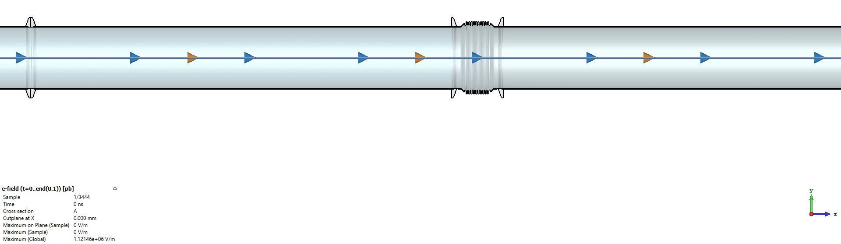
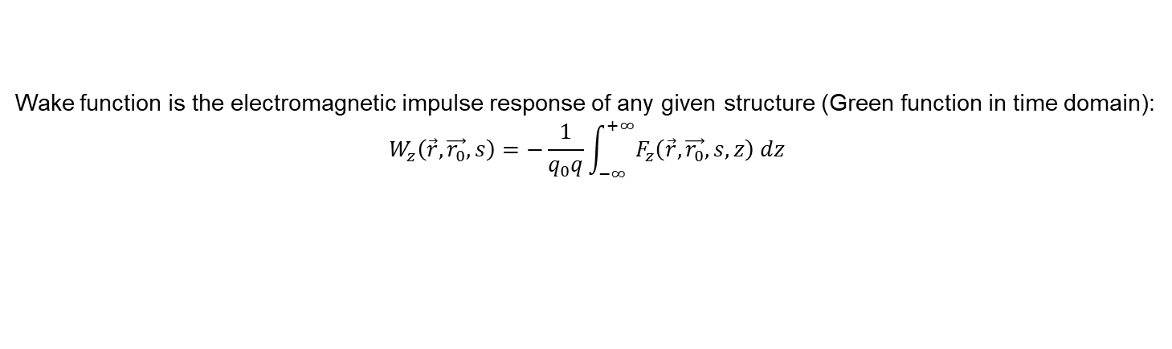
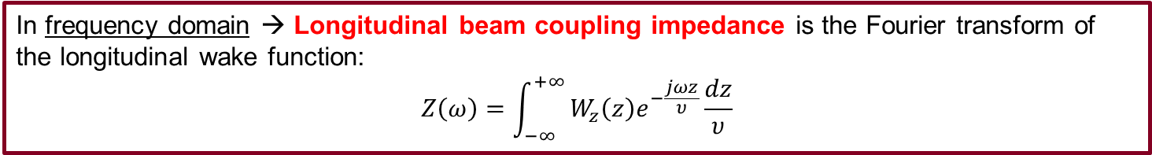
Longitudinal beam coupling impedance
When facing cross section variations of the vacuum chamber wall, as well as its finite resistivity, charged particles travelling in the accelerator, induce electromagnetic fields mainly left behind the generating particle ➔ Wakefield ➔ Beam losses and instabilities
Courtesy of M. S. Sullivan
Wake function is the electromagnetic impulse response of any given structure (Green function in time domain):
$$W_{z}\left(\vec{r},\vec{r_{0}}, s\right)=−\frac{1}{q_{0}q}\int_{−∞}^{+∞}{F_{z}\left(\vec{r},\vec{r_{0}}, s,z\right) dz}$$
In frequency domain → Longitudinal beam coupling impedance is the Fourier transform of the longitudinal wake function:
$$Z\left(ω\right)=\int_{−∞}^{+∞}{W_{z}\left(z\right)e^{−\frac{jωz}{υ}}\frac{dz}{υ}}$$

Slide 4
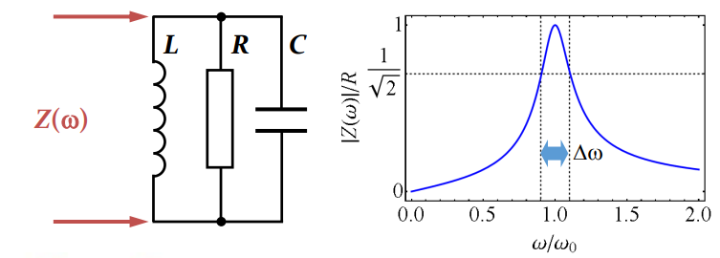
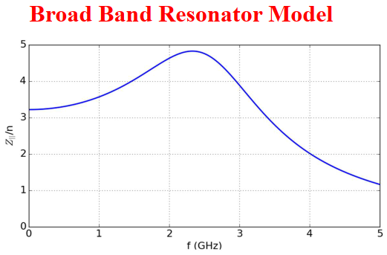
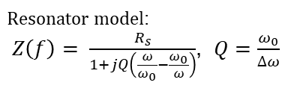
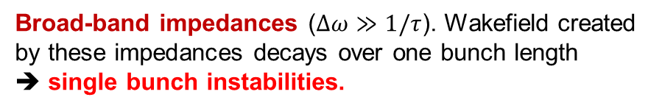
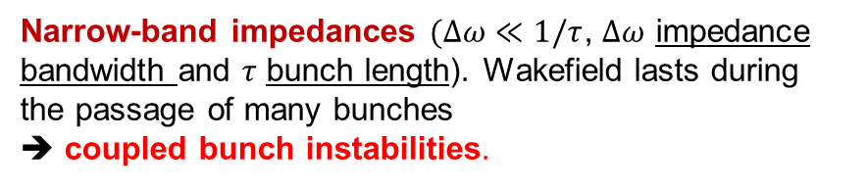
Beam instabilities and mitigation strategy
Depending on the decay time of the wakefield, we can distinguish two types of impedances:
Narrow-band impedances $(Δω≪1/τ$, $Δω$ impedance bandwidth and $τ$ bunch length). Wakefield lasts during the passage of many bunches
➔ coupled bunch instabilities.
$Resonator model$:
$Z\left(f\right)= \frac{R_{s}}{1+jQ\left(\frac{ω}{ω_{0}}−\frac{ω_{0}}{ω}\right)}$, $Q=\frac{ω_{0}}{∆ω}$
➔ Reducing Q factor: introduction of HOM-couplers, broadening methods like insertion of absorbers (e.g. ferrites).
Broad-band impedances ($Δω≫1/τ$). Wakefield created by these impedances decays over one bunch length
➔ single bunch instabilities.
➔ Reducing R/Q and therefore changing the overall geometry (to be decided in the design phase or mitigated with adding shields in an existing structure)

Slide 5
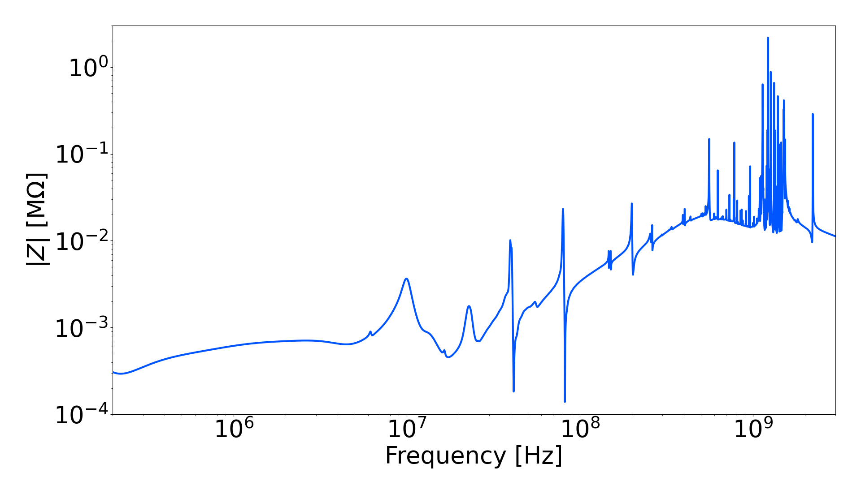
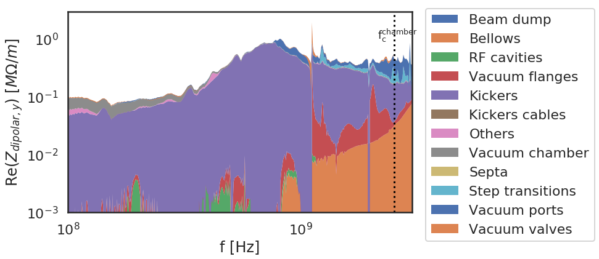
Motivations
LIU project (LHC Injectors Upgrade) in view of HL-LHC
Longitudinal coupled-bunch instabilities is one of the main limitations in the PS for reaching higher intensities in the LIU framework.
PS impedance model up-to-date with the most recent geometrical model of each component.
Kickers are one of the main source of broadband impedance in the PS, with unwanted effects, e.g. loss of Landau damping.
While the LIU target is reached today, tackling critical impedance sources will provide additional margin.
Total PS Longitudinal Impedance
PS Transverse Dipolar vertical impedance
Vacuum equipment
RF cavities
Kickers
Courtesy of S. Joly

Slide 6
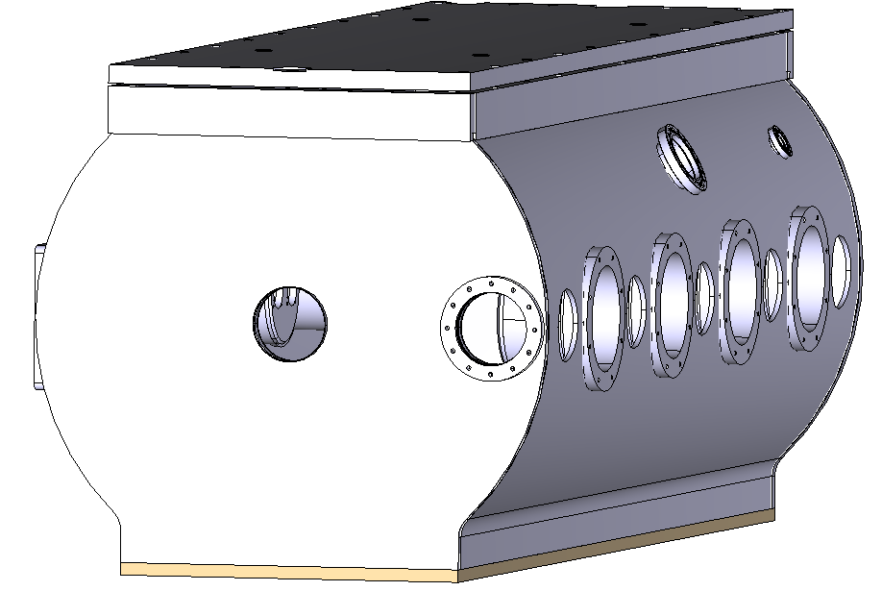
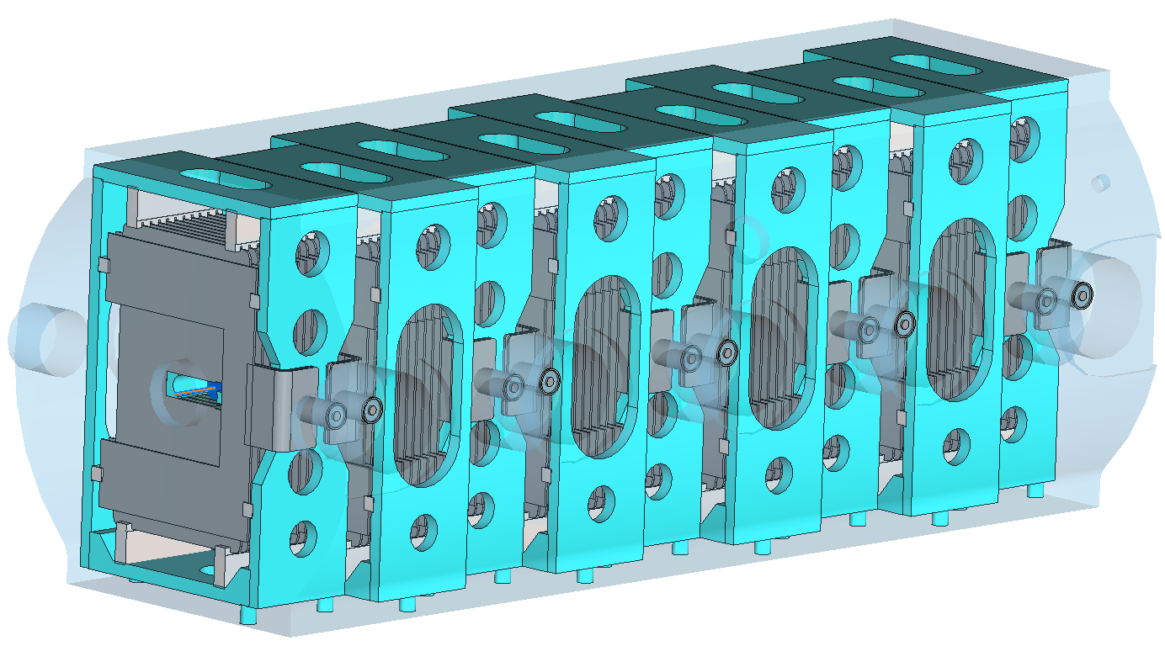
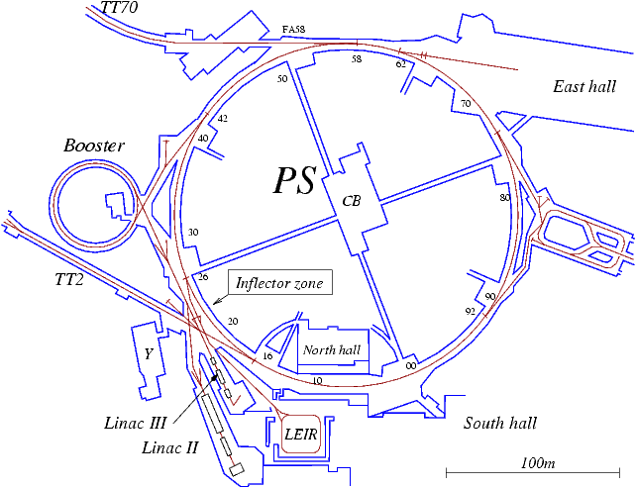
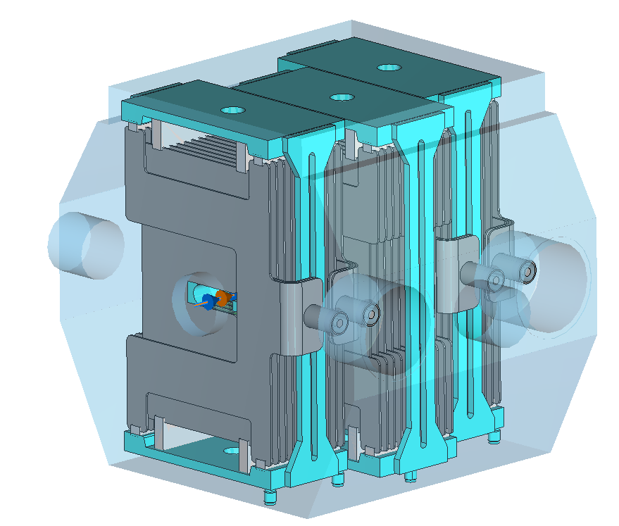
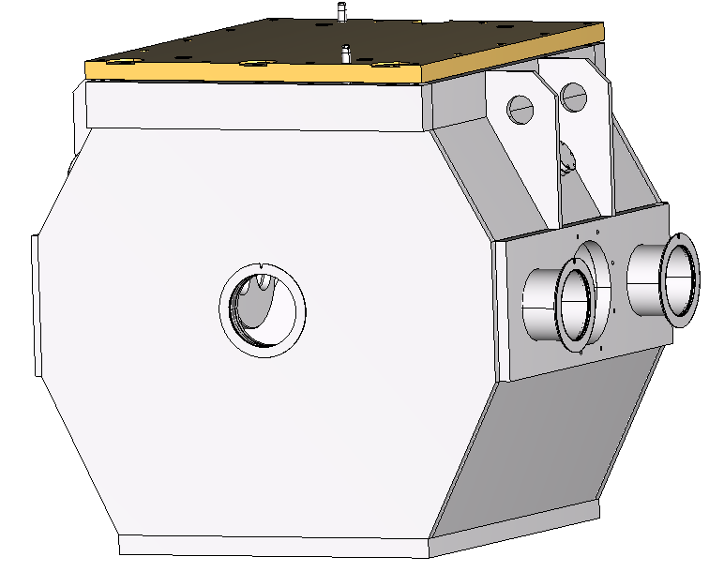
PS fast extraction kickers
KFA71, KFA79 and SMH16 involved in the main extraction from PS towards SPS and experimental areas.
Kickers first installed in the 1970s
Twelve magnet modules foreseen for extraction, split into two different devices
2.45 m
KFA71
KFA79
0.89 m
SMH16
IV

Slide 7
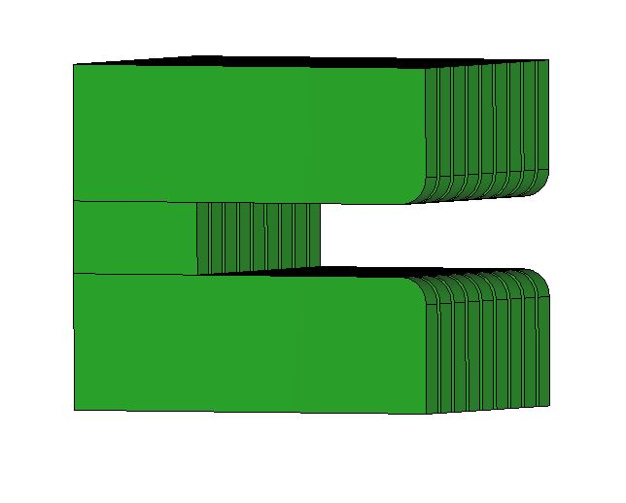
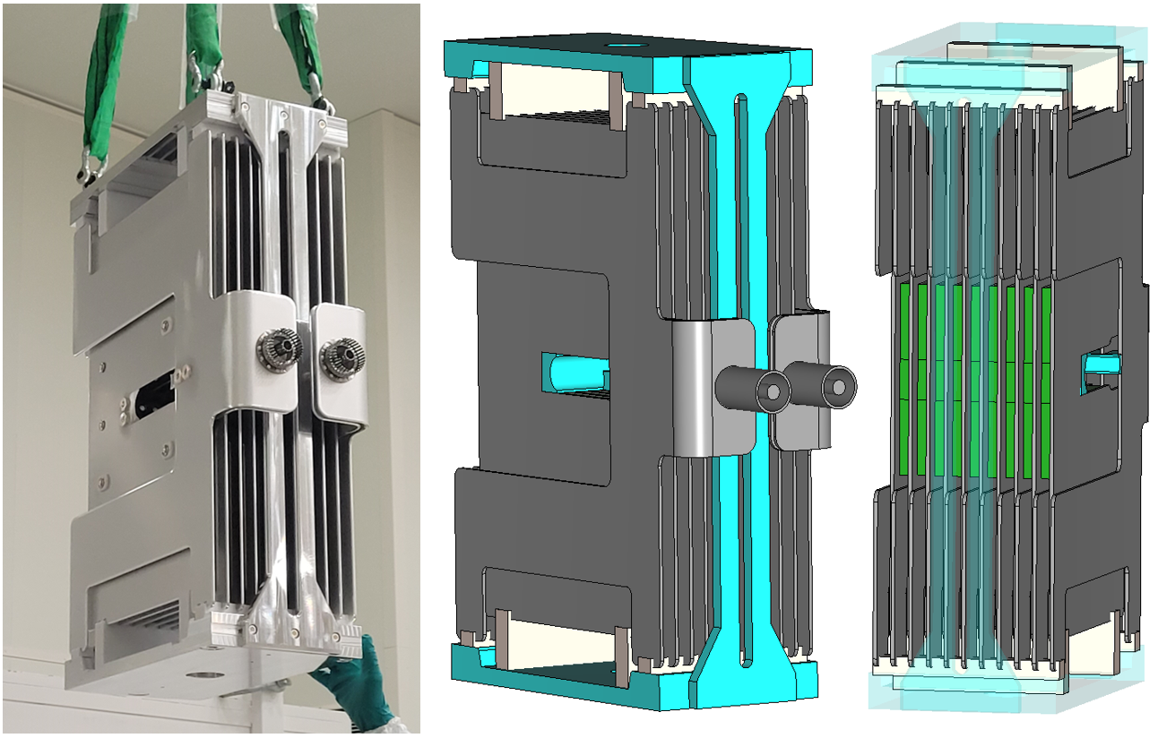
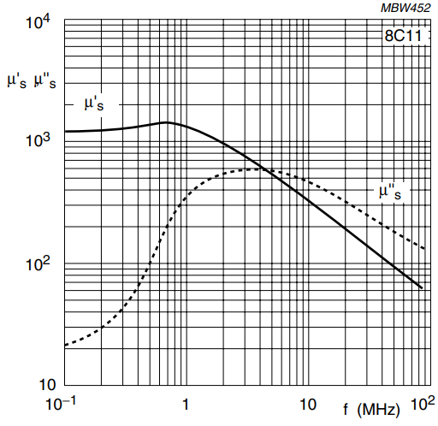
Model geometry and materials
3D models built in CST starting from old drawings and CATIA models
Plates combs Alumina
9-cells magnet
KFA79 module unit
Frame
ground/HV plates
ground/HV conductors
Aluminum alloys
Highly dispersive behaviour → magnetic permeability of Ferrite 8C11 by Ferroxcube
High geometrical complexity ➔
Large computational resources required

Slide 8
Outline
Introduction
        Longitudinal beam coupling impedance and implications on beam dynamics
        Motivation of the study
        The main extraction kickers in the CERN Proton Synchrotron
Electromagnetic simulations
        Wakefield simulation
        Frequency domain and schematic simulations
Radiofrequency measurements
        Single stretched wire measurements
Beam impedance mitigation
        Location of the critical resonances
        Mitigation strategy
Impedance of other components in the PS complex
Conclusions and outlook

Slide 9
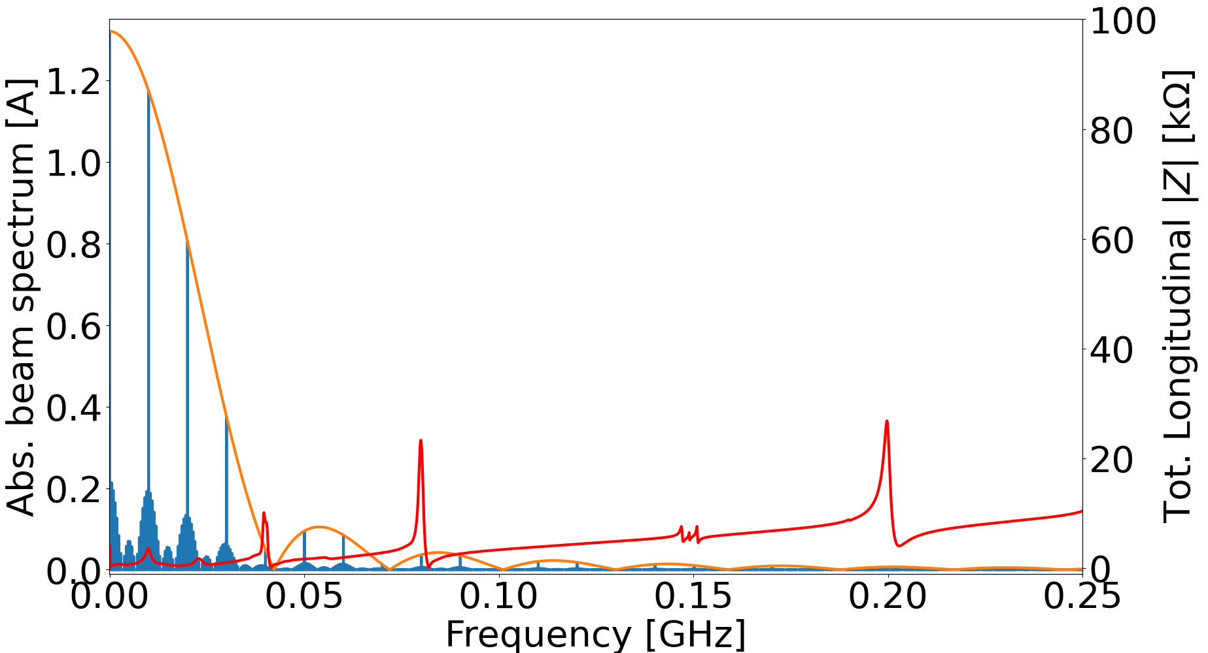
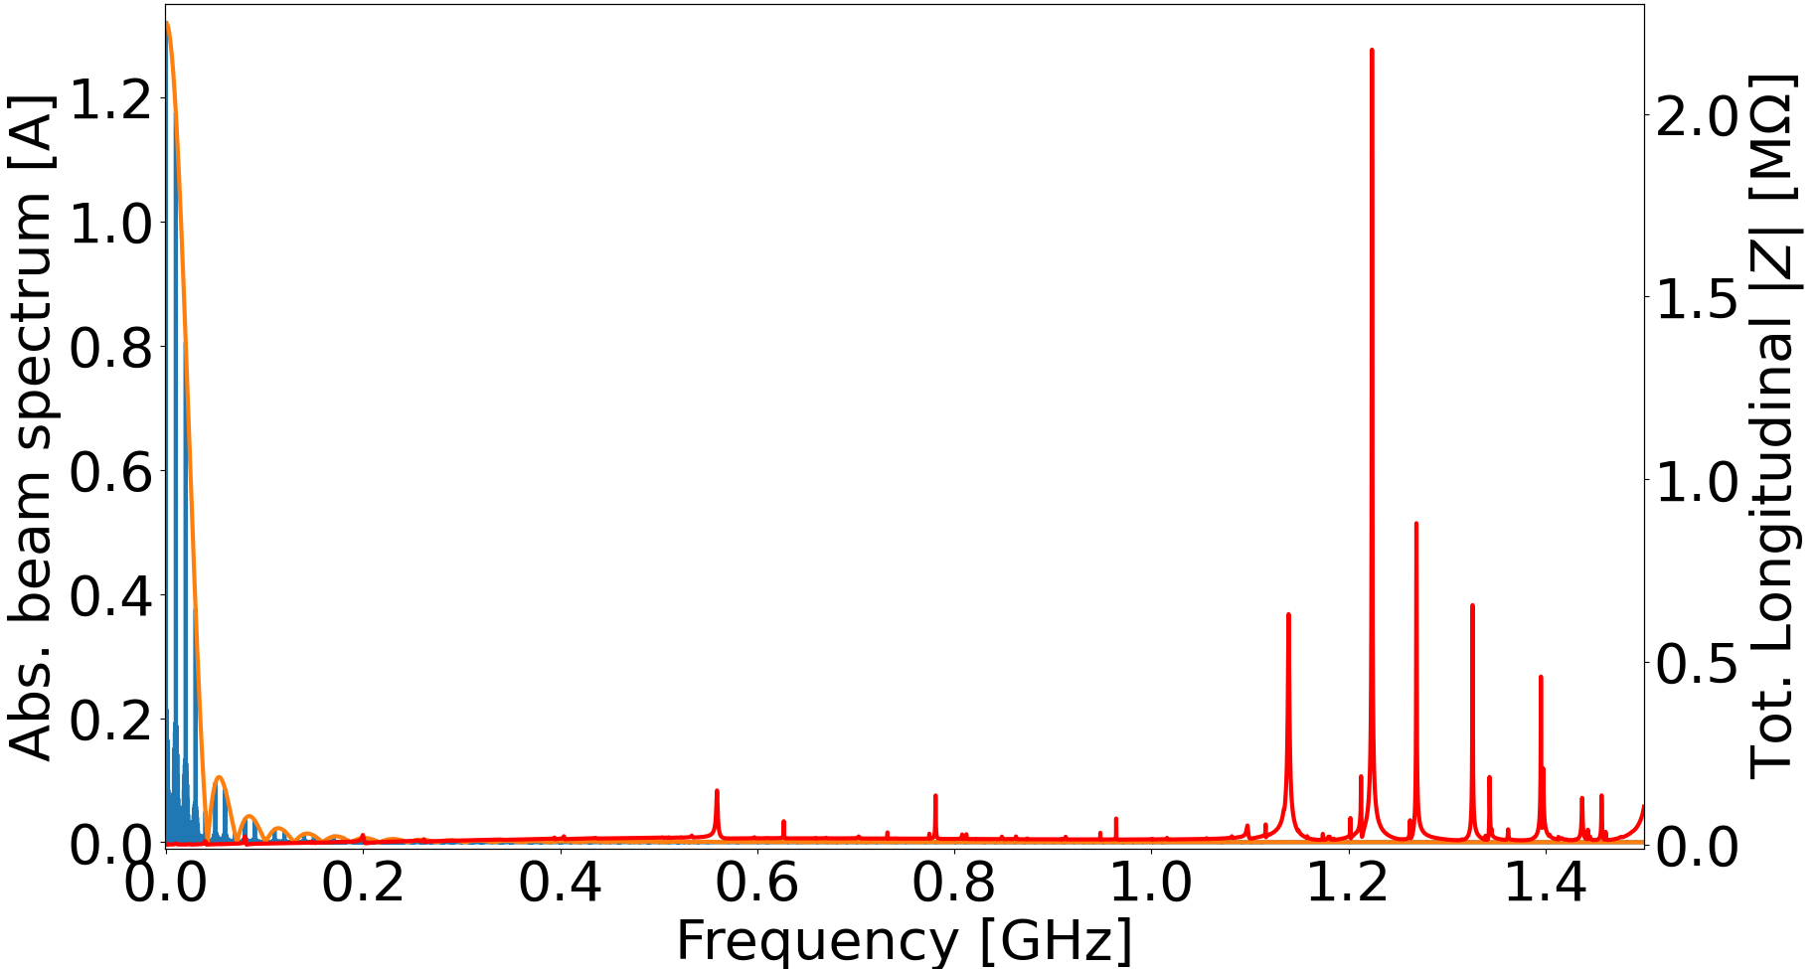
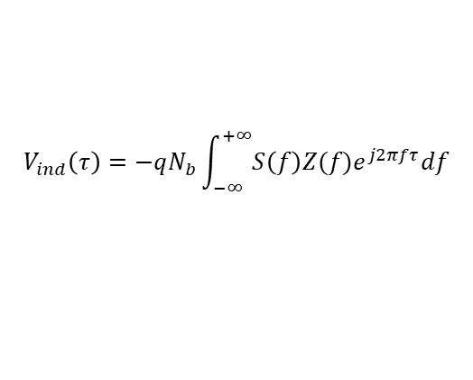




Induced voltage
Total voltage induced by the bunch on a charge in a time distance $τ$:
Bunch spectrum
$$V_{ind}\left(τ\right)=−qN_{b}\int_{−∞}^{+∞}{S\left(f\right)Z(f)e^{j2πfτ}df}$$
By expanding the exponential to the first order *
$$Re \{Z(f)\}$$
$$\frac{Im\left\{Z\left(f\right)\right\}}{f}$$
$$\frac{R}{Q}$$
➔
$$R_{s}$$
Broadband impedance contribution driven by the ferrite
→ Intrinsic in the kicker design
Energy loss
Coupled bunch instabilities
To avoid impedance peaks in the low frequency range, up to 150 MHz
For low frequencies → low coupled bunch instabilities threshold $R_{s} \sim kΩ$ (cumulative PS longitudinal shunt impedance) **
* J. L. Laclare, “Bunched beam coherent instabilities,” in Proceedings of CAS 1985 Vol. I, pp. 264–326, 1987
** E. Shaposhnikova, “Longitudinal beam parameters during acceleration in the LHC”, Tech. Rep. LHC-PROJECT-NOTE-242, CERN, 2000

Slide 10
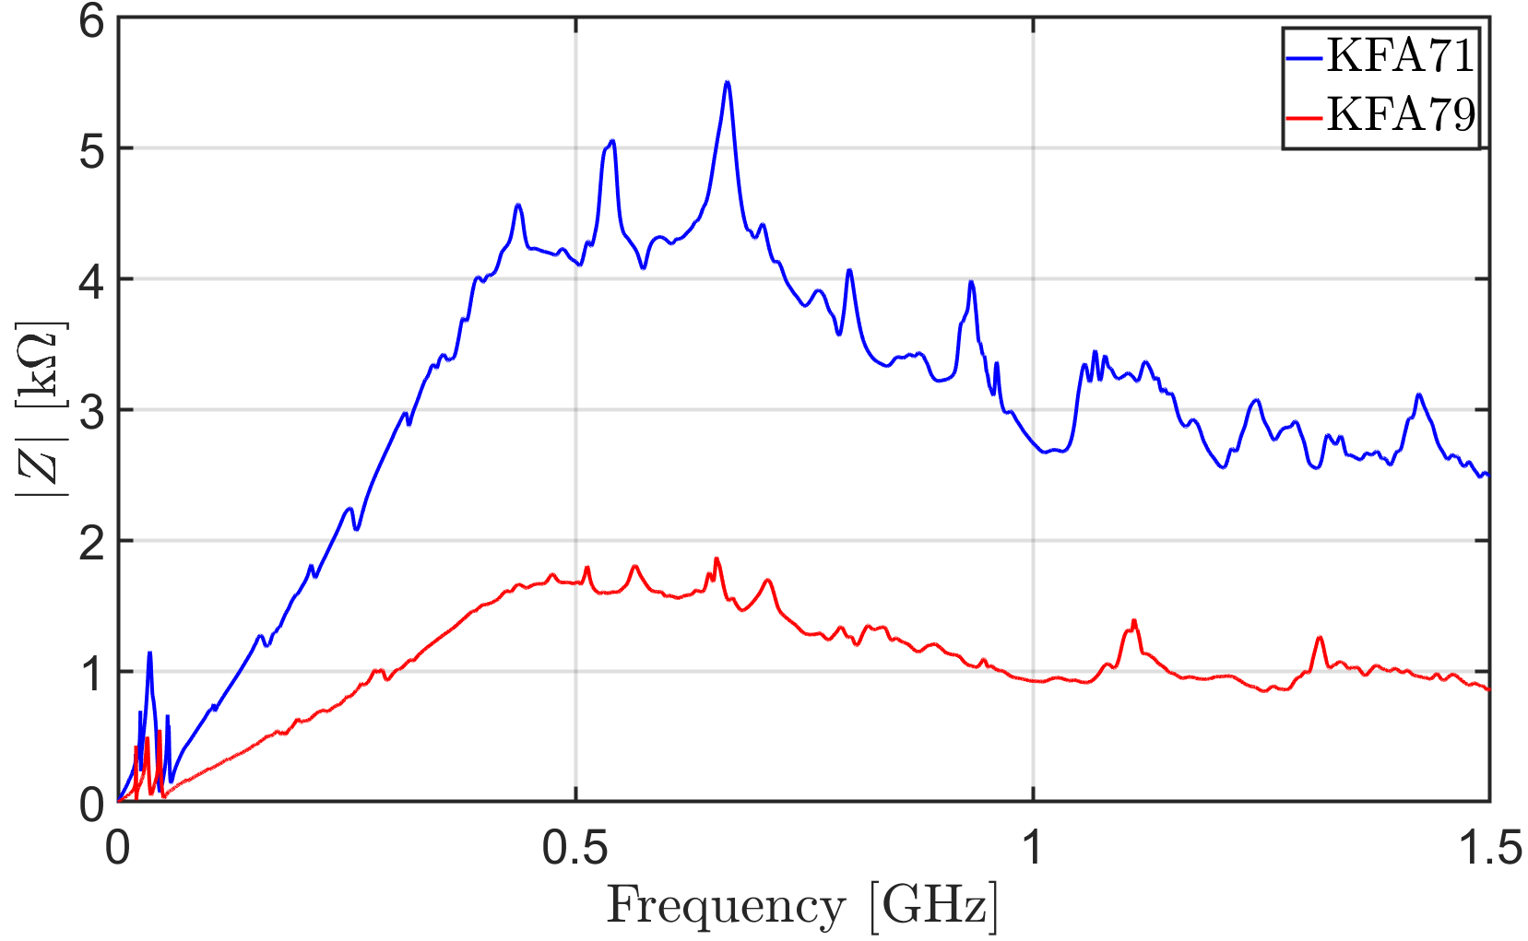
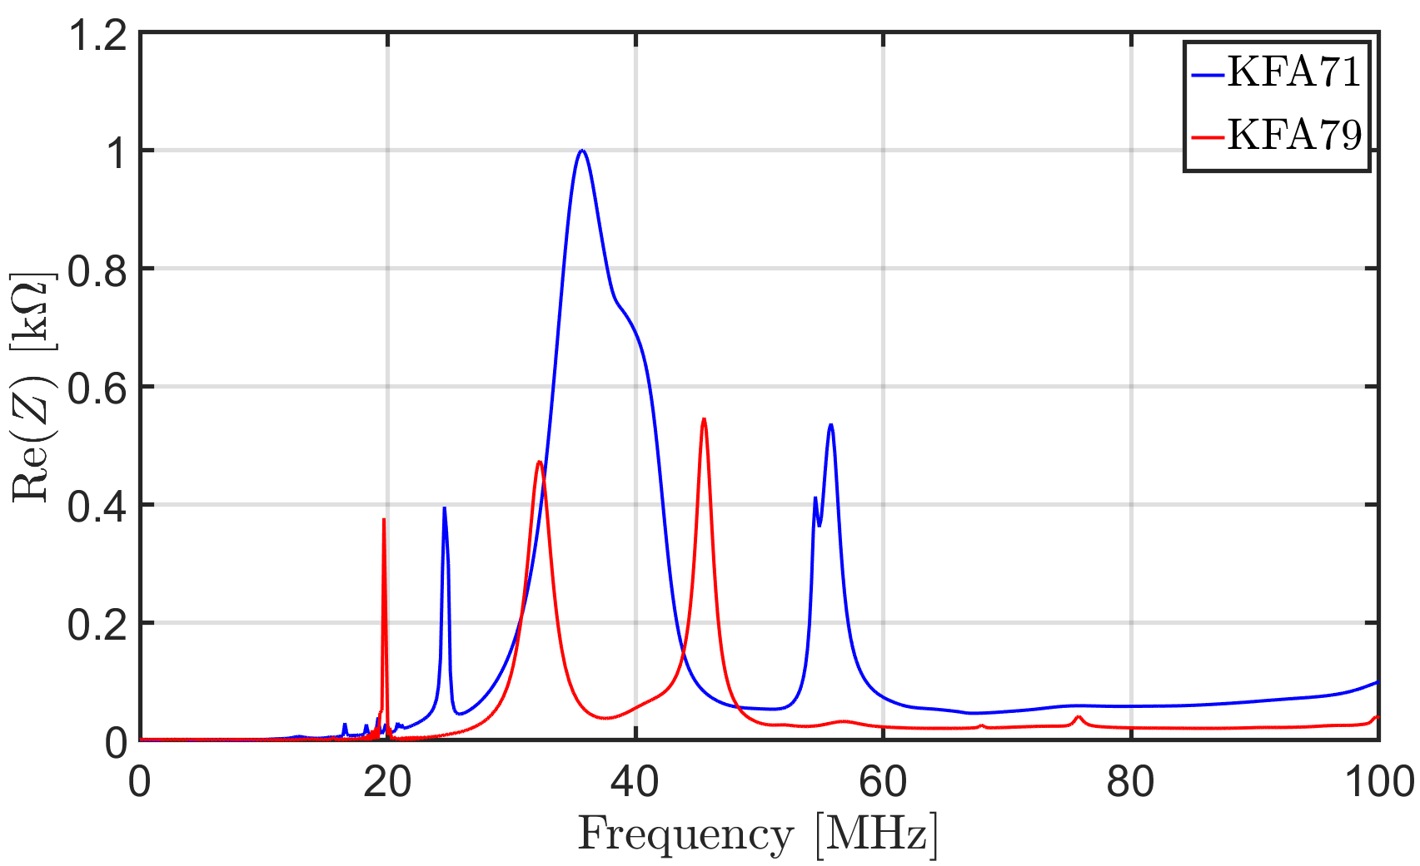
Wakefield simulations
PEC boundaries along x and y-axis, equivalent to short circuit
Open boundary along beam axis
Three impedance contributions:
Broadband
Low frequency
Higher frequency
→ Ferrite drives the broadband behavior as described by Tsutsui*
* H. Tsutsui, “Some simplified models of ferrite kicker magnet for calculation of longitudinal coupling impedance”, Tech. Rep. CERN-SL-2000-004-AP, CERN, 2000

Slide 11
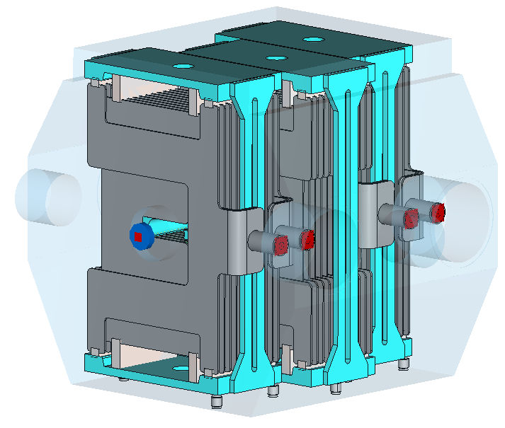
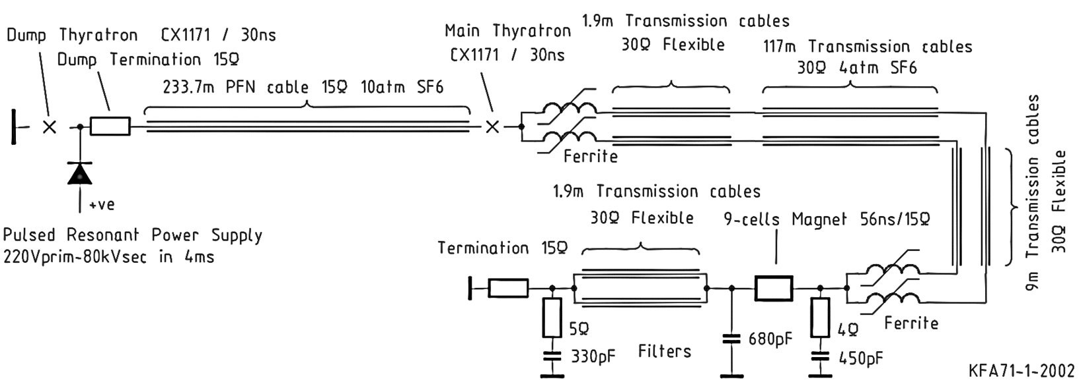
Adding cable terminations
Each magnet module is connected to the power circuit by means of very long cables ➔ impedance model of the component must include the kicker as it is in the actual configuration in the machine.
KFA79
Circuit schematic of a magnet module unit*
Input connector → cables terminated on open circuit when the main switch in off-state, i.e. when not extracting from the PS
Output connector →
Connecting cables terminated on 15 Ω
* L. Sermeus et al., “The kicker systems for the PS Multi-turn Extraction”, No. CERN-ATS-2010-140, 2010

Slide 12
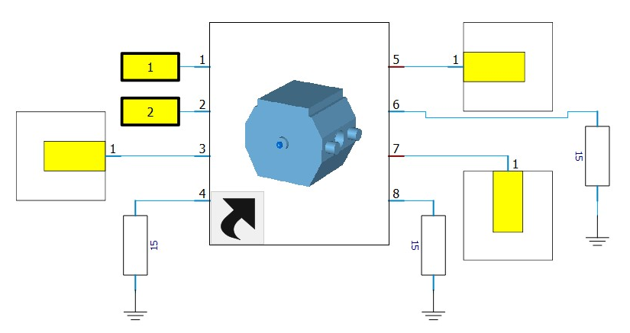
Simulating wire measurement
Frequency domain simulation (FD) to mimic single stretched wire measurements setup → including in the 3D model matching resistors and copper wire
Treating power connectors as waveguide ports ➔ 6 + 2 (kicker input/output) ports component
Combined schematic simulation: lumped element circuit connected to a 3D electromagnetic FD simulation
Three different configurations simulated:
    Input power connectors always terminated on ideal open transmission line
    Output power connector terminations considered as:
    ideal open transmission line
    short circuit
    15 Ω resistor (actual situation)

Slide 13
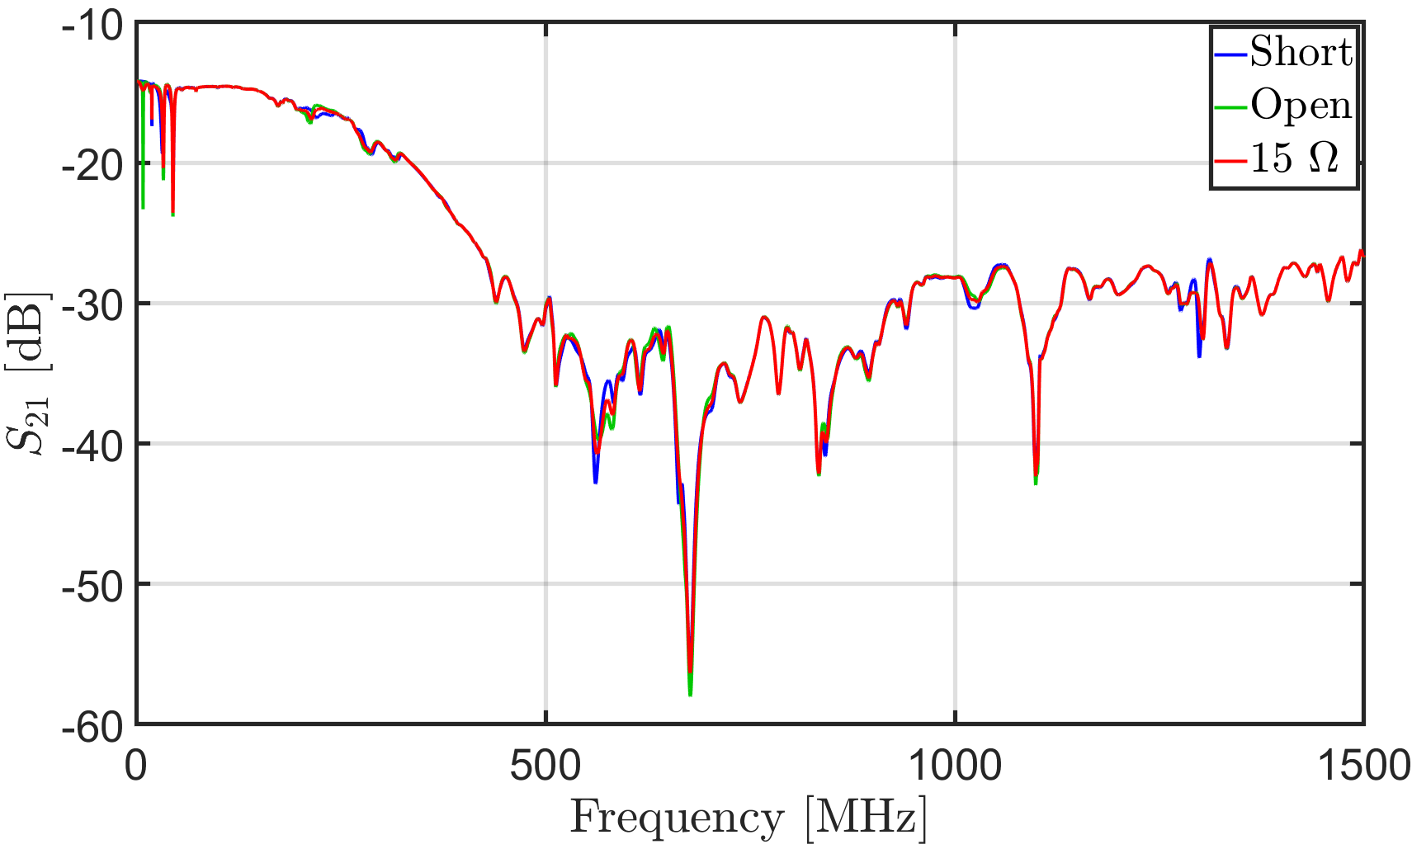
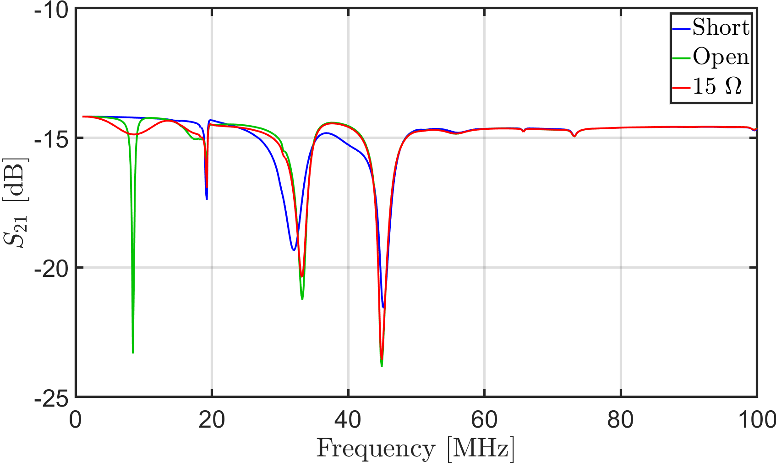
Effect of cable terminations
The transmission parameter, $S_{21}$, is of interest because it directly gives information on the longitudinal beam coupling impedance
Cable terminations highly influence impedance behaviour in the low frequency range

Slide 14
Outline
Introduction
        Longitudinal beam coupling impedance and implications on beam dynamics
        Motivation of the study
        The main extraction kickers in the CERN Proton Synchrotron
Electromagnetic simulations
        Wakefield simulation
        Frequency domain and schematic simulations
Radiofrequency measurements
        Single stretched wire measurements
Beam impedance mitigation
        Location of the critical resonances
        Mitigation strategy
Impedance of other components in the PS complex
Conclusions and outlook

Slide 15
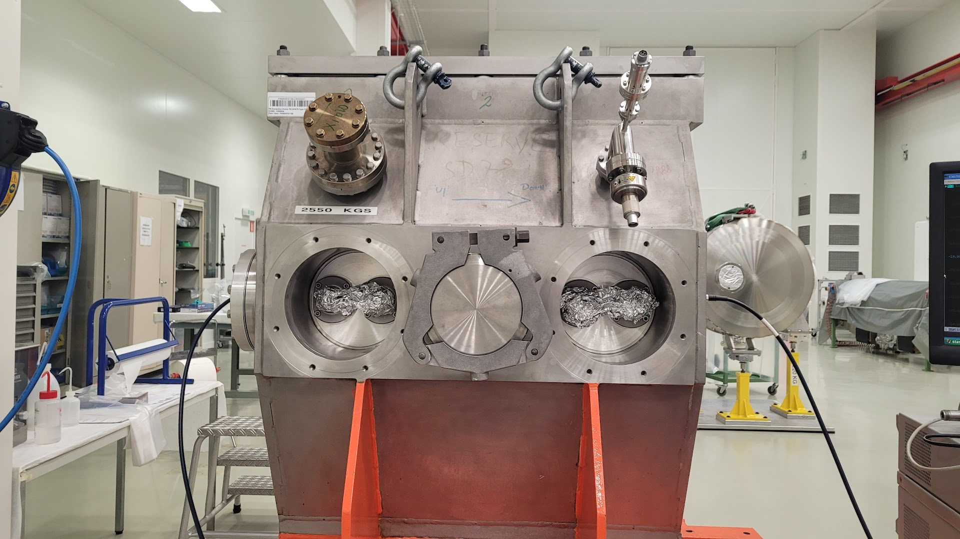
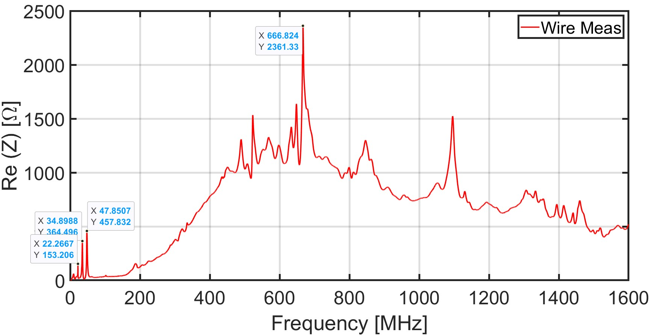
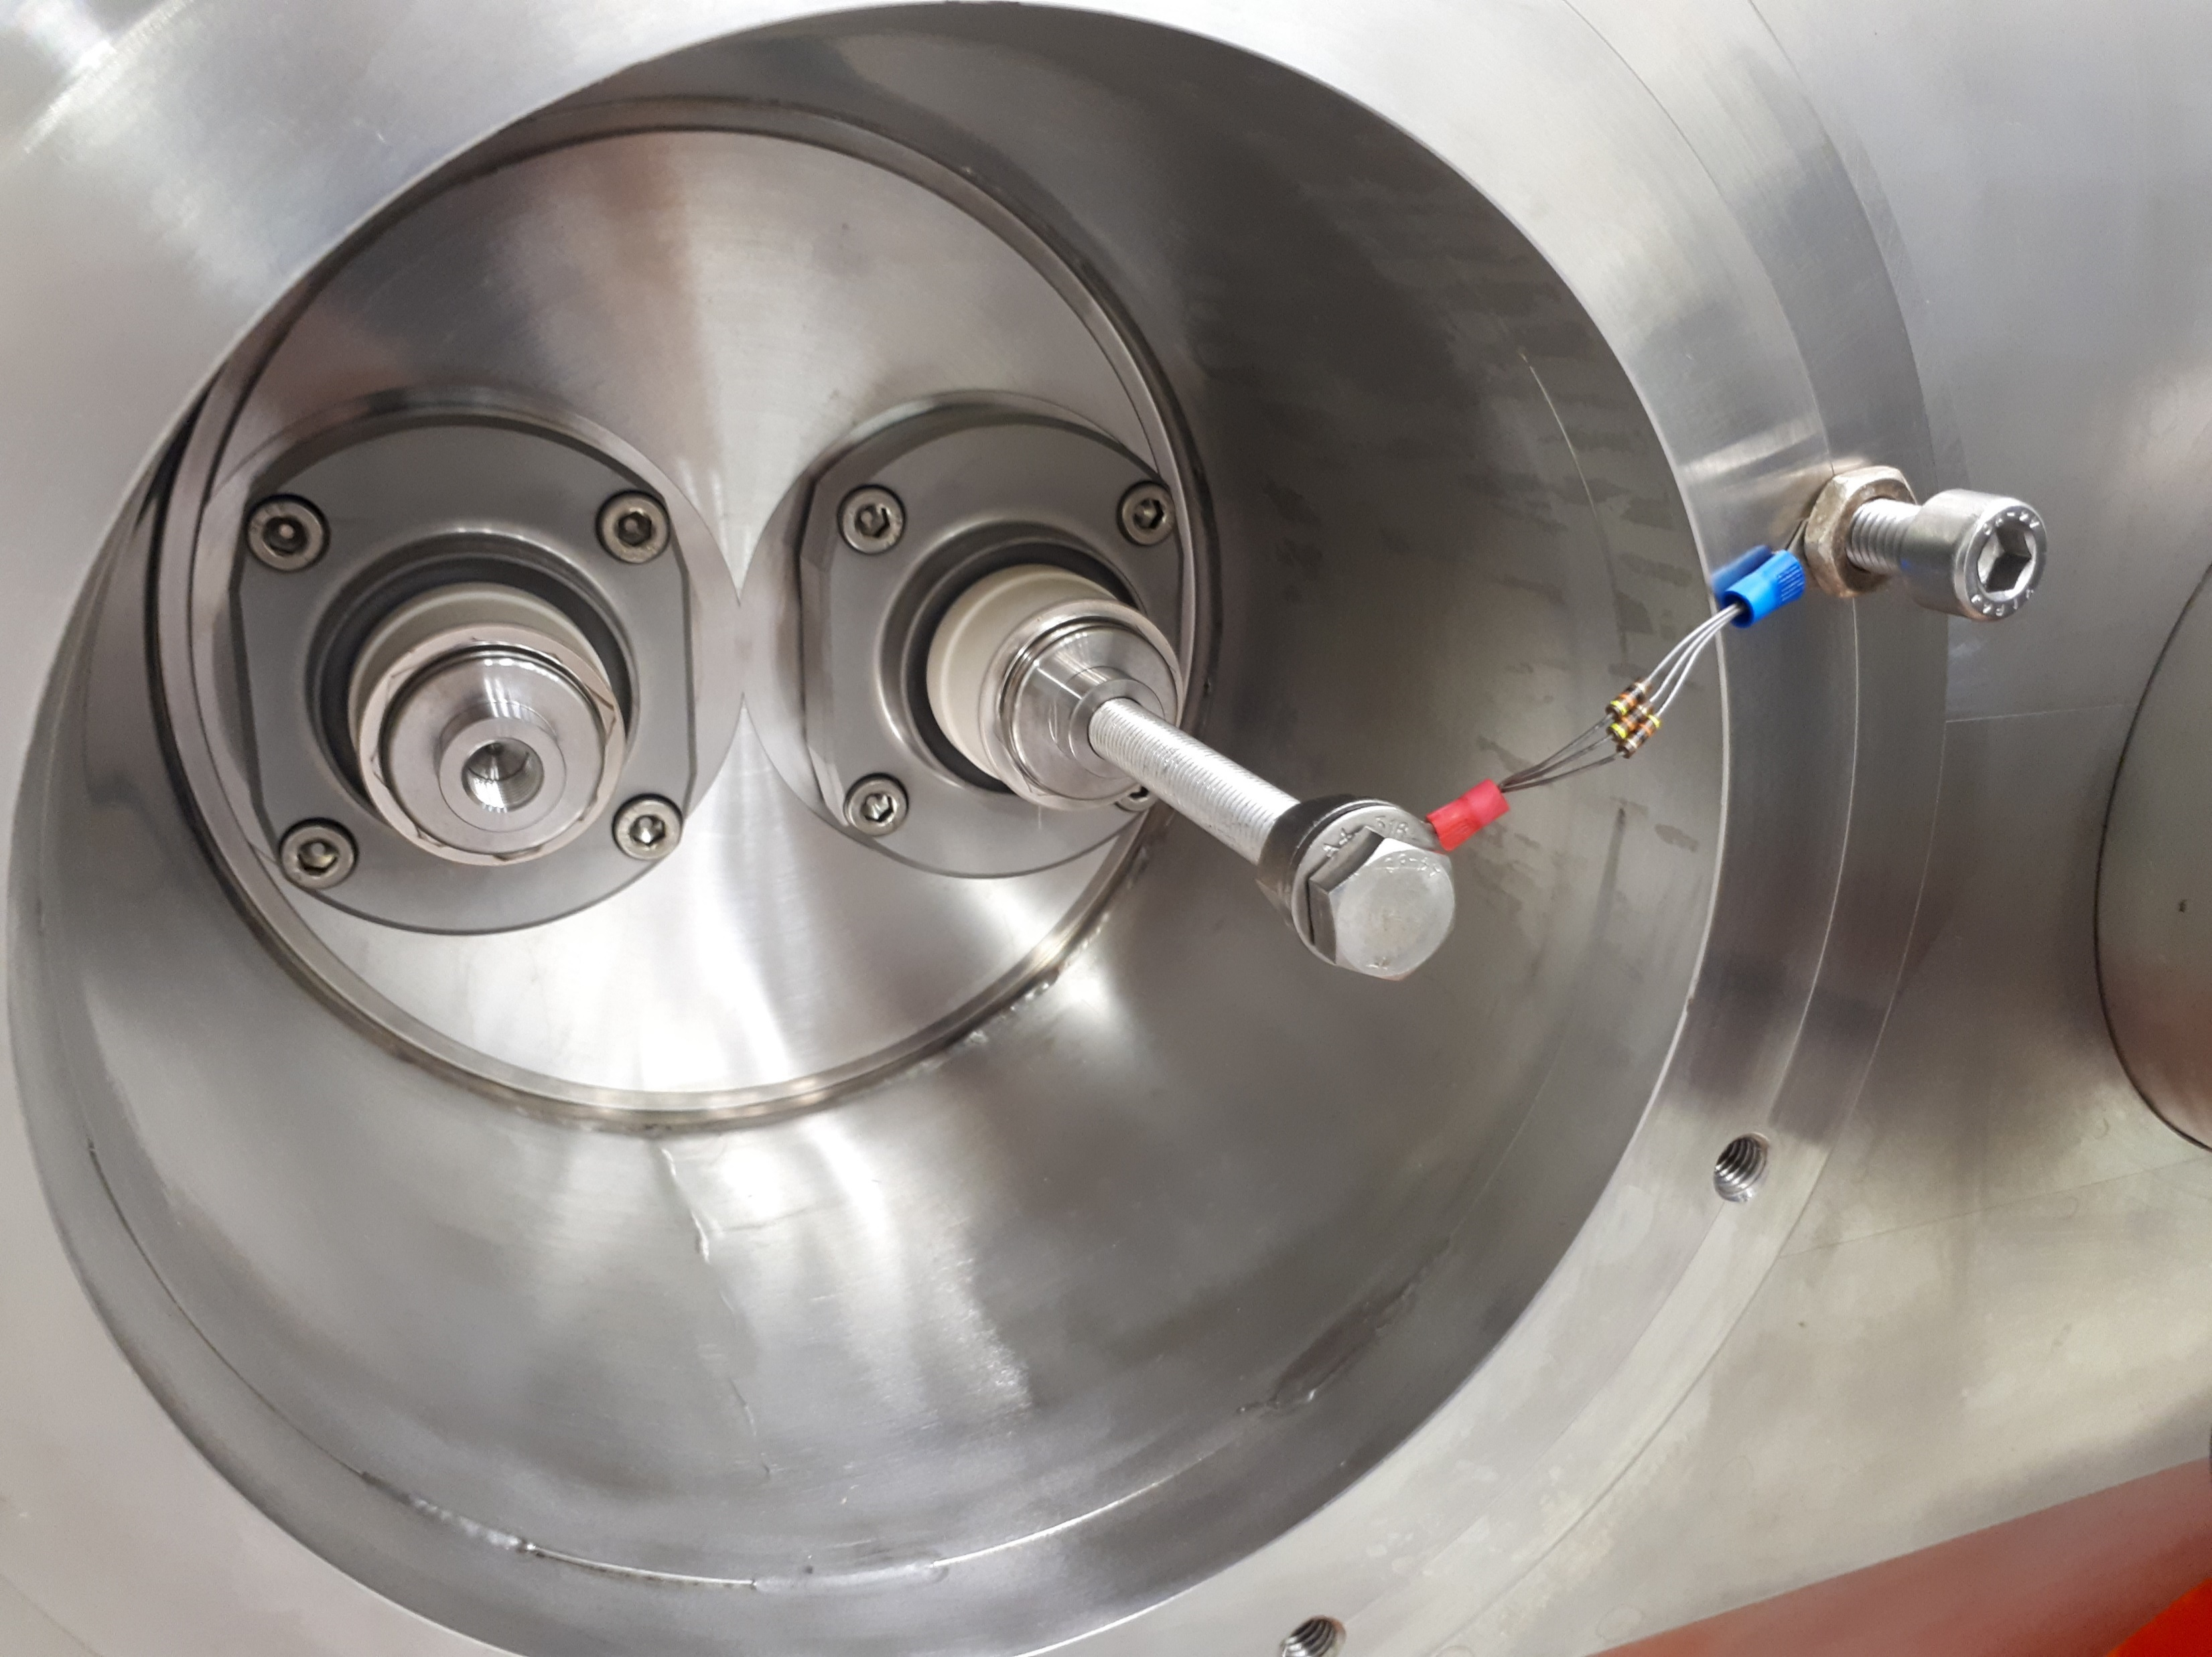


Stretched wire measurements
Wire measurements performed on KFA79 with 15 Ω resistor at the output power connector and input connector undefined open (effect of cable terminations at low frequency confirmed – see spare slides)
Matching resistor $R = 220 Ω$
Stretched wire $d = 0.5 mm$
$$Z=−2{∙Z}_{L}\log\left(\frac{S_{21}}{S_{21ref}}\right)$$
3 peaks in the low frequency range:
    22.3 MHz
    34.9 MHz
    47.8 MHz
High frequency peak at 667 MHz
Notes:
appendix

Slide 16
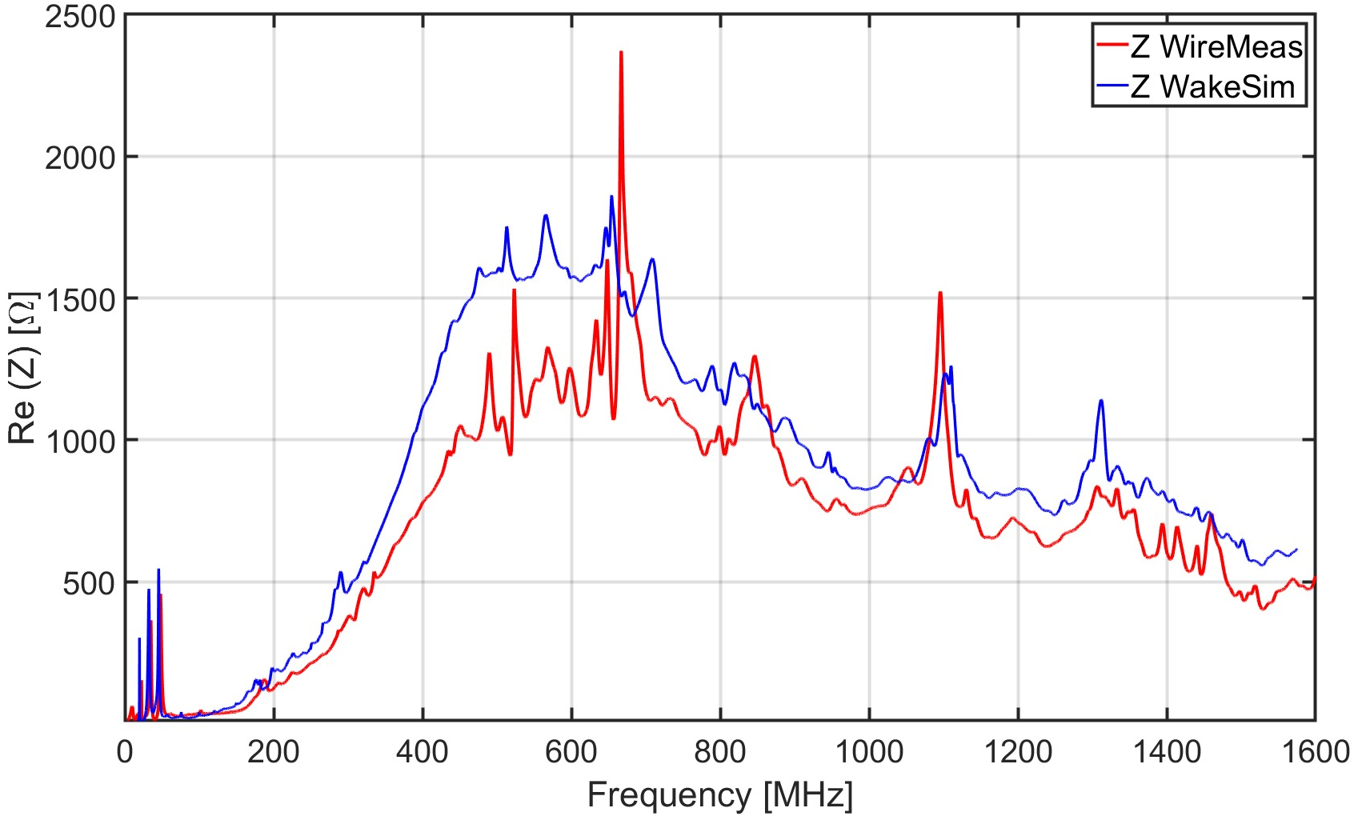
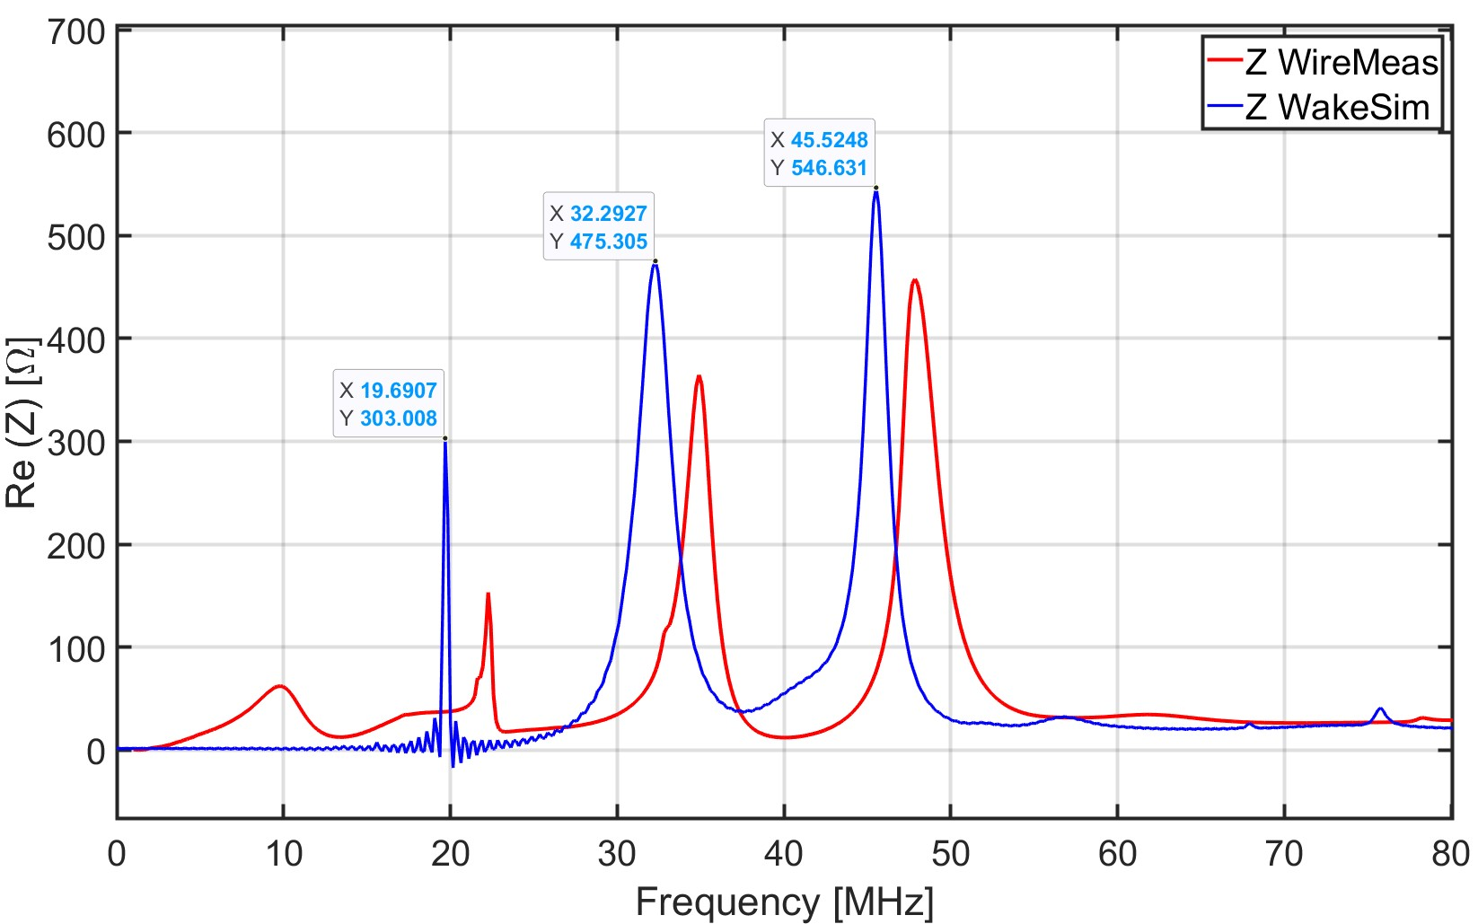
Wire measurements vs. wakefield simulation
Very good agreement between measured longitudinal impedance and simulated one:
Three low frequency resonances (within 2 MHz from the measured ones)
Main high frequency resonance around 660 MHz
Notes:
Different boundary conditions between Wakefield simulations and wire measurements. The wire may detune the resonant peak and it may modify the shunt impedance value. TEM configuration
Discrepancy may be due to different losses in real component and definition of the mesh

Slide 17
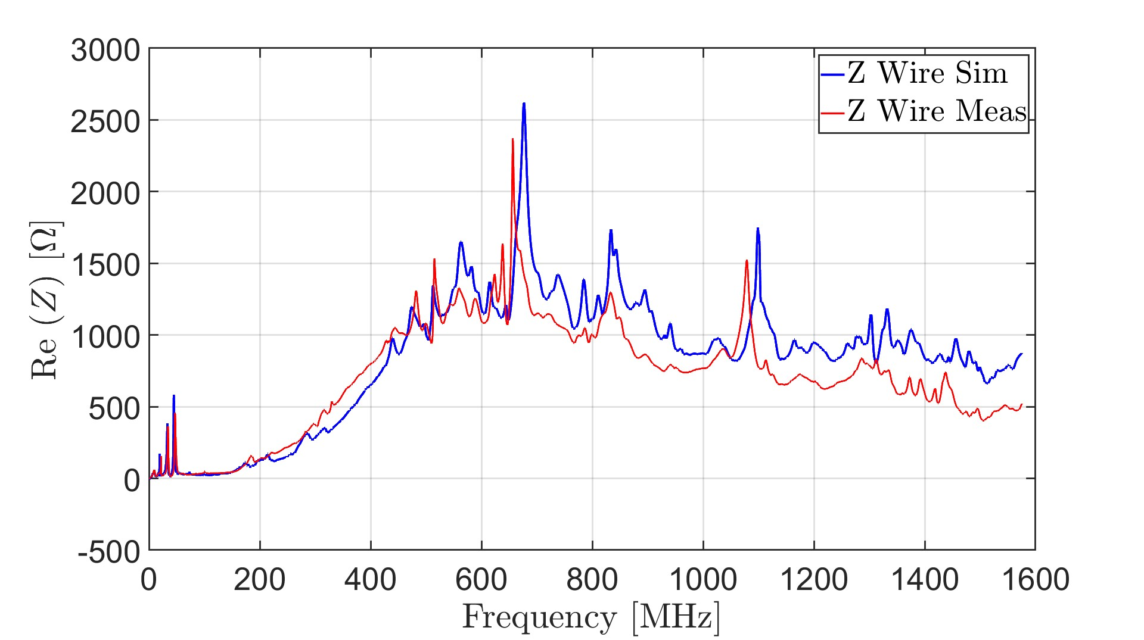
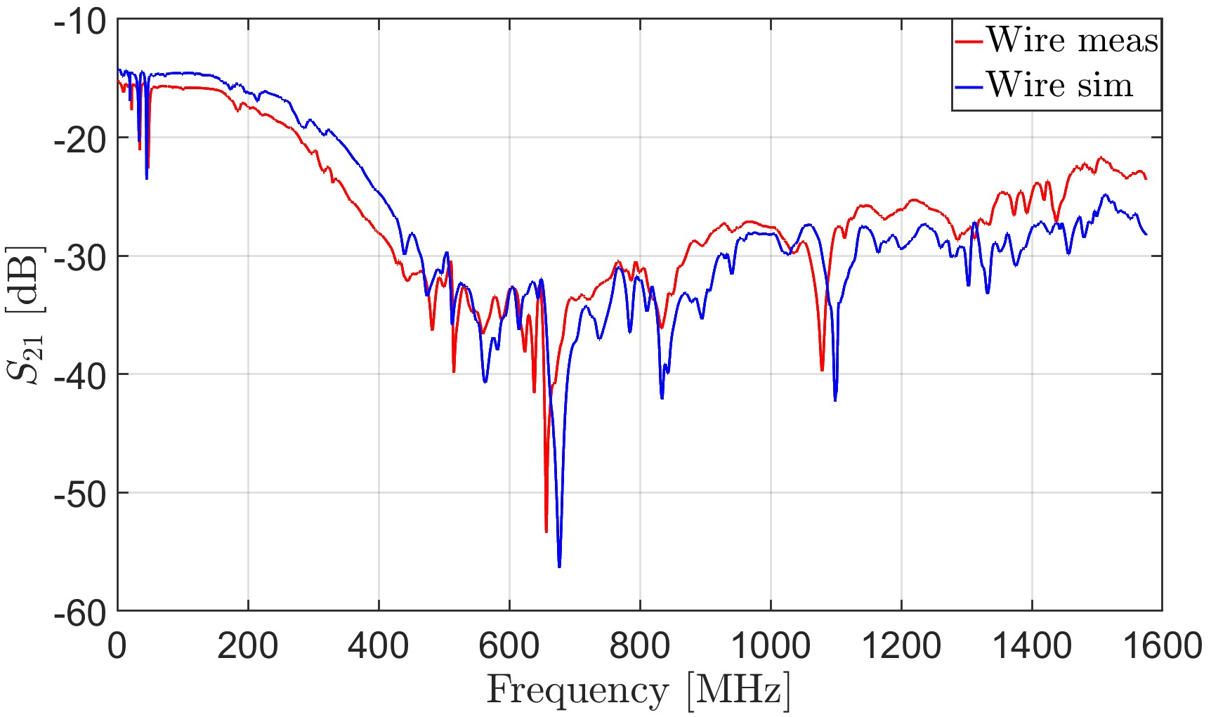
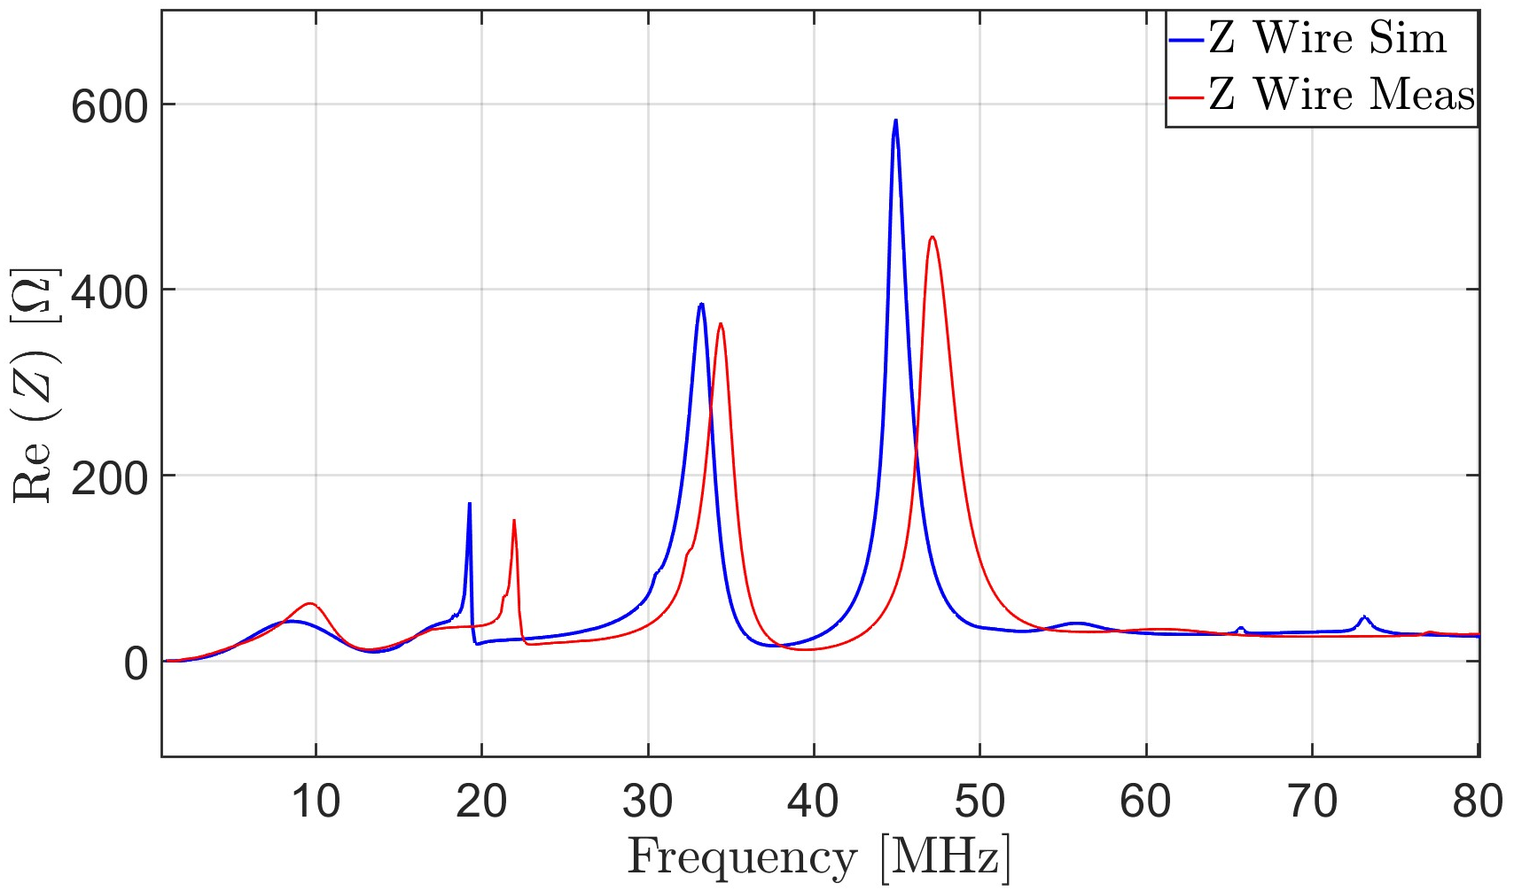
Wire measurements vs. wire simulations

Slide 18
Outline
Introduction
        Longitudinal beam coupling impedance and implications on beam dynamics
        Motivation of the study
        The main extraction kickers in the CERN Proton Synchrotron
Electromagnetic calculations
        Wakefield simulation
        Frequency domain and schematic simulations
Radiofrequency measurements
        Single stretched wire measurements
Beam impedance mitigation
        Location of the critical resonances
        Mitigation strategy
Impedance of other components in the PS complex
Conclusions and outlook

Slide 19
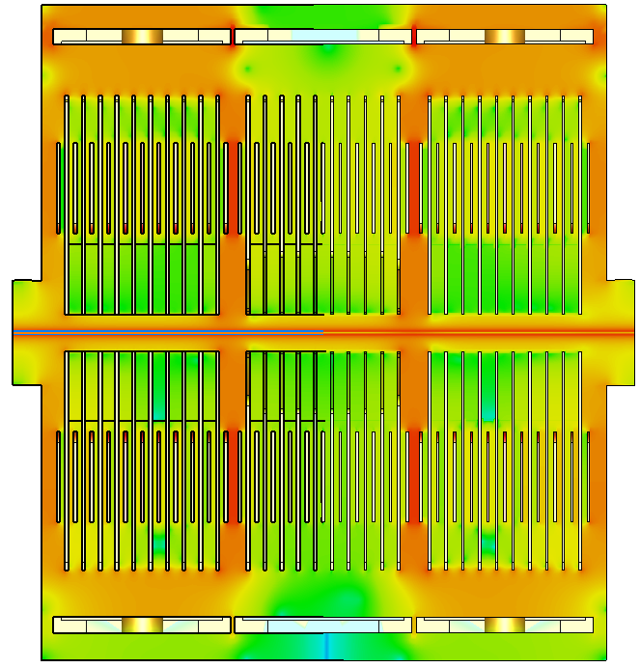
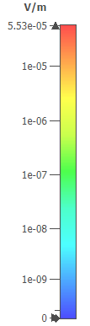
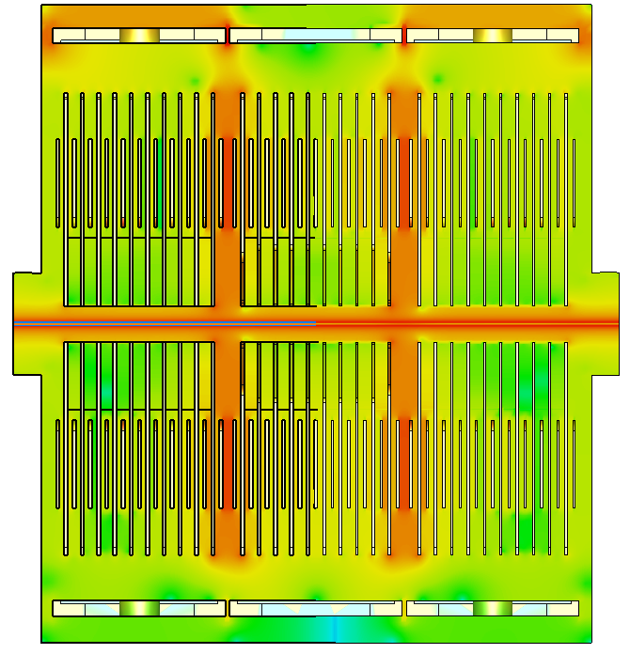

Location of the resonances
E-field monitor 19.69 MHz - Side view
E-field monitor 32.29 MHz - Side view

Slide 20
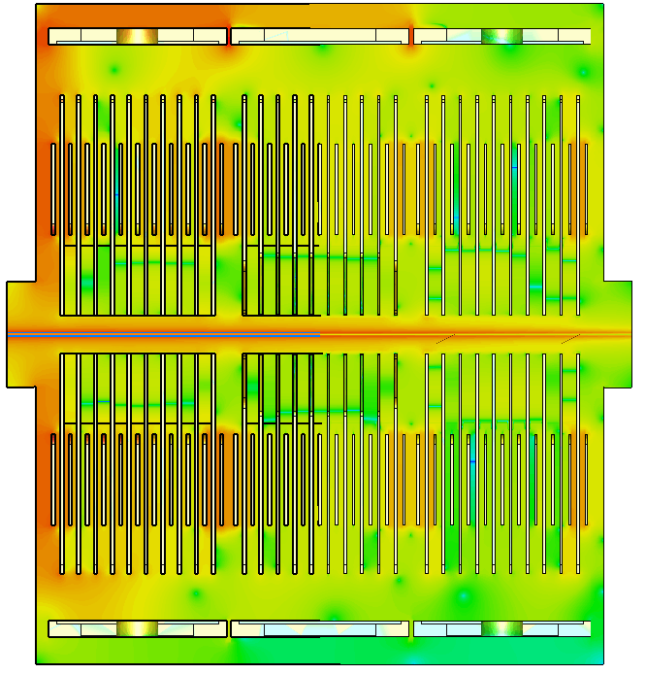

Location of the resonances
E-field monitor 45.5 MHz – Side view
How can we mitigate the unwanted contributions?
Idea: to create a conductive path for the induced currents by connecting all the ground contacts (plates of adiacent modules and modules-vacuum tank)

Slide 21
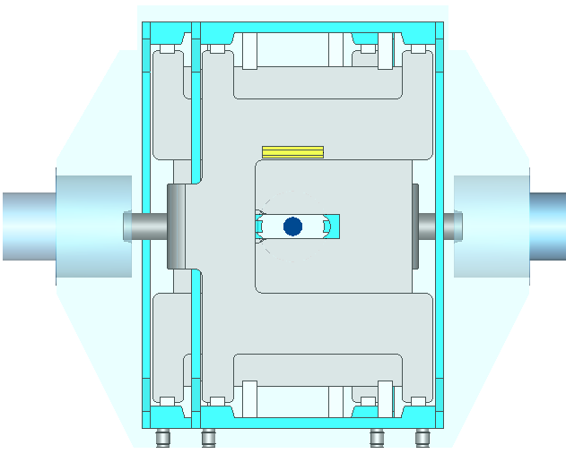
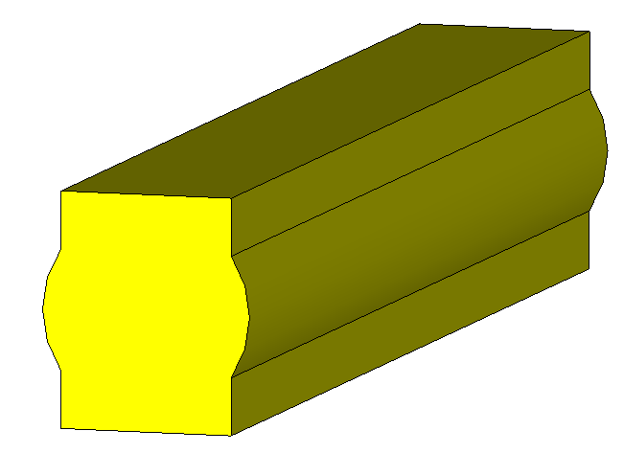
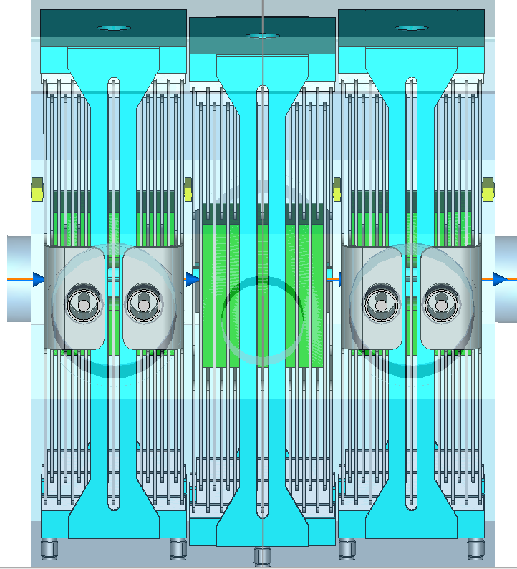
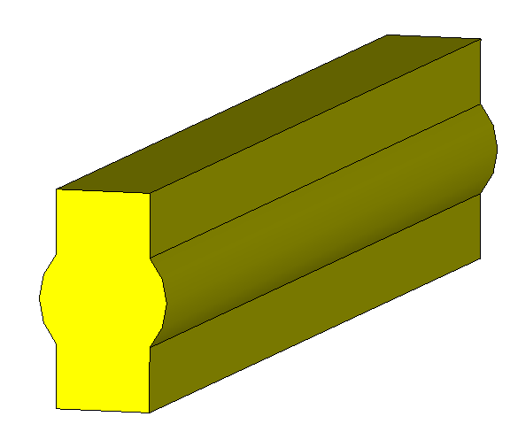
Adding transitions pieces
130mm
25mm
18.5mm
~12mm
22.5mm
130mm
Copper blocks are placed symmetrically respect to the x-axis (and respect to the center of the beam)
The corners and edges of the blocks must be rounded in the mechanical design
25mm
11mm
~10mm
15mm

Slide 22
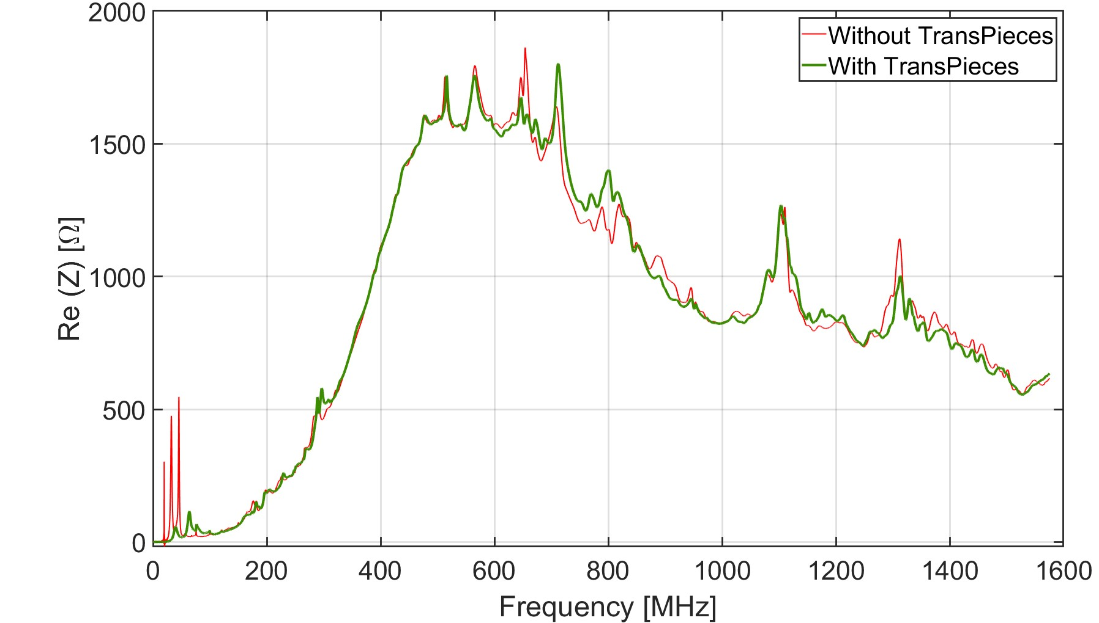
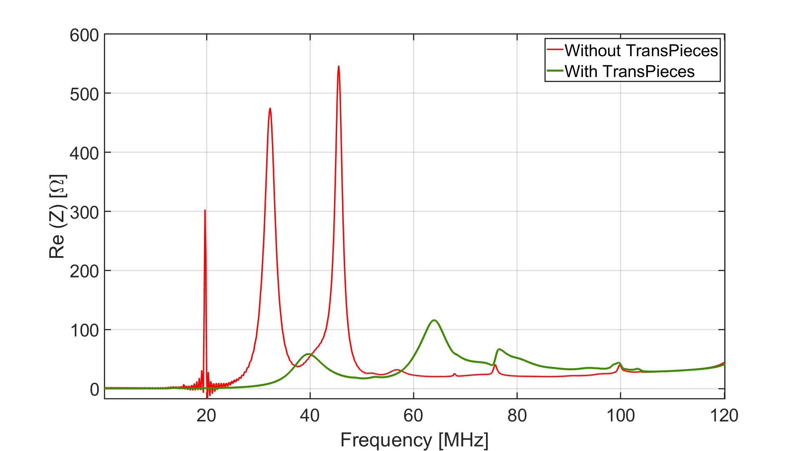
Impedance mitigation

Slide 23
Outline
Introduction
        Longitudinal beam coupling impedance and implications on beam dynamics
        Motivation of the study
        The main extraction kickers in the CERN Proton Synchrotron
Electromagnetic calculations
        Wakefield simulation
        Frequency domain and schematic simulations
Radiofrequency measurements
        Single stretched wire measurements
Beam impedance mitigation
        Location of the critical resonances
        Mitigation strategy
Impedance of other components in the PS complex
Conclusions and outlook

Slide 24
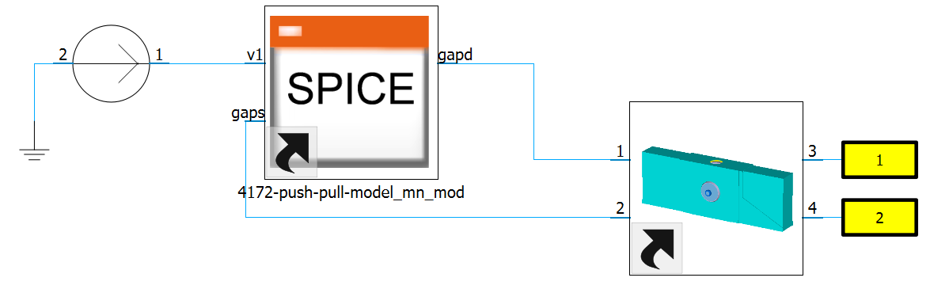
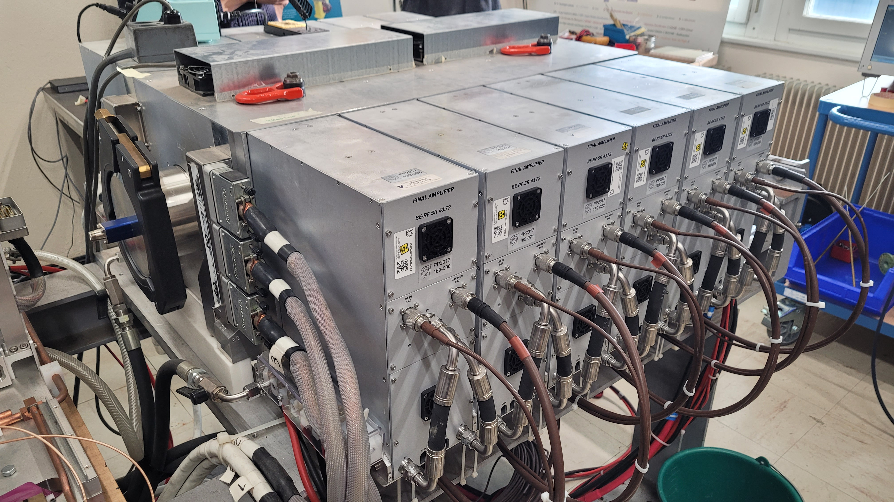
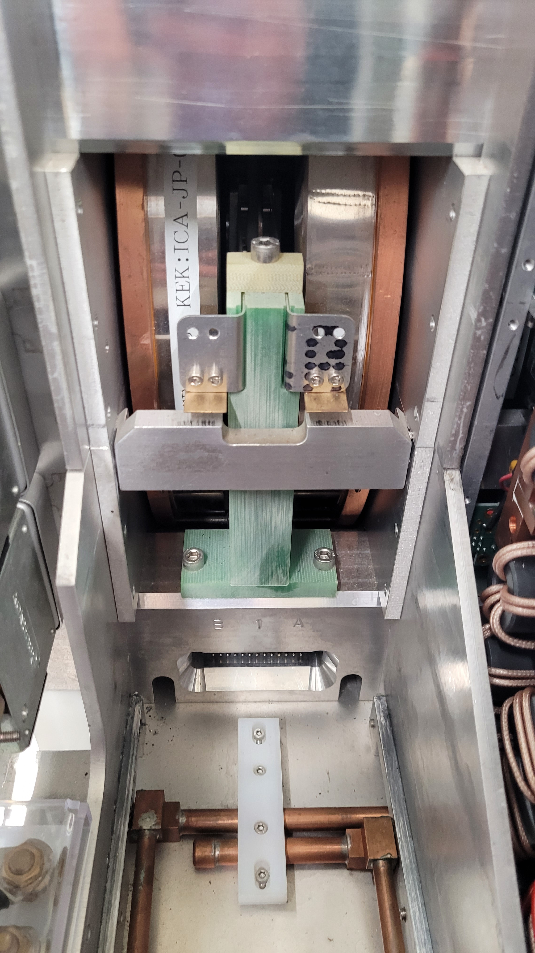
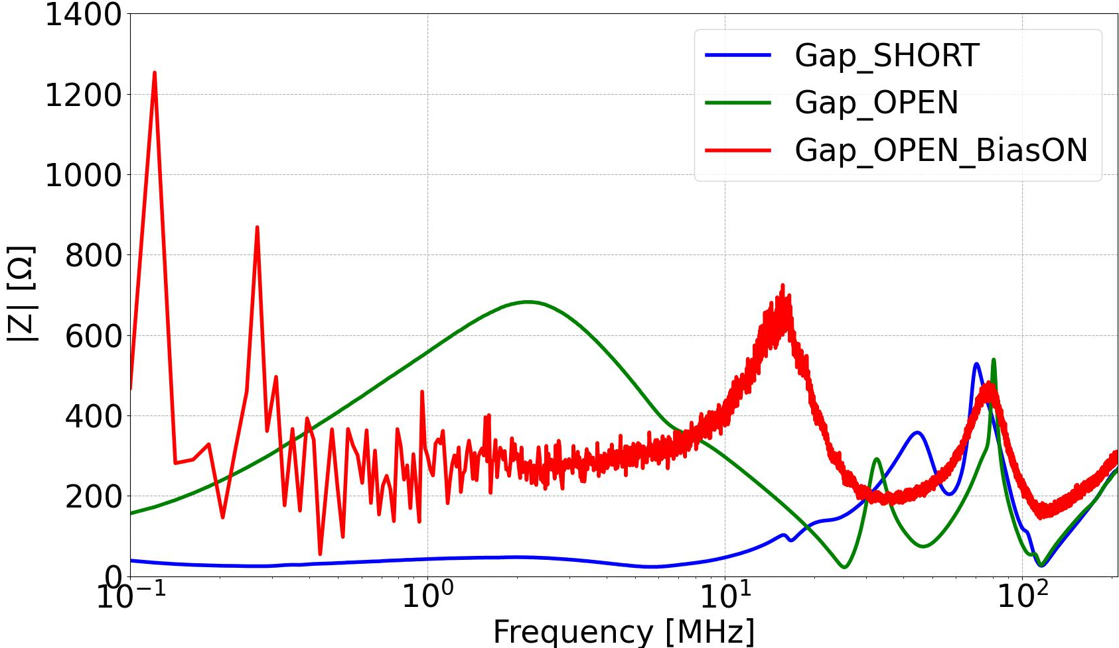



Impedance of PSB Finemet cavities
GOAL: to build an EM model of Finemet cavity + amplifier system, matching with measurements, for further impedance investigations.
Wire measurements – single cell result
1-cell model

Slide 25




Impedance of PS septa magnets
Simplified SMH16
EM simulations and RF measurements of upgraded septa magnets to verify their compliance with impedance requirements before installation in the PS.
PS 80 MHz fast ferrite tuner
GOAL: fast frequency shift of about 200 kHz on the fundamental mode, to allow a fast switching between proton and ion frequencies.
→ Simulations, radiofrequency and material permeability measurements to demonstrate the working principle of the instrument.
The use of the fast tuner can allow the number of cavities to be reduced from three to two in the PS ➔ impedance reduction
Courtesy of C. Vollinger

Slide 26
Outline
Introduction
        Longitudinal beam coupling impedance and implications on beam dynamics
        Motivation of the study
        The main extraction kickers in the CERN Proton Synchrotron
Electromagnetic calculations
        Wakefield simulation
        Frequency domain and schematic simulations
Radiofrequency measurements
        Single stretched wire measurements
Beam impedance mitigation
        Location of the critical resonances
        Mitigation strategy
Impedance of other components in the PS complex
Conclusions

Slide 27
Conclusions
The longitudinal beam coupling impedance results for both PS extraction kickers have been presented and critical resonances were discussed.
New 3D geometry benchmarked by very good agreement between measurements and simulations. The transmission cable terminations highly impacts the beam coupling impedance.
Transition pieces are confirmed to be beneficial in mitigating low frequency resonances → Mechanical implementation of transition pieces soon and measurements can be performed again afterwards.
Impedance model of the kickers and other upgraded PS components will serve to update the PS impedance model ➔ to have reliable beam dynamics simulations and instabilities studies.
If simulations and measurements the fast ferrite tuner would proof its working principle, this would allow a big improvement in the impedance reduction with the elimination of one out of three 80 MHz cavities.
Notes:
KFA71 cannot be measured

Slide 28
Spare slides

Slide 29


Coupled-bunch instabilities threshold
Shunt impedance threshold for coupled-bunch instabilities
Courtesy of A. Lasheen

Slide 30



Wire measurements – HV hookups termination
Wire measurements performed before including 15 Ω resistor at HV hookups output – HV hookups undefined open
Notes:
appendix

Slide 31


E-field monitor 654 MHz – Side view

Slide 32

Mitigation strategy – resonance location
KFA71
E-field monitor at 35.7 MHz
Mitigation strategy: M. Neroni et al., “Characterization of the longitudinal beam coupling impedance and mitigation strategy for the fast extraction kicker KFA79 in the CERN PS”, in Proc. 14th International Particle Accelerators Conference, 2023

Slide 33


Adding transition pieces
Connecting ground contacts (module-module, module-tank) → copper rods and bars
Notes:
Sufficient to see impact on the beam impedance from simulation

Slide 34


Adding transition pieces
Significant improvement

Slide 35




Field monitors with transition pieces
E-field monitor 64 MHz - Side view
E-field monitor 712 MHz - Side view

Slide 36

Implementation of transition pieces
Courtesy of P. Trubacova
Not possible to implement the same transitions which are in the KFA45

Slide 37

Implementation of transition pieces
Courtesy of P. Trubacova
5mm
15 mm

