Slide 1
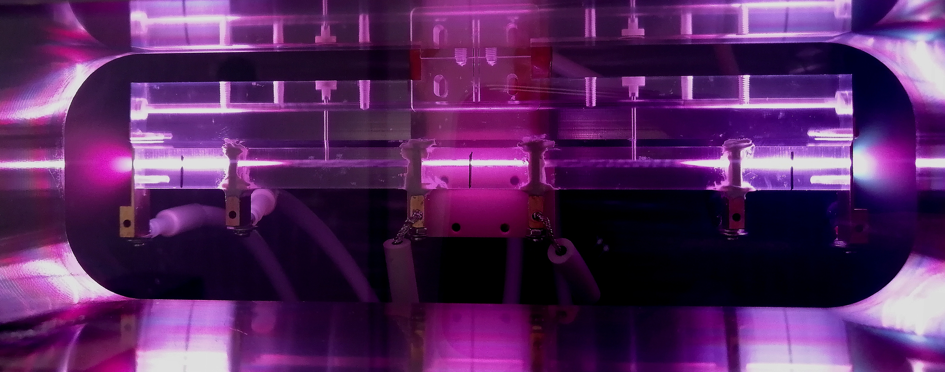




Experimental and theoretical development of plasma sources for plasma-based particle accelerators
Lucio Crincoli | PhD in Accelerator Physics, Sapienza Università di Roma
Supervisor: Prof. Massimo Ferrario
Co-supervisor: Dott. Angelo Biagioni
Candidate: Dott. Lucio Crincoli

Slide 2
Outline
Introduction
Plasma Wakefield acceleration
Experimental and numerical study of capillary geometry
Plasma density measurements with Stark broadening method
Neutral gas dynamics with OpenFOAM
Segmented capillary for m-scale plasma sources
Integrated capillary for staged focusing-acceleration
Plasma discharge capillaries
Conclusions
Future perspectives
Experimental setup for capillary testing at Plasma_Lab (LNF-INFN)
Novel schemes for long sources and staged acceleration
Lucio Crincoli | PhD in Accelerator Physics, Sapienza Università di Roma

Slide 3
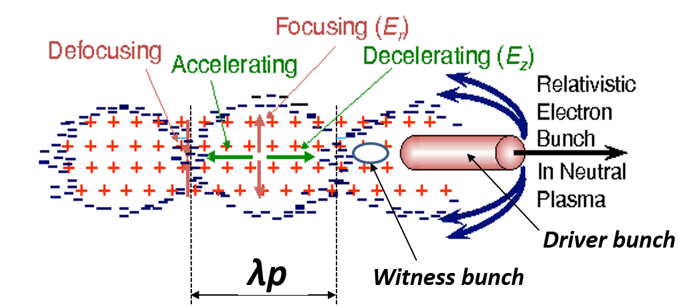
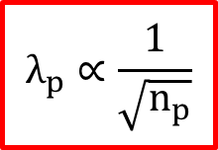
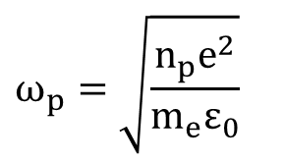
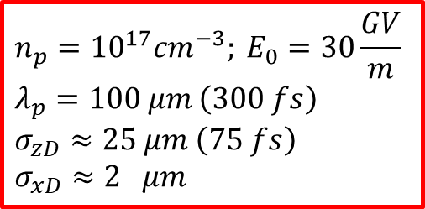
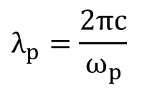

Plasma Wakefield acceleration
Introduction
Pre-formed neutral plasma channel
Density modulation excited by a driver beam (laser pulse or particle bunch)
Bubble shaped structure with GV/m accelerating fields in the driver wake
Plasma density dependence
Density uniformity required for witness beam acceleration
$$E_{acc}$$
$$n_{p}=10^{17}cm^{−3}; E_{0}=30\frac{GV}{m} \\ λ_{p}=100 μm \left(300 fs\right) \\ σ_{zD}≈25 μm \left(75 fs\right)$$
$$σ_{xD}≈2 μm$$
$$ω_{p}=\sqrt{\frac{n_{p}e^{2}}{m_{e}ε_{0}}}$$
$$λ_{p}∝\frac{1}{\sqrt{n_{p}}}$$
$$λ_{p}=\frac{2πc}{ω_{p}}$$
Lucio Crincoli | PhD in Accelerator Physics, Sapienza Università di Roma

Slide 4
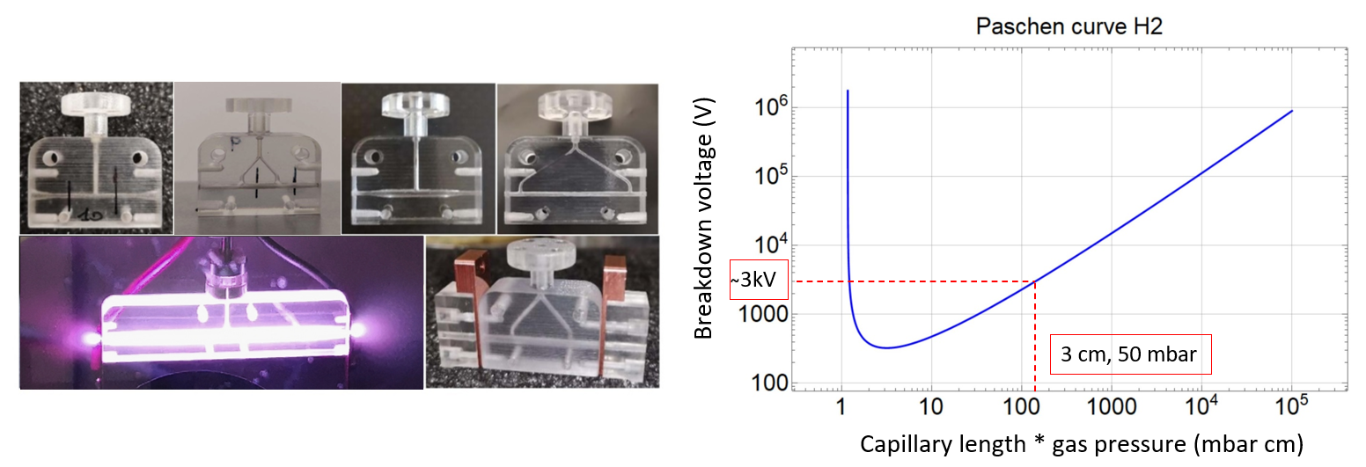
Gas-filled discharge capillaries
Introduction
Requirements:
Density uniformity
Shot to shot stability
Reproducibility
Longevity
Design:
Geometry
Plasma formation techniques
Materials
Lucio Crincoli | PhD in Accelerator Physics, Sapienza Università di Roma

Slide 5
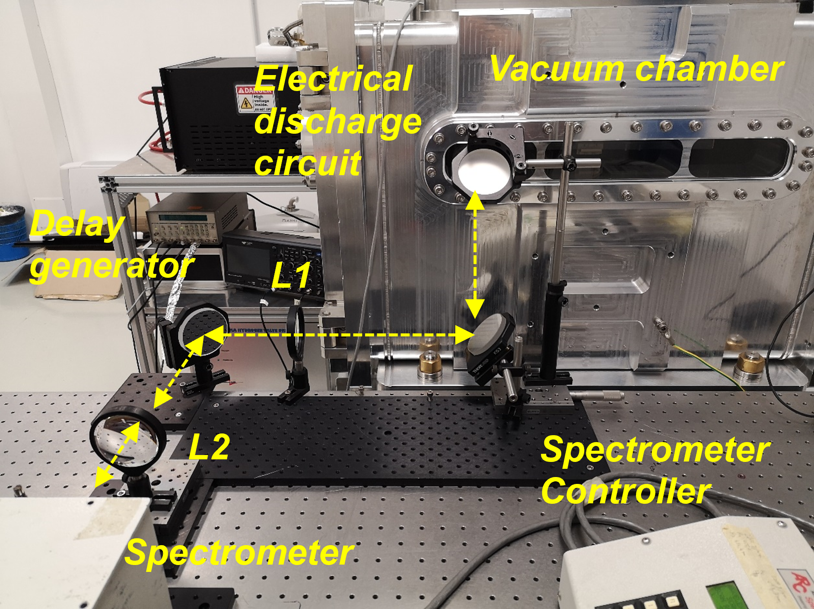
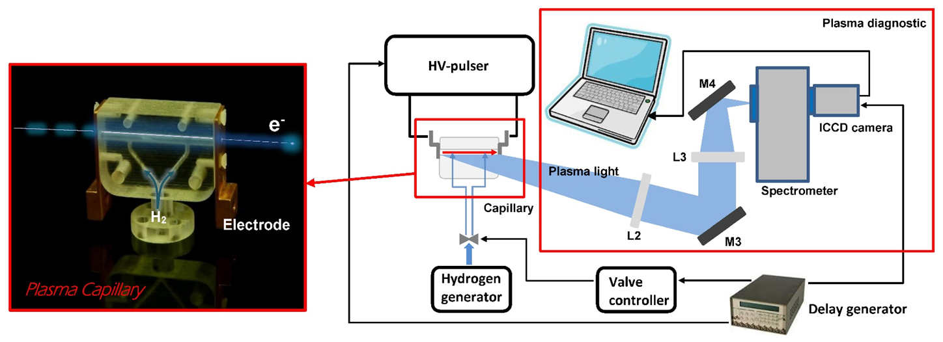
Plasma_Lab experimental setup
Introduction
Vacuum chamber
  10⁻⁶ mbar, 3 primary scroll pumps, 1 turbo-molecular pump
Gas injection system
  H₂, N₂, Ar
  10-50 mbar at 1 Hz
Electrical discharge circuit
  HV generator and pulser
  5-20 kV us-short pulses
Delay generator
Diagnostic system
  Optical line
  Imaging spectrometer
  ICCD camera
Lucio Crincoli | PhD in Accelerator Physics, Sapienza Università di Roma

Slide 6
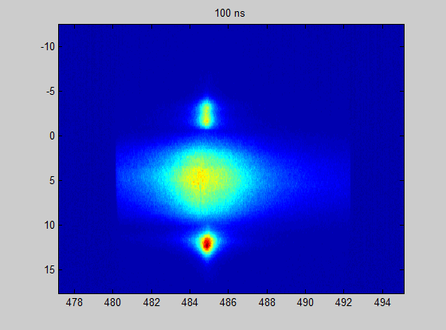
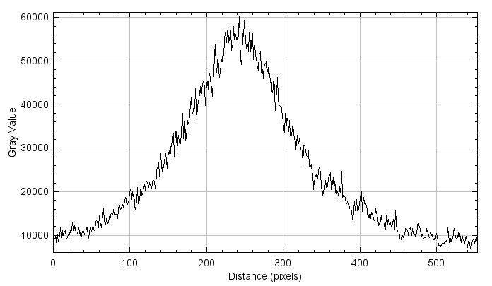
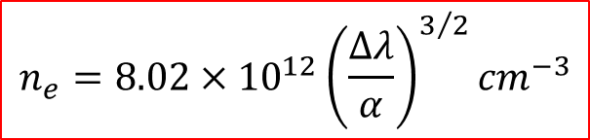

Stark broadening method
Introduction
Position (mm)
Balmer β line
The spectrometer acquires hydrogen spectral lines of Balmer series
Stark effect: correlation between plasma density and hydrogen spectral linewidth
Temporal and spatial resolved measurements of plasma density
Δλ
Capillary
Electrode
shadow
Plasma
channel
Plasma plume
λ (nm)
$$∆λ$$
$$n_{e}=8.02×{10}^{12}{\left(\frac{∆λ}{α}\right)}^{3/2}{cm}^{−3}$$
Lucio Crincoli | PhD in Accelerator Physics, Sapienza Università di Roma

Slide 7
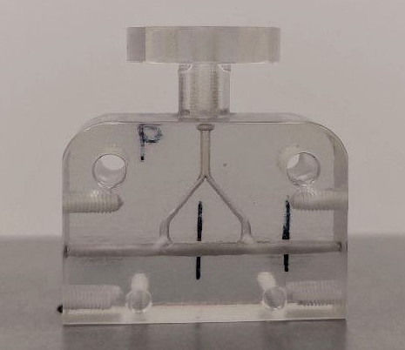
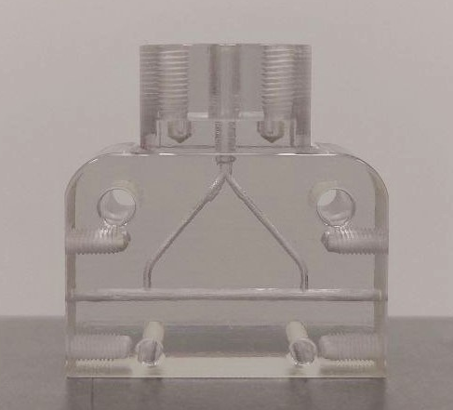
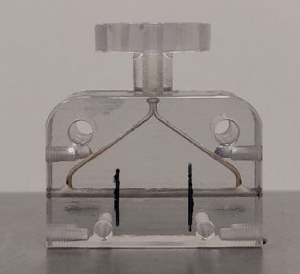
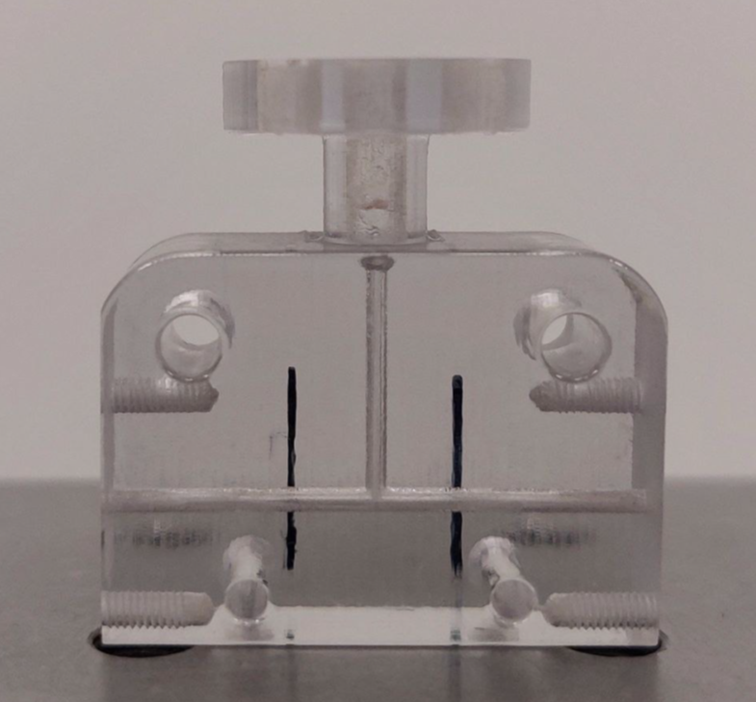
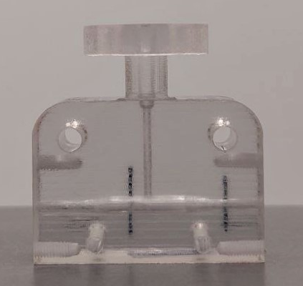
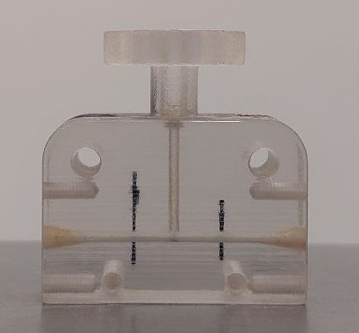
Geometrical design of capillaries
Experimental and numerical study of capillary geometry
3 cm long channel
1 mm diameter
2 inlets:
  Uniform channel
  Different distance between inlets (9, 15 and 24 mm)
1 inlet, various channel shapes:
  Uniform (Ø 1 mm)
  Cigar shape (Ø 1.3 mm inner, Ø 1 mm outer)
  Tapered with conical ends (Ø 1 mm inner, Ø 2 mm outer)
Lucio Crincoli | PhD in Accelerator Physics, Sapienza Università di Roma

Slide 8
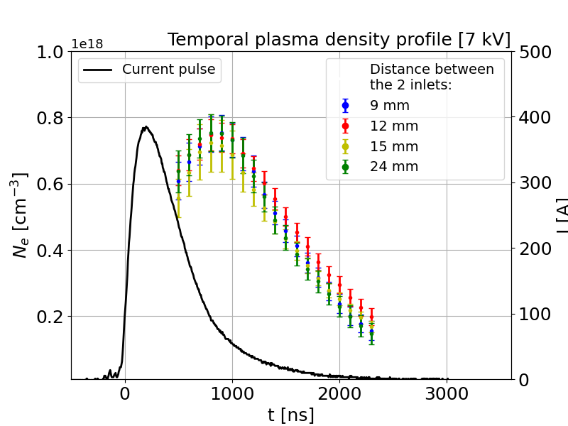
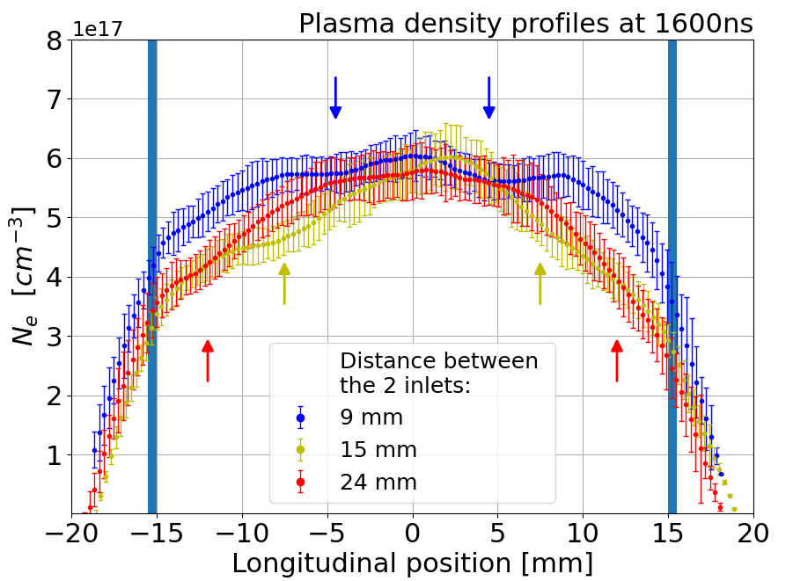
Plasma density measurements:
2 inlets at various distances
Experimental and numerical study of capillary geometry
H₂ pulses at 30-50 mbar
Opening valve for 5 ms at 1 Hz
7 kV pulses applied 7 ms after valve closure
Lucio Crincoli | PhD in Accelerator Physics, Sapienza Università di Roma

Slide 9
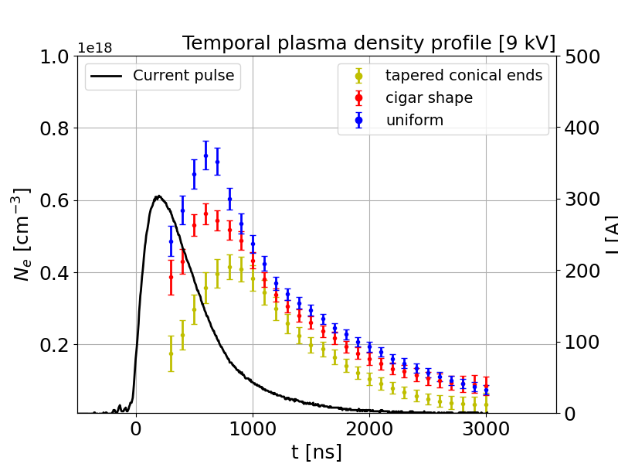
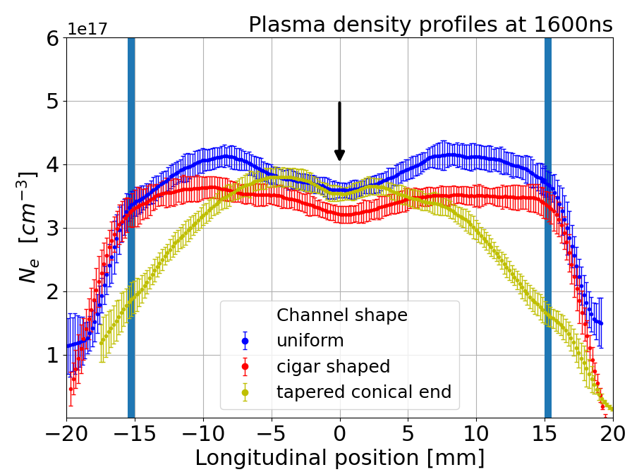
Plasma density measurements:
1 inlet - different channel shapes
Experimental and numerical study of capillary geometry
H₂ pulses at 30-50 mbar
Opening valve for 5 ms at 1 Hz
9 kV pulses applied 7 ms after valve closure
Lucio Crincoli | PhD in Accelerator Physics, Sapienza Università di Roma

Slide 10
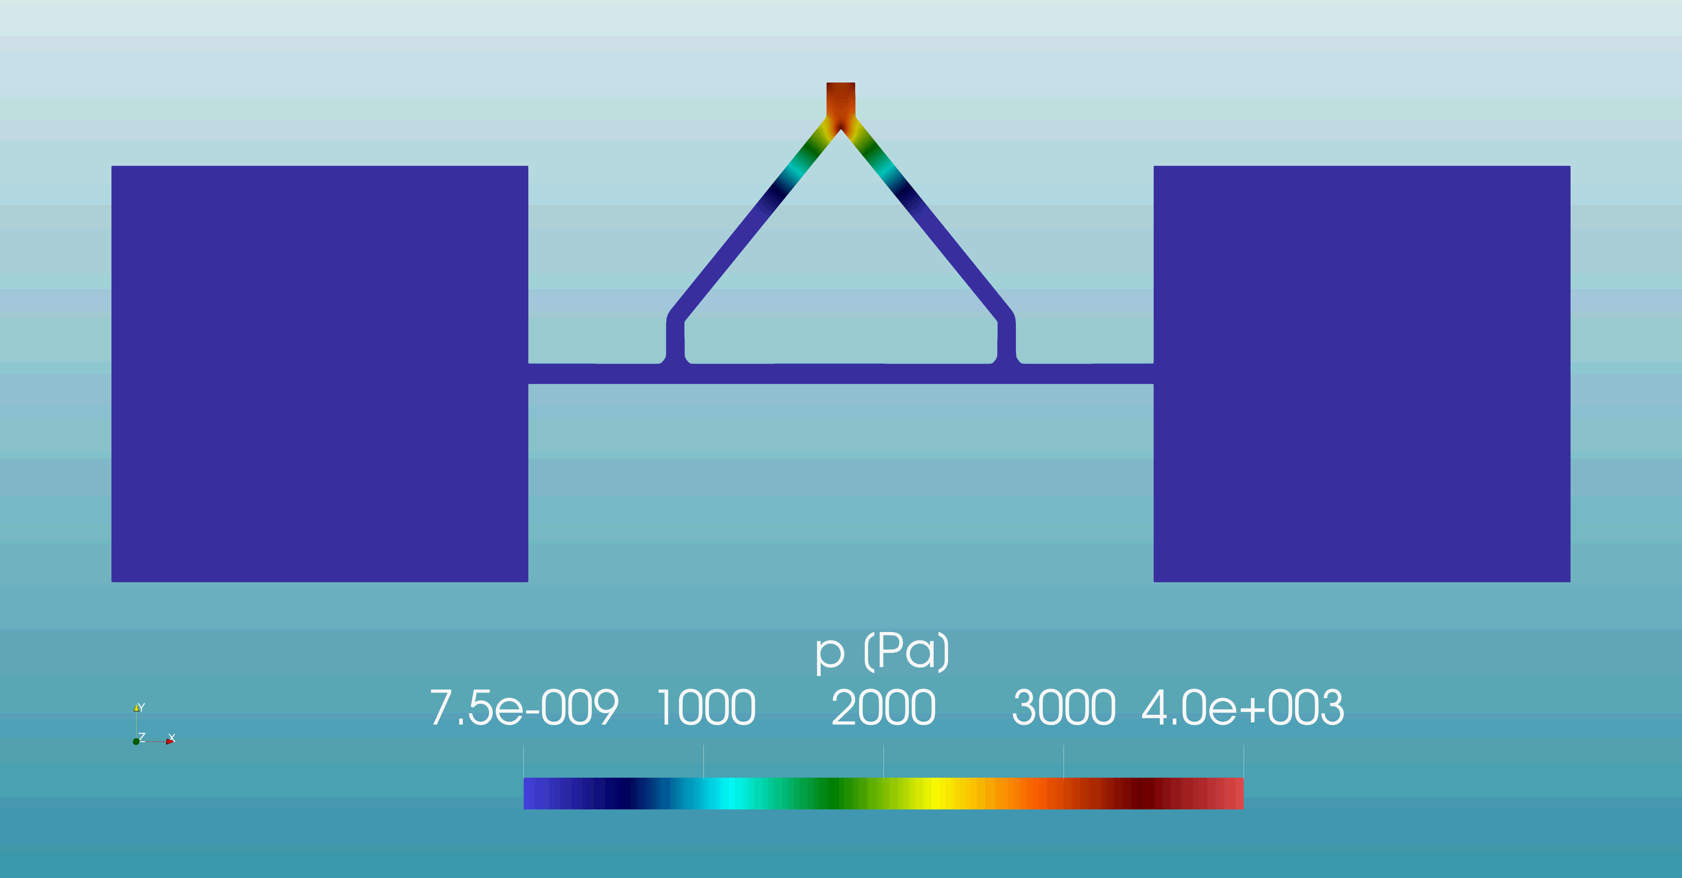
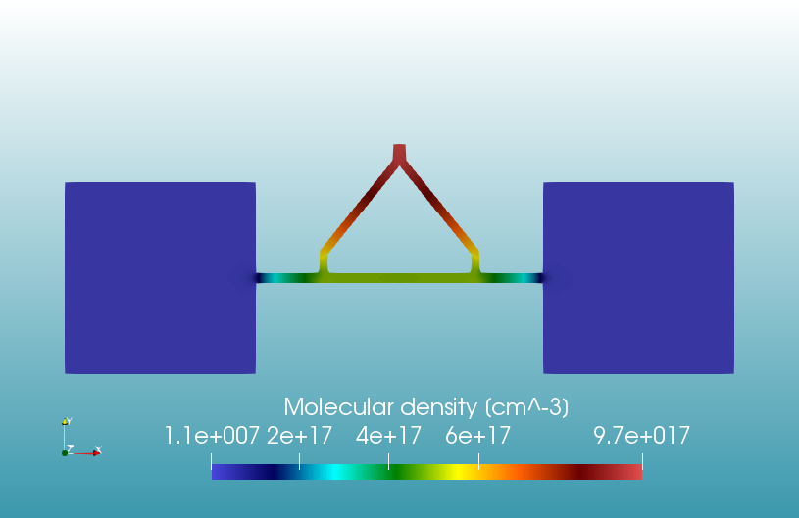
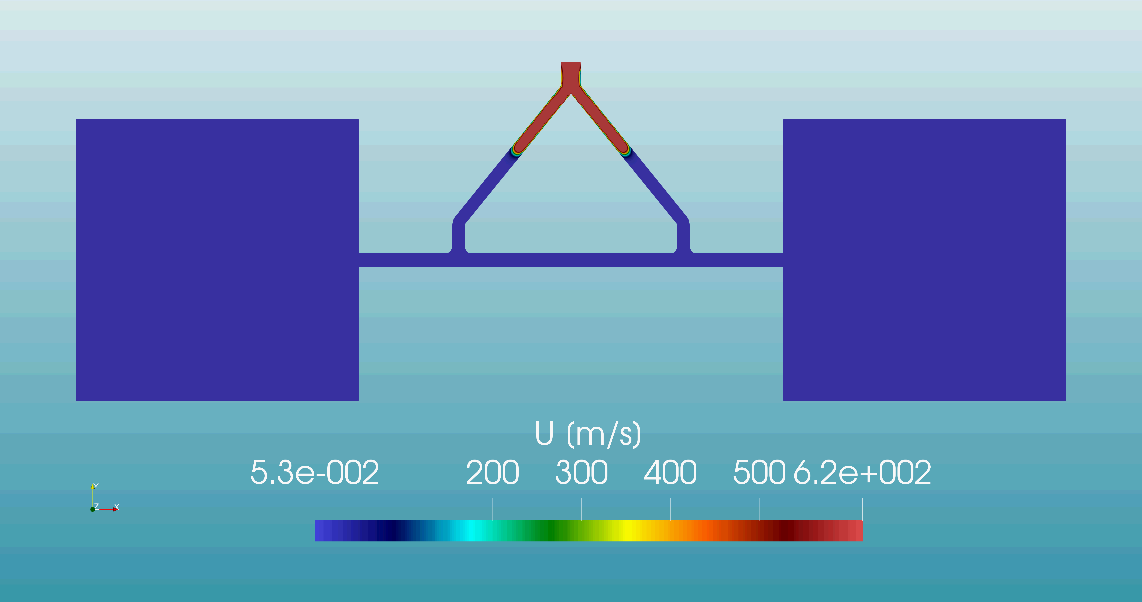
Neutral gas dynamics with OpenFOAM
Experimental and numerical study of capillary geometry
SonicFOAM solver
Mesh refinement 100-200 um
Vacuum boxes
p_in 40 mbar
Lucio Crincoli | PhD in Accelerator Physics, Sapienza Università di Roma

Slide 11
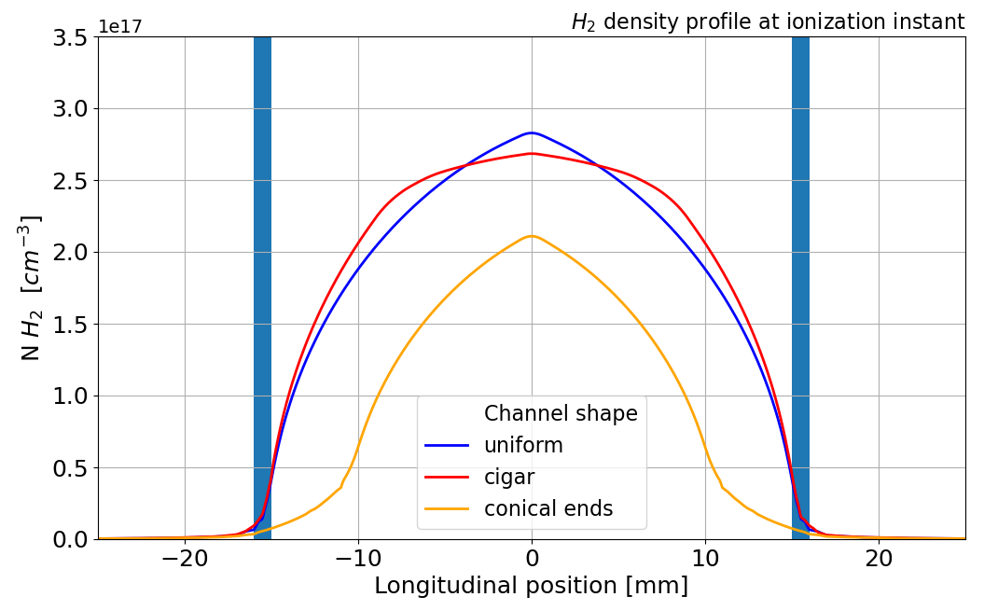
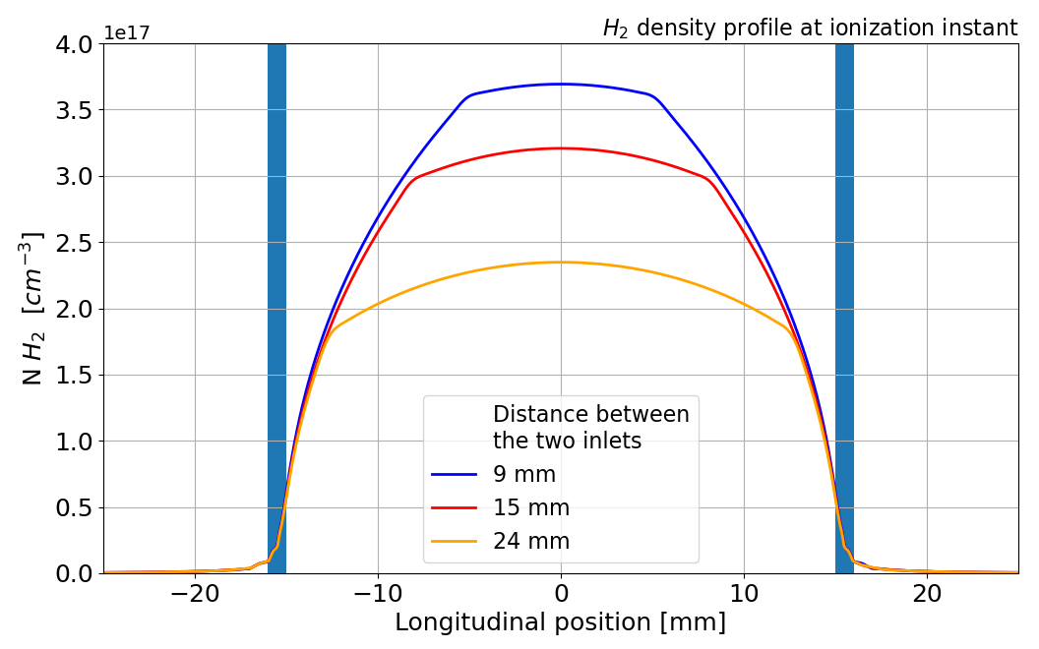
Longitudinal hydrogen density profiles
Experimental and numerical study of capillary geometry
2 inlets:
  Higher uniformity with closer inlets at ionization instant
1 inlet:
  Higher uniformity with cigar shape
  Controlled ramps with conical ends
Lucio Crincoli | PhD in Accelerator Physics, Sapienza Università di Roma

Slide 12
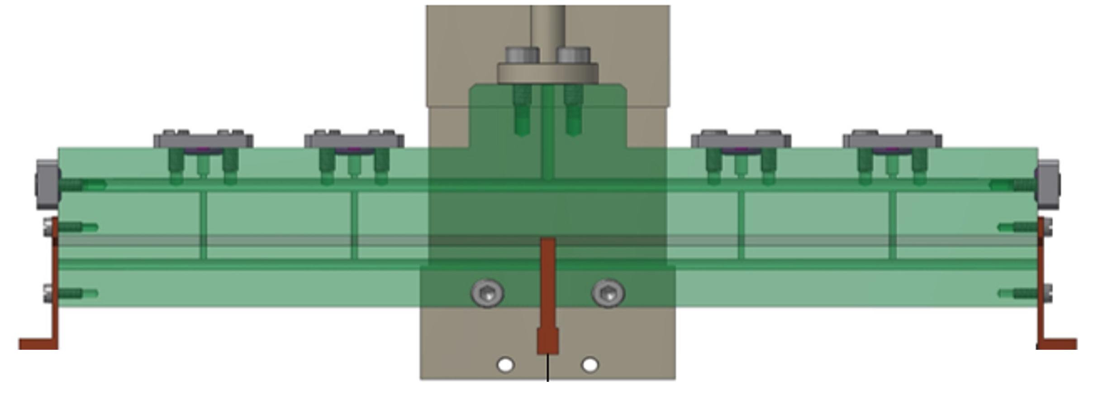
Segmented capillary
Novel schemes for long sources and staged acceleration
Independent plasma discharges
Parallel HV circuits
Modulation of longitudinal plasma density profile
Cheap and compact m-scale sources
HV
HV
Lucio Crincoli | PhD in Accelerator Physics, Sapienza Università di Roma

Slide 13
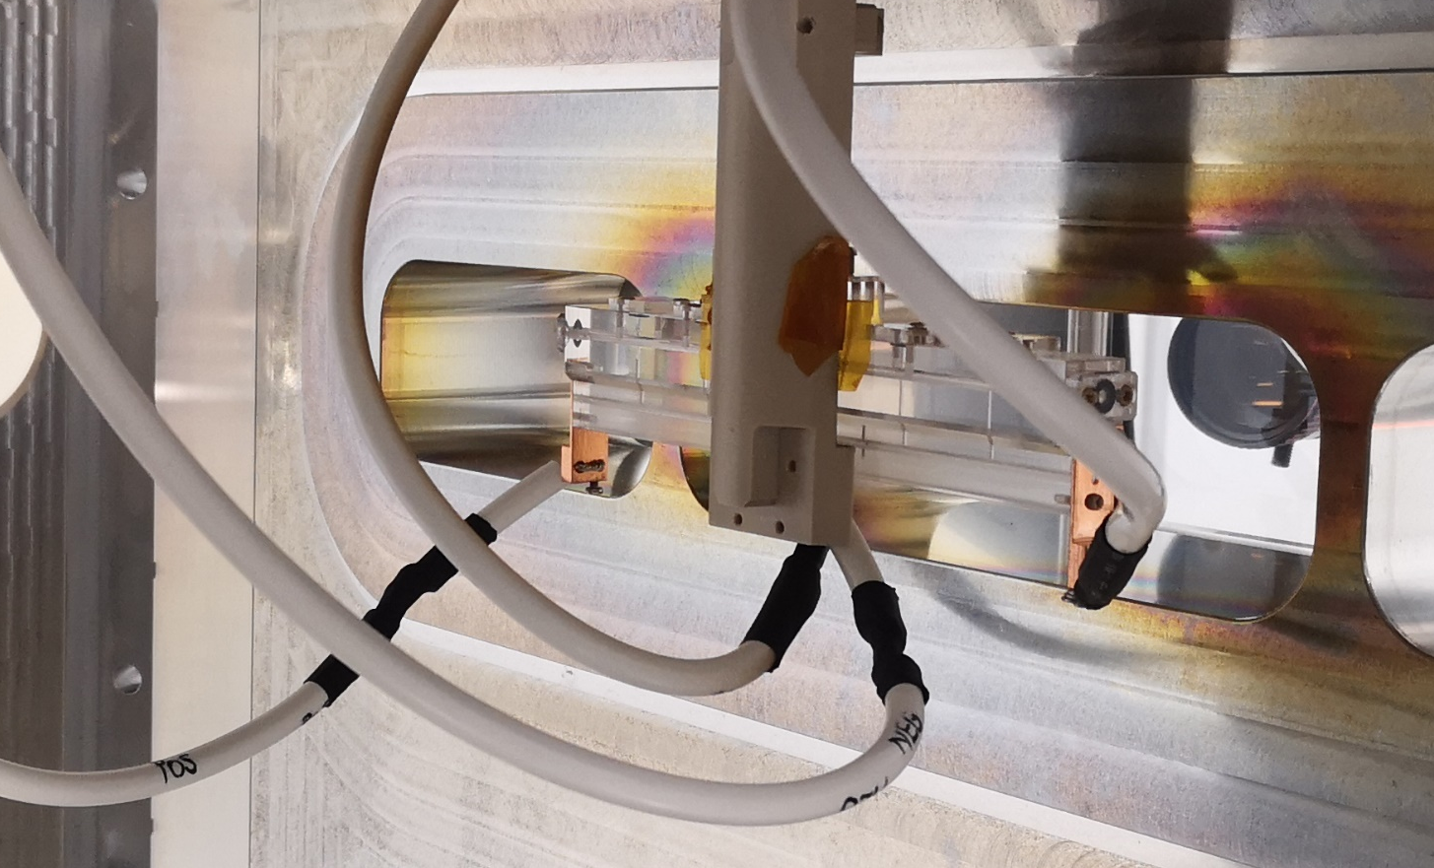
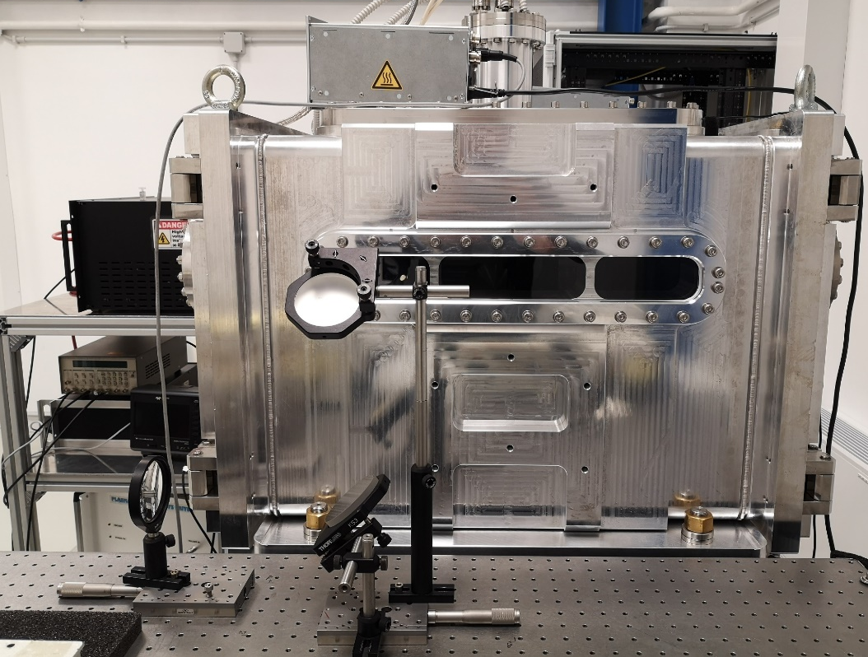
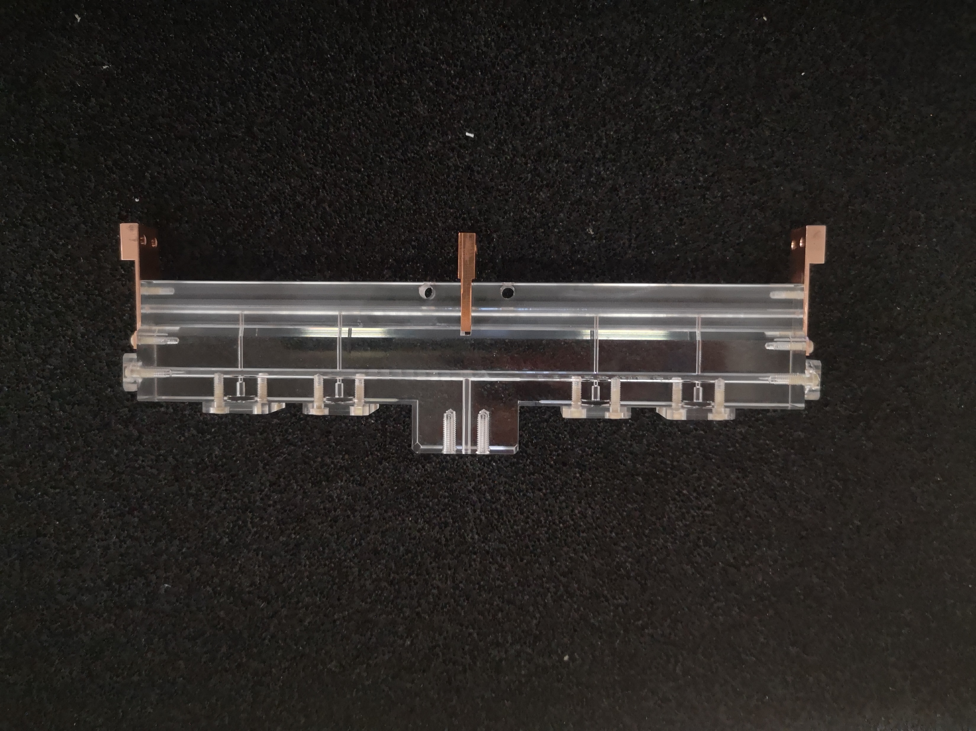
Novel schemes for long sources and staged acceleration
Capillary features
2 segments 8 cm long
2 mm diameter
Common grounded electrode
Experimental setup
2 HV generators and pulsers, one for each segment
5-20 kV voltage pulses
H2, N2, Ar neutral gas
10-50 mbar 1 Hz pulsed injection
Delay generator for discharge synchronization
Lucio Crincoli | PhD in Accelerator Physics, Sapienza Università di Roma

Slide 14
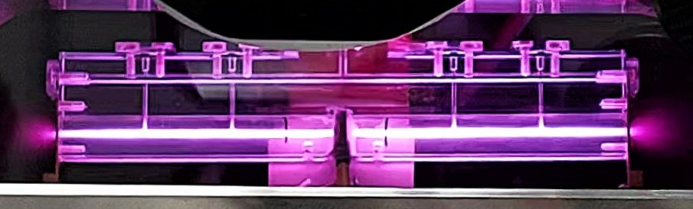
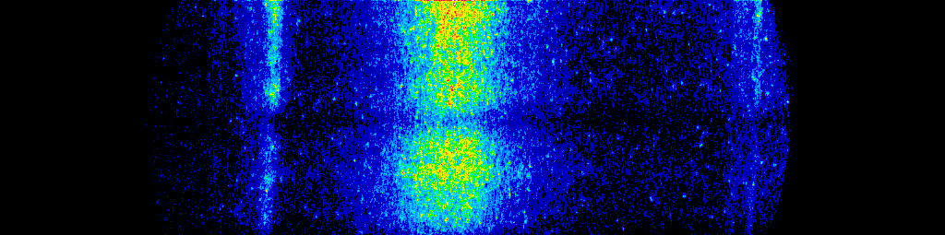
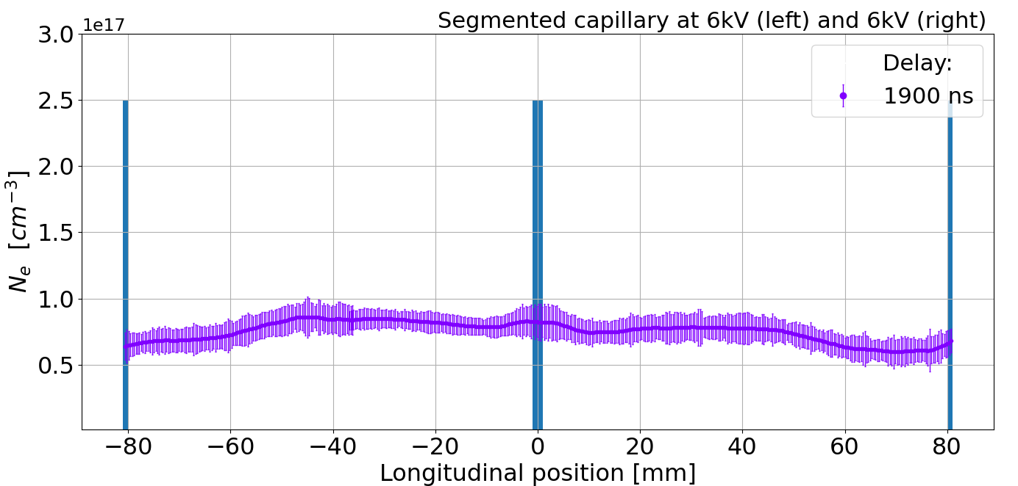
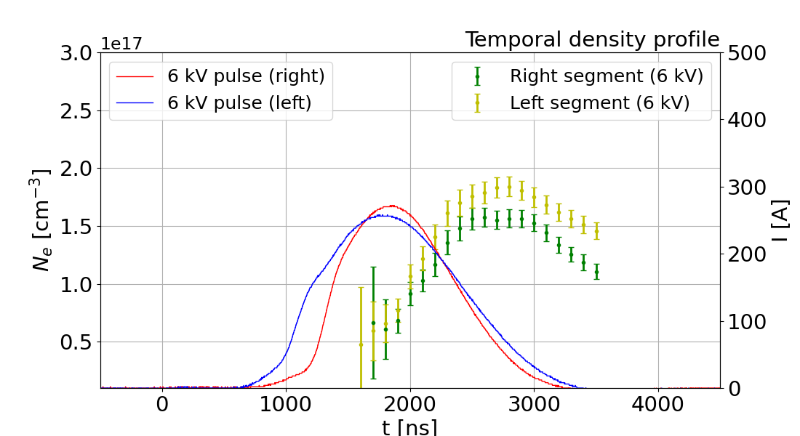
Novel schemes for long sources and staged acceleration
1st test
Goal
Uniform density profile
Test settings
Left segment: 6 kV
Right segment: 6 kV
Results
Symmetric distribution until 2000 ns
Density gradient after 2000 ns
6 kV
6 kV
H_{β} Balmer spectral line acquired by ICCD camera
Central electrode
Lucio Crincoli | PhD in Accelerator Physics, Sapienza Università di Roma
14

Slide 15
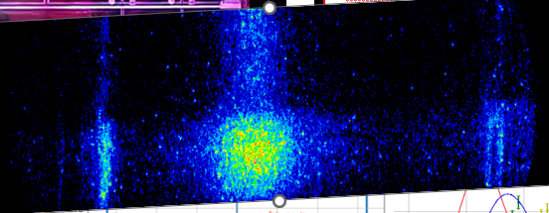
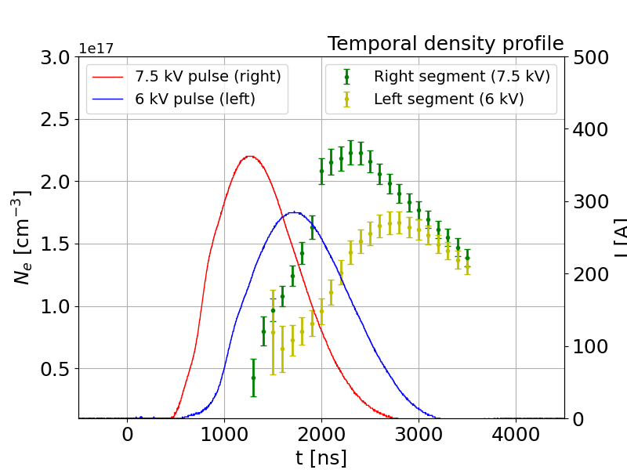
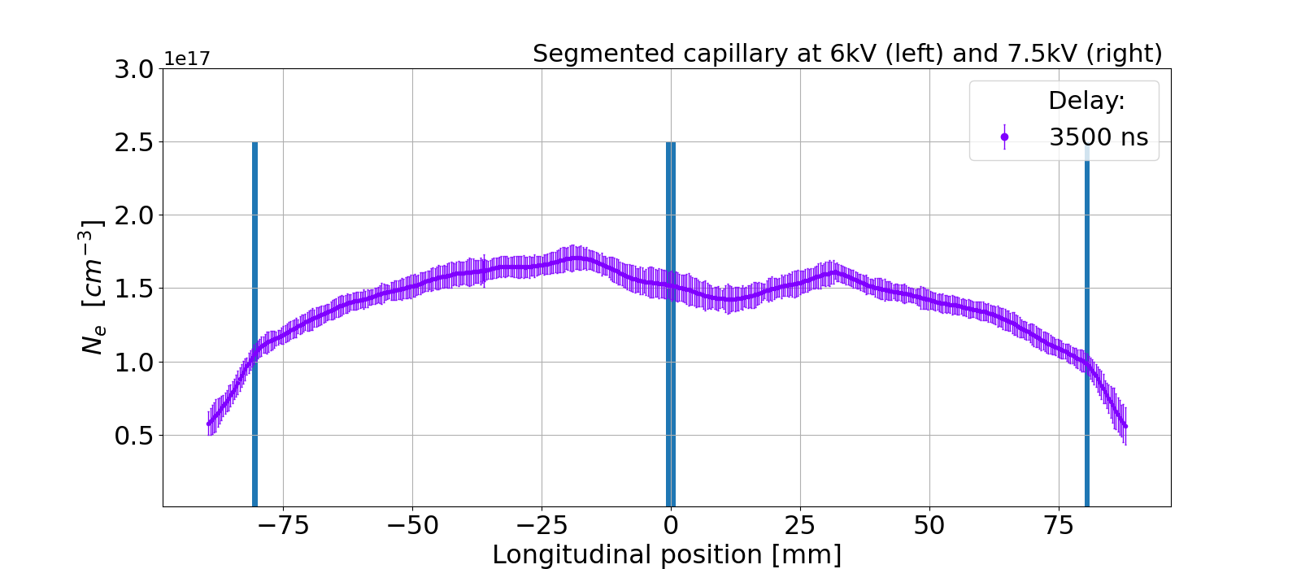
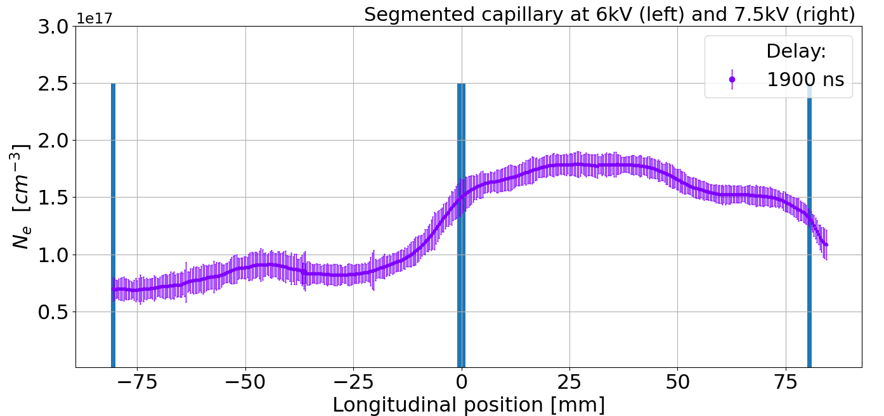
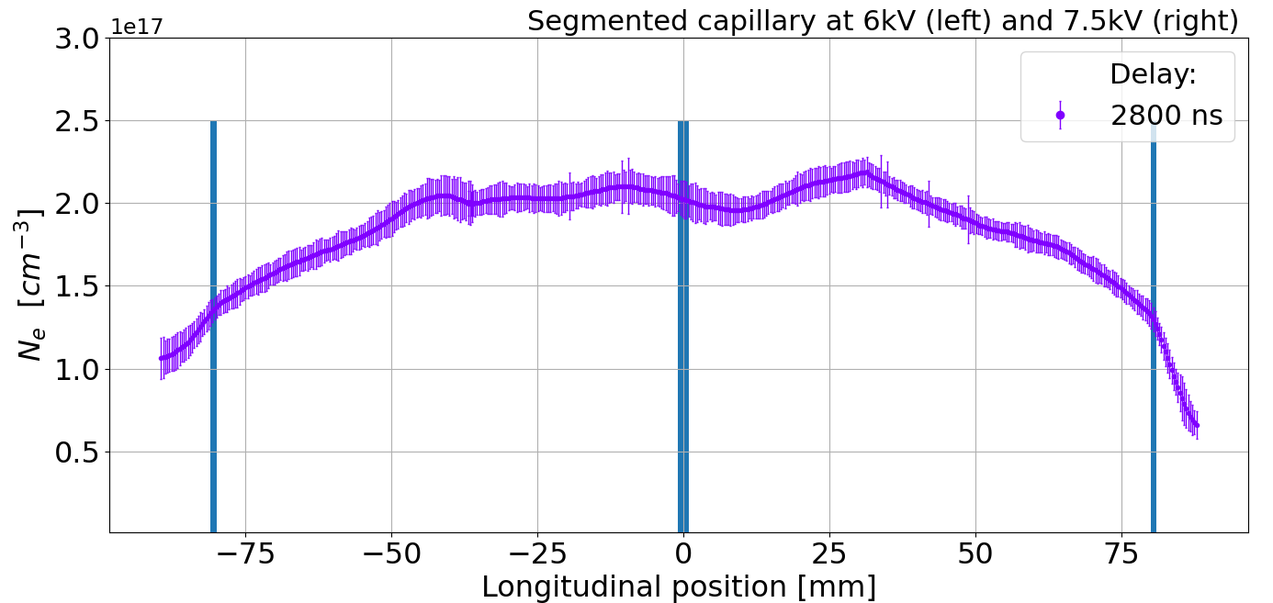
Novel schemes for long sources and staged acceleration
2nd test
Goal
Steep density gradient at segments crossing
Test settings
Left segment: 6 kV
Right segment: 7.5 kV
Results
Density gradient at until 2500 ns
Symmetric distribution after 2500 ns
6 kV
7.5 kV
H_{β} Balmer spectral line acquired by ICCD camera
Central electrode
Lucio Crincoli | PhD in Accelerator Physics, Sapienza Università di Roma
15

Slide 16
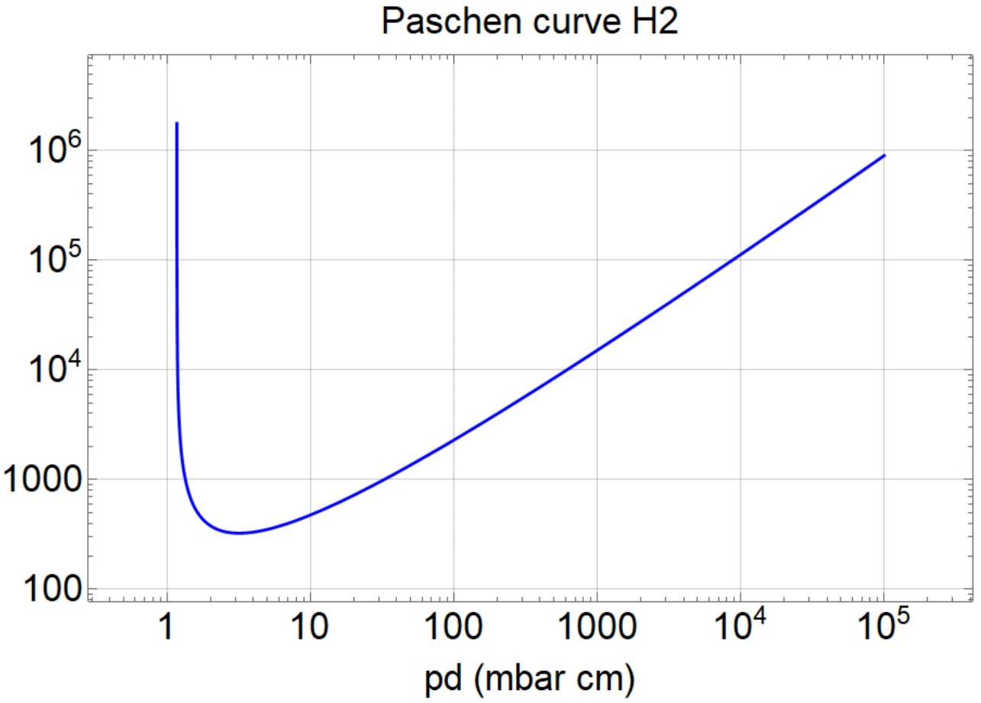
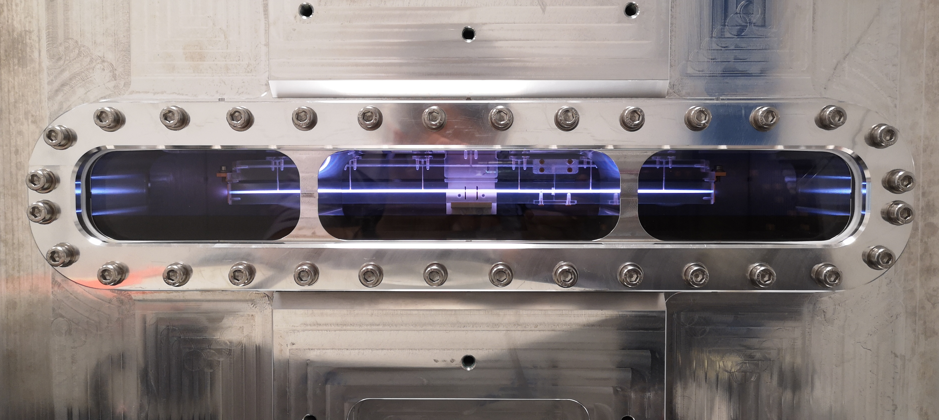
Novel schemes for long sources and staged acceleration
m-scale sources:
Continuous vs segmented channels
Vb (V)
16 cm capillary
Single segment
  16 cm, 20 mbar
2 segments
  8 cm, 20 mbar
70 kV
14 kV
6 kV
3 kV
EuPRAXIA 5 GeV case (1.5 GV/m)
Single segment
  3 m, 20 mbar
7 segments
  40 cm, 20 mbar
16 cm
40 cm
8 cm
3 m
Lucio Crincoli | PhD in Accelerator Physics, Sapienza Università di Roma
16

Slide 17
Integrated capillary for staged focusing and acceleration
Novel schemes for long sources and staged acceleration
APL1
PWFA
APL2
HV
Mixer
Lucio Crincoli | PhD in Accelerator Physics, Sapienza Università di Roma

Slide 18
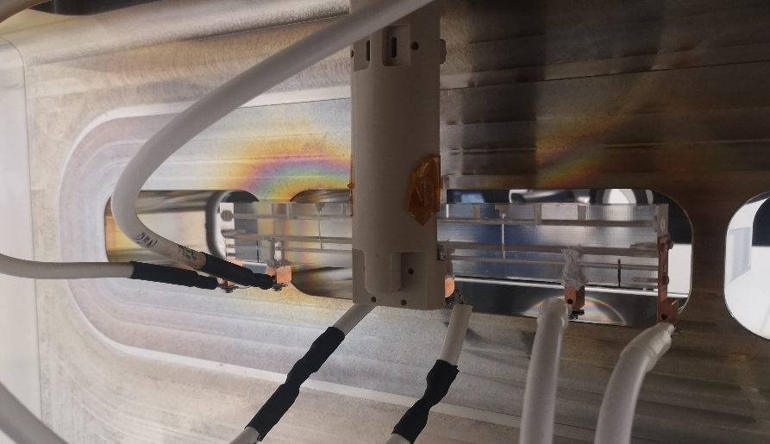
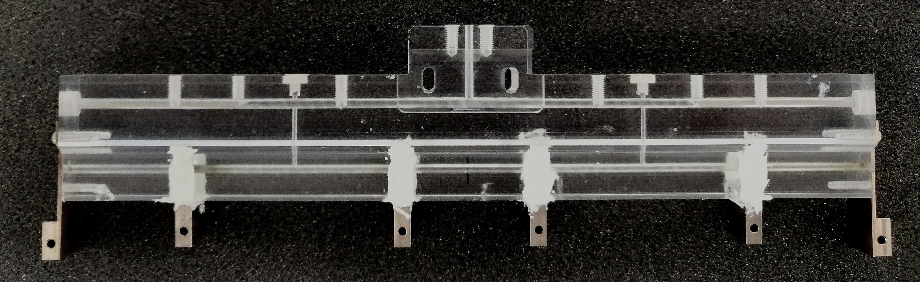
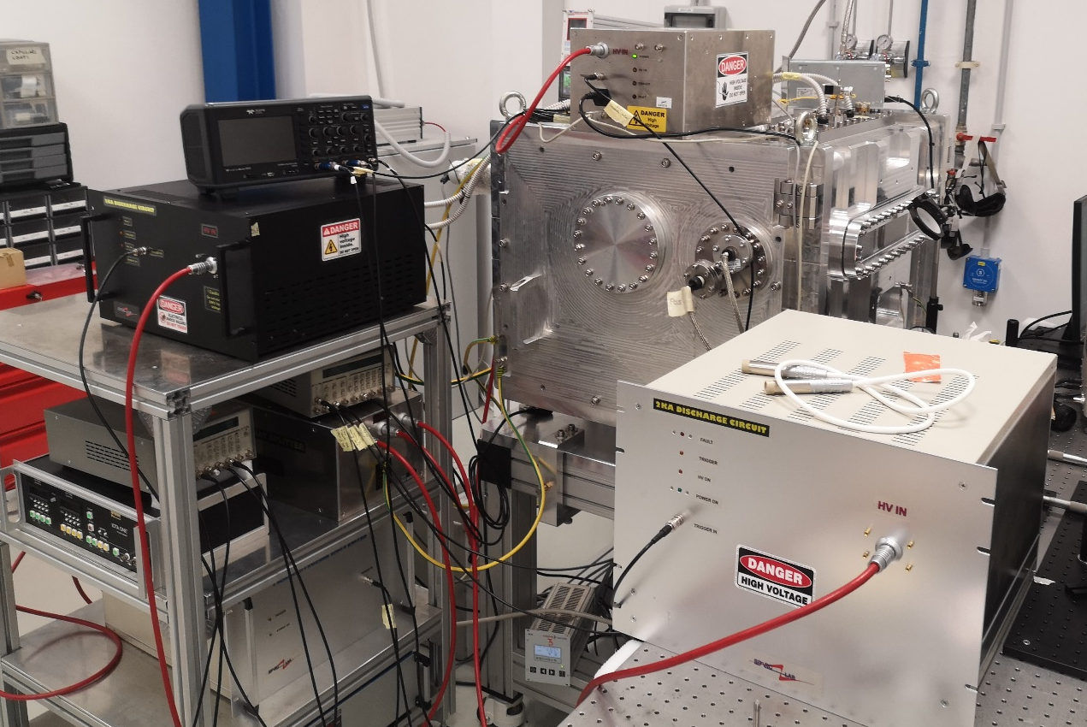
Novel schemes for long sources and staged acceleration
Design
3 segments, each 3 cm long
  2 active plasma lenses
  1 accelerating stage
5 cm long drifts
2 Inlets in the drifts
2 mm diameter
APL1
ACC
APL2
Experimental setup
1 High voltage generator
HV mixer feeding 3 parallel pulsers
Alternating polarization
HV pulser
HV pulser
HV pulser
HV generator
Mixer
Lucio Crincoli | PhD in Accelerator Physics, Sapienza Università di Roma

Slide 19
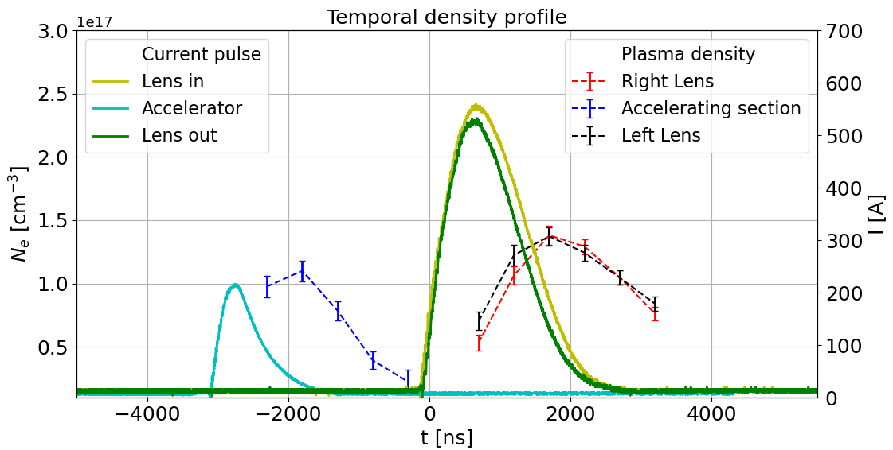
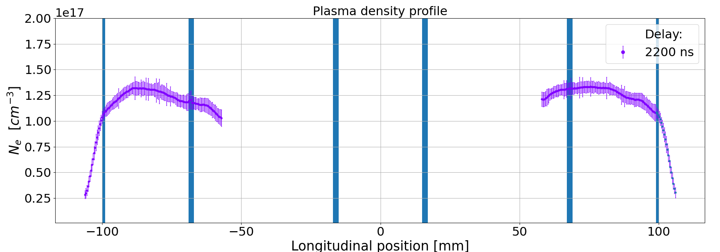
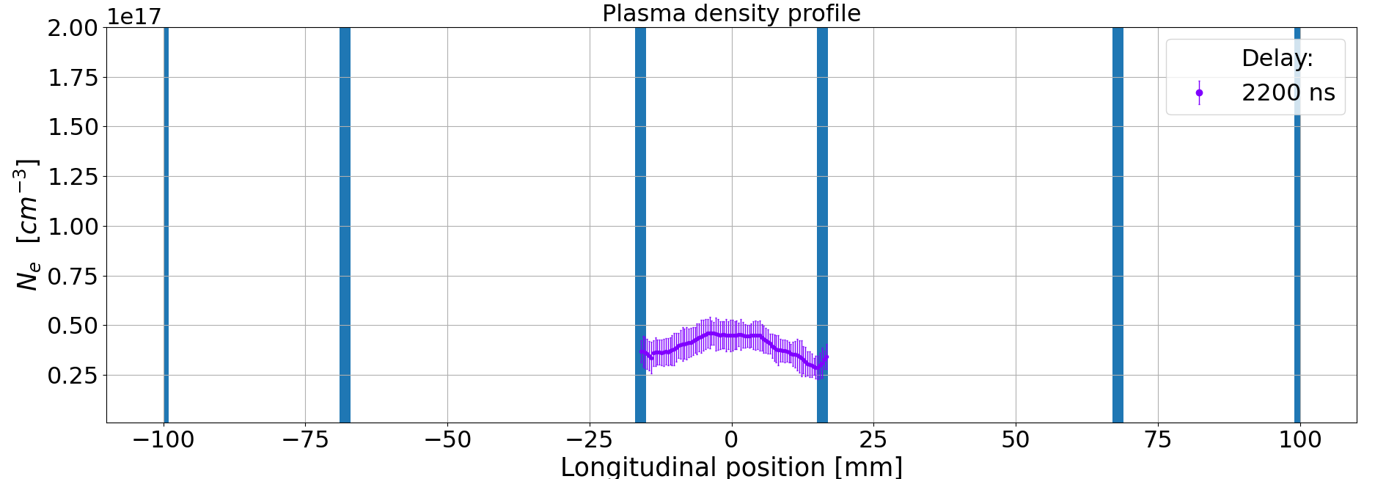
Novel schemes for long sources and staged acceleration
Operating properties
Discharges synchronization
  Lenses synchronized with the beam entrance
  Central discharge applied 3 µs before for plasma acceleration
10 kV voltage resulting in:
  500 A on the lenses
  250 A in the accelerator
Internal drifts behave like spacers
e-beam
Lucio Crincoli | PhD in Accelerator Physics, Sapienza Università di Roma
19

Slide 20
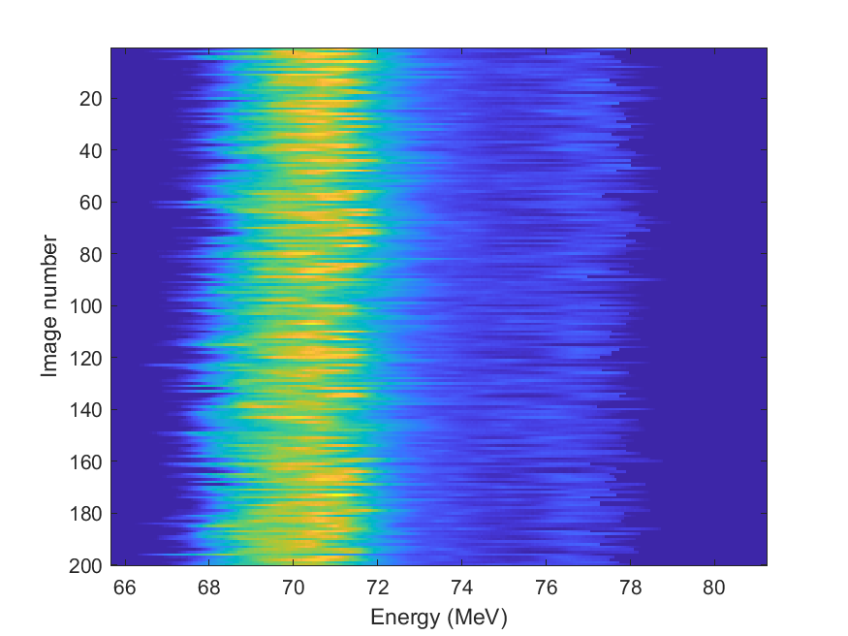
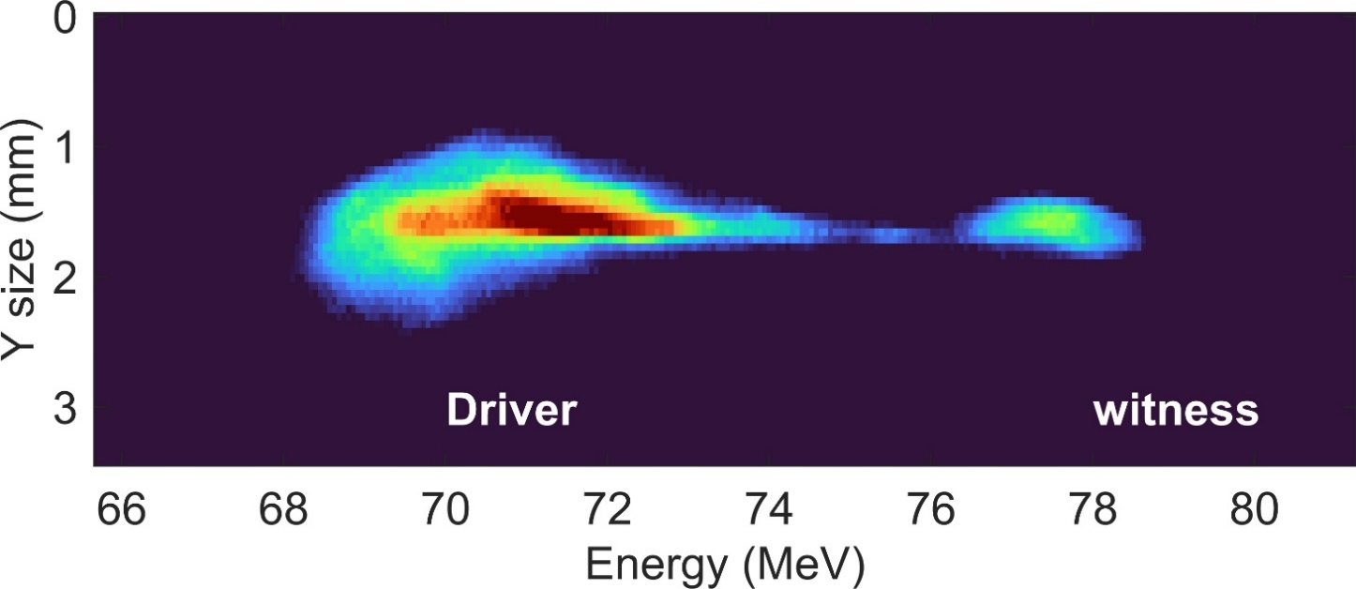
Novel schemes for long sources and staged acceleration
Electron beam focusing and acceleration at SPARC_LAB
200 consecutive shots taken with accelerated beam
200 pC driver – 50 pC witness
Plasma density for acceleration: 2x10¹⁵ cm⁻³
133 MV/m accelerating gradient
Stable accelerated beam
Lucio Crincoli | PhD in Accelerator Physics, Sapienza Università di Roma
20

Slide 21




Novel schemes for long sources and staged acceleration
Plasma source design for EuPRAXIA Advanced Photon source
Gas jet
Laser ionisation
Conveyor – Roots pump to remove gas of the jet from the interaction chamber
Turbo-molecular and scroll pumps to keep 10⁻⁴ mbar
1 Hz operation with helium at 30-40 bar
Lucio Crincoli | PhD in Accelerator Physics, Sapienza Università di Roma
21

Slide 22
Conclusions
Future perspectives
Experimental activities:
  High repetition rate sources
  m- scale sources
Numerical analysis developments:
  Simulation codes for electrical discharge and plasma dynamics
Lucio Crincoli | PhD in Accelerator Physics, Sapienza Università di Roma
22

Slide 23
Conclusions
References
Tajima T and Dawson J M 1979 Phys. Rev. Lett. 43(4) 267–270
Spence D J and Hooker S M 2000 Phys. Rev. E 63(1) 015401
Ferrario M et al. 2013 Nuclear Instruments and Methods in Physics Research Section B: Beam Interactions with Materials and Atoms 309 183–188 ISSN 0168-583X the 5th International Conference ”Channeling 2012”, ”Charged Neutral Particles Channeling Phenomena” September 23-28,2012, Alghero (Sardinia), Italy
Ferrario M et al. 2018 Nuclear Instruments and Methods in Physics Research Section A: Accelerators, Spectrometers, Detectors and Associated Equipment 909 134–138 ISSN 0168-9002 3rd European Advanced Accelerator Concepts workshop (EAAC2017)
Biagioni A et al. 2019 Technical report SPARC-PL-19/001, National Institute of Nuclear Physics – Frascati National Laboratories
Griem H R 1974 Spectral line broadening by plasmas (University of Maryland, College Park, Maryland: Academic Press)
Romeo S et al, 2023 Plasma Phys. Control. Fusion 65 115005
Weller H G, Tabor G, Jasak H and Fureby C 1998 Computer in Physics 12 620–631 ISSN 0894-1866
Pompili R et al, 2018 Phys. Rev. Lett. 121(17) 174801 URL https://link.aps.org/doi/10.1103/PhysRevLett.121.174801
Lucio Crincoli | PhD in Accelerator Physics, Sapienza Università di Roma
23

Slide 24
Thank you for the attention
Lucio Crincoli | PhD in Accelerator Physics, Sapienza Università di Roma

Slide 25
Backup slides
Lucio Crincoli | PhD in Accelerator Physics, Sapienza Università di Roma

Slide 26














Plasma sources
Introduction
Gas-filled discharge capillaries
Lithium/rubidium vapor oven
Gas jet plasma sources
Gas cells
Lucio Crincoli | PhD in Accelerator Physics, Sapienza Università di Roma
26

Slide 27



Backup slides
Plasma discharge capillaries R&D
Plasma density profile
Shot-to-shot stability
Very long sources for EuPRAXIA (m-scale)
A Biagioni et al 2021 Plasma Phys. Control. Fusion 63 115013
Lucio Crincoli | PhD in Accelerator Physics, Sapienza Università di Roma

Slide 28
Backup slides
Active plasma lenses
Lucio Crincoli | PhD in Accelerator Physics, Sapienza Università di Roma
28

Slide 29




Backup slides
Upgraded version
Inlets directly injecting in the stages
Open drifts to reduce electrical conductivity
Tungsten-copper electrodes
Reduced crosstalk
H_{β} Balmer spectral line acquired by ICCD camera
Lucio Crincoli | PhD in Accelerator Physics, Sapienza Università di Roma
29

Slide 30





Backup slides
Electron beam focusing and acceleration at SPARC_LAB
C-band structure
Optical/THz diagnostics
To the FEL
H2 filled capillary
Active plasma lens
Acelerating
section
Integrated plasma module
Focusing
lens
Plasma capillary
Plasma capillary
Extraction
lens
Lucio Crincoli | PhD in Accelerator Physics, Sapienza Università di Roma
30

