Slide 1
Status of PhD thesis Title : Methods to evaluate the beam coupling impedance of accelerators: a novel technique for bench measurements and beam-based measurements at the Proton Synchrotron Booster
CANDIDATE : ${CHIARA ANTUONO}^{1,2}$
Supervisors: Prof. ${\text{M}\text{. }\text{Migliorati}}^{1}$, Prof. ${\text{a}\text{. }\text{M}\text{OSTACCI}}^{1}$
Co-supervisor: ${DOTT. CARLO ZANNINI}^{2}$
$${}_{}^{1}{University of Rome,{}_{}^{′′}LaSapienza^{′′},Italy}$$
$${}_{}^{2}{CERN, Meyrin, Switzerland}$$
PhD in Accelerator Physics, XXXVII cycle

Slide 2
Outline
Introduction
Bench measurements
Standard methods and limitations
The new wireless method
Beam chambers
Resonant structures
Beam based measurements
Tune shift reference measurements at the PSB
Instability measurements at the PSB
Conclusions and outlook

Slide 3
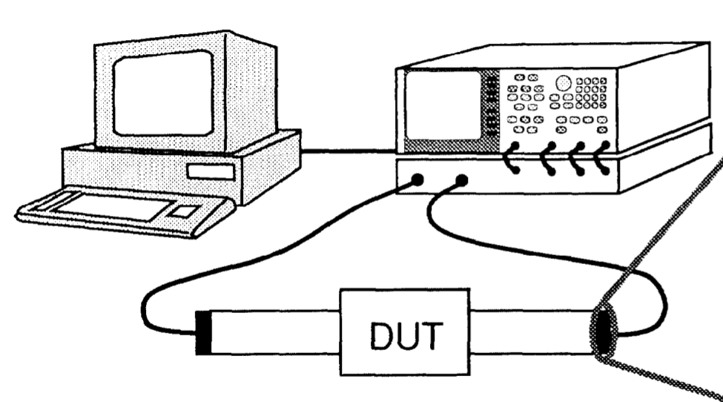
Introduction and motivations
The beam coupling impedance represents the EM interaction between the particle beam and the accelerator
It depends on geometry and material properties of the Device Under Test (DUT)
It is of extreme importance to quantify its contribution:
measurements/simulation/ analytical computations
cause of
Excessive heating on device
beam instabilities and beam losses
Beam based measurements
benchmark the impedance model of the accelerator
study beam instability
Bench measurements
Characterization of a device before the installation
Beam based measurements of the impedance are not always possible

Slide 4
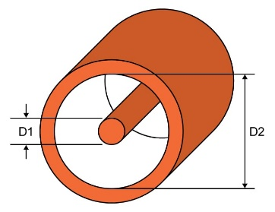
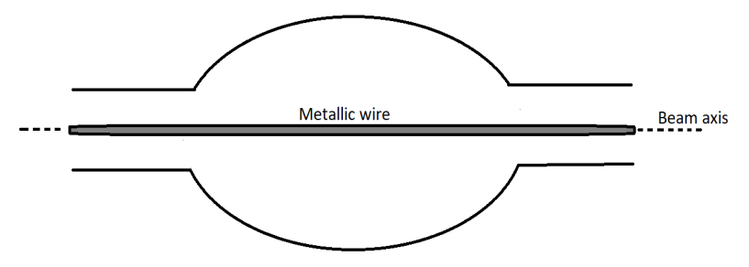
Standard bench method
The stretched wire method is a well-established technique *
The wire perturbs the EM boundary conditions : artificial propagation of the TEM mode through the device
Nowadays the limitations of this technique are known
$→$ to overcome these issues : techniques without the modification of the Device Under Test (DUT)
Other methods exists but they either not fully provide the needed information, or their setup implementation is rather difficult (probe measurements, bead-pull measurements)
$$Z_{long}=−2Z_{ch}\ln{\frac{S_{21}^{DUT}}{S_{21}^{REF}}}$$
$S_{21}^{DUT}$: transmission scattering parameter of the DUT
$S_{21}^{REF}$: a reference without the impedance sources
$Z_{ch}$: characteristic impedance of the equivalent transmission line (wire + chamber wall)
$$Z_{ch}=\frac{60}{\sqrt{ε_{r} }} \ln{\frac{D2}{D1}}$$
* V.G. Vaccaro, Coupling impedance measurements: an improved wire method, INFN/TC-94/023, Sezione di Napoli, November 1994.

Slide 5
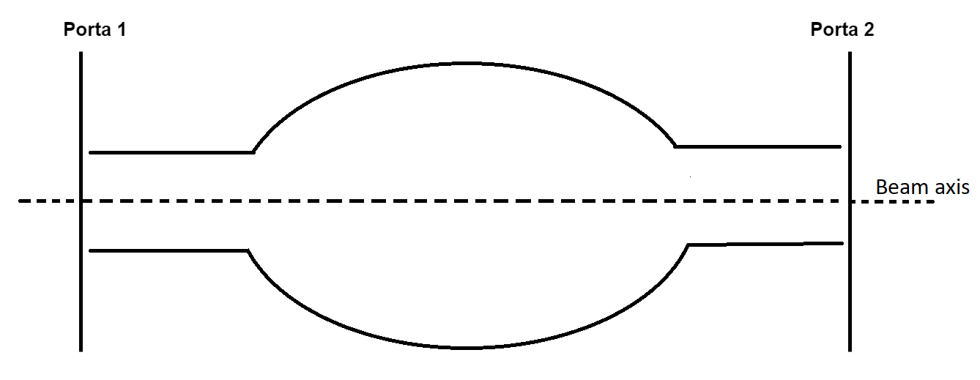
Wireless method for beam chamber
The longitudinal beam coupling impedance : energy loss of the electromagnetic wave propagating in the structure $→$intrinsically linked to the $S_{21}$
The idea : to study the first propagating TM mode of the DUT, instead of the TEM mode in the case of the Wire Method *
$$Z_{wireless}=−\frac{Z_{TM}}{2π}\ln{\frac{S_{21}^{DUT}}{S_{21}^{REF}}}$$
$Z_{TM}$: characteristic impedance of the TM mode
$ζ_{s}$: surface impedance of the beam pipe wall
$r$ : radius of the chamber
$L$ : length of the chamber
It reduces above and below the cut-off of the beam chamber to the theoretical RW impedance
Demonstrated analytically and in simulations for circular beam chambers
Can be generalized to arbitrary cross section geometry of the beam pipe (taking into account specific form factors)
$Z_{wireless}=−GF\frac{Z_{TM}}{2π}\ln{\frac{S_{21}^{DUT}}{S_{21}^{REF}}}$
The analytical approach was carried out under the assumption of thick wall regime, where $ζ_{s}$=$(1+j)ζ$
$$Z_{wireless}=−\frac{Z_{TM}}{2π}\ln{\frac{S_{21}^{DUT}}{S_{21}^{REF}}} → Z_{theory}=\frac{ζ_{s}L}{2πr}$$
Geometric factor
Yokoya form factor*
$$G=\frac{{(b}^{2}+a^{2})a}{b^{3}+a^{3}}$$
$F=\frac{W_{z}^{DUT}}{W_{z}^{CIRC}}$
* Improved simulation of the beam coupling impedance in frequency domain, C. Antuono, CERN-THESIS-2021-026
More in the CEI section meeting https://indico.cern.ch/event/1281957/
* K. Yokoya, Resistive wall impedance of beam pipes of general cross section, Part. Accel. 41, 221 (1993); KEK-Preprint-92-196

Slide 6
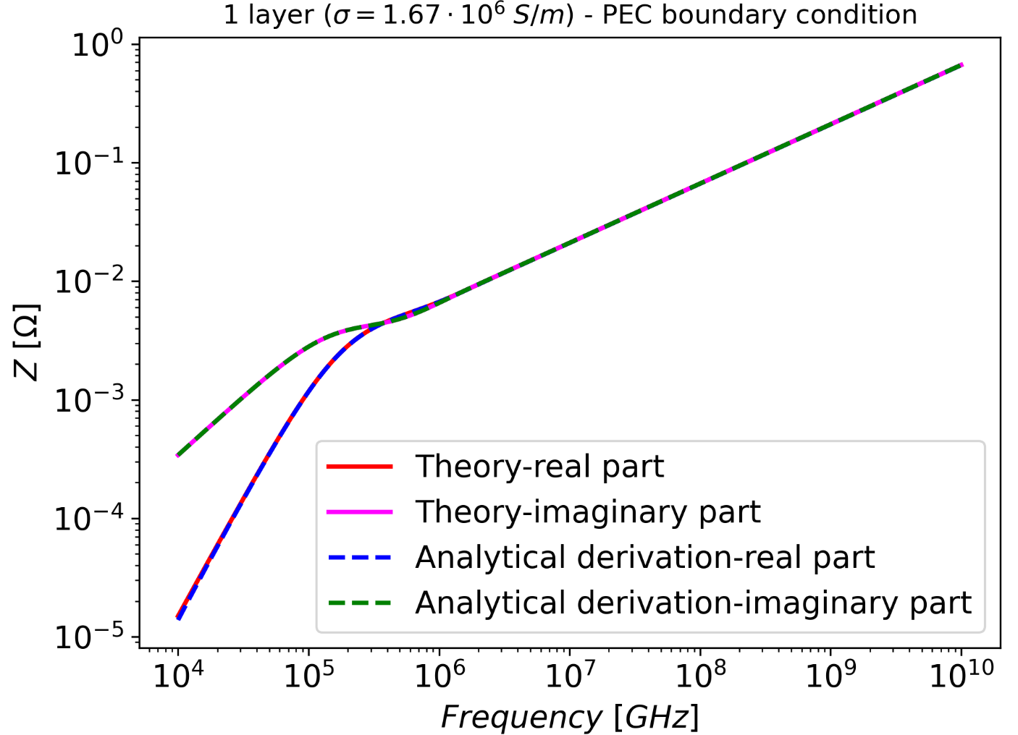
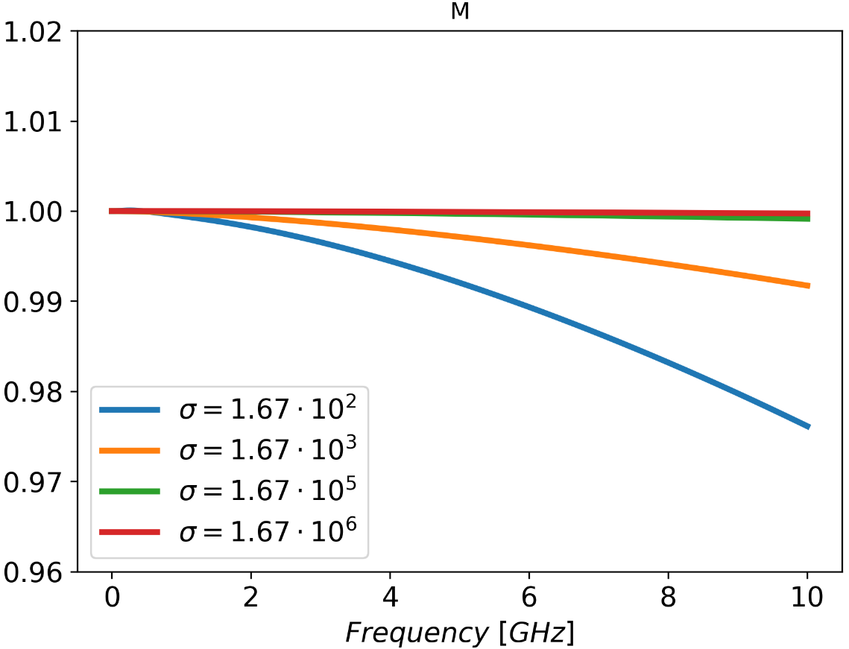
Wireless method for beam chamber: generalized formula
$$Z_{wireless}=−FG\frac{Z_{TM}}{M 2π}\ln{\frac{S_{21}^{DUT}}{S_{21}^{REF}}}$$
$M$ is a compound factor which depends on:
radius $r$, wall conductivity $σ$
magnetic permeability $μ_{0}$, electric permittivity $ε_{0}$
frequency $f$
Typical cases
Agreement also beyond the thick wall regime!
In the typical cases of interest $M$ can be neglected $→$wireless log-formula used in its simplest formulation

Slide 7
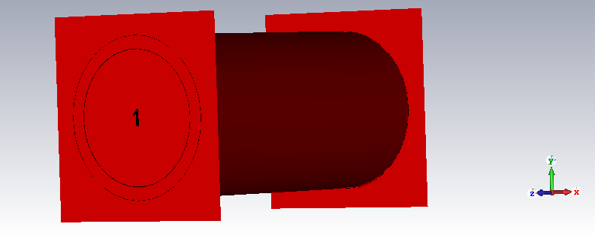
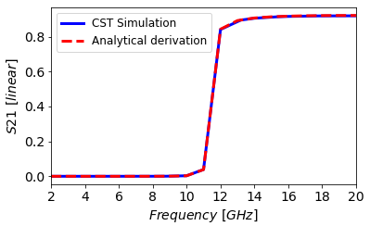
Implementation of the method for beam chamber
Wireless method for beam chamber:
Improved analytical approach
Method tested in simulation
Implementation in bench measurement to be exploited: what is missing?
Simulation
$S_{21}$
Ideal excitation of TM mode: waveguide port
Measurement
$S_{21}$ is a direct output (from VNA)
Real excitation of TM mode
Raw data
Wireless log-formula
$→$to implement the bench method a proper TM coupler/antenna needs to be developed
$$Z_{wireless}=−G F\frac{Z_{TM}}{2π}\ln{\frac{S_{21}^{DUT}}{S_{21}^{REF}}}$$

Slide 8
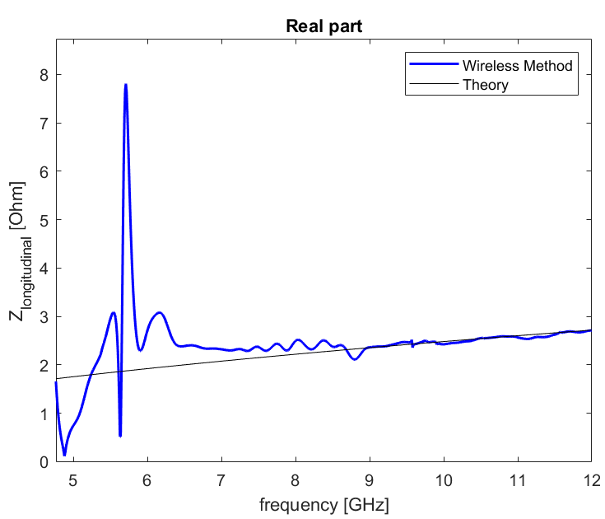
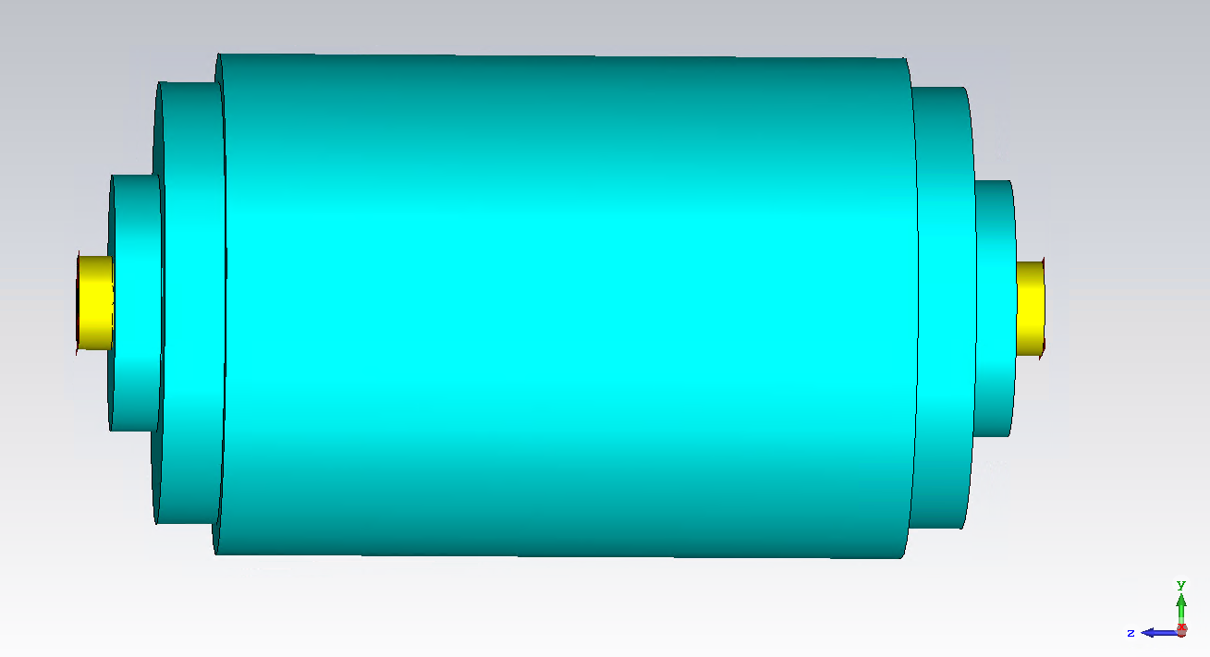
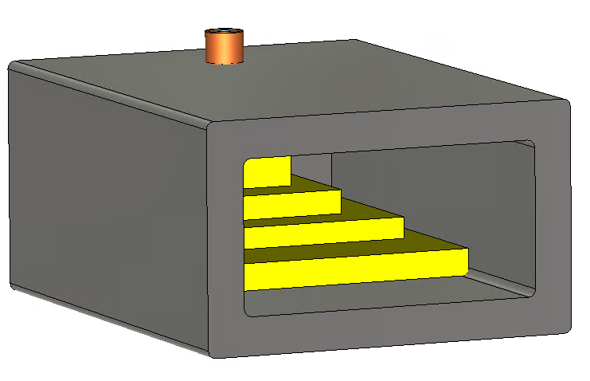
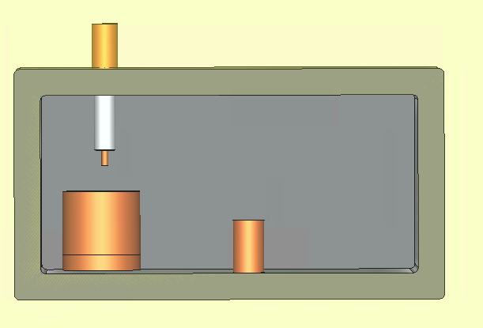
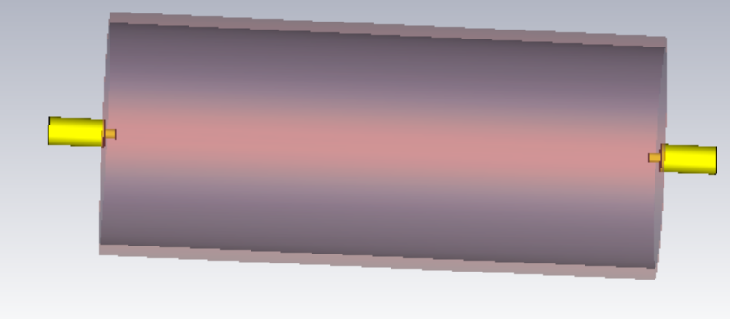
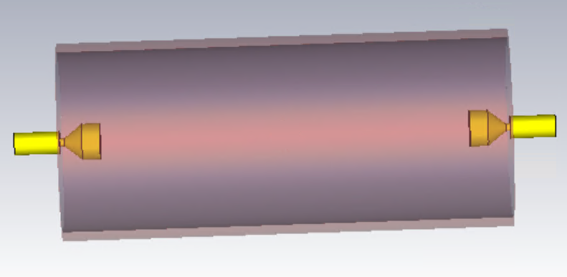
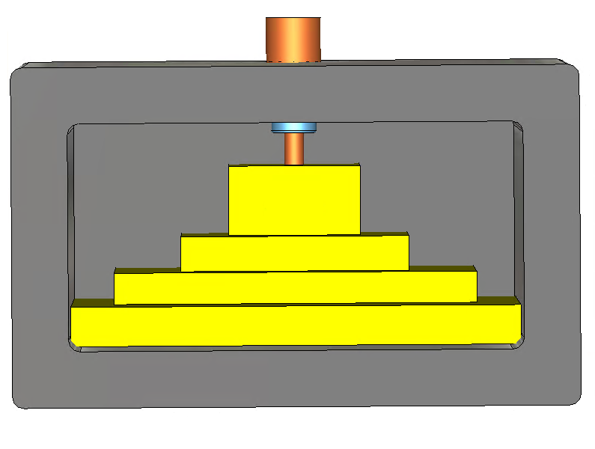
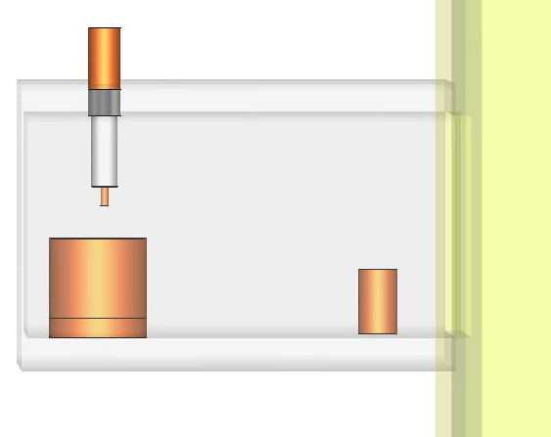
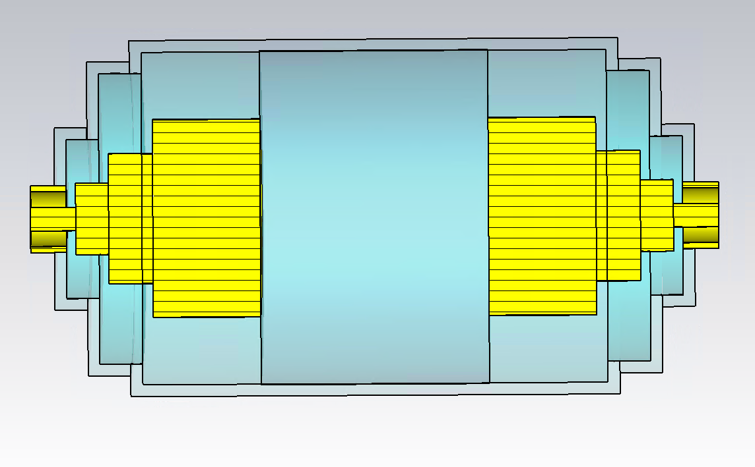
Investigation of the TM coupler
Several studies (simulations, coupler design studies, literature research) have been conducted to find the proper excitation
Each coupler found has some disadvantage
Circular pipe
cut-off
Tapered transition?
$$Z_{wireless}=−\frac{Z_{TM}}{2π}\ln{\frac{S_{21}^{DUT}}{S_{21}^{REF}}}$$
Could we find a simpler coupler to obtain the impedance for beam chambers?
* G. R. Lambertson, A. F. Jacob, R. A. Rimmer, and F. Voelker, “Techniques for Beam Impedance Measurements Above Cut-off”, in Proc. EPAC’90, Nice, France, Jun. 1990, pp. 1049–1052

Slide 9
Investigation of the TM coupler
Several studies (simulations, coupler design studies, literature research) have been conducted to find the proper excitation
Each coupler found has some disadvantage
* G. R. Lambertson, A. F. Jacob, R. A. Rimmer, and F. Voelker, “Techniques for Beam Impedance Measurements Above Cut-off”, in Proc. EPAC’90, Nice, France, Jun. 1990, pp. 1049–1052

Slide 10
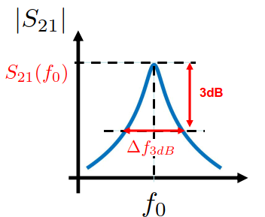
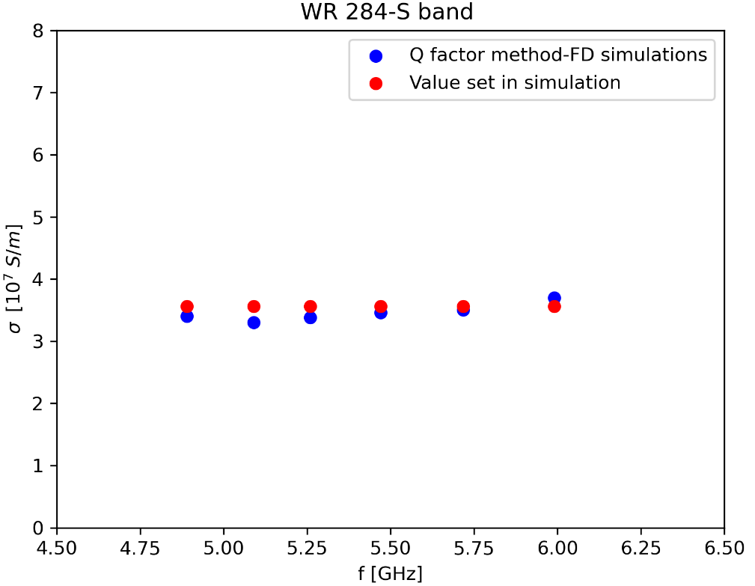
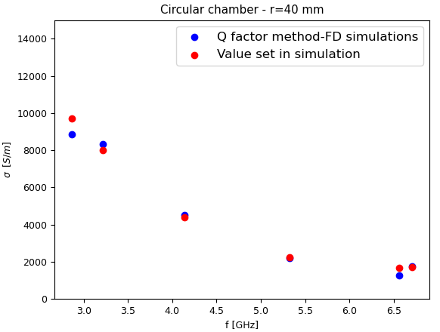
Probe setup as TM coupler
Probe setup : multiple resonances
Not possible to directly reconstruct the impedance from the $S_{21}$
Loaded Quality factor
$$Q_{l}=\frac{f_{0}}{Δf_{3dB}}$$
$Q_{l}:$ overall device
$$\frac{1}{Q_{l}} =\frac{1}{Q_{ext}}+\frac{1}{Q_{0}}$$
$Q_{ext}$ : ext. coupler /excitation
$Q_{0}$ : DUT wall
$Q_{0}$ can be measured from $Q_{l}$
From the expression of the $H$ field of a $TM_{mnl} →$ analytical $Q_{0}$
$Q_{0}^{rect}=\frac{1}{2δ(σ)}\frac{\left(ab\right)\left(a^{2}+b^{2}\right) }{\left(a^{3}+b^{3}\right)}$
$$Q_{0}^{cir}= \frac{r_{chamber}}{δ(σ)}$$
$δ=\sqrt{\frac{2}{ωμσ}}$ : skin depth
$r$ : radius of the chamber
$a,b$ : width and height of the cross section of the DUT
$σ$is found by simply inverting the analytical formula
Characterize the chamber as it should be installed
Method to measure the beam impedance from $σ$ above cut-off
$$Z_{theory}=F\frac{ζ_{s}L}{2πr}$$
It works also in presence of wall surface roughness
Next step
direct relation between $Q_{0}$ and $S_{21}$ -> wireless formula without knowning the geometry of the DUT
$$Z_{wireless}=−FG\frac{Z_{TM}}{M 2π}\ln{\frac{S_{21}^{DUT}}{S_{21}^{REF}}}$$

Slide 11
Virtual wireless measurements : resonant structures
DUT
$$Z_{wireless}(f)=\frac{Z_{TM}}{2π}\text{(}1−\frac{S_{21}^{DUT}}{S_{21}^{REF}}\text{)}$$
New coupler designed
Same results obtained exciting with the coaxial probe setup or with the tapered coupler in simulations
The clear advantage compared to the wire method is evident!
Probe setup
Wireless method :
to be tested for more complex devices
to be tested in a real measurement setup
ongoing

Slide 12
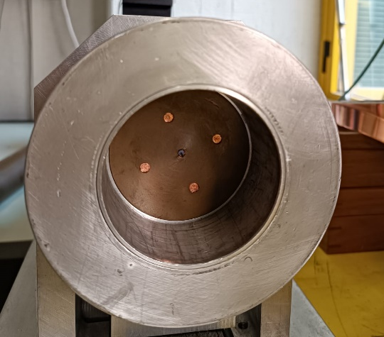
Real wireless measurements : proof of concept for a pillbox cavity
The telescopic setup and pillbox in the INFN section of Naples has been widely benchmarked in the past *
To compute the impedance we need to measure the $S_{21}^{DUT,REF}$, $Q$ and $f_{r}$
$$Z_{wireless}^{}(f)=\frac{Z_{TM}}{2π}\text{(}1−\frac{S_{21}^{DUT}}{S_{21}^{REF}}\text{)}$$
INFN Napoli
Plate to close the pipe
antenna
antenna
Pin of the antenna
Copper wall
Pipe with the antenna
* A. Passarelli, “Beam equipment electromagnetic interaction in accelerators: simulation and experimental benchmarking”, Master thesis, University of Naples “Federico II”, 2014 * S. Gallo, “Caratterizzazione dell'interazione elettromagnetica di uno "scraper" con il fascio di particelle in un acceleratore” , Master thesis, University of Naples “Federico II”, 2014

Slide 13
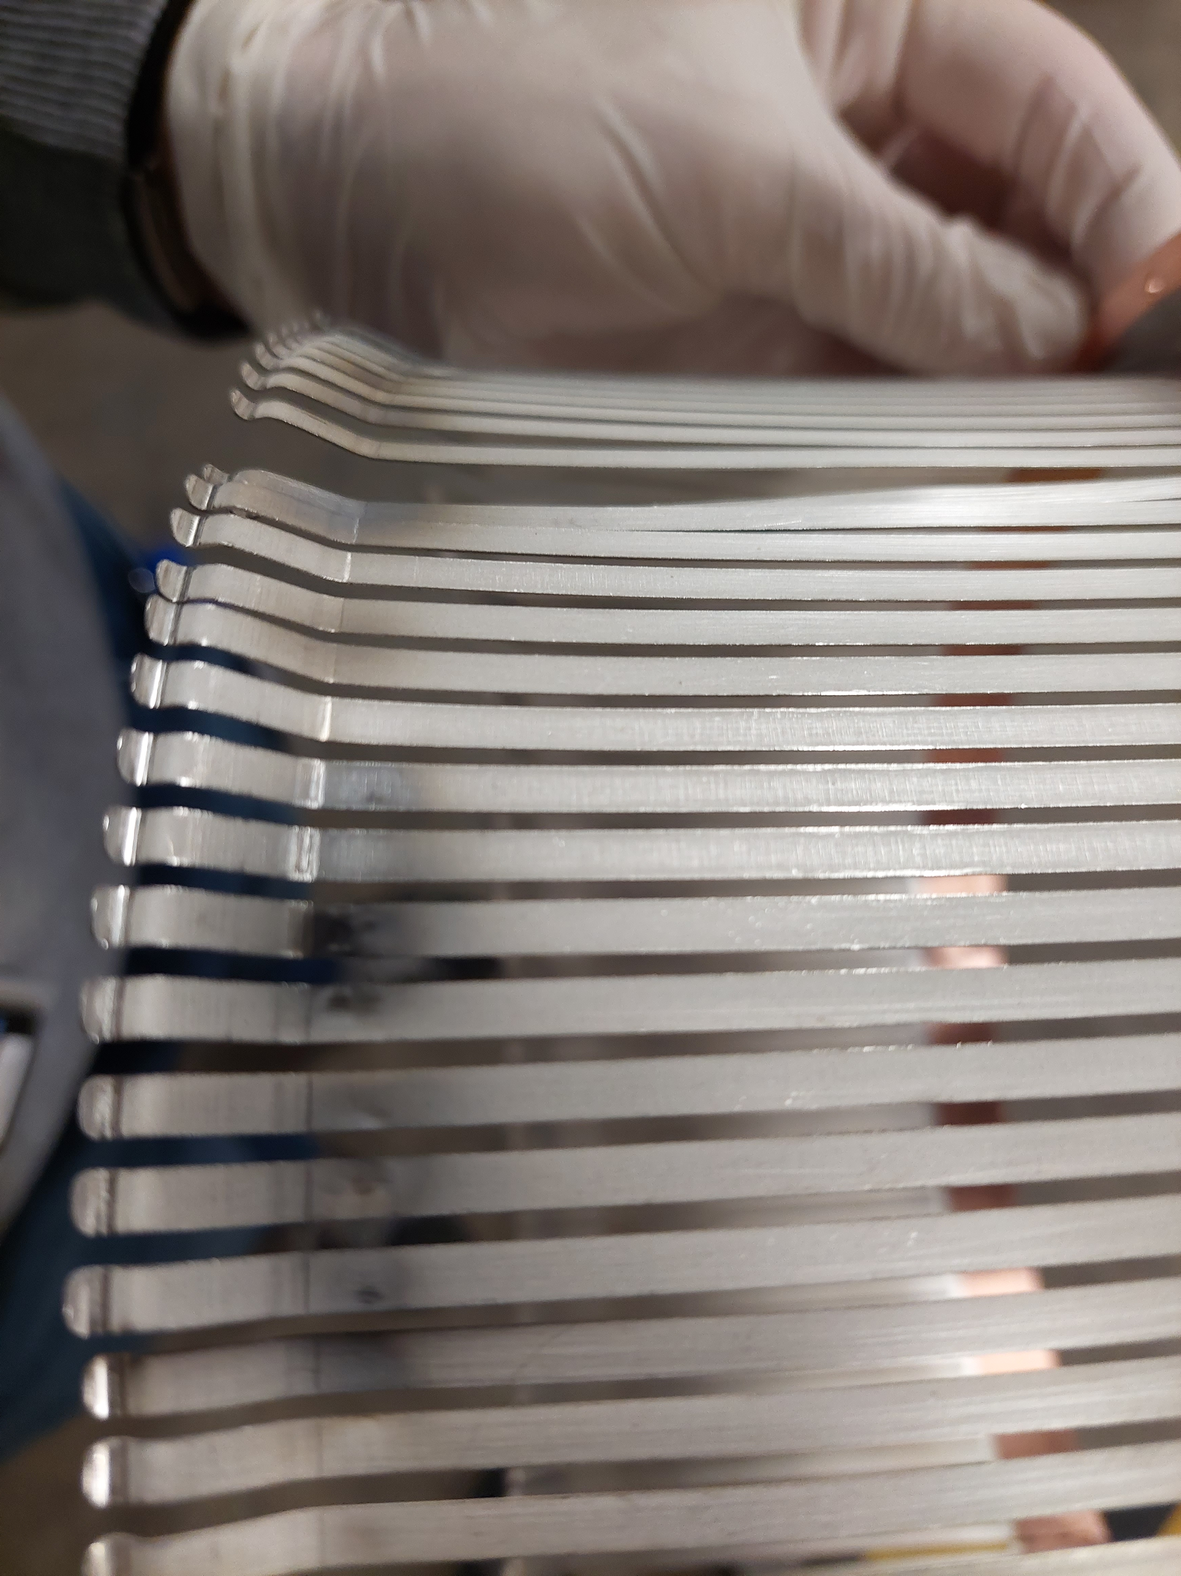
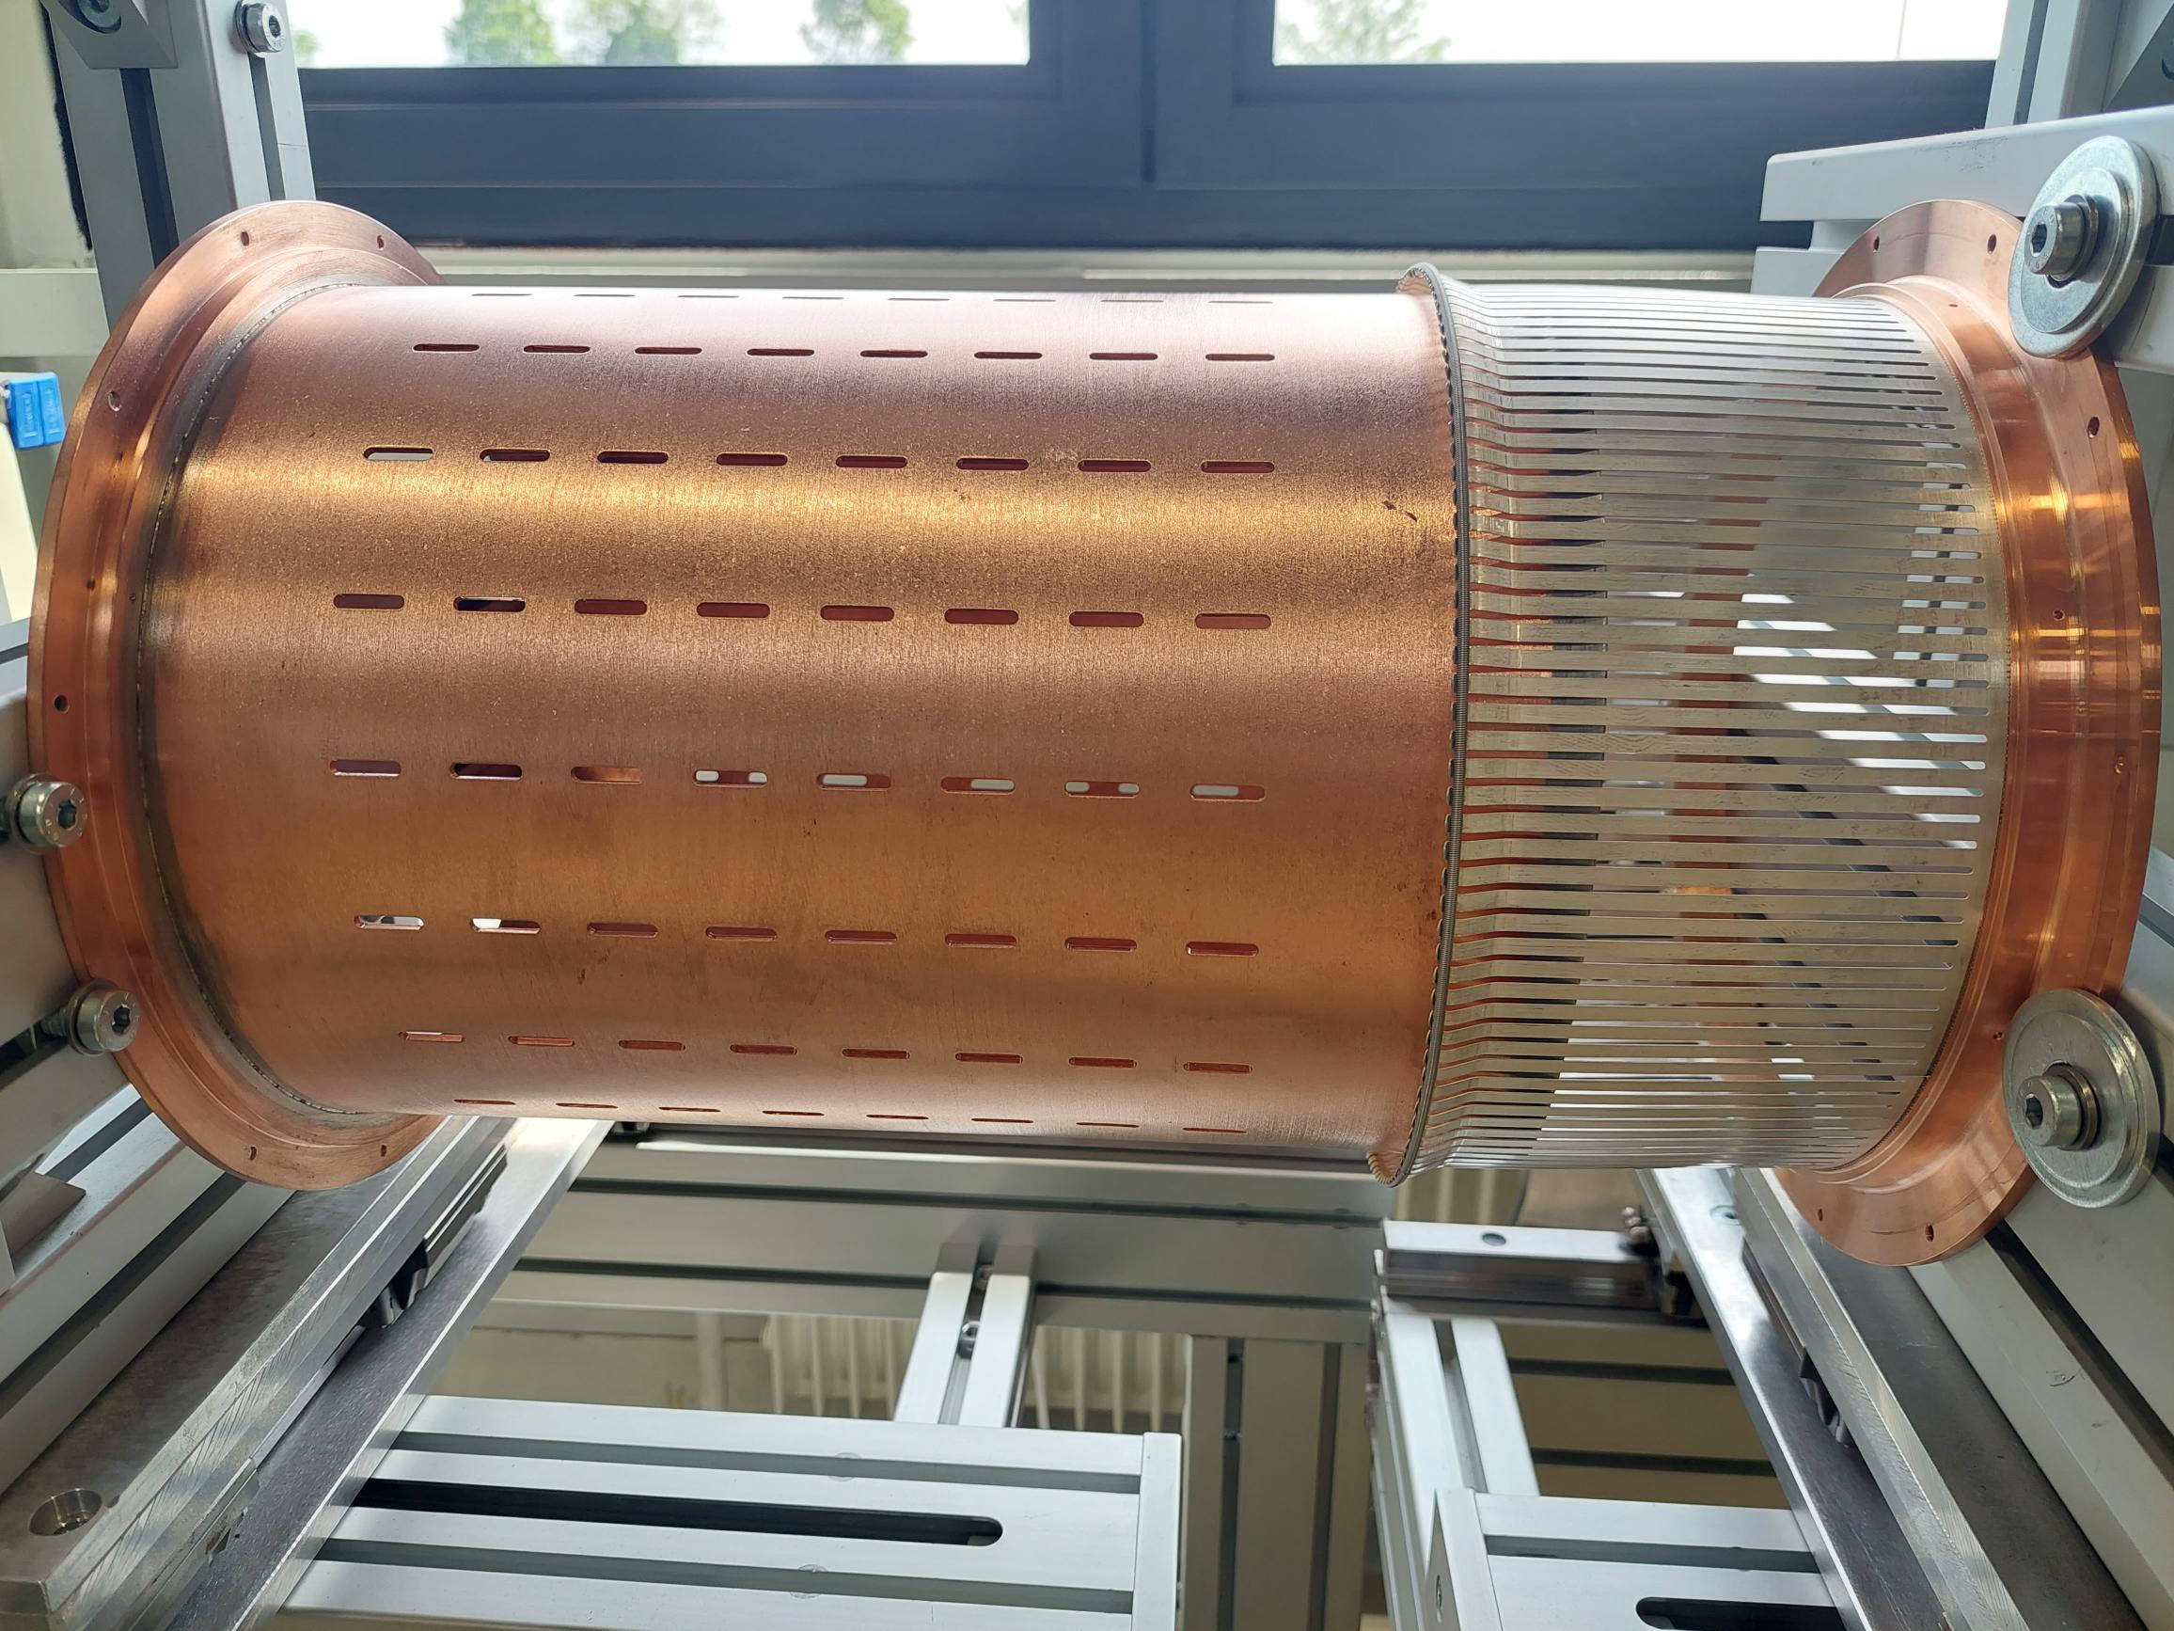
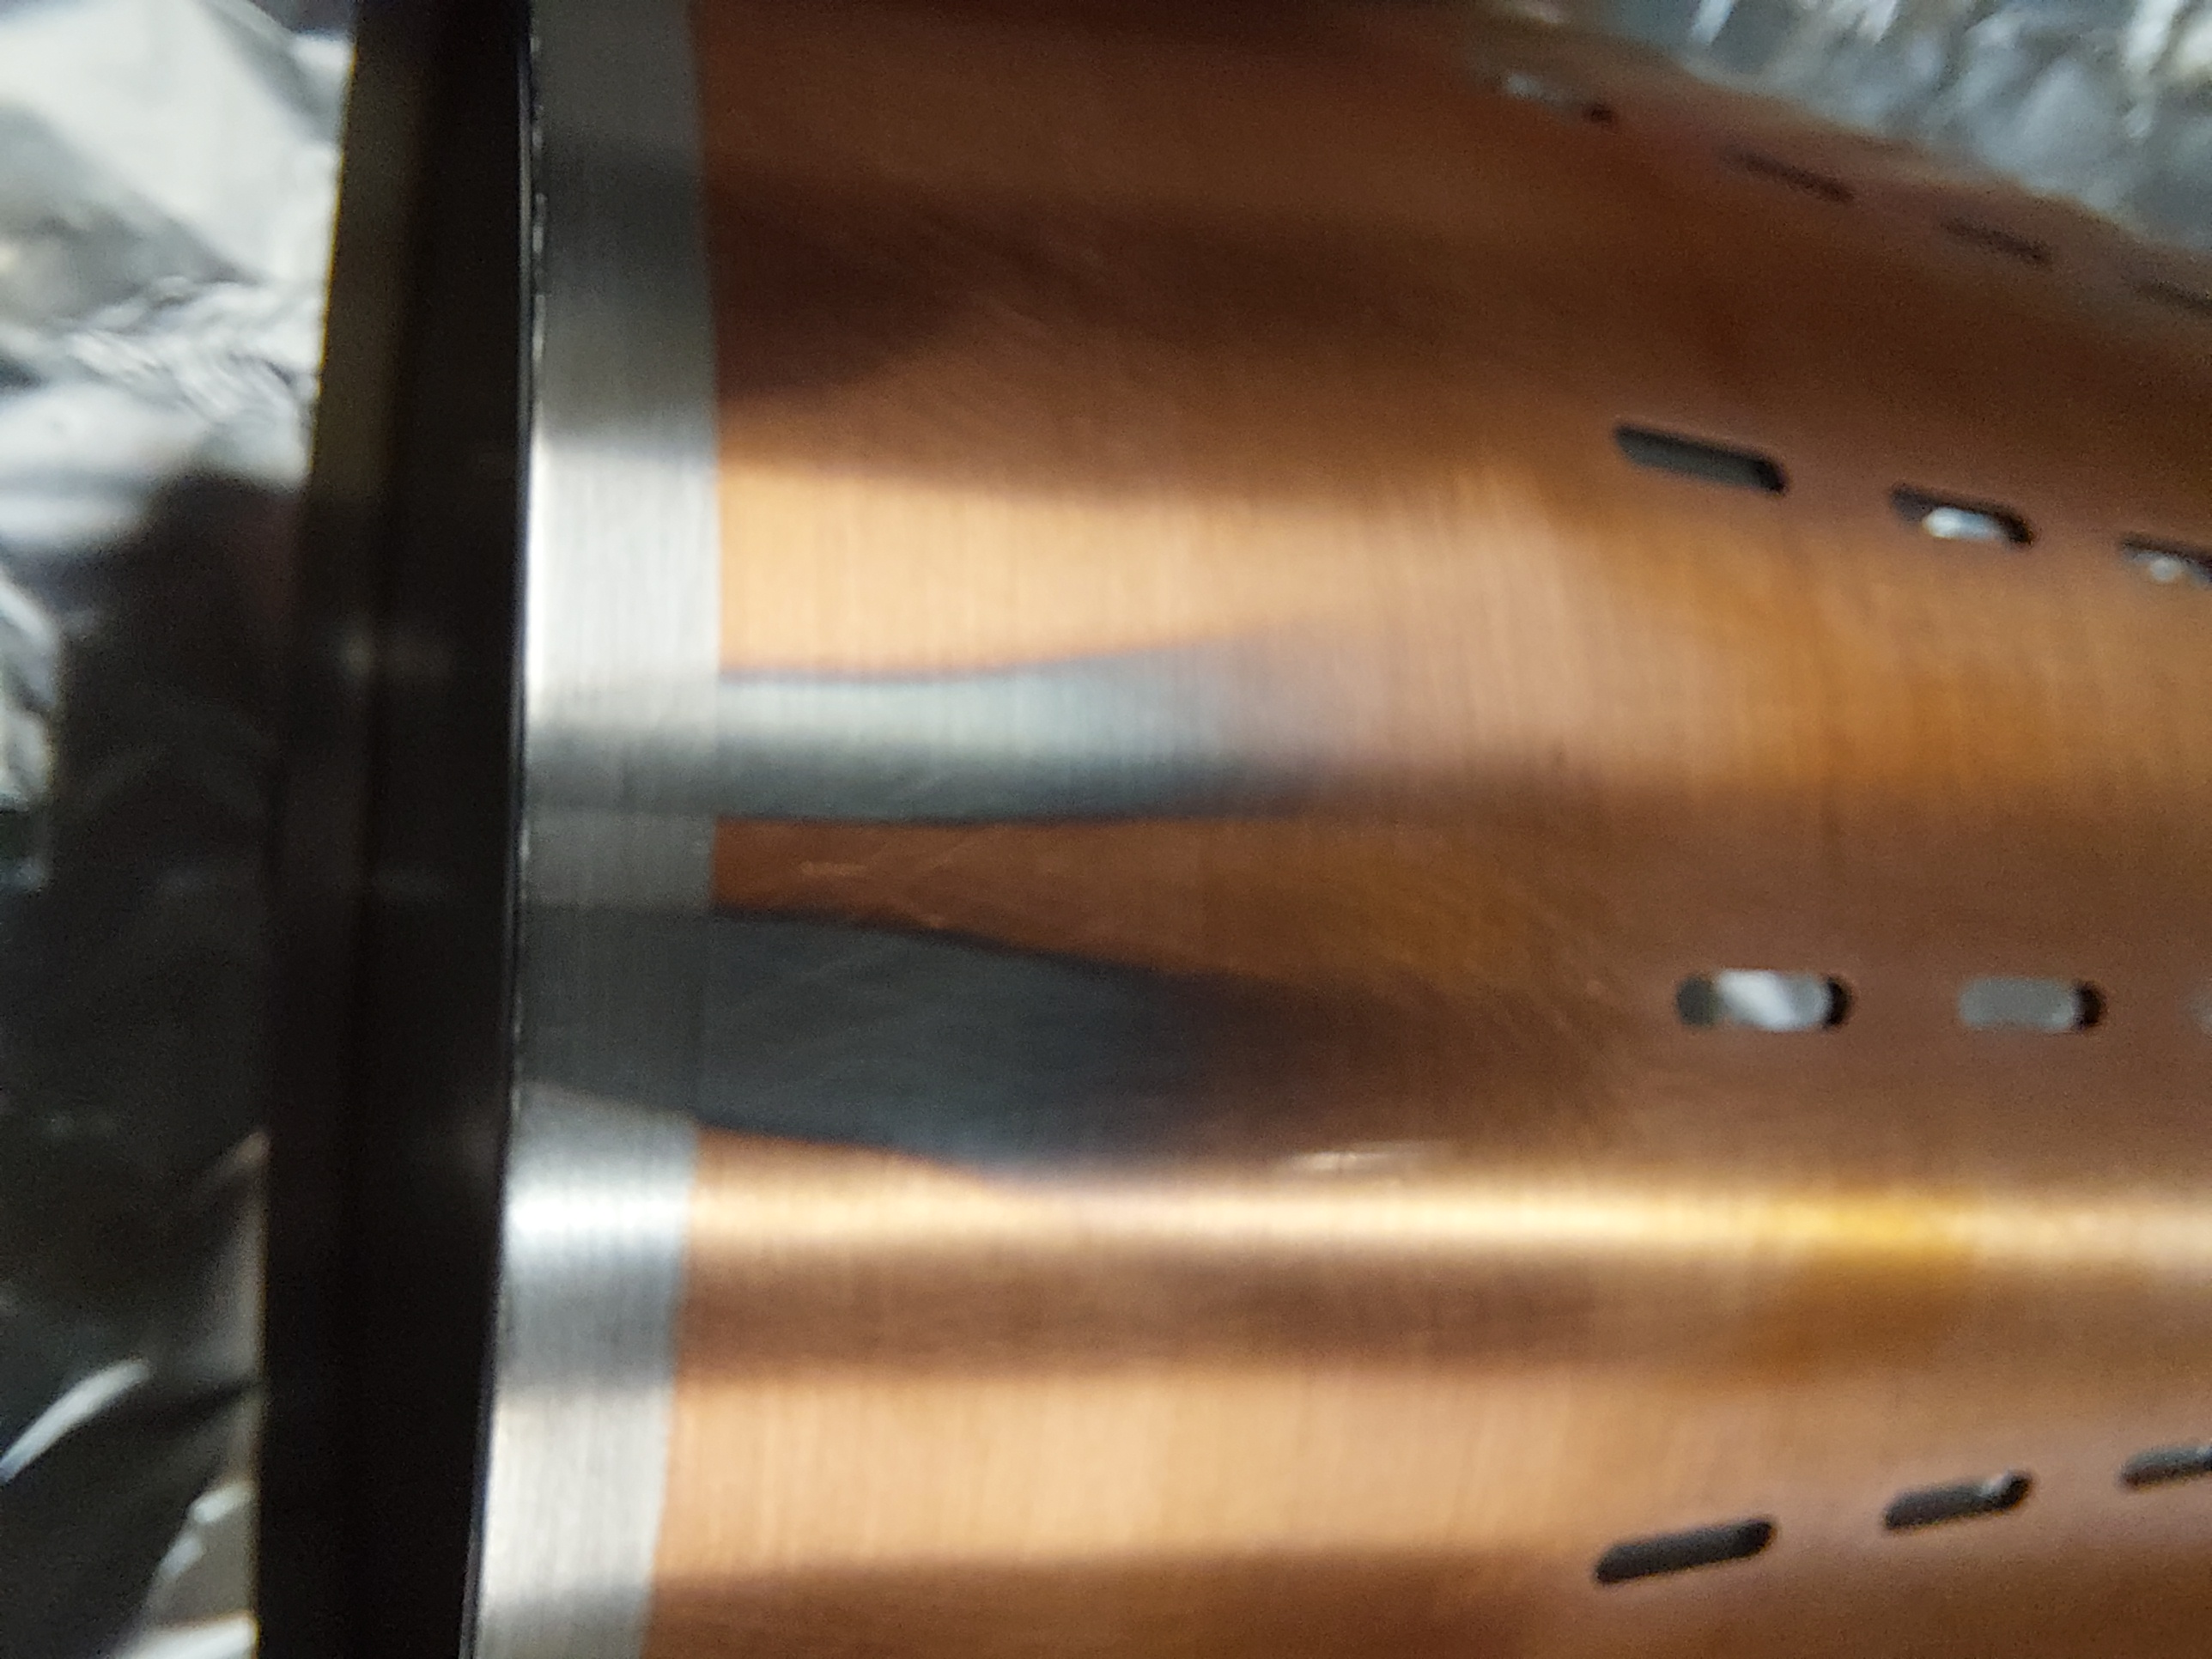
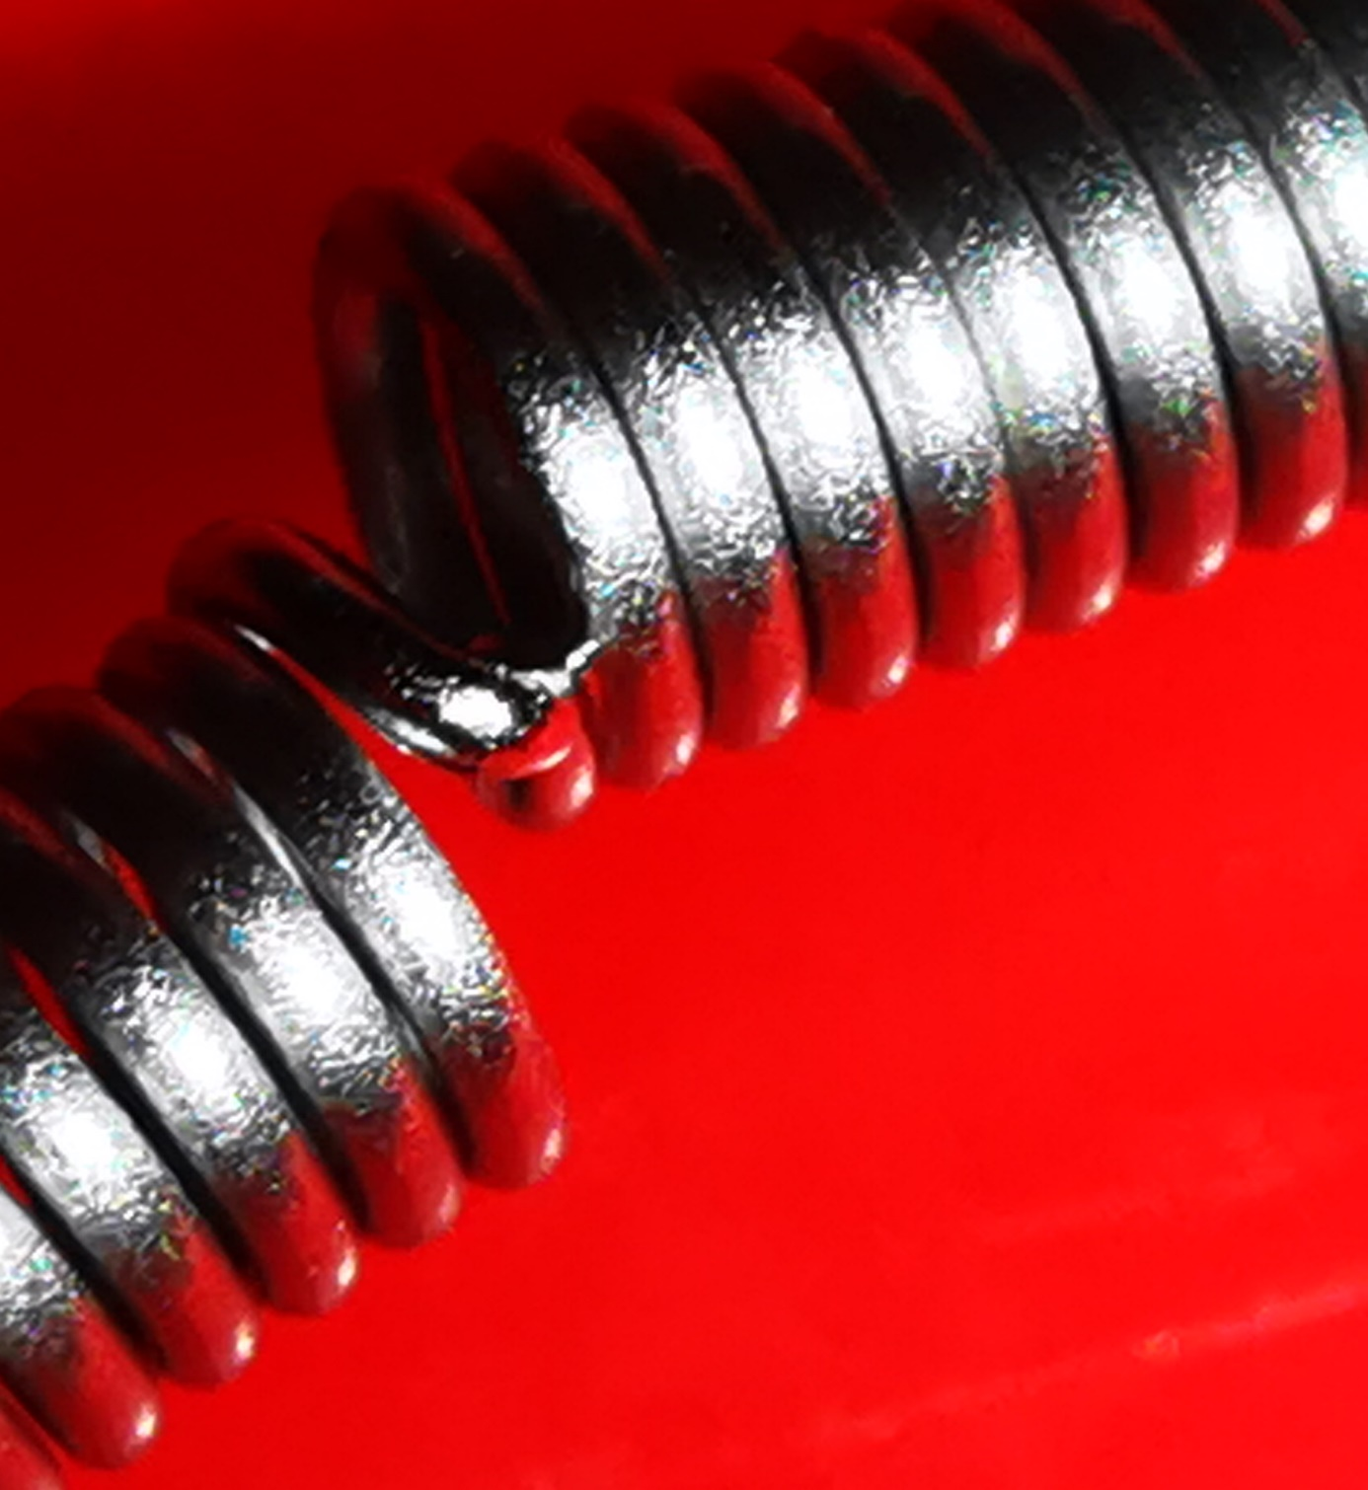
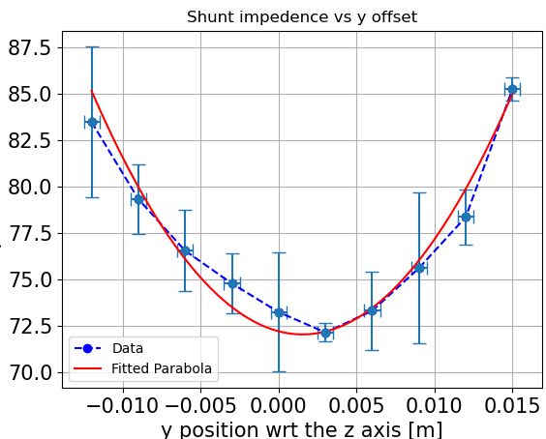
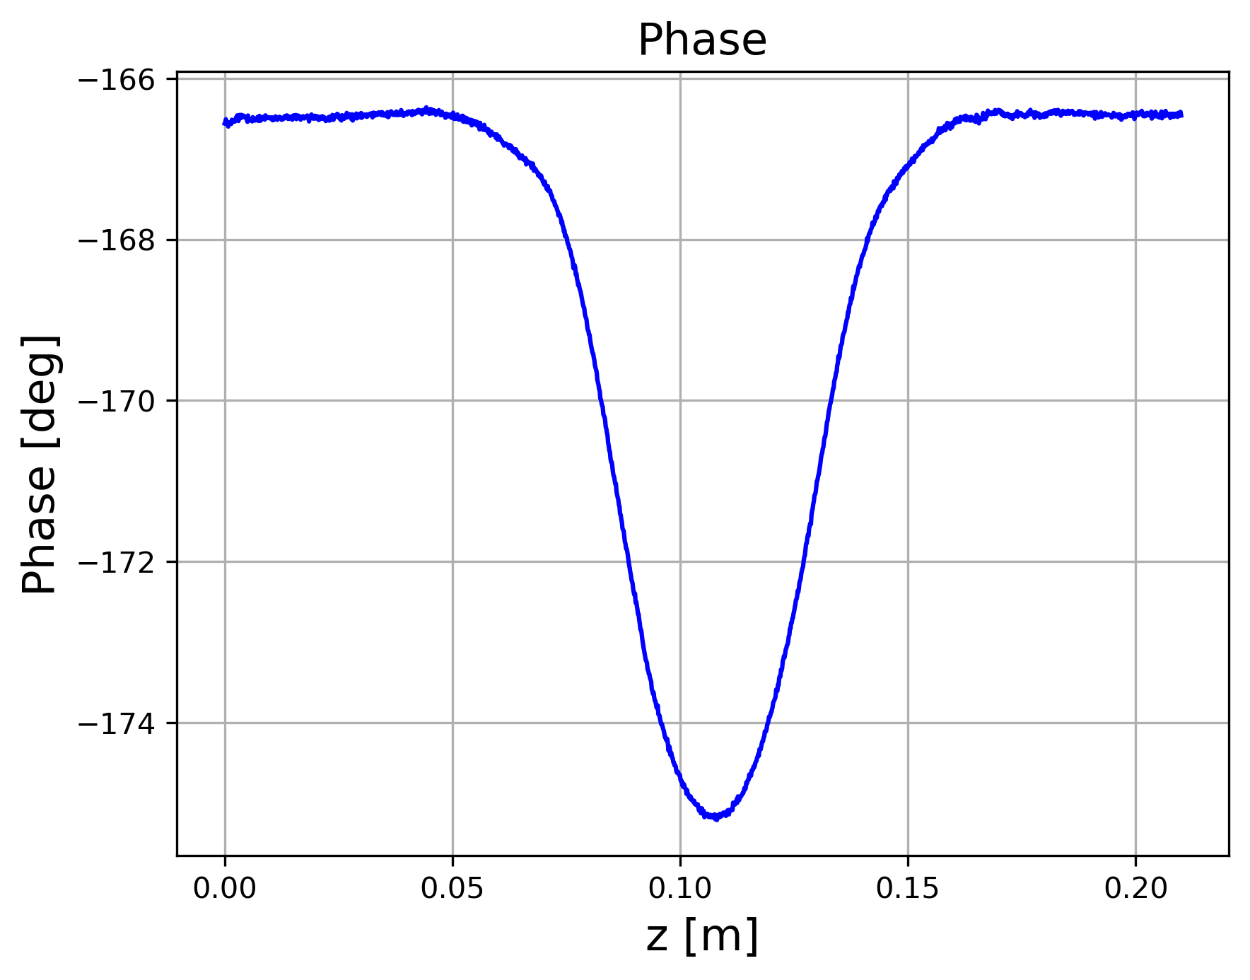
Others…
RF measurement and simulations for the installation of the LHC crystal goniometer (TCPC)
RF measurement and simulations for the RF fingers following the failure in the LHC due to beam impedance heating
Field leakage
Bead-pull technique for beam impedance measurements: transverse impedance performed for the first time!
Alternative bench measurements, still in the framework of wireless method (non-metallic wire)
I supervised a summer student working on this
Measure the Shunt Impedance: $R_{S}=\frac{Q_{0}}{2ω_{R}k_{SL}}(∫_{0}^{D}\sqrt{\frac{Δω(z)}{ω_{R}}}dz)^{2}$
Measure the phase $φ(z)$ when the bead is travelling in the cavity.

Slide 14
Outline
Introduction
Bench measurements
Standard methods and limitations
The new wireless method
Beam chambers
Resonant structure
Beam based measurements
Tune shift reference measurements at the PSB
Instability measurements at the PSB
Conclusions and outlook

Slide 15
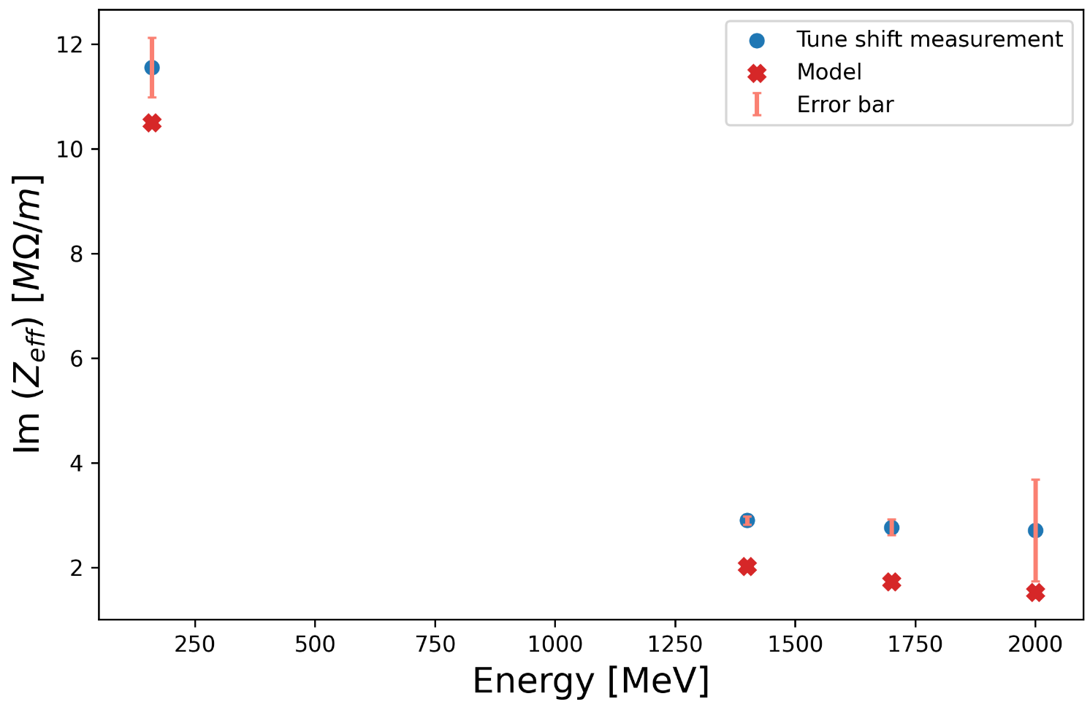
Impedance from tune shift
After the LHC Injectors Upgrade (LIU) project , the kinetic injection and extraction energy of the PS Booster have been increased from 50 MeV to 160 MeV and 1.4 GeV to 2 GeV.
need of new reference measurement campaigns
$$∆Q=−\sqrt{π}\frac{c^{2}Nr_{0}}{8π^{2}γω_{β}σ_{z}}Im(Z_{eff})$$
$r_{0}$: particle radius
$γ$: relativistic factor
$ω_{β}$: angular betratron frequency
$σ_{z}$ : bunch length
$N$: bunch intensity
First time
Slope of the linear fit $→∆Q$
1 MΩ/m
All measurements have good signal to noise ratio, except for 2 GeV, where a larger uncertainty is present
The impedance decreases as the energy increases, according to the indirect space charge reduction
Results are consistent with observations in the past, as expected (for 160 MeV and 1.4 GeV)
The discrepancy is about 1 MΩ and constant with energy suggesting that we are missing or underestimating some impedance contribution

Slide 16
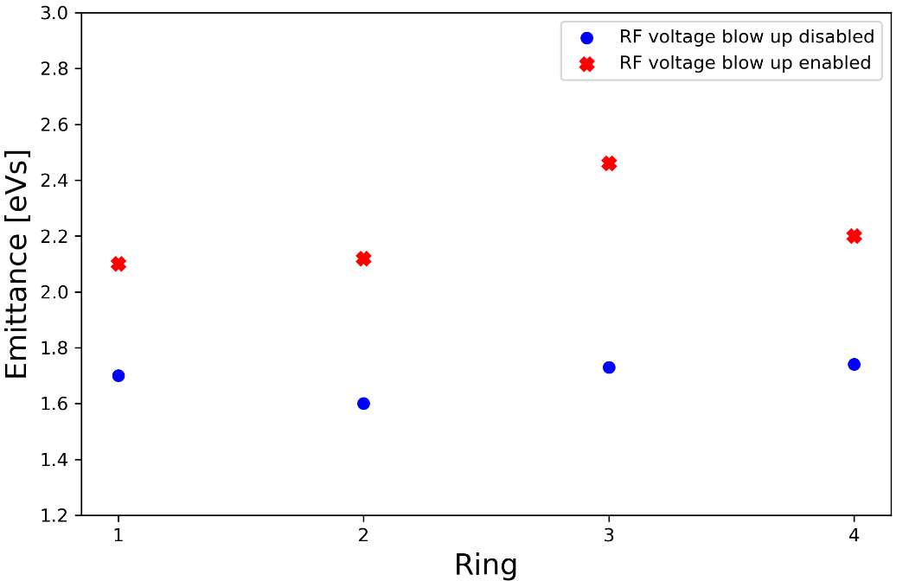
Instability measurements: 2022 Vs 2021
Horizontal instability (not yet understood) observed for the first time with high energy beam with TFB on, for intensities above 500e10 ppb*
Mitigation strategy identified: currently cured using linear coupling and QSKHO quadrupoles*
Accelerated more than 1000e10 protons!
Further studies conducted end of 2022
With TFB off
Ring | 2021 | 2022
R1 | ~250e10 ~C740 ms | ~300e10 ~C680 ms
R2 | ~250e10 ~C700 ms | ~350e10 ~C680 ms
R3 | ~350e10 ~C720 ms | ~530e10 ~C680 ms
R4 | ~350e10 ~C720 ms | ~390e10 ~C670 ms
Difference between 2021 and 2022!
2022 $$\overline{ε}=2.2$$ | 2022 $$\overline{ε}=1.7$$
~300e10 ~C680 ms | ~210e10 ~C680 ms
~350e10 ~C680 ms | ~255e10 ~C675 ms
~530e10 ~C680 ms | ~380e10 ~C680 ms
~390e10 ~C670 ms | ~320e10 ~C680 ms
Investigation of the reason of the different thresholds:
the different longitudinal emittance
Higher emittance $→$ higher thresholds
2022
* PSB reference measurements, C. Zannini, CEI section meeting, 12/08/2021

Slide 17
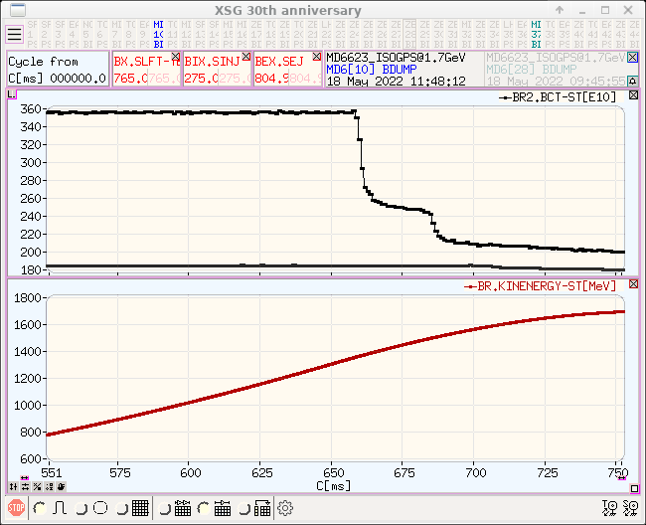
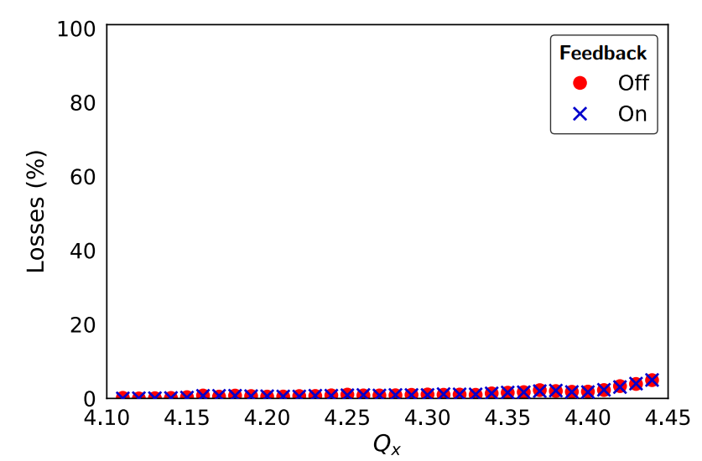
2022 instability: possible correlation with the “kicker instability”
Test changing the tune : the instability intensity thresholds could change with the energy and the tune as well
kicker instability
Not enough resolution
Finer scan of the tune is needed
Repeat the test with matched kicker cable as done in the past
The termination of the cable of the extraction kicker has been matched
Close to the energy ($≈$1.3 GeV) at which the kicker instability* was observed
Ongoing:
Finer scan of the tune (very recent)
The instability is not observed anymore!
To do:
Test with matched kicker cable planned for the 31st October
* Source of horizontal instability at the CERN Proton Synchrotron Booster, E. Koukovini-Platia, M.J. Barnes, H. Bartosik, G. Rumolo, L. Sermeus, C. Zannini, December 2019

Slide 18
Conclusions and outlook
Bench measurements and beam-based measurements of the impedance have been presented
Bench measurements:
A new wireless method to evaluate the impedance is proposed
Studied analytically and in simulations for beam chambers
Measurements on beam chambers (ongoing)
Studied in simulations for resonant structures and a proof of concept measurement has been performed with very good results
Test on more complex structure (ongoing)
Beam based measurements
Tune reference measurements performed to benchmark the impedance model
First time at 1.7 and 2 GeV
Additional work required to improve the impedance model of the machine
Instability measurement performed and a possible comprehension of the instability mechanism is under study for the PSB
Test with matched kicker cable at the end of the Run

Slide 19
Thank you !

Slide 20
Backup

Slide 21
How to measure the tune shift
In order to measure the transverse tune we can use the base-band-tune (BBQ) system.
It excites transversely the beam in both planes with a chirp signal.
FFT
For several beam intensities we acquires the horizontal and vertical tunes $Q_{x}$ and $Q_{y}$ .
The tune shifts : Δ $Q_{x,y}$=$Q_{x,y}\left({Int}_{max}\right)−Q_{x,y}\left({Int}_{min}\right)$.

Slide 22
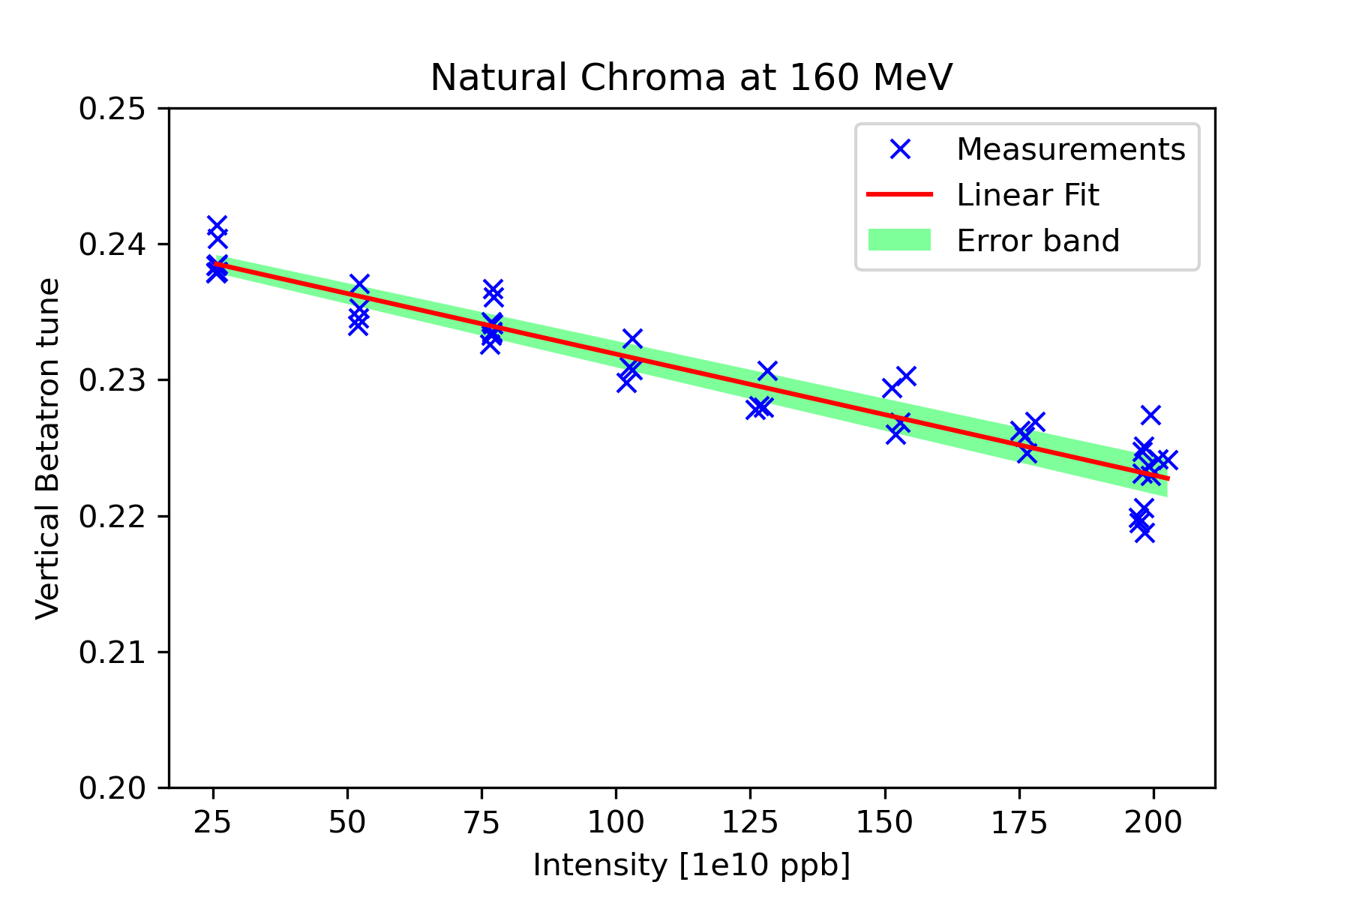
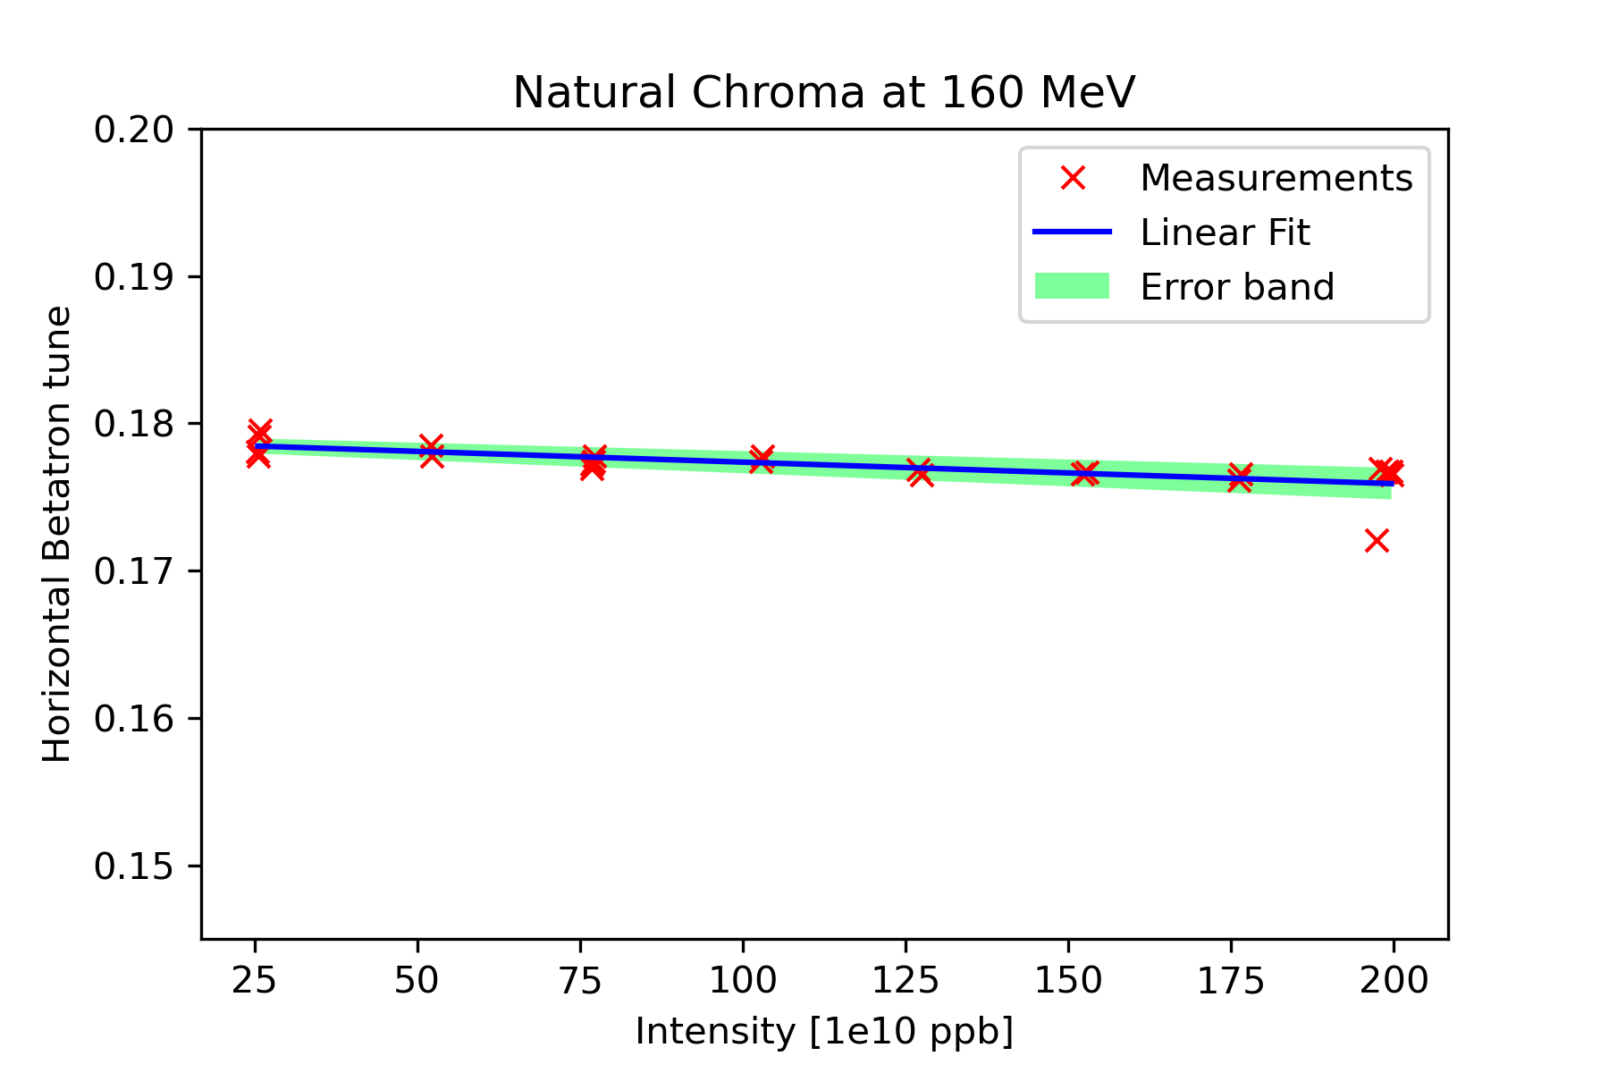
Measurements | Slope | $$Z_{eff}$$ [MΩ/m]
Post-LS2 2021, Ring 3, V plane 2021 , Ring 3, H plane | 6.7 e-5 1.1 e-5 | 11.70 1.90
2022 , Ring 3, V plane 2022 , Ring 3, H plane | 8.90e-5 $±$ 4.14e-6 1.46e-5 $±$ 3.22e-6 | $11.56$ $±$ 0.57 1.87 $±$ 0.41
The horizontal tune shift is much less than the vertical one.
The impedance at 160 MeV is dominated by the indirect space charge. It will decrease with the energy.
The effective impedances computed from the different tune shift measurements are consistent.

Slide 23
Instability measurements: 2022 Vs 2021
Horizontal instability (not yet understood) observed for the first time with high energy beam with TFB on, for intensities above 500e10 ppb*
Studies carried out in 2021*:
Intensity threshold depends on chromaticity
Suspected TMCI but intrabunch motion also observed
Mitigation strategy identified: currently cured using linear coupling and QSKHO quadrupoles*
Accelerated more than 1000e10 protons!
With TFB off
Difference between 2021 and 2022!
Ring | 2021 | 2022
R1 | ~250e10 ~C740 ms | ~300e10 ~C680 ms
R2 | ~250e10 ~C700 ms | ~350e10 ~C680 ms
R3 | ~350e10 ~C720 ms | ~530e10 ~C680 ms
R4 | ~350e10 ~C720 ms | ~390e10 ~C670 ms
2022 $$\overline{ε}=2.2$$ | 2022 $$\overline{ε}=1.7$$
~300e10 ~C680 ms | ~210e10 ~C680 ms
~350e10 ~C680 ms | ~255e10 ~C675 ms
~530e10 ~C680 ms | ~380e10 ~C680 ms
~390e10 ~C670 ms | ~320e10 ~C680 ms
Investigation of the reason of the different thresholds:
the different longitudinal emittance
Higher emittance $→$ higher thresholds
2022
* PSB reference measurements, C. Zannini, CEI section meeting, 12/08/2021

Slide 24
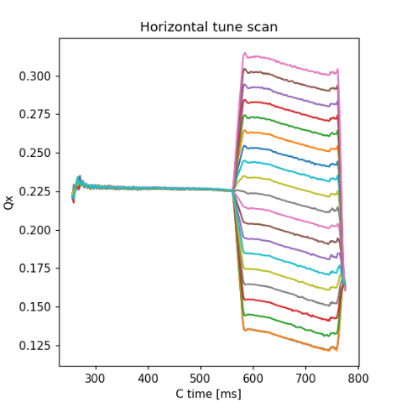
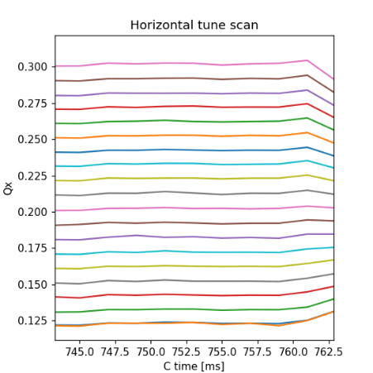
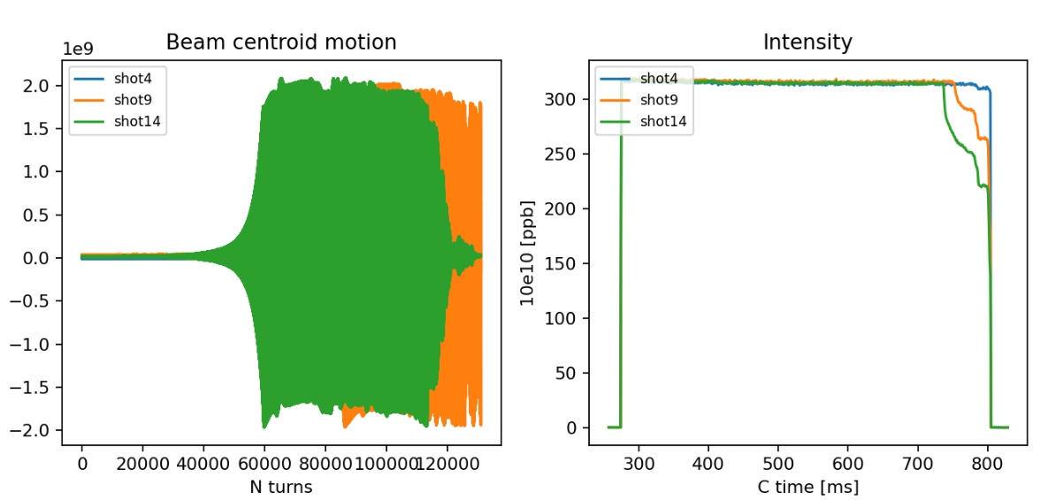
2022 instability measurements: losses and rise time versus tune
Scan of the tune on a plateau (constant energy) with the 1.7 GeV cycle
Not enough resolution
Finer scan of the tune is needed
Longer plateau would be beneficial
more degrees of freedom
Repeat the test with matched kicker cable as done in the past
Measure losses and rise time
Ongoing:
Finer scan of the tune (very recent)
Rise time
Losses (%)
To do:
Test with matched kicker cable planned for the 31st October

Slide 25
Wireless method for beam chamber: generalized formula
The analytical approach was carried out under the following assumption :
$ζ_{c}=(1+j)$ $ζ$, $ζ=\sqrt{ωμ_{0}/2σ}$
$r≫δ$= $\sqrt{\frac{ω}{2μ_{0 }σ}}$
The improved analytical approach removes the first assumption and considers a generic wall surface impedance:
$ζ_{c}=$ $ζ_{R}+jζ_{J}$
$r≫δ$= $\sqrt{\frac{ω}{2μ_{0 }σ}}$
$S_{21}$ is derived applying the equation of conservation of the energy from the attenuation constant $α$ *:
$S_{21}=exp\left(−\left|α\right|z\right)$
The wireless log-formula assumes the following form :
$ω$ : angular frequency
$μ_{0}$: magnetic permeability of free space
$σ$ : wall conductivity
$$Z_{wireless}=−\frac{Z_{TM}}{M 2π}\ln{\frac{S_{21}^{DUT}}{S_{21}^{REF}}}$$
* D. M. Pozar, Microwave Engineering. New York: Wiley, 1998

Slide 26
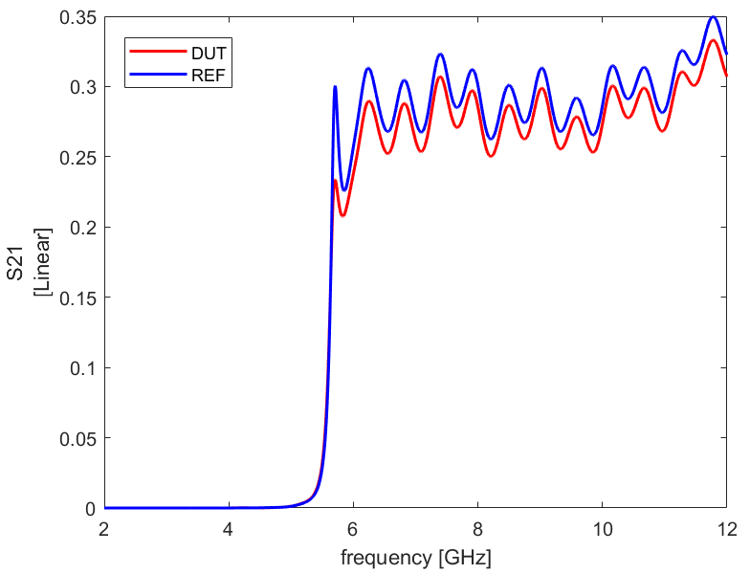
Wireless method for beam chamber: virtual measurement setup
After the appropriate adjustments to my case of interest, the proposed coupler * has been tested on a circular beam pipe
Linear coaxial taper from coaxial cable to outer circular pipe
Inner conductor ends abruptly forming an annular gap which excites the ${TM}_{0n}$ waveguides modes (E fields at the wall are radial, independent of azimuth)
Absorbing material : the shape is optimized to yield the most smooth transmission over the frequency range
The advantage: the smoothest $S_{21}$ compared to the others studied couplers
The impedance can be obtained with good agreement above the cut-off frequency of the chamber
Not working below cut-off
very low signal
cut-off
Could we find a simpler coupler to obtain the impedance for beam chambers?
* G. R. Lambertson, A. F. Jacob, R. A. Rimmer, and F. Voelker, “Techniques for Beam Impedance Measurements Above Cut-off”, in Proc. EPAC’90, Nice, France, Jun. 1990, pp. 1049–1052

Slide 27
Wireless method for the pillbox cavity : probe as TM coupler
We insert the probe in such a way that we do not perturb ( and we are undercoupled )
We fix the position of the probe
$$Z_{wireless}^{∗}(f)=\frac{Z_{TM}}{2π}\text{(}1−\frac{S_{21}^{DUT}}{S_{21}^{REF}}\text{)}$$
Again, very good agreement!

Slide 28
Technique
Pulley system;
Arduino script+motor;
+ Different beads.
Measure the phase $φ(z)$ when the bead is travelling in the cavity.
Measure the Shunt Impedance:
$$R_{S}=\frac{Q_{0}}{2ω_{R}k_{SL}}(∫_{0}^{D}\sqrt{\frac{Δω(z)}{ω_{R}}}dz)^{2}$$
Calibration constant $k_{SL}$
Normalized Delta frequency

Slide 29
Transverse Impedance measurements
We expect to get a parabola, from which we can measure the transverse impedance.
 $R_{S}=A⋅{\text{offset}}^{2}+B⋅\text{offset}+C$
Y
 $R_{T}=\frac{A⋅c}{2πf_{R}}=1.412\frac{\text{M}\text{Ω}}{m}$
X

Slide 30
Measurements on the y axis (x=0)
Goodness of the fit:
$$P(χ^{2}>2.3)=94\%$$
$$R_{S}=Ay^{2}+By+C$$
A | 71714713
B | -220165
C | 72207
$$R_{T}|_{measured}=\frac{A⋅c}{2πf_{R}}=1.412\frac{\text{M}\text{Ω}}{m}$$
$$R_{T}|_{simulated}=1.661\frac{\text{M}\text{Ω}}{m}$$

Slide 31
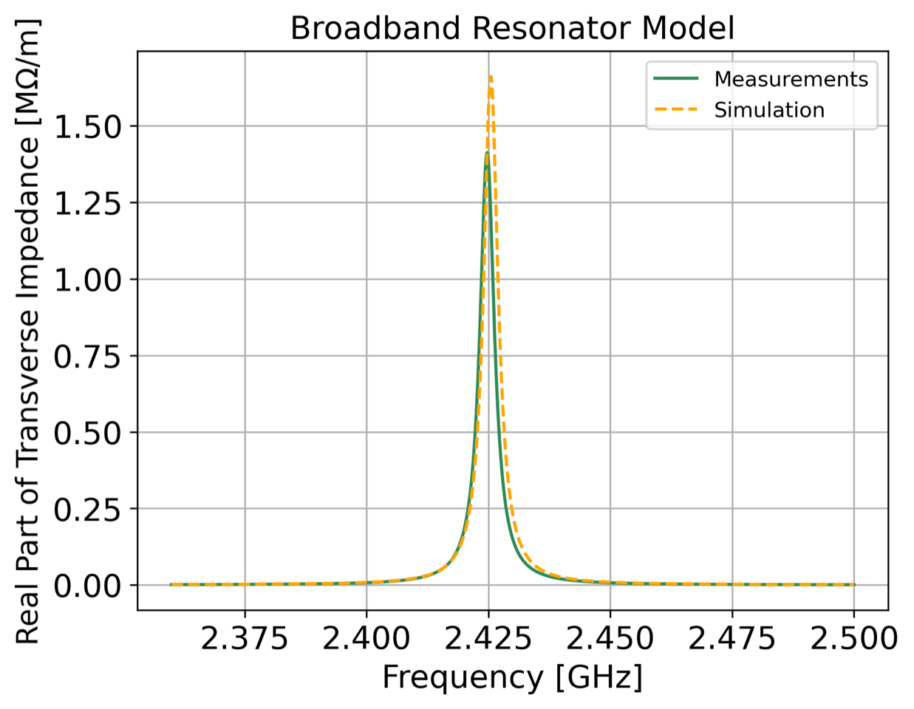
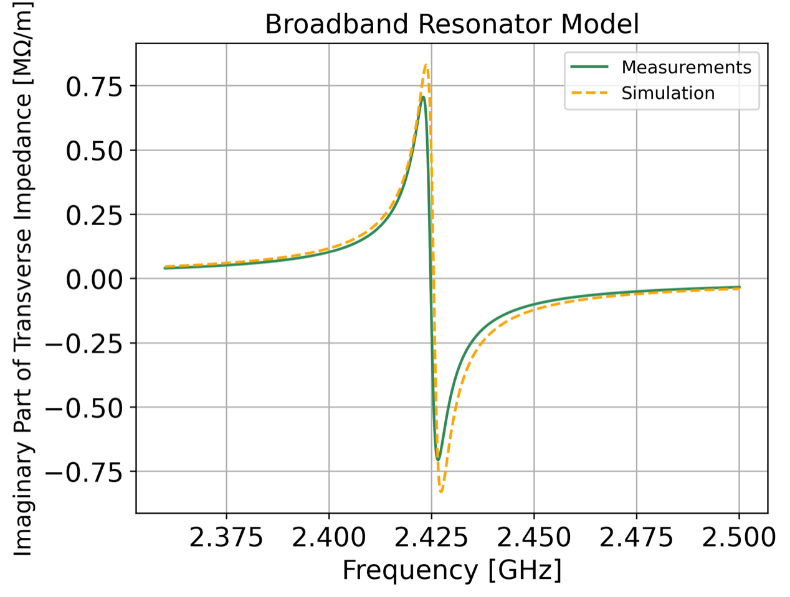
Comparison between measurements and simulation
of Transverse Impedance on the y axis

Slide 32
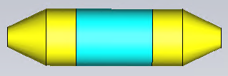
Virtual wireless method for resonant structures
DUT
$$Z_{wireless}(f)=\frac{Z_{TM}}{2π}\text{(}1−\frac{S_{21}^{DUT}}{S_{21}^{REF}}\text{)}$$
REF
The clear advantage compared to the wire method is evident!
Same results obtained exciting with the coaxial probe setup

Slide 33
Wireless method measurement: proof of concept for a pillbox cavity
Pipe with the antenna
INFN Napoli
Plate to close the pipe
antenna
antenna
Pin of the antenna
Copper wall
The telescopic setup and pillbox in the INFN section of Naples has been widely benchmarked in the past *
It is a pillbox cavity with a movable setup which allows to close the beam pipe at different distances from the cavity
The minimum distance plate-cavity is 4.5 cm
The penetration of the antenna inside the pipe is fixed at 0.7 cm
To compute the impedance we need to measure the $S_{21}^{DUT,REF}$, $Q$ and $f_{r}$
$$Z_{wireless}^{}(f)=\frac{Z_{TM}}{2π}\text{(}1−\frac{S_{21}^{DUT}}{S_{21}^{REF}}\text{)}$$
* A. Passarelli, “Beam equipment electromagnetic interaction in accelerators: simulation and experimental benchmarking”, Master thesis, University of Naples “Federico II”, 2014 * S. Gallo, “Caratterizzazione dell'interazione elettromagnetica di uno "scraper" con il fascio di particelle in un acceleratore” , Master thesis, University of Naples “Federico II”, 2014

Slide 34
Experimental results Vs expectations: $f_{r}$ and $Q$
The resonant frequencies and the quality factors are in a very good agreement between measurements and simulations:
The maximum relative error is around 5% for the determination of the Q
The maximum relative error is around 0.003% for the determination of the $f_{r}$
The Q is the unloaded parameter, Q of the cavity itself
Measured at one fixed position of the probe
Obtained through the unloading of the measured Q (loaded Q)
In such a way the contribution of the probe setup is decoupled
The results are also in agreement with the measurements performed in the past with the telescopic setup *

Slide 35
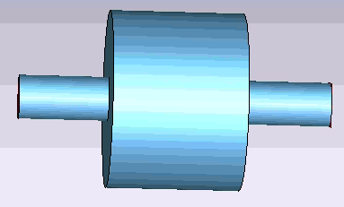
Resonant structures: analytical approach
$R_{s}$ shunt impedance
$Q$ loaded quality factor
$δ=\frac{f}{f_{0}}−\frac{f_{0}}{f}$
From the resonator model, the impedance of a resonant structure can be computed as follows*:
$Z(f)=R_{s}\frac{ (1−jQδ)}{1+{(Qδ)}^{2}}$
$$E_{z}=\frac{1}{jω_{0}ε_{0}}\frac{χ_{01}}{r}\sqrt{\frac{1}{π}}\frac{J_{0}(χ_{01}\frac{ρ}{r})}{J_{1}(χ_{01})}$$
For a pillbox cavity and considering the fundamental mode ${TM}_{010}$
$Z\left(f_{010}\right)=R_{s}$
$R_{s}$ can be derived from em fields
$$H_{φ}=μ_{0}\sqrt{\frac{1}{πa}}\frac{J_{0}(χ_{01}\frac{ρ}{r})}{J_{1}(χ_{01})}$$
$R_{s}=\frac{\sqrt{2 r ησχ_{01}}}{2(1+\frac{r}{l})}\frac{1}{(1+2β)}\frac{4}{{\frac{l}{r} χ}_{01}^{3}}\frac{\sin^{2}{(\frac{χ_{01}l}{2r})}}{{J_{1}(χ_{01})}^{2}}$ $\frac{η}{π}$ = $Q_{0Pbox}\frac{1}{(1+2β)}\frac{4}{{ χ}_{01}^{3}}\frac{\sin^{2}{(\frac{χ_{01}l}{2r})}}{{J_{1}(χ_{01})}^{2}}$ $\frac{ηr}{πl}$
Unkown parameters
Known parameters
The impedance depends on many parameters:
Geometric dimensions ($l,r$)
Material properties ($σ$, which is contained in $Q_{0Pbox}$)
Excitation of the structure ($β=\frac{Q_{0}}{Q_{ext}}$, the coupling factor)
$Q_{0Pbox}$and $β$ can be computed from $S_{21}$ !
To directly link the beam impedance and $S_{21}$
$→$ we need an analytical expression for $S_{21}$
Mar 16, 2023
CEI section meeting
Mar 16, 2023
CEI section meeting
35
Mar 16, 2023
CEI section meeting

Slide 36
Pillbox cavity: analytical expression for $S_{21}$
cavity
Equivalent circuit of a resonant mode of a cavity
The ports represent the coupling with the excitation source (power generator / circulating beam etc...)
$$V_{inc}$$
$$V_{out}$$
RLC resonance circuit represents the cavity itself
$$S_{21}=\frac{V_{out}}{V_{inc}}=after some calculations…=\frac{\frac{2β}{\left(1+2β\right)}}{\left(1+jQδ\right)} → S_{21}\left(f_{0}\right)=\frac{2β}{(1+2β)}$$
Also for the pillbox cavity is possible to directly link the beam impedance with the S21
$R_{s}(f_{0})=Q_{0Pbox}\text{(}\frac{1}{(1+2β)}\text{)}\frac{4}{{ χ}_{01}^{3}}\frac{\sin^{2}{(\frac{χ_{01}l}{2a})}}{{J_{1}(χ_{01})}^{2}}$ $\frac{ηa}{πl}$
$R_{s}(f_{0})=Q_{0Pbox}\text{(}1−S_{21}\text{)}\frac{4}{{ χ}_{01}^{3}}\frac{\sin^{2}{(\frac{χ_{01}l}{2a})}}{{J_{1}(χ_{01})}^{2}}$ $\frac{ηa}{πl}$
How can we get the S21 from simulations/measurements?
How can we excite the structure in the proper way?
Mar 16, 2023
CEI section meeting
Mar 16, 2023
CEI section meeting
36

Slide 37
Investigation of the TM coupler
As done for the beam chambers, several studies have been conducted to find the proper excitation in a real bench setup
A simple taper / transition seems to be the best option
Possible optimization of the device are still ongoing
The resonances agree with the impedance resonances from wakefield and eigenmode simulations !
It could really be the right way to excite the strcture
More in backup
Nov 22, 2022
Feb 15, 2023
Mar 16, 2023
Mar 16, 2023
CEI section meeting
CEI section meeting
IWG
CEI section meeting

Slide 38
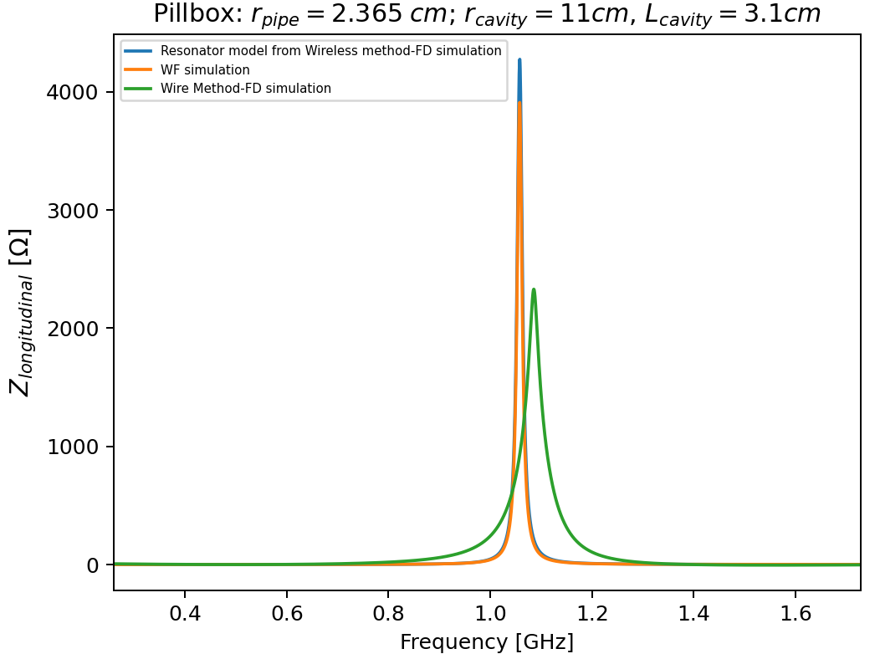
Implementation of the Wireless method for the pillbox cavity
Good agreement
Clear advantage compared to the wire method is evident
$R_{s}(f_{0})=$ $Q_{0Pbox}\text{(}1−S_{21}\text{)}\frac{4}{{ χ}_{01}^{3}}\frac{\sin^{2}{(\frac{χ_{01}l}{2a})}}{{J_{1}(χ_{01})}^{2}}$ $\frac{ηa}{πl}$
Resonator model
$Q_{0Pbox}$, $R_{s}, f_{r}$ computed from the simulated $S_{21}$
Wireless method: very good resolution in the determination of $f_{r}$, $Q$ $→$ agreement with wakefield and eigenmode simulations
the analytic approach for $f_{r010}$shows a relation between $S_{21}$ and the beam impedance
Is it possible to find a relation between the $S_{21}$ and the beam impedance, as done for beam chambers in the case of wireless method?
Could we get the impedance for every resonant structure and for the whole frequency range?
Mar 16, 2023
CEI section meeting

Slide 39
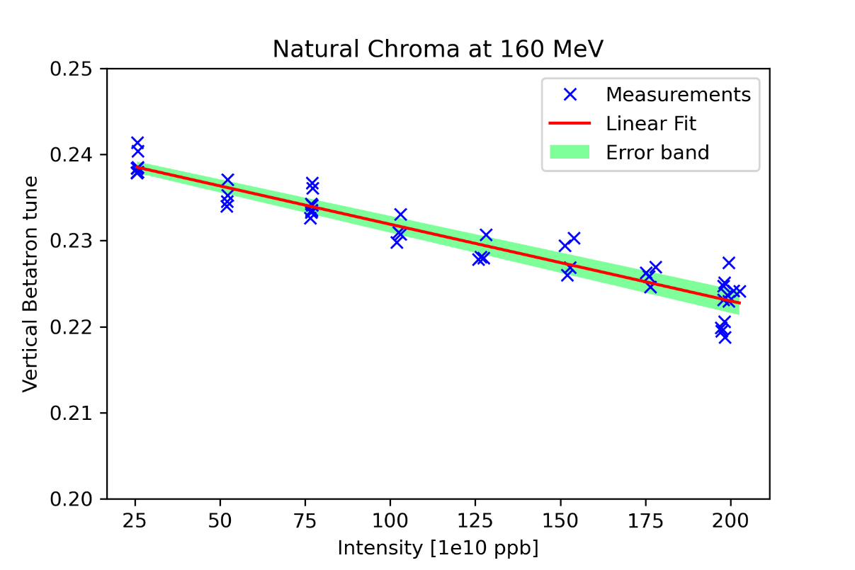
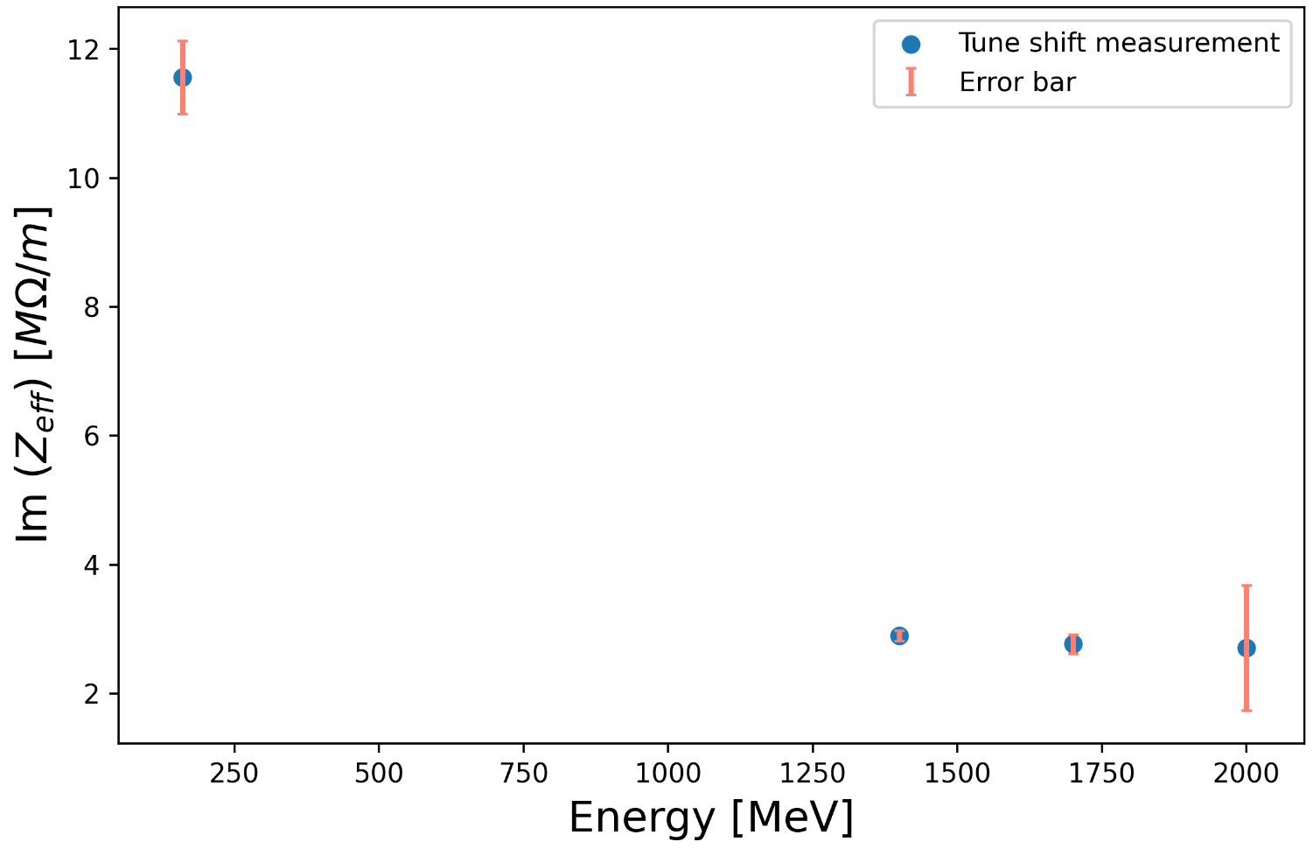
Impedance from tune shift
$$∆Q=−\sqrt{π}\frac{c^{2}Nr_{0}}{8π^{2}γω_{β}σ_{z}}Im(Z_{eff})$$
Slope of the linear fit $→∆Q$
$r_{0}$: particle radius
$γ$: relativistic factor
$ω_{β}$: angular betratron frequency
$σ_{z}$ : bunch length
$N$: bunch intensity

Slide 40
Impedance from tune shift
$$∆Q=−\sqrt{π}\frac{c^{2}Nr_{0}}{8π^{2}γω_{β}σ_{z}}Im(Z_{eff})$$
Slope of the linear fit $→∆Q$
Slope of the linear fit $→∆Q$
$r_{0}$: particle radius
$γ$: relativistic factor
$ω_{β}$: angular betratron frequency
$σ_{z}$ : bunch length
$N$: bunch intensity

