Slide 1
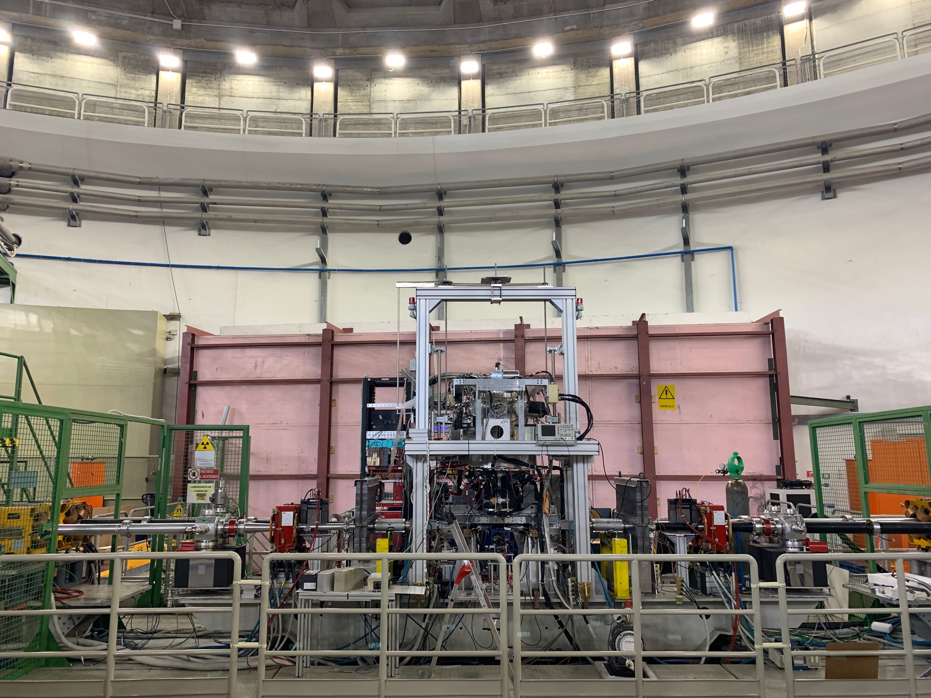
SIDDHARTA-2: Status report
Catalina Curceanu and Francesco Sgaramella
on behalf of the SIDDHARTA-2 collaboration
66th Scientific Committee Meeting – 8th November 2023

Slide 2






SIDDHARTA-2 Collaboration
Silicon Drift Detectors for Hadronic Atom Research by Timing Application
LNF-INFN, Frascati, Italy
SMI-ÖAW, Vienna, Austria
Politecnico di Milano, Italy
IFIN –HH, Bucharest, Romania
TUM, Munich, Germany
RIKEN, Japan
Univ. Tokyo, Japan
Victoria Univ., Canada
Univ. Zagreb, Croatia
Univ. Jagiellonian Krakow, Poland
ELPH, Tohoku University
Univ. of Palermo, Italy
IMEM-CNR, Parma, Italy
2

Slide 3
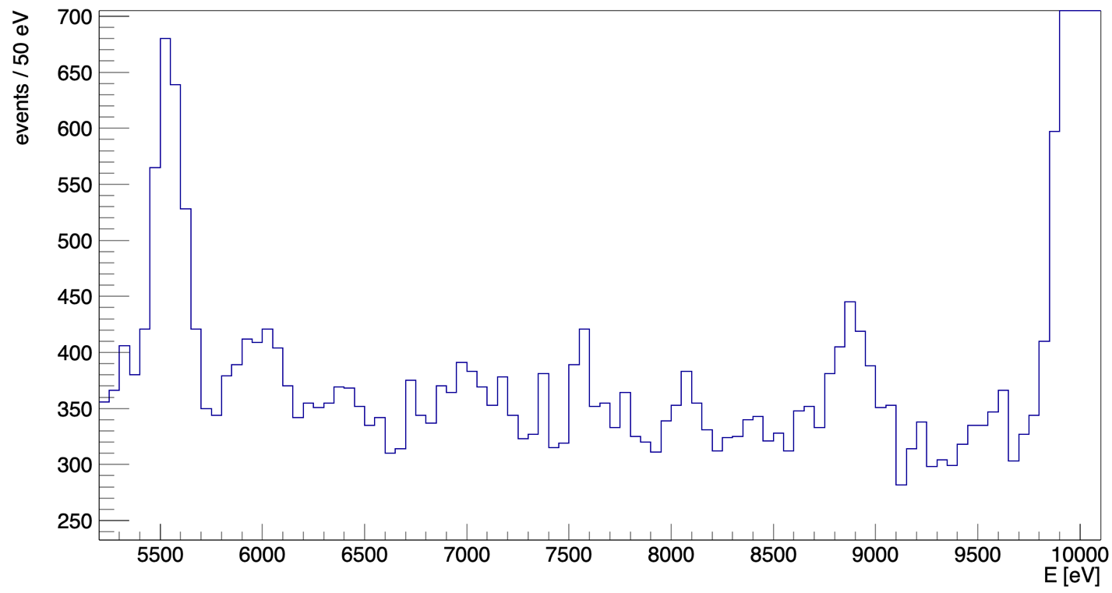


The Kaonic deuterium measurement – Very Preliminary results
First Kd spectrum, May – July 2023, integrated luminosity 200 pb⁻¹ (including injections)
KC6->5
5545 eV
ROI
KC5->4
10216 eV
We are very grateful to DAΦNE team and accelerator division, to INFN, Gr 3, LNF management and Director and applaud these achievements which set a solid ground for the ongoing kaonic deuterium first measurement ever and other kaonic atoms measurements!
KC7->5
8886 eV
KO7->6
6007 eV
KN6->5
7595 eV
Cu K$α$
8041 eV
Fe $K_{α}$
6400 eV

Slide 4
Publications since last SciCom – May 2023
1) C. Curceanu et al., Kaonic atoms at the DAFNE collider: a strangeness adventure, Front.in Phys. 11 (2023) 1240250
2) L. Abbene et al., Potentialities of CdZnTe Quasi-Hemispherical Detectors for Hard X-ray Spectroscopy of Kaonic Atoms at the DAΦNE Collider, Sensors 23 (2023) 17, 7328
3) L. De Paolis et al, The KAMEO proposal: Investigation of the E2 nuclear resonance effects in kaonic atoms, Nuovo Cim.C 46 (2023) 3, 59
4) M. Skurzok et al., A review of the low-energy K--nucleus/nuclei interactions with light nuclei AMADEUS investigations, Front.in Phys. 11 (2023) 1237644
5) K. Piscicchia et al., First Simultaneous K−−p →(Σ0/Λ) π0→(Σ0/Λ)π0 Cross Sections Measurements at 98 MeV/c, Phys. Rev. C 108 (2023) 055201
6) S. Wycech and K. Piscichia, Pionization: A method to study the nuclear surface, Phys. Rev. C (2023) 108, 014313
7) M. Tuchler et al., The SIDDHARTA-2 Veto-2 system for X-ray spectroscopy of kaonic atoms at DAΦNE, JINST, accepted

Slide 5
Publications since last SciCom – May 2023
8) L. De Paolis et al., The measurements of E2 nuclear resonance effects in kaonic atoms at DAFNE; the KAMEO proposal, submitted to EPJ Web conf
9) F. Sirghi et al., Kaonic atoms with SIDDHARTA-2 at the DAFNE Collider, submitted to EPJ Web conf
10) F. Sgaramella et al., First measurement of kaonic helium-4 M-series transitions, e-Print:2310.20584, submitted to Journal of Phys. G
11) A. Scordo et al., CdZnTe detectors tested at the DAΦNE collider for future kaonic atoms measurements , arXiv:2310.15062, submitted to NIM A
12) F. Sirghi et al., SIDDHARTA-2 apparatus for kaonic atoms research on the DAΦNE collider, to be submitted to NIM
+3 articles in preparation
> 10 invited talks in International Workshops and Conferences

Slide 6
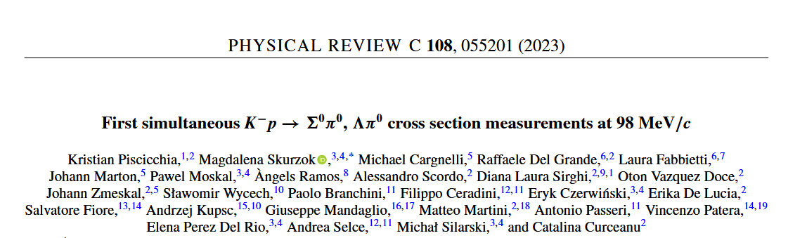

cross section at p_{K-} = 98 ± 10 MeV/c
AMADEUS (analyses of KLOE data with support of KLOE collaboration)
Record: cross sections at the lowest energy ever and improving the relative errors of about one order of magnitude w.r.t any other measurement

Slide 7
Contents
65th Scientific Committee recommendations and our related actions
Kaonic Deuterium run: status and future plans
(More) Scientific outcomes: highlights
Updates on HPGe and CdZnTe detectors and preliminary results
Request for supplementary run: light kaonic atoms (Li - Be - B) measurements with 1 mm SDDs
Future plans: EXKALIBUR

Slide 8
65th Scientific Committee recommendations
Recommendations for SIDDHARTA-2:
The SC encourages the collaboration to move swiftly and decisively to the Kd data taking in two runs this year, with the aim of taking advantage of the maximum integrated luminosity attainable in 2023.
To complete the quality studies of the data recorded during injection time, with the aim of obtaining valuable additional Kd data.
Keep the usual maintenance and upgrading duties in signal/background reduction, as well as the coordinated effort with the DAΦNE team to study reinforcement options for the shielding (by removing, reshaping, or displacing the luminometers close to the SIDDARTHA setup).
During runs 1 and 2 undertake data acquisition with the satellite HPGe and CdZnTe detectors, minimizing the interference with the Kd data taking.

Slide 9
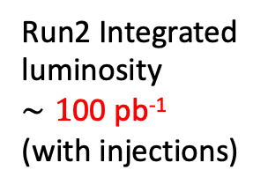
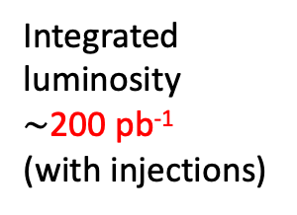
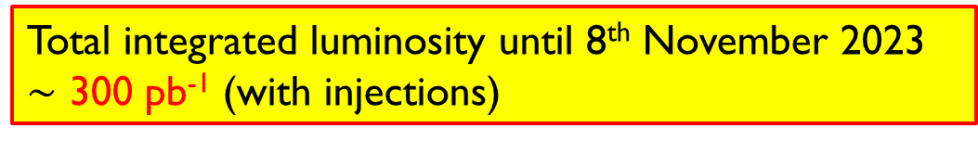
The kaonic deuterium measurement – Timeline
First run with SIDDHARTA-2 optimized setup for 200 pb⁻¹ integrated luminosity: May – July 2023 - completed
Second run Autumn – Winter 2023 goal: estimated 200-300 pb⁻¹ ongoing
Third run 2024 – goal: 300-400 pb⁻¹
Calibration runs: Kaonic He; Kaonic Ne; …. 50-100 pb
Run2 Integrated
luminosity
$∼1$00 pb⁻¹
(with injections)
Setup maintenance and upgrade
Integrated
luminosity
$∼$200 pb⁻¹
(with injections)
66th Scientific Committee
2023, 8th November
Start kaonic deuterium Run2
2023, October
HPGe and CdZnTe runs
Summer stop
2023, July – September
End of Run1
2023, July
Start kaonic deuterium Run1
HPGe and CdZnTe test run
2023, May
Total integrated luminosity until 8th November 2023
$∼$ 300 pb⁻¹ (with injections)

Slide 10

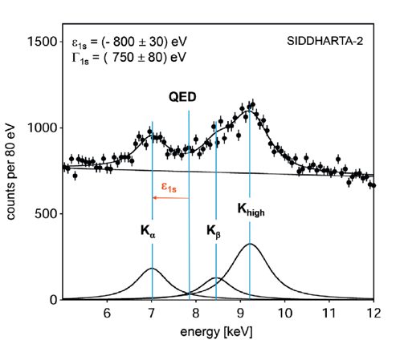
Kaonic deuterium shift and width (Theoretical predictions)
Scientific goal: first measurement ever of kaonic deuterium X-ray transition to the ground state (1s-level) such as to determine its shift and width induced by the presence of the strong interaction, providing unique data to investigate the QCD in the non-perturbative regime with strangeness.
achievable precision
Liu 2020
Monte Carlo Simulation
ROI
Weise 2017
Oset 2001
Mizutani 2013
Meißner 2011
Gal 2007
Shevchenkov 2012

Slide 11
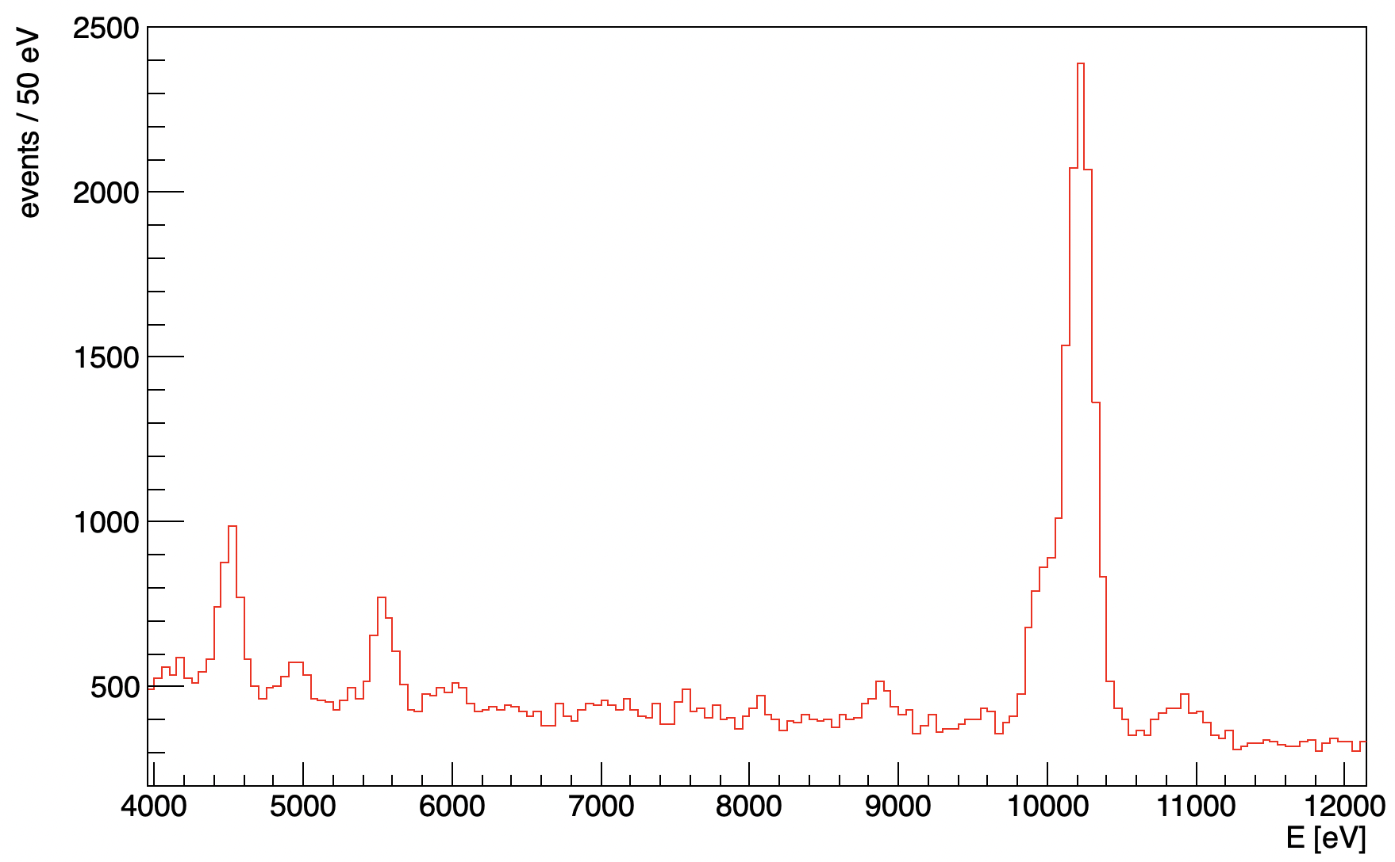
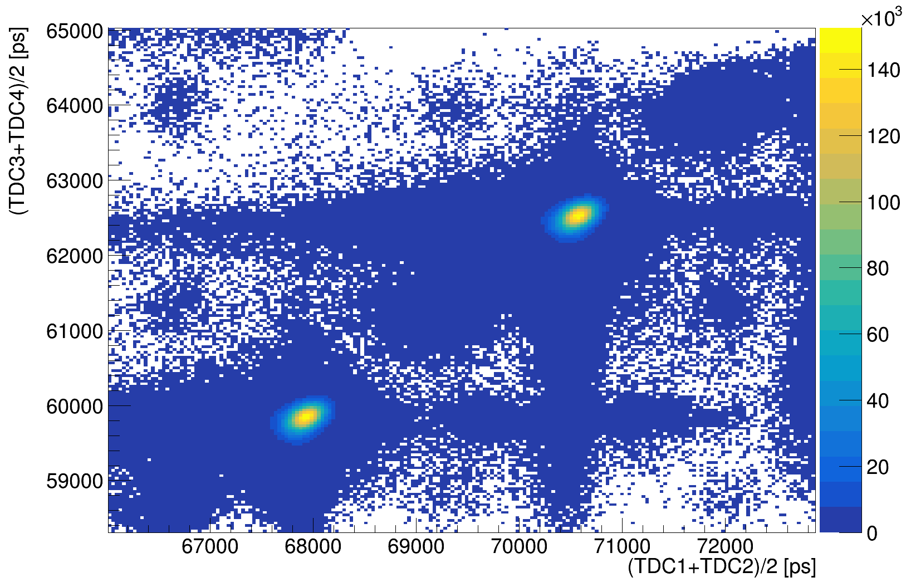
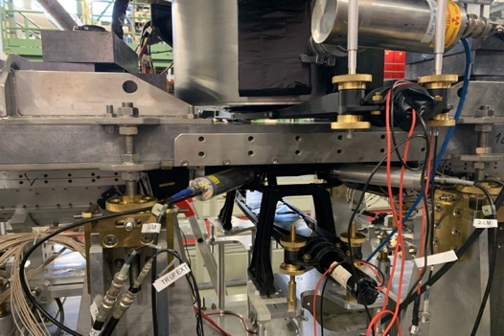
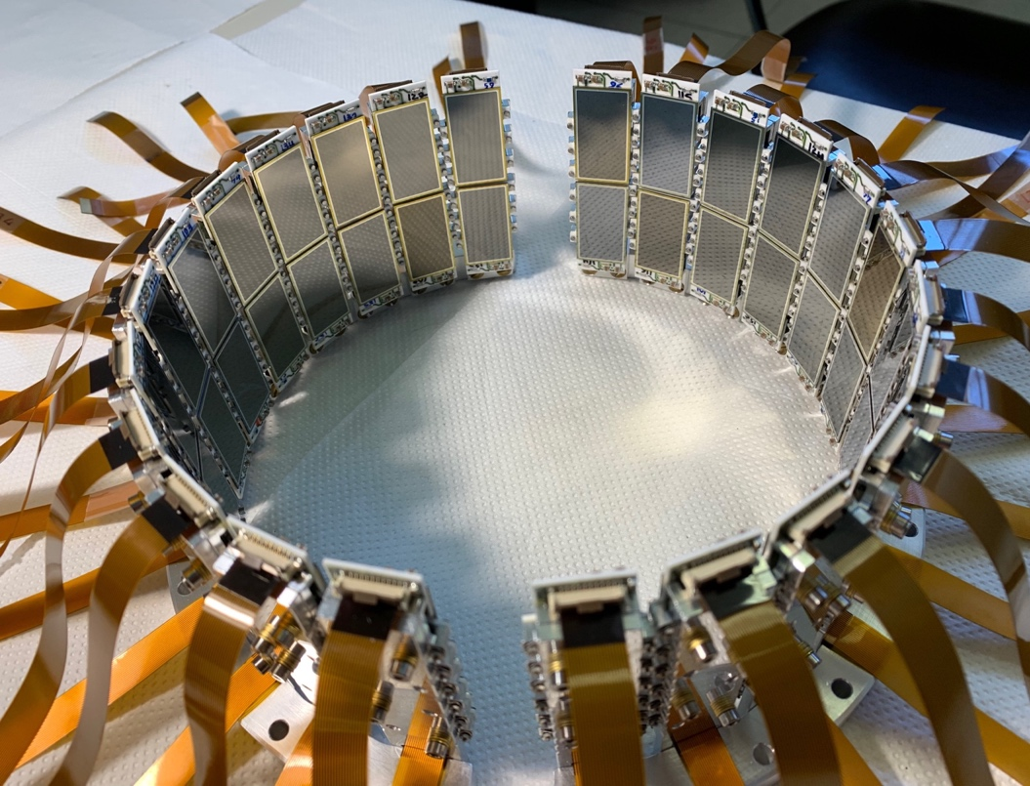
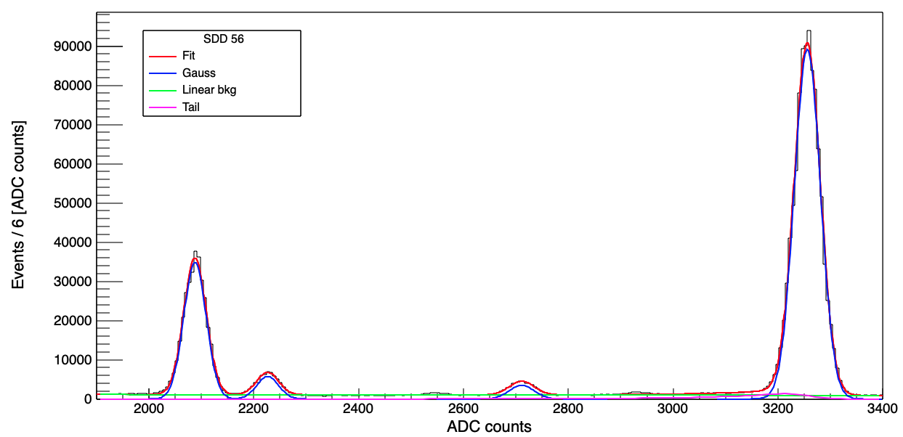
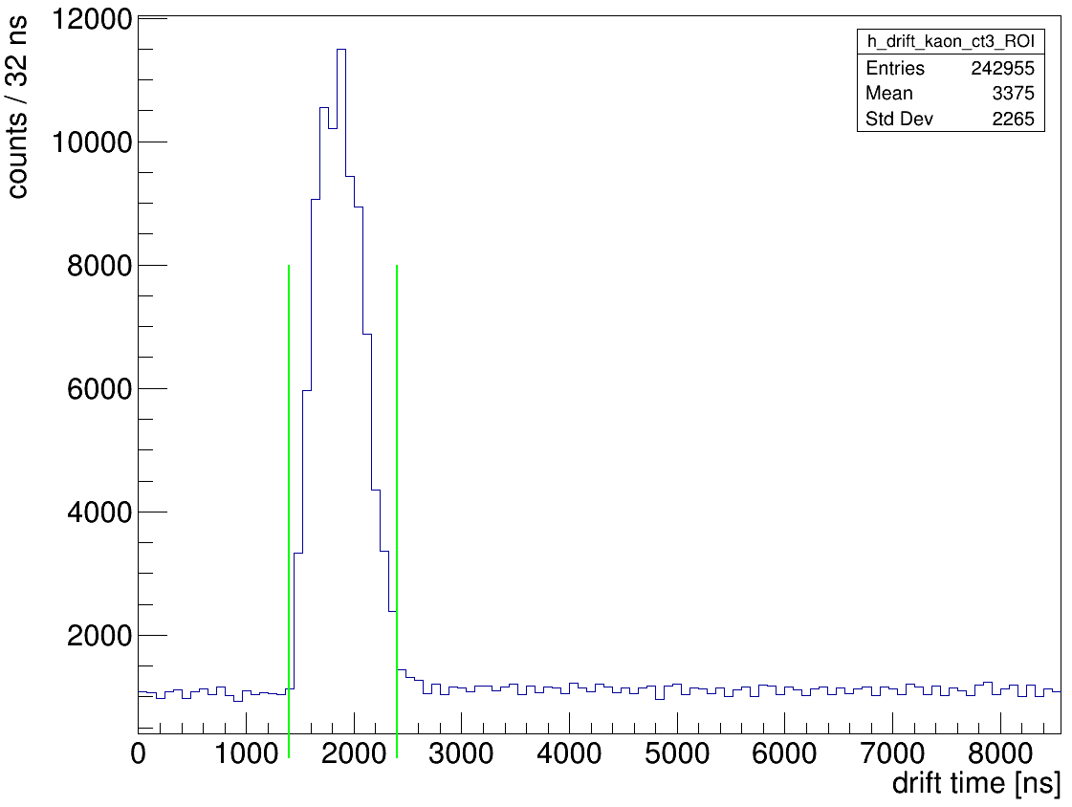



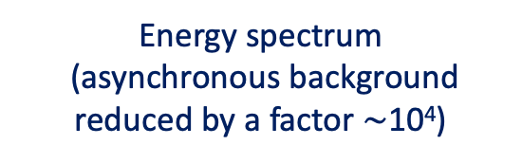





Kaonic deuterium – Run1 data analysis
Energy spectrum
(asynchronous background reduced by a factor $∼$10⁴)
KC5->4
10216 eV
kaons
KAON TRIGGER
kaons
Ti K$α$
4509 eV
KC6->5
5545 eV
$$K^{−}$$
e⁻
e⁺
Energy spectrum
(before background rejection)
$$K^{+}$$
SDD Calibration
Cu $K_{α}$
Ti $K_{α}$
SDDs
Drift Time
Ti $K_{β}$
Fe $K_{α}$

Slide 12
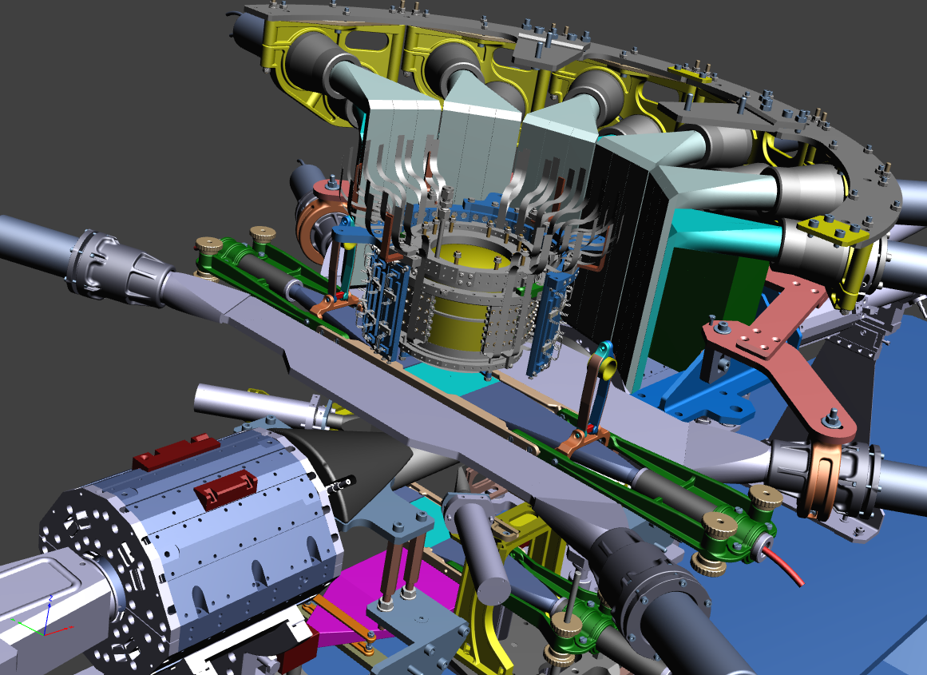
Kaonic deuterium – data analysis – synchronous background
SIDDHARTA-2 Setup
Veto-1
Kaon Trigger
Target
Veto-2
384 SDDs
Veto-3
Three Veto systems for synchronous background reduction

Slide 13
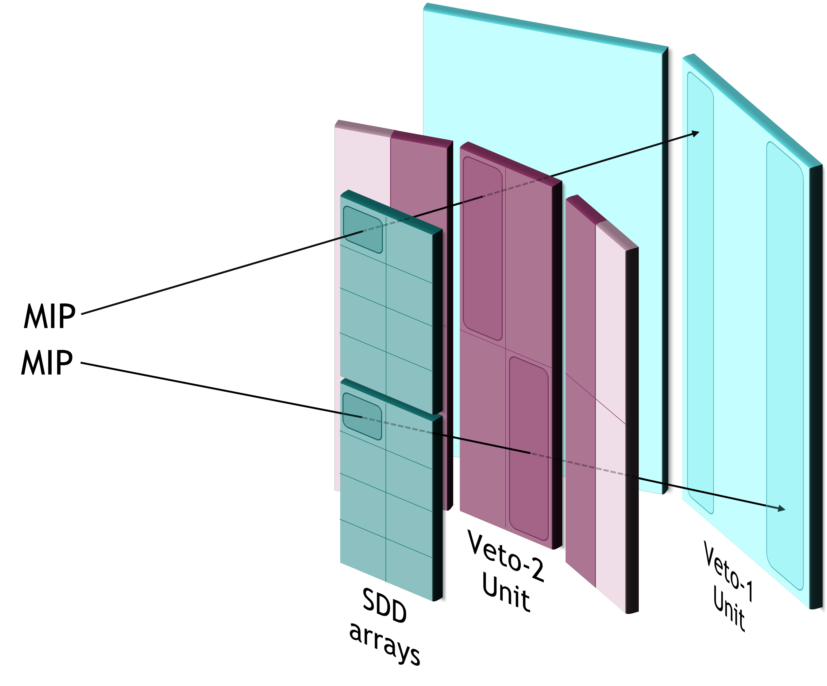
Kaonic deuterium – data analysis – synchronous background
Veto-2:
suppression of MIPs induced background by using topological correlation
SIDDHARTA-2 Setup
Veto-1
Kaon Trigger
Target
Veto-2
384 SDDs
Veto-3
Three Veto systems for synchronous background reduction (M. Iliescu, J. Zmeskal, M. Tuchler…)
M. Tuchler et al., The SIDDHARTA-2 Veto-2 system for X-ray spectroscopy of kaonic atoms at DAΦNE, JINST, accepted
13

Slide 14


Kaonic deuterium preliminary results (F. Sgaramella)
First run, May – July 2023, integrated luminosity 200 pb⁻¹ (with injections)
KC6->5
5545 eV
ROI
PRELIMINARY
KC5->4
10216 eV
KC7->5
8886 eV
KO7->6
6007 eV
KN6->5
7595 eV
Cu K$α$
8041 eV
Fe $K_{α}$
6400 eV

Slide 15

The Kaonic deuterium measurement – Preliminary results
First run, May – July 2023, integrated luminosity 200 pb⁻¹ (with injections)
KC6->5
5545 eV
ROI
PRELIMINARY
KC5->4
10216 eV
KC7->5
8886 eV
KO7->6
6007 eV
KN6->5
7595 eV
Fe $K_{α}$
6400 eV
Cu K$α$
8041 eV
Next Steps:
Refined calibration
Veto-1
Veto-3
Injection
selection
Data Analysis

Slide 16

The Kaonic deuterium measurement – Preliminary results
First run, May – July 2023, integrated luminosity 200 pb⁻¹ (with injections)
KC6->5
5545 eV
ROI
PRELIMINARY
KC5->4
10216 eV
KC7->5
8886 eV
KO7->6
6007 eV
KN6->5
7595 eV
Fe $K_{α}$
6400 eV
Cu K$α$
8041 eV
Next Steps:
Refined calibration
Veto-1
Veto-3
Injection
selection
Data Analysis

Slide 17
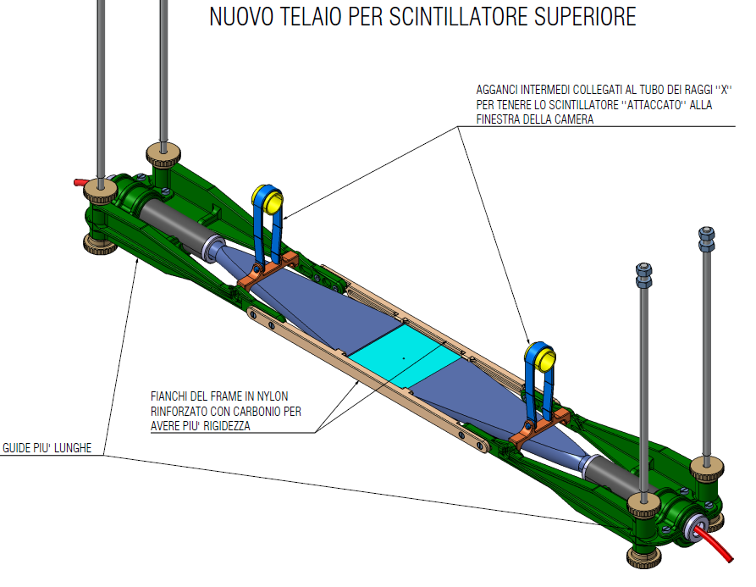
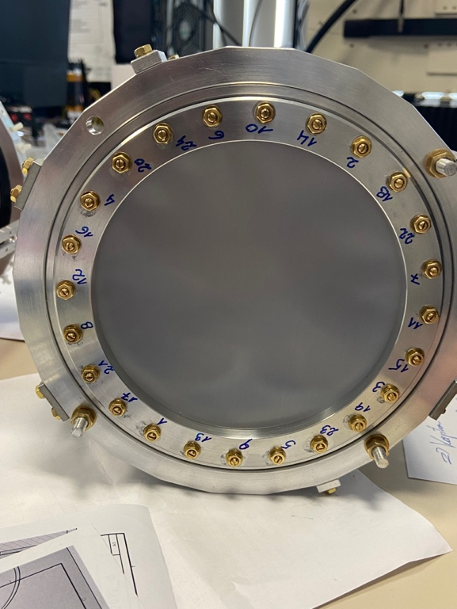
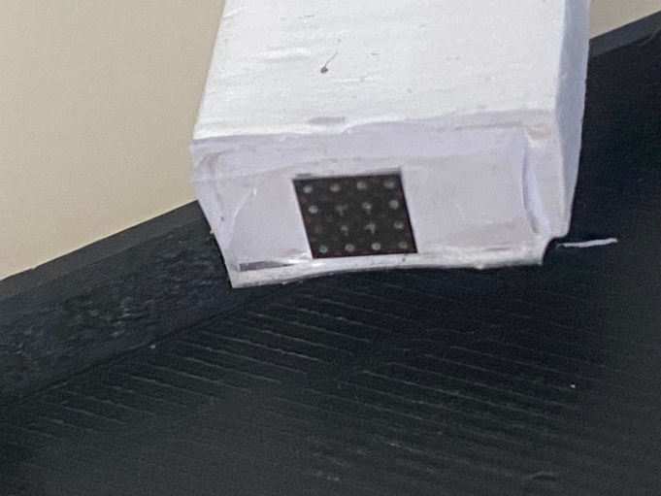
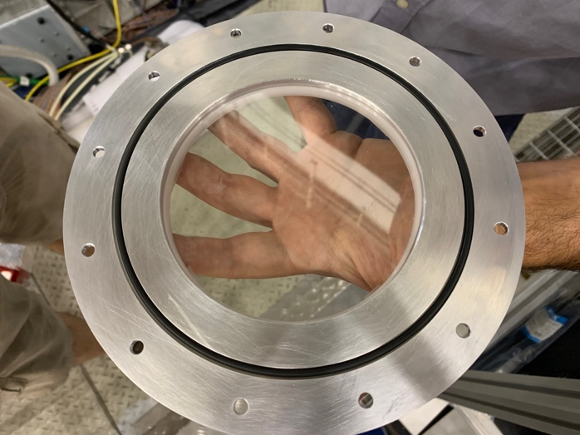
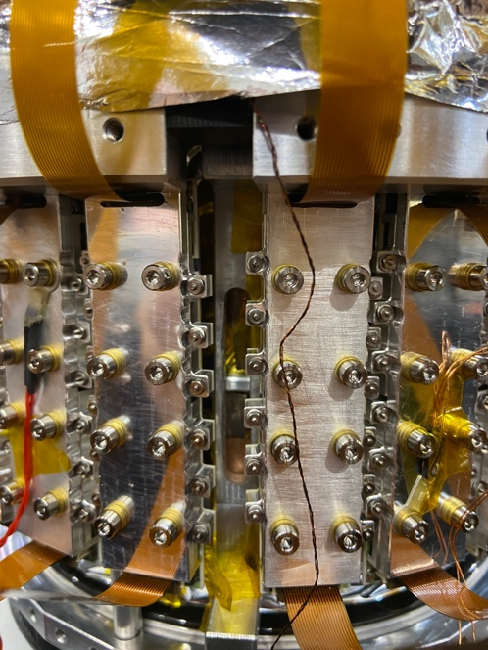
SIDDHARTA-2 setup (F. Sirghi, Technical Coordinator)
Optimization of the SIDDHARTA-2 setup during the summer stop of DA$Φ$NE (July - September)
Replaced some of the screws with Ti ones bottom of the target behind the SDD holders
Replaced the vacuum chamber’s entrance window with a new
Mylar window to remove the contamination due to Nitrogen
Kaon trigger: redesign the support structures and replaced the scintillator
Replaced some Veto-2 SiPMs damaged by radiation
Run2: 100 pb⁻¹ already acquired. Data analysis on going

Slide 18
65th Scientific Committee recommendations
Recommendations for SIDDHARTA-2:
The SC encourages the collaboration to move swiftly and decisively to the Kd data taking in two runs this year, with the aim of taking advantage of the maximum integrated luminosity attainable in 2023.
To complete the quality studies of the data recorded during injection time, with the aim of obtaining valuable additional Kd data.
Keep the usual maintenance and upgrading duties in signal/background reduction, as well as the coordinated effort with the DAΦNE team to study reinforcement options for the shielding (by removing, reshaping, or displacing the luminometers close to the SIDDARTHA setup).
During runs 1 and 2 undertake data acquisition with the satellite HPGe and CdZnTe detectors, minimizing the interference with the Kd data taking.

Slide 19
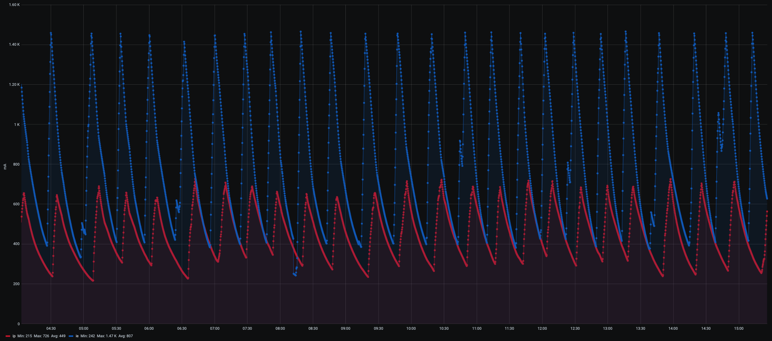
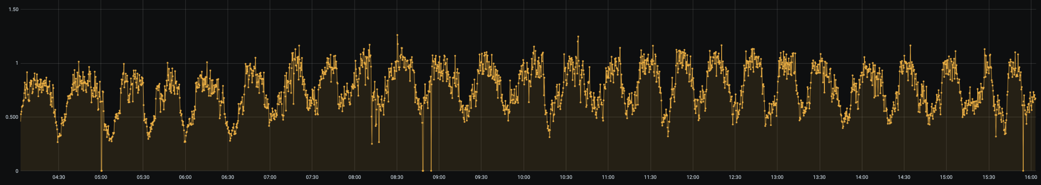
Injections data analysis
Kaon/SDD rate to evaluate the background during the e⁻e⁺ injections
Run1: 200 pb⁻¹ of which 70 pb⁻¹ during injections $⟶$ more than 50 pb⁻¹ usable (under evaluation)
1
0.5
Threshold: 0.50 (i.e. background on SDDs increased by no more than a factor 2)
0

Slide 20
Contents
65th Scientific Committee recommendations and our related actions
Kaonic Deuterium run: status and future plans
(More) Scientific outcomes: highlights
Updates on HPGe and CdZnTe detectors and preliminary results
Request for supplementary run: light kaonic atoms (Li - Be - B) measurements with 1 mm SDDs
Future plans: EXKALIBUR

Slide 21
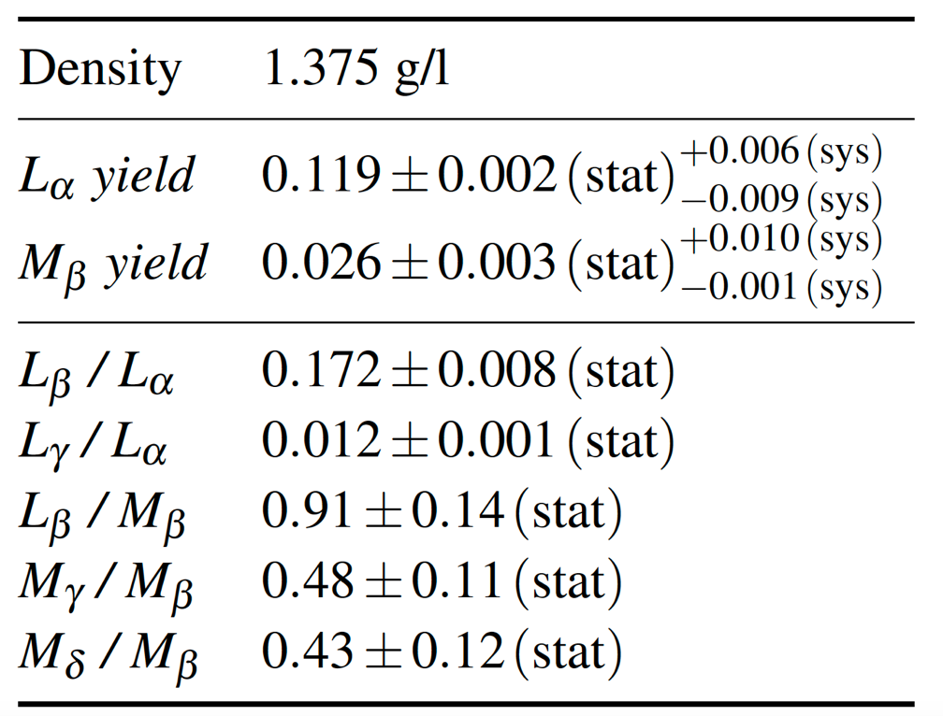
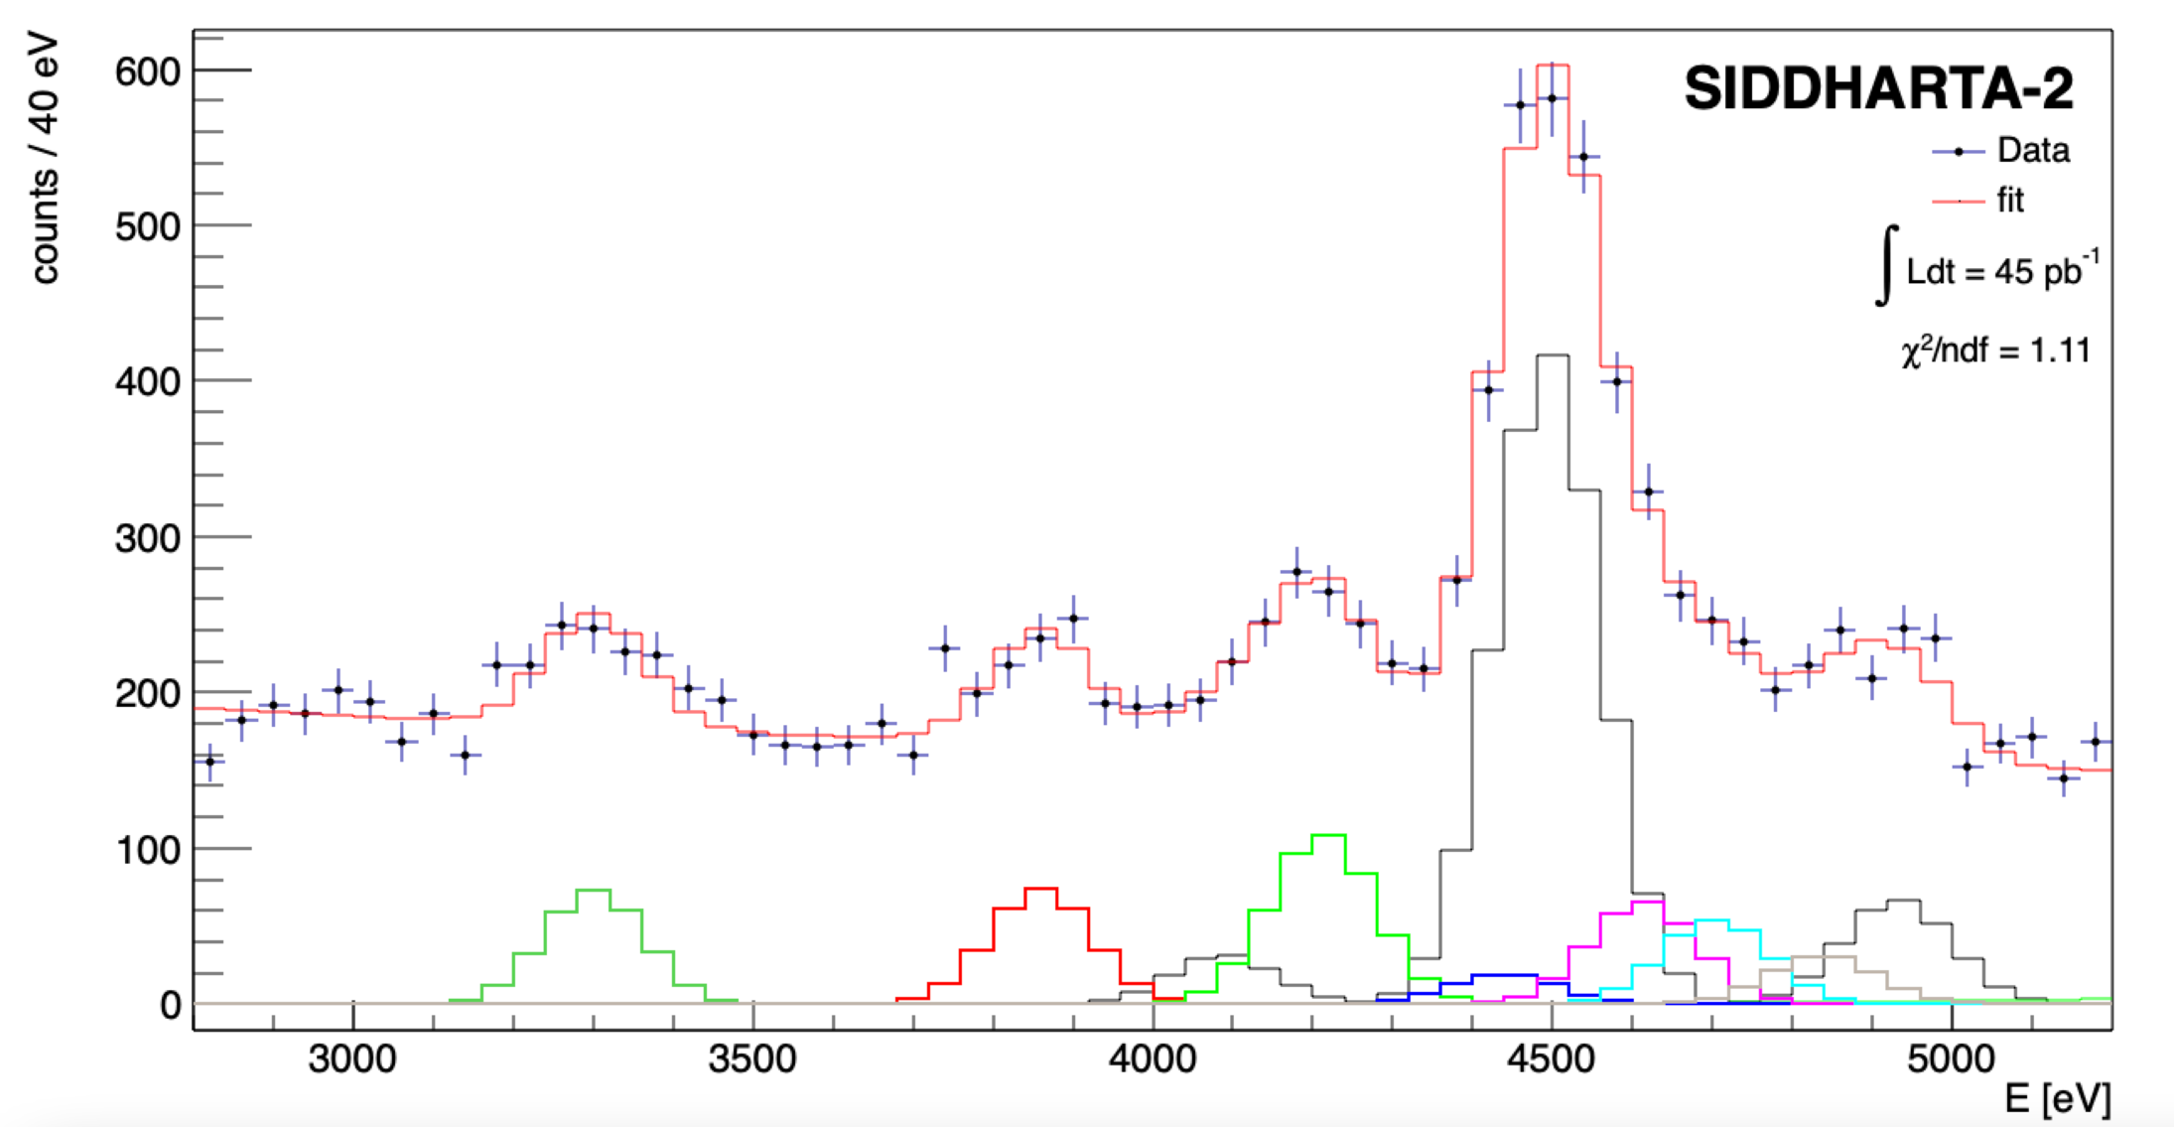
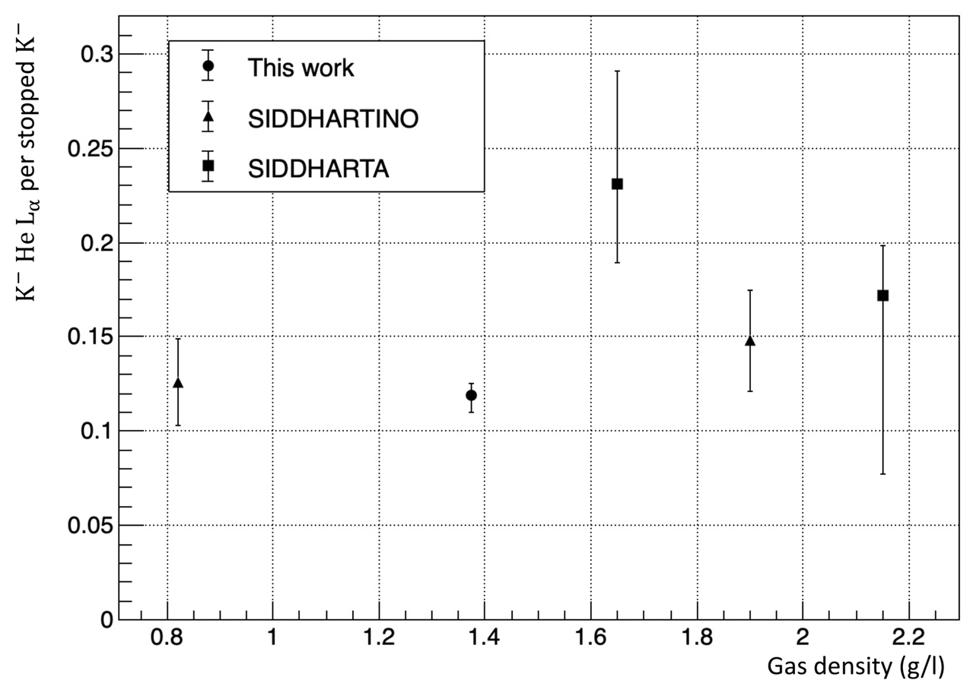
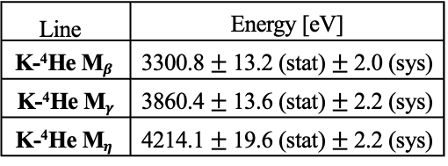




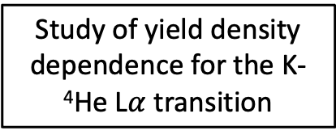

The Kaonic ⁴He – M-series transitions (2022)
First observation and measurement of kaonic helium M-series transition
New experimental data for cascade models calculations
The X-ray yield is the key observable to understand the de-excitation mechanism in kaonic atoms
and develop more accurate kaonic atoms cascade models.
Line | Energy [eV]
K-⁴He M$β$ | 3300.8 $±$ 13.2 (stat) $±$ 2.0 (sys)
K-⁴He M$γ$ | 3860.4 $±$ 13.6 (stat) $±$ 2.2 (sys)
K-⁴He M$η$ | 4214.1 $±$ 19.6 (stat) $±$ 2.2 (sys)
First measurement of
K-⁴He M-series transition
KHe 6->3
(M$γ$)
KHe 7->3
(M$η$)
Ti K$α$
KHe 5->3
(M$β$)
SIDDHARTA-2
SIDDHARTINO
Study of yield density dependence for the K-⁴He L$α$ transition
Ti K$β$
Sgaramella F., et al, submitted to J. Phys. G Nucl. Part. Phys
21

Slide 22
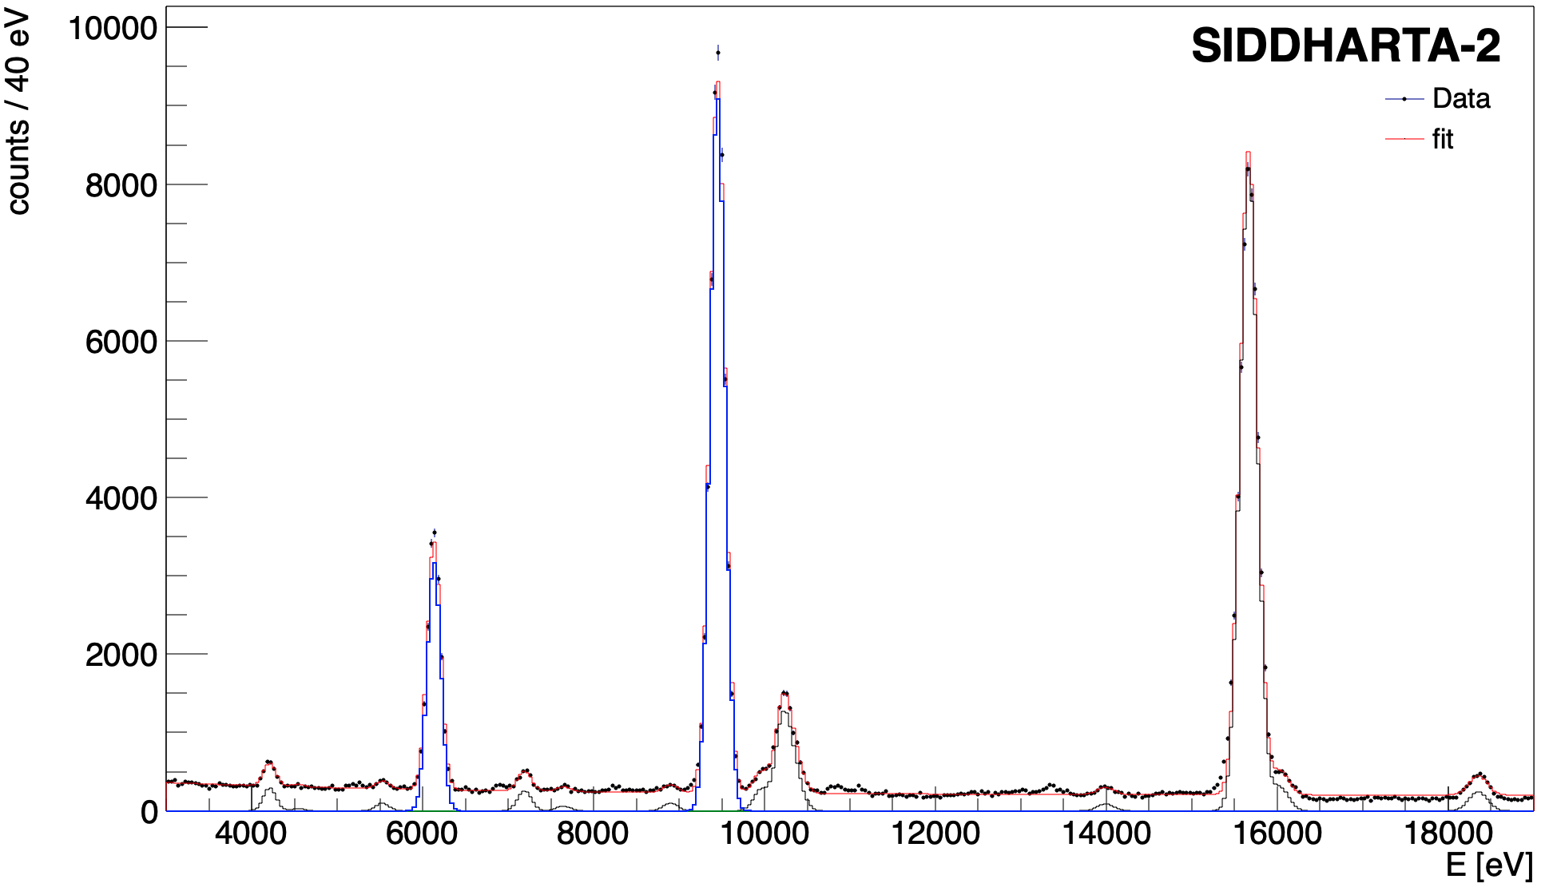
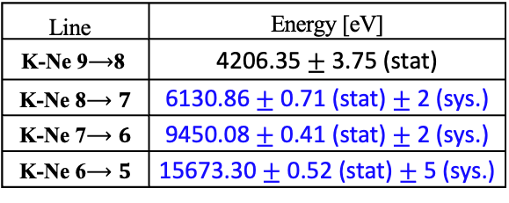




First measurement of kaonic neon X-ray transitions
The Kaonic Neon measurement (2023)
First measurement of kaonic neon X-ray transitions ( record of precision $<1$ eV )
Line | Energy [eV]
K-Ne 9$⟶$8 | 4206.35$±$ 3.75 (stat)
K-Ne 8$⟶7$ | 6130.86 $±$ 0.71 (stat) $±$ 2 (sys.)
K-Ne 7$⟶6$ | 9450.08$±$ 0.41 (stat) $±$ 2 (sys.)
K-Ne 6$⟶5$ | 15673.30 $±$ 0.52 (stat) $±$ 5 (sys.)
K-Ne 7->6
K-Ne 6->5
Implications on
kaon - multinucleon interaction
and kaon mass
K-Ne 8->7
KO 6->5
KC 5->4
K-Ne 9->8
KAl 7->6
KC 6->4
KC 7->5
KAl 8->7
KO 5->4
Paper in preparation
22

Slide 23
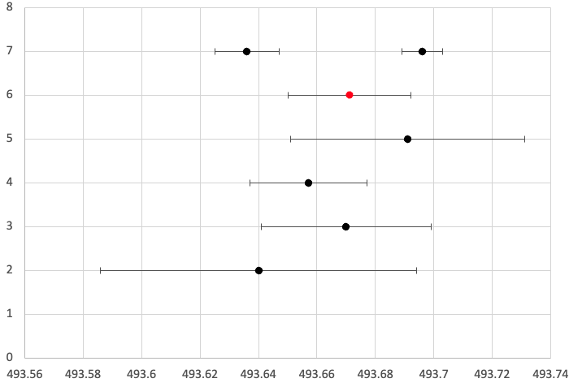
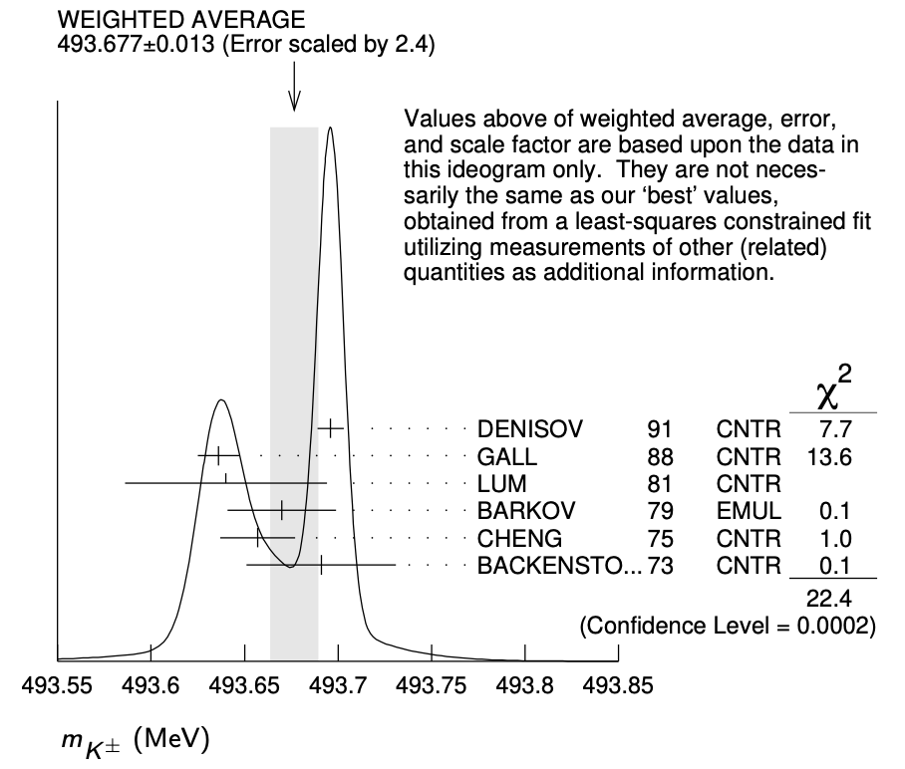
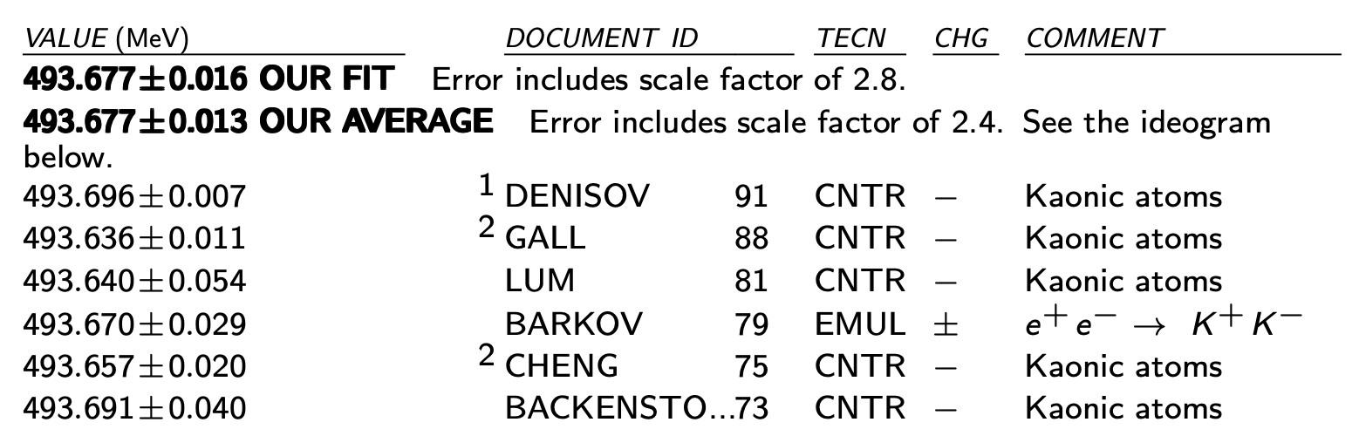

The (charged) Kaon mass puzzle and kaonic Neon
Kaon mass (K-Ne $8⟶7$and K-Ne $7⟶6$) = $493.671 ±0.021 \left(stat\right) MeV$
(stat. error $\sim 15$keV including the K-Ne $6⟶5$ )
GALL 88
DENISOV 91
Preliminary
SIDDHARTA-2
Kaon mass discrepancy
BACKENSTO 73
The kaonic Neon measurement to determine the K⁻ (K⁺) mass
Particle Data Group, 2020, 083C01 (2020)
CHENG 75
BARKOV 79
LUM 81
Less systematic uncertainty with respect to DENISOV 91 and GALL 88 measurements, thanks to the use of a low Z gas (Ne) target
Kaon mass [MeV]
Impact on the charmonium spectrum and on all processes in which charged kaons are involved
It could solve the kaon mass discrepancy issue

Slide 24
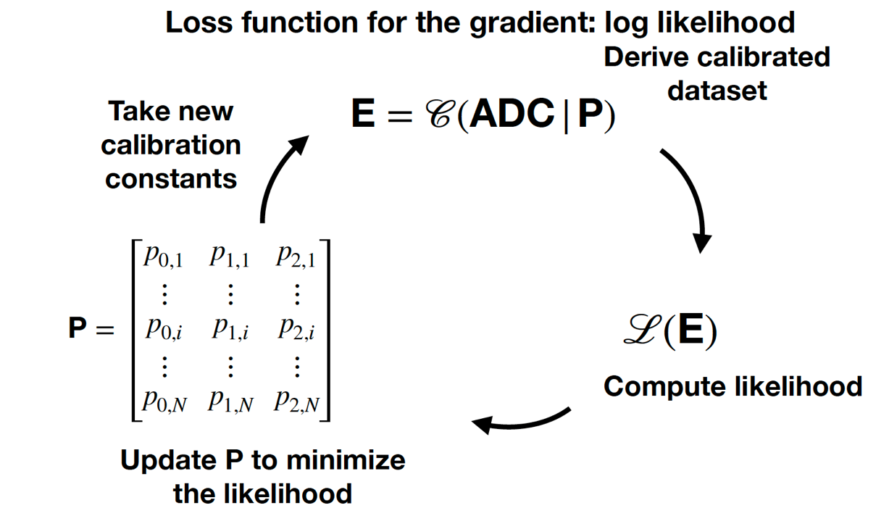
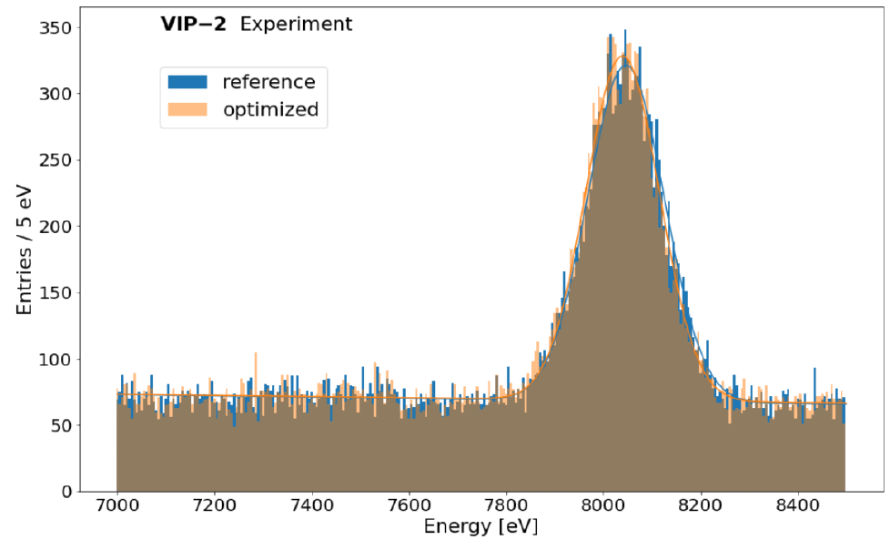
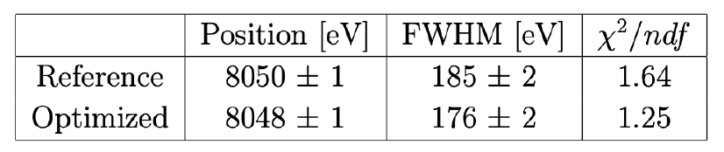

SDD energy calibration with ML and Differential Programming
The method can correct for miscalibration improving the systematic error and the energy resolution allowing to perform high precision measurement with an accuracy below 1 eV
Cu $K_{α}$
Fabrizio Napolitano et al 2023 Meas. Sci. Technol. in press https://doi.org/10.1088/1361-6501/ad080a
Fabrizio Napolitano and Simone Manti

Slide 25
Contents
65th Scientific Committee recommendations and our related actions
Kaonic Deuterium run: status and future plans
(More) Scientific outcomes: highlights
Updates on HPGe and CdZnTe detectors and preliminary results
Request for supplementary run: light kaonic atoms (Li - Be - B) measurements with 1 mm SDDs
Future plans: EXKALIBUR

Slide 26
65th Scientific Committee recommendations
Recommendations for SIDDHARTA-2:
The SC encourages the collaboration to move swiftly and decisively to the Kd data taking in two runs this year, with the aim of taking advantage of the maximum integrated luminosity attainable in 2023.
To complete the quality studies of the data recorded during injection time, with the aim of obtaining valuable additional Kd data.
Keep the usual maintenance and upgrading duties in signal/background reduction, as well as the coordinated effort with the DAΦNE team to study reinforcement options for the shielding (by removing, reshaping, or displacing the luminometers close to the SIDDARTHA setup).
During runs 1 and 2 undertake data acquisition with the satellite HPGe and CdZnTe detectors, minimizing the interference with the Kd data taking.

Slide 27
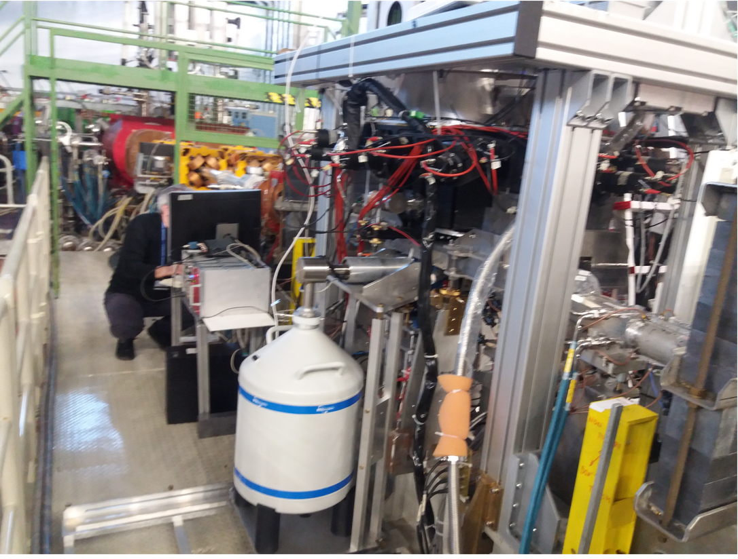
Kaonic Lead Measurement at DA$Φ$NE with HPGe
HPGe provided by Zagreb University (Croatian Science Foundation project 8570)
to perform the kaonic lead measurement
in parallel with the SIDDHARTA-2 kaonic deuterium measurement
BSI HPGe detector with transistor reset preamplifier (TRP).
DAQ based on CAEN DT5781 digitizer
Coincidence between:
-> ch0 Luminometer
-> ch1 HPGe signal
-> ch2 TAC signal
Data acquired:
-> June-July 2023: 109.38 pb⁻¹
-> September-now 2023: 117.67 pb⁻¹
HPGe active detector
diameter ~60 mm,
height ~60 mm.
27

Slide 28
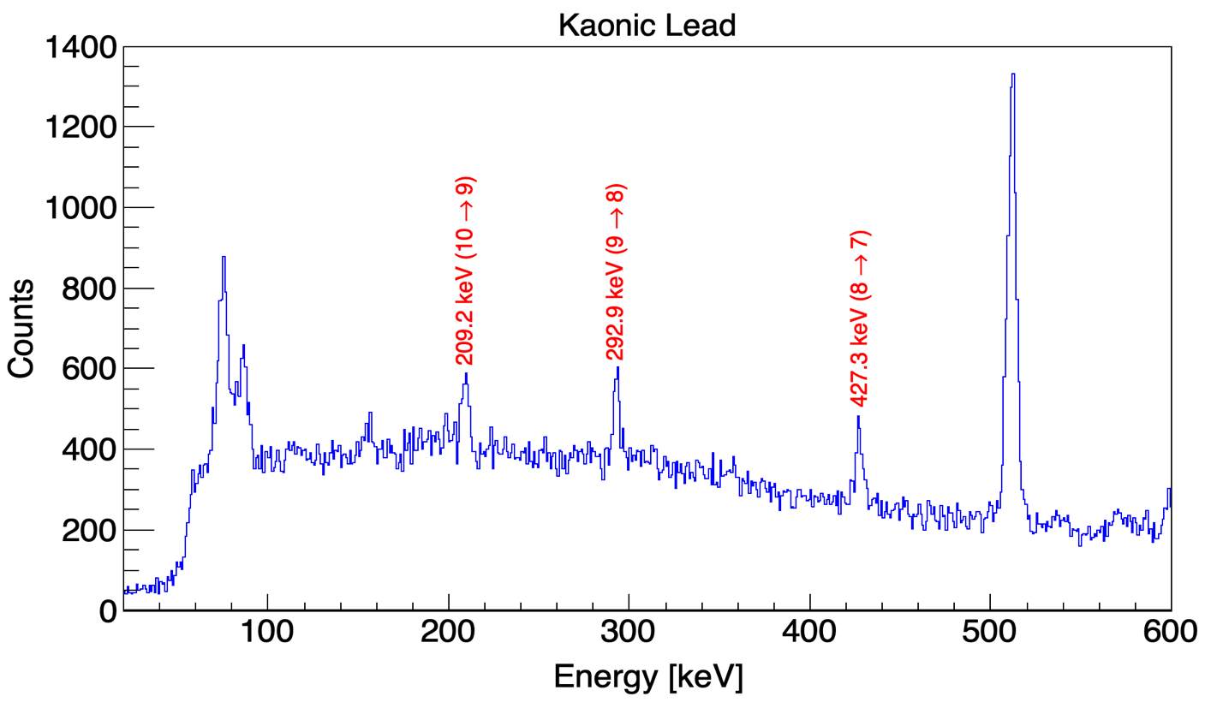
The Kaonic Lead Measurement (Zagreb Uni; Krakow, Jagiellonian Uni – Lumi)
Integrated luminosity: 109.38 pb⁻¹ ( June – July 2023)
Preliminary analysis of June-July 2023 data (D.. Bosnar and I. Friščić) :
Gaus+linear function was fitted for each peak:
(10 -> 9) : 906 events in peak,
position 209.191 ± 0.171 keV
(9 -> 8) : 947 events in peak,
position 292.939 ± 0.134 keV
(8 -> 7) : 943 events in peak,
position 427.200 ± 0.152 keV
Optimization and detailed analysis is in progress-> towards a publication
Preliminary

Slide 29
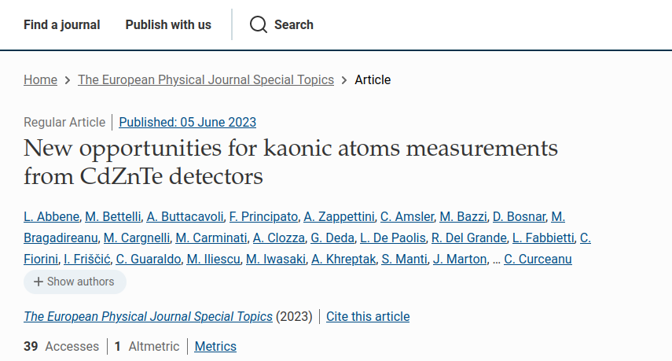
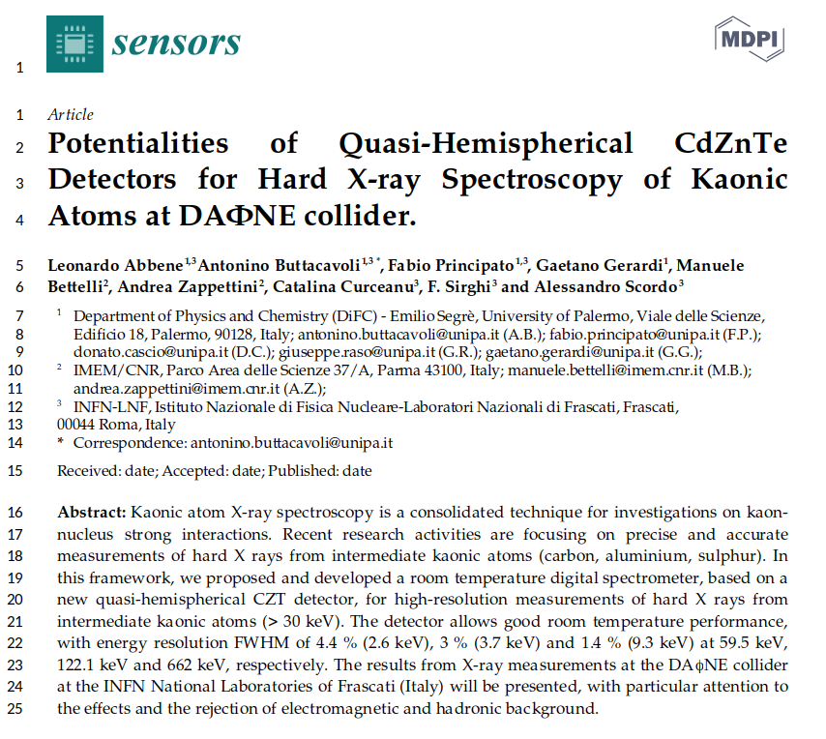
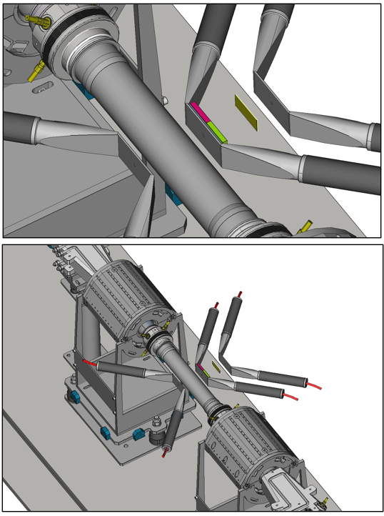
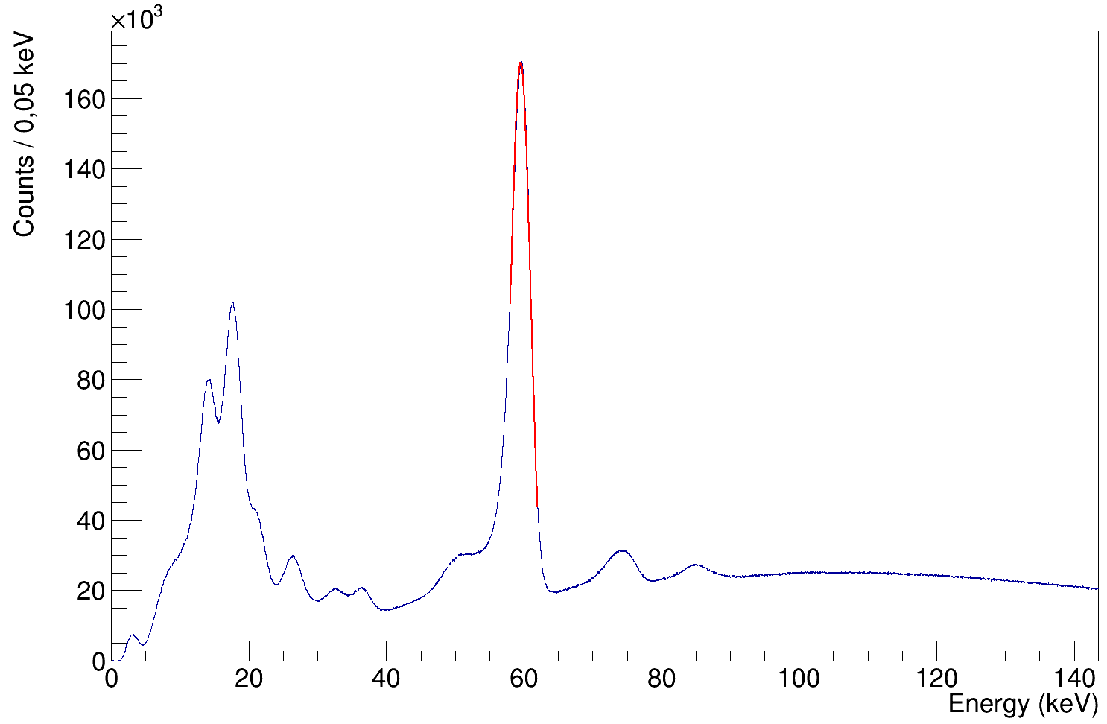
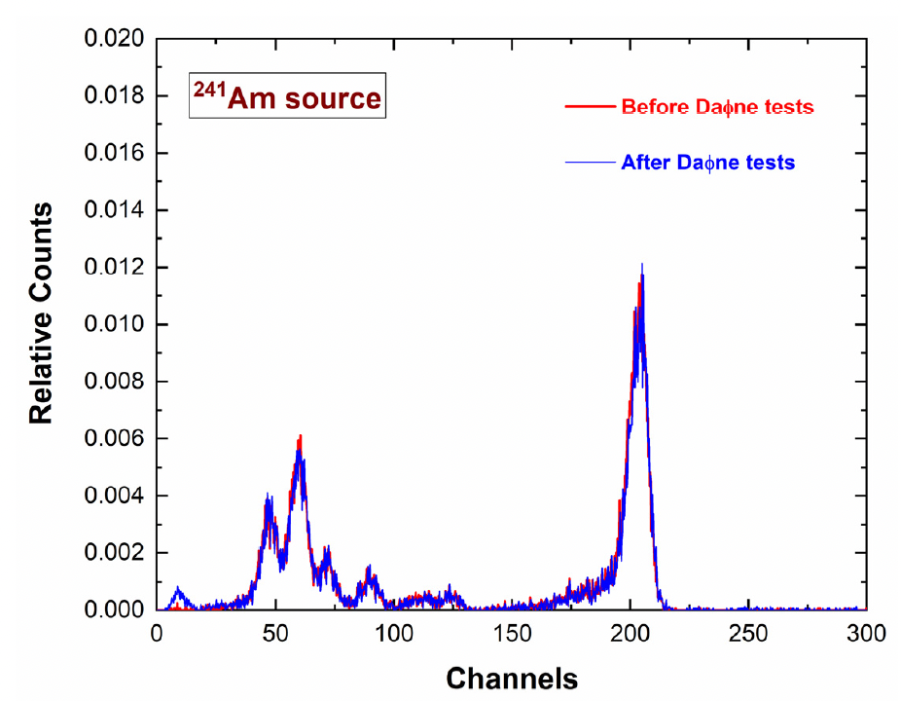
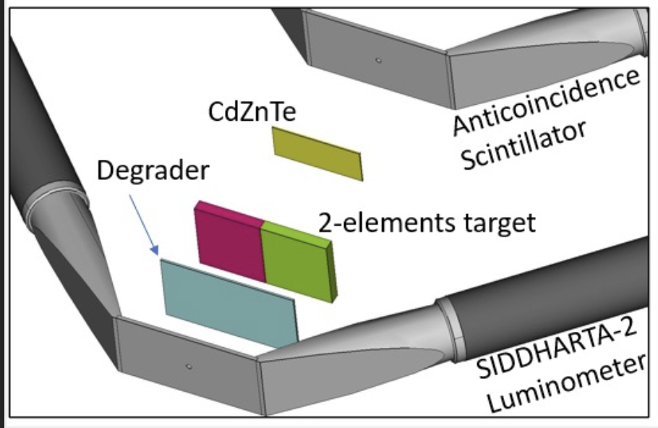
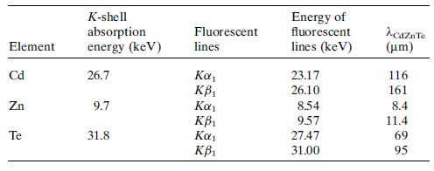

CdZnTe detectors: first test at DA$Φ$NE
Detector Key Points:
High efficiency in the 20-100 keV region - Reasonable efficiencies up to 300 keV - Good resolution (FHWM/E ~ %)
Fast response and time resolution (< 50 ns) - No need for cooling - Compact readout and installation package
L. Abbene, et al., Sensors 23 (2023) 17, 7328
Eur. Phys. J. Spec. Top. 232, 1487 (2023)
²⁴¹Am
FWHM = 3,5 keV
(5,9 % @ 60 keV)
Good resolutions are confirmed
Full capabilities recovered after DA$Φ$NE
Np L_{β}
Np L_{α}
²⁴¹Am
Pb Kα_{1,2}
Pb K_{β}
29

Slide 30
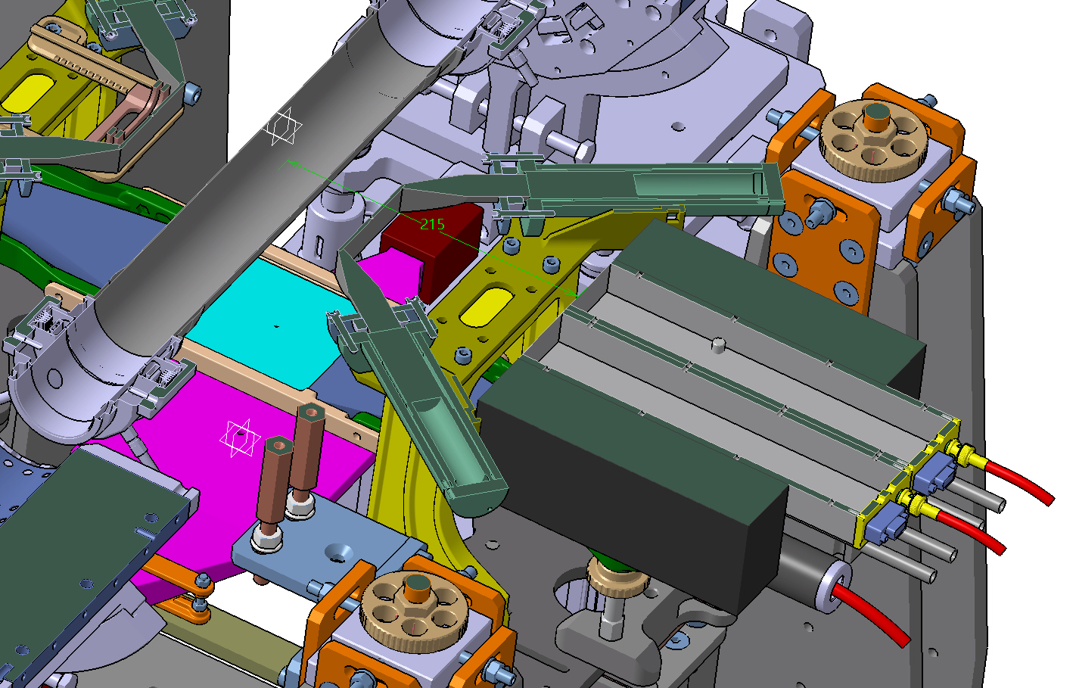
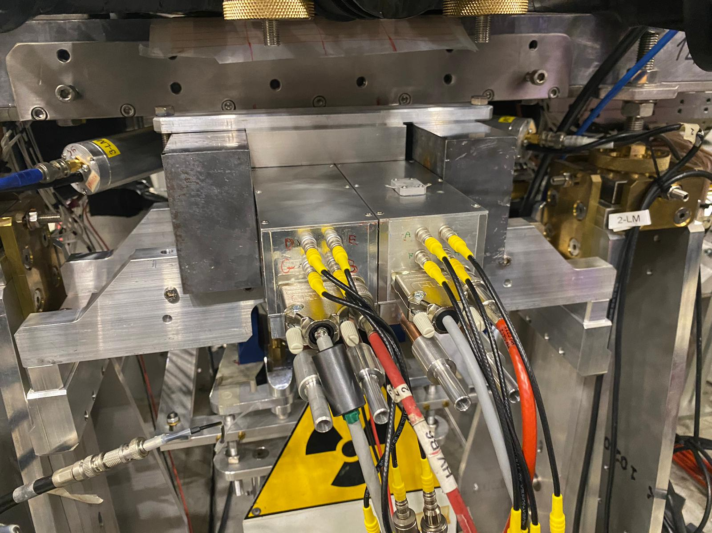


CdZnTe detectors: next run with 16 cm²
16 cm² CdZnTe detectors to perform X-ray spectroscopy of kaonic carbon and aluminium in parallel with SIDDHARTA-2 kaonic deuterium run (L. Abbene, A. Buttacavoli, F. Principato, A. Scordo)
New lead shield installed
Two modules (8 CdZnTe) installed and ready
MCarlo: For KAl (4→3) with 10% yield we expect :
10 (signal) ev/pb⁻¹

Slide 31
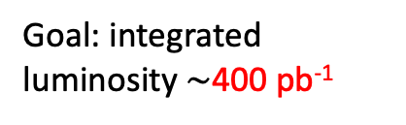
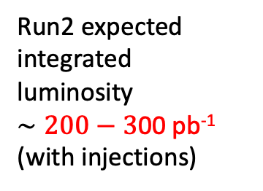
Project Timeline – Future plans
First run with SIDDHARTA-2 optimized setup for 200 pb⁻¹ integrated luminosity: May – July 2023 - completed
Second run Autumn – Winter 2023 goal: estimated 200-300 pb⁻¹ ongoing
Third run 2024 – goal: 400 pb⁻¹
Calibration: solid targets – Li, B, Be – 100-150 pb
Integrated luminosity 100-150 pb⁻¹ (1 month)
Goal: integrated luminosity $∼$400 pb⁻¹
Start kaonic deuterium Run3
HPGe and CdZnTe run
2024, January
End Run3
2024
Total: 900 pb⁻¹
(to ensure 800 pb⁻¹ of useful data)
Light kaonic atoms Run
(Li - Be - B)
Extension of the SIDDHARTA-2 run, also as post-calibration
End of kaonic deuterium Run2
2023, December
Total: 400 - 500 pb⁻¹
HPGe and CdZnTe run
Run2 expected integrated
luminosity
$∼200−3$00 pb⁻¹
(with injections)

Slide 32
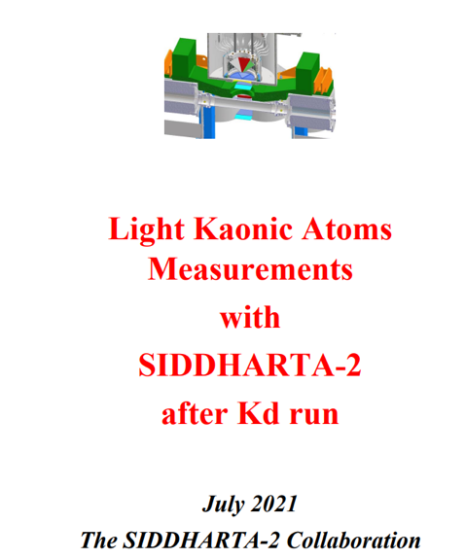
We reiterate the request for an extension of SIDDHARTA-2 run
with solid targets (post calib)
using also 1 mm SDDs
The energy spectra of light kaonic atom transitions for Li, Be and B can achieve a precision below 2-3 eV, for an integrated luminosity of about 100-150 pb^{-1;} ; kaon-multi-nucleon, L(1405)…
1mm SDDs and target materials financed – construction ongoing
32

Slide 33





Development of KAONNIS Detector Modules (C. Fiorini; G. Deda; G. Borghi)
Single SDD Module: the Prototype Design
1 mm SDD array
SDD monolithic array (designed and produced by Fondazione Bruno Kessler, FBK):
$2×4$ matrix, square pixels, each one having active area of $8×8$ mm²;
1-mm-thick, total chip dimensions are 20 mm $×$ 36 mm;
Spectroscopic measurements with a first prototype with partially working channels:
irradiation with an ⁵⁵Fe X-ray source;
detector temperature: -30° C;
spectra acquired with SFERA APP, shaping time 6 $μ$s;
best energy resolution @5.9keV (Mn-K$α$ peak ): 138.2 eV, (channel 2).
33

Slide 34



Light kaonic atoms measurement with SIDDHARTA-2
The energy spectra of light kaonic atom transitions for Li, Be and B can achieve a precision below 2-3 eV,
for an integrated luminosity of about 100-150 pb^{-1;} ;
Use of present SDDs + 1mm SDDs and target materials financed – construction ongoing
SDD 1mm detector
Multi element target (Li, Be, B) under construction financed by INFN (gr 3)
Production run very successfully concluded at FBK: test of all the devices with automatic probers – completed
First SDD samples delivered to PoliMi – July 2023
Development of the new PCB and DAQ on going

Slide 35


Francesco Sgaramella: best young talk at High Precision X-Ray Measurements 2023, June 2023, Frascati
Good news about SIDDHARTA folks:

Slide 36

Marlene Tuechler: "Probing the strong interaction with kaonic atom X-ray measurements at low energies", Ph. D. thesis at Vienna University, June 13th, 2023, with the highest qualifications
Good news about SIDDHARTA folks:

Slide 37

Francesco ARTIBANI and Francesco CLOZZA from La Sapienza University – finalizing their Master Theses in SIDDHARTA-2
Ph D students: from Tokoku Japan: Toho Kairo
Ph D: Francesco Artibani
Good news about SIDDHARTA folks:

Slide 38


Eventi – workshops and Conferences
Organized events

Slide 39


Eventi – workshops and Conferences
Organized events

Slide 40
Contents
65th Scientific Committee recommendations and our related actions
Kaonic Deuterium run: status and future plans
(More) Scientific outcomes: highlights
Updates on HPGe and CdZnTe detectors and preliminary results
Request for supplementary run: light kaonic atoms (Li - Be - B) measurements with 1 mm SDDs
Future plans: EXKALIBUR

Slide 41
Future plans beyond SIDDHARTA-2: EXKALIBUR
proposal to perform fundamental physics at the strangeness frontier at DAFNE
for a 3-years period (post-SIDDHARTA-2)
- detailed presentation at 62nd LNF Scientific Committee Meeting, November 8, 2021
EXtensive
Kaonic
Atoms research: from
LIthium and
Beryllium to
URanium
We propose to do precision measurements along the periodic table at DAFNE for:
Kaonic Hydrogen: 200 pb⁻¹ – with SIDDHARTA-2 setup – to get a precision < 10 eV (KH)
Selected light kaonic atoms (LHKA)
Selected intermediate and heavy kaonic atoms charting the periodic table (IMKA)
Ultra-High precision measurements of Kaonic Atoms (UHKA)
Dedicated runs with different types of detectors: CZT detectors, HpGe, SDD 1mm, crystal HAPG spectrometer from VOXES project - MODULAR
Fundamental physics at the strangeness frontier at DAΦNE. Outline of a proposal for future measurements,
C. Curceanu et al., Front.in Phys. 11 (2023) 1240250
Members of Sci Com: document and letters support
EXKALIBUR

Slide 42



Slide 43




Kaonic Atoms to Investigate Global Symmetry Breaking Symmetry 12 (2020) 4, 547
The modern era of light kaonic atom experiments Rev.Mod.Phys. 91 (2019) 2, 025006
Part. and Nuclear physics QCD @ low-energy limit Chiral symmetry, Lattice
Fundamental physics New Physics
Kaonic atoms
Kaon-nuclei interactions
(scattering and nuclear interactions)
Astrophysics
EOS Neutron Stars
Dark Matter studies
On self-gravitating strange dark matter halos around galaxies Phys.Rev.D 102 (2020) 8, 083015
The equation of state of dense matter: Stiff, soft, or both? Astron.Nachr. 340 (2019) 1-3, 189
Kaonic Atoms with SIDDHARTA-2 at the DAFNE Collider
Notes:
The kaonic atoms spectroscopy is really a unique opportunity to obtain information about QCD at threshold energy because compared to scattering experiments the kaon interacts with the nucleus with relative energy of a few keV, instead of the tens MeV.

Slide 44

New experimental proposal
Herewith our group would like to express our strong interest to carry out a new experiment in the DAΦNE collider called “Laser spectroscopy of kaonic helium and sub-ppm scale determination of the charged kaon mass”. The aim of this small experiment is to synthesize metastable kaonic helium atoms using the low-energy negative kaons available at your facility, and to irradiate the atoms with high-power, high repetition rate laser beams and observe the resulting resonance of the laser-induced transition of the kaonic orbital.
The experiment will utilize the latest quantum optics techniques and
will allow an exploration of quantum electrodynamics for systems that include the strange
quark at heretofore unprecedented, 10⁻⁷ scale or better precision.

Slide 45
EXKALIBUR
EXKALIBUR proposes to conduct a series of unique kaonic atom measurements with a total integrated luminosity ranging from approximately 600 (but also 400) pb to 1500 pb. It is a feasible, comprehensive scientific program that can be executed modularly (i.e., over a few months each year) in the next 2-3 years, becoming a global reference for research on strangeness.
To be underlined that the program is elastic, and one can extend it from 400 pb to more than 1000, in various runs periods; we are available for discussions and reschedule our plans function of machine and beam time availability.
Very significant physics measurements at the best possible machine

Slide 46
Conclusions & REQUESTS
The first Run (Run1) of SIDDHARTA-2 Kd has been successfully; finalized Run 2 is ongoing; overall 300 pb up to now (including injections)
We answered all issues/suggestions raised by 65th Sci Com
We performed a preliminary analyses of first 200 pb Kd Run – very promising results!
We finalized first KHe M-lines and KNe data analyses -> articles and test run for K mass
We are implementing Macchine Learning techniques for our data analyses – enhanced outcomes
>10 articles were published/submitted since the last Sci Com, 3 are in preparation and > 10 invited talks
We are ready and very motivated to continue and finalize the SIDDHARTA-2 (first) Kd measurement within summer 2024 (in parallel with test measurements with HPGe and CdZnTe)
We plan to perform solid targets measurements with SIDDHARTA-2 (reinforced) setup for 100-150 pb⁻¹ after Kd run – as post-calibration (more infos @SC62)
We reiterate our EXKALIBUR proposal – after SIDDHARTA-2 run – modular strangeness kaonic atoms measurements along the periodic table – support letters

Slide 47


Special thanks to the accelerator, research and technical divisions, and in particular to the DA$Φ$NE staff, to Cesidio Capoccia, and to the LNF Director

