Slide 1
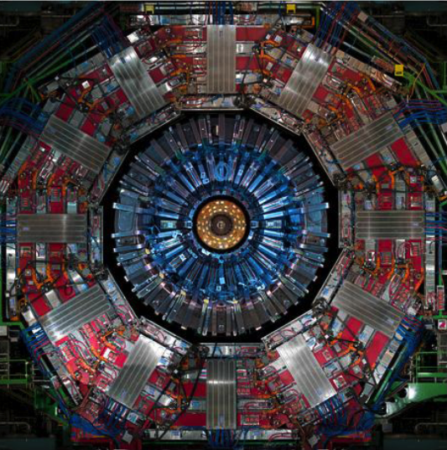
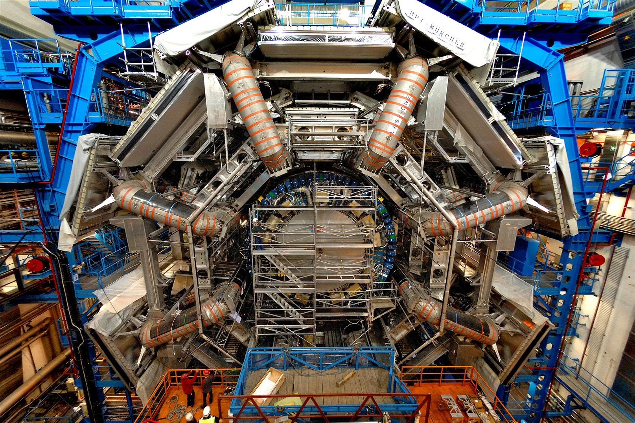
Progettazione di un rivelatore per la ricerca del bosone di Higgs nel decadimento H→ZZ→4 muoni
LUDOVICO PONTECORVO (CERN)

Slide 2
Disclaimer
I will present mainly the Muon measurements and trigger due to my personal knowledge and background
  Only few slides will be devoted to electrons and jets measurement and triggers
    Chiara can give you much more details than me on the calorimetry
I will concentrate mostly on ATLAS for the same reasons
  Few comparisons with CMS will be shown

Slide 3
Outline (1)
Physics considerations in the design of an experiment
  Production Cross sections for background and signal
    Implication on trigger design
  Momentum and angular distributions of decay products for Signal and Background
    Implications on angular coverage and momentum resolution
Trigger strategies
  Lepton triggers
Reminder of the techniques for the experimental identification and measurement of particles
  Electrons and Photons
  Hadrons
  Muons

Slide 4
Outline (2)
Magnetic configurations
  Conceptual difference between ATLAS and CMS
The ATLAS Detector
How Muons are measured in ATLAS
  The Inner Detector
  The Muon system
    Identification and measurement of Muons in ATLAS
  The Construction of the ATLAS muon spectrometer
    Detector technologies for triggering and tracking
  The use of the ATLAS muon spectrometer in the search for the Standard Model Higgs.

Slide 5
Production cross sections
Total P-P Cross section @ 14 TeV ~100 mb ~ 10⁹ Minimum Bias Events/s
bb pair Cross section ~100 μb ~ 5x10⁶ bb/s
W→lν Cross section ~ 40 nb ~ 300/s
Z→ll Cross section ~ 4 nb ~ 30 / s
tt pair Cross section ~ 1 nb ~ 8/s
H (150 GeV) ~ 25 pb ~ 0.2/s
Need to achieve a reduction factor from the total cross section of 5x10⁹
  The Trigger is FUNDAMENTAL for Hadron Colliders

Slide 6
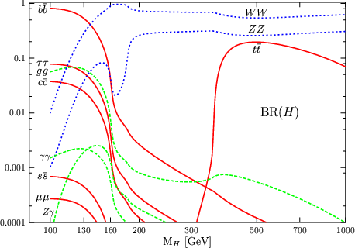
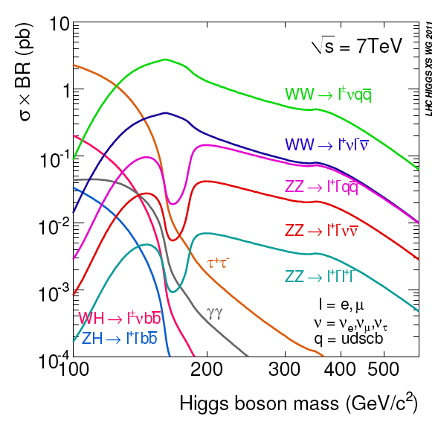
Branching Ratios
Very large variation of branching ratios with Higgs mass
H →ZZ→ 4l and H→ γγ
Golden channels for Higgs Discovery have very low BR
Need to optimize the acceptance of the detector to exploit these rare channels

Slide 7
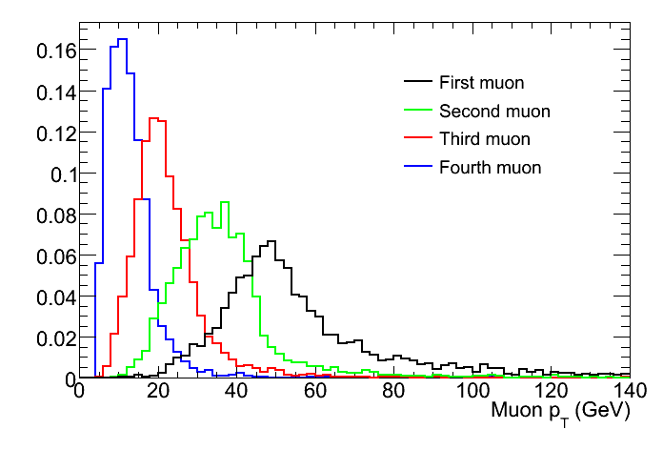
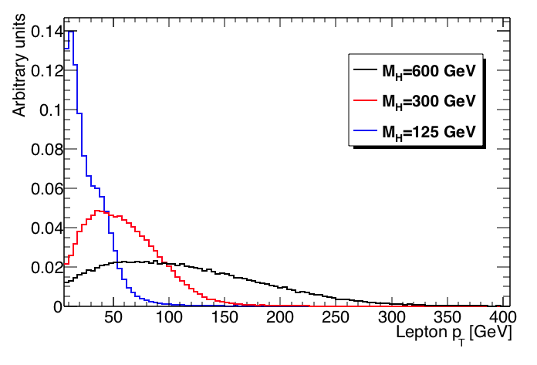
Momentum Spectrum H→ZZ→4l
Pt of all leptons
The Momenta of the 4 Leptons in the H→ZZ decays are in general rather low even for High Higgs Masses
  Max Momentum ~ 100 GeV
But….
We should also be able to discover high Mass Resonances eg. Z’, W’
  lepton momenta are as high as few TeV.
Pt of highest leptons
For Various Higgs Mass
The detector should be optimized for both momentum ranges

Slide 8
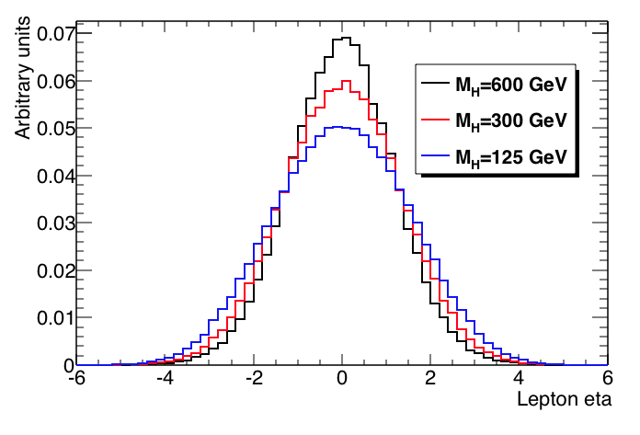
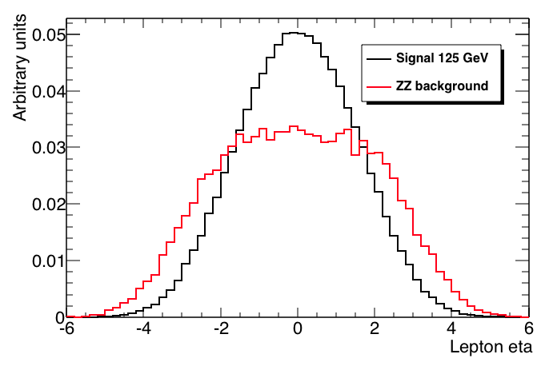
Angular Distributions for H→ZZ→4l
The final state contains 4 leptons so the event selection efficiency is highly dependent on the lepton acceptance
But… Also Signal to Background ratio should be considered to optimize detector’s performance

Slide 9
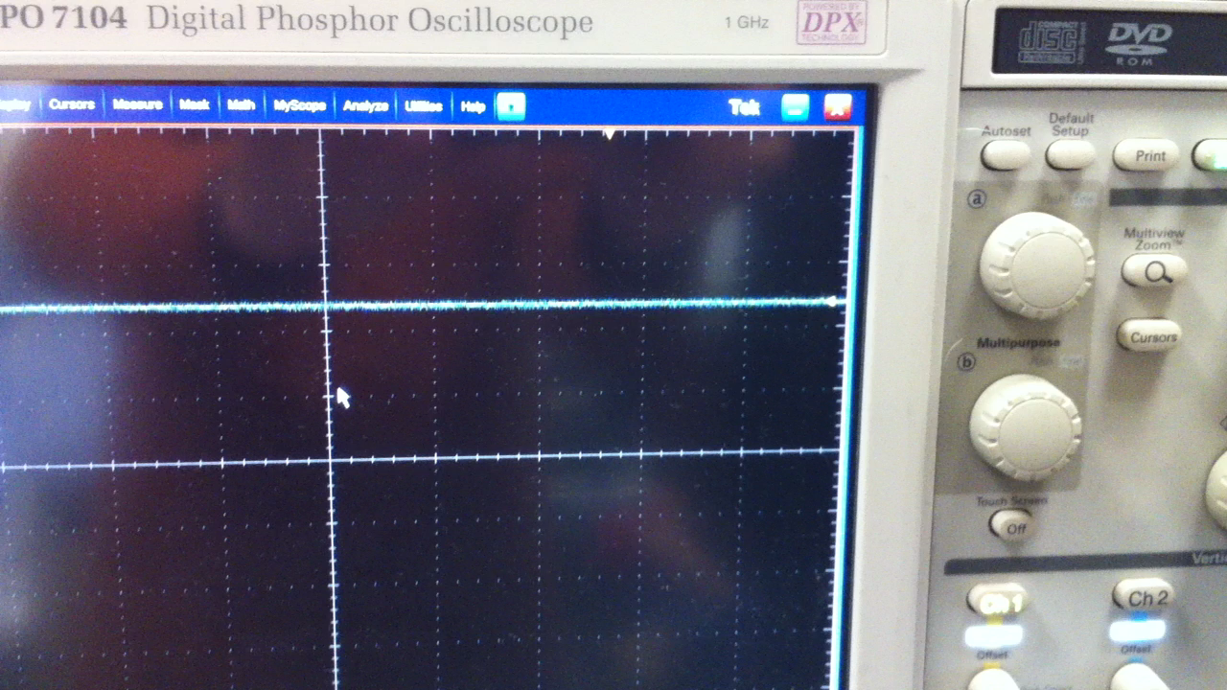
Trigger strategies
The signal is THERE but you have to isolate it from the HUGE background
Trigger threshold

Slide 11
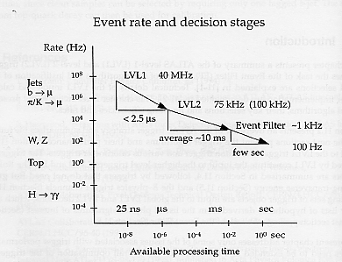
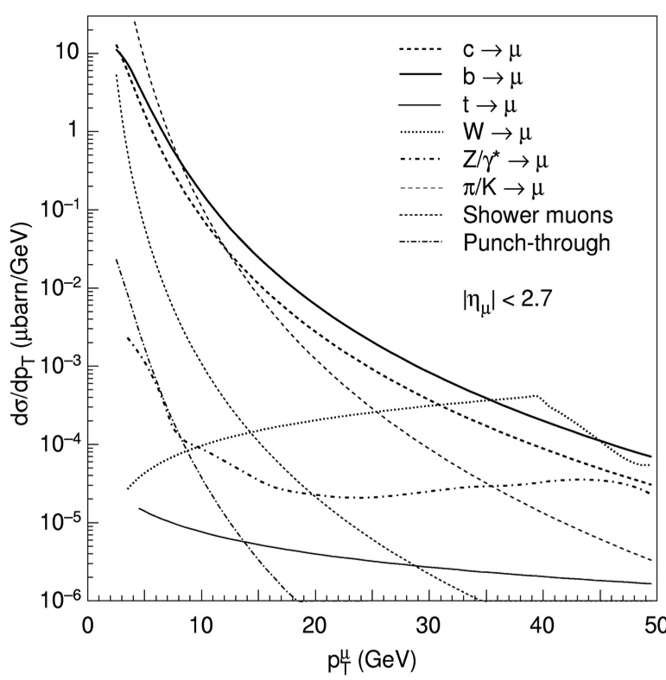
Trigger Strategies (1)
Low Pt trigger
High Pt trigger
Bunch crossing frequency: 40 MHz
  Not possible, and also not interesting, to read-out all the data at this frequency.
Use a Multi-Level trigger to select interesting events based on kinematical variables:
  Level 1: Transverse momentum for muons , Energy for electrons and Jets, Missing Energy.
  Level 2: Refinement of Energy/momentum measurement + Lepton Isolation etc.
  Level 3: Full reconstruction of events, complex signatures correlations btw trigger objects

Slide 12
Trigger strategies (2)
Reduction factors (at design times*):
  R.F. Latency
  LVL1 from 40 MHz to 100 KHz 400 3.2 μs Hardware
  LVL2 from 100 KHz to 1 KHz 100 ~ms Software
  LVL 3 from 1 KHz to 100 Hz 10 ~s High lvl soft
Need very fast detectors for LVL1 trigger (minimize Latency)
Need very good time resolutions (Bunch Crossing ID)
  Gasseous detectors for muon trigger (RPC and TGC)
  Calorimeter for electrons and photons and taus
Need to keep the detector data in memories up to the LVL1 signal is generated (Long memories of 3.2 μs)
* At the moment the LVL2 trigger runs at 10 KHz and we are able to write data up to 1 KHz profiting from the improvement in computer technologies

Slide 13
Trigger strategies (3)
Need of high granularity detectors at high LVL triggers to minimize pile up (O 10⁸ channels)
  LVL2 Trigger based (in ATLAS) on Region of Interest (ROI) provided by LVL1 objects
    Reconstruct with full granularity event only in a small part of the detector (move and analyze a small part of the data)
    Get a much better definition of the kinematical variables WRT LVL1
    Start using correlations btw different sub-detectors (eg Muon isolation uses Muon detector, calorimeter and ID informations)
  LVL3 trigger based on full reconstruction of event by means of powerful computer farms
    Complex

Slide 14
Important issues for the trigger system
The trigger should be highly efficient
  It is better to have some more rate rather than loosing important rare events
Need to measure precisely the trigger efficiency
  Redundant triggers are needed to measure trigger efficiency and to enhance the efficiency
The trigger should be UNBIASED in order not to compromise physics results and invent discoveries.
The trigger menu has to cover the physics channels to be studied, plus additional event samples required to complete the analysis:
  Measure backgrounds, check the detector calibration and alignment, etc.

Slide 15
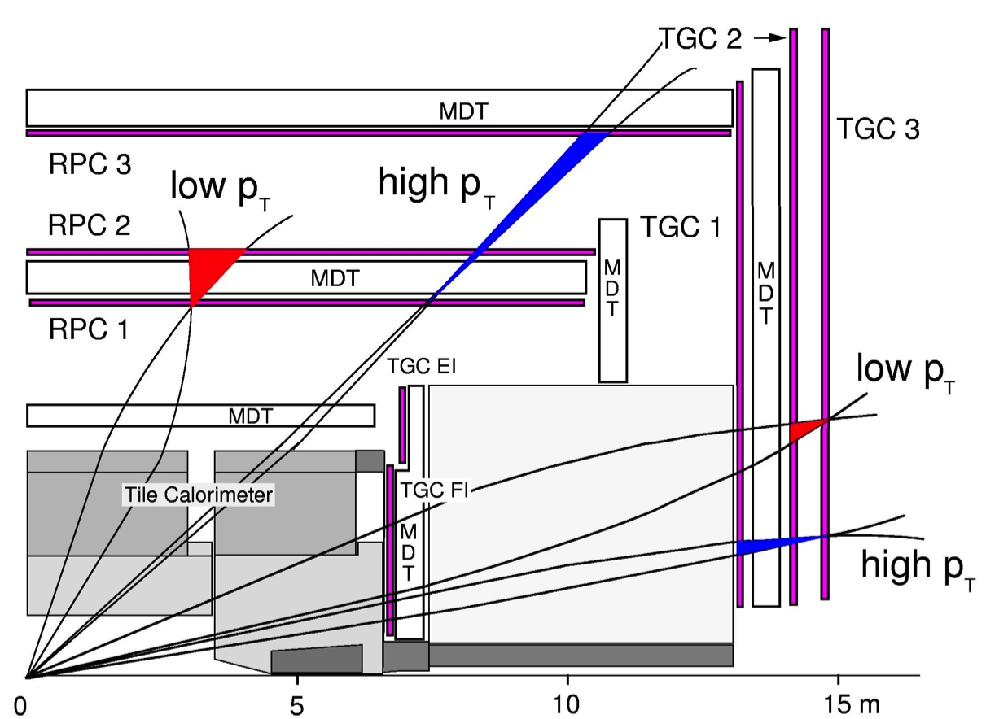
Implementation: The ATLAS LVL1 Muon Trigger
ATLAS LVL1 μ trigger is based on coincidences among hits within “window” in layers of RPCs (TGCs), taking into account the primary vertex.
  Window size determines pT threshold.
Trigger performed in bending and non bending plane (adds rejection power)
Low pT trigger use inner 2 layers (3 thresholds) 6-10 GeV
High pT trigger use outer 2 layers (+ low pT trigger) (3 thresholds) 11- 40 GeV

Slide 16
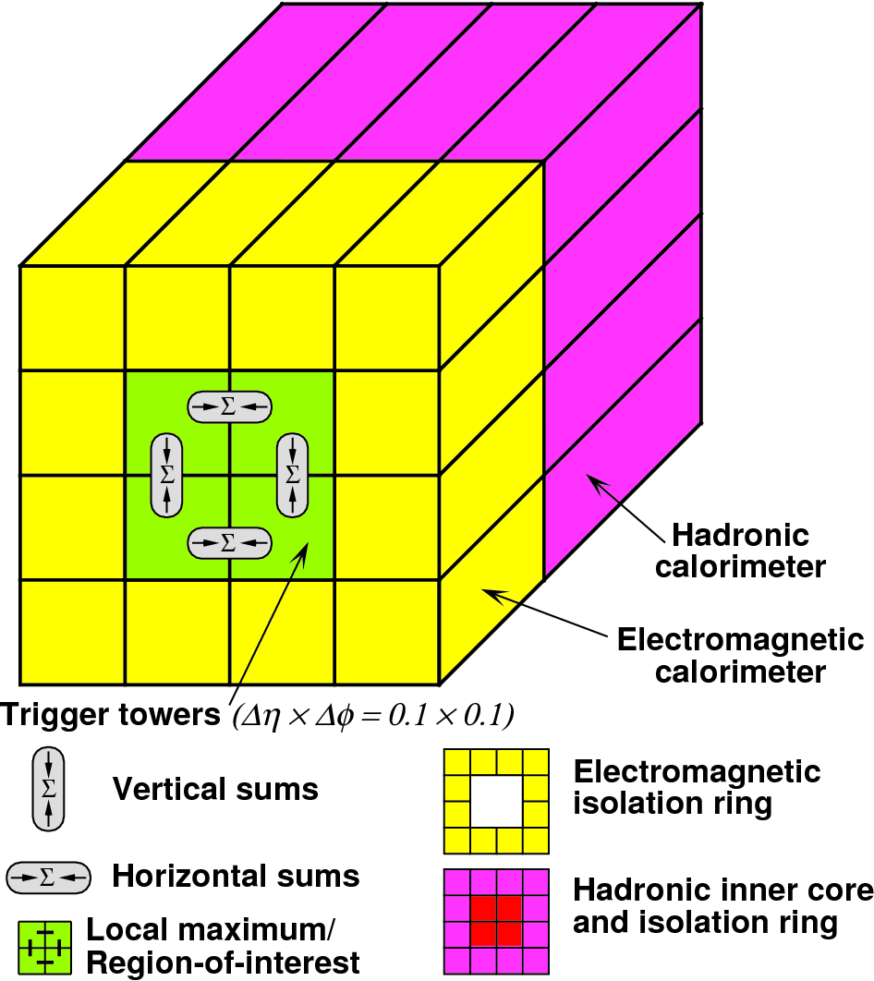
Implementation: The ATLAS LVL1 Photon/Electron trigger
Trigger based on analogue sums of calorimeter elements within projective regions, called trigger towers
  Reduced Granularity
  Δ􏰀η × 􏰀Δφ = 0.1 × 0.1
Electromagnetic and Hadronic calorimeters have separate trigger towers and two separate processors
  Cluster processor looks for electromagnetic clusters using full LVL1 calo Granularity
  Jet and energy Sum processor uses sums of 2x2 trigger towers to form global energy sums
Energy sums are compared with programmable thresholds

Slide 17
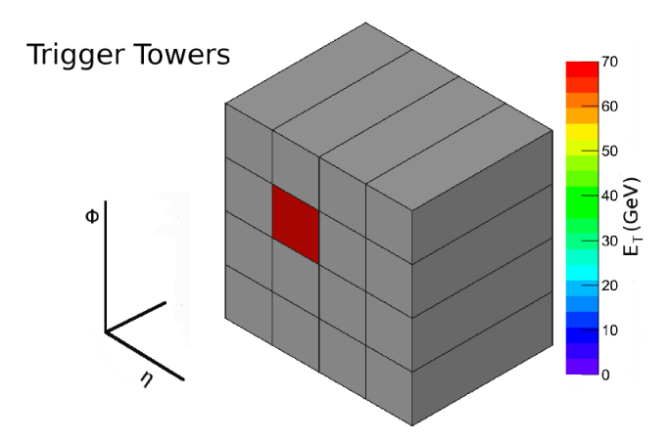
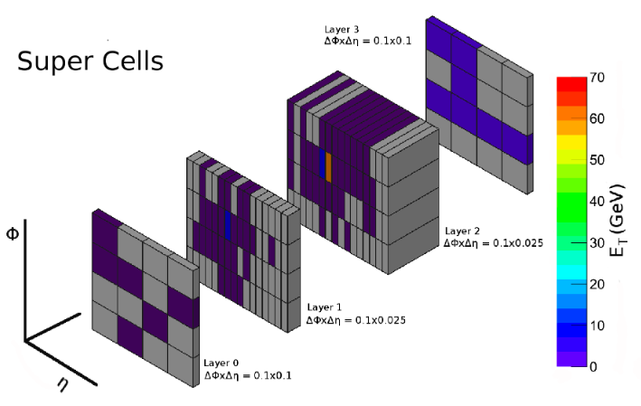
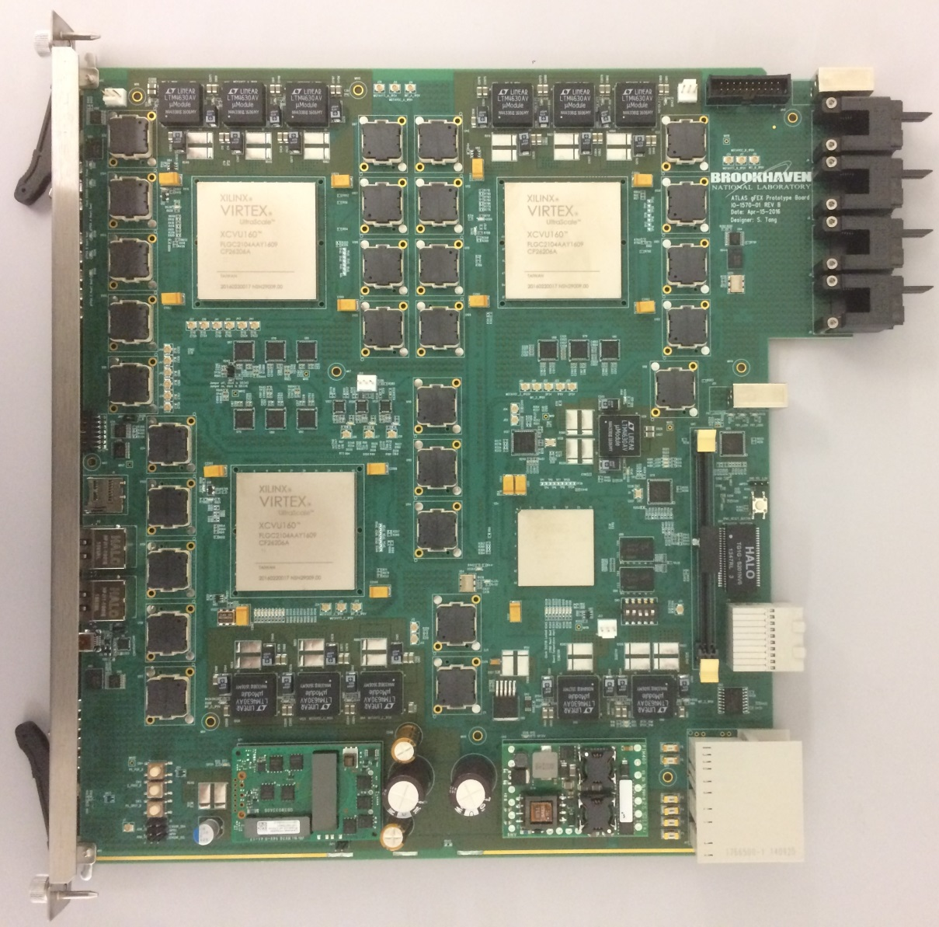
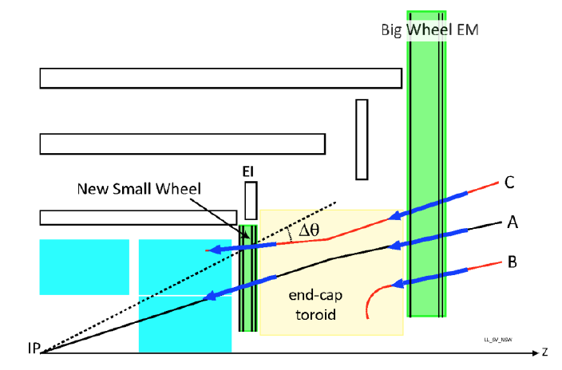
..And a word on Phase I upgrade
Liquid Argon Trigger Electronics upgrade
Aim to improve the Level-1 trigger level calorimeter decision for Run 3 and beyond by enhancing granularity at trigger level
Trigger / DAQ
Take full advantage of the LAr trigger electronics upgrade to enhance e/gamma selectivity and Jet rejection, improved end-cap muon trigger information (NSW), new read-out architecture for Phase II (FELIX)
Muon System: New Small Wheel
Replacement of the inner muon stations in the endcap region of the detector → reduced muon fake trigger rate, preserve position resolution and efficiency at HL-LHC

Slide 18
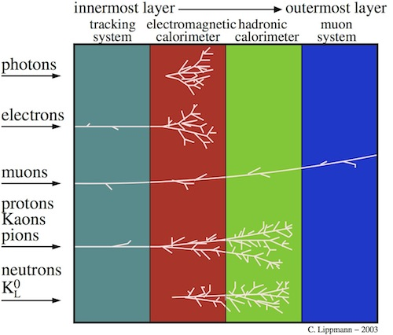
Identification of particles
Photons : presence of an EM cluster NOT associated to a track in the ID or associated to a conversion vertex
Electrons: presence of an electromagnetic cluster and a track in the ID pointing to the EM shower.
Muons: penetrating charged particles with a track in the ID, a MIP release in the Calorimeters and a matching track in the muon spectrometer
Charged Hadrons : track in the ID pointing to a small release in the EM Calo and an large release in the Hadronic Calo
Neutral Hadrons: large release in the Hadronic Calo and no track pointing to it.

Slide 19
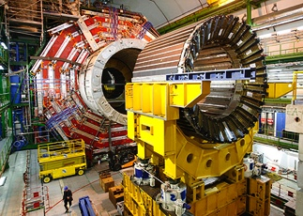
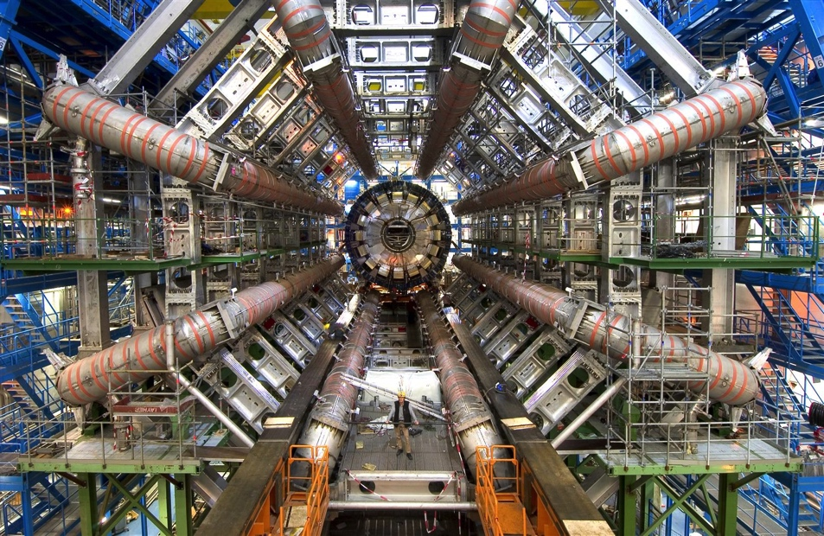
The Magnetic system
The choice of the magnetic configuration has direct conseguences in the design of the experiment:
  Total Dimensions and weight
  Momentum Resolution
  Angular coverage
  Etc.

Slide 20
Momentum measurements in magnetic field

Slide 21
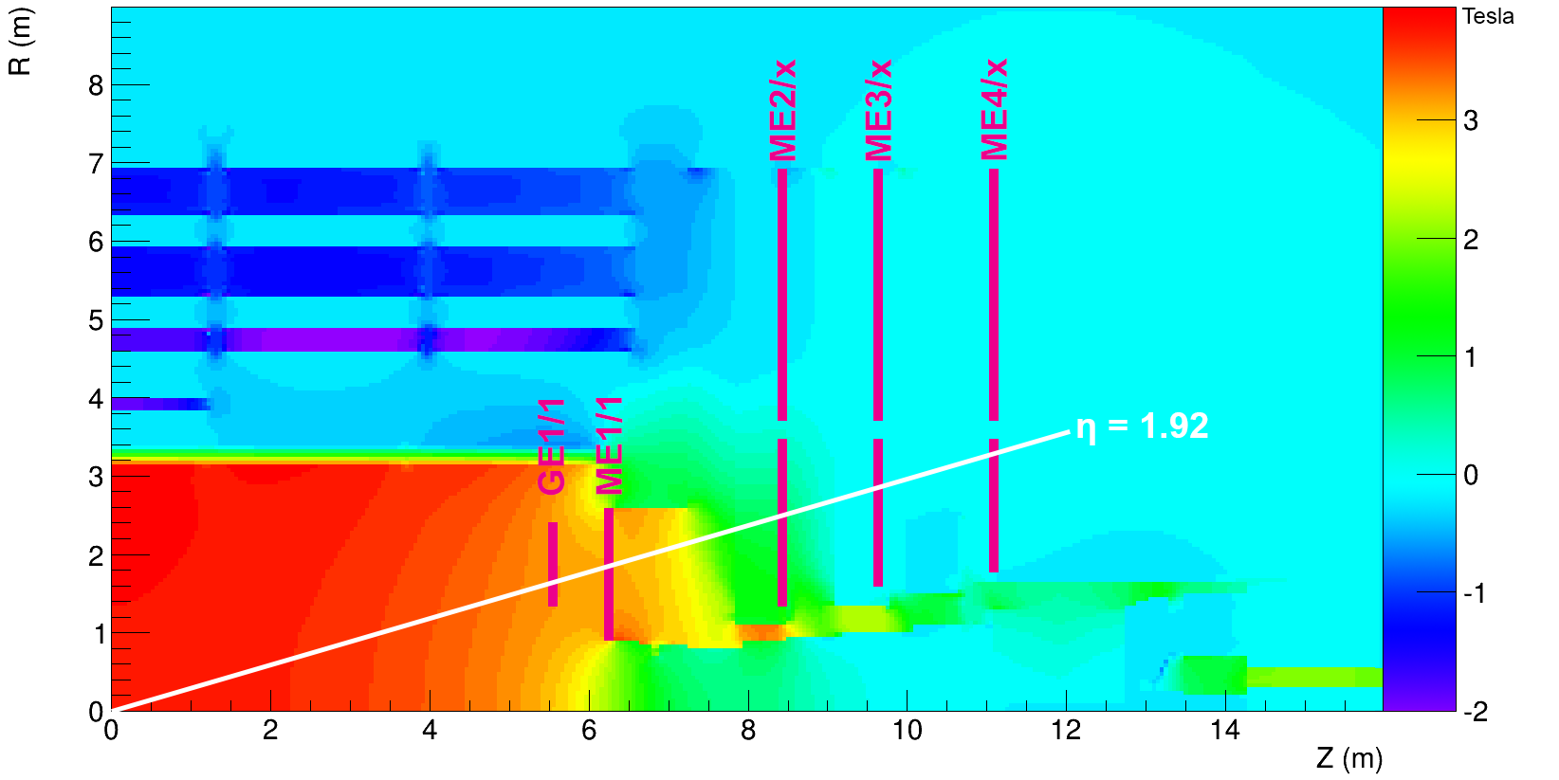
Magnetic Configurations: Solenoid
Very uniform field along the beam axis almost constant in the whole tracking volume
Measure the Momentum transverse to the beam axis by bending charged particles in the plane transverse to the beam axis (R,Φ )
No Material from magnet structures inside the tracking volume
Do not introduce(large) disturbances on beam dynamics since B is perpendicular to beam direction (in first approx.)
Large experience also for large systems and High Field (up to 4 T for CMS)
Not ideal for forward direction. Bending power reduces in forward direction due to the fact that B and P are more and more collinear and Track lenght perpendicular to the field is shorter
Need of an iron yoke for magnetic flux return → Very heavy detectors.

Slide 22
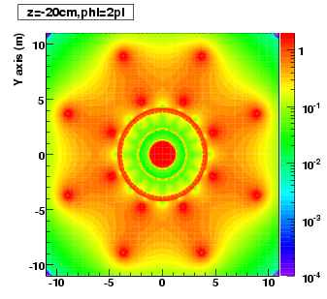
Magnetic configuration: Toroids
In theory ideal configuration both in the central region and in the forward region since B is always perpendicular to the Momentum of the particle.
  The integrated field along the trajectory increases as η increases hence mantain the same resolution independent on the particle angle.
No need of Iron yoke
No field along the beam axis
But… Field is NOT homogeneous in the tracking volume (even for Ideal Toroid ~ 1/r)
In practice it is difficult to built an Ideal toroid
  Difficulty of constructing very large superconducting coils
  Presence of large structures to keep the coils in place hence Multiple Scattering
  Large Non uniformities of B field in particular in the region where the field of the central toroid and the one of the forward toroid interfere.
  The forward coverage of toroids is limited by the maximum current density allowed in the inner bore of the toroid.

Slide 23
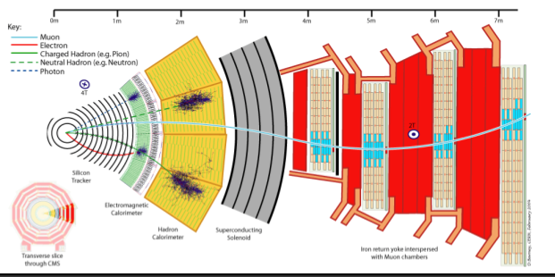
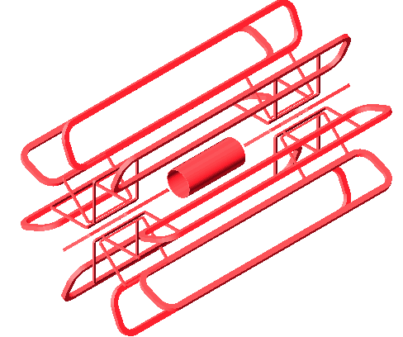
Magnetic configuration: a Strategic Choice
CMS: Large Central solenoid with muon measurement and ID in the Iron used for Flux return
  High precision muon measurement based on using the inner tracker and the first chamber of the Muon system, MS dominates resolution in the Standalone muon system.
  Excellent muon identification capability
  No need of very high resolution detectors and alignment for muon system
  Compact but heavy detector
ATLAS:Air Core Toroid + “small Solenoid”
  Excellent Muon identification and muon momentum measurement based on combination of ID and Muon spectrometer
  Excellent stand alone momentum measurement (in case of unforseen problem with the ID)
  But… Need very large detector
  Very demanding on detectors performances, calibration and alignment

Slide 24
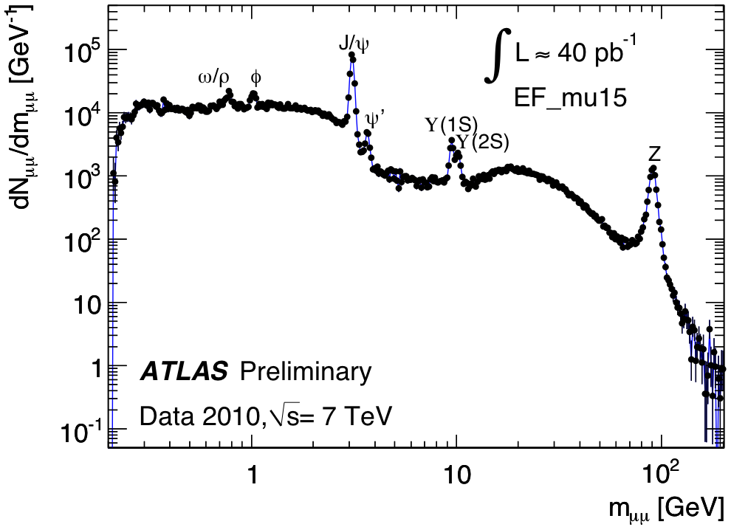
With Excellent results for both
For Low-Medium momentum muons the Larger Solenoidal Field of CMS gives a better resolution
It is also interesting to note that these Performance are still available at High luminosity with 40 Pile up events per BC
  This last point was not obvious at all when the detectors were designed and was one of the main driver for ATLAS for the choice of Stand Alone Muon measurement capability

Slide 25
The ATLAS Detector

Slide 26
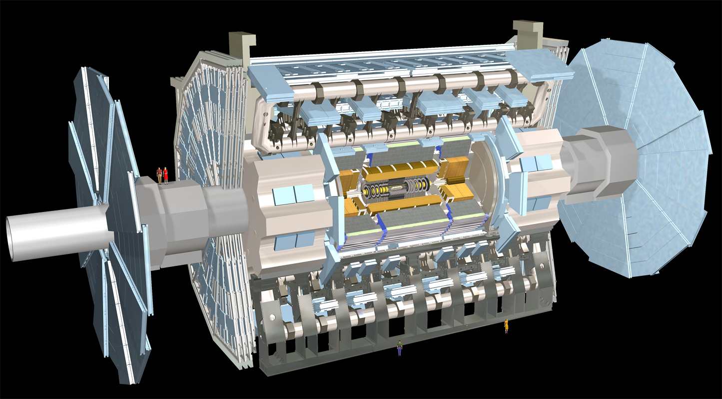
The ATLAS Detector: Overview
4 (Gas)-Detector technologies: three station layers |η|<2.7 + 3 air-core TOROIDS
μ P Measurement + LV1 Trigger (|η|<2.4)
HAD Calorimeter (|η|<4.9):
Fe-Tiles, Cu/W-Lar(forward)
LV1 Trigger
E-resolution ~ 50%/√E + 3%
Forward: ~ 100%/√E + 7%
EM Calorimeter (|η|<3.2):
Accordion Pb-LAr,
e/γ Id and E Measurement +
LV1 Trigger
E resolution ~ 10%/√E + 0.7%
High Granularity +
Longitudinal Segmentation
3 (Silicon+Gas) Detector technologies + Solenoid Field ~2T: |η|<2.5
Charged particles: P_{T} Measurement + Vertex Measurement + b-tag + LV2 Trigger

Slide 27
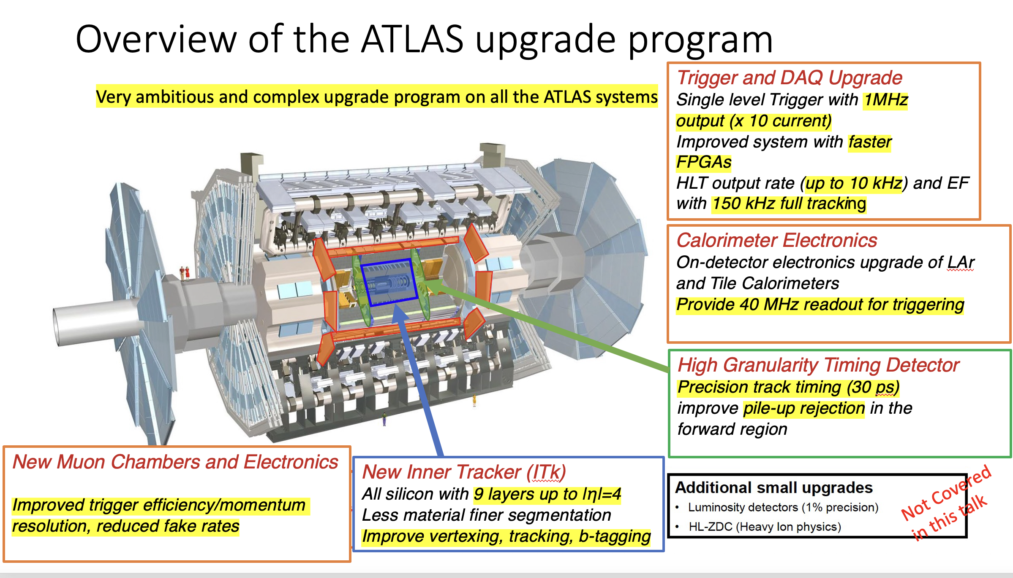
And a word on Phase II upgrade

Slide 28
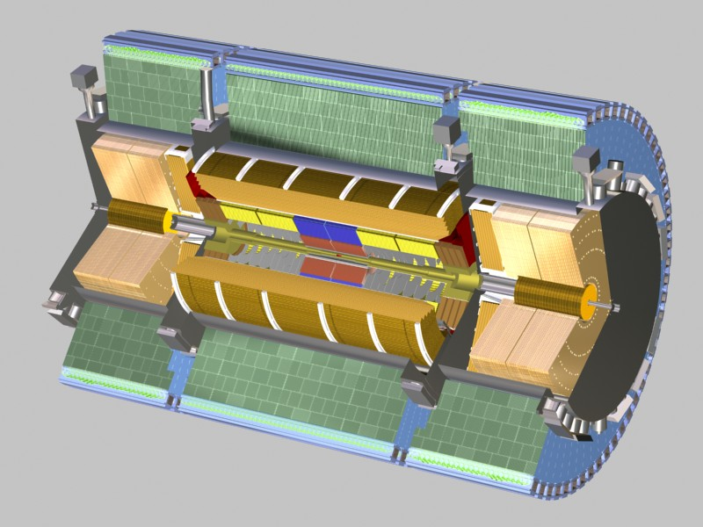
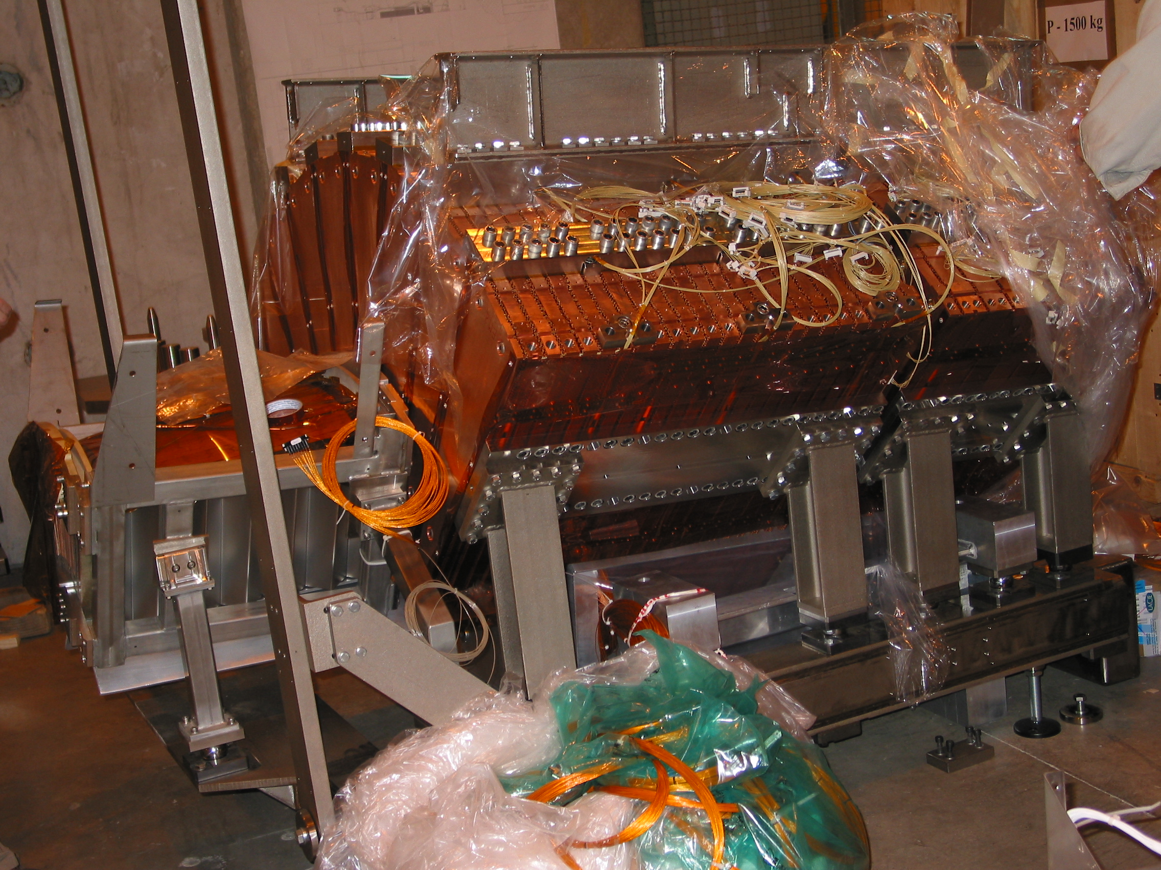
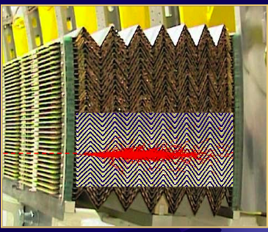
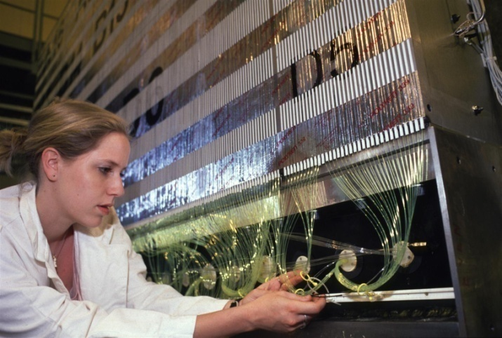
Calorimeters
Hadron Calorimeter
Barrel: Iron-Tile (10⁴ channels)
EC/Fwd: Cu/W-LAr (~2*10⁴ channels)
σ/E ~ 50%/√E ⊕ 0.03 pion (10 λ)
σ/E ~ 100%/√E ⊕ 0.1 (Forward)
LAr/Pb electromagnetic
Electromagnetic Calorimeter:
barrel, end-cap: Pb-LAr Accordeon
~10%/√E energy resolution e/γ
180’000 channels: 3 longitudinal samplings + presampler
Fe/scintillator hadronic Tilecal
HEC
EM
FCAL
LAr/Cu hadronic
~ 12 m long, 4.3 m radius
LAr/W forward

Slide 29
Inner Detector
Pixel: 3 layers 2D - Hit resolution bending plane: 10 μm (NOW 4 Layers with the IBL)
Silicon Strips: (SCT) 4-9 layers 2D (stereo strips) - Hit resol bending plane: 17 μm
Straw Tubes (TRT): up to 160 planes -1D Hit resol bending plane: 130 μm
Magnetic Field : Solenoid 2 T, Angular Coverage η<2.5

Slide 30
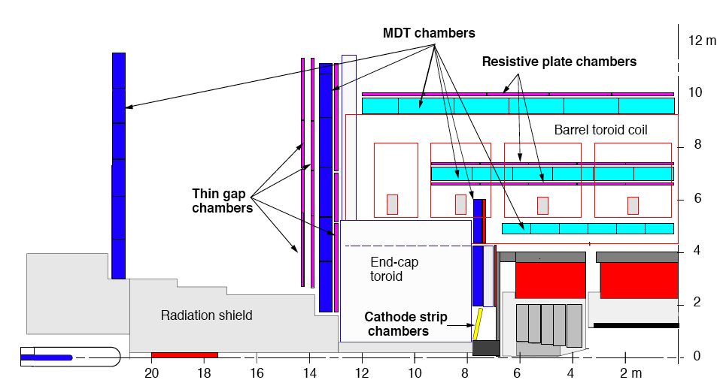
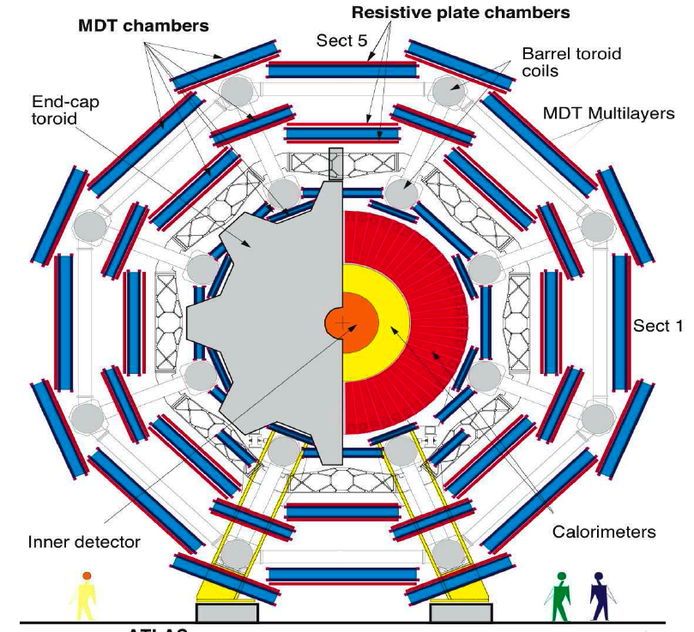
Muon Specrometer
Outer
Middle
Large
Outer
Small
Middle
Inner
Precision Chambers: from 3-stations sagitta in bending plane → measures P
  Monitored Drift Tubes (MDT) + Cathode Strip Chambers (CSC) 2.7>|η|>2
Trigger Chambers: LVL1 μ trigger + coordinate in non-bending plane
  Resistive Plate Chambers (RPC)|η|<1+Thin Gas Chamber (TGC) 2.4>|η|>1

Slide 31
The “real” Muon Spectrometer
Small
Large

Slide 32
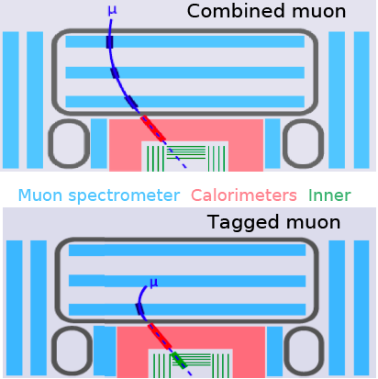
Muons in ATLAS
ATLAS has 2 μ tracking systems:
  Muon Spectrometer (MS)
  Inner Detector (ID)
Muon ‘Definition’:
  TAG: P_{T} from ID + Iden. from MS (or calorimeters): Low-P_{T} or poorly instrumented MS regions
  MS StandAlone (SA): P + iden. from MS only:
    Extends to 2.7>|η|>2.5, need to correct for E-loss
  ComBined (CB): P_{T} from ComBination of MS + ID: Best Track Parameters Measurement over full P_{T} range
ID and MS bending planes are orthogonal
TAG
SA
CB
160 X₀

Slide 33
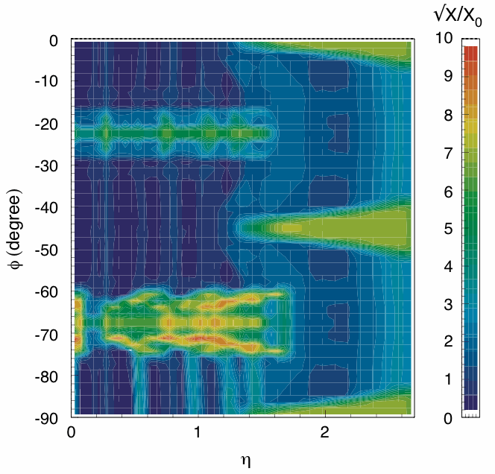
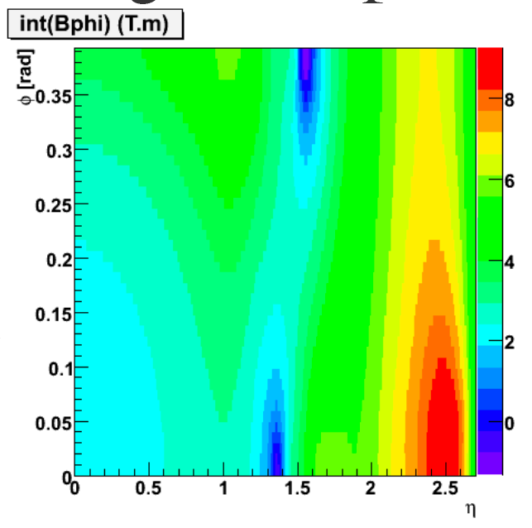
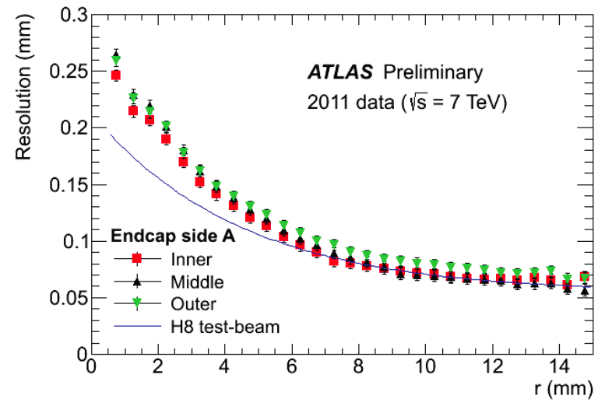
P resolution: MS
Φ (1/4)
Material Budget
BL (Tm)
Field Map vs η
Coils
Coils
Small Sectors
Small Sectors
Large Sectors
Feet
Large Sectors
η
Single point Resolution
Bending power: designed to keep constant P_{T} resolution vs η
  2-9 Tm
  Small region BL~0 ! → 4th station layer installed (BEE)
Material distribution
  Range 1-8 √X/X₀
Hit resolution
  Average ~80μm
  6/8 layers per station ~40μm
  Align 3-stations (up to 10m) at ~40μm

Slide 34
Expected P resolution MS
σ(P)/P= K₂ P + K₁ + K₀/P
Intr. Mul-Scatt E-loss
-------------------------------
E-Loss K₀ ~ 0.350 GeV
Mult-Scattering K₁ ~ 3.2%
Intrinsic: K₂ ~ (12×10⁻⁵) GeV⁻¹
Barrel |η|<1
Intrinsic
E-loss
Multiple Scattering
High-Pt muons resolution dominated by
“intrinsic term”:
alignment + hit resolution

Slide 35
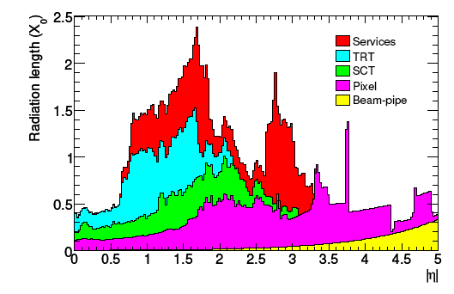
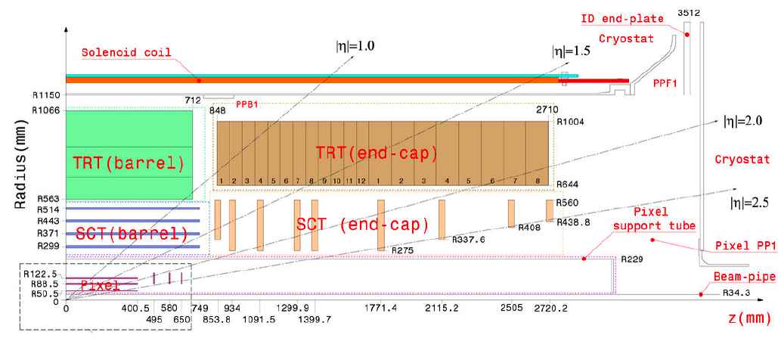

P resolution ID
Material Budget:
  Increase with |η|
Intrinsic Resolution:
  Hit resolution + Alignment
  |η| dependency: above1.7 FAST degradation due to BL² effect
|η|~1.7
X = q/P_{T}
@ P_{t} = 45 GeV - Z region
  0.25 <|η| < 0.50 σ(P_{t})/P_{t} ~ 1.5% MS (+) 1.5% Intrinsic ~ 2.1%Total
  1.50 <|η| < 1.75 σ(P_{t})/P_{t} ~ 3.3% MS (+) 1.8% Intrinsic ~ 3.8% Total

Slide 36
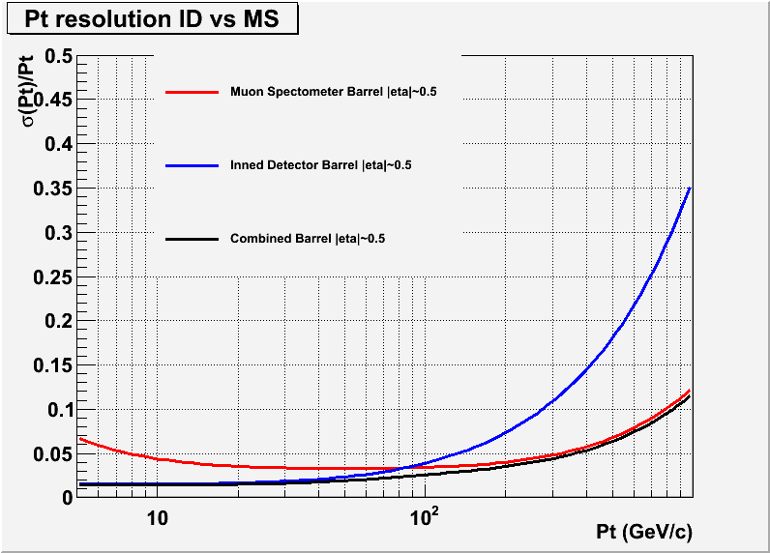
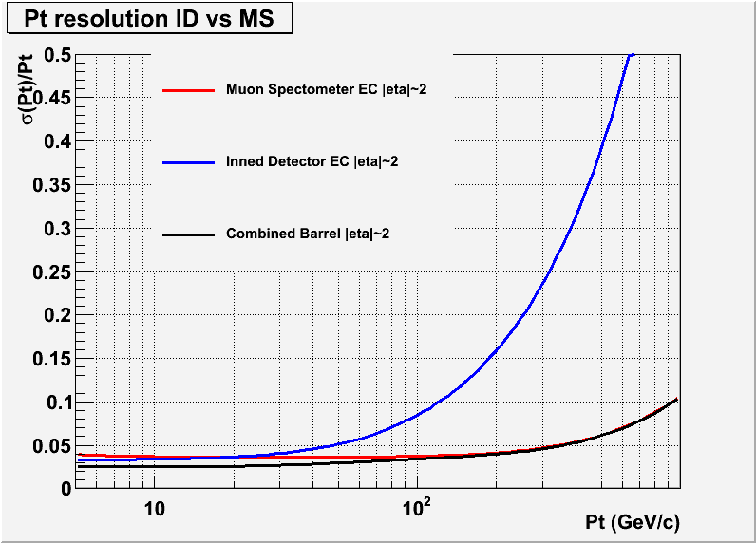
Expected CB P resolution
|η|~0.4
ID
Z’/W’
|η|~2
Z’/W’
ID
Z/W/H
MS
Z/W/H
B-phys
B-phys
MS
CB
CB
Barrel:
MS needed at very high P_{t}
ID better up to P_{t}~80 GeV
Endcap:
ID better up to P_{t}~20 GeV
MS as Barrel up to |η|~2.7 thanks to forward TOROID’s
BEST resolution over full P_{t} and η range → CB

Slide 37
Trigger and precision chambers: requirements
Trigger chambers
  Very good time resolution for bunch crossing ID and moderate (1 cm) space resolution
  Very high efficiency
  High rate capabilities and good ageing properties
    RPC barrel region | η | < 1.0
    TGC forward | η | < 2.4
Precision chambers
  Very high space resolution (80 μm per point)
  Very accurate mechanical construction, wire positioning at 20 μm rms
  Very good knowledge of Calibration and Alignment (20 μm and 40 μm)
  High efficiency
  High rate capabilities and good ageing properties
    MDT | η | < 2.0
    CSC 2.0 < | η | < 2.7

Slide 38
Some System issues related to air core toroids Spectrometers

Slide 39
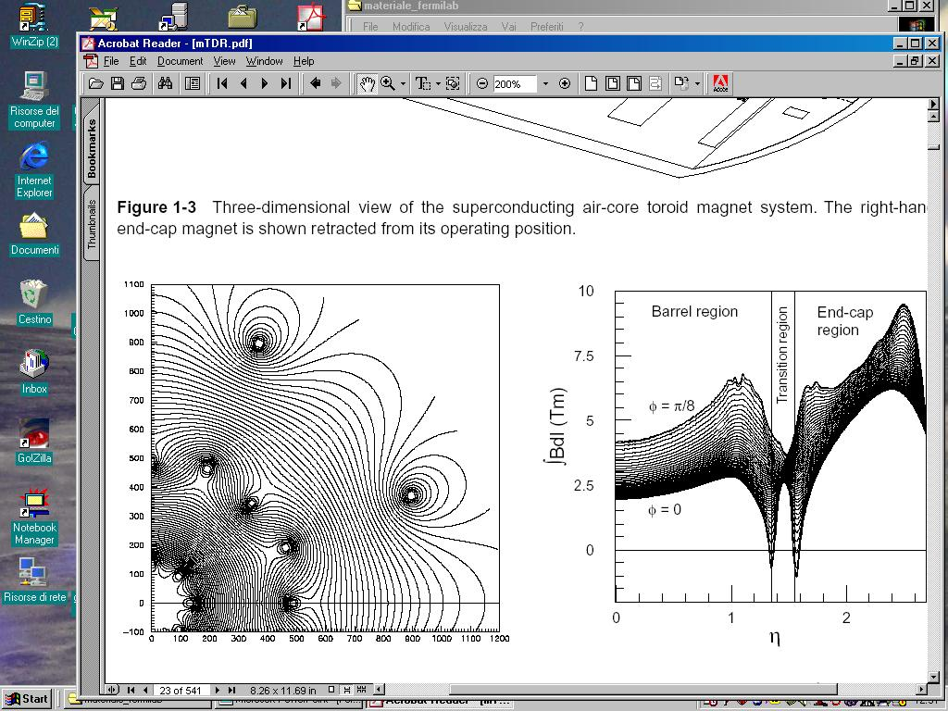
Toroidal Magnetic field in real life
Need to measure accurately the coordinate in
the non bending plane
Field integral
inhomogeneous
in the tracking volume
RPC and TGC
Need to take into account the differences in
Lorentz angle for the calibration of the
precision chambers
More than a single
RT relation per wire
Precision tracking more difficult, accurate knowledge of B field needed.
Y (cm)
Field lines
Field Integral vs η
X (cm)

Slide 40
Alignment Requirements
The high momentum performance for Muon measurement in ATLAS is driven by the Muon spectrometer
  The final momentum resolution at 1 TeV(sagitta =500 μm) (goal is 12%) will be defined by :
    Chamber intrinsic resolution (see slides above) 80 μm per point
    The knowledge of the Alignment of the chambers to better than 40 μm
      Reminder: dimension of the ATLAS detector ~ 40 mt x 20 mt
    The ability to follow the changes of the relative positions of the chambers with time with the same accuracy.
      Very complex system of optical alignment rays that monitor the displacements of chambers with time (and give an initial geometry at 50-300 μm level depending on the spectrometer region)
      The chambers moves for many reasons including: Magnet cycles, Temperature, vibrations etc.

Slide 41
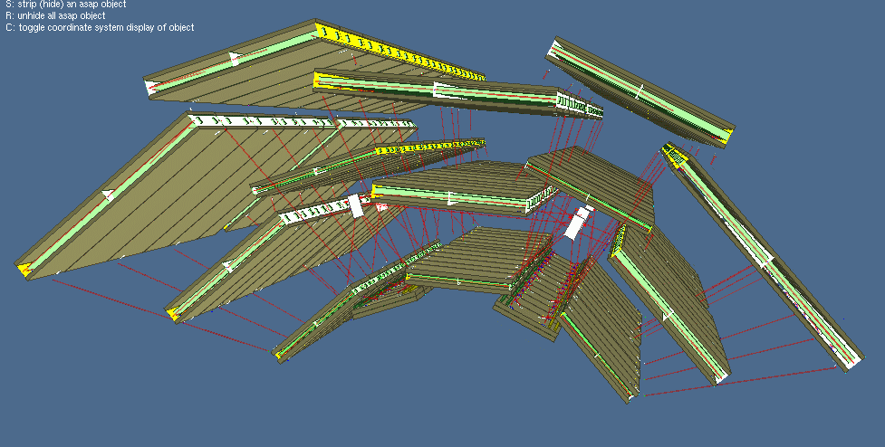
Alignment
Alignment concept in ATLAS:
  Projective optical lines emulate straight tracks from the vertex
  Axial lines ensure the alignment along the sectors
  Optical alignment within a chamber measure chamber distortions

Slide 42
The Muon Spectrometer Installation

Slide 43
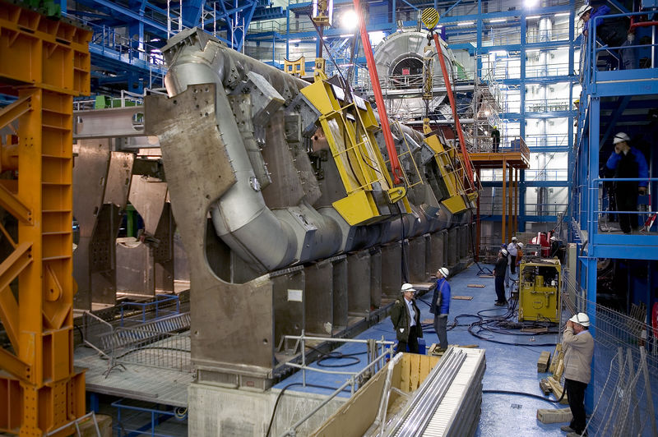
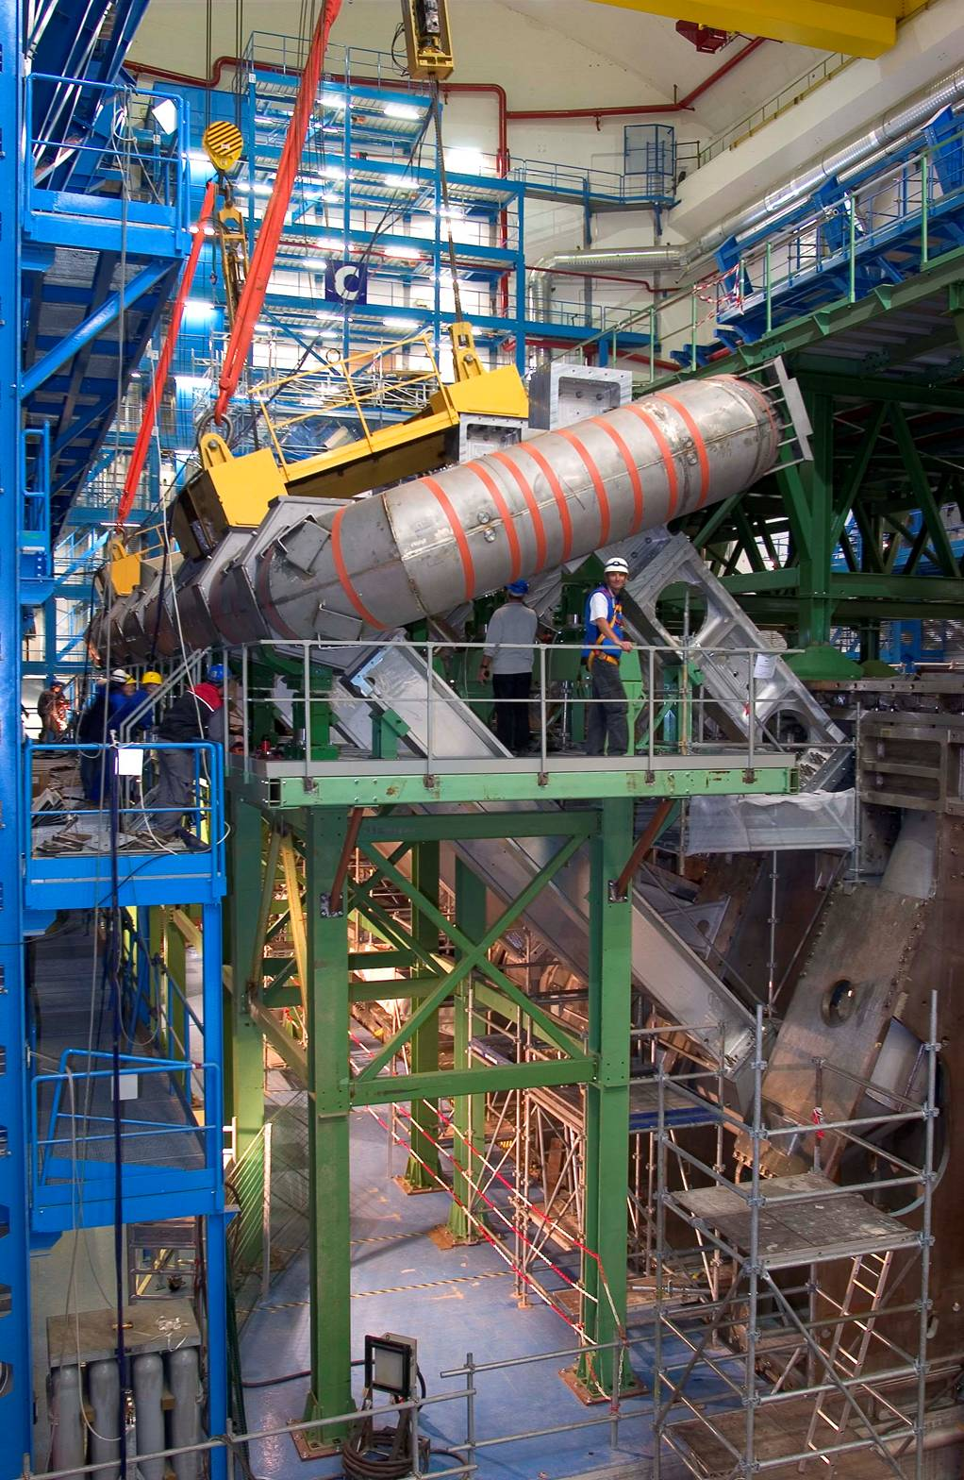
Muon Spectrometer Installation
Installation Started Jan 2005
Barrel finished end 2006
Big wheels finished mid 2007
Small wheels installed spring 2008
EE wheels completed in 2013

Slide 44
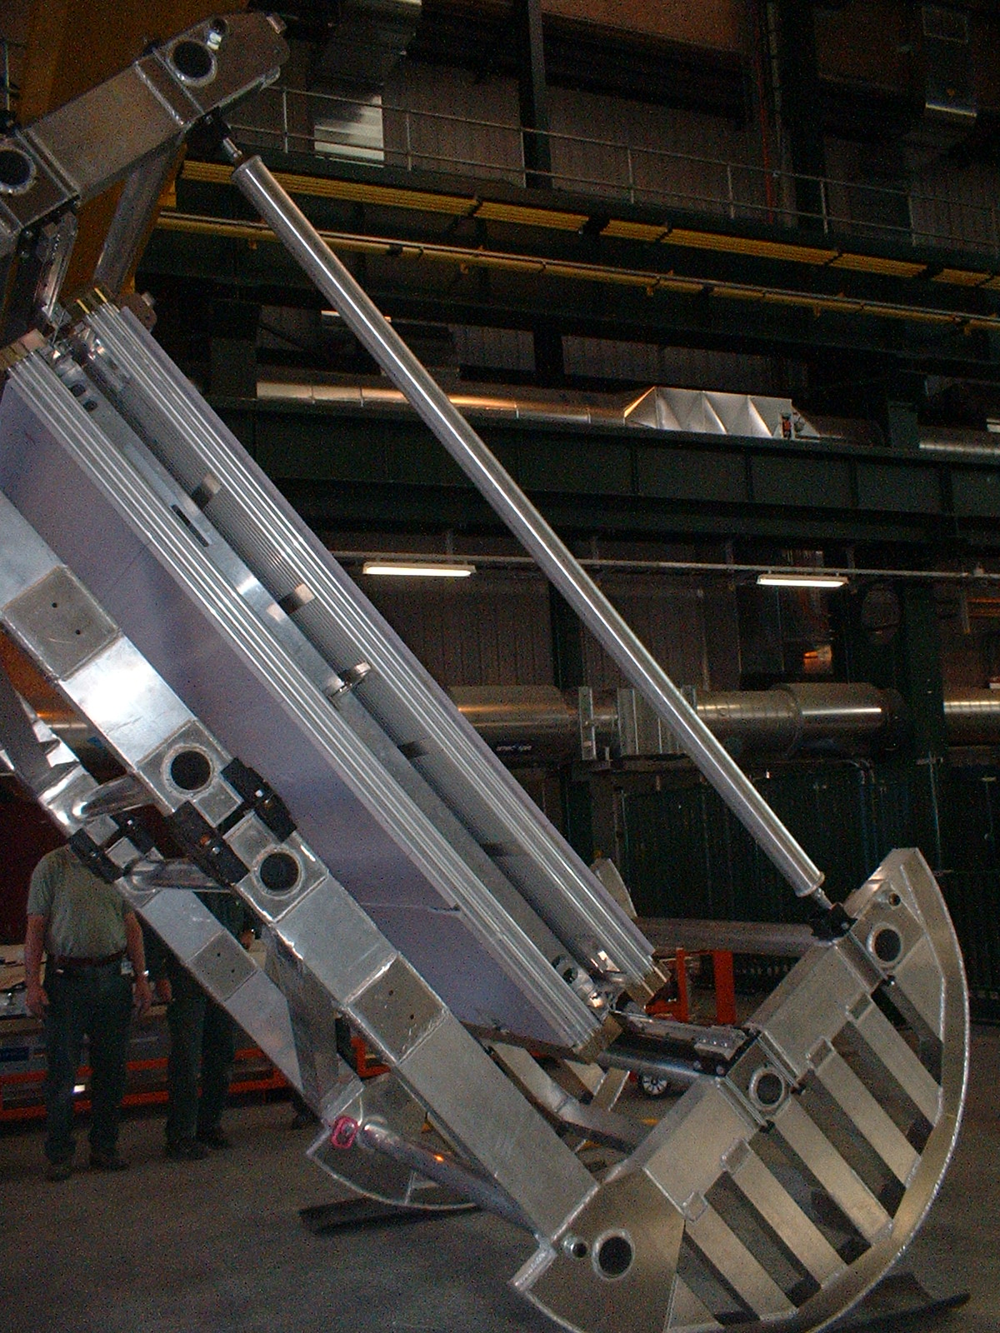
Installation of BIL Chambers
BIL Chambers were built in Rome and Pavia
This photo shows the first BIL Chamber while being installed in ATLAS

Slide 45
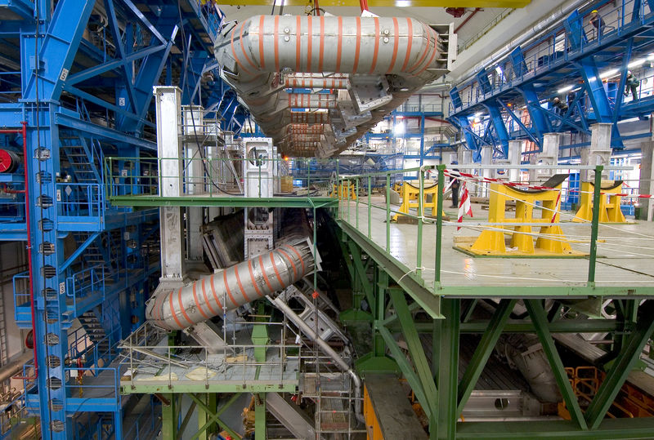
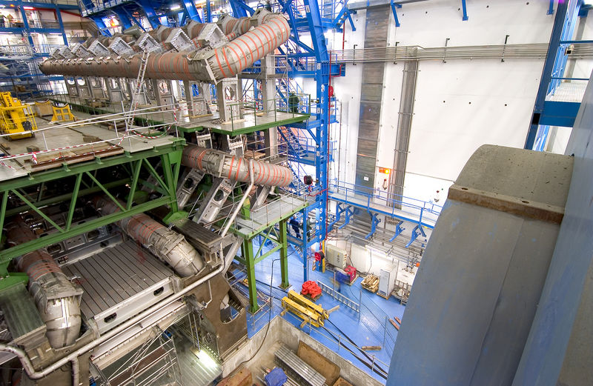
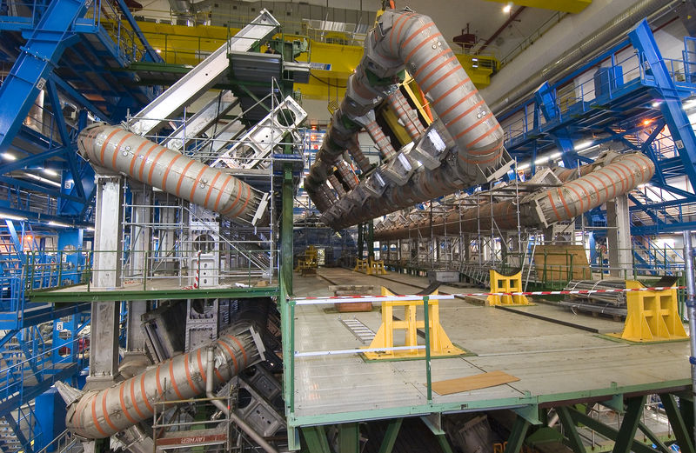
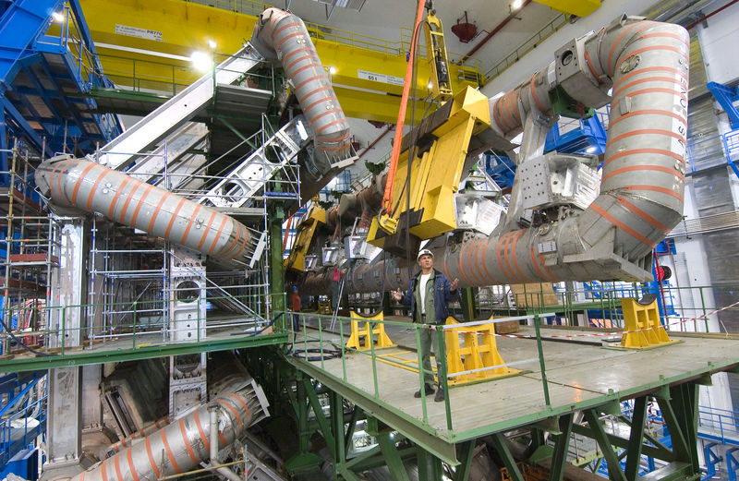
Barrel toroid construction

Slide 46

The Beauty of a Bare Toroid

Slide 47



End Cap toroids Installation

Slide 48



Big Wheels installation

Slide 49

























Many Many People has worked very hard for YEARS to achieve this beautiful result

Slide 50
Large statistic measurements: final determination of the Muon performance and relevance for the H→ 4Muons analysis

Slide 51
H→ 4 Muons
Need to optimize Higgs selection efficiency over full momentum range
  Use all possible Muon “Types” : Combined, Segment Tagged, Stand Alone and Calo Tag
Need to measure accurately Trigger efficiency and Reconstruction efficiency
  Use Tag and Probe Techniques with known resonances decaying in 2 μ
Momentum range from as low as possible (6 GeV) to ~100 GeV
  Need to know the muon momentum scale with 0.1 % accuracy over full momentum range for accurate Higgs mass determination
  Need to know momentum resolution to determine the ERROR on the Higgs Mass
  Again use known resonances (J/psi, Y, Z)

Slide 52
Optimization of Acceptance
Use Combined (CB) muons wherever possible i.e. Between 0.1 < |η|< 2.5
In some regions |η|~ 1.0-1.3 CB muons have lower efficiency
  Use also TAG Muons
For 2.5< |η|> 2.7 use Stand Alone Muons (SA)
For |η| <0.1 Use CaloTag Muons (with higher Pt threshold)
TAG
SA
CB
160 X₀

Slide 53
Determination of Efficiency
Tag and probe method
  Use known resonances decaying in 2 Muons e.g J/Psi (low momentum) and Z (high momentum)
  (Tag): a well reconstructed isolated (high momentum) muon which triggered the event
  Look for the other muon (Probe)
  Eff.= (Numb of rec. Probes)/(Number of Tags)
Measure separately the rec. Eff. for CB, TAG, SA and Calo types.
  Use as Tag a CB muon and for Probe a Track either in the ID (to measure SA, Tag, Calo and CB) or in the MS (to measure Calo and ID)
For high precision efficiency
measurements the background has to be calculated and subtracted

Slide 54



Efficiency Results
Important to notice:
  Very High and Stable reconstruction efficiency when combining all muon types
  The comparison with the MC simulation shows a VERY accurate understanding of the efficiencies (Much better than 1%)

Slide 55
Determination of the resolution and Scale
Need to check the Momentum scale and possibly define Scale corrections (Used in the Higgs Mass Determination)
Measured resolution is (in general) a bit worst than the calculated resolution from “First Principles” eg MC.
Need to understand the causes and “smear” the simulation to reproduce the experimental results
The Measured resolution is used to define the error on the Muon measured momentum which in turns defines the error on the Measured Higgs Mass.
Use a Monte Carlo Template Maximun Likelihood unbinned fit to known resonances mass to extract
  Scale corrections: S_{n}^{Det}
  Resolution Corrections: Δr_{m}^{Det}

Slide 56



Determination of the Momentum scale
Make use of the large number of J/PSI, Y and Z decaying in 2 muons
Make use of the very well known mass and width of these particles (Standard Candles)
Derive Muon Scale and Resolution in bins of η and Pt and use them in the analysis.

Slide 57

Eccolo!
On June 18 2012 I received a mail with this Plot…
…Simply the first evidence of the Higgs, an incredible shock!

Slide 58

Higgs in 4 Muons Candidate

Slide 59
Spares

Slide 60
The commissioning of the Muon Spectrometer

Slide 61


First Cosmic Ray with B field ON (Nov 2006)
BIL MDT
BML MDT+RPC
BOL MDT+RPC

Slide 62
Commissioning with Cosmic Rays
Cosmic rays are a very powerful tool for the commissioning of any HEP detector
  Available during all the installation period
  Large momentum span (even higher than achievable with beams)
  Decent rate of events
With Cosmic rays it is possible to:
  Assess the basic responce of the detectors
  Debug all the cabling of the detector
  Debug the read out system and “time in” the detector
  Align to very high accuracy the detector (mainly the Barrel)
    Cosmic rays have large angular span and are not coming from a single point, these characteristic are optimal to constraint the so called Alignemnt Weak modes.
  Have a first determination of the momentum resolution
    At high momentum CR are almost the only source to determine the resolution

Slide 63

Results with Cosmic Rays
From channel to channel correlations it is possible to check the cabling maps
From Toroid Off runs it is possible to measure the “Fake sagitta” due to chamber mis-alignment and achieve a much better alignment
Barrel: <100 μm alignment achieved

Slide 64

Results with Cosmic rays
Cosmic passing through ATLAS IP crosses 2 halves of tracking detectors
P Resolution and Scale:
  Same μ is measured TWICE !
  From 2 measurements: extract the scale and resolution (d₀, P, ….):
  σ(P_{UP} – P_{DOWN}) = √2 × σ(P)
Efficiency - Each track is a μ:
ID <-> MS
Tag <-> Tag

Slide 65


Cosmic ray results: Performance of ID and Muon Spectrometer Combined
Muon Spectrometer
Multiple Scattering ~3.2% MC vs ~3.8% DT (missing material in MC Large Sectors)
  Intrinsic resolution:
  MC~12% TeV⁻¹ vs DT~20%TeV⁻¹
  (Alignment and drift time phase)
  Inner Detector
  Multiple Scattering: ~OK
  Intrinsic resolution : MC~36% TeV⁻¹ vs DT~53%TeV⁻¹ (Alignment)
|η|<1

Slide 66
Commissioning with Beams

Slide 67

pipo
10-9-2008 First Beam Splash in ATLAS
One of the most exciting day in my life

Slide 68



Momentum Scale results
Ratio of the Fitted invariant mass for Data and MC simulation
The Momentum Scale is known with an accuracy of better than 0.1% after corrections over (almost) the full angular region and the full Momentum range relevant for the Higgs Search.
This Result was extremely important to give confidence in the measurement of the Higgs Mass in the 4 lepton channel

Slide 69



Resolution determination: Results
The Use of resonances of different mass allows to explore different momentum ranges for the corrections and hence different physical sources for the corrections
Low Momentum gives sensitivity to defects in the modelling of dead material (E-loss and Multiple Scattering)
High Momentum gives sensitivity to alignment and measurement precision issues.

Slide 70


Implementation: The ATLAS LVL1 Muon Trigger
RPC (TGC) strip signals from the two trigger planes are sent to a trigger matrix.
Programmable road in the matrix defines the acceptance window.
Matrix size: 32x64 ( ~1 m on the pivot plane)
  Window size :
  Barrel lowpt ~25 cm (8 strips)
  Barrel high pt (20 Gev) ~30 cm (10 strips)
Decision time: ~900 ns. Latency = 2.5 ms

