Slide 1
Scientific writing and publishing
Department of Physics
Dr Gaia Donati
Science Communication Specialist, ETH Zurich
PhD Seminars Event, 20.12.2023

Slide 2
Outline
A bit about me
Part one: Writing a scientific paper
Intermission: Your questions
Part two: Publishing a scientific paper

Slide 3
A bit about me
Occasional assignments as a freelance science writer: Institute of Physics (UK), Nature, Technologist, etc.
Editor at Nature Photonics and Nature, London
PhD in quantum optics, Oxford
1
2
Communication jobs at Zurich Instruments and ETH, Zurich
BSc and MSc in physics, Rome
Credit: Mark Cacahuate on WikiTravel

Slide 4
Why write a paper about your research?
Possible answers
To get a first-author publication so that I can finish my PhD.
To get a job following my PhD.
To show everyone we did it first/better/etc.
Because that’s how academic research works.
Because I’d like my research community to know what I found out.
No matter your main objective – a paper must communicate effectively what you did.
Key questions
What do I want to say?
Who’s my audience?

Slide 5
How do you know that you wrote a good paper?
None of this means your paper is badly written
The manuscript is rejected by a journal.
The published paper doesn’t get cited.
The research isn’t highlighted or promoted by the journal.
The paper isn’t picked up by the media.
A paper is badly written if relevant readers don’t understand what you did, how and why.

Slide 6
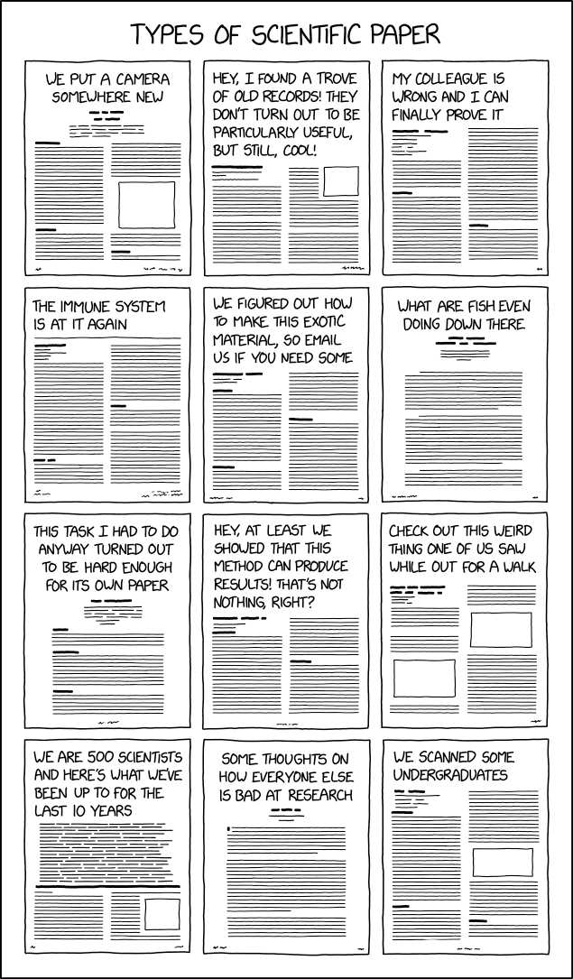
So how do you start?
Preparation work
Identify your main finding(s): in general, one paper presents one key result.
Classify your main finding(s): new observation or calculation, characterisation, new application, reproducibility study, etc.
Identify the context of your research.
Points to discuss with your co-authors
Everyone should be clear on their role.
It’s best to limit the number of writers to 2 or 3.
When asking a co-author for a draft review, be explicit on the kind of feedback you seek.
https://xkcd.com/2456/

Slide 7
So how do you start?
Possible ways to warm up
Option one:
Write an ‘editorial summary’ of your study – it can be as short as 200 characters!
Broaden that into an abstract – count about 200 words.
Option two:
Draw a conceptual map with keywords linked to your work.
From the terms – and connections! – on your map, identify a linear structure that can be turned into an abstract.
Once you have your ‘proto-abstract’, make a list of key sketches, plots, tables, etc.

Slide 8
The structure of a paper
The IMRaD template
Introduction
Methods
Results and
Discussion
Examples of variants
Methods at the end (see Nature) or found within results section
Conclusions or outlook separate from discussion section
Articles not about primary research can have different structures, but the ‘hourglass’ remains.
Broad
Detailed
Broad

Slide 9
The structure of a paper
Introduction: area of work and main topic, current knowledge, goal(s) of your study
Results: evidence (data, simulations, calculations)
Discussion: caveats, limitations, outlook
Can be one or few paragraphs
Generally divided into subsections with headings
(Contains references to Methods and to supplementary material)
Can be one or few paragraphs

Slide 10
The structure of an introduction
General
Specific
Focus: literature review, rationale and objective(s) of your work
Context: what is known, what isn’t, where your study comes in
Findings: a preview (optional)

Slide 11
The structure of a discussion
Specific
General
Focus: new or puzzling outcomes, limitations, open questions
Outlook: what comes next (optional?)
Findings: a recap

Slide 12
Zoom – Paragraphs
The paragraph is the fundamental organisational unit in a paper.
In general, a paragraph corresponds to one idea/sizable bit of information.
It helps the reader to find clear transitions that connect paragraphs.
Continue: also, furthermore, in addition, etc.
Pause: for instance, similarly, likewise, etc.
Compare and contrast: by contrast, compared to/with, conversely, unlike, but, etc.
Express cause and effect: therefore, thus, consequently, because, as a result, etc.
The start and the end of a paragraph should carry the most important input.

Slide 13
Zoom – Sentences
In a long sentence, readers often skip over the words in the middle, focussing instead on the words at the start and at the end…
… So here comes the “old before new” rule¹:
The beginning of a sentence makes a connection with what precedes it and sets the context.
The ending of a sentence can emphasise known information or, crucially, introduce new and complex information.
In any case, do your best to avoid long sentences!
¹ See “The craft of research” by Wayne C. Booth, Gregory G. Colomb, Joseph M. Williams, Joseph Bizup, and William T. Fitzgerald, The University of Chicago Press, 4th edition (2016).

Slide 14
Tips – Hype and firsts
No need for hype
Adverbs to avoid: surprisingly, strikingly, etc.
Nouns and catch phrases to forget: breakthrough, holy grail, smoking gun, paradigm shift, etc.
No need for firsts
“Here, we show for the first time …” – are you sure that you’re the first? And does it really matter?
“To the best of our knowledge, this is the first demonstration/study/etc. …” is more mindful of potential ‘other firsts’.

Slide 15
Tips – Ambiguity and wordiness
Keep confusion at bay
Repetition isn’t necessarily bad, especially if it promotes clarity over confusion.
The main causes of ambiguity are found in word choices, word order, pronouns and punctuation. Beware of the standalone “this”!
Watch out for misplaced modifiers²: “Rising 24000 meters into the atmosphere in only 15 minutes, scientists estimated the height of the ash cloud.”
Prefer action
“If rain forests are stripped to serve short-term economic interests, the earth’s biosphere may be damaged.” vs
“The stripping of rain forests in the service of short-term economic interests could result in damage to the earth’s biosphere.”
The first sentence is shorter and easier to read.²
² These examples are taken from “The craft of scientific writing” by Michael Alley, Springer, 4th edition (2018).

Slide 16
Tips – From acronyms to appendices
Acronyms
Define them when you introduce them!
When you revise your paper, monitor the density of acronyms and decrease it if necessary.
Figures
Refer to all figures – in the right order – in the main text.
Write figure captions so that they can be understood without having to check the main text.
References
Cite papers you found useful, and prefer more recent articles to older ones (on a given topic).
Check the journal’s guidelines for constraints on the number of references.
Beyond the main text
Don’t use supplementary material/information or appendices as a dump… or a carpet.
In the main text, refer to relevant sections and/or figures in the supplementary material.

Slide 17
The title of a paper
It’s often the first visible piece of information about your work – make it stick.
The title, like the abstract, should be searchable – think of the best keywords for your area of study.
Avoid lengthy titles.
Avoid questions, punctuation, puns, and acronyms (where possible).
Aim for a (difficult!) balance between not being specific enough and being cryptic.

Slide 18
Examples of paper titles

Slide 19
Back to the abstract
Once a first paper draft is ready, look at your ‘proto-abstract’ again (remember it?).
How well does it match your main text in terms of key message?
Make changes to the abstract to improve how it reflects the main text, because…
… An abstract is a miniaturised paper.
Area of study and main question or issue addressed
Key findings
Implications

Slide 20
A ‘classic’ abstract
“Quantum computing promises to offer substantial speed-ups over its classical counterpart for certain problems. However, the greatest impediment to realizing its full potential is noise that is inherent to these systems. The widely accepted solution to this challenge is the implementation of fault-tolerant quantum circuits, which is out of reach for current processors. Here we report experiments on a noisy 127-qubit processor and demonstrate the measurement of accurate expectation values for circuit volumes at a scale beyond brute-force classical computation. We argue that this represents evidence for the utility of quantum computing in a pre-fault-tolerant era. These experimental results are enabled by advances in the coherence and calibration of a superconducting processor at this scale and the ability to characterize¹ and controllably manipulate noise across such a large device. We establish the accuracy of the measured expectation values by comparing them with the output of exactly verifiable circuits. In the regime of strong entanglement, the quantum computer provides correct results for which leading classical approximations such as pure-state-based 1D (matrix product states, MPS) and 2D (isometric tensor network states, isoTNS) tensor network methods^{2,3} break down. These experiments demonstrate a foundational tool for the realization of near-term quantum applications.” (Nature 618, 500-505 (2023))

Slide 21
A reader-friendly abstract
“Molecules are a powerful platform to probe fundamental symmetry violations beyond the standard model, as they offer both large amplification factors and robustness against systematic errors. As experimental sensitivities improve, it is important to develop new methods to suppress sensitivity to external electromagnetic fields, as limits on the ability to control these fields are a major experimental concern. Here we show that sensitivity to both external magnetic and electric fields can be simultaneously suppressed using engineered radio frequency, microwave, or two-photon transitions that maintain large amplification of CP-violating effects. By performing a clock measurement on these transitions, CP-violating observables including the electron electric dipole moment, nuclear Schiff moment, and magnetic quadrupole moment can be measured with suppression of external field sensitivity of ≳100 generically, and even more in many cases. Furthermore, the method is compatible with traditional Ramsey measurements, offers internal co-magnetometry, and is useful for systems with large angular momentum commonly present in molecular searches for nuclear CP violation.” (Phys. Rev. Lett. 131, 183003 (2023))

Slide 22
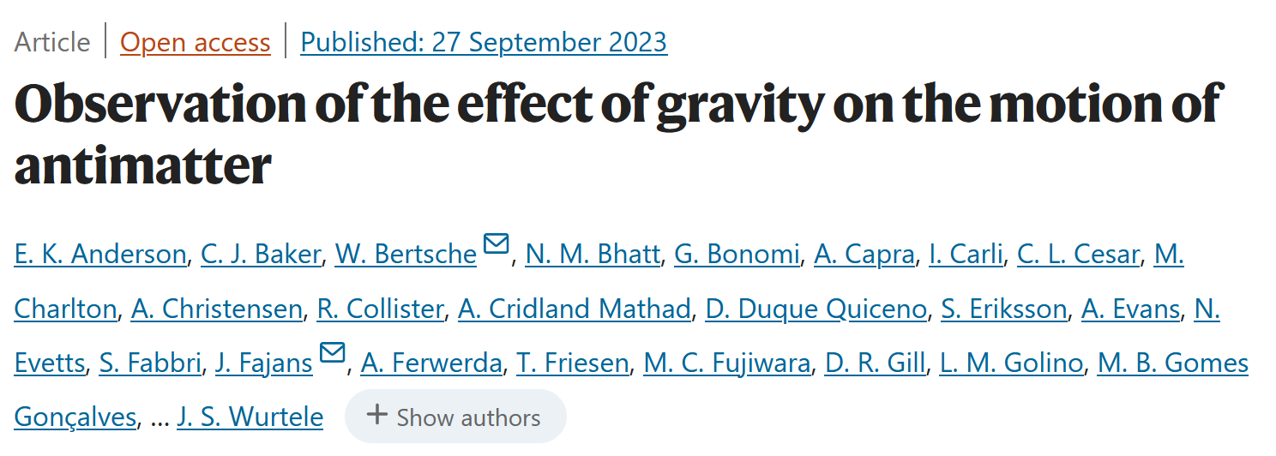
An imbalanced abstract
“Einstein’s general theory of relativity from 1915¹ remains the most successful description of gravitation. From the 1919 solar eclipse² to the observation of gravitational waves³, the theory has passed many crucial experimental tests. However, the evolving concepts of dark matter and dark energy illustrate that there is much to be learned about the gravitating content of the universe. Singularities in the general theory of relativity and the lack of a quantum theory of gravity suggest that our picture is incomplete. It is thus prudent to explore gravity in exotic physical systems. Antimatter was unknown to Einstein in 1915. Dirac’s theory⁴ appeared in 1928; the positron was observed⁵ in 1932. There has since been much speculation about gravity and antimatter. The theoretical consensus is that any laboratory mass must be attracted⁶ by the Earth, although some authors have considered the cosmological consequences if antimatter should be repelled by matter^{7,8,9,10}. In the general theory of relativity, the weak equivalence principle (WEP) requires that all masses react identically to gravity, independent of their internal structure. Here we show that antihydrogen atoms, released from magnetic confinement in the ALPHA-g apparatus, behave in a way consistent with gravitational attraction to the Earth. Repulsive ‘antigravity’ is ruled out in this case. This experiment paves the way for precision studies of the magnitude of the gravitational acceleration between anti-atoms and the Earth to test the WEP.” (Nature 621, 716–722 (2023))

Slide 23
An imbalanced abstract
“Einstein’s general theory of relativity from 1915¹ remains the most successful description of gravitation. From the 1919 solar eclipse² to the observation of gravitational waves³, the theory has passed many crucial experimental tests. However, the evolving concepts of dark matter and dark energy illustrate that there is much to be learned about the gravitating content of the universe. Singularities in the general theory of relativity and the lack of a quantum theory of gravity suggest that our picture is incomplete. It is thus prudent to explore gravity in exotic physical systems. Antimatter was unknown to Einstein in 1915. Dirac’s theory⁴ appeared in 1928; the positron was observed⁵ in 1932. There has since been much speculation about gravity and antimatter. The theoretical consensus is that any laboratory mass must be attracted⁶ by the Earth, although some authors have considered the cosmological consequences if antimatter should be repelled by matter^{7,8,9,10}. In the general theory of relativity, the weak equivalence principle (WEP) requires that all masses react identically to gravity, independent of their internal structure. Here we show that antihydrogen atoms, released from magnetic confinement in the ALPHA-g apparatus, behave in a way consistent with gravitational attraction to the Earth. Repulsive ‘antigravity’ is ruled out in this case. This experiment paves the way for precision studies of the magnitude of the gravitational acceleration between anti-atoms and the Earth to test the WEP.” (Nature 621, 716–722 (2023))

Slide 24
An imbalanced abstract
“Einstein’s general theory of relativity from 1915¹ remains the most successful description of gravitation, with many crucial experimental tests passed. However, singularities in general relativity and the lack of a quantum theory of gravity suggest that our picture is incomplete. Exploring gravity in exotic physical systems may thus lead to useful insights. Since the positron’s observation⁵ in 1932, there has been much speculation about gravity and antimatter. The theoretical consensus is that any laboratory mass must be attracted⁶ by the Earth, although some authors have considered the cosmological consequences if antimatter should be repelled by matter^{7,8,9,10}. In the general theory of relativity, the weak equivalence principle (WEP) requires that all masses react identically to gravity, independent of their internal structure. Here we show that antihydrogen atoms, released from magnetic confinement in the ALPHA-g apparatus, behave in a way consistent with gravitational attraction to the Earth. Repulsive ‘antigravity’ is thus ruled out in this case. This experiment paves the way for precision studies of the magnitude of the gravitational acceleration between anti-atoms and the Earth that will test the WEP.” (Nature 621, 716–722 (2023))

Slide 25
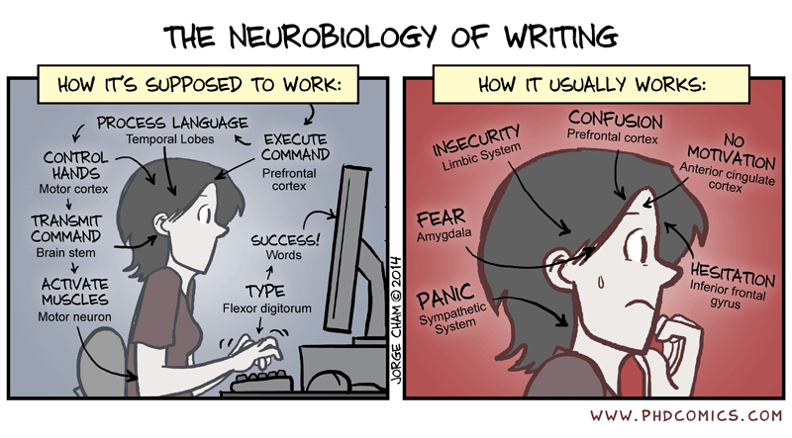
Intermission – Please ask questions!
https://phdcomics.com/comics/archive.php?comicid=1734

Slide 26
Navigating the publishing landscape
Questions to discuss and answer with your co-authors
Do your research funders have specific policies about publication strategies?
What journals/information platforms cover your area of study?
What publishing models do these journals/platforms offer?
Are they highly selective journals (see Science) or are they mega-journals (see Scientific Reports)?
Who are the editors responsible for manuscript assessment and the peer review process?
How does peer review work?
What is the offered level of curation – that is, how do these journals/platforms add context to a paper?

Slide 27
Shining some light on a journal’s editorial process
New submission
Reject
Read-discuss-decide
Appeal
Accept (plus optional extra coverage)
Invite revision
Peer review
(Transfer)
Evaluate feedback & decide
Reject
Appeal

Slide 28
Tips and thoughts from a former editor
If you don’t value dissemination, transparency and reproducibility, this will show up in your paper.
When they exist, use pre-submission enquiries to get prompt feedback (special tip for consortia papers!).
Non-trivial suggestions for experts and reasonable requests for referee exclusions are great input for editors.
Be honest about the limitations of your work – hiding shortcomings will not help.
Don’t be lazy with your revisions – it will only slow down the review process.
Authors and referees are two sides of one coin.
An editorial rejection isn’t a judgment on the quality of your research or of your writing.

Slide 29
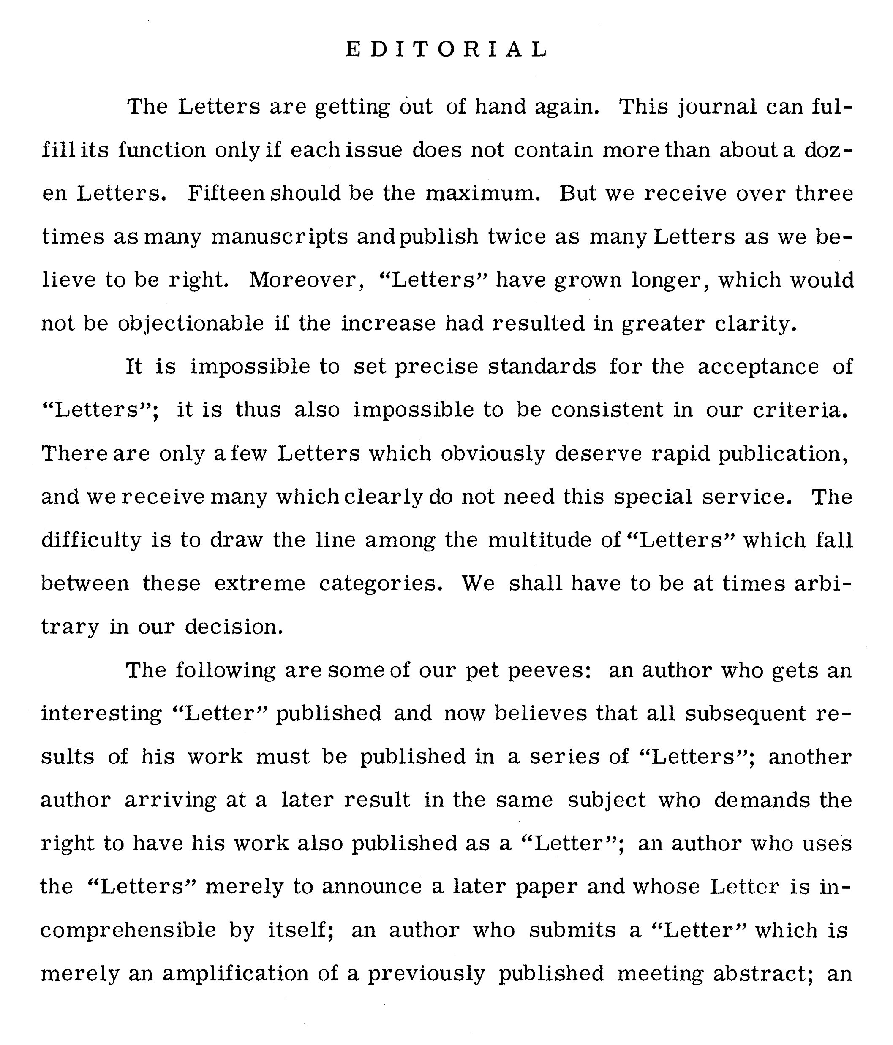
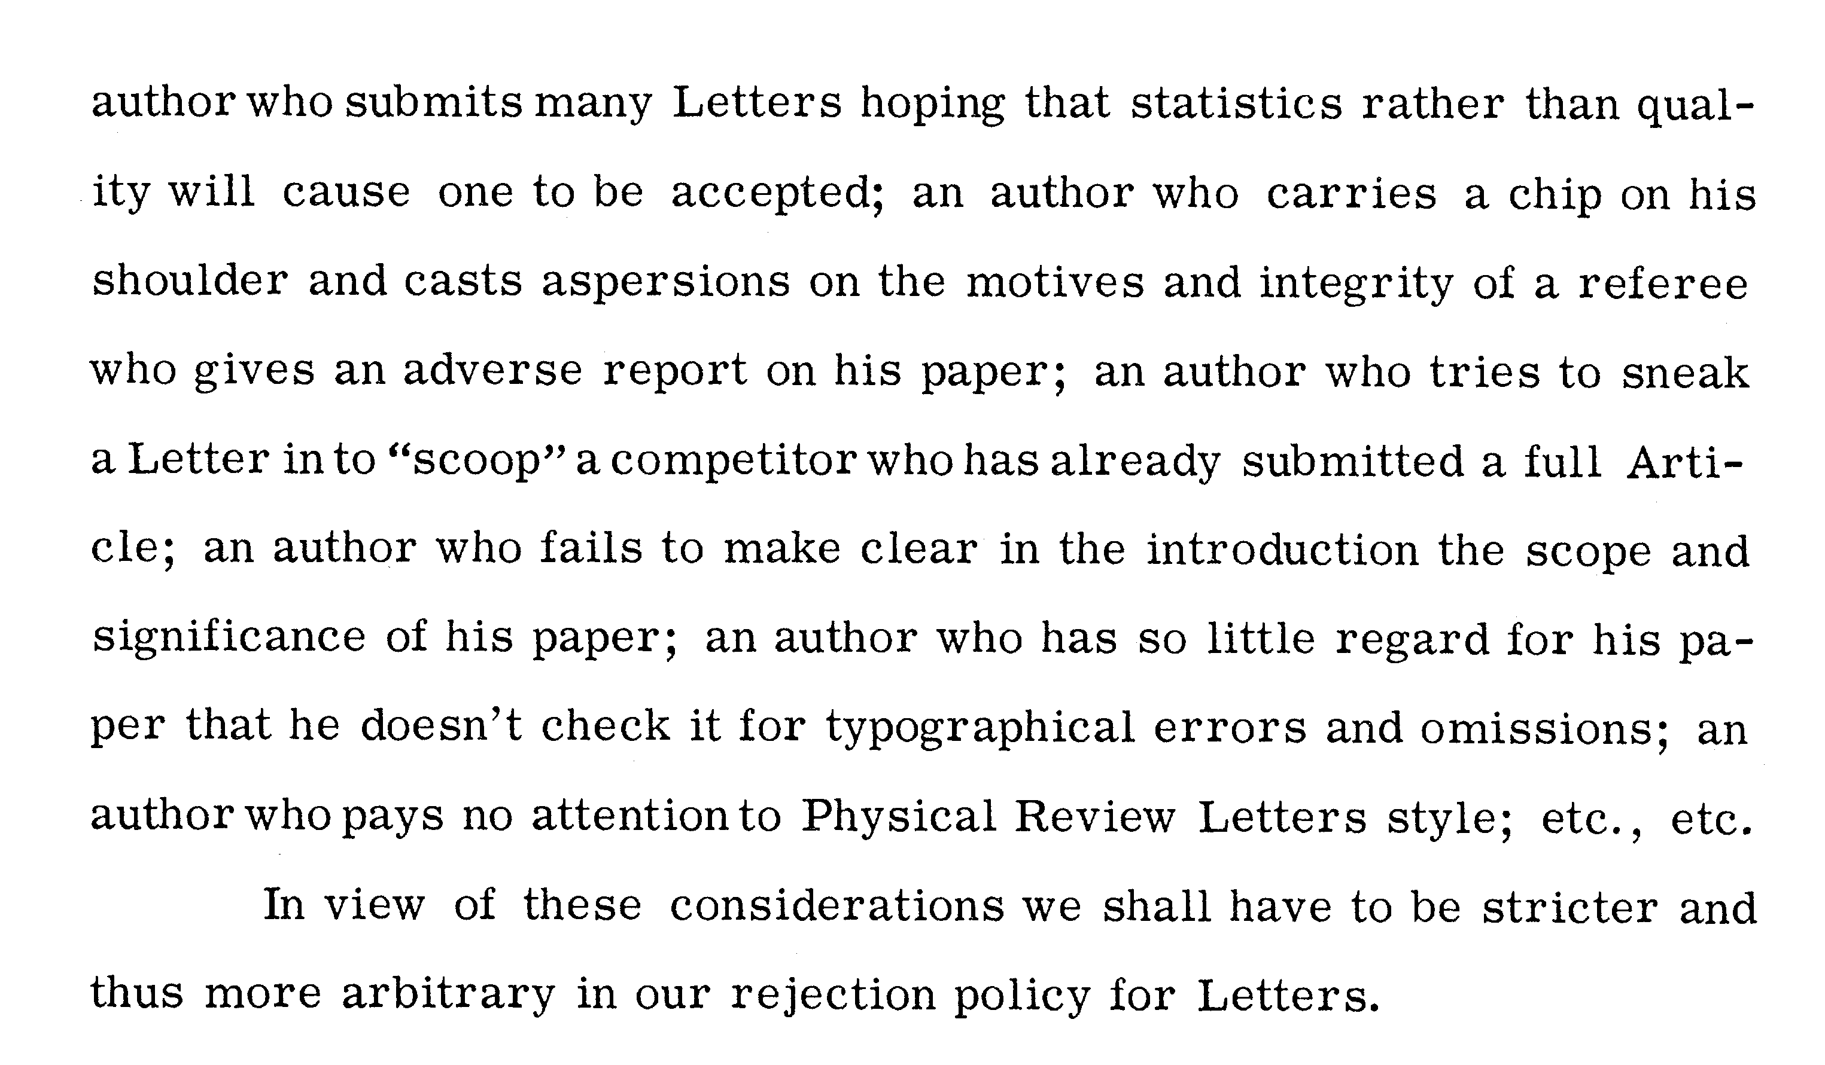
Further food for thought
(Phys. Rev. Lett. 6, 587)
When do you think this was written?

Slide 30
Further food for thought
(Phys. Rev. Lett. 6, 587)
When do you think this was written?
1 June 1961

Slide 31
Write to me at donatiga@phys.ethz.ch
Find me on LinkedIn (Gaia Donati) and Twitter/X (@dubitareaude)

