Slide 1


SuperB a Super-Flavour-Factory
M. Biagini, INFN-LNF
on behalf of the SuperB Accelerator Team
SuperB Workshop
Oxford May 18-19, 2011

Slide 2
Present & Past SuperB Accelerator Contributors
M. E. Biagini, S. Bini, R. Boni, M. Boscolo, B. Buonomo, S. Calabro’, T. Demma, E. Di Pasquale, A. Drago, M. Esposito, L. Foggetta, S. Guiducci, , S. Liuzzo, G. Mazzitelli, L. Pellegrino, M. A. Preger, P. Raimondi, R. Ricci, U. Rotundo, C. Sanelli, M. Serio, A. Stella, S. Tomassini, M. Zobov (INFN-LNF)
F. Bosi, E. Paoloni (INFN & University of Pisa)
P. Fabbricatore, R. Musenich, S. Farinon (INFN & University of Genova)
K. Bertsche, A. Brachman, Y. Cai, A. Chao, R. Chestnut, M. H. Donald, C. Field, A. Fisher, D. Kharakh, A. Krasnykh, K. Moffeit, Y. Nosochkov, A. Novokhatski, M. Pivi, C. Rivetta, J. T. Seeman, M. K. Sullivan, S. Weathersby, A. Weidemann, J. Weisend, U. Wienands, W. Wittmer, M. Woods, G. Yocky (SLAC)
A.Bogomiagkov, I. Koop, E. Levichev, S. Nikitin, I. Okunev, P. Piminov, S. Sinyatkin, D. Shatilov, P. Vobly(BINP)
J. Bonis, R. Chehab, O. Dadoun, G. Le Meur, P. Lepercq, F. Letellier-Cohen, B. Mercier, F. Poirier, C. Prevost, C. Rimbault, F. Touze, A. Variola (LAL-Orsay)
B. Bolzon, L. Brunetti, G. Deleglise, A. Jeremie (LAPP-Annecy)
M. Baylac, O. Bourrion, J.M. De Conto, Y. Gomez, N. Monseu, D. Tourres, C. Vescovi (LPSC-Grenoble)
A. Chancé (CEA-Saclay)
D.P. Barber (DESY & Cockcroft Institute)
S. Bettoni (PSI)
R. Bartolini, A. Wolski (UK)
Yuan Zhang (IHEP, Beijing)
K. Ohmi (KEKB)

Slide 3
SuperB Accelerator
SuperB is a 2 rings, asymmetric energies (e⁻ @ 4.18, e⁺ @ 6.7 GeV) collider with:
  large Piwinski angle and “crab waist” (LPA & CW) collision scheme
  ultra low emittance lattices
  longitudinally polarized electron beam
  target luminosity of 10³⁶ cm⁻² s⁻¹ at the Υ(4S)
  possibility to run at τ/charm threshold with L = 10³⁵ cm⁻² s⁻¹
Criterias used for the design:
  Minimize building costs
  Minimize running costs
  Minimize wall-plug power and water consumption
  Reuse of some PEP-II B-Factory hardware (magnets, RF)
SuperB can be also a good “light source”: there will be some Sinchrotron Radiation beamlines (collaboration with Italian Institute of Technology) → work in progress

Slide 4
World e⁺e⁻ colliders luminosity
SuperB
Super
Factories
Linear colliders
Factories
SuperB: highest world
luminosity collider ever
B-Factories
Φ-Factories
Future Colliders

Slide 5
SuperB design
The design requires state-of-the-art technology for emittance and coupling minimization, vibrations and misalignment control, e⁻cloud suppression, etc...
SuperB has many similarities with the Damping Rings of ILC and CLIC, and with latest generation SL sources, and can profit from the collaboration among these communities
For details see the new Conceptual Design Report (Dec. 2010) on:
http://arxiv.org/abs/1009.6178

Slide 6
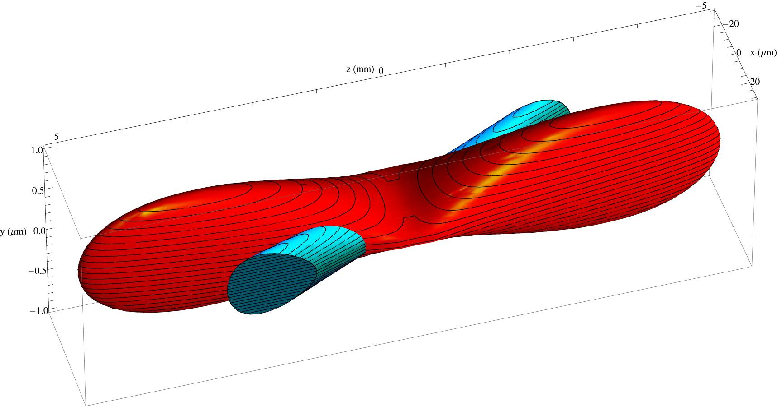
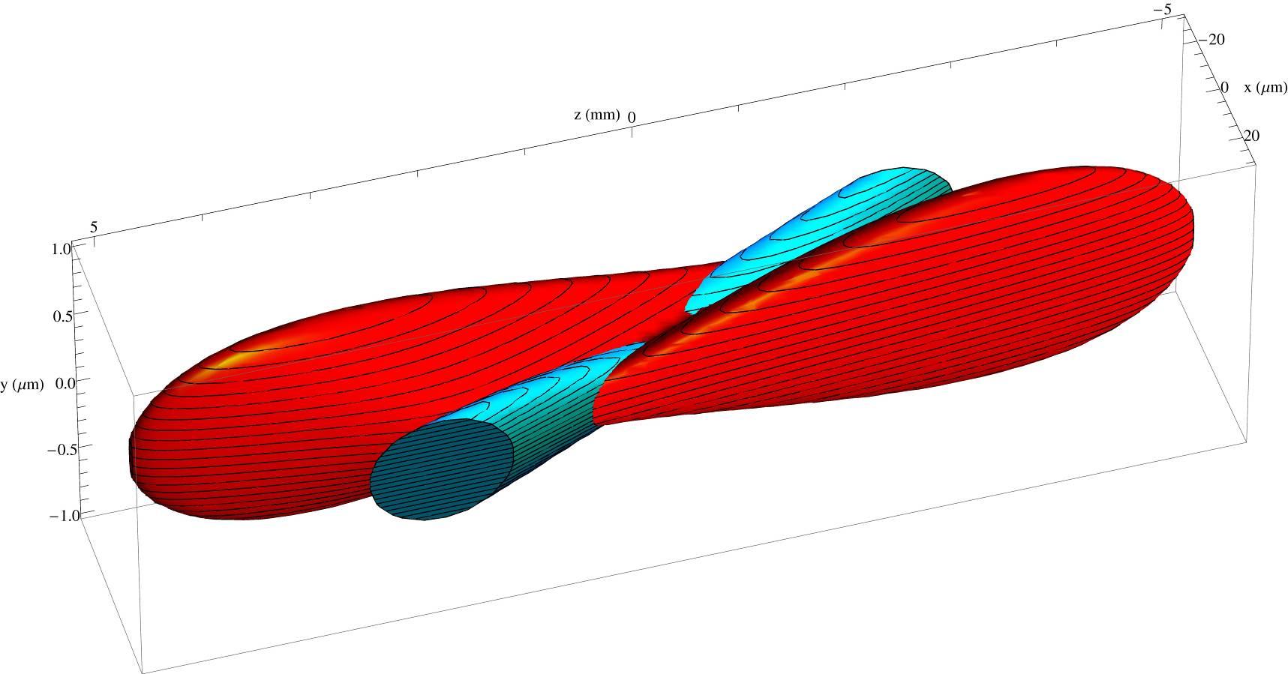
Crab-waist scheme
Raimondi, Shatilov, Zobov http://arxiv.org/abs/physics/0702033
Crab sextupoles OFF: Waist line is orthogonal to the axis of other beam
Crab sextupoles ON: Waist aligned with path of other beam
particles at higher ß do not see full field of other beam
no excessive beam-beam parameter due to hourglass effect

Slide 7
SuperB Parameters
IP and ring parameters have been optimized based on several constraints. The most significant are:
  Maintain wall plug power, beam currents, bunch lengths, and RF requirements comparable to past B-Factories;
  Plan for the reuse as much as possible of the PEP-II hardware;
  Require ring parameters as close as possible to those already achieved in the BFactories, or under study for the ILC Damping Ring or achieved at the ATF ILC-DR test facility;
  Simplify IR design as much as possible. In particular, reduce the synchrotron radiation in the IR, reduce the HOM power and increase the beam stay-clear;
  Eliminate the effects of the parasitic beam crossing;
  Relax as much as possible the requirements on the beam demagnification at the IP;
  Design the Final Focus system to follow as closely as possible already tested systems, and integrating the system as much as possible into the ring design

Slide 8
SuperB Parameters (cont.)
Column 1 of Table shows the baseline parameters set that closely matches these criteria.
The machine is also designed to have flexibility for the parameters choice with respect to the baseline. In particular:
  horizontal emittance can be decreased by about a factor 2 in both rings by changing the partition number (by changing the RF frequency [LEP] or the orbit in the ARCS) and the natural ARC emittance by readjusting the lattice functions;
  Final Focus system as a built-in capability of about a factor 2 in decreasing the IP beta functions;
  RF system will be able to support higher beam currents (up to a factor 1.6) than the baseline ones, when all the available PEP RF units are installed

Slide 9
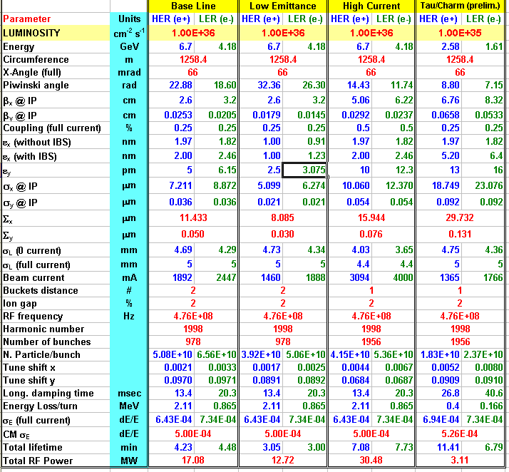
Parameter Table
Tau/charm
threshold running
at 10³⁵
Baseline +
other 2 options:
Lower y-emittance
Higher currents
(twice bunches)
Baseline:
Higher emittance
due to IBS
Asymmetric beam
currents
RF power includes
SR and HOM

Slide 10
SuperB Parameters (cont.)
Columns 2 and 3 in Table show different parameters options:
  Low Emittance case relaxes the RF requirements and all the problems related to high current operations (including wall-plug power) but put more strain on the Optic and the Tuning Capabilities
  High Current case has the opposite characteristics. The requirements on vertical emittance and IP β-functions are relaxed but the high currents issues are enhanced (instabilities, HOM and synchrotron radiation, wall-plug power etc…)
Overall the collider should be flexible enough to reach the target specifications, superseding the encountered limitations by pushing more the less critical parameters
The cases shown have several parameters kept has much constant as possible (bunch length, IP stay clear etc…), in order to reduce their impact on other unwanted effects (Detector backgroung, HOM heating etc…)

Slide 11
SuperB at τ/charm threshold
SuperB can operate at a lower cm energy with a somewhat reduced luminosity (last Column in Table). In order to operate at τ/charm threshold energies (in the vicinity of 3.8 GeV) with minimal modifications to the machine, beam energies will be scaled, maintaining the nominal energy asymmetry ratio used for operation at the cm energy of the Υ(4S). All magnet currents will be rescaled accordingly
In order to provide the necessary damping at low current wigglers can be installed in the straight sections (dispersion free) and in the ARCs, in a relative number matched to achieve the desired beam parameters (emittance etc…). The permanent magnets in the IR will be replaced with weaker versions
Luminosity should scale linearly with energy, but damping time and collective effects will result in a further decrease the luminosity. However, given all factors, we expect that operations at lower energy will require a decrease of the beam current and an increase of the beam emittance
It is thus reasonable to expect a luminosity about 10 times lower than that at 10.58 GeV

Slide 12
The crab waist @ DAΦNE
In 2007-2008 DAΦNE was upgraded to include a crab-waist IR for testing the principle
There were some additional (conventional) improvements as well
  Improved injection
  Improved impedence reduction
  Improved feedback systems
The predicted luminosity increase was about a factor of 3 (from 1.6x10³² to 4.5x10³²)

Slide 13
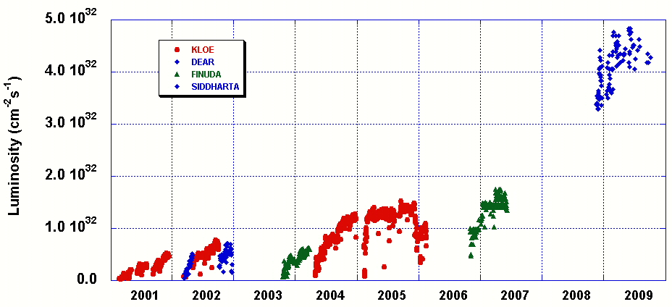
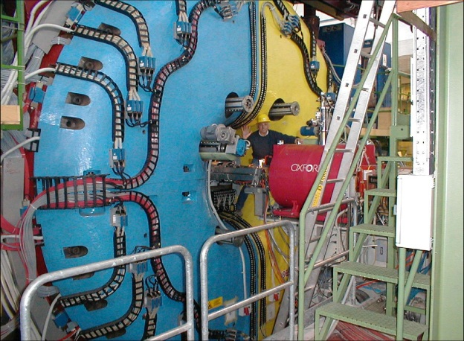
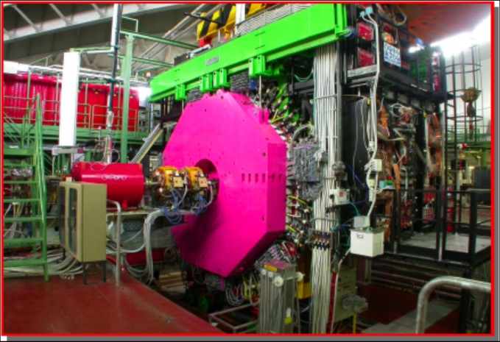
DAΦNE Peak Luminosity
Design Goal
NEW COLLISION SCHEME

Slide 14
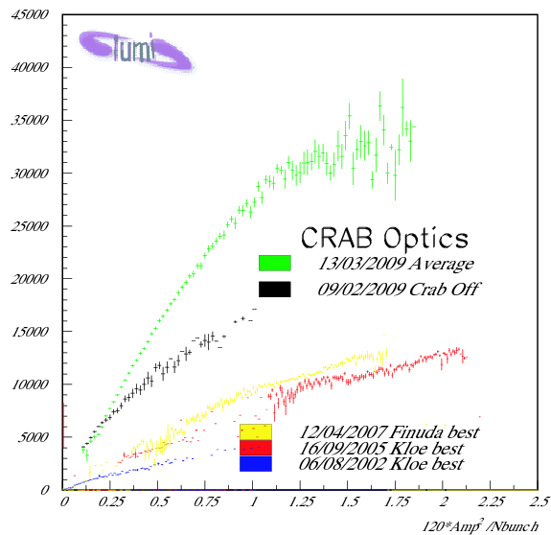
Peak luminosity vs currents
Data averaged on a full day
βy=9mm, Pw_angle=1.9
Luminosity [10²⁸ cm⁻² s⁻¹]
LPA alone gives more luminosity
βy=18mm, Pw_angle=0.6
βy=25mm, Pw_angle=0.3

Slide 15
Layout 2 rings, 1 tunnel
LER SR
IP
66 mrad
LER SR
HER and LER arcs are parallel to each other in the H-plane while separated by 2.1 m.
Each ring has one inner and one outer arc.
Both inner and outer arcs provide the same bending angle but outer arc is made longer (increased drift space around the dipoles) in order to provide the same azimuth location as the inner arc
LER
arc
LER
arc
HER
arc
HER
arc
Rings
crossing
e-
e+
RF

Slide 16
Beam-beam tune scan
D.Shatilov
CDR, ξ_{y} = 0.17
CDR2, ξ_{y} = 0.097
L (red) = 1. ∙10³⁶

Slide 17
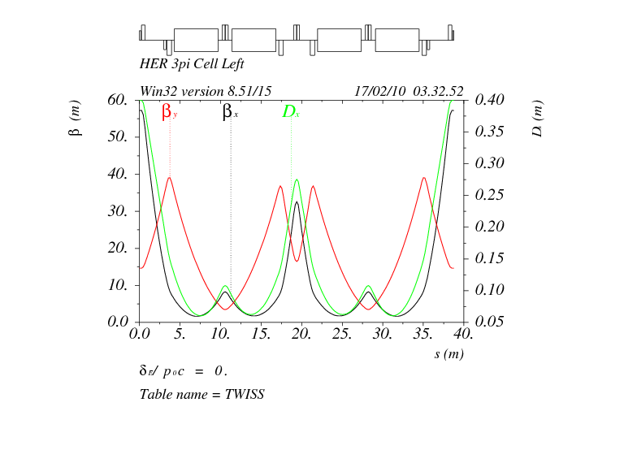
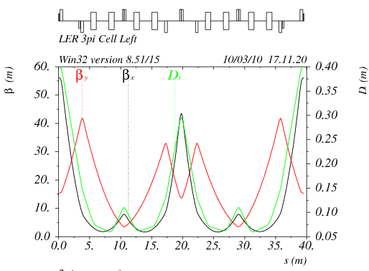
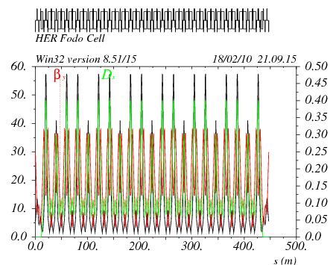
SuperB Arcs
HER and LER arcs have conceptually the same lattice. LER arc dipoles are shorter (bend radius about 3 times smaller) than in the HER in order to match the ring emittances at the asymmetric beam energies
μ_{x} = 3π, μ_{y} = π
Cell in HER
LER
HER
μ_{x} = 3π, μ_{y} = π
Cell in LER

Slide 18
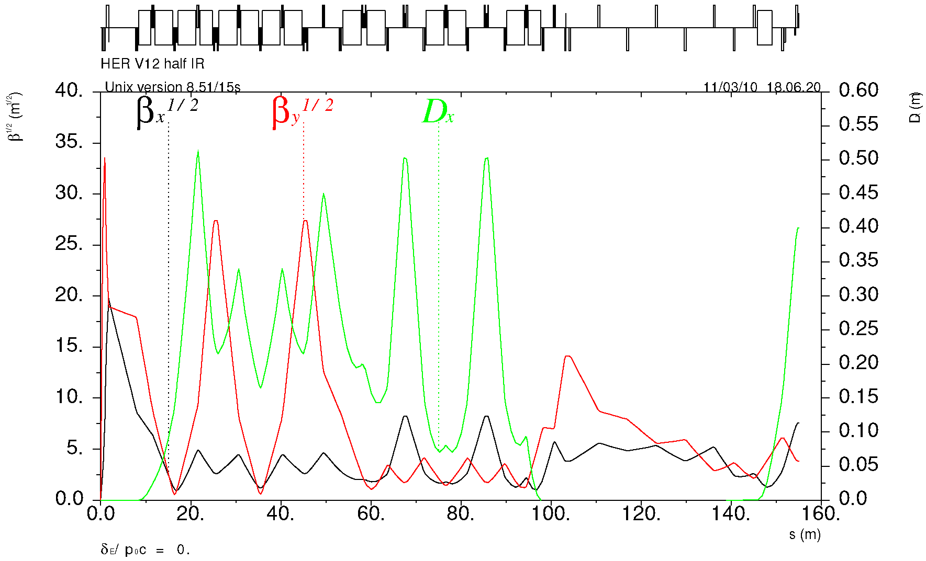
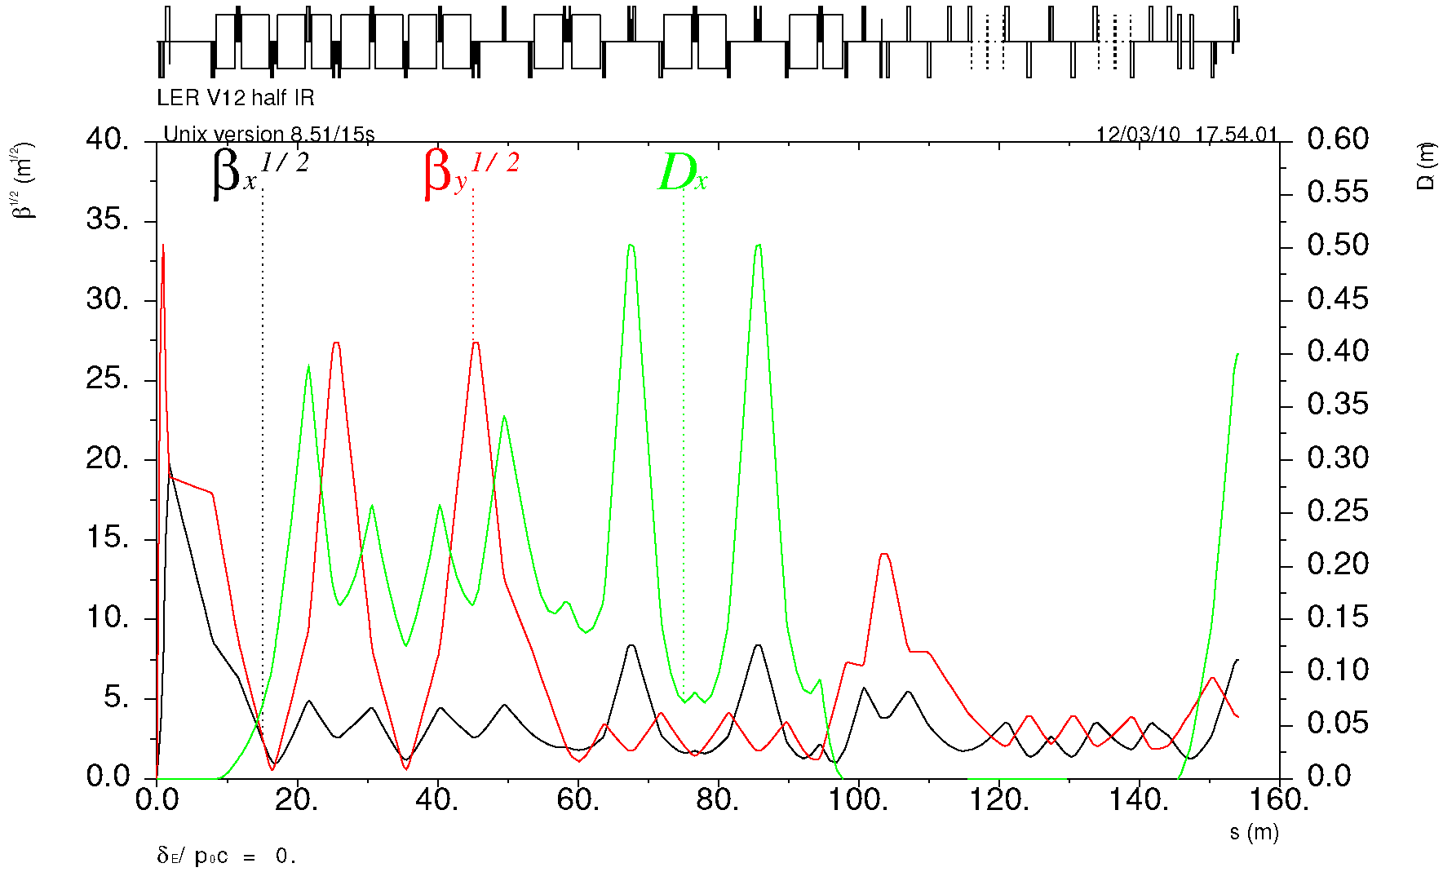
FF optics
“Spin rotator” optics is replaced with a simpler matching section
IP
β* = 26 / 0.25 mm
Y-sext
Crab
Match
X-sext
HER
Matching section is shorter than HER to provide space for spin rotator optics.
±33 mrad bending asymmetry with respect to IP causes a slight spin mismatch between SR and IP resulting in ~5% polarization reduction.
IP
β* = 32 / 0.21 mm
Y-sext
LER
Crab
Match & SR
X-sext

Slide 19
IR design
We have two designs that are flexible and have good:
  SR backgrounds
  Lattice functions
  Beam apertures
The two designs are:
  Vanadium Permendur for QD0 and QF1
  Parallel air-core dual quads for QD0 and QF1 (prototype in progress)
    Both designs include additional vanadium permendur Panofsky quads on the HER
These IR design demonstrates initial robustness
  Two separate QD0 designs work
  The direction of the beams can be either way with a weak preference for the incoming beams to be from the outside rings due to the location of the SR power on the cryostat beam pipe

Slide 20
QD0 Design: 2 possible choices
Vanadium Permendur
“Russian” Design
Air core “Italian” QD0, QF1 Design

Slide 21
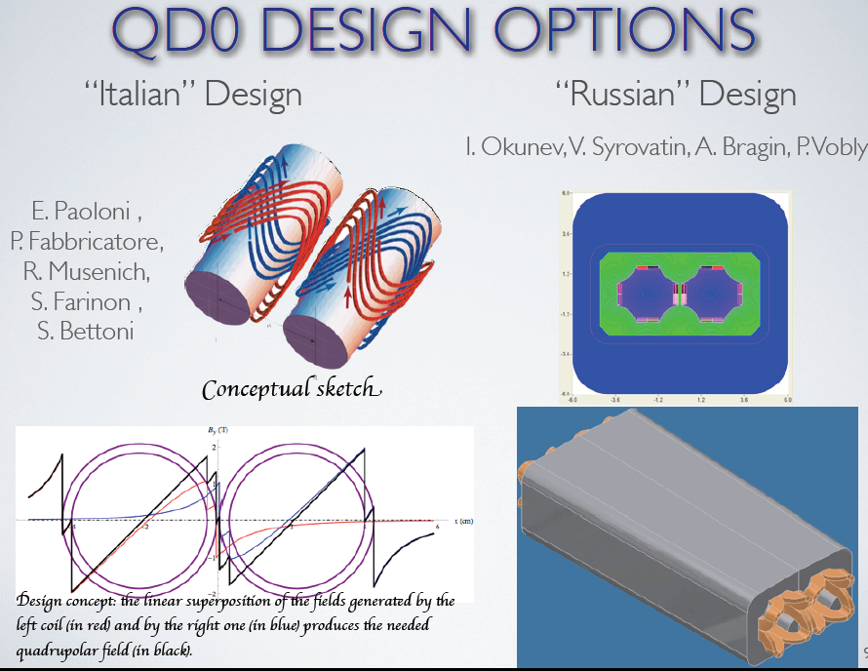
Air-core QD0 is a SC iron free septum double quad

Slide 22
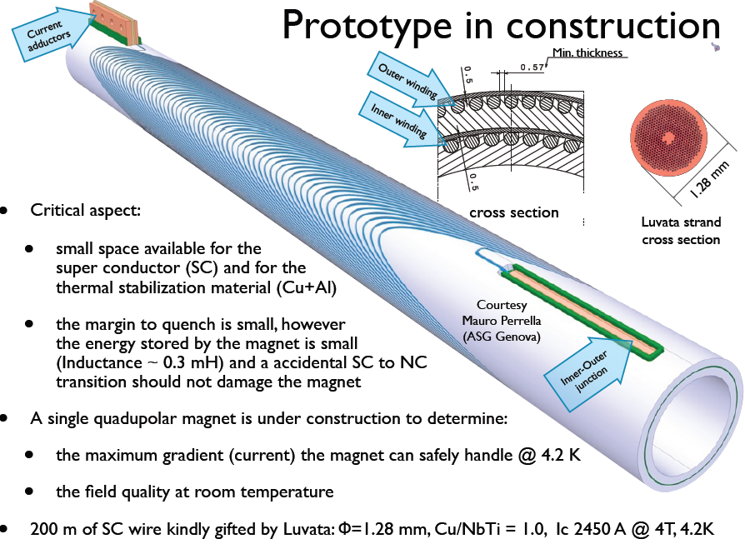
Field generated by 2
double helix windings
in a grooved Al support
Fabbricatore, Farinon, Musenich (Genova) Paoloni (Pisa)

Slide 23
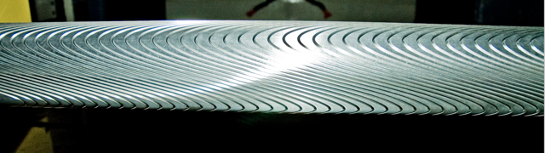
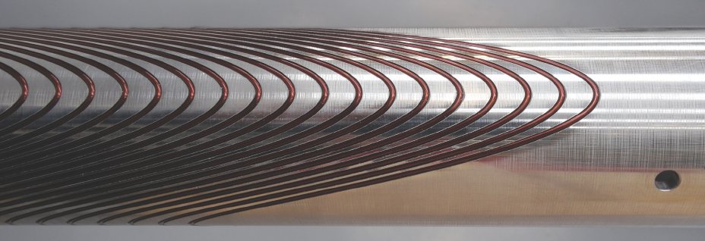
The actual QD0
Grooved Al support
Winding in progress
Ready this Summer for tests and field measurements @ CERN

Slide 24
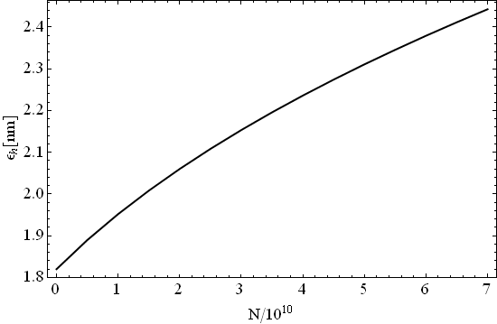

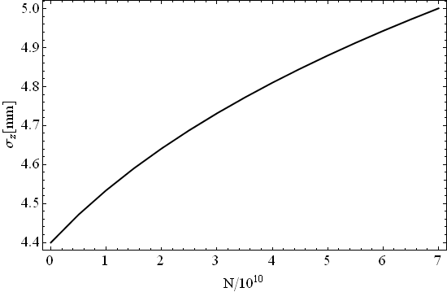
Intra Beam Scattering in LER
ε_{h}=2.412 nm
@N=6.5e10
ε_{v}=5.812 pm
@N=6.5e10
The effect of IBS on the transverse emittances is about 30% in the LER and less then 5% in HER.
Interesting aspects of the IBS such as its impact on damping process and on generation of non Gaussian tails are being investigated with a multiparticle algorithm →6D MC
σ_{z}=4.97 mm
@N=6.5e10

Slide 25
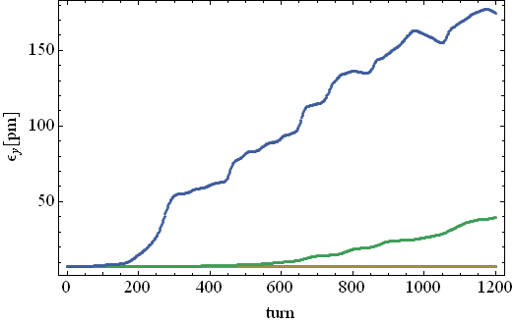
e-cloud instability
Single bunch instability simulations for SuperB HER taking into account the effect of solenoids have been performed using CMAD (Pivi, SLAC). They indicate a threshold density of ~10¹² e-/m³ (roughly 2 times previous estimates)
The obtained thresholds have to be compared with build-up simulations using updated parameters to determine safe regions of the parameter space (SEY, PEY)
Work is in progress to:
  Estimate the effect of radiation damping on long term emittance growth
  Estimate the fraction of synchrotron radiation absorbed by antechambers
ρ=5x10¹¹
Vertical emittance growth
induced by e-cloud
ρ=4x10¹¹
ρ=3x10¹¹

Slide 26
Build-up in Free Field Regions
Snapshot of the electron (x,y) distribution
Snapshot of the electron (x,y) distribution 50G solenoids on
Density at center of the beam pipe is larger then the average value.
Solenoids reduce to 0 the e-cloud density at center of beam pipe

Slide 27
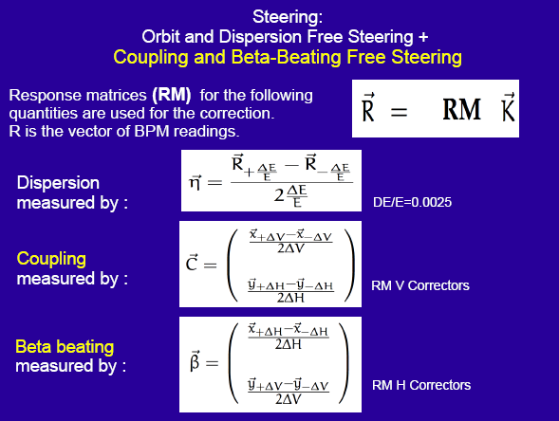
Low Emittance Tuning
S.Liuzzo

Slide 28
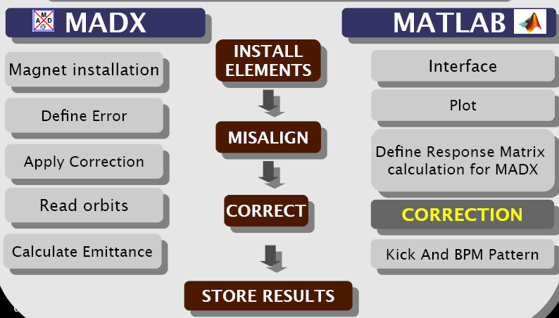
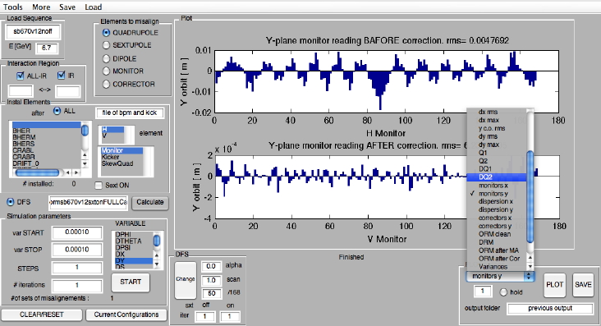
LET Tool

Slide 29
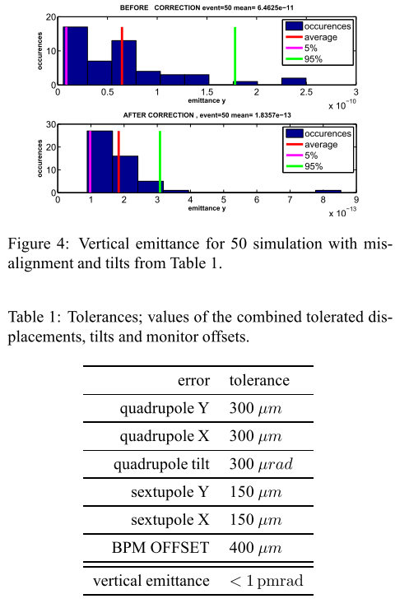
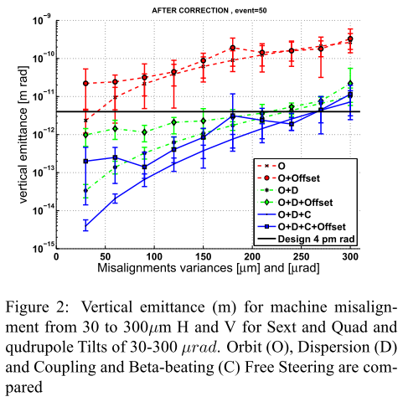
Low Emittance Tuning: HER tolerances
Steering:
Orbit & Dispersion Free steering +
Coupling & Beta-beating Free steering
Using only correctors
Or
Correctors and skew quads
4x10¹²

Slide 30
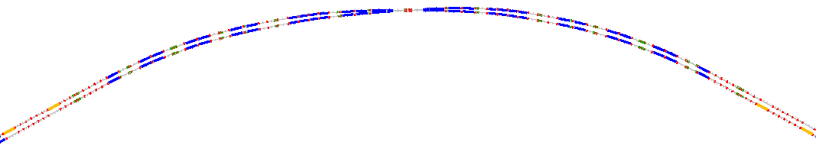
Polarization in SuperB
90°spin rotation about x axis
  90°about z followed by 90°about y
“flat” geometry → no vertical emittance growth
Solenoid scales with energy → LER more economical
Solenoids are split & decoupling optics added
The SR optics design has been matched to the Arcs and a similar (void) insertion added to HER
This design poses severe constraints on the FF bending angles of LER and HER in order to achieve the “right” spin dynamics
A polarimeter has been designed to measure polarization
LER
IP
HER
S.r. dipoles
(270° spin)
HER
LER
S.R. solenoids
(90° spin)

Slide 31
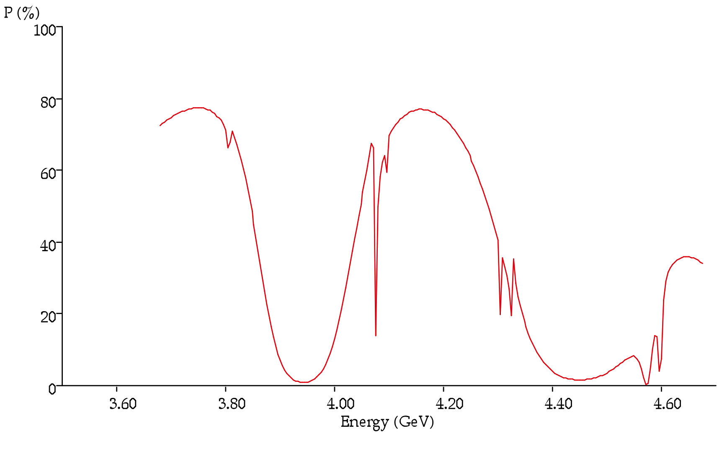
Polarization resonances
Beam polarization resonances do constraint the beam Energy choice
Plot shows the resonances in the energy range of LER
Beam polarization computed assuming
  90% beam polarization at injection
  3.5 minutes of beam lifetime (bb limited)
From this plot is clear that the best energy for LER should be 4.18 GeV → HER must be 6.7 GeV
E_{LER}

Slide 32
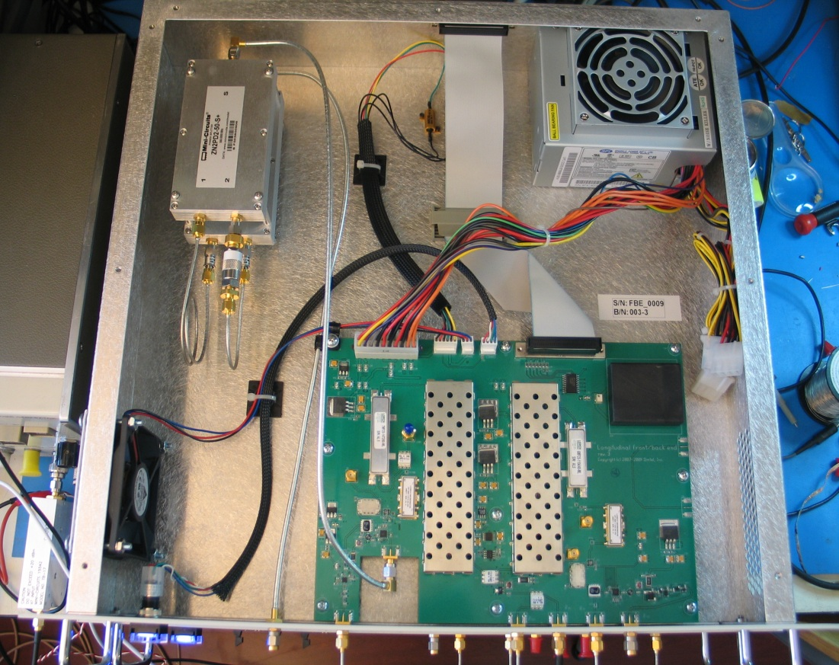
Bunch-by-bunch feedback
All 6 DAΦNE feedbacks have been upgraded with a new 12bit system
VFB – new 12 bit iGp systems with larger dynamic range and software compatibility with the previous version
LFB - completely new systems in place of the old systems designed in 1992-1996 in collaboration with SLAC/LBNL: fe/be analog unit connected to iGp-8 as processing unit
HFB: upgrade hw/sw of the iGp-8bit system already used
This will be the baseline design for SuperB H-V-L feedbacks
New front-end/back-end analog unit used in the longitudinal feedback

Slide 33
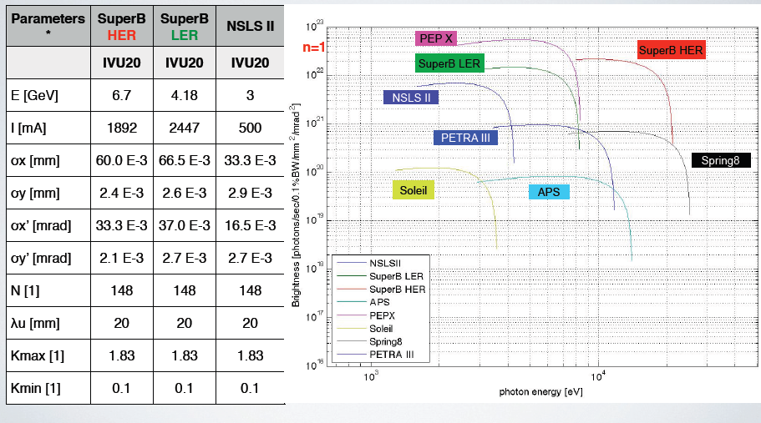
Synchrotron light options @ SuperB
Comparison of brightness and flux from undulators for different energies dedicated SL sources & SuperB HER and LER
Light properties from undulators better than most SL
Brightness from undulators

Slide 34
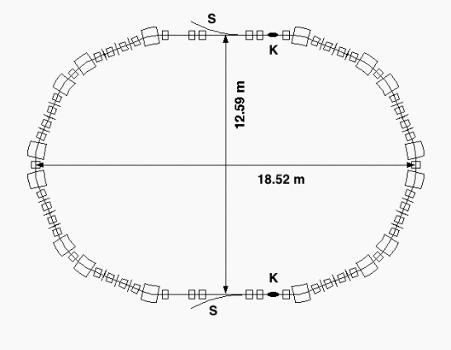
Injection System
Proposed scheme
positron linac
e+
1 GeV
CAPTURE
SECTION
PC
0.6 GeV
SHB
THERMIONIC
GUN
combiner
DC dipole
e+
e+
BUNCH
COMPRESSOR
5.7 GeV e+ 3.9 GeV e-
POL.
SLAC
GUN
Wien
filter
Mott
polarim
50 MeV
CAPTURE
SECTION
0.25 GeV
e-
SHB
Main Rings injection rate: 50 Hz
Damping Ring just for positrons
collimators
Parameter | Units | SLC
Electron charge per bunch | nC | 16
Bunches per pulse |  | 2
Pulse rep rate | Hz | 120
Cathode area | cm² | 3
Cathode bias | kV | -120
Bunch length | ns | 2
Gun to SHB1 drift | cm | 150
e_{n,rms,gun} (fm EGUN) | 10⁻⁶ m | 15
from A. Brachmann - SuperB Workshop
SLAC, October 2009
Round beam
Emittance @ 4.16 GeV = 1.8 nm
Required bunch charge for e- ≈ 0.3 nC
… scrapers .. collimators needed
R. Boni, XiV SuperB meeting, Frascati 29-09-2010
Notes:
34

Slide 35
Layout, Site
The rings footprint is at the moment the same as the baseline (2 rings in same tunnel, about 1250 m long)
The insertion of synchrotron beamlines, with their impact on the layout and lattice is being studied
We are looking for a green field site in order to exploit at best the facility (SuperB and SL)
Several sites seems available, first pick at the moment is in Tor Vergata University campus and we are studying its compatibility with the requirements
Preliminary ground measurements have been performed at Tor Vergata in mid-April, waiting for their elaboration
The layout will be adjusted as soon as the site is chosen to further optimize the system performances

Slide 36
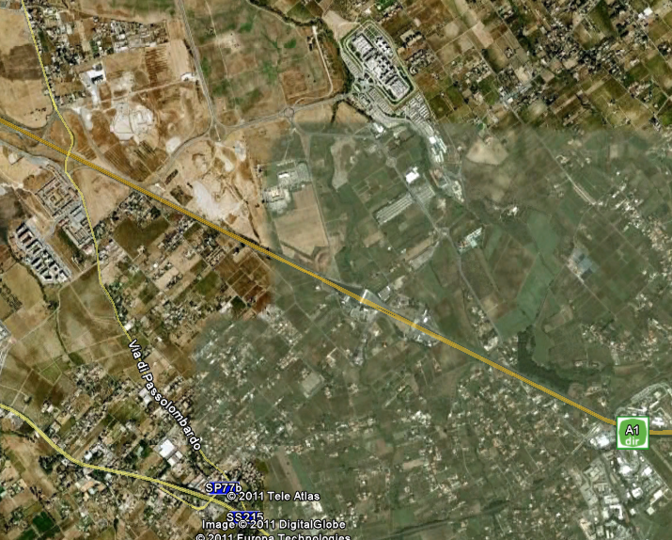
Tor Vergata University campus
Site under
study
About 4.5 Km
LNF

Slide 37
Possible Improvements under study
SL users need a lower emittance lattice, dedicated ID cells, long beamlines: difficult to achieve with 2 rings at different energies in the same tunnel
HER can be some 100 m shorter (no need of matching sections to match LER spin rotators)
A shorter (about ½ HER) LER ring can be better optimized:
  Same SR power (present LER arcs have many unused drifts just to match HER geometry)
  Polarization is about 5% larger since spin rotators geometry can be optimized (no matching to HER)
  With ε_{x} ≈ ½ → Luminosity ≈ x2 (L ∝1/ε_{x})
  Collective effects in a shorter ring are less severe
  Final Focus also simpler (left=right)
  The boost β can be increased for τ/charm running (good for physics)

Slide 38
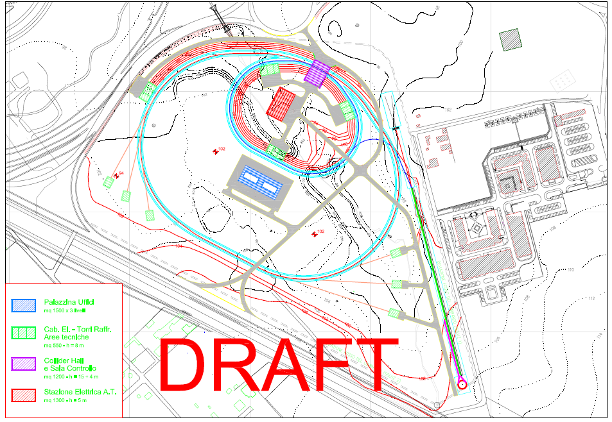
Possible layout (1 & 2 tunnels)

Slide 39
Beam-beam resonances for asymmetric rings
The «short» against «long» rings collision has been theoretically studied in the early ‘90 by Hirata, Keil, Chao…
They pointed out the rising of strong low order coherent resonances for asymmetric colliding rings
Some analytical estimation have been done for the simple example of DAΦNE by M. Zobov (LNF)
Strong-strong bb simulations are needed, work in progress by Y. Zhang (BEPCII) on the same example
For the moment results are that a suitable choice of the tunes (close to half-integer for «short» ring and to integer for «long» ring) can avoid the resonances and provide enough space for operation even with a high vertical tune shift

Slide 40
Tune space with coherent bb resonances
M. Zobov
Symmetric Rings
Asymmetric Rings (2:1)
M. Zobov

Slide 41
Synergies with state-of-the art international efforts
SuperB design has many characteristics in common with state-of-the-art colliders (LC, CLIC) and SL sources, to cite just a few:
  Alignment of magnets, and orbit and coupling correction with the precision needed to produce vertical emittances of just a few pico-meters on a routine basis
  Optimization of lattice design and tuning to ensure sufficient dynamic aperture for good injection efficiency (for both) and lifetime (particularly for SuperB LER), as well as control of emittances
  Feedbacks (IP and rings)
  Control of beam instabilities, including electron cloud, ion effects and CSR
  Reduction of magnet vibration to a minimum, to ensure beam orbit stability at the level of a few microns
All these issues are presently active areas of research and development, the similarity of the proposed operating regimes presents an opportunity for a well-coordinated program of activities that could yield much greater benefits than would be achieved by separate, independent R&D programs

Slide 42
Conclusions
Accelerator design is converging
Lattice and parameters optimization is continuing, for better performances and more flexibility
Synchrotron Light beamlines are being considered
A possible new layout is being studied, with special IDs insertions
Work is in progress on more subtle beam dynamics issues (IBS, FII, CSR, e-cloud, beam-beam, feedbacks,…)
Components and lattice tolerances with corrections are being studied
Polarization is progressing: beam-beam depolarization studies, trying to simplify the polarized gun, spin tracking, spin measurements set-up
We are collaborating with other Labs (SLAC, LAL, BINP, CERN, PSI, DIAMOND, IHEP, Cornell,…) to solve common issues

Slide 43
Accelerator WBS (Draft)

Slide 44
Accelerator WBS (Draft)

