Slide 1
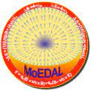
MoEDAL Machine Learning & AI
MoEDAL NTD Data Augmentation
& Automatic pit detection
Giuseppe Levi
INFN BOLOGNA

Slide 2
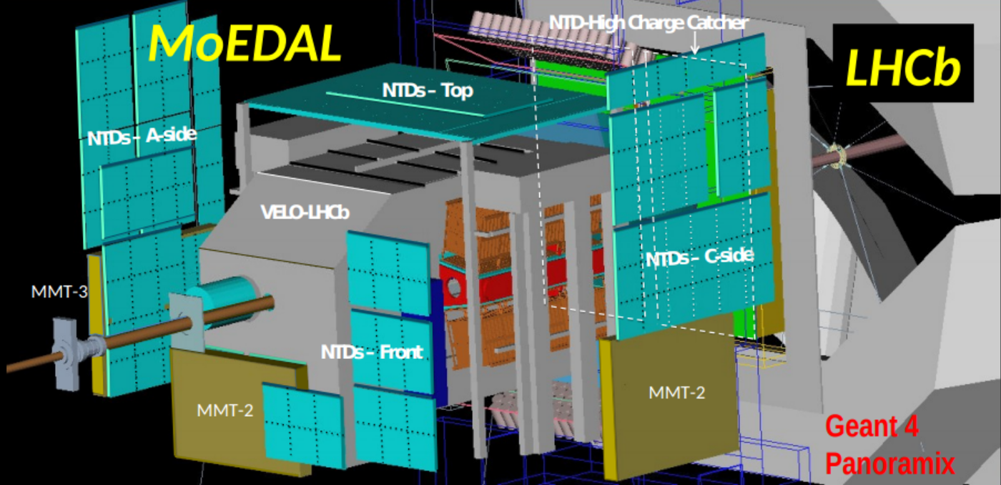
MoEDAL NTD Data Augmentation
MoEDAL is a CERN experiment (LHC-IP8) dedicated to the search for highly ionizing exotic particles such as monopoles.
it consists mainly of passive detectors.

Slide 3
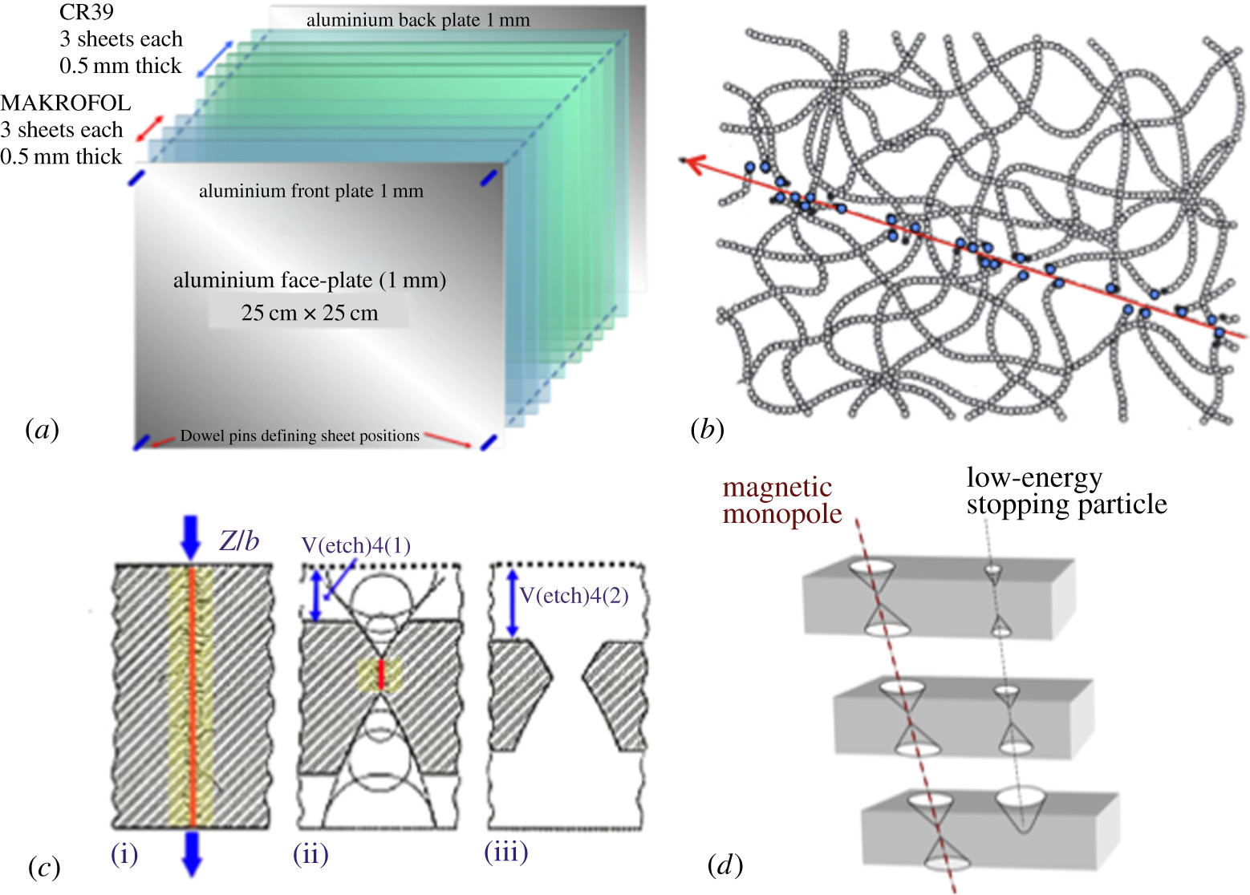
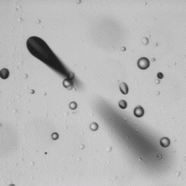
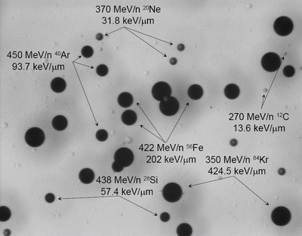
MoEDAL NTD Data Augmentation
Nuclear Track Detectors are passive plastic sheets. The tracks are developed by a chemical attack and revealed through a microscope.

Slide 4
MoEDAL NTD Data Augmentation
We have an enormous amount of images (frames) to analyze for NTD. Scanning 20m^2 of detector with a 2x2 mm FOV means that we have about 5M frames for each side. (8.8 M with a 1.5mm step) If we want to make this process automatic we should divide it into steps e.g.:
DAQ (exposure + etching) → Bologna Microscope → Data storage
Pit identification → to select frames with tracks
Measure → (Calibration + Data)
AI can be used along with CV for Pit Identification but a large number
of labeled images tipically in the order of from 1000 to 10000 for each CLASS.

Slide 5
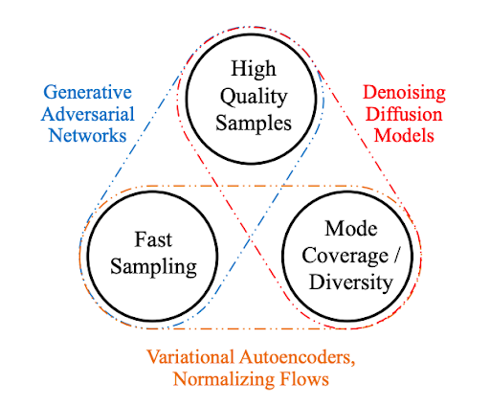
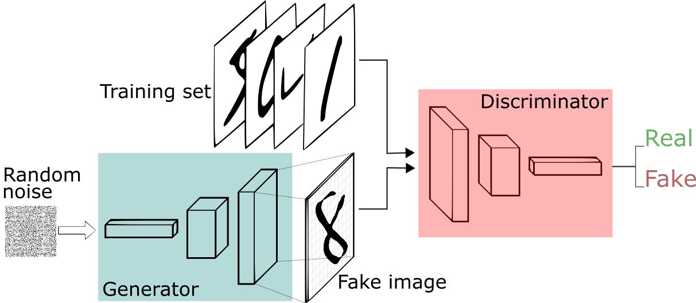
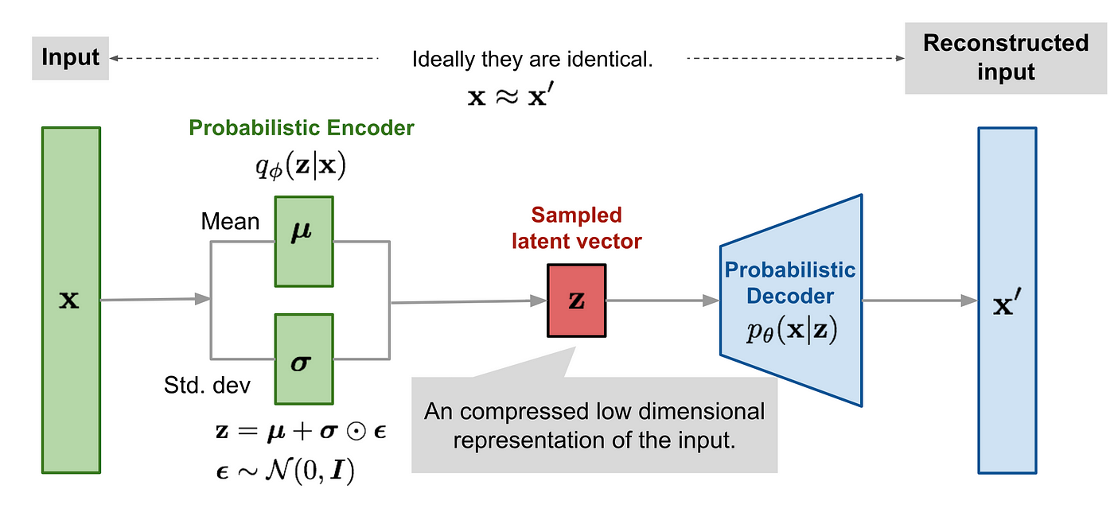
MoEDAL NTD Data Augmentation
Apart from the convenctional data augmentation techniques (rotation,mirroring)
there is now the possibility to GENERATE «syntetic data» from a small sample.

Slide 6
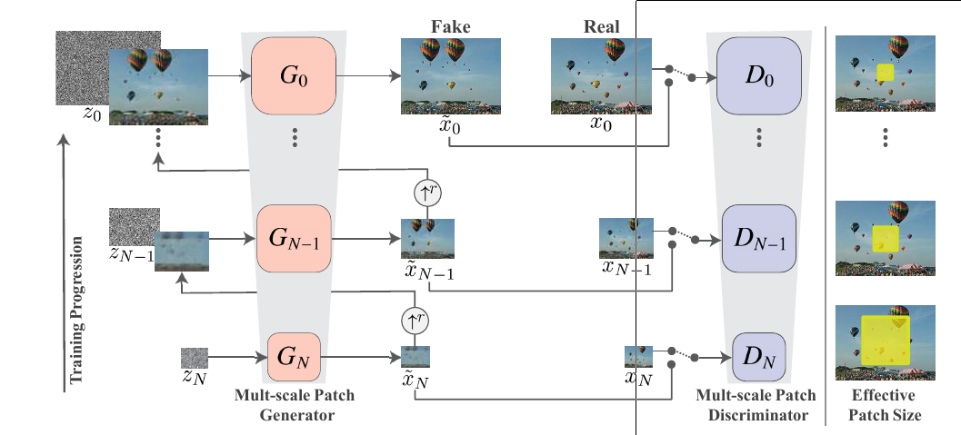
MoEDAL NTD Data Augmentation
GAN is well tested technology and are simpler to implement and train than diffusion models.
Normally a GAN would need a large number of images to be trained BUT in 2019 a new technique has been introduced to train a GAN starting from a single image. (Rott et al 2019)
The main point is to create a pyramid of GAN networks sampling the image at different scales.

Slide 7
MoEDAL NTD Data Augmentation

Slide 8
MoEDAL NTD Data Augmentation
Limitation on image size is due to memory. Full use of GPU (up to 86/80 W) (Now on CNAF HPC machine we can go up to 1000x1000 px.)
FAST
100Hz
Train from single image
Generation
SLOW
3h
400x300

Slide 9
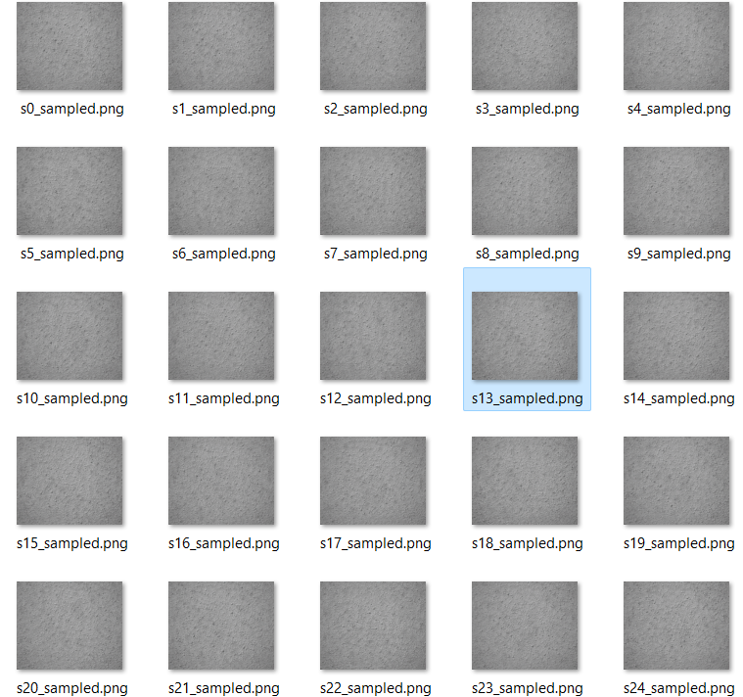
MoEDAL NTD Data Augmentation
From one backgroud:
MANY

Slide 10
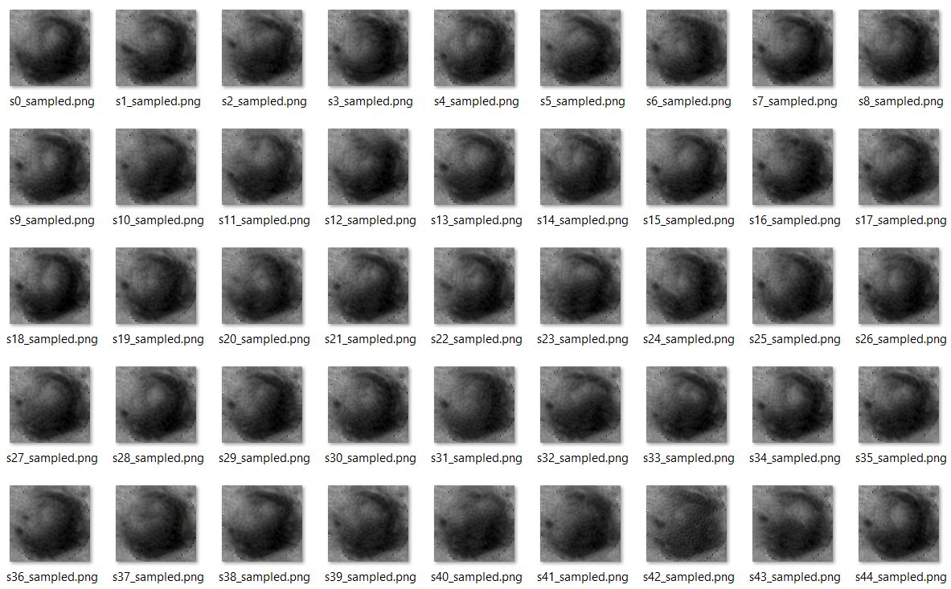
MoEDAL NTD Data Augmentation
From few pits:
MANY

Slide 11
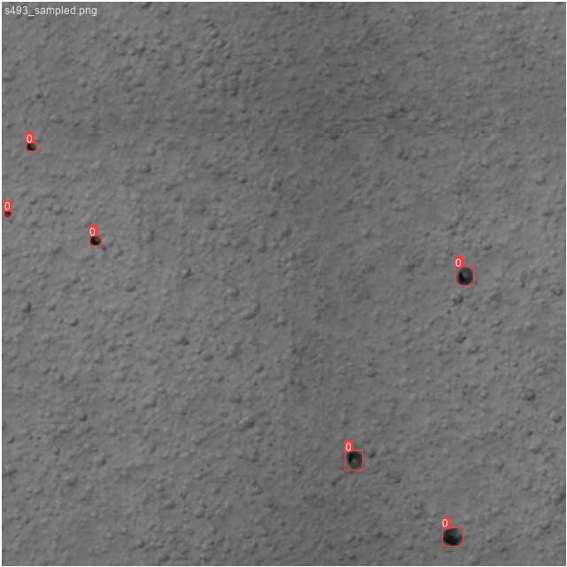
MoEDAL NTD Data Augmentation
We can then combine backgrounds and pits to obtain many images AND
generate also LABELS. In the process data are even more augmented with scaling and reflections.

Slide 12
MoEDAL NTD Data Augmentation
We have to:
Train on simulated data
Validate on new data
Test on real data

Slide 13
MoEDAL NTD Data Augmentation
We used «yolov5» networks from small to xlarge with 300 epochs
Fast detection permits ONLINE data analisys.
Train on simulated data
FAST
50ms/picture
Test on real data
SLOW
8h/3d
Validate on new data

Slide 14
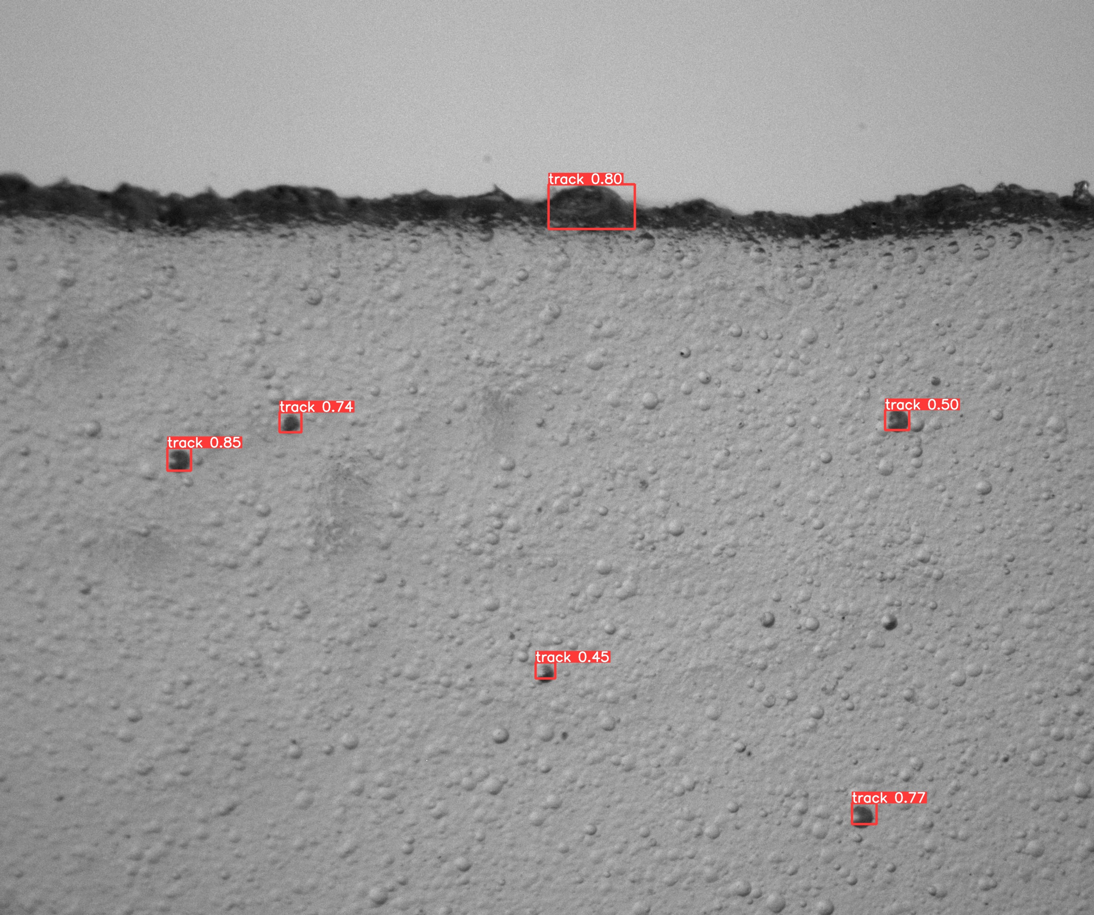
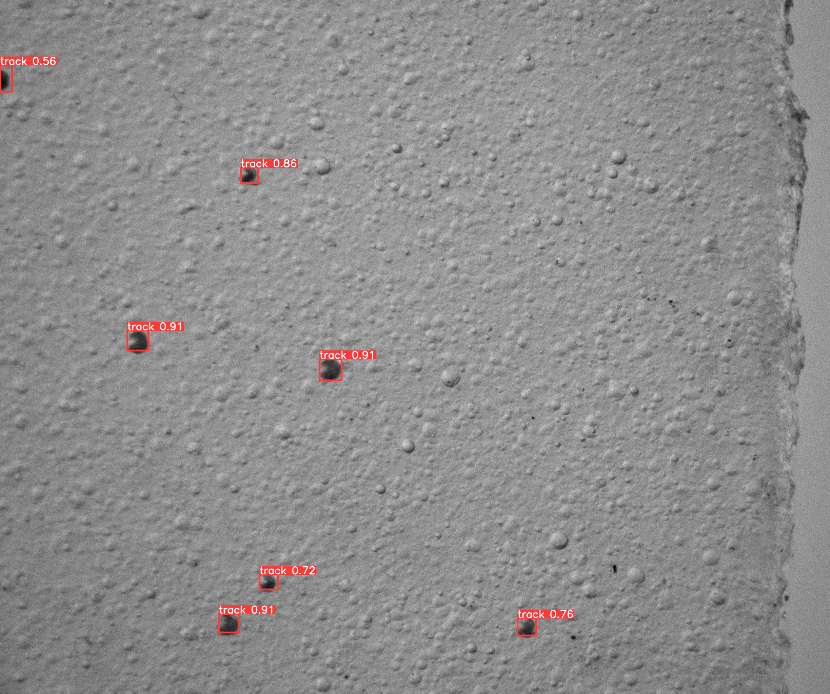
MoEDAL NTD Data Augmentation
Even if it was trained on small (400x300) images the network works nicely on REAL (2448x2048) images.

Slide 15
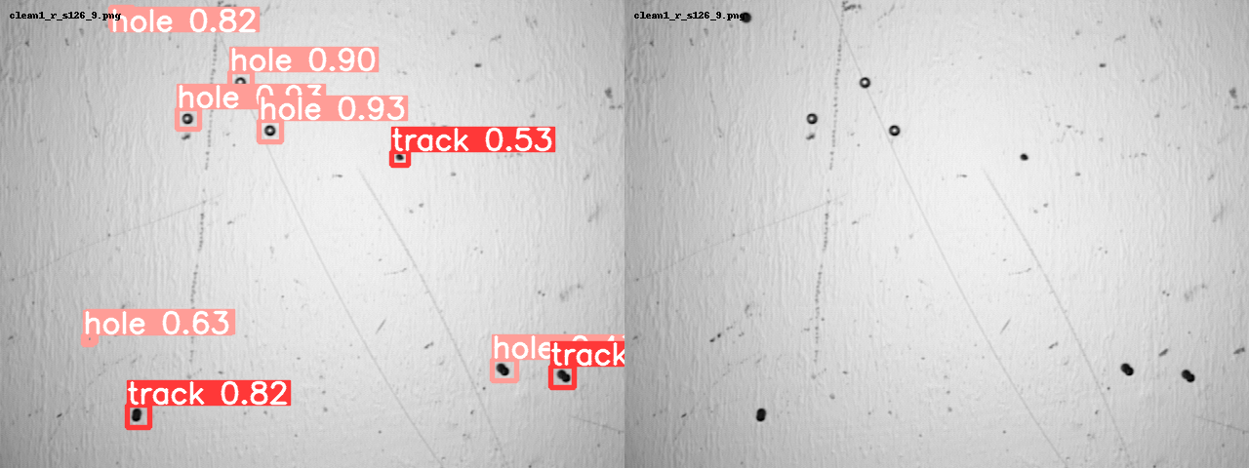
MoEDAL NTD Data Augmentation
Test has been done also on data and images from the AI group:

Slide 16
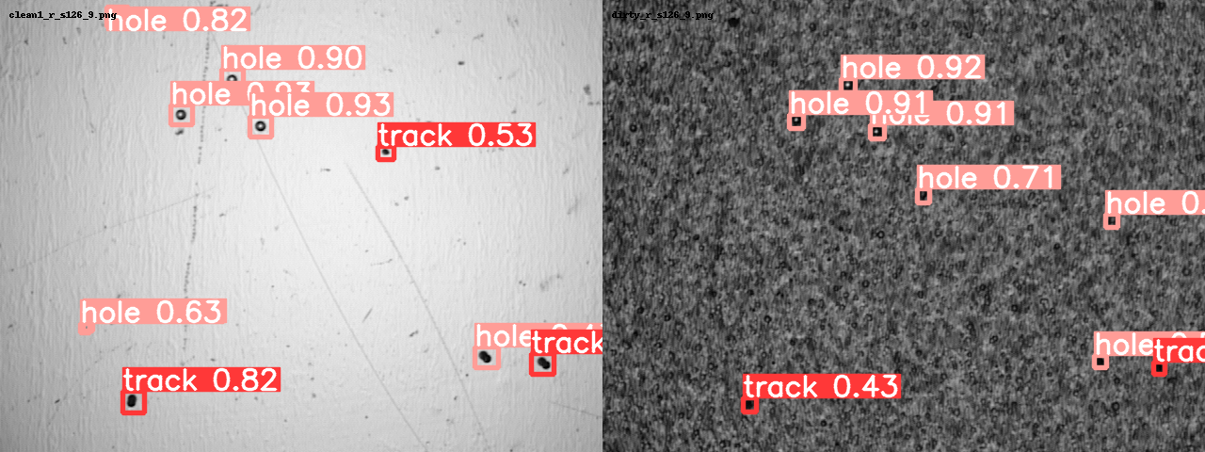
MoEDAL NTD Data Augmentation
Test has been done also on data and images from the MoEDAL AI-group:

Slide 17
MoEDAL NTD Data Augmentation
Very Preliminary results (manually verified):

Slide 18
MoEDAL NTD Data Augmentation
First test of :
Generation of syntetic images (400x300 due to memory limitation)
Object detection network traing on syntetic images
Object detection on REAL data
Has been successful!
We will now fine tune the analisys pipeline in order to deploy a ‘real time’ image analysis system for the Bologna Microscope. Referrences: https://github.com/tamarott/SinGAN https://github.com/ultralytics/yolov5/releases

Slide 19
MoEDAL NTD Data Augmentation
Giuseppe Levi,
University of Bologna, INFN
Levi_at_unibo.it

