Slide 1
2023 CNAO data taking
Matteo Morrocchi, Francesca Cavanna

Slide 2
Schedule
Monday | Tuesday | Wednesday | Thursday | Friday | Saturday | Sunday
18 Sept. Start of Calorimeter Assembly | 19 Sept. | 20 Sept. | 21 Sept. | 22 Sept. | 23 Sept. | 24 Sept.
25 Sept. | 26 Sept. | 27 Sept. End of Magnet Assembly | 28 Sept. | 29 Sept. | 30 Sept. | 1 Oct.
2 Oct. Measurement B Field LNF | 3 Oct. Measurement B Field LNF | 4 Oct. Summary of B All materials for Table at PI | 5 Oct. | 6 Oct. | 7 Oct. | 8 Oct.
9 Oct. IT integration | 10 Oct. IT integration | 11 Oct. IT integration | 12 Oct. Accelerator downtime IT integration | 13 Oct. Accelerator downtime IT integration | 14 Oct. Accelerator downtime | 15 Oct. Accelerator downtime

Slide 3
Schedule
Monday | Tuesday | Wednesday | Thursday | Friday | Saturday | Sunday
16 Oct. Accelerator downtime | 17 Oct. | 18 Oct. Table-magnet integration test at LNF | 19 Oct. | 20 Oct. Night Shift (8h-6h) 22:00 Beam Tuning | 21 Oct. Night Shift (8h) 22:00 Beam Tuning | 22 Oct.
23 Oct. Calo and magnet at CNAO Installation | 24 Oct. Magnet in Exp. Room. Installation | 25 Oct. Installation | 26 Oct. Installation | 27 Oct. Night Shift (8h-6h) 22:00 Calo Screen Saver Run | 28 Oct. Night Shift (8h) 22:00 Installation VTX + IT Calib. + Trig thresholds | 29 Oct. Night Shift (6h) 22:00 TW-calib
30 Oct. | 31 Oct. | 1 Nov. | 2 Nov. | 3 Nov. | 4 Nov. After. Shift (8h) 14:00-22:00 | 5 Nov. After. Shift (8h) 14:00-22:00
6 Nov. Night Shift (6h) 22:00 | 7 Nov. Night Shift (6h) 22:00 Emulsion Run | 8 Nov. Uninstallation | 9 Nov. Uninstallation | 10 Nov. No Material in the room | 11 Nov. Next Exp. In Exp. Room. | 12 Nov.

Slide 4
Beam Tuning
Maria Cristina and Adele will be present to the tests the first night and will bring the dummy emulsion to CNAO
Energies to be tuned for electronic setup:
  Physics: C-200 (different rates for minimum bias and fragmentation trigger)
→ 2 kHz corresponds to about one event in the Vertex, 4kHz rate maximum for frag.
  TW Calib: C-200, p-200, p-230, (p-150?)
  Calo Calibration: C-115, C-150, C-200, C-250, C-300 MeV/u, p-200, p-250 MeV(230?)
  IT-VTX Calibration: No additional energies are needed.
Tuning for emulsion irradiation:
  C-200 with uniform irradiation
  p-70 NIT?

Slide 5
Documentation
Need to fill the required safety modules:
- Module for radioprotection, one for each participant (please check the expiration date of your medical certificates and send a copy to me, radioprotection course expires after 5 years)
- Declaration of possession of requirements for professional and technical suitability, one for each institution (the module expires after 1 year)
- Safety Approval Form, one for the whole experiment (sent, needs some attachments)
All modules are available here. The deadline was September, the 22nd, only partially received
In addition:
- An online course (0.5 h) needs to be attended, and a form needs to be filled. The course expires after 3 years. Francesca will inform the people that need to attend the course.
- Each Local Coordinator should send to us the participant list specifying (if possible) dates of arrival and departure, radioprotection status, and the means of transportation used by each group (i.e. to optimize the number of vans to be used).

Slide 6
Measurement Plan - Calibration
Calorimeter (8h)
Calibration with screen saver, 4 positions, as many energies as possible.
Reconstruction of the response curve for each crystal
10000 evts x crystal x energy
2h → 9 energies for ¼ of the calorimeter
No other detectors in the beamline
Vertex and IT (6h, very low beam intensity)
Cross-check the threshold for each sensor
Collect statistics with tracks in different region of the detector
→ need for a thick target in front of the vertex to scatter the beam (3-6 mm alluminum)
The calibration needs to be done with and without magnetic field, with more than one energy
TW (1-2h)
Scan of the TW using the same energy used in the fragmentation runs. Also protons (few energies).
MSD
Just a quick alignment run without magnet
→ 5 different points in the detector (same energy used in the frag. runs)

Slide 7
Measurement Plan - Frag. Measurements
4 Shifts - 28 hours total (6 + 8 + 8 + 6)
Assuming the following event rate:
about 200 Hz with MB trigger (Average rate)
about 100 Hz with fragmentation trigger (Average rate)
To demonstrate the capability to work in inverse kinematic we need to acquire data with C₂H₄ target
29 Oct.
C: MB (trg. thr)
C: MB (trg. thr)
C: MB (trg. thr)
C: Frag
C: Frag
C: Frag
4 Nov.
C: Frag
C: Frag
C: Frag
C: Frag
C: No Target
C: No Target
C: No Target
C: No Target
5 Nov.
C2H4: MB (trg. thr)
C2H4: MB (trg. thr)
C2H4: MB (trg. thr)
C2H4: Frag
C2H4: Frag
C2H4: Frag
C2H4: Frag
C2H4: Frag
6 Nov.
C2H4: Frag
C2H4: Frag
TW calib
TW calib

Slide 8
Measurement Plan - Emulsion Run
Two bricks, C and C₂H₄.
Emulsions need to leave CNAO the 8 of November (preferably in the morning) to go back to Naples.
A radioprotection survey is needed before emulsions leave CNAO
→ Naples will send a sample to CNAO ad a brief description of the samples that will be irradiated with the estimated total number of particles. The sample will be irradiated the nights of the beam tuning.
Integration of the Emulsion support in the table will be made by the Emulsion group.
Need for a scan spanning an area of 2.4 cm x 2.4 cm with a 15-18 kg brick.
→ Use of CNAO magnets and SC to count the particles impinging on the brick and to veto the beam.

Slide 9
Detector Geometry
A sketch of the geometry can be found at the following link:
https://docs.google.com/presentation/d/1DzUenzIyc6Cj2bNaSvUu9zLl-9GCPmDk/edit?usp=drive_link&ouid=113616464667677823577&rtpof=true&sd=true
A document with all the channel maps and geometry of TW and Calo is available:
→ The Channel map of the TW remains the same
→ The Channel map of the Calo is under definition
All detector experts must upload in shoe the configuration files before the data taking

Slide 10
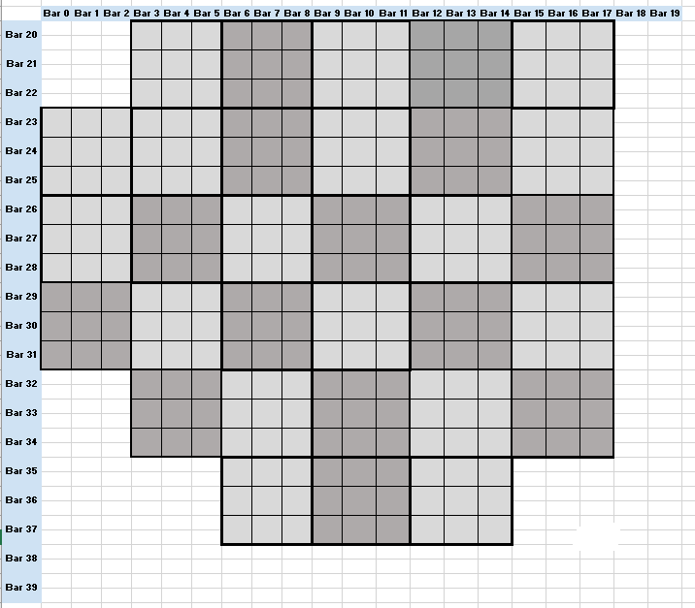
Detector Geometry
Front view (beam-eye view)

Slide 11
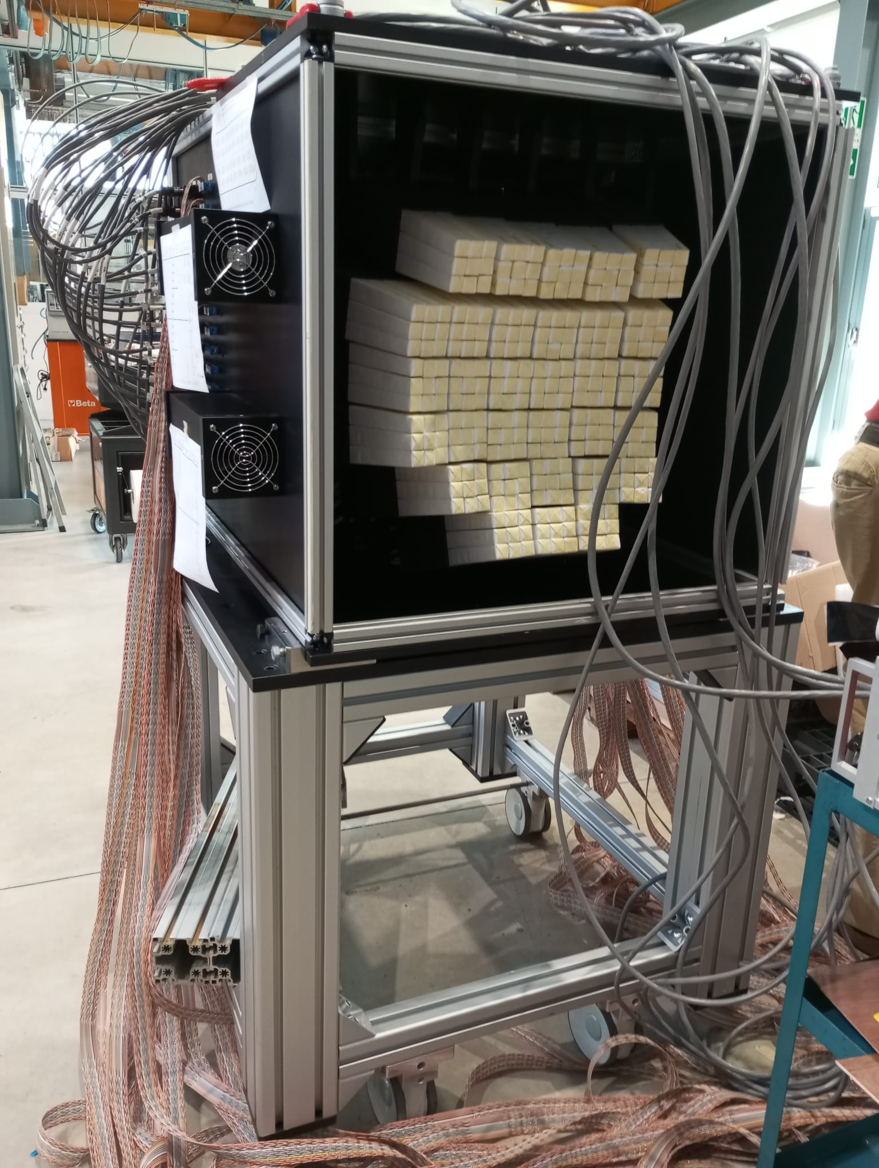
Detector Geometry
Front view (beam-eye view)

Slide 12
Installation
For the CALO screen saver run, no other detector should be on the beam line, this calibration will be performed at the beginning of the data taking. So it would be nice that:
All the detectors will be installed on the beamline by the 26th to test the whole apparatus (without beam).
Move the detectors out of the beamline, except for the calorimeter, the 27th.
Mount again the morning of the 28th
Step by step plan divided into 3-4 days to coordinate the activities in the room (see Gantt)
https://docs.google.com/spreadsheets/d/1IqRL4kOycADrqjhl-oJBJijQHcKq9icJ/edit#gid=275983815

Slide 13
Logistic
Calorimeter and Magnet transportation in the Expr. Room: The calorimeter will be unloaded from the van using the CNAO forklift and will be transferred to the Pisa van and moved in the construction site, so to enter from there.
Magnet transportation in the Expr. Room: The magnet will be unloaded in the construction site from the tail lift of the van the 24th. The magnet will be then transported to Pisa after the data taking.
Table transportation in the Expr. Room: The table will be unloaded in the construction site from the tail lift of the van.
Use of the crane in the experimental room to mount the calorimeter on top of the support and to mount the magnet on the table.
The procedure to integrate the magnet on the table was tested in Frascati yesterday → Andrea, Maurizio

Slide 14
Uninstallation
All the materials have to be removed from the experimental room before November, 10th.
Materials cannot be left at CNAO, some exceptions for limited volumes can be discussed with Marco, but please let us know in advance if this is needed, so to identify a possible solution.
Also the uninstallation needs the coordination with the construction site.
It is difficult to perform the whole radioprotection survey on November, 8th, the exact schedule of the surveys will be decided later (need to be known a bit in advance to schedule the rent of the vans)
Uninstallation follows the same logistic unless specified.

Slide 15
Logistic
The following “big” components need to be moved to CNAO:
Calorimeter (about 400 kg)
Table (... kg)
Magnet (... kg)
(Also a transpallet from Pisa will be used for the installation)
From Pisa: van with tail lift to load and unload the table without need for a forklift in the construction site. (23-26 October, 7-10 November) → maximum load of tail lift: 750 kg.
From Torino: van of the institution with calorimeter top and calorimeter base on two pallets, another pallet for the lifter to use during calibration
From Frascati: van with tail lift with a box over a pallet, arrival 23 October, evening, unload 24 October, morning.
A gas bottle need to be transported from Milano to CNAO, Piergiorgio (24th)
A forklift is available at CNAO, outside the construction site and will be used to transfer the materials from a van to another.
Fixed date to enter in the construction site: October, 23rd (aft.), October, 24th (morn.)

Slide 16
Notes
Documents in preparation:
FOOT Installation documentation
https://docs.google.com/document/d/1MEzwqrbLDyMm2NgS3HrTBZ9IP_4TM_T8W9C09qAZNt8/edit
Electronic setup Sketch
https://docs.google.com/presentation/d/1DzUenzIyc6Cj2bNaSvUu9zLl-9GCPmDk/edit?usp=drive_link&ouid=113616464667677823577&rtpof=true&sd=true
Gantt
https://docs.google.com/spreadsheets/d/1IqRL4kOycADrqjhl-oJBJijQHcKq9icJ/edit#gid=275983815
This presentation is continuously updated and can be found at the following link:
https://docs.google.com/presentation/d/1Z5GhAc4msEjNLL_mqJcTx-BF5PDRneSg/edit#slide=id.p1

