Slide 1
S process
The main component
Oscar Straniero
Italian National Institute of Astrophysics
INFN-Roma
“Nuclear reaction rates for the s-process”
Feb 22-23, 2024

Slide 2
OVERVIEW:
Weak, main and strong component
Bottlenecks and branch points
Low-mass Asymptotic Giant Branch (AGB) stars.
Neutron sources: convective versus radiative neutron bursts.
About the origin of the main (and strong) s-process component.
Observational evidences of a more complex world.

Slide 3
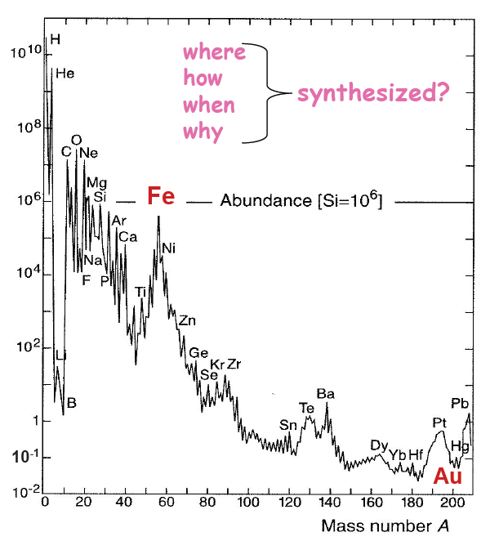
Solar System abundances
Neutron Captures
r-process
s-process
s-process
r-process
r-process
s-process

Slide 4
s process
Weak
A<90
Main
90 ≤ A ≤ 204
Strong
A>204
Fe

Slide 5
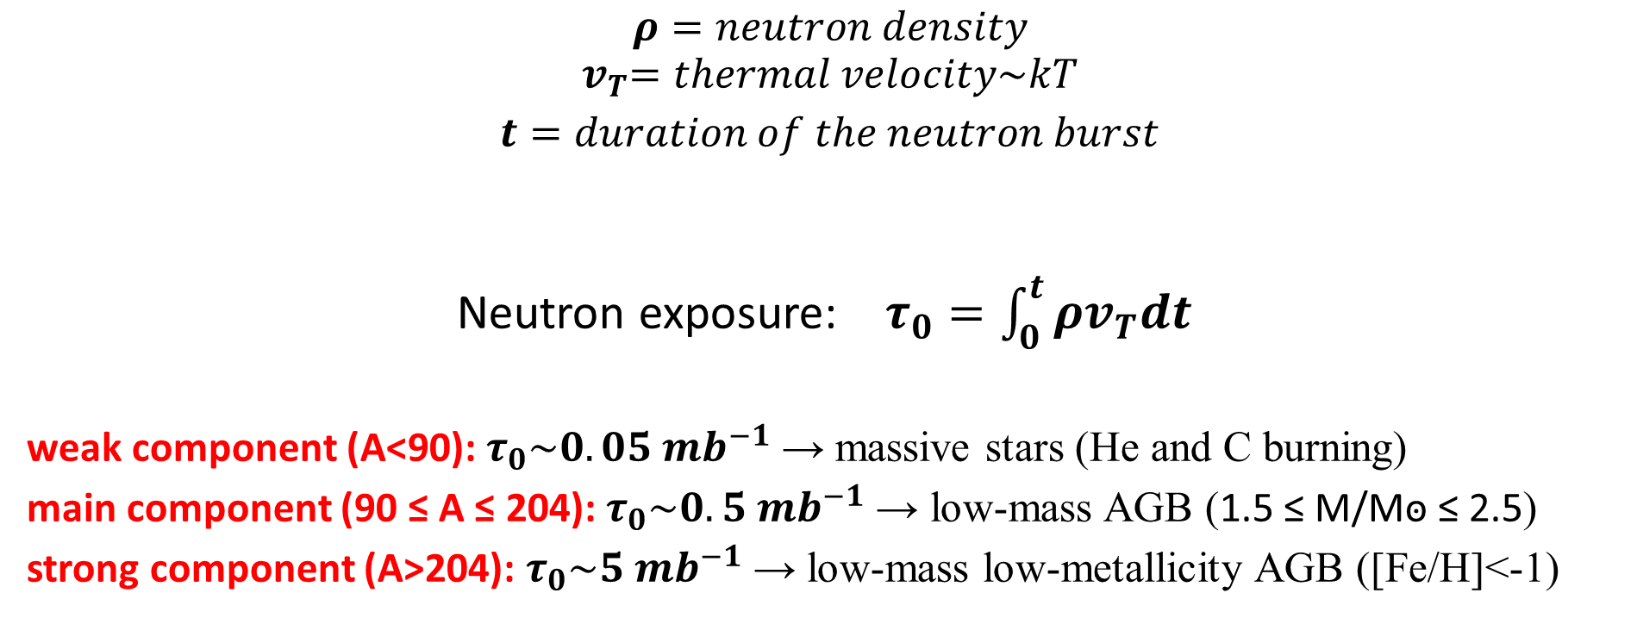
Neutron density and neutron exposure
$ρ=neutron density$
$${ v}_{T}=thermal velocity\sim kT$$
$t=duration of the neutron burst$
Neutron exposure: $τ_{0}=\int_{0}^{t}{ρv_{T}dt}$
weak component (A<90): $τ_{0}\sim 0.05 {mb}^{−1}$ → massive stars (He and C burning)
main component (90 ≤ A ≤ 204): $τ_{0}\sim 0.5 {mb}^{−1}$ → low-mass AGB (1.5 ≤ M/Mꙩ ≤ 2.5)
strong component (A>204): $τ_{0}\sim 5 {mb}^{−1}$ → low-mass low-metallicity AGB ([Fe/H]<-1)

Slide 6
Neutron magic numbers and s process bottlenecks
N=50: 88Sr, 89I, 90Zr
N=82: 138Ba, 139La, 140Ce, 141Pr, 142Nd
N=128: 208Pb, 209Bi, 210Po
Nuclei with full shells → low n-capture cross section.
Large number of neutrons required to go ahead in the s-process path

Slide 7
Neutron/seed ratio
The main seeds for the s process are Fe nuclei.
If the neutron source is primary (i.e., its efficiency does not depend on the original composition of the star) the neutron/seed ratio increases as the stellar metallicity decreases.
At metallicity as high as the solar, the N=82 bottleneck stops the s process.
The major contribution to nuclei A=140-204 comes from stars with [Fe/H]~-1. while the strong component require lower Fe abundances.
From Cameron 1957

Slide 8
Asymptotic Giant Branch stars

Slide 9
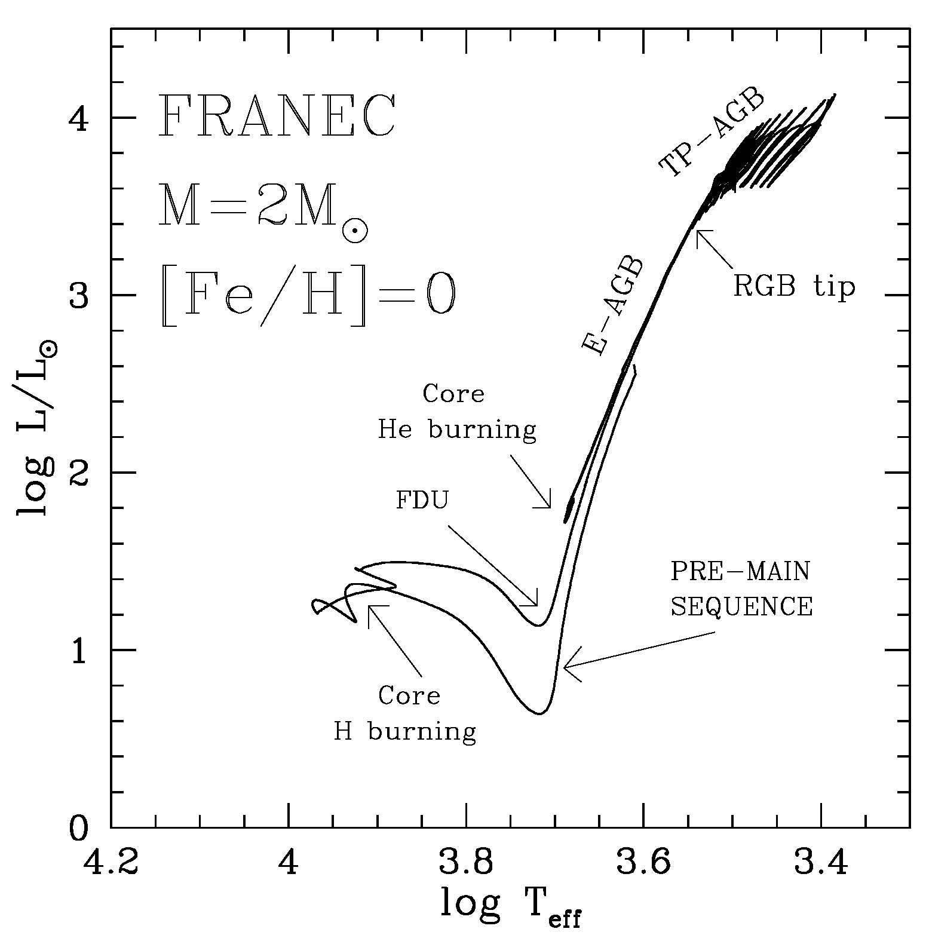
The Hertzsprung-Russell diagram
Pre-MS → fully convective star (because of large opacity.
MS → convective core (powered by H burning through the CNO cycle)
FDU (first dredge up) → the envelope cool down and a deep convective envelope develops (due to shell-H burning + large opacity)
RGB → degenerate core and deep convective envelope.
RGB tip → activation of the triple-α (He-flash)
Core-He burning → triple-α followed by 12C+α, fully convective core surrounded by a semiconvective layer (where partial mixing of He,C and O allows neutrality).
Early-AGB → two burning shell (H and He) → deep convective envelope (large opacity).
Thermal Pulse AGB → Alternate shell burnings, deep convective envelope periodically penetrating the H-exhausted core – when H burning off (third dredge up or TDU)
Post-AGB
RGB
start

Slide 10
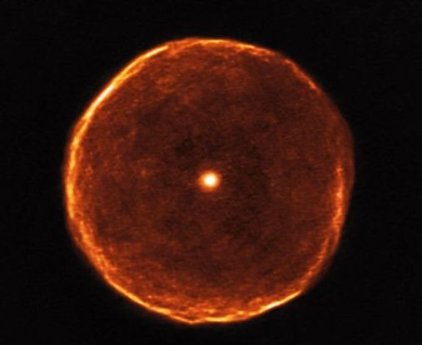
U Antliae in the Pneumatic Machine

Slide 11
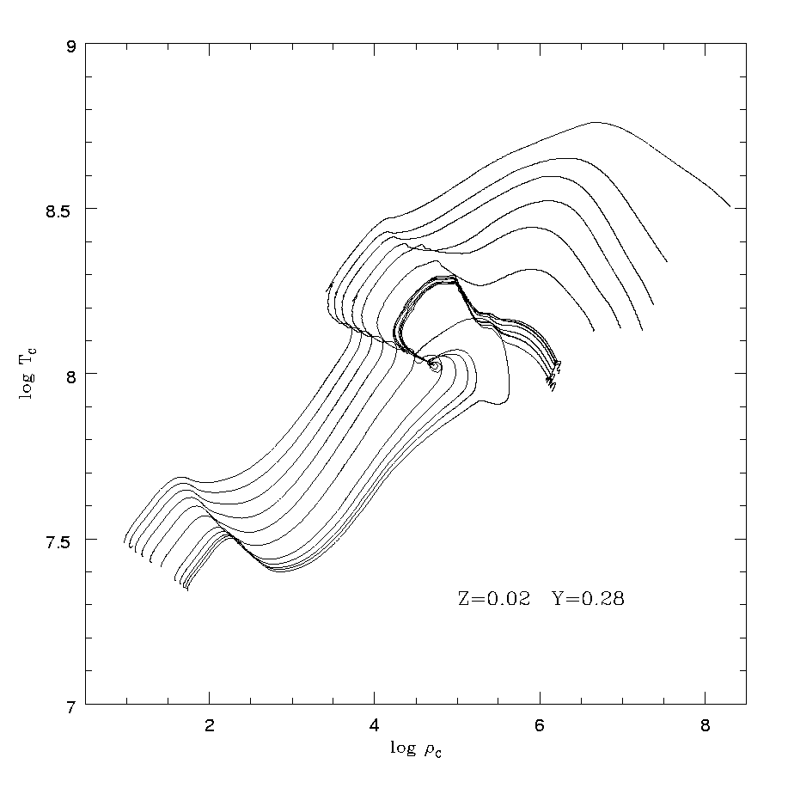
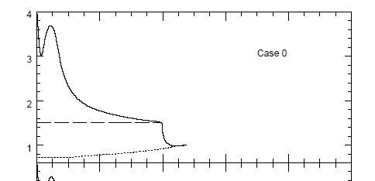

Beyond the core He burning: the early-AGB
Central temperature vs central density for 1-9 Mꙩ evolutionary tracks
E-AGB
ν-cooling
RGB
He burning
H-rich
H burning
1-9 Mꙩ
He
CO
Conv. Env.
Second dredge up
H burning
He burning

Slide 12
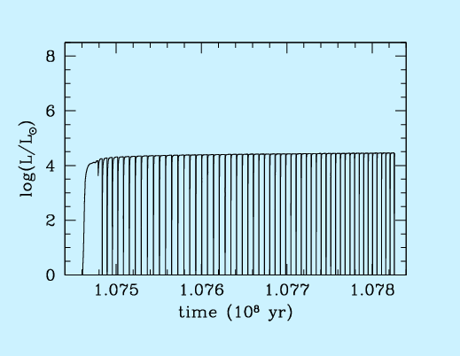
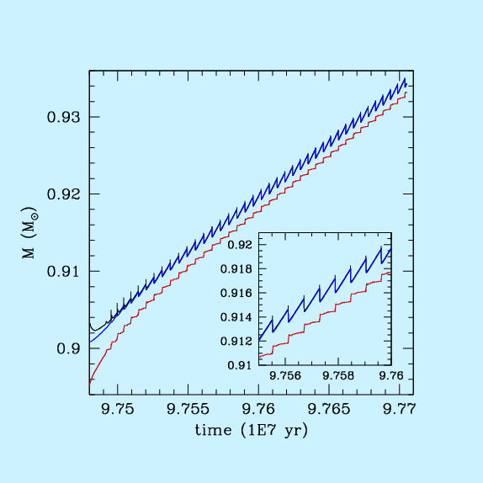
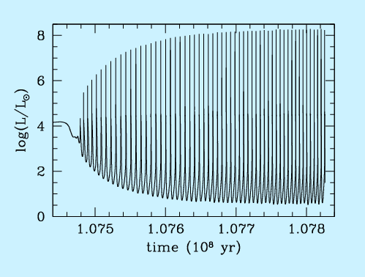
Thermal pulses and TDU in AGB stars
H-rich (30% He)
For most of the time, the H-burning (upper panel) provides the energy to sustain the star shine.
When enough helium has been accreted on top of the H-exhausted core, a He flash occurs (lower panel), eventually followed by a third dredge up (TDU).
CNO
C/O
3α
He-rich (20% C )

Slide 13
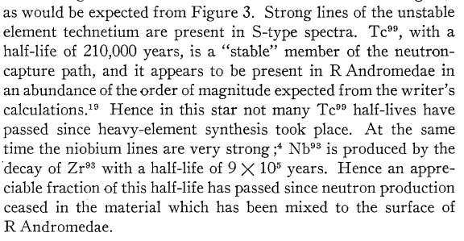
Why AGB stars?
From Cameron 1957
Merrill 1952 (ApJ 116, 21), Tc is found alive in S and C (N-type) stars. It is the smoking gun of the ongoing n-capture nucleosynthesis.
Clayton et al. (1961). A superposition of neutron exposures is required to reproduce the observed abundance distribution for the s-process isotopes (Ann. Phys. 12, 331; also SFC 1965 ApJS 11, 121).
Weigert (1966), Schwarzschild & Harm (1967). Thermal pulses occurs during the AGB phase (Z.Ap 64, 395; ApJ 150, 961).
Ulrich (1973). The partial overlap of successive convective shells generated by TPs in AGB stars naturally leads to multiple neutron exposures (in “Explosive Nucleosnthesis, Univ. Texas, Austin)

Slide 14
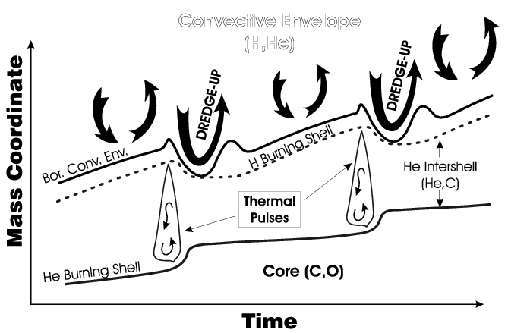
TP→convective shell →TDU →overlap of convective shells
C is produced at the base of the convective shell powereded by the TP and it is mixed up to the top of the He-rich mantel.
Then, the following TDU bring this C up to the stellar surface. This process generates carbom stars (C/O>1).
The H burning leaves He, 14N and 13C on top of the He-rich mantel.
During the TP, the 14N is converted into 22Ne.

Slide 15
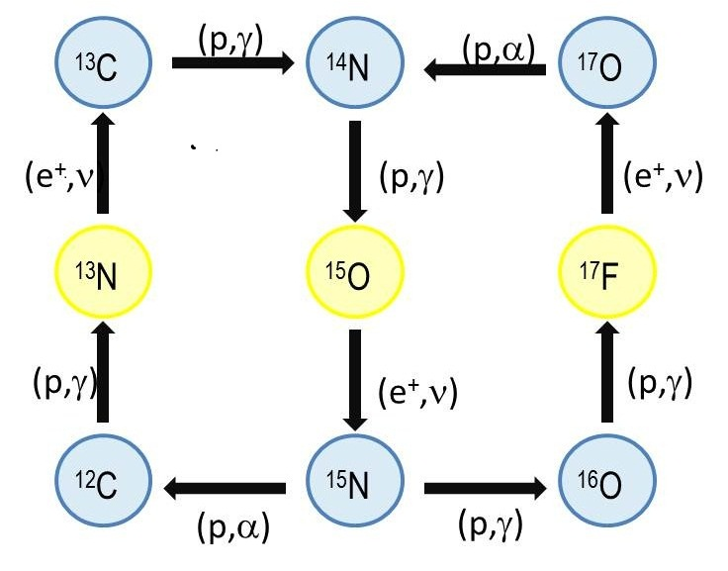
The two burning shells
H burning shell: CNO cycle → α and 14N
……. also traces of 13C.
He burning shell: 3α →12C (eventually 16O from 12C(α,γ))…….. also 14N(α,γ)18F →18O(α,γ)22Ne.
  Possible neutron sources: 22Ne(α,n)25Mg and 13C(α,n)16O.
  Issues: Only at high-metallicity there is enough 22Ne* and the secondary 13C is always insufficient.
  *Note: Primary C from the third dredge up alleviates this problem.

Slide 16
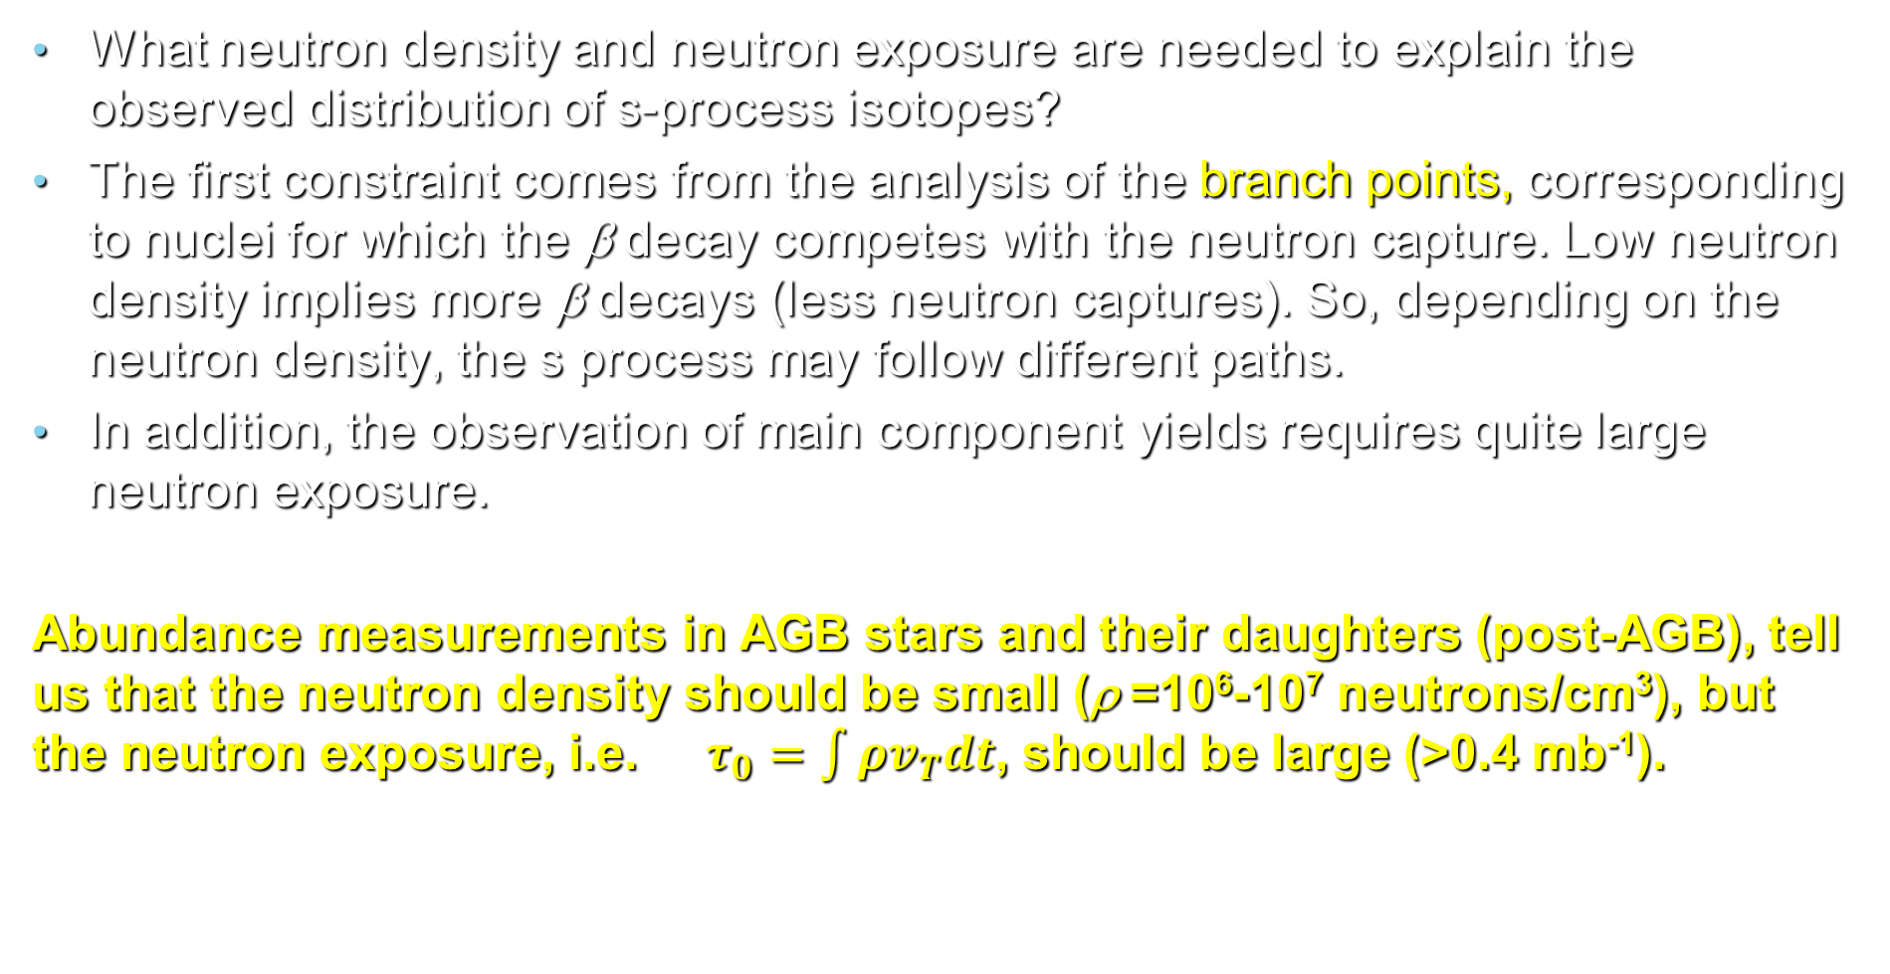
Questions about n-capture nucleosynthesis in AGB stars
What neutron density and neutron exposure are needed to explain the observed distribution of s-process isotopes?
The first constraint comes from the analysis of the branch points, corresponding to nuclei for which the β decay competes with the neutron capture. Low neutron density implies more β decays (less neutron captures). So, depending on the neutron density, the s process may follow different paths.
In addition, the observation of main component yields requires quite large neutron exposure.
Abundance measurements in AGB stars and their daughters (post-AGB), tell us that the neutron density should be small (ρ =10⁶-10⁷ neutrons/cm³), but the neutron exposure, i.e. $τ_{0}=\int{ρv_{T}dt}$, should be large (>0.4 mb⁻¹).

Slide 17
The standard paradigm: ratiative 13C burning
Before the 1995, all the proposed scenarios for AGB s process supposed that the neutron source were active within the convective shell generated by a thermal pulse (see, e.g., Iben and Renzini 1984).
It implies high temperature (>300 MK or 30 keV), high neutron density (10¹⁰-10¹³ cm⁻³), but short timescale (months), so that the neutron exposure is quite low (<0.1 mb⁻¹), not enough for the main and the strong component
These features are in contrast with the observational evidences.
The solution was firstly proposed by Straniero et al. 1995 (ApJ 440L,85):
A proton-tail is left by the third dredge up at the interface between H-rich envelope and He-rich mantel.
During the subsequent interpulse, a 13C-pocket forms (12C+p→13N→13C) and, later on, neutron are released by the activation of the 13C(a,n)16O reaction.
A second neutron burst, as driven by the 22Ne(a,n)25Mg reaction, may eventually occur within the convective shell generated by a TP, but only if T>300 MK

Slide 18

s-Proess paradigm for low-mass AGB (1.5-3 M⊙)
Straniero et al. 1995 – Gallino et al. 1998
Bagnasciuga (wet&dry)
A ¹³C pocket shall form in the transition strip between the sea (convective env.) and the shore (core)

Slide 19
s-Proess paradigm for low-mass AGB (1.5-2.5 M⊙)
Straniero et al. 1995 – Gallino et al. 1998
The convective shell generated by a TP mix 12C up to the top of the He-rich mantel
When the H-burning is off, the convective envelope penetrate the H-exhausted region and, then, recedes, leaving protons in the zone enriched in 12C.
During the interpulse, ¹²C(p,γ)¹³N →¹³C and, later on, ¹³C(α,n)¹⁶O activate the s process.
The pocket enriched with heavy isotopes is engulfed into the next TO and, then, dredged up.
Convective Envelope (H rich)

Slide 20
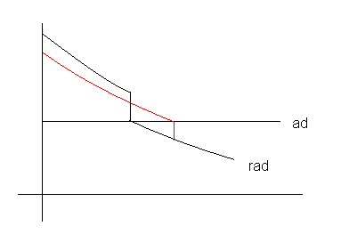

Case b: dredge up
In case of dredge up, the H-rich envelope penetrates the He-rich mantel. The sharp variation of the chemical composition at the conv. border, causes a drop of the radiative opacity and, in turn, a sharp decrease of the radiative gradient. Then, the convective border becomes unstable and convection can easily penetrate inward. In this case, the overshoot induced by the chemical discontinuity is much larger
Convective layer
Transition layer
stable radiative layer
overshoot
convective
radiative
Hydrodynamical models of overshoot:
1) the penetration increases as the stability of the radiative layer below the convective zone decreases , e.g. Singh 1995
The velocity decays exponentially,
e.g. Freytag 1996
T gradients ($∇_{T}$)
H
He

Slide 21
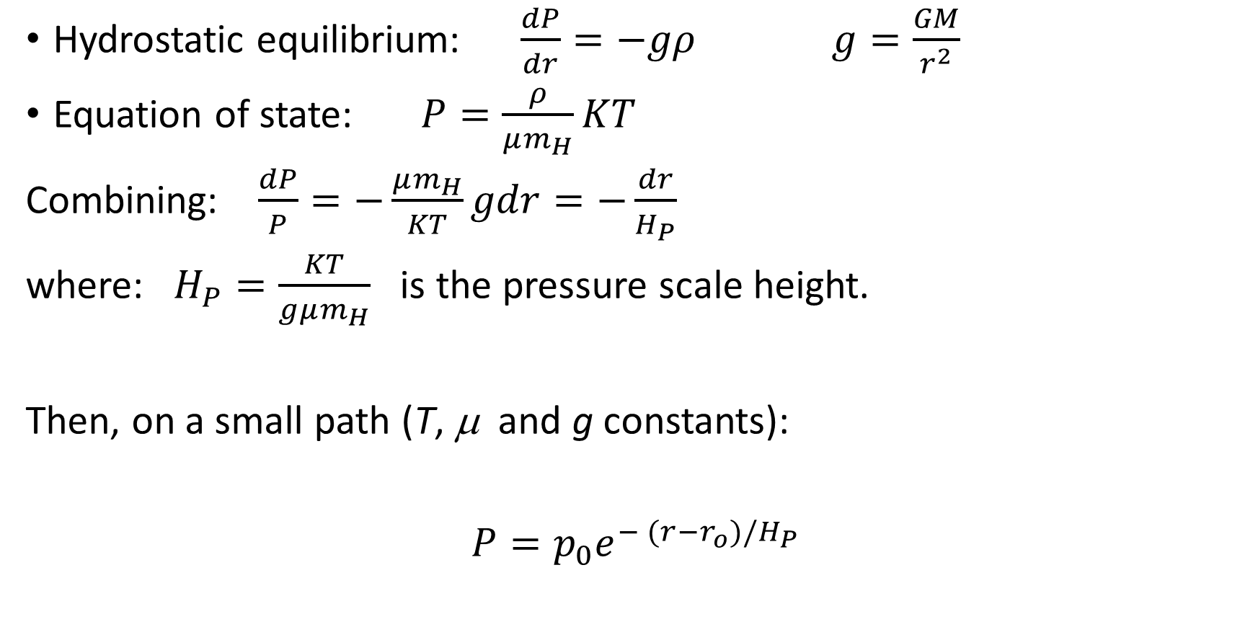
Pressure scale height
Hydrostatic equilibrium: $\frac{dP}{dr}=−gρ$ $g=\frac{GM}{r^{2}}$
Equation of state: $P=\frac{ρ}{μm_{H}}KT$
Combining: $\frac{dP}{P}=−\frac{μm_{H}}{KT}gdr=−\frac{dr}{H_{P}}$
where: $H_{P}=\frac{KT}{gμm_{H}}$ is the pressure scale height.
Then, on a small path (T, μ and g constants):
$P=p_{0}e^{− (r−r_{o})/H_{P}}$

Slide 22
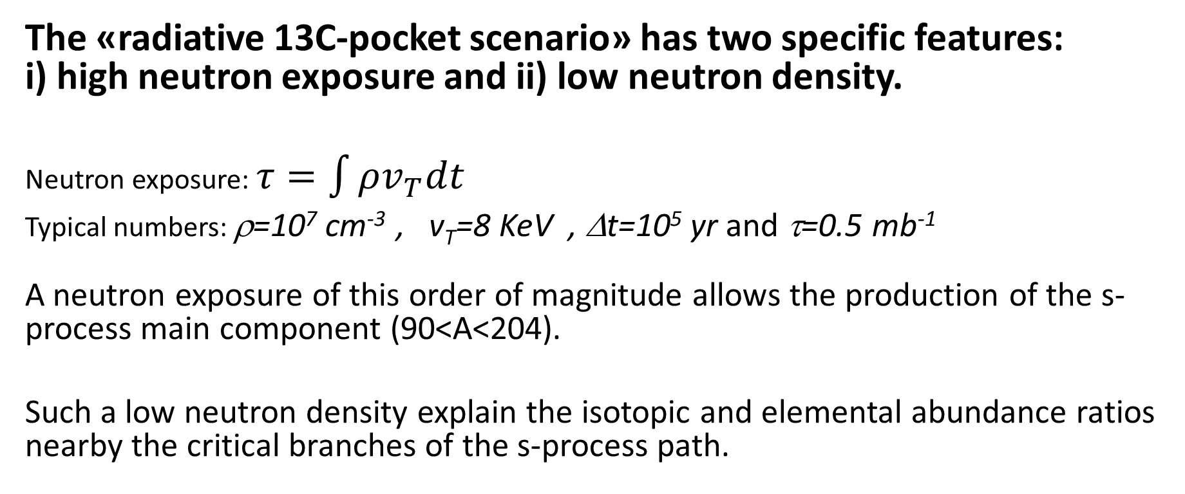
The «radiative 13C-pocket scenario» has two specific features: i) high neutron exposure and ii) low neutron density.
Neutron exposure: $τ=\int{ρv_{T}dt}$
Typical numbers: ρ=10⁷ cm⁻³ , v_{T}=8 KeV , Δt=10⁵ yr and τ=0.5 mb⁻¹
A neutron exposure of this order of magnitude allows the production of the s-process main component (90<A<204).
Such a low neutron density explain the isotopic and elemental abundance ratios nearby the critical branches of the s-process path.
* 1 barn=10⁻²⁴ cm²

Slide 23
Why an exponential decay of V?
Viscous dissipation of kinetic energy ->
V[r(t)]=average velocity of a penetrating convective cell;
Vo= V at the convective border (r=r_{o} at time t=0)

Slide 24
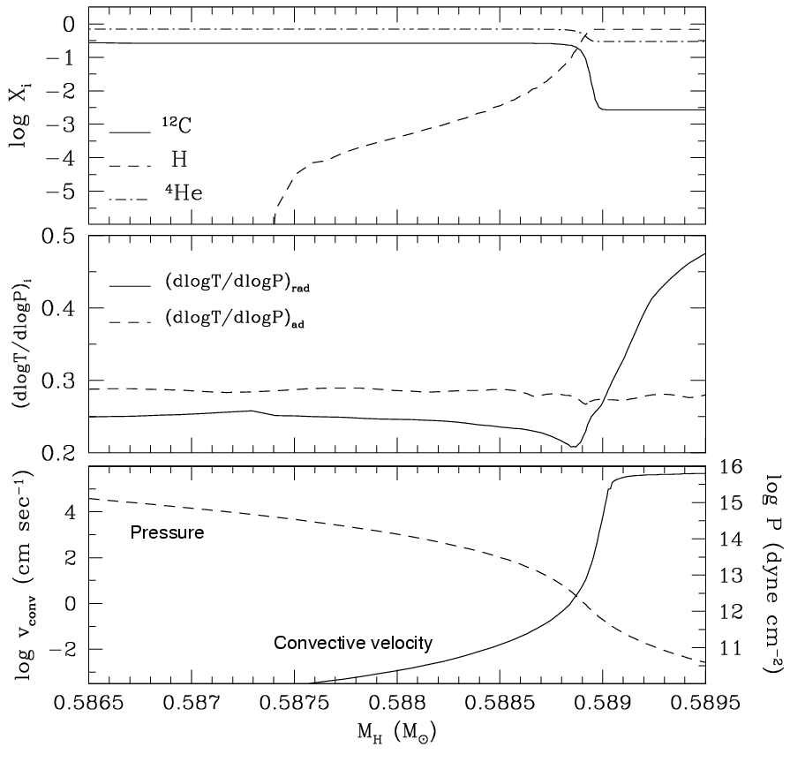
Convective envelope attains the maximum penetration into the He core
(Straniero et al. 2006, Nucl. Phys. A, 777,311)
Chemical stratification
proton tail
Temperature gradient
He
H
Radiative core | Transition zone | Convective envelope
*note: below the convective envelope, r<r₀ or δr<0

Slide 26
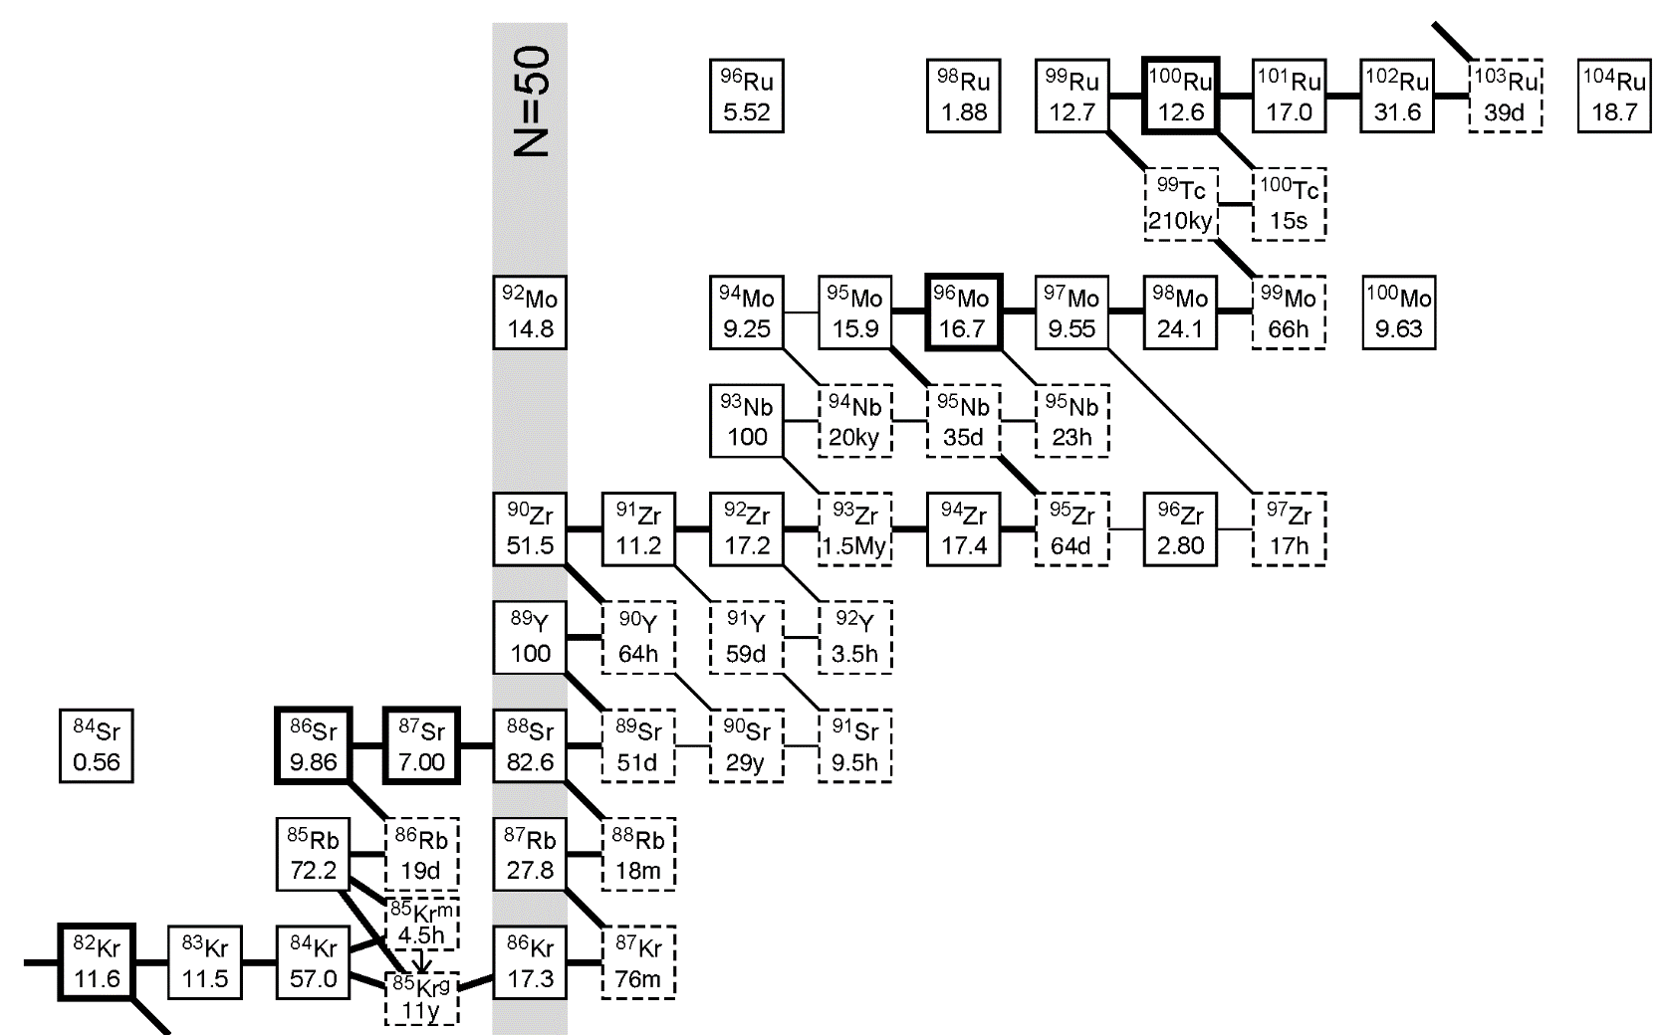
Many observational confirmations of the low-mass AGB scenario:
Low Rb/Sr in S and C stars (Lambert 1995, Abia 2001)
Low ⁹⁶Zr in S stars and SiC grains (Zinner 1995, Lugaro 2003)
Branches discriminate between different scenarios

Slide 27
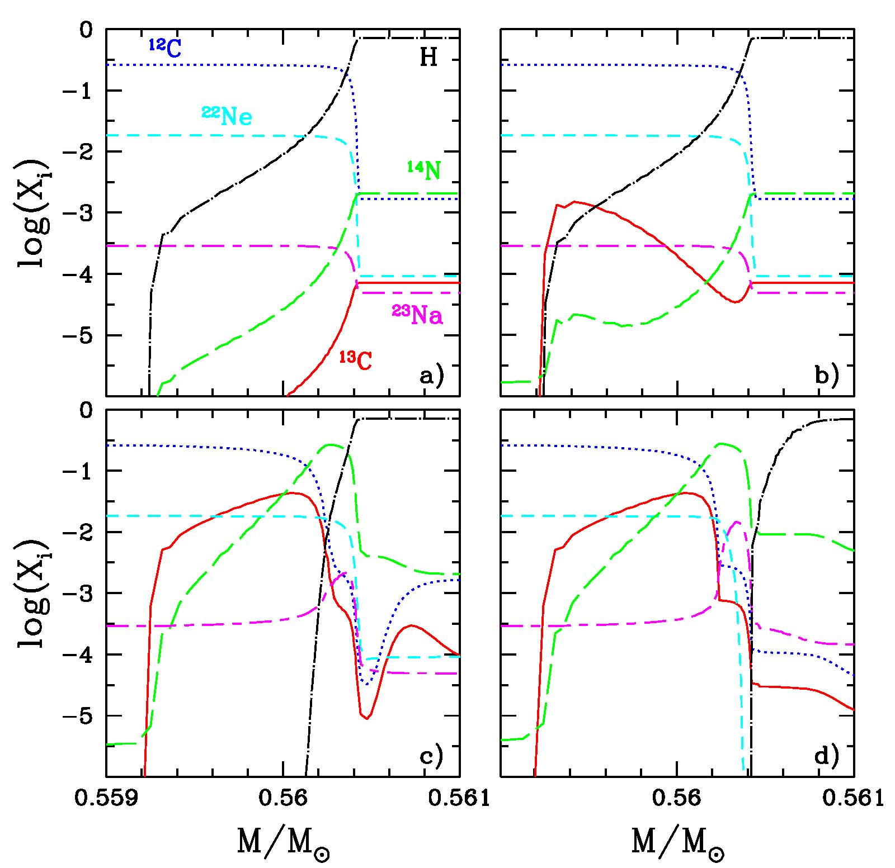
The formation of the ¹³C pocket.
a)
Maximum envelope
penetration (TDU);
b) & c)
¹²C(p,γ)¹³N(β⁻)¹³C followed by ¹³C(p,γ)¹⁴N;
d)
²²Ne(p,γ)²³Na;
M=2M
Z=Z

Slide 28
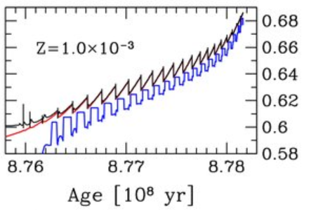
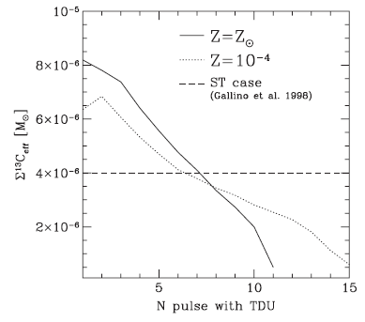
Nucleosynthesis in the He-rich mantel of AGB stars
Multiple neutron exposures. After each TDU, a new ¹³C pocket forms. Due to the overlap of the convective shells powered by the TPs, the final s-process yield is the cumulative contribution of all these pockets

Slide 29
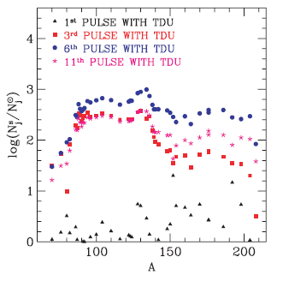
Multiple neutron exposures in AGB stars
After each TDU, the ashes of the s-process are mixed and diluted with the envelope material. Heavy elements appear at the surface.

Slide 30
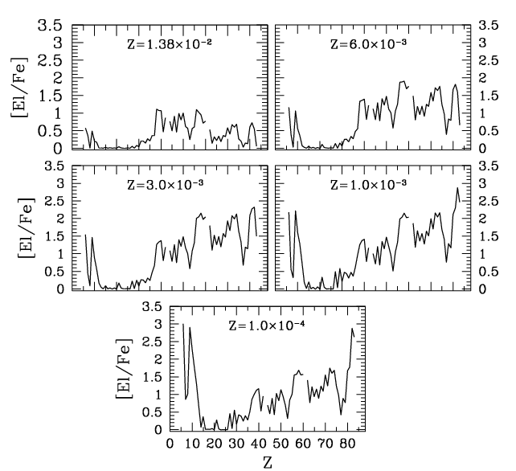
Final AGB composition for 0.0001<Z<Z
Pb, Bi
hs=Ba,La,Cs,Nd,Sm
ls=Y,Sr,Zr

Slide 31
AGB nucleosynthesis is a complex interplay of several phenomena, among which convection and nuclear burning are the most important, but other physical processes may be in action.
Interferences may be constructive or destructive, so that the resulting nucleosynthesis may be enhanced or suppressed.

Slide 32

A 3 player game
poisons
seeds
neutrons
(neutrons-poisons)
$$\left[\frac{hs}{ls}\right]$$
seeds

Slide 33
Evidences for a more complex world:
Spread of hs/ls at different metallicity
s-exceptions: CEMPs and Ba-stars
They are binary stars; in this case we see the secondary component of the binary, polluted with the material lost by the primary when it was on the AGB (see Bisterzo et al. 2011-2012). Todays the primary is a faint white dwarfs

Slide 34
Additional processes….
Instabilities induced by Rotation may modify the H profile left by the third dredge up and, later on, the ¹³C and the ¹⁴N profile into the pocket (Piersanti et al. 2013).
The bulk motion in the convective envelope generates gravity waves propagating inward . Turbulence may be generated by non-linear effects (Denussenkov 2003) or by interaction with rotation (Talon 2007). The consequent mixing may affect nucleosynthesis and angular momentum transport
Magnetic field dissipates angular momentum (magnetic breaking, Sujis 2008), but may also induce magnetic buoyancy, possibly operating in the He-rich intershell (see Vescovi et al. 2021).

Slide 35
Conclusions
The formation of the 13C pocket is an unavoidable consequence of the third dredge up.
There are evidences for additional processes that may model the shape of the pocket.
The rate of the main neutron source, 13C(α,n), at T~100 MK is a crucial ingredient of the theoretical recipe. In particular, a lower rate may leave some 13C unburned before the onset of the subsequent TP, giving rise to a second, convective, 13C neutron burst.
Precise neutron-capture and β-decay rates at the branch points and neutron-capture rates on neutron magic nuclei are also key ingredients

Slide 36
More Slides

Slide 37
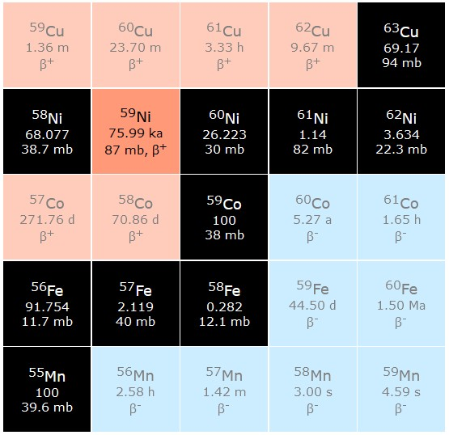
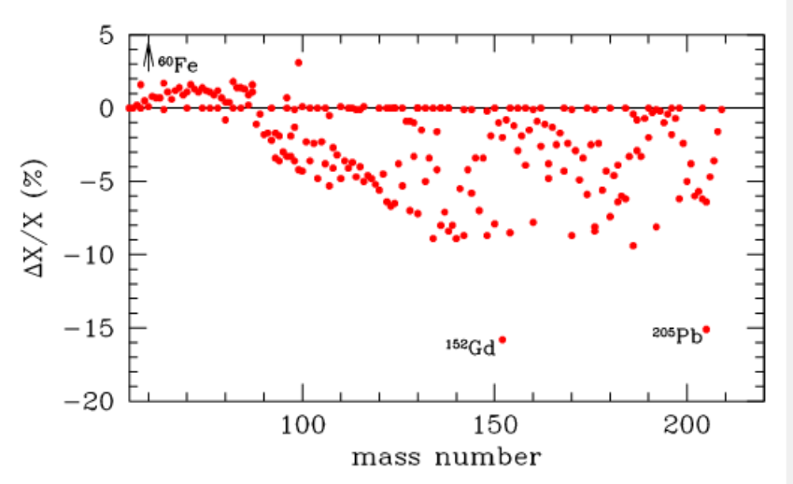
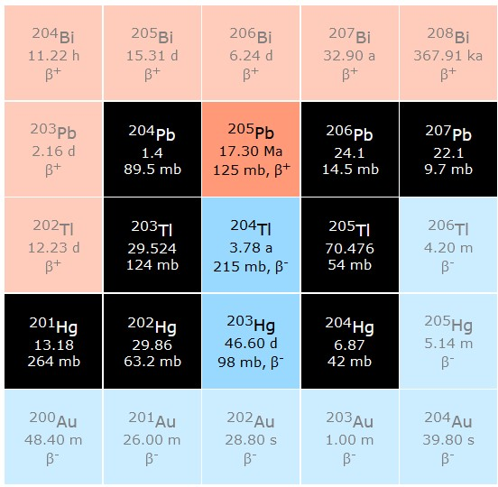
Radioactive nuclei from AGB stars
⁶⁰Fe enhanced by a factor of 100 (from Ciani et al. 2021m PRL)

Slide 38
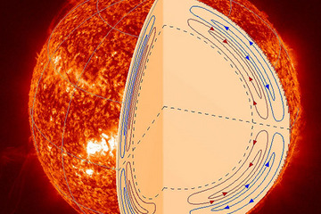
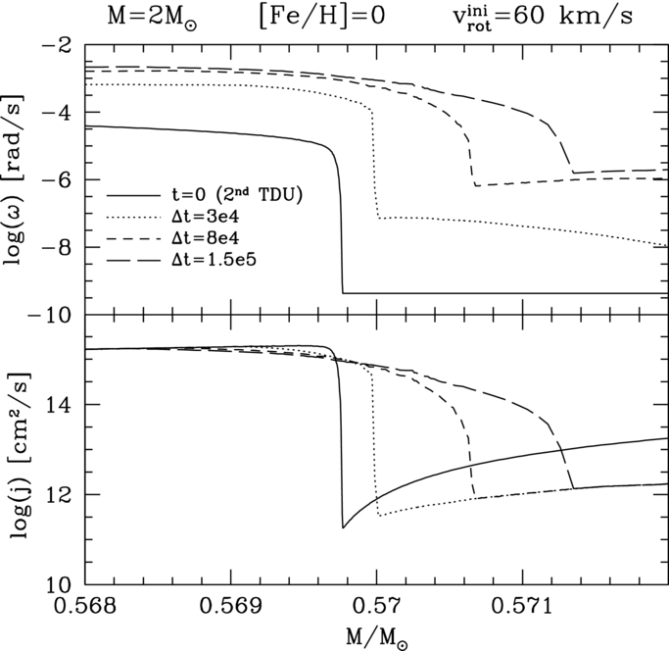
Differential Rotation: ES + GSF instabilities during the interpulse
Sharp variations of ω and j
left by the TDU drives GSF
Meridional Circulation is always
active in rotating stars, because of
the von Zeipel effect, but it is
inhibited by a μ gradient.
See, e.g. Langer et al. 1999, Siess et al. 2004, Herwig et al. 2003, Piersanti et al. 2013

Slide 39
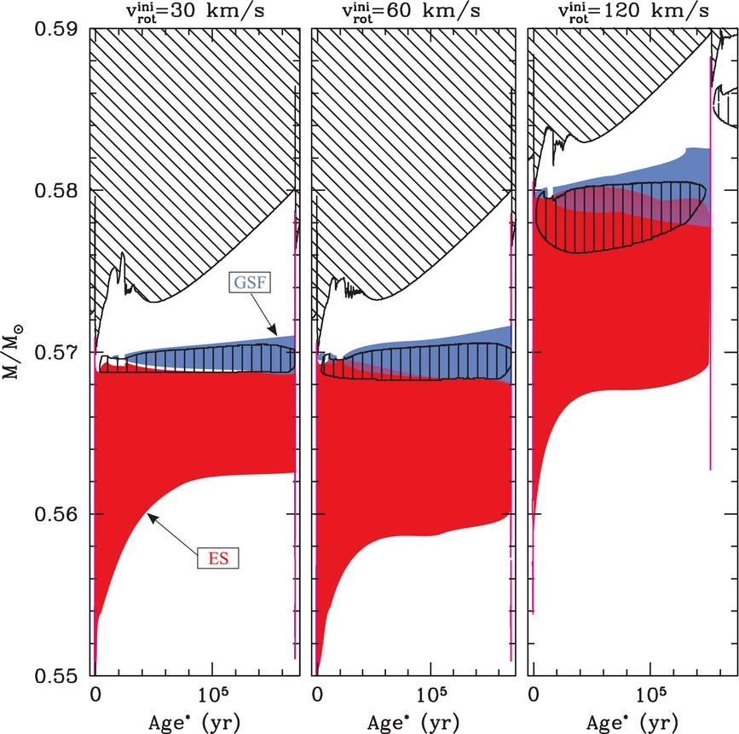
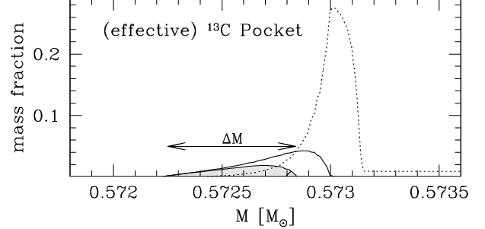
Development of rotation-induced instabilities between the 2nd and the 3rd TDU (M=2 M_{ʘ} [Fe/H]=0). Piersanti et al 2013, ApJ 774, 98
\\\ convection
||| X(¹³C)>10⁻³
ES
GSF

Slide 40
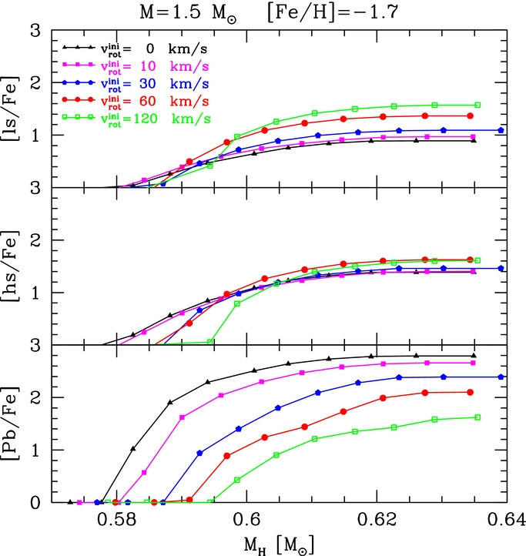
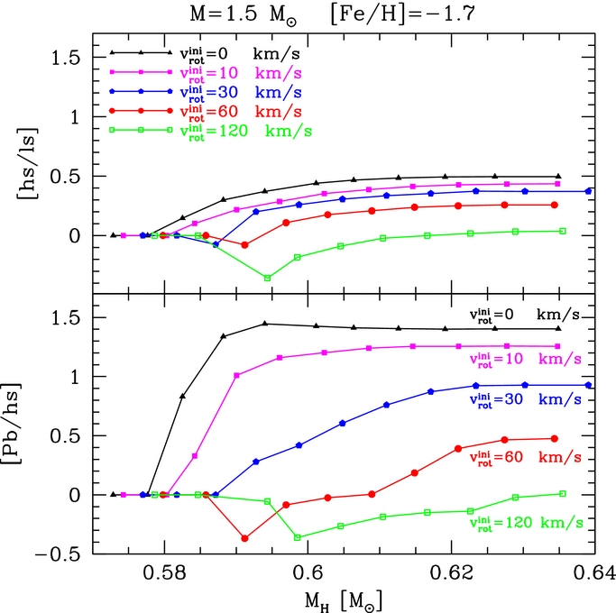

Consequences of rotational induced mixing
From Piersanti et al. 2013

Slide 41
A (theoretical) classification
 | Type I | Type II | Type III | Type IV | Type V | Type VI super-AGB
Mass range: Disk Halo | <1.2 <1.0 | 1.2-1.8 | 1.8-3.5 1.0-2.5 | 3.5-5 2.5-3 | 5-8 3-6.5 | 8-10 6.5-9
TDU | NO | YES | YES | ? | ? | ?
HBB | NO | NO | NO | marginal | YES | YES
s-process: ²²Ne(α,n) ²⁵Mg ¹³C(α,n)¹⁶O | NO NO | NO YES | marginal YES | YES YES | YES marginal | YES NO
Final core mass | 0.5-0.6 | ~ 0.6 | ~ 0.7 | 0.7-0.9 | 0.9-1.1 | 1.1-1.3
C/O | 0.35 | 0.5-0.9 | 0.5 -2 0.5-1000 | 0.5 to >1 | <1 >1 | <1
spectral type | M | M, MS, S | M,MS,S & C | M,MS, S &C | M,MS, S &C | M

Slide 42
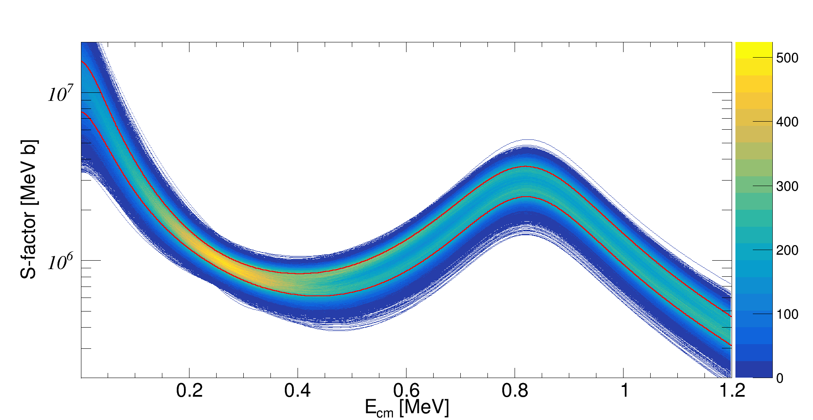
13C(α,n)16O

