Slide 1


SuperB a Super-Flavour-Factory
P.Raimondi, INFN-LNF
on behalf of the SuperB Accelerator Team
42th LNF Scientific Committee
Frascati, June 6, 2011

Slide 2
Present & Past SuperB Accelerator Contributors
M. E. Biagini, S. Bini, R. Boni, M. Boscolo, B. Buonomo, S. Calabro’, T. Demma, E. Di Pasquale, A. Drago, M. Esposito, L. Foggetta, S. Guiducci, , S. Liuzzo, G. Mazzitelli, L. Pellegrino, M. A. Preger, P. Raimondi, R. Ricci, U. Rotundo, C. Sanelli, M. Serio, A. Stella, S. Tomassini, M. Zobov (INFN-LNF)
F. Bosi, E. Paoloni (INFN & University of Pisa)
P. Fabbricatore, R. Musenich, S. Farinon (INFN & University of Genova)
K. Bertsche, A. Brachman, Y. Cai, A. Chao, R. Chestnut, M. H. Donald, C. Field, A. Fisher, D. Kharakh, A. Krasnykh, K. Moffeit, Y. Nosochkov, A. Novokhatski, M. Pivi, C. Rivetta, J. T. Seeman, M. K. Sullivan, S. Weathersby, A. Weidemann, J. Weisend, U. Wienands, W. Wittmer, M. Woods, G. Yocky (SLAC)
A.Bogomiagkov, I. Koop, E. Levichev, S. Nikitin, I. Okunev, P. Piminov, S. Sinyatkin, D. Shatilov, P. Vobly(BINP)
J. Bonis, R. Chehab, O. Dadoun, G. Le Meur, P. Lepercq, F. Letellier-Cohen, B. Mercier, F. Poirier, C. Prevost, C. Rimbault, F. Touze, A. Variola (LAL-Orsay)
B. Bolzon, L. Brunetti, G. Deleglise, A. Jeremie (LAPP-Annecy)
M. Baylac, O. Bourrion, J.M. De Conto, Y. Gomez, N. Monseu, D. Tourres, C. Vescovi (LPSC-Grenoble)
A. Chancé (CEA-Saclay)
D.P. Barber (DESY & Cockcroft Institute)
S. Bettoni (PSI)
R. Bartolini, A. Wolski (UK)
Yuan Zhang (IHEP, Beijing)
K. Ohmi (KEKB)

Slide 3
SuperB Accelerator
SuperB is a 2 rings, asymmetric energies (e⁻ @ 4.18, e⁺ @ 6.7 GeV) collider with:
  large Piwinski angle and “crab waist” (LPA & CW) collision scheme
  ultra low emittance lattices
  longitudinally polarized electron beam
  target luminosity of 10³⁶ cm⁻² s⁻¹ at the Υ(4S)
  possibility to run at τ/charm threshold with L = 10³⁵ cm⁻² s⁻¹
Design criterias :
  Minimize building costs
  Minimize running costs (wall-plug power and water consumption)
  Reuse of some PEP-II B-Factory hardware (magnets, RF)
SuperB can also be a good “light source”: work is in progress to design Sinchrotron Radiation beamlines (collaboration with Italian Institute of Technology)

Slide 4
World e⁺e⁻ colliders luminosity
SuperB
Super
Factories
Linear colliders
Factories
SuperB: highest world
luminosity collider ever
B-Factories
Φ-Factories
Future Colliders

Slide 5
SuperB design
The design requires state-of-the-art technology for emittance and coupling minimization, vibrations and misalignment control, e⁻cloud suppression, etc...
SuperB has many similarities with the Damping Rings of ILC and CLIC, and with latest generation SL sources, and can profit from the collaboration among these communities
For details see the new Conceptual Design Report (Dec. 2010) on:
http://arxiv.org/abs/1009.6178

Slide 6
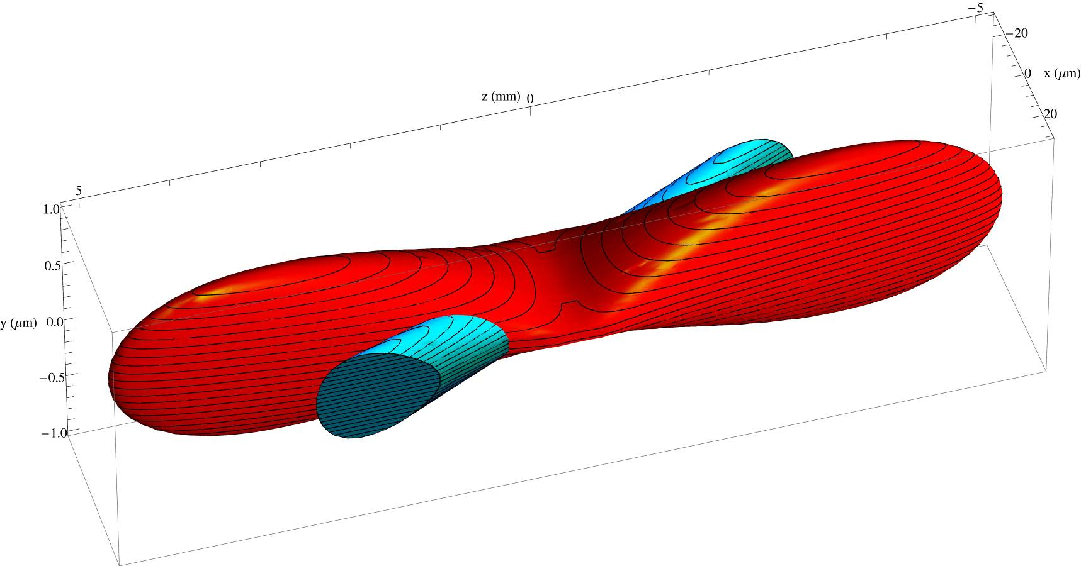
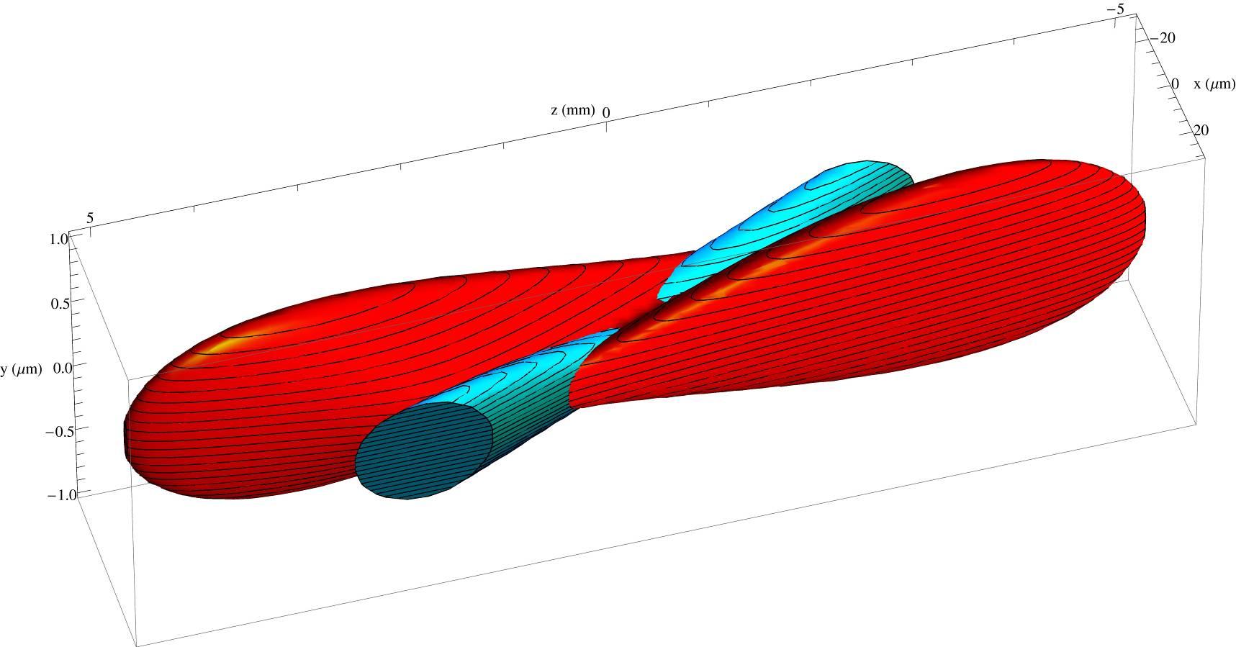
Crab-waist scheme
Raimondi, Shatilov, Zobov http://arxiv.org/abs/physics/0702033
Crab sextupoles OFF: Waist line is orthogonal to the axis of other beam
Crab sextupoles ON: Waist aligned with path of other beam
particles at higher ß do not see full field of other beam
no excessive beam-beam parameter due to hourglass effect
Plots by E. Paoloni

Slide 7
SuperB Parameters
IP and ring parameters have been optimized based on several constraints. The most significant are:
  Maintain wall plug power, beam currents, bunch lengths, and RF requirements comparable to past B-Factories;
  Require ring parameters as close as possible to those already achieved in the BFactories, or under study for the ILC Damping Ring or achieved at the ATF ILC-DR test facility;
  Simplify IR design as much as possible, reducing synchrotron radiation in the IR, HOM power and increasing beam stay-clear;
  Eliminate the effects of parasitic beam crossings;
  Design the Final Focus system to follow as closely as possible already tested systems, integrating it as much as possible into the ring design
  Column 1 of Table shows the baseline parameters set that closely matches these criteria

Slide 8
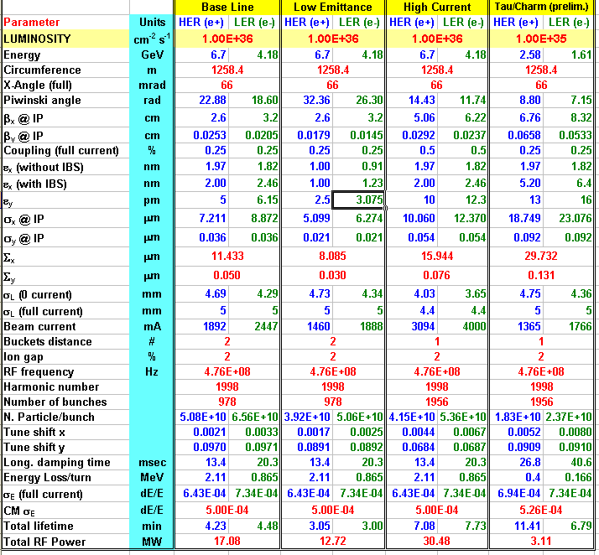
Parameter Table
Tau/charm
threshold running
at 10³⁵
Baseline +
other 2 options:
Lower y-emittance
Higher currents
(twice bunches)
Baseline:
Higher emittance
due to IBS
Asymmetric beam
currents
RF power includes
SR and HOM

Slide 9
SuperB Parameters (cont.)
Columns 2 and 3 in Table show different parameters options:
  Low Emittance case relaxes RF requirements and problems related to high current operations (including wall-plug power) but puts more strain on optics and tuning capabilities:
    Horizontal emittance can be decreased by about a factor 2 in both rings
    IP beta functions can be still decreased in the Final Focus system
  High Current case has opposite characteristics: requirements on vertical emittance and IP β-functions are relaxed but high current issues are enhanced (instabilities, HOM and synchrotron radiation, wall-plug power etc…):
    PEP-II RF system will be able to support higher beam currents (up to a factor 1.6) than the baseline ones, when all the available RF units are installed
The cases shown have several parameters kept has much constant as possible (bunch length, IP stay clear…), in order to reduce their impact on other unwanted effects (Detector backgrounds, HOM heating…)

Slide 10
SuperB at τ/charm threshold
It is foreseen that SuperB can also operate at the τ/charm threshold with a somewhat reduced luminosity: beam energies will be scaled, maintaining the nominal energy asymmetry ratio used for operation at the cm energy of the Υ(4S). All magnet currents will be rescaled accordingly
In order to provide the necessary damping at low current wigglers will be installed. Permanent magnets in the IR will be replaced with weaker versions
Given all factors, we expect that operations at lower energy will require a decrease of the beam current and an increase of the beam emittance
It is thus reasonable to expect a luminosity about 10 times lower than at Υ(4S)

Slide 11
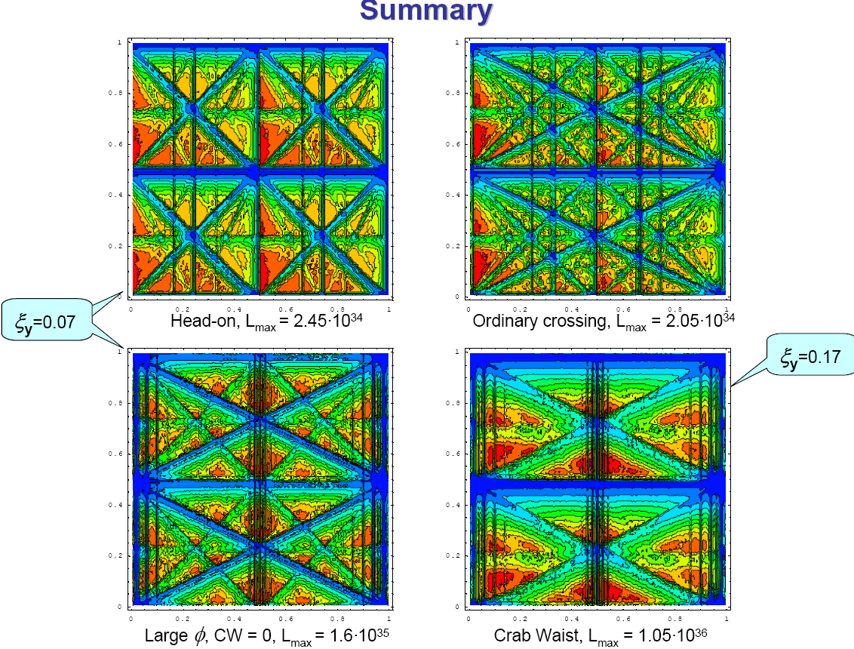
Beam-beam (weak-strong) in the LPA&CW
Red: good
Blu: bad
D. Shatilov

Slide 12
Beam-beam tune scan with different tune shifts
Crab-Waist ON
CDR, ξ_{y} = 0.17
CDR2, ξ_{y} = 0.097
D.Shatilov
L (red) = 1. ∙10³⁶

Slide 13
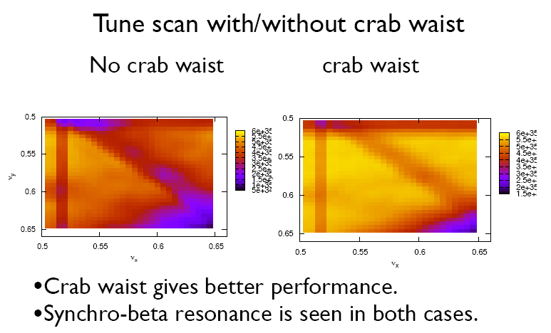
Strong-strong bb simulations
K. Ohmi

Slide 14
Present layout: 2 rings, 1 tunnel
IP
LER SR
66 mrad
LER SR
HER and LER arcs are parallel to each other in the H-plane while separated by 2.1 m.
Each ring has one inner and one outer arc.
Both inner and outer arcs provide the same bending angle but outer arc is made longer (increased drift space around the dipoles) in order to provide the same azimuth location as the inner arc
LER
arc
LER
arc
HER
arc
HER
arc
Rings
crossing
e-
e+
RF

Slide 15
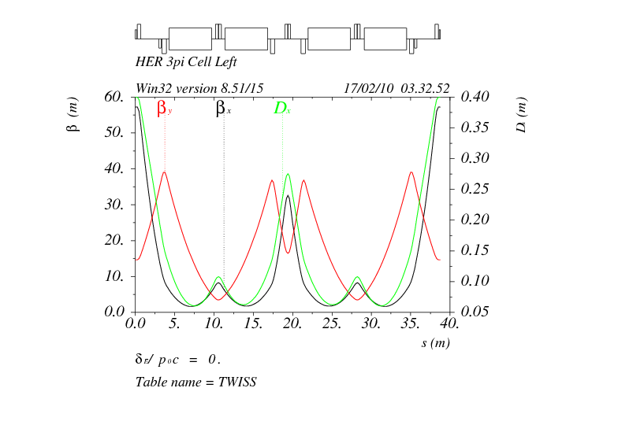
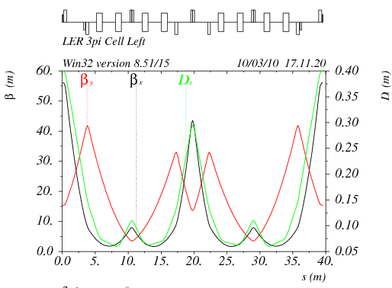
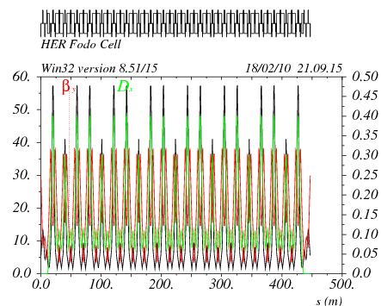
SuperB Arcs
P. Raimondi et al…
HER and LER arcs have conceptually the same lattice. LER arc dipoles are shorter (bend radius about 3 times smaller) than in the HER in order to match the ring emittances at the asymmetric beam energies
μ_{x} = 3π, μ_{y} = π
Cell in HER
LER
HER
μ_{x} = 3π, μ_{y} = π
Cell in LER

Slide 16
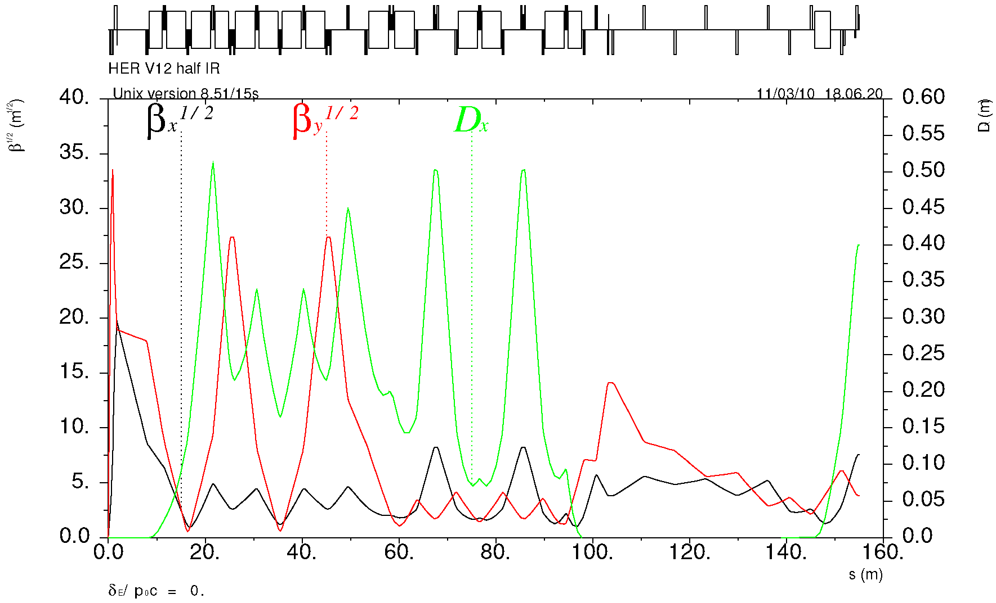
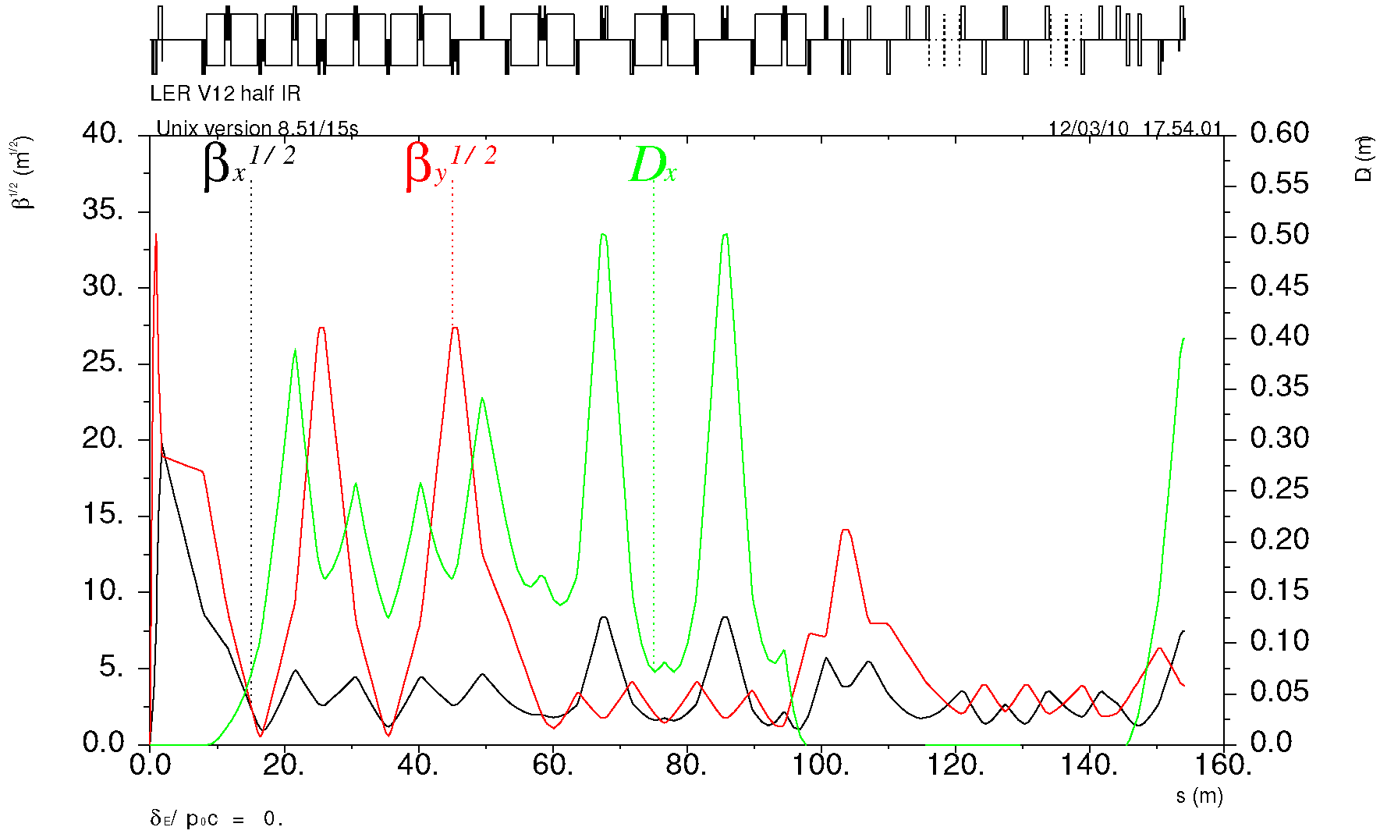
Final Focus optics
P. Raimondi
“Spin rotator” optics is replaced with a simpler matching section
IP
β* = 26 / 0.25 mm
Y-sext
Crab
Match
X-sext
HER
Matching section is shorter than HER to provide space for spin rotator optics.
±33 mrad bending asymmetry with respect to IP causes a slight spin mismatch between SR and IP resulting in ~5% polarization reduction.
IP
β* = 32 / 0.21 mm
Y-sext
LER
Crab
Match & SR
X-sext

Slide 17
IR design
We have two designs that are flexible and have good:
  SR backgrounds
  Lattice functions
  Beam apertures
These designs greatly improve the lattice and energy flexibility of the overall IR design. IP doublets options:
  Vanadium Permendur for QD0 and QF1 (prototype in progress @ BINP)
  Parallel air-core dual quads for QD0 and QF1 (prototype in progress @ Genova)
    Both designs include additional vanadium permendur Panofsky quads on the HER
We have a scheme for correcting the coupling induced by the detector solenoid and we know also how to run the machine without the detector solenoid
M.Sullivan

Slide 18
QD0 Design: 2 possible choices
Vanadium Permendur
“Russian” Design
Air core SC QD0, QF1 “Italian” Design

Slide 19
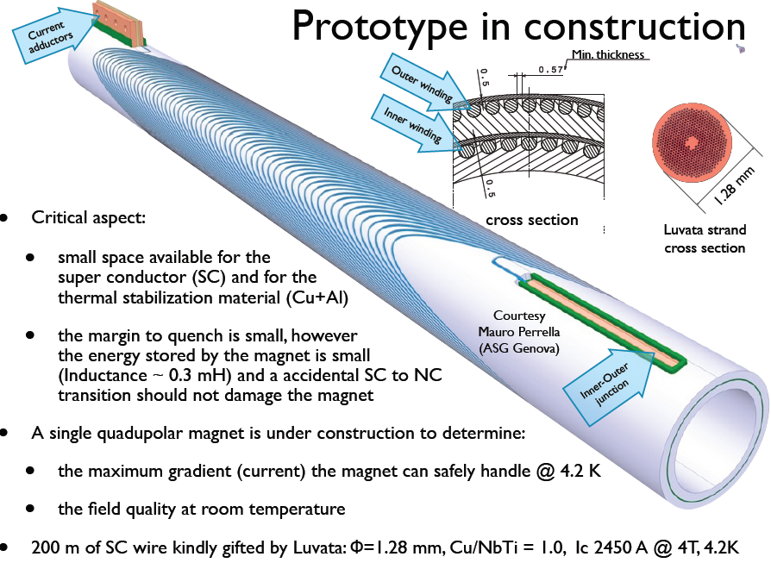
Field generated by 2
double helix windings
in a grooved Al support
P. Fabbricatore, S. Farinon, R. Musenich (Genova) Paoloni (Pisa)

Slide 20
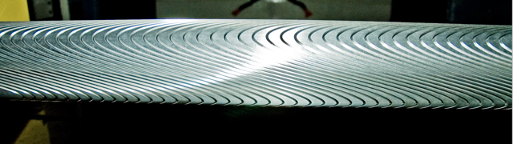
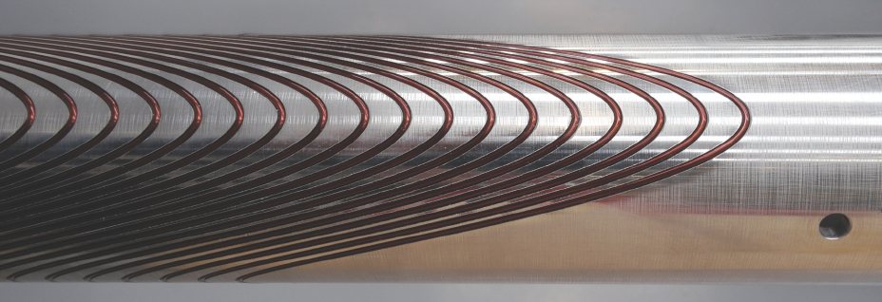
The actual QD0
Grooved Al support
See Fabbricatore’s talk Tuesday morning
Winding in progress
Ready this Summer for tests and field measurements @ CERN

Slide 21
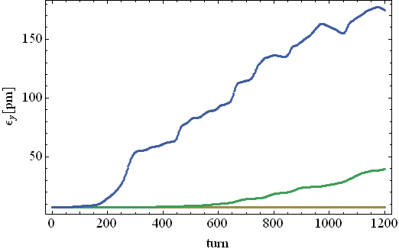
e-cloud instability
T. Demma
Single bunch instability simulations for SuperB HER taking into account the effect of solenoids have been performed using CMAD (Pivi, SLAC). Threshold density: ~10¹² e-/m³
The thresholds have to be compared with build-up simulations using updated parameters to determine safe regions of the parameter space (SEY, PEY)
Work is in progress to:
  Estimate the effect of radiation damping on long term emittance growth
  Estimate the fraction of synchrotron radiation absorbed by antechambers
ρ=5x10¹¹
Vertical emittance growth
induced by e-cloud
ρ=4x10¹¹
ρ=3x10¹¹
Updates on Demma’s talk Tuesday afternoon

Slide 22
Cloud build-up in Free Field Regions
Snapshot of the electron (x,y) distribution
Snapshot of the electron (x,y) distribution 50G solenoids on
Density at center of the beam pipe is larger then the average value
Solenoids reduce to 0 the e-cloud density at center of beam pipe
This work has been possible thanks to the support of the INFN-NA group (in particular Dr. S. Pardi) that provided access (and assistance) to the SCOPE-GRID Cluster to perform all the parallel simulations

Slide 23
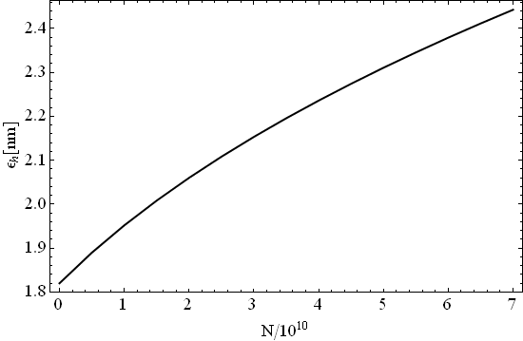

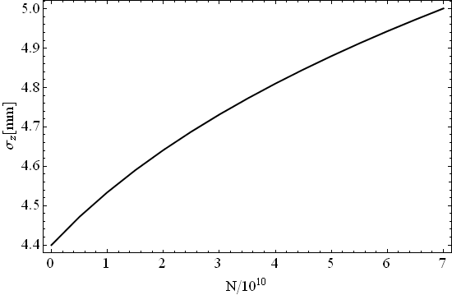
Intra Beam Scattering in LER
T. Demma
ε_{v}=5.812 pm
@N=6.5e10
ε_{h}=2.412 nm
@N=6.5e10
The effect of IBS on the transverse emittances is about 30% in the LER and less then 5% in HER
Interesting aspects such as its impact on damping process and on generation of non Gaussian tails are being investigated with a multiparticle algorithm →6D MC in progress (CMAD, parallel)
σ_{z}=4.97 mm
@N=6.5e10
Updates on Demma’s talk Tuesday afternoon

Slide 24
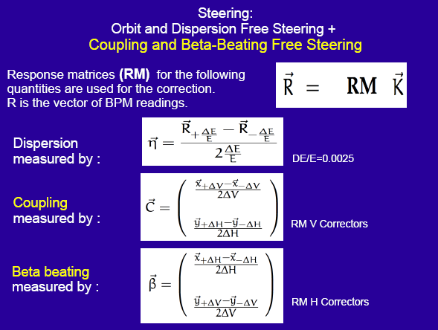
Low Emittance Tuning
S. Liuzzo
Tool tested at DIAMOND (RAL), SLS (PSI)

Slide 25
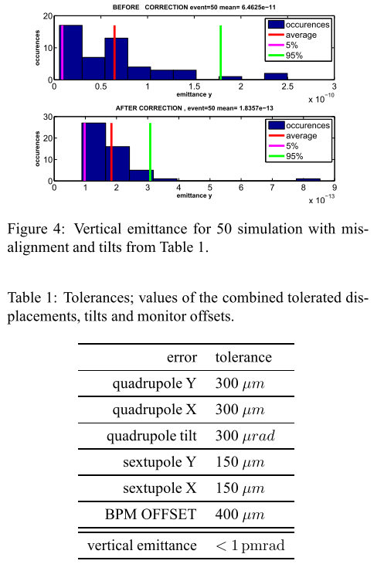
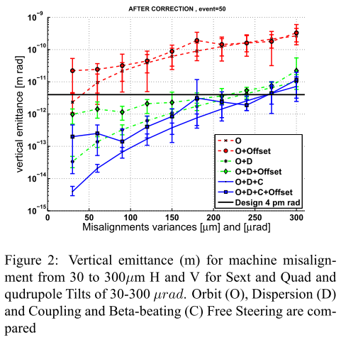
Low Emittance Tuning: HER tolerances
Steering:
Orbit & Dispersion Free steering +
Coupling & Beta-beating Free steering
Using only correctors
Or
Correctors and skew quads
4x10¹²

Slide 26
Low Emittance Tuning: LER tolerances
LER ARC's tolerances evaluated using a Response Matrix technique that optimizes orbit, in order to recover the design values for Dispersion, Coupling and Beta-beating, and obtain the lowest possible vertical emittance
Note: H scales different!
Final Focus introduces
stringent restrictions on alignment of both FF and
ARCS (even for no errors in FF)

Slide 27
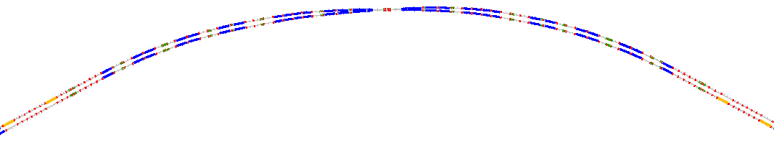
Polarization in SuperB
90°spin rotation about x axis
  90°about z followed by 90°about y
“flat” geometry → no vertical emittance growth
Solenoid scales with energy → LER more economical
Solenoids are split & decoupling optics added
The SR optics design has been matched to the Arcs and a similar (void) insertion added to HER
This design poses severe constraints on the FF bending angles of LER and HER in order to achieve the “right” spin dynamics
A polarimeter has been designed to measure polarization
LER
IP
HER
S.r. dipoles
(270° spin)
HER
LER
S.R. solenoids
(90° spin)
U. Wienands, W. Wittmer

Slide 28
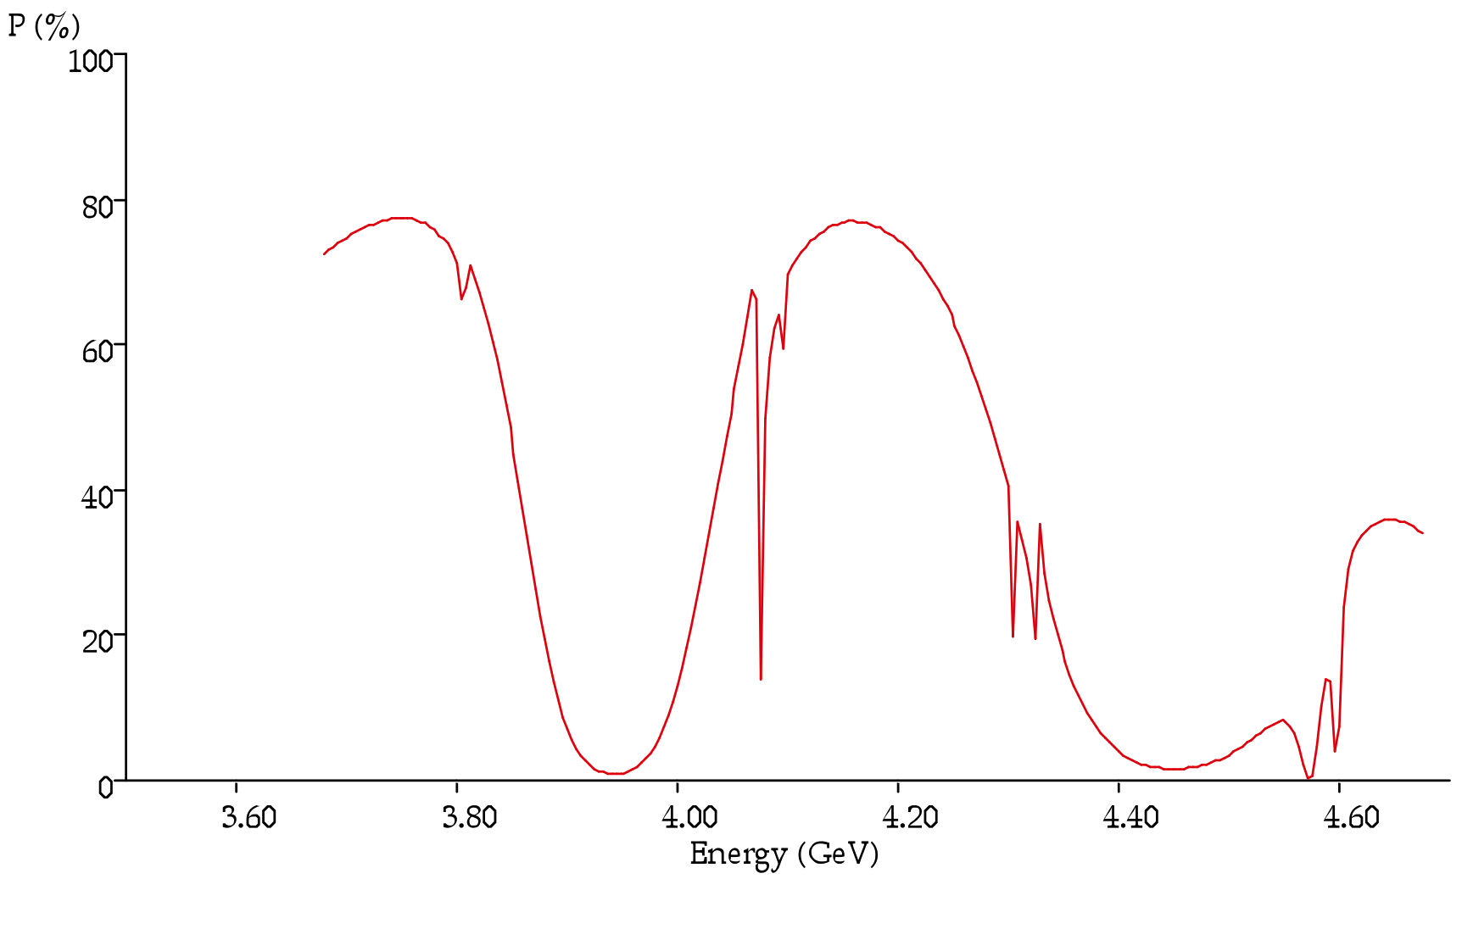
Polarization resonances
Beam polarization resonances do constraint the beam Energy choice
Plot shows the resonances in the energy range of LER
Beam polarization computed assuming
  90% beam polarization at injection
  3.5 minutes of beam lifetime (bb limited)
From this plot is clear that the best energy for LER should be 4.18 GeV → HER must be 6.7 GeV
E_{LER}

Slide 29
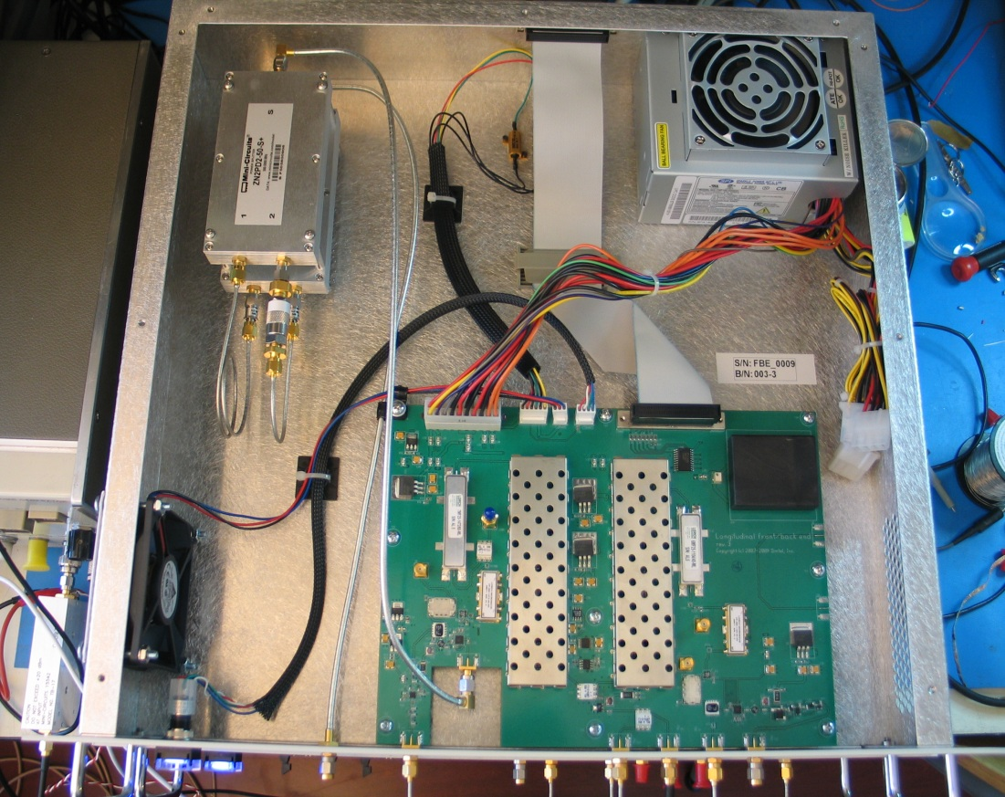
Bunch-by-bunch feedback
A. Drago
All 6 DAΦNE feedbacks have been upgraded with a new 12bit system
VFB – new 12 bit iGp systems with larger dynamic range and software compatibility with the previous version
LFB - completely new systems in place of the old systems designed in 1992-1996 in collaboration with SLAC/LBNL: fe/be analog unit connected to iGp-8 as processing unit
HFB: upgrade hw/sw of the iGp-8bit system already used
This will be the baseline design for SuperB H-V-L feedbacks
New front-end/back-end analog unit used in the longitudinal feedback

Slide 30
Bunch-by-bunch feedback improvements
A. Drago
Larger dynamic range → system more flexible
Fast and easy back-end timing in the trasverse or longitudinal systems
“Bunch cleaning” function can be used to “kick out” a specific bunch or bunch pattern
Better performances, more sophisticate software, simpler hardware
RF & Feedbacks & Controls parallel Wed. morning

Slide 31
RF & Power
Novokhatski
Need
collimators

Slide 32
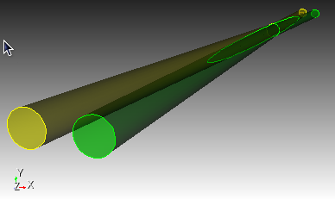
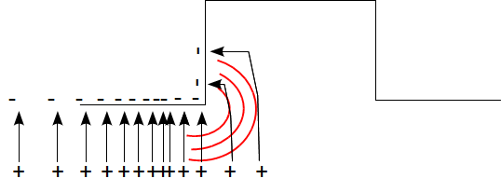
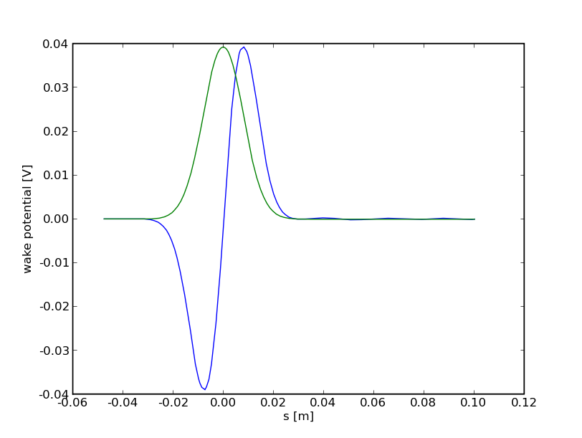
Wakefields in the IR
S. Weathersby
Compare SLAC parallel Finite Element Method electromagnetic time domain solver (t3p) with gdfidl finite integration (MAFIA)
Consider simple intersecting tubes as a generic model
Electromagnetic “wake” fields are generated by the bunch image charges as they move along changing beam pipe boundaries
Following particles within the bunch feel the wake fields caused by the previous particles
Wake potential is the accumulated voltage seen by particles as the bunch traverses the structures
wake fields
bunch
longitudinal
wake potential

Slide 33
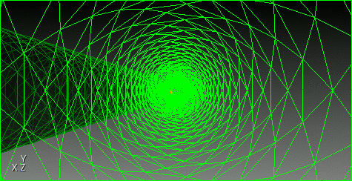
Beam’s eye view
S. Weathersby

Slide 34
HOMs Absorbers
S. Novokhatski
PEP-II absorbers
suitable
and
available

Slide 35
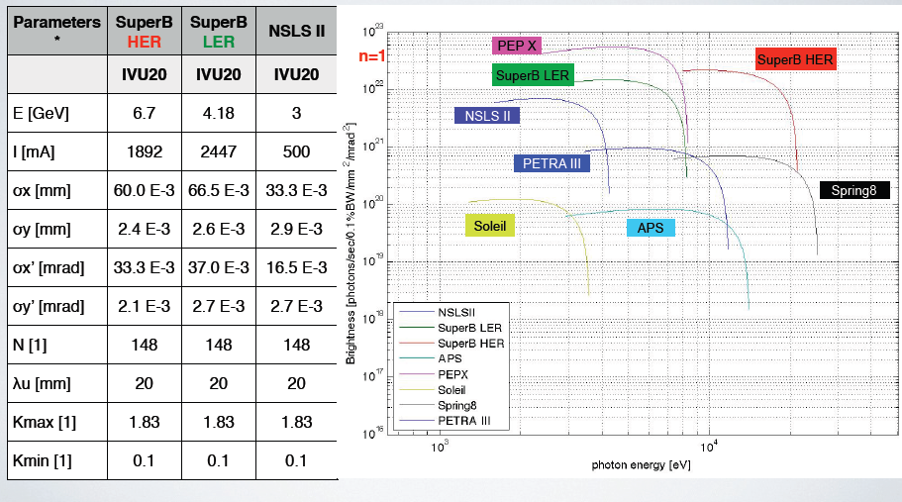
Synchrotron light options @ SuperB
Comparison of brightness and flux from undulators for different energies dedicated SL sources & SuperB HER and LER
Light properties from undulators better than most SL
Brightness from undulators
W. Wittmer

Slide 36
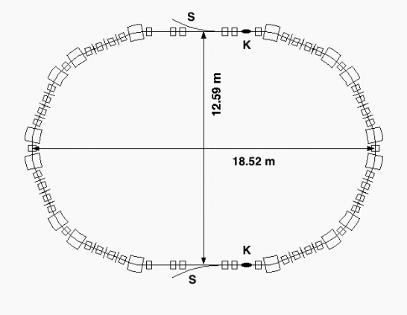
Injection System
Proposed scheme
positron linac
e+
1 GeV
CAPTURE
SECTION
PC
0.6 GeV
SHB
THERMIONIC
GUN
combiner
DC dipole
e+
e+
BUNCH
COMPRESSOR
5.7 GeV e+ 3.9 GeV e-
POL.
SLAC
GUN
Wien
filter
Mott
polarim
50 MeV
CAPTURE
SECTION
0.25 GeV
e-
SHB
Main Rings injection rate: 50 Hz
Damping Ring just for positrons
collimators
Parameter | Units | SLC
Electron charge per bunch | nC | 16
Bunches per pulse |  | 2
Pulse rep rate | Hz | 120
Cathode area | cm² | 3
Cathode bias | kV | -120
Bunch length | ns | 2
Gun to SHB1 drift | cm | 150
e_{n,rms,gun} (fm EGUN) | 10⁻⁶ m | 15
from A. Brachmann - SuperB Workshop
SLAC, October 2009
See Guiducci, Variola’s talks
this afternoon
Round beam
Emittance @ 4.16 GeV = 1.8 nm
Required bunch charge for e- ≈ 0.3 nC
… scrapers .. collimators needed
R. Boni, XiV SuperB meeting, Frascati 29-09-2010
Notes:
36

Slide 37
Layout, Site
The rings footprint is at the moment the same as the baseline (2 rings in same tunnel, about 1250 m long)
The insertion of synchrotron beamlines, with their impact on the layout and lattice is being studied
We are looking for a green field site in order to exploit at best the facility (SuperB and SL)
Several sites seems available, first pick at the moment is in Tor Vergata University campus and we are studying its compatibility with the requirements
International Site Committee met in April and visited tor Vergata
Preliminary ground measurements have been performed at Tor Vergata in mid-April. Vibration should not be a problem at LNF and Tor Vergata, even at rush hour
The layout will be optimized as soon as the site is chosen to further optimize the system performances
Site & vibrations parallel session Monday morning

Slide 38
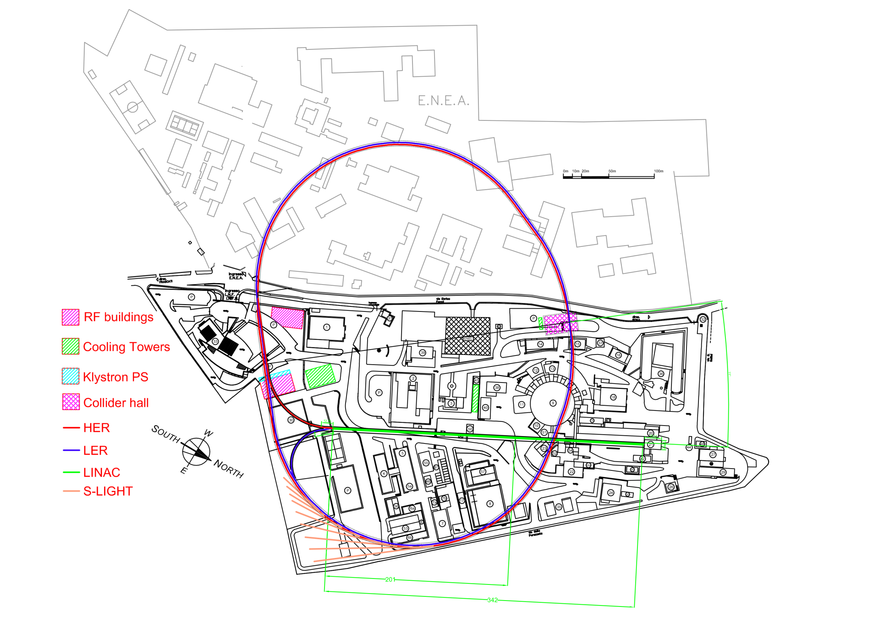
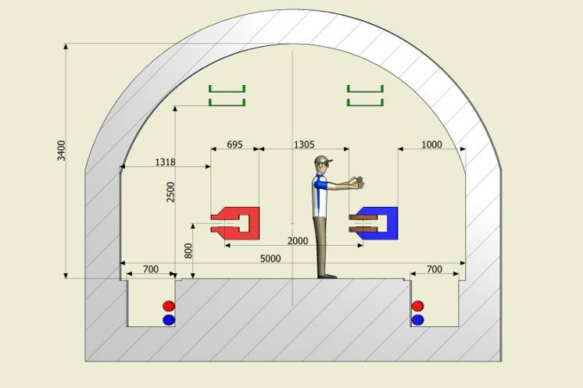
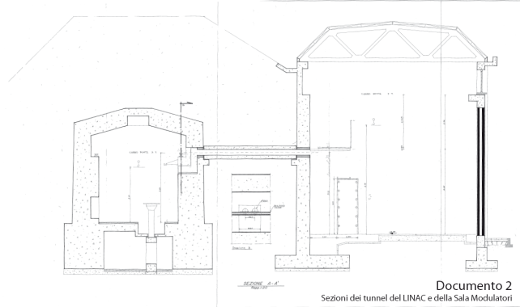
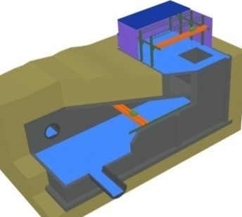
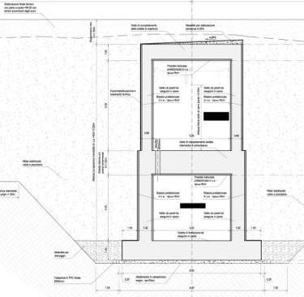
LNF site
Collider hall
Damping ring

Slide 39
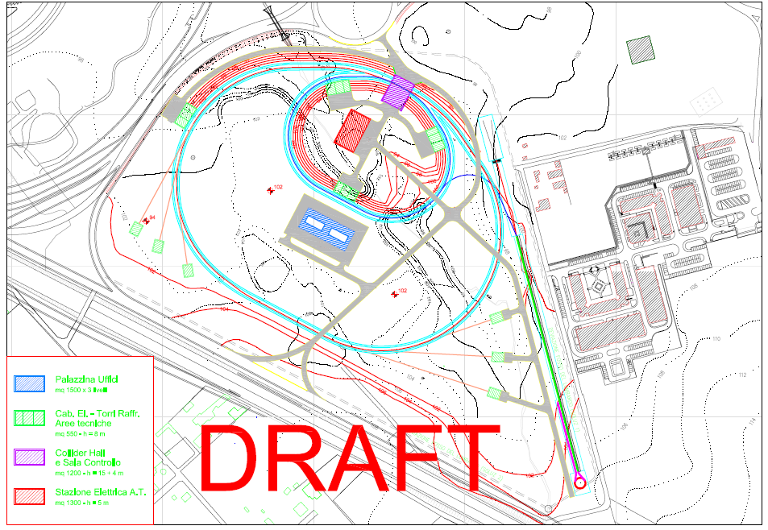
Possible layout @ Tor Vergata

Slide 40
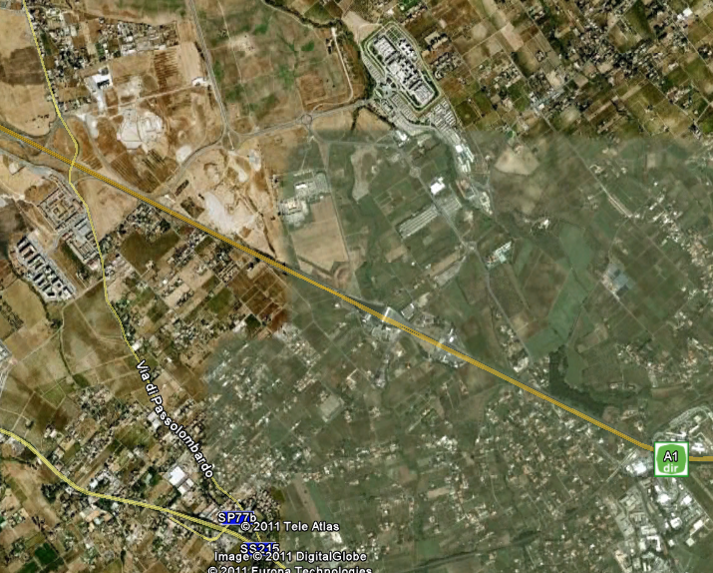
Tor Vergata University campus
Site under
study
About 4.5 Km
LNF

Slide 41
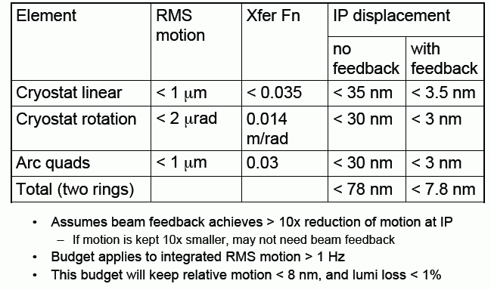
FF vibrations budget
K. Bertsche
An overall vibration control design is being developed for the FF magnets. The added measurements of the Frascati site are very encouraging and the fact that the beams tend to move together with QD0 motion has significantly loosened the tolerance requirements on cryostat motion

Slide 42
Vibrations summary
Must keep quad motion below 1 μm
  Cantilevered cryostat should be designed for low vibration
    Damp resonances and push > 10 Hz
    Support cryostat on both sides of detector door
Must keep cryostat rotation below 2 μrad
  Avoid building torques into magnet supports
Beam feedback should extend to > 100Hz, provide > 10x vibration reduction at LF
  But we may not even need beam feedback during quiet parts of day
Vibration should not be a problem for SuperB at LNF and Tor Vergata, even at rush hour

Slide 43
Synergies with state-of-the art international efforts
SuperB design has many characteristics in common with state-of-the-art colliders (LC, CLIC) and SL sources, to cite just a few:
  Alignment of magnets, and orbit and coupling correction with the precision needed to produce vertical emittances of just a few pico-meters on a routine basis
  Optimization of lattice design and tuning to ensure sufficient dynamic aperture for good injection efficiency (for both) and lifetime (particularly for SuperB LER), as well as control of emittances
  Feedbacks (IP and rings)
  Control of beam instabilities, including electron cloud, ion effects and CSR
  Reduction of magnet vibration to a minimum, to ensure beam orbit stability at the level of a few microns
All these issues are presently common active areas of research and development, → opportunity for a well-coordinated program of activities rather than independent R&D programs

Slide 44
Near term future (Strategic)
We need to form a solid groups of experts (Lattice, SL, magnets) homed at LNF
This will allow us to:
  finalize SuperB Accelerator design
  start the engineering design and construction

Slide 45
Near term future activities
(detailed list, to be continued…)
The IR layout (near IP) needs to have few adjustment since now we know the dimensions and constraints of QD0
Definition of diagnostics needed and start R&D on few items (ex. IP feedback, vibration sensors, emittance monitor….)
…

Slide 46
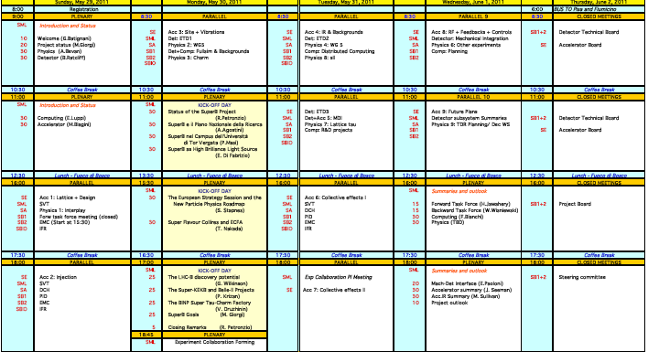
Agenda of the Accelerator Parallels
This afternoon:
  Lattice & Design
  Injection
  Discussion session
Monday morning:
  Site & Vibrations
Tuesday morning (with Detector):
  IR & Backgrounds
  MDI
Tuesday afternoon:
  Collective effects I & II
Wednesday morning:
  RF & Feedbacks & Controls
  Future plans

Slide 47
Accelerator Board issues for the next 6 months
  Assemble a design/construction Team
  Define the structure of the Accelerator Team and assign responsabilities
  Define the project management structure
  Determine how to hire people
  Determine how SLAC and US will contribute to the accelerator
  Determine what is needed for the TDR
  Determine what is needed for construction
  Determine what is needed for operations
  Integration of the SR facility into the design of the Accelerator and the Infrastructure

Slide 48
Conclusions
SuperB accelerator design is converging
Lattice and parameters optimization is continuing, for better performances and more flexibility → need to finalize soon !
R&D on IP quadrupole is proceeding fast
Synchrotron Light beamlines are being considered → possible new layout, with special IDs insertions
Work is in progress on more subtle beam dynamics issues (IBS, FII, CSR, e-cloud, beam-beam, feedbacks,…)
Components and lattice tolerances with corrections are being studied
We are strenghtening the collaboration with other Labs (SLAC, LAL, BINP, CERN, PSI, DIAMOND, IHEP, STFC, Cornell,…) to solve common issues. Need to enlarge it, with the contribution of all INFN structures (Labs and «sezioni»)
We need to define the Accelerator Structure asap !

