Slide 1
Preparation for the MAMI Beam test
Fahad A. ALHARTHI
Laboratoire de Physique des 2 Infinis Irène Joliot-Curie (IJCLab)
CNRS, Université Paris-Saclay
Many thanks to: I. Chaikovska, R. Chehab, V. Mytrochenko, S.Wallon

Slide 2
Content
Floor plan and beam structure at MAMI.
Measurement setup.
Measurement at position A and C.
Planning & Discussion.

Slide 3
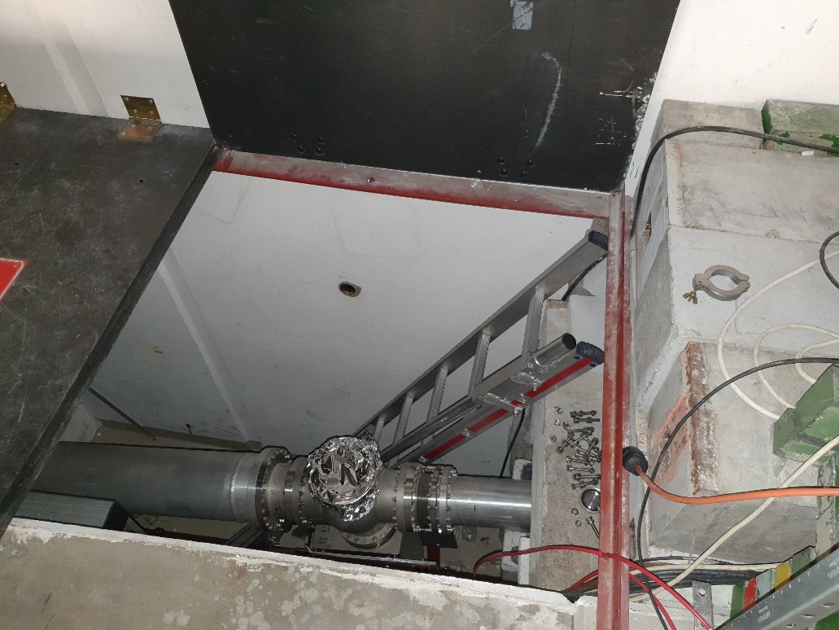
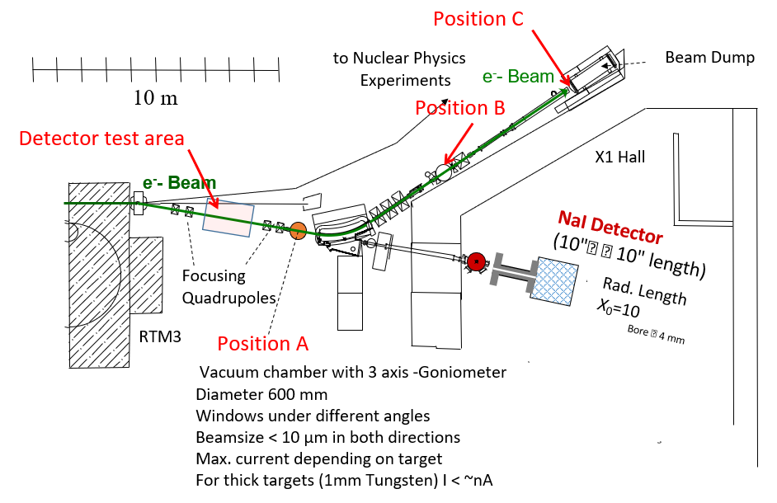
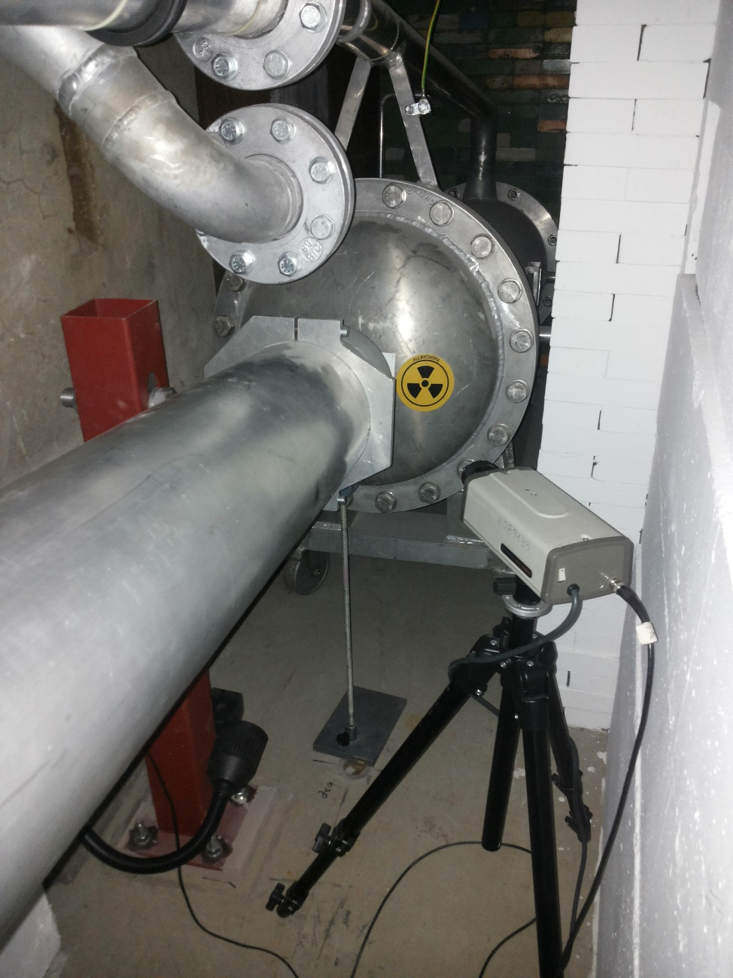
Floor plan at MAMI

Slide 4
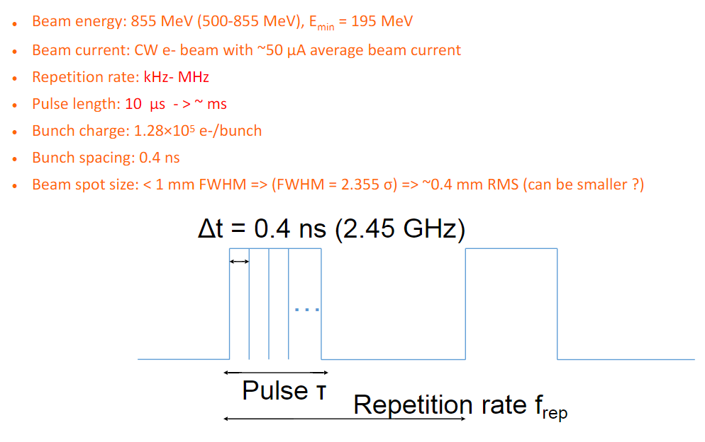
Beam Structure at MAMI

Slide 5
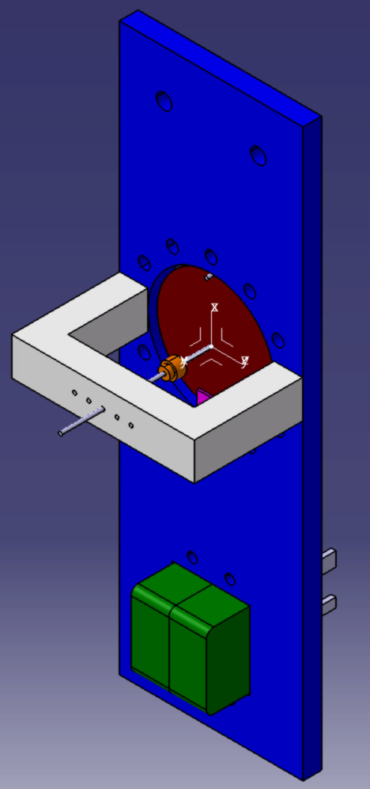
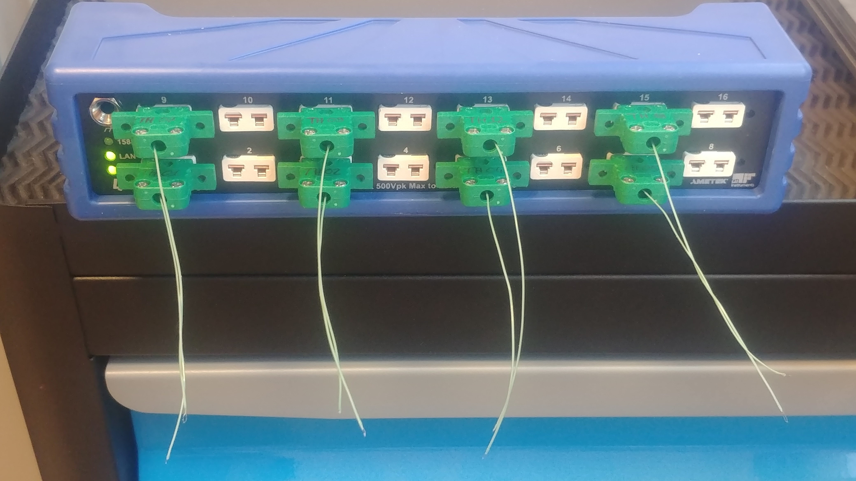
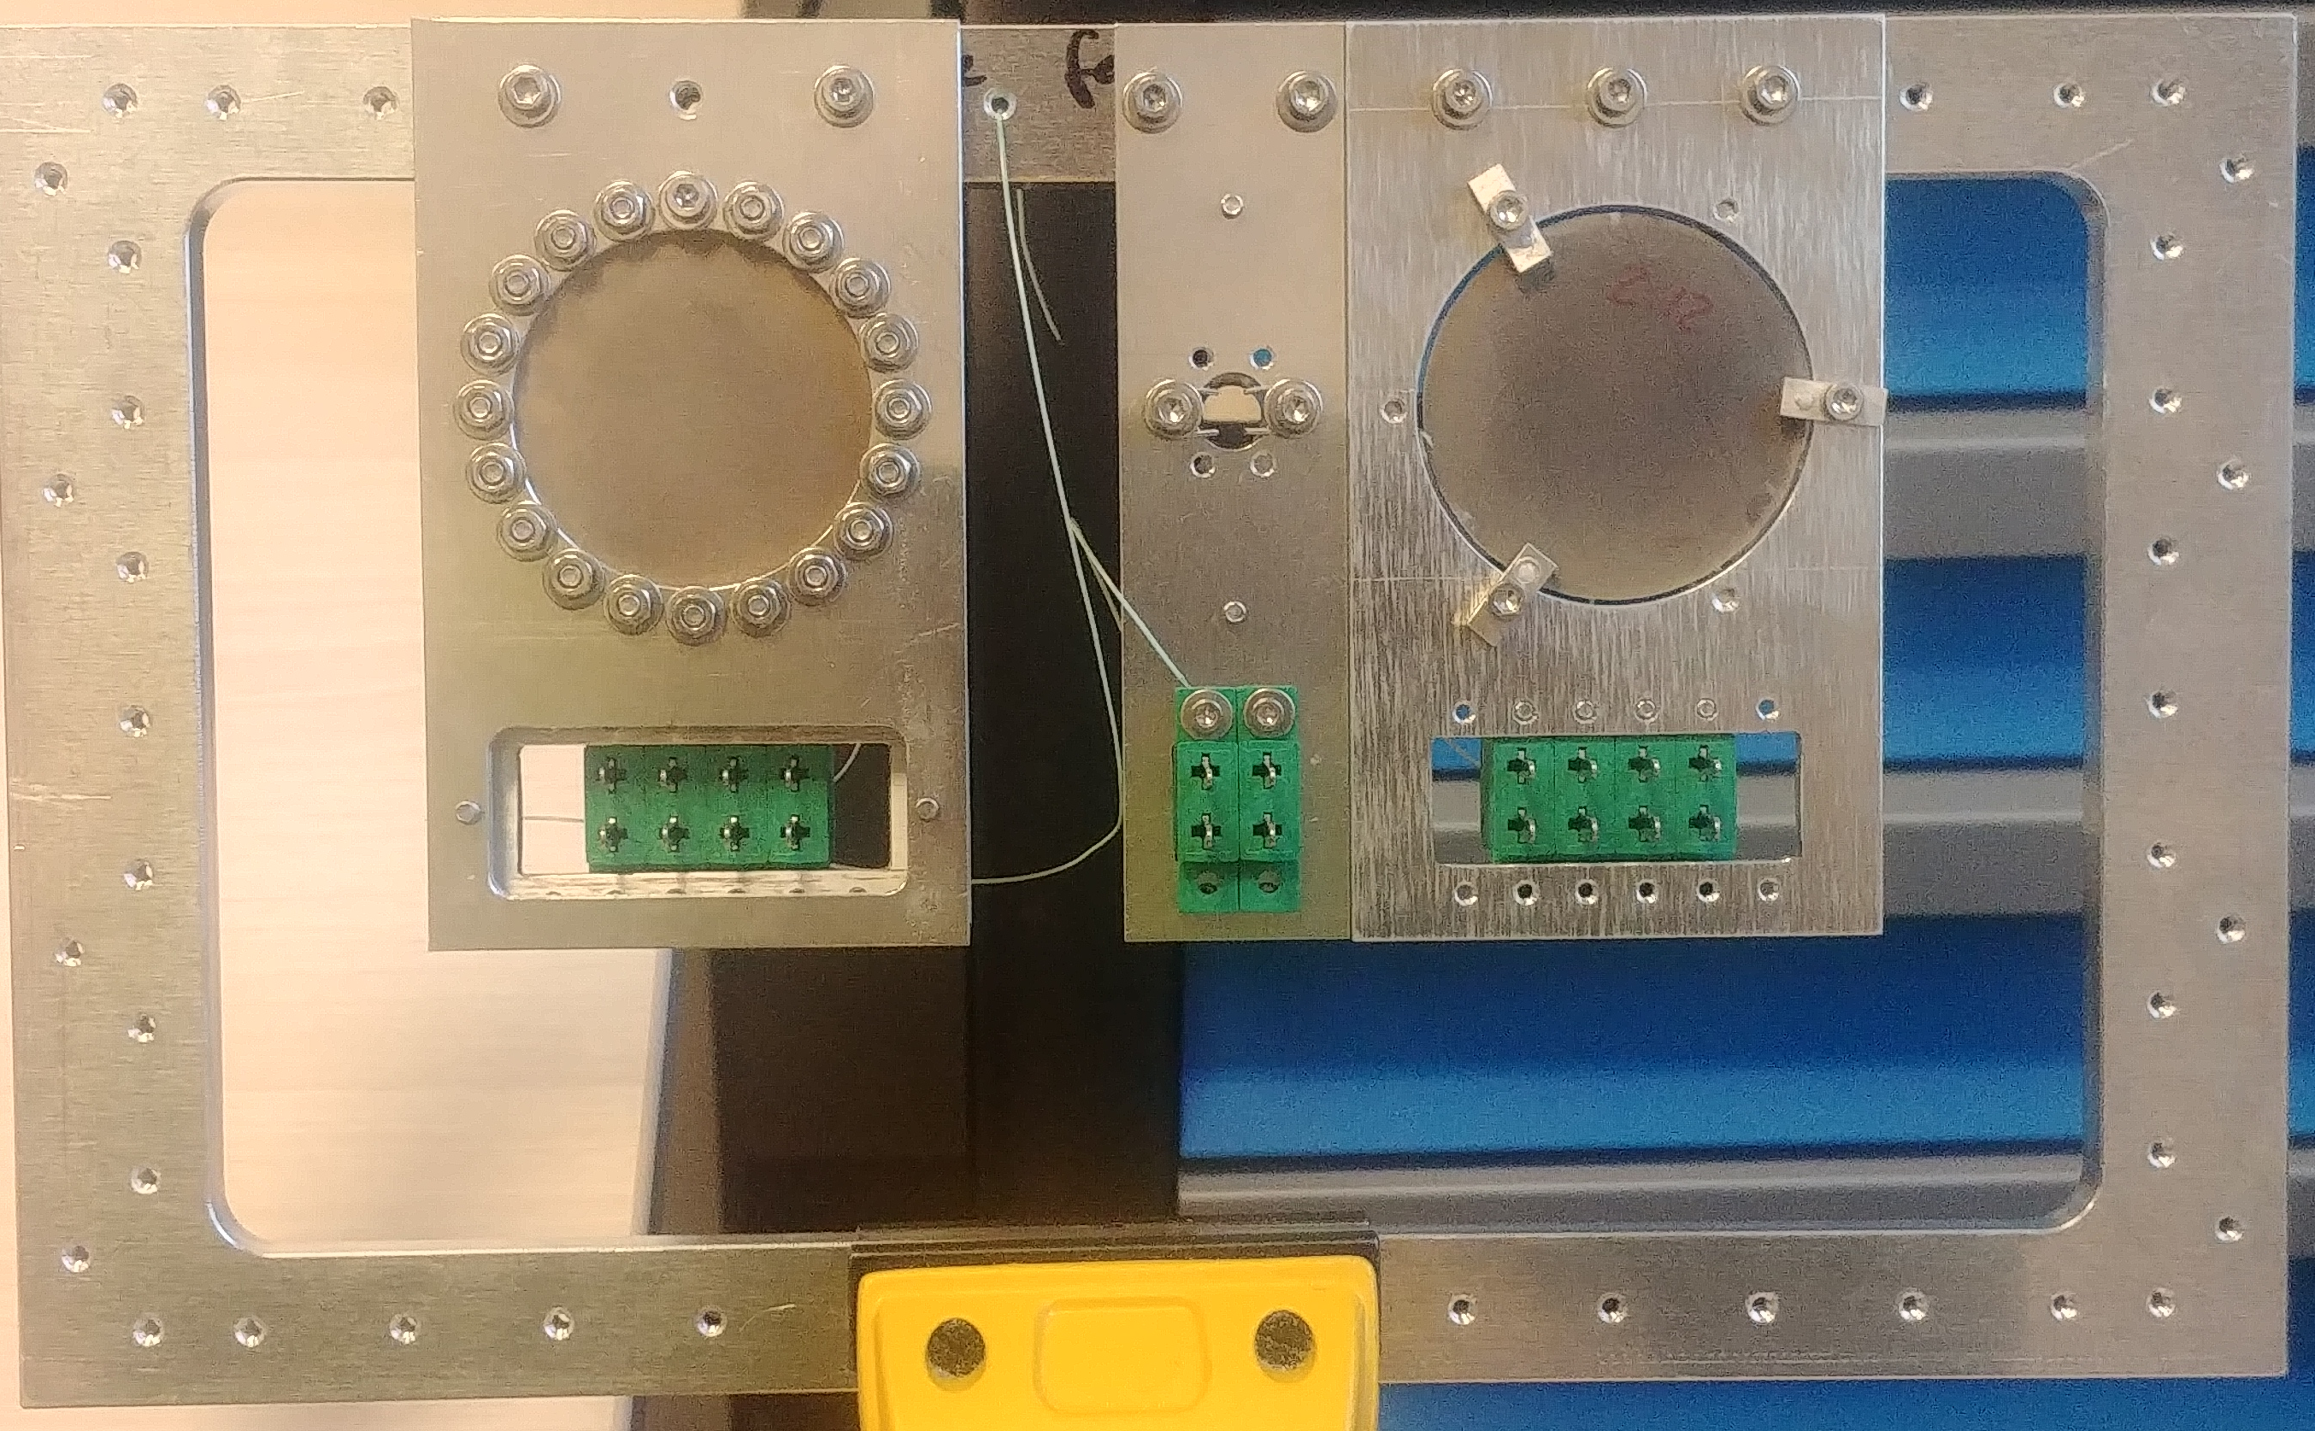
Measurement setup.
Plan : 30/01/2024 – 4/02/2024
Improved design of the target holder and the thermocouples attachment.
Data Acquisition system (DAQ)
Ametek VTI Instruments EX1401, 16 channels
New design of
Target holder
Amorphous holder => D 25mm
Crystal holder => D8mm
Amorphous
target
10 and 50 um thermocouples
Thermocouples
connectors
Work in progress to develop a system to acquire the data and have an intermediate summary of the results.
We can fit 10 holders in the frame.
2 rows 5 holder in each.
Same design of the Target frame as
the last campaign.

Slide 6
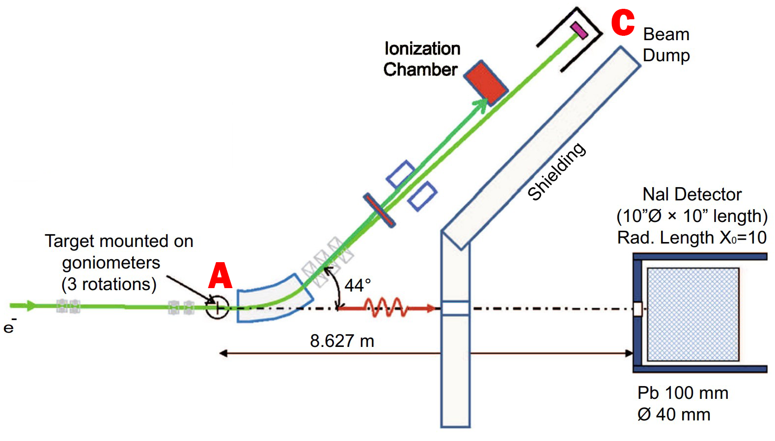
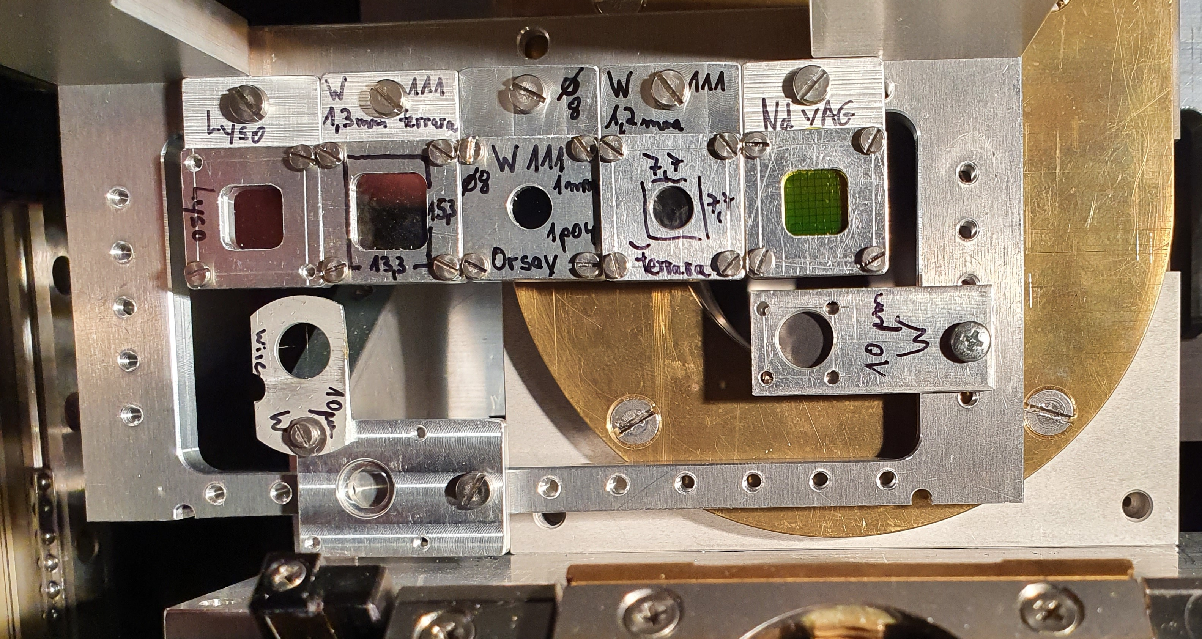
Measurement at position A.
Goal: measurements in different beam-to-lattice relative orientations, and the irradiation-induced heating and damage
Beam is highly focused
Beam current ~10nA.
Wire scanner to measure the beam size (h/v) ~ 50um
A goniometer is available to remotely control the crystalline sample position and orientation with high precision.
IJCLab crystal: 1.4mm thick and 8mm diameter.
Ferrara crystal: to be discussed.
Previous campaign 2021

Slide 7
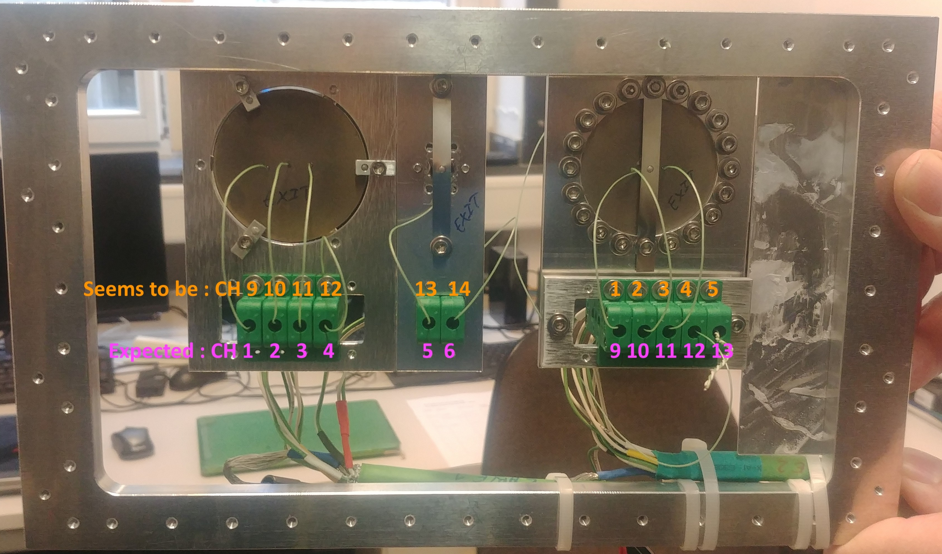
Measurement at position C.
Goal: measurements of the irradiation-induced heating and damage
Flexible beam current.
New design of the target holder.
Thermocouple is not welded to the target.
Concept of pseudo wire scanner to measure the beam size.
4 different materials [W, W-Re, Ta, Ta-W].
Also we are considering to irradiate a Granular target.
Geant4 simulation is ongoing.
IJCLab crystal: 1.4mm thick and 8mm diameter.
Ferrara crystal: to be discussed.
Previous campaign 2021

Slide 8
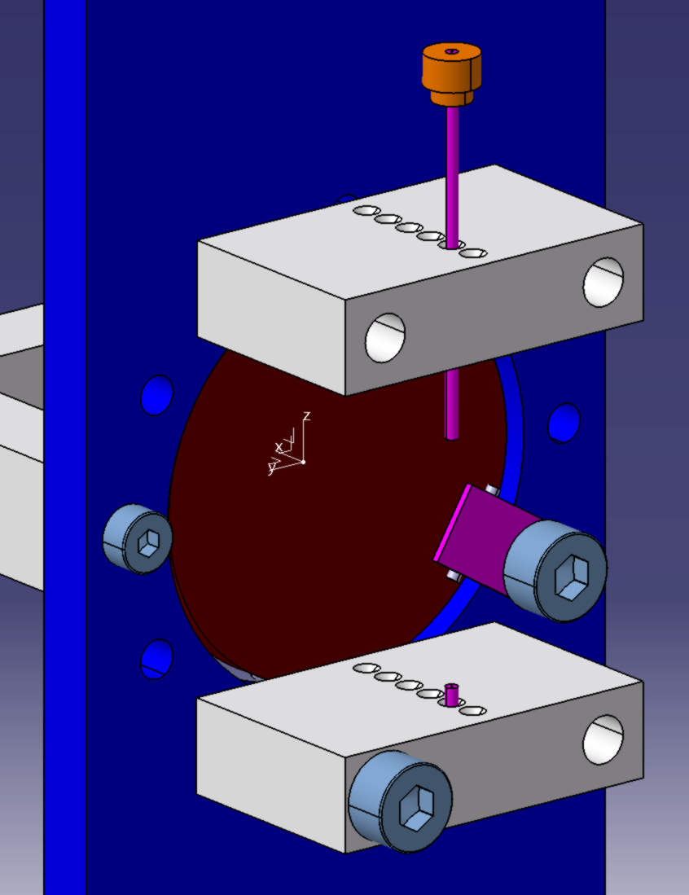
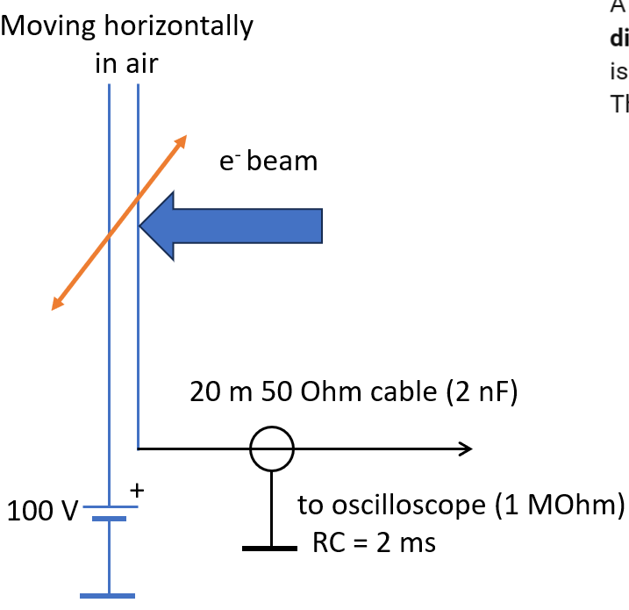
Pseudo wire scan
Goal: measurement of the beam size at position C.
Measure the beam size to estimate the achieved fluence during the test.
Wire scanner at the exit of the LUE-40 NSC KIPT (Kharkiv) electron linac
Wires

Slide 9
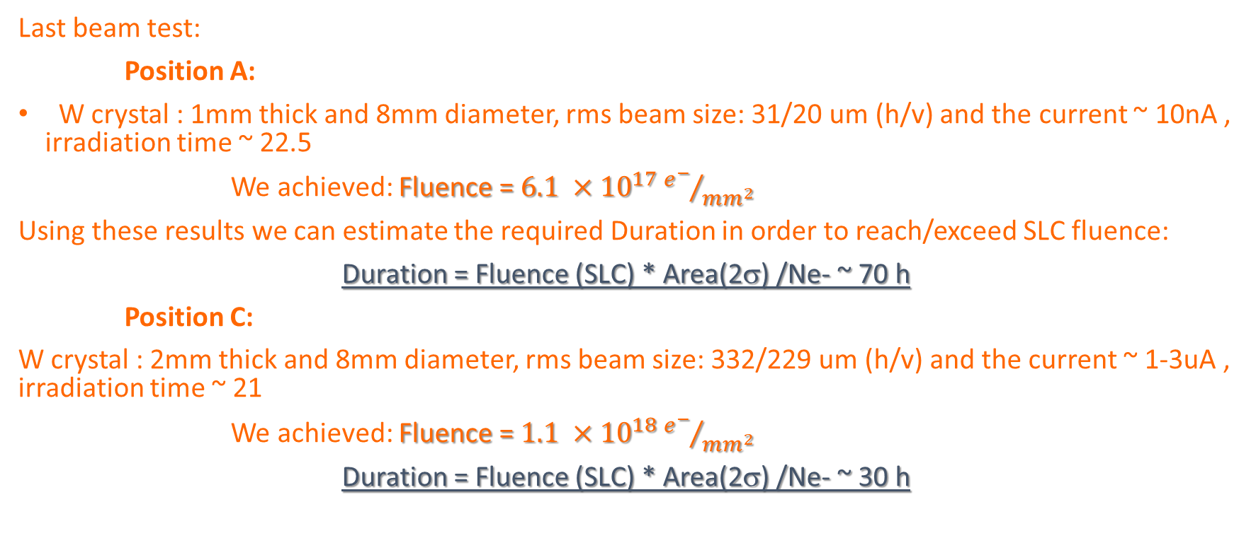
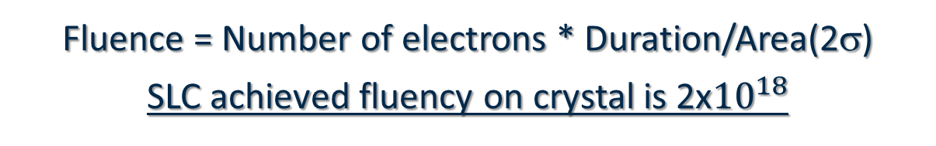
Fluence calculation for crystal
Fluence = Number of electrons * Duration/Area(2σ)
SLC achieved fluency on crystal is 2x${10}^{18}$
Last beam test:
Position A:
W crystal : 1mm thick and 8mm diameter, rms beam size: 31/20 um (h/v) and the current ~ 10nA , irradiation time ~ 22.5
We achieved: Fluence = $6.1 ×{10}^{17}{e^{−}}/{{mm}^{2}}$
Using these results we can estimate the required Duration in order to reach/exceed SLC fluence:
Duration = Fluence (SLC) * Area(2σ) /Ne- ~ 70 h
Position C:
W crystal : 2mm thick and 8mm diameter, rms beam size: 332/229 um (h/v) and the current ~ 1-3uA , irradiation time ~ 21
We achieved: Fluence = $1.1 ×{10}^{18}{e^{−}}/{{mm}^{2}}$
Duration = Fluence (SLC) * Area(2σ) /Ne- ~ 30 h

Slide 10
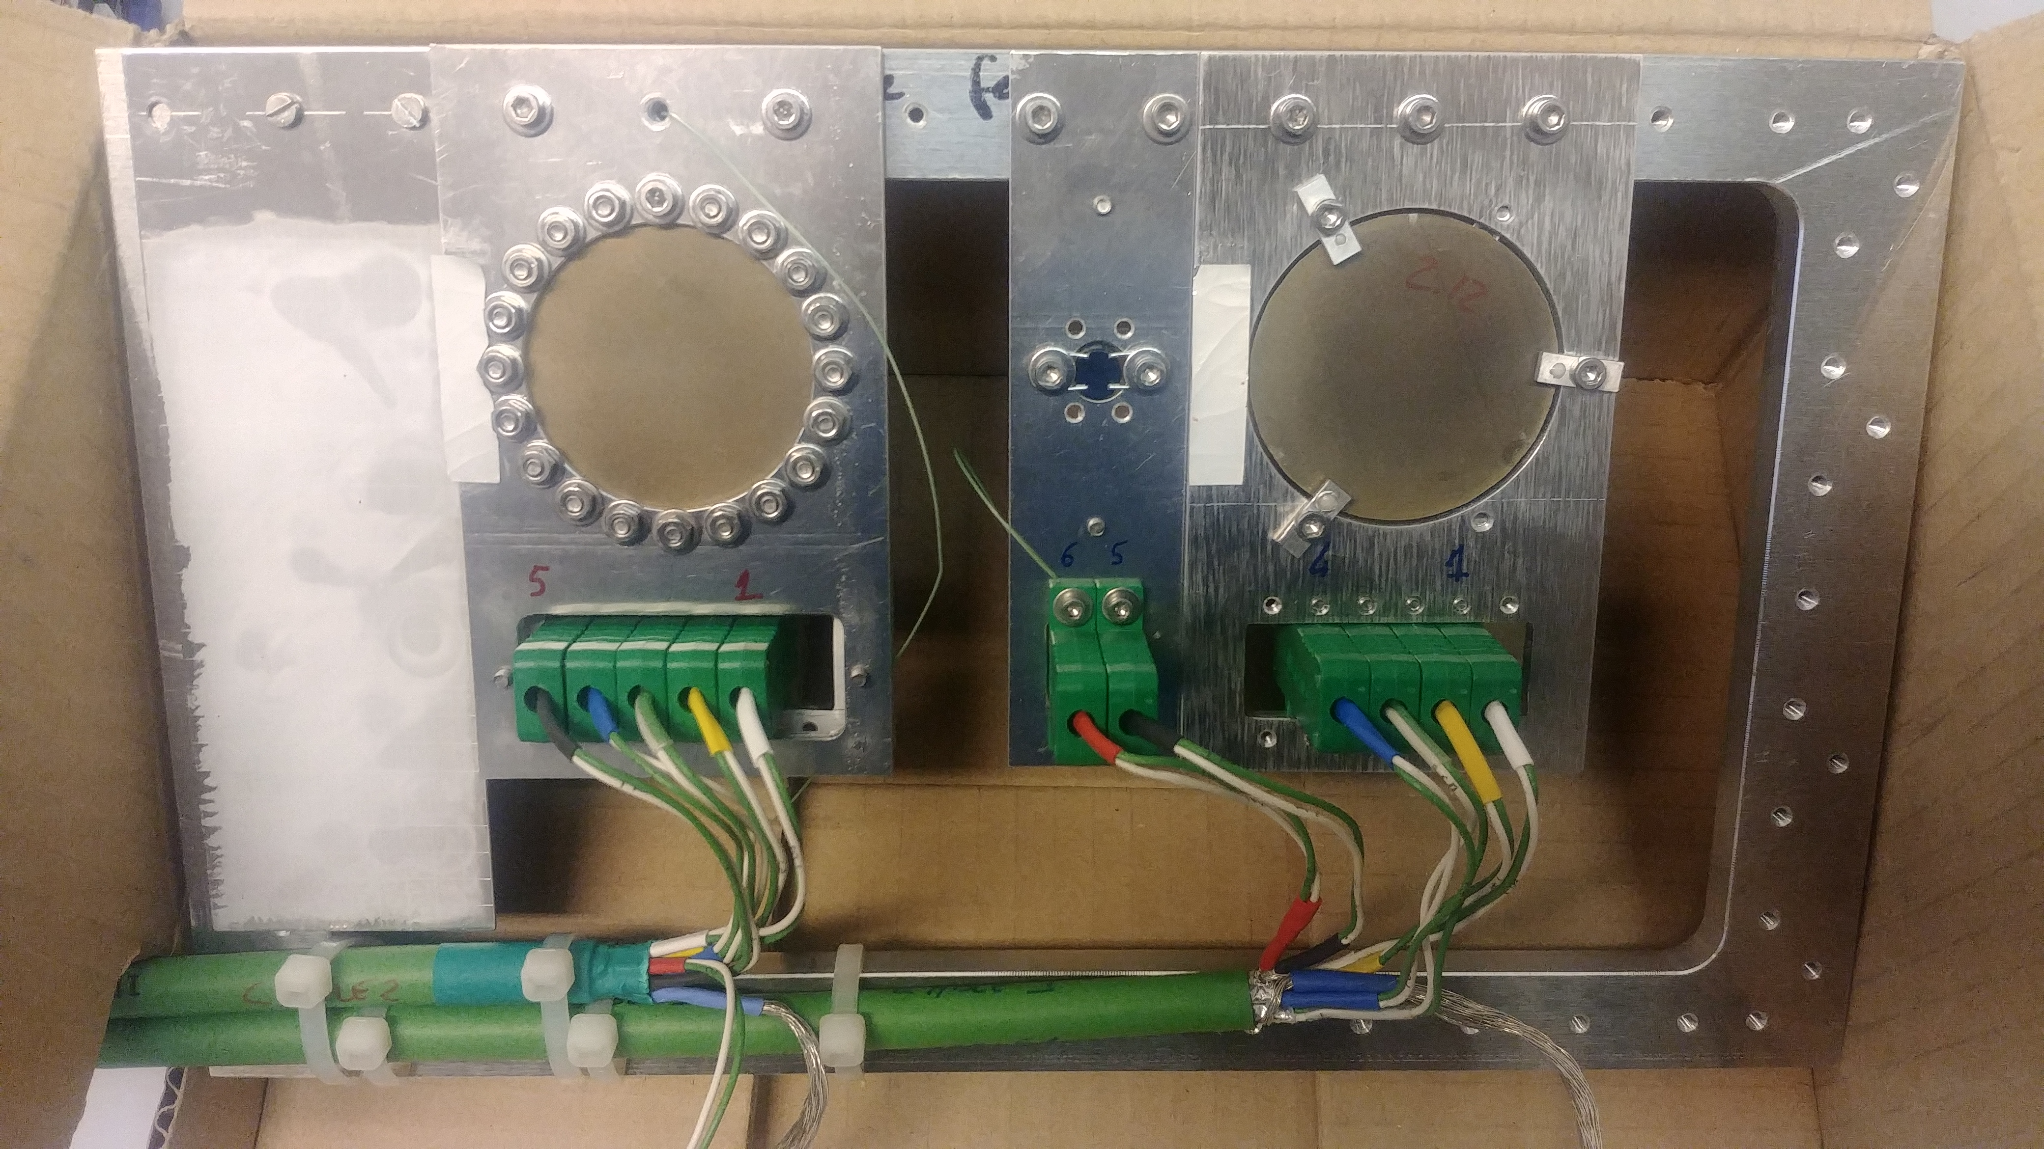
Holder and cables
With the new design of the target holder we can fit 9 amorphous targets and 1 pseudo wire scan in arranged in two rows.
1 for the granular target
DAQ with 16 channel.
Cables : we have 1 ready at MAMI, 1 at MAMI (connecters need to be re-screwed), 1 need to be manufactured, each cable with 6 pairs.
Pseudo wire
Granular
IJCLab
W crystal
Cable with 6 pairs 1 pair for each channel

Slide 11
Planning
We have 5 days (120 h) starting from: 30/01(Tuesday) – 04/02 (Sunday)
Installation and checks ~ 20 h
If we irradiate two crystals at position C that means ~ 60 h.
Remining time ~ 40 h for irradiating the amorphous targets
Either we irradiate one amorphous for as long as possible or two amorphous ?
2 Options : reach FCC limit , or irradiates as long as we can during the available time.

Slide 12
Discussion
Crystals and participant from Ferrara.
Analysis after the irradiation test.
Short description of the experiments and what should be measured.
What equipment is needed. (moving tables, goniometers, detectors, etc.)?
Maximum beam current and beam spot size at positions A, C?
Time structure of the beam and how long should be measured especially at high current?
Which targets will be used (thickness, material)?
What should happen with the targets after the experiment?
Do you have a handling permit if the targets are radioactive?
Which persons will take part in the experiment?

Slide 13
Thank you

Slide 14
Backup

Slide 15
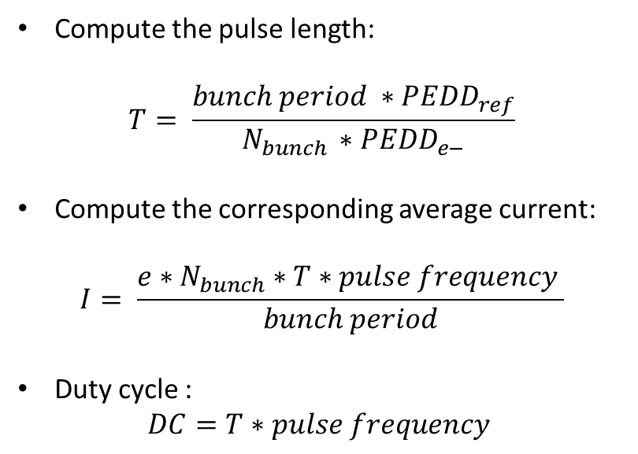
Beam Structure at MAMI
Extract PEDD/e- from geant4 simulation.
The reference PEDD ~ 7.7 J/g
Pulse frequency = 200 Hz
Compute the pulse length:
$$T= \frac{bunch period ∗{PEDD}_{ref}}{N_{bunch }∗{PEDD}_{e−}}$$
Compute the corresponding average current:
$$I= \frac{e∗N_{bunch}∗T∗pulse frequency }{bunch period}$$
Duty cycle :
$$DC=T∗pulse frequency$$

Slide 16
Geant4 Simulations
Goal: Initial estimation of the required pulse duration and the average current to reach the reference PEDD.
Several scans are performed:
  Target material: [W, W-Re, Ta, Ta-W]
  Target thickness: [1 : 0.5 : 4]* mm
  Beam sizes: [0.1 : 0.1: 0.5]* mm (RMS)
Results:
  All the materials are exhibiting a similar behavior in terms of the energy deposition.
  Required pulse duration: 0.14ms – 0.32ms
  More studies are ongoing to estimate the surface temperature.

Slide 17
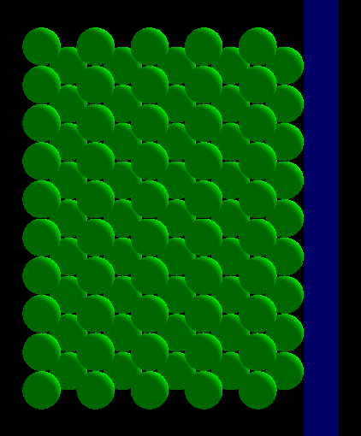
Granular Target
Staggered stack of Tungsten spheres with 2.2mm diameter.
Geant4 simulation is in progress to estimate the deposited energy in each sphere.
Spheres are arranged in layers (even, odd …)
y
z

