Slide 1
GIOTTO and recent results
M. Rossetti Conti & A. Bacci from Milano BD group
Ferrara October 2023

Slide 2
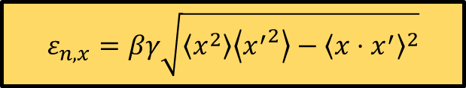
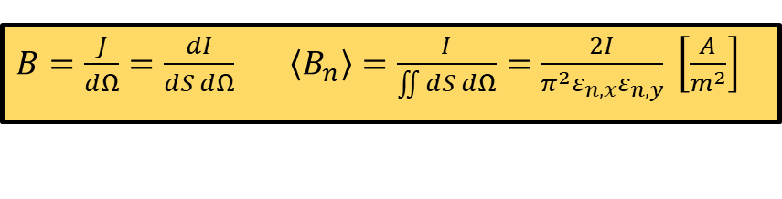
High brightness beams (SPARC legacy)
Current density X unit solid angle
It is really a main request for many scientific activities:
Free Electron Laser (FEL), it is a switch to tour-on the LASER emission. (non-linear collective effect)
Inverse Compton Scattering ICS to minimize the hour-glass effect VS the spot size (Flux ∝ 1/σ²)
Injection in plasma waves accelerators or dielectric acc.
Chromatic length in bunches plasma accelerated
Chromatic length in proton beam from TNSA (Target-Normal-Sheath-Acceleration)
$B=\frac{J}{dΩ}=\frac{dI}{dS dΩ}$ $\left\langle B_{n}\right\rangle =\frac{I}{\iint{dS dΩ}}=\frac{2I}{π^{2}ε_{n,x}ε_{n,y}} \left[\frac{A}{m^{2}}\right]$
$$ε_{n,x}=βγ\sqrt{\left\langle x^{2}\right\rangle \left\langle {x^{′}}^{2}\right\rangle −{\left\langle x⋅x^{′}\right\rangle }^{2}}$$
Martin Reiser – Theory and Design of Charged Particle Beams
Notes:
Some hints of our main BD expertise

Slide 3
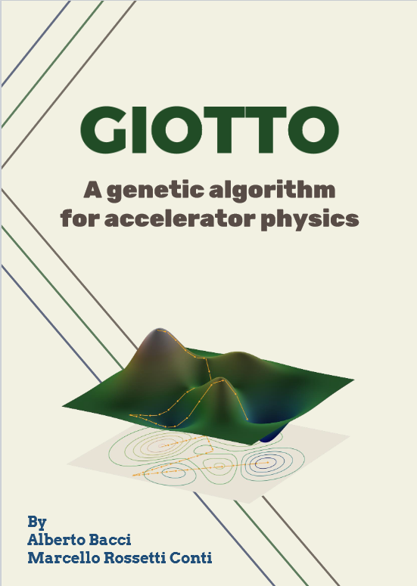
Optimization using GIOTTO

Slide 4
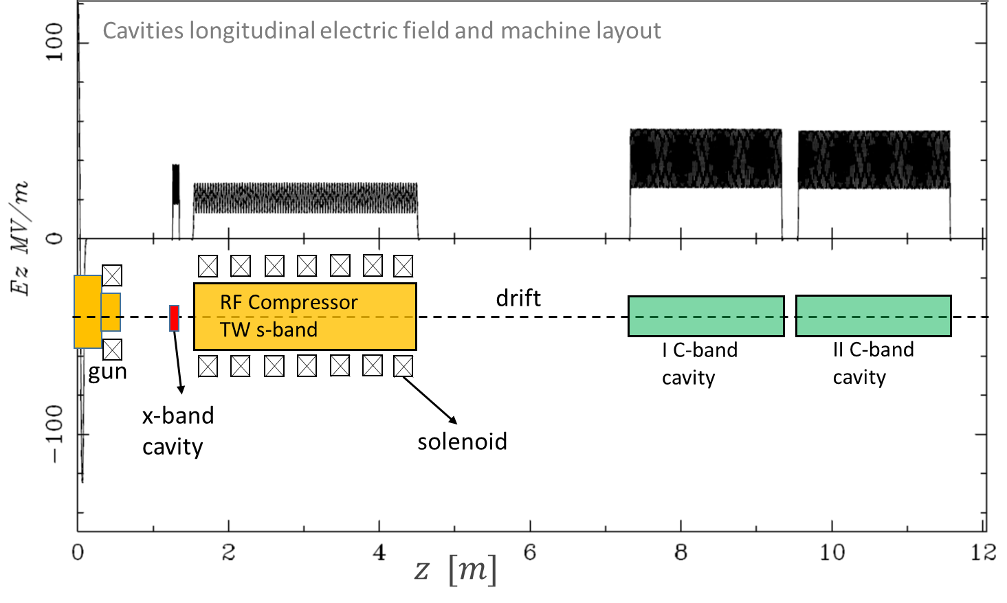
2A - non-linear correlation in BD
Laminar Bunching
Invited oral @
LINAC2018
TU1P01
40 MeV/m
X-band →
symmetric space-charge distribution
In the drift →
a laminar compression controlled by space charge
in-scale sketch

Slide 5
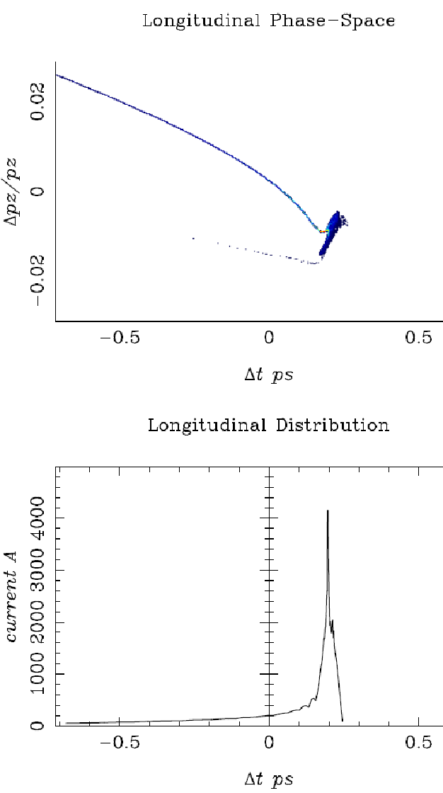
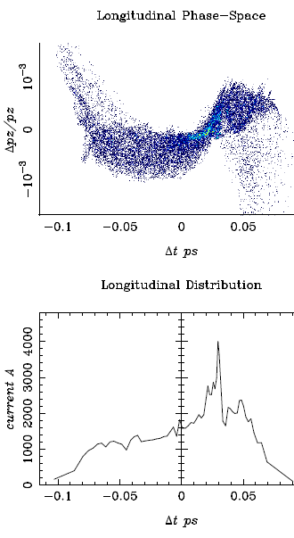


2B - non-linear correlation in BD
A strong simplification of the longitudinal phase space modification
Velocity Bunching
Laminar Bunching
Classic methods
chirping
Max.
compression
$$γ$$
Dispersive path
Vel. Bunching
Ballistic Bunc.
$$z$$
Laminar Bunching,
Space charge
trasformation
Notes:
emittanze molto buone

Slide 6
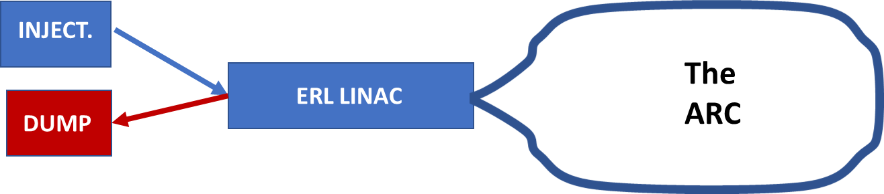
3 – Machine with complex BD
2019 MariX project ~ 1 G€
SC LINAC 1.3 GHz Tesla-like
Two-Pass Two-Way acc. (TPTW)
Bubble arc compressor
A. Bacci, et al., PRAB 22, 111304 (2019)
2022 ERL BriXSinO ~ 10 M€
Test Facility for:
TPTW acc.
Low Energy Arc Compression
ERL TPTW high flux ICS & THz FEL
~30 m

Slide 7
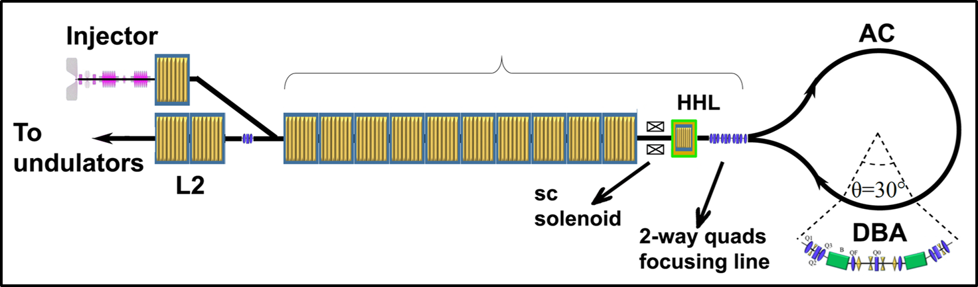
3 – MariX 1 MHz rep. rate FEL
Arc compressor → compression factor of ~ 100 on the current peak
130 m
Two-pass 2-way region
40 m

Slide 8
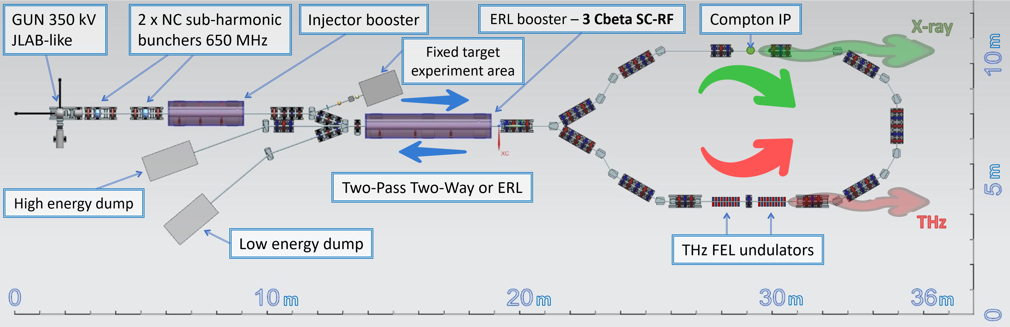
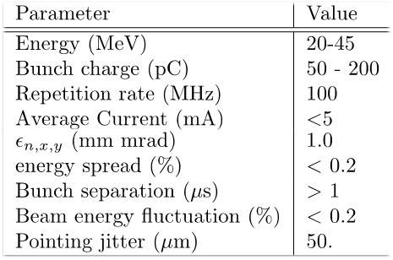
3 – BriXSinO
Brilliant source of X-rays based on Sustainable and innOvative accelerators
1.3 GHz
1.3 GHz
1.3 GHz
The ERL Low Energy High Peak Brightness injector
Maximum Energies
TPTW acceleration up to 80 MeV
ERL WP up to 45 MeV

Slide 9
FCC-ee Positron capture optimization
using GIOTTO

Slide 10


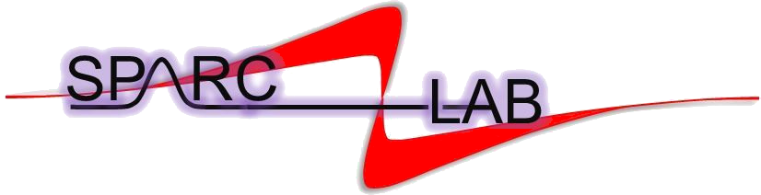


AI optimizer
10
Genetic Interface for OpTimizing Tracking with Optics
Genetic Interface for OpTimizing Tracking with Optics
One of first AI codes for beam line design & optimization.
Solves complex multi-objective problems (correlated parameters, space-charge like) & statistical analysis (machine jitters studies).
Drives the beam dynamics PIC code ASTRA. Natively compatible with NameList std.
V. 13.0 for Linux & Windows, parallelized with MPI.
Successfully used in important projects, as:
Recently, a possibility of choosing the particular population selection (window) withing the bunch distribution has been implemented to run the optimization in a more efficient way. Useful for the positron injector.
Notes:
The acronym stays for Genetic Interface for OpTimizing Tracking with Optics
GIOTTO is an AI optimizer based on a Genetic Algorithm developed in Milano by me and Alberto Bacci
Giotto drives ASTRA and potentially other simulators and postprocessors.
We applied it on a variety of BD problems from plasma driven Free Electron Lasers Capture and Matching lines to Energy Recovery Linacs low energy injection design

Slide 11
Optimization process
11
AMD
DC solenoid
Target
e⁺
e⁻
L-band TW (60 cells)
L-band TW (60 cells)
z [m]
0.
9
Genetic knobs: Variation range:
AMD: Length 2-6 cm
AMD: peak field 5-18 T
AMD low field (DC solenoid) 0.3 - 1.2 T
Cavity 1: inj. phase ± 180°
Cavity 2: inj. phase ± 180°
Cavity 1: acc. gradient (peak) ± 20-40 MV/m
Cavity 2: acc. gradient (peak) ± 20-40 MV/m
Evolutionary objectives in 1st bucket:
Maximize Yield
Contain ε_{n,x}
Contain σ_{x}
Contain σ_{z}
Contain σ_{E}
Keep E ↑
Wide range search:
Refinment:
Macroparticles: 5 k
Macroparticles: 136 k
Notes:
Aggiungere un commento sul numero di macroparticelle usate per il fast scanning e la simulazione più accurata
The acronym stays for Genetic Interface for OpTimizing Tracking with Optics
GIOTTO is an AI optimizer based on a Genetic Algorithm developed in Milano by me and Alberto Bacci
Giotto drives ASTRA and potentially other simulators and postprocessors.
We applied it on a variety of BD problems from plasma driven Free Electron Lasers Capture and Matching lines to Energy Recovery Linacs low energy injection design

Slide 12
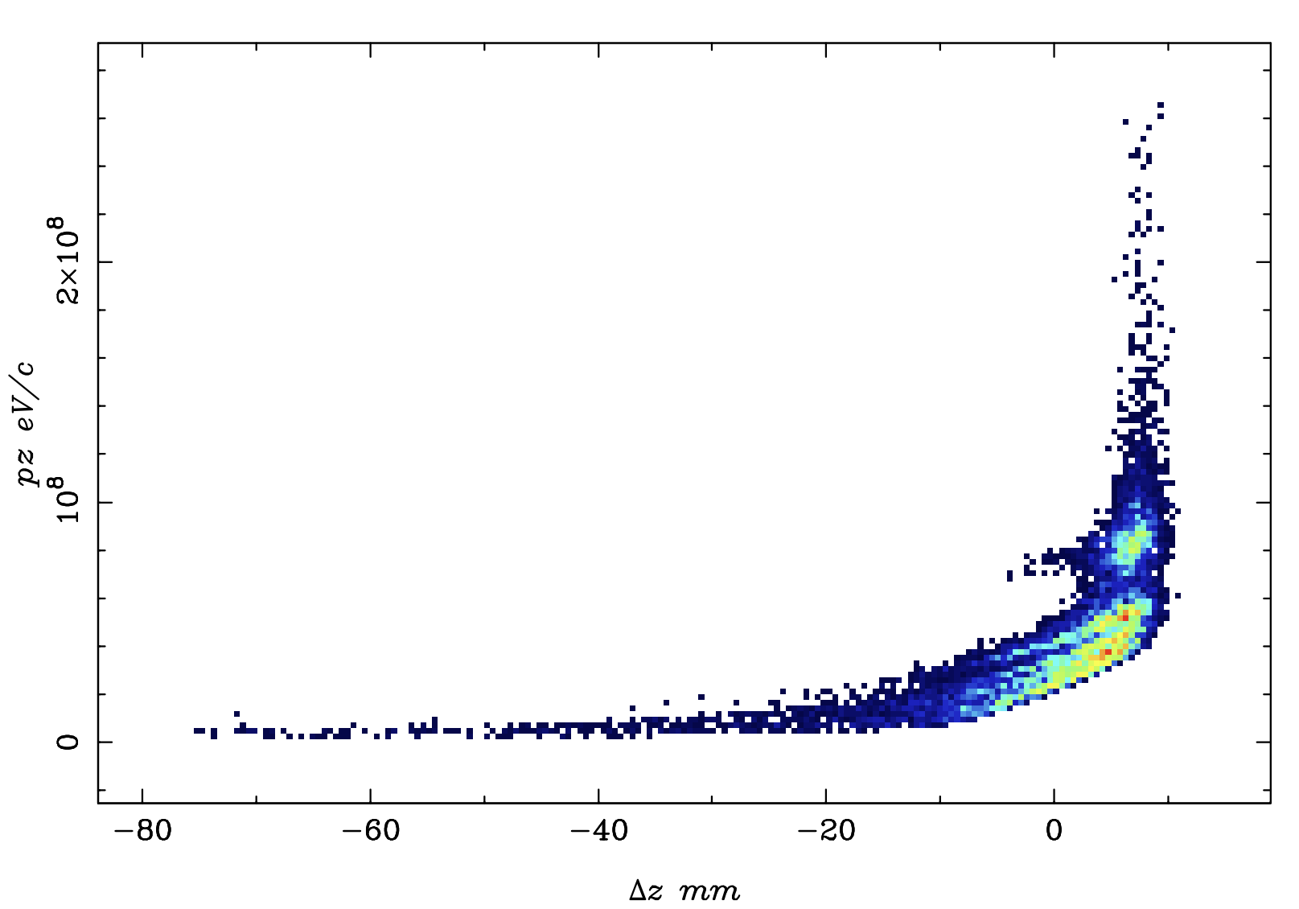
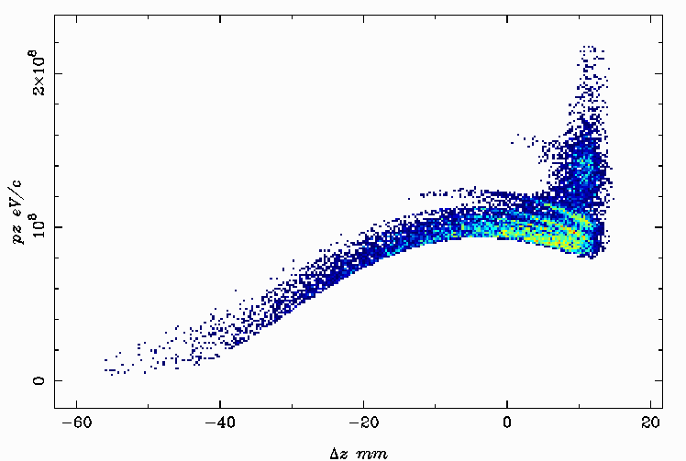
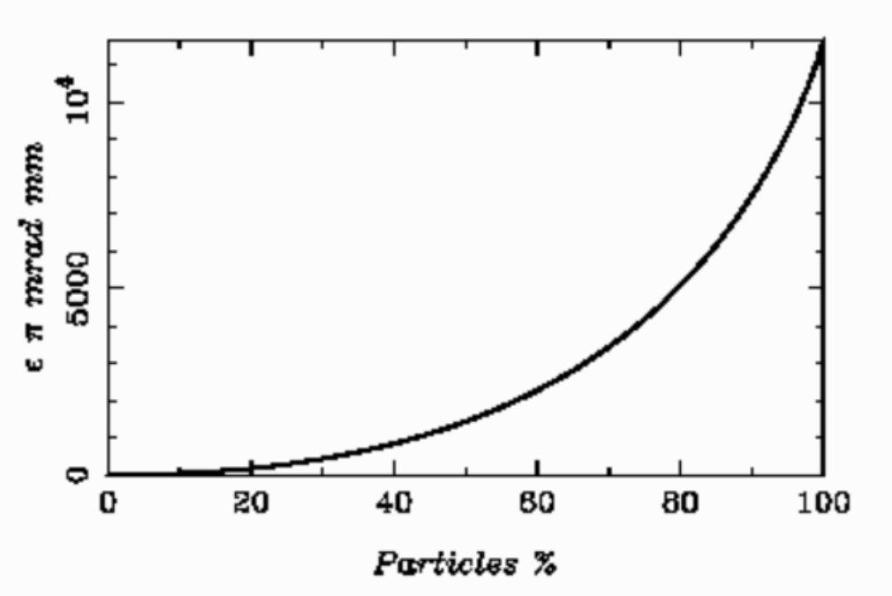
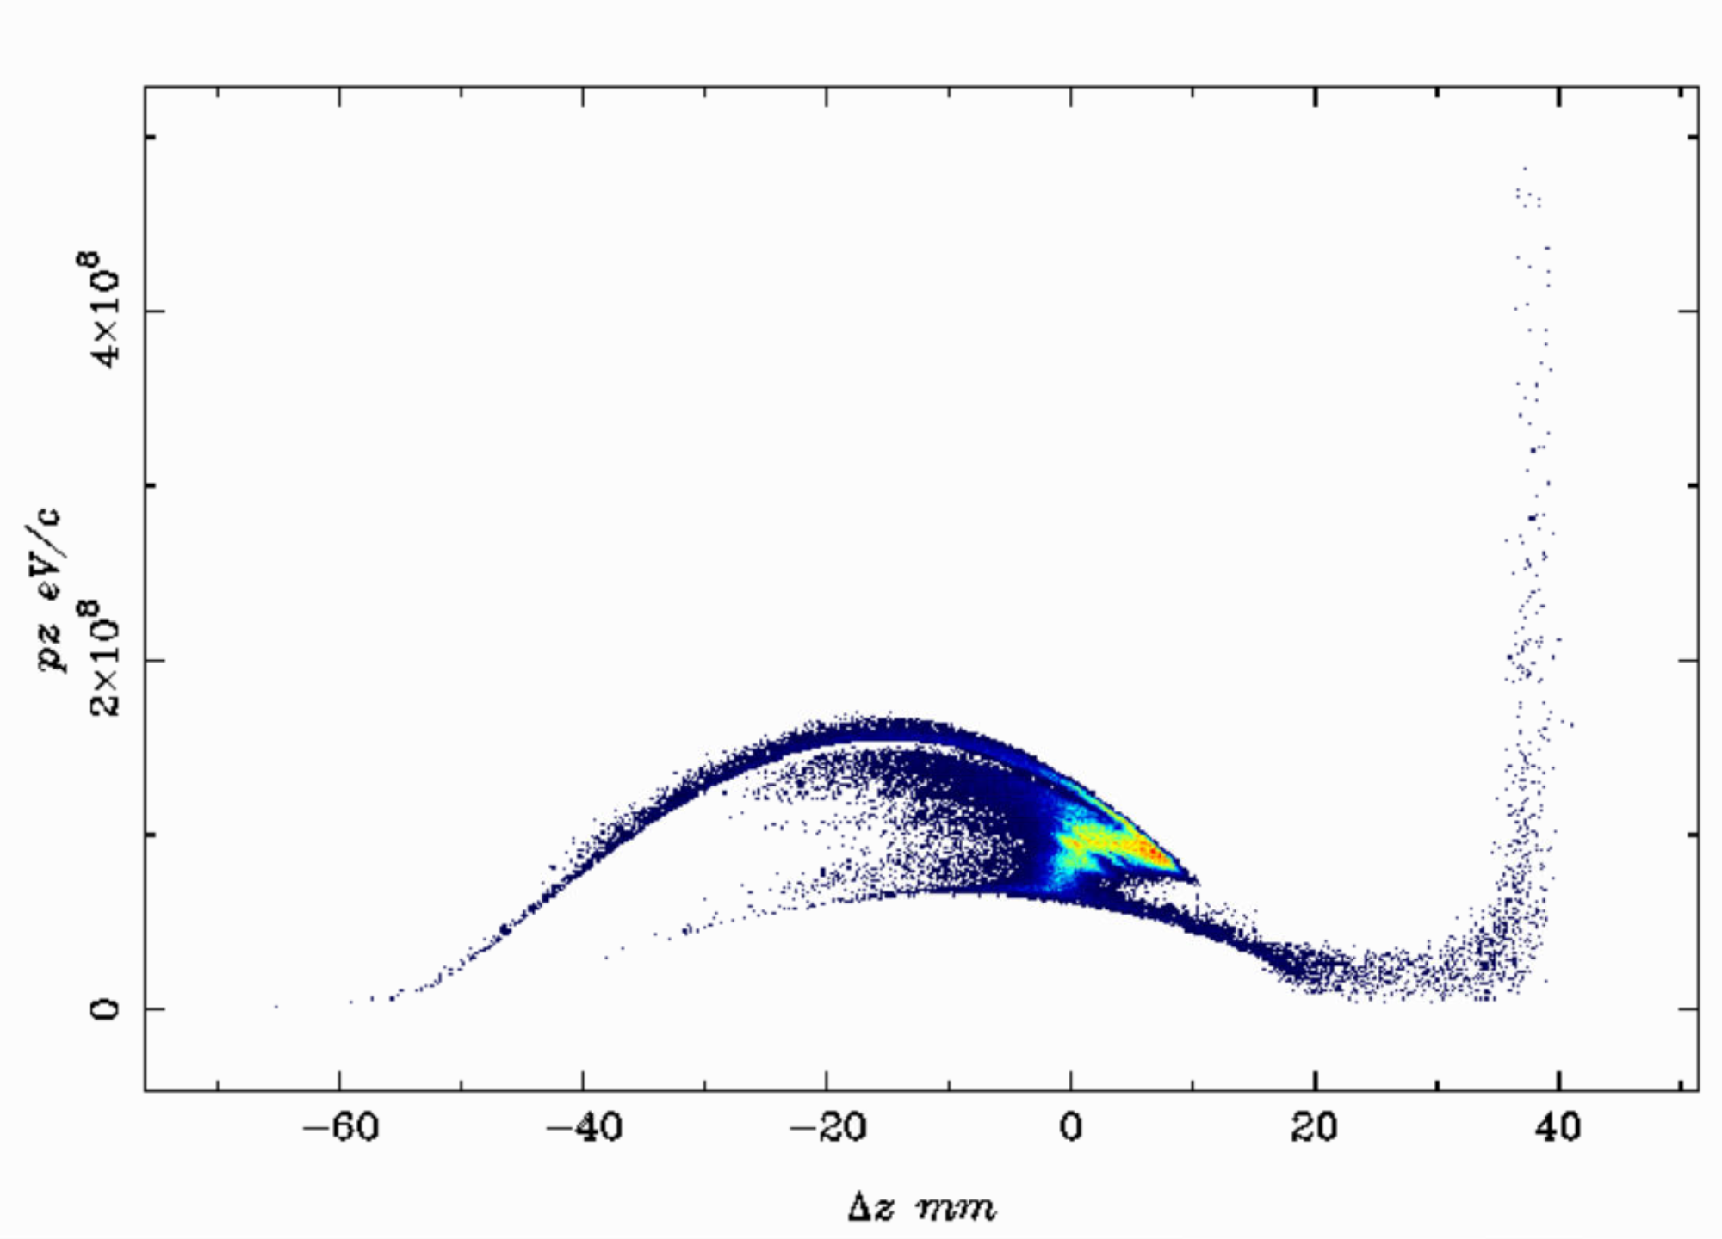
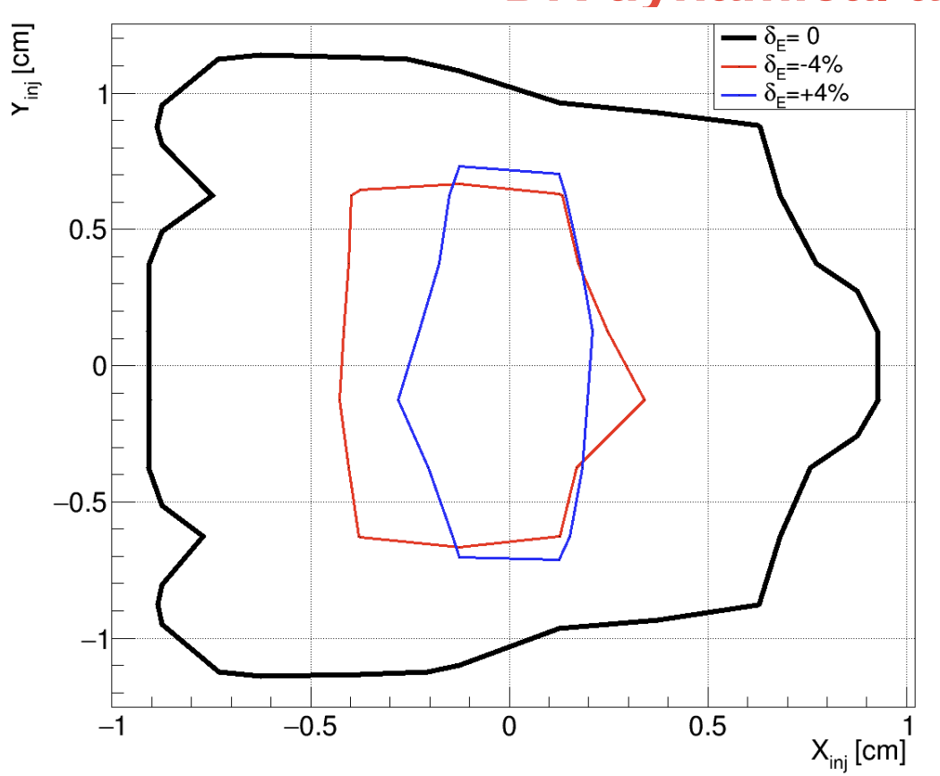
Starting Point
GIOTTO First Optimized Point
@ FCC-ee: application in e⁺ capture line
presented by M. Rossetti Conti in Lyone FCC-workshop 21-nov-22
40.7% of extracted e⁺ in 1st RF bucket
E = 45 MeV (64% ΔE/E)
59.4% of extracted e⁺ in 1st RF bucket
E = 100 MeV (24% ΔE/E)
Core transverse emittance
Last activities under development
Last Optimized Point
Coding of GIOTTO, NEW FITNESS FUNCTION based on Damping ring dynamical aperture
68.0% of extracted e⁺ in 1st RF bucket
E = 97.53 MeV
ΔE = 51.8 MeV (53% ΔE/E)
ε_{n,x} = 11.57 10³ mm-mrad
σ_{x} = 8.64 mm
σ_{z} = 8.34 mm
Courtesy of A. De Santis
Macroparticles: 136 k

Slide 13
Thanks for the attention

Slide 15
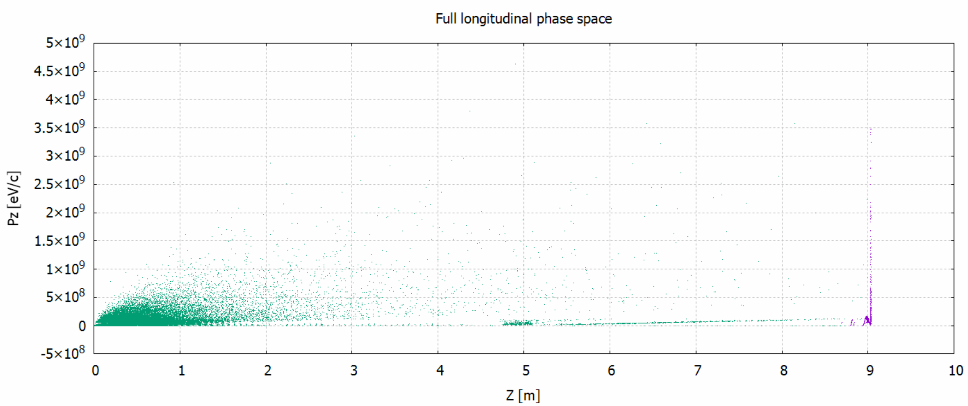
Window optimization
15
GIOTTO now optimizes particle distribution subsets within specific windows, now enhancing first bucket optimization (z-cut).
It could optimize potentially in-acceptance window particles.
Macroparticles: 136 k

Slide 16
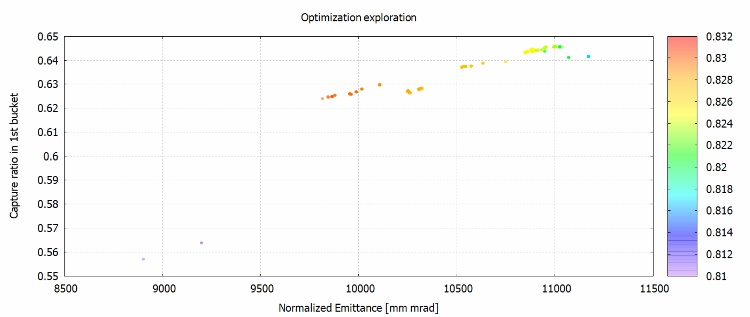
Particles vs emittance
16
The fitness function defines the tradeoff between emittance in the first bucket and the capture ratio.
>18 T
~18 T
~15 T
Macroparticles: 5 k

Slide 17
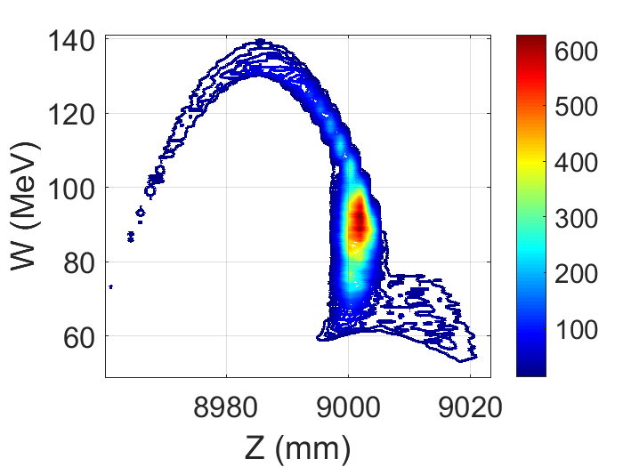
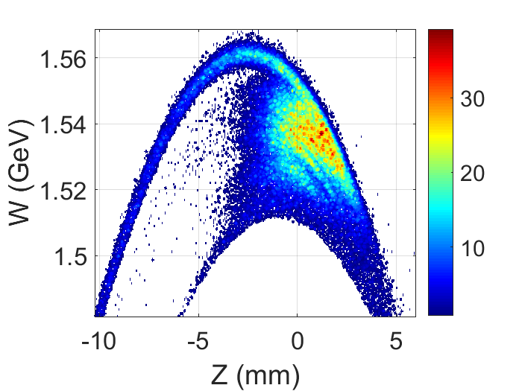
Boosting the beam
17
Beam distribution @ 9 m
Fully boosted beam
Optimized beam (up to now):
∆ W/W (1σ) = 0.99 %,
∆ Z (1σ) = 2.4 mm
Hor./Vert. beam size (1σ) = 8.7 mm
Acc. Yield = 7
ε_{n rms x,y} = 9.6⋅10³ mm⋅mrad
Capture system -V0:
∆ W/W (1σ) = 1.6 %,
∆ Z (1σ) = 3.1 mm
Acc. Yield = 7
ε_{n rms x,y} = 12⋅10³ mm⋅mrad
Courtesy of V. Mytrochenko

Slide 18
Considerations and coming improvements
18
GIOTTO now optimizes on specific window.
Transporting more particles increase the yield but also the energy spread.
Energy spread is misleading: high energy e⁺ will be lost in bendings.
GIOTTO now saves them sacrificing others useful e⁺ .
Coming soon:
Energy cut window support to increase further bunch core quality.
Full capture line optimization.
Notes:
The acronym stays for Genetic Interface for OpTimizing Tracking with Optics
GIOTTO is an AI optimizer based on a Genetic Algorithm developed in Milano by me and Alberto Bacci
Giotto drives ASTRA and potentially other simulators and postprocessors.
We applied it on a variety of BD problems from plasma driven Free Electron Lasers Capture and Matching lines to Energy Recovery Linacs low energy injection design

Slide 20
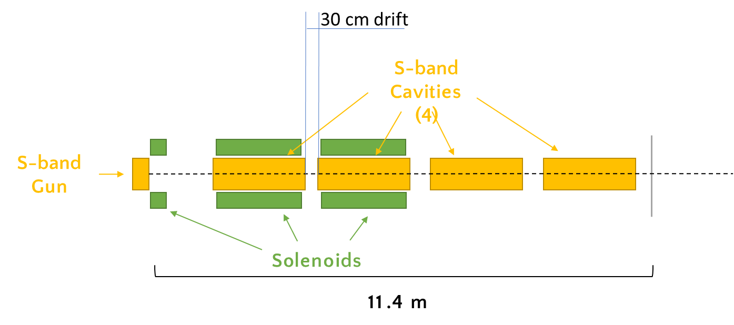
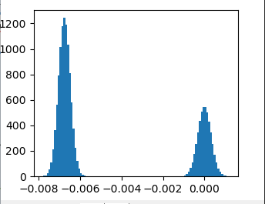
The injector preliminar scheme
Driver: 200 pC
Witness: 30 pC
RF-Gun
1.6 Cells
S-band
X-band position
= 1.25 m
Driver
witness
Laser longitudinal profile 320 fs (driver) and 280 fs (witness) sig_t
but the optimization tools considers a minimum value of 100 fs
(That clearly is the conservative value that the system can give)
T [ns]

Slide 21
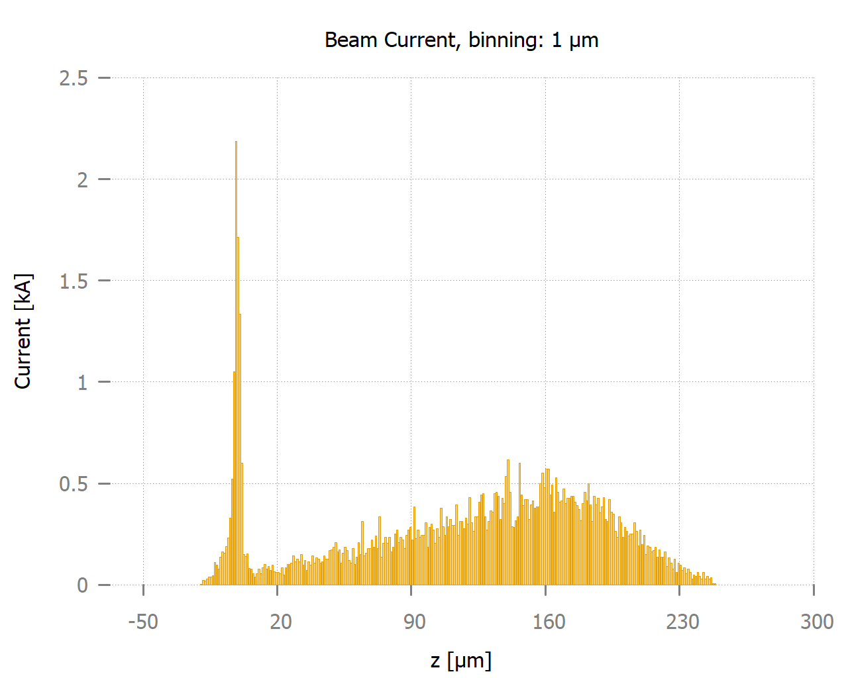
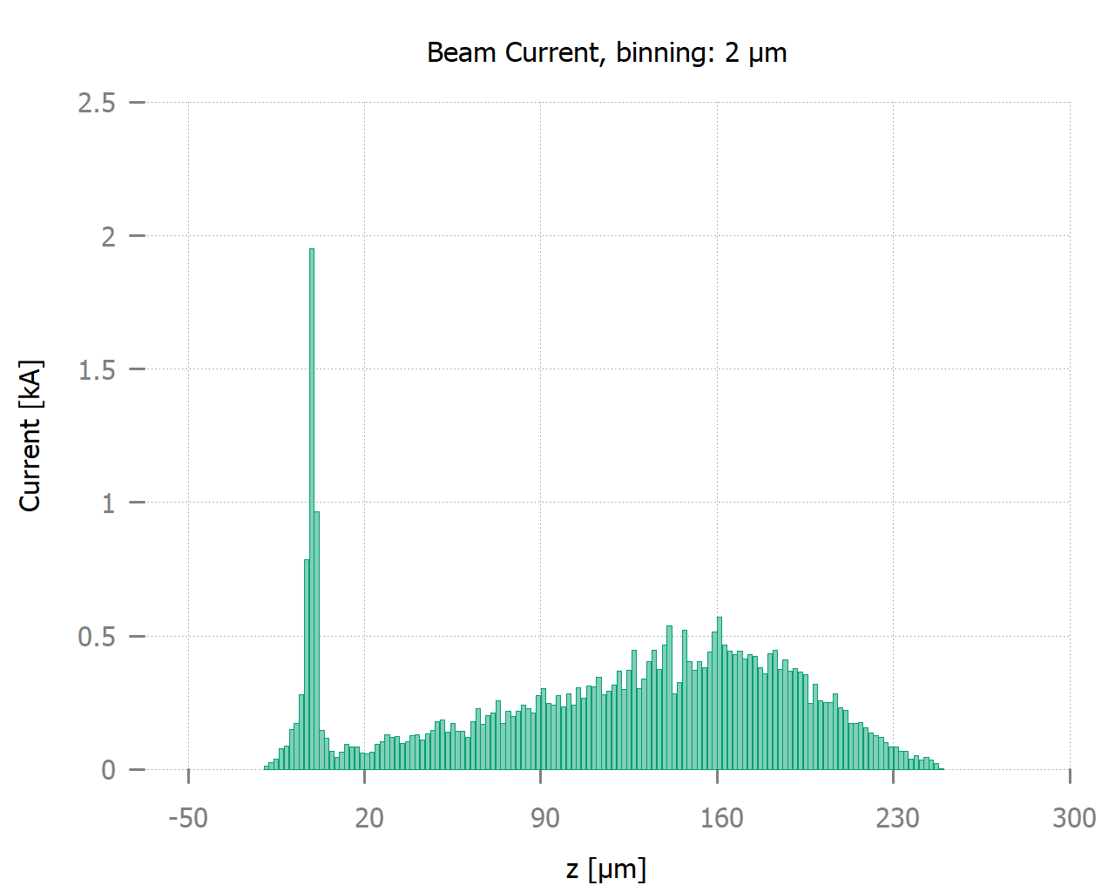
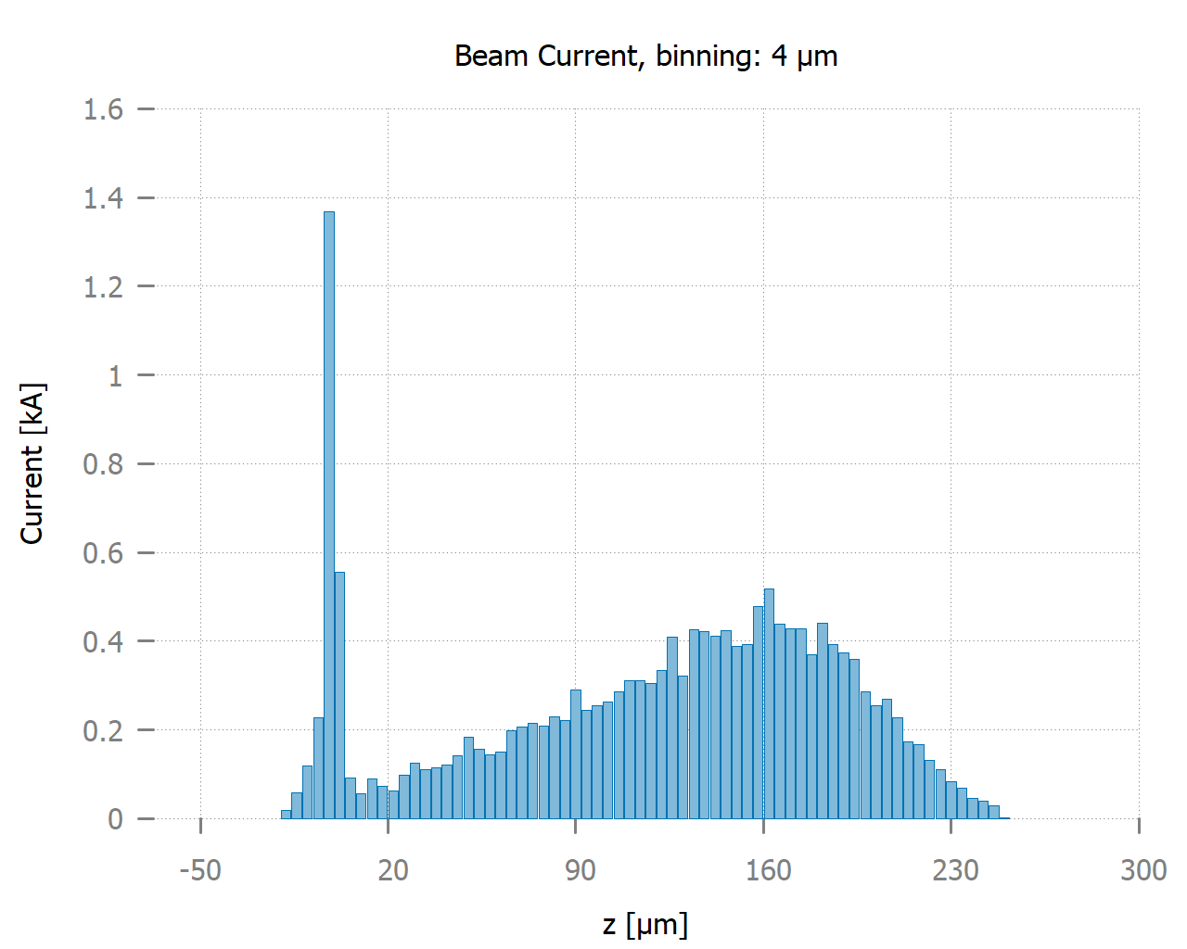
1 um Binning
Current
binning
2 um Binning
4 um Binning

