Slide 1
Predictive@ENI
WP4/INFN
Alessandro Costantini, Antonio Falabella, Elisabetta Ronchieri
INFN-CNAF
alessandro.costantini<at>cnaf.infn.it
elisabetta.ronchieri<at>cnaf.infn.it
antonio.falabella<at>cnaf.infn.it

Slide 2
The Problem to be addressed
Demonstrate the usability of modern AI-based techniques in the realization of systems for
Predictive maintenance
Modeling of the interdependencies between systems in complex industrial apparatuses.
Notes:
GDPR Rights for individuals:
the right to be informed,
the right of access,
the right to rectification,
the right to erasure,
the right to restrict processing,
the right to data portability,
the right to object and also rights around automated decision making and profiling

Slide 3
WP4 Objectives (M 0-24)
Objectives
Ingestion of Heterogeneous data for Anomalies Detection
Anomalies Detection Approaches for Generated Data
Focus on Open-source technologies and solutions
Milestones
M1-INFN (synced with MS8-Jun24): Selection of the approaches and related algorithms for analysis. PoC of the data ingestion platform to be used for the project purposes
M2-INFN (synced with MS10-Aug25): PoC results and comparison with the different approaches proposed by the partners
Deliverables
D1-INFN: report activities related to milestone 1
Contains the description of the selected approaches and related algorithms used for data analysis. It also contains the description of the data ingestion platform PoC and related technological solutions.
D2-INFN: report activities related to milestone 2
Contains the results and comparison of the outcomes among the different models, including those proposed by the project partners when possible.
Notes:
GDPR Rights for individuals:
the right to be informed,
the right of access,
the right to rectification,
the right to erasure,
the right to restrict processing,
the right to data portability,
the right to object and also rights around automated decision making and profiling

Slide 4
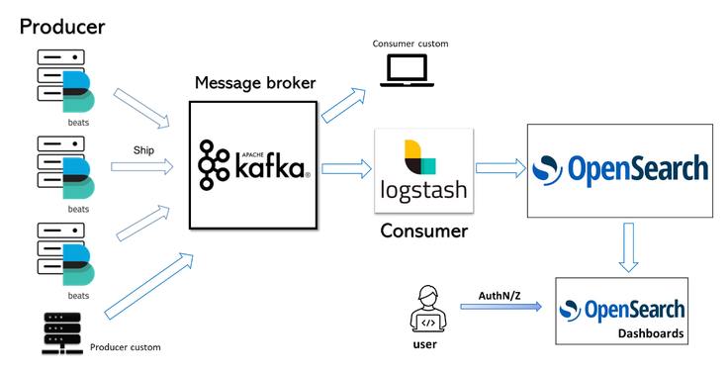
WP4: Activities for Data Ingestion (M 0-24)
Objectives
Ingestion of Heterogeneous Data for Anomalies Detection
Activities
Ingestion of ENI data on CNAF’s BDP (Big Data Platform) and test of performance. Within this scenario, the following actions are foreseen:
Evaluation of user requirements (type and amount of data, ingestion rate, number and type of producer, type of producer, etc.)
Set up of user environment and starting collecting the data
Support in platform exploitation to the projects activities
Data streaming infrastructure to manage heterogeneous data
Notes:
GDPR Rights for individuals:
the right to be informed,
the right of access,
the right to rectification,
the right to erasure,
the right to restrict processing,
the right to data portability,
the right to object and also rights around automated decision making and profiling

Slide 5
WP4: Activities for AD (M 0-24)
Objectives
Anomalies Detection Approaches for Generated Data
Activities
Depending from the nature of the data
In case of unstructured data (e.g. log or report data), activities relate to textual data extracting valuable features where to apply AD models
e.g. Applying NLP techniques to identify event candidates for anomalies and classify events
Applying different techniques to analyze and compare the related outcomes
In the case of structured data (e.g. observability data), activities relate to the adoption of techniques and procedures aimed at pre-processing data where to apply AD models, e.g.
Adopting multivariate adaptive statistical filtering
Applying a sliding window approach to detect anomalies in time series,
Applying supervised and unsupervised ML techniques to detect and predict anomalies
Working with different AD models techniques to analyze and compare the related outcomes
Notes:
GDPR Rights for individuals:
the right to be informed,
the right of access,
the right to rectification,
the right to erasure,
the right to restrict processing,
the right to data portability,
the right to object and also rights around automated decision making and profiling

Slide 6
WP4 Effort and Requirements
Objectives
Ingestion of Heterogeneous data for Anomalies Detection
Anomalies Detection Approaches for Generated Data
Human resources
Alessandro Costantini (1 PM)
Elisabetta Ronchieri (3 PM)
Antonio Falabella (1 PM)
Staff (1PM)
One year of Assegno di Ricerca
HW/SW requirements from ICSC:
INFN: 1 server with 2 A100 equivalent GPUs for 24 months
Milestones
M1-INFN (synced with MS8-Jun24): Selection of the approaches and related algorithms for analysis. PoC of the data ingestion platform to be used for the project purposes
M2-INFN (synced with MS10-Aug25): PoC results and comparison with the different approaches proposed by the partners
Notes:
GDPR Rights for individuals:
the right to be informed,
the right of access,
the right to rectification,
the right to erasure,
the right to restrict processing,
the right to data portability,
the right to object and also rights around automated decision making and profiling

