Slide 1

Event classification in SAND with deep learning
Meeting della collaborazione DUNE-Italia
Lecce, 7/11/2023
Alessandro Ruggeri on behalf of the Nu@FNAL Bologna group

Slide 2
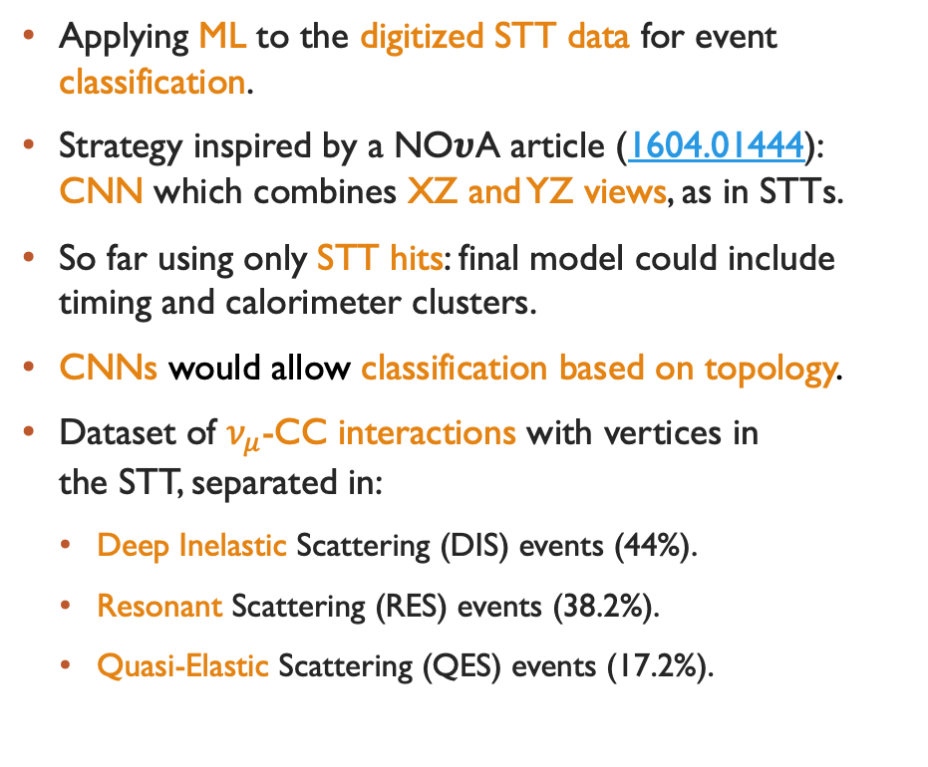
STT-event classification with CNNs
Applying ML to the digitized STT data for event classification.
Strategy inspired by a NO𝝊A article (1604.01444): CNN which combines XZ and YZ views, as in STTs.
So far using only STT hits: final model could include timing and calorimeter clusters.
CNNs would allow classification based on topology.
Dataset of $ν_{μ}$-CC interactions with vertices in
the STT, separated in:
  Deep Inelastic Scattering (DIS) events (44%).
  Resonant Scattering (RES) events (38.2%).
  Quasi-Elastic Scattering (QES) events (17.2%).

Slide 3
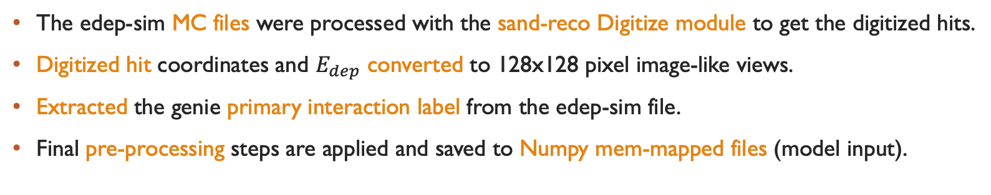
Processing workflow
The edep-sim MC files were processed with the sand-reco Digitize module to get the digitized hits.
Digitized hit coordinates and $E_{dep}$ converted to 128x128 pixel image-like views.
Extracted the genie primary interaction label from the edep-sim file.
Final pre-processing steps are applied and saved to Numpy mem-mapped files (model input).
Saved to a Pandas Dataframe for each MC file.
For each event
edep-sim file
Event primary interaction labels
RDataFrame
Pandas Dataframe
Additional processing
For each file
Numpy mmaps
Digits file
Uproot
Event hits coordinate list
NumPy
Pixelated XZ & YZ views

Slide 4
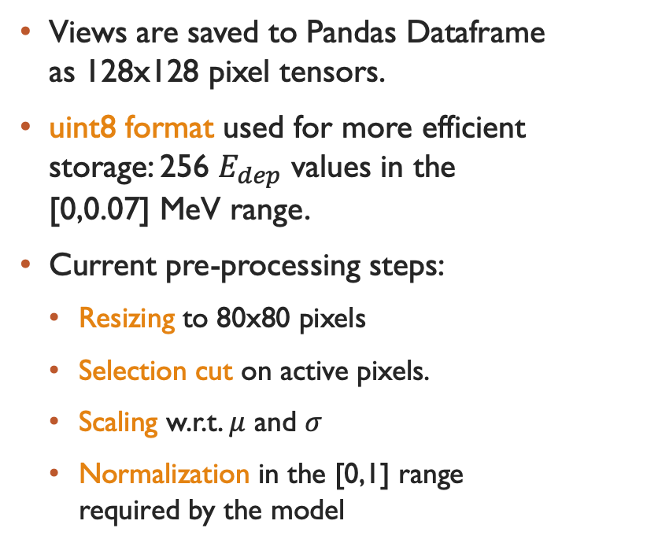


Pixelated views
Views are saved to Pandas Dataframe
as 128x128 pixel tensors.
uint8 format used for more efficient storage: 256 $E_{dep}$ values in the
[0,0.07] MeV range.
Current pre-processing steps:
  Resizing to 80x80 pixels
  Selection cut on active pixels.
  Scaling w.r.t. $μ$ and $σ$
  Normalization in the [0,1] range
  required by the model
$$ν−beam$$
$$ν−beam$$

Slide 5
GoogLeNet architecture
Architecture based on NOvA model.
Views are passed to parallel branches based on the GoogLeNet architecture.
Inception modules extract features at different scales in a parallel fashion.
The resulting features are concatenated and then passed to a final inception module to extract combined features.
Final classification after down-sampling.
Used the Tensorflow/Keras Python libraries.

Slide 6
Googlenet performance
Current results are not satisfactory: overfitting occurs since the initial epochs, even with high regularization.
Multiple strategies for regularizing the network were tried, with no improvement.
Alternative pre-processing procedures did not improve the performance either.

Slide 7
Resnet18 architecture
Alternative model based on the ResNet18 architecture.
Parallel branches with four residual blocks each.
Concatenation and convolution before final classification layer.
Current results are not satisfactory: network is underfitting.

Slide 8
Visual checks

Slide 9
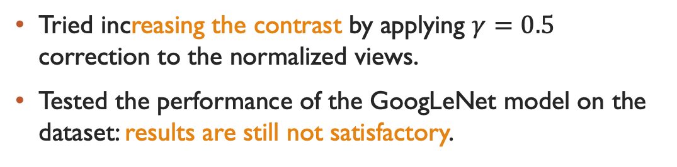
Increased contrast
Tried increasing the contrast by applying $γ=0.5$ correction to the normalized views.
Tested the performance of the GoogLeNet model on the dataset: results are still not satisfactory.

Slide 10
Conclusions
By visual inspection, event topologies are not well separated.
Distributions of some potential features do not show separation.
E.g. weighted std. of active pixels in the x and y directions.
Alternative strategies could be explored: different architectures or features.

Slide 11
Grazie per l’attenzione

