Slide 1
Updates on event reconstruction with Coded Aperture Masks
V. Cicero
DUNE Italia collaboration meeting , Lecce
6/11/2023

Slide 2
Coded aperture (CA) cameras
Alternative to traditional optical systems
evolution of a single pinhole camera -> Matrix of multiple pinholes to improve light collection
Image formed on sensor is the superimposition of multiple pinhole images.
Advantages:
- light transmission ~ 50%
- Good depth of field
- compact and easy to build
- no Xenon doping needed

Slide 3
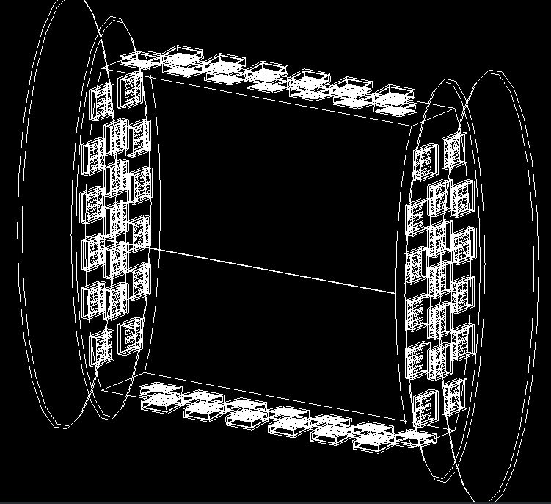
GRAIN coded aperture system
Mask-sensor
Distance: 2cm
10 cm
10 cm
Camera configuration selected by evaluating performance of muon track reconstruction in a test volume:
1024 SiPM matrix
SiPM 3x3 mm² area
mask same size and hole pitch of SiPM matrix
MURA pattern but random one has equivalent performances
60 cameras inside GRAIN, total 62k channels
Detector layout

Slide 4
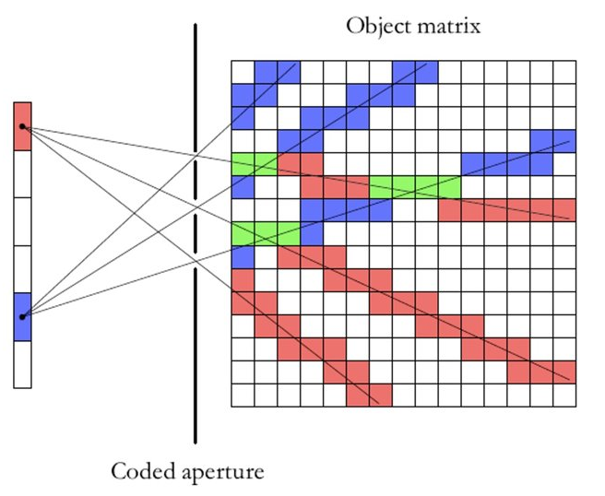
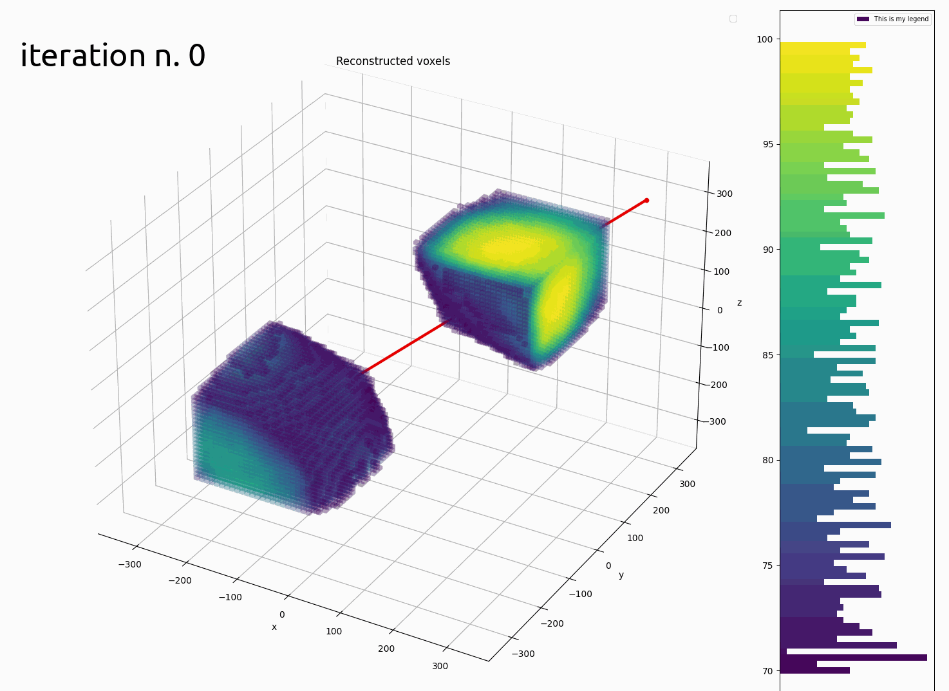
Reconstruction algorithm
Reconstruction directly in 3 dimensions
Iterative algorithm based on maximum likelihood expectation maximization
Backpropagation of the detected photons in the LAr volume through all mask holes, weighted appropriately
Weights (system matrix) represent the Bayesian probability of the voxel to be a source of the detected photons, computed analytically
Algorithm implemented in GRAIN using 4 GPUs and 120GB RAM to store weights

Slide 5
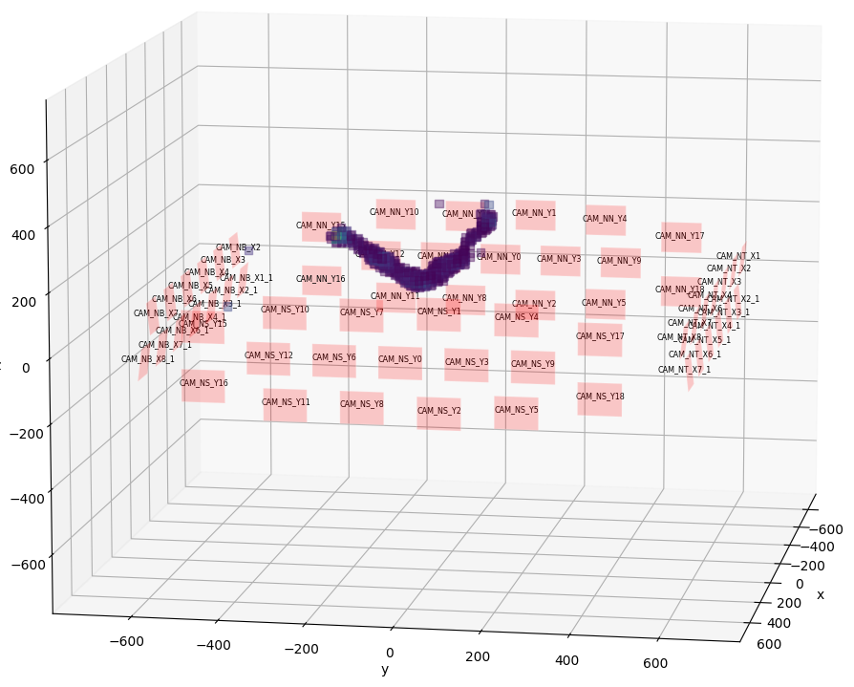
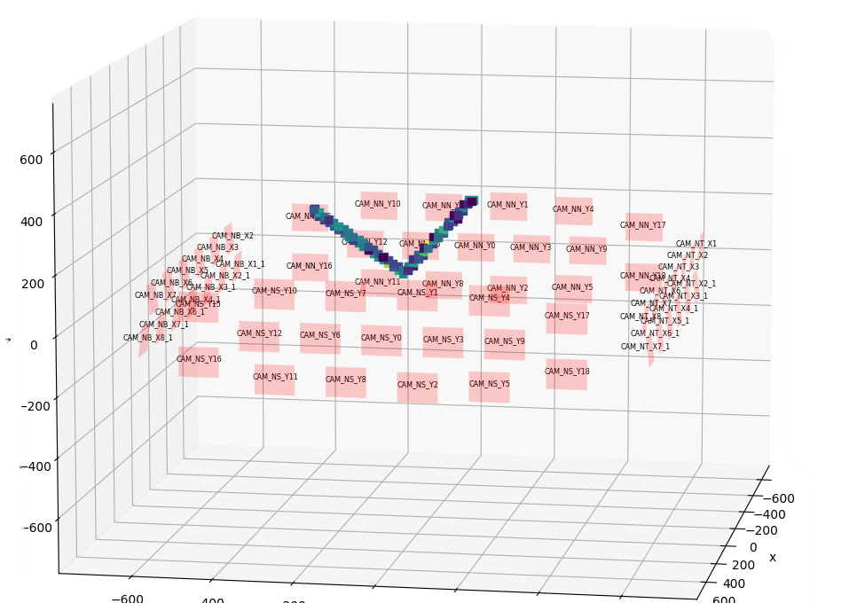
Event reconstruction in GRAIN
Voxel size 12 mm -> limited by system matrix size
500 iterations, 3 s per iteration
Cut on fiducial volume ~ 6 cm distance from sensor plane
Studies for extraction of points from voxel cloud and track fitting in progress
ν_{µ} → µ + p
Reconstructed photons emission point
MC-truth photons emission point

Slide 6
Room for improvement
Reconstruction artifacts near cameras: geometrical approximation used to compute weights need correction factor
Reconstruction time:
Optimization of GPU implementation
Reconstruction postprocessing to further improve contrast and reduce number of iterations
Explore OSEM (ordered subset expectation maximization) algorithms
Camera configuration optimization

Slide 7
Conclusions
Imaging system based on Coded Aperture masks implemented in GRAIN geometry for simulations
we developed an iterative 3D reconstruction algorithm and tested with simulated neutrino events in GRAIN
Future work will be focused on:
Assessing GRAIN spatial resolution with CA system
Improvements of the reconstruction algorithm for faster reconstruction
Further optimization of camera geometry

Slide 8
BACKUP SLIDES

Slide 9
3D ITERATIVE RECONSTRUCTION
Maximum Likelihood Expectation Maximization Algorithm:
Describe the pdf of the detected data -> samples of a set of random variables;
Calculate the probability that any initial distribution density in the object under study can produce the observed data.
The distribution density with the highest probability is the maximum likelihood estimate of the original object
$$f\left(H_{s}\right|{[λ}_{s}])=e^{−[λs]} \frac{{[λ_{s}]}^{H_{s}}}{H_{s} !}$$
$$λ_{j}^{k+1}=\frac{λ_{j}^{k}}{\sum_{s}{p\left(j,s\right)}}⋅\sum_{s}{\frac{H_{s}⋅p\left(j,s\right)}{\sum_{j}{p(j,s)}⋅λ_{j}^{k}}}$$
$${[λ}_{s}] = \sum_{j}{λ_{j }p(j,s)}$$
Log-likelihood maximization
H_{s} number of detected photons by pixel s
$λ_{j}$ unknown photon emission in voxel to be estimated from measured data
p(j,s) probability of a photon that originated in voxel j is detected by pixel s
k = iteration number
$λ_{j}^{0}>0$ initial distribution
Notes:
Maximum Likelihood Expectation Maximization Algorithm:
The measured data are samples from a set of random variables whose pdf are related to the object distribution according to a model of the data acquisition process;
Calculate the probability that any initial distribution density in the object under study can produce the observed data.
The distribution density with the highest probability is the maximum likelihood estimate of the original object.

Slide 10
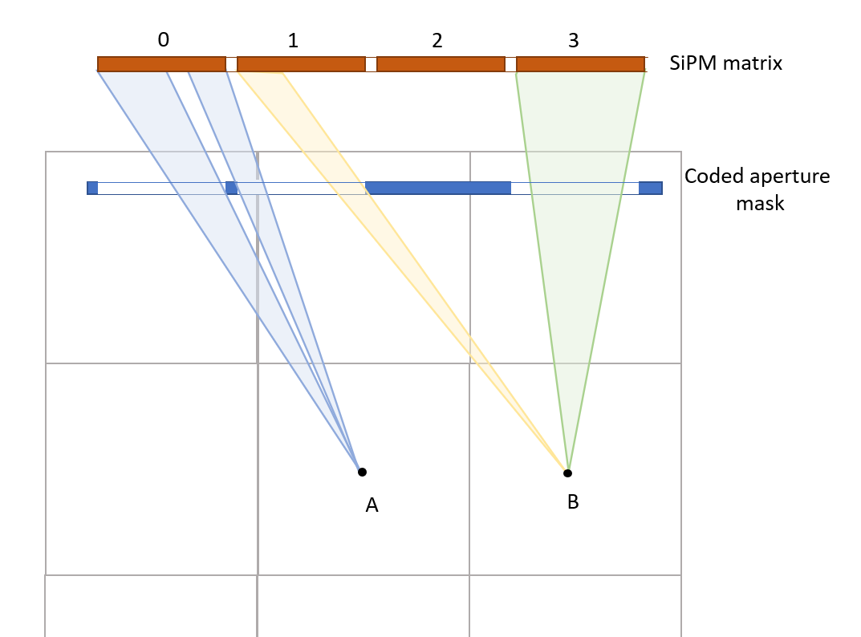
IMPLEMENTATION DETAILS
System matrix p(j,s) computation:
p(j,s) = P geometrical acceptance $∙$ P attenuation $∙$ P detection
Reconstruction with multiple cameras:
The ML-EM algorithm can be used directly with multiple cameras by including in the system matrix the probabilities for all sensors, regardless of which camera they belong to.
memory constraints: system matrix size = C x J x S
reconstruction algorithm implemented in Python with OpenCL for GPU acceleration

