Slide 1

Drift Chamber design
Meeting della collaborazione DUNE-Italia
Lecce, 6/11/2023
Alessandro Ruggeri on behalf of the Nu@FNAL Bologna group

Slide 2
Motivations
A potential backup design to the STT for the tracking system in SAND.
The hope is to reduce complexity:
  in the mechanical design and setup, by having wider connected drift volumes kept at a lower pressure.
  in the number of channels, by having a smaller number of sense wires with a wider spacing.
Physics performance would need to be comparable to that of STTs.

Slide 3
Initial development steps
The base concept: alternating field and sense wires with planar electrodes for field shaping and drift-volume separation:
  no grading wires for design simplicity
  gaps between the planar electrodes to allow for gas passage.
First step in the design process was definition of the base cell configuration:
  spacing and orientation of the wires and electrodes
  wire and electrode thicknesses and voltages.
  composition and pressure of the gas mixture
Aiming at a simple relation between DCA and drift time: ideally linear.
Toy cell implemented in Garfield++ simulation software to compute the Electric field, drift properties and signal production.
E [V/cm]

Slide 4
overview of garfield++
Successor of Garfield, written in C++ and interfaced with ROOT.
The main application is the simulation of ionization detectors: from field computation to signal simulation. Magnetic fields can be included.
Detector configurations can be implemented in different ways:
  As components with analytical fields (infinite wires, tubes and planes)
  As imported field maps from FEM software.
  As geometric shapes passed to an internal solver ➔ current choice as elements have finite size.
Cell and gas configurations are passed to a Sensor object which interfaces with track and drift simulation classes to compute the ionization signal on an electrode.

Slide 5




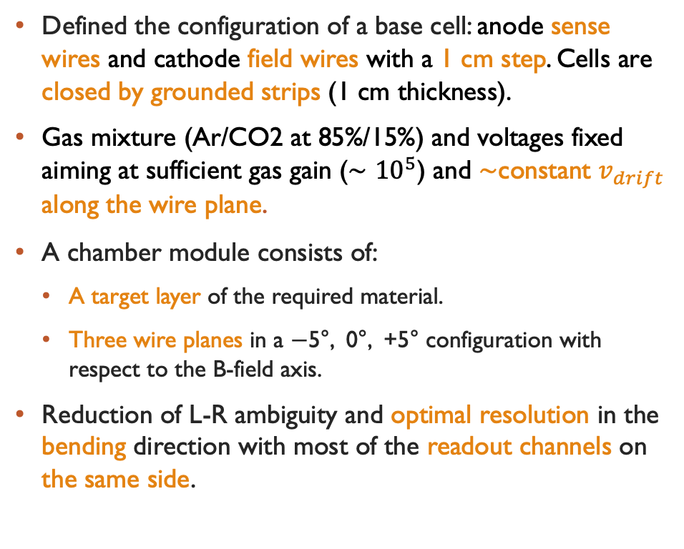






Definition of a Baseline module
-5°-plane
0°-plane
+5°-plane
Field wire
$$d_{f}=100 μm$$
$$V=−2.5 kV$$
Defined the configuration of a base cell: anode sense wires and cathode field wires with a 1 cm step. Cells are closed by grounded strips (1 cm thickness).
Gas mixture (Ar/CO2 at 85%/15%) and voltages fixed aiming at sufficient gas gain ($∼{10}^{5}$) and $∼$constant $v_{drift}$ along the wire plane.
A chamber module consists of:
  A target layer of the required material.
  Three wire planes in a −5°, 0°, +5° configuration with respect to the B-field axis.
Reduction of L-R ambiguity and optimal resolution in the bending direction with most of the readout channels on the same side.
$ν$ beam
$$g$$
$$1 cm$$
Signal wire
$$d_{f}=25 μm$$
$$V=+2 kV$$
Target layer
$$thickness∼0.5 cm$$
$$1 cm$$
$$1 cm$$
Aluminized Mylar
$$thickness∼20 μm$$
$$V=0 V$$
$$E>1 kV/cm$$
µ-track

Slide 6
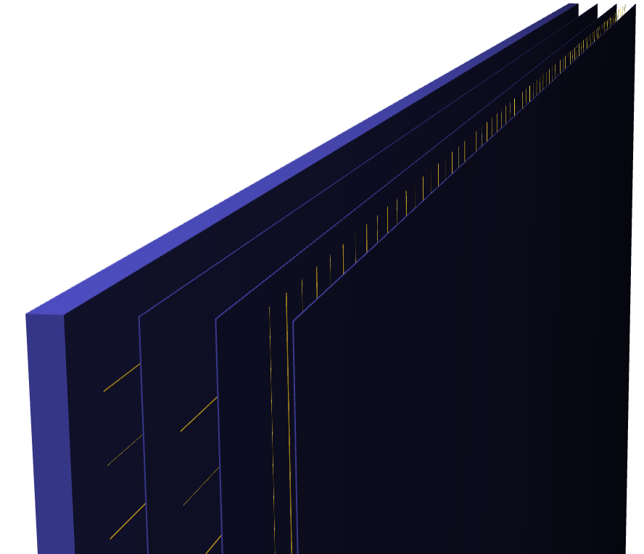
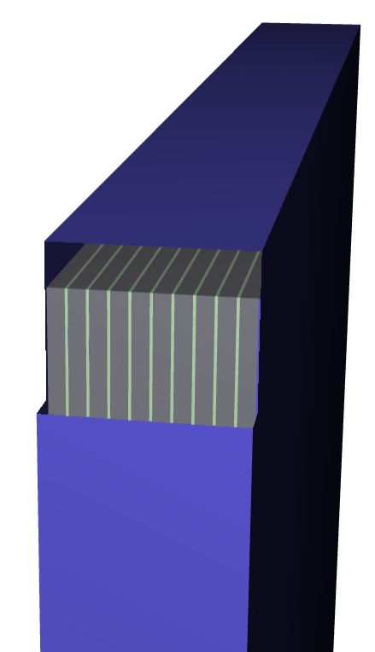
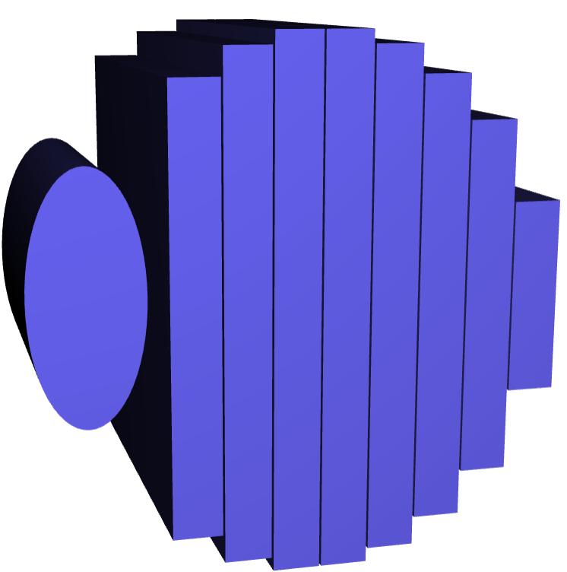
detector layout
Mylar strips
Drift volumes
Size of a module is consistent with an STT one, excluding the TRD.
Supermodules consisting of: 1 C-target module + 9 C3H6-target modules.
8 supermodules can be fitted in the remaining SAND volume: 6 symmetric and 2 downstream.
This preliminary configuration was implemented in the SAND simulations (thanks to G. Ingratta).
The geometry includes updated GRAIN dimensions and clearances between supermodules.
y
Target layer
3.2 m
x
34.98 cm
z
C mod
8 cm
9 x C3H6 mods
x
8 cm
y
B
A
A
B
z
C
C
Lengths in mm
X
X
20
902
20
2938
120
350
Clearance GRAIN - ECAL
Clearance tracker - ECAL
Clearance tracker - GRAIN
15 mm Supermod clearance

Slide 7
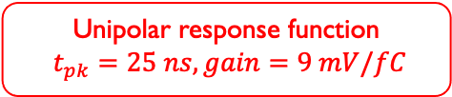
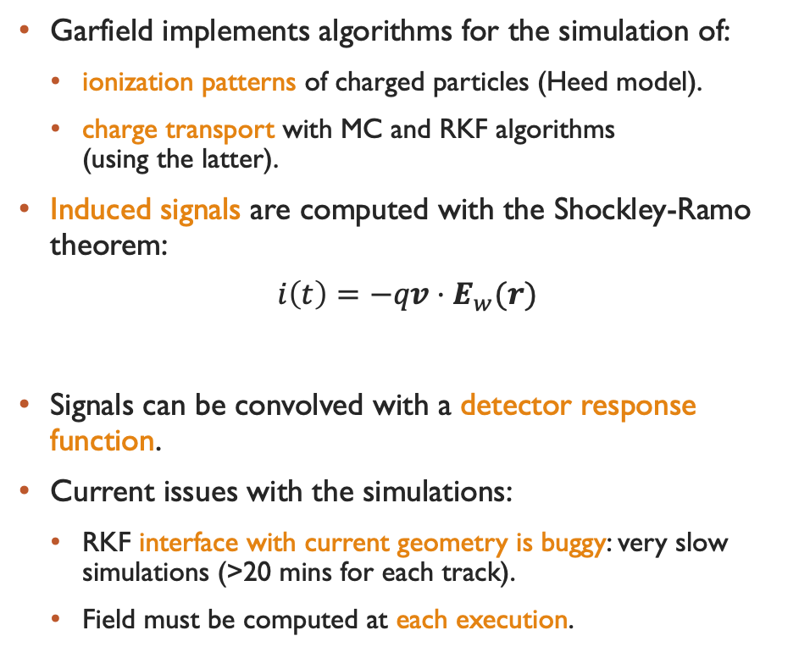

signal simulations in Garfield++
Garfield implements algorithms for the simulation of:
  ionization patterns of charged particles (Heed model).
  charge transport with MC and RKF algorithms
  (using the latter).
Induced signals are computed with the Shockley-Ramo theorem:
$$i\left(t\right)=−qv⋅E_{w}(r)$$
Signals can be convolved with a detector response function.
Current issues with the simulations:
  RKF interface with current geometry is buggy: very slow simulations (>20 mins for each track).
  Field must be computed at each execution.
field wire
Induced current
2 GeV µ⁻ track
y
Induced current
z // $\vec{B}$
x
drifting e⁻
Unipolar response function
$t_{pk}=25 ns, gain=9 mV/fC$
Charge velocity
Weighting field
sense wire
drifting ions
Output signal
field wire

Slide 8
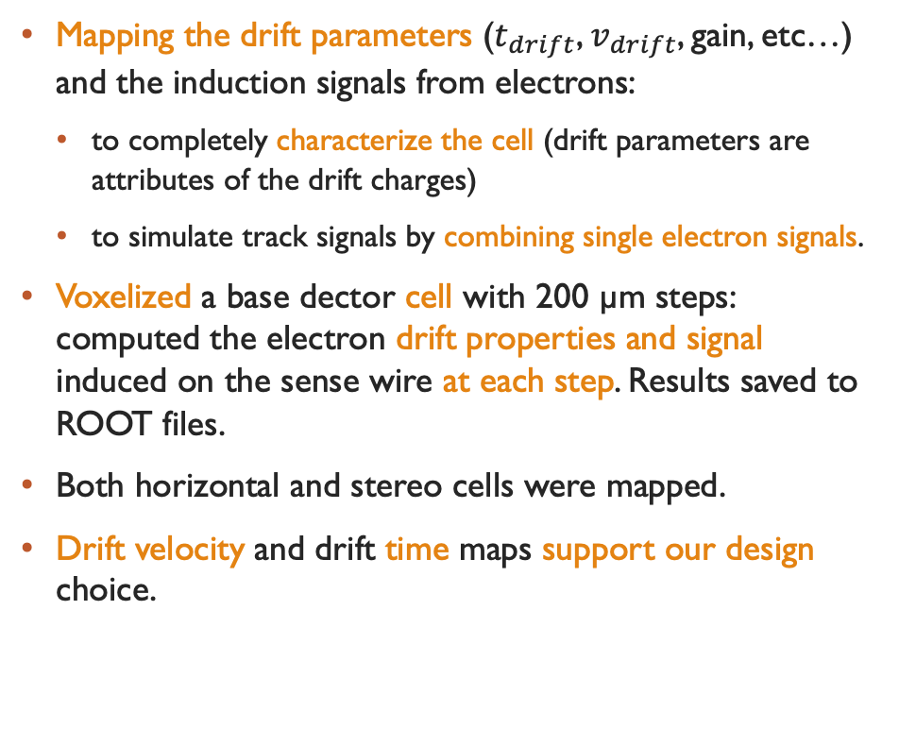
MAPPING of the drift parameters
Mapping the drift parameters ($t_{drift}$, $v_{drift}$, gain, etc…) and the induction signals from electrons:
  to completely characterize the cell (drift parameters are attributes of the drift charges)
  to simulate track signals by combining single electron signals.
Voxelized a base dector cell with 200 µm steps: computed the electron drift properties and signal induced on the sense wire at each step. Results saved to ROOT files.
Both horizontal and stereo cells were mapped.
Drift velocity and drift time maps support our design choice.

Slide 9
Discretized simulation of Signals
In Garfield++, signals from track primary e⁻/ions are summed separately bin-by-bin.
Response obtained by summing single e⁻ at each point in the trajectory. Ions neglected for simplicity.
Algorithm accounts for cell periodicity.
Comparison between toy tracks at different starting points and angles.
Convolution can be performed separately.
Sub-optimal features:
  Finite resolution: deviations are less relevant in the convolved signal.
  Producing and storing map files is not particularly efficient.
Response convolution

Slide 10


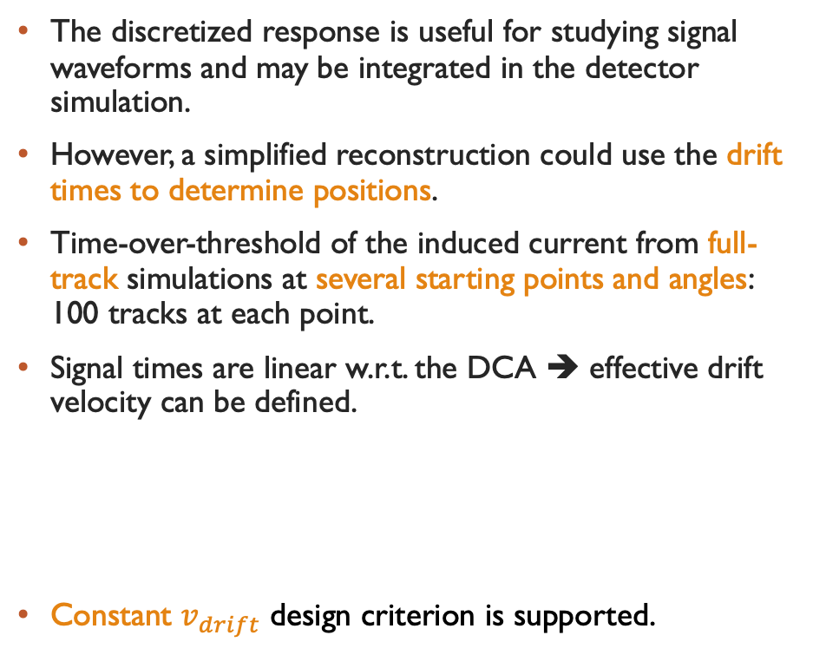

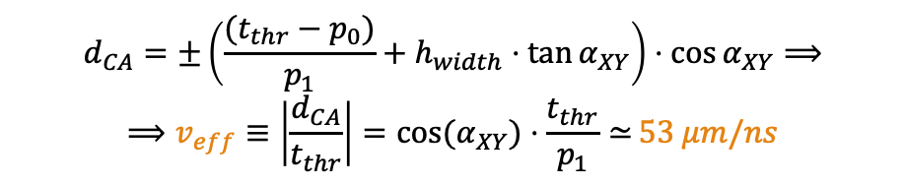
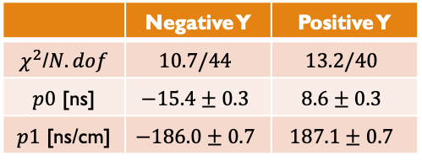
drift times from full tracks
The discretized response is useful for studying signal waveforms and may be integrated in the detector simulation.
However, a simplified reconstruction could use the drift times to determine positions.
Time-over-threshold of the induced current from full-track simulations at several starting points and angles:
100 tracks at each point.
Signal times are linear w.r.t. the DCA ➔ effective drift velocity can be defined.
Constant $v_{drift}$ design criterion is supported.
$$α_{XY}$$
$$y$$
y
z // $\vec{B}$
x
$$d_{CA}=±\left(\frac{(t_{thr}−p_{0})}{p_{1}}+h_{width}⋅\tan{α_{XY}}\right)⋅\cos{α_{XY}}⟹$$
$$⟹v_{eff}≡\left|\frac{d_{CA}}{t_{thr}}\right|=cos{(α}_{XY}{)⋅\frac{t_{thr}}{p_{1}}≃}53 μm/ns$$
 | Negative Y | Positive Y
$χ^{2}$/$N.dof$ | $$10.7/44$$ | $$13.2/40$$
$p0$ [ns] | $$−15.4±0.3$$ | $$8.6±0.3$$
$p1$ [ns/cm] | $$−186.0±0.7$$ | $$187.1±0.7$$

Slide 11
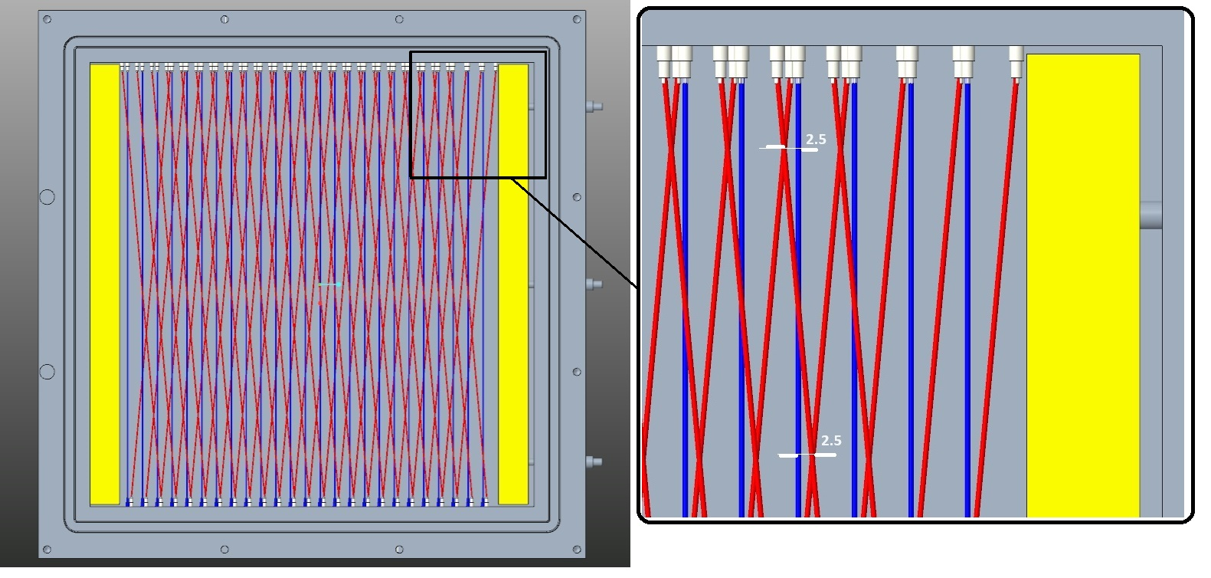
Small scale prototype
Current activities for the design and construction of a small 30x30 cm chamber module prototype.
The aim of the prototype is to gain experience in the construction, operation and readout design of this type of detectors.
Mechanical design has been finalised, construction to start in the next few weeks.

Slide 12
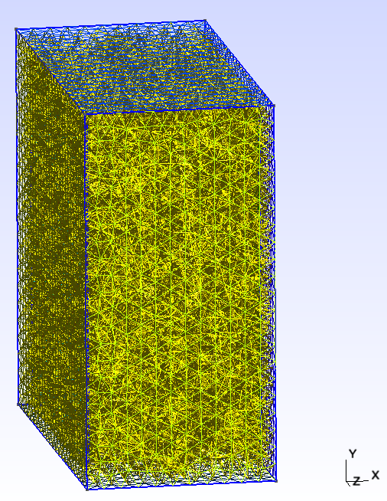
Current issues
Full simulations in Garfield take too long: potential issue with the geometry definition.
Only possible to simulate a few cells: field maps for the full (small scale) geometries would be useful.
But drift chamber simulations are taxing for FEM software: producing quality meshes with Ansys-Maxwell or gmsh+elmer FEM libraries has not been possible.
Instrumental effects are not included in Garfield++ simulations: capacitance and admittance matrices estimated from simplified models.

Slide 13
Conclusions
Defined the base configuration of a Drift Chamber tracking system for SAND.
Electric field and drift simulations on the current model so far support the design.
Current resources only allow simplified simulations: no realistic geometries, electrical/mechanical disturbances.
Development of a 30x30 cm prototype module is ongoing: initial experience in construction and operation.
Design of a larger 120x80 cm prototype for design validation is to start.

Slide 14
Grazie per l’attenzione

