Slide 1
Neutrino 2024
Opening Talk: Where are we?
Art McDonald
Queen’s University, Canada
Milan, Italy
June 17, 2024

Slide 2
Neutrinos reaching the Earth
Neutrinos Reaching the Earth

Slide 3
Topics of the Conference
Neutrino Oscillations (CP violation, Hierarchy, Sterile neutrinos)
  Long Baseline
  Short Baseline
  Reactor
  Atmospheric, Solar, Geo
Neutrino Properties
  Majorana: Neutrino-less Double Beta
  Mass: Direct, Cosmological
Neutrino and Multi-messenger Astronomy
Neutrino-Matter Interactions, including coherent scattering
Theory
  Beyond Standard Model
  Neutrino Mass
  Neutrino Cosmology

Slide 4
As of today: Oscillation of 3 massive active neutrinos is clearly the dominant effect:
If neutrinos have mass:
For 3 Active neutrinos.
Flavor (e, μ, τ)
Mass 1,2.3
Pontecorvo-Maki-Nakagawa-Sakata matrix
(Double β decay only)
?
?
Atmospheric, Accel.
CP Violating Phase
Reactor, Accel.
Solar,Reactor
Majorana CP Phases
Range defined for Δm₁₂, Δm₂₃
For two neutrino oscillation in a vacuum: (a valid approximation in many cases)
MSW
Interactions with high electron density can influence the process in the sun and the earth

Slide 5
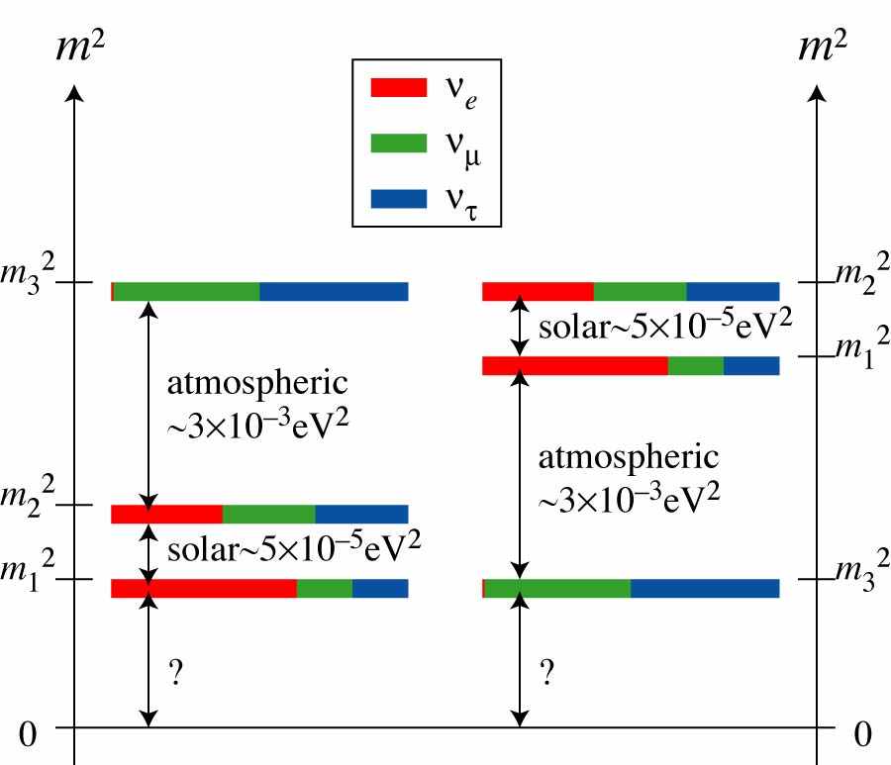
SUMMARY OF OSCILLATION RESULTS FOR THREE ACTIVE ν TYPES
Particle Data Group
Solar, Reactor
Atmospheric,Accelerator
Reactor, Accelerator
Mass Hierarchies
Future objectives:
δ_{CP}
θ₂₃ max?
Hierarchy?
Majorana ν?
Absolute mass
Sterile ν?
Accelerator,Reactor,
Atmospheric
0νββ, Cosmology, Electron spectrometers,
Accelerator,Reactor,
Atmospheric
Normal
Inverted

Slide 6
Long-Baseline Neutrino
Oscillation Measurements in Progress
K. Sakashita at NPB2024, Hong Kong, Feb 2024

Slide 7
Future improvements and more running at both experiments. Next Talks!
B. Clerbeau Summary Talk Moriond Mar 2024

Slide 8
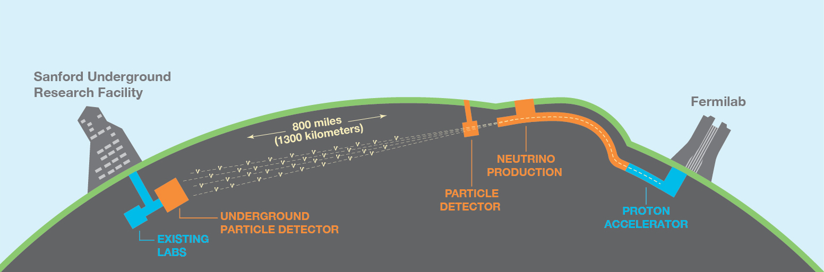
In progress: Next-Gen Long-Baseline experiments: Different neutrino interactions in the earth. Combined analysis will be valuable.
DUNE
- DUNE in the US and
Hyper-Kamiokande in Japan
Compare neutrino oscillations initiated by muon neutrinos and their anti-particles.
δ_{CP}, θ₂₃ max?, Hierarchy?
Status of each experiment will be presented, including schedules.
295 km

Slide 9
Sterile Neutrinos
Short Baseline
Sterile Neutrinos
Gallium
Short-Baseline Neutrino
Oscillation + Source Measurements in Progress
Reactor Neutrinos
Summary Talk by M. Danilov at Moriond Mar 2024

Slide 10
Fermilab Short Baseline program
ICARUS
SBN
Two similar Liquid Argon Detectors
Search for neutrino oscillations at O(Δm2) ~ 0.1-10 eV²
Measure ν-Ar interactions
Search for physics beyond the Standard Model
ICARUS in operation
SBN about to cool down

Slide 11

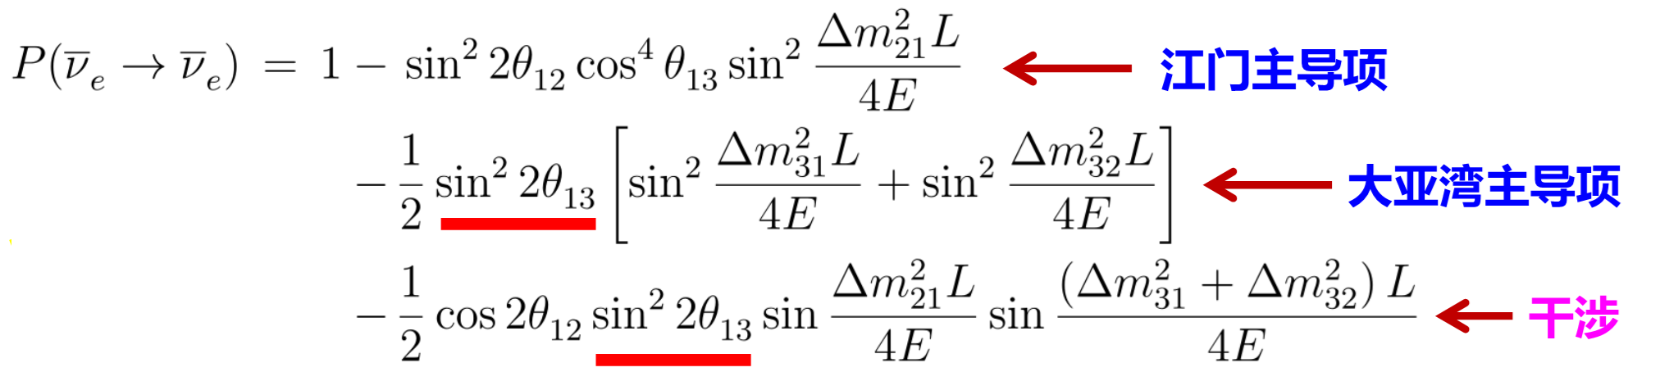
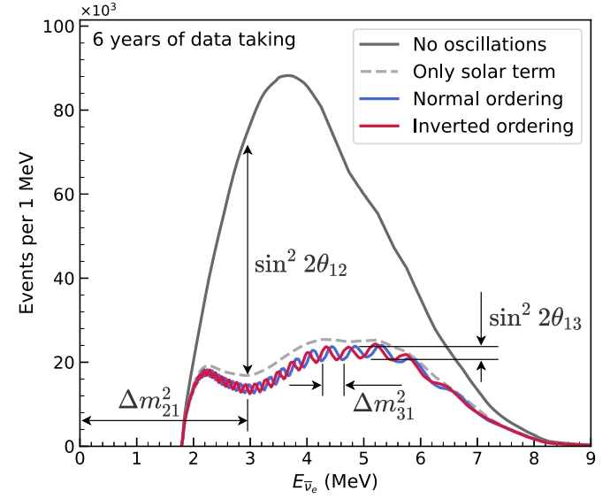
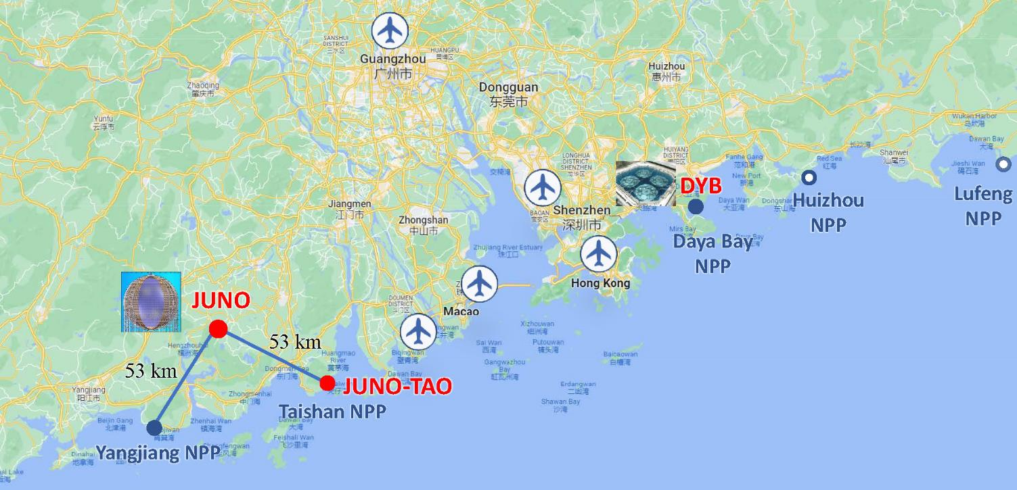
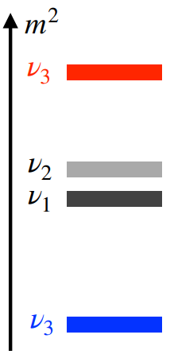

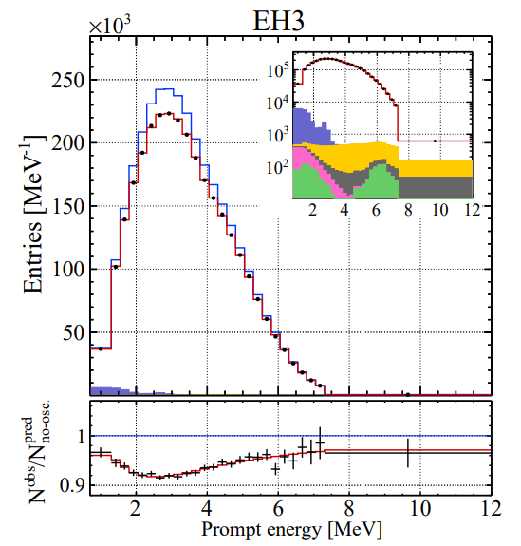
Jiangmen Underground Neutrino Observatory
Leading term at JUNO
Z. Yu at NPB 2024
Leading term at Daya Bay
Sensitive to mass ordering
Key for NMO:
1、20 kton liquid scintillator detector
2、3% energy resolution at 1 MeV energy deposit
3、low background
Daya Bay Far Hall

Slide 12
Jiangmen Underground Neutrino Observatory
Leading term at JUNO
Leading term at Daya Bay
Sensitive to mass ordering
Key for NMO:
1、20 kton liquid scintillator detector
2、3% energy resolution at 1 MeV energy deposit
3、low background
Daya Bay Far Hall

Slide 14
ν-less Double Beta Decay: Measuring Effective ν Mass
(T_{1/2})⁻¹= F(Q_{ββ},Z) |Μ^{0ν}|² <m_{νββ}>²
Additional phases
m_{νββ} = |m₁ cos²θ₁₃cos²θ₁₂ + m₂ e^{2iα} cos²θ₁₃sin²θ₁₂ + m₃ e^{2iβ} sin²θ₁₃|
2 ν
Emission
¹³⁰Te
Neutrinoless
Requires: Neutrinos to be their own antiparticle (Majorana particles)
Finite ν mass: Lifetimes > ~10²⁶ years imply ν mass < 0.1 eV

Slide 15
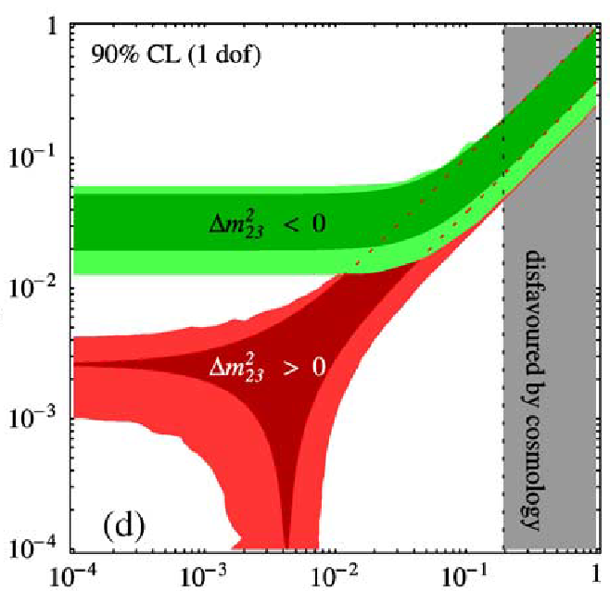
Variation of m_{ββ} vs Lightest ν mass
Present Limit
Inverted
Degenerate
Objective for nearer term experiments
m_{νββ} (eV)
Objective for longer term experiments
Normal
Mass
Hierarchy
Very long term objective.
Lightest neutrino mass in eV

Slide 16

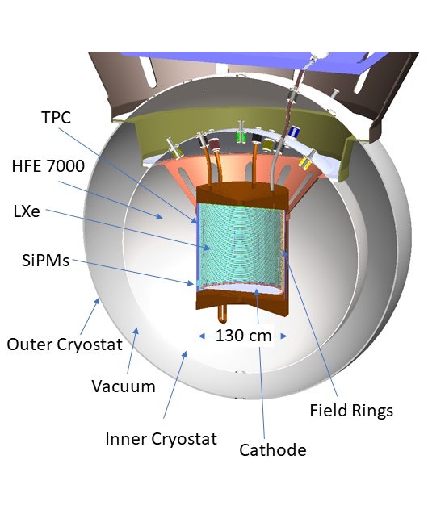
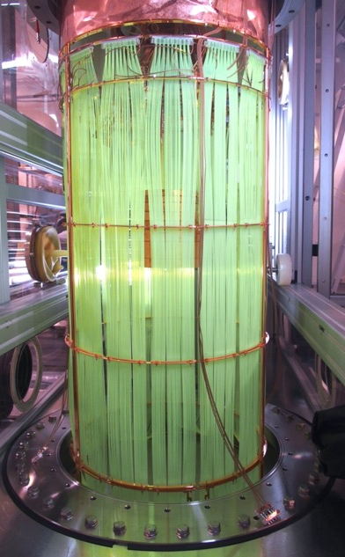
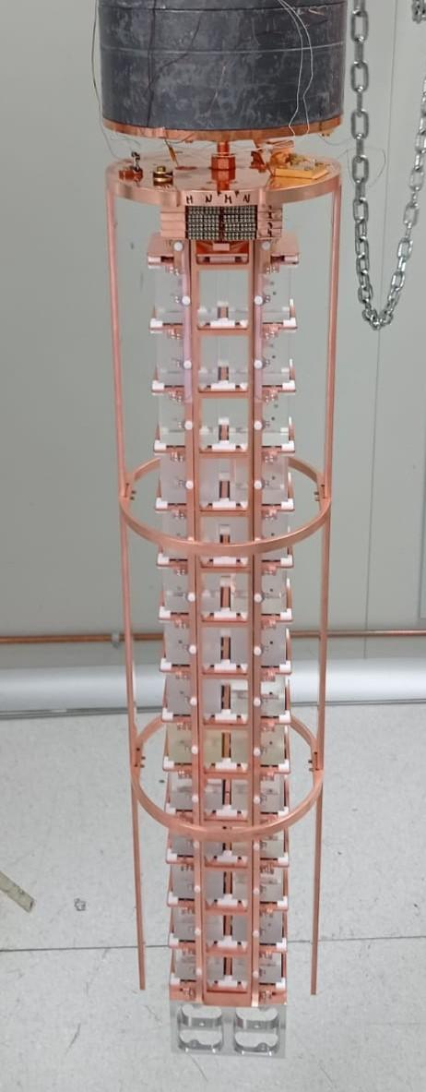
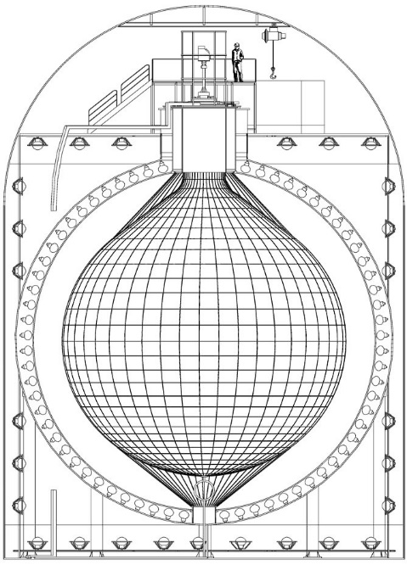
Neutrino-less Double Beta Decay
SNO+ (Te)
nEXO (Xe)
LEGEND (Ge)
CUPID (Mo)
KAM-ZEN (Xe)
There are a number of experiments in operation and others in development with several different isotopes. This will be an advantage in the advent of a discovery
Detailed nuclear theory calculations are needed to interpret these measurements and are an important part of the field.
There is a question of quenching of g_{A} that could reduce the sensitivity of these experiments to effective neutrino mass by a factor of 2 to 4.

Slide 17
Summary plot from NSAC LRP White Paper (Augmented) (Values provided by experiments)
(Assuming that process is mediated by low mass neutrinos and g_{A} is not quensched)
XLZD
AMORE
NEXT Bold
3-MANTIS
LEGEND 6000
MANTIS
CUPID 1T
SELENA
Inverted Order Minimum
Long Term
Top of Normal Ordering for lightest mass
From: Fundamental Symmetries, Neutrons, and Neutrinos (FSNN):
Whitepaper for the 2023 Nuclear Science Advisory Committee Long Range Plan: arXiv:2304.03451iv:2304.03451

Slide 18
Neutrino Mass from Tritium Beta decay
KATRIN
Both Projects will also search for kinks in the spectra at lower energy to look for sterile neutrinos: KATRIN Next Phase
PROJECT 8
Cyclotron Radiation Emission Spectrometry (CRES)
Published result:
Neutrino Mass < 150 ev/c²
Future: Atomic Tritium, greater statistics:
Projected reach: ~ 0.040 ev/c²
IO Minimum

Slide 19
Studies of the Large-scale Matter Power Spectrum are sensitive to the sum of ν masses
Future Measurements will improve this sensitivity

Slide 22
ICECUBE
And
KM3NET
ICECUBE
Future P-ONE?
High-Energy Neutrinos and Multi-messenger Astronomy
ICECUBE: Potential correlation between active galaxy NGC 1068 and neutrino hot spot (with 79 +22 -21 events). Significance 4.2 sigma. [Halzen at NPB 2024 Hong Kong]
[Coyle for KM3NET at NPB 2024]
Two Major Talks at this conference

Slide 23
Neutrino-Matter Interactions, including coherent scattering
COHERENT Collaboration
Efremenko at NPB 2024

Slide 24
Beyond Standard Model Searches
Talk at the Conference:
Neutrinos @ LHC: de Roeck

Slide 25
Theory
  Beyond Standard Model
  Neutrino Mass
  Neutrino Cosmology
  Leptogenesis
Theory Talks at the conference:
  Theory of Leptonic Flavor Mixing: Ding
  Nu Mass and the Origins of Baryons: Shaposhnikov
  Open Problems in Neutrino Astrophysics: Spurio
  0νDBD searches: theory and motivation: Mendendez
  Single/Double Beta Decay spectral shapes and theory:
  Beyond Standard Model: Overview (Theory): Fernanandez-Martinez

Slide 26
This will be an interesting week
Have fun!

