Slide 1


Other Future Long Baseline Projects
Alfons Weber
JGU Mainz & FNAL
Milano, June 18th, 2024

Slide 2
Motivation
Precision neutrino observatories under construction
  HyperK (water Cherenkov detector)
  DUNE (liquid argon TPC)
Physics program
  Neutrino oscillations (mixing angles, mass ordering, leptonic CPV)
  Solar neutrinos
  Supernova neutrinos
  Baryon number violation
  …
Opportunity to explore additional/improved physics
  Korea Neutrino Observatory
  Theia

Slide 3
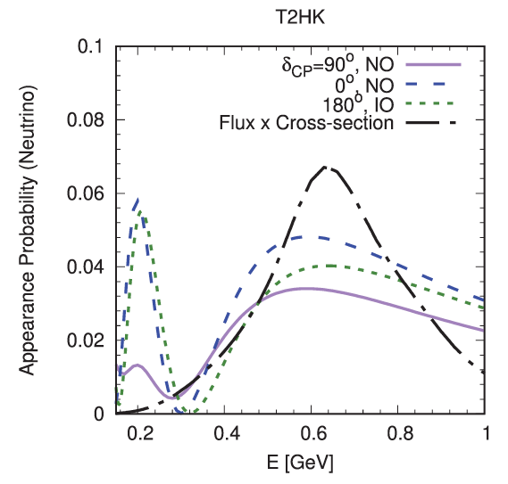
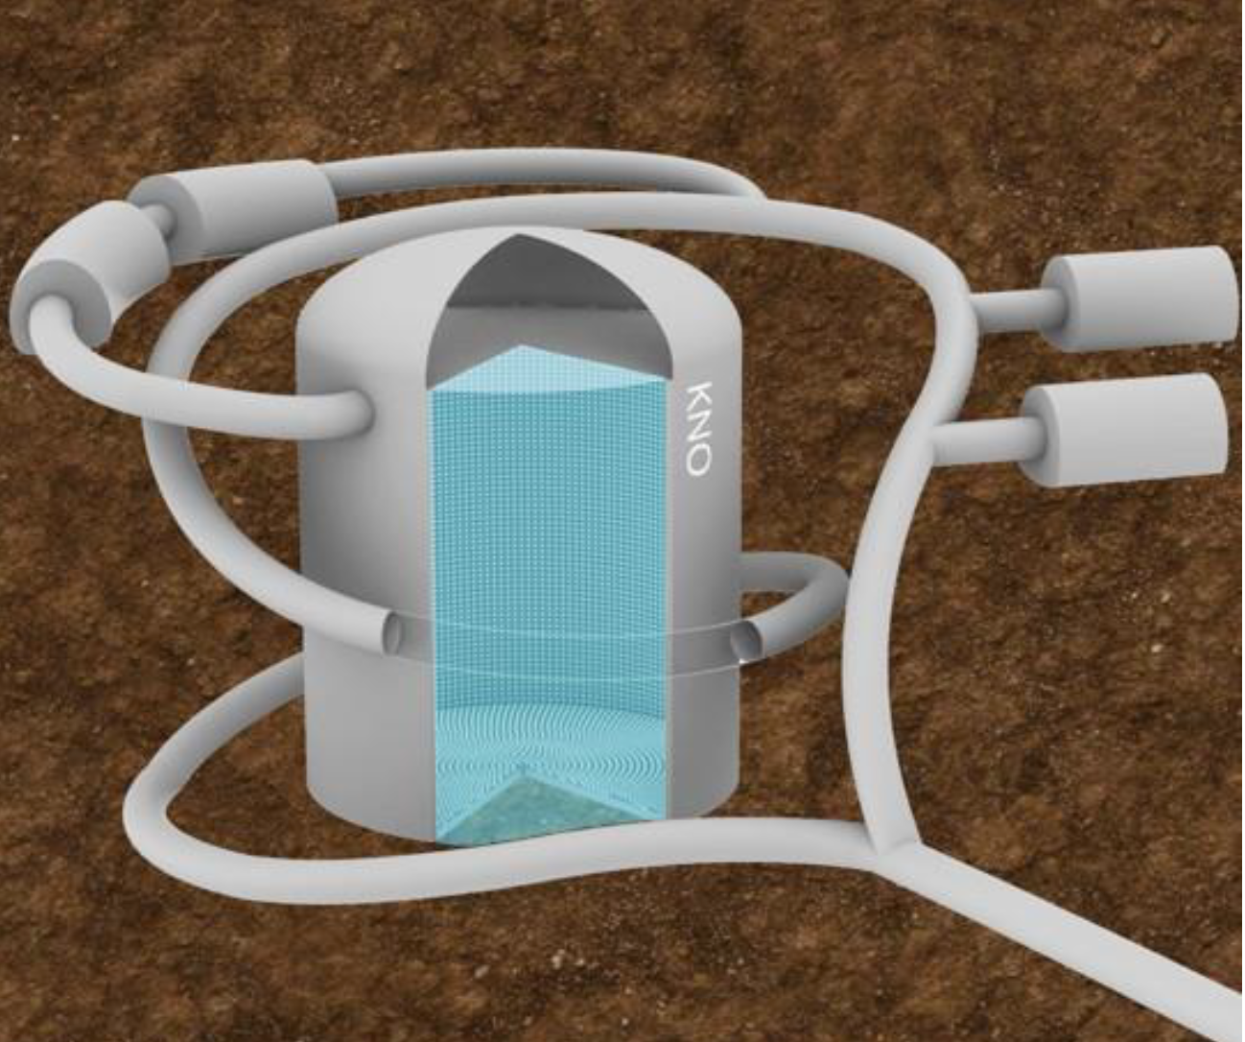
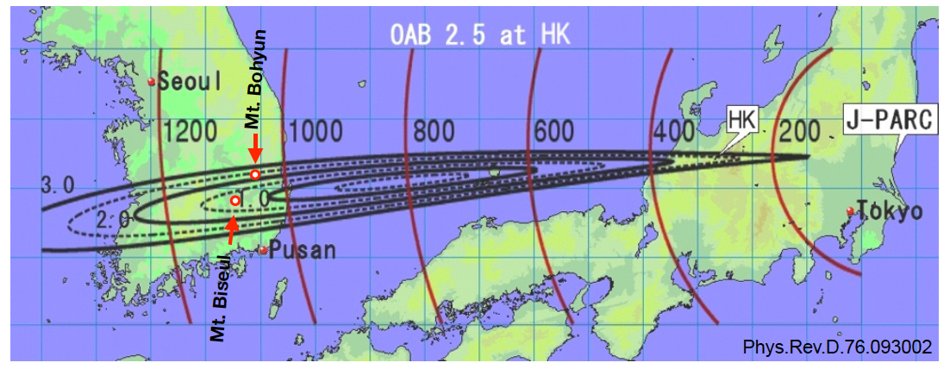
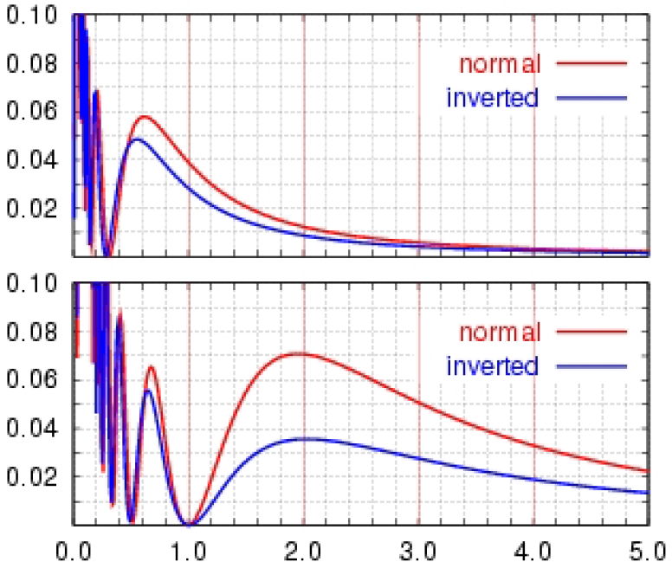

Korea Neutrino Observatory (KNO)
The detector formerly known as T2HKK
  Water Cherenkov Detector
  Similar size to HyperK, significantly more overburden
Physics
  Mass ordering & 2nd oscillation maximum
  Non-standard interactions, (diffuse) supernova, proton decay
Japan
$p(υ_{μ}→$ $υ_{e})$
Korea

Slide 4
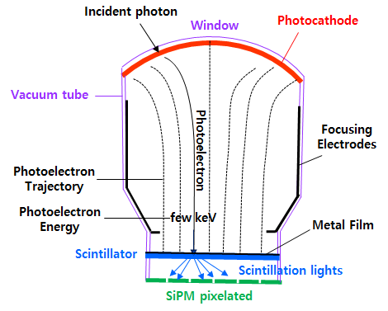
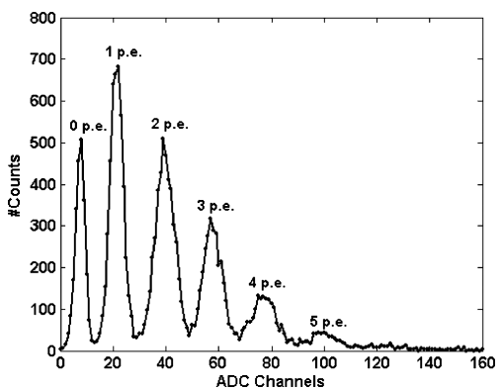
KNO Detector Technology
Potential to use novel detector technology
Hybrid Silicon Photon Multiplier Tubes
  PE resolution of SiPM
  Area of large PMT

Slide 5
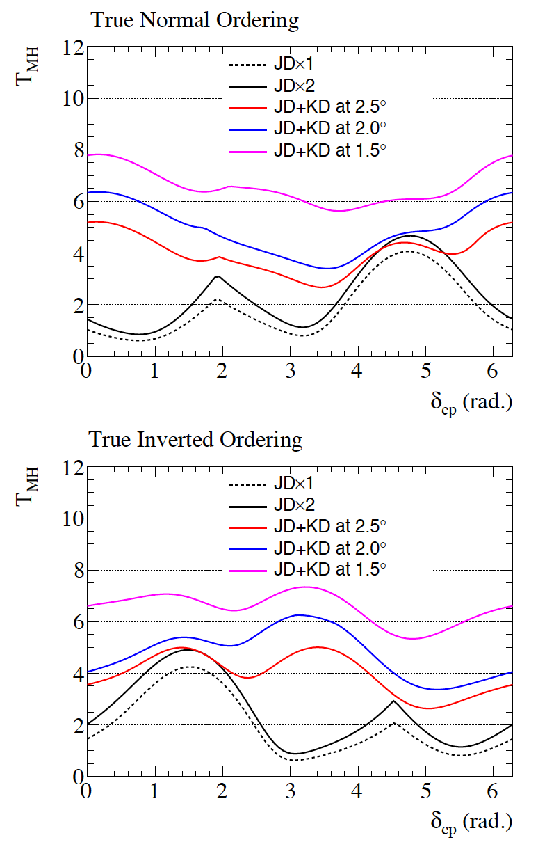
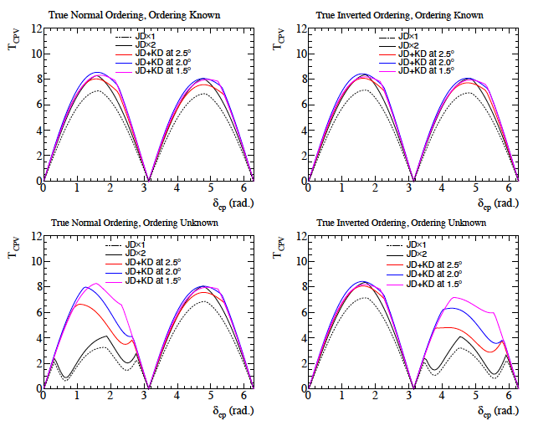
KNO Physics Potential
JD: Japanese det.
KD: Korean det.
arXiv:1611.06118

Slide 6
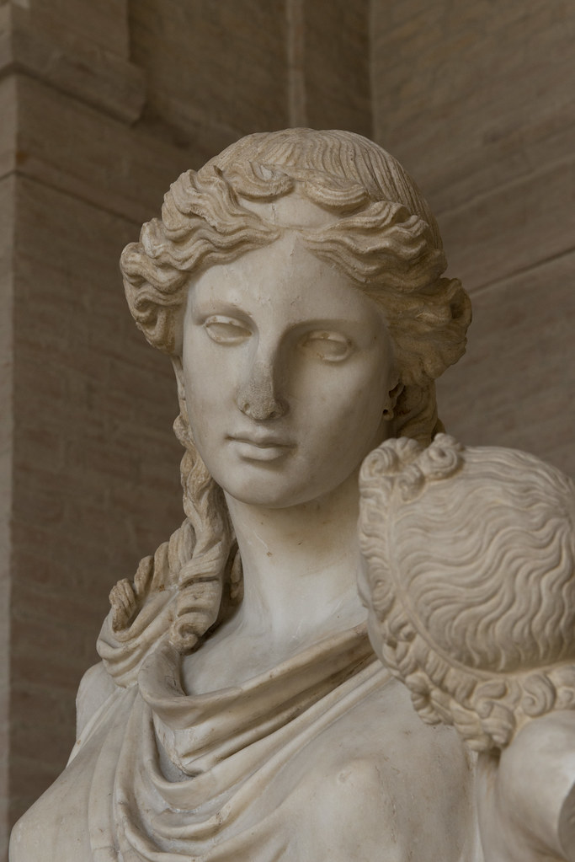

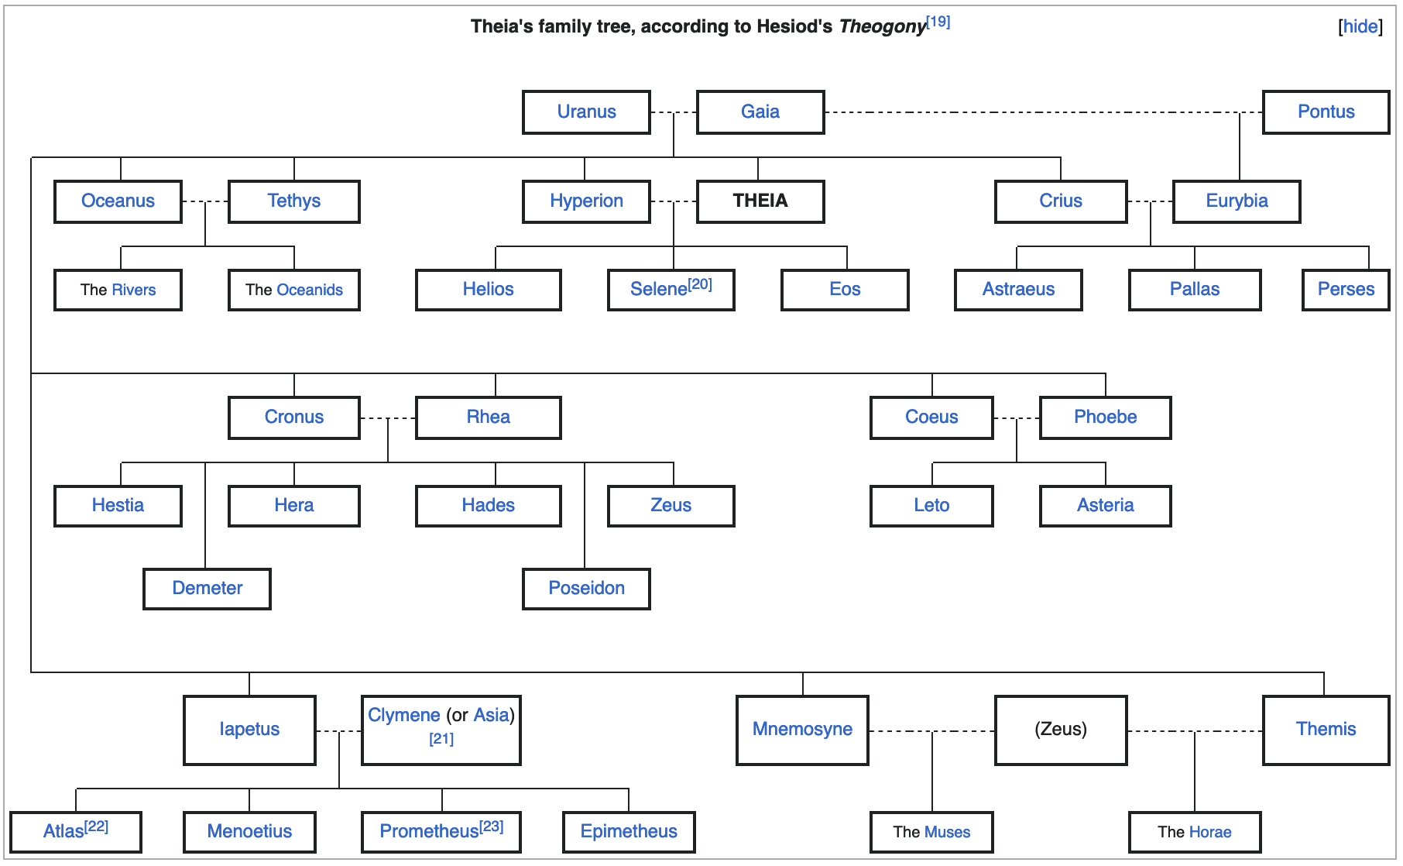
Theia — The Goddess of Glittery Things

Slide 7
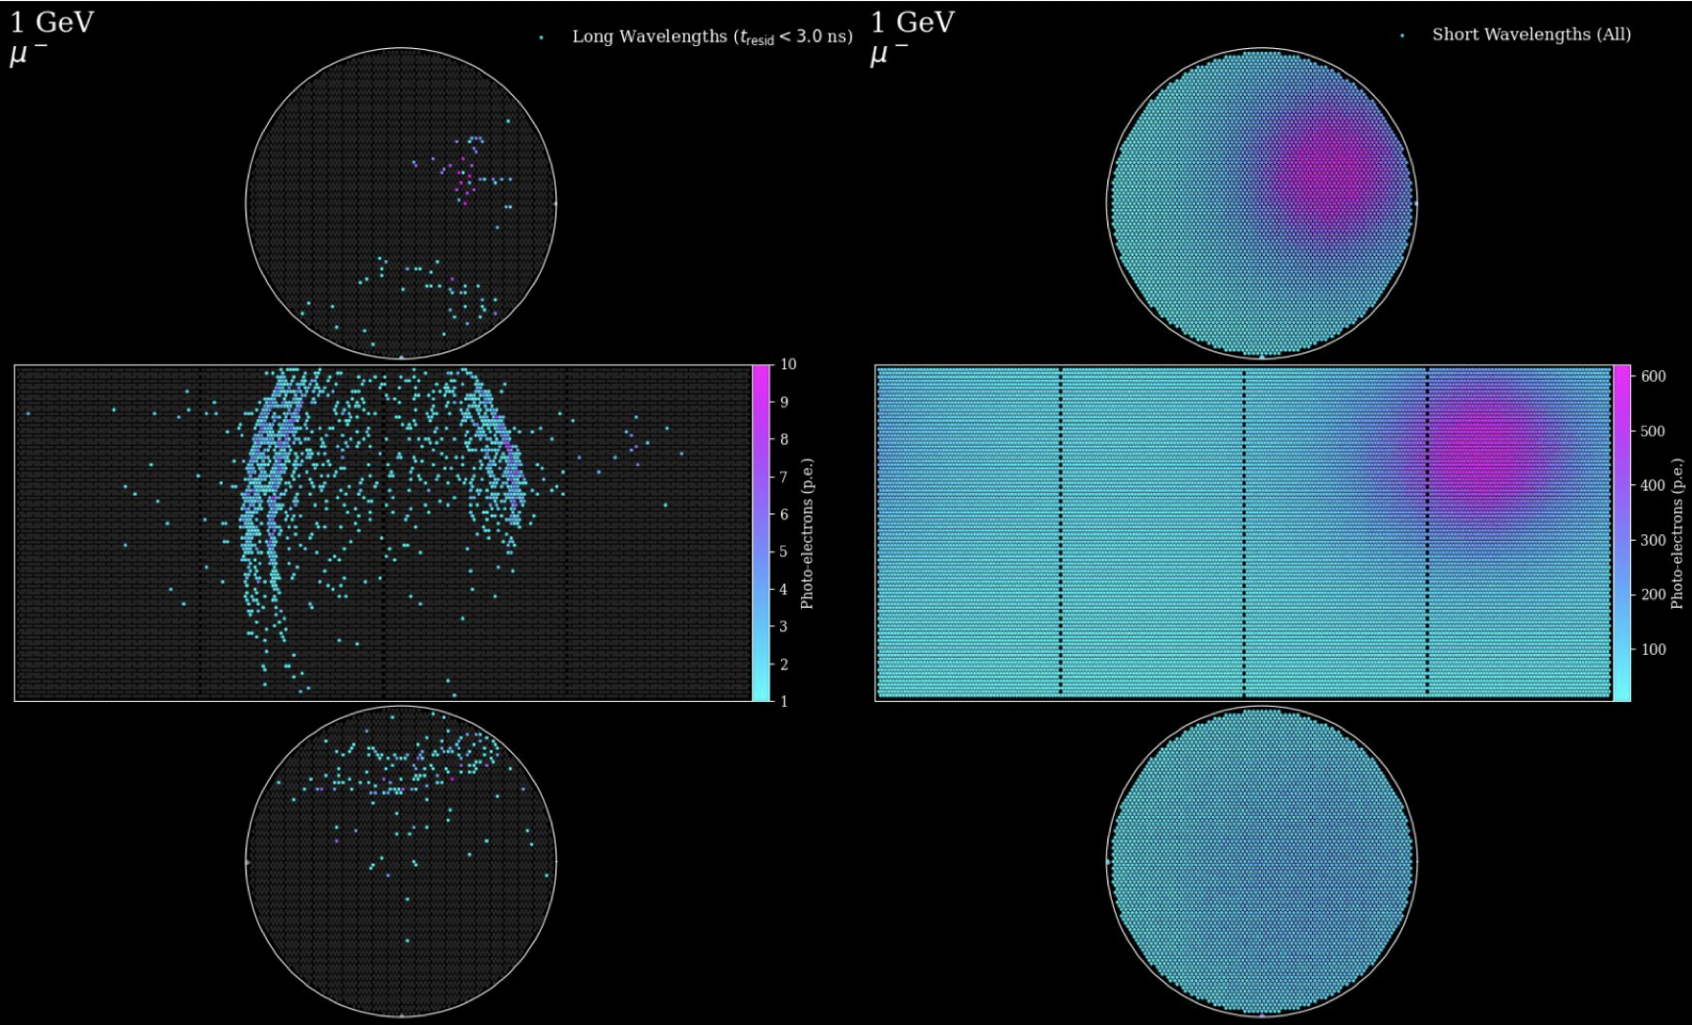
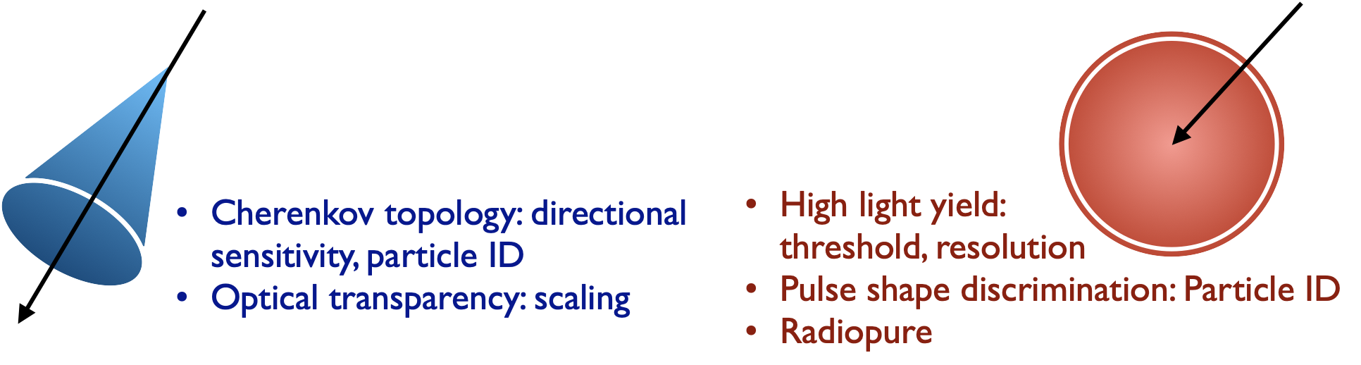
The Light

Slide 8
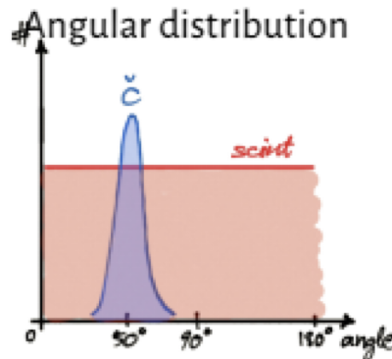
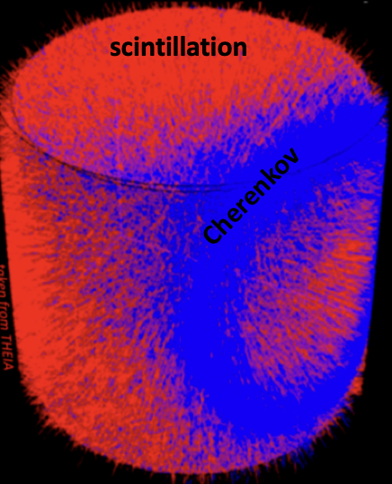

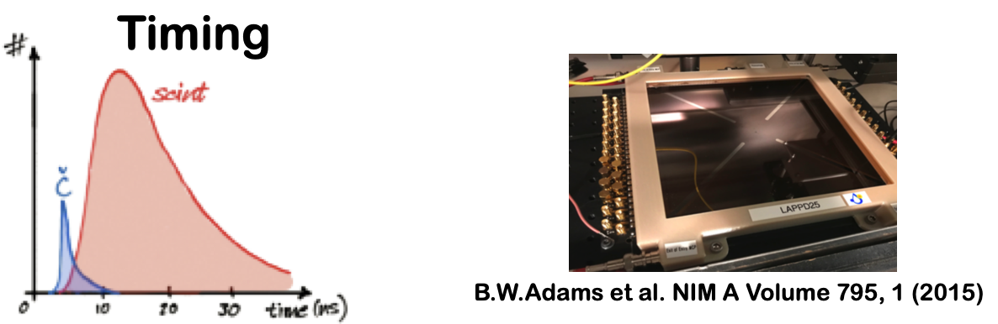

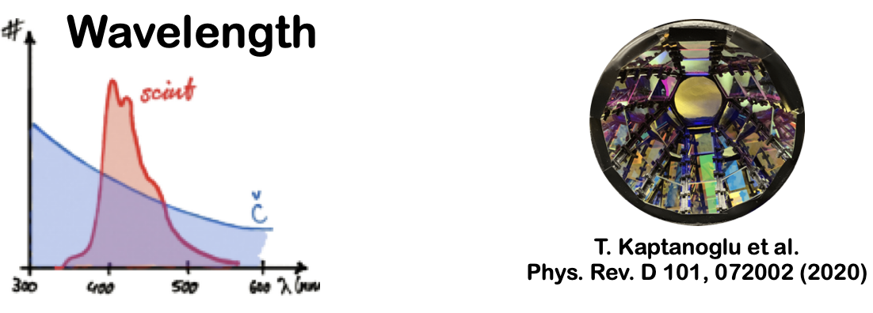
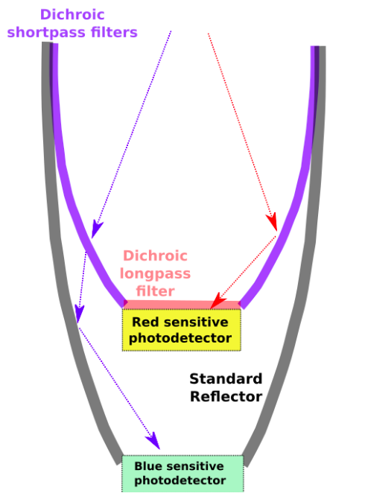
Light Patterns
Cherenkov
Poster
Tue: 545
LAPPD
Scintillation

Slide 9
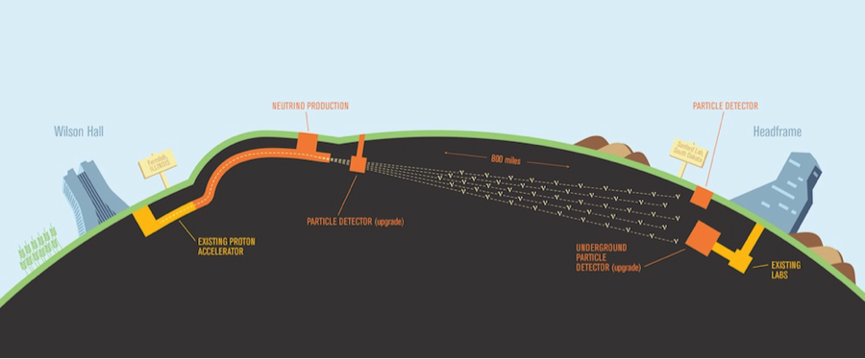
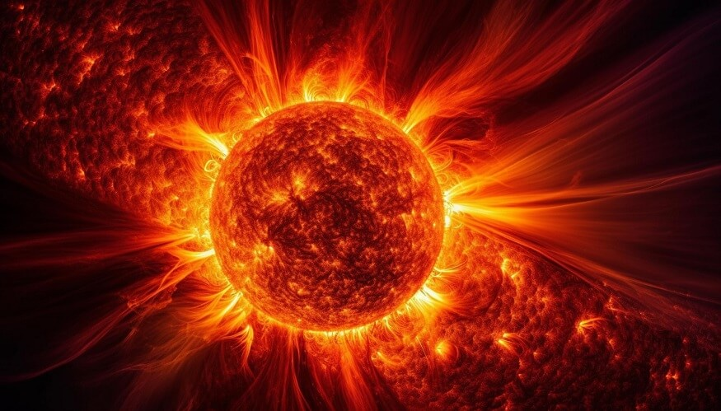
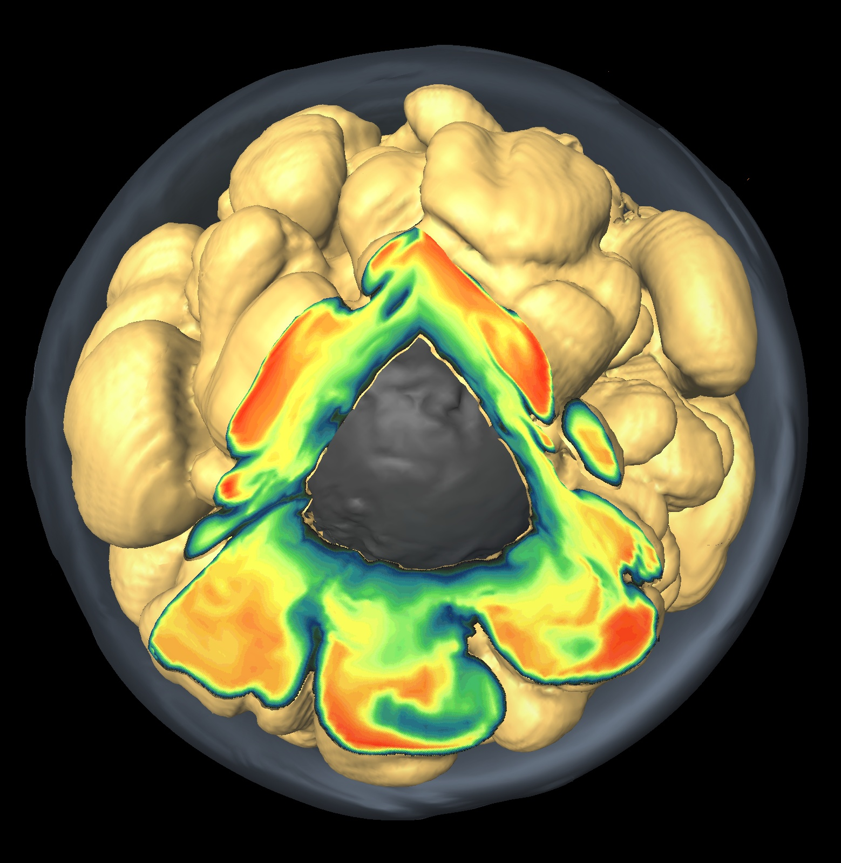
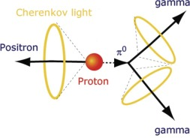
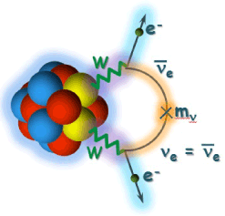
Physics Potential
Long baseline oscillations
Solar neutrinos
SN neutrinos
Diffuse SN background
Baryon number violation
Neutrino-less double beta decay

Slide 10
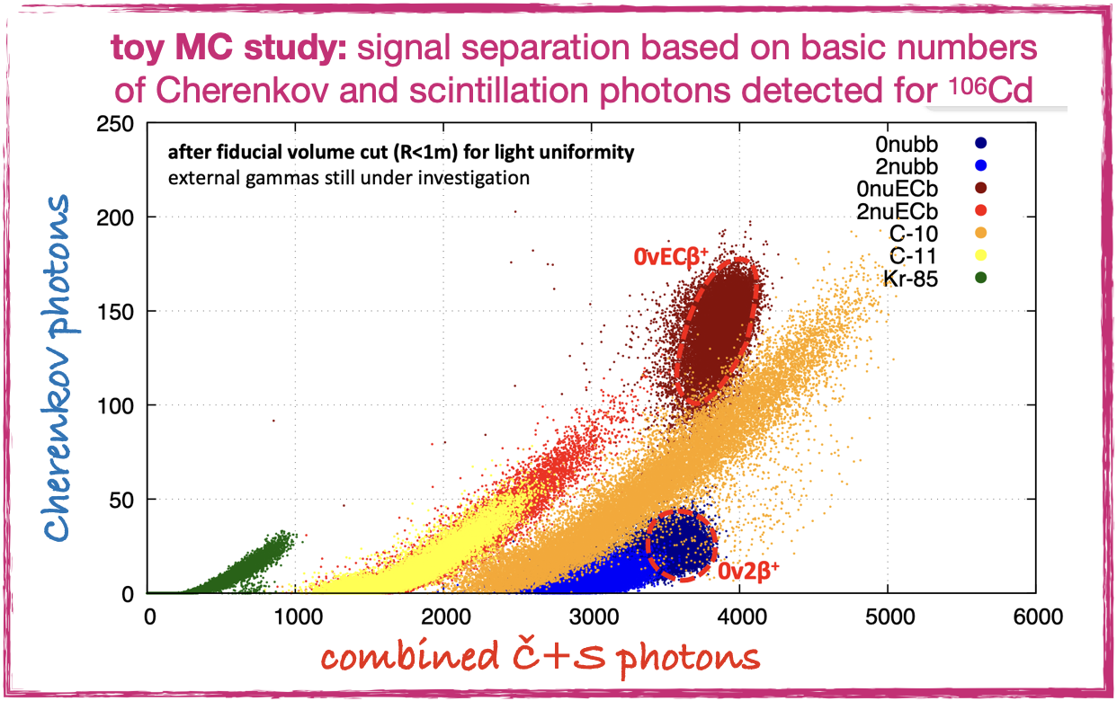
Why Hybrid?
Scintillation
  Excellent energy reconstruction
Cherenkov
  Directional information
Relative sharing used for PID
Example:
Double beta decay
  Signal and BG have different
  Cherenkov fraction
Kai Loo @JGU Mainz

Slide 11
A 4th DUNE Far Detector
DUNE Program (talk by Chris Marshall)
  Start with 2 far detector modules
  P5 supported DUNE Phase II: design and construction of FD3, improved ND and R&D for FD4
  3rd will be improved LAr technology
  4th more ambitious designs (pixel or
  optical r/o) including non-LAr technologies
  ‘module of opportunity’
Requirements
  Provide similar or better
  long baseline oscillation sensitivity
Theia is one opportunity to extend physics program

Slide 12
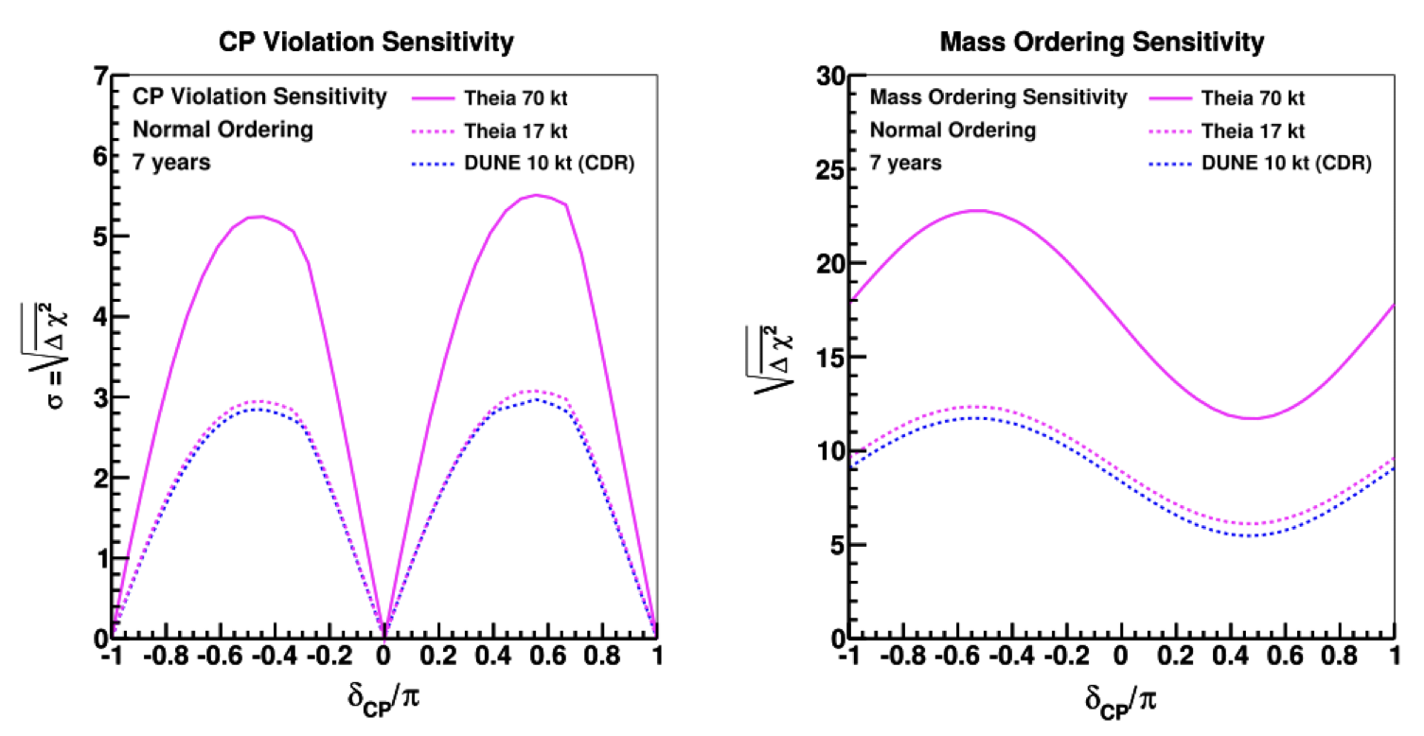
Oscillation Sensitivity
Similar sensitivity for neutrino oscillation program as LAr
  17 kt Theia (Cherenkov only & equiv. ND) ⬄ 10 kt LAr

Slide 13
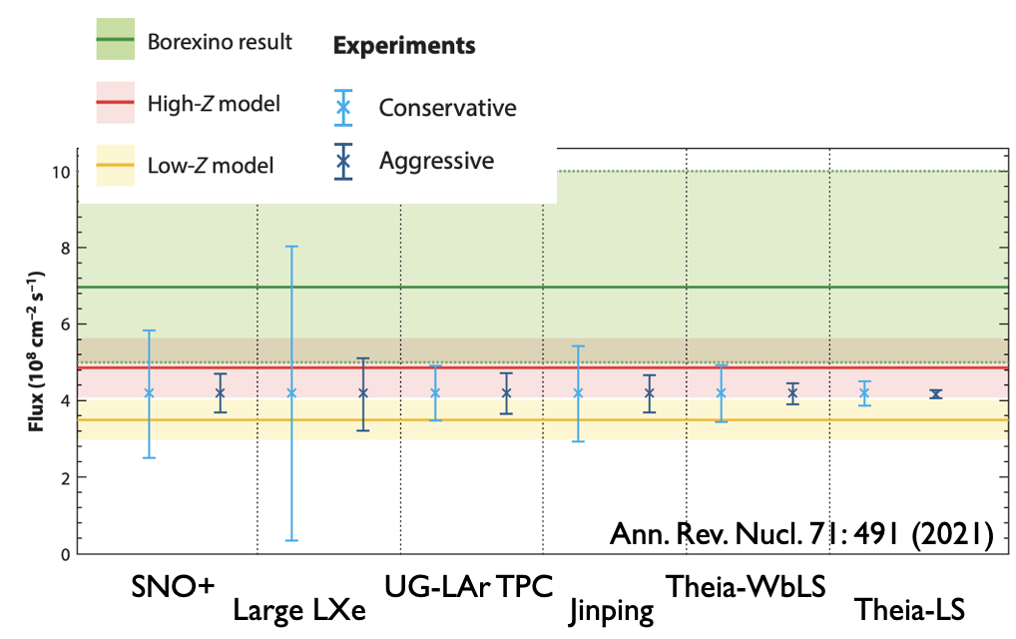
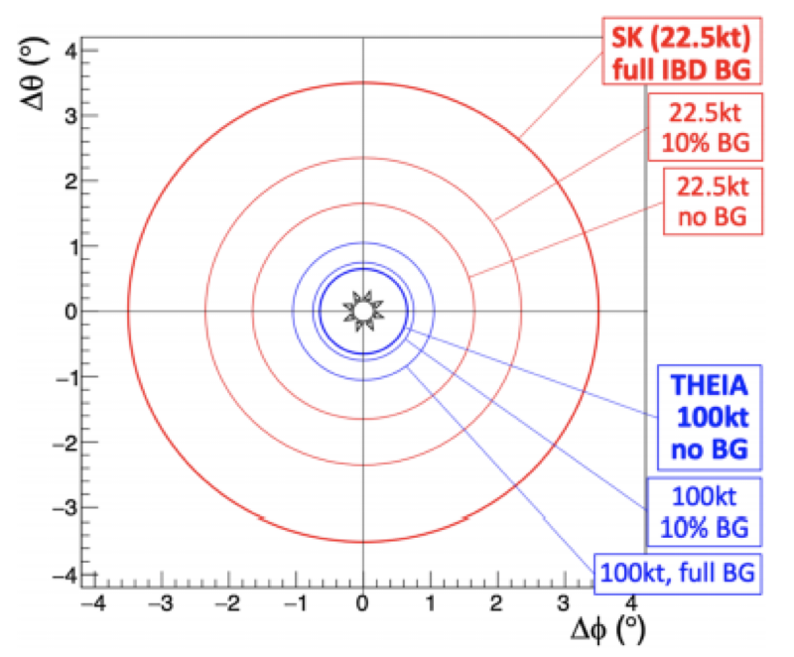
Additional Physics (examples)
Solar Neutrinos
  BG: natural radioactivity
  unique low-E, directional
  PID from scintillator time profile, quenching, Ch/S ratio
Supernova
  ~90% IBD
  ES ⇒ pointing accuracy < 1º
  Mono-E γ from NC
  Flavour-resolved neutrino spectra
  Pre-supernova ν sensitivity (Si-burning)
  Enhanced CC sensitivity with Li doping
CNO flux

Slide 14
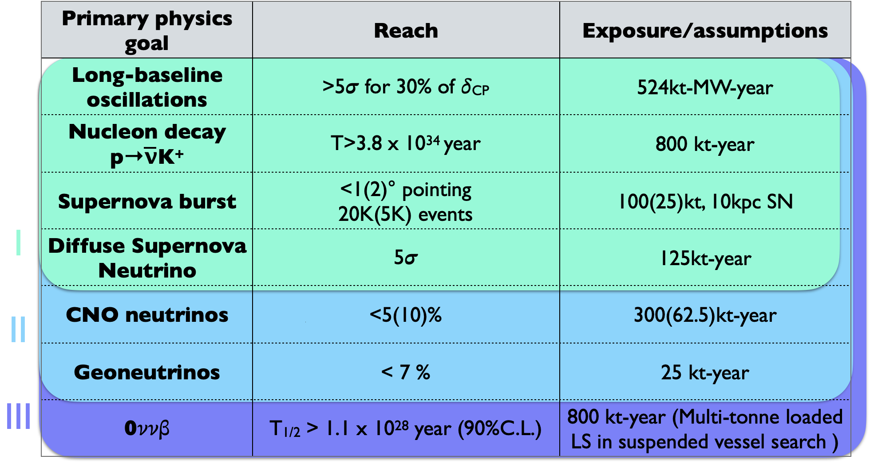
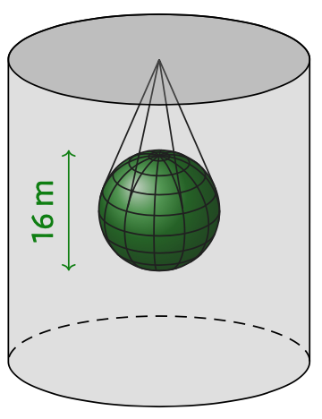
Physics Program
poster
Fri: 578, 596
Snowmass white paper arXiv:2202.12839 and ref. therein

Slide 15
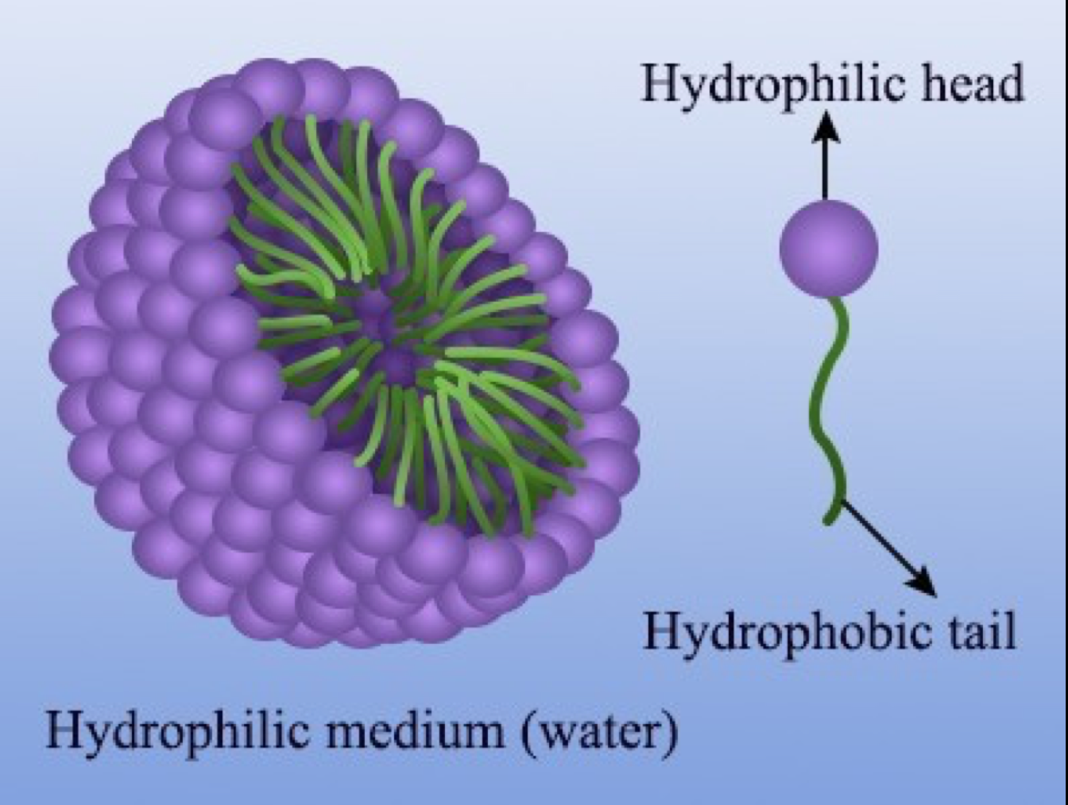

Scintillator Technology
Scintillator can be tuned depending on the physics that is targeted.
(see talks on Saturday)
  Novel concepts of light sensors and light detection techniques for neutrino physics by Ettore Segreto
  Novel Liquid Technologies by Minfang Yeh
Hybrid scintillator (could be water based)
  Tune light level
  Make it slow
  Loading,
  double beta isotopes, …
Active R&D Program

Slide 16
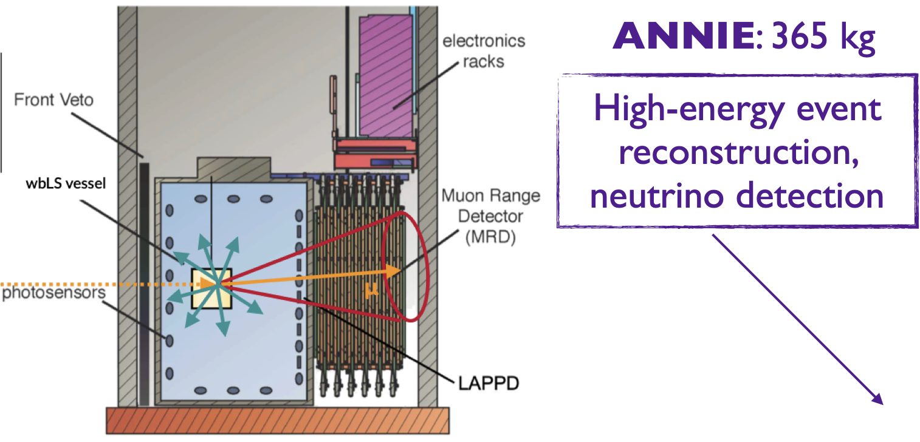
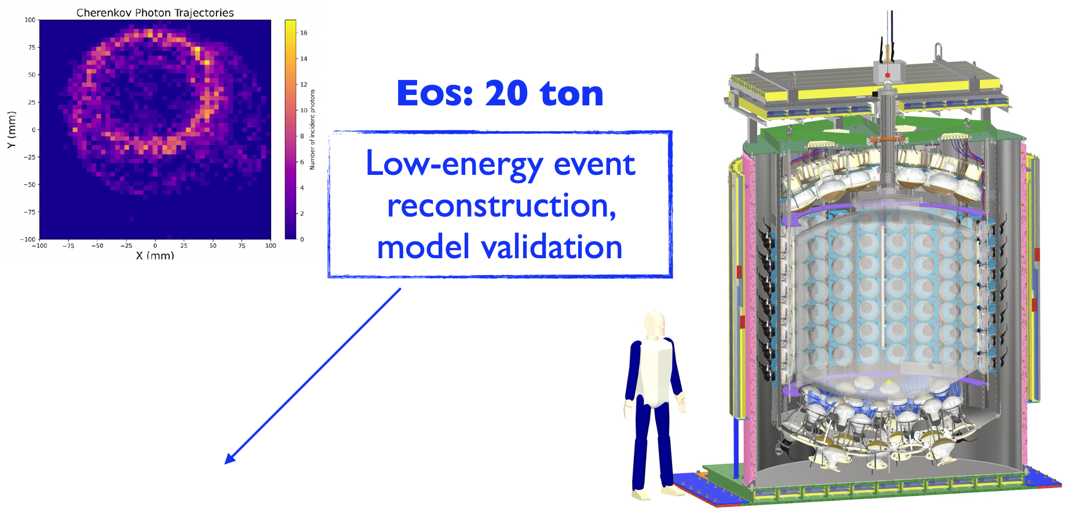
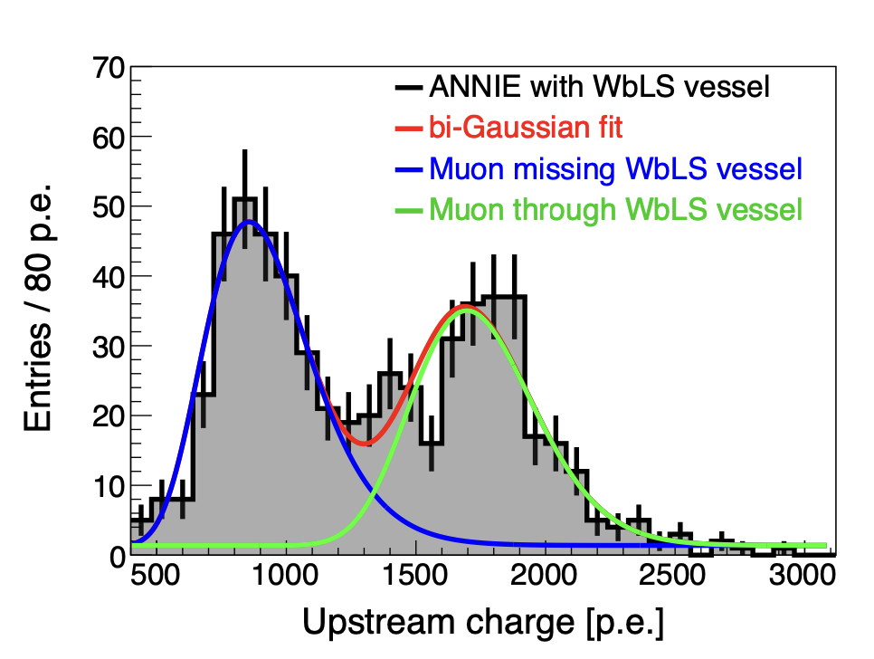
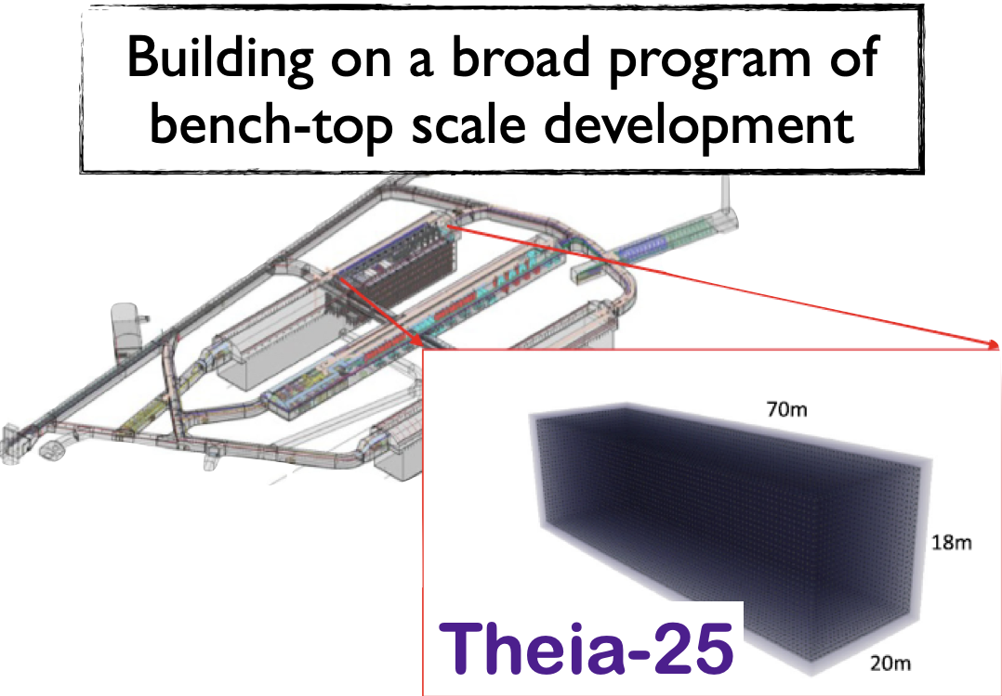
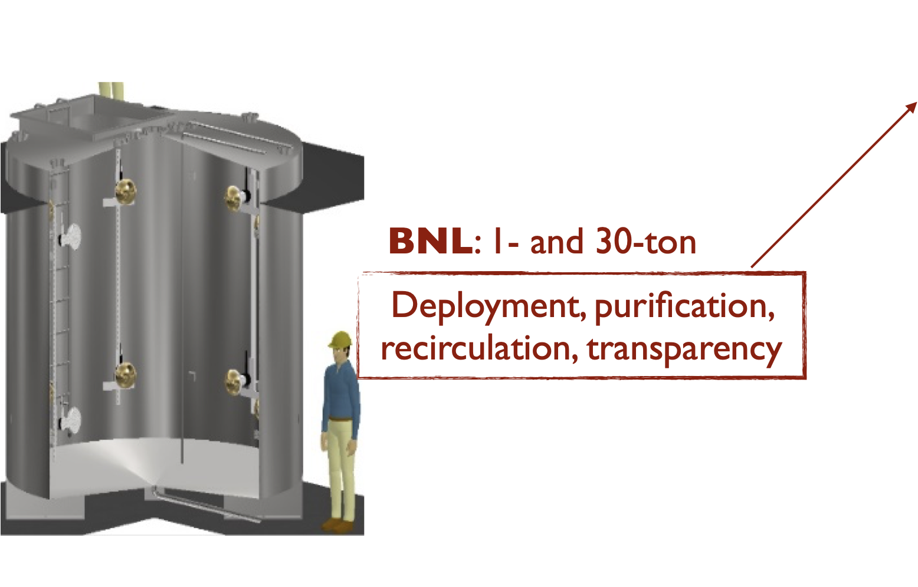
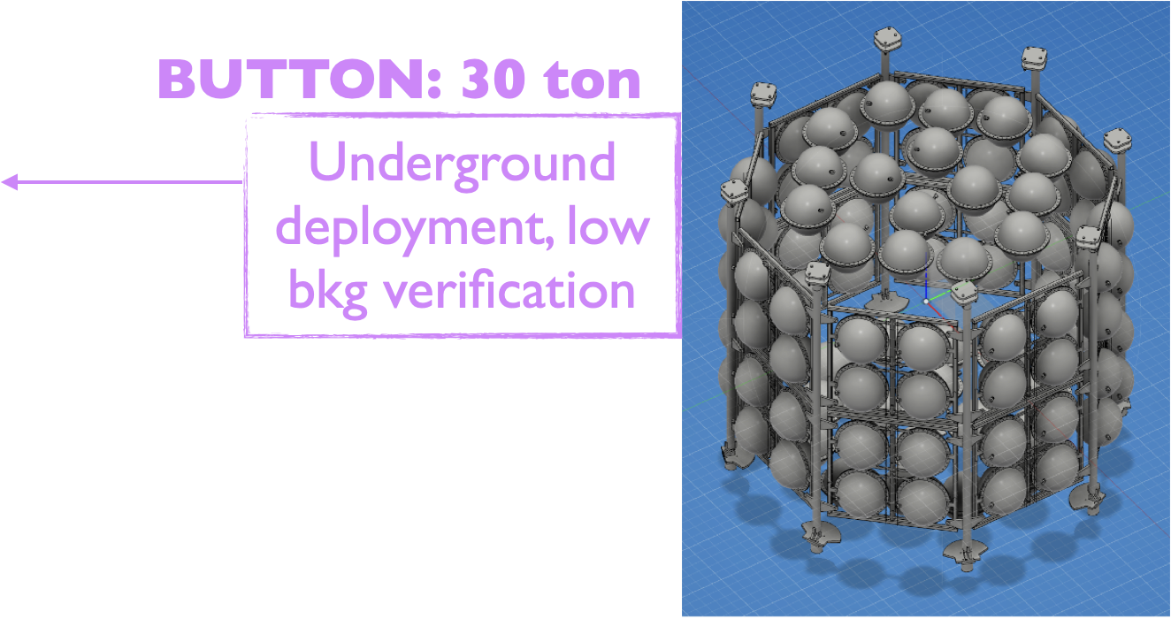
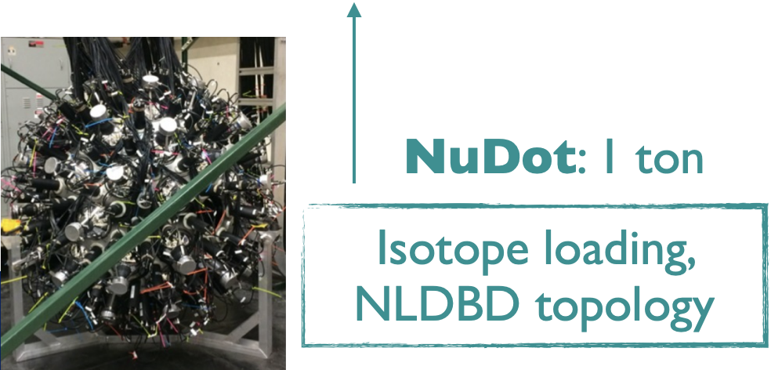
R&D Activities
Tue: 467
Fri: 481, 518, 553

Slide 17

Near Detector
A precision near detector for liquid scintillator or Cherenkov far detectors
Same target as far detector
potentially different technology
High spatial resolution

Slide 18
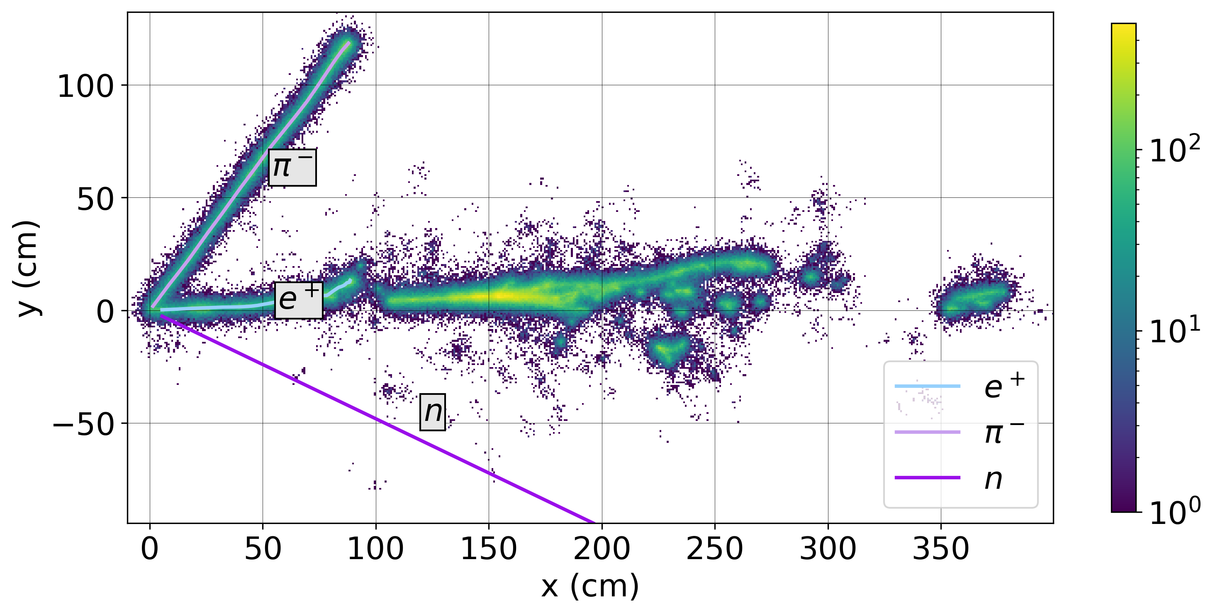
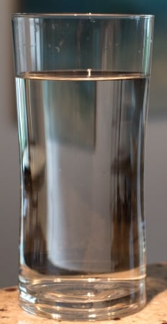


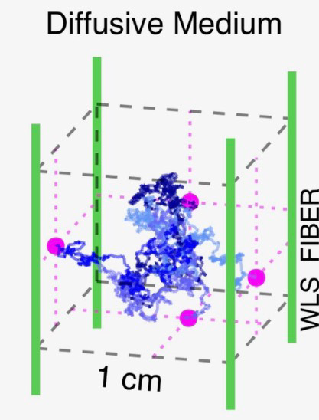
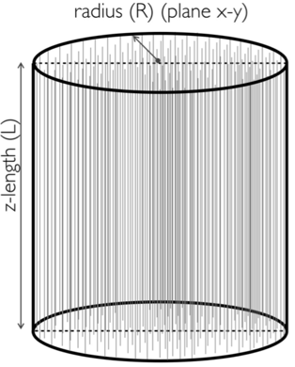
LiquidO Technology
Poster
Tue: 393
Fri: 328, 579, 612, 635
Use same target as Far Detector, but make it opaque
  Scattering, not absorption
Light is stochastically confined
Readout with
wavelength-
shifting fibre
array & SiPM
High resolution O(1 mm)
  detailed image of interaction
Could also be used as
a Far Detector
doi:10.5281/zenodo.7645759

Slide 19
List of Posters
# | Title | Author | Day
328 | CLOUD: the first reactor antineutrino experiment using the novel LiquidO detection technology | D Navas (Ciemat) | Fri
393 | Simulations of the LiquidO-based CLOUD Inner Detector | S Wakely (JGU Mainz) | Tue
467 | The Science of the Accelerator Neutrino Neutron Interaction Experiment | F Lemmons (SDSM) | Fri
481 | First Neutrinos on Large Picosecond Photodetectors in ANNIE | A Weinstein, M Wetstein (Iowa State U) | Fri
518 | Deployment of water-based liquid scintillator in ANNIE | A Augusthy, N Göhlke (JGU Mainz) | Fri
545 | Scintillation and Cherenkov Light Separation in Novel Liquid Scintillators for Large Scale Neutrino Detectors | J Steiger, M Lu (TU Munich) | Tue
553 | Initial Look at Event Reconstruction in ANNIE | J He (UC Davis) | Fri
578 | The broad physics Program of Theia | L Lebanowski (UC Berkeley) | Fri
579 | Simulation of CLOUD, the first LiquidO reactor neutrino experiment | C Girard-Carillo (JGU Mainz) | Fri
596 | Technology and reconstruction development for Theia | T Kaptanoglu (UC Berkeley) | Fri
612 | Deep Learning Event Reconstruction Techniques for the CLOUD LiquidO Based Experiment | G Wendel (Penn State) | Fri
635 | The SuperChooz project: a LiquidO-based neutrino oscillation experiment | R Gazzini (IJCLab) | Fri
# is linked to poster

Slide 20
Summary and Conclusion
Ideas/proposals to expand the physics reach of future LBL facilities
  Korea Neutrino Observatory
  Theia@DUNE
Extract additional physics to fully exploit the massive investment
  Solar neutrinos
  Supernova & Diffuse SN background
  (neutrino-less) double beta decay
  Baryon number violation
Active R&D program & supporting community
  Photon Detectors
  Hybrid & opaque scintillators
  Scaling up
Let’s realise the potential!

