Slide 1
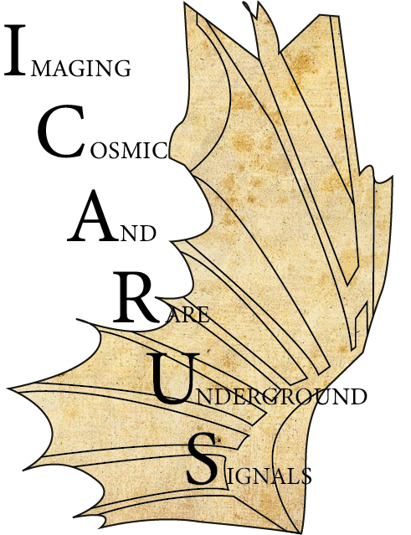
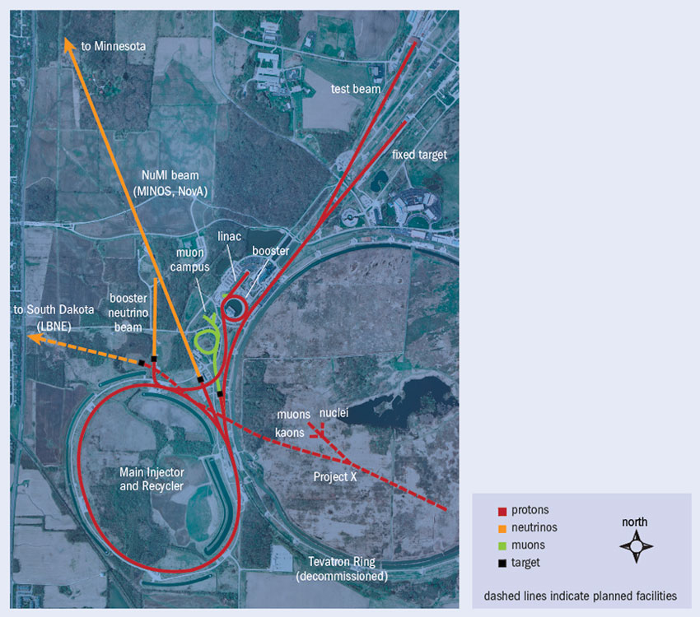
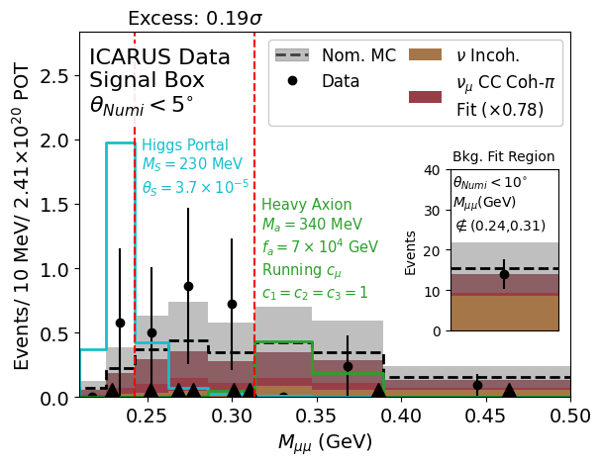
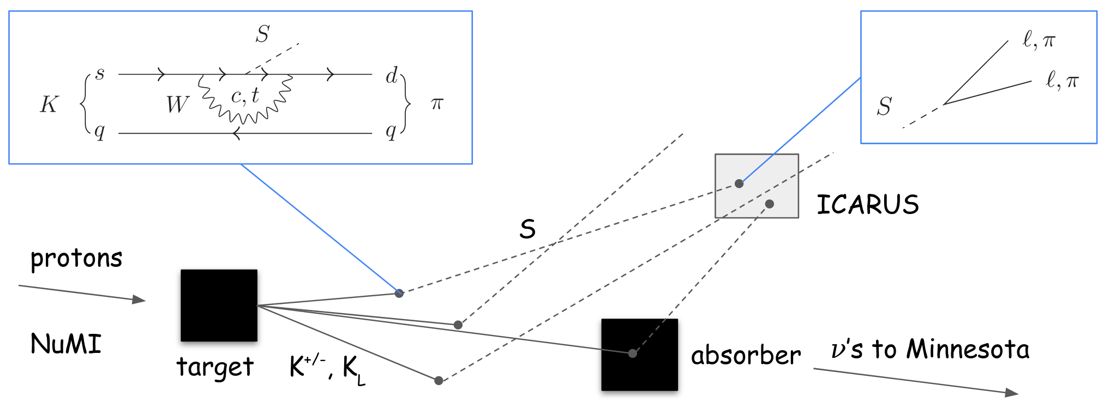
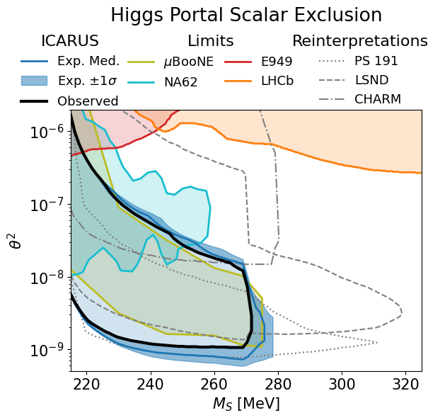
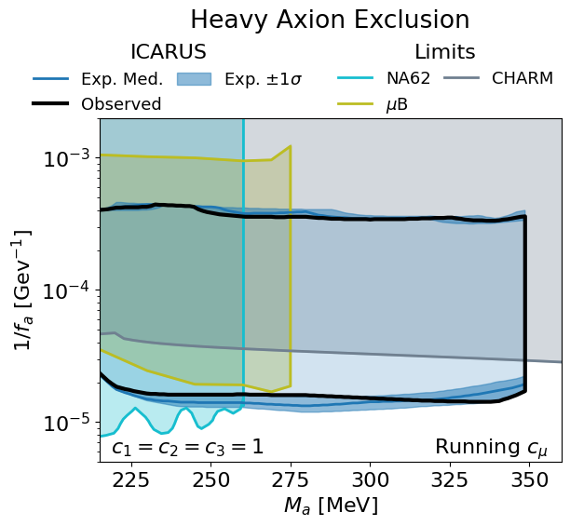
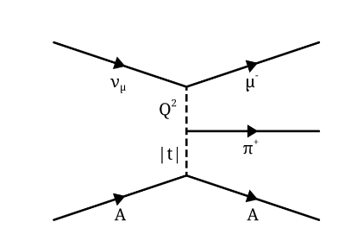
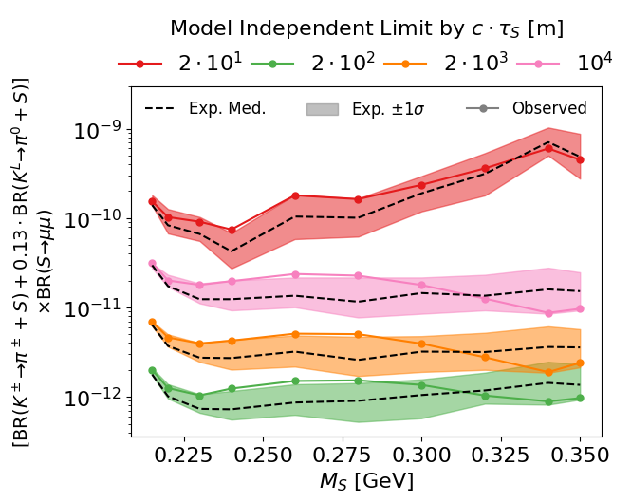
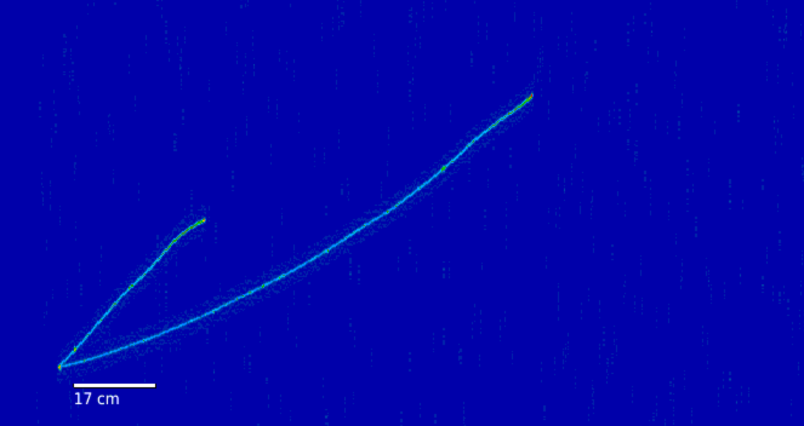
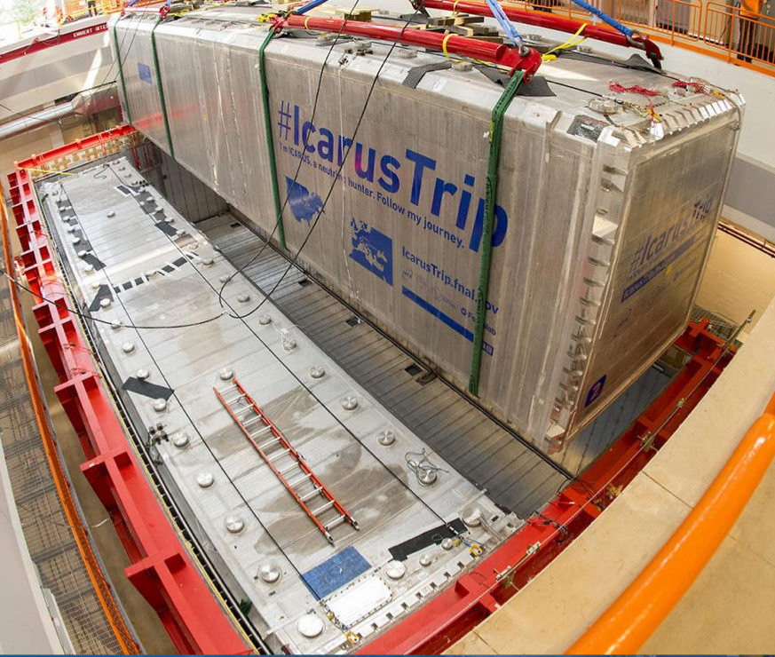
Search for a Long-Lived $μμ$ Resonance in the NuMI Beam at ICARUS
Gray Putnam, Fermilab
On behalf of ICARUS Collaboration
Searching for New Physics at ICARUS
Signal Box Result
The ICARUS neutrino detector¹ is at the intersection of the BNB and NuMI neutrino beams at Fermilab.
New physics particles like the Higgs Portal Scalar² (HPS) and an Axion-Like Particle³ (ALP) can be produced in kaon decay in the NuMI target, travel to ICARUS, and decay into SM final states (including $μμ$!)
Overhead view of Fermilab $ν$ experiments
ICARUS
Preliminary
Below: Production and decay of a Scalar particle (the Higgs Portal Scalar) in ICARUS with the NuMI beam.
A scale factor is fit to the $ν_{μ}$ CC Coh.-$π$ rate in a control region and simultaneously a bump-hunter algorithm identifies the significance of any excess.
No new physics is found. The biggest excess is $0.19σ$.
Limits on LLP Models
Imaging $μμ$ Decays with the ICARUS LArTPC
Preliminary
Calorimetric and topological information distinguish stopping $μμ$ events. Kinematic cuts further reject the neutrino background.
The residual background is mostly: $ν_{μ}$ CC Coherent-$π$ scattering (right).
Preliminary
Diagram of background $ν_{μ}$ CC Coh.-$π$ scattering process.
The null result enables limits to be set on the Higgs Portal Scalar (top left) and a muon-coupled heavy axion (top right).
More generally, we can also set model-independent limits (left) on the process:
$K→π+S(→μμ)$
ICARUS MC
HPS $→μμ$
$M_{S}:$265 MeV
Preliminary
$$μ$$
Simulated image of particle trajectories taken with the ICARUS detector (above).
$$μ$$
This is the first particle physics result at ICARUS!
Future searches are planned and ongoing, including with other final states and using the NuMI beam structure timing.
34 cm
This material is based upon work supported by the National Science Foundation Graduate Research Fellowship under Grant No. DGE-1746045. It will be part of the UChicago thesis: Search For A Long-Lived Di-Muon Resonance in The NuMI Beam at The ICARUS Experiment.
1: P. Abratenko, et al., Eur. Phys. J. C 83, 467 (2023).
2: B. Batell, J. Berger, and A. Ismail, Rev. D 100, 115039 (2019)
3: J. Berger and G. Putnam, arXiv:2405.18480

