Slide 1
Qub-IT @ INFN Pisa
Claudio Puglia, Gianluca Lamanna
25 Ottobre 2023

Slide 2
Radiofrequency PCB
Faraday Cage
Measurement setup

Slide 3
1
PCB: requirements
4x radiofrequency lines
Operation frequency 4-8 GHz (minimal range)
Sample space: 10x5 mm², 10x2.5 mm², 5x5 mm²

Slide 4
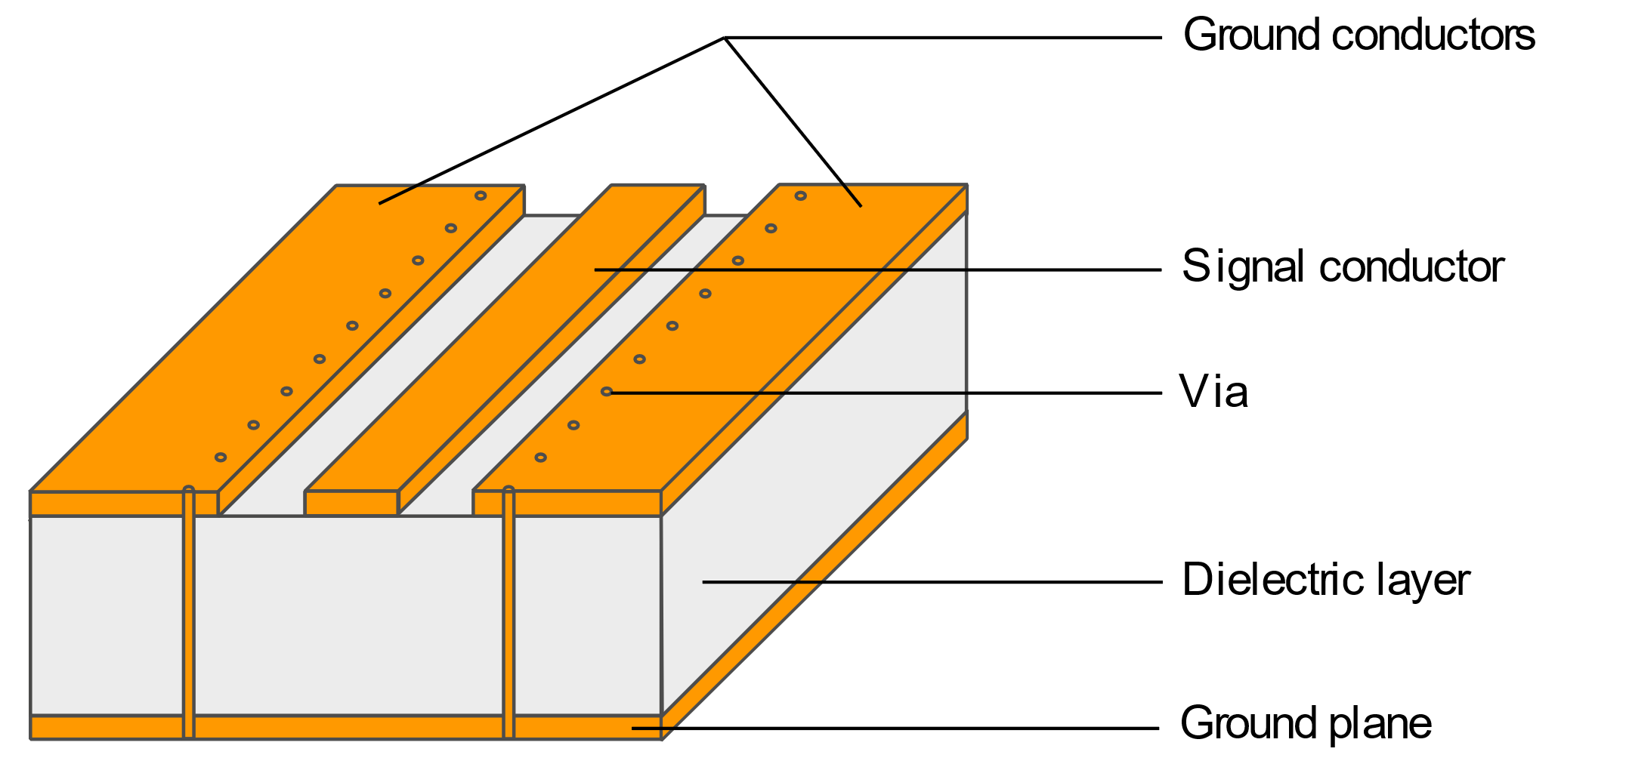
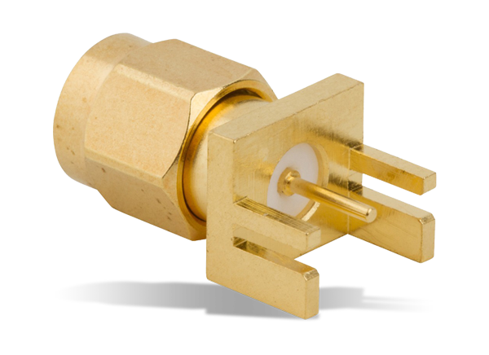
1
PCB: requirements
4x radiofrequency lines
Operation frequency 4-8 GHz (minimal range)
Sample space: 10x5 mm², 10x2.5 mm², 5x5 mm²
Coplanar waveguide technology (CPW)
SMA Standard

Slide 5
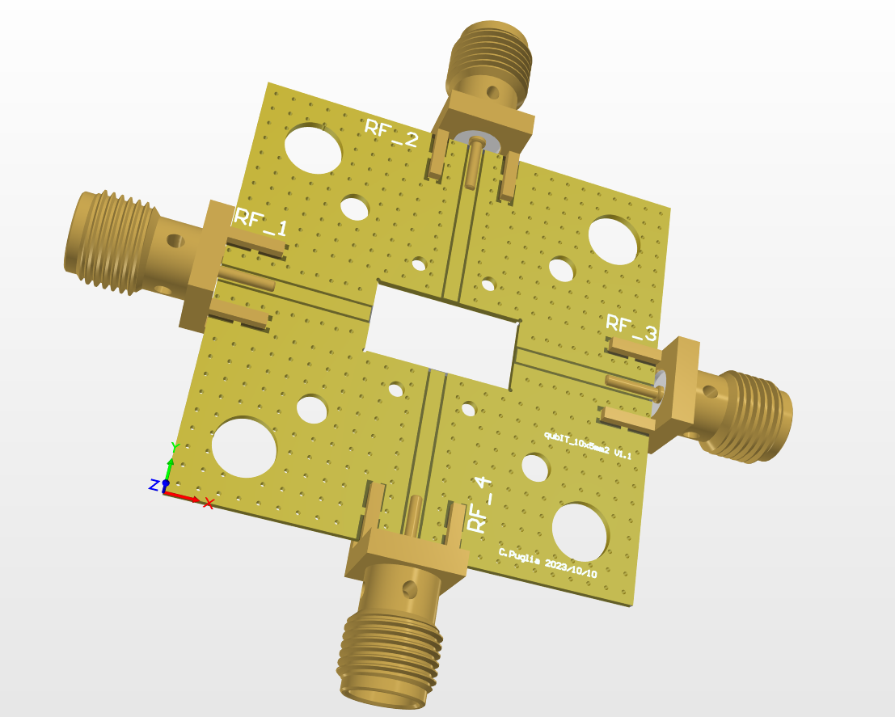
1
PCB: design
2x Copper layes (Signale + Ground)
Rogers 4003C, thickness 20 mil (508 µm)
Clamp anchoring
Sample

Slide 6
1
PCB: design
Sample
Mounting screw clamps
PCB-to-Bottom screws
Top-to-Bottom screws

Slide 7
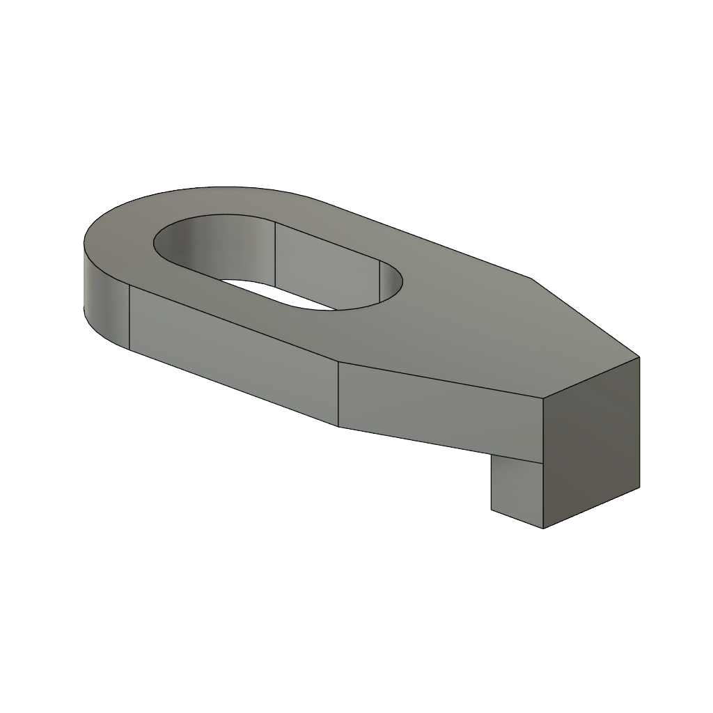
1
PCB: design
Clamp
Sample
Mounting screw clamps
PCB-to-Bottom screws
Top-to-Bottom screws

Slide 8
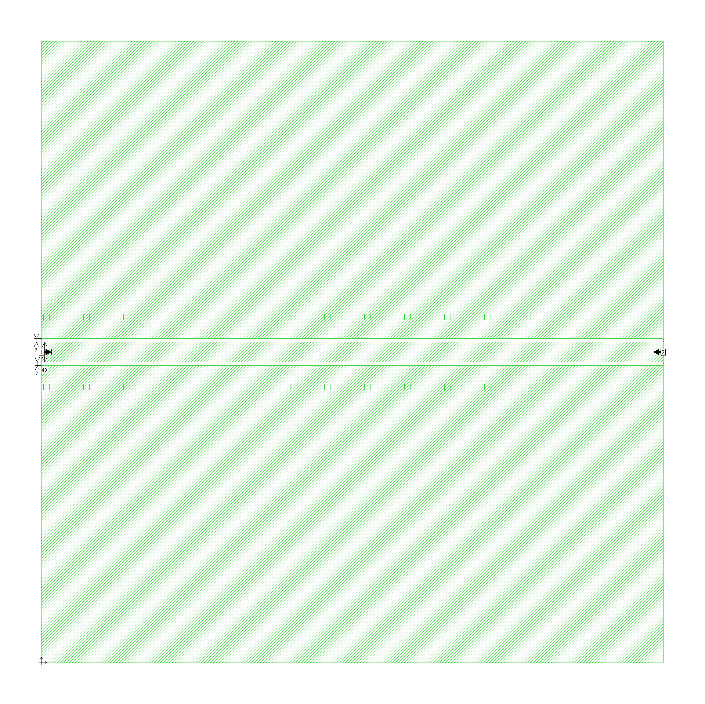
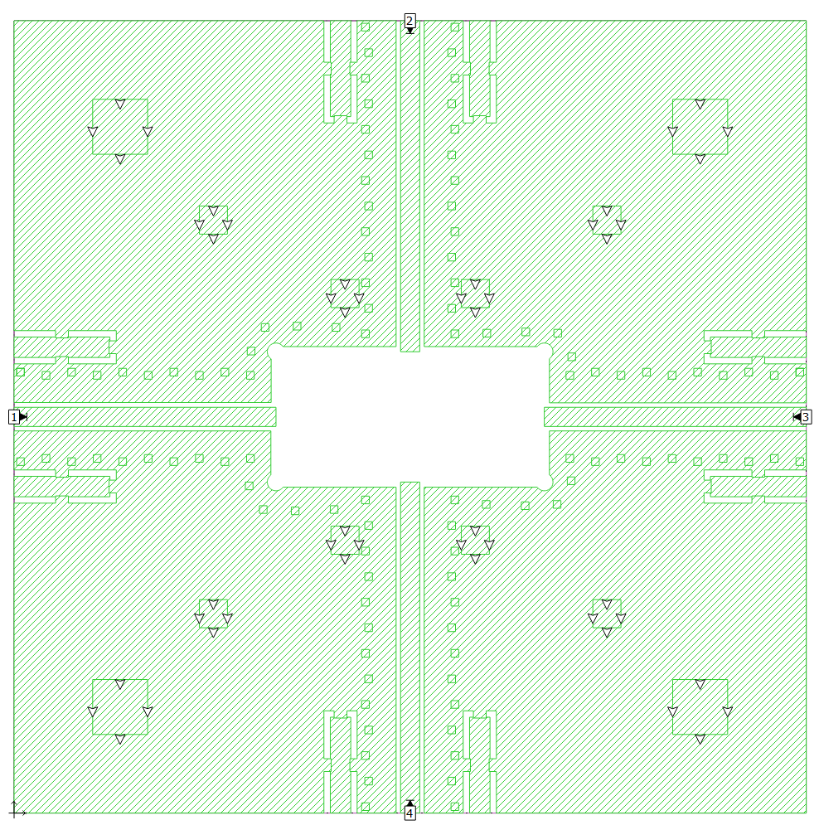
PCB: simulation
1
Clamp
1
2

Slide 9
1
PCB: simulation
2
1

Slide 10
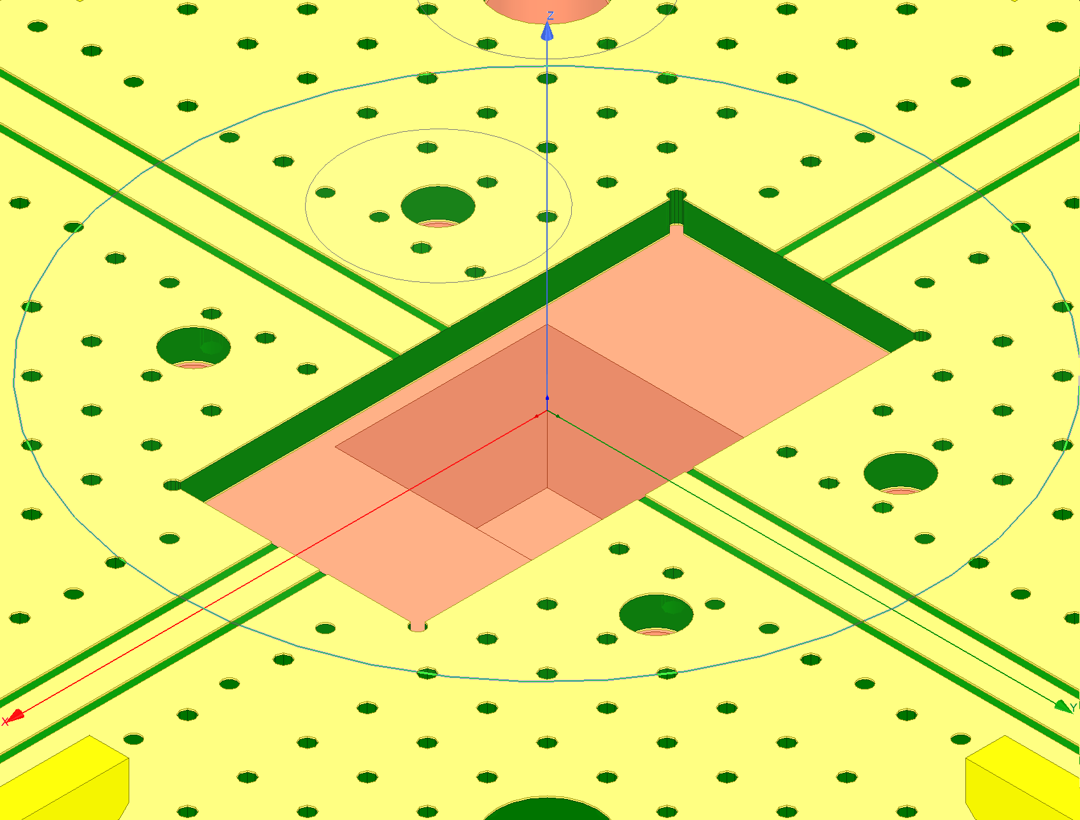
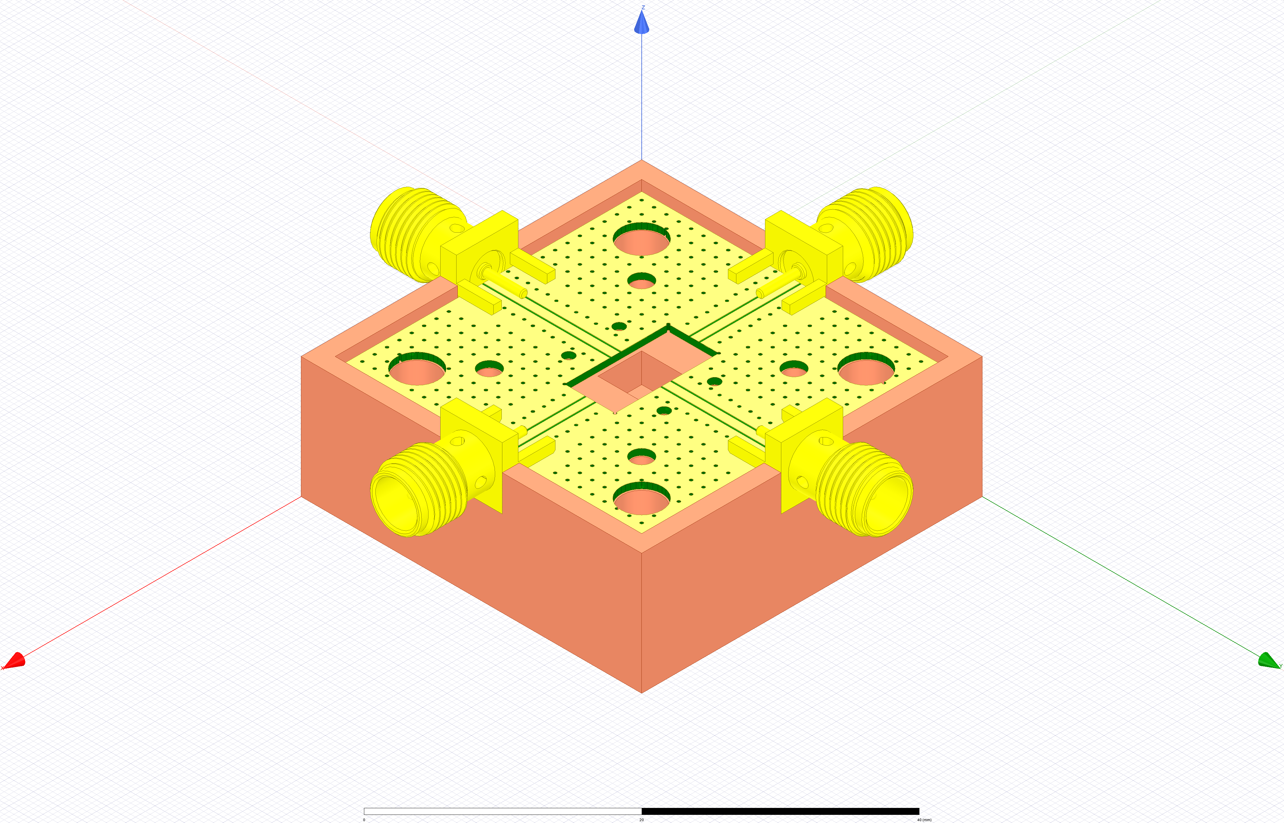
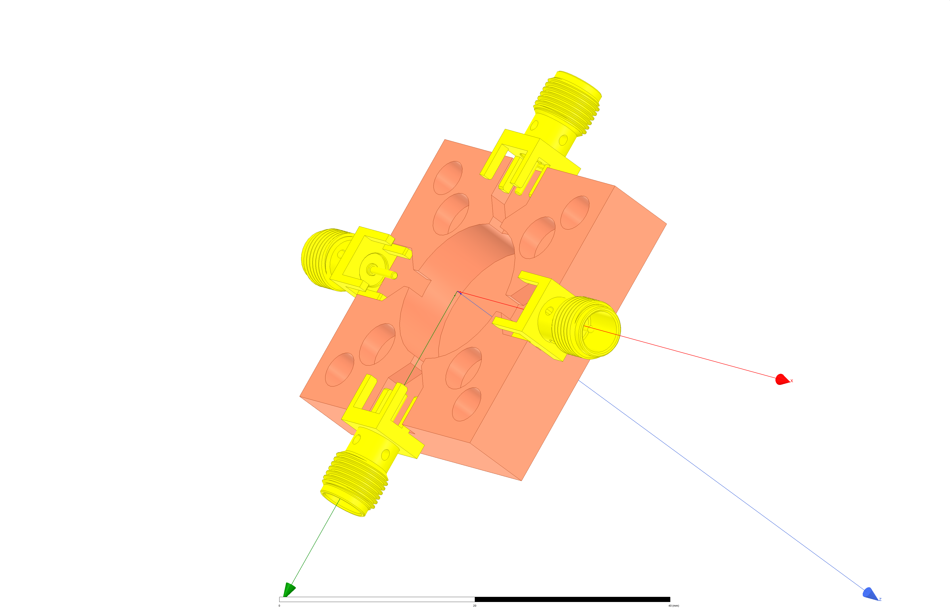
2
Faraday cage
Top
Bottom

Slide 11
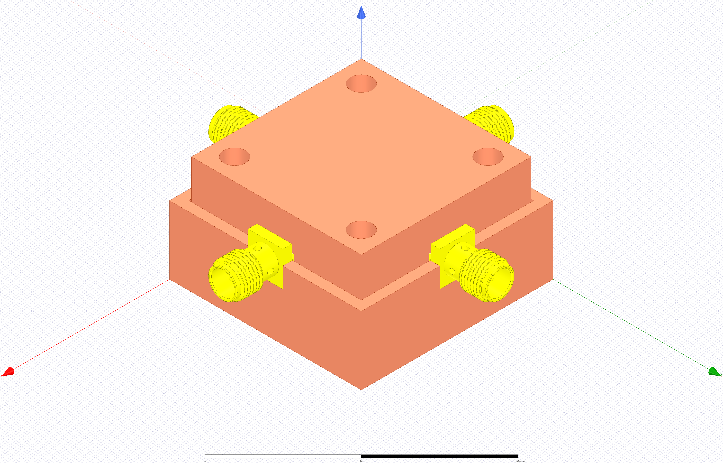
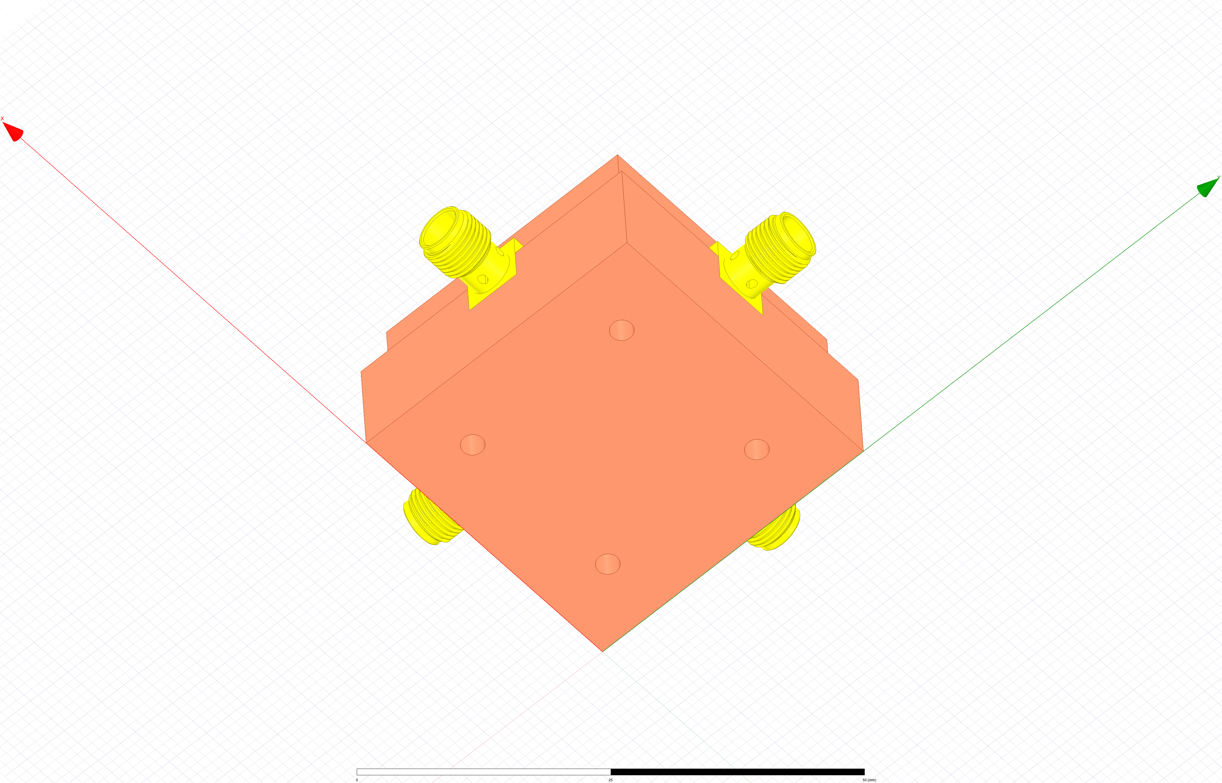
2
Faraday cage
19.4 mm
12.5 mm
35 mm
Retaining screws
Top view
Bottom view

Slide 12
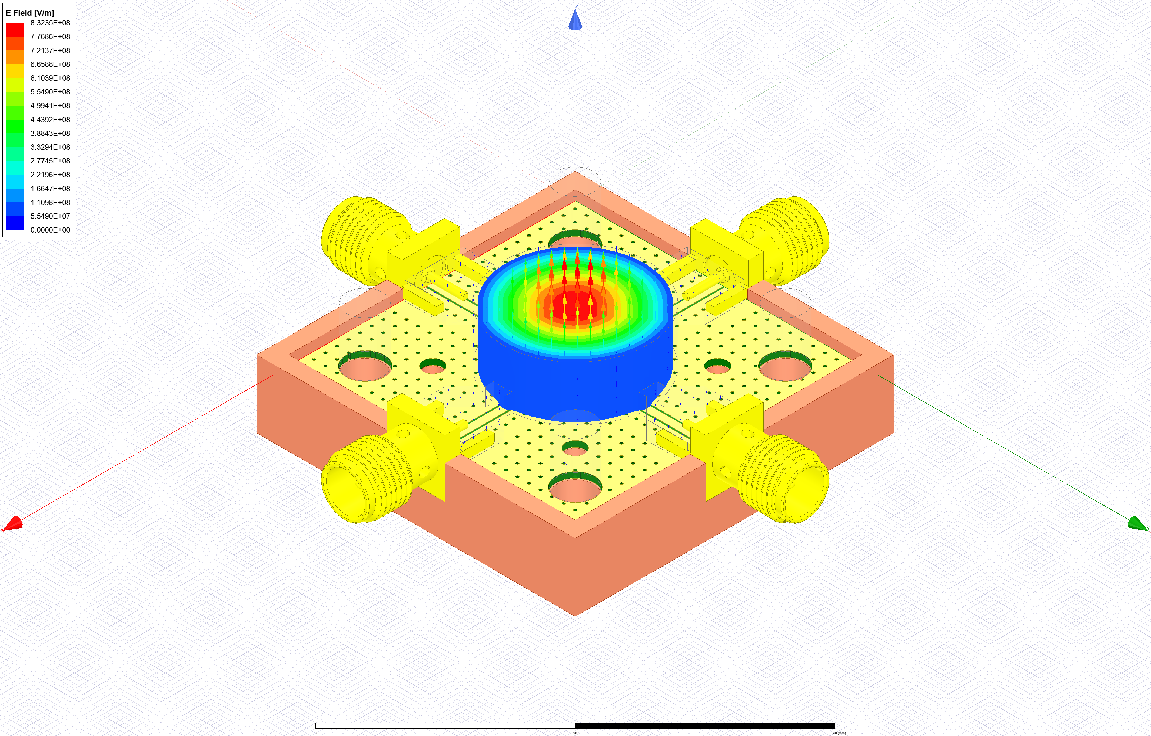
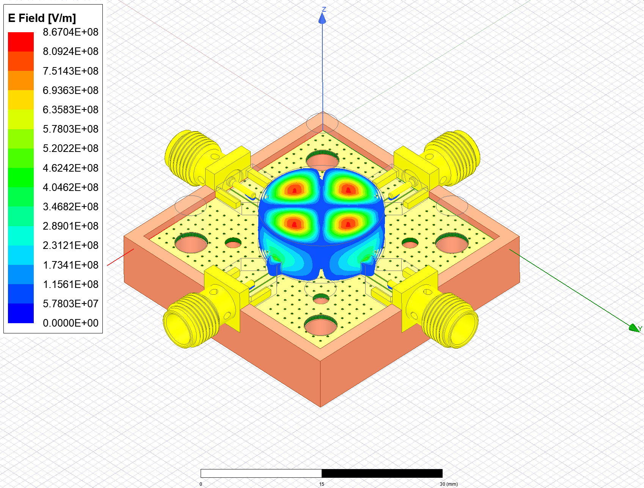
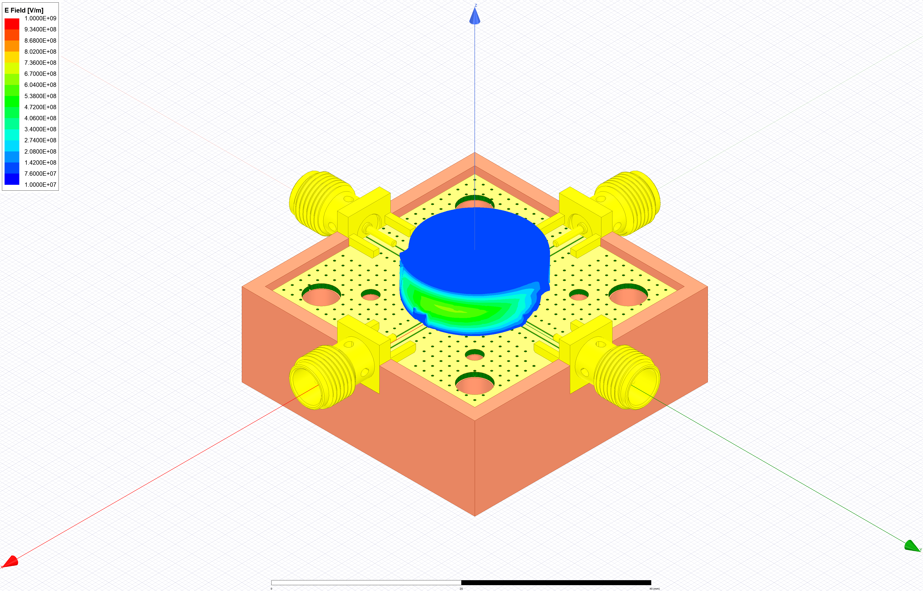
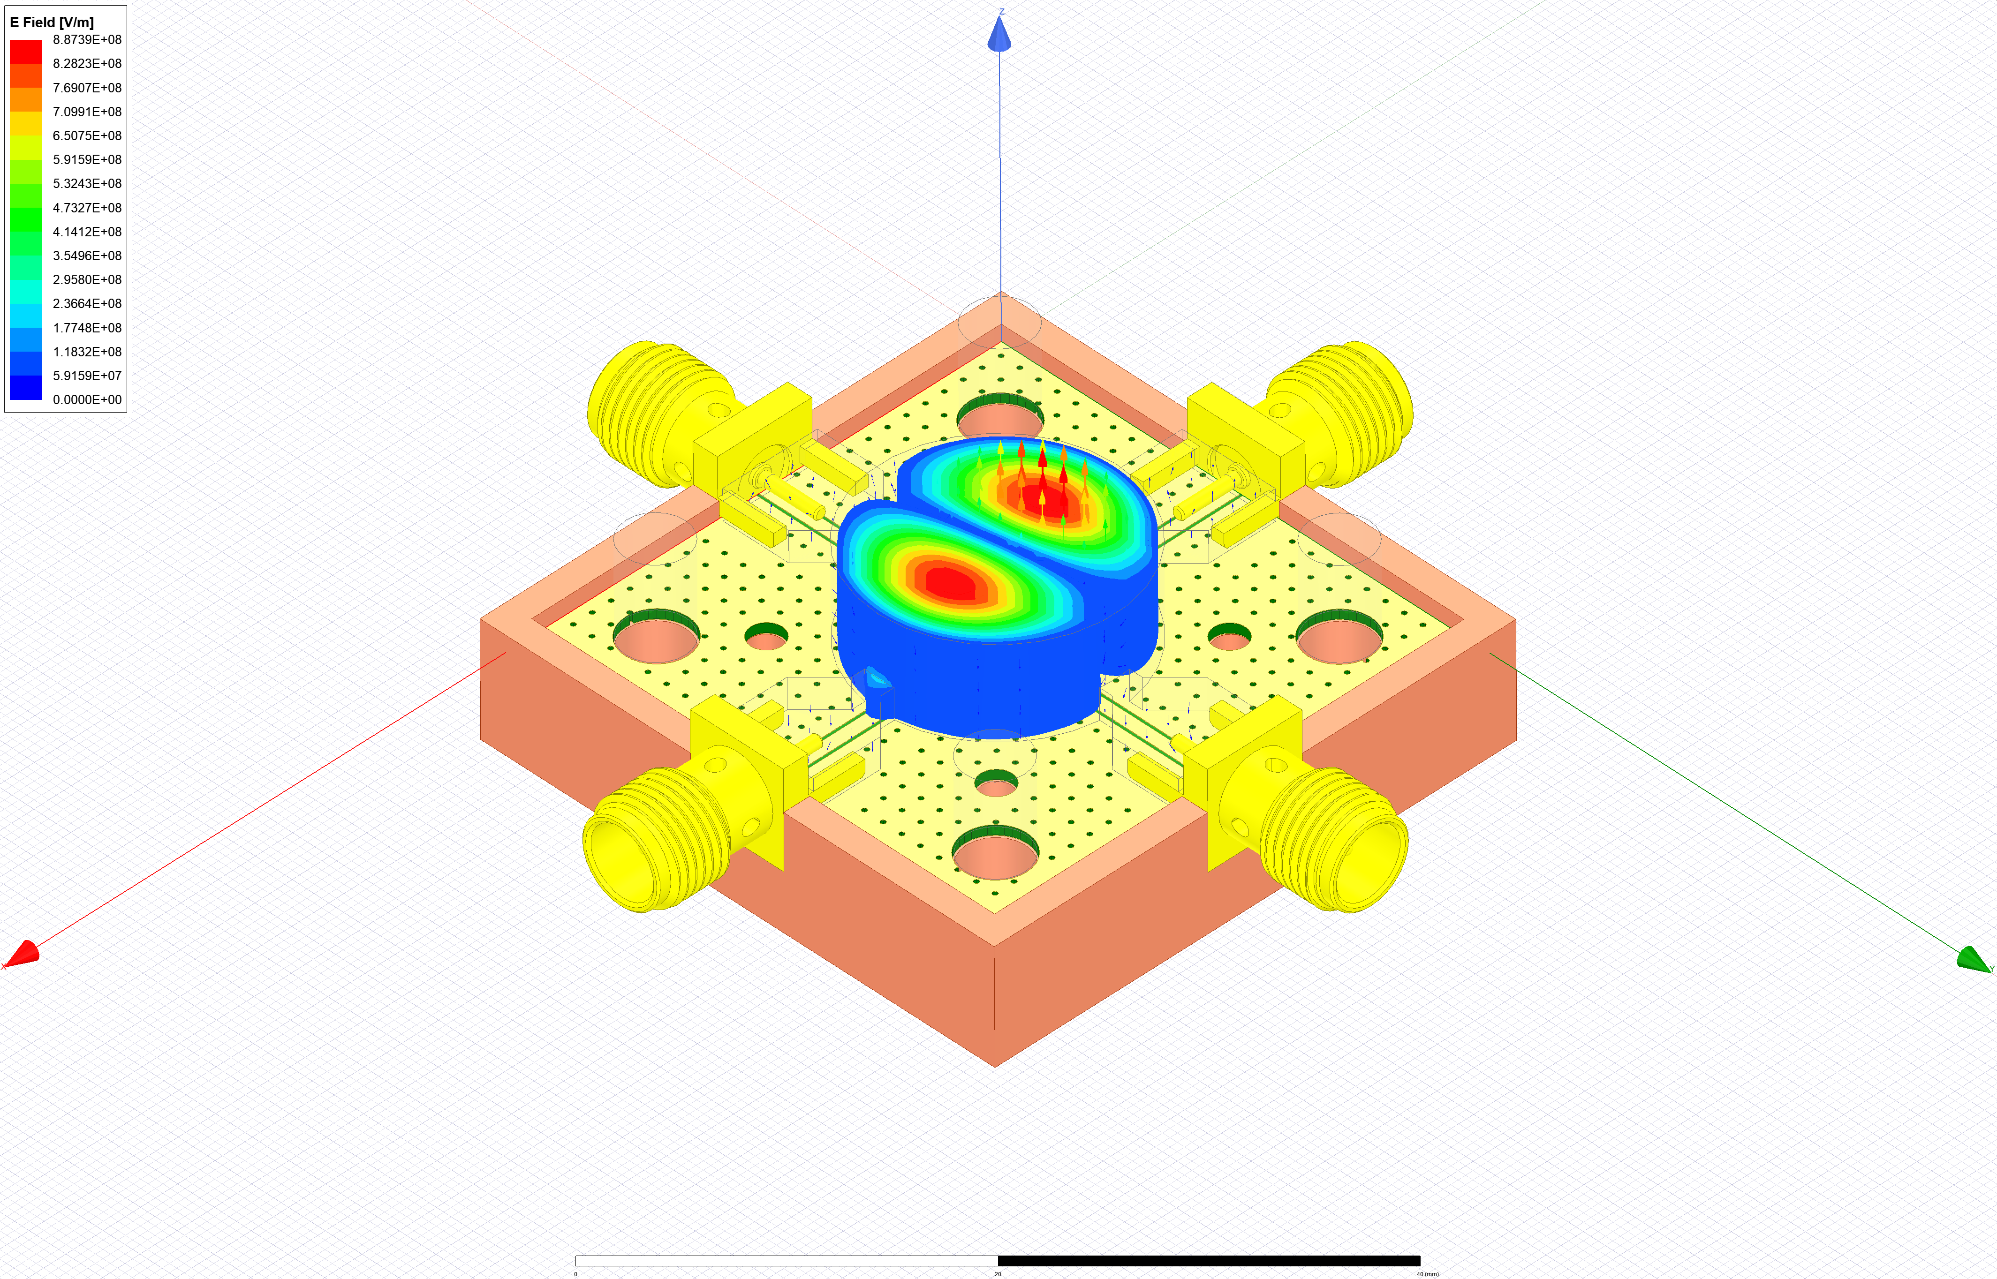
2
Faraday cage
 | Attesa (GHz) | No Chip | Chip | Q
TM010 | 14.34 | 14.313 | 14.089 | 6613
TM110 | 22.85 | 22.80 | 22.38 | 9000
TE111 | 27.29 | 27.22 | 26.6 | 9600
TM011 | 28.81 | 28.69 | 28.12 | 6900
TE211 | 30.92 | 30.63 | 29.79 | 11000
TM010
TM210
TE111
TM110

Slide 13
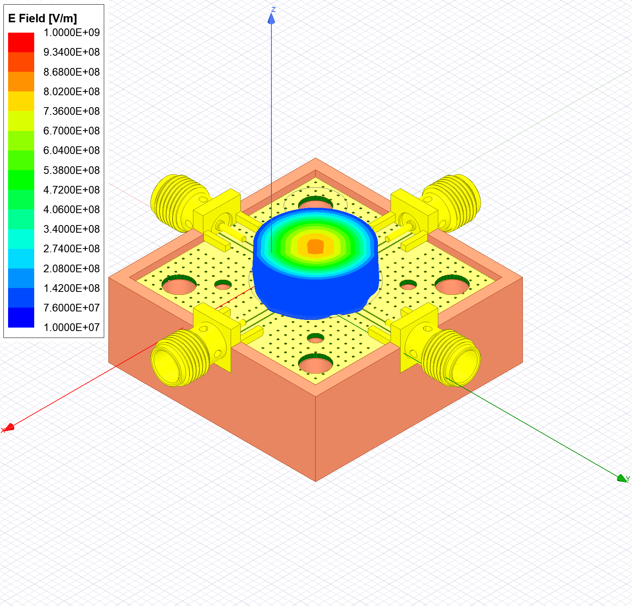
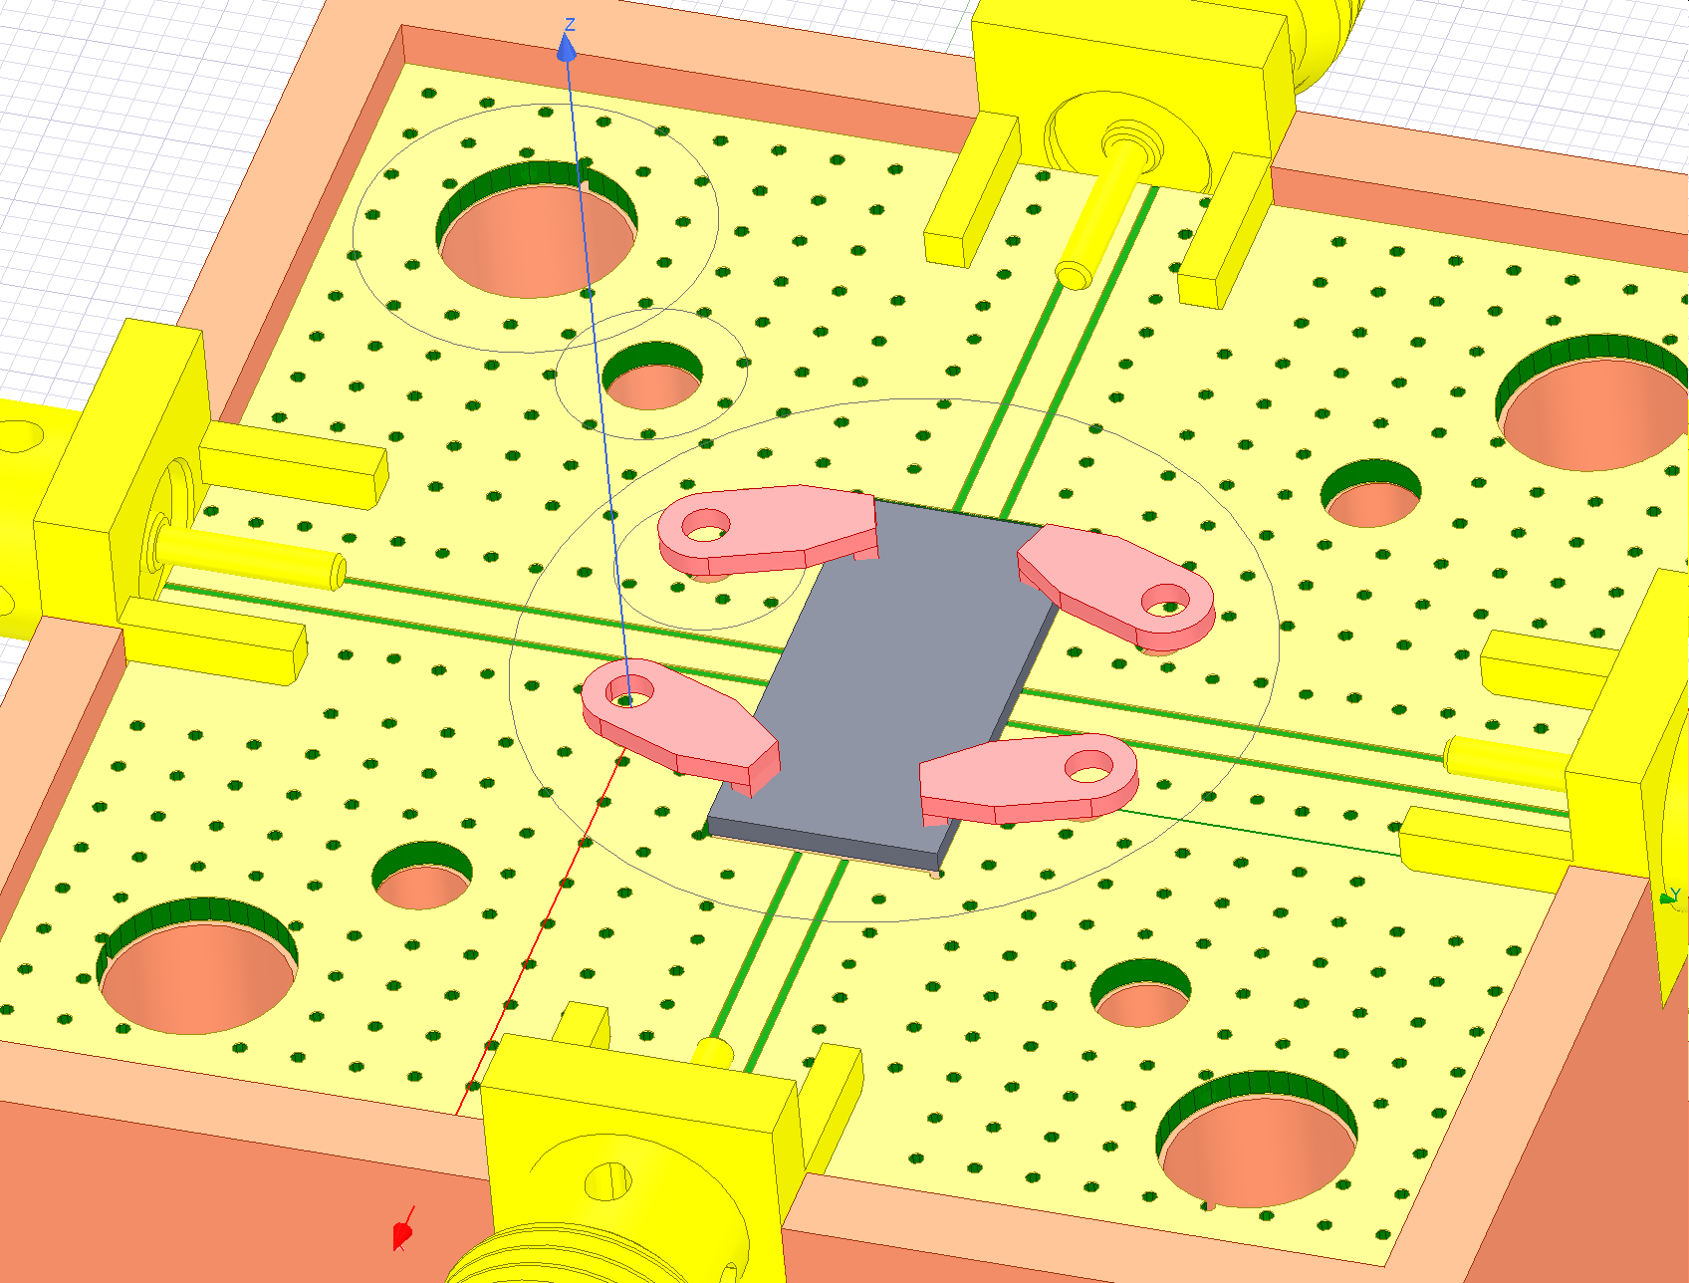
2
Faraday cage
The clamps have almost no effect on the resonance frequencies:
TM010 from 14.089 GHz to 14.13 GHz

Slide 14
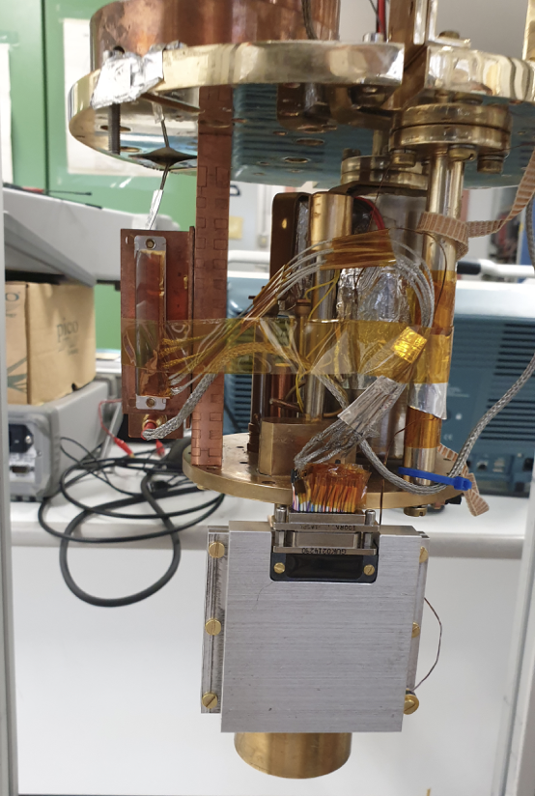
3
Measurement setup
Custom 300 mK
T~ 280 mK
Cooldown < 24 h
Capabilities:
37x DC lines
37x DC lines
4x SS-SS + NbTi-NnTi coaxial lines

Slide 15
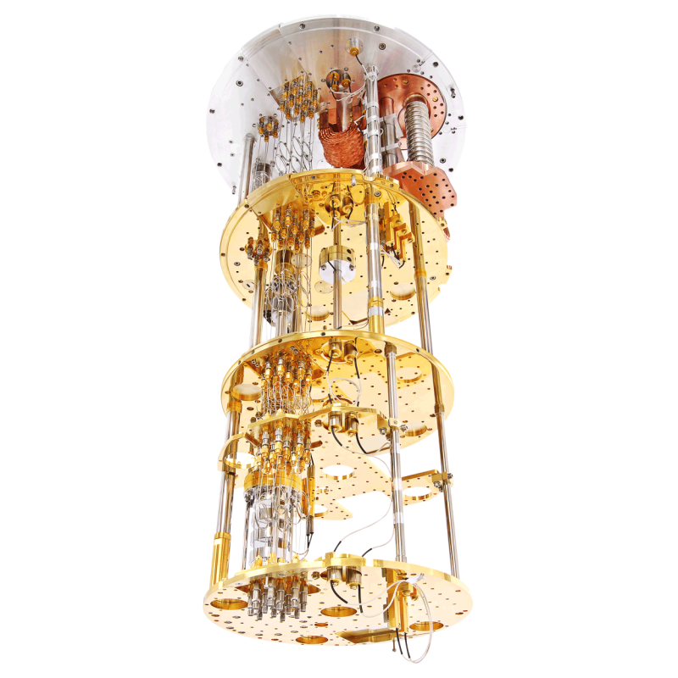
3
Measurement setup
Custom 300 mK
T~ 280 mK
Cooldown < 24 h
T~ 10 mK
Cooldown < 72 h
Magnetic field 6-1-1
August 2024
8x coaxial lines
48x DC lines
Capabilities:
37x DC lines
37x DC lines
4x SS-SS + NbTi-NnTi coaxial lines

Slide 16
Claudio Puglia
claudio.puglia@pi.infn.it
25/10/2023

