Slide 1

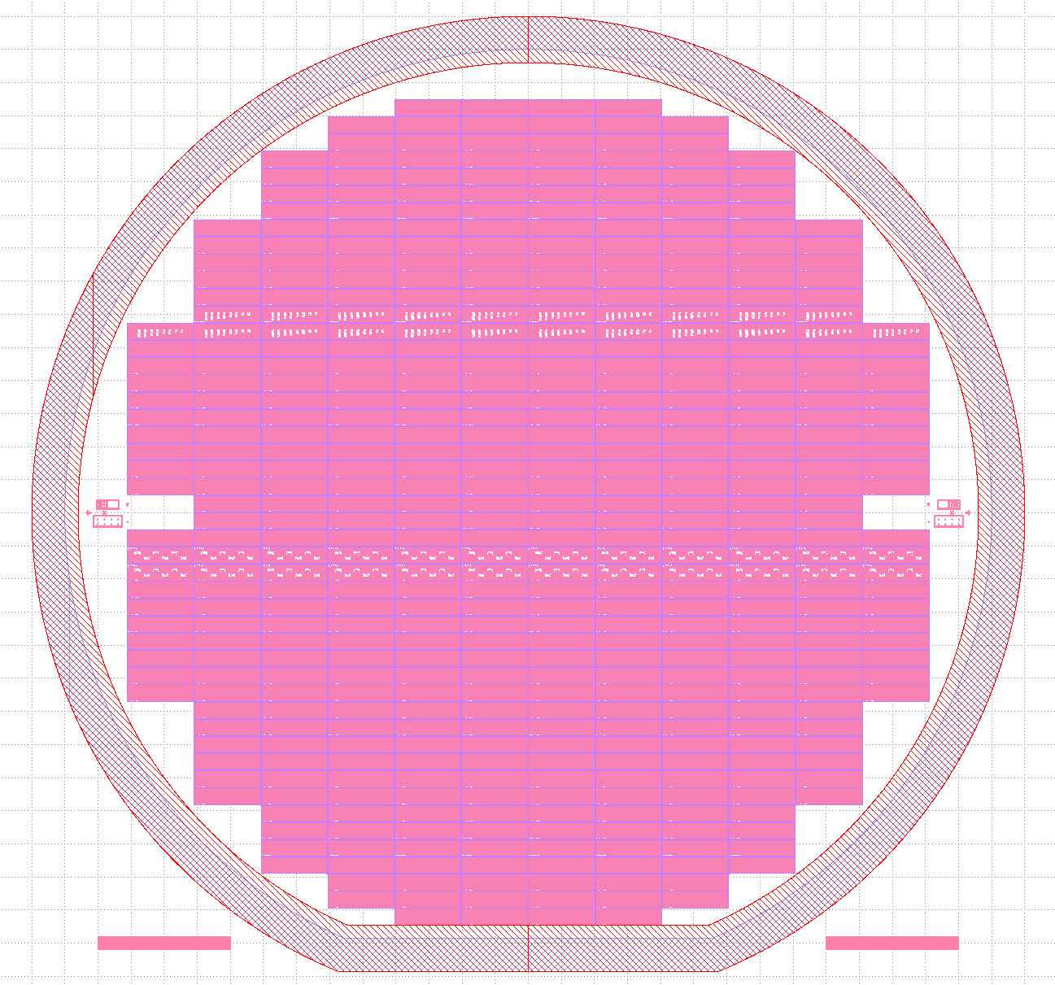

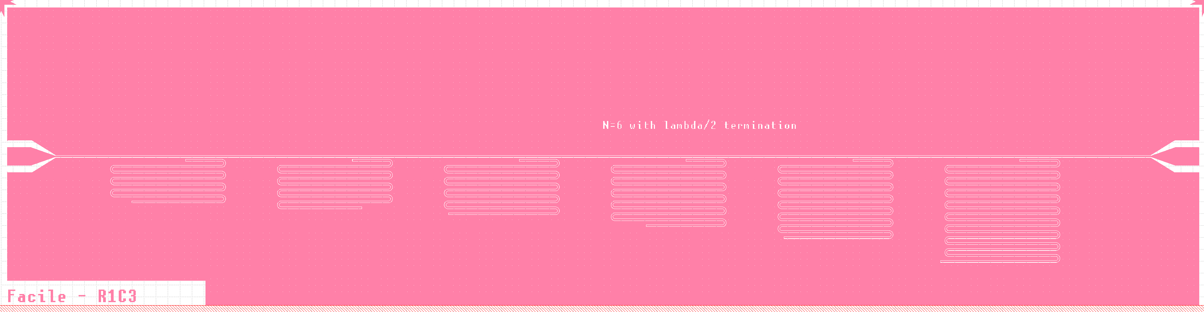

New multi purpose resonator test mask @ FBK
Transmission line resonators (CPW):
various couplings
λ/2 & λ /4
optimized for Lk=0pH/sq, 10pH/sq, 30pH/sq

Slide 2
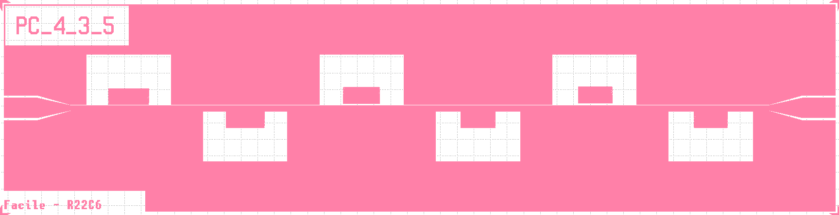
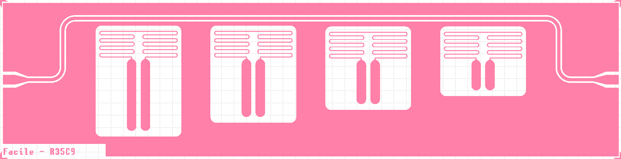
New multi purpose resonator test mask @ FBK
Lumped element resonators:
Benchmark design PC_4_3_5 (used in ResTest3 & 4)
Large design optimised for microfabrication development

Slide 3

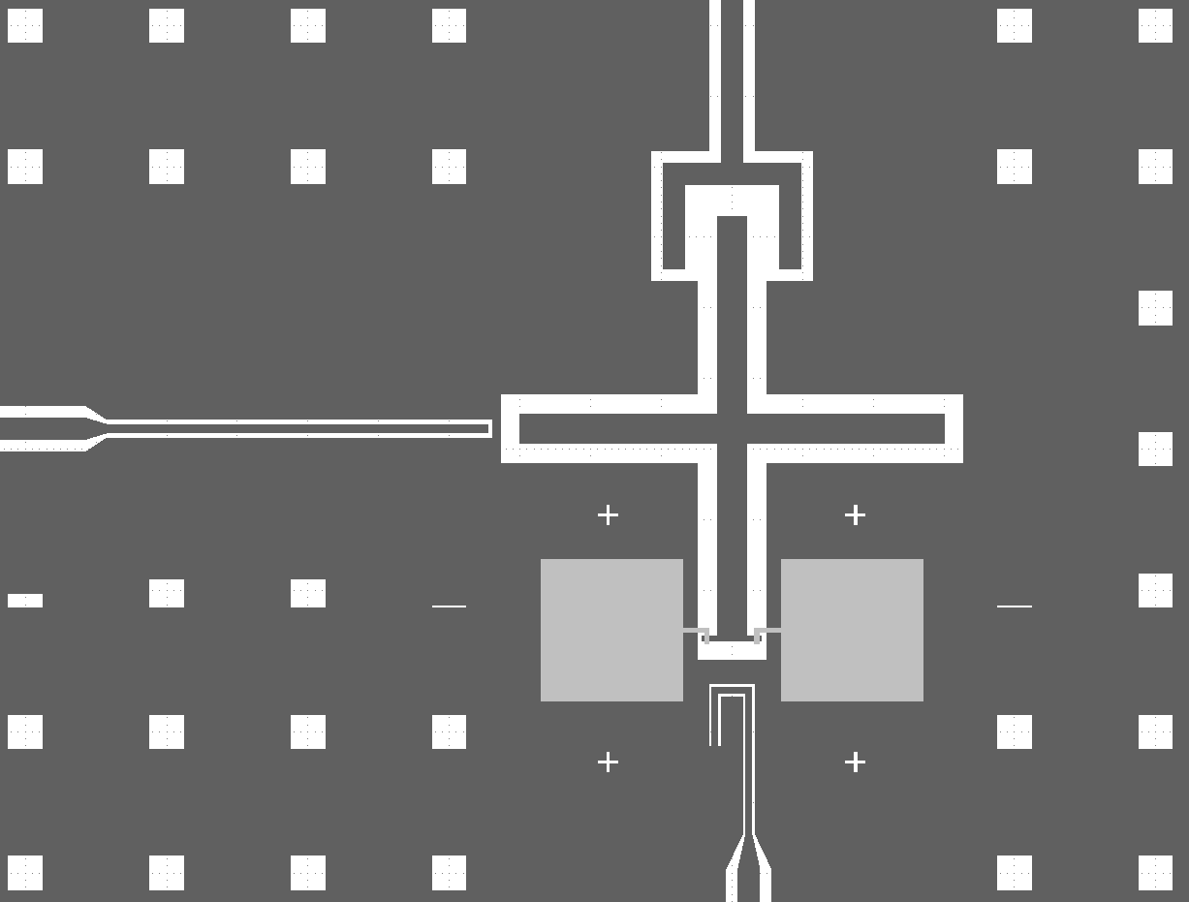
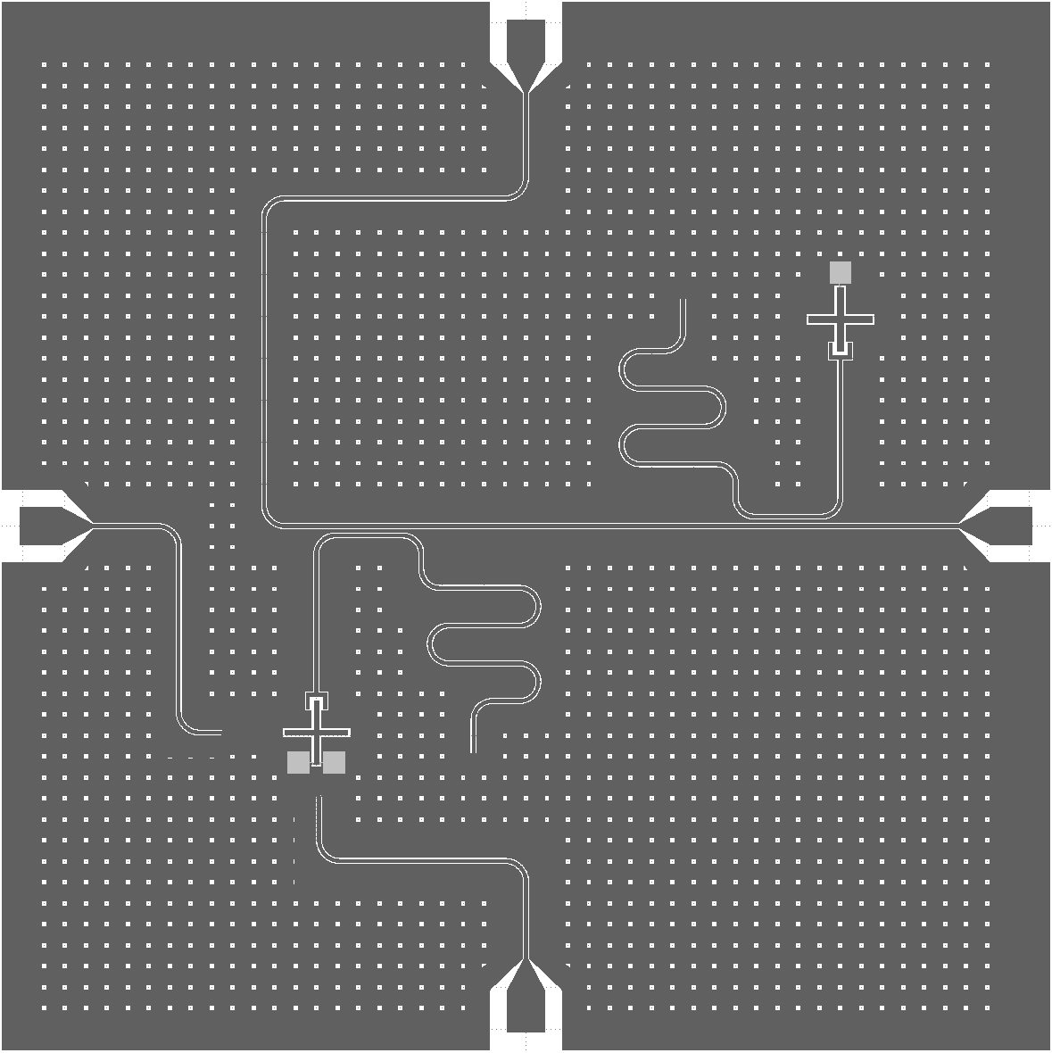
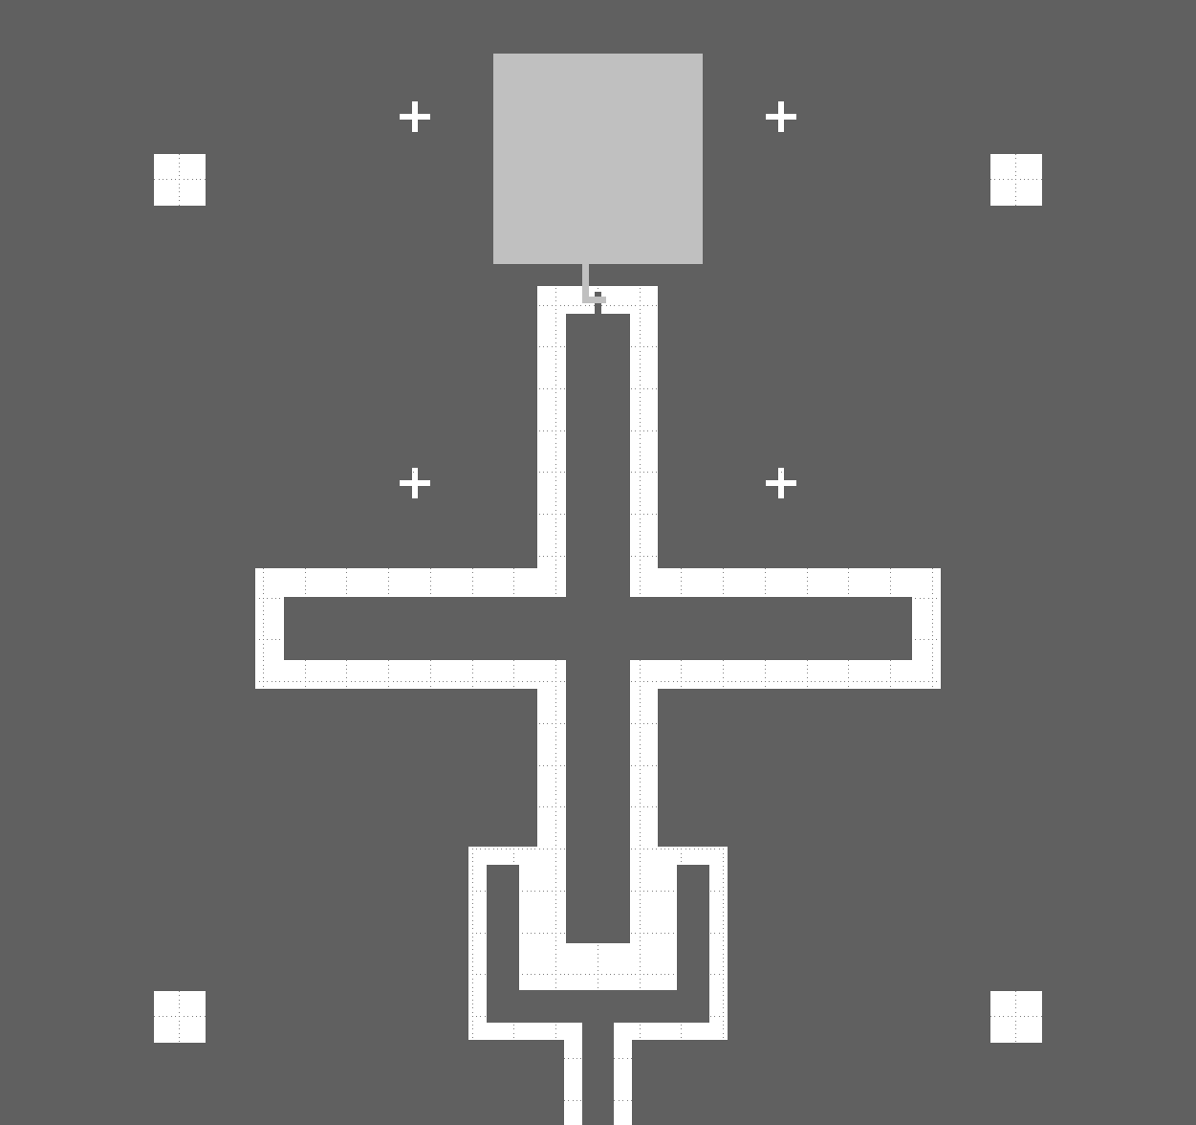
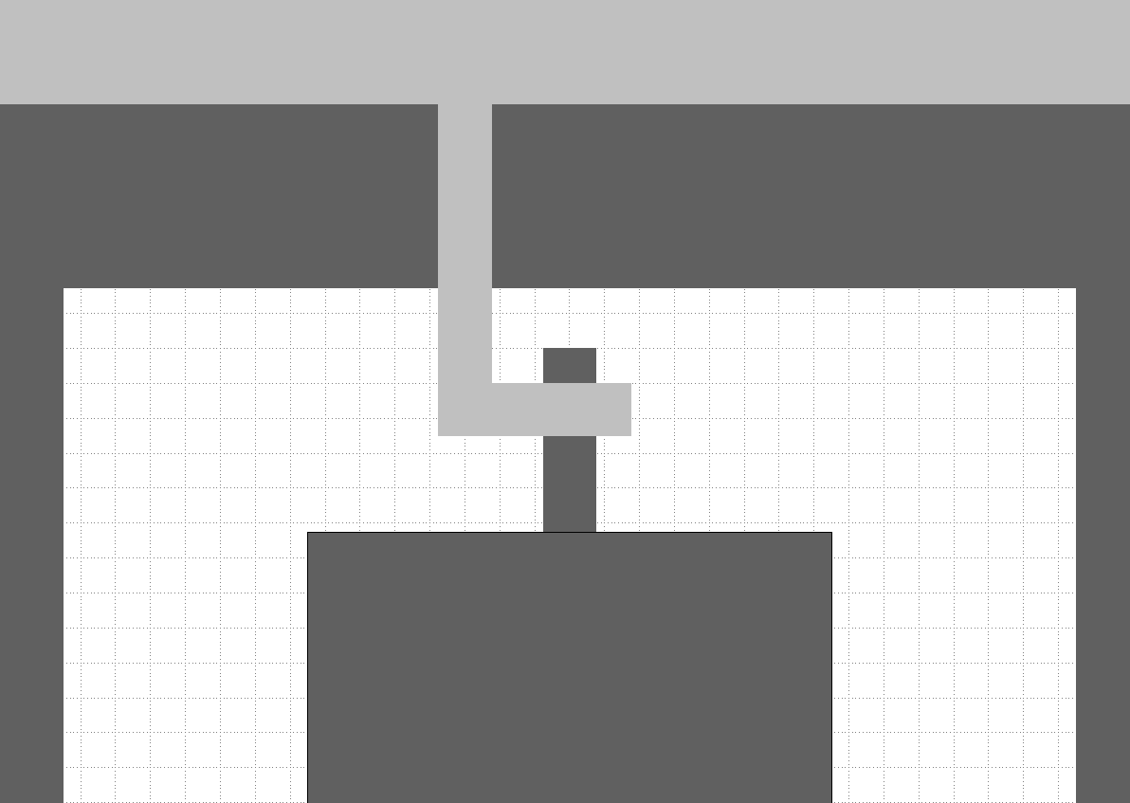
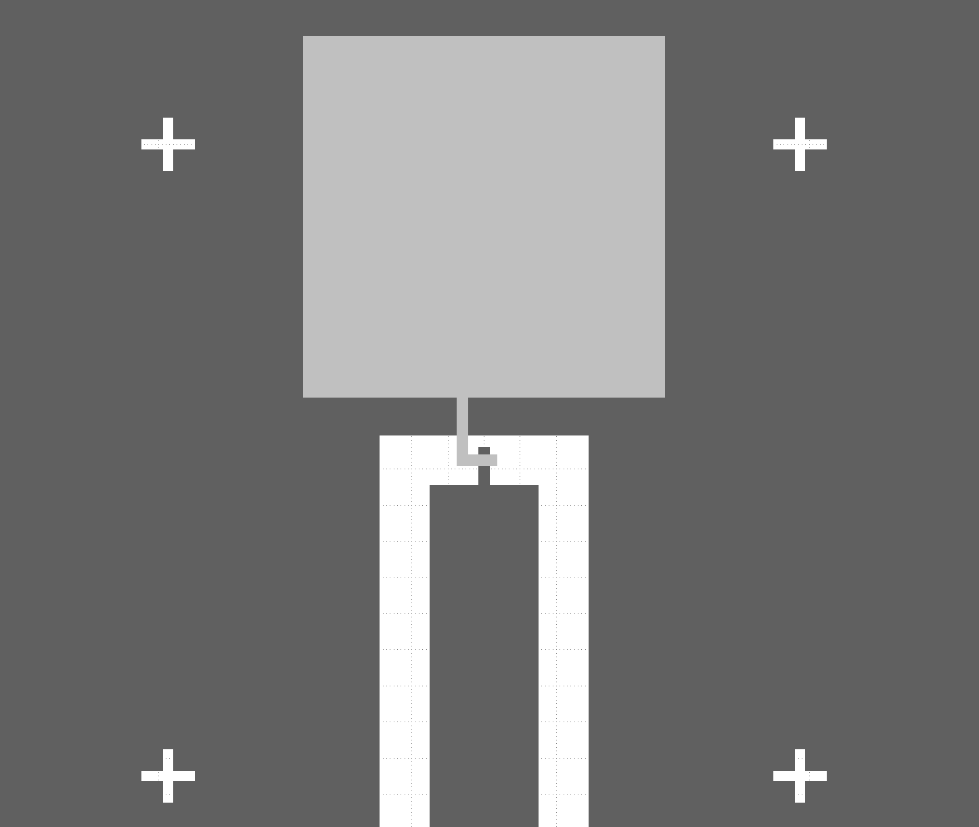
Qubit design adapted to FBK fabrication process – design 1
Cross-JJ area limited to ≥ 3x3 μm² (mask lithography @ FBK)
→ use Focused Ion Beam (FIB) to reduce JJ area after production
FIB alignment
structures
Aluminium layer 2 (lift-off)
Aluminium layer 1 (etched)
Wafer substrate
Cross Josephson junction

Slide 4
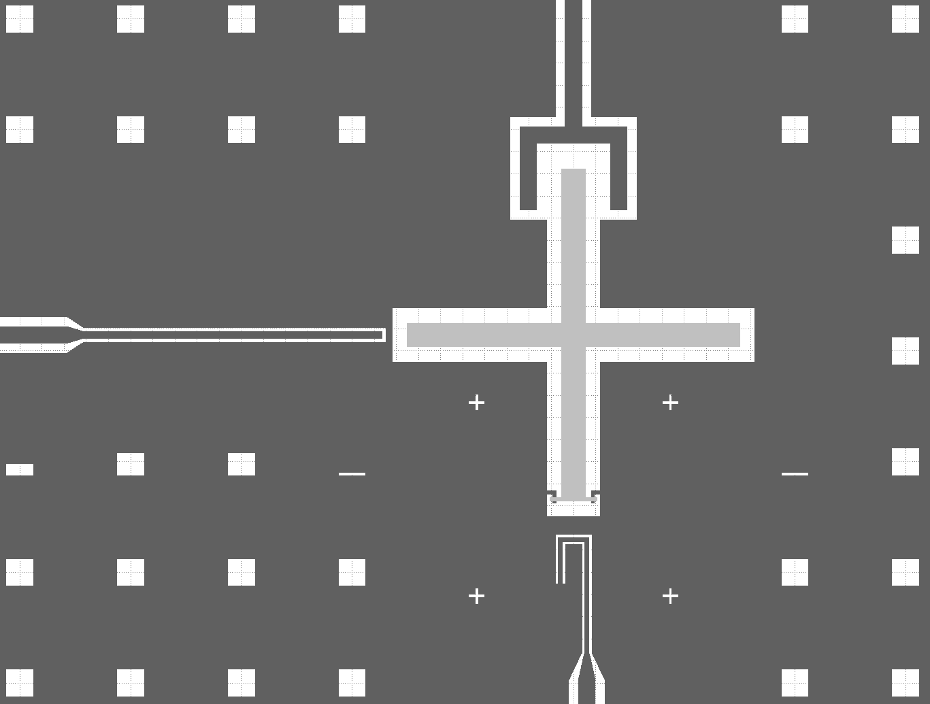
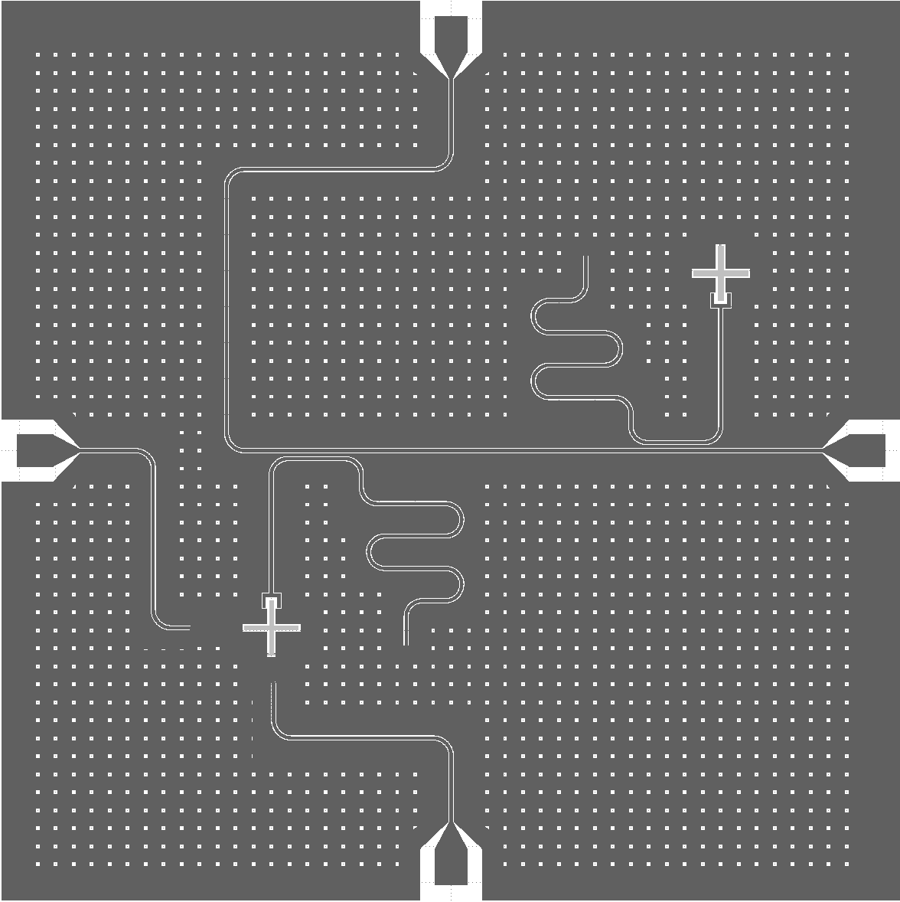
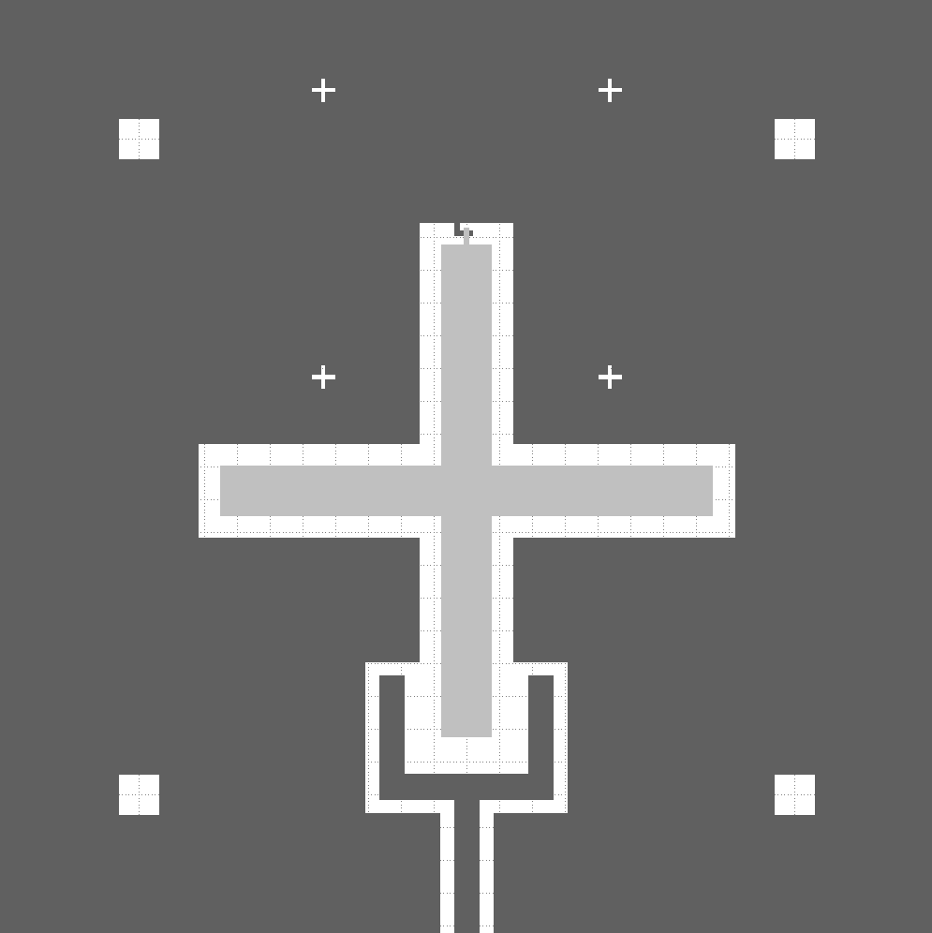
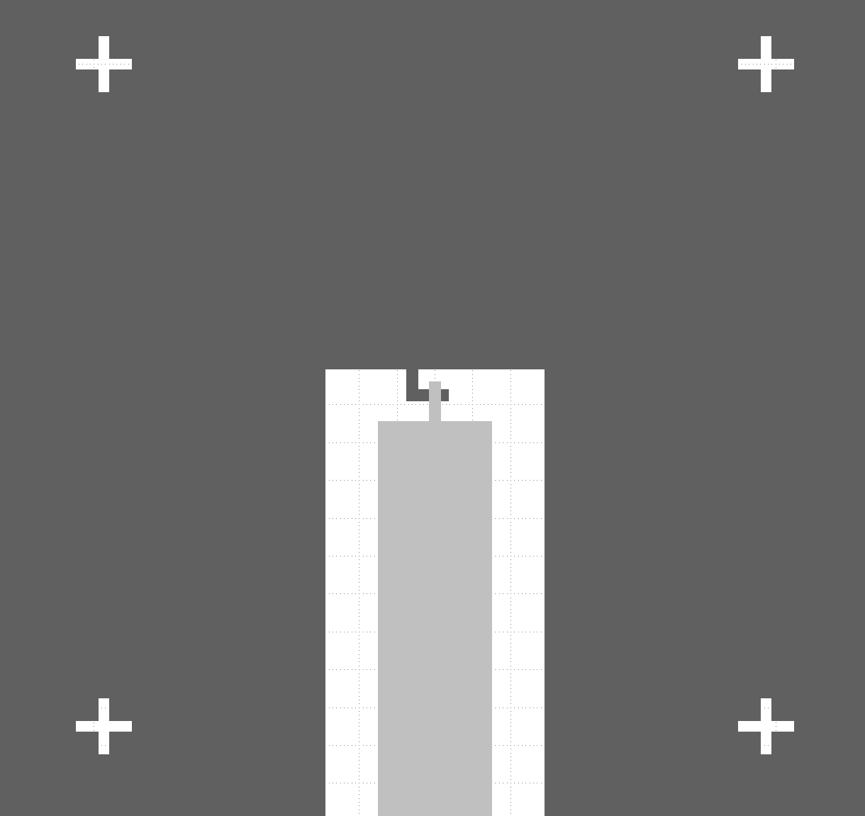
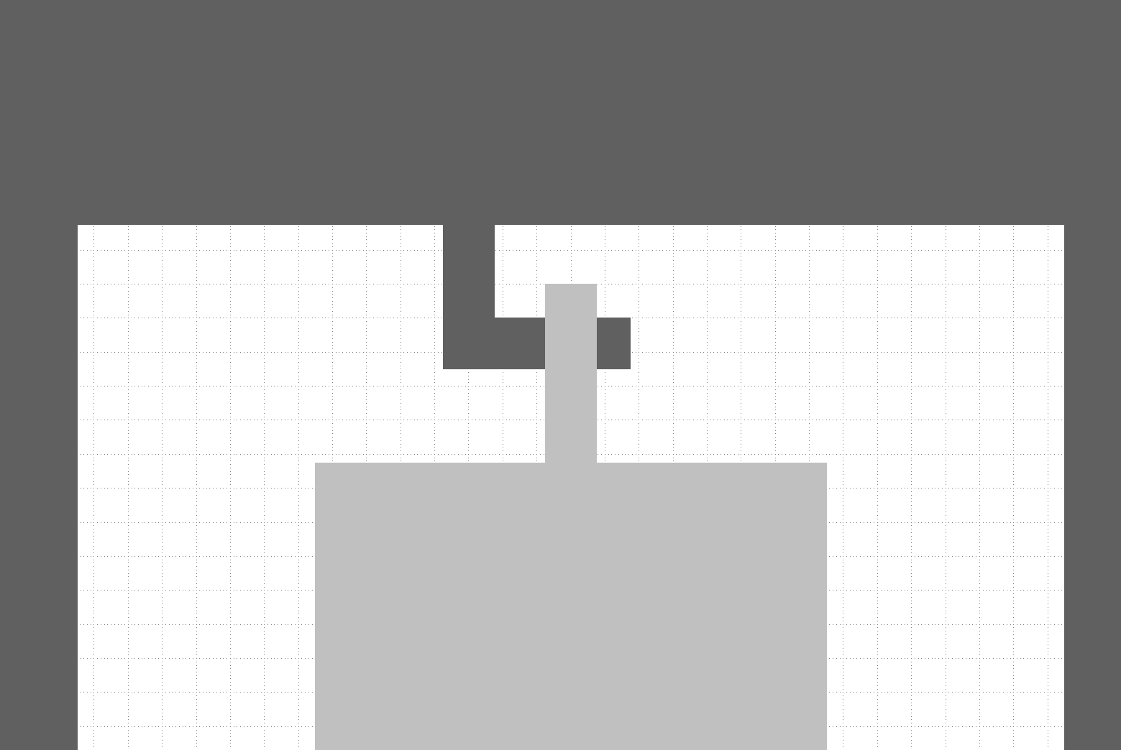
Qubit design adapted to FBK fabrication process – design 2
Cross-JJ area limited to ≥ 3x3 μm² (mask lithography @ FBK)
→ use Focused Ion Beam (FIB) to reduce JJ area after production
FIB alignment
structures
Aluminium layer 1 (etched)
Wafer substrate
Cross Josephson junction
Aluminium layer 2 (lift-off)

