Slide 1
Qub-IT – Resonators and Next Fabrication at FBK
Felix Ahrens, Nicolò Crescini, Paolo Falferi, Federica Mantegazzini, Benno Margesin, Renato Mezzena, Andrea Vinante

Slide 2
Aluminium resonator fabrication @ FBK in Cleanroom Detector & Cleanroom MEMS
Fabrication step | First Qub-IT resonators | Res-Test-2 w1 | Res-Test-3 w3 | Res-Test-3 w4
Substrate oxide | Removed & regrown (high quality) | Removed | Removed | Removed
Sputter deposition | fast & hot deposition | slow & cold deposition | slow & cold deposition | slow & cold deposition
Lithography | Stepper | Mask | Mask | Mask
Resonator design | λ/4 & λ/2 CPW resonators | compact lumped element resonators | compact lumped element resonators | compact lumped element resonators
Etching | Dry etching | Wet etching | Wet etching (CR-M) | Wet etching (CR-M)
Ground plane
Feedline
Lumped element resonator

Slide 3
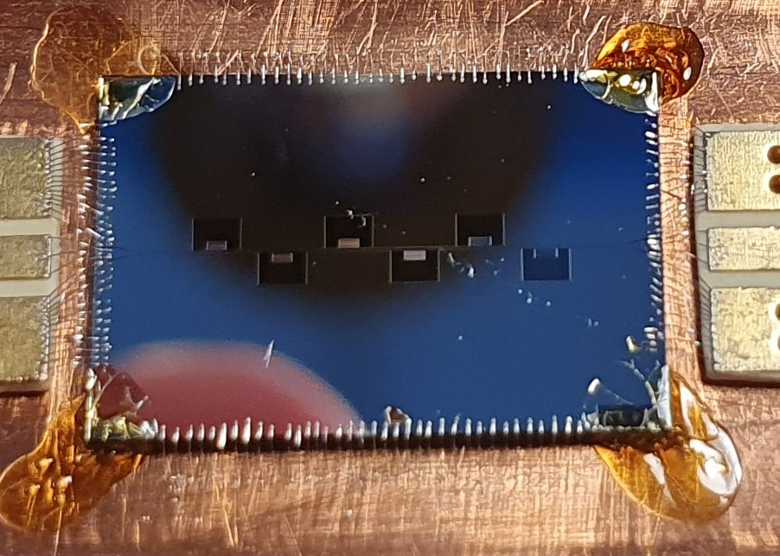
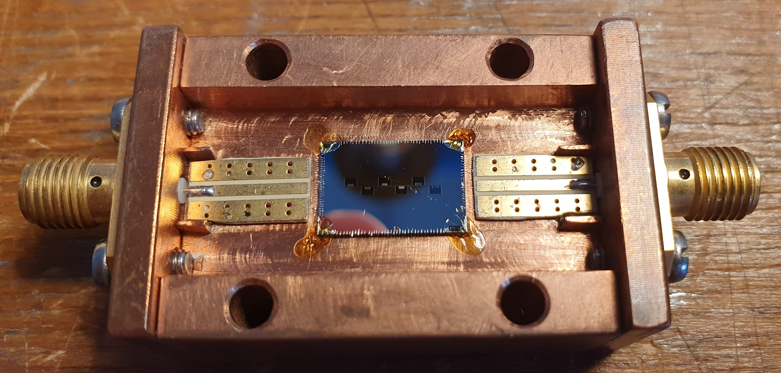
COPPER HOLDER

Slide 4
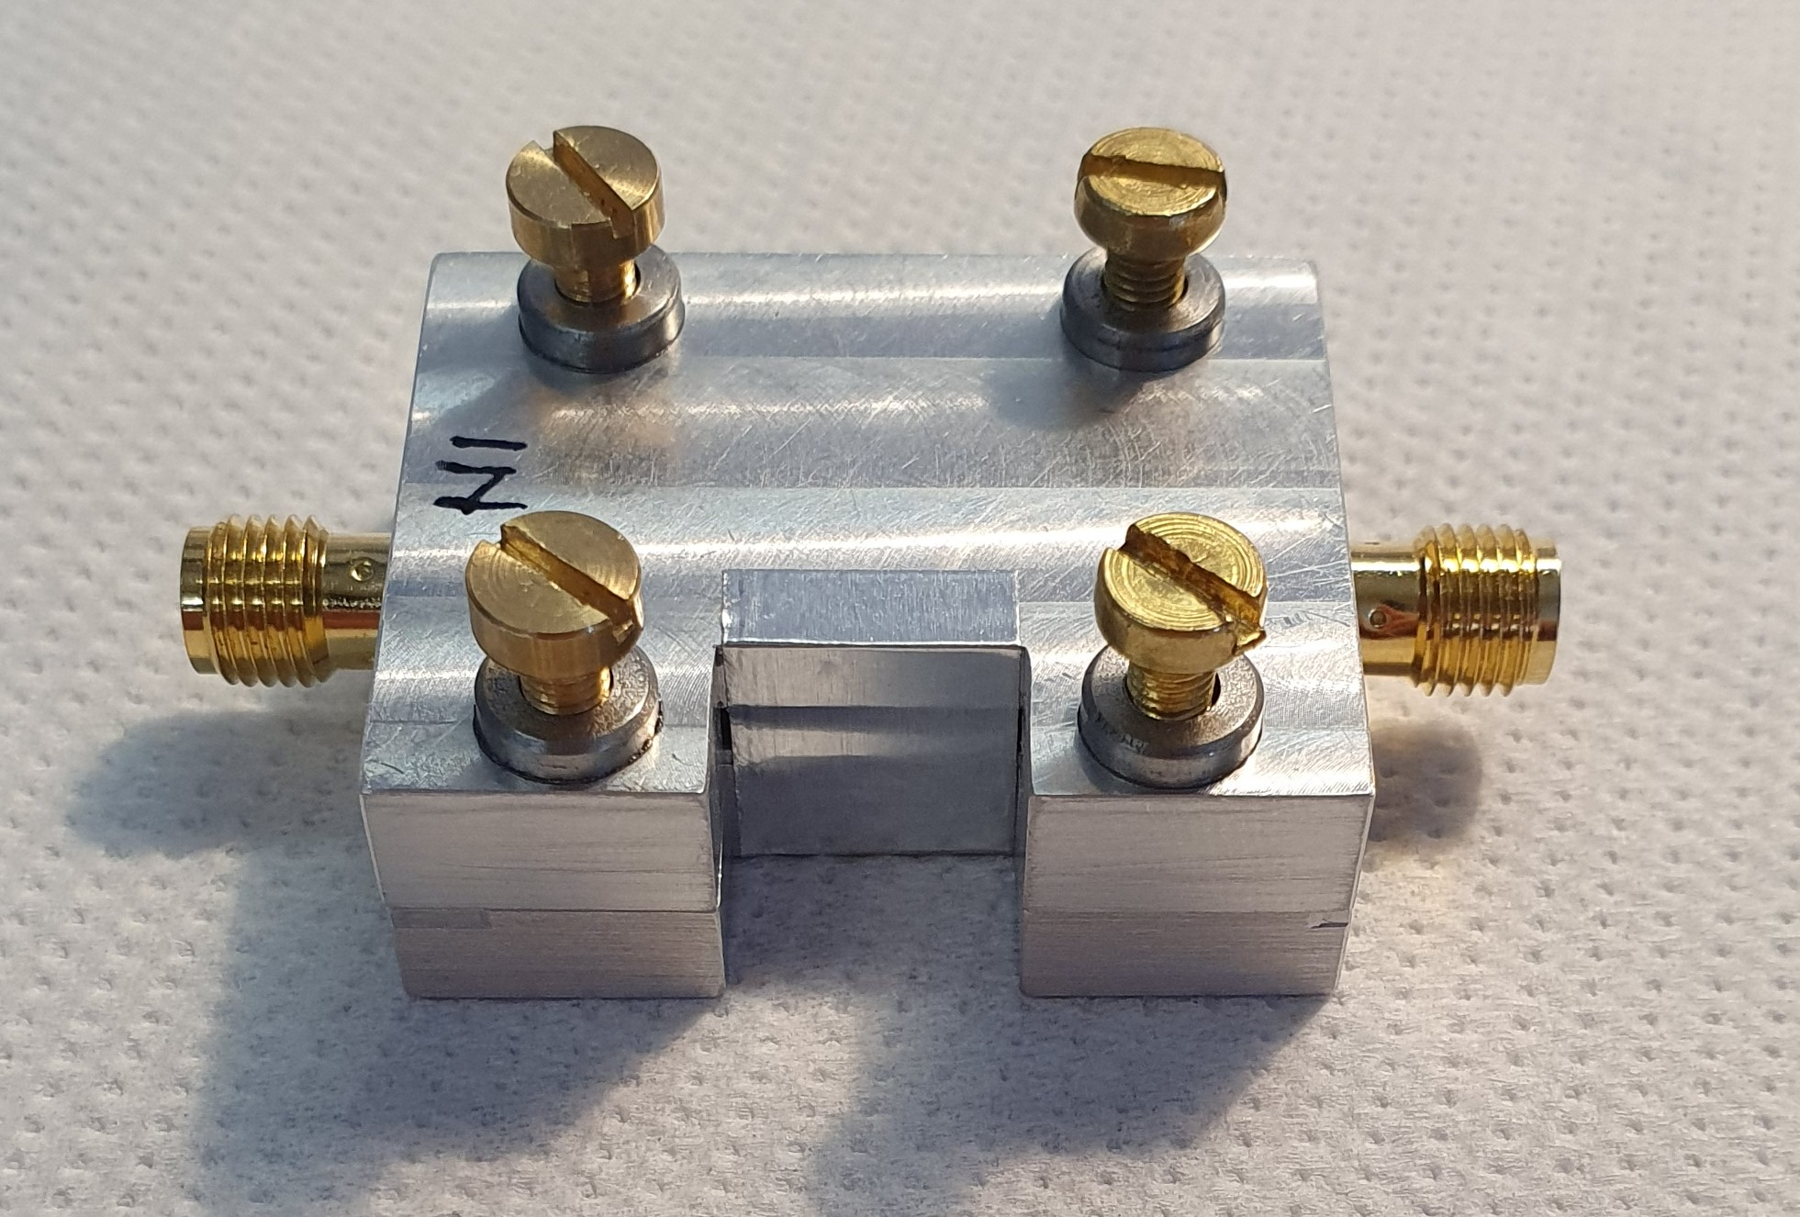
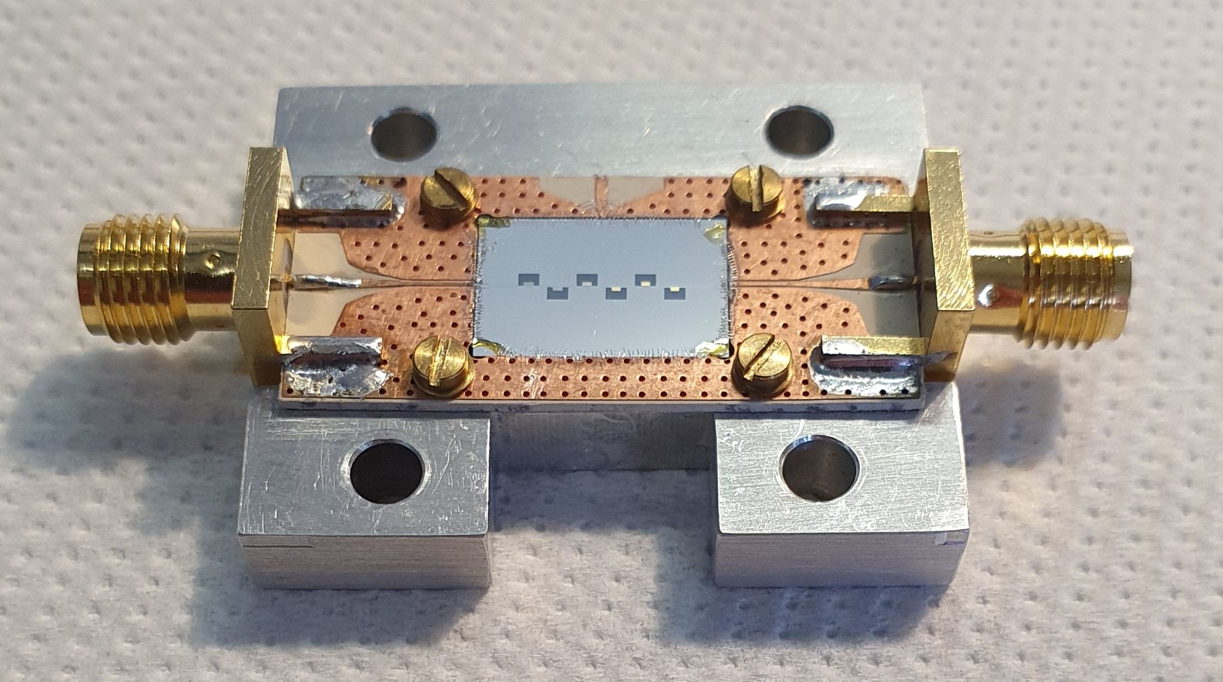
ALUMINUM HOLDER

Slide 5
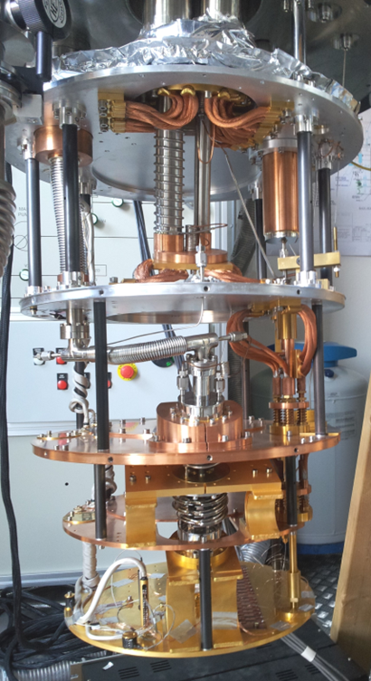
DILUTION REFRIGERATOR
Janis, Model JDry-100-ASTRA, Cryogen-free
Pre-cooling: Cryomech PT-405 Pulse Tube cryo-cooler
100μW @ 100mK
T_{base}= 20 mK
Mixing Chamber Plate diam 320 mm

Slide 6
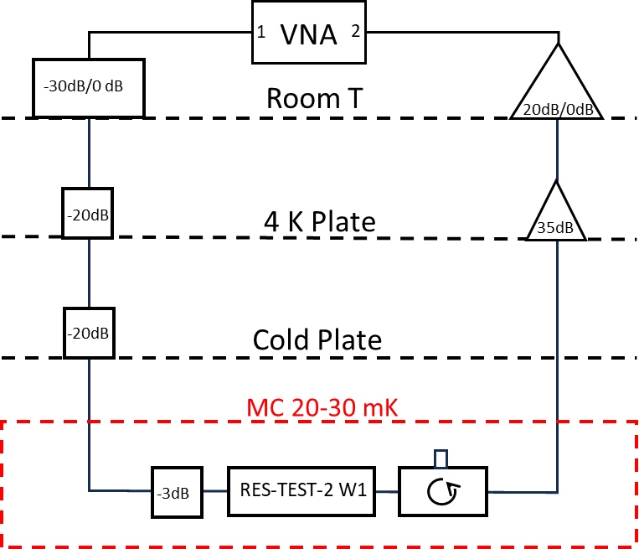
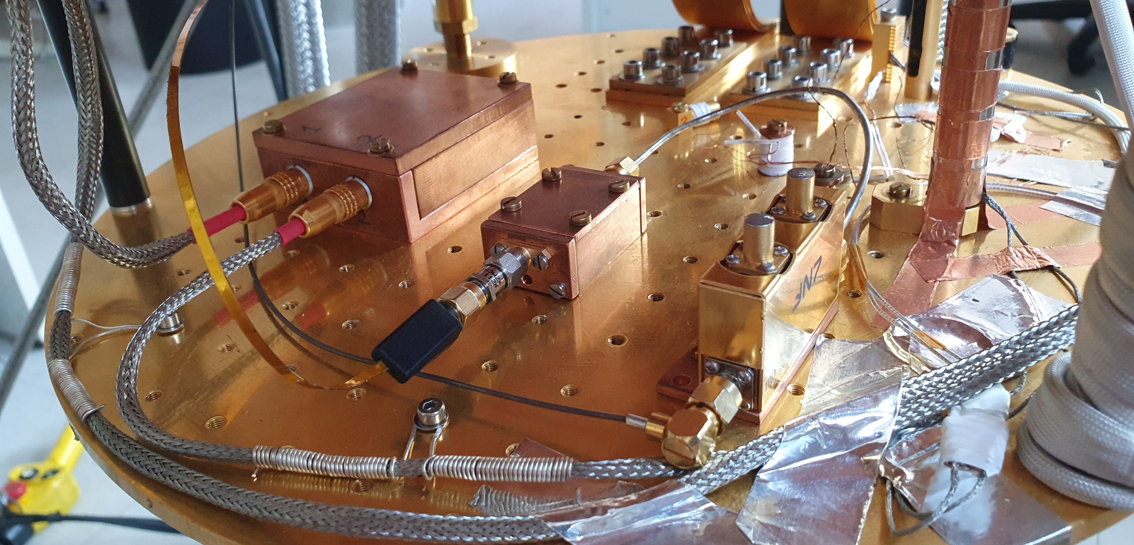
REFRIGERATOR RUN 128

Slide 7
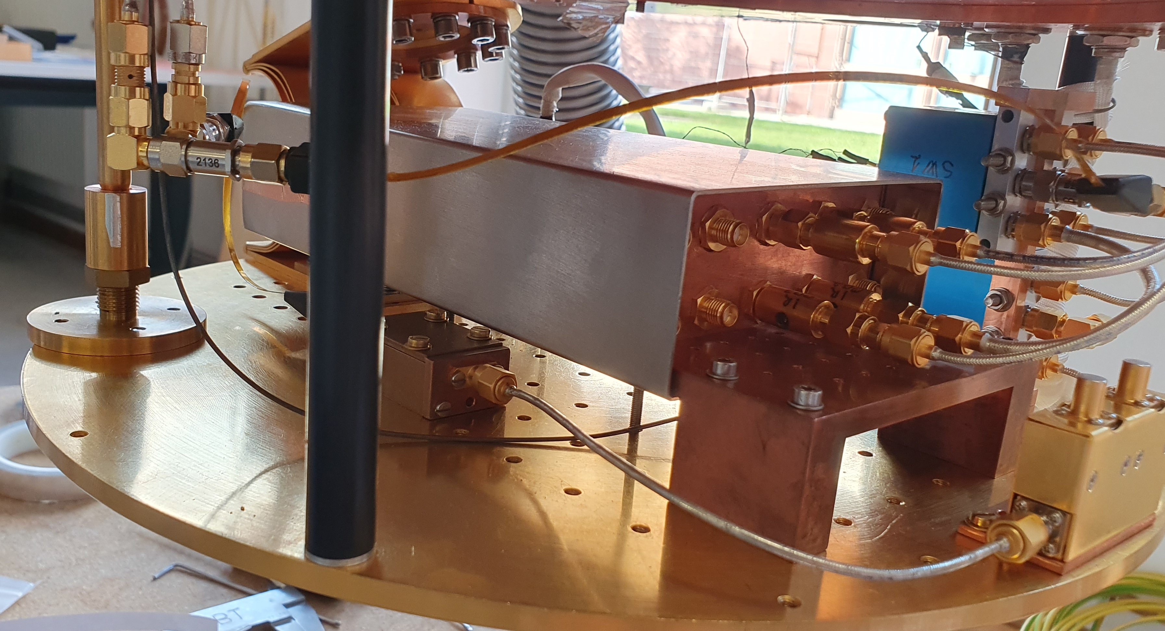
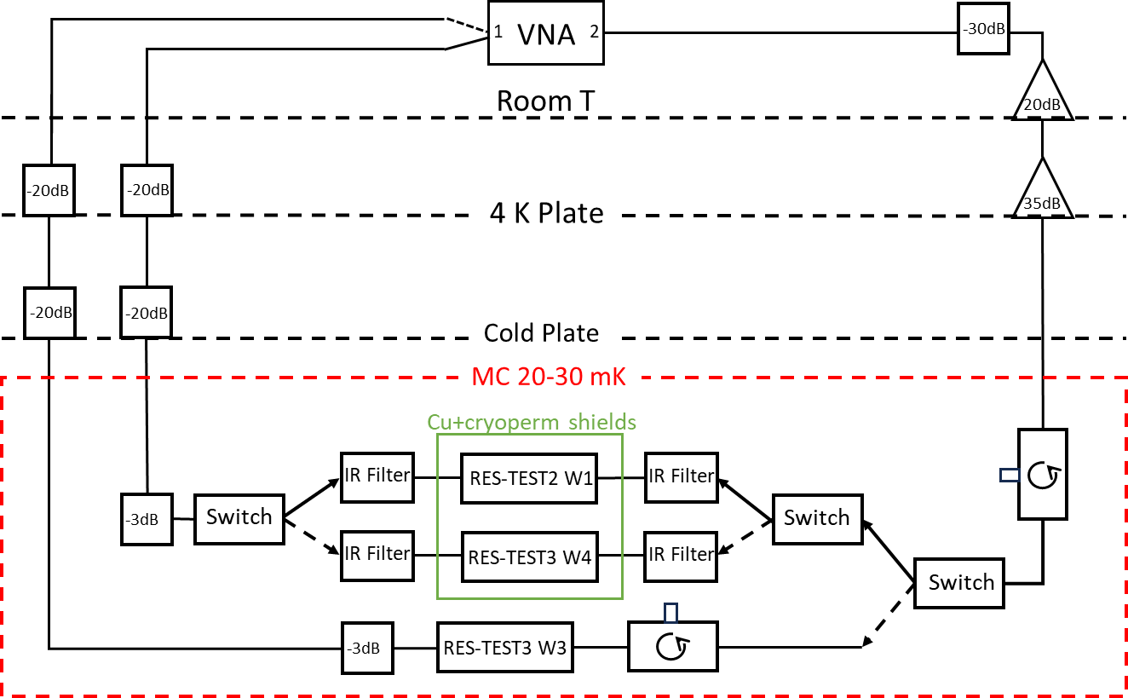
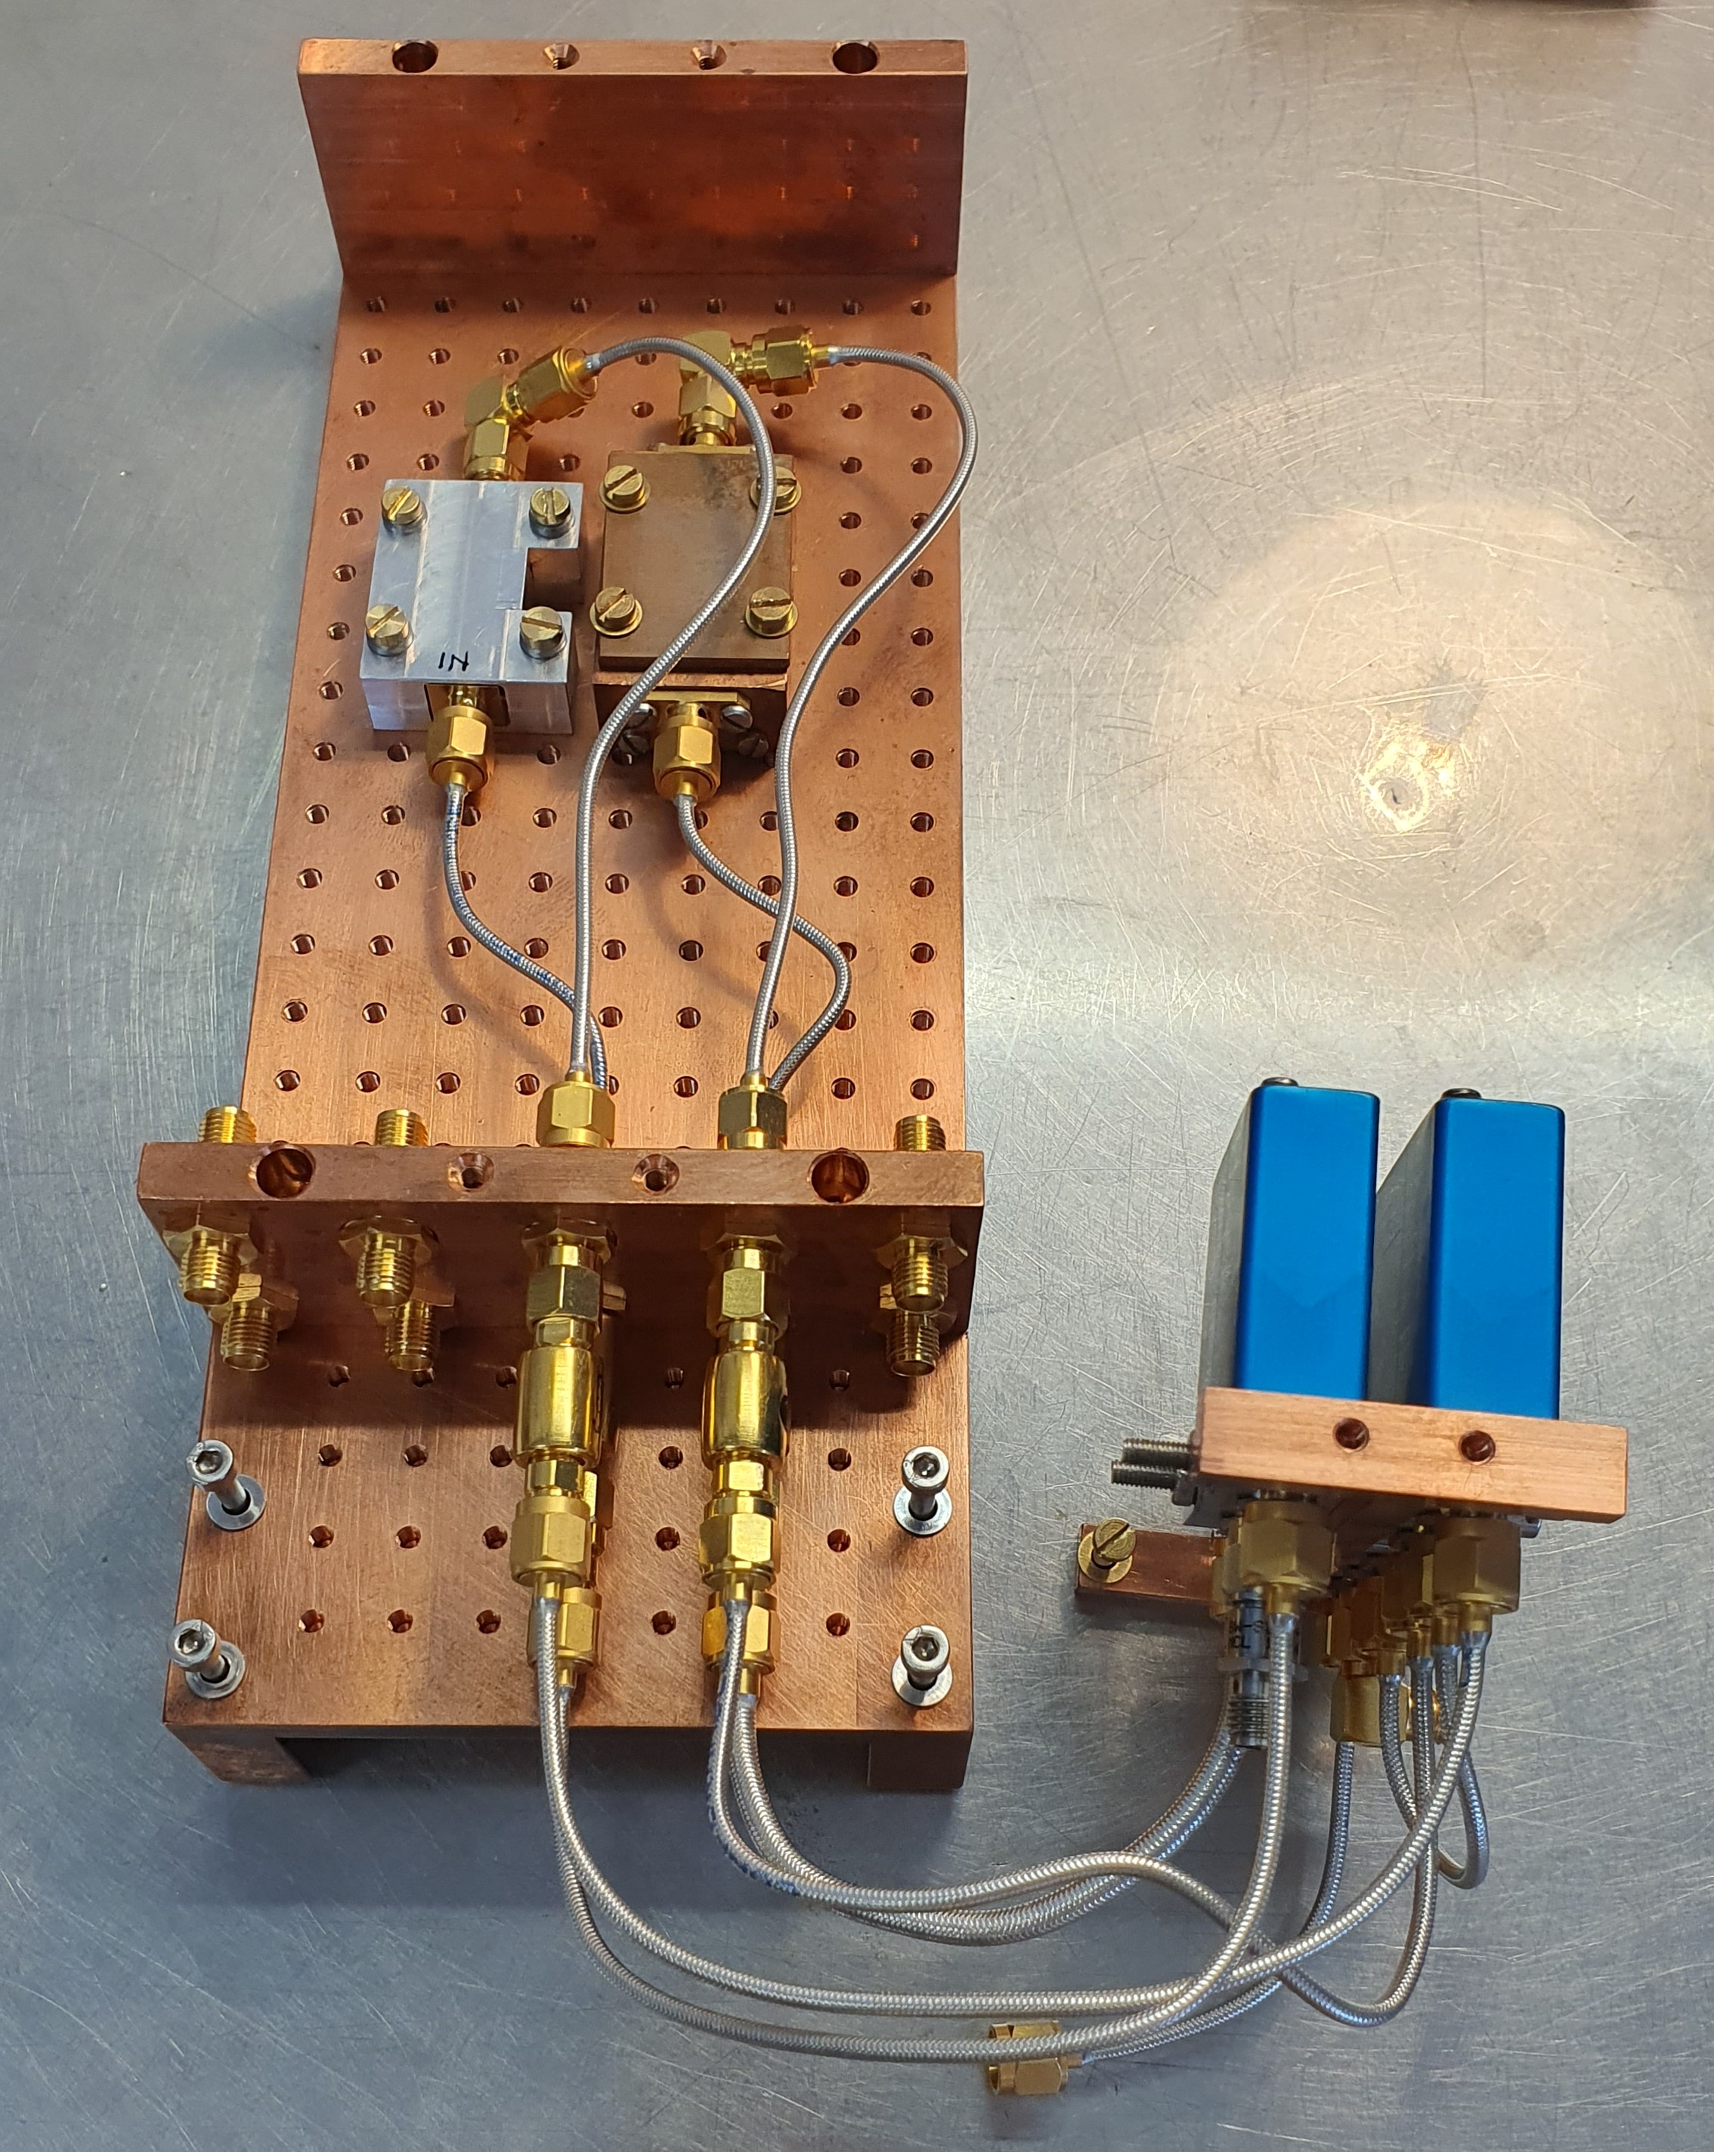
REFRIGERATOR RUN 129

Slide 8
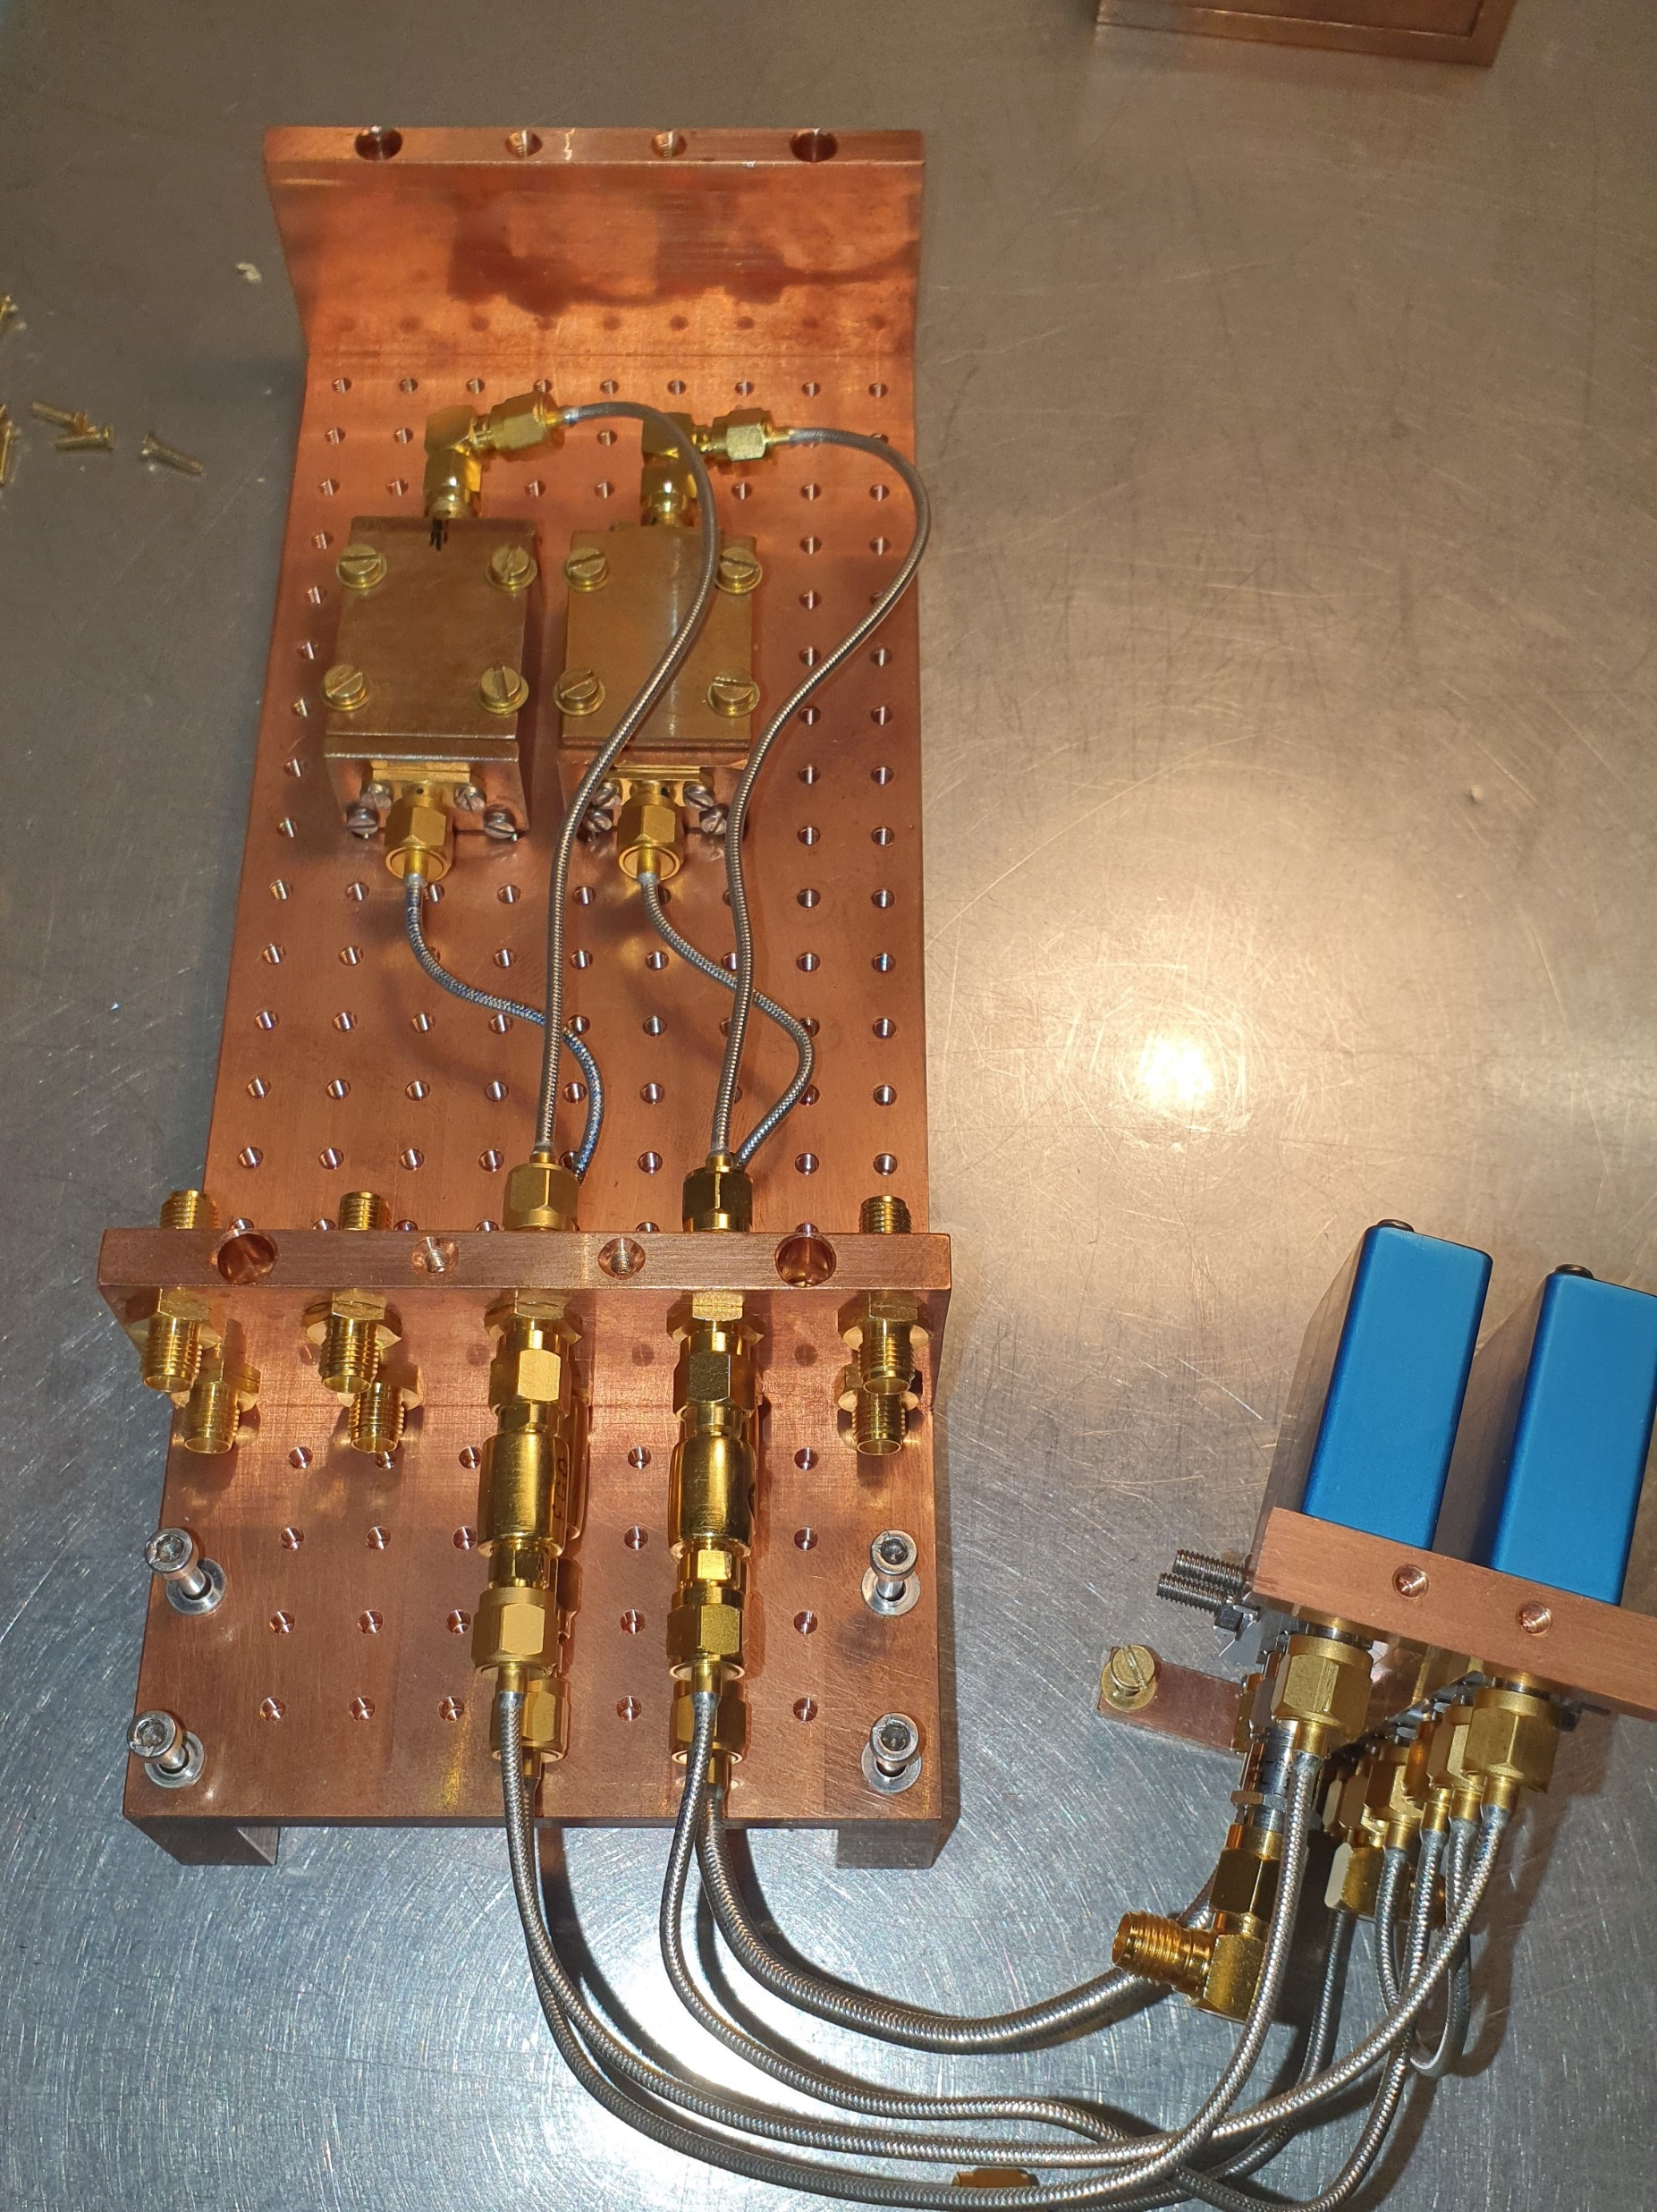
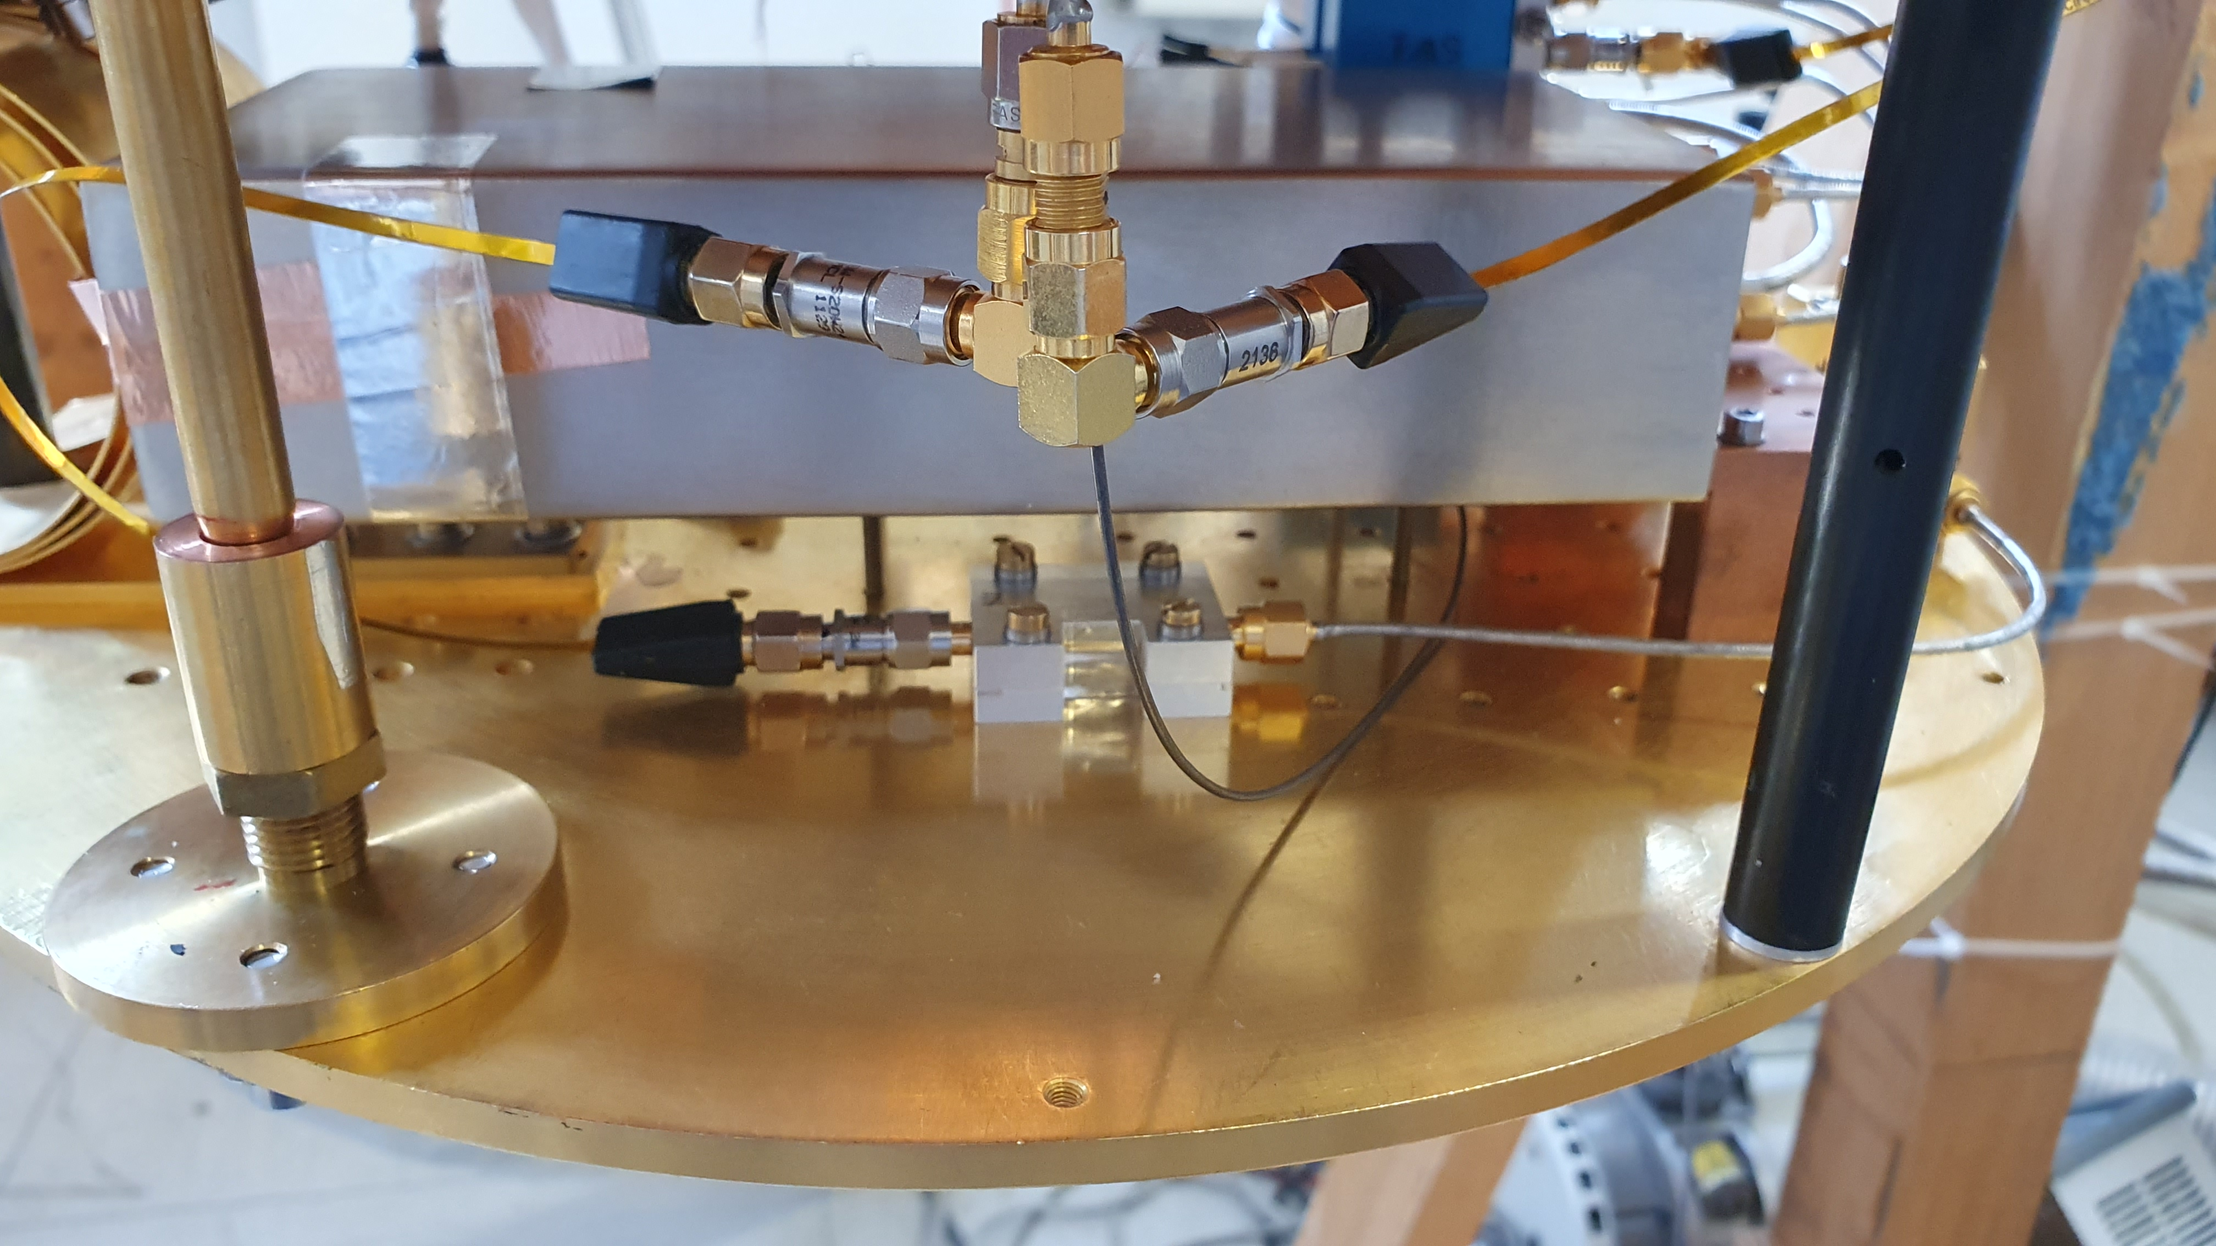
REFRIGERATOR RUN 130

Slide 9
Internal Quality Factors
RUN | ResTest2w1 CR-M Kenosistec |  |  |  |  |  | ResTest3w3 CR-D Eclipse |  |  |  |  |  | ResTest3w4 CR-M Kenosistec
 | 1° | 2° | 3° | 4° | 5° | 6° | 1° | 2° | 3° | 4° | 5° | 6° | 1° | 2° | 3° | 4° | 5° | 6°
128 | Setup: Cu Holder 1, outside shields, no switch, no IR filters
128 | 420 k | 920 k | 790 k | hidden by stray resonance | 32 k near stray resonance | 77 k
129 | Setup: Chip moved in Al holder, inside shields, 3 switches, IR filters, DAMAGED CABLE |  |  |  |  |  | Setup: Cu Holder 1, outside shields, 1 switch, no IR filters |  |  |  |  |  | Setup: Cu Holder 2, inside shields, 3 switches, IR filters, DAMAGED CABLE
129 | 16 k | 88 k | 200 k | 250k | 210 k | 1050 k | 5090 k | 270 k | 46 k near stray resonance | 310 k | hidden by stray resonance | 96 k near stray resonance | 460 k | 940 k | 410 k | hidden by stray resonance | 68 k near stray resonance | 150 k
130 | Setup: Without opening moved holder out of shields, 1 switch, no IR filters |  |  |  |  |  | Setup: Without opening moved holder inside shields, 3 switches, IR filters, removed damaged cable |  |  |  |  |  | Without opening left holder where it was, removed damaged cable
130 | ? | 330 k | 370 k | 270 k | ? | 2050 k | 160 k near stray resonance | 560 k | 12 k hidden by stray resonance | 440 k | 1190 k | 500 k | 13 k hidden by stray resonance | 440 k | 430 k | 480 k | 9 k hidden by stray resonance | 28 k near stray resonance

Slide 10
Conclusions
Good news: high Q are possible (up to 5 million)
Bad news: we are unable to reproduce the results
The next refrigerator runs will be dedicated to achieving reproducibility, evaluating Two-Level-States losses, avoiding stray resonances

