Slide 1
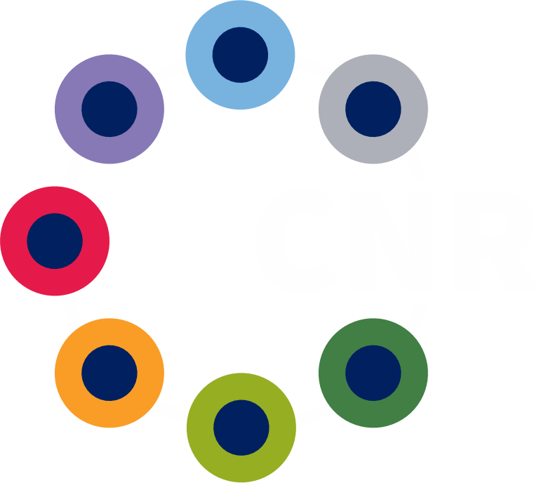
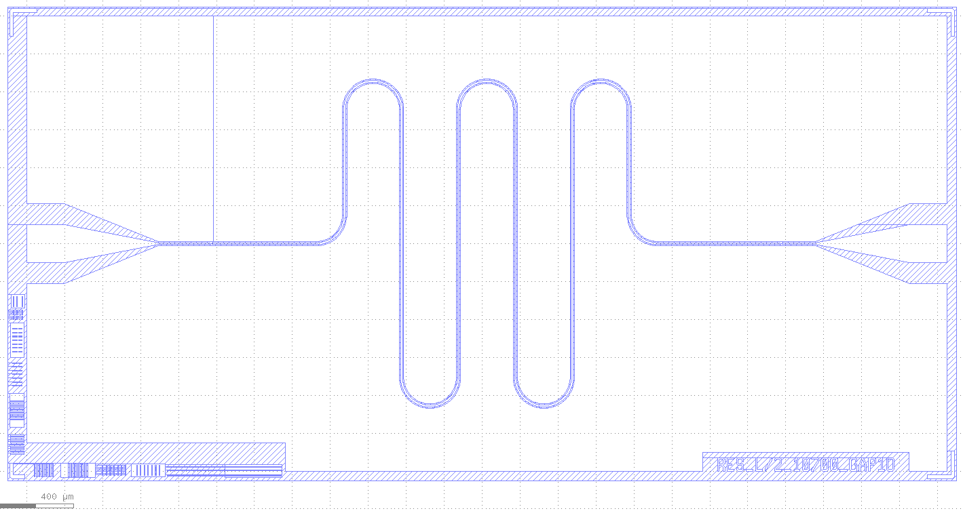
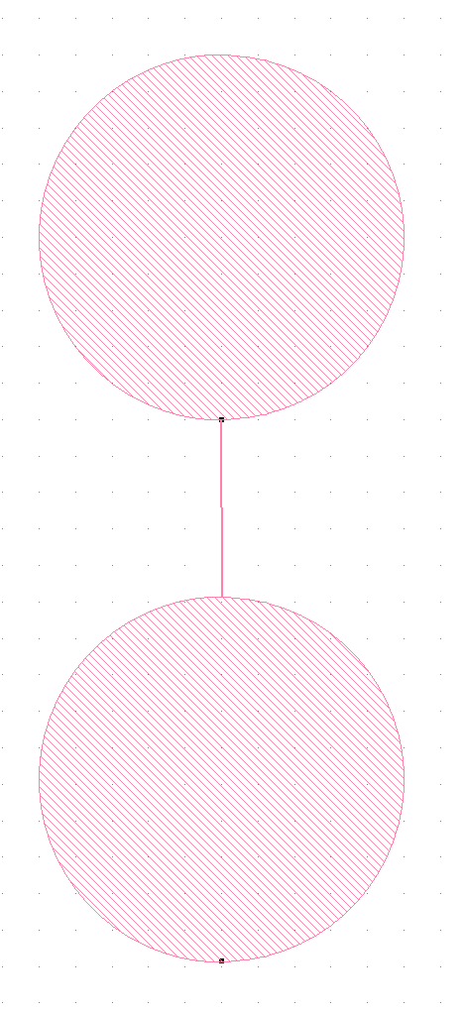
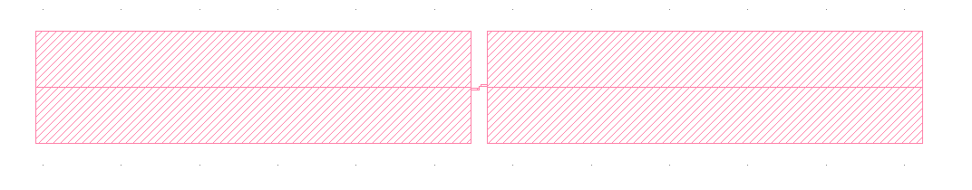

Francesco Mattioli
Fabio Chiarello
Fabbricazione di Q-bit 3d

Slide 2
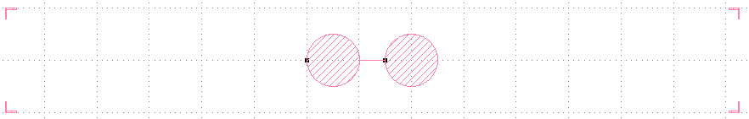
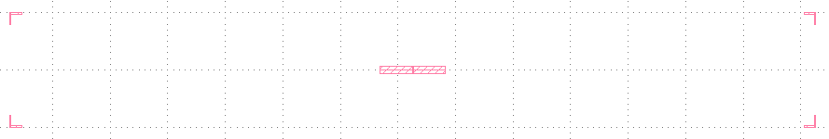
Q-bit 3D
High resistivity 4 inch Wafer
Thickness 650-670 μm
Chip 14mm x 2mm
Francesco Mattioli, Fabio Chiarello
Notes:
2

Slide 3
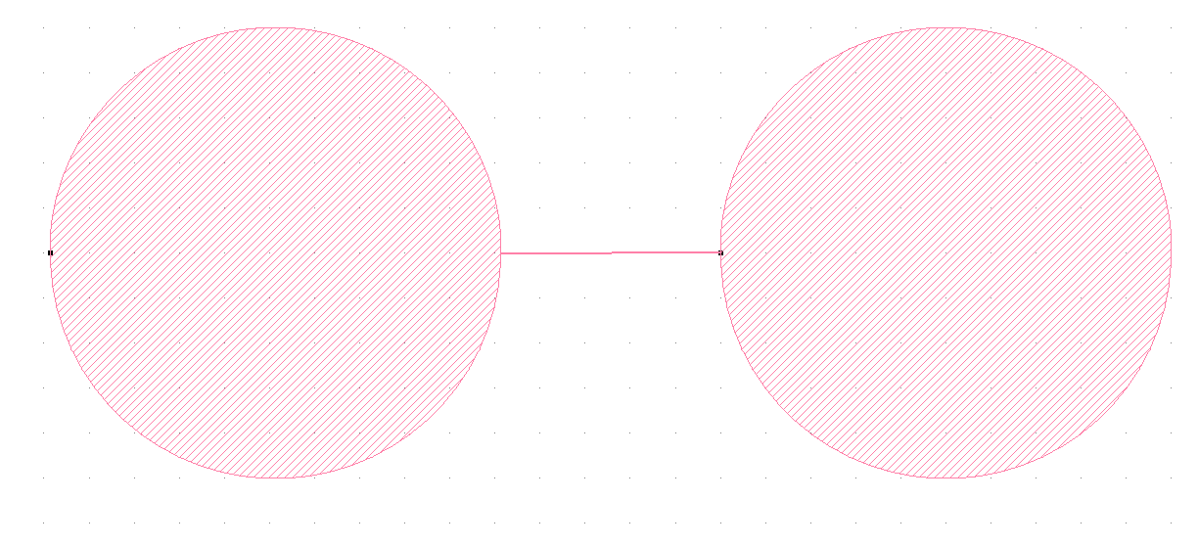
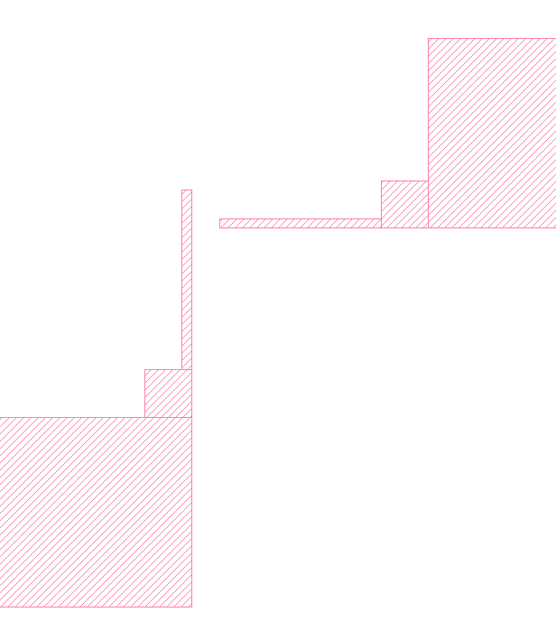
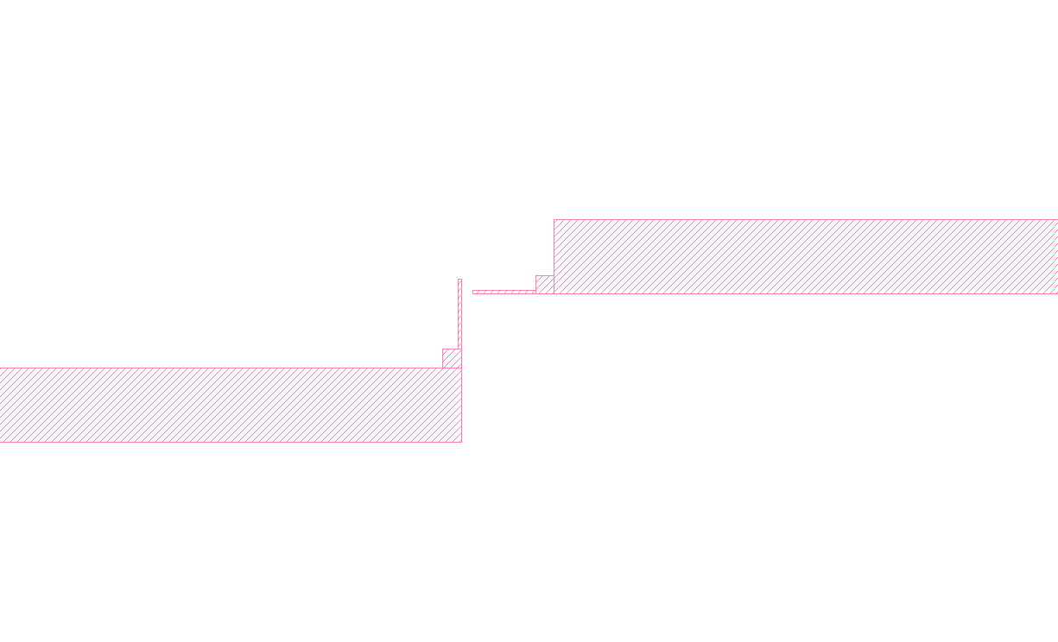
Q-bit 3D
Geometry
Radius 500 μm
Distance 486 μm
High resistivity 4 inch Wafer
Thickness 650-670 μm
Chip 14mm x 2mm
Francesco Mattioli, Fabio Chiarello
Notes:
3

Slide 4
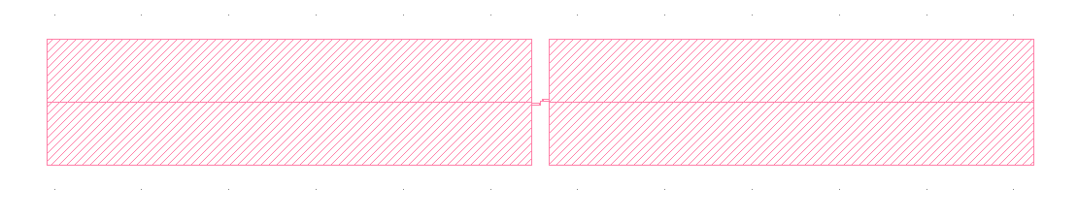
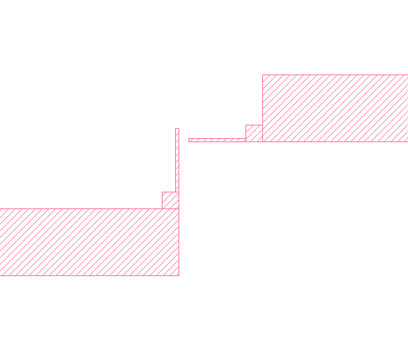
Q-bit 3D
Geometry
Square 556x144 μm
Distance 20 μm
High resistivity 4 inch Wafer
Thickness 650-670 μm
Chip 14mm x 2mm
Francesco Mattioli, Fabio Chiarello
Notes:
4

Slide 5
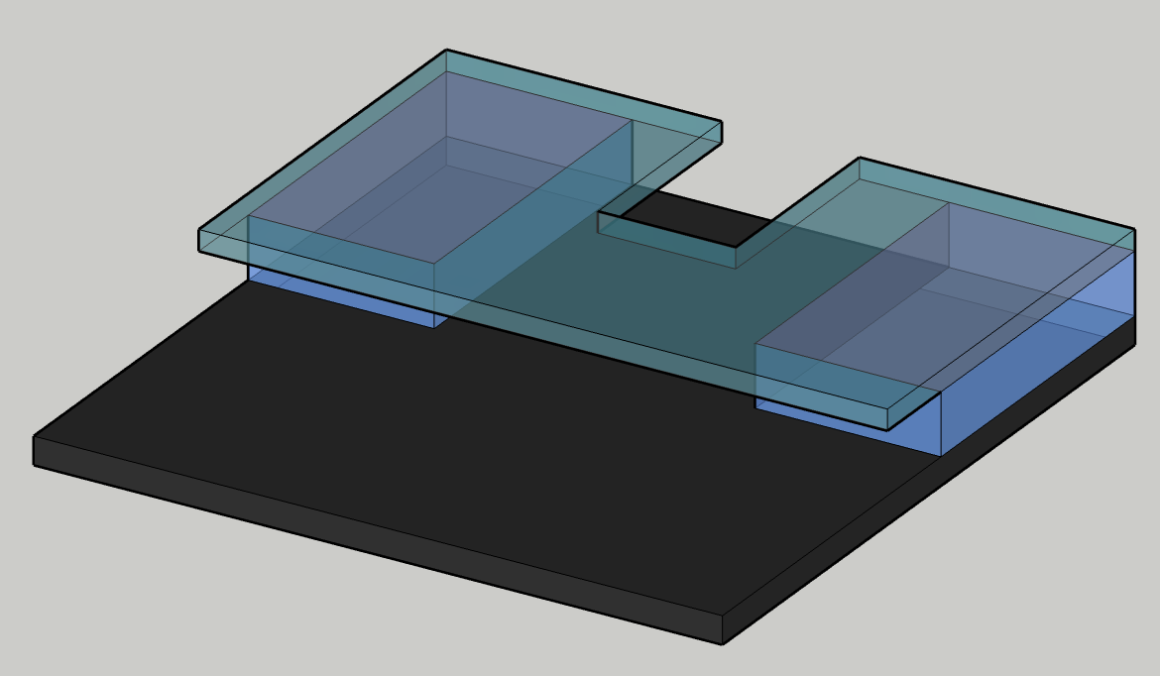
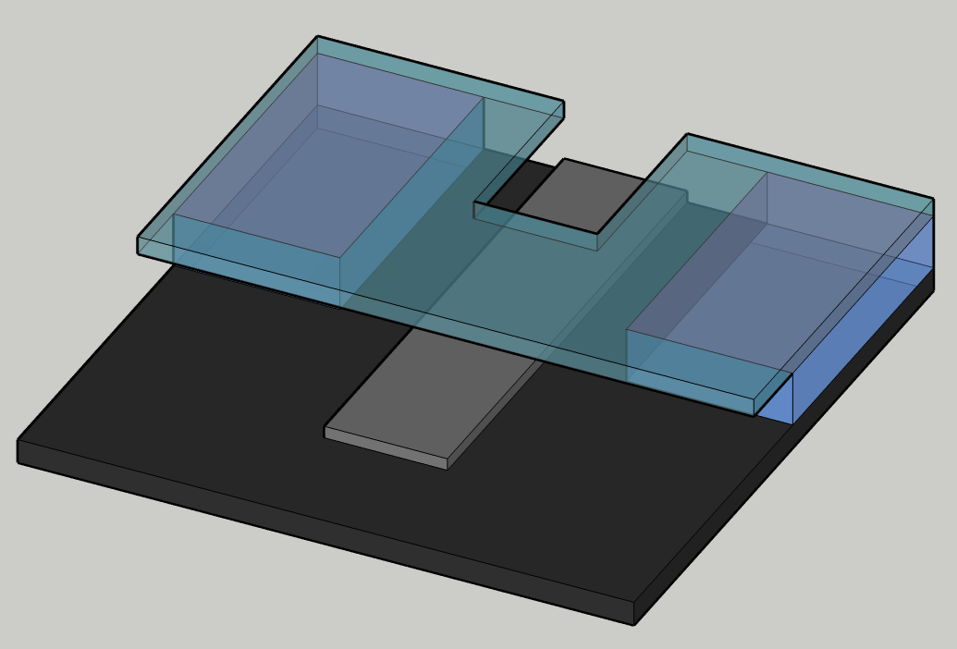
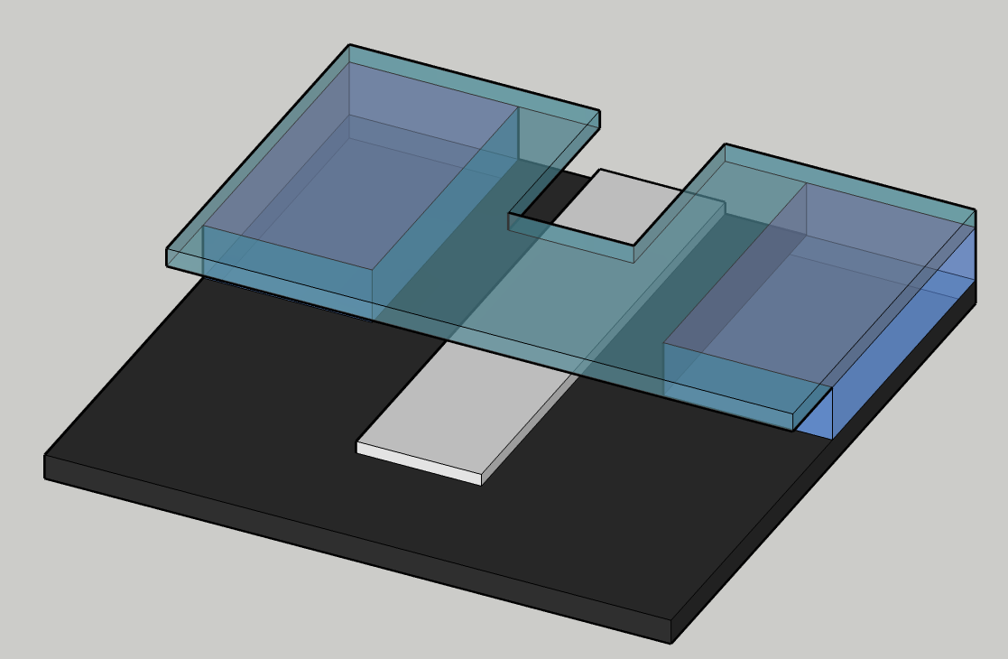
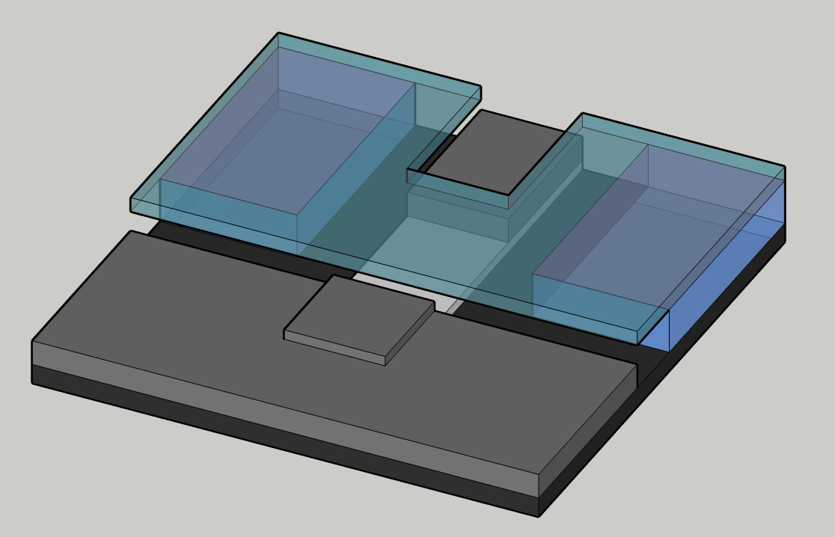
Q-bit 3D
155° 600 Å Al
Bilayer
COP 33 10% AR-P ≈ 1μm
    3500 giri/min per 60”
Hot Plate 5’ @ 170 °C
PMMA 6% AR-P 669.06 ≈ 1μm
    3000 giri/min per 60”
Hot Plate 5’ @ 170 °C
100 Å Al (anticharging)
O₂ 5 min. 1.0 mbar
90° 700 Å Al
Francesco Mattioli, Fabio Chiarello
Notes:
5

Slide 6
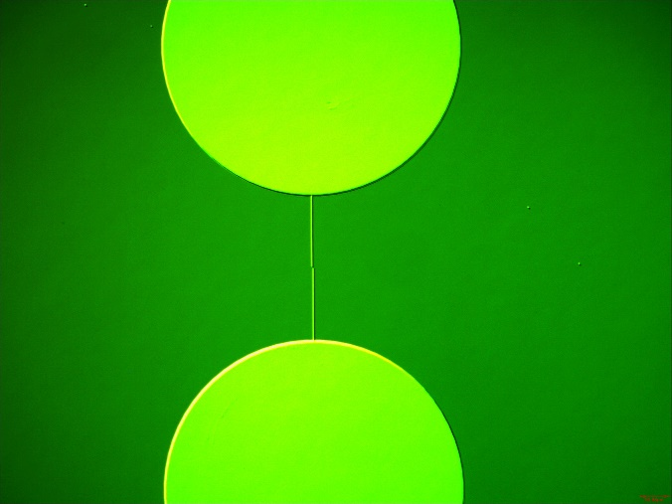
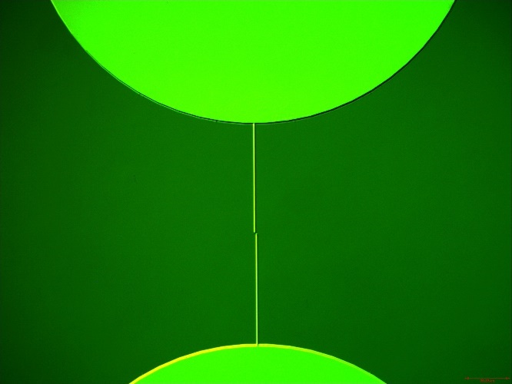
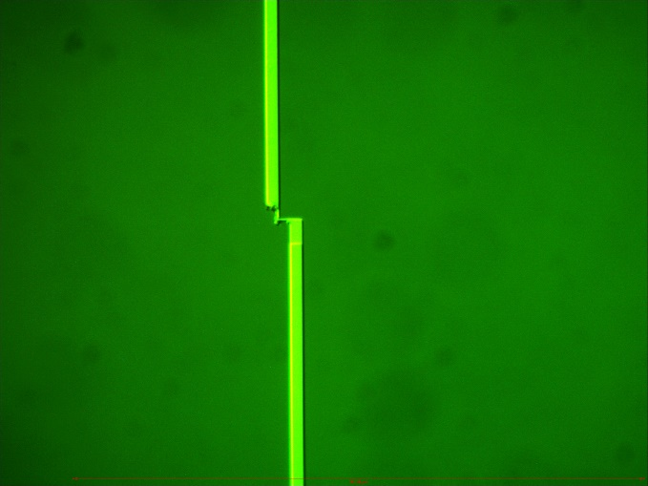
Q-bit 3D
First results
Circular geometry
Giunction
170x420nm
Angle and geometry to be optimized
Francesco Mattioli, Fabio Chiarello
Notes:
6

Slide 7
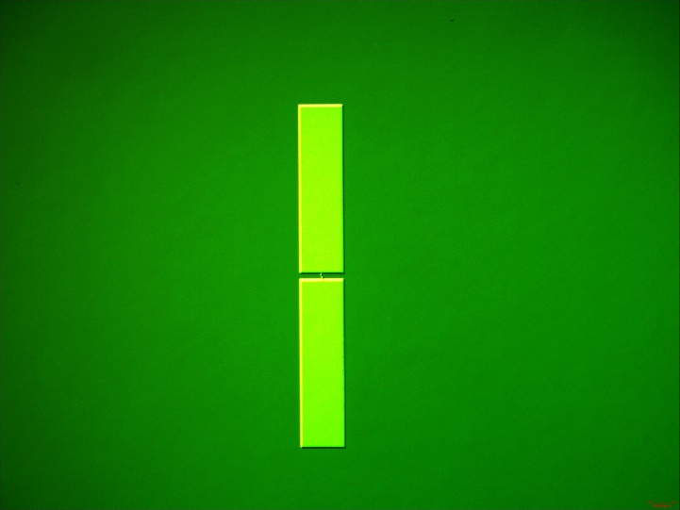
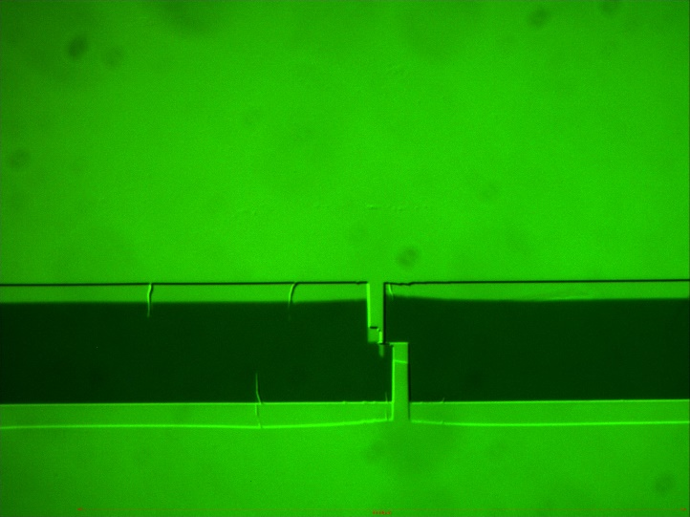
Q-bit 3D
First results
Square geometry
Litography, angle and geometry to be optimized
Francesco Mattioli, Fabio Chiarello
Notes:
7

Slide 8
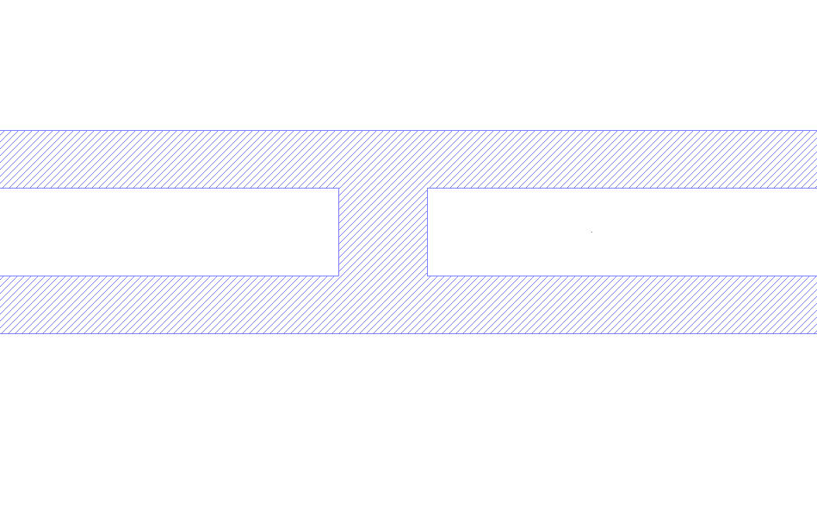
Risuonatori
10μm capacitance gap
High resistivity 4 inch Wafer
Thickness 650-670 μm
Chip 25mm x 50mm
Francesco Mattioli, Fabio Chiarello
Notes:
8

Slide 9
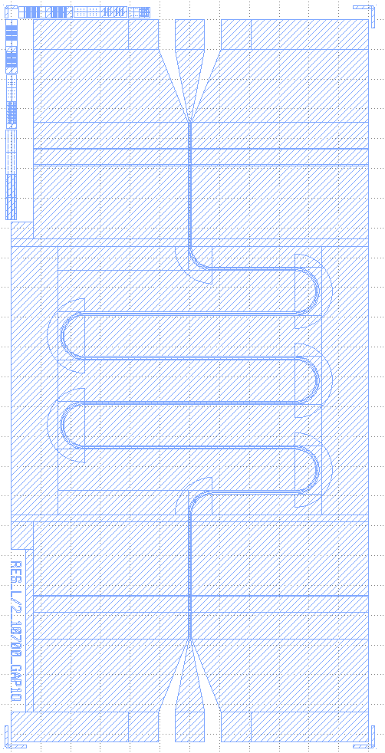
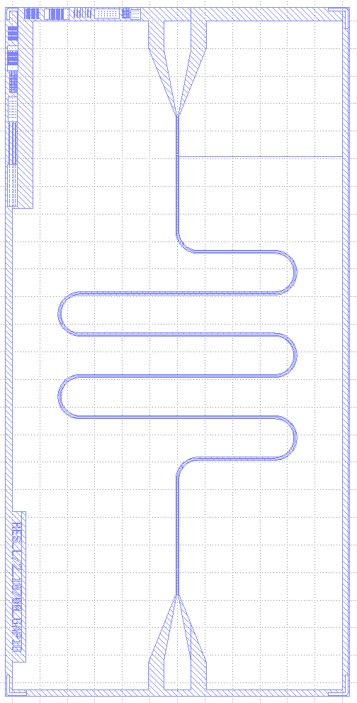

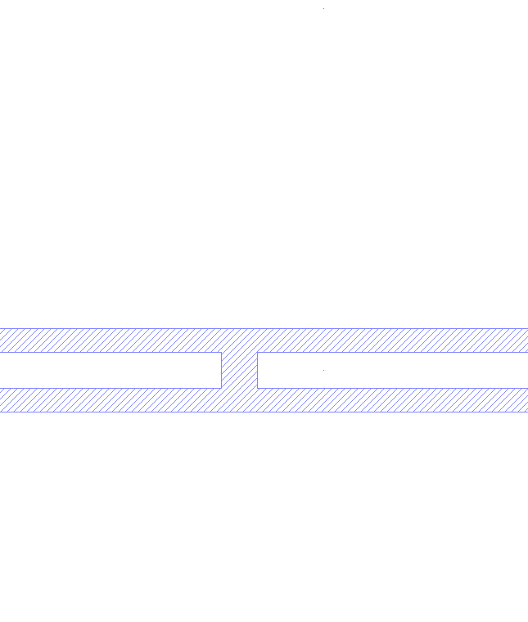
Risuonatori
Bilayer for Lift off approach
PMMA 6% AR-P 669.06 ≈ 1μm
3000 giri/min 60”
    Hot Plate 5’ @ 170 °C
HSQ
  1500 giri/min 60” ≈ 0,3μm
    Hot Plate 2’ @ 150 °C
    Hot Plate 2’ @ 220 °C
100 Å Al (anticharging)
Advantages:
Less exposure time
No metal contamination on the surface
Francesco Mattioli, Fabio Chiarello
Notes:
9

Slide 10
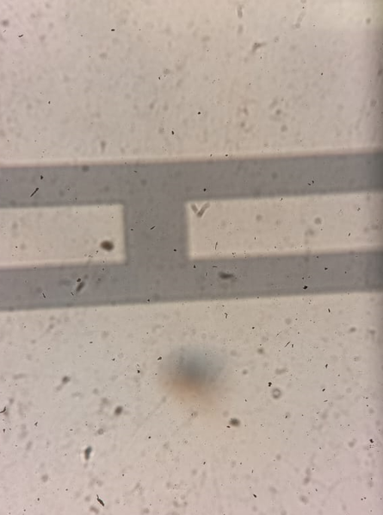
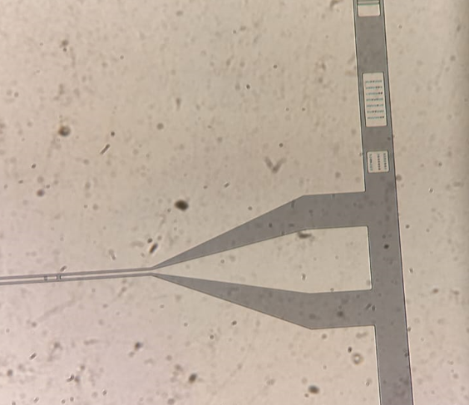
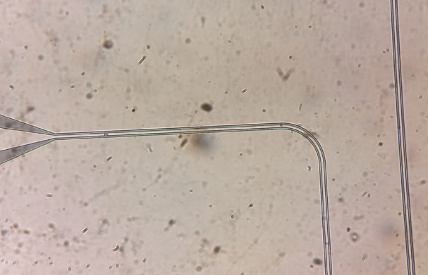
Risuonatori
1500 Å Al and lift off
Advantages:
Less exposure time
No metal contamination on the surface
Francesco Mattioli, Fabio Chiarello
Notes:
10

Slide 11

“Fabbricazione di Q-bit 3D”
25/10/2023
Thank you for your attention!
Francesco Mattioli and Fabio Chiarello

