Slide 1
WG4 meeting
October 2023

Slide 2
COST Events 2024
General Meeting Istanbul 3-6 Sept 2024
Training School Lubjiana 10-14 June 2024
Working Group Meeting DESY Hamburg for 1-2 Feb 2024 (Includes the Technology Forum)
Technology Forum 2024: (Quantum) Sensing
1 afternoon: how many talks?
Technologies:
Superconducting devices
AMO?
….
Companies:
EZ SQUID (M. Mueck MS SQUID)
QuantWare (JTWPA, qubits)
N Roch (TWPA)
Supracon
Research R&D:
Loredana’s Lab
Sorin
6 or 7 talks:

Slide 3
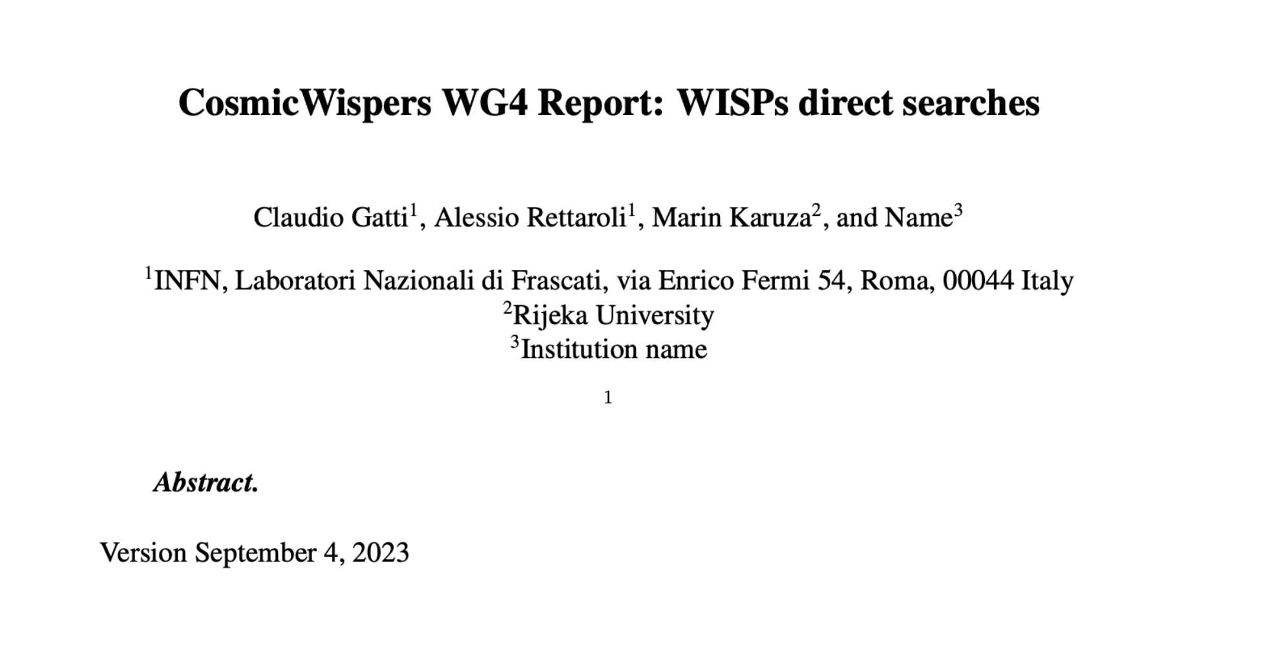
WG4 report draft
Link to Report: https://www.overleaf.com/4678842289cfhfndnmvtyr

Slide 4
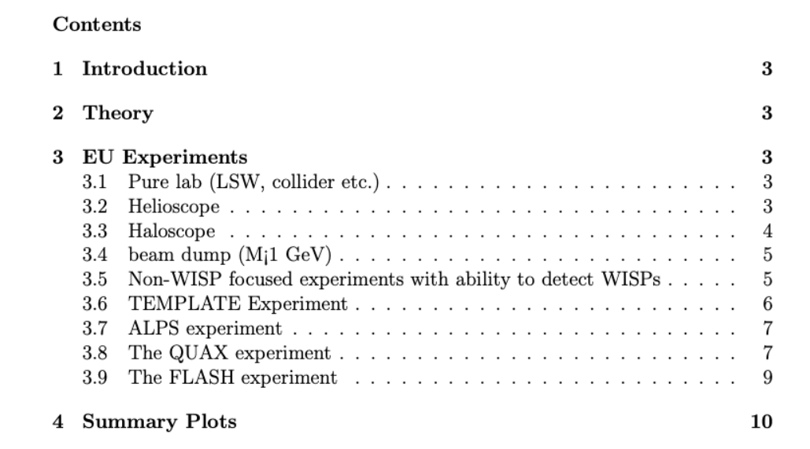
WG4 Report
Now we have:
QUAX
FLASH
Ongoing: Brass, WispFi
Copy and paste Template, and include file in main latex

Slide 5
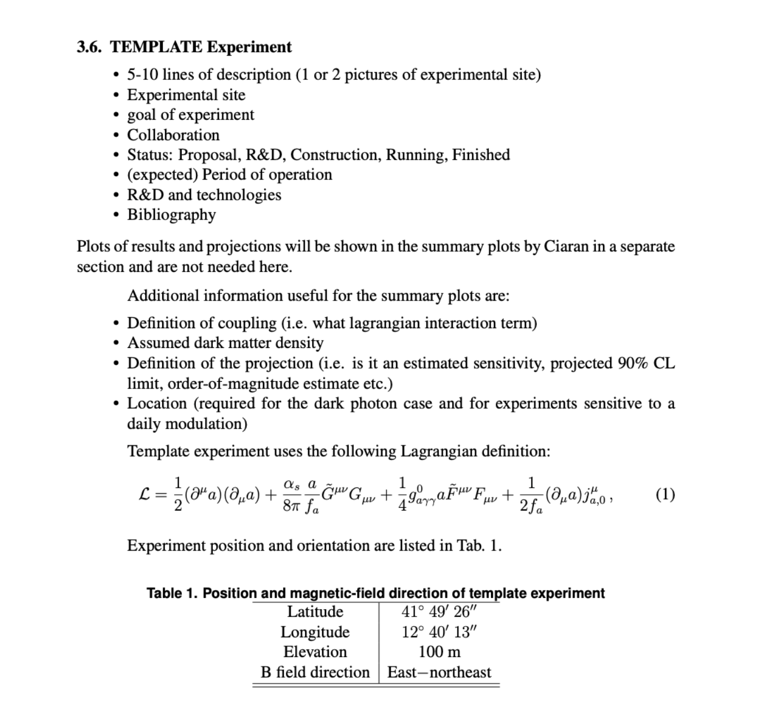
Latex template for experiments

Slide 6
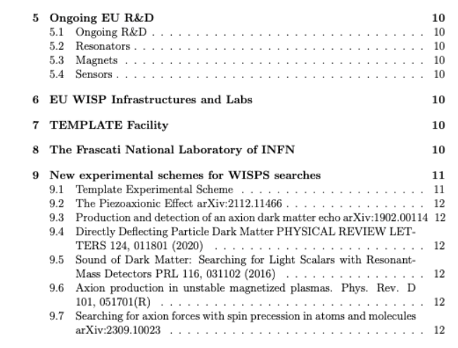
WG4 Report
Also an output of technology forum
Pierre can help on magnets?
Make a list of labs and a template
Any suggestion here?
Sebastian Ellis
Hugo Tercas
Today talk by Mario

