Slide 1

Temperature measurements and evaluation for FOOT ECAL
B. Spadavecchia

Slide 2

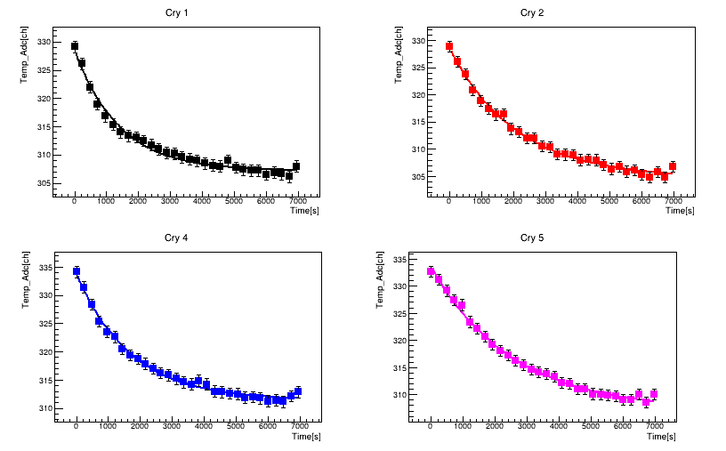
A small recap
Each crystal was put in a climate chamber whose temperature was raised in the range 22.5 – 50°C in 2.5°C steps.
Arduino ADC channel were read and converted via the Steinhart – Hart expression:
ln(1/T) = p0 + p1 ln(TADC) + p2 ln(TADC)³

Slide 3
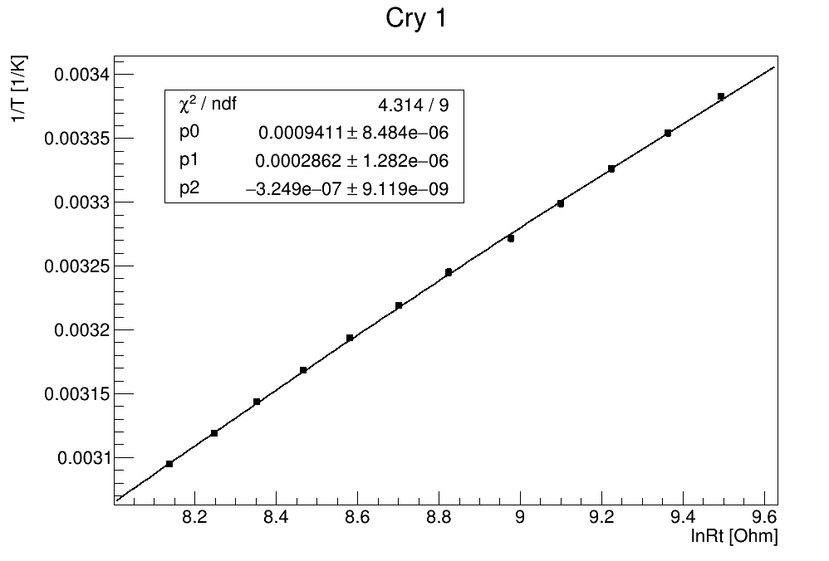
A small recap
The so-obtained coefficients p0, p1, p2 were updated in the file
Reconstruction/config/TACA_Temperature_Calibration_perCry.map

Slide 4
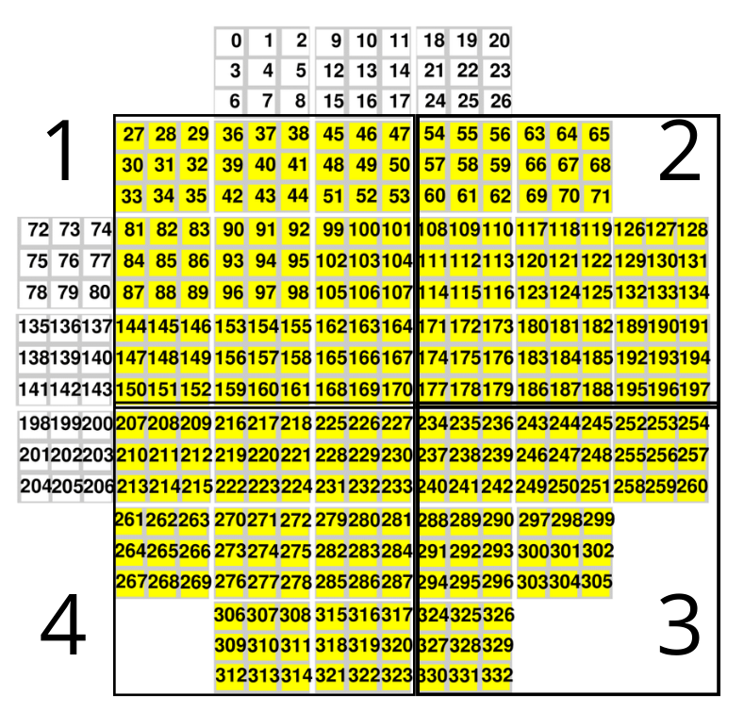
Results from CNAO2023
During the screen saver runs (27-28/10/2023) the 4 quarters of the calorimeter were irradiated with C ions @ 115, 150, 200, 250 MeV/u.
The last quarter also a point @ 300 MeV/u was measured.
Note: Cry 131 and 313 were shut down due to technical issues.

Slide 5
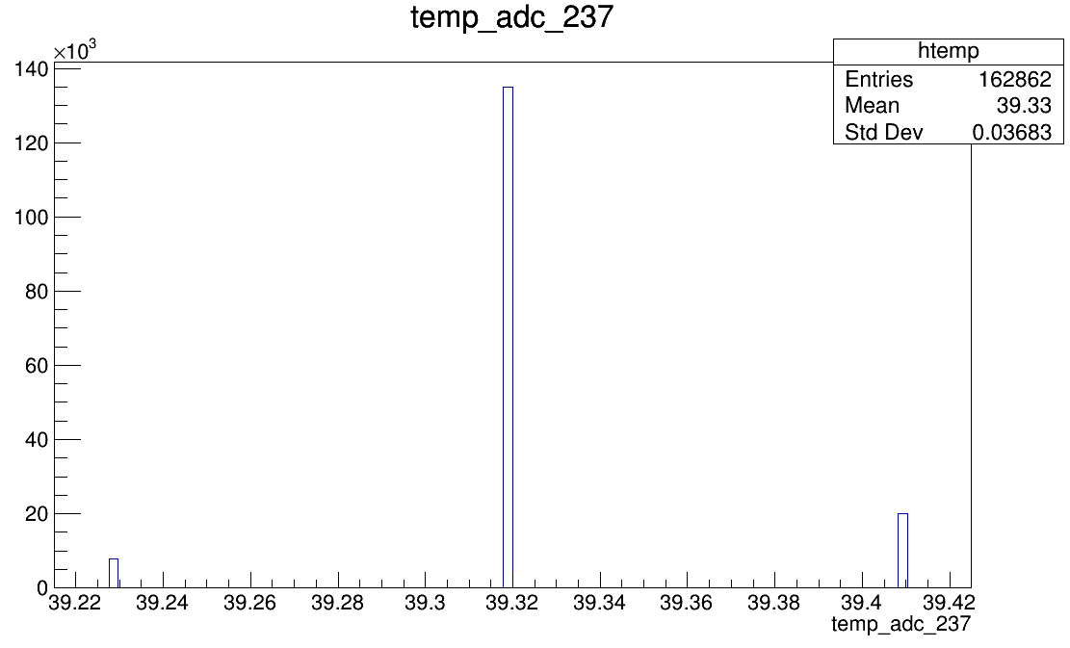
Results from CNAO2023
The file DecodeCA.cc converts ADC read temperatures into real, calibrated values.
For each run, a histogram is plotted and for each crystal the mean temperature value is extracted (with a 0.1 °C sensitivity).

Slide 6
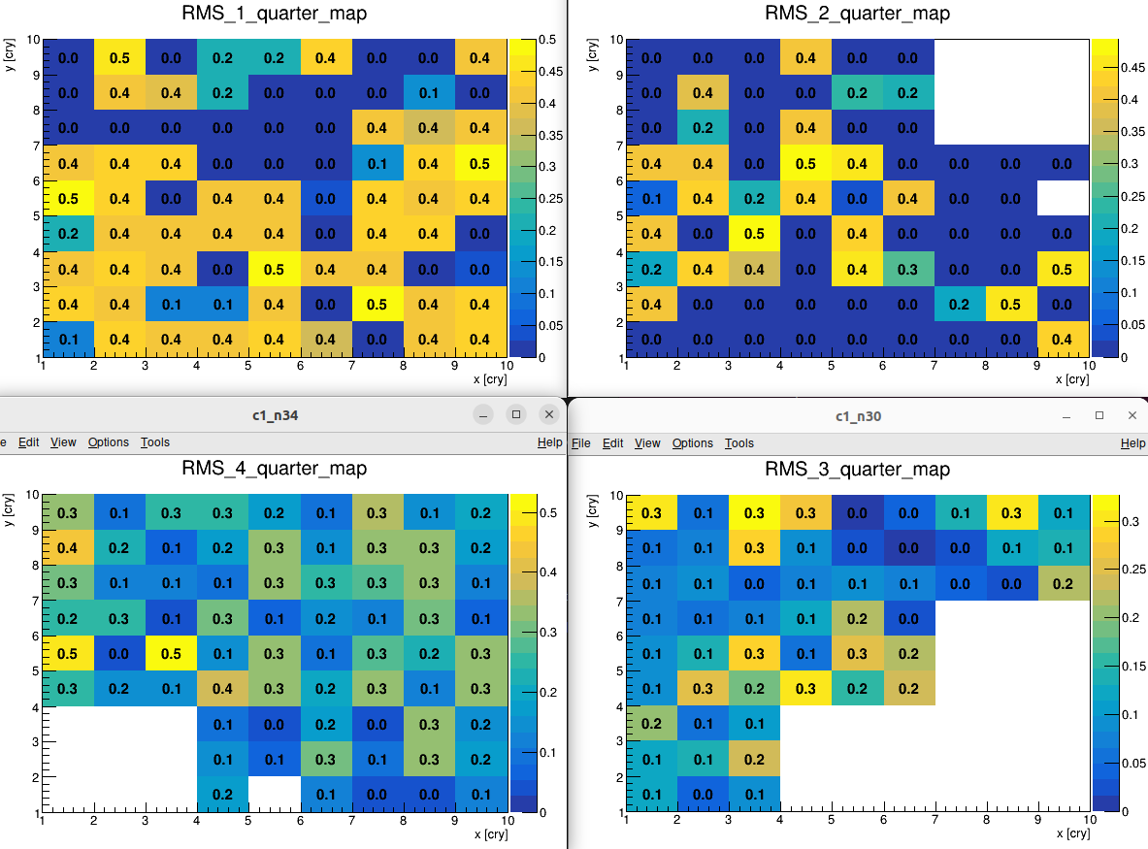
The figure shows σT on single T measurements for each crystal.
The dispersion on Taverage for each crystal is 2 times smaller (√5 for the 4th quarter) → within the experimental resolution...

Slide 7
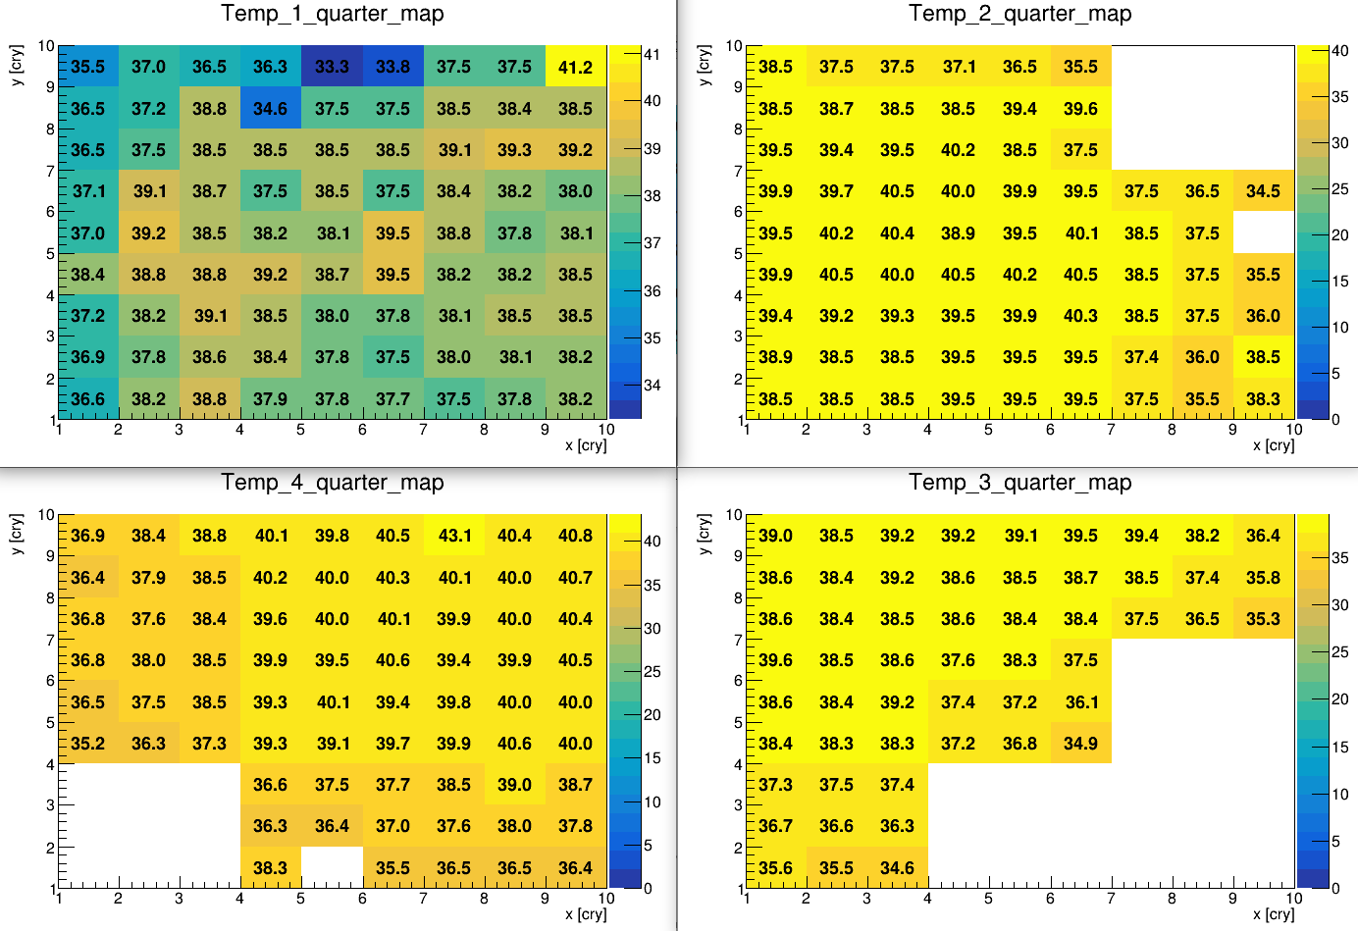
...for each crystal, Taverage was calculated by mediating among the measurements in different runs, then used in order to properly calibrate the energy response.
Note: 244 and 248 gave no T signal → their temperature was mediated among the closest crystals.

Slide 8
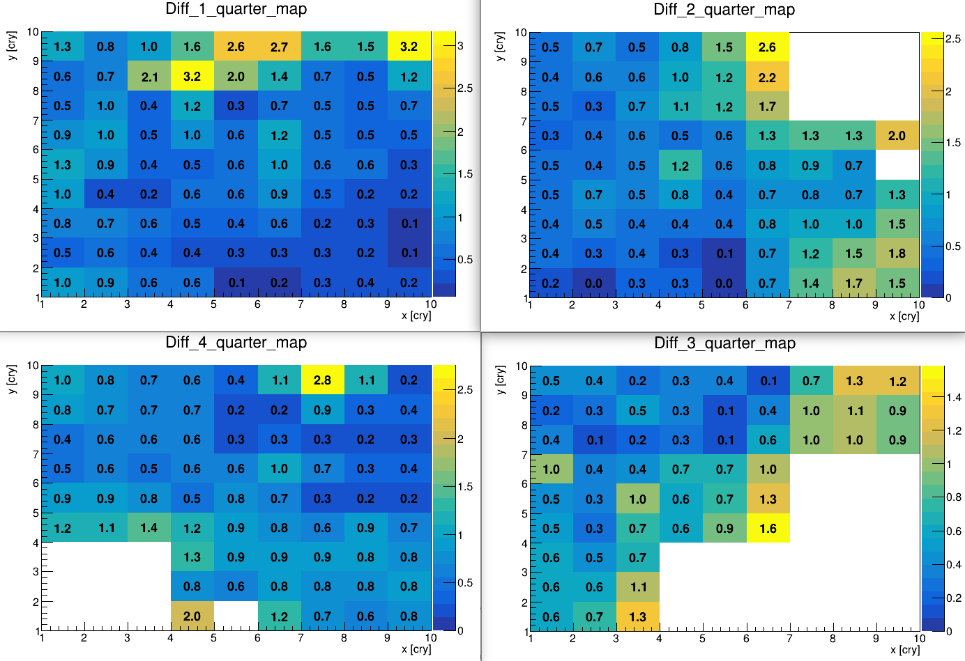
These plots represent the average |ΔT| among one crystal and the nearest ones
..for some crystals show ΔT > 2 °C.

Slide 9
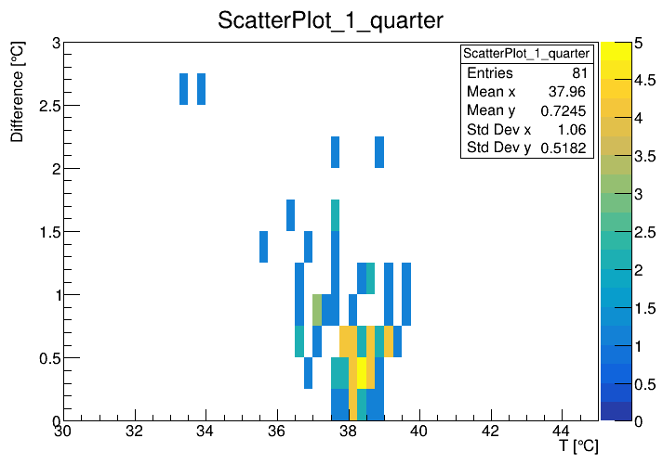
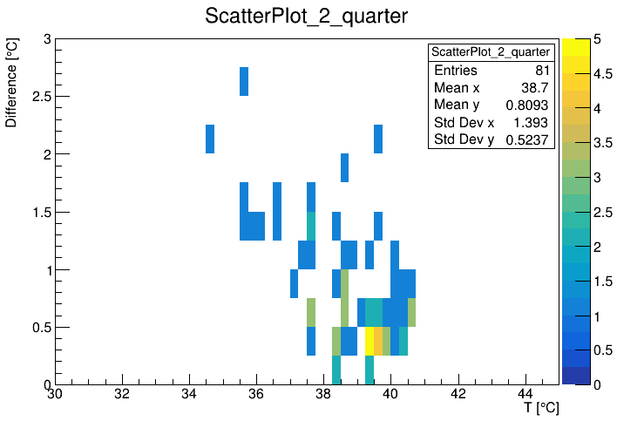
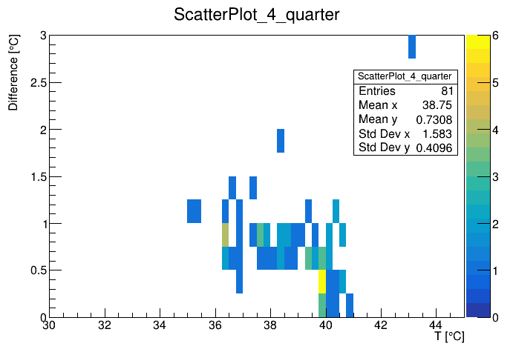
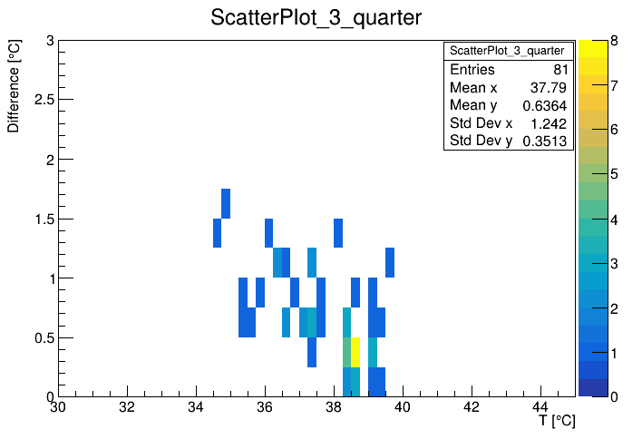

Slide 10
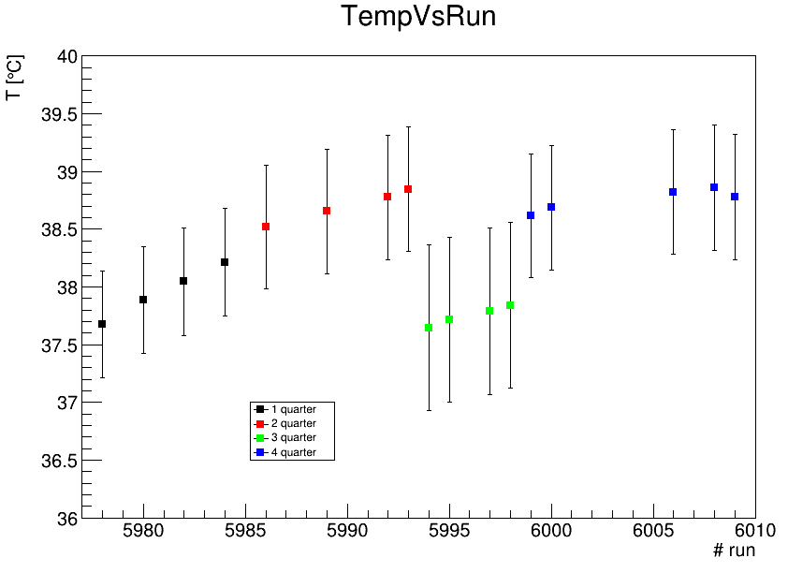
Results from CNAO2023
This plot reports the average T in each quarter (the error is already reported on the mean values, not on the single measurements).

