Slide 1

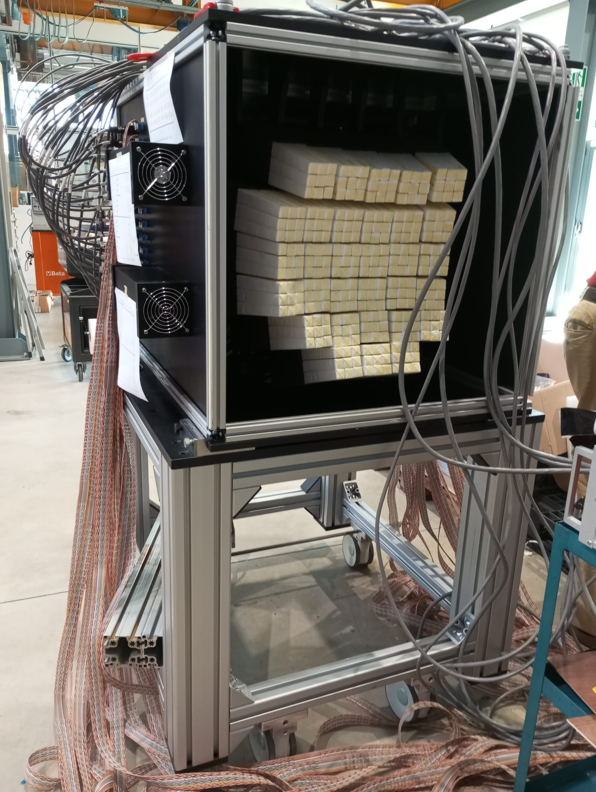
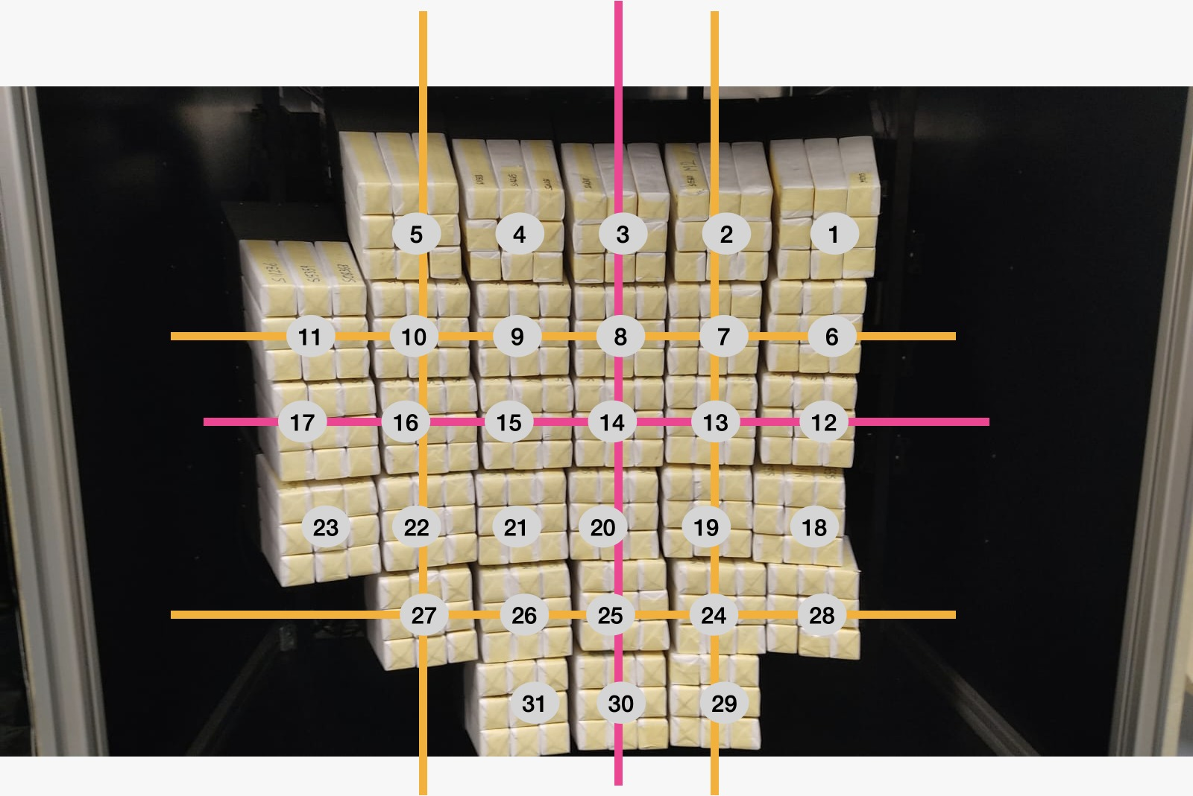
FOOT calorimeter
Status Report
Construction and operation

Slide 2
Overview
Missing items:
Mechanical pieces:
- 31 modules out of 36 (mechanical constraints)
- 32 ready and calibrated, 33 to be assembled
- 34 to 36: crystals already glued, to be wrapped and assembled (next January/February)
-
- vertical module holders being redesigned to mount in a 6x6 configuration
            Detectors:
                - delivery of 15 spare tiles at the beginning of December

Slide 3
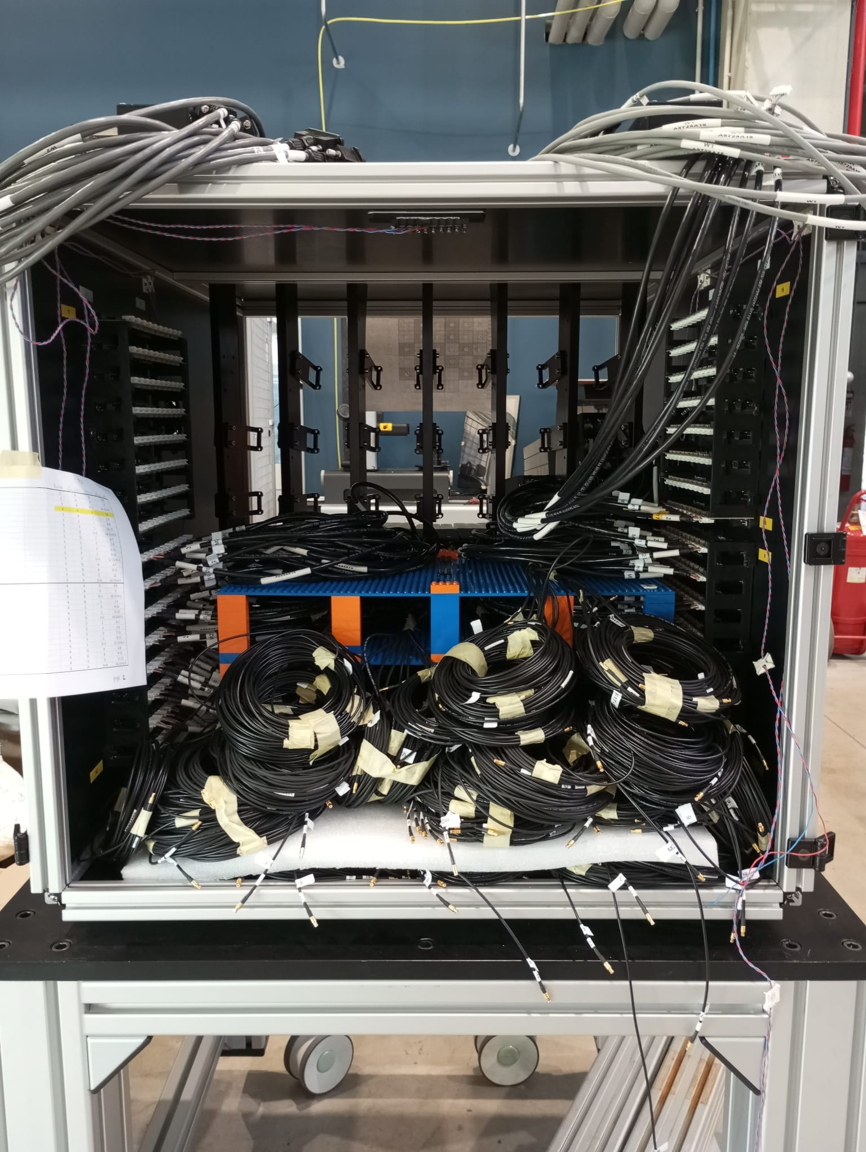
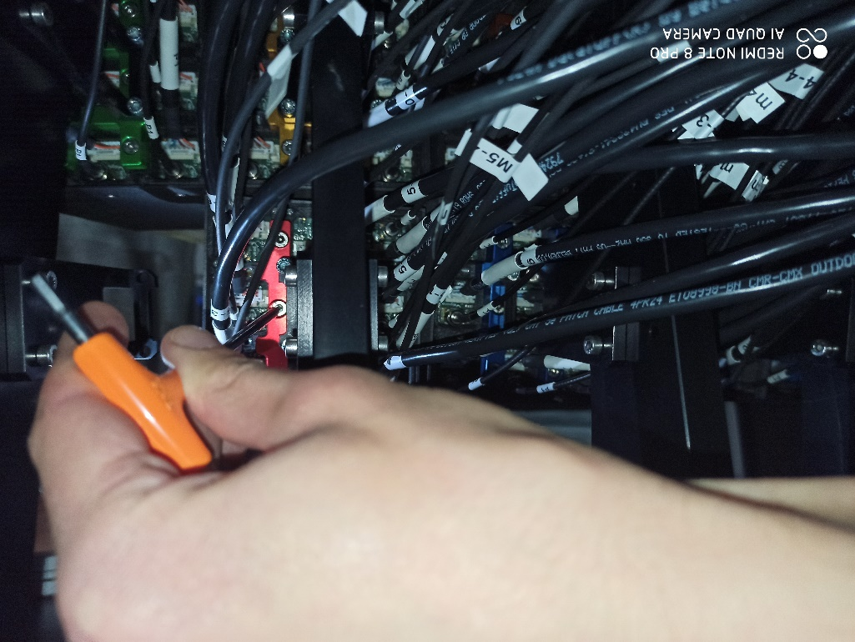
Overview

Slide 4
Overview
Construction issues:
Mechanical structure to be redesigned (circular to square symmetry):
- new vertical bars (2 ordered, 4 with 2024 budget)
- new holding scheme for modules, easier to assemble
- switchboard with non-aligned connectors: 8 new boards ordered
- signal cables wavedaq connectors sometimes break: spare cables to be ordered on 2024 budget (but replacing them is a long and difficult task!
- cable holder with LEGO works very well
- connection scheme for power supply cables to be redefined taking into account to module mounting order

Slide 5
Overview
Installation / Operation:
Overall, power supply stability, thermal stability and energy resolution ok
- new table perfectly suitable for CNAO, but the old one must be used at GSI
- only 1 problem with power supply: 1 channel tripped during the first night
(strange effect of signal saturating after the power supply trip now understood)
- might be useful to monitor Voltage and current

Slide 6
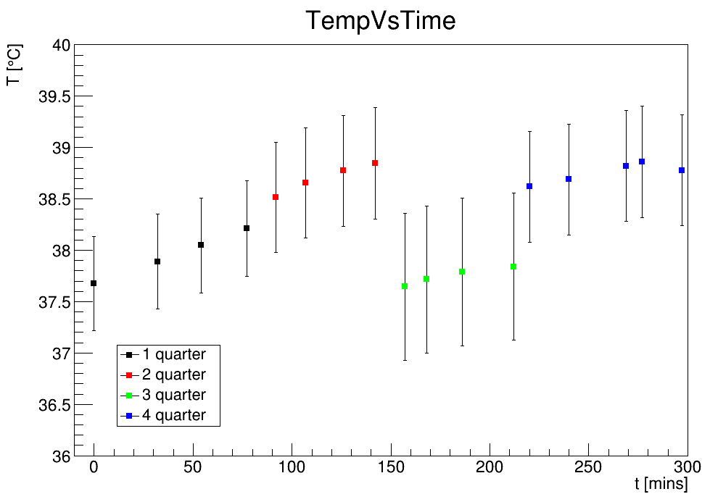
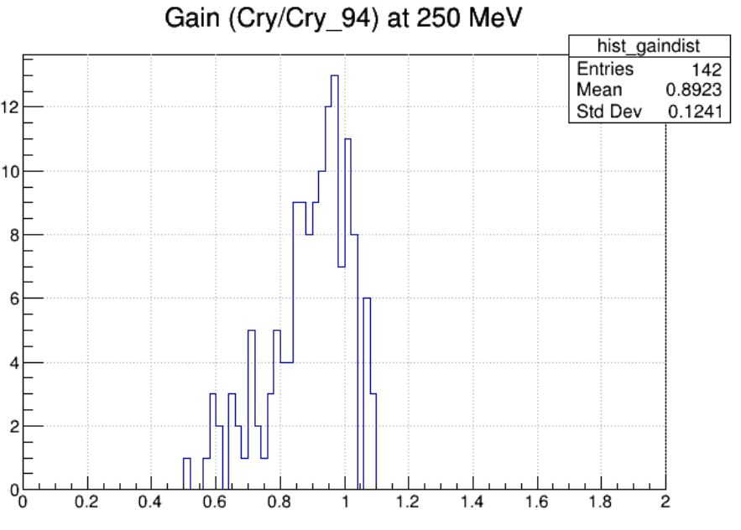
Overview

Slide 7
Overview
Timeline for 2024:
New mechanical design:
  - wait for delivery of all the new pieces before dismounting
  Missing modules: assembly and temperature calibration
  - to be completed by end of February
  Data takings:
  - calibration run in spring
  - common FOOT run in October/november
  System re-assembly:
  - between calibration and common data takings

