Slide 1
Trento FOOT general meeting ( december 2023 )
Vertex and Inner Tracker
Where do we stand
Spring 2023 - Inner tracker ladders arrived
August 2023 – Magnet arrived at LNF
September 2023 – Magnet/IT mechanics arrived at LNF
Summer 2023 – Inner tracker ladders tested in lab
September 2023 – Full Inner tracker tested at the BTF (LNF)
October 2023 – Full Inner Tracker (with old Vertex version) operational at CNAO
Magnet system operational at CNAO
December 2023 – Full pixel tracking system back at LNF
Where do we go
October 2023 – HP-DMAPS (PRIN2022) started
December 2023 – HP-DMAPS DAQ board design under way at LNF
December 2023 – HP-DMAPS slow control software started in Bologna
Spring 2024 – HP-DMAPS proximity board design foreseen at LNF
December 11° 2023 – «MIMOSIS-2.1 has been approved for submission»
January 2024 – MIMOSIS1 test boards available (at LNF and Bo)
Beginning 2024 – refurbishment of Vertex

Slide 2
Where we were
at december 12° 2022 FOOT General meeting in Perugia
Vertex and Inner Tracker summary
FOOT tracker mechanical setup:
Final mechanical design available
Electronic system support table ordered. We’ll give start production beginning 2023.
Inner Tracker readout electronics (Terasic boards) mechanical support under design.
Magnet system:
Delivery foreseen june/july 2023
Pixel vertex detector:
Used at GSI and at CNAO (last november) see 30 november Christian presentation.
New Vertex readout board under production (DE0nano board compatible)
Inner Tracker:
Plume ladder assembly process definition concluded in Strasbourg
All production tools available
First module tested at LNF, wrong bonding discovered (bonding plan modified)
10 modules assembled
1 ladder (out of 5) assembled ( problems in dead sensors!!! ) SHOWSTOPPER
All needed hardware/software pieces available
Intermediate PC readout software (event building) written and tested at CNAO (for 2 channels out of 8 – extension to 8 not a problem)

Slide 3
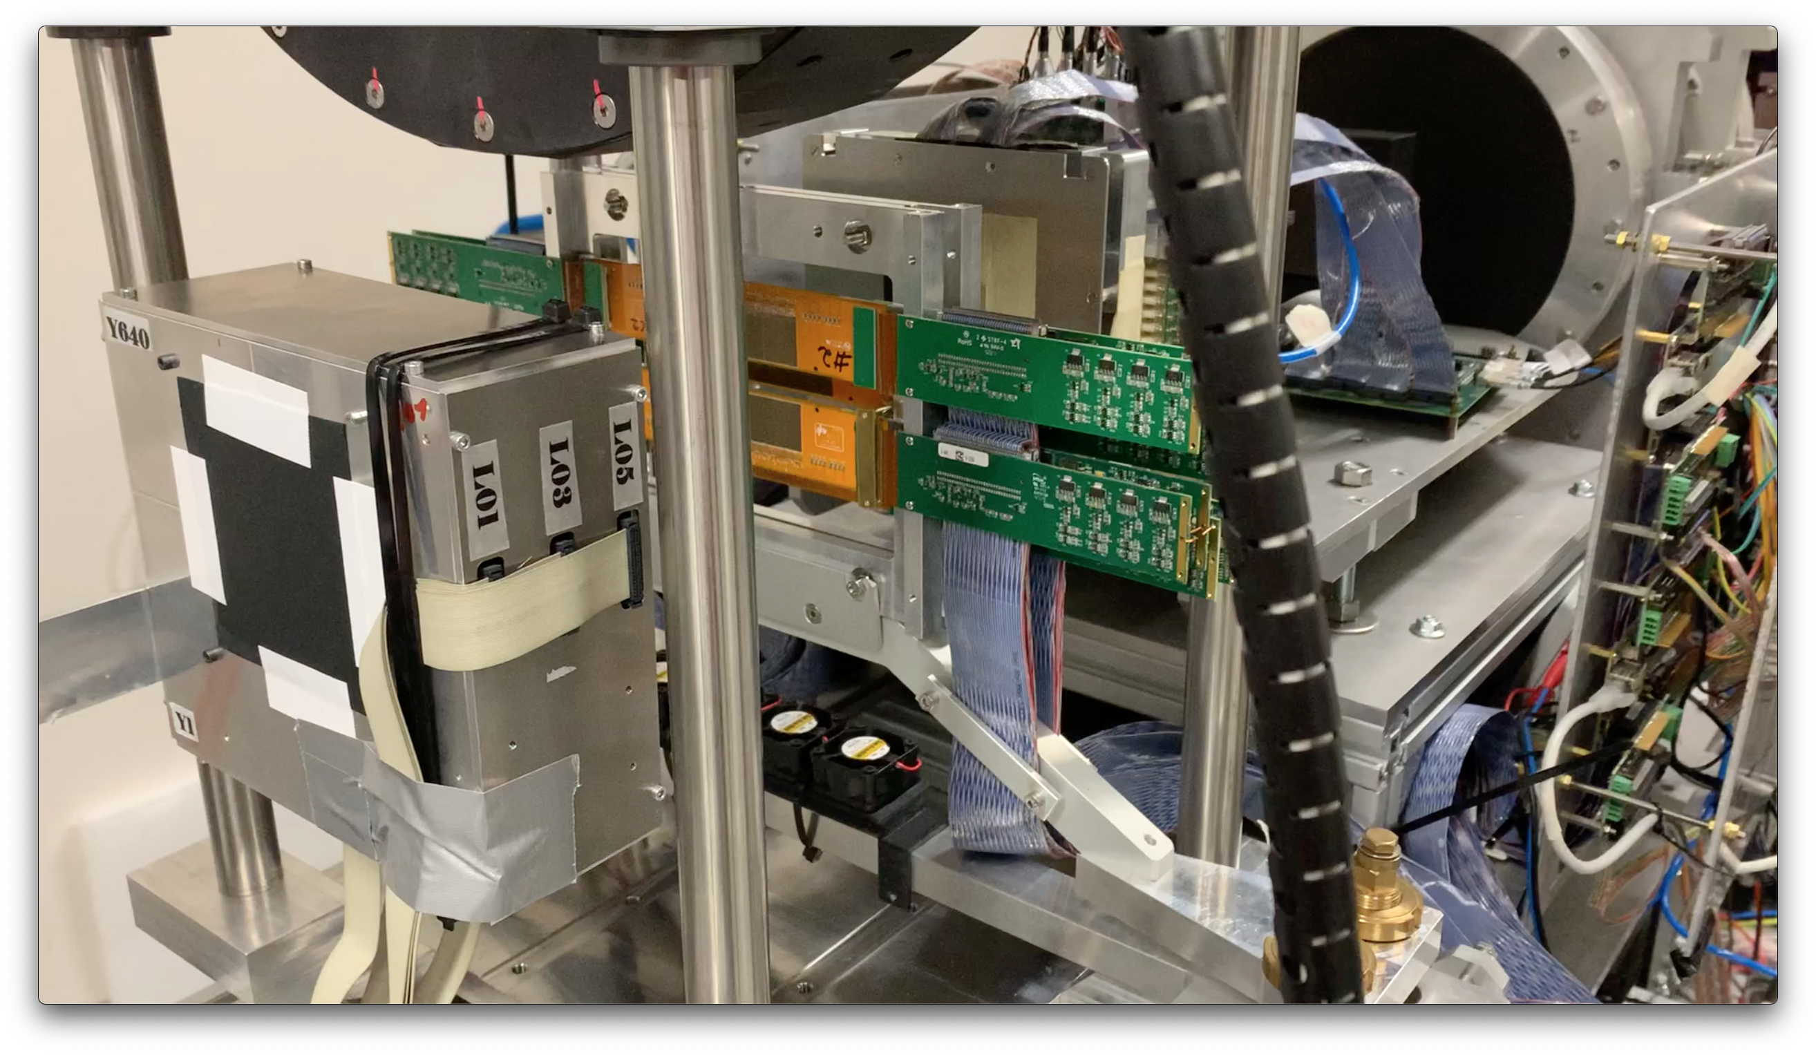
Picture taken at CNAO ( end of october 2023 )

Slide 4
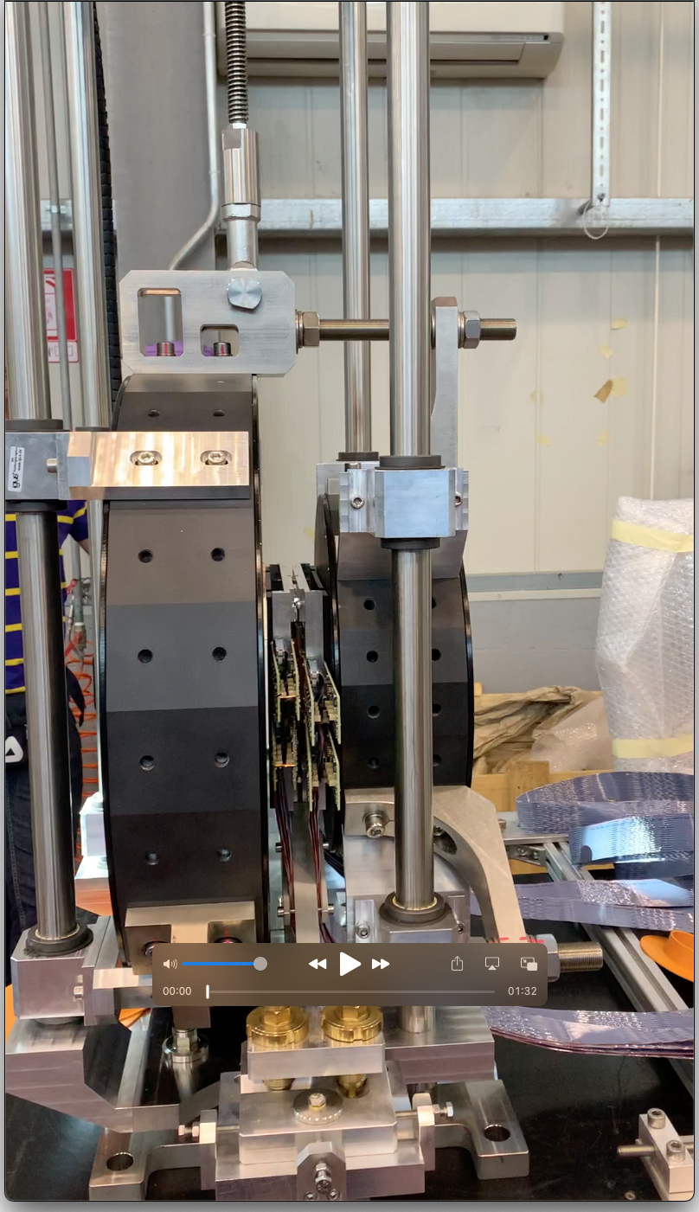
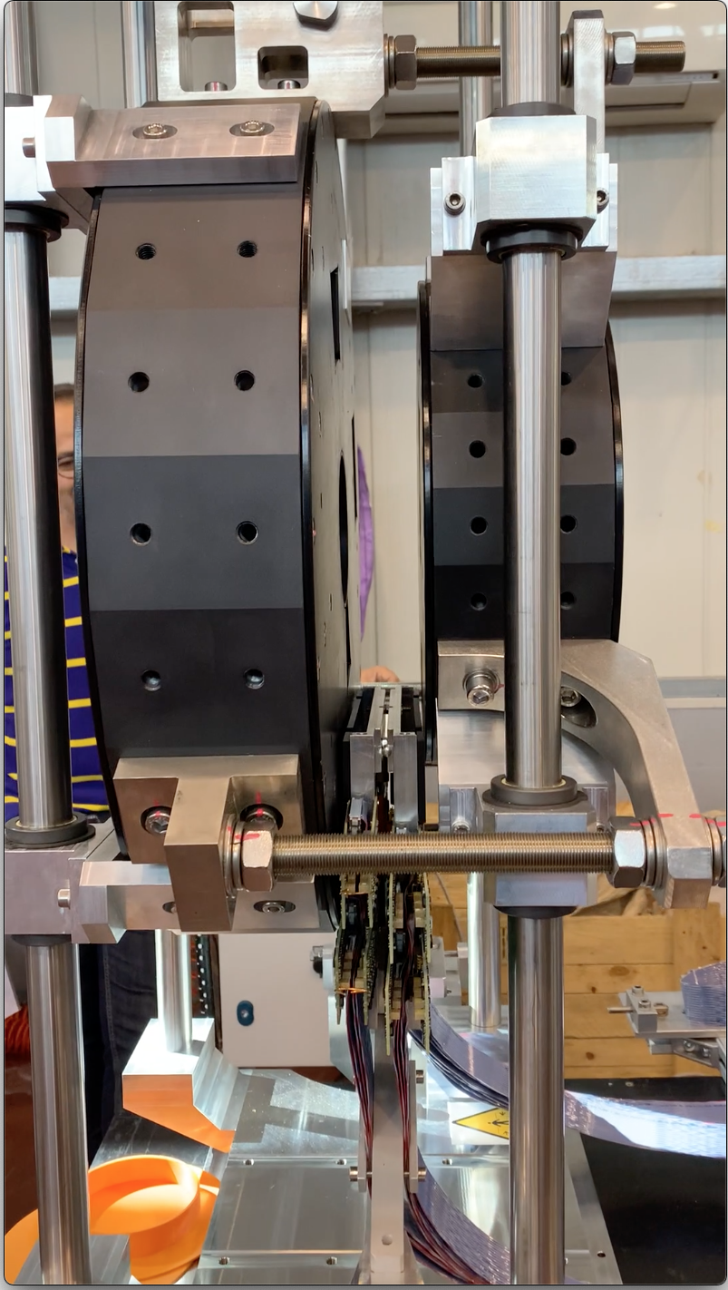
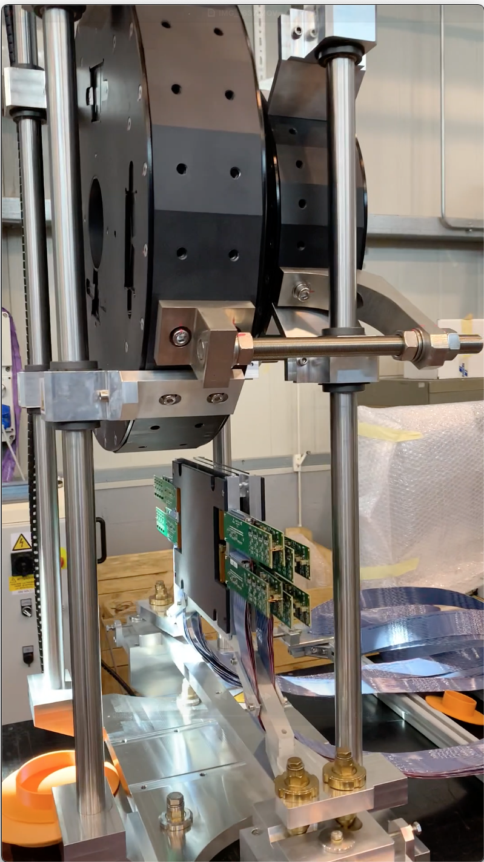
Picture taken at CNAO ( end of october 2023 )

Slide 5
PRIN 2022
«High performance DMAPS (Depleted Monolithic Active Pixel Sensor) for hadrontherapy»
«…….we propose this project with the aim of significantly improving the capabilities of the pixel tracker, particularly in terms of the amount of data that can be collected for the same amount of time and spatial resolution, which for obvious statistical reasons allows for greater accuracy of the measurements to be made………»
We propose to improve the detection characteristics of the FOOT experiment's vertex detector by using the MIMOSIS sensor, recently developed for the CBM experiment by the In2p3 research group in Strasbourg.
A. Dorokhov (VCI 2022)

Slide 6
Status of MIMOSIS2 sensor ( december 2023 )
9 chips diced and tested ( from different wafers/process)
MIMOSIS-2 does not work properly
✓ Unexpected issues on the design (e.g. frequency limitation for some standard cells, reset)
✓ Ongoing discussions with the foundry (NDA)
MIMOSIS-2.1 submitted to foundry december 11°
MIMOSIS.2.1 back from foundry in four months

Slide 7
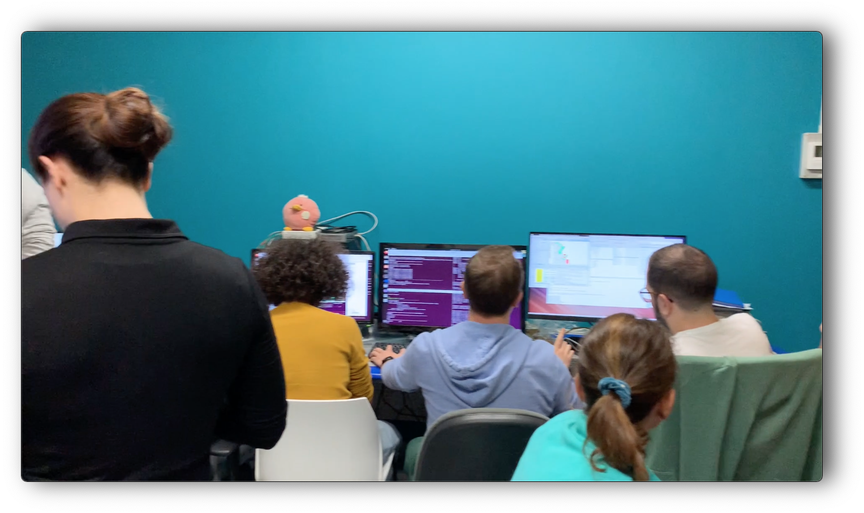
Picture taken at CNAO ( end of october 2023 )
Partial view of the FOOT crew at CNAO!!!!!
Many more pictures available

