Slide 1
ST performance @ CNAO vs past campaigns
Giacomo Traini
FOOT general meeting, Trento, 11th December 2023

Slide 2
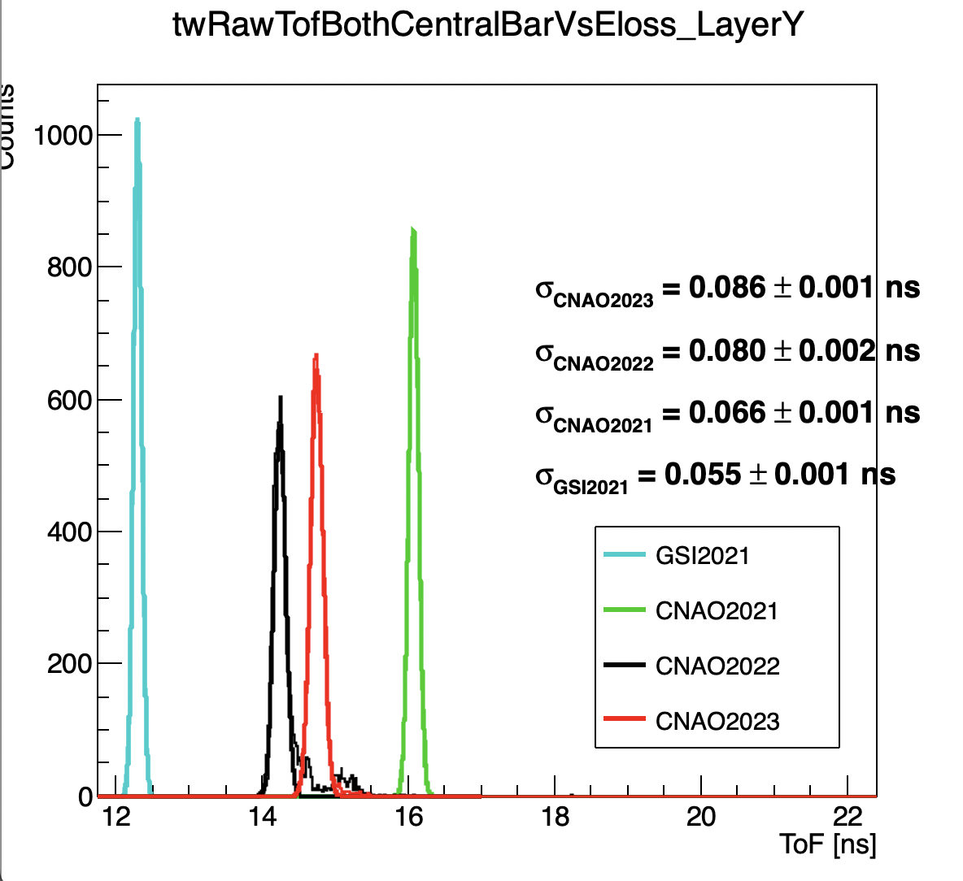
ToF Comparison with the past campaigns
As spotted by Roberto during the analysis meeting the ToF resolution @ CNAO202{2,3} is significantly worse than the past
Comparing with the data published in old papers, thesis, presentations, it seems that the effect is due to the ST
Negligible impact in Z-id but potentially serious impact in mass resolution
ToF
¹²C @ 200 MeV/u with C target**
CNAO2023 Run 6172 (Maj)
**except GSI 16O @ 400 MeV/u

Slide 3
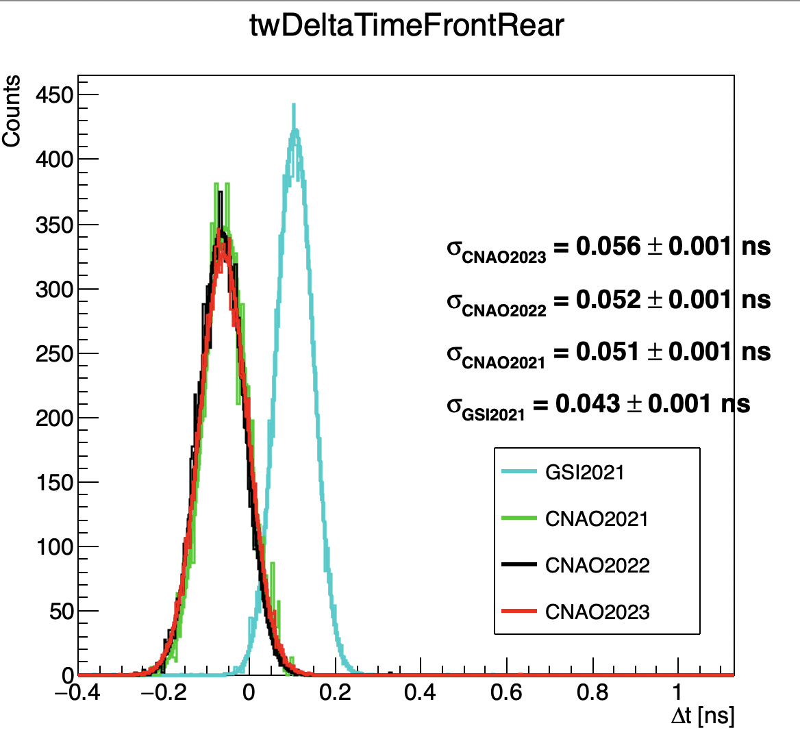
TW response
TW reso
12C @ 200 MeV/u with C target**
Looking at the Δt between the central bars, the TW seems to be quite stable, even if numbers suggest that a tiny effect is present
However, the TW contribution to the ToF is negligible as expected
**except GSI 16O @ 400 MeV/u

Slide 4
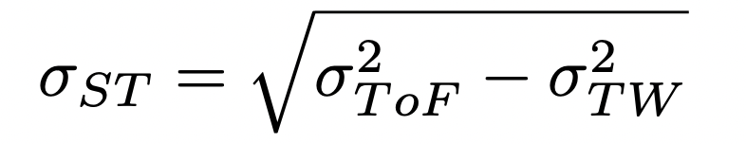
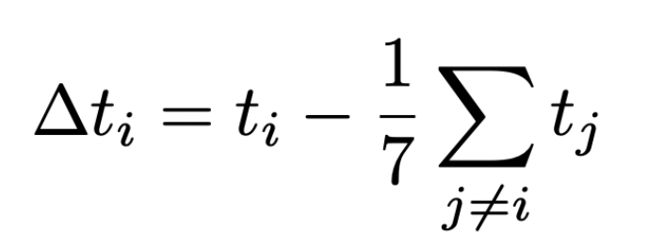
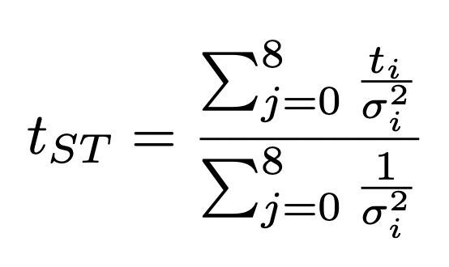
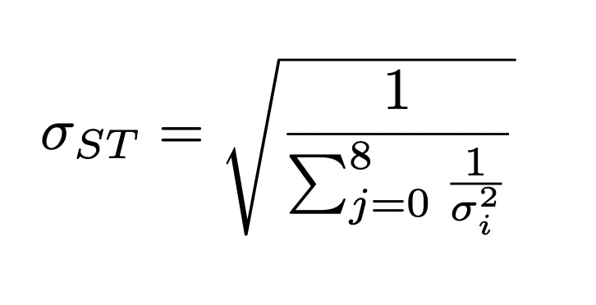
ST performance
Method 1:
We can not unfold the resolution contribution due to the clock synchronization!
Method2:
Correlation between channels is not taken into account
Not exactly the method that we use to compute the ToF
 | σ_{TW} | σ_{ST} (Met1) | σ_{ST} (Met2)
GSI2021* | 30 ps | 46 ps | 43 ps
CNAO2021 | 36 ps | 55 ps | 42 ps
CNAO2022 | 37 ps | 71 ps | 62 ps
HIT2022 | - | - | 48 ps
CNAO2023 | 40 ps | 76 ps | 60 ps

Slide 5
ST performance
 | σ_{TW} | σ_{ST} (Met1) | σ_{ST} (Met2)
GSI2021* | 30 ps | 46 ps | 43 ps
CNAO2021 | 36 ps | 55 ps | 42 ps
CNAO2022 | 37 ps | 71 ps | 62 ps
HIT2022 | - | - | 48 ps
CNAO2023 | 40 ps | 76 ps | 60 ps
Comments:
The ST channels power supply has been slighlty changed in each campaign to “equalize” noise (i.e. to have no random coincidences with majority=5) . A straight comparison is not really possible
Nevertheless, a significant difference is observed in CNAO202{2,3} campaigns

Slide 6
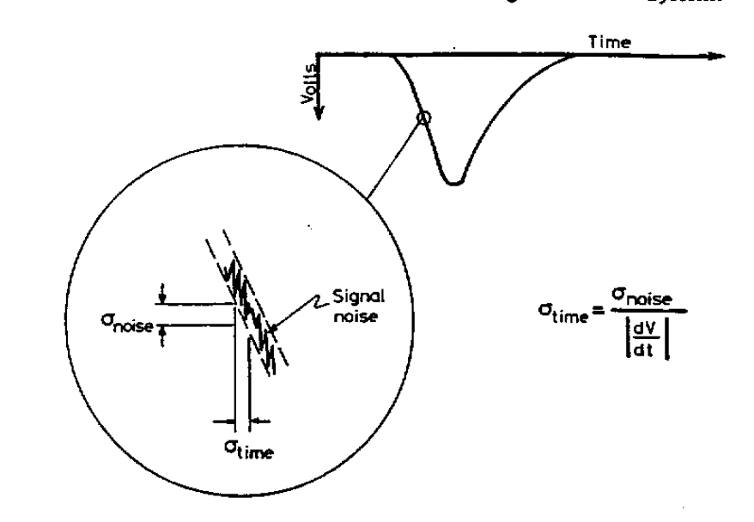
An always useful reminder
ST time evaluation method:
The 8 collected signals are summed up
Time is taken @ 20% of max amplitude with respect to the baseline (using linear interpolation)
Resolution depends on:
Time steepness
Electronic noise
Sampling rate, accuracy in amplitude and baseline evaluation
From W.R. Leo…

Slide 7
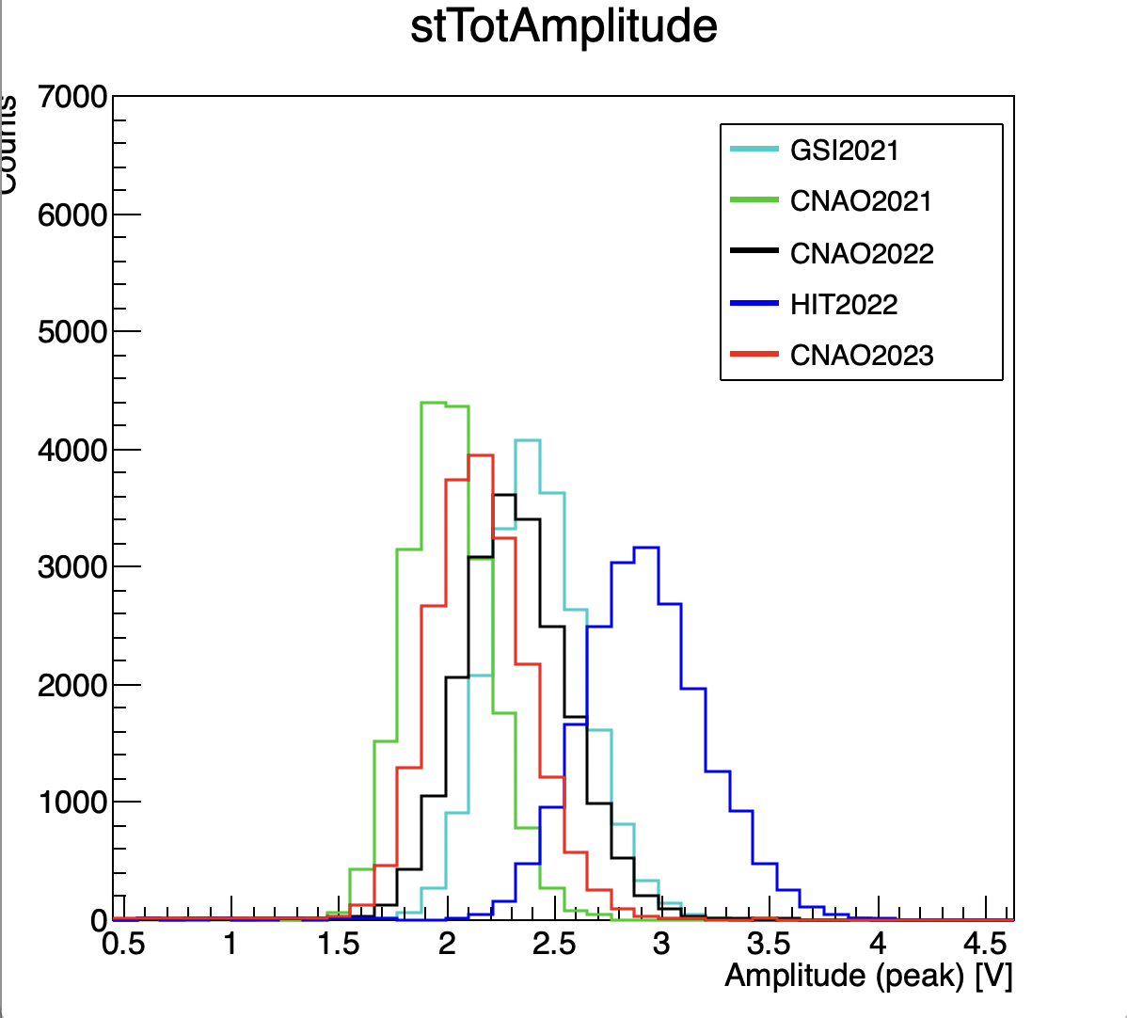
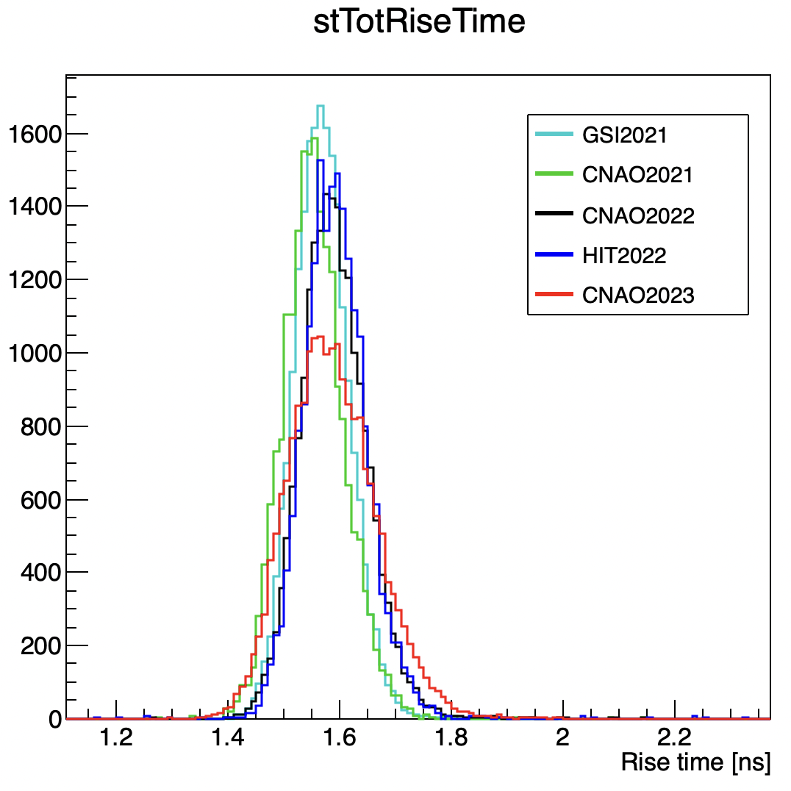
ST response
CNAO2021 has the lower amplitude, unexpected…
CNAO2023 has a more spread rise time distribution

Slide 8
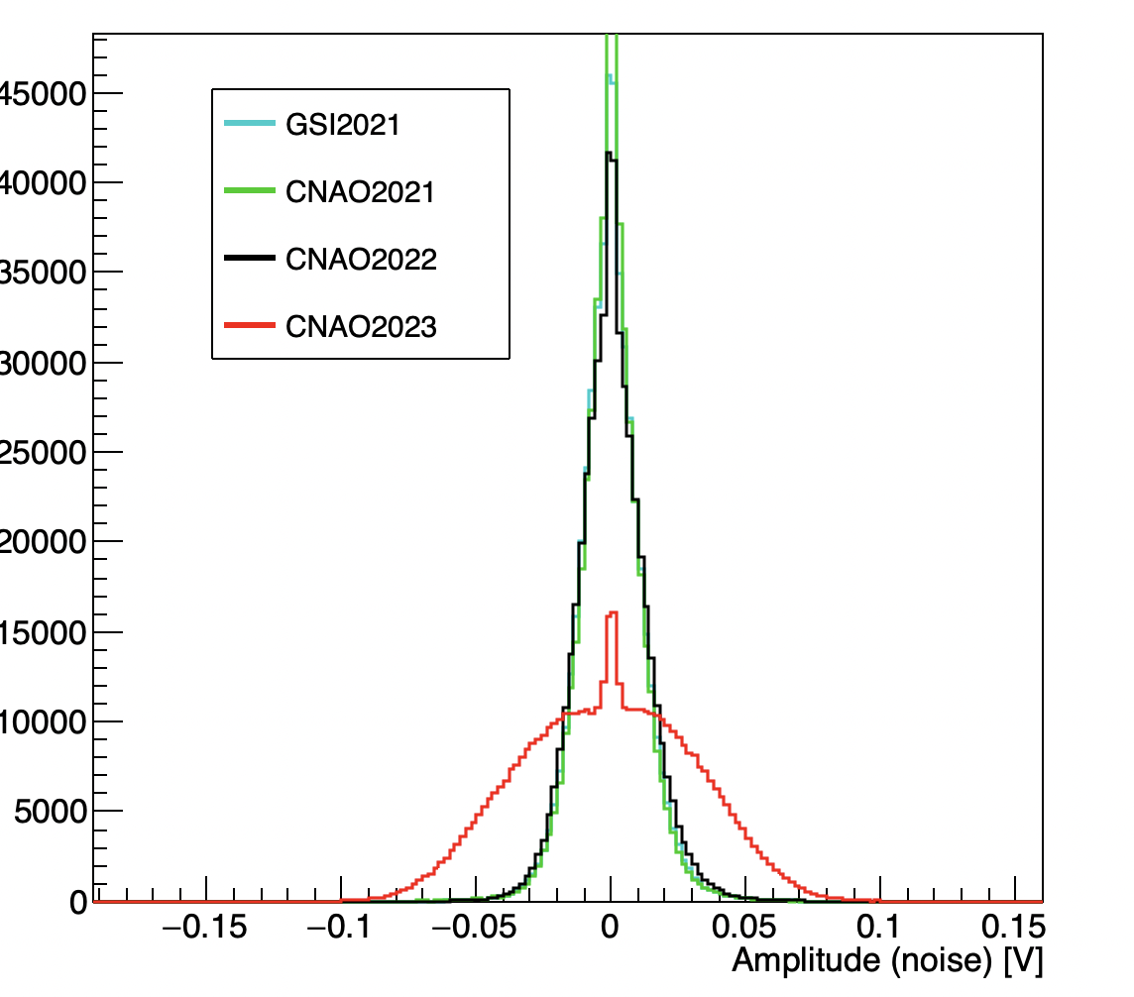
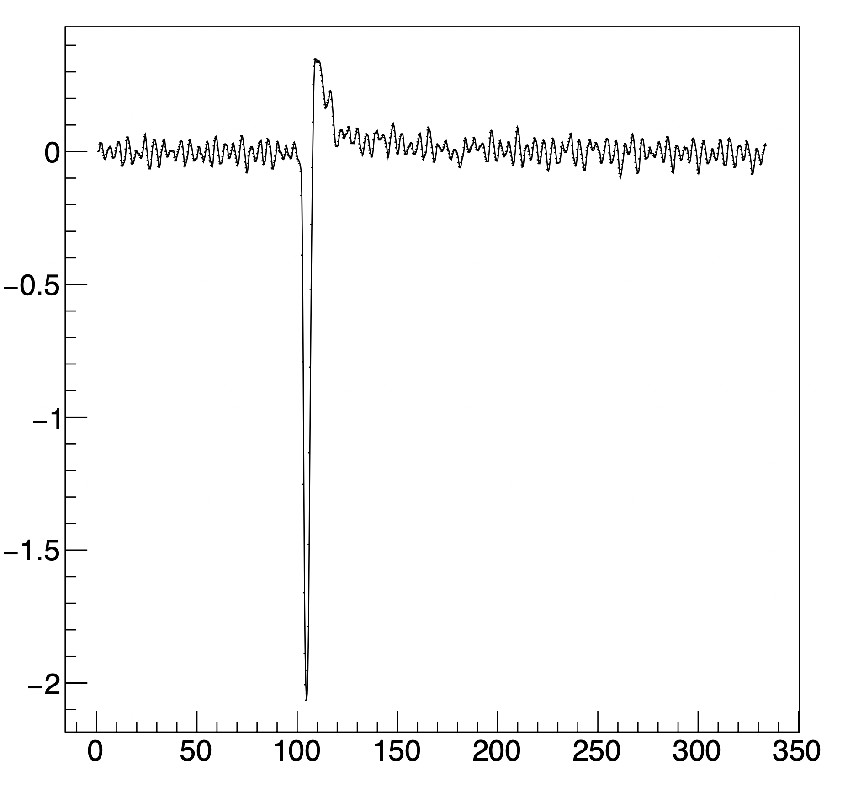
Noise…
 | σ_{noise}
GSI2021 | 12 mV
CNAO2021 | 11 mV
CNAO2022 | 13 mV
HIT2022 | 12 mV
CNAO2023 | 31 mV
Electronic noise (i.e. baseline fluctuations) seems to be significantly larger @ CNAO2023
Can be filtered?

Slide 9
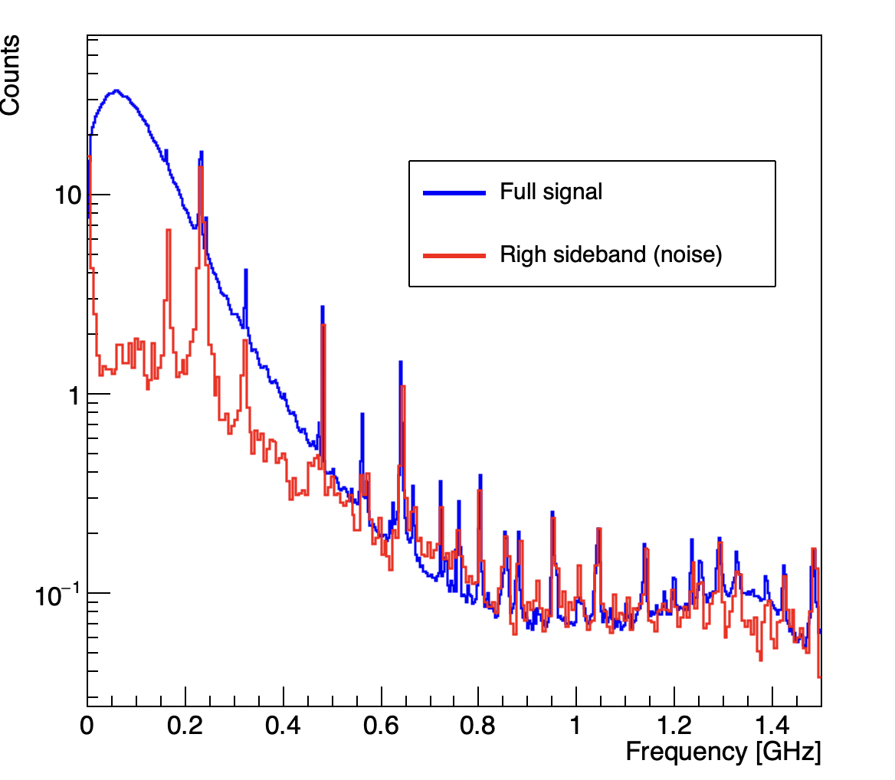
Fourier analysis
FFT implemented in shoe (ROOT libraries), still to be pushed
Clear peaks due to electronic noise can be observed in frequency spectrum
Let’s try to implement a filter. The idea is to :
Compute the frequency spectrum event-by-event
Apply a filter
Compute the inverse Fourier transform on the manipulated spectrum to re-obtain the signal in the time domain
230 MHz peak observed in waveform
average on ~ kEvents

Slide 10
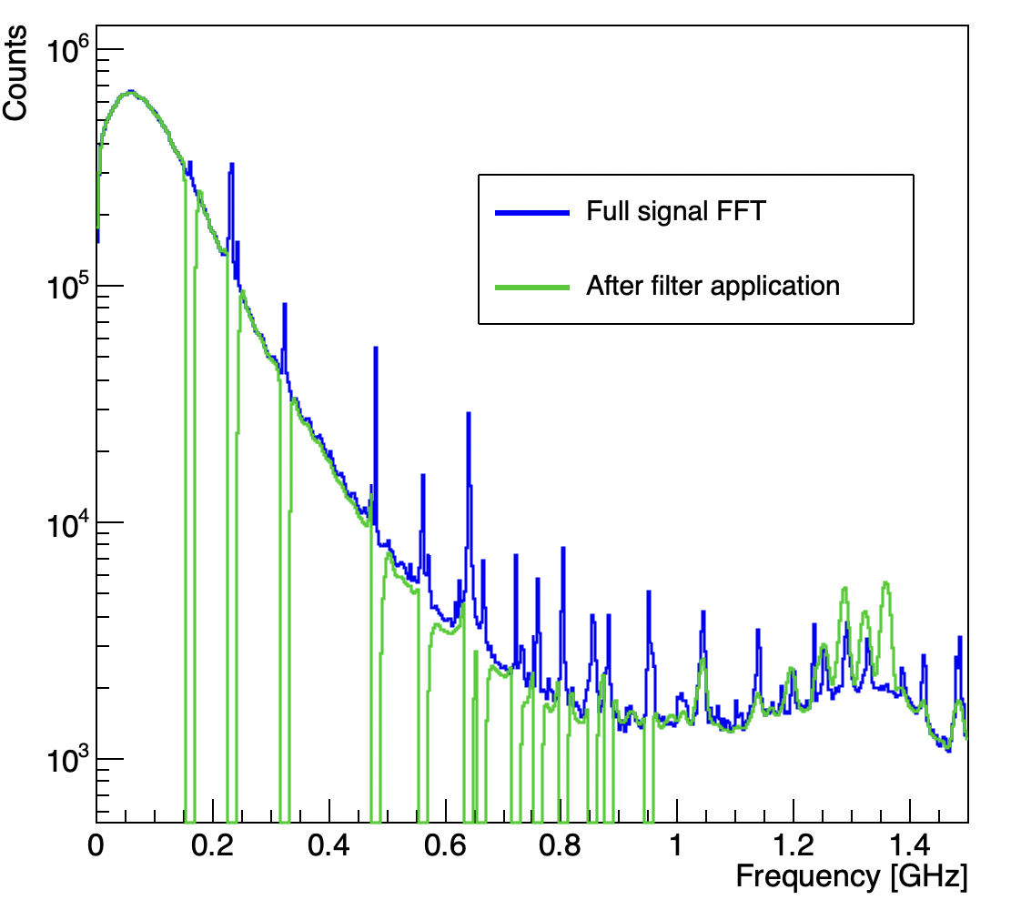
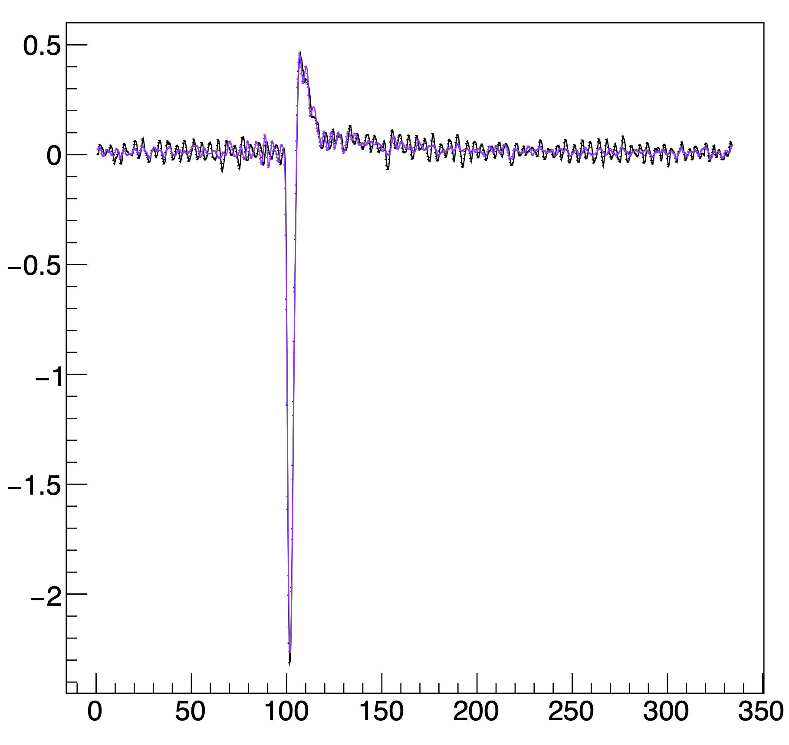
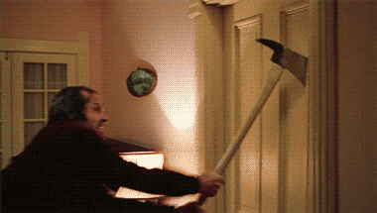
Filter
A lot of quick attempts (smoothing, low-pass, peak finder to automatically look for noise peak…)
I show you just the best (at present) option: rough cut on single frequencies “by hand”
Orig.
Inv.FFT
There is room for improvement…

Slide 11
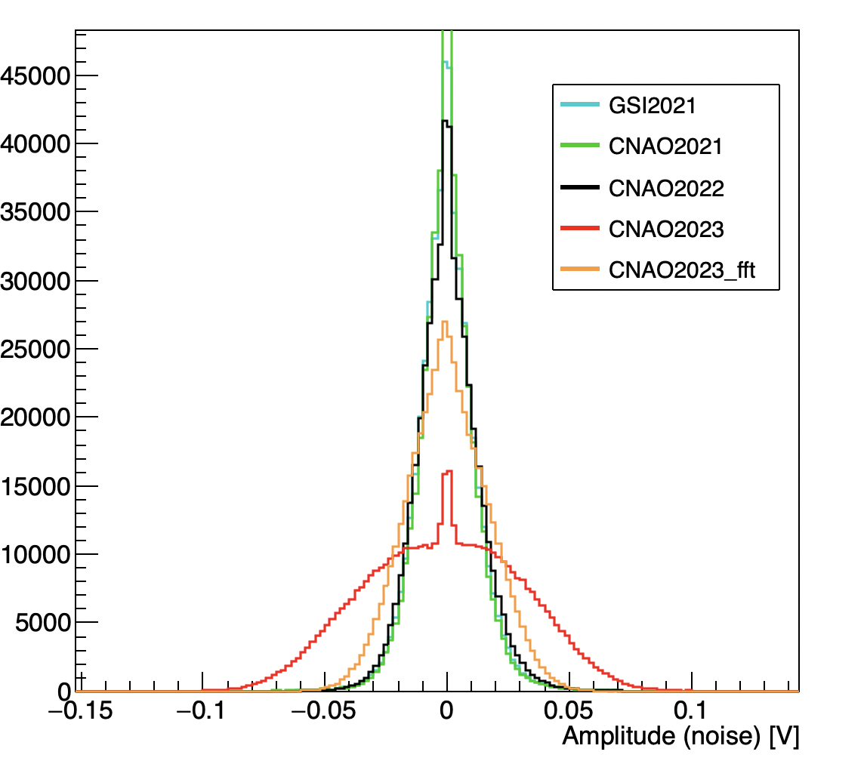
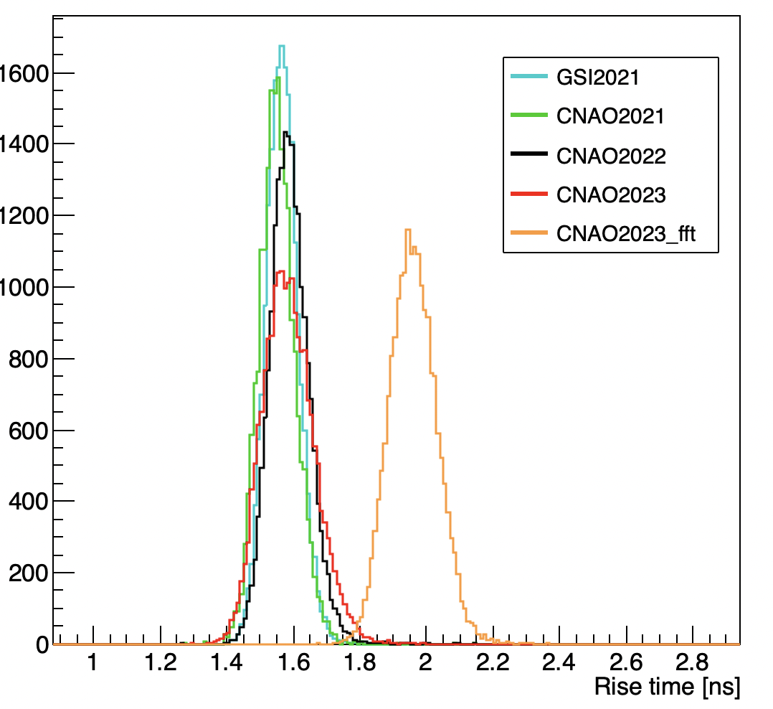
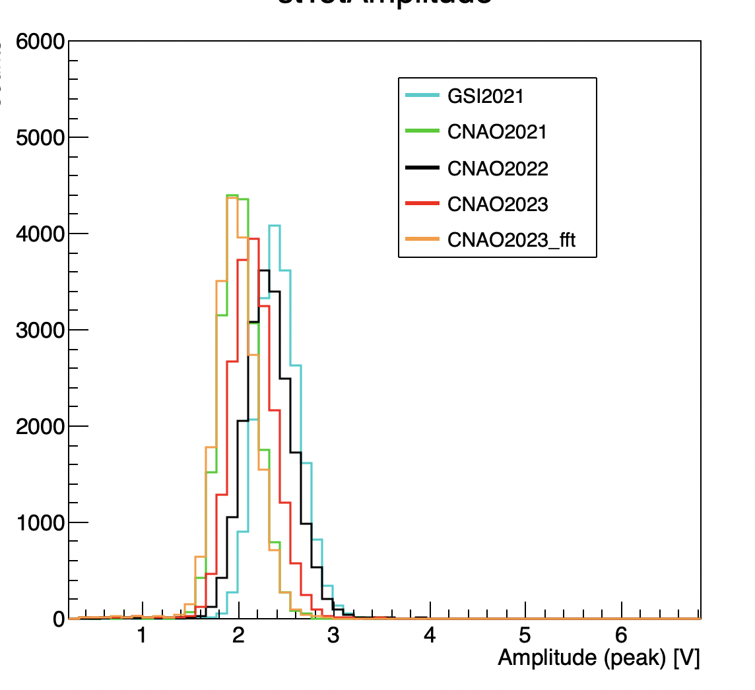
Effect on the ST response
Noise reduction
Rise time enhancement
Amplitude lowering
Noise is reduced at expense of signal steepness... It seems not promising

Slide 12
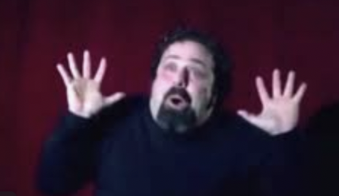
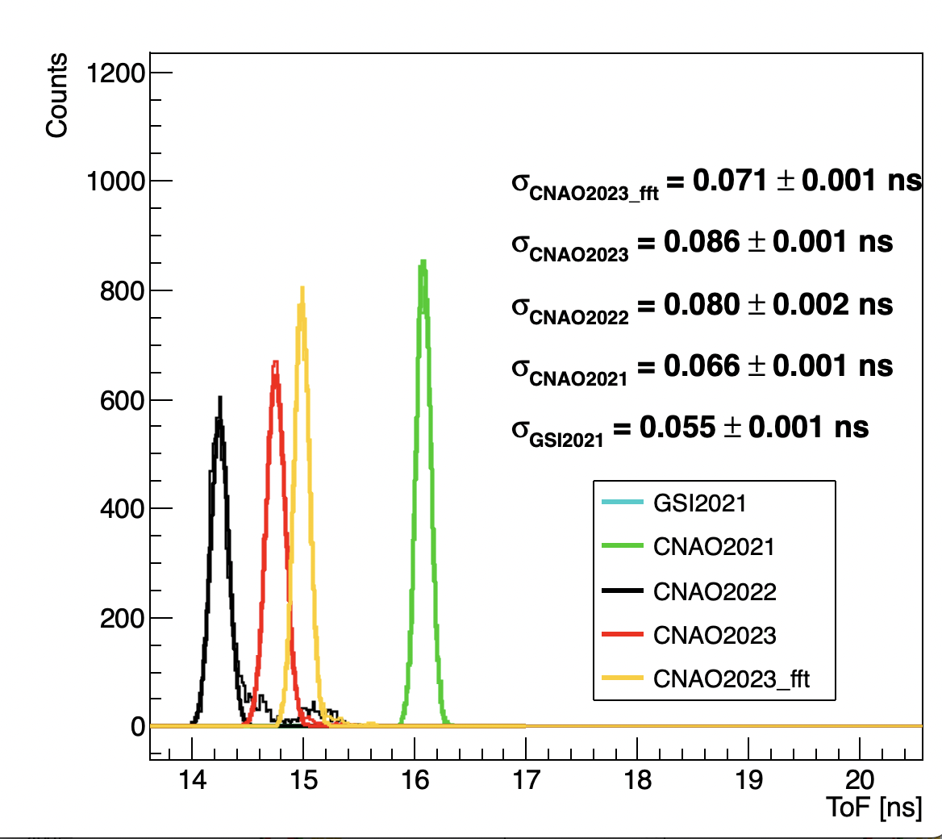
Effect on time of flight
ToF resolution passes by 86 ps to 71 ps
Good improvement, we are quite close to CNAO2021 resolution.
Possible explanation of such counterintuitive behaviour:
More favourable S/N ratio
Better assessment of baseline (helps in CFD algorithm)

Slide 13
Conclusions
Such method seems to be capable of improving time resolution. As the FFT is computed just on the sum signal, it has a negligible computational cost in shoe too.
However inconsistencies between campaign still remain (CNAO2022??) and should be understood to be prepared for next data taking
Lot of curiosity in:
Apply the filtering process in the past campaign runs
Apply the filtering process to TW signals
From HW point of view a check on scintillator performance should be done (it was mounted in 2018..)

Slide 14
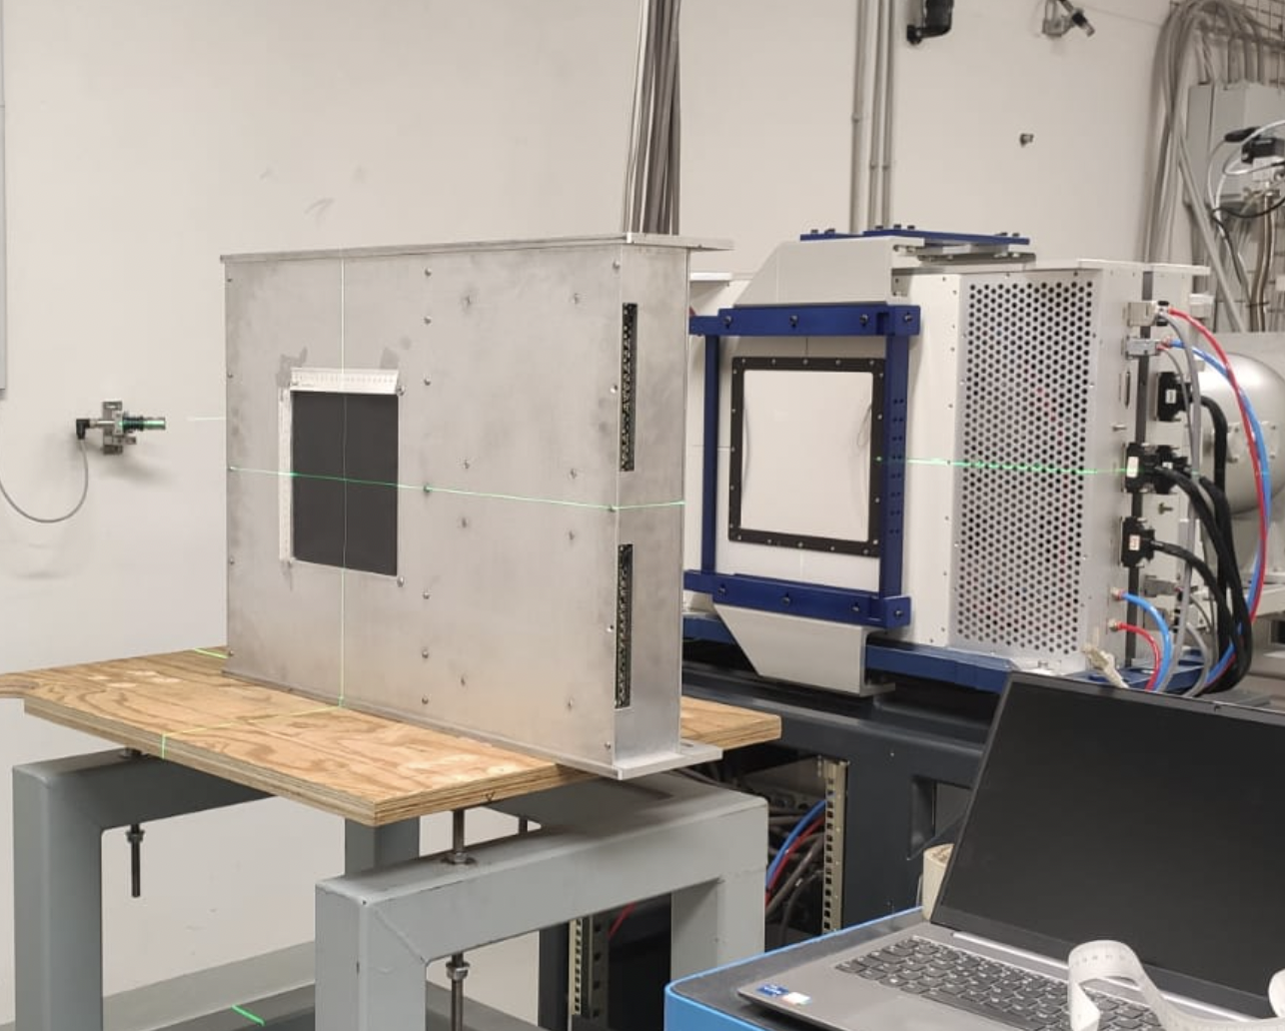
Addendum: beam tuning @ CNAO2023
We used the low intensity beam monitor to create a set of configurations spanning on different energies of p and ¹²C
Goal: match the rate requirements while keeping the beam as narrow as possible
Unfortunately, beam time structure at μs level is not directly measurable with such detector…
archive image

Slide 15
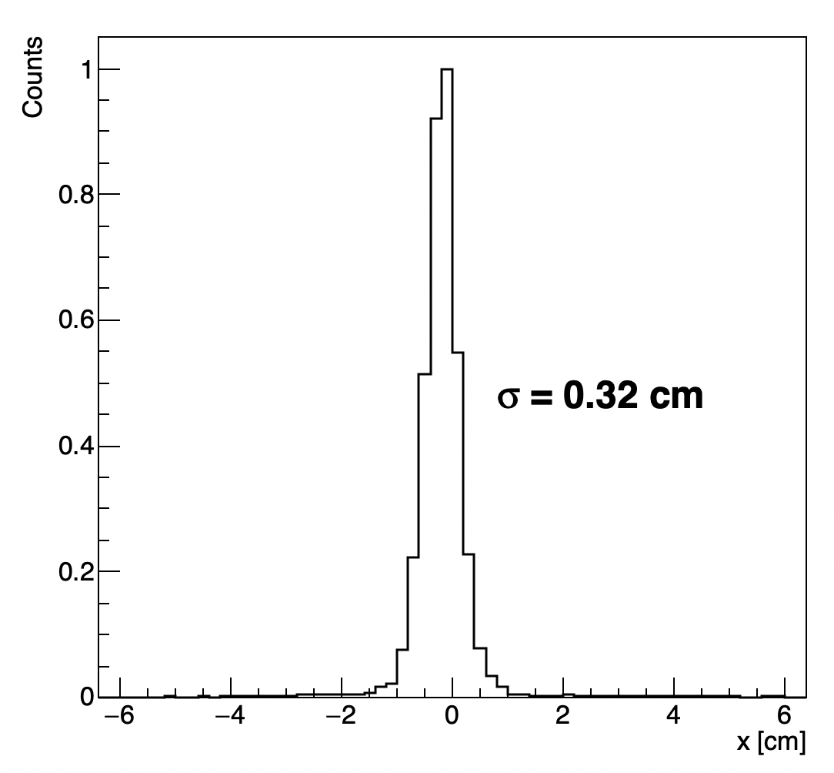
Final report I
Two time-shifts was needed to create ~ 15 different configurations
Beam size was in the range 3-8 mm (highest and lowest energies are the most critical), systematically larger in y axis.
Comments:
not always the prepared beam settings worked as expected during the data taking (¹²C 115 MeV/u and 250 MeV/u)
Some minor adjustments needs to be done online
Particular care has been addressed to avoid beam fluctuation for physics run.
Configuration for physics run

Slide 16
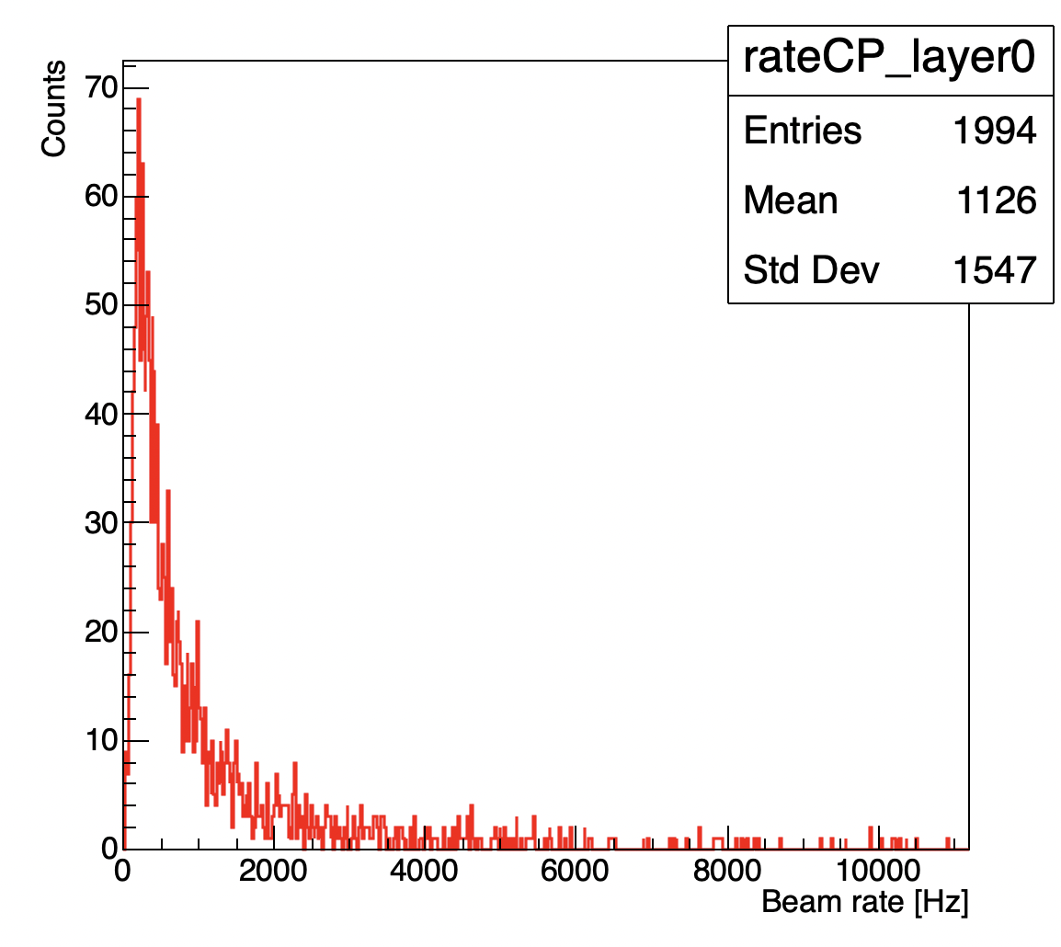
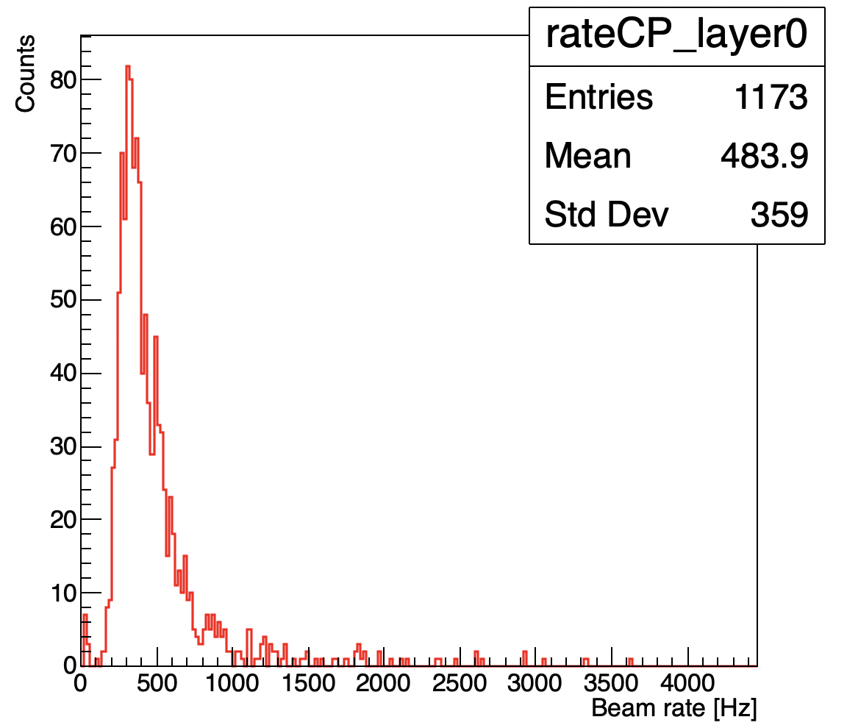
Final report II
Take home message: a very accurate assessment of our beam rate capability( i.e. pile-up rejection ) is fundamental
“Config31” 12C @ 200 MeV/u
Attempt to enhance the intensity 12C @ 200 MeV/u

Slide 17
Backup

Slide 18
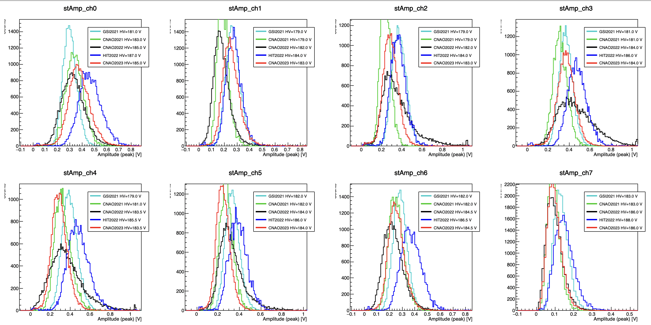
ST single channels response (Amplitude)

Slide 19
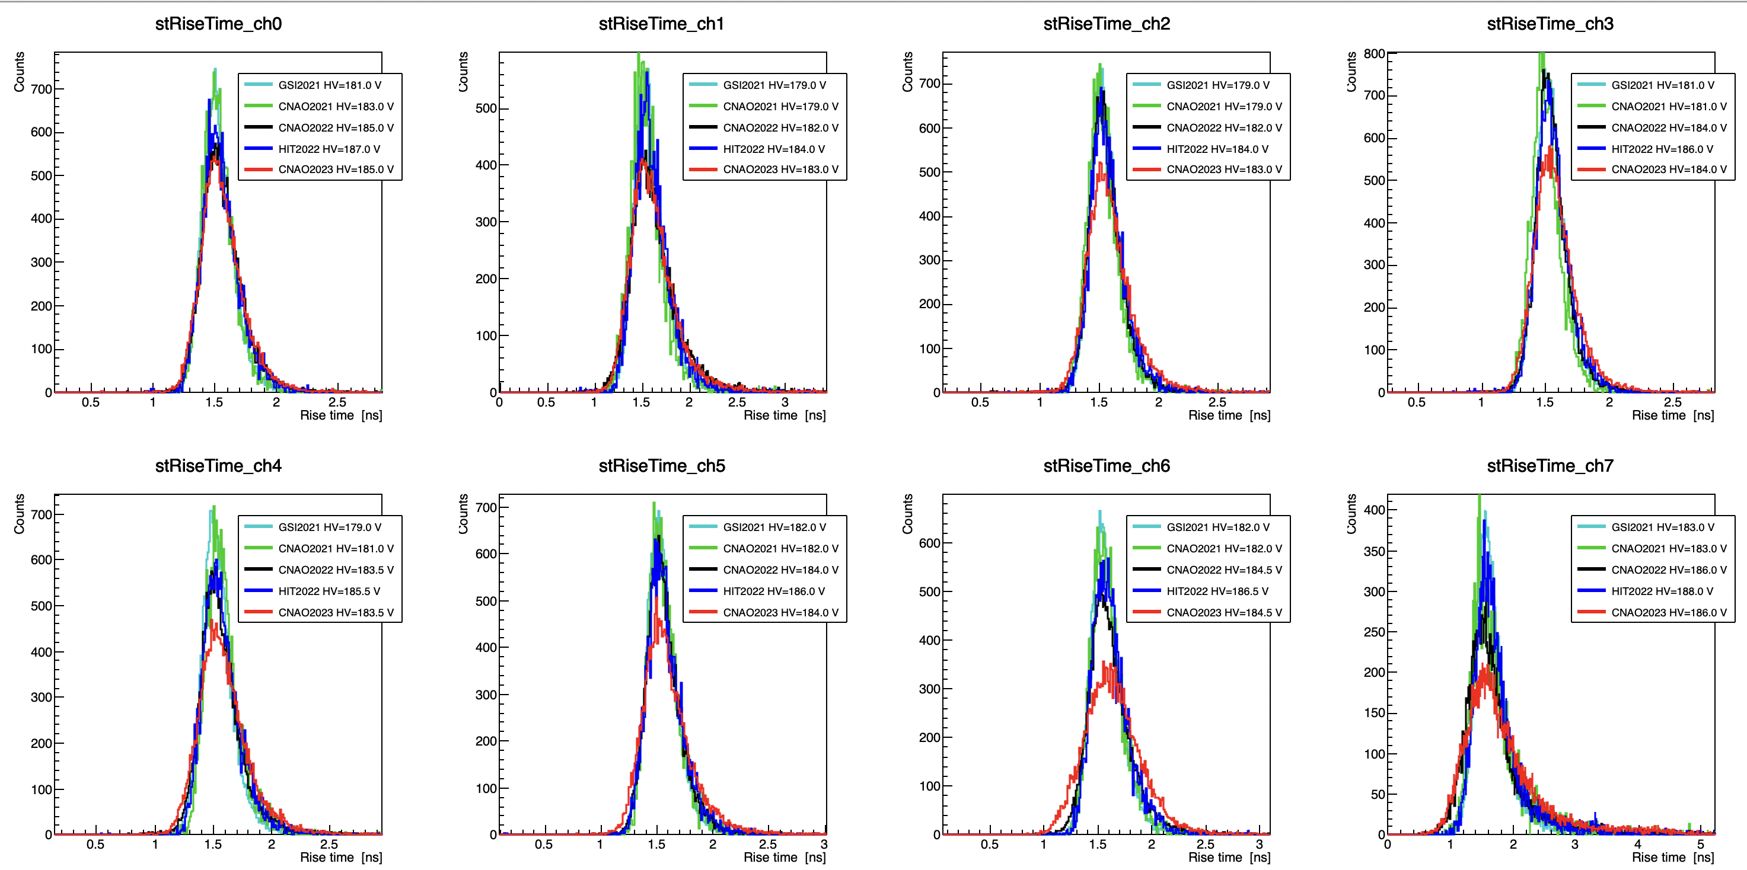
ST single channels response (Rise Time)

Slide 20
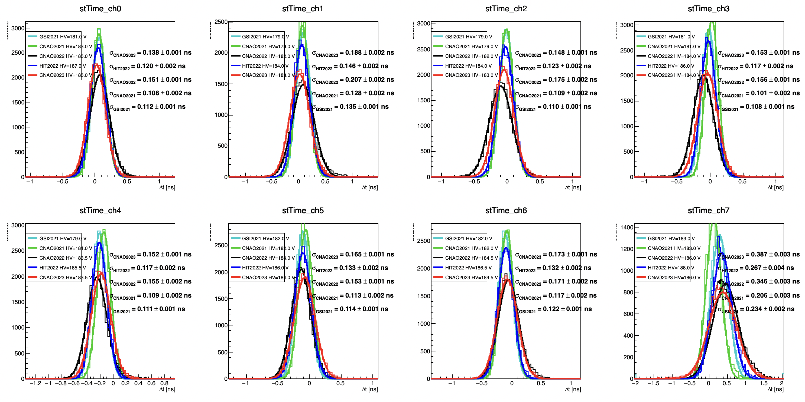
ST single channels response (Time reso)

Slide 21
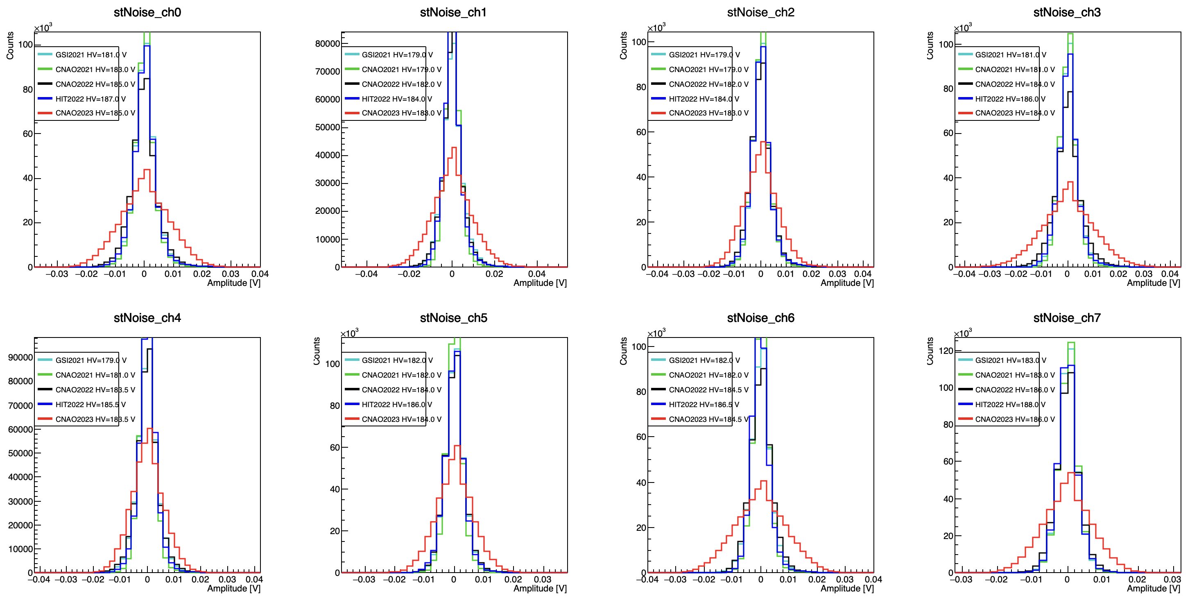
Noise

Slide 22
WaveDream clocks synchronisation and time calibration
 | σ_{TW} | σ_{ST} (Met1) | σ_{ST} (Met2) | σ_{Δclk}
GSI2021* | 30 ps | 46 ps | 43 ps | 16 ps
CNAO2021 | 36 ps | 55 ps | 42 ps | 36 ps
CNAO2022 | 37 ps | 71 ps | 62 ps | 35 ps
HIT2022 | - | - | 48 ps
CNAO2023 | 40 ps | 76 ps | 60 ps | 47 ps
No change using differences using old time calibrations in CNAO2023
In CNAO2021 we used board 173 instead of the 27 for the ST… this is of course suspicious, as we noticed at that time that F type boards was more noisy at gain 50…
Does the noise have impact also in clk sync?

Slide 23
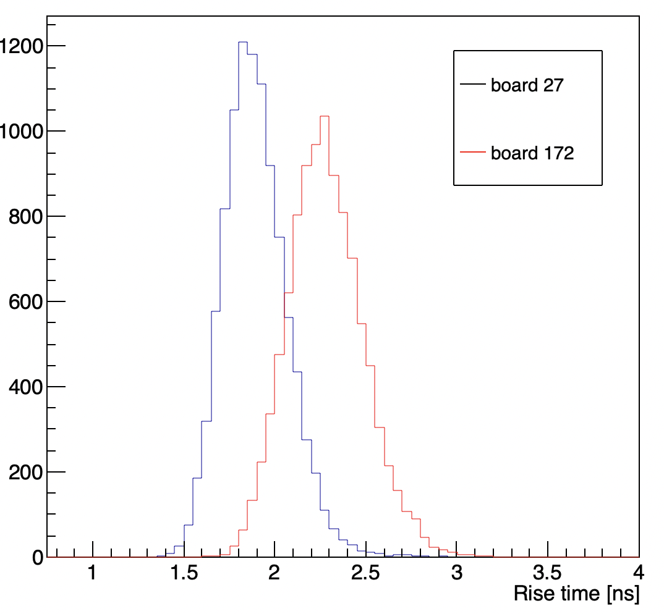
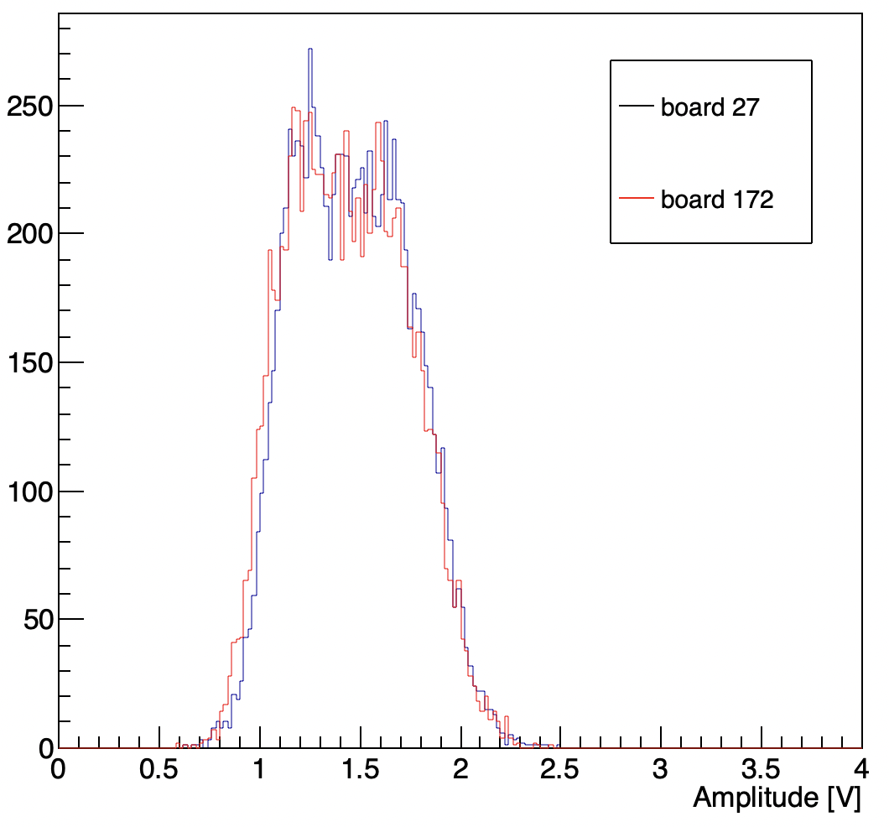
Test in lab with LED
ST
led
Rise time of sum channel
Amplitude of sum channel
The light has been tuned to reasonably reproduced the signals obtains with C ions
We measured the ST time resolution using board 27 and 172
Same setup, same amount of light, same geometry, same signal peak butdifferent rising time!

Slide 24
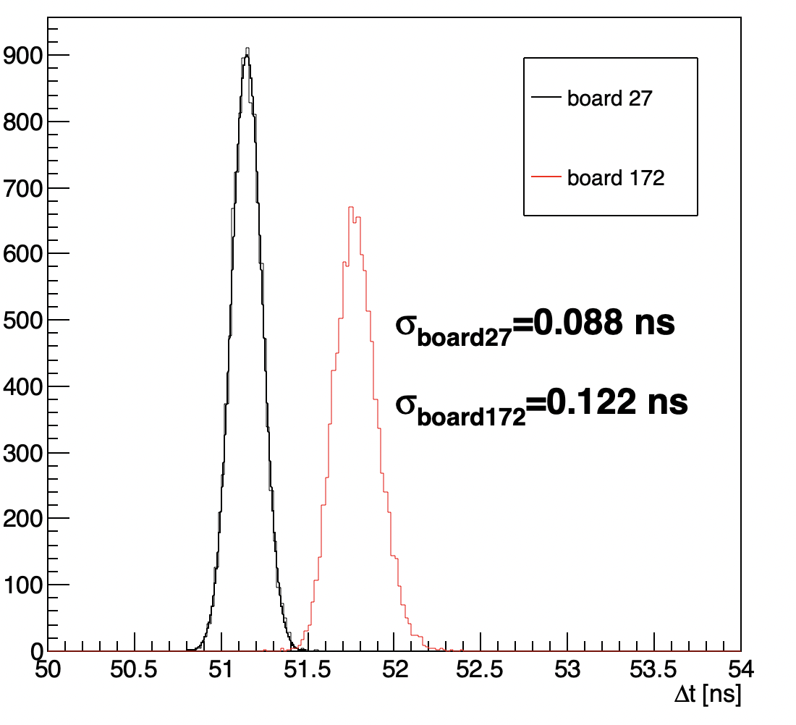
Test in lab with LED
ST
led
The light has been tuned to reasonably reproduced the signals obtains with C ions
We measured the ST time resolution using board 27 and 172
Time resolution computed using the difference between the ST time and the LED trigger signal
Board 27 seems to be better, as expected

Slide 25
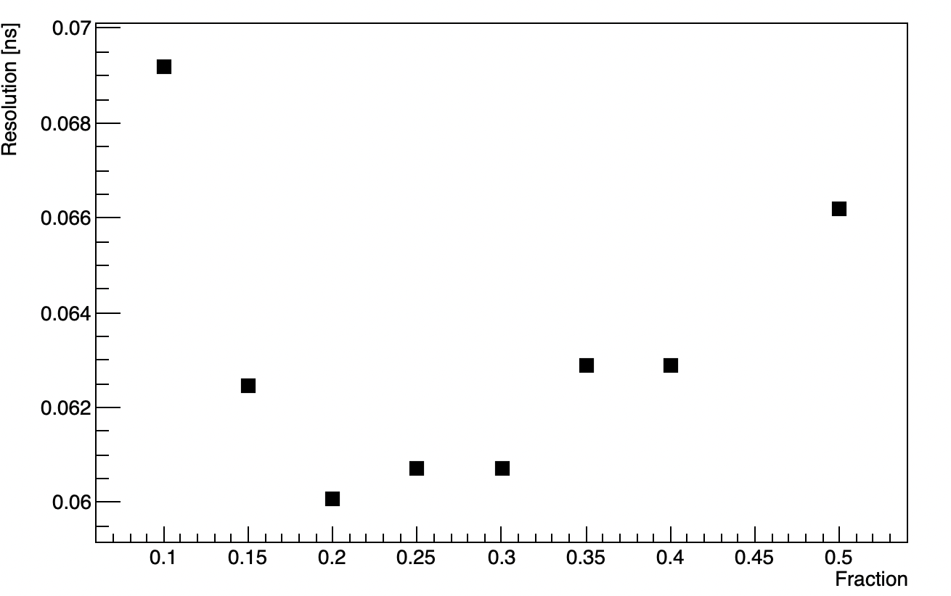
Are we able to improve resolution with software trick?
I tried to re-optimise the cfd parameters..
HW cfd behave like simpleCFD (as expected)
ZarrCFD performs worsen than simple CFD (sorry Roberto)
The simpleCFD fraction that lead to resolution remains 20%

