Slide 1
EB report
Giacomo Traini, Aafke Kraan, Adele Lauria
FOOT general meeting, Trento 13th December 2023

Slide 2
Papers 2023
L. Galli | The fragmentation trigger of the FOOT experiment | Proceeding | NIMA
G. Ubaldi | The FOOT experiment: A first measurement of nuclear fragmentation cross section for hadrontherapy | Proceeding | Il Nuovo Cimento
G. Ubaldi | Nuclear fragmentation cross section measurements with the FOOT experiment | Proceeding | Zakopane proceeding
R. Ridolfi | Nuclear fragmentation cross section measurements with the FOOT experiment | Proceeding | EPJ Web of Conferences
A. Kraan | Calibration and performance assessment of the TOF-Wall detector of the FOOT experiment | Proceeding | NIM A
G. Galati | Charge identification of fragments produced by interaction of 16O beam at 200MeV/n and 400MeV/n on C and C2H4 target | Research paper | Frontiers in Physics
R. Zarella | Characterization of the FOOT neutron detectors for 5 nuclear fragmentation measurements at the n_TOF facility | Research paper | JINST
F. Peverini | A new photon calibration method for silicon microstrip sensors | Research paper | JINST o NIMA
M. Montesi | O16 ions at 200 MeV Nuclear reaction cross section on carbon and polyethilene targets | Research paper | Open Physics
? (PG) | Construction and commissioning of the MicroStrip Detector for the FOOT experiment | Research paper | ?
50% detector performance, 50% analysis
Preview on 2024: two proceedings related to 2023 conferences, GSI data, calo performance?
Published
Accepted for publication
Submitted
Revised by EB
Draft

Slide 3
Conferences 2023
Bormio 2023 | Bormio, Italy | Francesca Cavanna | Measuring the Impact of Nuclear Interaction in Particle Therapy and Radio Protection: the FOOT experiment
PTCOG61 | Madrid, Spain | Vincenzo Boccia | Study of hadron beam fragmentation with the foot experiment
56 Zakopane Conference | Zakopane, Poland | Giacomo Ubaldi | Nuclear fragmentation cross section measurements with the FOOT experiment
TIPP 2023 | Cape Cape Town, South Africa Town, South Africa | Gaia Franciosini | Status of the FOOT experiment and first measurements of 16O fragmentation cross sections on C target”
 |  | Alessandro Valetti | Energy response function and calibration of the FOOT calorimeter
SIF 2023 | Salerno | Giuliana Galati | STUDY OF HADRON BEAM FRAGMENTATION WITH THE FOOT EXPERIMENT
ICFNP 2023 | Crete, Greece | Angelica De Gregorio
IPRD 2023 | Siena, Italy | Roberto Zarrella | Characterization of the FOOT neutron detectors for nuclear fragmentation measurements at the n_TOF facility
Oral
Poster

Slide 4
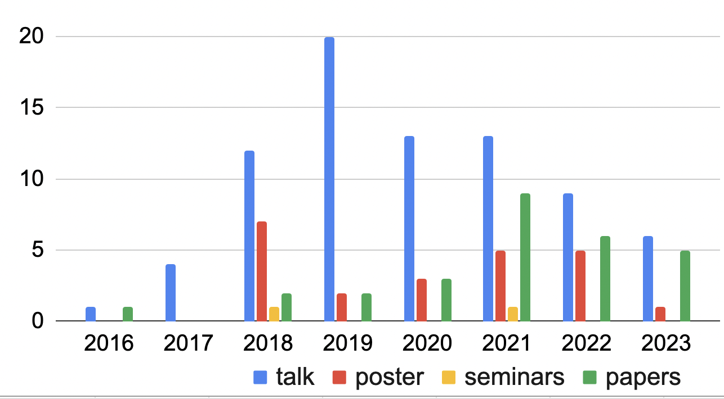
Summary
2024

Slide 5
A first look at 2024
What | Where | When | Deadline for abstract |  | Canditate
60th International Winter Meeting on Nuclear Physics 22-26.01.2024 (Bormio) | Bormio | 22-26/01/2024 | 5/11/2023 | https://indico.mitp.uni-mainz.de/event/380/ | Silvia
16th Pisa Meeting on Advanced Detectors in La Biodola, Isola d’Elba (Italy), CALOR2024 | Isola d'Elba | 26/5-1/6 2024 | 24/1/2023 | www.pi.infn.it/pm | Giuliana, Vincenzo
Sesto Incontro Nazionale di Fisica Nucleare | Trento | 26-28/02/2024 | 5/12/2023 | https://agenda.infn.it/e/infn2024 | Yun
14th International Conference on Nucleus Nucleus Collisions (NN2024) | Whistler, British Columbia, Canada | 18-23\8 | 31/12/2023 | https://nn2024.triumf.ca/
XX th International Conference on the use of Computers in Radiation therapy (ICCR) | Lyon, France | 8-11\7\2024 | 31/1/2024 | https://www.iccr2024.org/index.html
International Conference on Calorimetry in Particle Physics | Tsukuba, Japan | 20-24/5/2024 | boh | https://indico.cern.ch/event/1339557/
12th edition of the Beam Telescopes and Test Beams Workshop (BTTB12) | Edinburgh, Scotland | 15-19/4/2024 | 14\1\2024 | https://indico.cern.ch/event/1323113/abstracts/

Slide 6
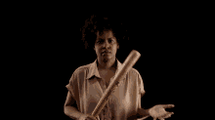
A first look at 2024
Submit!!!
What | Where | When | Deadline for abstract |  | Canditate
60th International Winter Meeting on Nuclear Physics 22-26.01.2024 (Bormio) | Bormio | 22-26/01/2024 | 5/11/2023 | https://indico.mitp.uni-mainz.de/event/380/ | Silvia
16th Pisa Meeting on Advanced Detectors in La Biodola, Isola d’Elba (Italy), CALOR2024 | Isola d'Elba | 26/5-1/6 2024 | 24/1/2023 | www.pi.infn.it/pm | Giuliana, Vincenzo
Sesto Incontro Nazionale di Fisica Nucleare | Trento | 26-28/02/2024 | 5/12/2023 | https://agenda.infn.it/e/infn2024 | Yun
14th International Conference on Nucleus Nucleus Collisions (NN2024) | Whistler, British Columbia, Canada | 18-23\8 | 31/12/2023 | https://nn2024.triumf.ca/
XX th International Conference on the use of Computers in Radiation therapy (ICCR) | Lyon, France | 8-11\7\2024 | 31/1/2024 | https://www.iccr2024.org/index.html
International Conference on Calorimetry in Particle Physics | Tsukuba, Japan | 20-24/5/2024 | boh | https://indico.cern.ch/event/1339557/
12th edition of the Beam Telescopes and Test Beams Workshop (BTTB12) | Edinburgh, Scotland | 15-19/4/2024 | 14\1\2024 | https://indico.cern.ch/event/1323113/abstracts/

